Slide 1
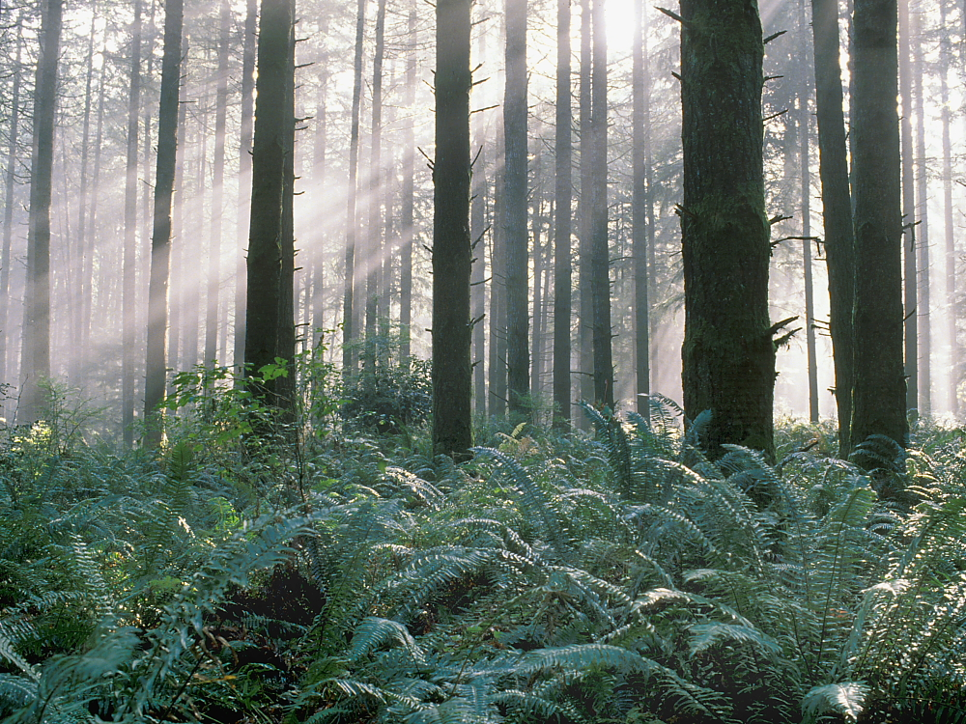
Bird Conservation on Commercial Forests in the Northern Forest
Henning Stabins, Weyerhaeuser
Forest Ecosystem Monitoring Cooperative Meeting Burlington, VT December 14, 2018

Slide 2
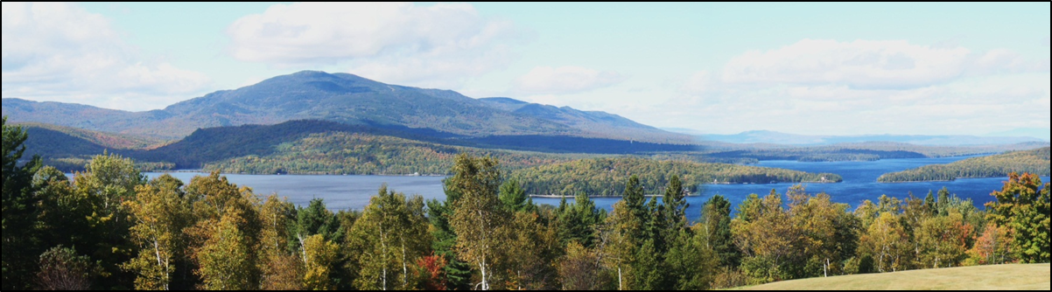
Presentation Overview
Landscape – big picture
Stand-scale & species-specific management
Collaborative research & engagements
Conservation drivers
Opportunities

Slide 3
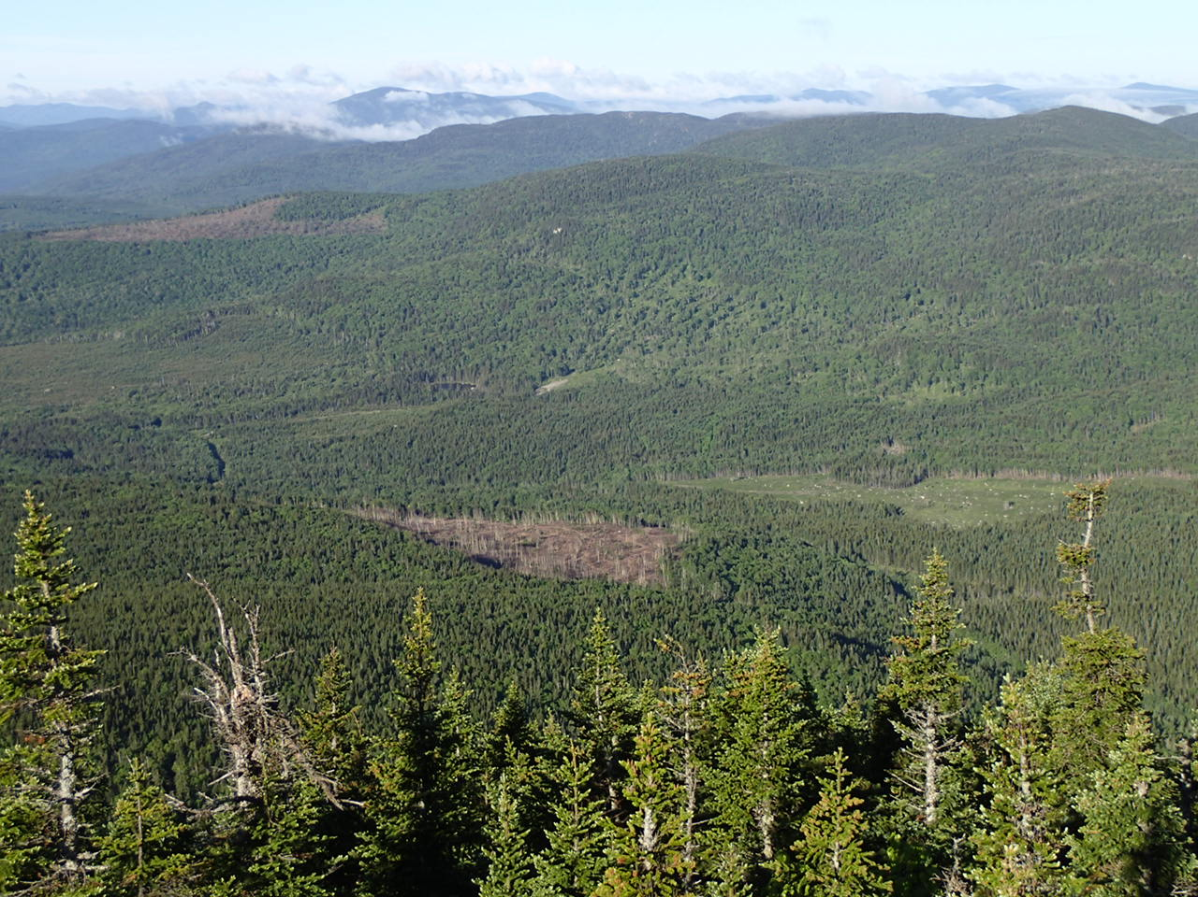
The Landscape View
  Keeping forests, forests.
    State taxation programs
    Healthy wood product markets in a dynamic world
  Multiple landowners, large & small private, state & federal, etc.
    Management diversity
  Other landscape tools
    Conservation easements
    Conservation sales
  Shifting habitat mosaic
    Stand structures
    Space
    Time

Slide 4
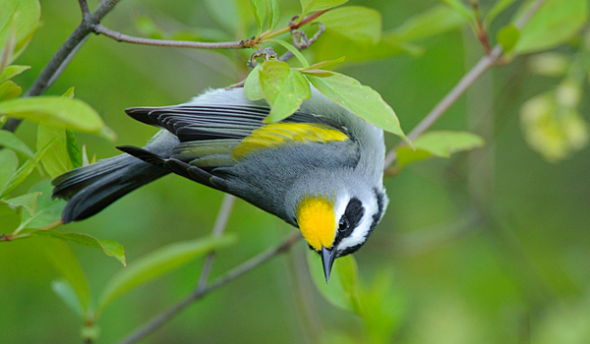
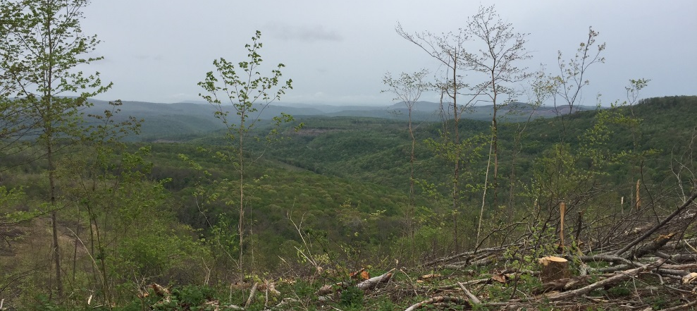
Shifting Habitat Mosaic
Growing recognition of the need for active forest management
  Landscape needs
  Early-succession stages
  Forest thinnings – mid-story growth
Emerging science
  Post-fledgling period
  Migration fueling
Multi-species approach
  Canada lynx, bats, marten
  Herpetofauna, pollinators
  Coarse & fine-scales
G. Vyn

Slide 5
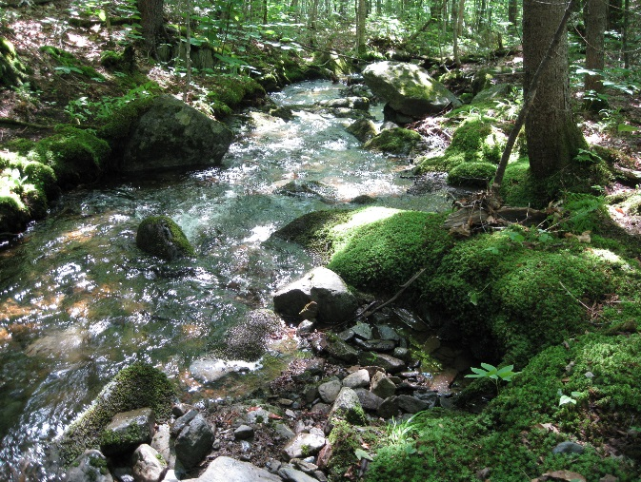
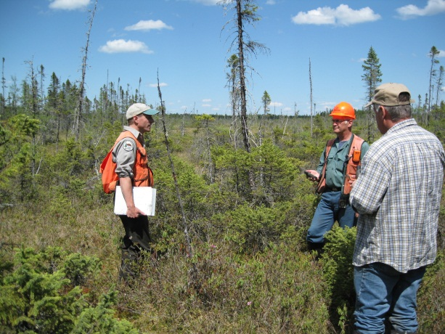
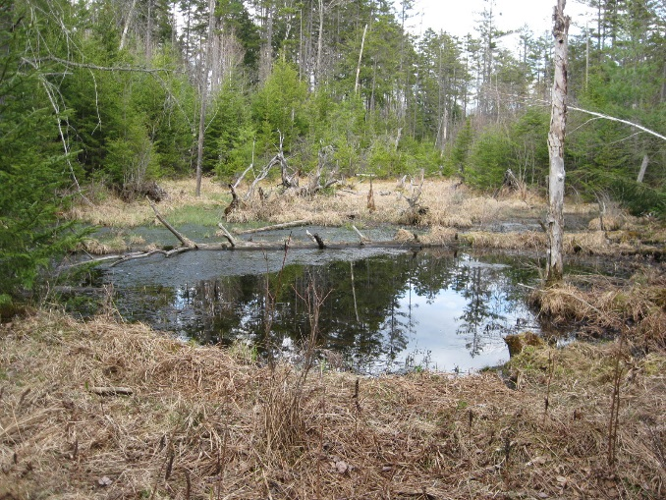
Stand-scale Management
Variable forest patch sizes
  Influencers: previous management, water features, state regulations, topography, soil types, harvest & regeneration goals …
Protection of special sites
  Streams, wetlands, ponds, bogs, seeps, vernal pools, rare plants & natural communities, deer wintering areas,…

Slide 6
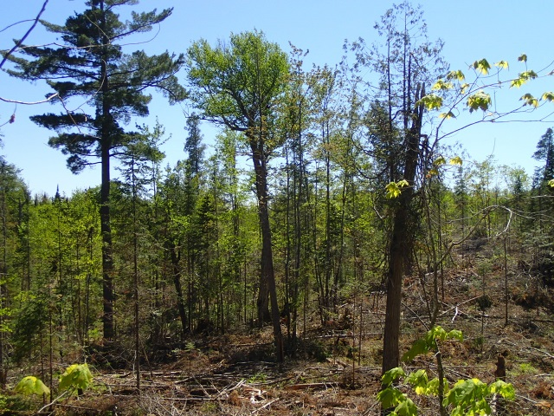
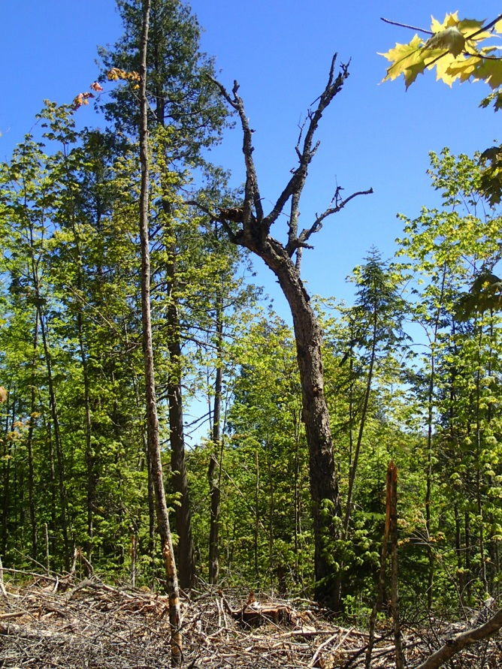
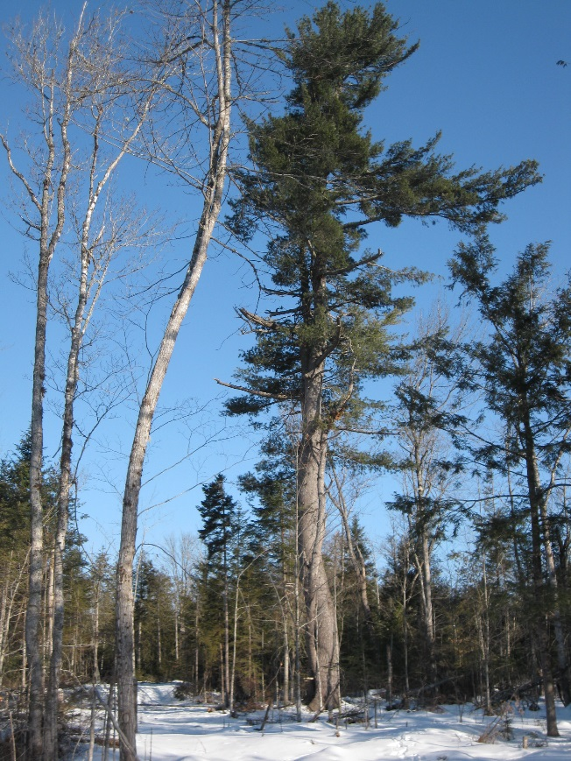
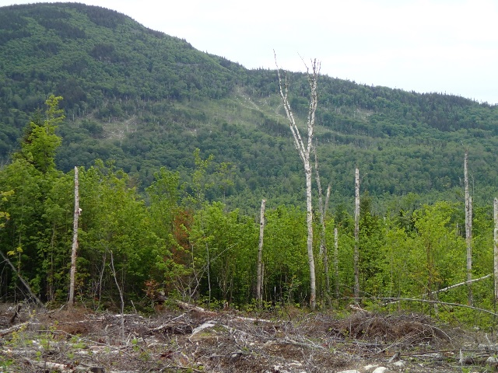
Stand-scale Management
Habitat feature retention
  Snags, larger diameter “legacy” trees, down wood, patch retention,…

Slide 7
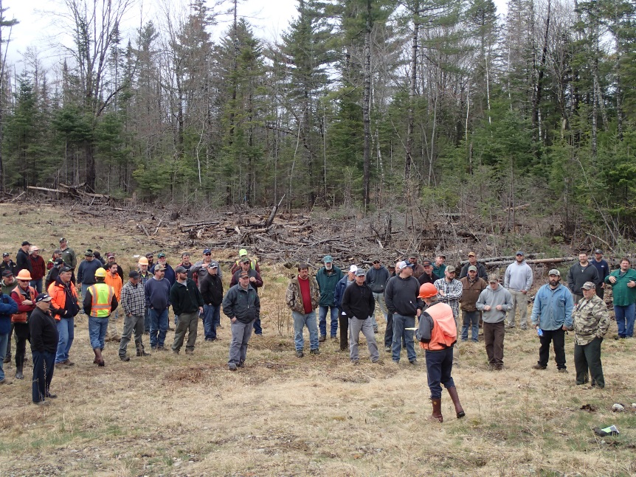
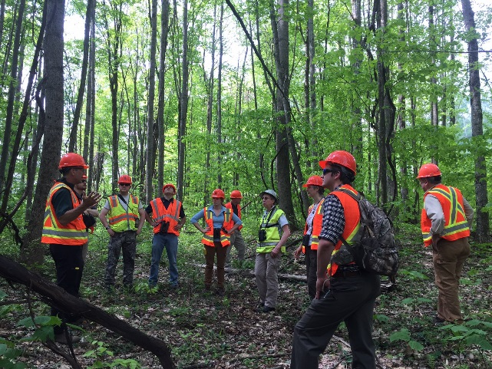
Stand-scale Management
How does it happen on the ground?
  Forester & logger training
  Audubon’s “Forestry for the Birds”
  Company operating procedures
  Cooperative research & field tours

Slide 8
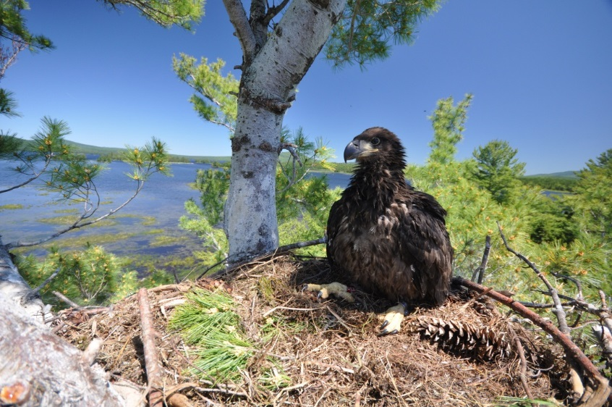
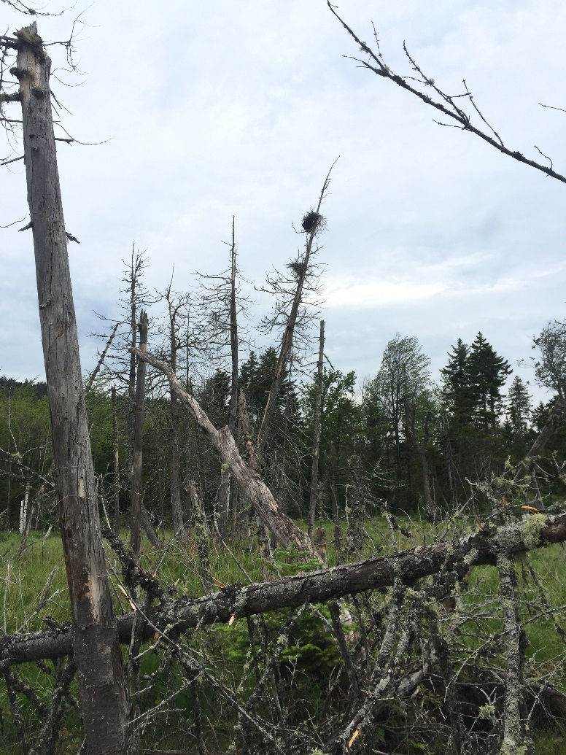
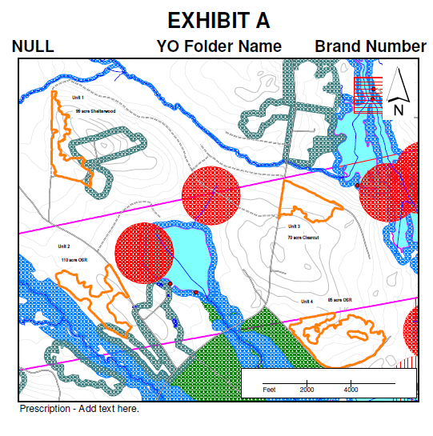
Species-specific Management
Site-dependent species
  E.g., Bald eagles, great blue herons, osprey
B. Hanson

Slide 9
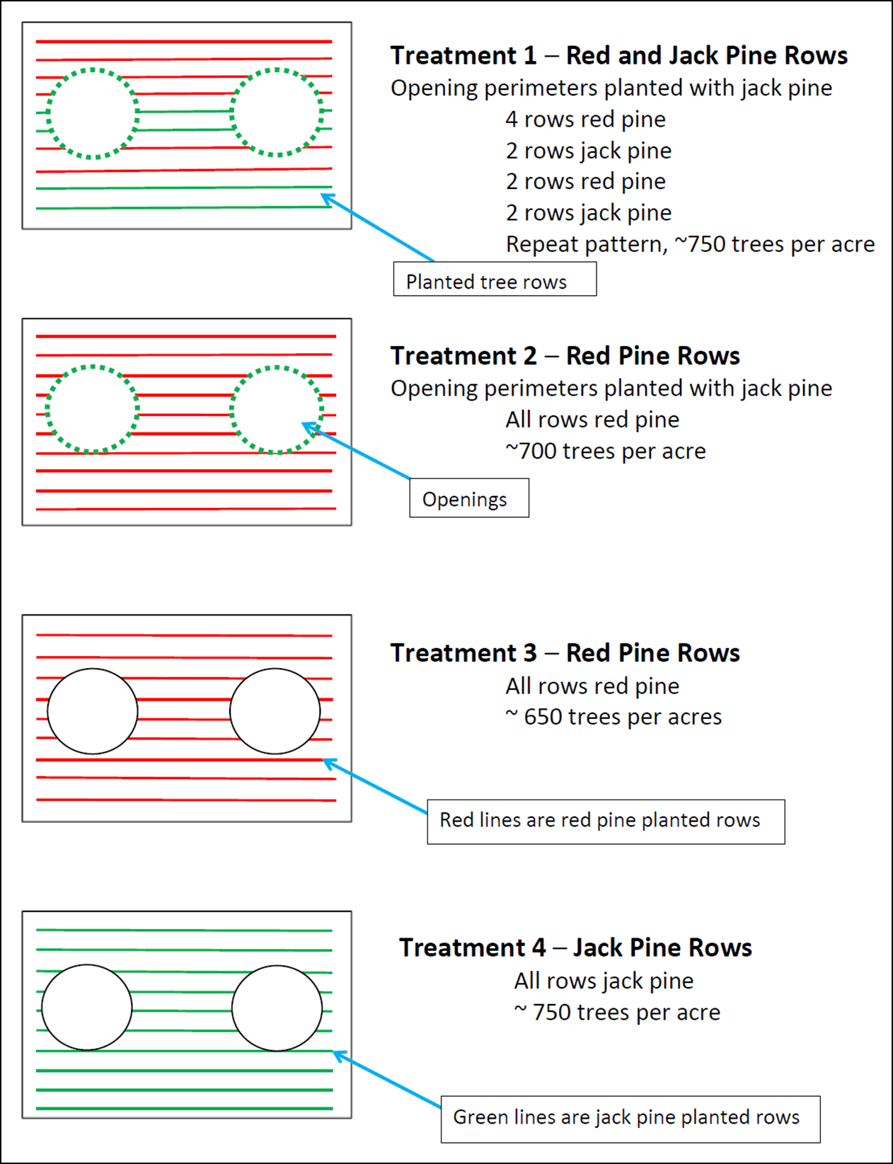
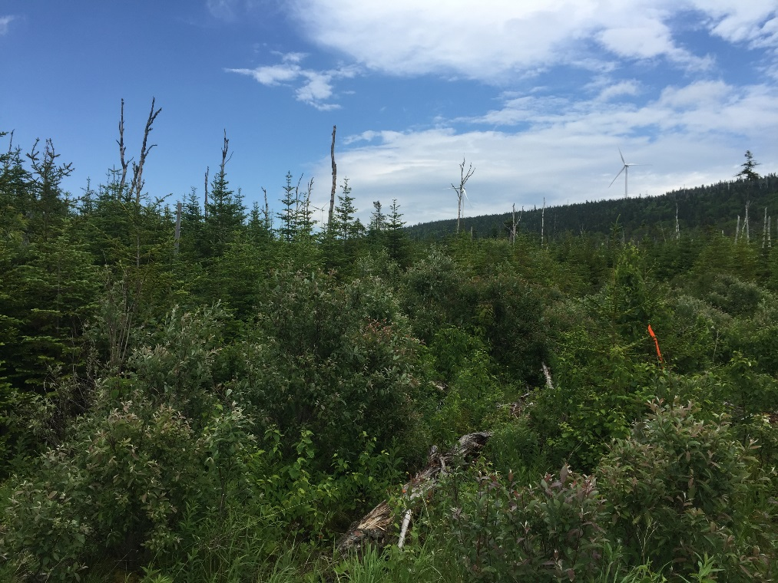
Species-specific Management
Special habitat needs – experiments underway…
  E.g., Bicknell’s thrush, Kirtland’s warbler

Slide 10
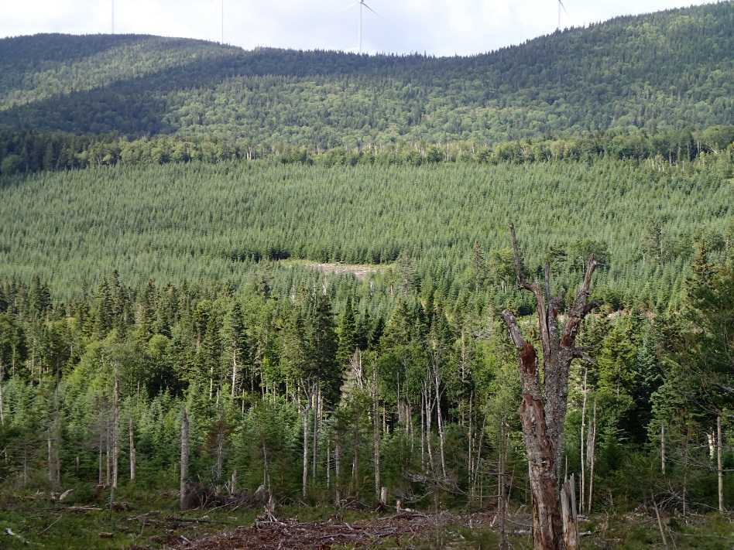
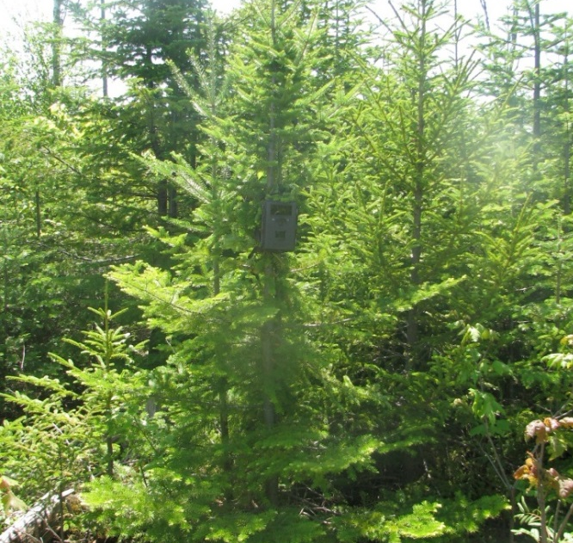
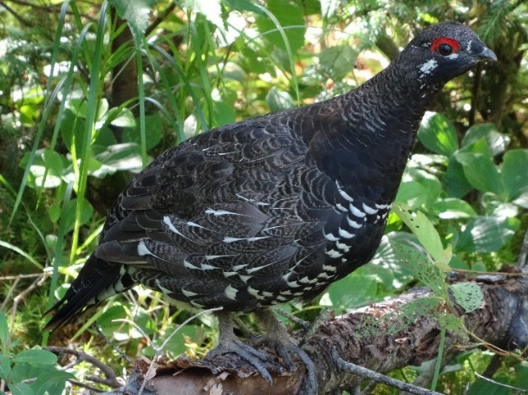
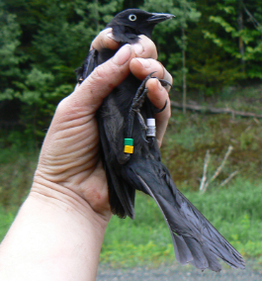
Species-specific Management
Positive intersections between birds and forest management
  E.g., Woodcock, spruce grouse, rusty blackbird, spruce/fir-associated birds
J. Sweitzer
C. Foss

Slide 11
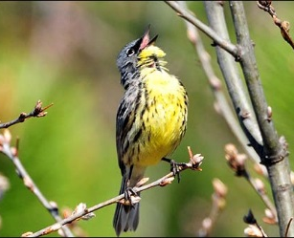
Collaborative Research & Engagements - Examples
Universities
  Univ. of Maine – Cooperative Forestry Research Unit
    SUNY-ESF, Univ. of New Brunswick,…
Cooperatives
  National Council for Air and Stream Improvement
  Partners in Flight – Industry Working Group
  Boreal Avian Modeling Network
NGO’s
  Wildlife Management Institute
  Vermont Center for Ecostudies
  American Bird Conservancy
State & Federal agencies
  SWAPs, NAFO At-Risk Species Initiative with industry
J. Trick, USFWS

Slide 12
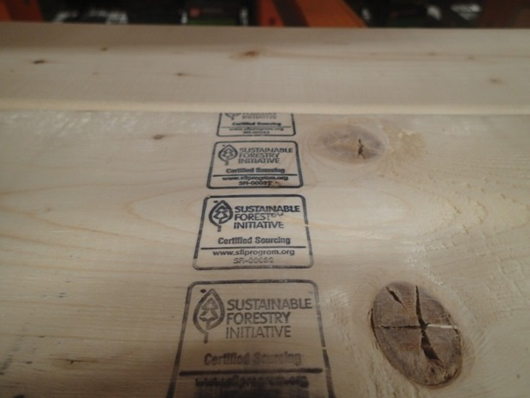
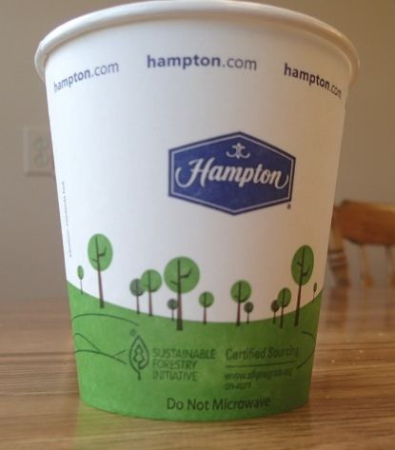
Conservation Drivers
Changing societal expectations for environmental stewardship.
Forest management is a long-term business.
Recognition of the benefits of working forests.
  Part of solutions.
Sustainable forestry certification
  3 Systems – all with biodiversity standards.
  Majority of commercial forests are
    certified with third-party audits.
  Mechanism for engagement & action.

Slide 13
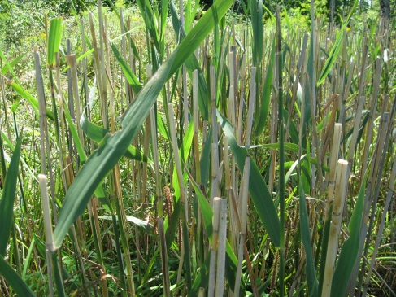
Sustainable Forestry Standards
Examples of sustainable forestry biodiversity standards:
Biodiversity program for species, wildlife habitats, and ecological community types at stand and landscape levels.
Retention of stand-level habitat elements – snags, mast trees, down wood, den & nest trees…
Incorporation of regional conservation planning & priority-setting efforts.
Threatened, endangered, & species of
    concern.
Invasive species issues.

Slide 14
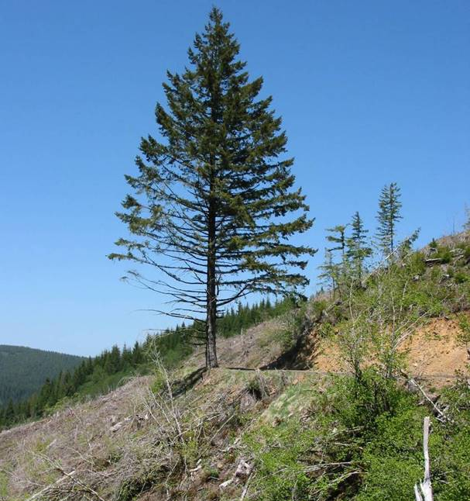
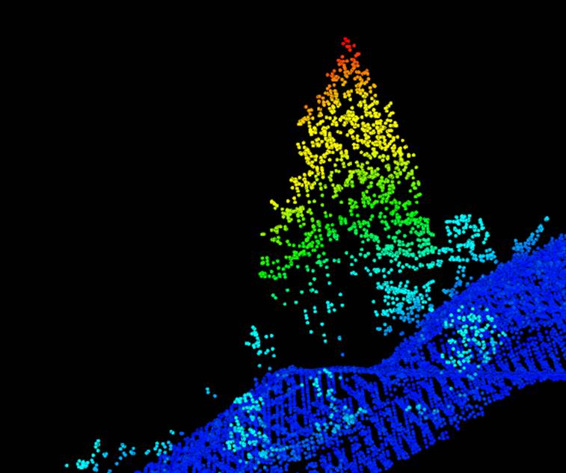
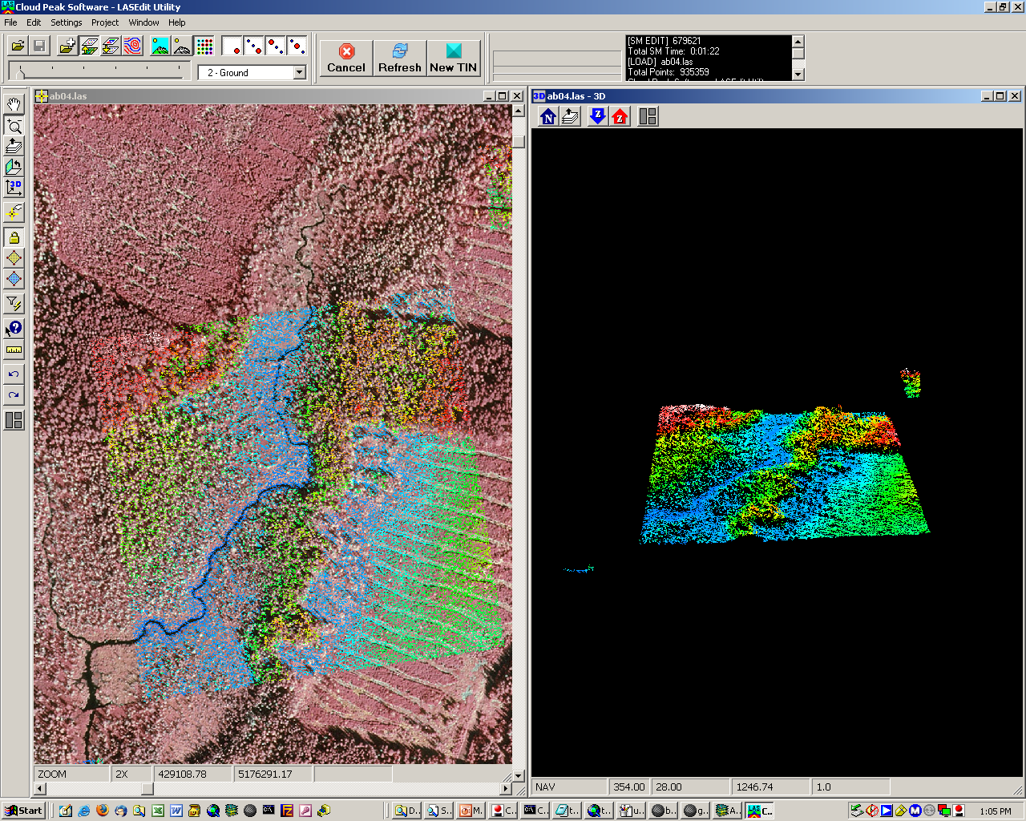
Exciting Opportunities
Technology Advances
Remote-sensing opportunities
  LIDAR – stand structure, etc.
Acoustic bird detection monitoring
What’s next!
Future Considerations
Continued species-level work
Landscape modeling

Slide 15
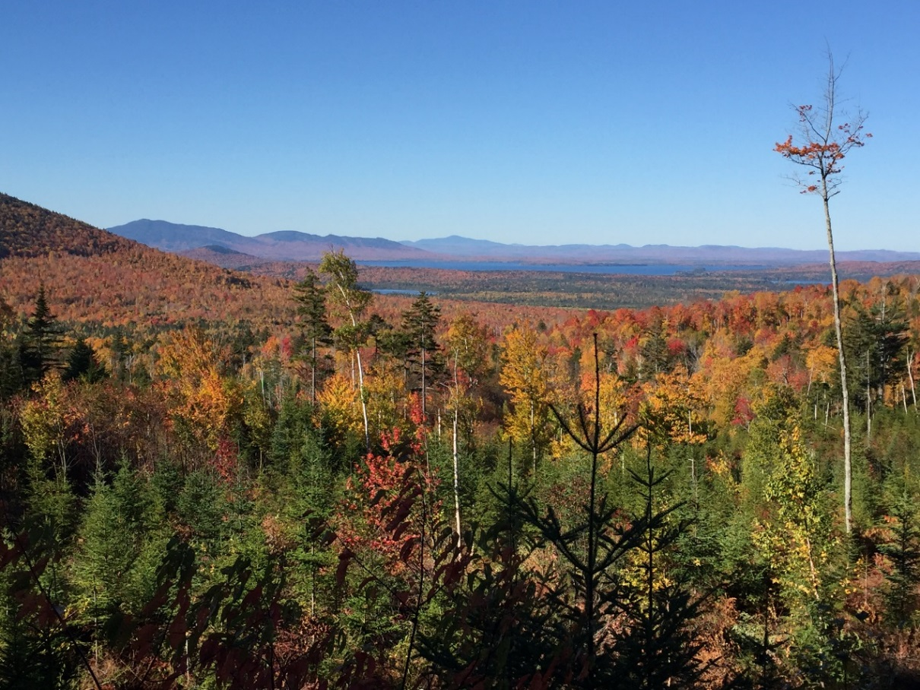
Questions?

