Slide 1
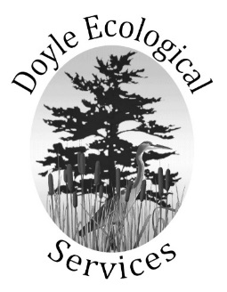

Flower Brook Landscape Assessment
Lake Champlain Basin Program
Pollution Prevention Grant
Poultney-Mettowee Natural Resources Conservation District
and
Doyle Ecological Services
December 14, 2018

Slide 2
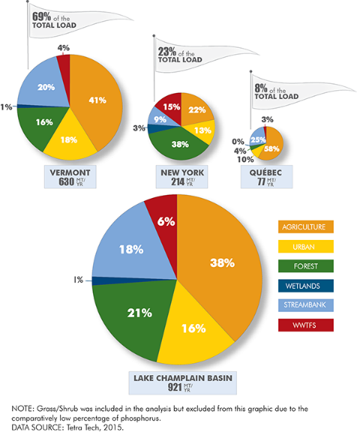
Contributions of Phosphorus to Lake Champlain by Types of Land Use
Relative Contribution of Phosphorus by Land Use: Agriculture – 38%
Urban – 16%
Forest – 21%
Wetlands – 1%
Streambanks – 18%
WasteWater Treatment Plants – 6%
Forest Land – Approximately 75% of the land area in the Vermont;
Agricultural Land – approximately 14% of the land area in Lake Champlain Basin

Slide 3
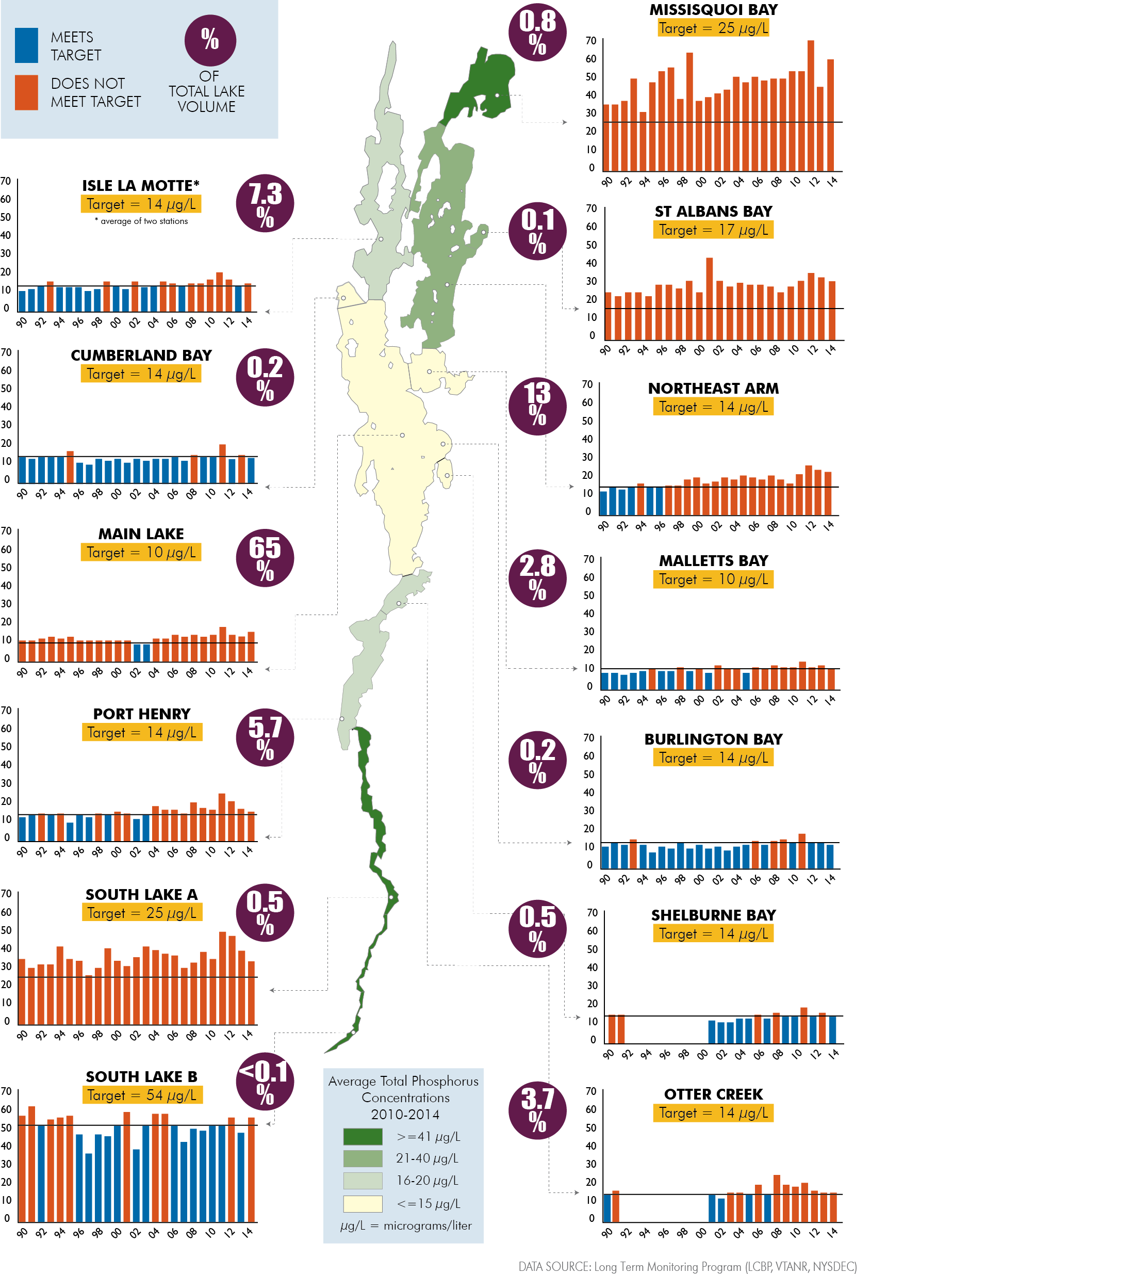
Contributions of Phosphorus to Lake Champlain by Types of Land Use
Figure 2. Lake Champlain phosphorus
concentration by lake segment, 1990-2014.
Source LCBP (2015).
South Lake Reductions to meet TMDL
40% Forest Lands
46.7% Streambanks
62.9% Agriculture NPS
80% Agriculture Production Areas
21% Developed Land

Slide 4
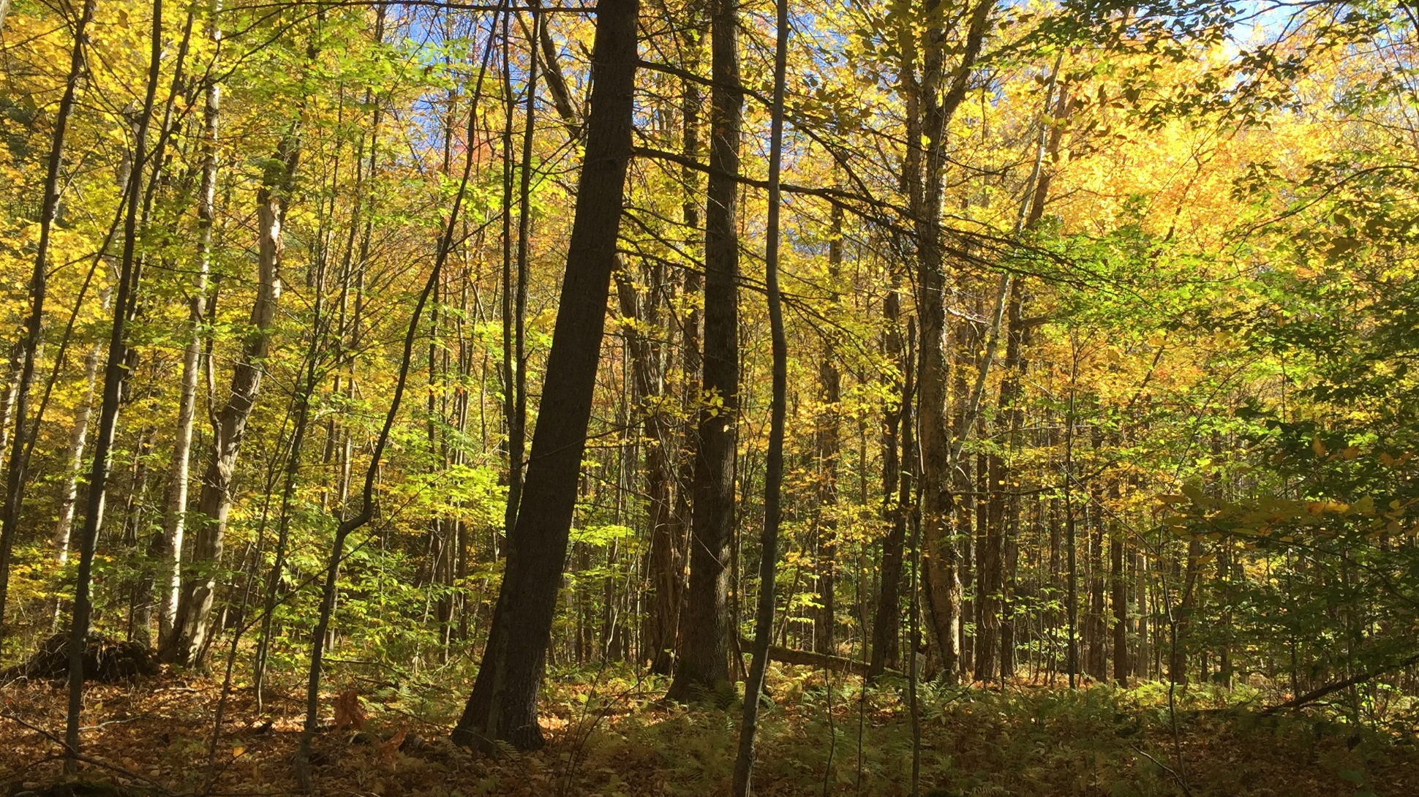
Flower Brook Landscape Assessment
PROJECT GOALS
Identify Phosphorus Sinks and Sources
Identify Phosphorus / Flood Restoration Projects
Implement a Project / Communicate w Landowners
Reduce Phosphorus loading in Lake Champlain and improve flood resiliency in Pawlet Village
Notes:
Reduce Phosphorus loading in Lake Champlain
Mapping Exercise to Identify Phosphorus Sinks and Sources
Add to the inventory of phosphorus-related restoration or
conservation projects (District and DEC Tactical Basin Plan)
Prioritize and implement one of the projects identified
(notes: SWMP, Ag work, road assessments, water quality monitoring- trying to create a comprehensive list of projects in the Flower Brook watershed.) (forests can be a source or sink)
HMF activities photos, stream GA photos, …

Slide 5
Flower Brook Landscape Assessment
INFLUENTIAL SOURCES OF INFORMATION
Booth DB, Hartley D, and Jackson R. 2002. Forest Cover, Impervious Surface Area, and Mitigation of Stormwater Impacts
  Maintaining forest cover is more important than limiting impervious percentages (in rural areas) ie: cluster development
  At 65% forest retention (5 houses per 100 acres, clustered), the 2-year developed discharge will just stay below the 10-year forested discharge (goal).
Brynn D and Underwood K. 2015. Enhancing Flood Resiliency of State Lands
  Natural vulnerabilities and legacy impacts have combined to create upland forests sensitive to changing climate; less resilient than pre-settlement old growth forests.
  Forests are more connected to streams, due to deforestation and upland development.
  Forest resources should be identified as part of the stormwater management infrastructure and forest plans should more explicitly identify flood resiliency as a management objective.
Sorenson E, Zaino R, Hilke J, Thompson E. Vermont Conservation Design: Maintaining and Enhancing an Ecologically Functioning Landscape, Vermont Land Trust
  Riparian Connectivity, Responsibility Conservation Areas, Interior Forest Blocks, and Connectivity Forest Blocks
The Nature Conservancy, Water Quality Blueprint- Areas of greatest focus for conservation and water quality benefit.
UVA program enrollment maps for Rutland County
Conserved lands (VLT, other) for Rutland County
Vernal Pools Study by Center for Ecosystem Studies / UVM GIS lab
Act 171 Planning Document
Notes:
DELETE THIS ONE????

Slide 6
Flower Brook Landscape Assessment
LAKE CHAMPLAIN TMDL IMPLEMENTATION PLAN
Estimating Phosphorus Reductions and Other Benefits of HEALTHY FOREST LANDS
• Improve watershed health through water interception, filtration and evapotranspiration, and nutrient attenuation.
• Trees and forests reduce stormwater runoff by capturing and storing rainfall in the canopy
• The growth of tree roots, as well as the decomposition of roots and leaf litter, increase soil infiltration rates and overall infiltration capacity.
• Through evapotranspiration trees draw moisture from the soil surface, providing an increased soil water capacity.
• Trees and forests directly reduce soil and water phosphorus through root uptake; 1 acre of riparian forest buffer will remove 2 lbs of phosphorus and 2,500 lbs of sediment annually.
• Forest cover reduces soil erosion by buffering the impact of raindrops on barren surfaces.
• Trees and forests provide a host of ecological, social and economic benefits including wildlife habitat, fores- based industry, improved health and well-being, and recreation and aesthetic values.
Lake Champlain TMDL Implementation Plan, May 2014, pp 98-100.

Slide 7
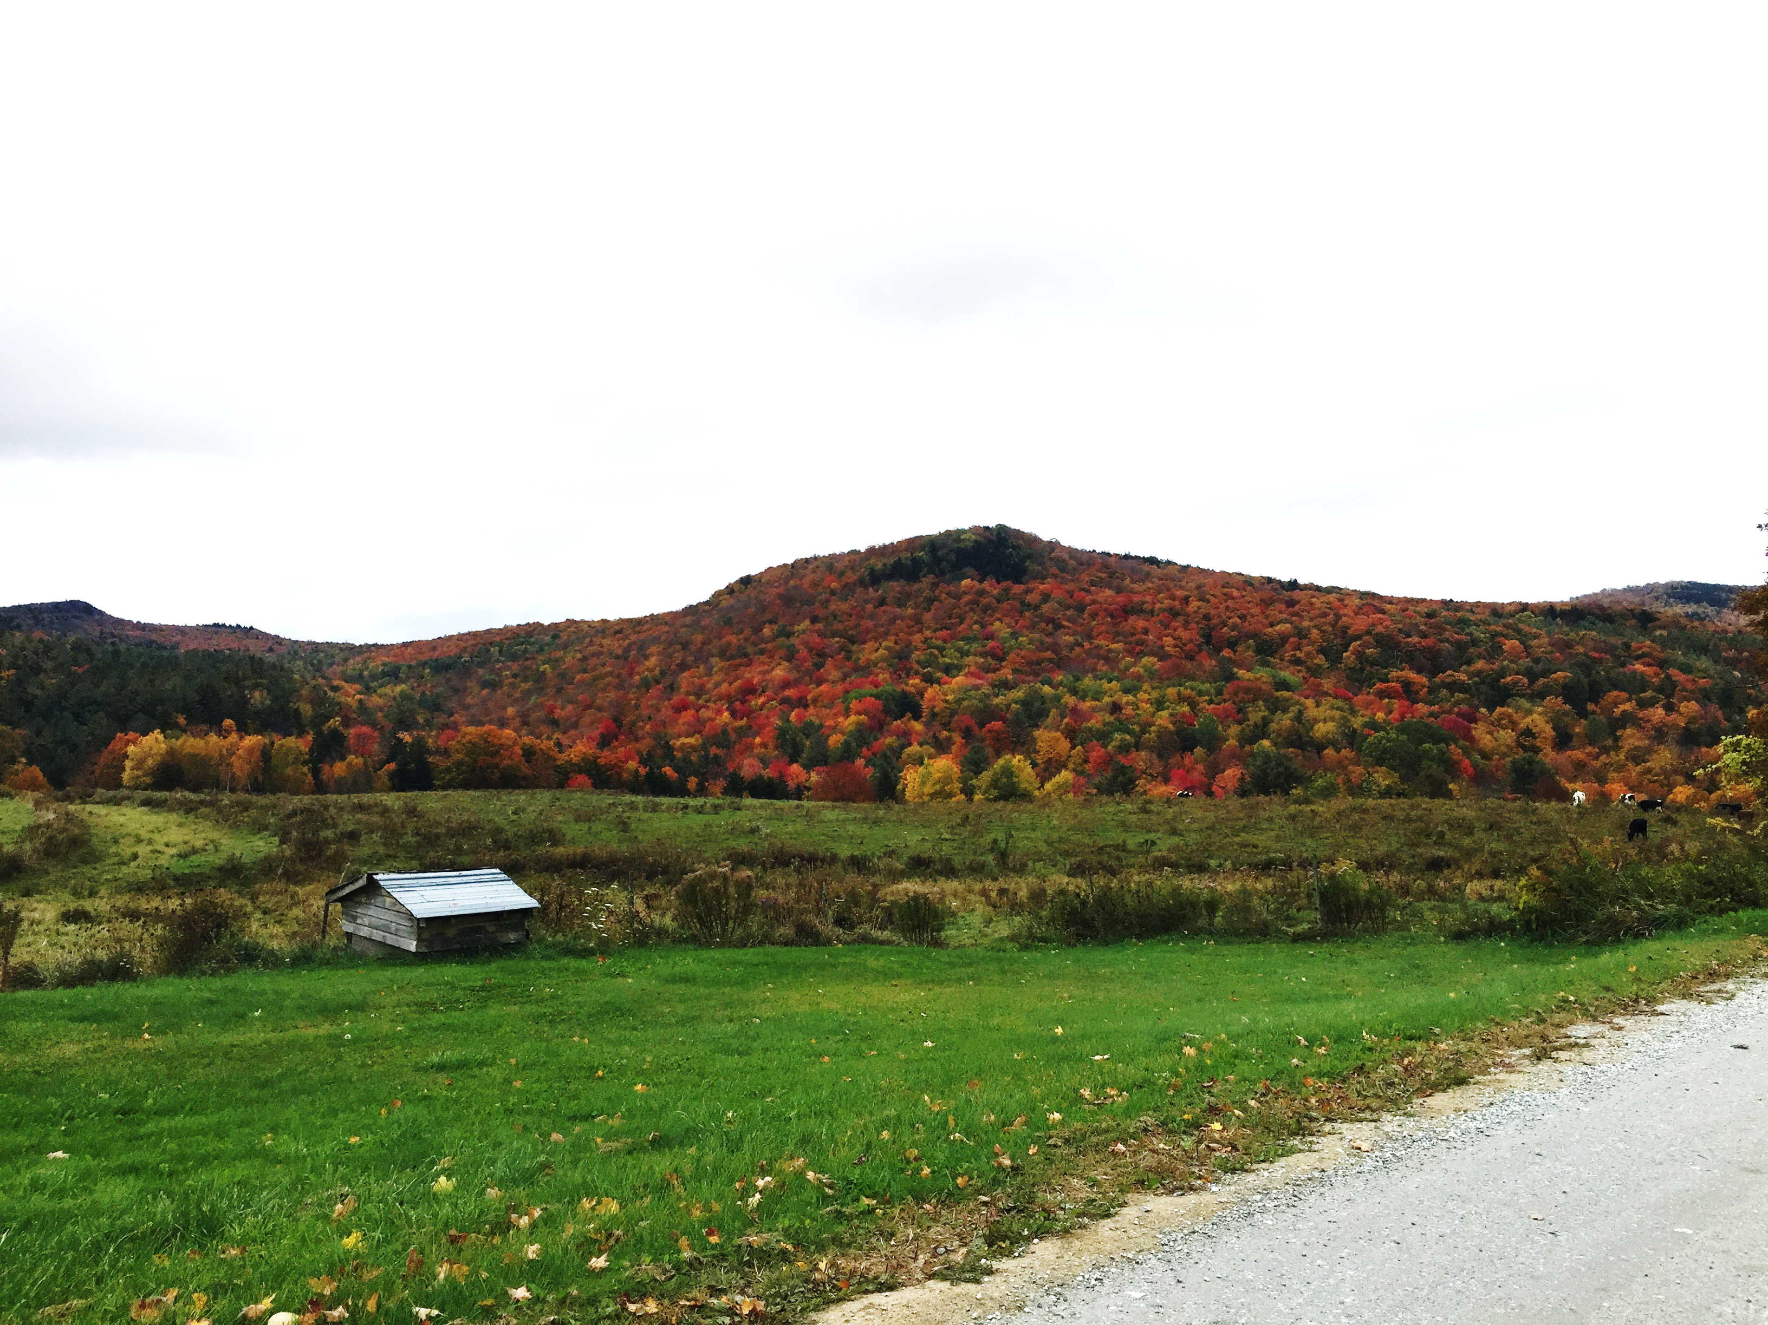
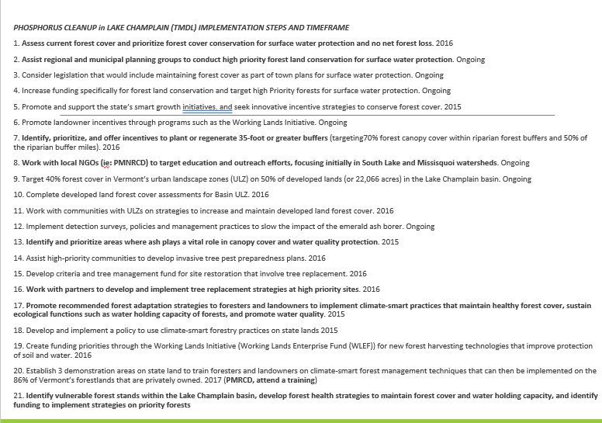
Flower Brook Landscape Assessment
Forest Land projects are the focus of 21 steps in the Phosphorus Cleanup TMDL Implementation Timeframe
Greene Hill, Flower Bk headwaters

Slide 8
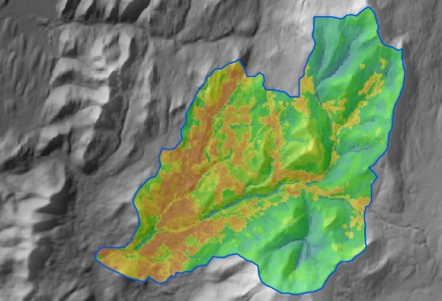
Flower Brook Landscape Assessment
Flower Brook Previously-identified
Water Quality / Flood Resilience Threats

Slide 9
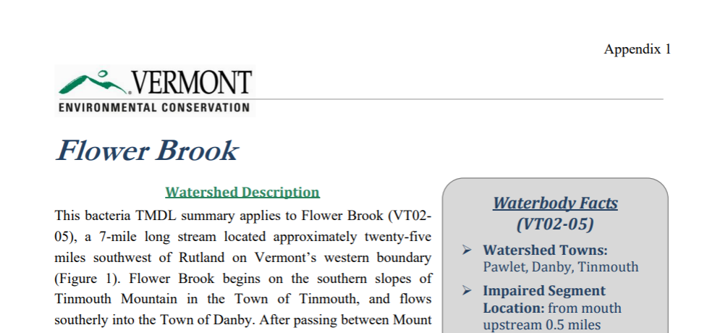
Flower Brook Landscape Assessment
Flower Brook Bacteria TMDL

Slide 10
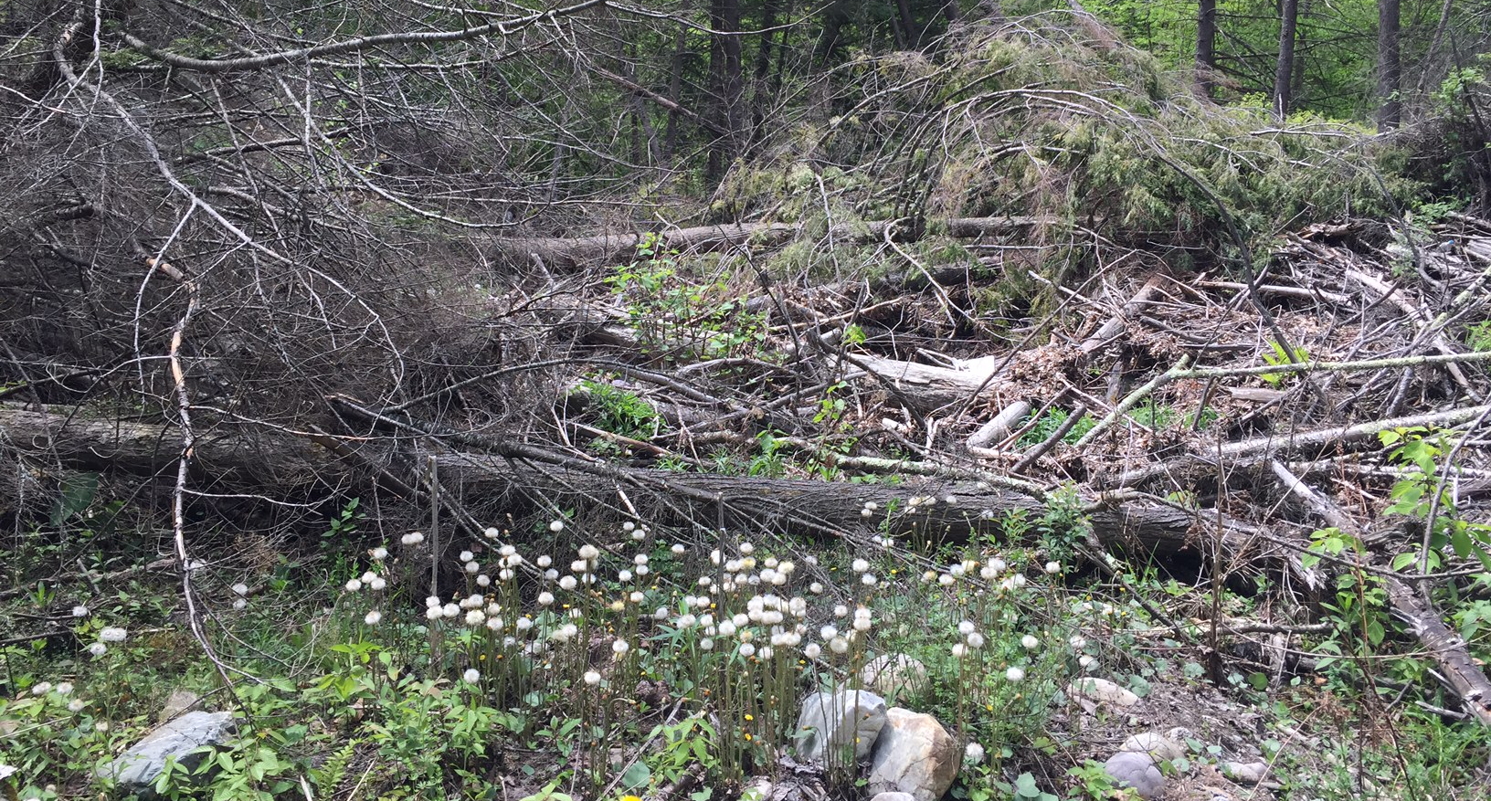
Flower Brook Post-Irene: a lot of woody material and gravel recruitment into the stream system…

Slide 11
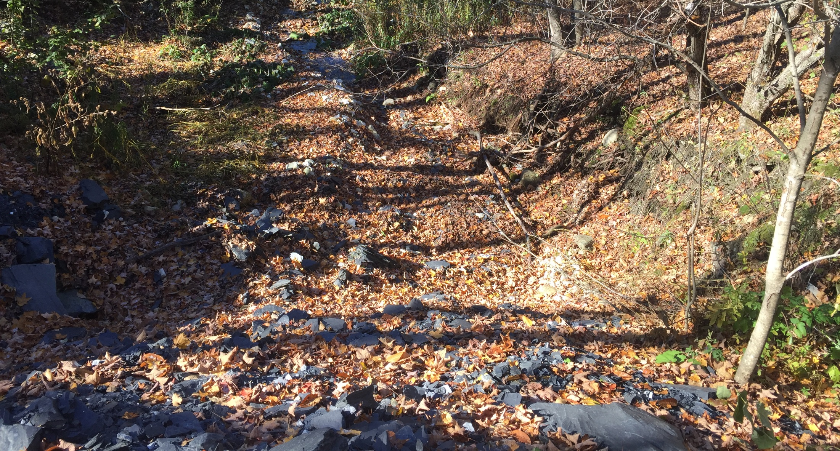
Pervasive Gullies in the Flower Brook Watershed: formed in small ephemeral streams

Slide 12
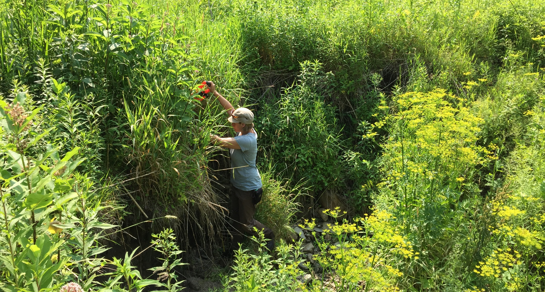
Pervasive Gullies: headcut in an abandoned hay field

Slide 13
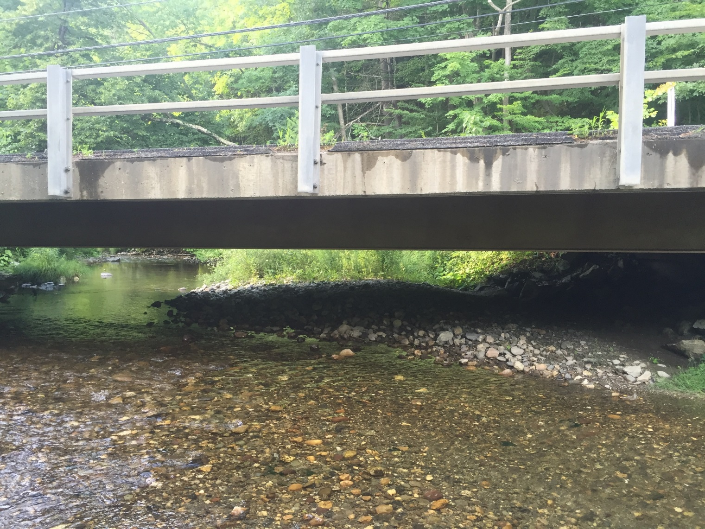
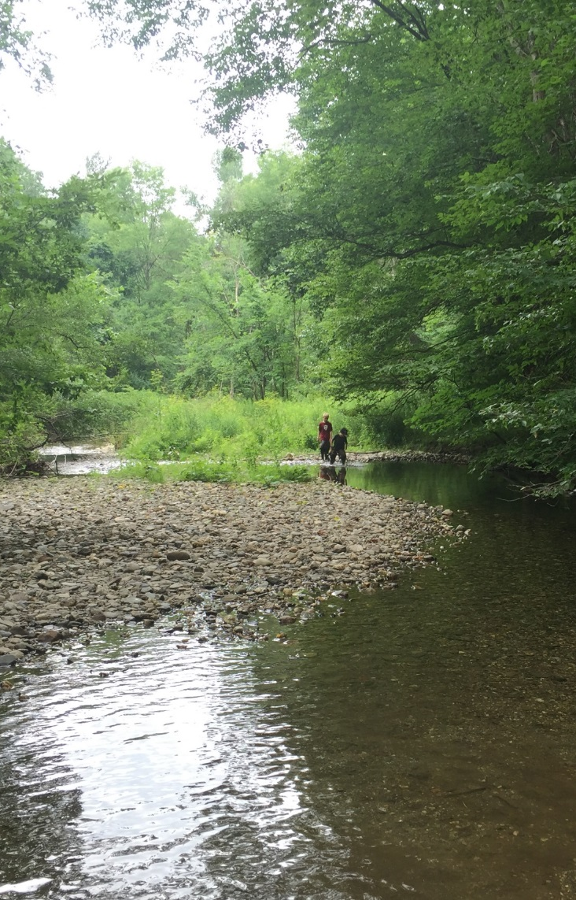
Gravel Fills the Stream Channel in the Village and increases chances of flooding in Pawlet.

Slide 14
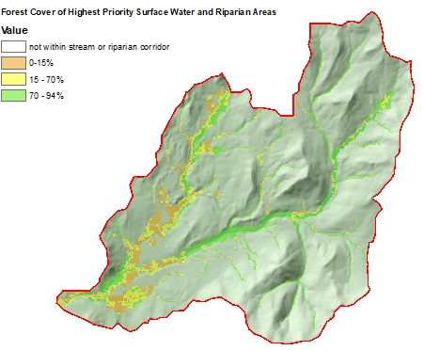
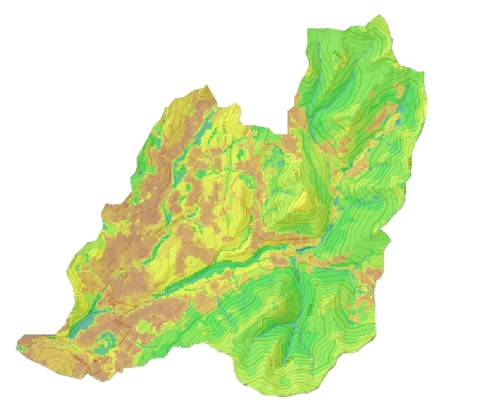
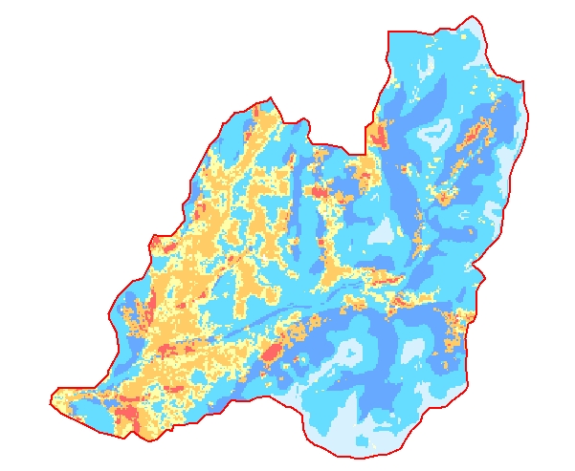
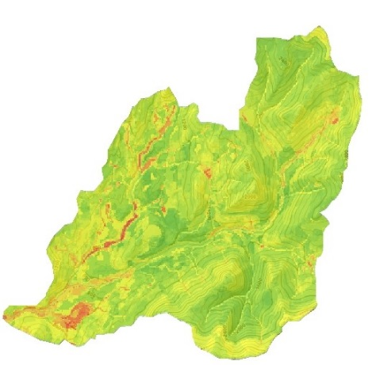
Flower Brook Landscape Assessment
2) Phosphorus Attenuation:
High Priority Forest Areas
1) River Corridors:
4) Vulnerable Areas:
Most likely to Contribute Phosphorus
3) Forest Restoration and Conservation Priorities:

Slide 15
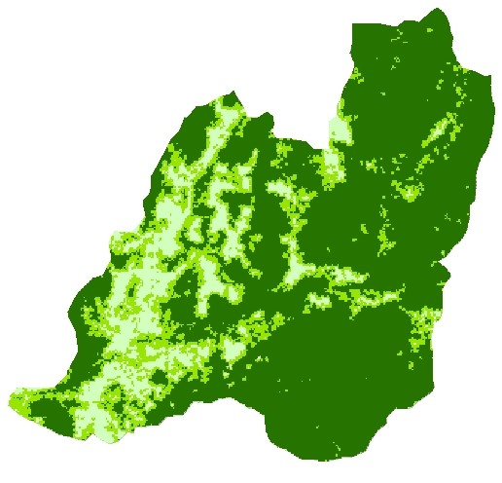
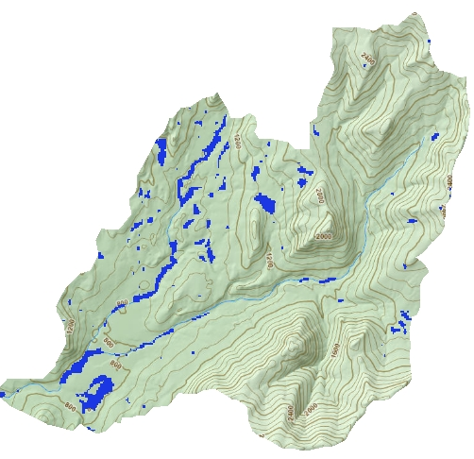
Tree Canopy Cover
Vulnerability to Contributing Phosphorus
VULNERABLE AREAS: PHOSPHORUS SOURCES
  Tree Canopy Cover
  Wetlands (including vernal pools and Hydric Soils)
  High Elevation (greater than 2500’)
  Steep Slopes
  Hydrologic Soil Groups (likely to erode when wet)
  River Corridor
  Development Density
Wetlands

Slide 16
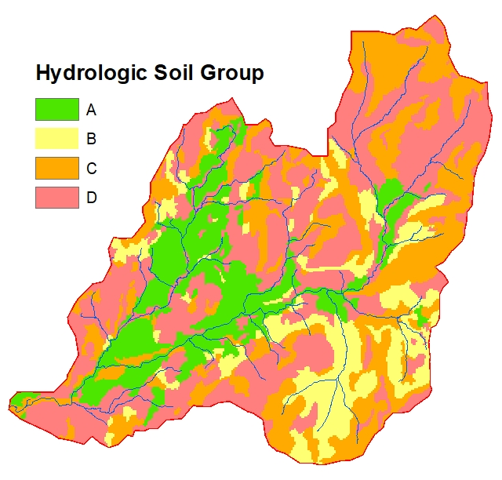
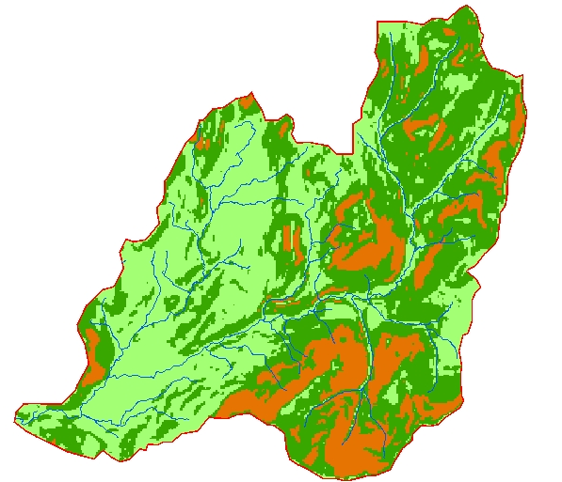
Vulnerability to Contributing Phosphorus
Slope
0-15%
15-35%
>35%

Slide 17
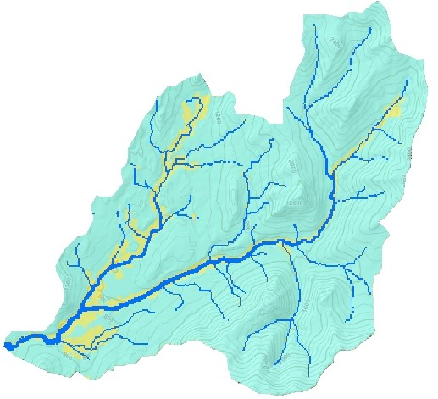
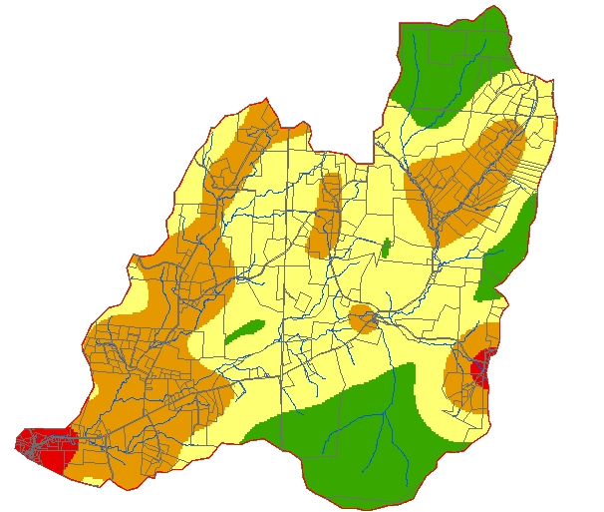
Vulnerability to Contributing Phosphorus
River Corridors
Development Density

Slide 18
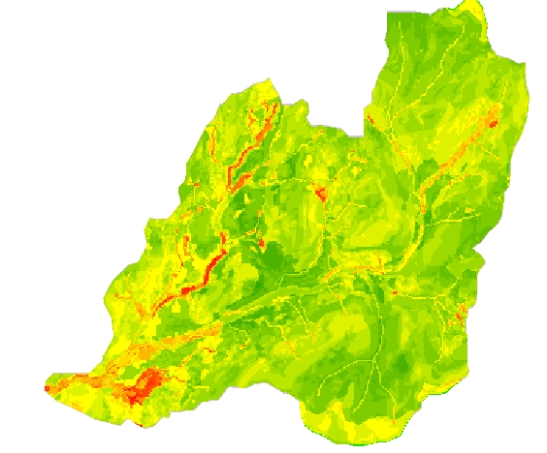
Vulnerability to Contributing Phosphorus
Vulnerable Areas --
Most likely to contribute Phosphorus to stream waters through erosion and runoff.
Percentage of Watershed --
Low Vulnerability - 24.5%
Moderate - 68%
High – 6.5%
Very High Vulnerability – 1%

Slide 19
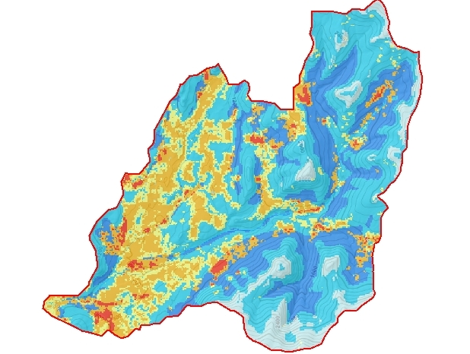
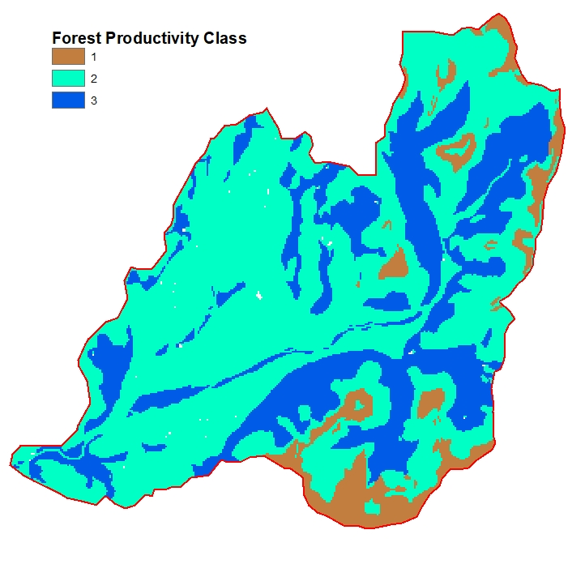
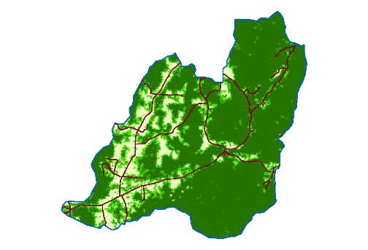
Forest Restoration and Conservation Priorities
RESTORATION and CONSERVATION PRIORITIES
Red- Highest Restoration Priority – 11%
(low forest cover and high productivity)
Orange- Restoration Priority -- 16%
(low forest cover and moderate productivity or medium forest and high productivity)
Darker Blues- Highest Conservation Priority -- 24%
(high or medium forest cover and high productivity)
Tree Canopy Cover X Forest Productivity
X
Forest Productivity Class –
Based on geology, elevation, landform, plant hardiness, slope, and precipitation. VLT 2009.

Slide 20
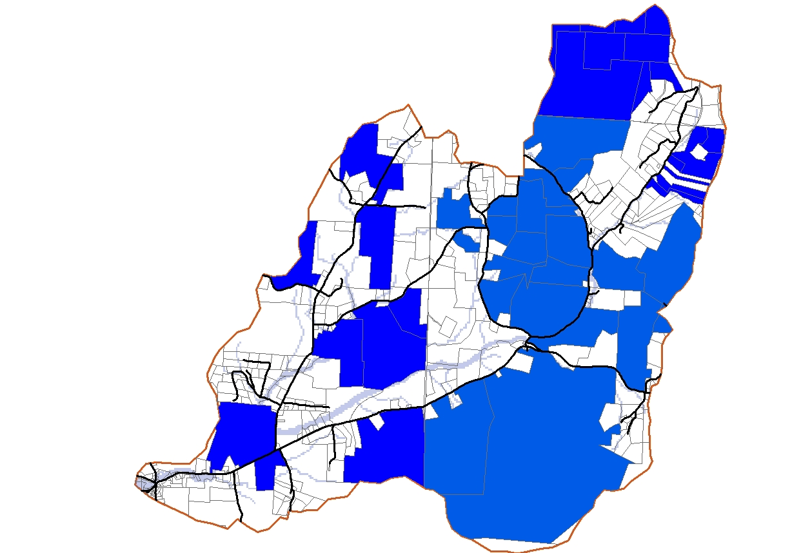
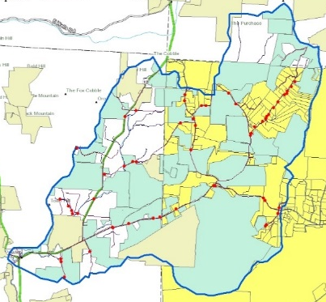
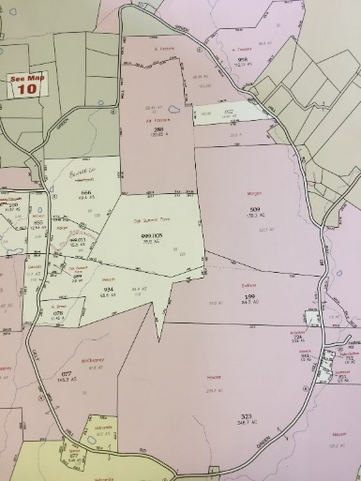
Flower Brook Landscape Assessment
PARCELS OF INTEREST
High Quality forests or high-value ecological characteristics
Map

Slide 21
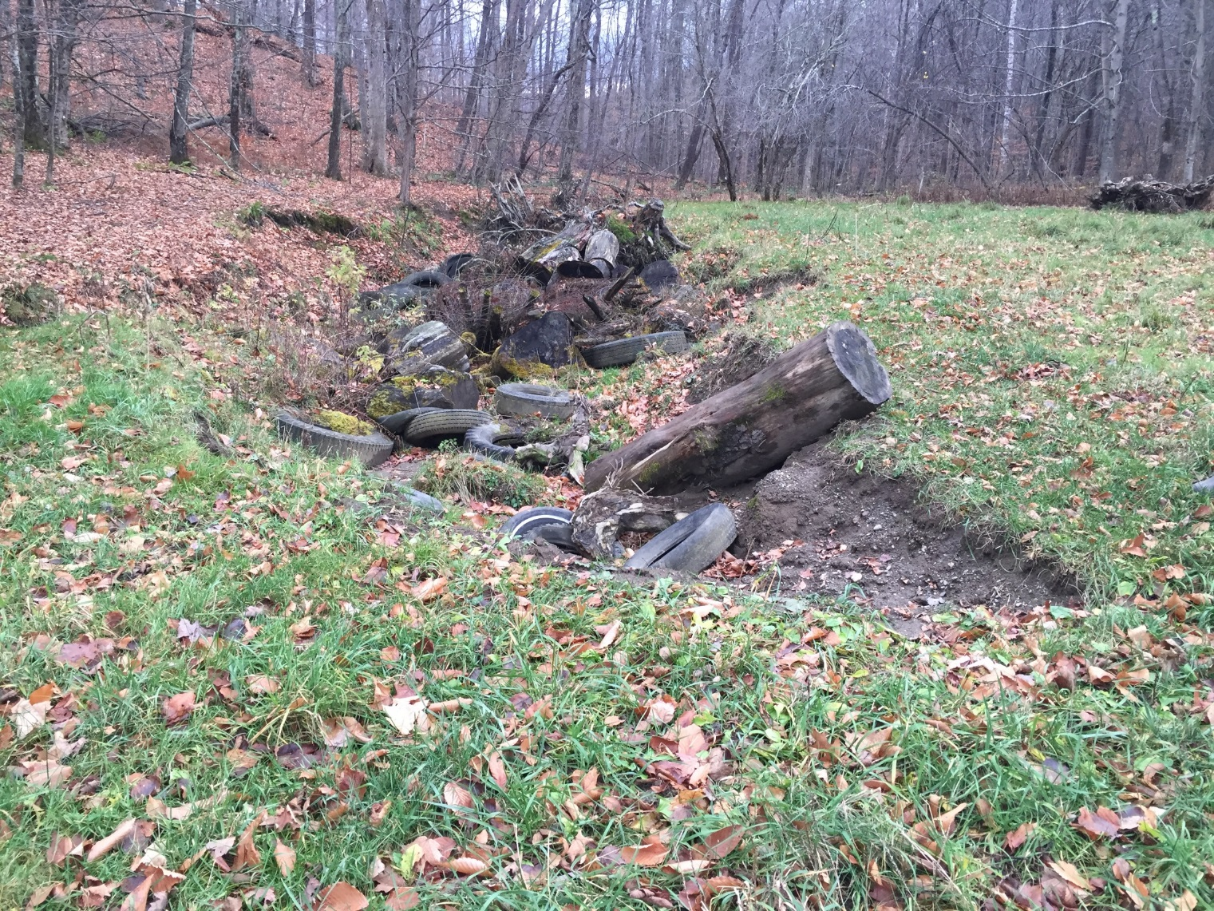
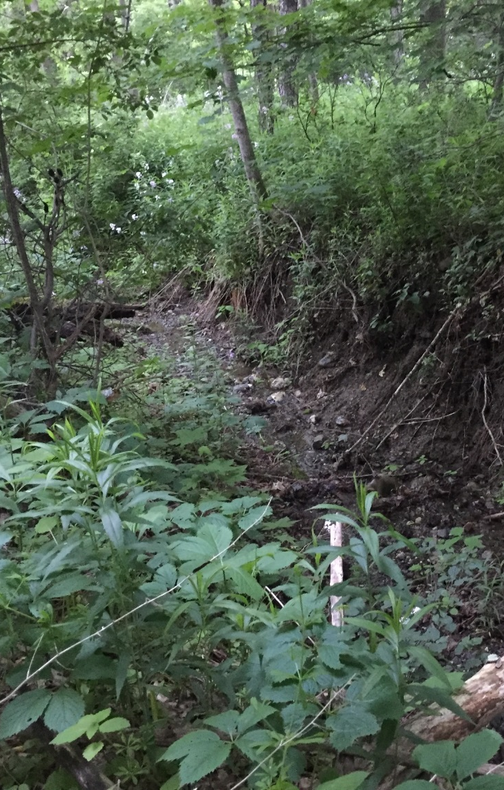
Gully #5: The Mason Farm – pasture and hayfield with a spring that drains to this area

Slide 22
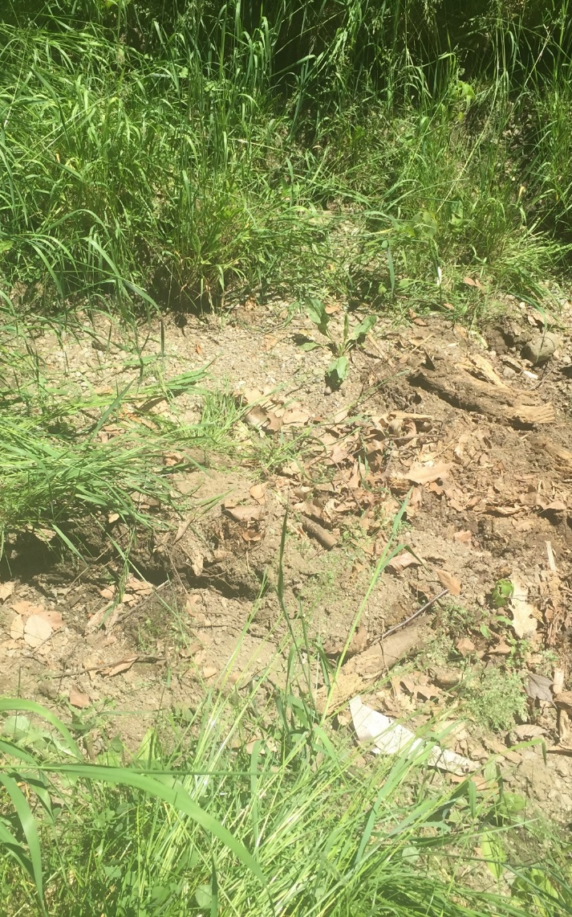
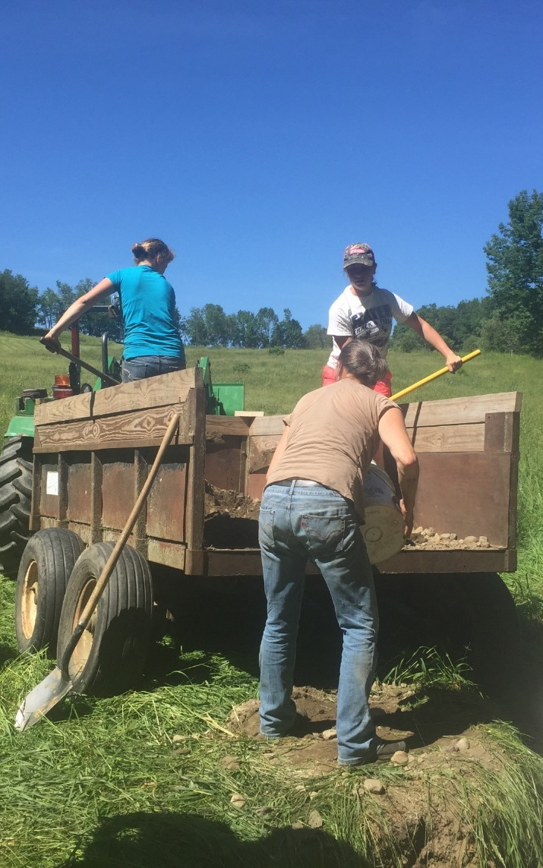
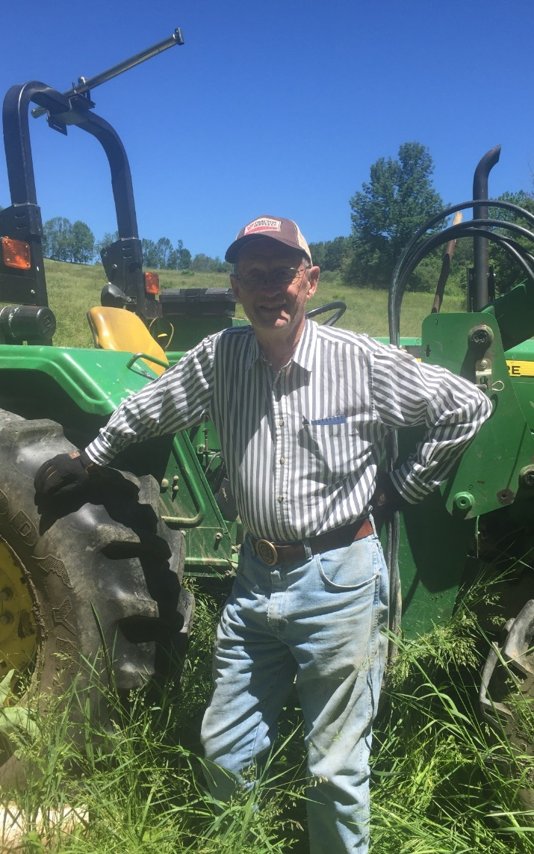
Project Implementation

Slide 23
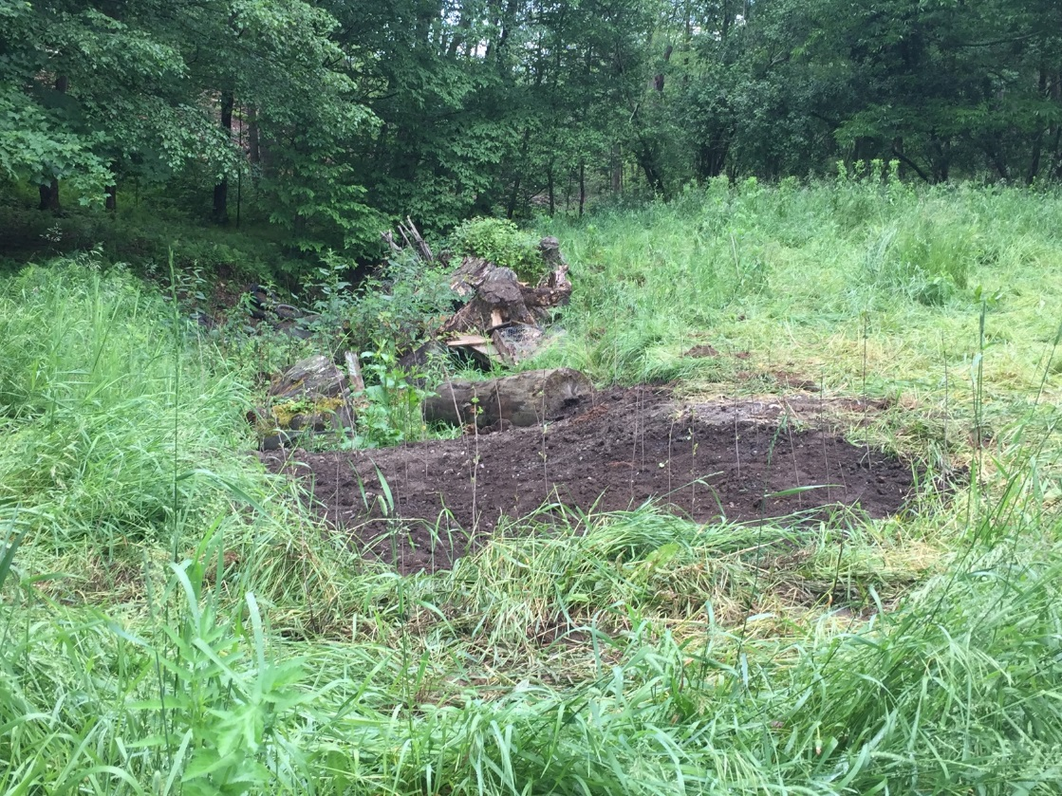
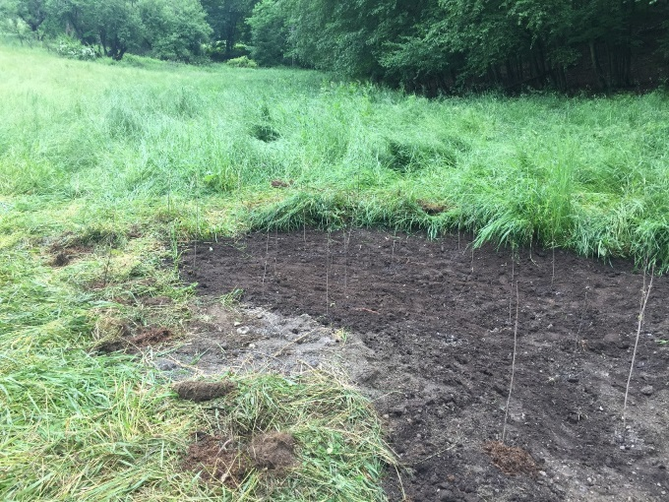
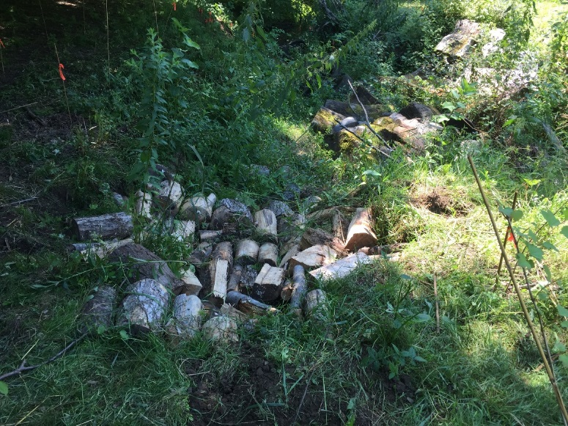
Flower Brook Landscape Assessment
Implementation Project
June 2017

Slide 24
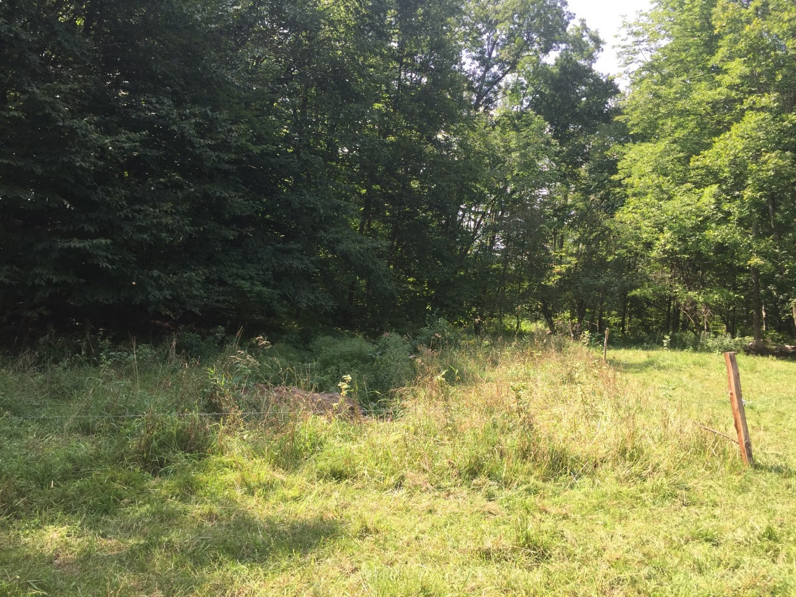
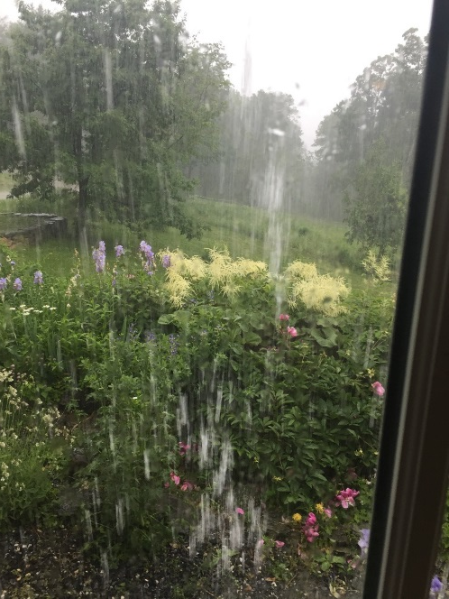
Flower Brook Landscape Assessment
One Year Later…

Slide 25
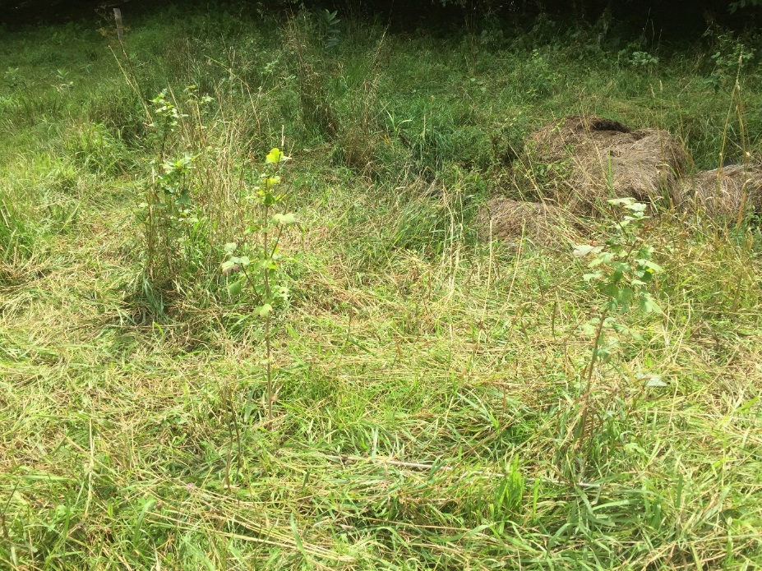
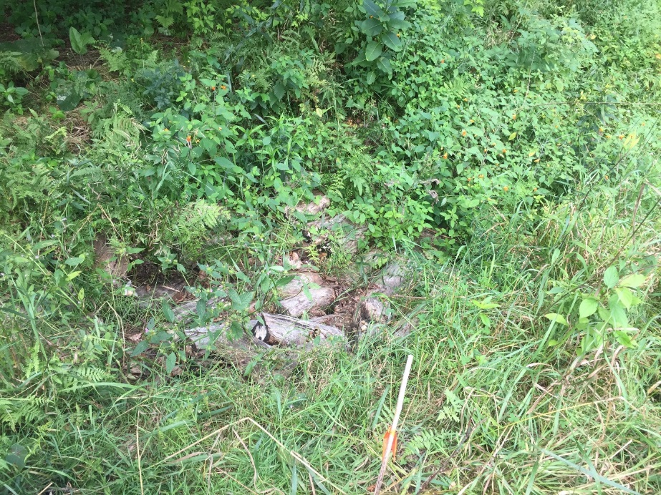
Flower Brook Landscape Assessment

Slide 26

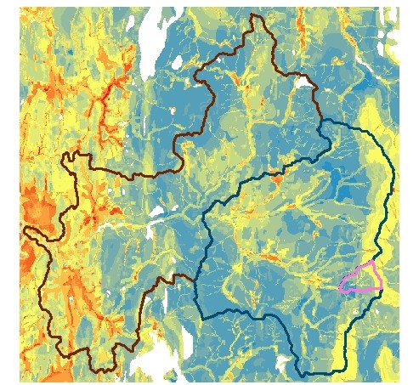
Landscape Analysis of
Middlebury River Watershed
Middlebury College Natural Science and the Environment students (Fall 2018) conducted a landscape analysis of the Middlebury River Watershed
Students generated maps depicting:
  Areas vulnerable to contributing Phosphorus
  Forest conservation and restoration priorities

Slide 27
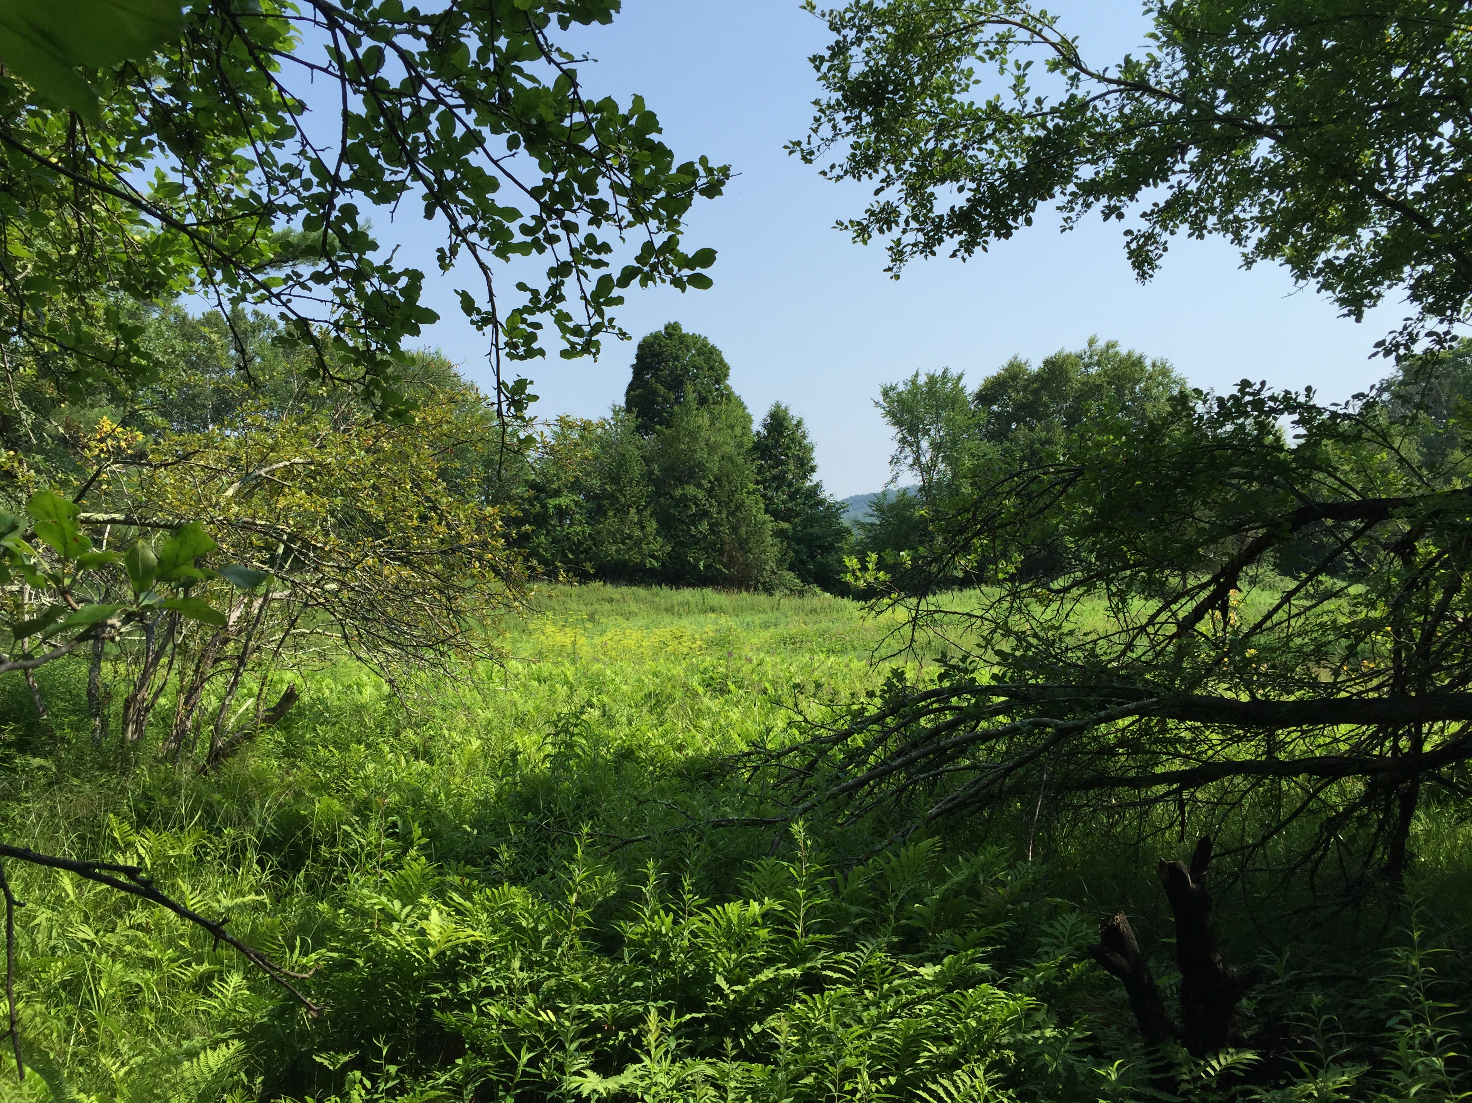
Flower Brook Landscape Assessment
Thank you to:
Towns of Pawlet, Danby, and Tinmouth, VT
Lake Champlain Basin Program
The High Meadow Fund
Vermont DEC
Vermont Center for Geographic Information
Generosity of colleagues and partners with time, knowledge, and advice

