Slide 1

A simulation modeling approach to investigate hydrologic regime transformations following Eastern hemlock mortality
Kanishka Singh, MS/PhD Student
James Knighton, PhD Candidate
Cornell University
ks983@cornell.edu

Slide 2
A foundation species
Maintains water budget^{1,2,3,4,5,6}
  Year-round transpiration
  Spatial throughfall patterns
  Soil moisture
  GW recharge
  Baseflow volume
  Discharge patterns

Slide 3
A foundation species
Coupled nutrient cycling^{7,8}
  N mineralization, nitrification, turnover
  N and C pools
  C:N ratio
  Lower levels of pH, Ca, Mg, K, mineralizable N

Slide 4
With an invasive problem
Hemlock woolly adelgid
  Starch reserves in parenchyma cells of EH xylem
  Range
    Southern Appalachia in 1950s
    Georgia to Maine, west to Tennessee⁴
  Mortality recorded 4-15 years post onset

Slide 5
Hydrologic budget transformations
Declines in AET (Appalachian studies)⁹
  Water use reduction ~40%
  Diminishment annual stand-level T ~10%
  Winter/Spring stand-level T ~30%
EH 50-60% of total basal area^{1,4}
  Diminishment annual stand-level T ~22%
  Winter stand-level T ~74%
Increase and spatial pattern distortion of throughfall⁵

Slide 6
Hydrologic budget transformations
In the immediate term¹⁰
  Soil moisture
  Discharge
  Annual catchment yield
  Daily amplitude of flow
  VSA dilation

Slide 7
Expanding the picture
Multivariate regression analysis of hydrology at 138 USGS gauged sites
Simulation modeling analysis of 75 sites with JoFlow
  Regionally parameterized ecohydrologic model
  Lumped daily water budget
  Spatially distributed runoff processes

Slide 8
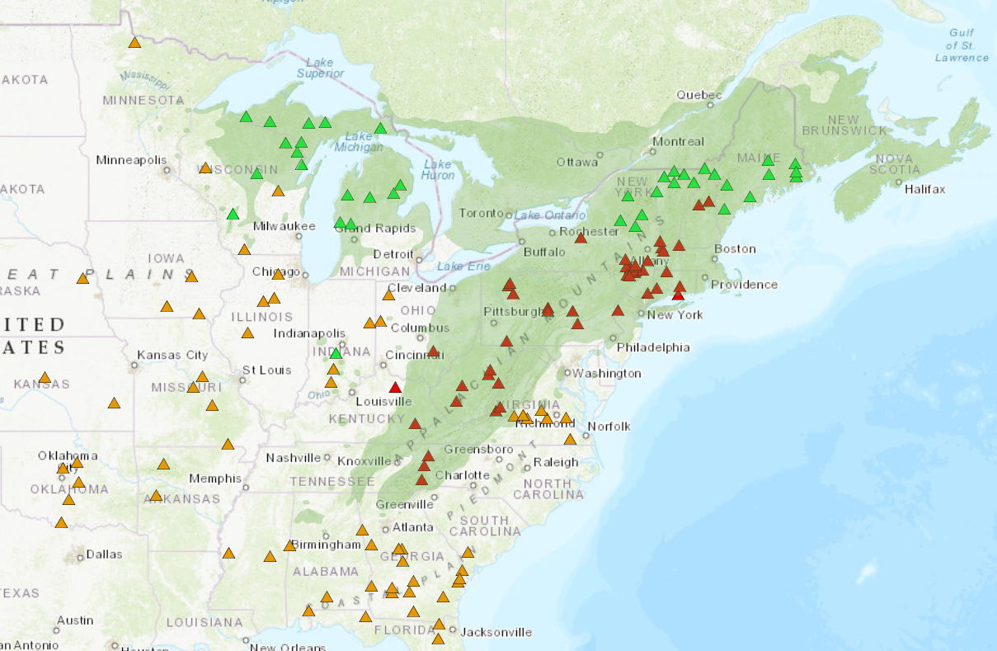
Regression site selection

Slide 9
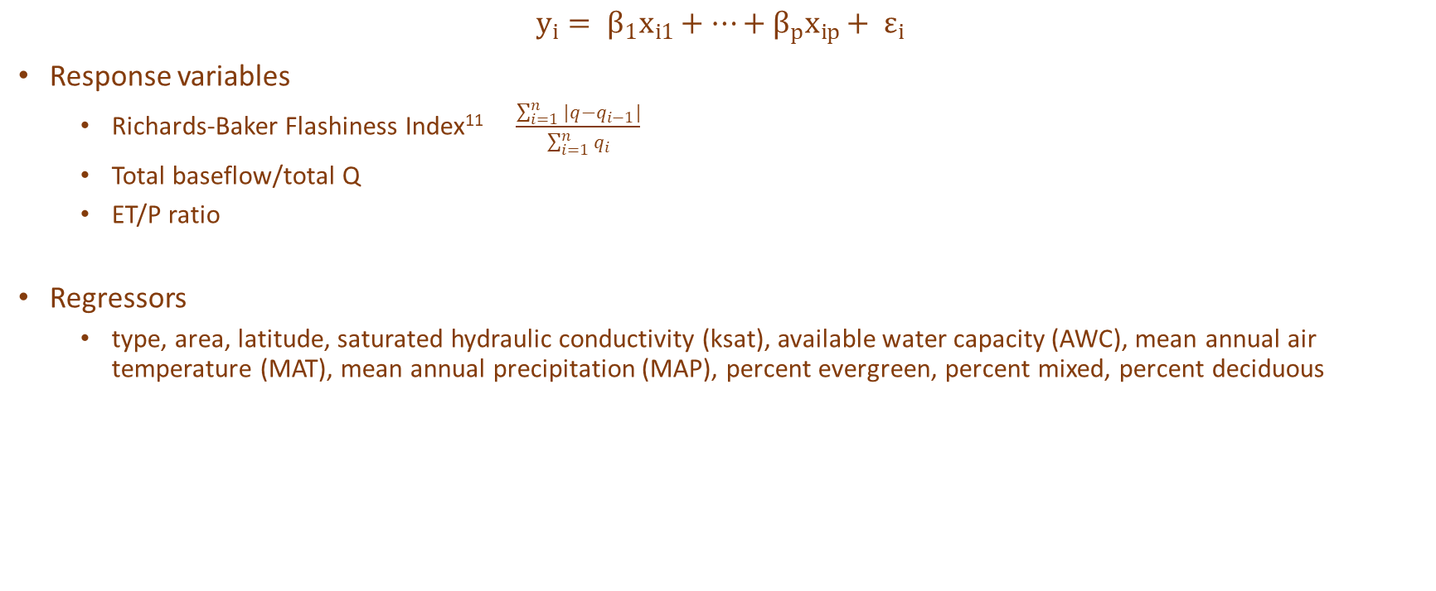
Regression approach
$$y_{i}= β_{1}x_{i1}+…+β_{p}x_{ip}+ ε_{i}$$
Response variables
  Richards-Baker Flashiness Index¹¹ $\frac{\sum_{i=1}^{n}{|q}−q_{i−1}|}{\sum_{i=1}^{n}{q_{i}}}$
  Total baseflow/total Q
  ET/P ratio
Regressors
  type, area, latitude, saturated hydraulic conductivity (ksat), available water capacity (AWC), mean annual air temperature (MAT), mean annual precipitation (MAP), percent evergreen, percent mixed, percent deciduous

Slide 10
Regression results
ET/P ratio
  Type, MAT and %mixed significant (at 99.9% level)
  Lat, ksat, %decid significant (at 99% level)
  Adjusted R-squared ~0.69
Landcover lumped ET/P ratio
  MAT, %forest significant (at 99.9% level)
  Type, latitude significant (at 99% level)
  Adjusted R-squared ~0.68

Slide 11
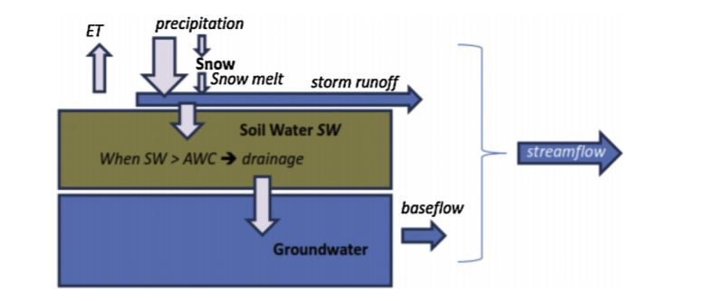
Simulation approach
Lumped VSA model¹² calibrated with a Dynamically Dimensioned Search (DDS) algorithm¹³
Forcing data: precip (mm), daily min and max temp (C), daily date
  Precip record supplemented with snowpack melt data with Snowmelt Calculator in EcoHydRology package
Assuming constant albedo of 0.23 and soil porosity volumetric fraction of 0.50
DDS to uniquely parameterize:
  Forest cover shade
  Hydrograph time-to-peak
  Initial abstraction for surface water pooling
  Max daily PET
  % of watershed comprised by impervious surface
  Baseflow recession coefficient
  Minimum daily curve number
  Coefficient relating curve number to soil water
10,000 iterations, and NSE calculated
Source: Archibald et al., 2014

Slide 12
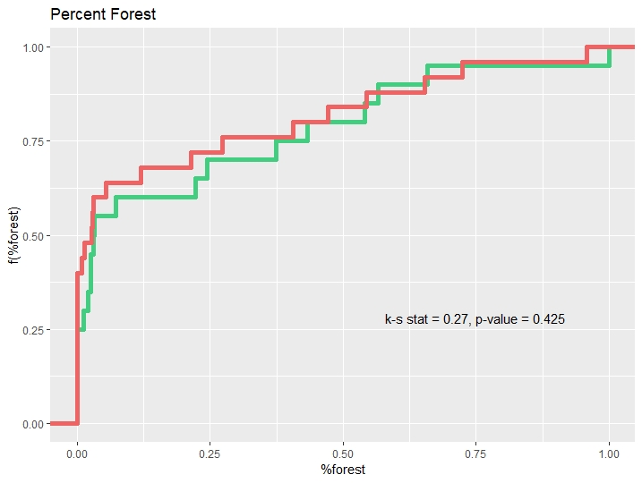
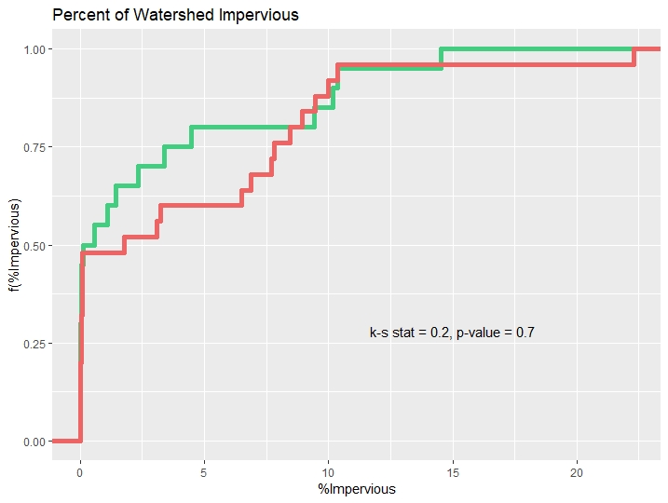
Modeling results

Slide 13
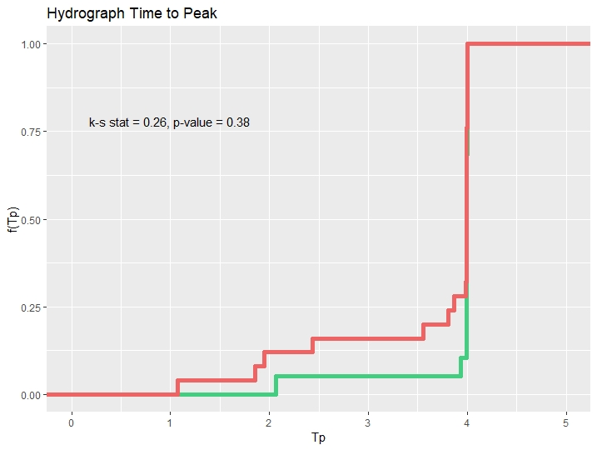
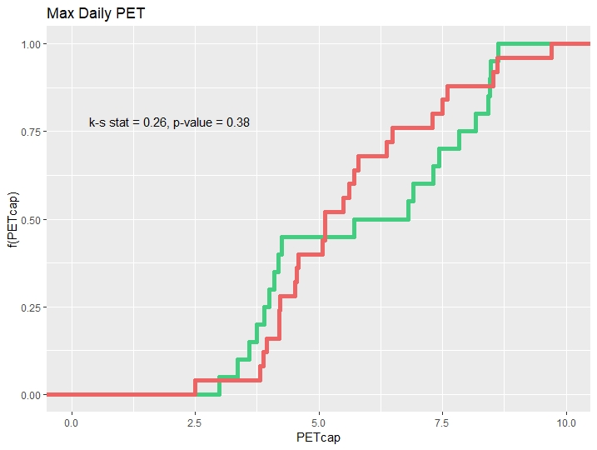

Slide 14
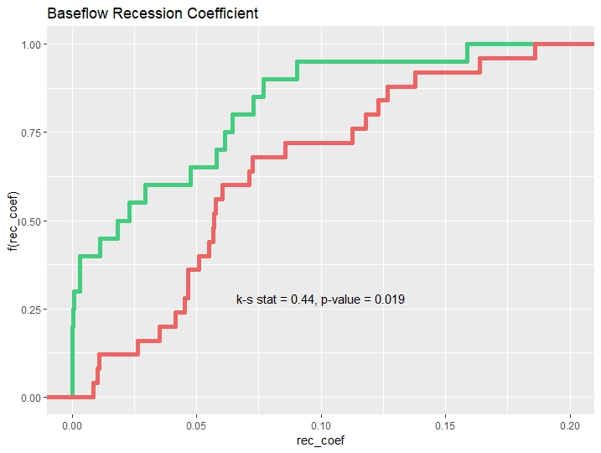
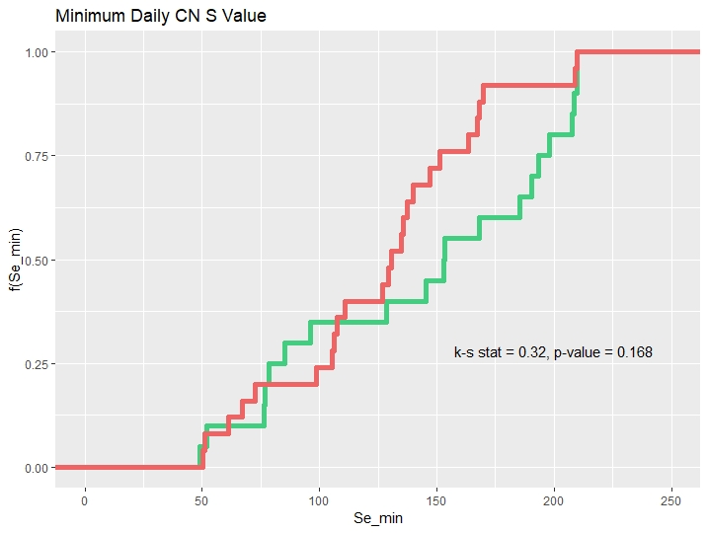

Slide 15
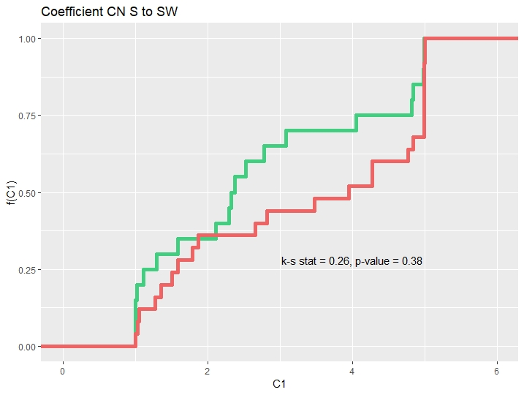
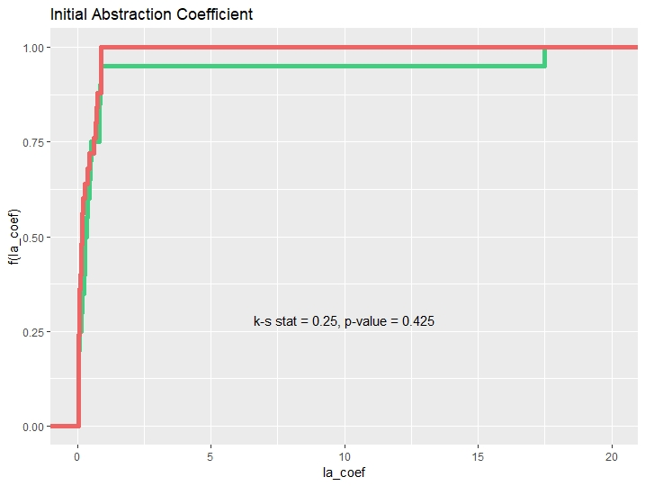

Slide 16
What’s next
Vegetation hydraulics as flooding risk control
Hydrologic LSMs predicting flooding extremes generalize plant dynamics taxonomically
Stable water isotope analysis indicates EH GW uptake > American Beech¹⁴ in dry and wet seasons
  EH a control on catchment storage and surface runoff

Slide 17
Tentative design
Key hydrologic data for EH and candidate successional species:
  Sap flux
  Soil moisture at varying depths
  Isotopic fractionation δ¹⁸O and ^{δ}2H
Apply plot-scale ecohydrologic model to understand species-specific water uptake depth
Parameterize a regional hydrologic land-surface model (ech2o) to simulate flooding scenarios under different vegetation compositions

Slide 18
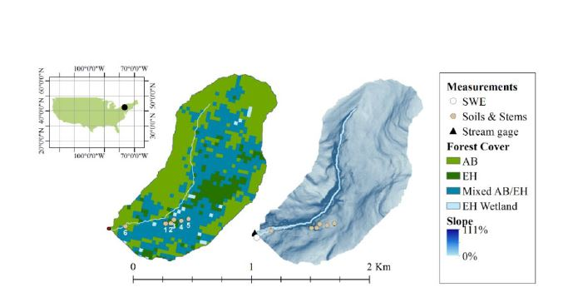

Slide 19
References
Brantley, S., Ford, C. R., & Vose, J. M. (2013). Future species composition will affect forest water use after loss of eastern hemlock from southern Appalachian forests. Ecological Applications, 23(4), 777-790.
Brantley, S. T., Miniat, C. F., Elliott, K. J., Laseter, S. H., & Vose, J. M. (2015). Changes to southern Appalachian water yield and stormflow after loss of a foundation species. Ecohydrology, 8(3), 518-528.
Daley, M. J., Phillips, N. G., Pettijohn, C., & Hadley, J. L. (2007). Water use by eastern hemlock (Tsuga canadensis) and black birch (Betula lenta): implications of effects of the hemlock woolly adelgid. Canadian Journal of Forest Research, 37(10), 2031-2040.
Ford, Chelcy R., and James M. Vose. “Tsuga Canadensis(L.) Carr. Mortality Will Impact Hydrologic Processes In Southern Appalachian Forest Ecosystems.” Ecological Applications, vol. 17, no. 4, 2007, pp. 1156–1167., doi:10.1890/06-0027.
Guswa, Andrew J., and Caitlin M. Spence. “Effect of Throughfall Variability on Recharge: Application to Hemlock and Deciduous Forests in Western Massachusetts.” Ecohydrology, vol. 5, no. 5, Aug. 2011, pp. 563–574., doi:10.1002/eco.281.
Kim, J., Hwang, T., Schaaf, C. L., Orwig, D. A., Boose, E., & Munger, J. W. (2017). Increased water yield due to the hemlock woolly adelgid infestation in New England. Geophysical Research Letters, 44(5), 2327-2335.

Slide 20
References
7. Jenkins, J. C., Aber, J. D., & Canham, C. D. (1999). Hemlock woolly adelgid impacts on community structure and N cycling rates in eastern hemlock forests. Canadian Journal of Forest Research, 29(5), 630-645. doi:10.1139/x99-034
8. Boettcher, S. E., & Kalisz, P. J. (1990). Single-Tree Influence on Soil Properties in the Mountains of Eastern Kentucky. Ecology, 71(4), 1365-1372. doi:10.2307/1938273
9. Domec, J. C., Rivera, L. N., King, J. S., Peszlen, I., Hain, F., Smith, B., & Frampton, J. (2013). Hemlock woolly adelgid (A delges tsugae) infestation affects water and carbon relations of eastern hemlock (T suga canadensis) and C arolina hemlock (T suga caroliniana). New Phytologist, 199(2), 452-463.
10. Adams, Henry D., et al. “Ecohydrological Consequences of Drought- and Infestation- Triggered Tree Die-off: Insights and Hypotheses.” Ecohydrology, vol. 5, no. 2, July 2011, pp. 145–159., doi:10.1002/eco.233.
11. Baker, David B., et al. “A New Flashiness Index: Characteristics And Applications To Midwestern Rivers And Streams.” Journal of the American Water Resources Association, vol. 40, no. 2, 2004, pp. 503–522., doi:10.1111/j.1752-1688.2004.tb01046.x.

Slide 21
References
12. Archibald, J.a., et al. “A Simple, Regionally Parameterized Model for Predicting Nonpoint Source Areas in the Northeastern US.” Journal of Hydrology: Regional Studies, vol. 1, 2014, pp. 74–91., doi:10.1016/j.ejrh.2014.06.003.
13. Tolson, Bryan A., and Christine A. Shoemaker. “Dynamically Dimensioned Search Algorithm for Computationally Efficient Watershed Model Calibration.” Water Resources Research, vol. 43, no. 1, 2007, doi:10.1029/2005wr004723.
14. Knighton J., Coneelly, J.., Walter, M.T. In Review. Alignment of Ecohydrologic and Climate Seasonality Control the Influence of Forest Cover on Catchment Flooding: An Evaluation of Eastern Hemlock Loss in the Northeastern US. Water Resources Research.

