Slide 1
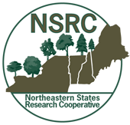

Continued progress in better aligning Northeastern States Research Cooperative and Forest Ecosystem Monitoring Cooperative
Elissa Schuett¹, William B. Bowden¹, Anthea Lavallee², William McDowell³, David Newman⁴, Aaron Weiskittel⁵, and Chris Woodall⁶
FEMC Annual Meeting
14 December 2018
¹ Rubenstein School of Environment and Natural Resources, University of Vermont, Burlington, VT
² Hubbard Brook Research Foundation, Woodstock, VT
³ Department of Natural Resources and the Environment, University of New Hampshire, Durham, NH
⁴ Forest and Natural Resources Management, SUNY-ESF, Syracuse, NY
⁵ School of Forest Resources, University of Maine, Orono, ME
⁶ Northern Research Station, Center for Research on Ecosystem Change, USDA Forest Service, Durham, NH

Slide 2
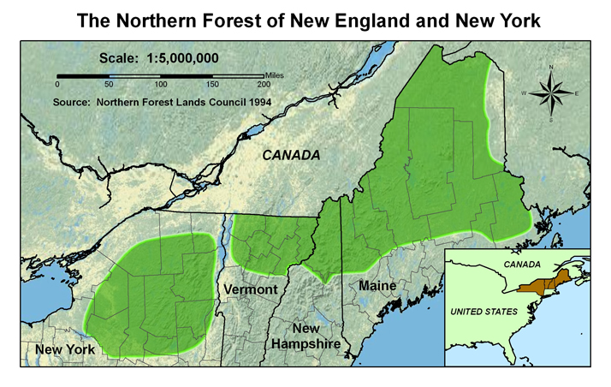
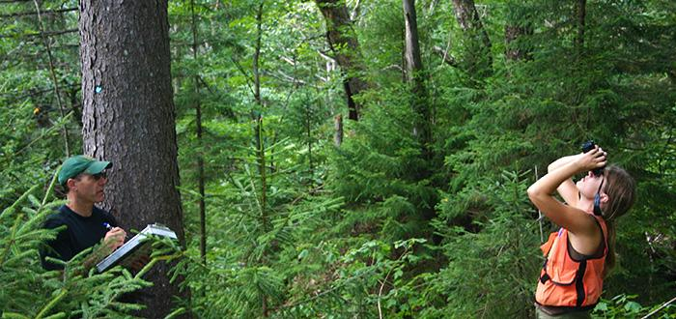
NSRC Mission
The NSRC addresses the importance of the Northern Forest to society and the need for research to have relevance and benefit to the people who live there, work with its resources, use its products, visit it, and care about it.
Public Law 105-185

Slide 3
NSRC Scope
Interest Areas
Atmospheric Pollution
Climate Change
Community & Landowner Engagement
Conservation & Biodiversity
Ecology
Economy of the Northern Forest
Energy & Carbon
Forest Health & Invasive Species
Forest Management & Productivity
Forest Products
Land Use Planning & Development
Recreation & Tourism
Water & Watersheds
Wildlife
Thematic Areas
Sustaining productive communities
Sustaining ecosystem health
Sustaining productivity and products
Sustaining biodiversity
NSRC
See: https://nsrcforest.org/

Slide 4
NSRC Partnerships
Businesses
Ecosystems
New
Hampshire
Vermont
Northern Forest Lands
NGOs
New
York
Communities
Maine
Forest
Service
HBRF
Agencies
Institutions

Slide 5
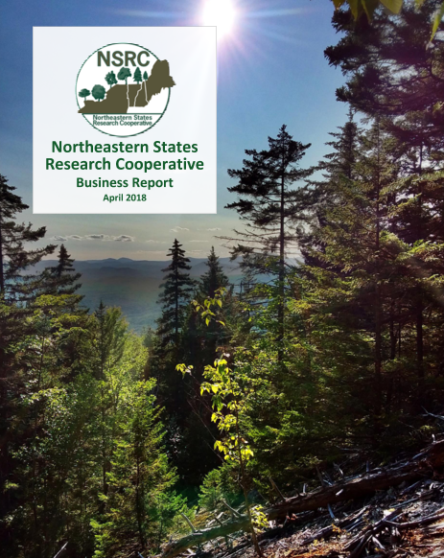
NSRC Business Report
Released in spring of 2018
Provides an overview of the organization’s history, past accomplishments, key projects, and future direction
Available as a hard-copy or online at NSRC website

Slide 6
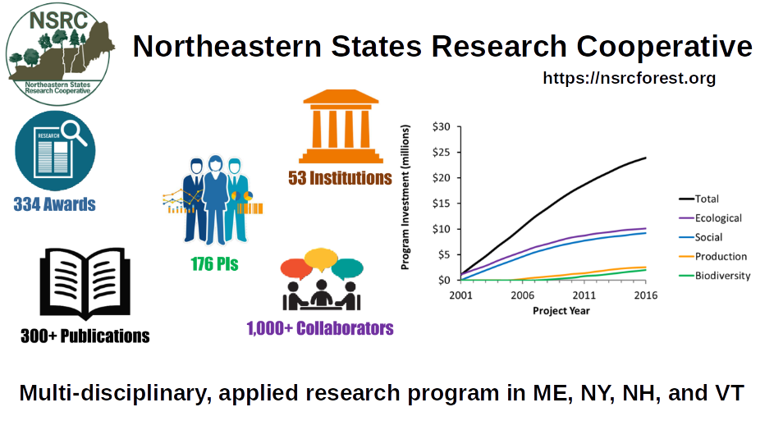

Slide 7
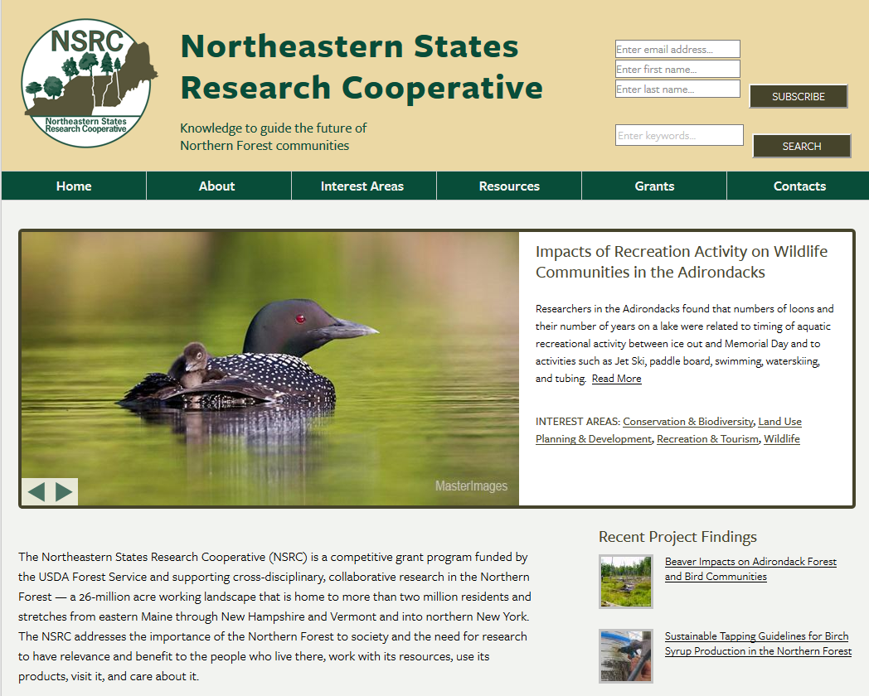
https://nsrcforest.org/

Slide 8
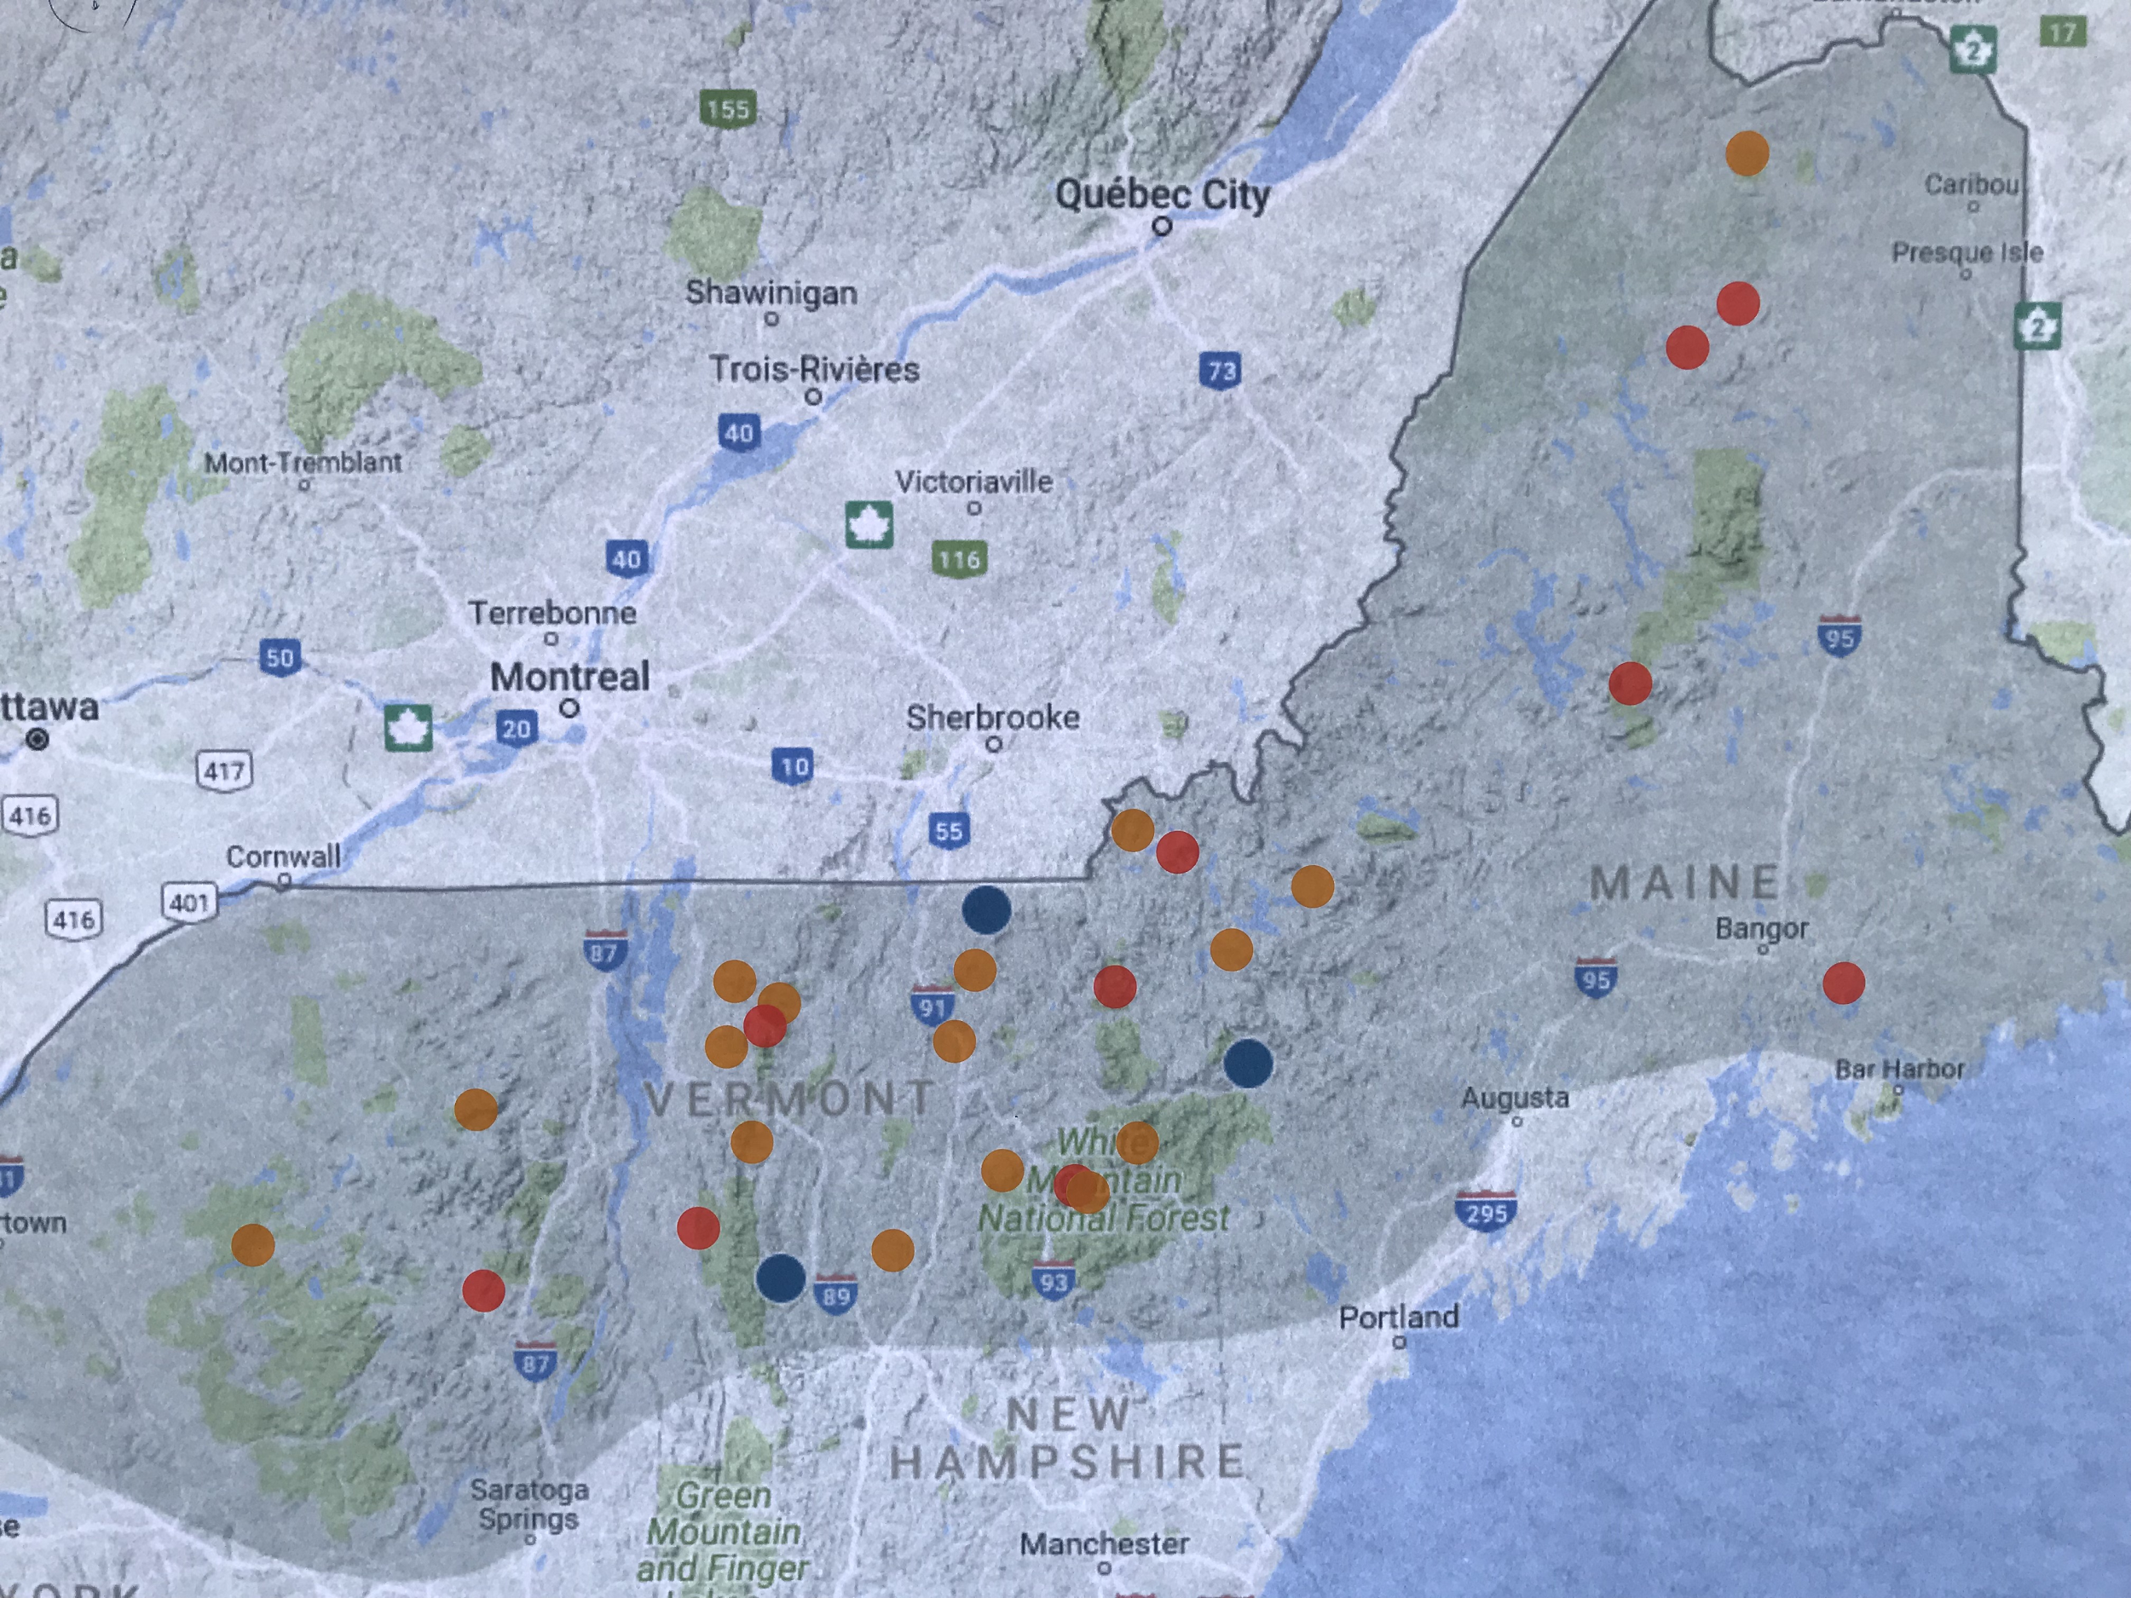
NSRC Stakeholder Meeting
Hosted Jan 18, 2018 in Portsmouth, NH
  30+ participant across various sectors
  Equal representation across the region
Strong support for a program like NSRC
Need an advisory group composed of diverse Northern Forest Stakeholders
Meeting participants’ favorite locations in the Northern Forest

Slide 9
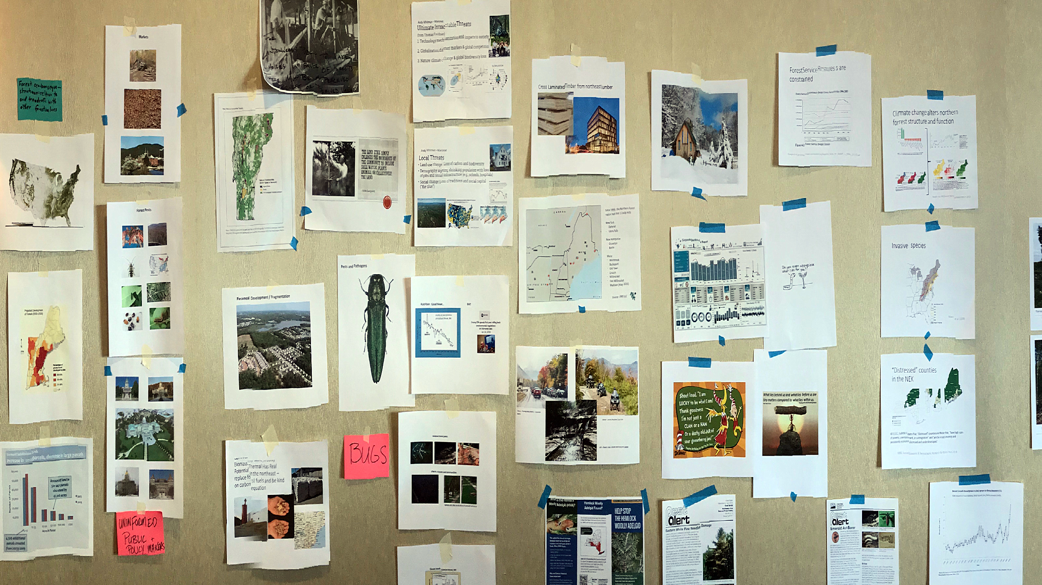
NSRC Stakeholder Meeting
Key future research topics with driving research questions identified
  Socioeconomics and Jobs
  Invasive Species
  Science to Policy
  Silviculture
  Land Use and Fragmentation
  Ecosystems Services
  Energy & Carbon (Source and Sequestration)
Full summary report available
Northern Forest Research Priorities

Slide 10

NSRC and FEMC
Complementary parts of a whole?
FEMC: State and Private Forestry
To serve the northeast temperate forest region through improved understanding of long-term trends, annual conditions, and interdisciplinary relationships of the physical, chemical, and biological components of forested ecosystems.
NSRC: Forest Service Research
To support cross-disciplinary, collaborative research in the Northern Forest that is relevant to and benefits the people who live within its boundaries, work with its resources, use its products, visit it, and care about it.

Slide 11
A potential collaboration serving the Northern Forest Communities
Support and Guidance
Research and Outreach
Forest Service
NSRC
2.0
Monitoring and Synthesis
Solutions
FEMC
Northern Forest Communities
Challenges and Needs
There are other components in this complex machine!

Slide 12
What’s next?
As of FY2017, the NSRC is in a funding hiatus
Currently funded projects will continue
Strategic Plan for “NSRC2.0”
Explore new funding opportunities

Slide 13
What can you do?
Help distribute NSRC materials
Speak to the importance of NSRC
Highlight benefits of past NSRC funding
Identify potential future partners for NSRC
Provide feedback

Slide 14
Summary
NSRC has been a vital regional program with a long and productive history
Given current transitions in the region, the need for a program like NSRC likely has not been higher
Future of the organization remains highly uncertain
Partnership with FEMC is logical and leverages strengths of both organizations

Slide 15
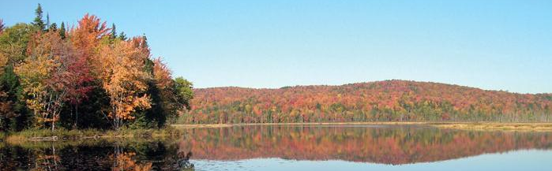
Thank you!
Breck Bowden (breck.bowden@uvm.edu)
Bill McDowell (bill.mcdowell@unh.edu)
Aaron Weiskittel (aaron.weiskittel@maine.edu)
Dave Newman (dnewman@esf.edu)
Anthea Lavallee (alavalee@hbresearchfoundation.org)
Chris Woodall (cwoodall@fs.fed.us)
The Wilderness Society

