Slide 1
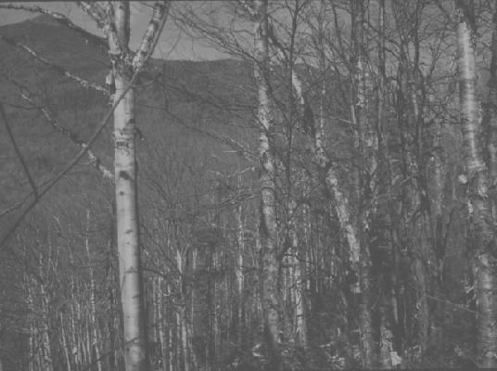
Trends in Exchangeable Cations (and Carbon) after 15 Years into a 150-Year Soil Monitoring Study
Don Ross, University of Vermont
Scott Bailey, USFS Northern Research Station
Angie Quintana, USFS GMNF
Thom Villars, USDA NRCS (retired)
Sandy Wilmot, VT Forests, Parks and Rec (retired)
Jim Duncan, Forest Ecosystem Monitoring Coop

Slide 2
Initial Project Goals:
Establish five 50 x 50 m relatively uniform plots in sites associated with the Vermont Monitoring Coop.
Sample plots at designated intervals: 0, 5, 10, 25, 50, 100, 150, and 200 years (with 2 other times in reserve)
  Year 0 = 2002
Analyze initial samples to determine baseline values.
Archive samples for later comparisons.
Protect the plots for future monitoring.

Slide 3
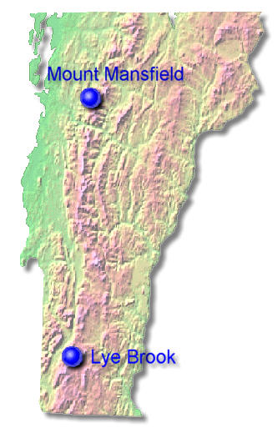
5 Monitoring Sites:
Mt. Mansfield Ranch Brook
  northern hardwood
Mt. Mansfield Forehead
  high elevation spruce/fir
Mt. Mansfield Underhill State Park
  transitional forest
  SCAN site
Lye Brook “Road”
  northern hardwood
  SCAN site
Lye Brook “Trail”
  transitional forest

Slide 4
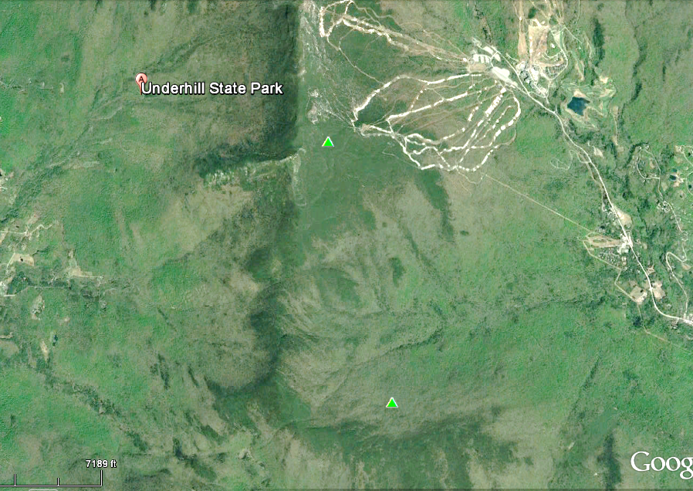
Forehead
Ranch Brook

Slide 5
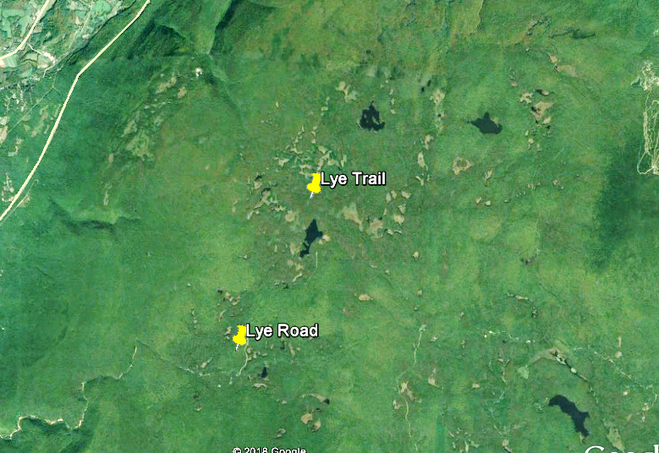
Stratton
Route 7

Slide 6
Sampling years have been:
  2002, 2007, 2012, 2017…
Sampling Protocols for 2007, 2012, 2017:
Four large sample bags collected from each soil pit:
Oi and Oe combined: Litter layer
Oa and/or A: near-surface humified horizons
B horizon: Top 10 cm
Between 60-70 cm (usually is the C horizon)
Also collected small samples of each genetic horizon.

Slide 7
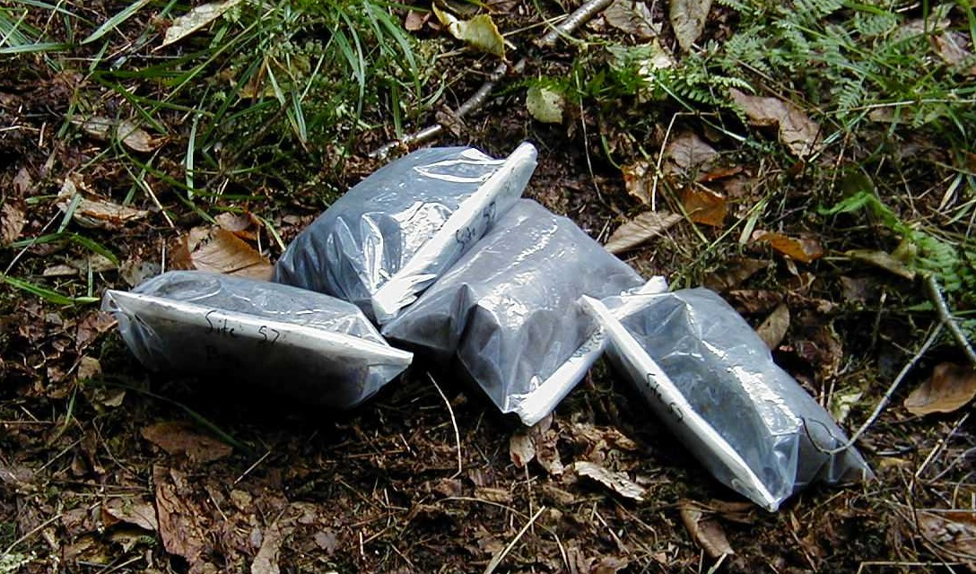
Four bulk samples taken from each soil pit

Slide 8
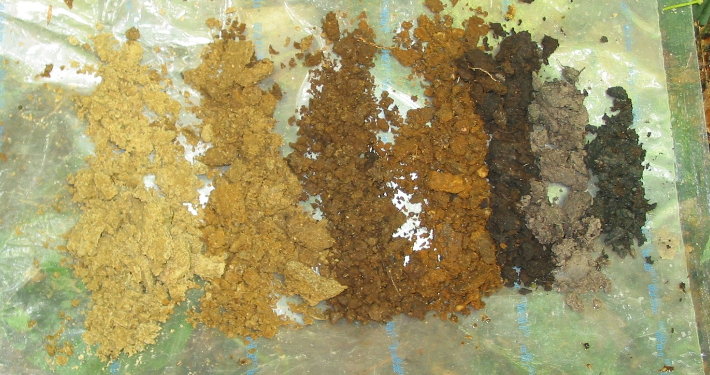
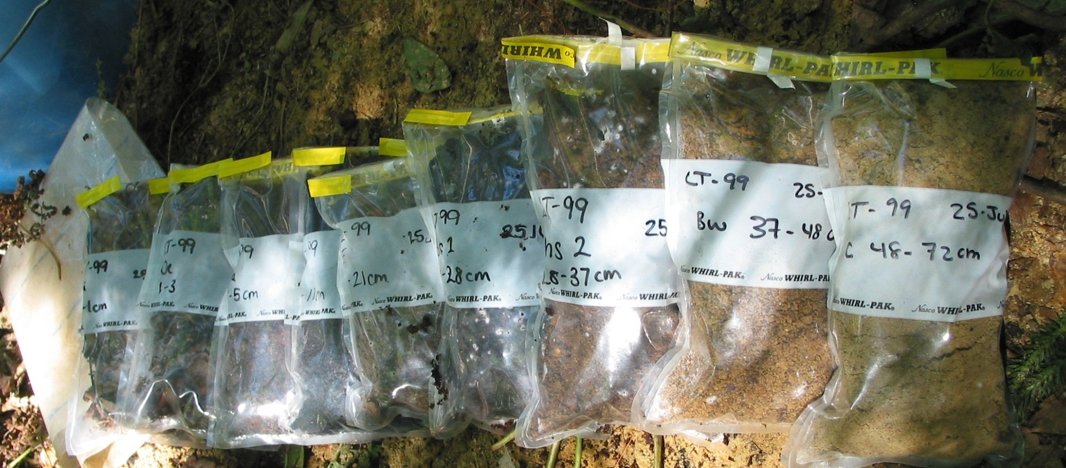
Genetic horizons at each soil pit
sampled in smaller bags

Slide 9
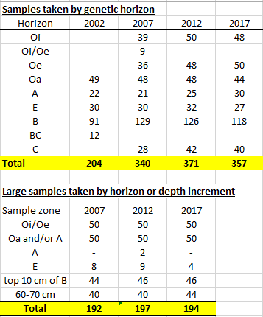
Over 1800 soil samples have been collected since 2002 at the 5 study sites.
The last three sampling rounds have each generated over 500 unique soil samples. These are used for lab analysis and are archived at UVM.
=1855

Slide 10
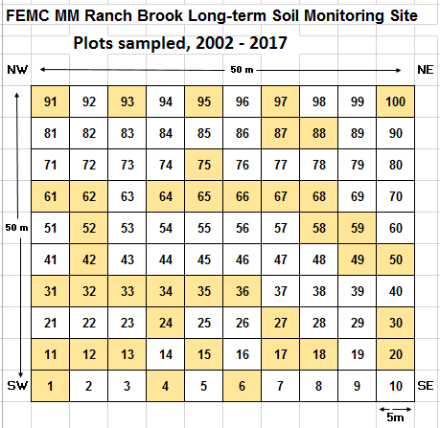
Typical site plan with 100 5x5m plots.
Plots in yellow have been sampled in 2002-2017 (40 plots to date).

Slide 11
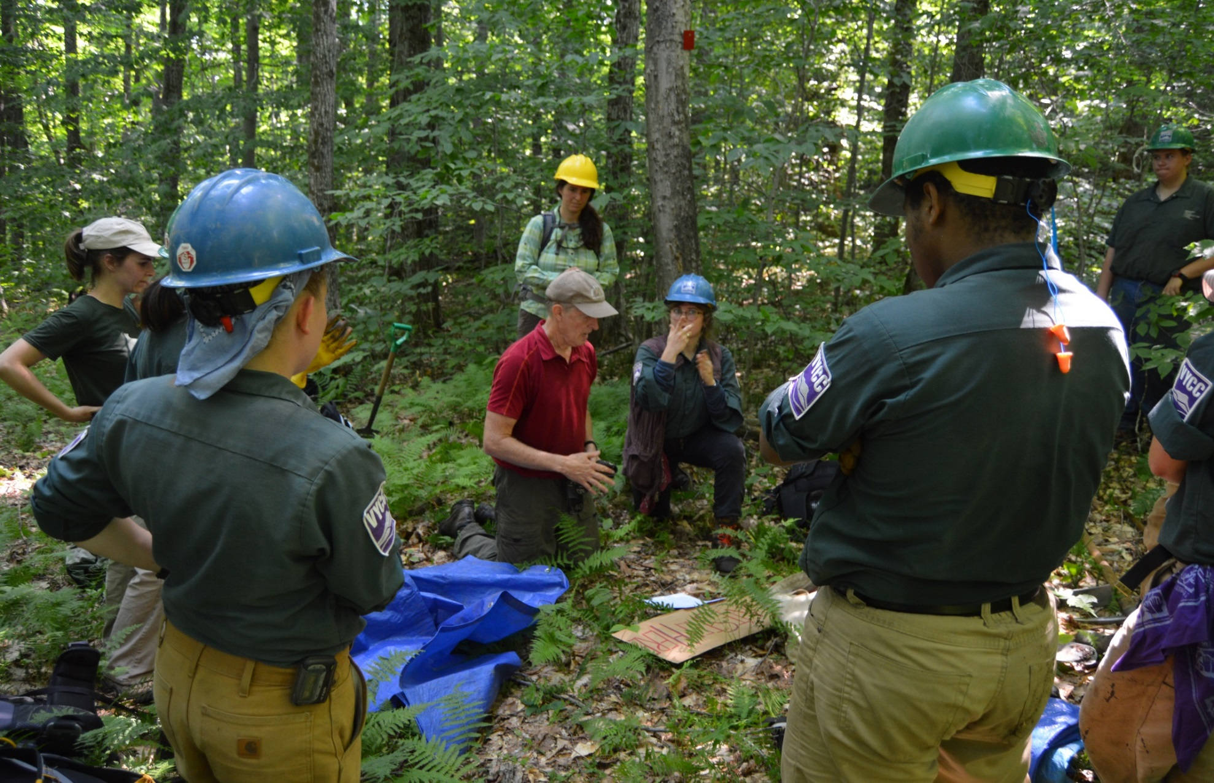
VYCC crew getting digging instructions on 2017 Day One at Ranch Brook site

Slide 12
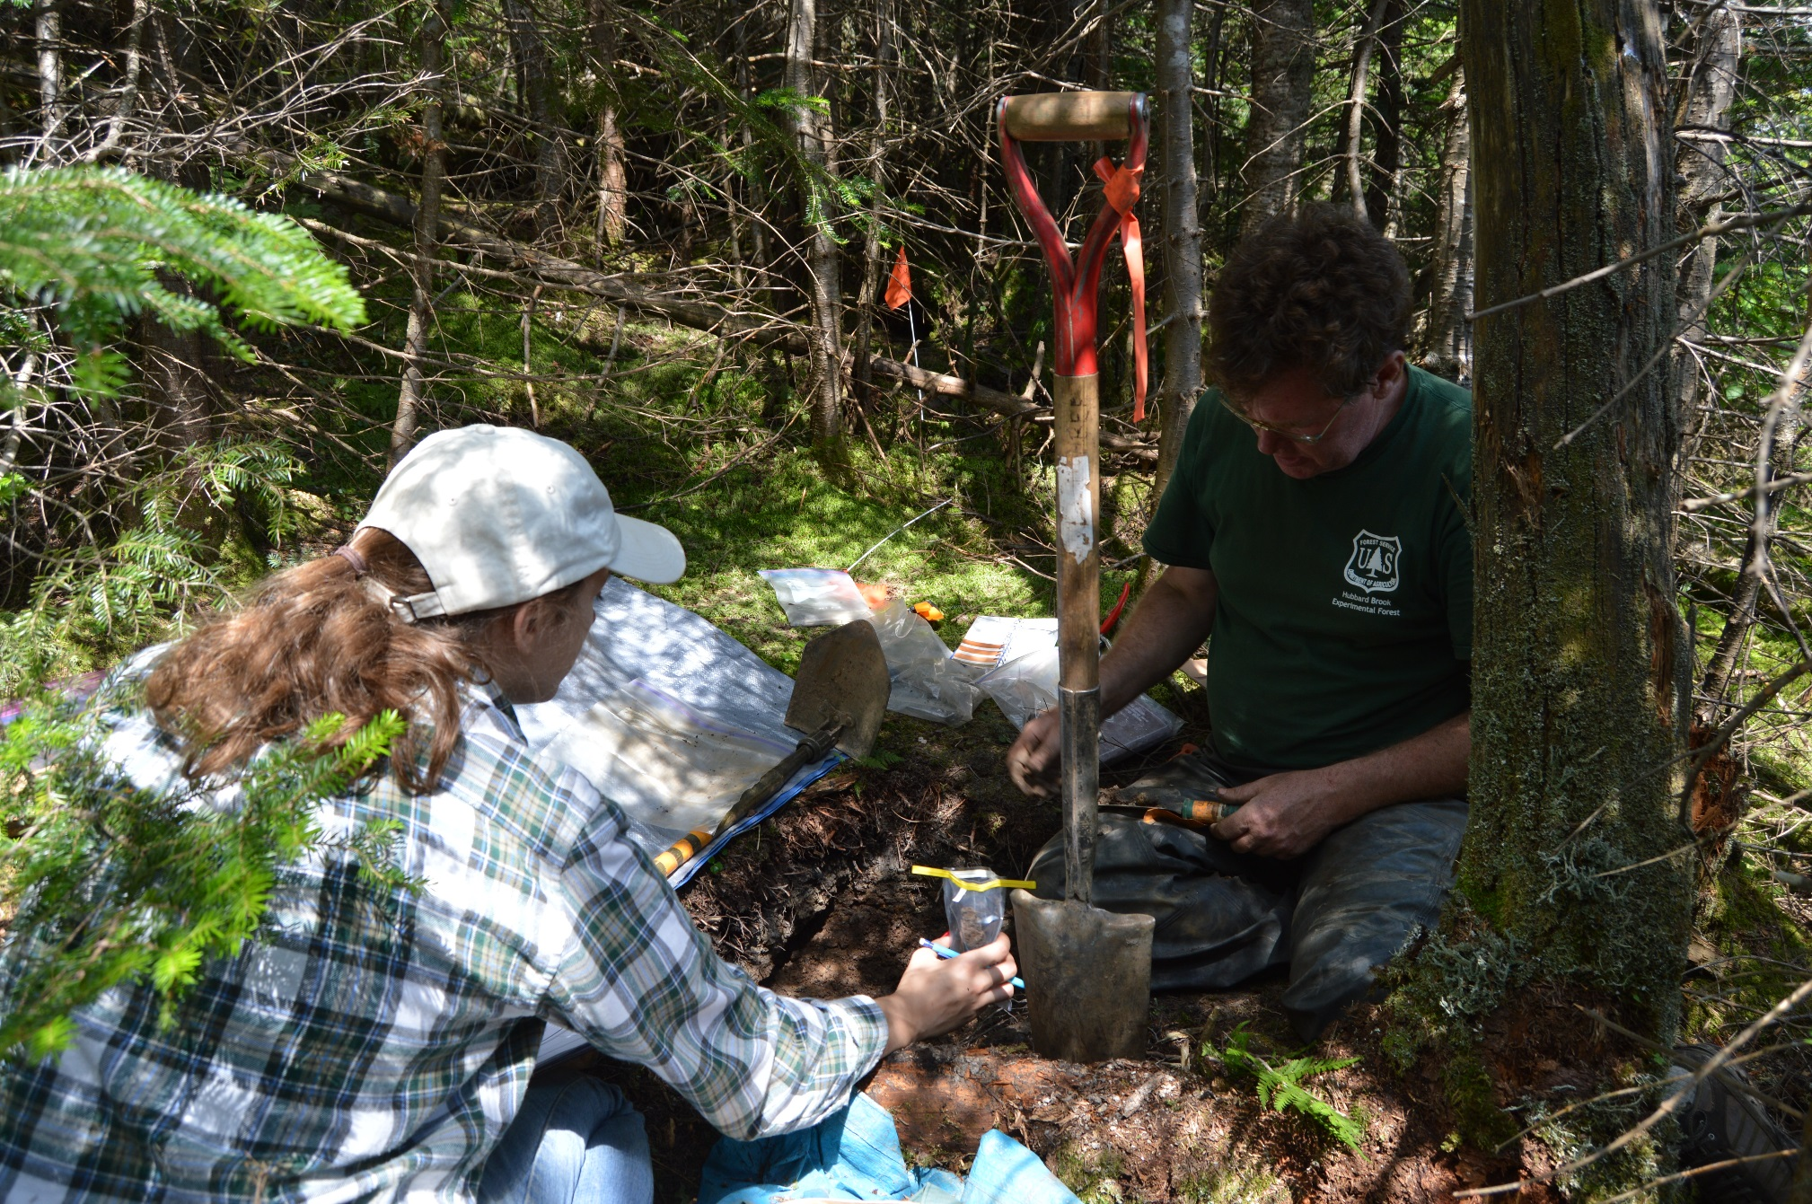
Scott Bailey, USFS, and Emily Piersiak, UVM, sampling at Forehead site

Slide 13
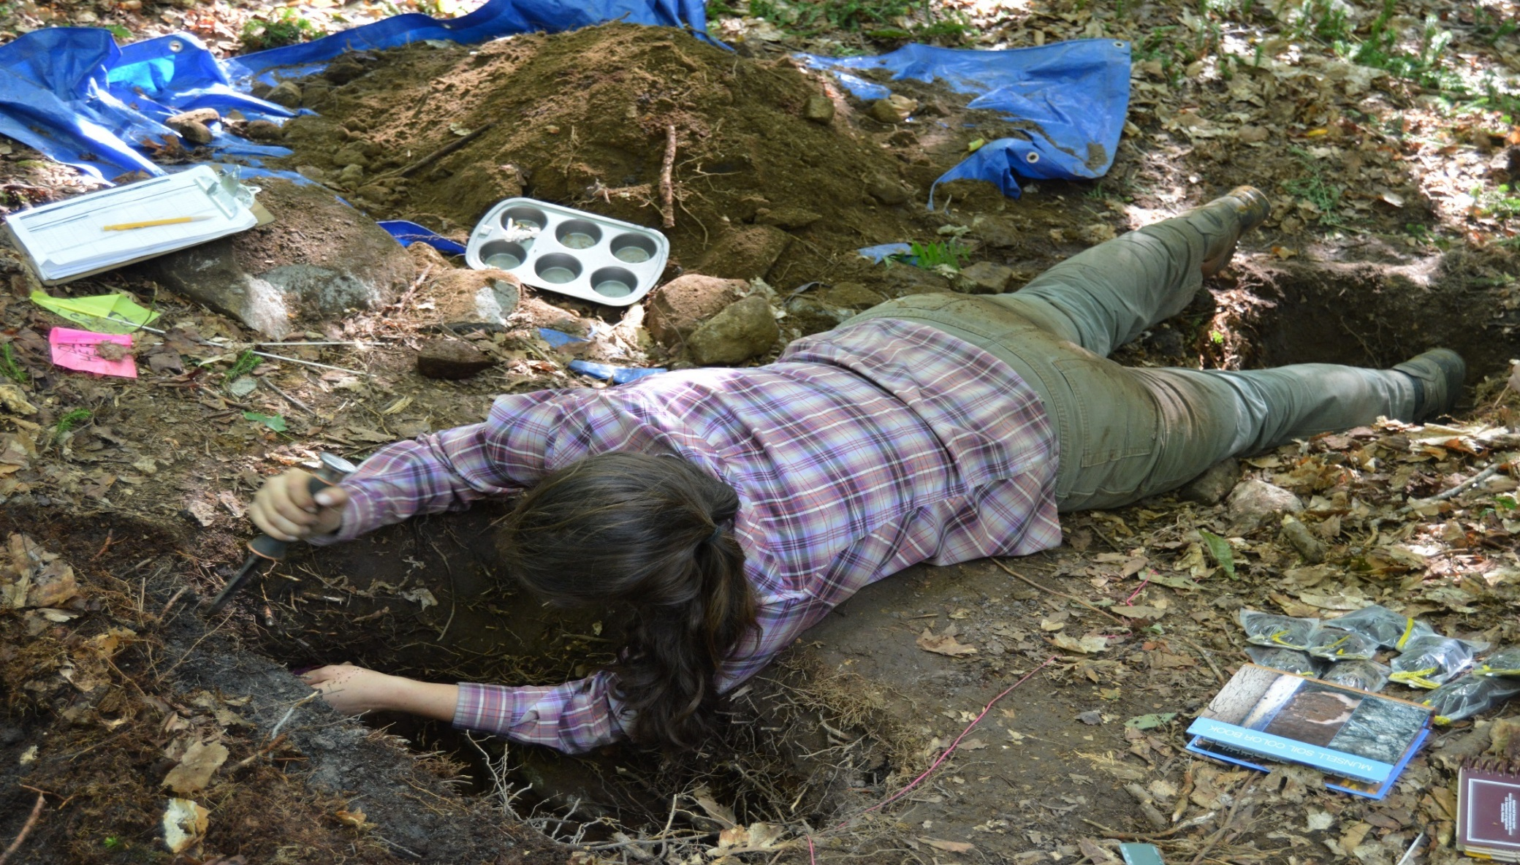
Angie Quintana– attacking a soil pit

Slide 14
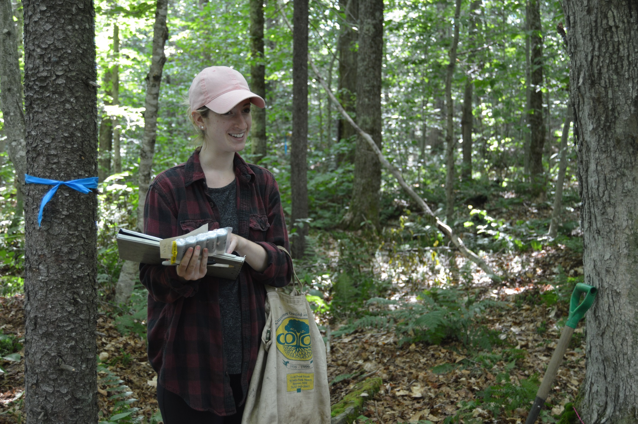

Slide 15
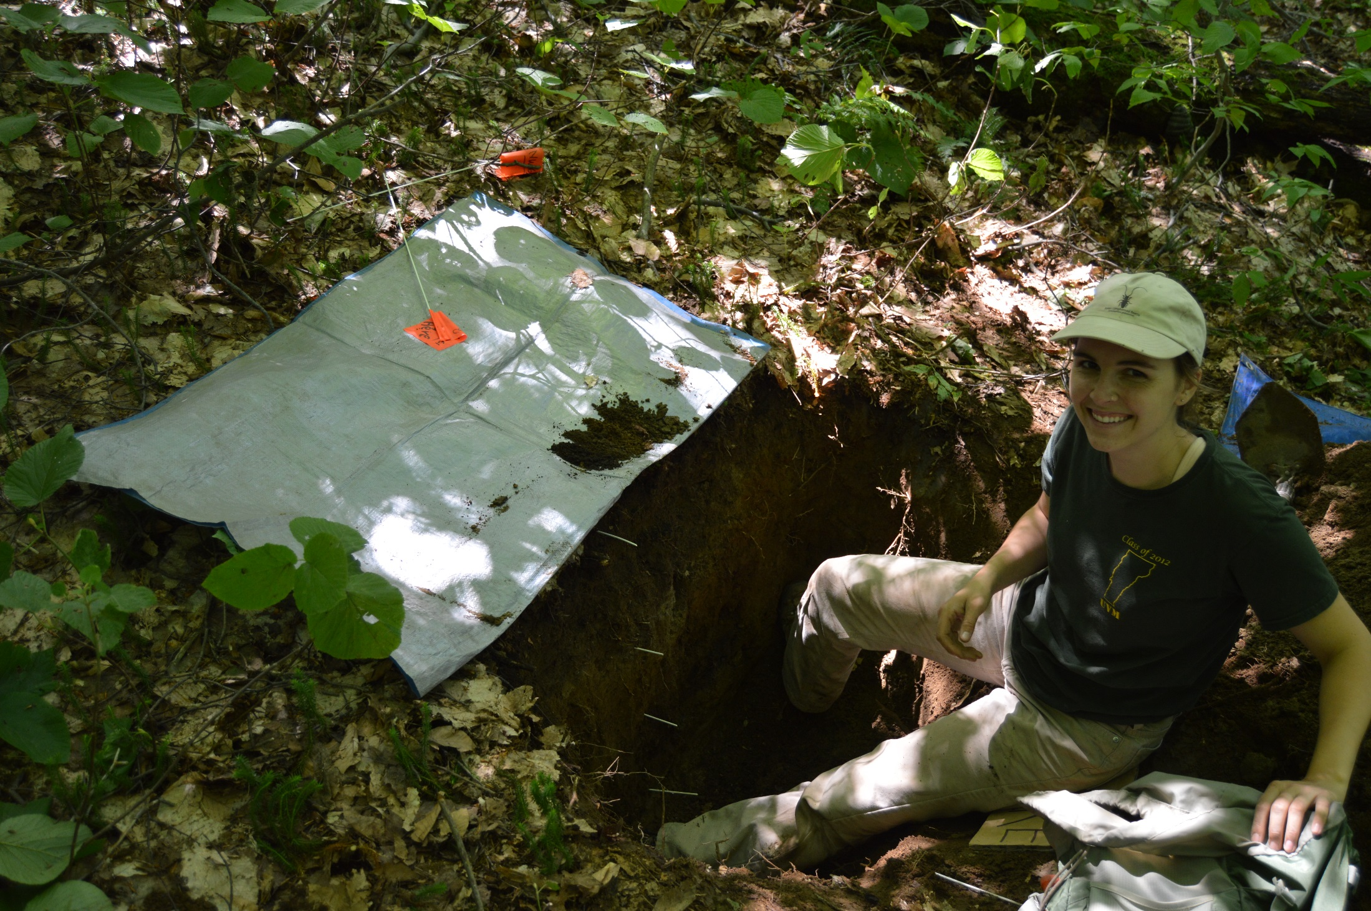

Slide 16
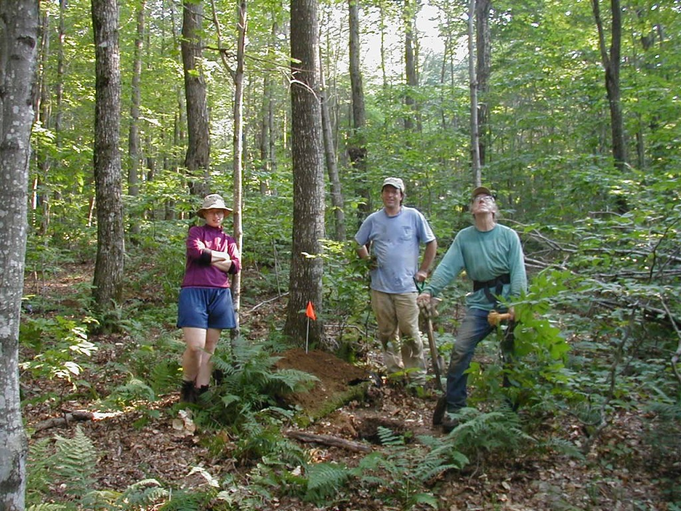
Ranch Brook 2002

Slide 17
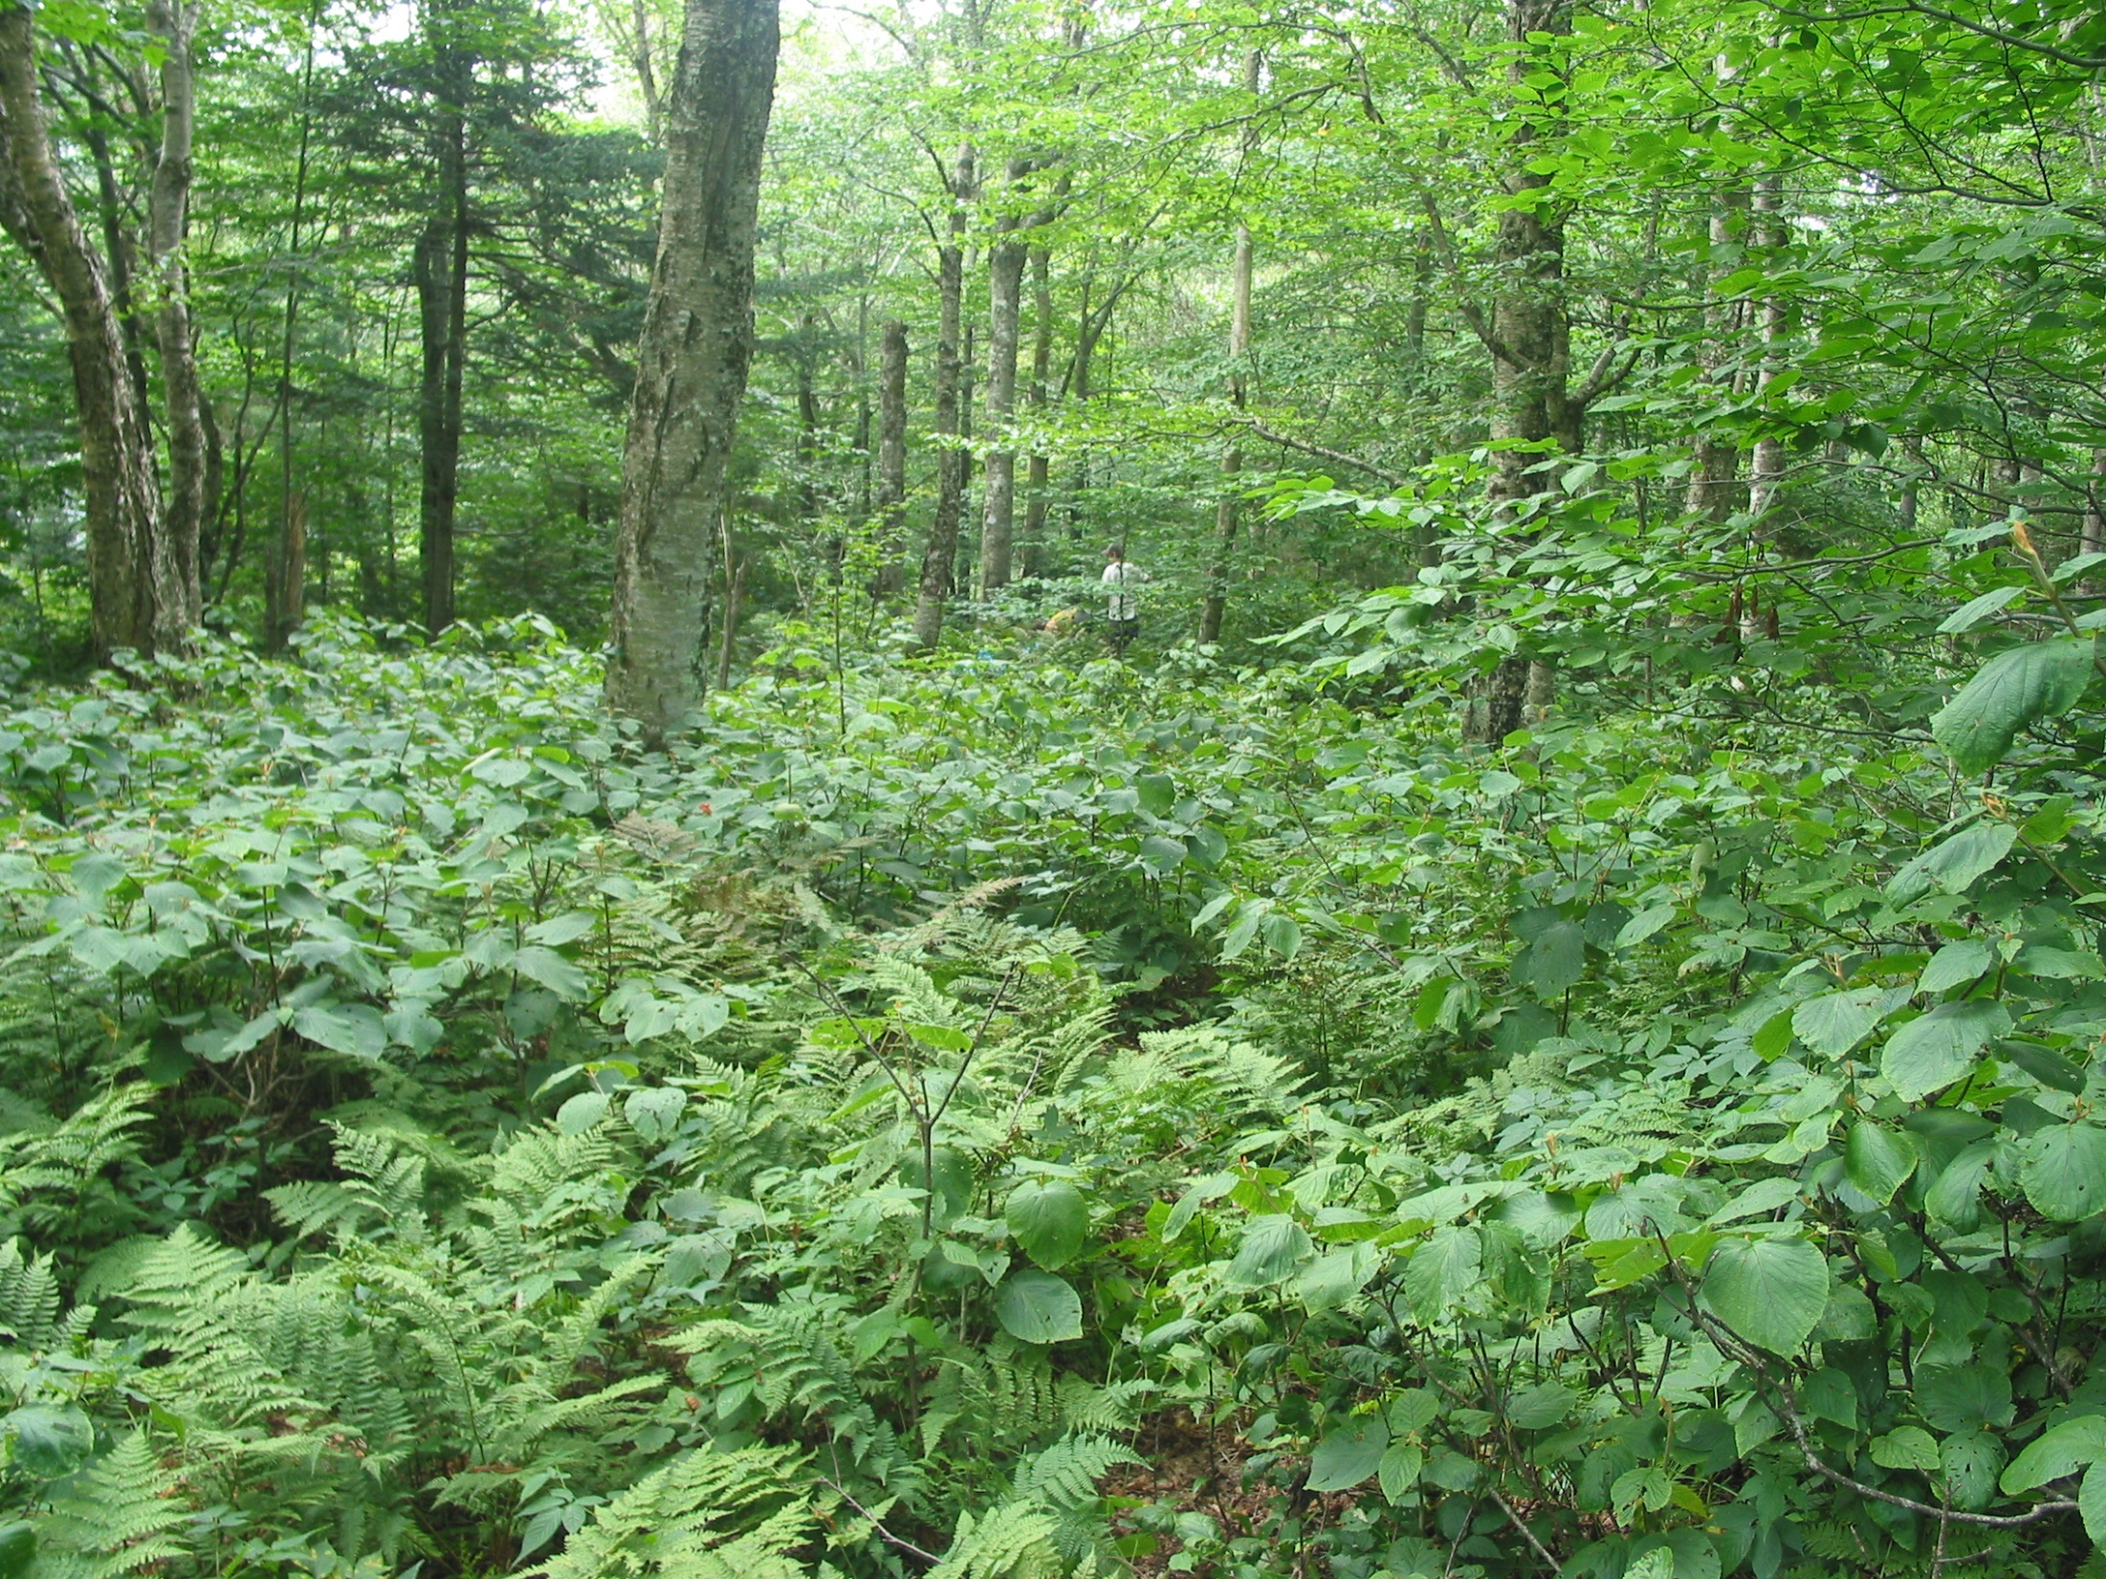
Underhill State Park or ‘Polka-Dot’, 2400’

Slide 18
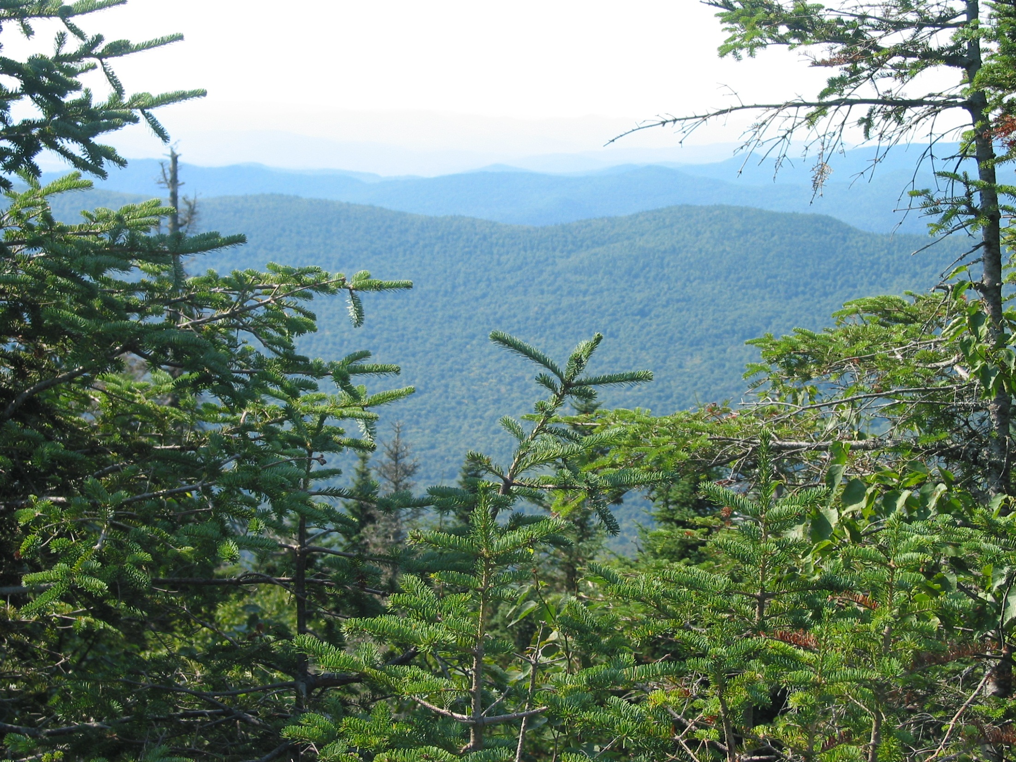
Forehead, 3600’

Slide 19
Forehead soil profiles – all years
FH is only site that has bedrock within depth of study

Slide 20
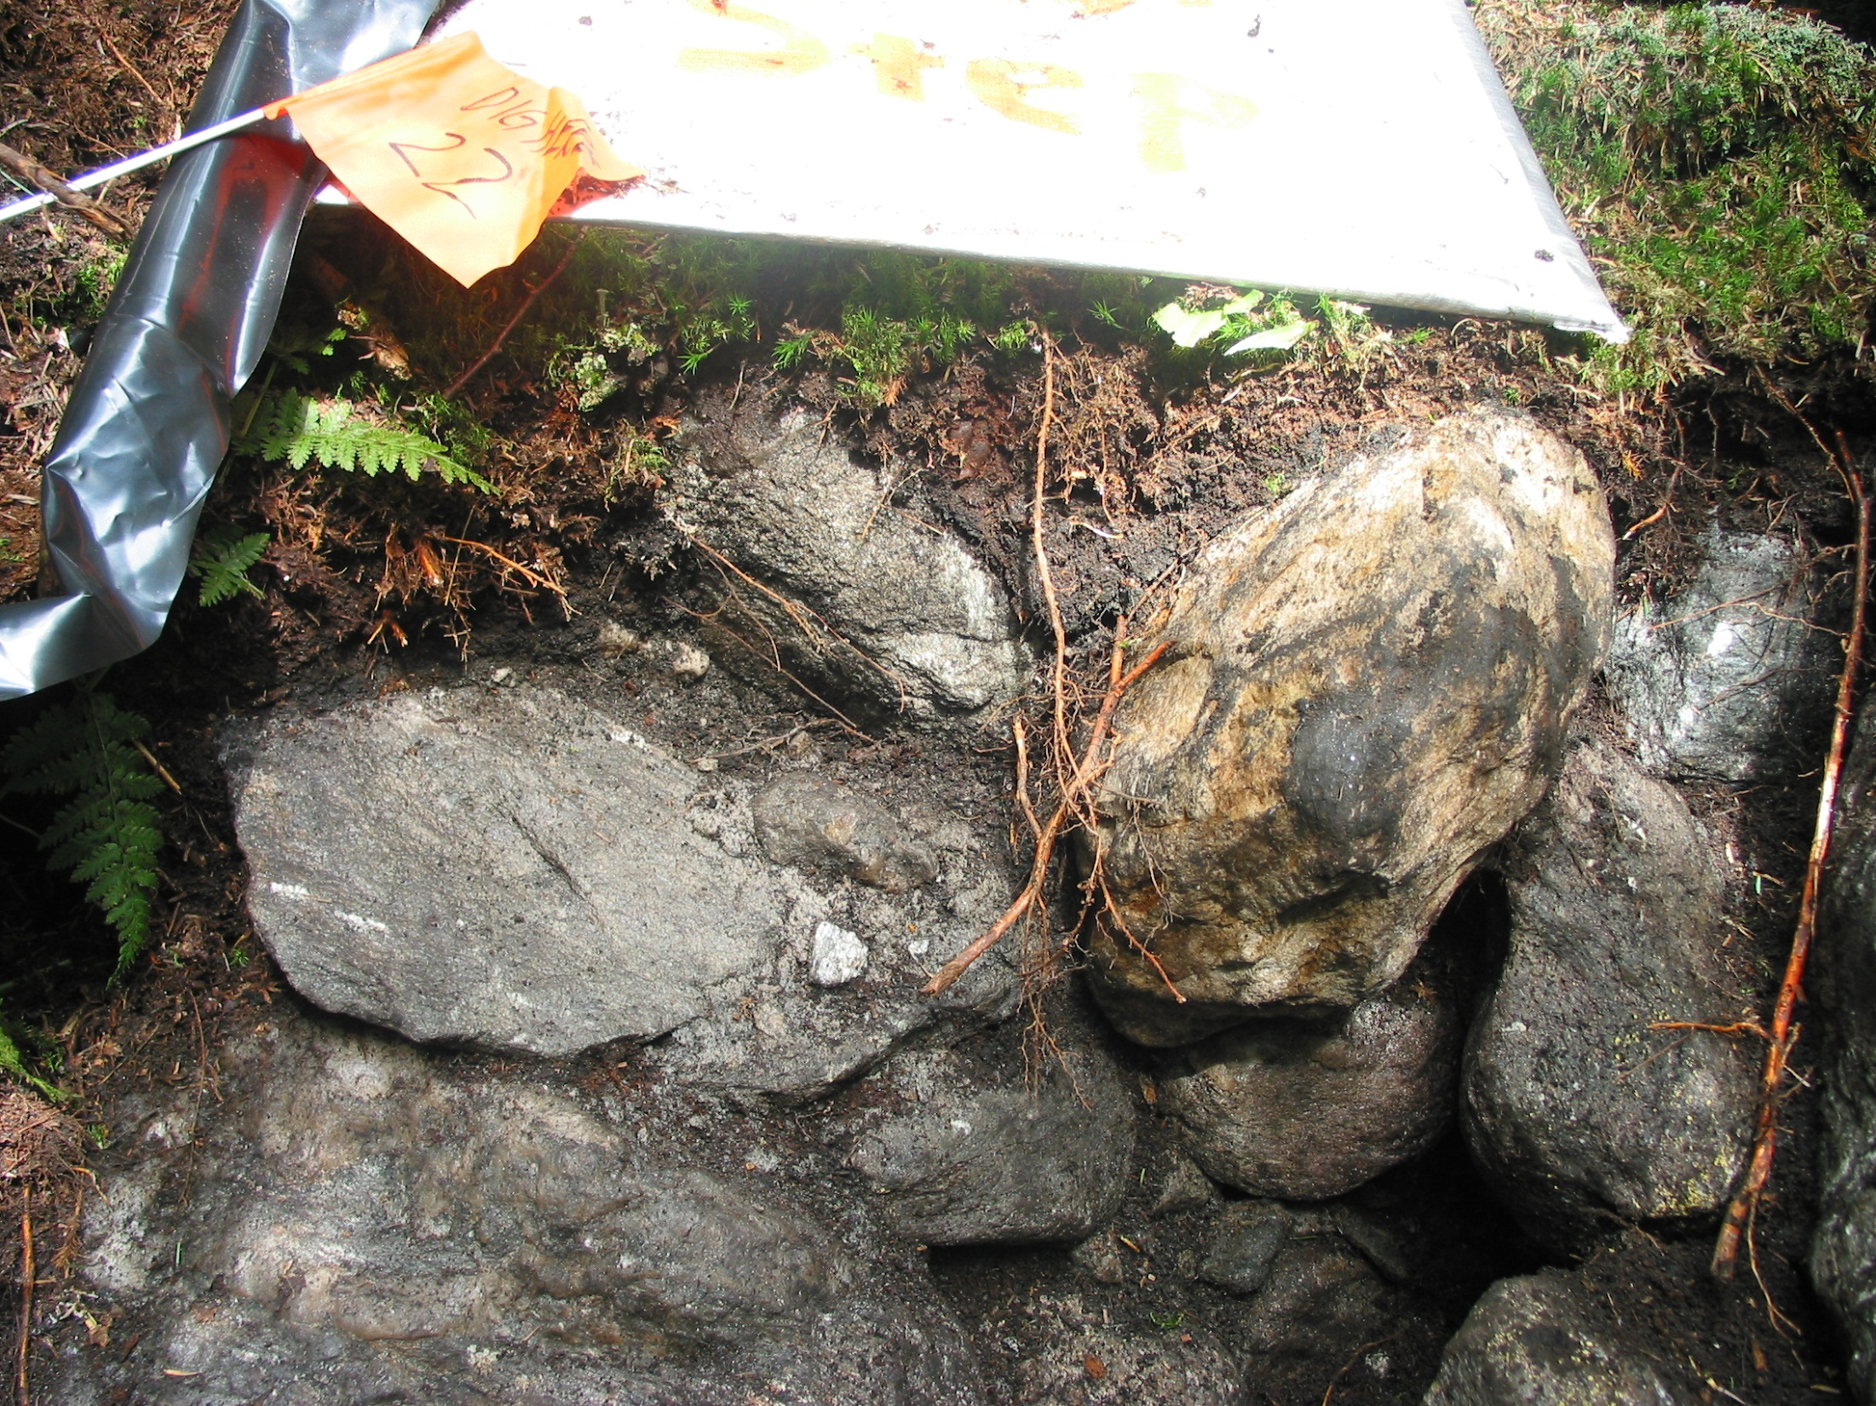
Forehead

Slide 21
Lye Brook Trail soil profiles – all years

Slide 22
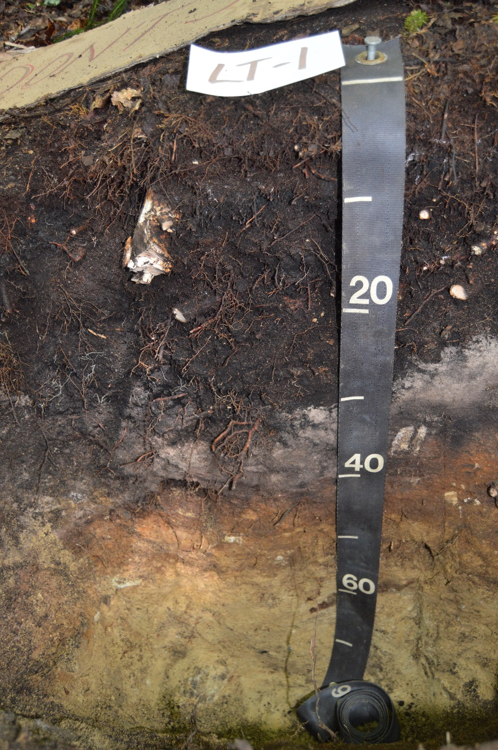
Lye Brook Trail plot 1 with thick O horizon

Slide 23
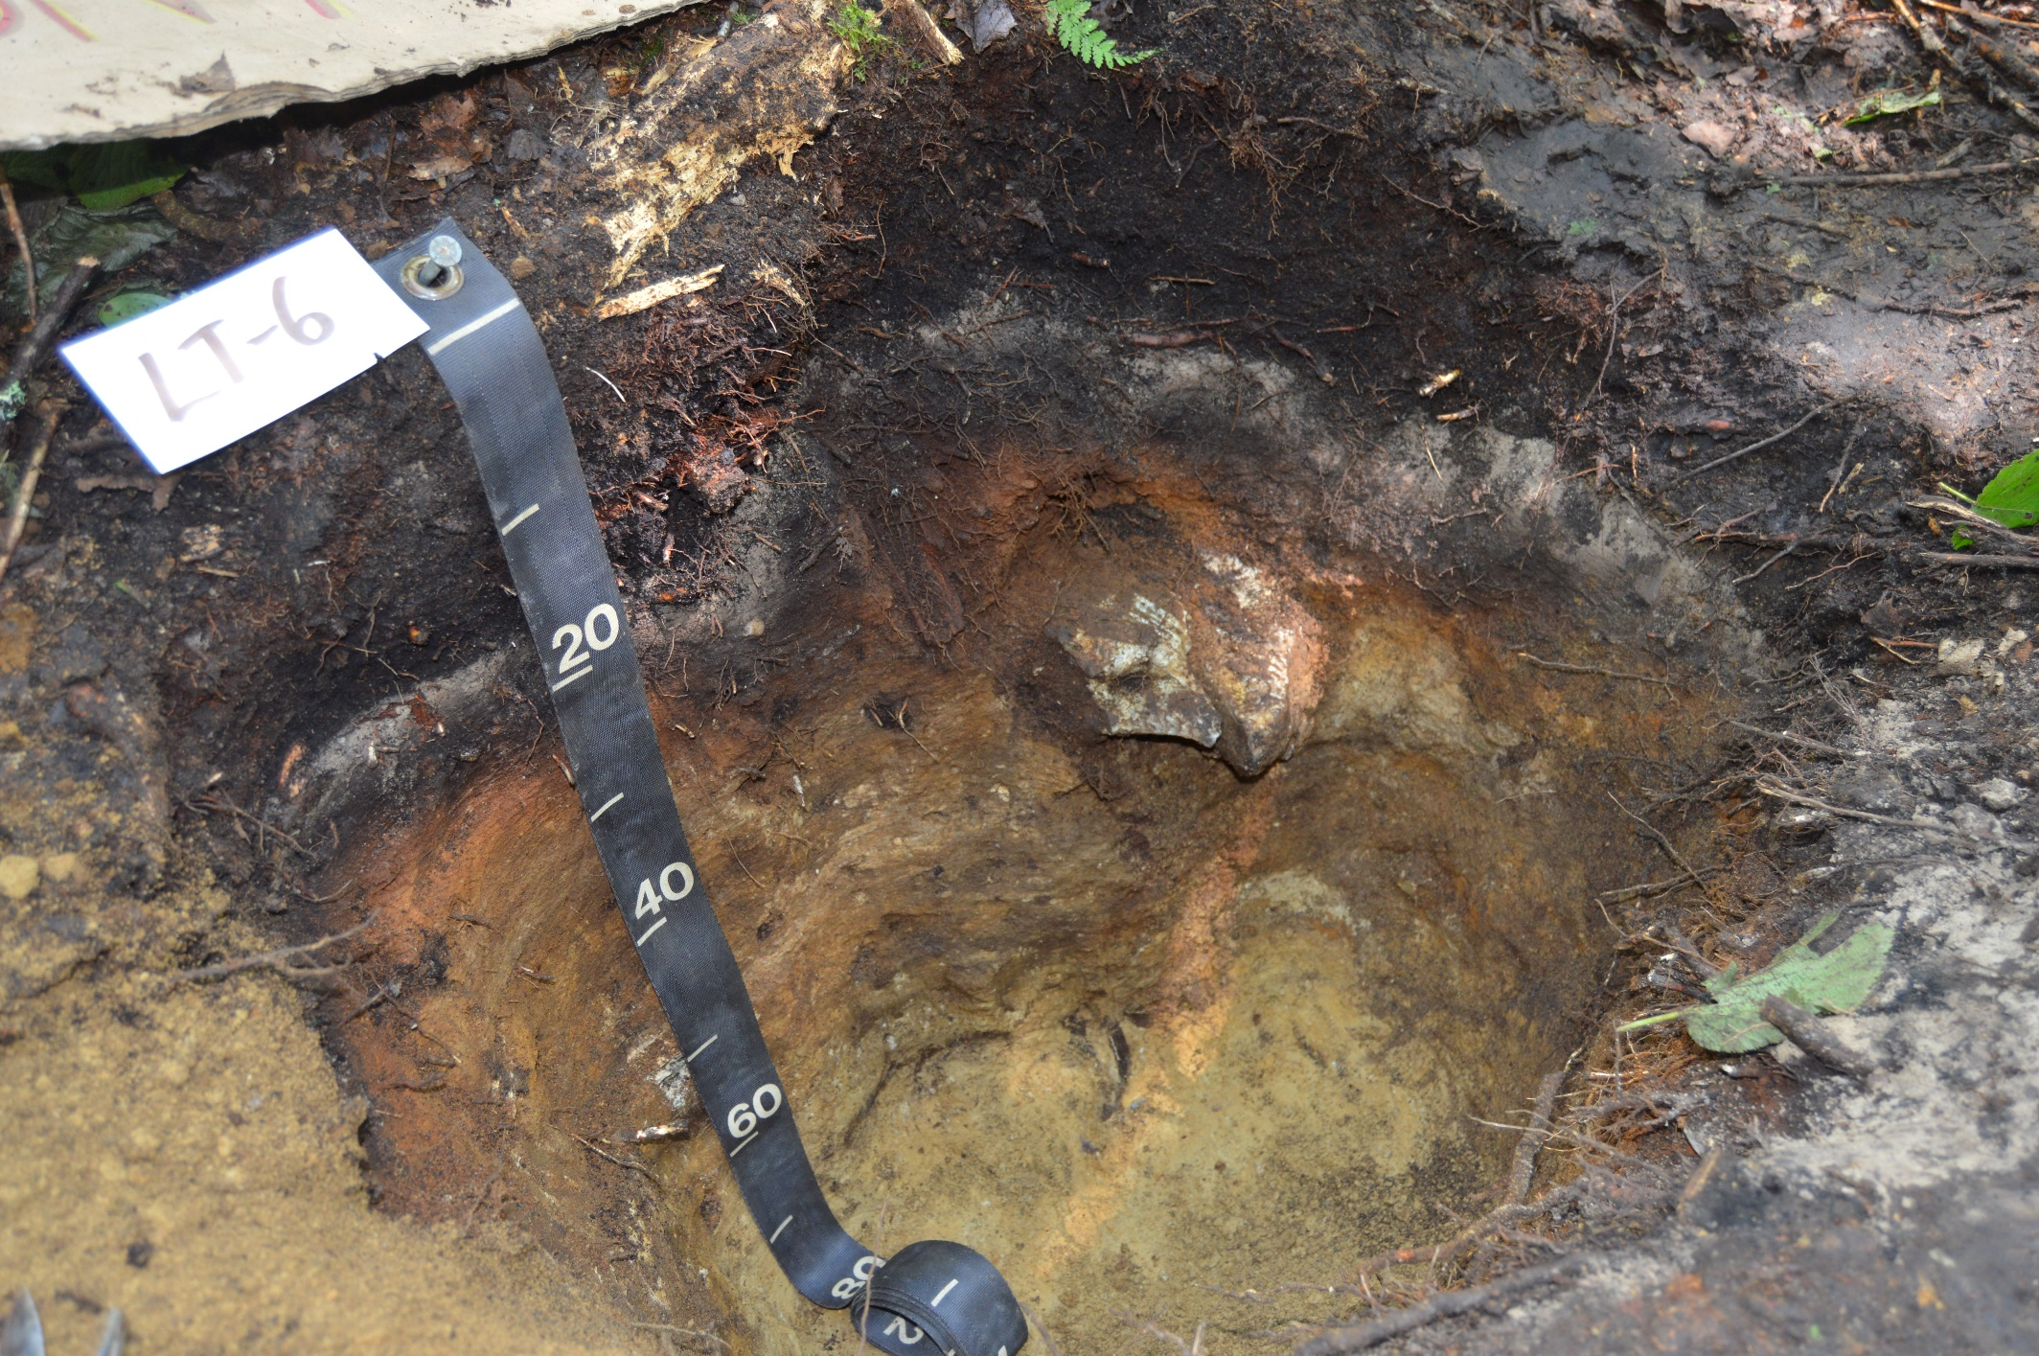
Lye Brook Trail plot 6

Slide 24
Ranch Brook soil profiles – all years

Slide 25
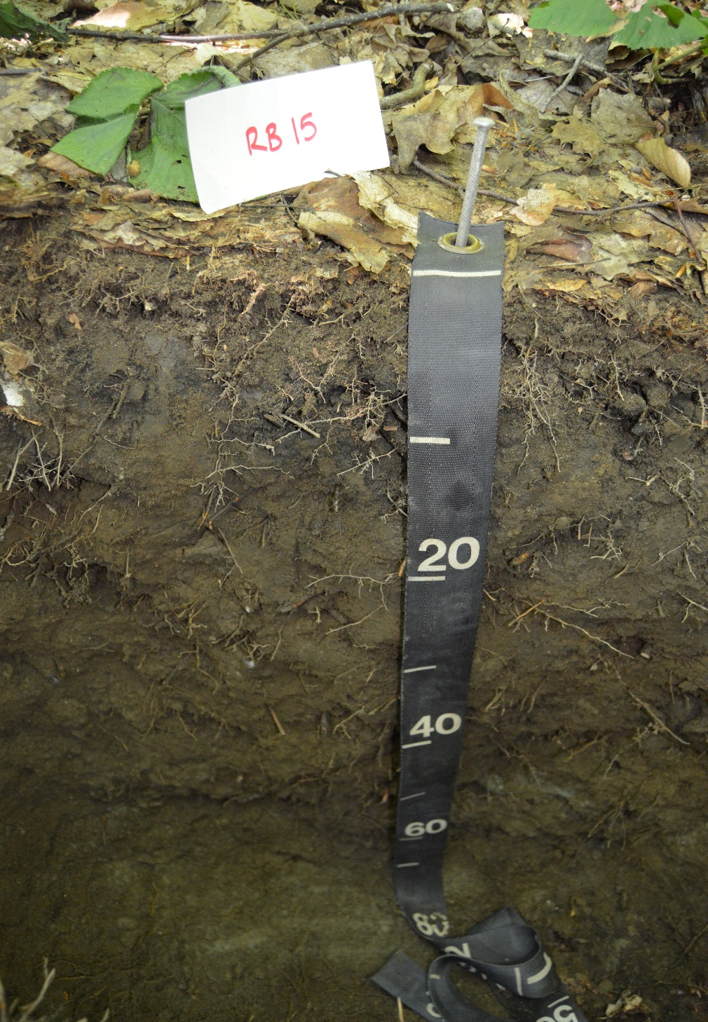
Ranch Brook plot 15 with shallow O horizon

Slide 26
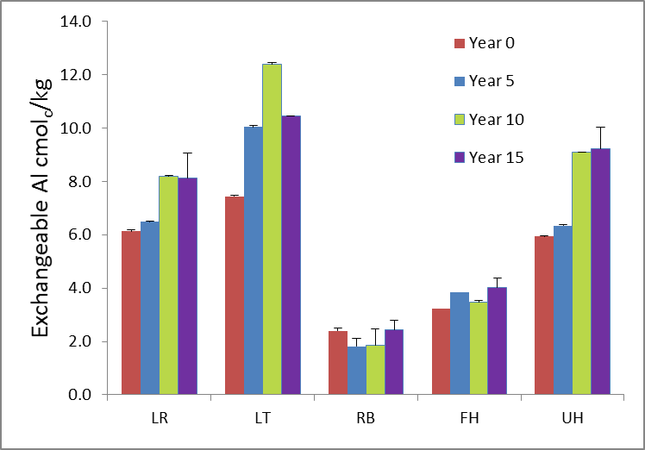
Exchangeable Al in the B horizon

Slide 27
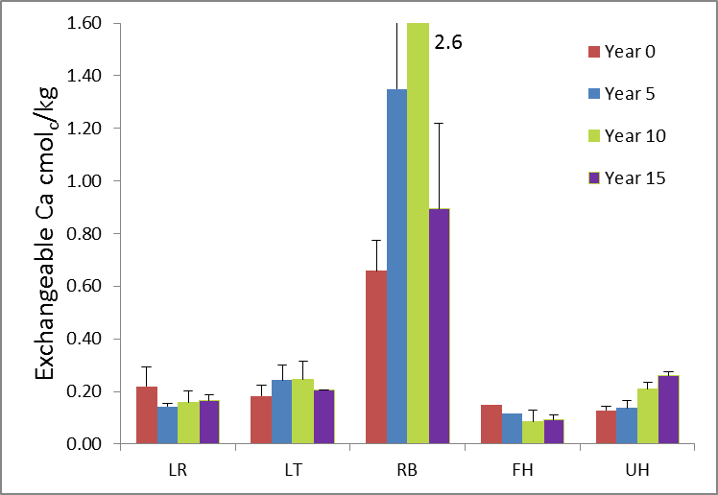
Exchangeable Calcium in B horizons

Slide 28
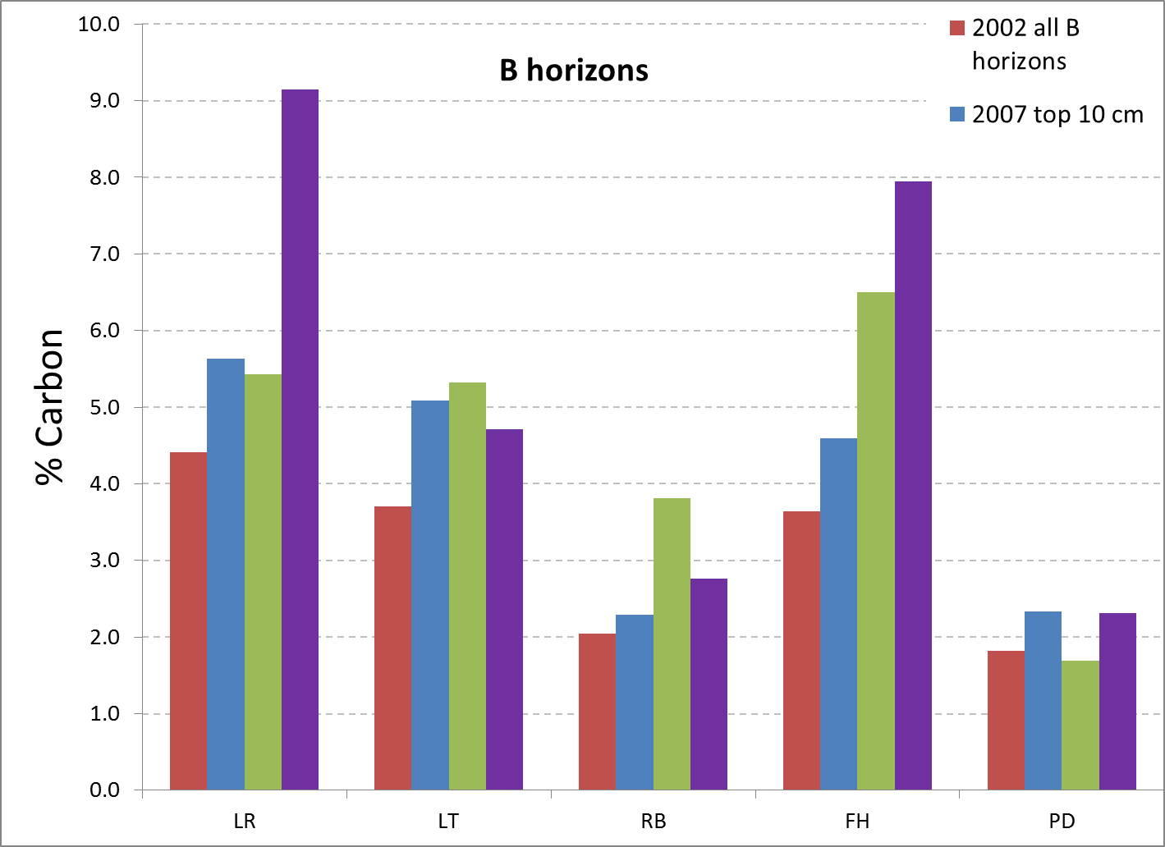
Carbon in the B horizons

Slide 29
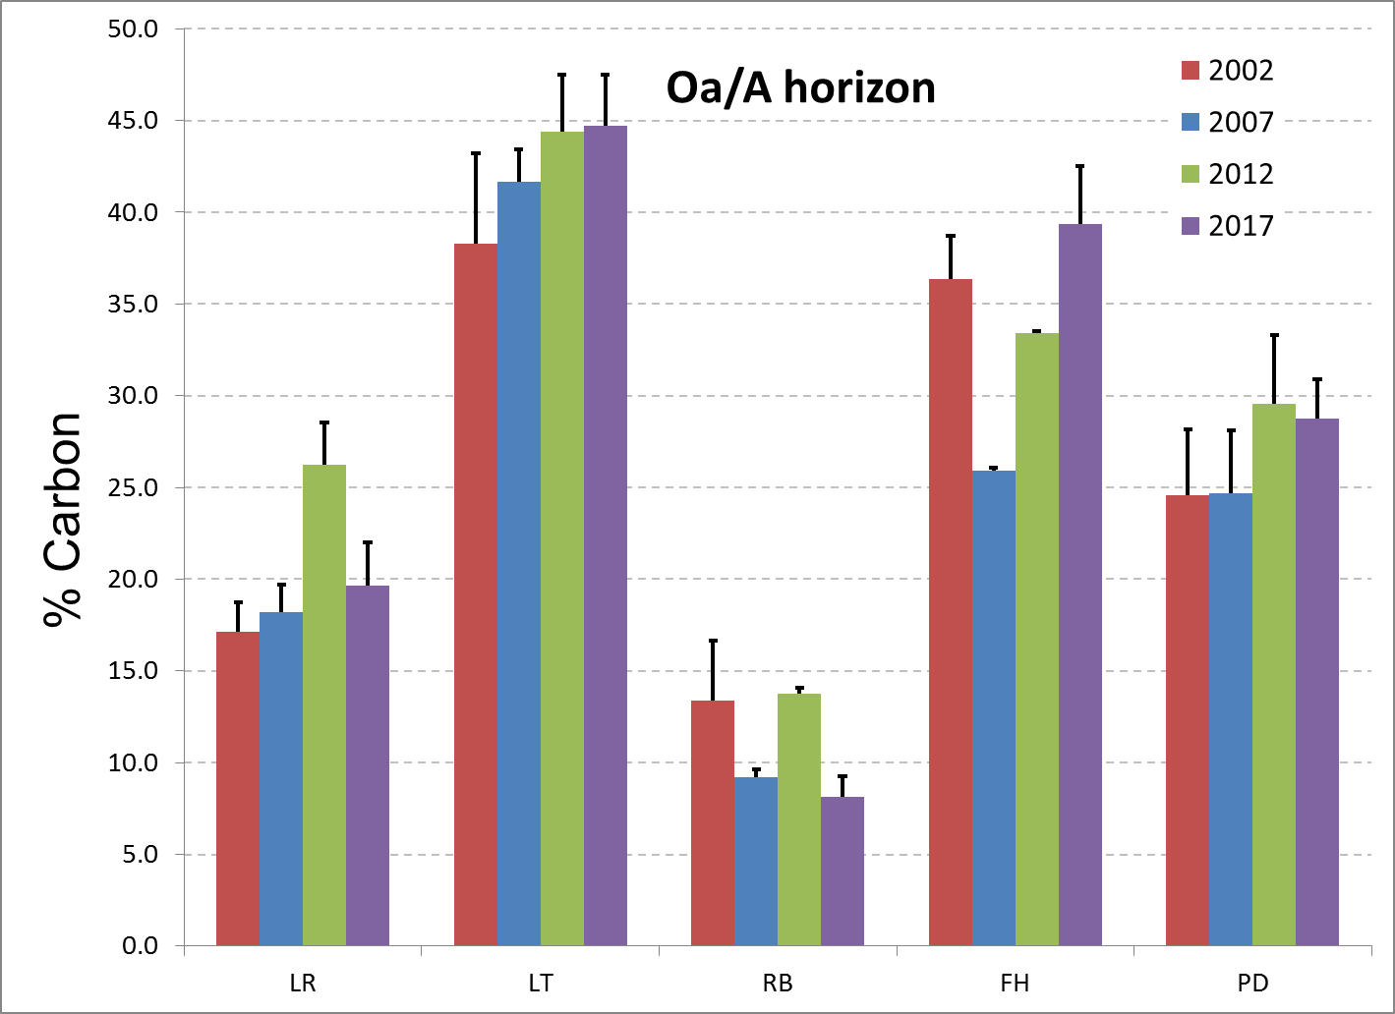
Carbon in the Oa/A horizon

Slide 31
Extending the 5-year intervals
Starting in 2017, each of remaining 5x5m sampling plots was subdivided into four quadrants (2.5x 2.5m).
Plots are now located and marked by surveyors.
This provides a possible 280 remaining subplots or 28 sampling times or 140 more years at 5-year intervals (beginning 2017).
The 200-year study is now a 150-year study.

Slide 32
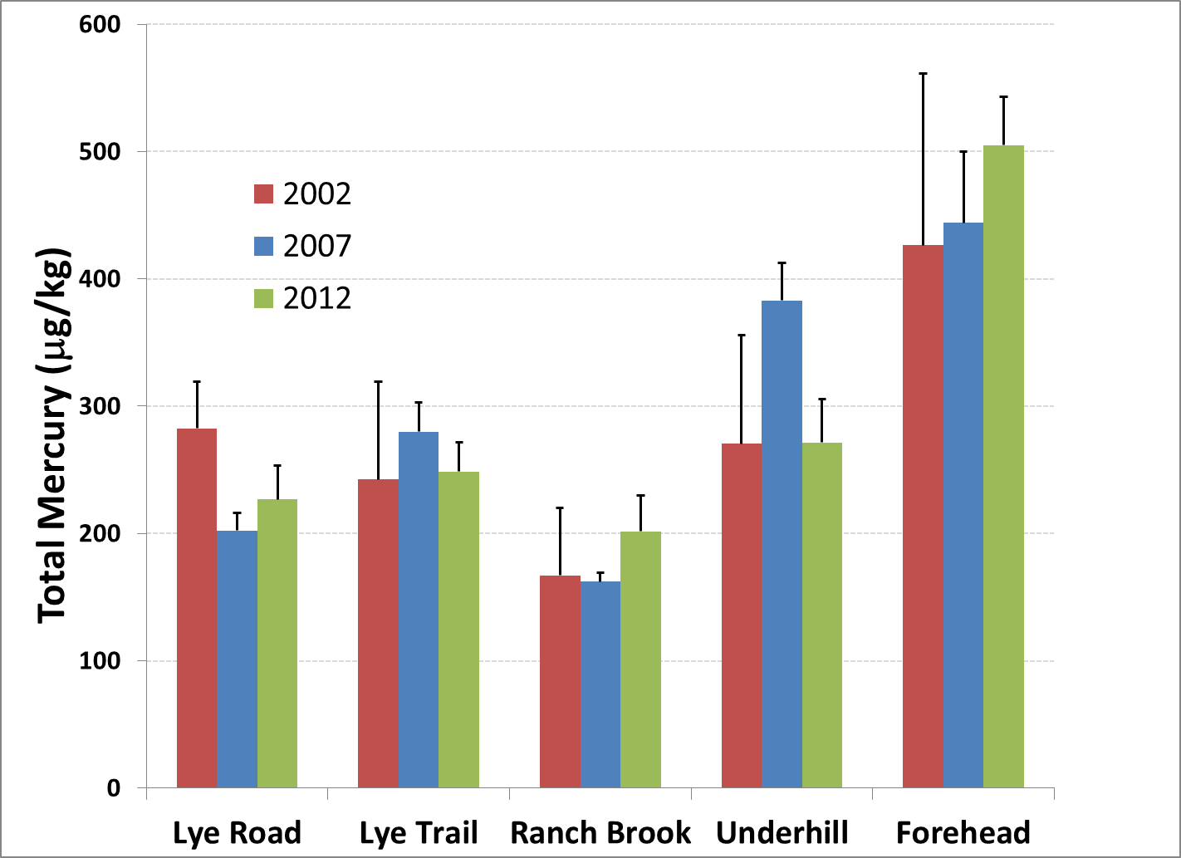

Slide 33
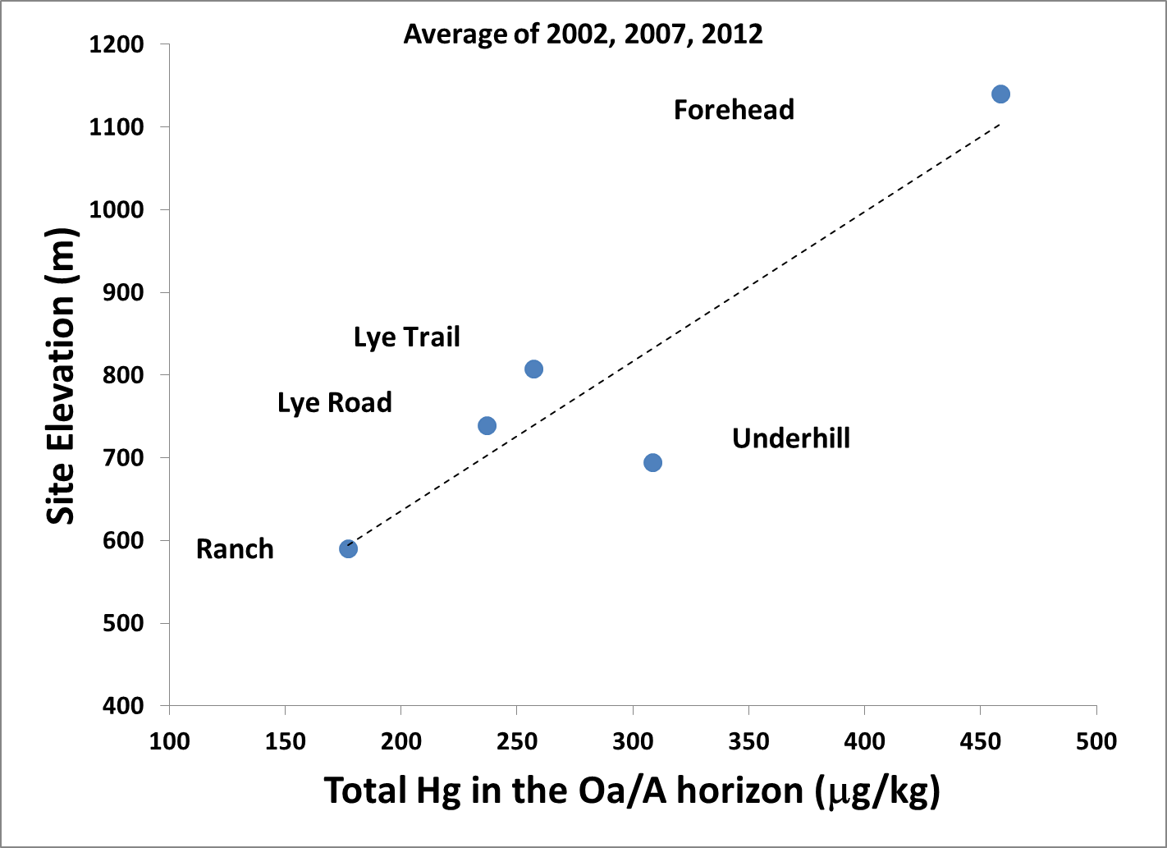

Slide 34
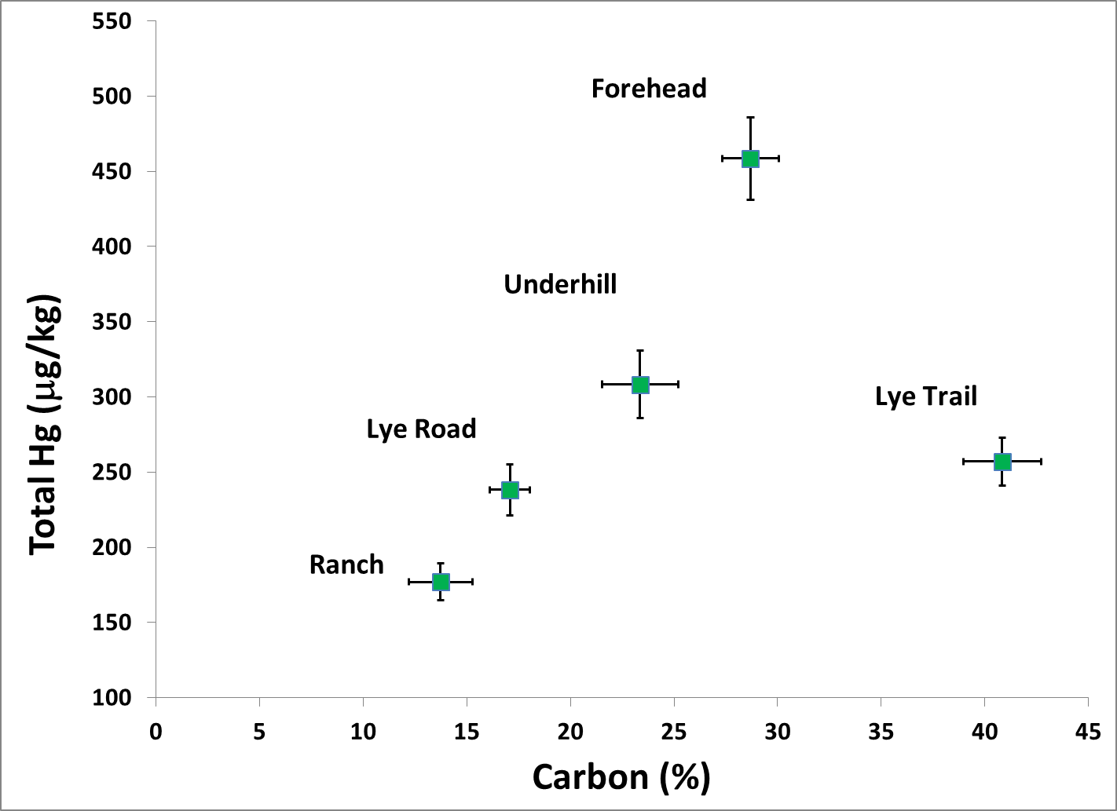

Slide 35
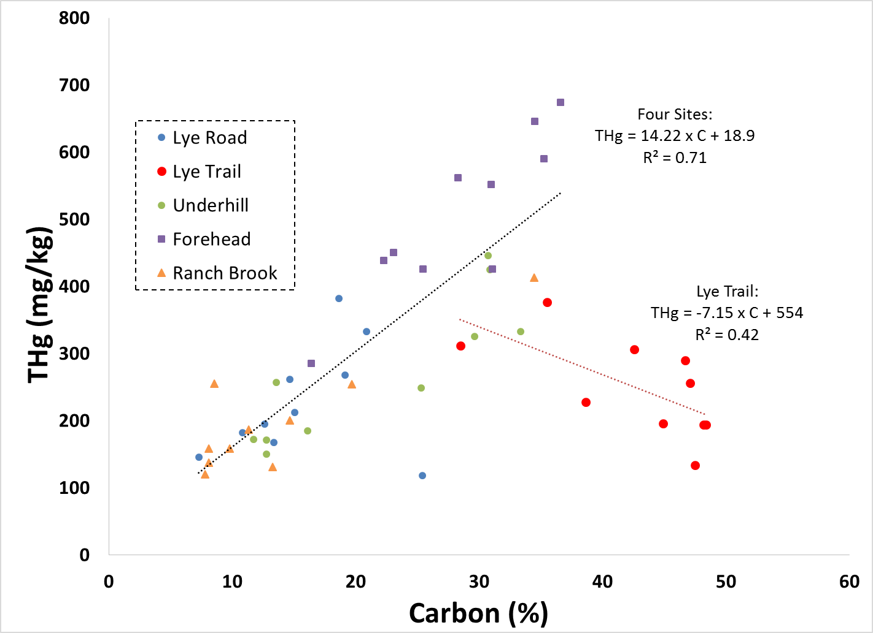

Slide 36
Challenges
Variability!
Archiving—still nothing permanent guaranteed
People keep retiring!
Funding difficult
  Some funding through the Forest Service and the FEMC

Slide 37
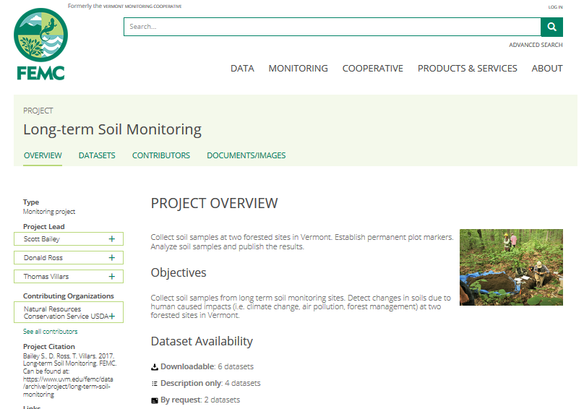
Data now available!

Slide 38
(Almost) everyone involved in 2017:
Sandy Wilmot, Vermont Forests, Parks and Rec
Joshua Halman, Vermont Forests, Parks and Rec
Isaac Estey, Vermont Forests, Parks and Rec
Deane Wang, UVM
Don Ross, UVM
Emily Piersiak, UVM
Liza Lemieux, UVM
Jim Duncan, FEMC
John Truong, FEMC
Matt Gorton, FEMC
Scott Bailey, US Forest Service, Northern Research Station
Emily Piche, US Forest Service, Northern Research Station (now UVM)
Angie Quintana, US Forest Service, GMNF
Josh Lobe, US Forest Service, GMNF
Thom Villars, NRCS-VT
Alexis Clune, NRCS-VT
Vermont Youth Conservation Corps (8 crew members)
Funding generously provided by FEMC and Green Mountain and Finger Lakes National Forests

Slide 39
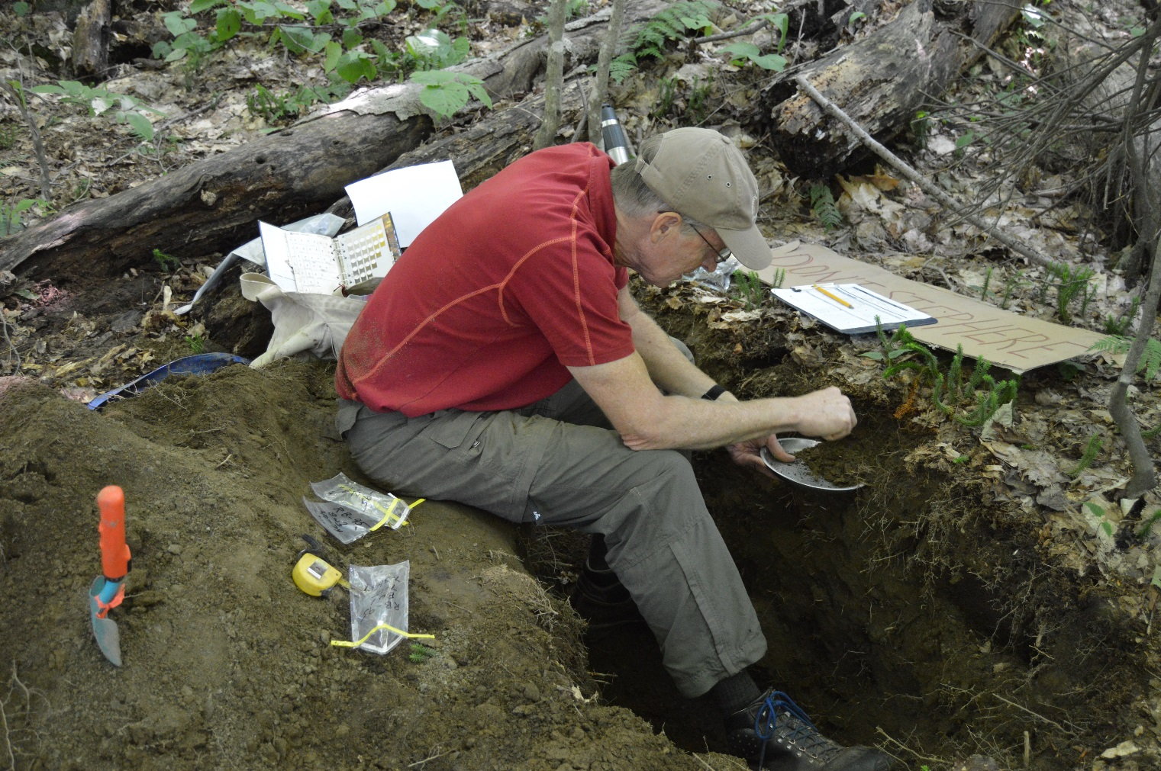
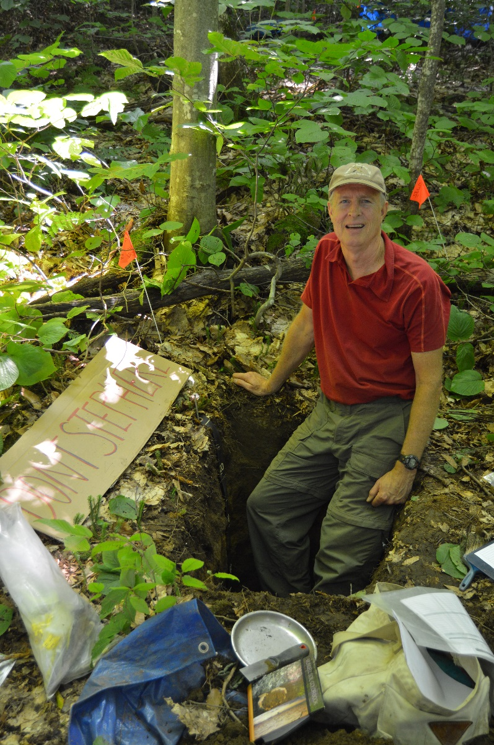
Thanks Thom!
(retired last spring)

