Slide 1
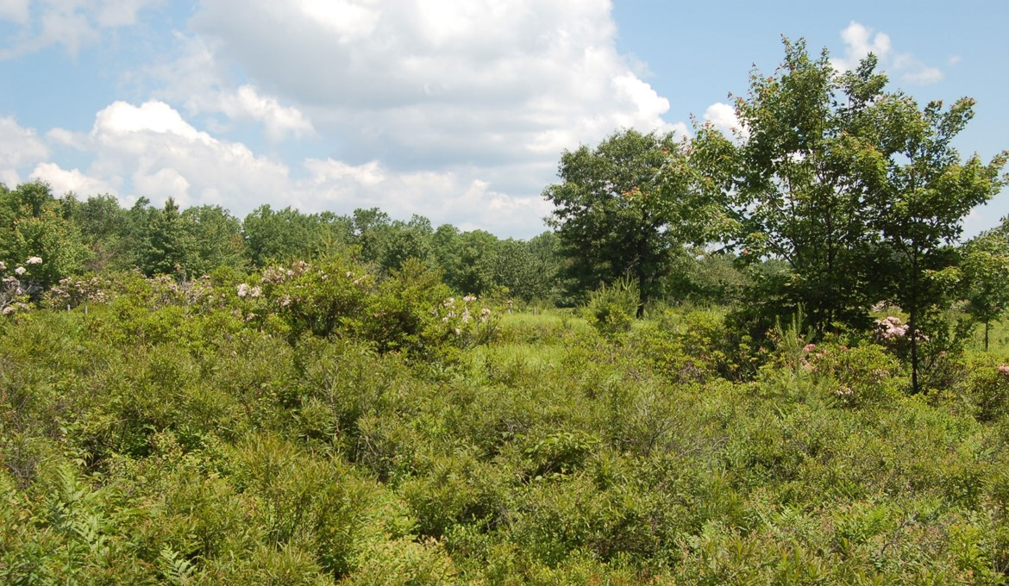
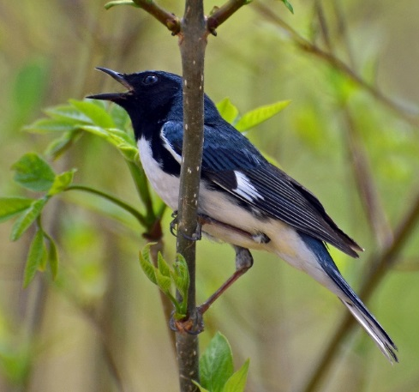
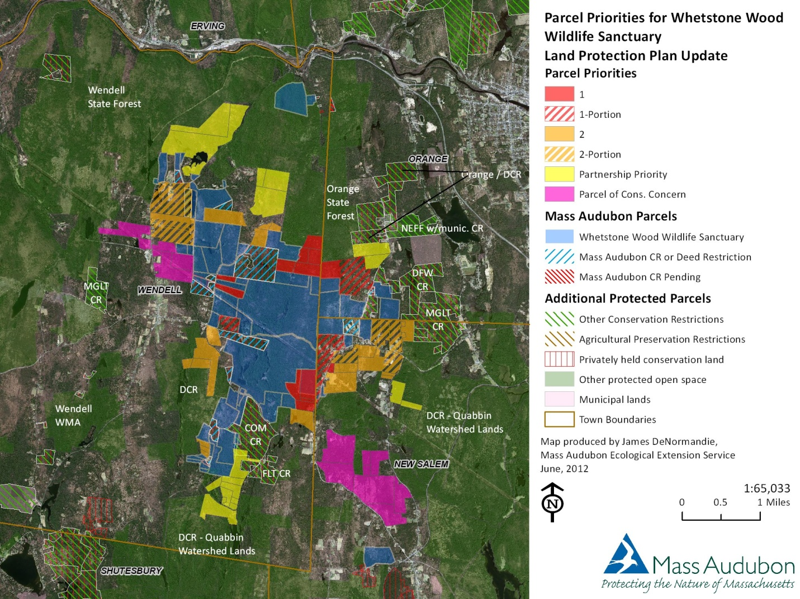
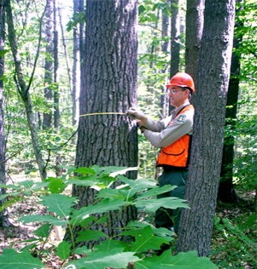

Forest Bird Conservation at
Mass Audubon
The role of sanctuaries and private lands
© Rodney Campbell
Jeff Ritterson
FEMC Conference 12/14/18

Slide 2
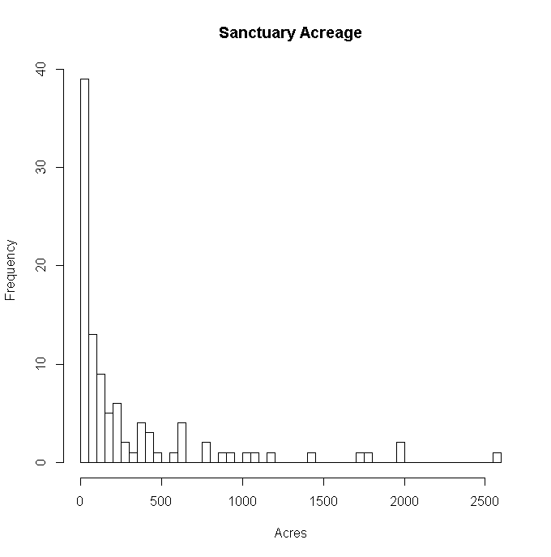
Sanctuaries
38,000 acres (15,400 ha)
Notes:
Mention that these can act interactively to further exacerbate conditions, give examples

Slide 3
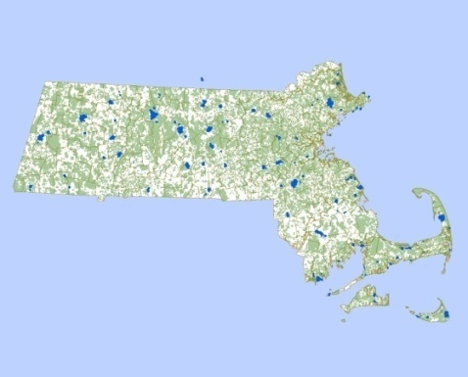
Land protection plan
Whetstone Wood Sanctuary
2592 acres
BioMap2
Conservation Assessment and
Prioritization System
Nat Heritage and Endangered Species

Slide 4
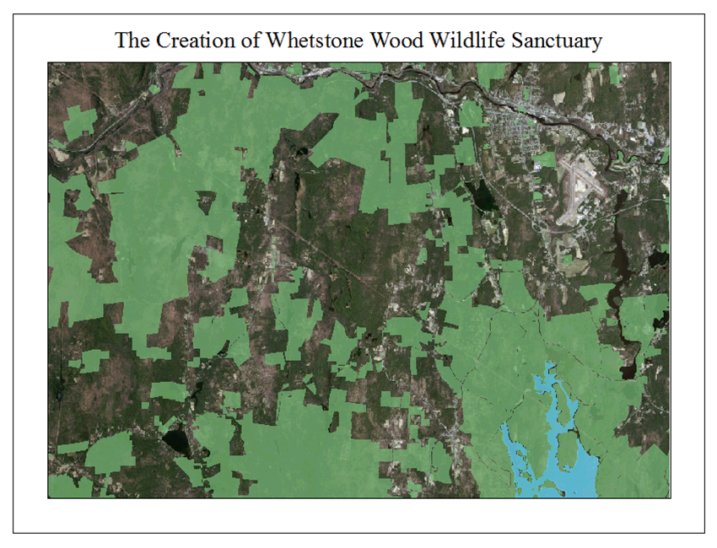
Wendell and Orange State Forests 15,000 Acres
Whetstone Wood Wildlife Sanctuary
Quabbin Watershed 50,000 Acres
Quabbin

Slide 5
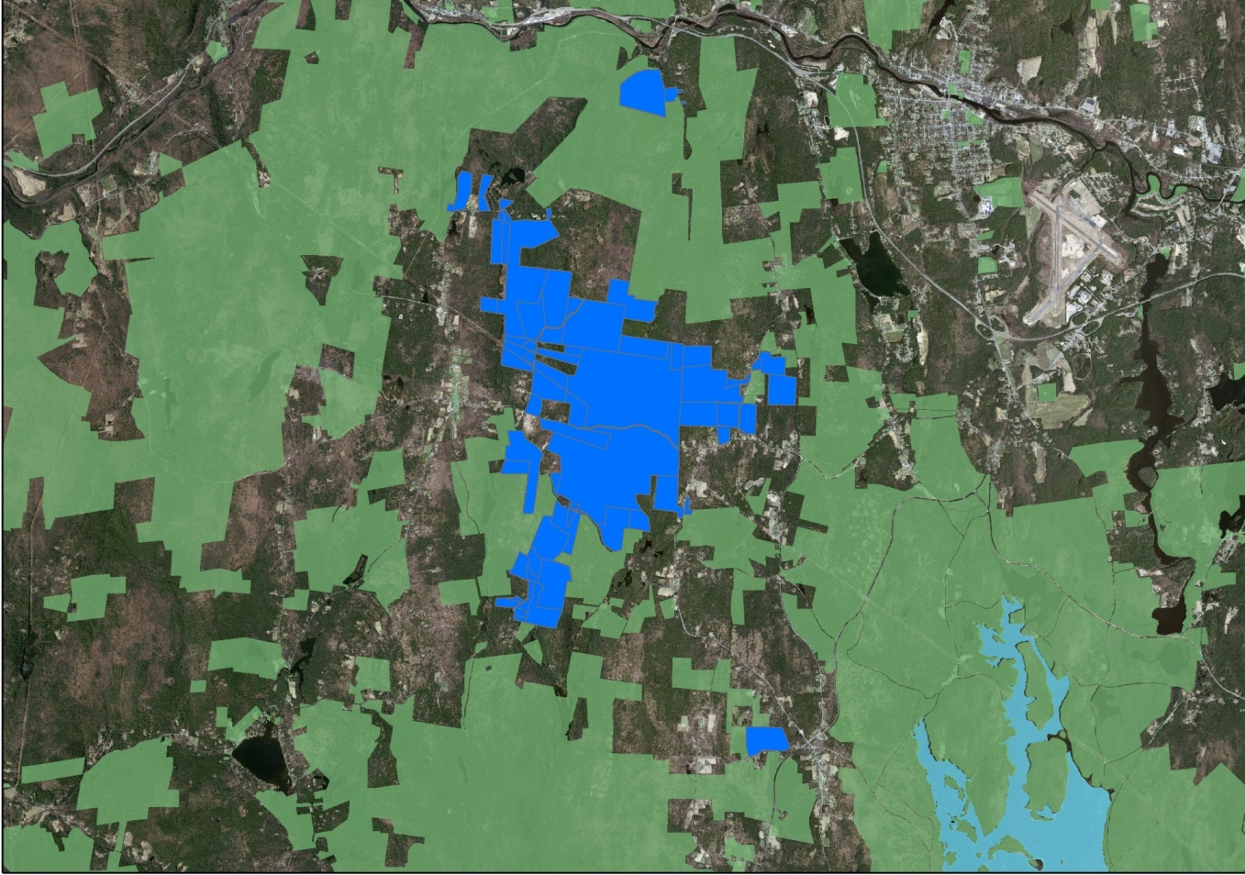
Wendell and Orange State Forests 15,000 Acres
Quabbin Watershed 50,000 Acres
Quabbin
Connects Nearly 75,000 acres of Protected Lands

Slide 6

City of Attleboro
(population 44,000)
City of Attleboro
City of Attleboro
Attleboro Springs Wildlife Sanctuary
Oak Knoll
Wildlife Sanctuary
Source: Esri, DigitalGlobe, GeoEye, Earthstar Geographics, CNES/Airbus DS, USDA,
USGS, AeroGRID, IGN, and the GIS User Community

Slide 7
Attleboro Springs Wildlife Sanctuary, 116 acres
Future Focus Area
Conservation Restriction held by Mass Audubon
Oak Knoll
Wildlife
Sanctuary, 50 acres

Slide 8
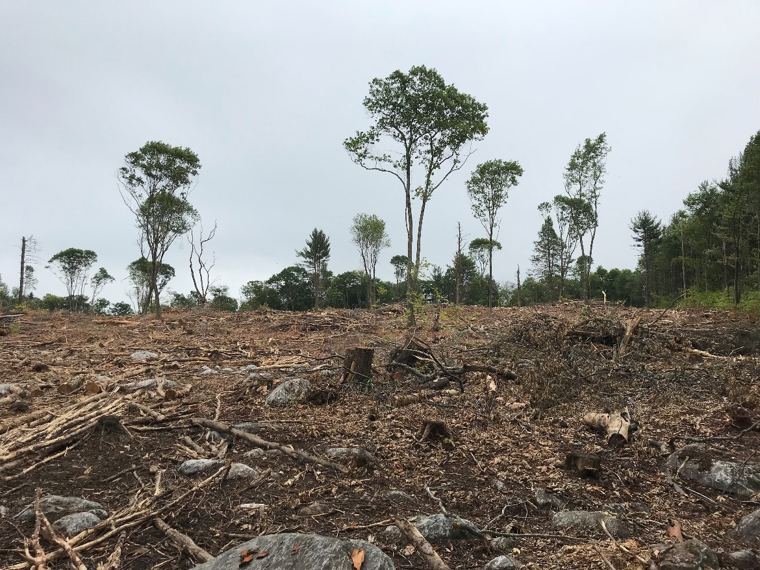
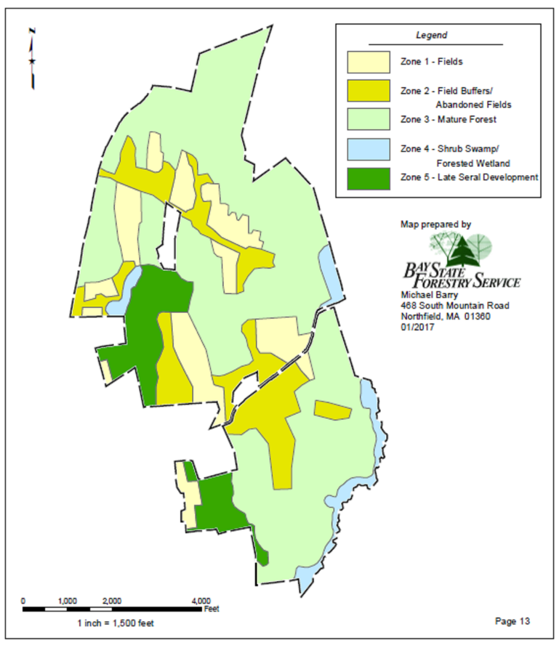
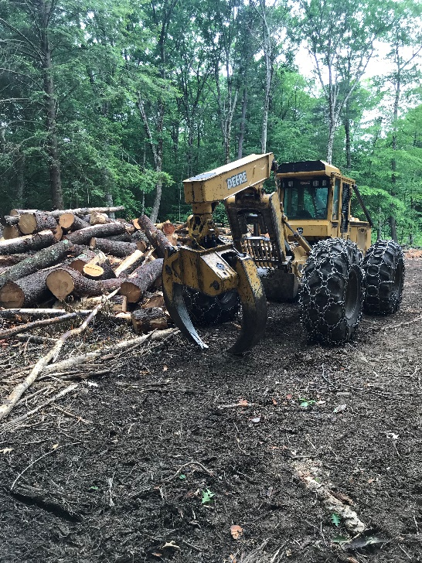

Sanctuary management
Elm Hill demonstration site
Richardson Brook Sanctuary
16 acre cut

Slide 9
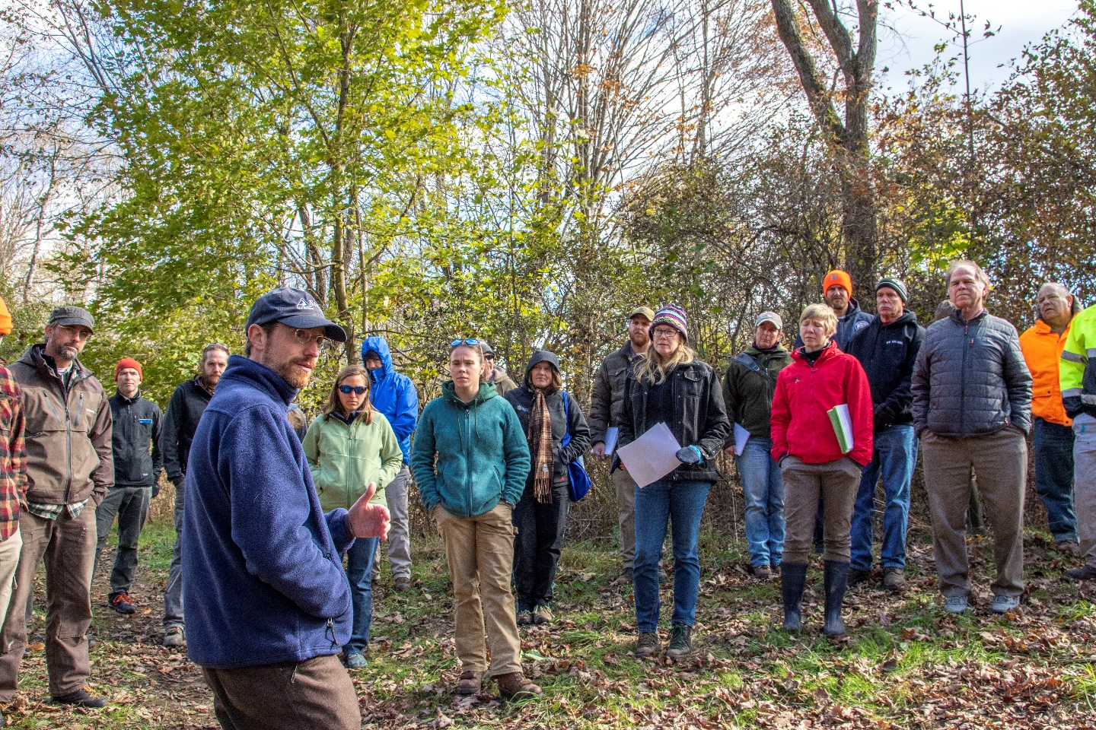
Foresters for the Birds
About 40 private foresters trained
in 3 step process
Cost-share funding

Slide 10
Foresters for the Birds
Total = 156 plans
Total = 18,114 acres
Estimated 20% implementation
Monitoring in 2019

Slide 11
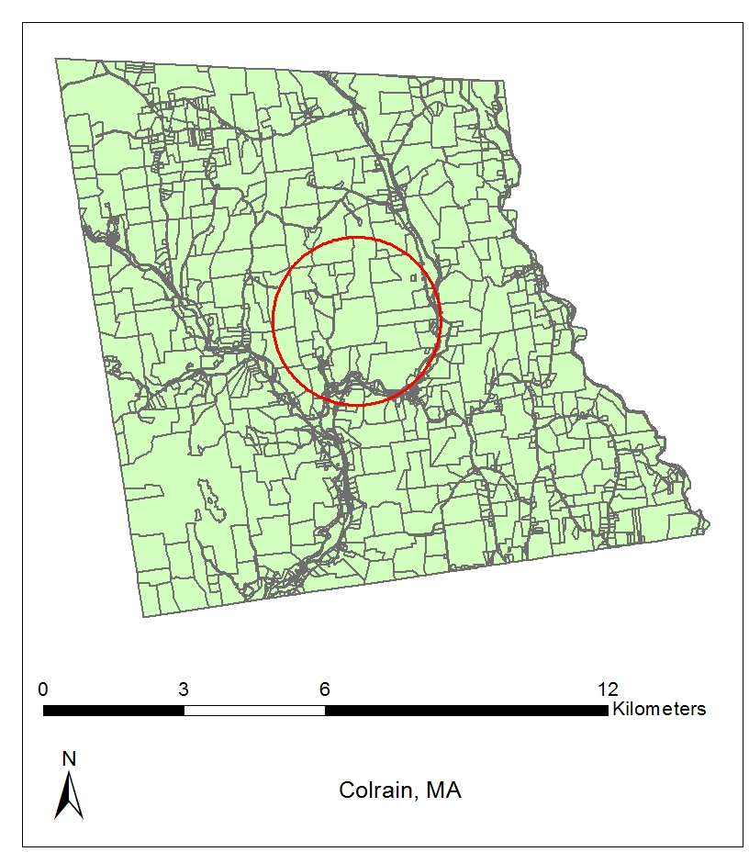
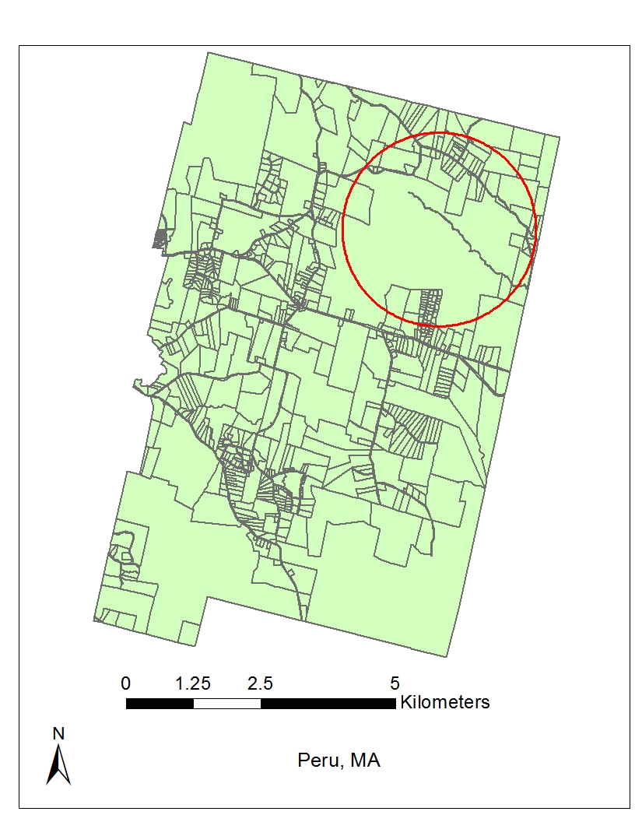
Small ownerships
Median Ownerships
  West - 8.6 ac
  East - 4.8 ac
Average (>10 ac)
17.9 ac
Kittredge et al 2008

Slide 12
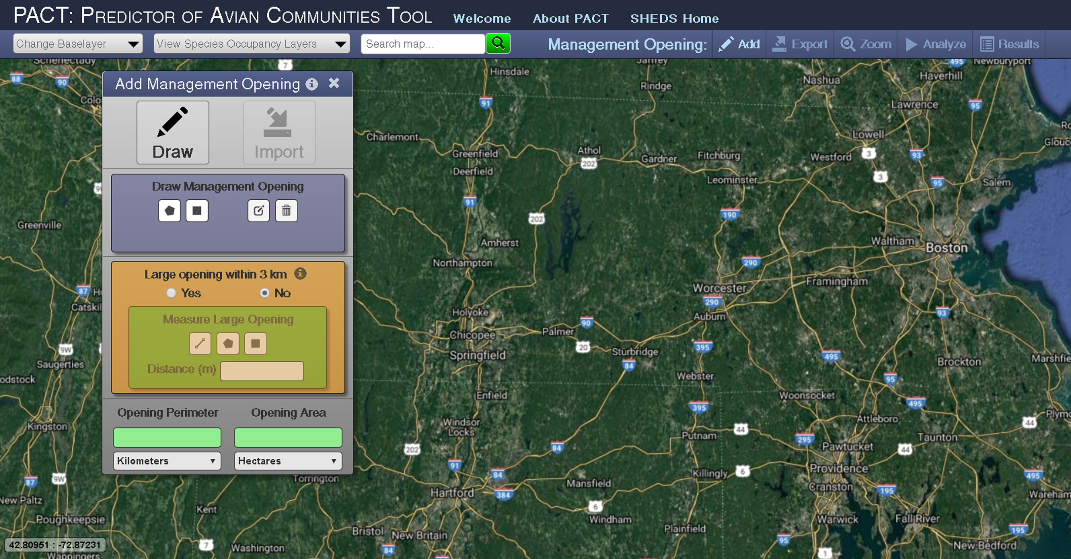
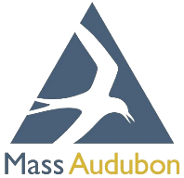
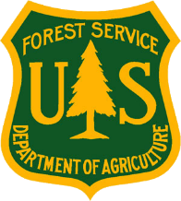

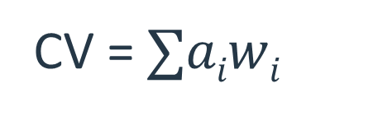
PACT: Predictor of Avian Communities Tool
pact.ecosheds.org
Regional Occupancy * Habitat Occupancy = Local occupancy
Conservation Value = Local Occupancy * PIF Regional Conservation Score, summed across all species
s
CV = $∑aiwi$
i=1
Nuttle et al 2013

Slide 13
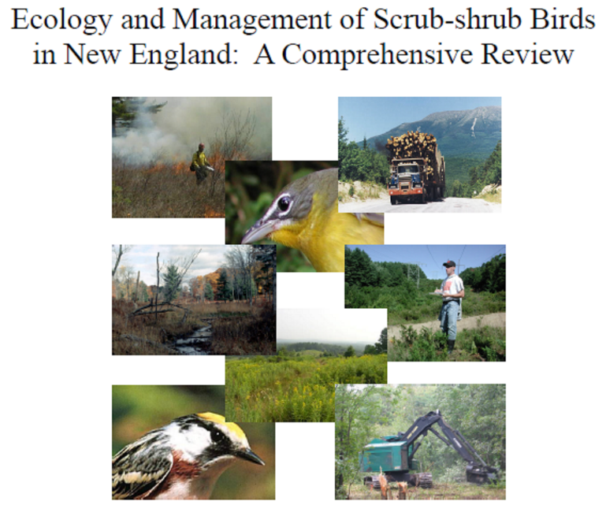
PACT: Species list
Northern Bobwhite | Prairie Warbler | Wilson’s Snipe
American Woodcock | Palm Warbler | Yellow-billed Cuckoo
Alder Flycatcher | Mourning Warbler | Whip-poor-will
Willow Flycatcher | Common Yellowthroat | Ruby-thr Hummingbird
White-eyed Vireo | Wilson’s Warbler | Cedar Waxwing
House Wren | Yellow-breasted Chat | Magnolia Warbler
Gray Catbird | Eastern Towhee | Black-and-white Warbler
Brown Thrasher | Field Sparrow | Canada Warbler
Blue-winged Warbler | Song Sparrow | Dark-eyed Junco
Golden-winged Warbler | Lincoln’s Sparrow | Carolina Wren
Tennessee Warbler | White-throated Sparrow | Rusty Blackbird
Nashville Warbler | Northern Cardinal | Ruffed Grouse
Yellow Warbler | Indigo Bunting | Northern Mockingbird
Chestnut-sided Warbler | American Goldfinch
Schlossberg and King 2007

Slide 14
PACT: Species list
Northern Bobwhite | Prairie Warbler | Wilson’s Snipe
American Woodcock | Palm Warbler | Yellow-billed Cuckoo
Alder Flycatcher | Mourning Warbler | Whip-poor-will
Willow Flycatcher | Common Yellowthroat | Ruby-thr Hummingbird
White-eyed Vireo | Wilson’s Warbler | Cedar Waxwing
House Wren | Yellow-breasted Chat | Magnolia Warbler
Gray Catbird | Eastern Towhee | Black-and-white Warbler
Brown Thrasher | Field Sparrow | Canada Warbler
Blue-winged Warbler | Song Sparrow | Dark-eyed Junco
Golden-winged Warbler | Lincoln’s Sparrow | Carolina Wren
Tennessee Warbler | White-throated Sparrow | Rusty Blackbird
Nashville Warbler | Northern Cardinal | Ruffed Grouse
Yellow Warbler | Indigo Bunting | Northern Mockingbird
Chestnut-sided Warbler | American Goldfinch
Schlossberg and King 2007
21 Species

Slide 15
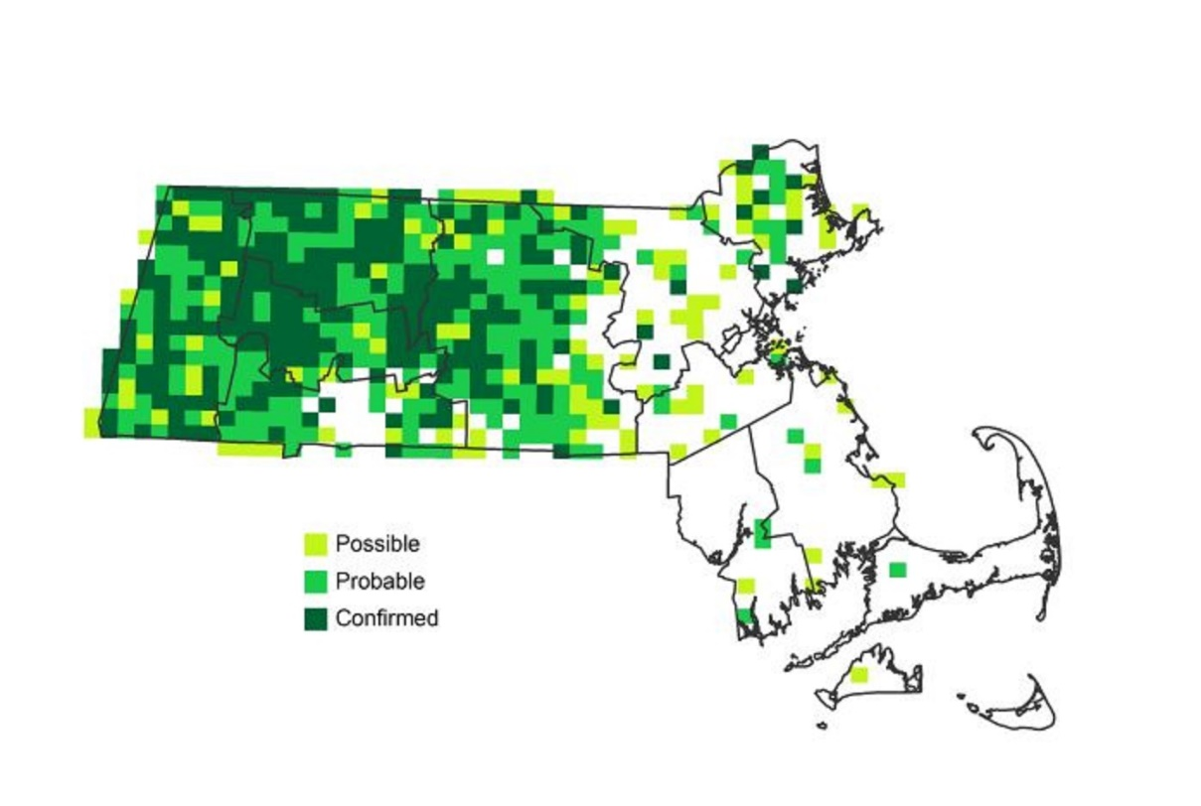
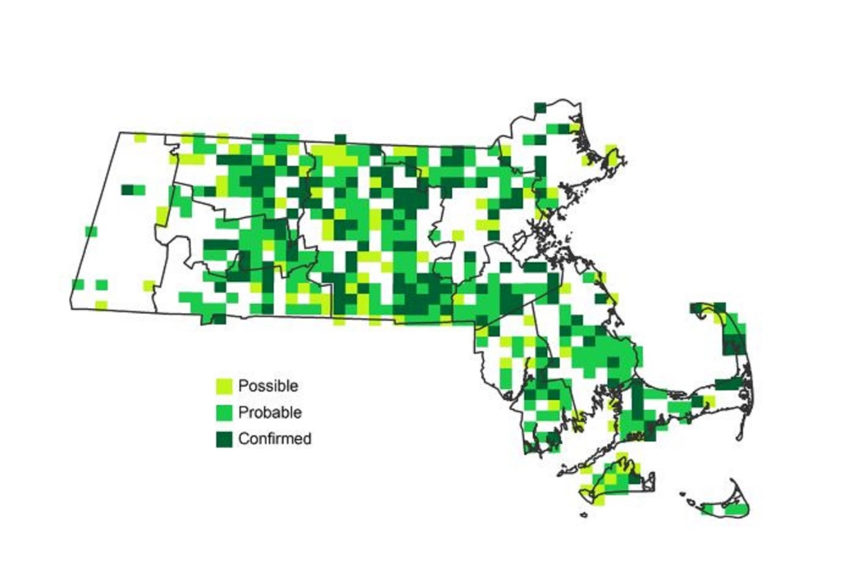
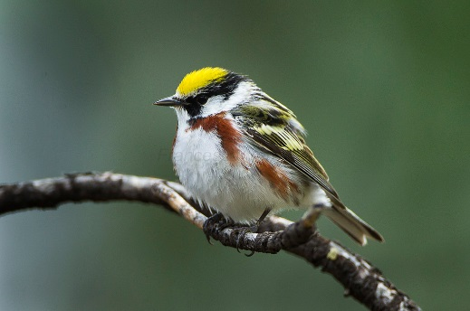
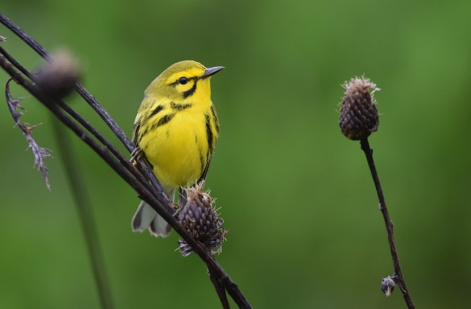
PACT: Regional Occupancy
Francesco Veronesi
Andy Reago & Chrissy McClarren
Matthews et al 2007 - ongoing

Slide 16
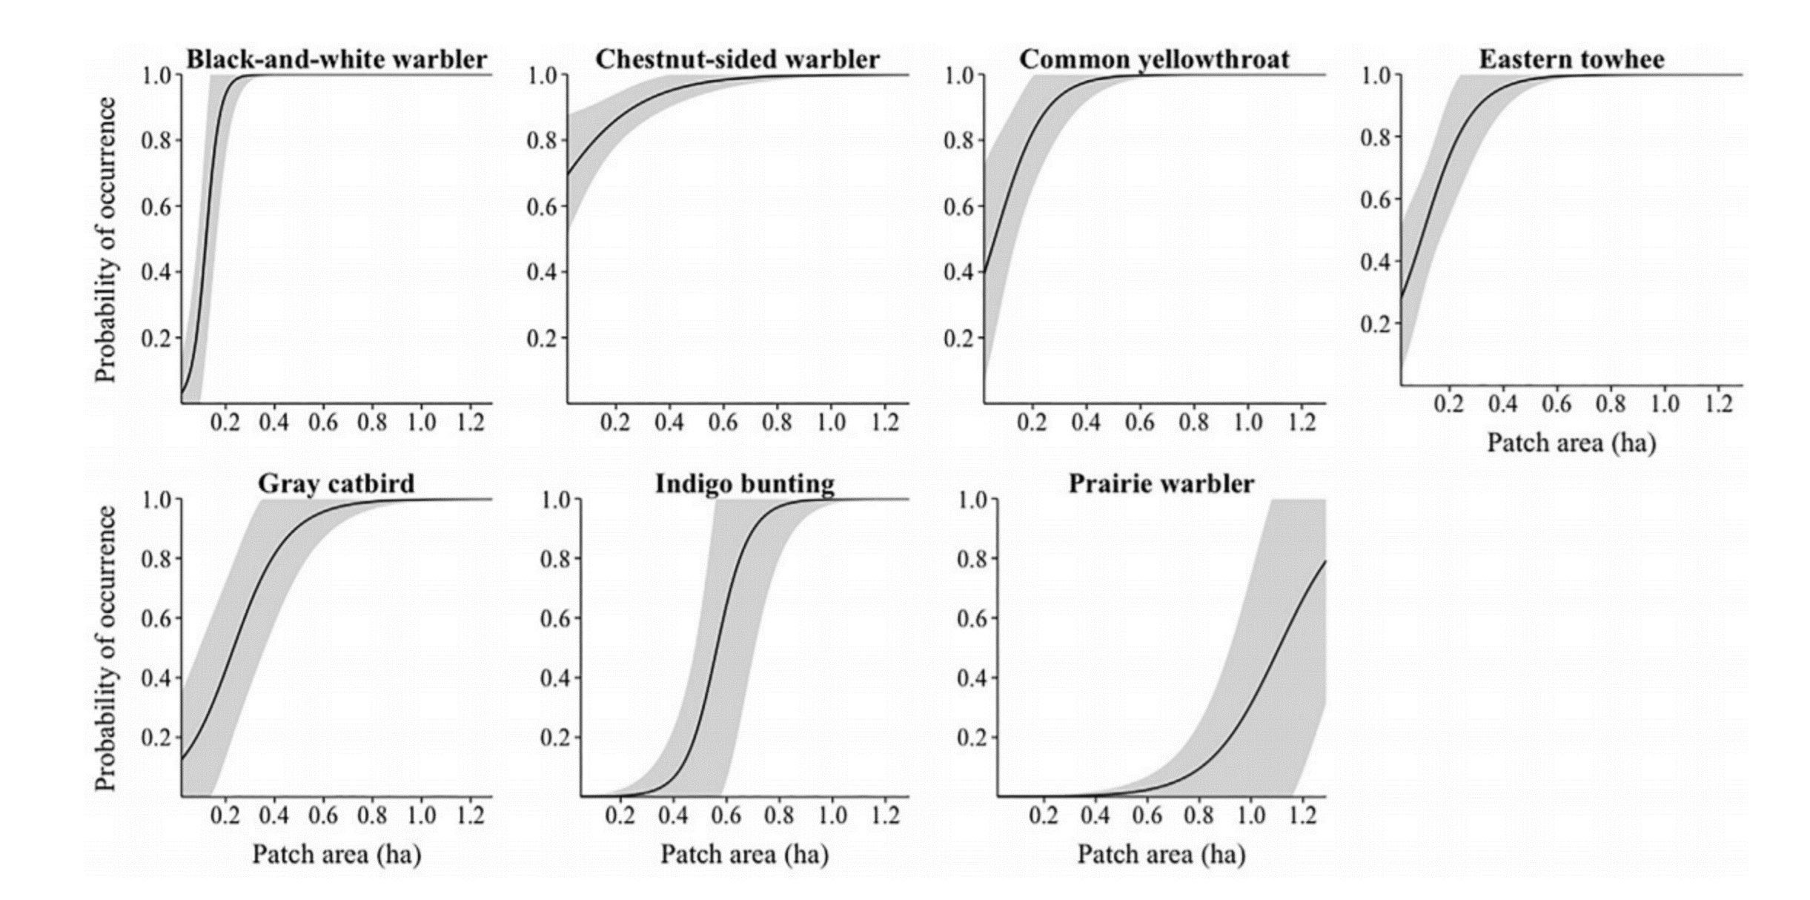
PACT: Habitat Occupancy
Occupancy-area relationships of young forest birds in Massachusetts
Roberts, H. Patrick; King, David I. 2017. The Journal of Wildlife Management. 81(7): 1298-1307.

Slide 17
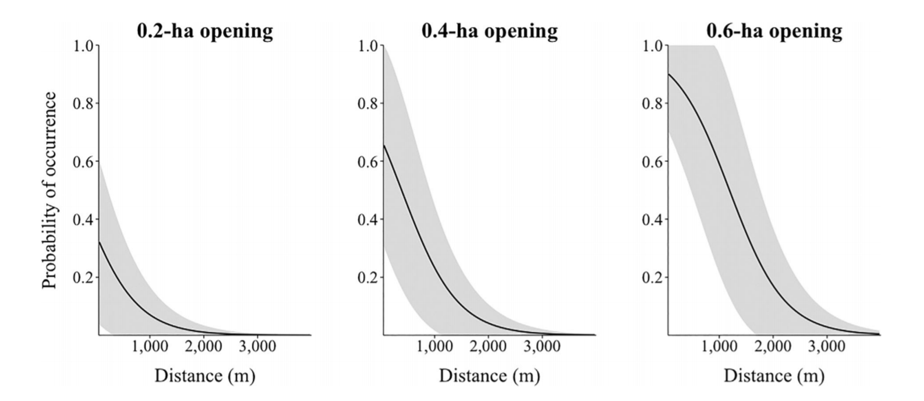
PACT: Patch proximity (landscape scale)
Prairie Warbler occurrence in relation to large patch proximity
Roberts, H. Patrick; King, David I. 2017. The Journal of Wildlife Management. 81(7): 1298-1307.

Slide 18
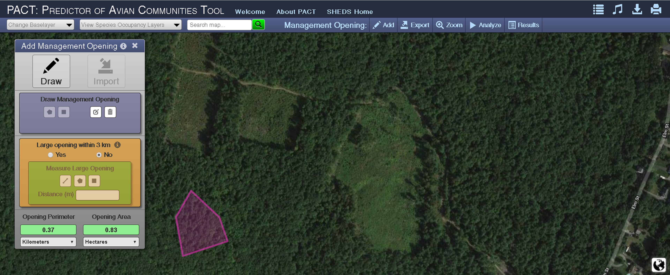
PACT: Predictor of Avian Communities Tool

Slide 19
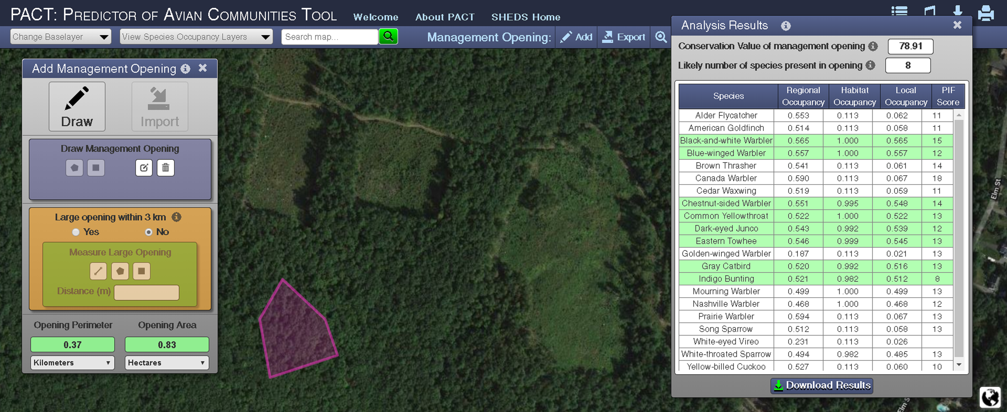
PACT: Predictor of Avian Communities Tool

Slide 20
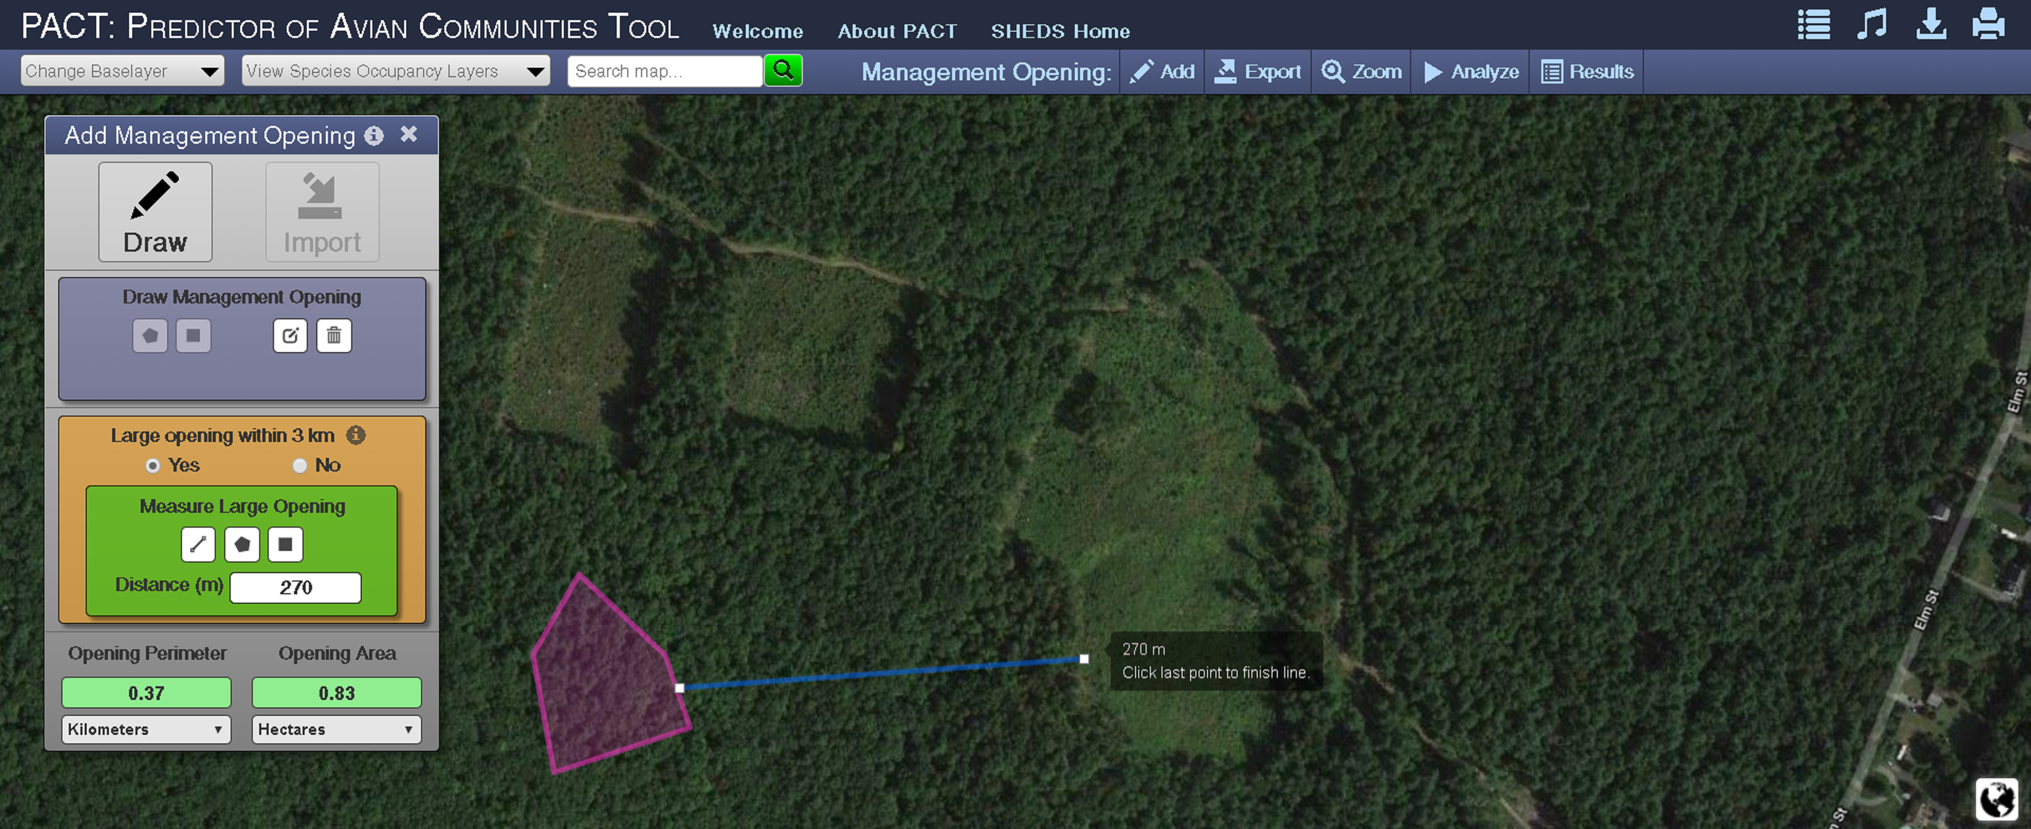
PACT: Predictor of Avian Communities Tool

Slide 21
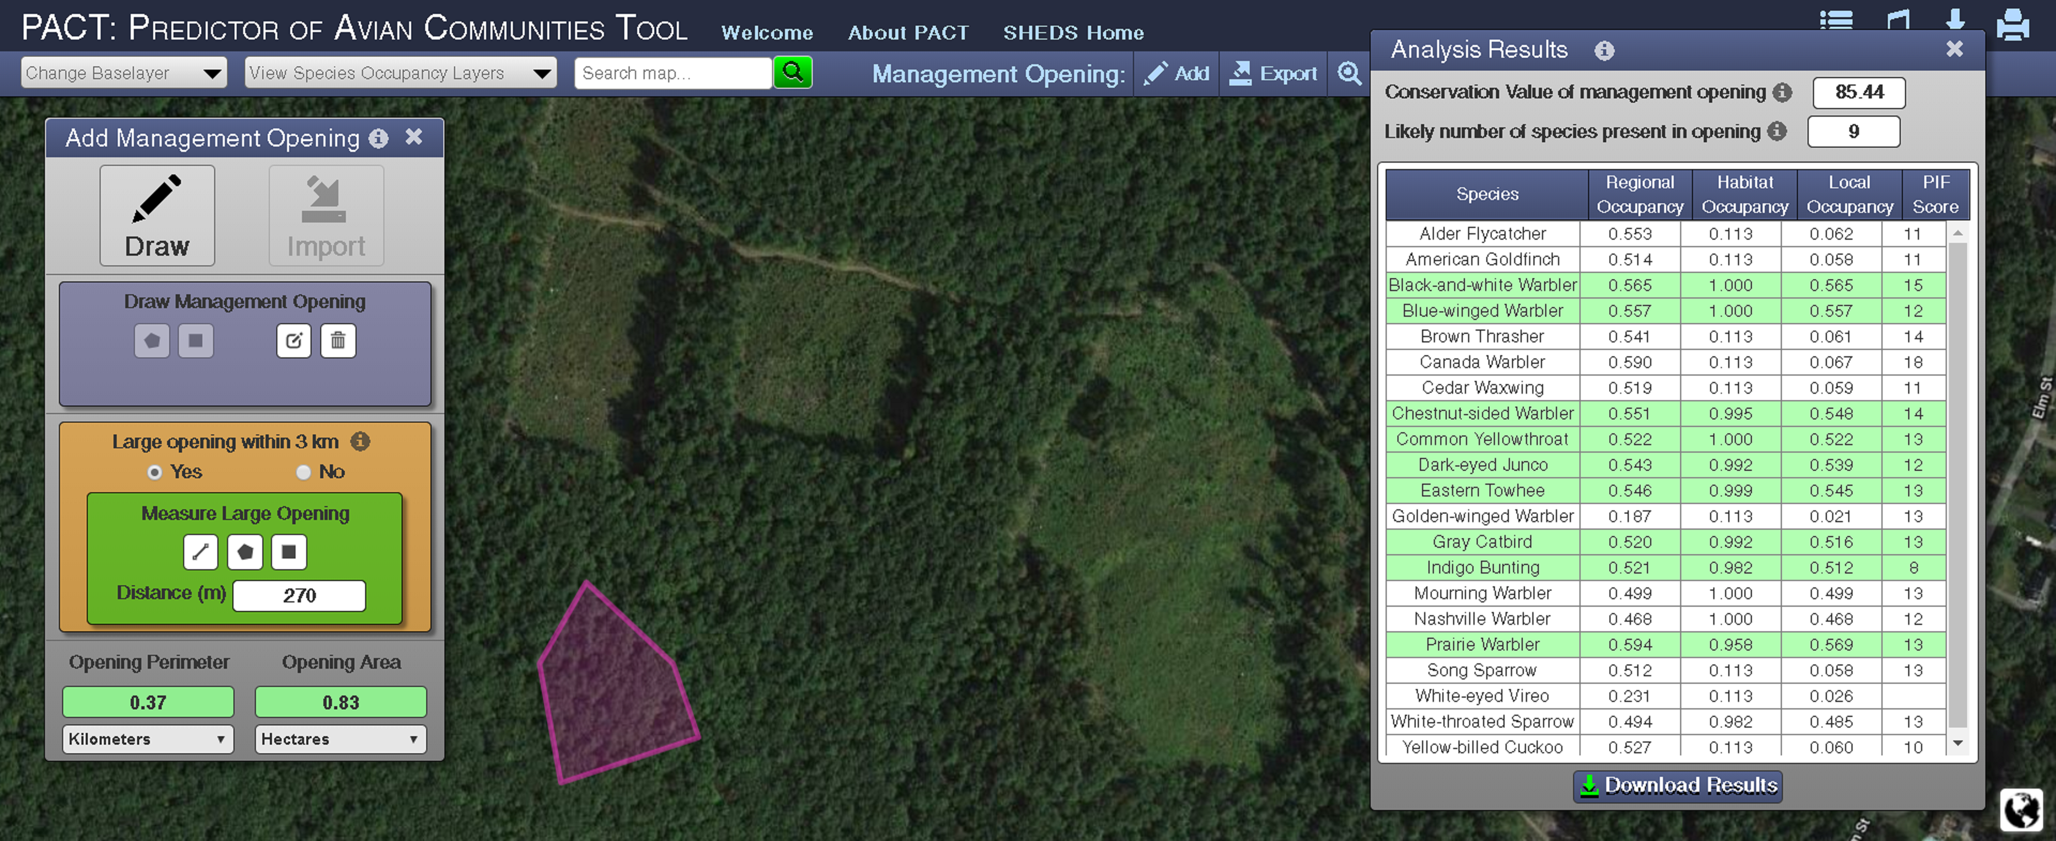
PACT: Predictor of Avian Communities Tool
pact.ecoshed.org

Slide 22
Forest Bird Conservation at
Mass Audubon
The role of sanctuaries and private lands
© Rodney Campbell
Jeff Ritterson
jritterson@massaudubon.org

