Slide 1
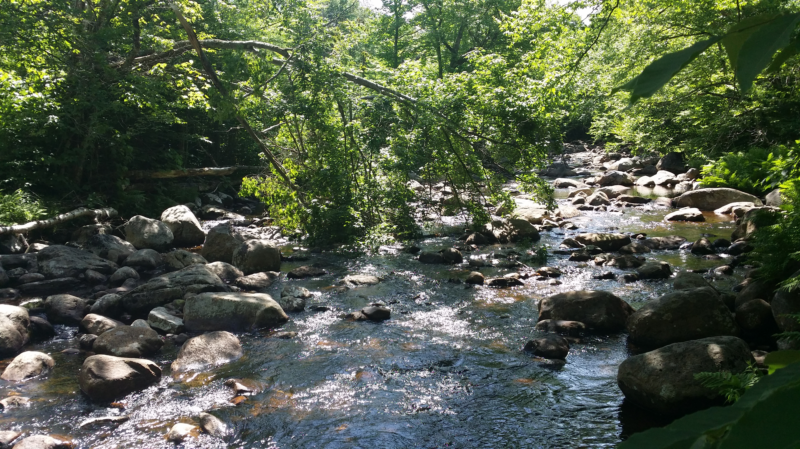
Beaver Foraging Preferences and Impacts on Forest Structure Adirondack Mountains, New York
Michael J. Mahoney and John C. Stella, SUNY College of Environmental Science and Forestry

Slide 2
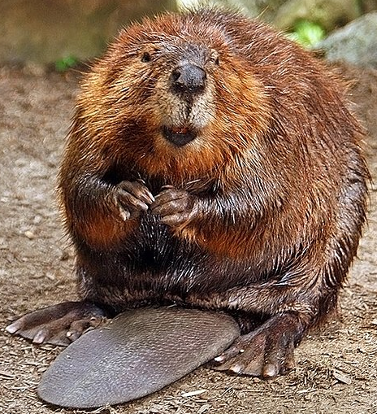

Slide 3
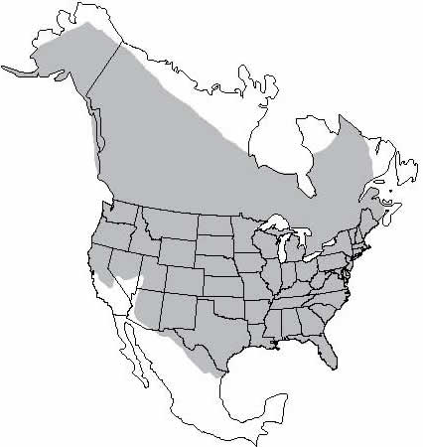

Slide 4
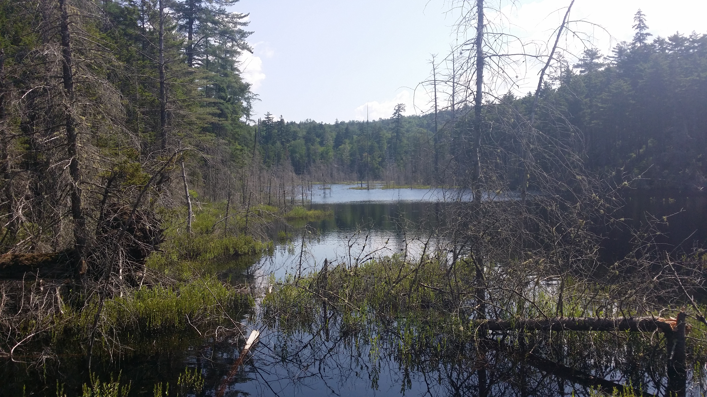

Slide 5
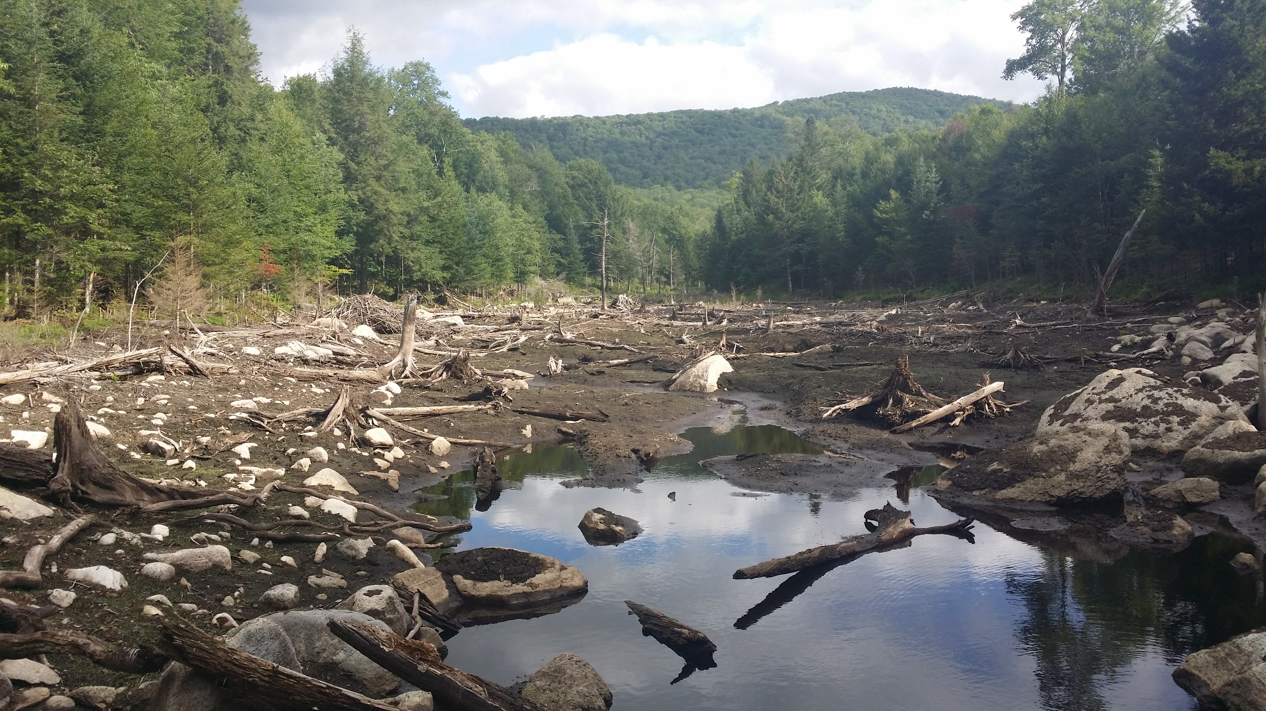

Slide 6
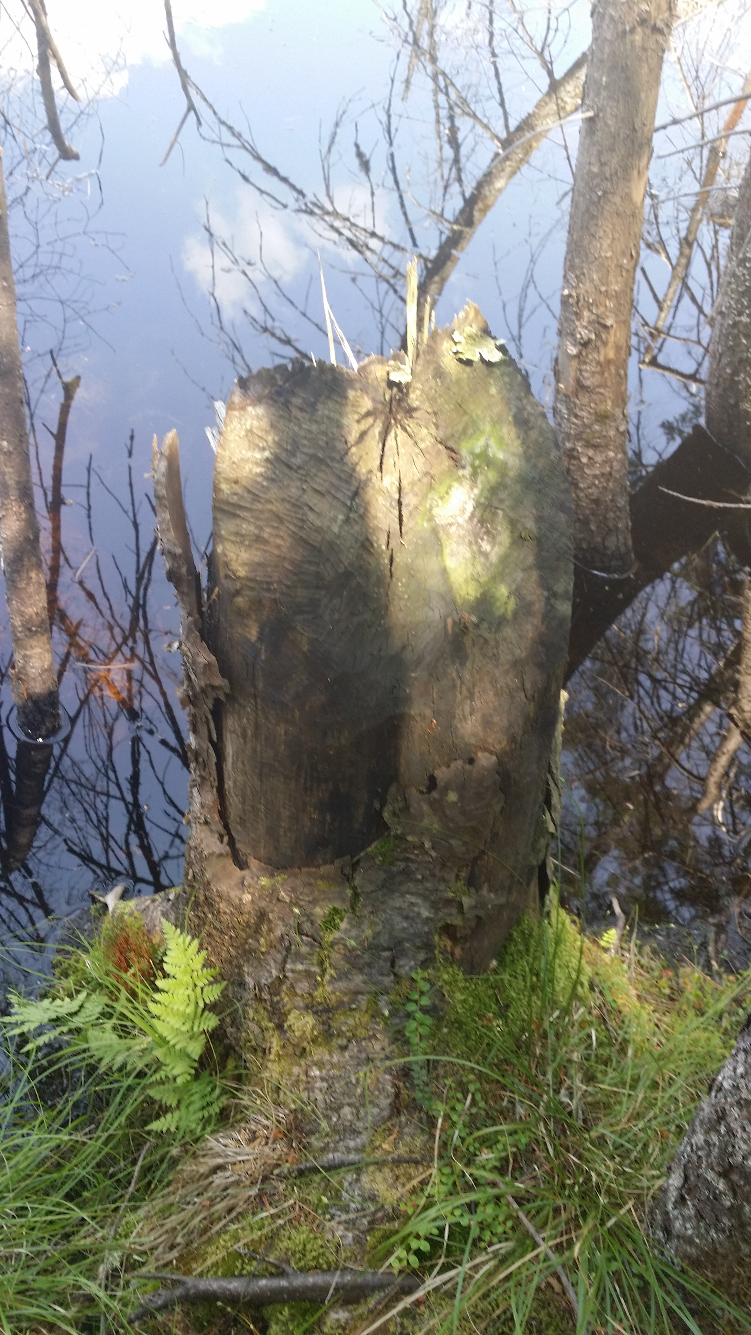
Foraging Behavior
Central place foragers
Forage selectivity increases with distance from pond
In other regions, strong preferences for stems 2-5 centimeters and aspens

Slide 7
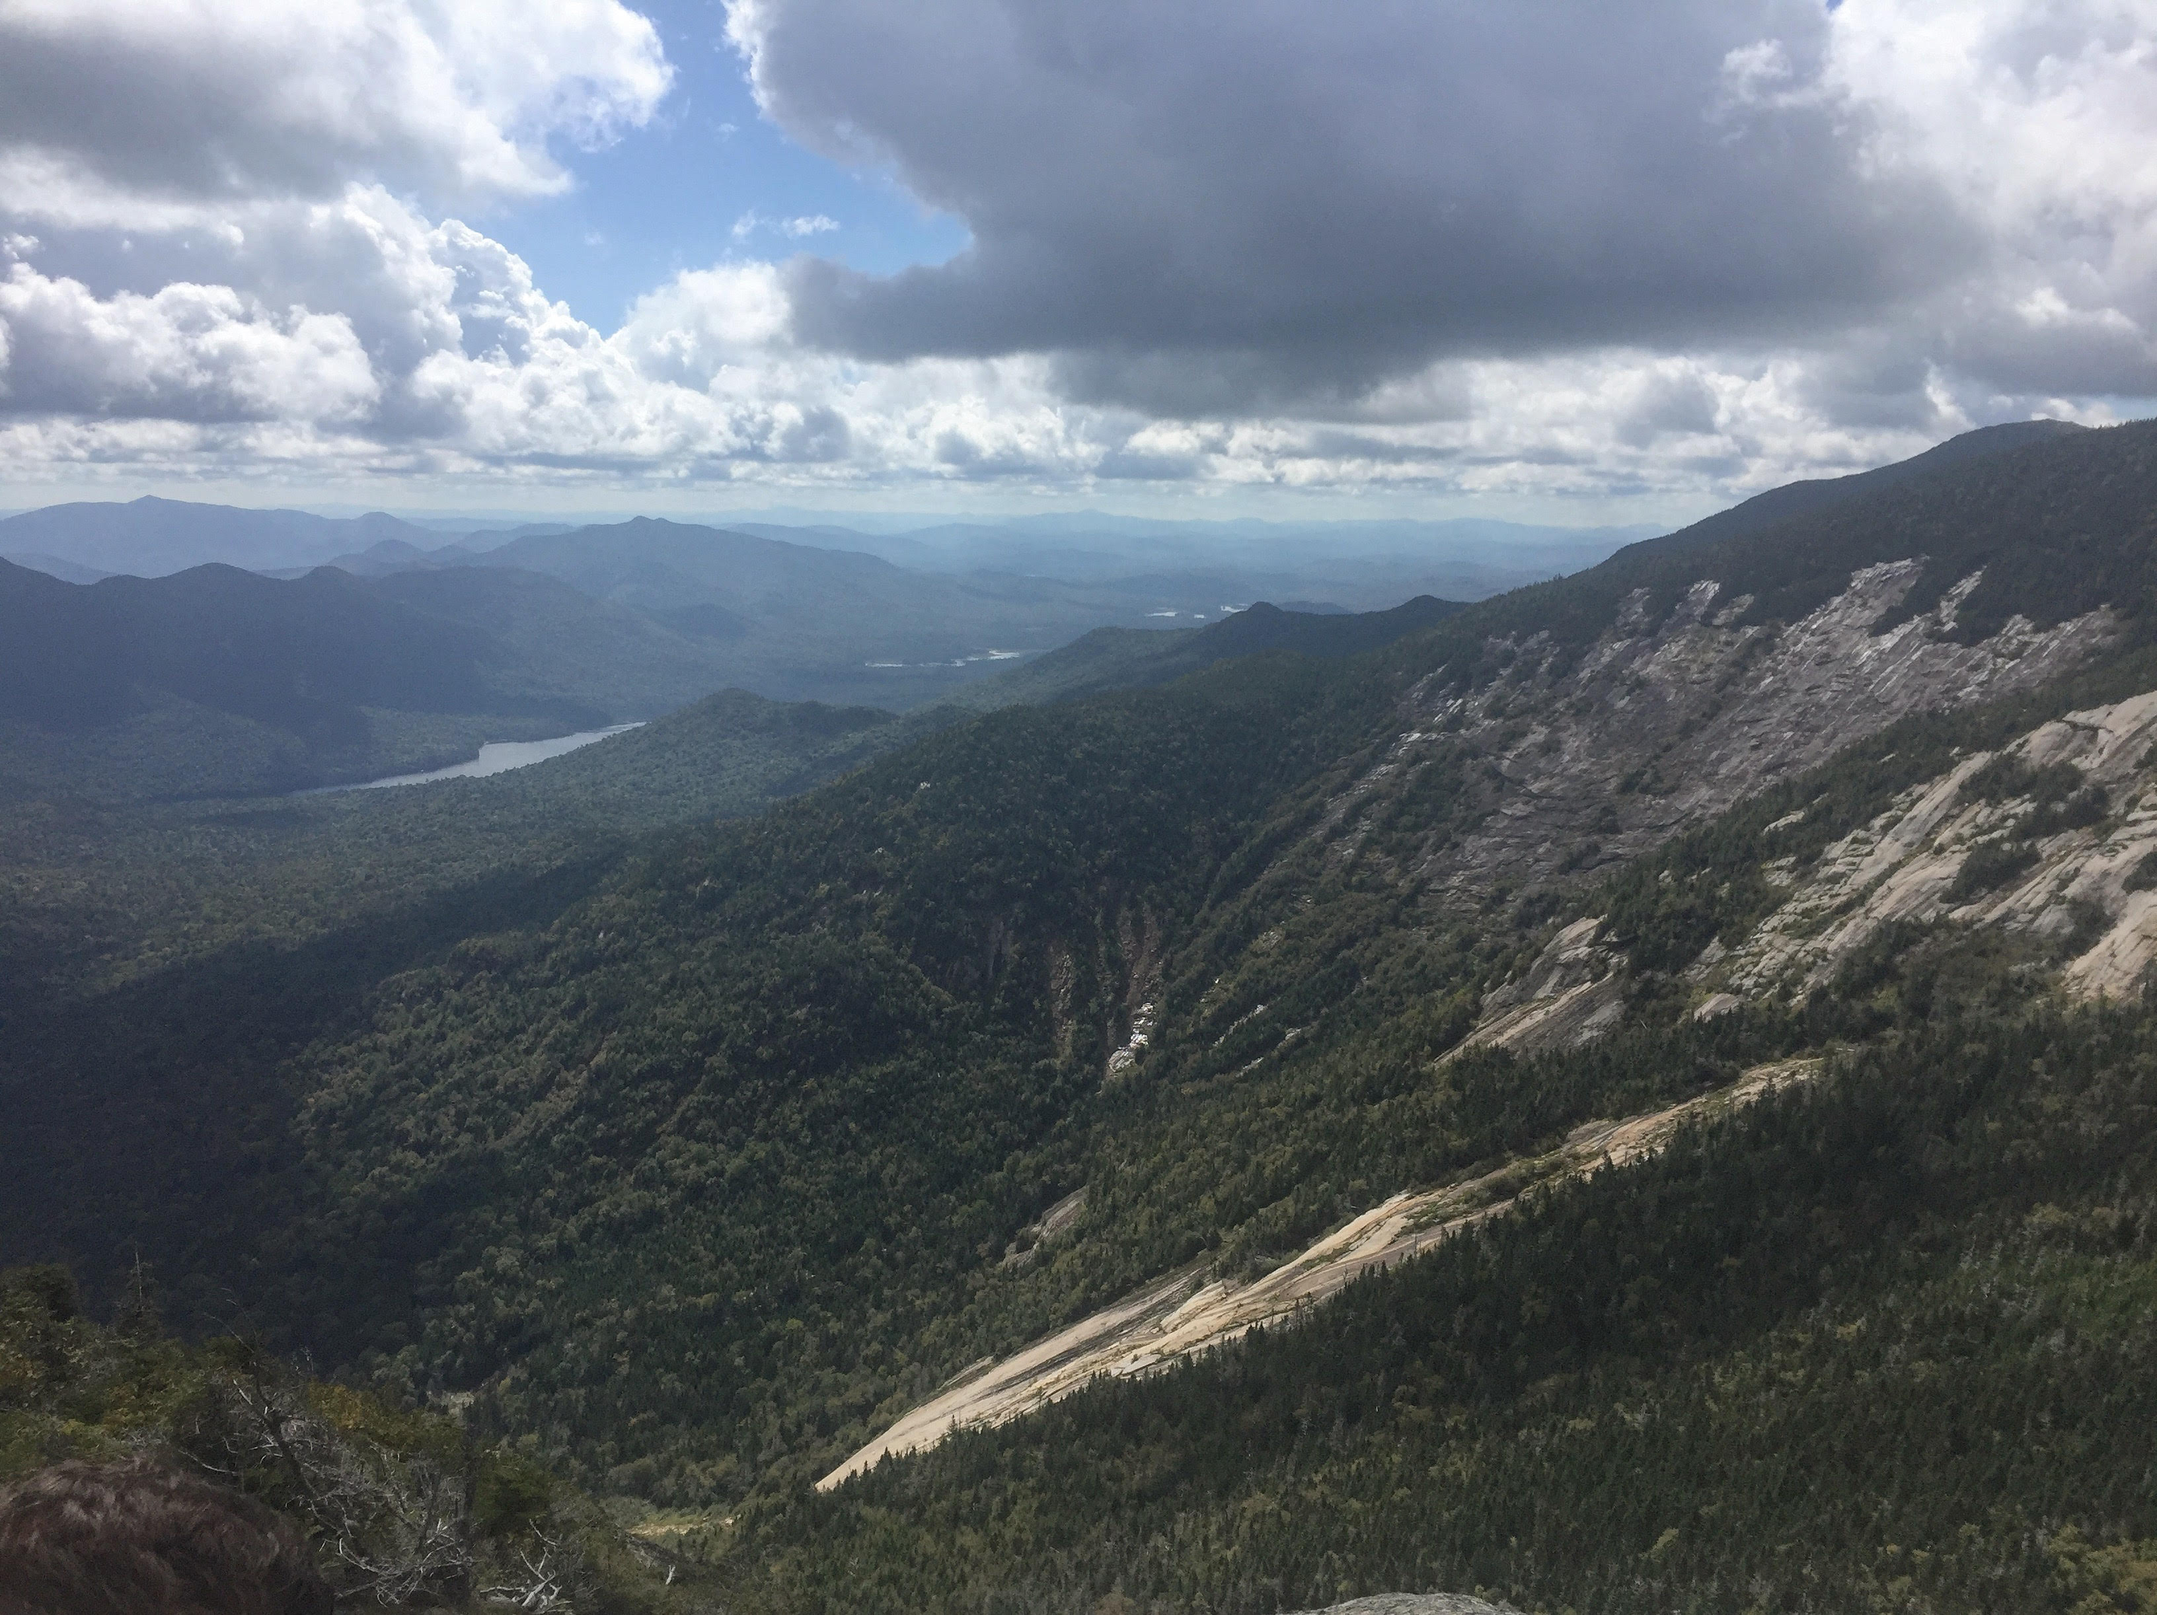

Slide 8
Research questions:
Are certain stem diameters and species preferentially foraged?
Can we effectively predict these preferences?
How does beaver activity impact forest structure?

Slide 9
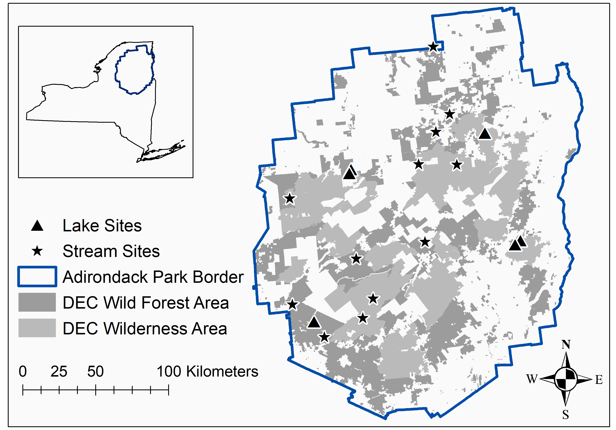

Slide 10
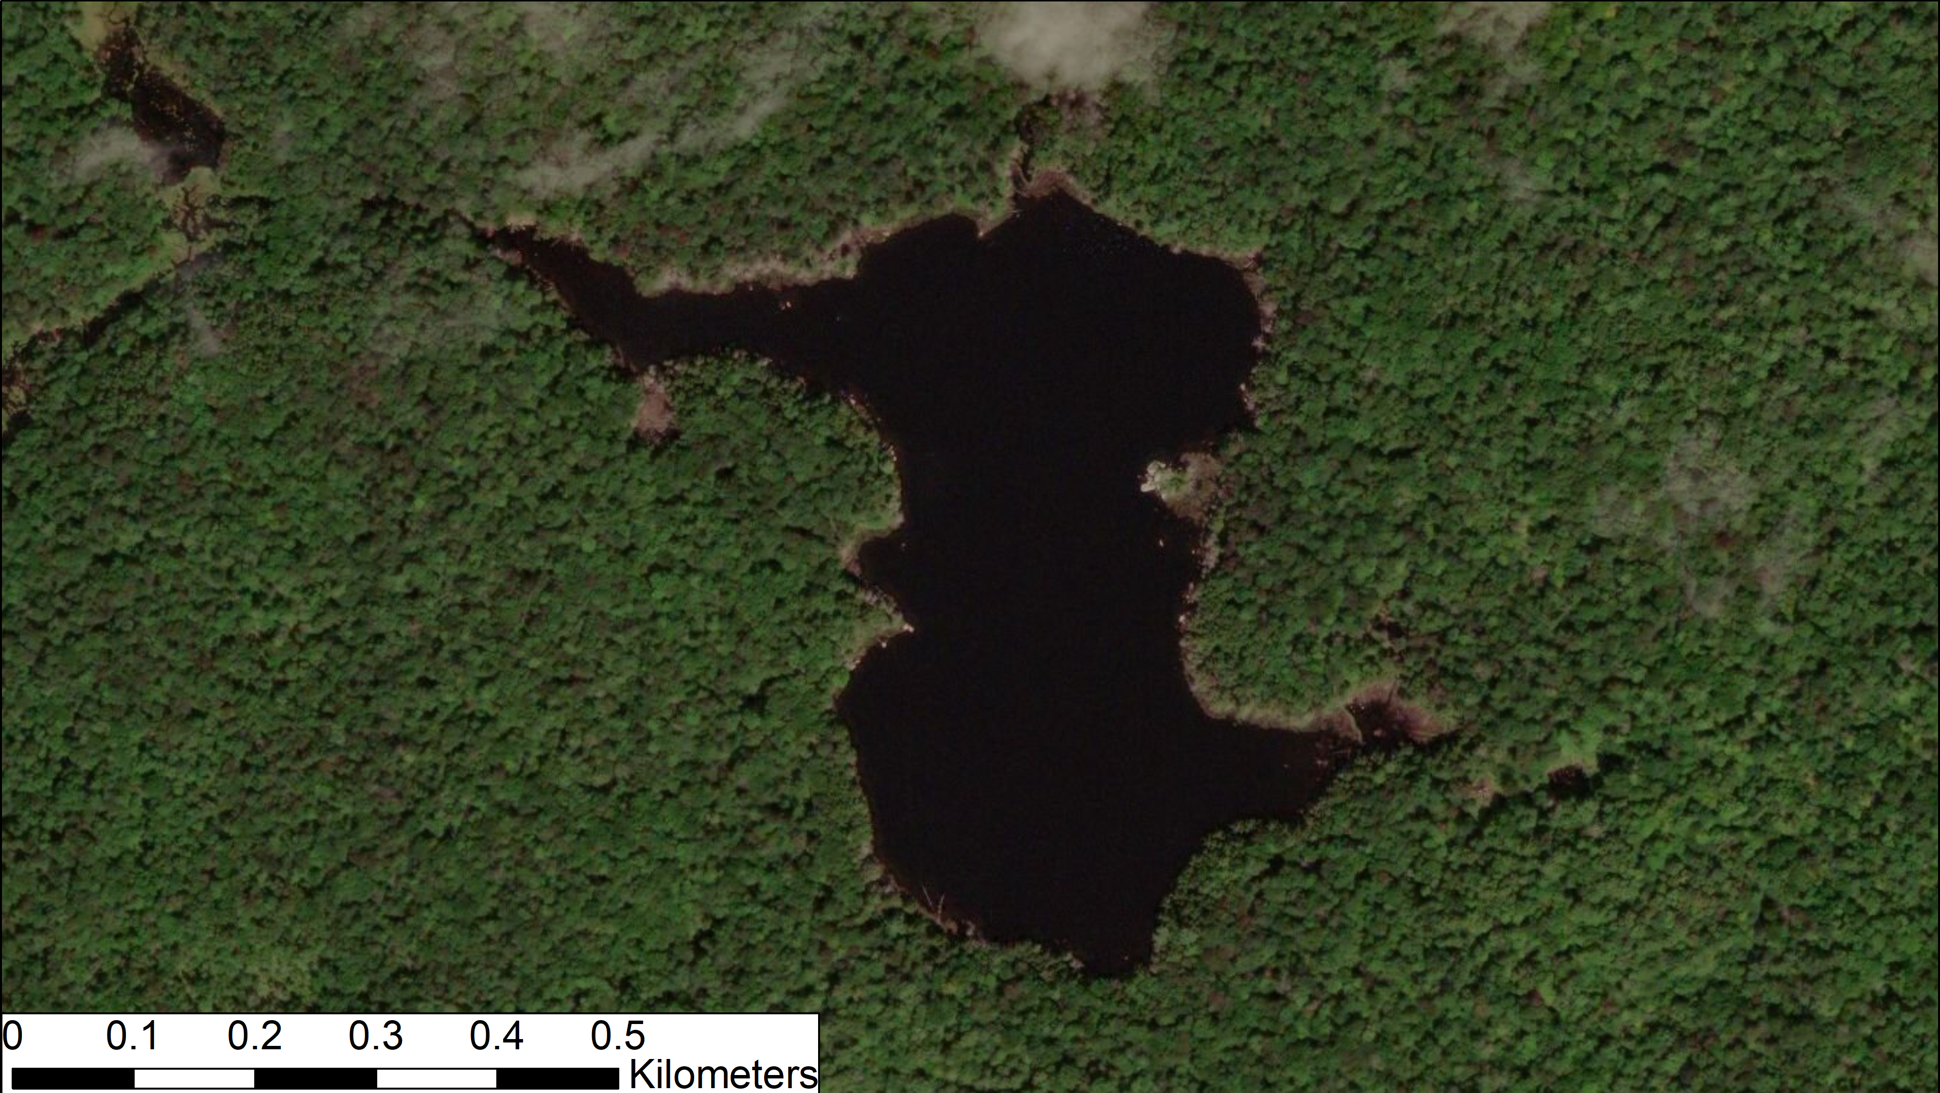

Slide 11
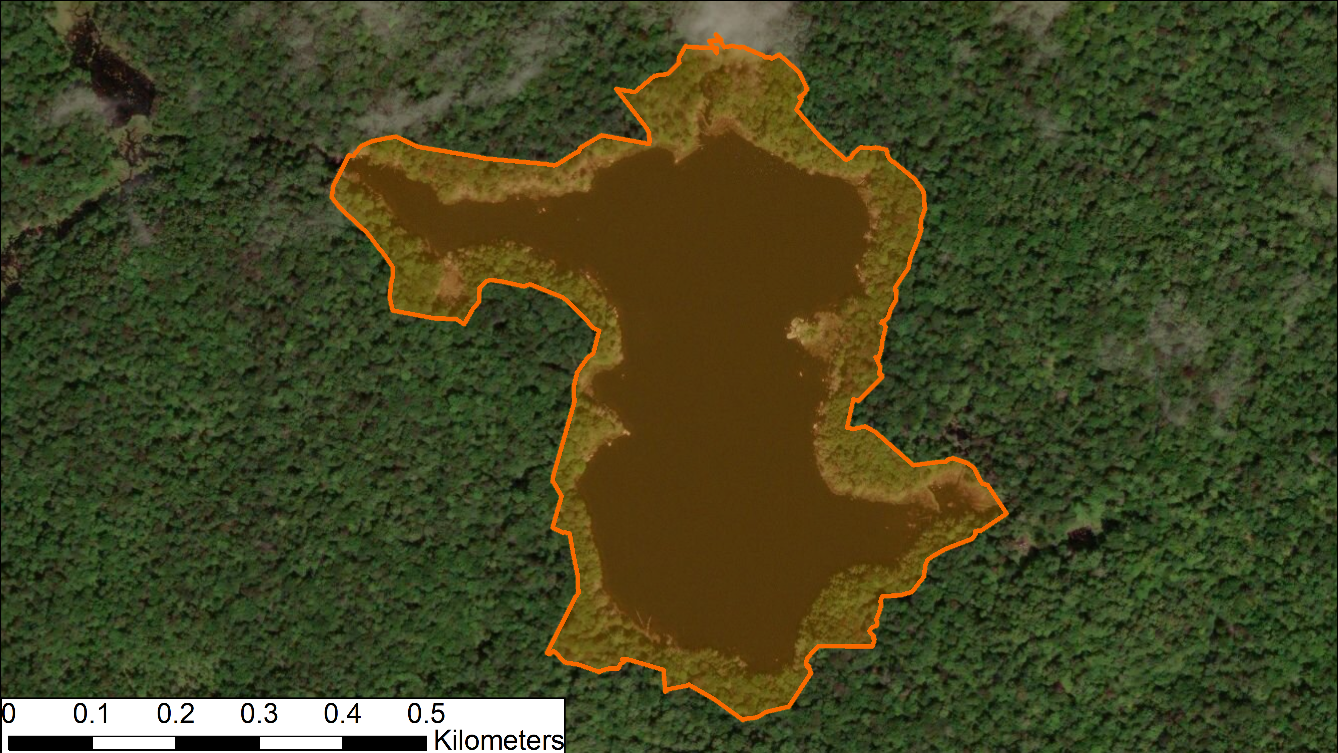

Slide 13
Plot centers:
Canopy cover, slope
12.57 m² plots:
Seedling density, all woody vegetation
50.27 m² plots:
All woody vegetation over 5 cm

Slide 14
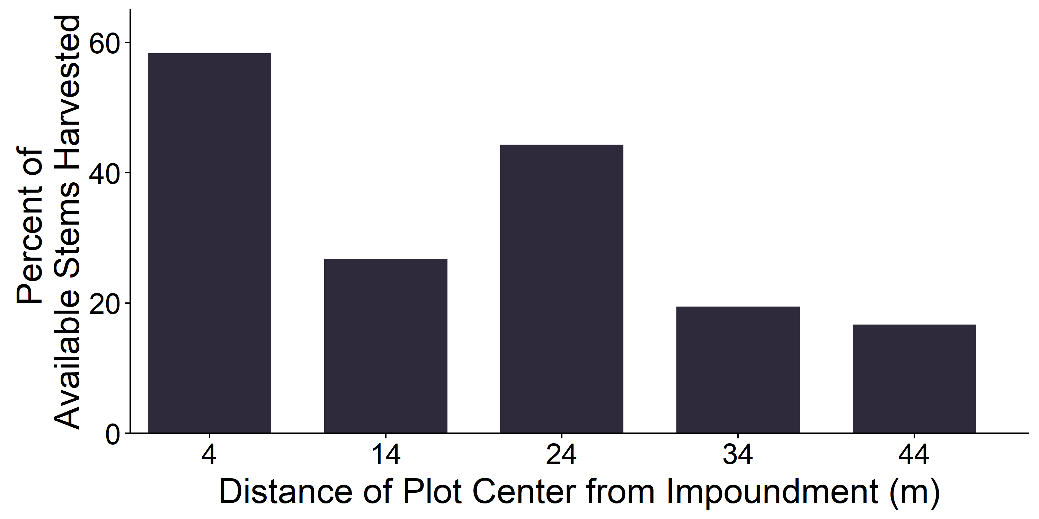
Foraging was concentrated close to the impoundment…

Slide 15
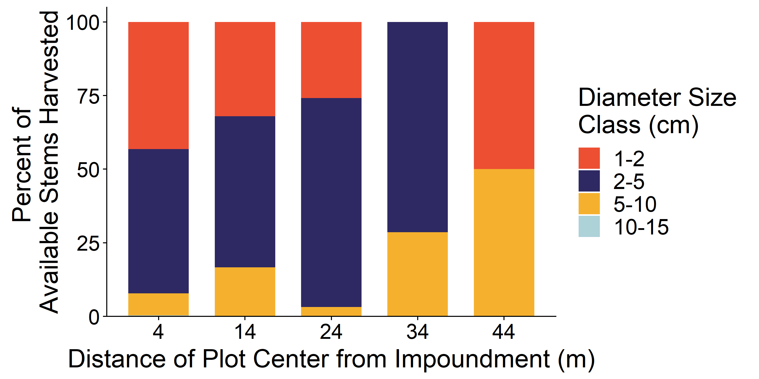
…with a clear preference for stems of 2-5 cm

Slide 16
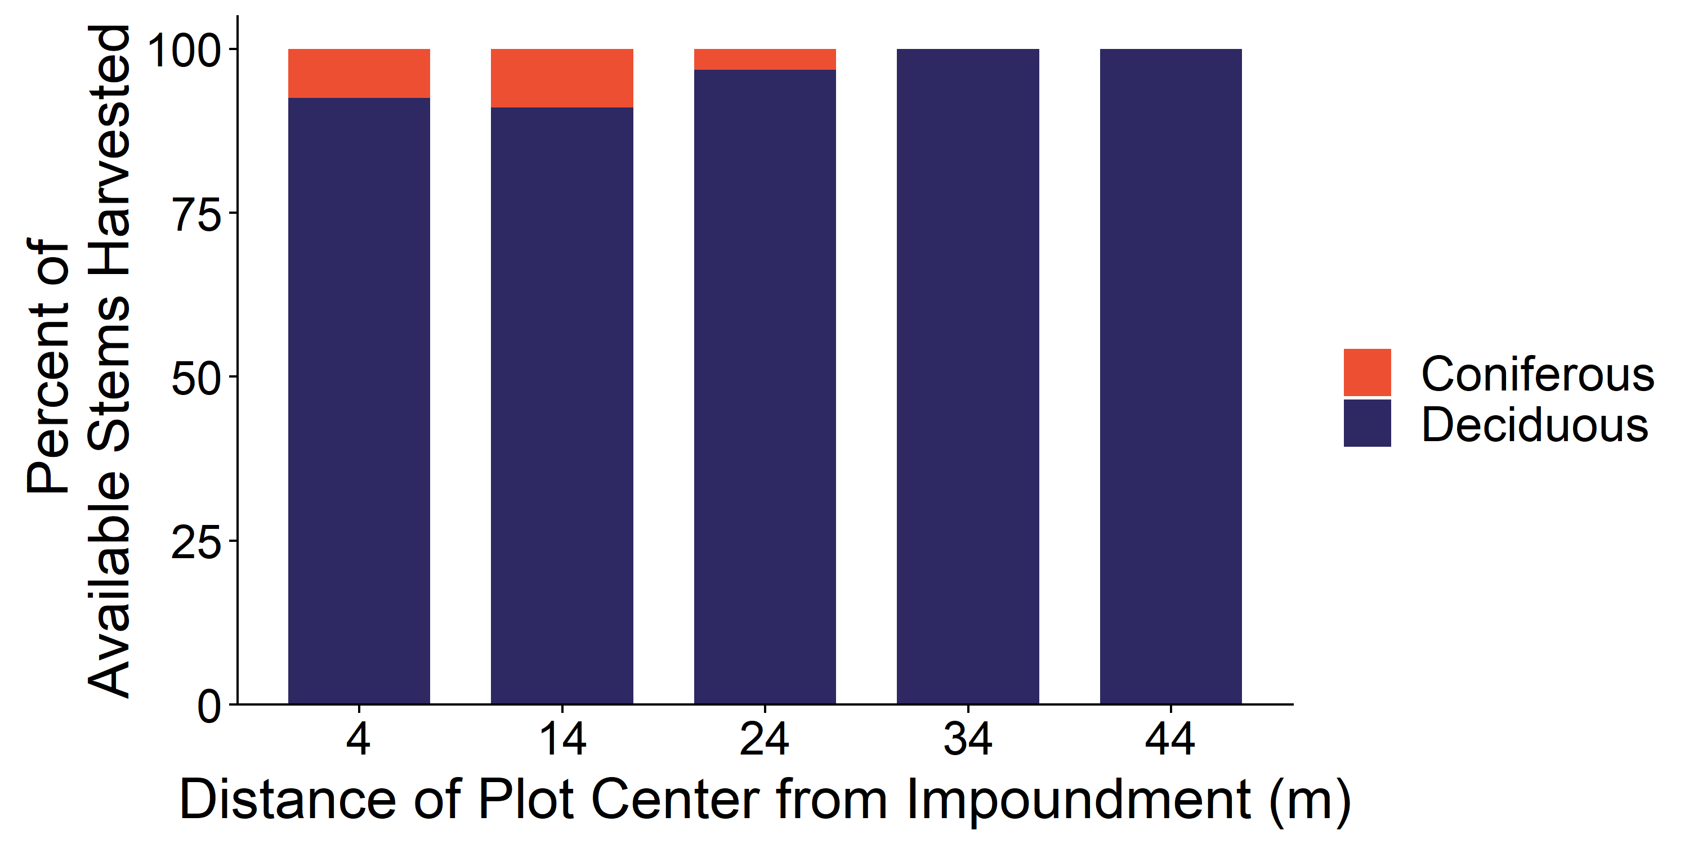
Deciduous species were strongly preferred

Slide 17
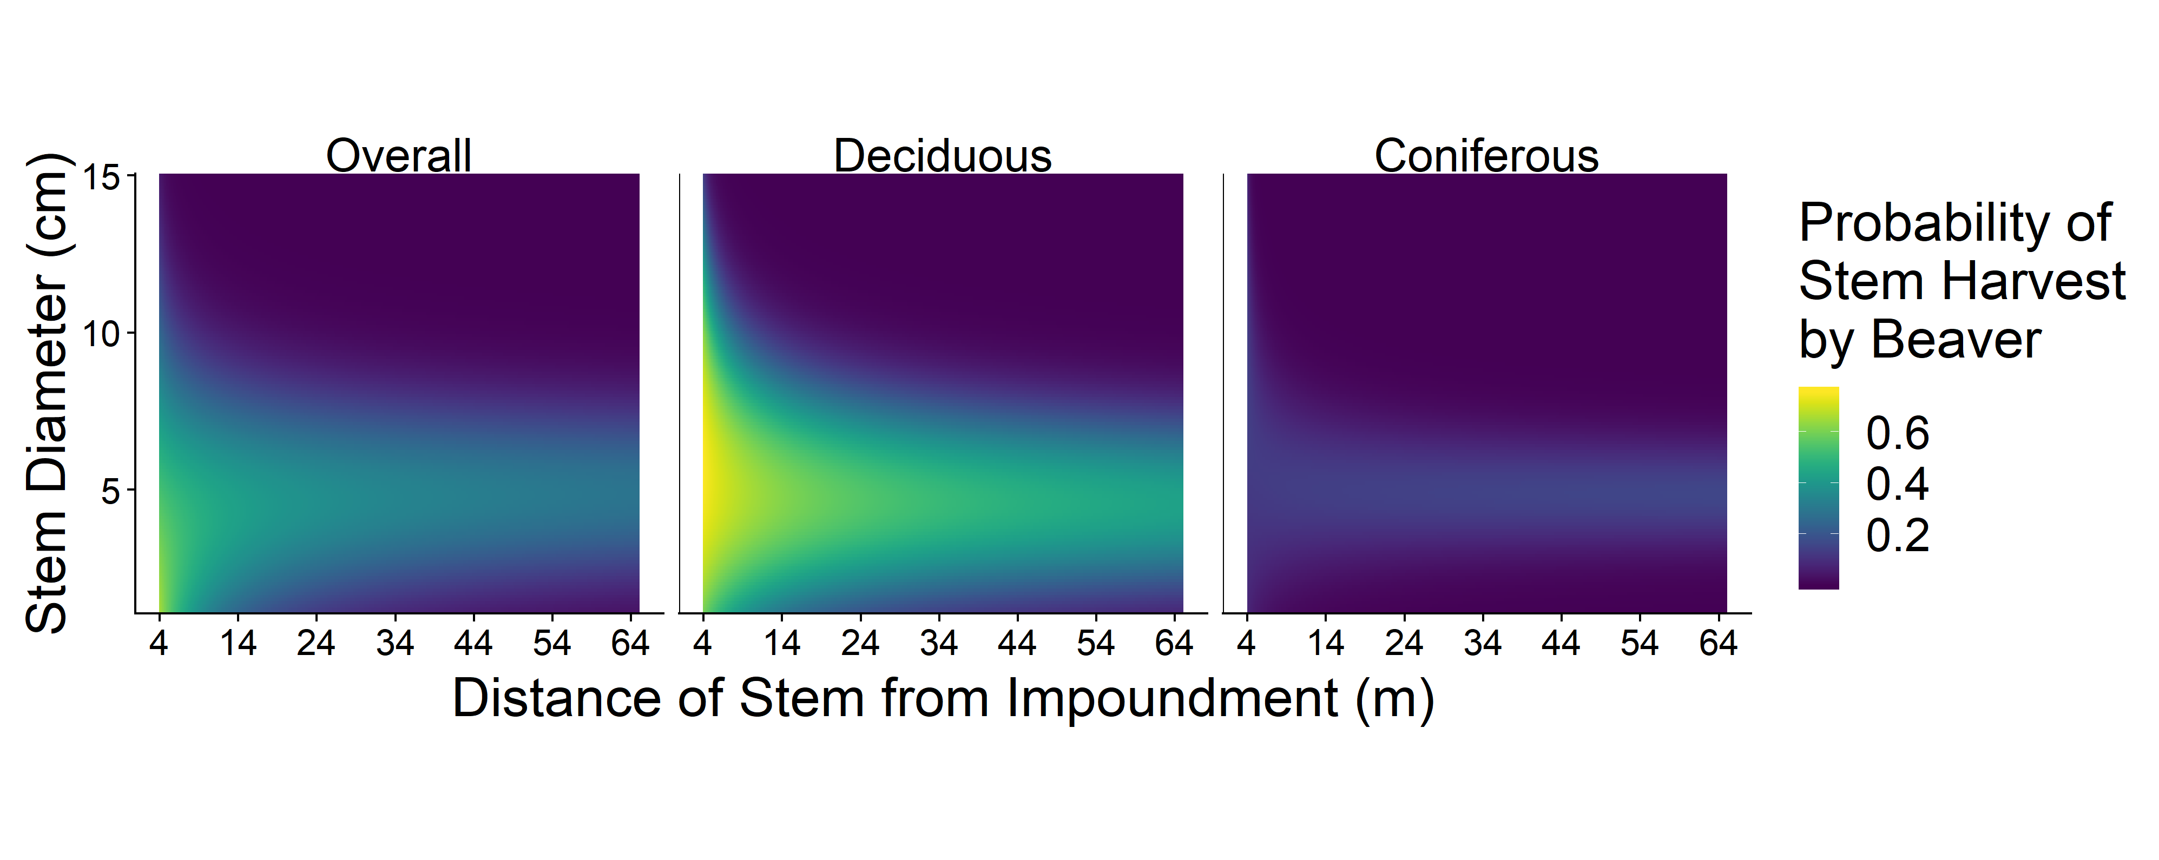
Models show preference for close stems of intermediate size

Slide 18
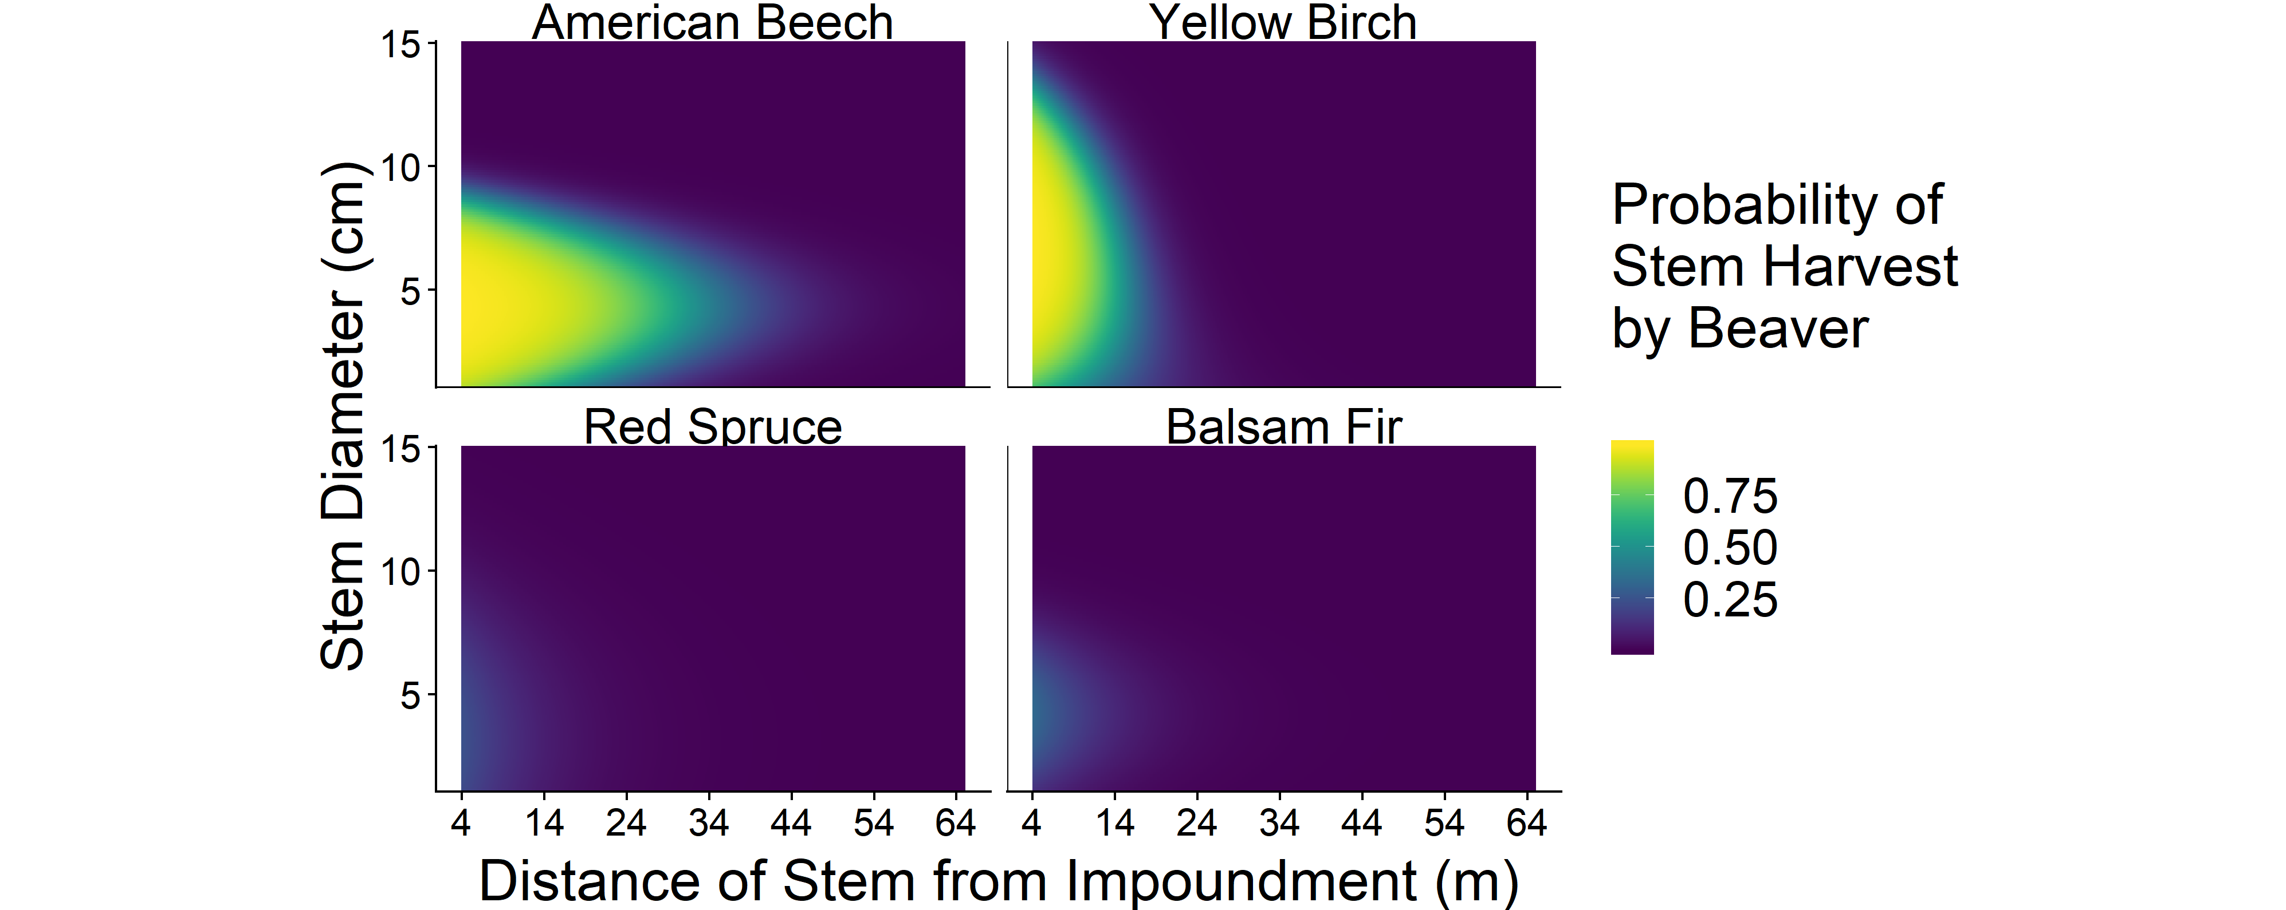
Models show preferences for close stems of intermediate size

Slide 19
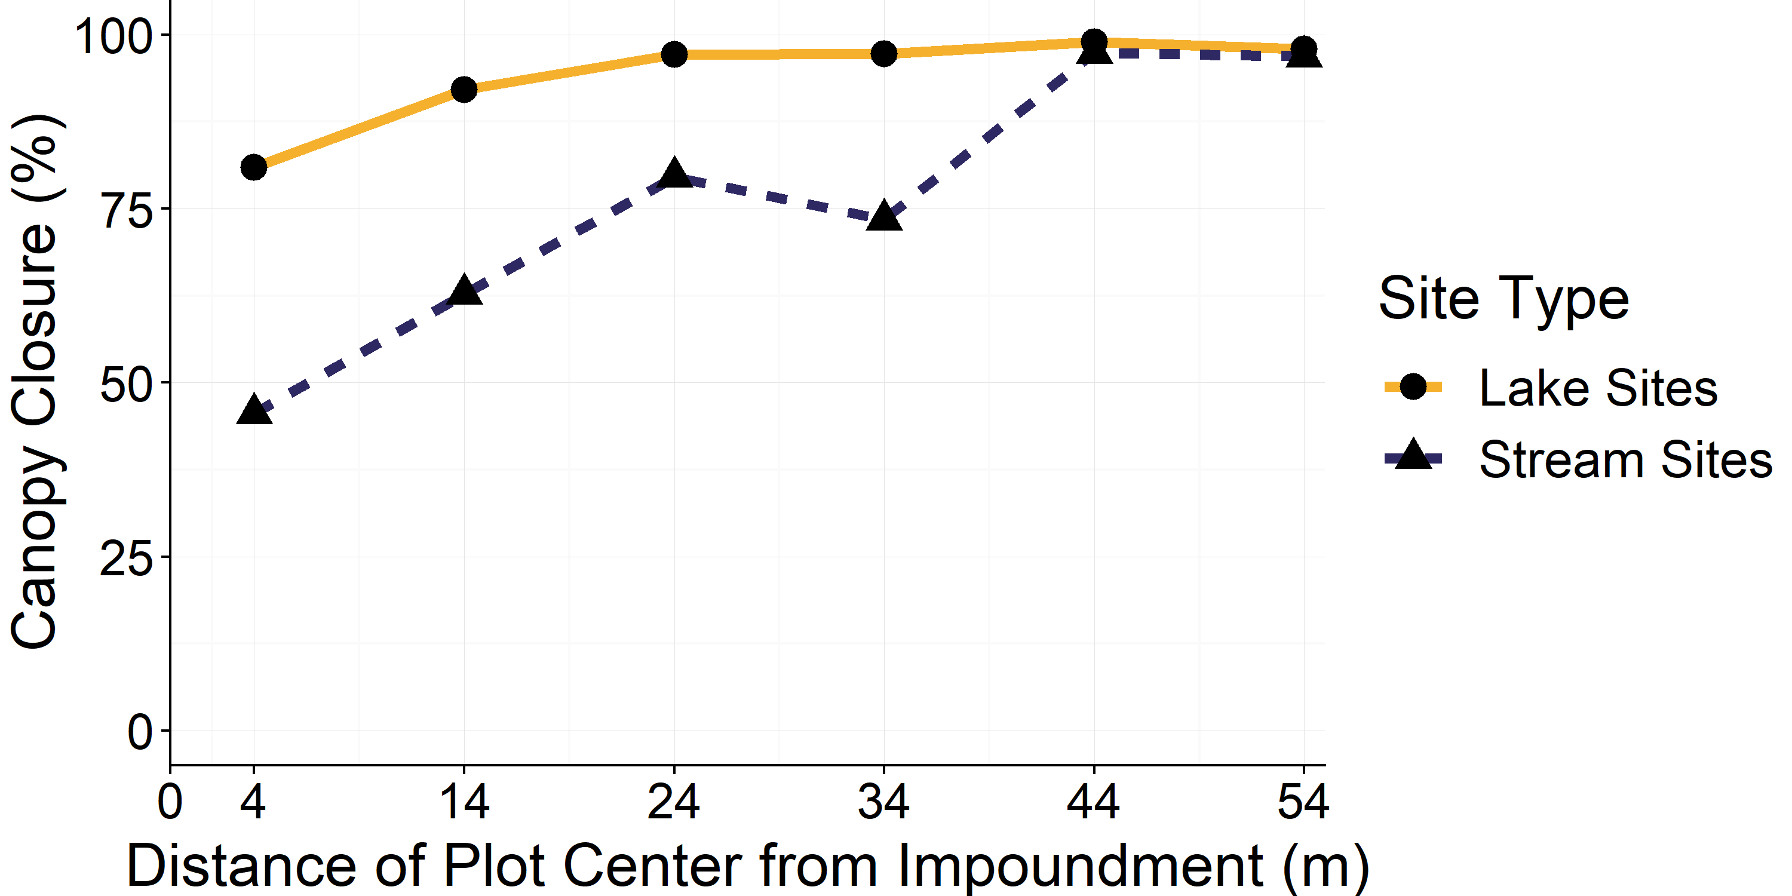
Impacts on canopy closure are linear with distance, but vary with site type

Slide 20
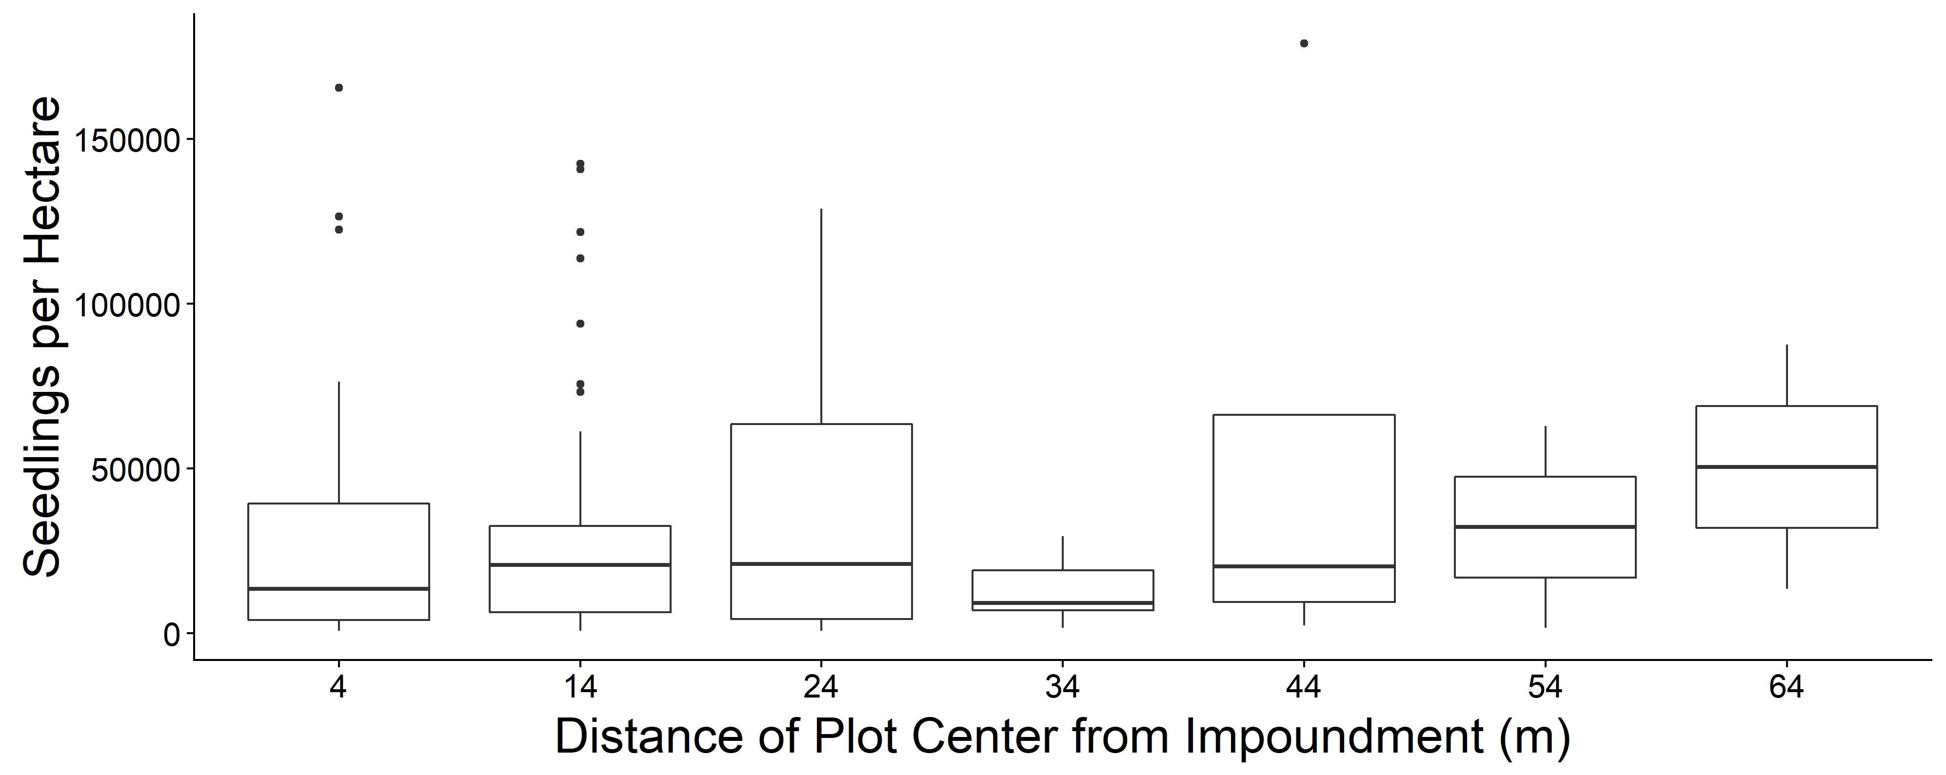
Seedling density increased with distance…

Slide 21
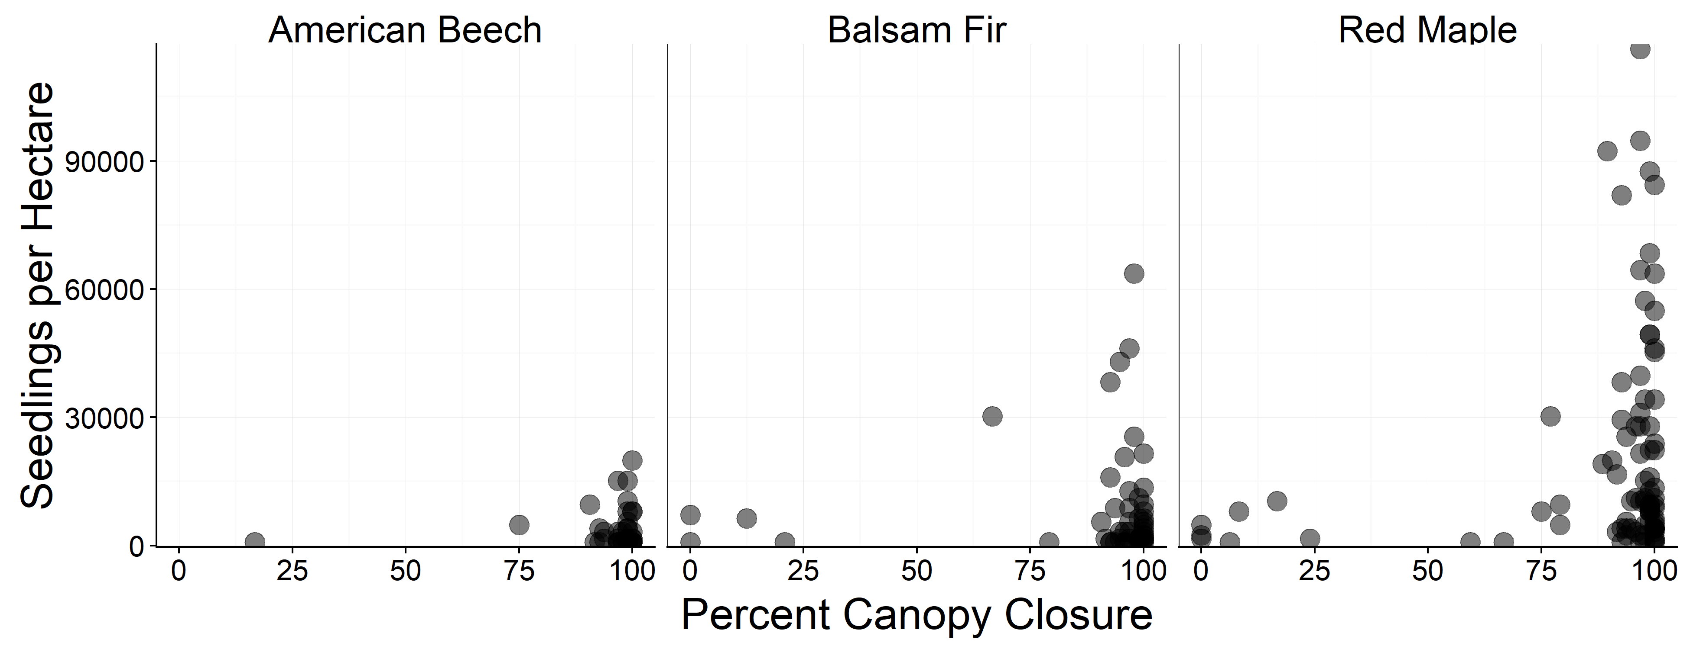
…correlating with canopy closure.

Slide 22
Conclusions
Beaver prefer stems that are smaller, closer, of preferred species
Foraging and flooding have large effects on riparian community
Similar patterns (though not identical) in Northeast as other regions

Slide 23
Importance & future work:
Beaver populations going to increase
Conflicts between beavers and humans going to increase
Management challenges – and opportunities – going to increase!

Slide 24
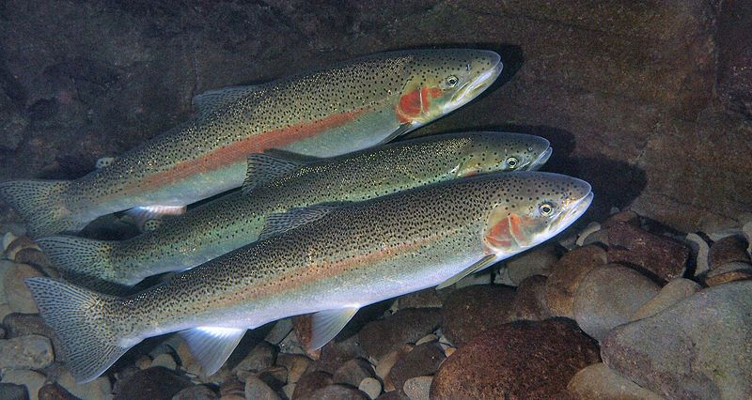
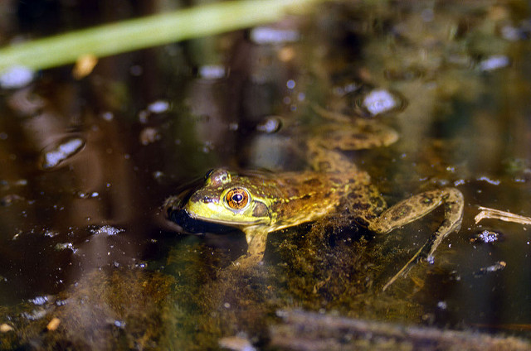
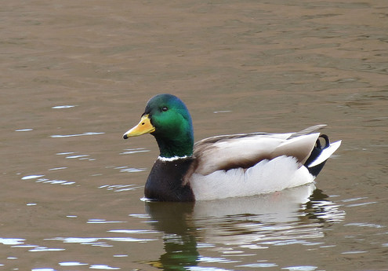
Notes:
Steelhead (like impounded areas, nutrients), mink frog (climate refuge), mallard (increase in benthic macroinvert assemblages make marginal environments more productive)

Slide 25
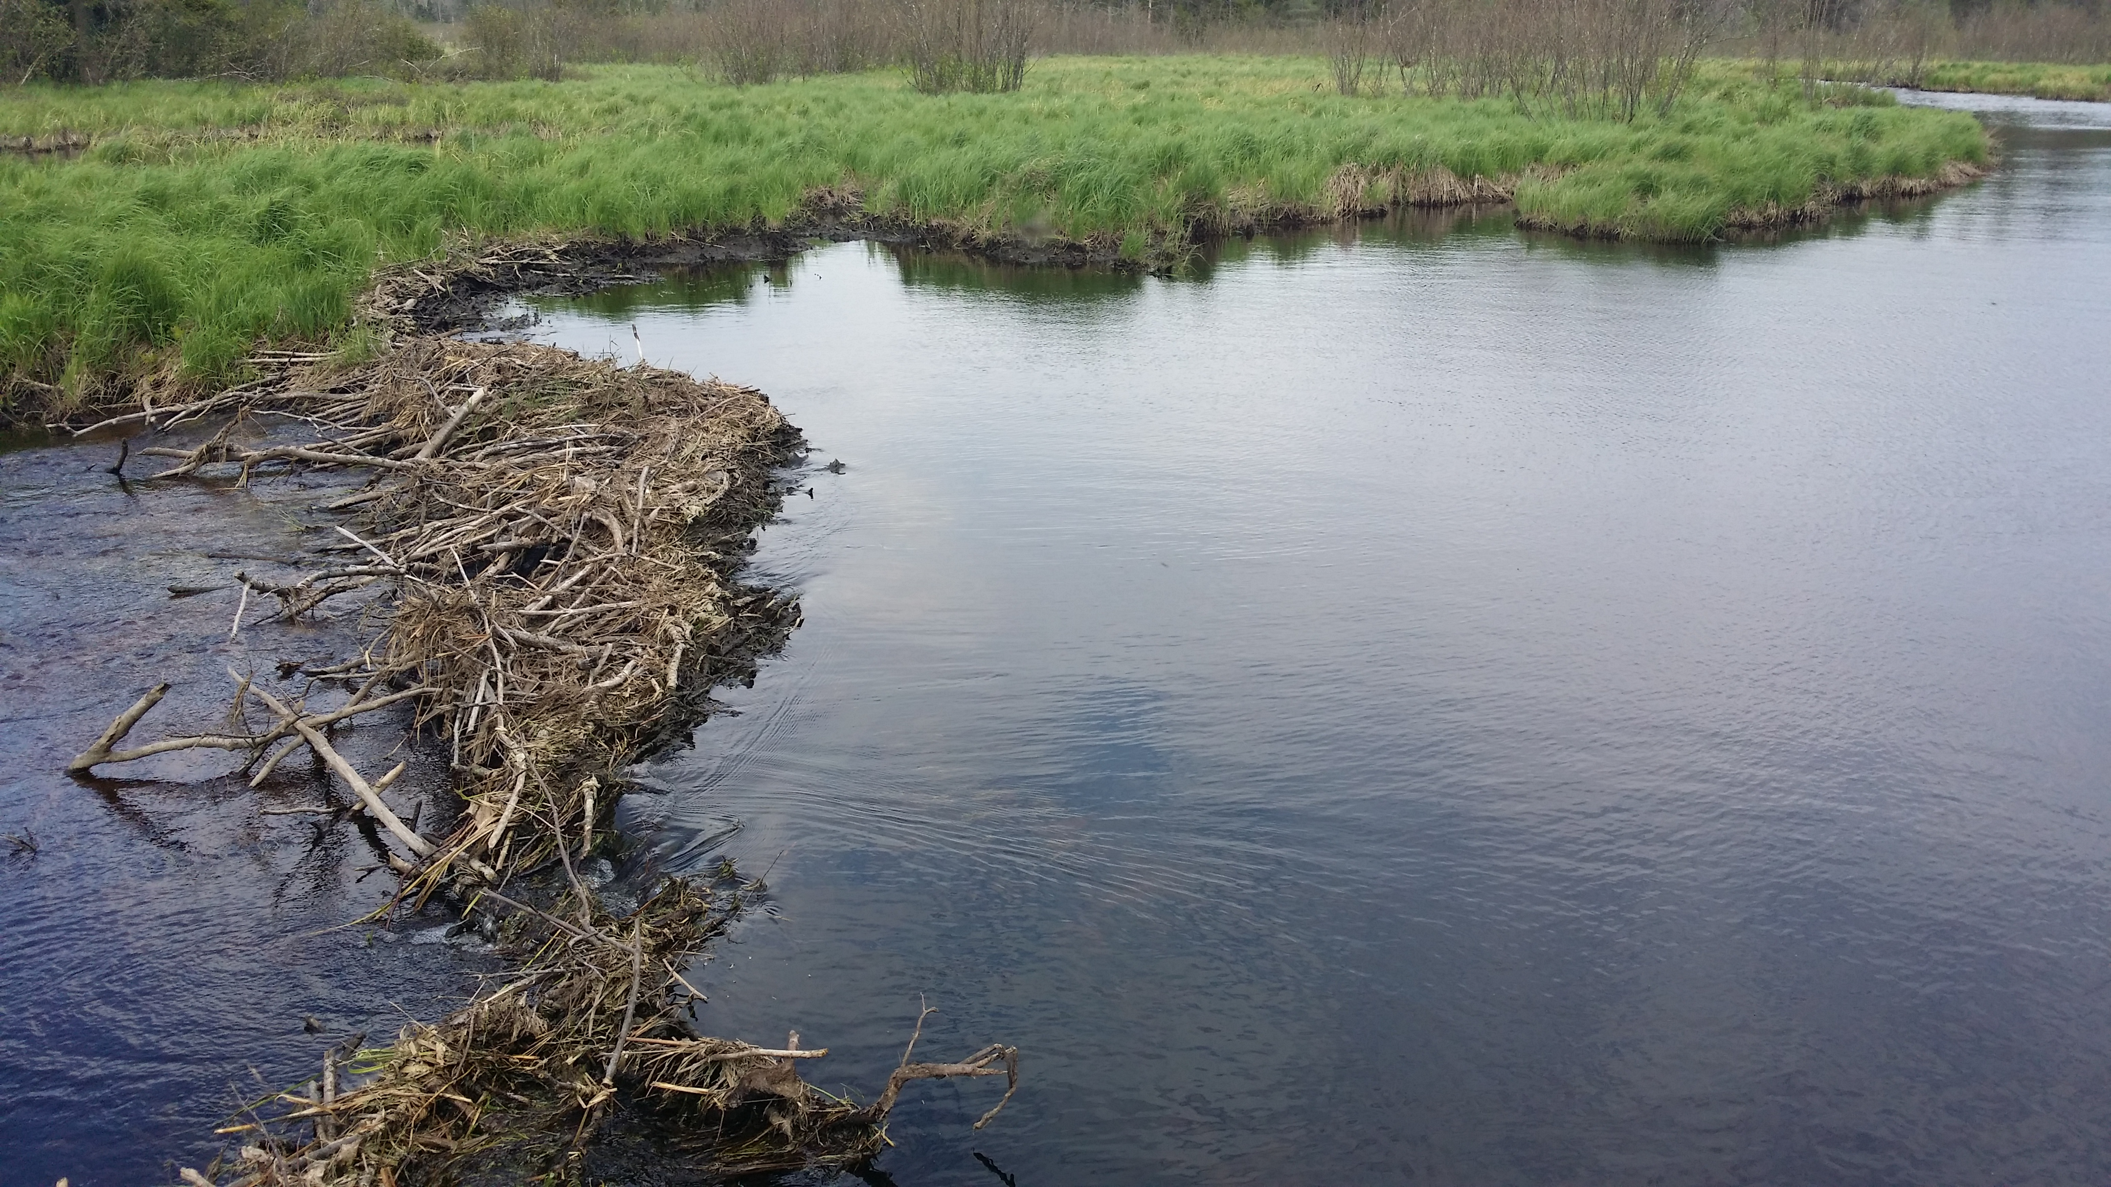
Thank you!
Thanks to:
Rachel Zevin
Anna Harrison
New York State Department of Environmental Conservation
Photo credits:
“Happy Beaver”. Steve Hersey, 2007. Retrieved from https://www.flickr.com/photos/31563480@N00/2452702213/ October 3, 2018. CC-BY-SA
“Range”. Scott E. Hygnstrom, 2009. Retrieved from http://icwdm.org/handbook/rodents/beavers.asp October 30, 2018.
“Steelhead”. Oregon State University, 2016. Retrieved from https://www.flickr.com/photos/oregonstateuniversity/24354769644/ October 3, 2018. CC-BY-SA
“Rana septrionalis (mink frog)”. Alan Wolf, 1995. Retrieved from https://www.flickr.com/photos/alumroot/32751405 October 3, 2018. CC-NC-BY
“Mallard”. Katja Schulz, 2016. Retrieved from https://www.flickr.com/photos/treegrow/25338328581/ October 3, 2018. CC-BY

Slide 26
List of Slides
Title
About beavers
Historic Range
Photo: impoundment
Photo: burst dam
Foraging Behavior
Photo: ADK Forest
Research questions
Site map
Site image
Forage area
Transects
Measurements
Distance selectivity
Size selectivity
Deciduous and coniferous
Group models
Species models
Canopy closure
Seedlings and distance
Seedlings and canopy cover
Conclusions
Importance
Photos: importance
Acknowledgements
List of slides

