Slide 1
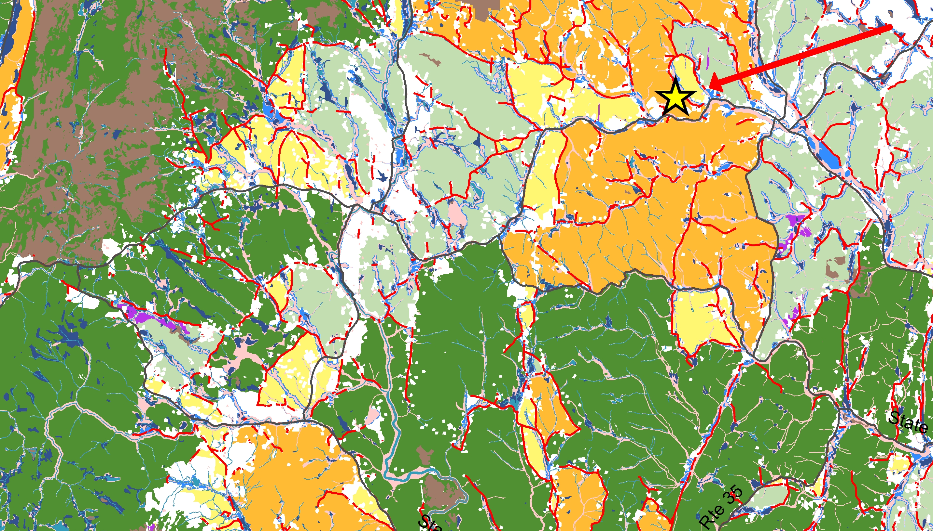
Bringing “Vermont Conservation Design” to Private Landowners
Carolyn Loeb, M.S. Candidate in the Field Naturalist Program at the University of Vermont

Slide 2
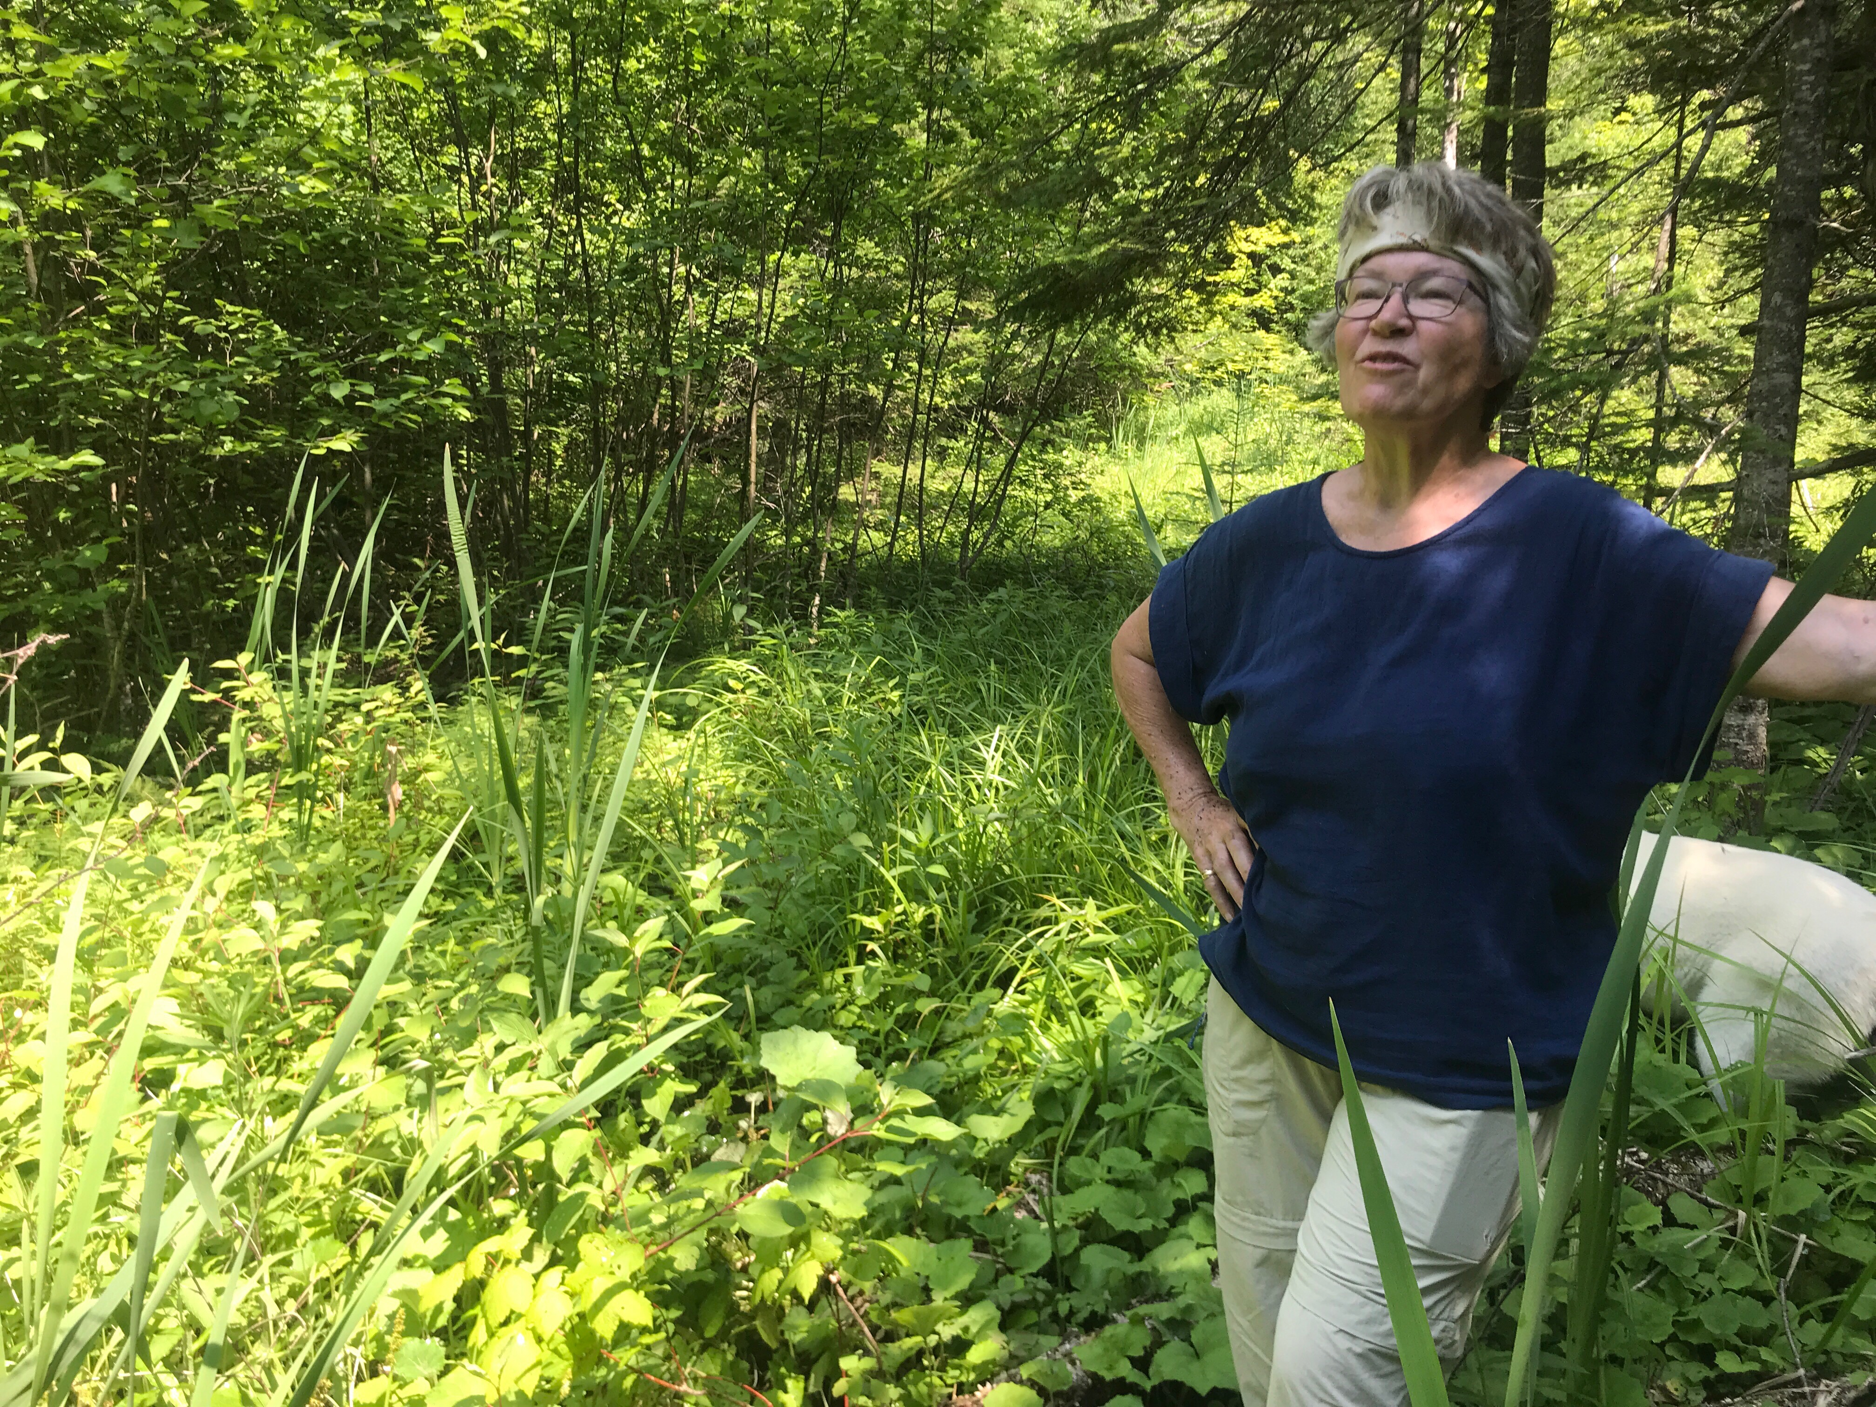

Slide 3
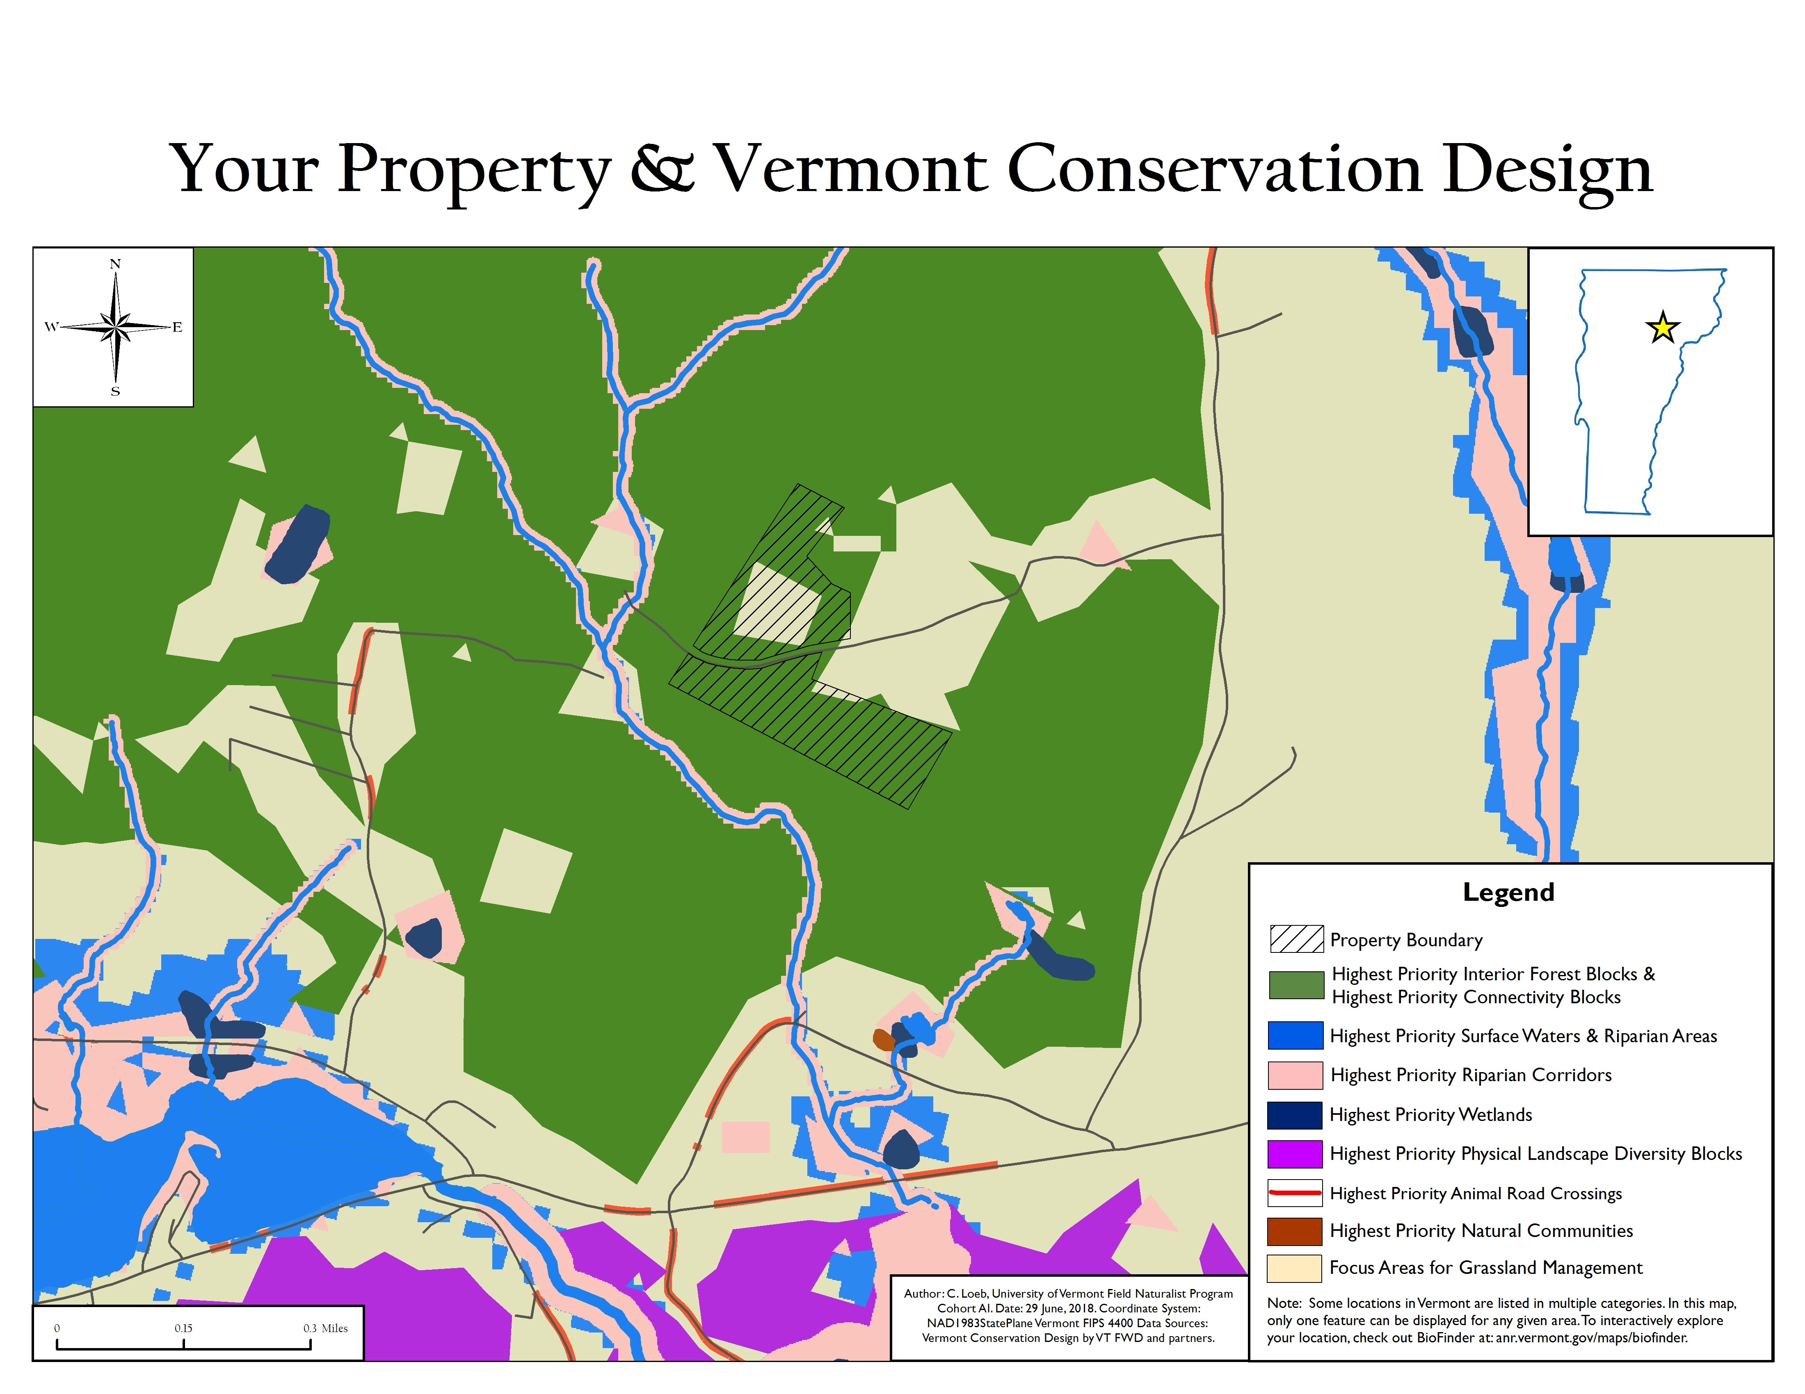
Your Property and “Vermont Conservation Design”

Slide 4
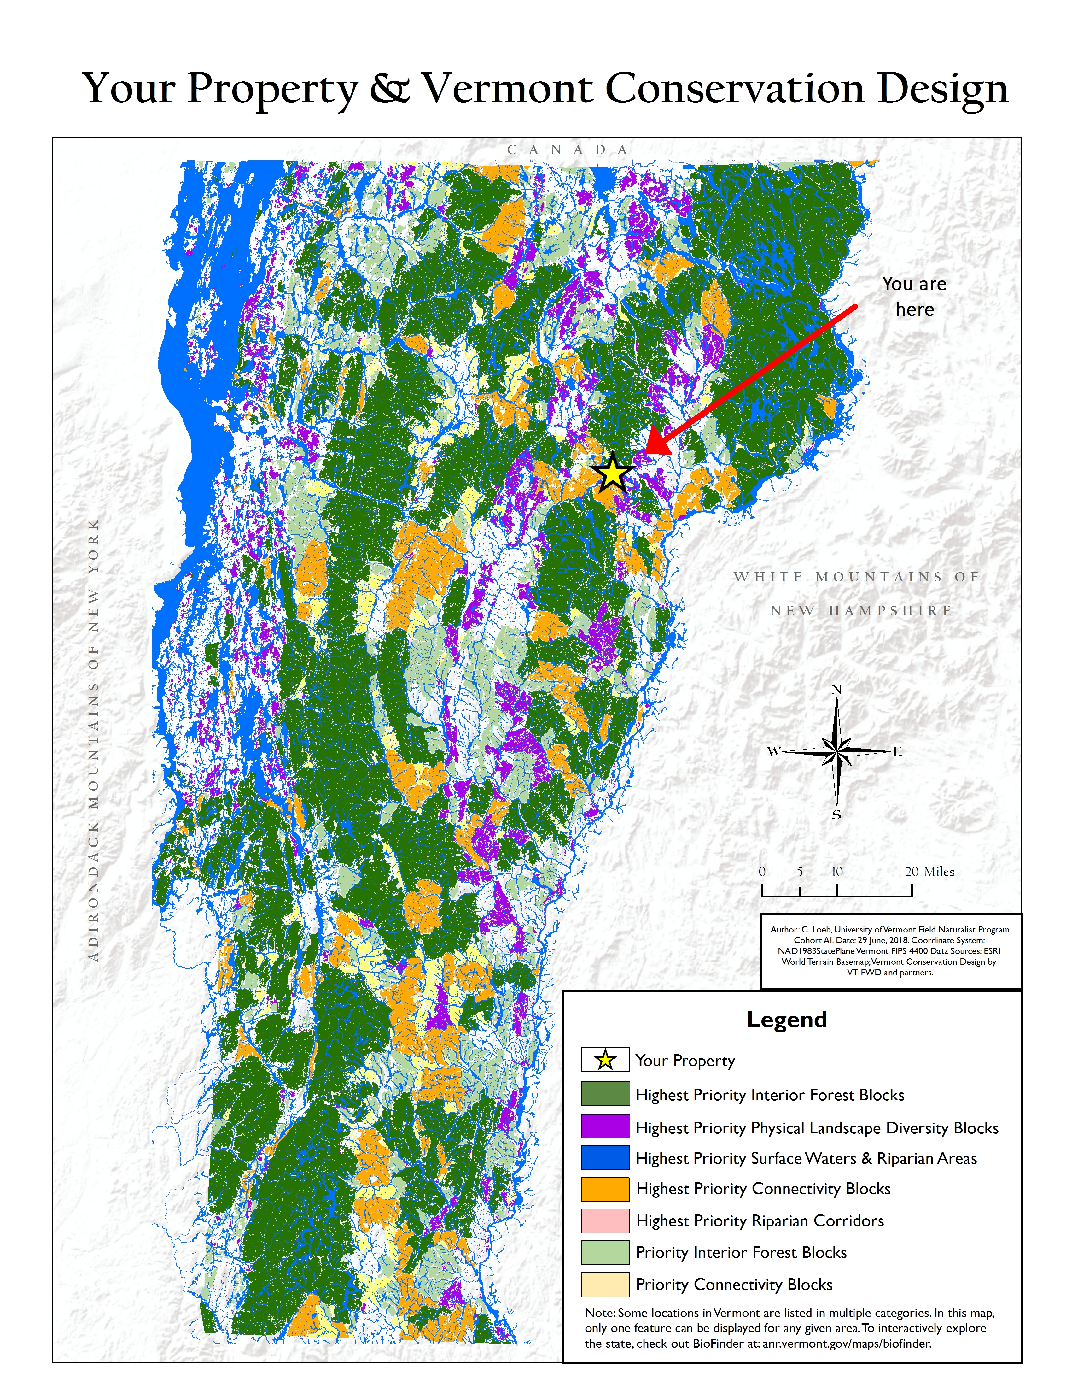
Your Property and “Vermont Conservation Design”

Slide 5
Landowners Weigh In…
All respondents (10/10) said they understood the basic concept of the “Vermont Conservation Design” either moderately well or very well
Half of all respondents said they were very likely to modify their management plans after seeing the design’s maps of their property in 5+ years; the other half said they were slightly to moderately likely to do so

Slide 6
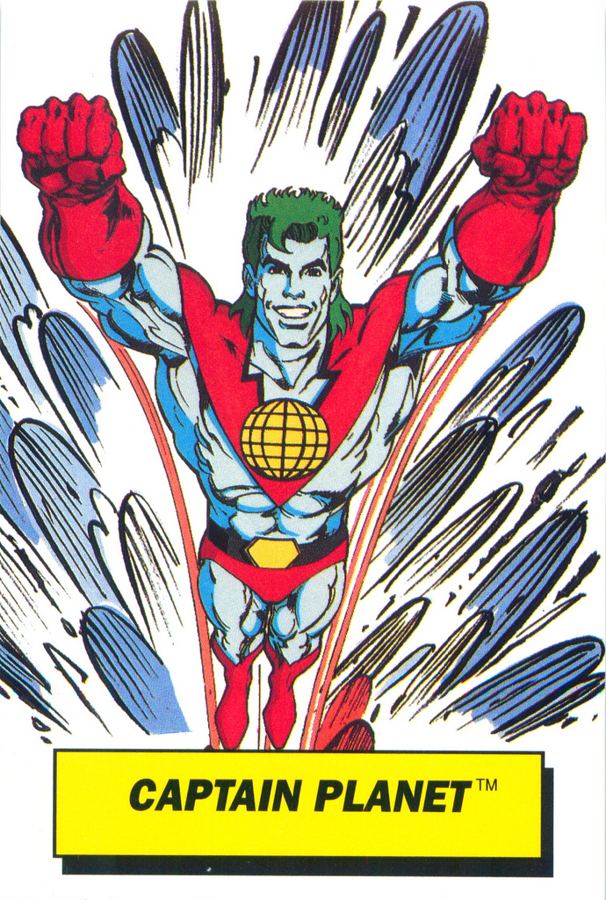
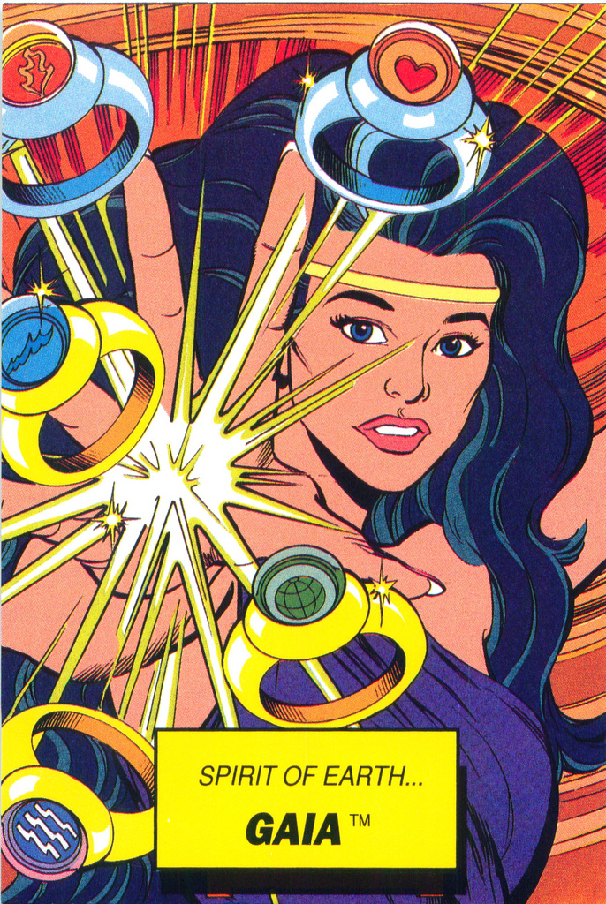
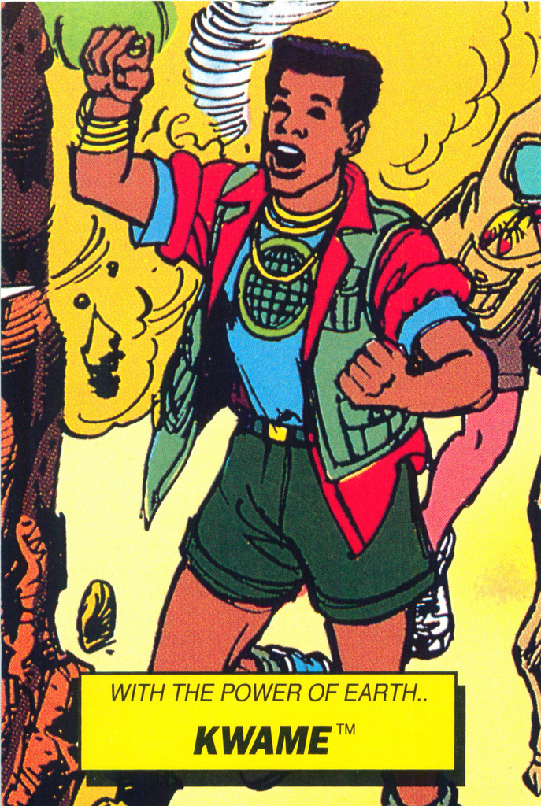
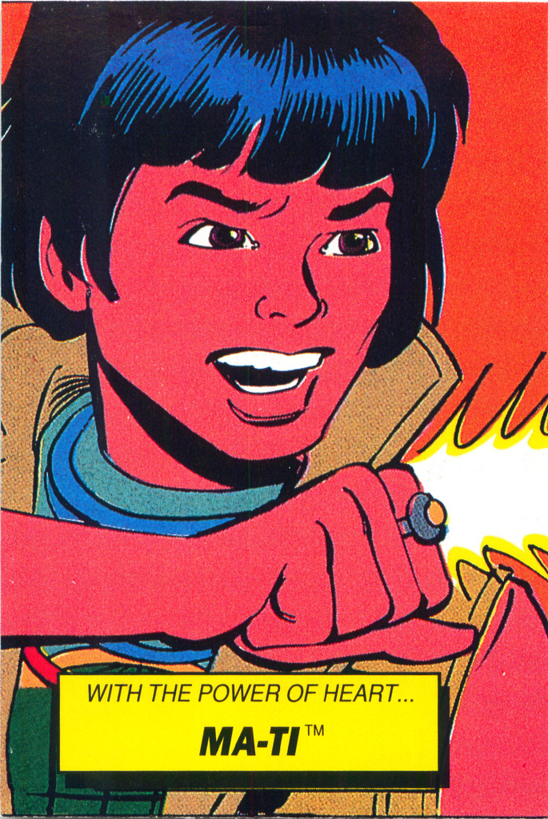
So Now What?
Captain Planet Dunkin’ Donut Cards by Mark Anderson at https://www.flickr.com/people/andertoons-cartoons, CC2.0 licensed

Slide 7
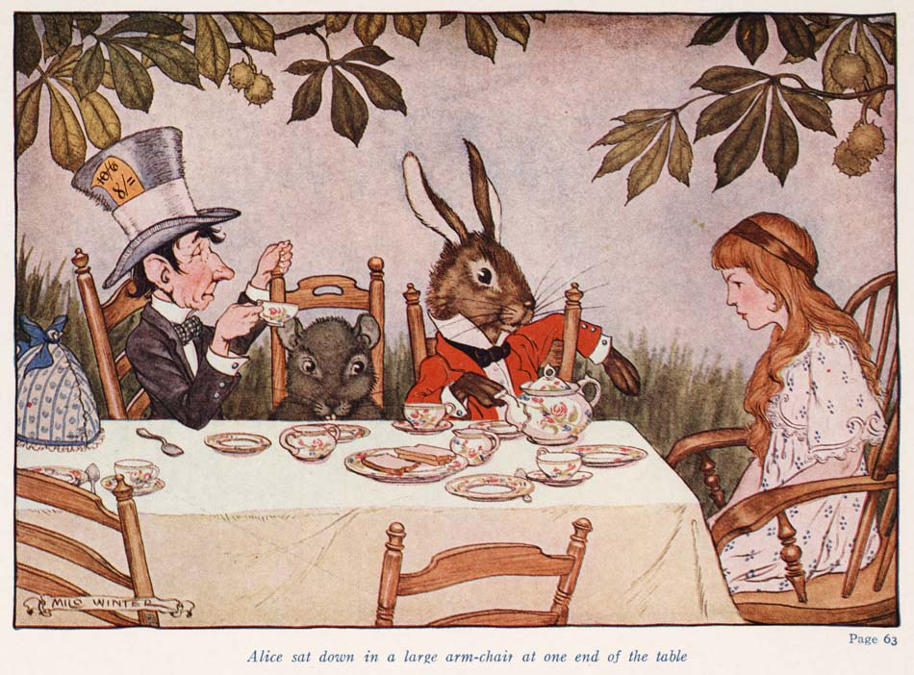
Challenges & Strategies
Be a counselor!
  Have tea
  Keep it simple
  Use paper
  “Add on”
  Think about strategies for reaching people

Slide 8
80%

Slide 9
2/3^{rds}

Slide 10
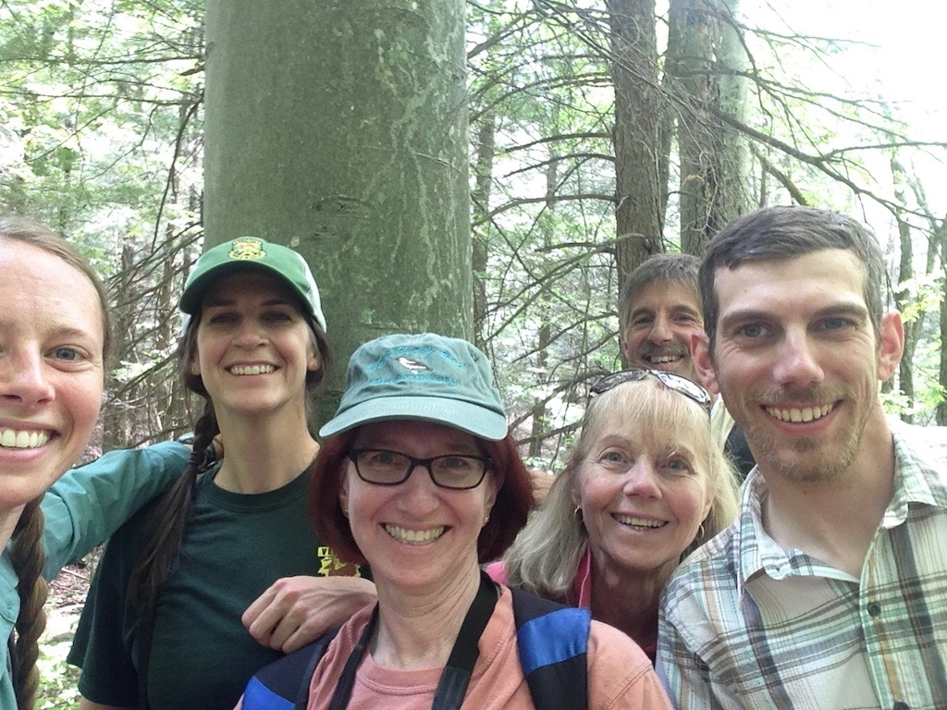
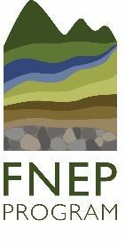


A Special Thanks To:
Project Sponsors
Vermont Fish & Wildlife Department
Bob Zaino, Eric Sorenson, Kim Royar,
& Andrea Shortsleeve
Vermont Coverts
Lisa Sausville, Blair Brooks, the Coverts Board, and all Cooperators who took part in the pilot
UVM Graduate Committee Members
Dr. Jeffrey Hughes
Dr. Tony D’Amato
Dr. Kris Stepenuck
Dr. Liz Thompson
Field Naturalists & Ecological Planners past and present and friends of the FNEP program

Slide 11
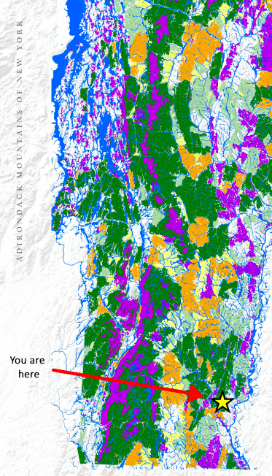
Any questions?

