Slide 1

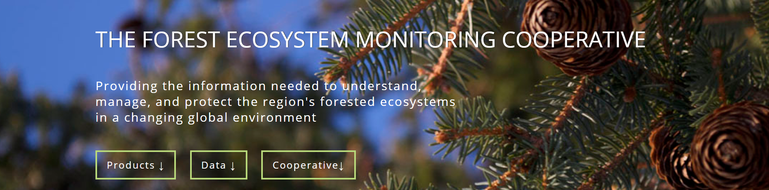
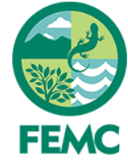
Staying relevant: a cooperatively-designed online database to house natural resource survey data collected by citizen scientists
Jason Hill, Mike Finnegan, Jim Duncan
Notes:
Outline the talk

Slide 2
Growth of citizen science as a data-gathering tool
(Follett and Strezov 2015)
Notes:
Citizen science (also known as community and citizen science) is the partnerships between scientists and non‐scientists in which authentic data are collected, shared, and analyzed. Citizen science has emerged as a global phenomenon and tool, not without criticism, to conduct ecological research at unprecedented scales, and citizen scientist projects have correspondingly grown in scope and geographic scale. Don’t worry about the colors, but here you see peer-reviewed publications that used data collected by citizen scientist. At the moment, this is clearly exponential growth.

Slide 3
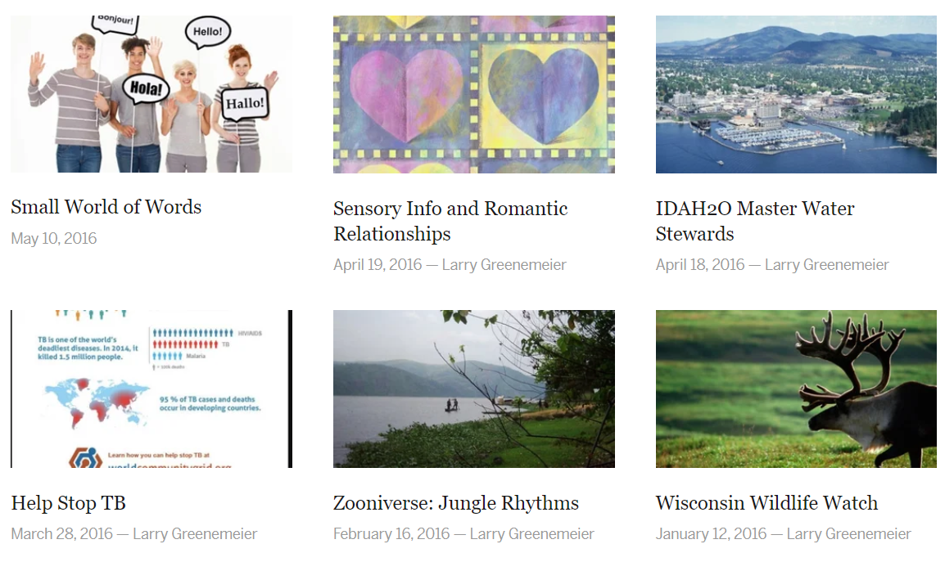
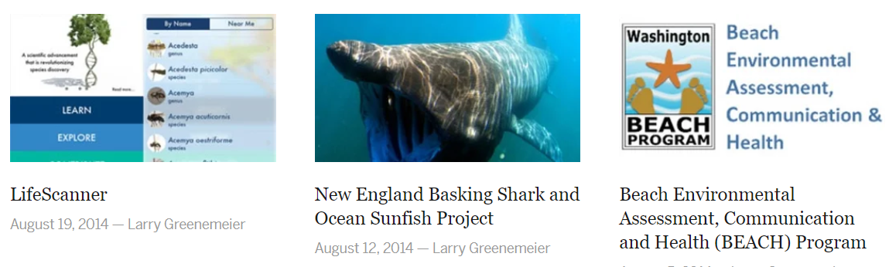
Growth of citizen science as a data-gathering tool
(Follett and Strezov 2015)
Notes:
A primary factor driving the growth of citizen science is the increasing realization among professional scientists that the public represent a voluntary source of labor, skills, computational power and even finance. And correspondingly, there are literally 1000s of citizen science projects out there all vying for your attention. Ranging from projects that ask you to record the most intimate details of your love life and reproductive cycles to submitting observations of wildlife to categorizing photographs of galaxies by their shape. But the larger point is, that many volunteers have had experience with multiple citizen science projects, and they are judging and comparing your project to others they have worked on, to determine which projects will get a slice of their time.
It’s easy to view this as a form of competition between projects. There are, for example, dozens of projects that ask you to submit photographs of wildlife for identification.

Slide 4
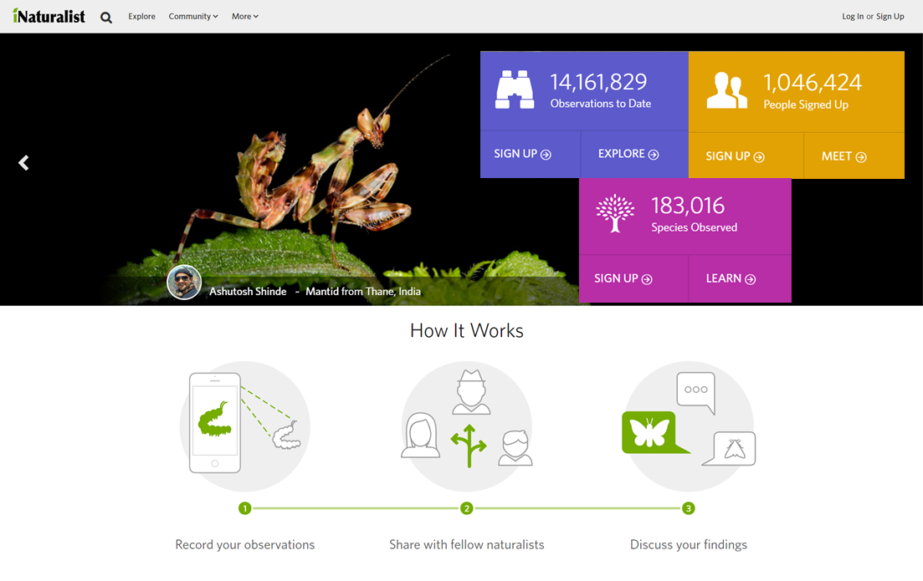
iNaturalist as a (highly) successful model
Notes:
And the iNaturalist citizen science program probably does it better than anyone else. It is a global phenomenon which grew out of a Master's project in California in 2008 and now includes >1 million observers around the world. It has almost everything you’d want in a citizen science project. It’s social, intuitive and easy-to-use, all of the data are freely available to download, and it has some great tools for the volunteers (like great interactive maps and it’s basically a free photo-identification tool). Now, iNaturalist has a huge team of taxonomic and computational and programming resources behind it, and it’s backed by National Geographic and the California Academy of Natural Sciences.

Slide 5
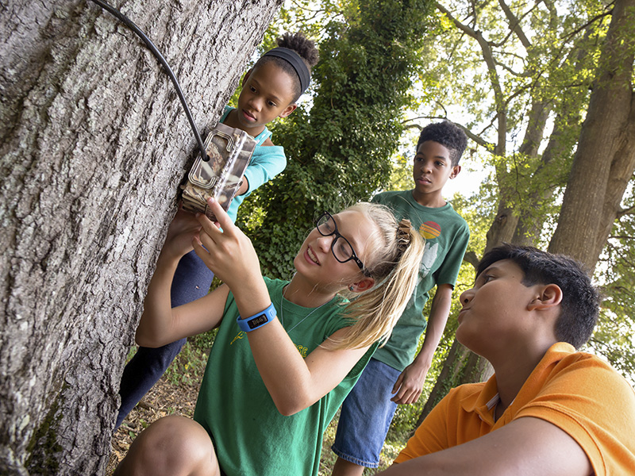
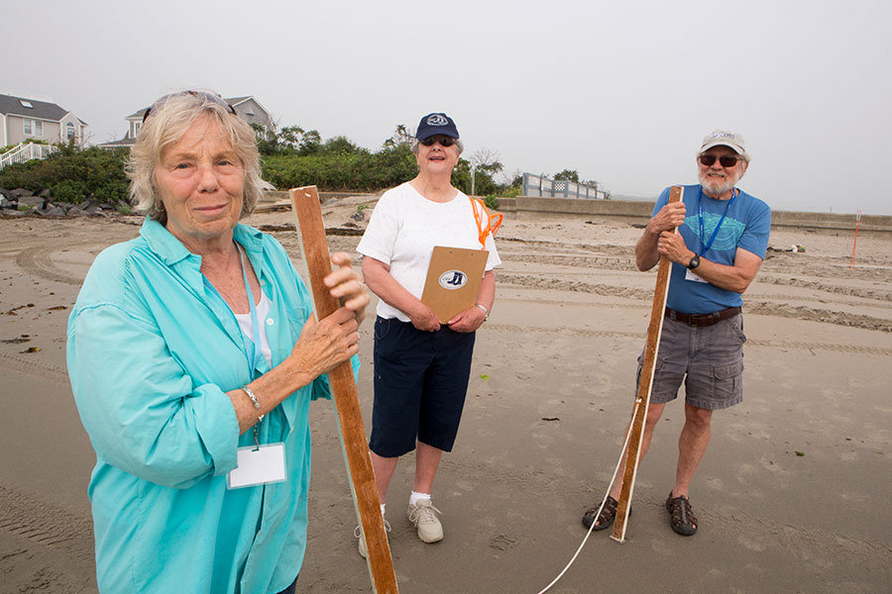
Simple or sophisticated…just don’t get in the way
© eMammal
© Coastal Research Volunteers
Notes:
Now, I’m not saying that you have to be as sophisticated as iNaturalist or eBird, and that certainly isn’t my goal. Just don’t get in the way of their enthusiasm. You can thrive with far less sophisticated tools, and you can get by with poorly-designed tools. The more intrinsically motivated your volunteers are the more they will put up with convoluted protocols, a messy and confusing data entry process, and collecting data for dead-end projects: projects that collect data, but never actually do anything meaningful with those data.
In a recent study of volunteer interaction with online tools, volunteers identified "format" and "professional appearance" of the tools as having the greatest effect on their decision to use them. What? So now we have to have good science and good-looking science? Yes.

Slide 6
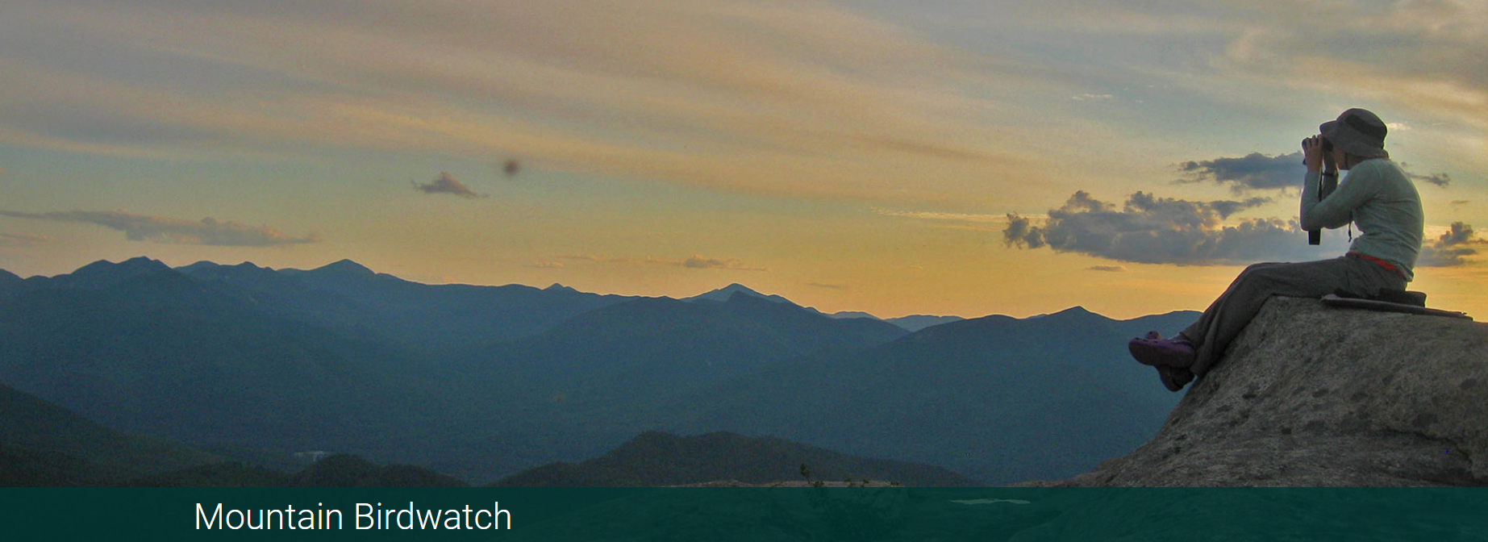
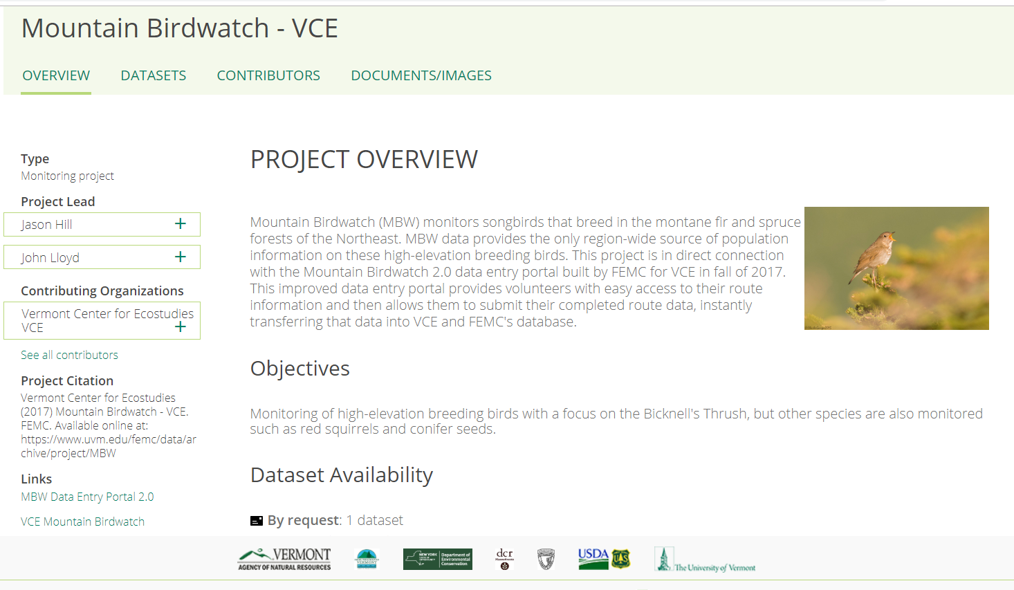
Mountain Birdwatch
Notes:
All of these thoughts were fresh on our mind last year when we all sat down to think about the citizen science project that I coordinate: Mountain Birdwatch. And I want to tell you about our motivations for creating change and to show you what we came up with, but first I think it would be helpful if I introduced the project to you, especially in case you’re looking for a citizen science opportunity for yourself.
Started in 2000, Mountain Birdwatch is an initiative by the Vermont Center for Ecostudies to engage hikers and wildlife enthusiasts, and to harness the power of the public to conduct wildlife monitoring across northern New England and eastern New York.

Slide 7
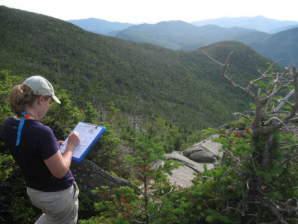
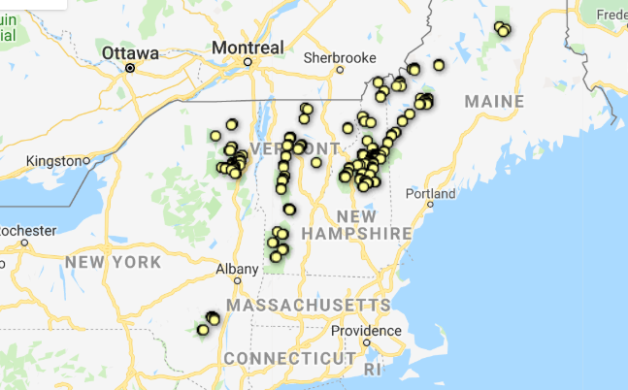
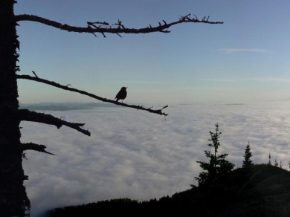
Mountain Birdwatch
(747 sampling stations)
© Kent McFarland
(125 survey routes, ~750 sampling stations)
Notes:
Each year, volunteers adopt one of the 125 long-term survey routes located along hiking trails in the spruce-fir zone. Each route consists of 3-6 sampling points, where observers conduct repeated point counts for 10 bird species on any day in June each year starting at ~4:30 am (so they hike in and camp). The dispersed and rural geographic scale and physicality of the project create substantial challenges to recruiting volunteers. Nevertheless, each year between 70 and 100 citizen scientists participate. Since 2010 alone, volunteers have conducted >20,000 point counts. Last year our volunteers collectively drove >15,000 miles and contributed ~1,900 hours to the project.

Slide 8
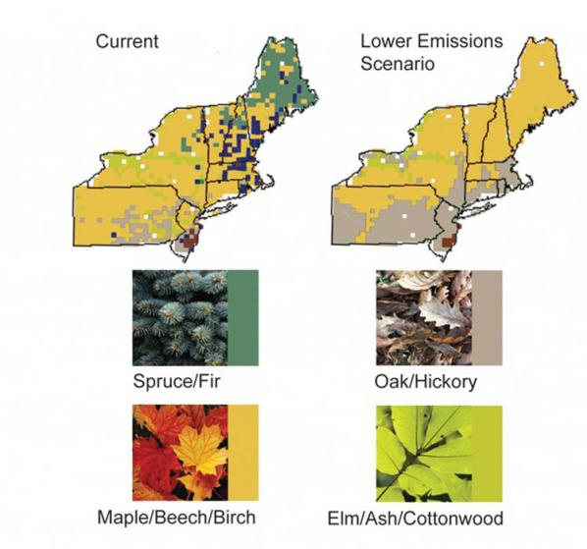
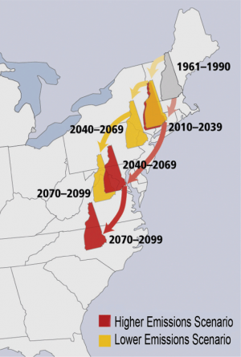
Motivation for monitoring
Union of Concerned Scientists
Iverson et al. 2008
Wang et al. 2016
Notes:
This year we’ll be surveying our volunteers about their motivation for participating, but I suspect that many of our volunteers are already hikers and birders and have concerns about climate change.

Slide 9
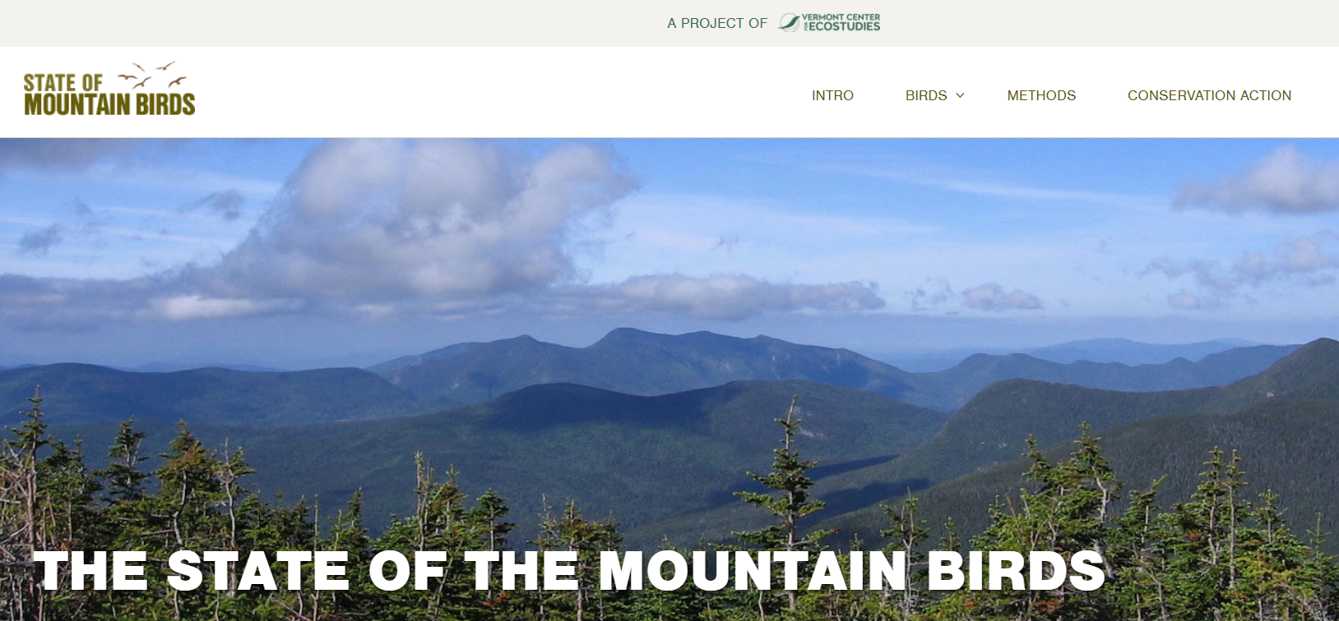
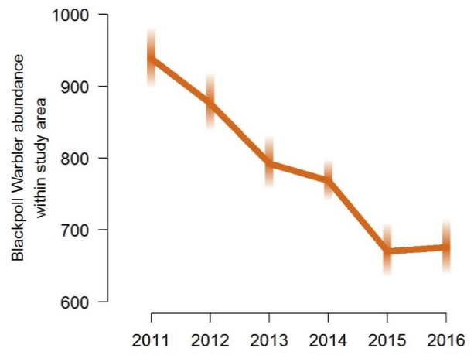
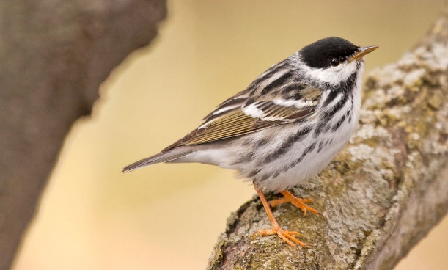
Yellow-bellied Flycatcher
Bicknell’s Thrush
Hermit Thrush
Swainson’s Thrush
Boreal Chickadee
Black-capped Chickadee
Winter Wren
Blackpoll Warbler
White-throated Sparrow
Fox Sparrow
(Red Squirrel)
Bryan Pfeiffer
Notes:
Data are analyzed annually using cutting edge statistical models in a Bayesian framework, and the results are shared on our website. Mountain Birdwatch data are deposited annually in the KNB Data Repository and eBird. Anyone can fully download the raw data. And this year, I’ll be building some interactive graphics with R Shiny.

Slide 10
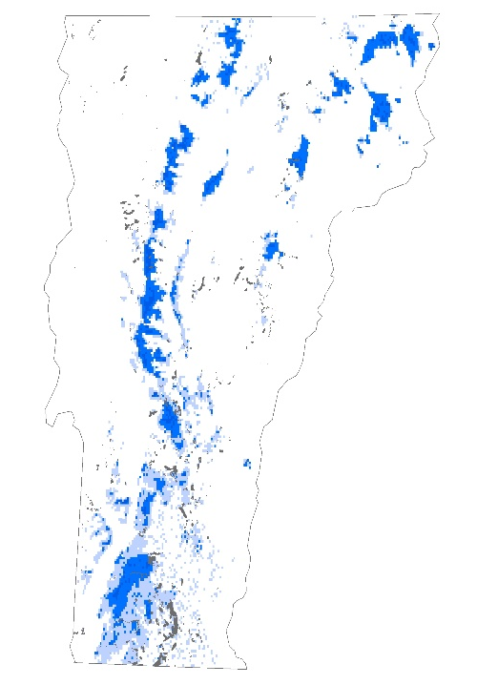
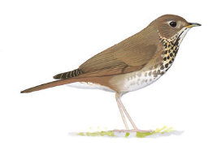
Data outputs
Katahdin, Maine
Bicknell’s Thrush fine-scale population estimation
(Hill & Lloyd 2017)
Blackpoll Warbler & wind energy development
© David Sibley
Notes:
We use these data for diverse purposes, from generating population estimates of Bicknell’s Thrush to identifying potential areas of conflict between Blackpoll Warblers and wind energy developments. We publish with these data using cutting-edge sophisticated models, and quite frankly…

Slide 11
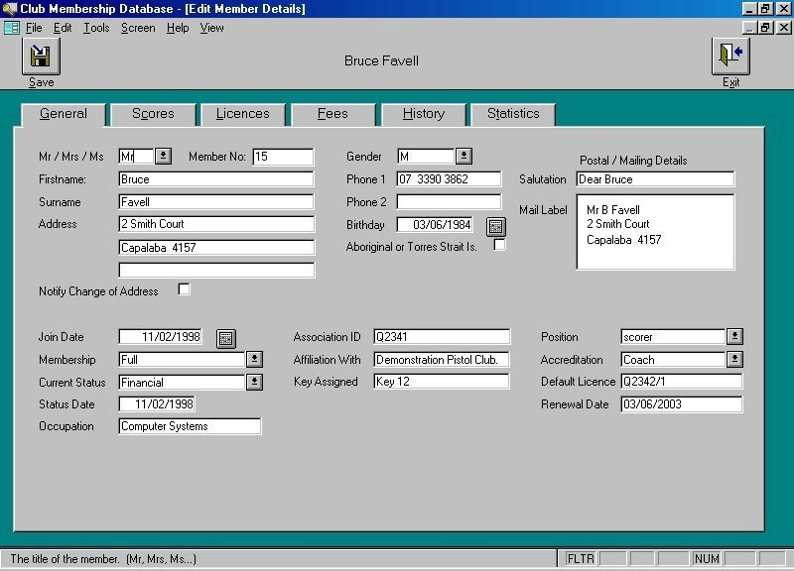
Out with the old…database
Notes:
Our former online data entry portal (which looked like this), didn’t convey that sophistication. But more importantly, it was confusing and cumbersome, written in a proprietary language that only the programmer could speak, and created a lot of frustration with our volunteers. Mountain Birdwatch had used the same online database (with few structural or cosmetic changes) for almost a decade, and the outdated appearance and limited functionality of the database likely stymied citizen scientist participation and lowered volunteer retention rates. It was very easy to make data entry mistakes, like put the survey date in the future or record seeing an impossibly large number of White-throated Sparrows. The size of the database (with a hundred thousand records) was also becoming large enough that became burdensome to efficiently store and retrieve those data. So we went from something like this to….

Slide 12
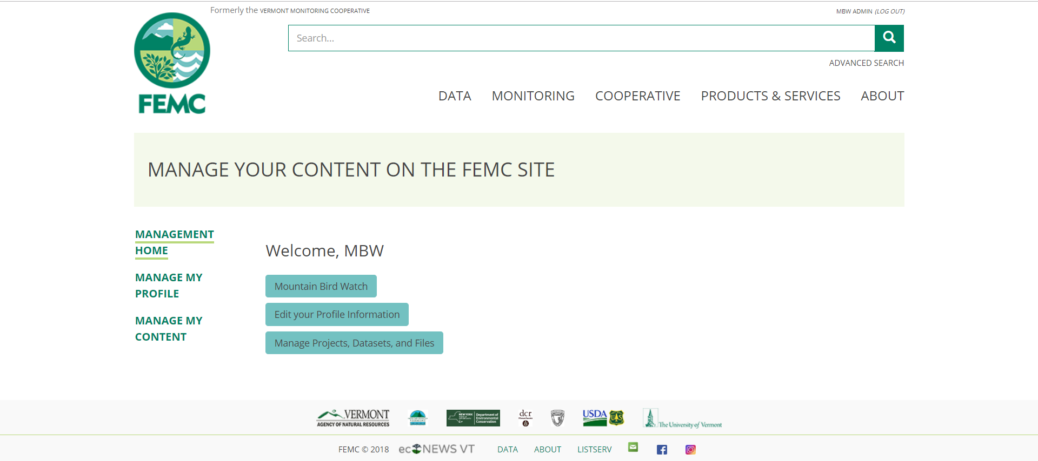
Out with the old…database
Notes:
This. This online database for volunteer data entry grew out of a series of conversations with Mike Finnegan and Jim Duncan at FEMC. It’s a flexible and adaptable online system, that is redundantly backed up. I’ll be walking you through the data entry portal; our volunteers never see or interact with the underlying database, which is what you want of course.

Slide 13
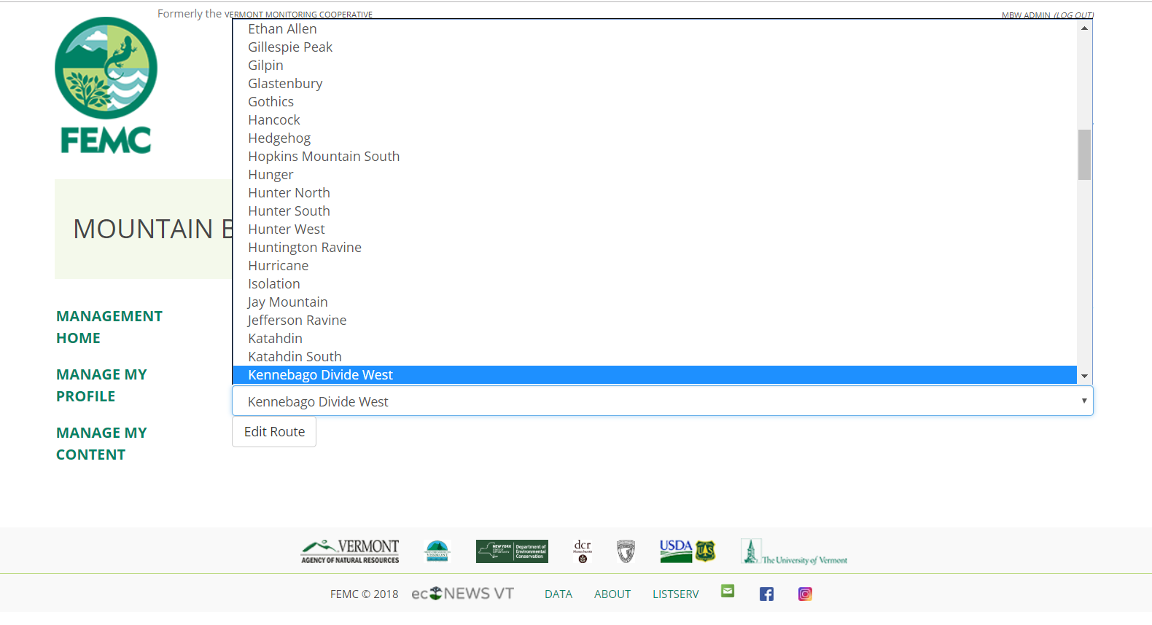
User-specific custom view

Slide 14
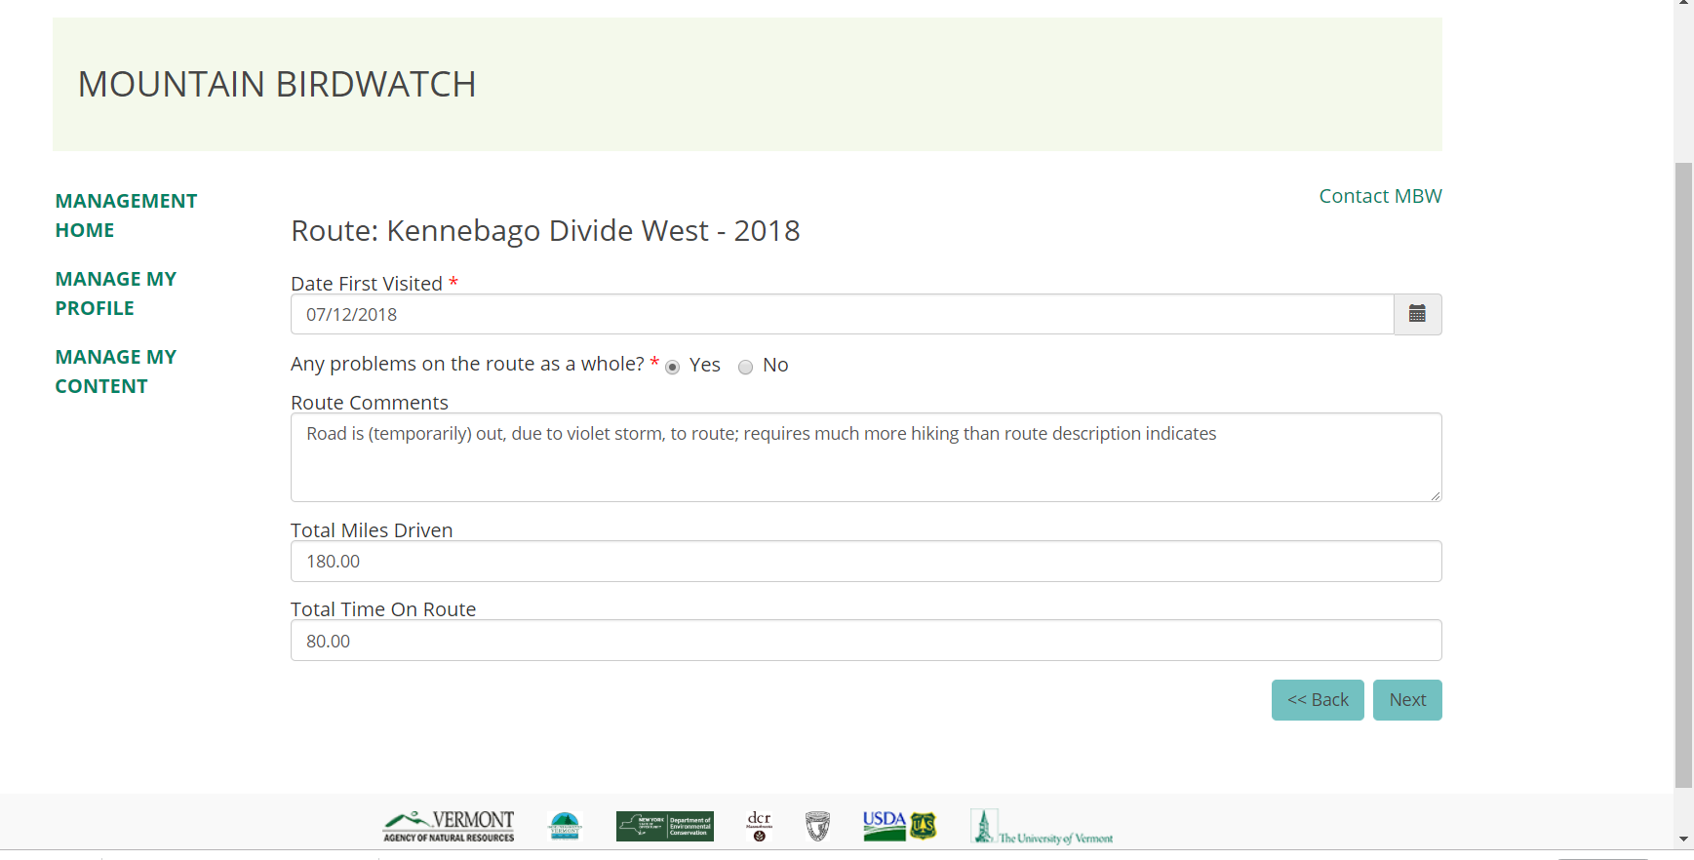
Flagging concerns for another look
Notes:
Users enter a lot of comments to the 1000s of point counts conducted each year—the vast majority of these are not relevant to the data analysis. So we needed a way to flag problems/concerns that users had to immediately draw our attention to it.

Slide 15
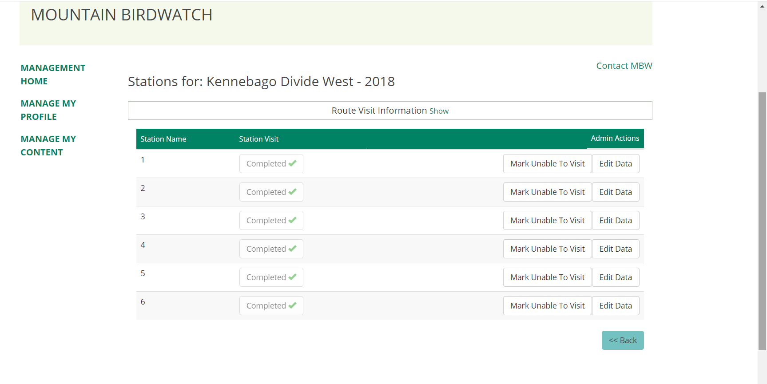
Simple non-complicated design

Slide 16
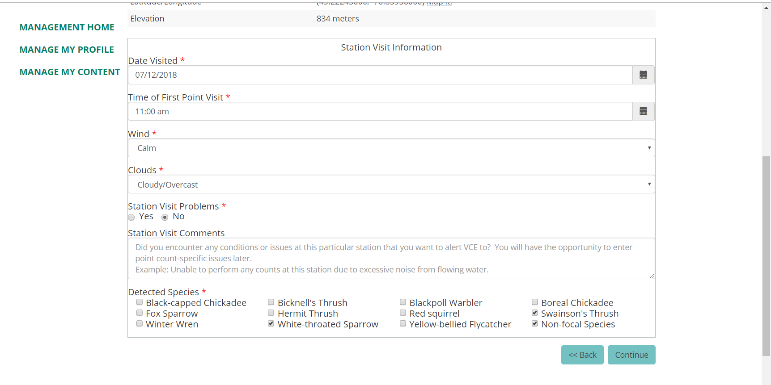
Straight forward data entry process

Slide 17
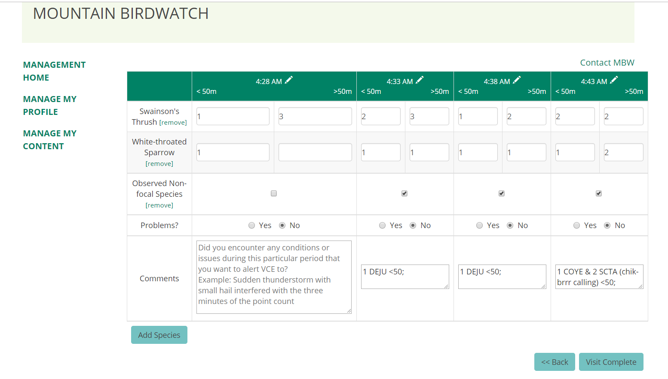
Minimizing opportunities for data entry mistakes

Slide 18
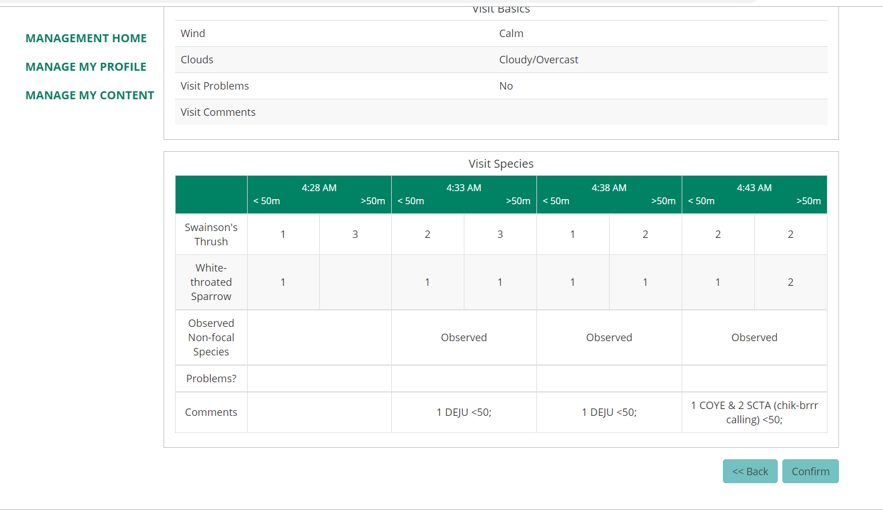
User error checks
Notes:
Data checking
Export in format for R analysis

Slide 19
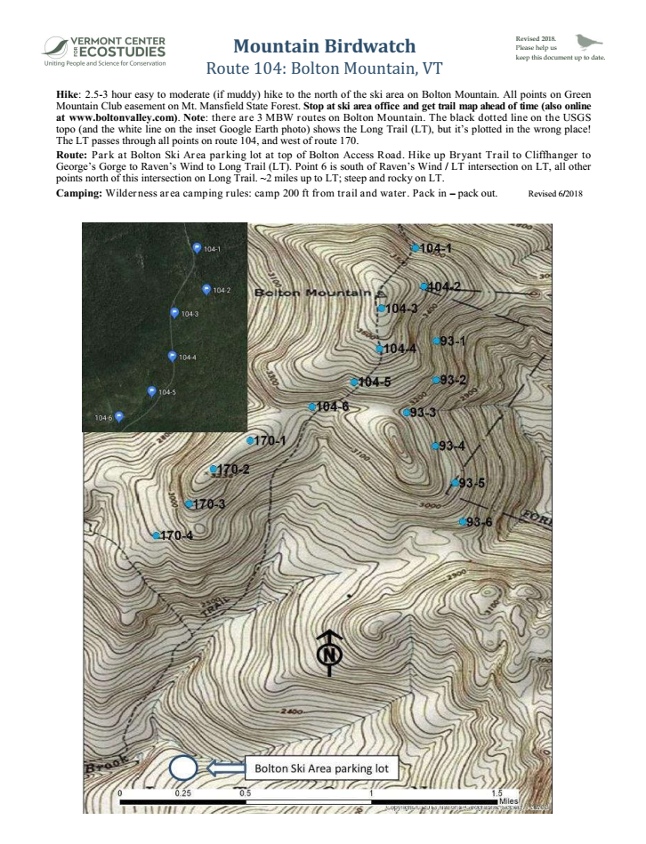
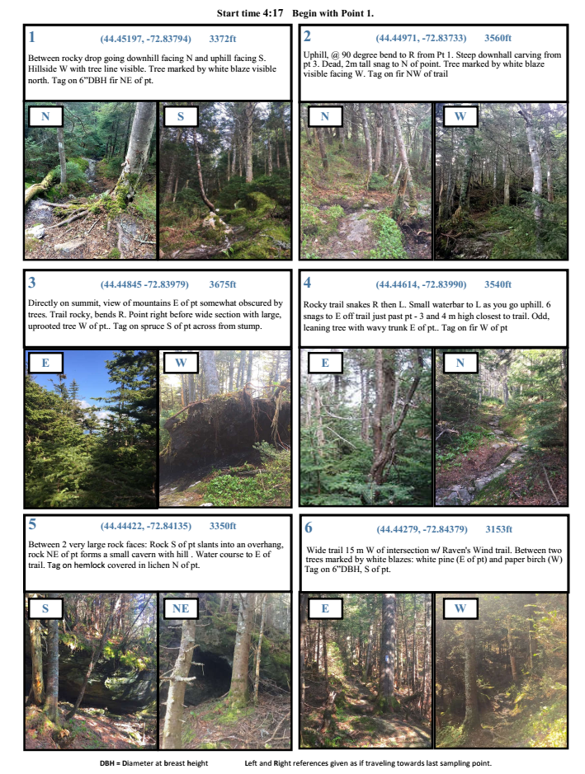
Future database additions
Pop up video help
Allow observers to directly suggest edits to their route documents and to upload new photos
Notes:
Collecting data on motivation of users, formal querying of what volunteers are learning

Slide 20
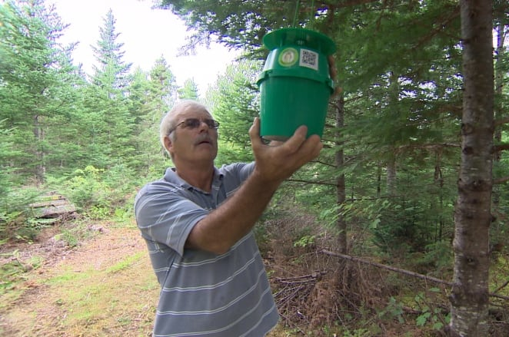
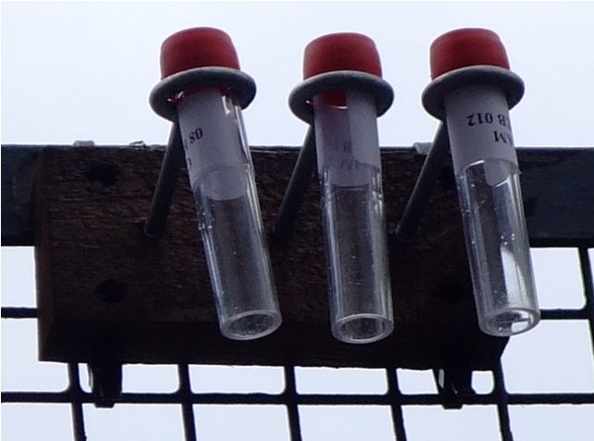
Mountain Birdwatch possible future expansion &
opportunities for collaboration
Insect monitoring
Atmospheric air pollution monitoring

Slide 21
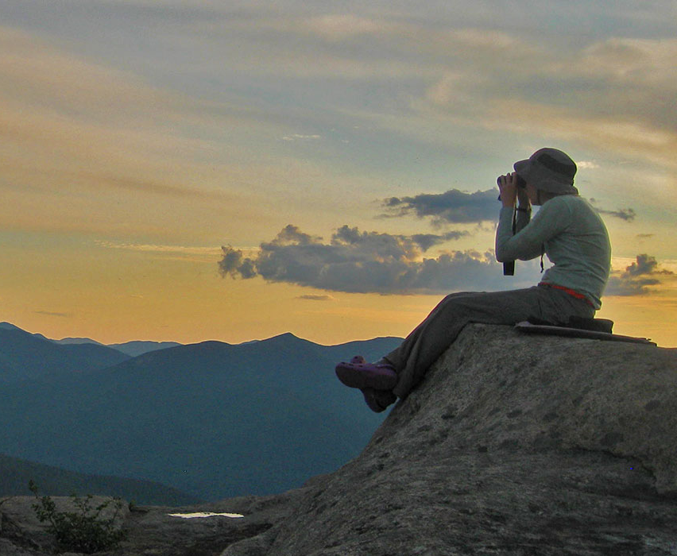

Contact me at jhill@vtecostudies.org
for data & collaboration
Funding generously provided: U.S. Fish and Wildlife Service Region 5, the National Fish and Wildlife Foundation, the National Park Service, the Canadian Wildlife Service, the Vermont Agency of Natural Resources, Plum Creek, the Cullman Foundation, the New York State Department of Environmental Conservation, and numerous private donors. Thank you to the ESRI Conservation GIS Program for software and support.
Thank you to the International Bicknell’s Thrush Conservation Group (IBTCG) for prioritizing MBW as a key conservation action.
Thank you all
Mountain Birdwatch
citizen scientists
Notes:
Thank you to all of the Mountain Birdwatch citizen scientists and funders who make our research possible.

