Slide 1
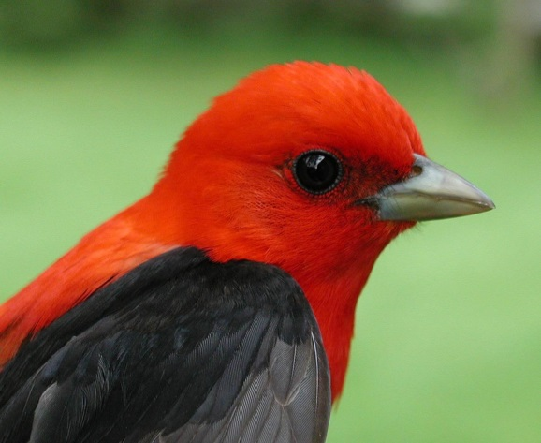
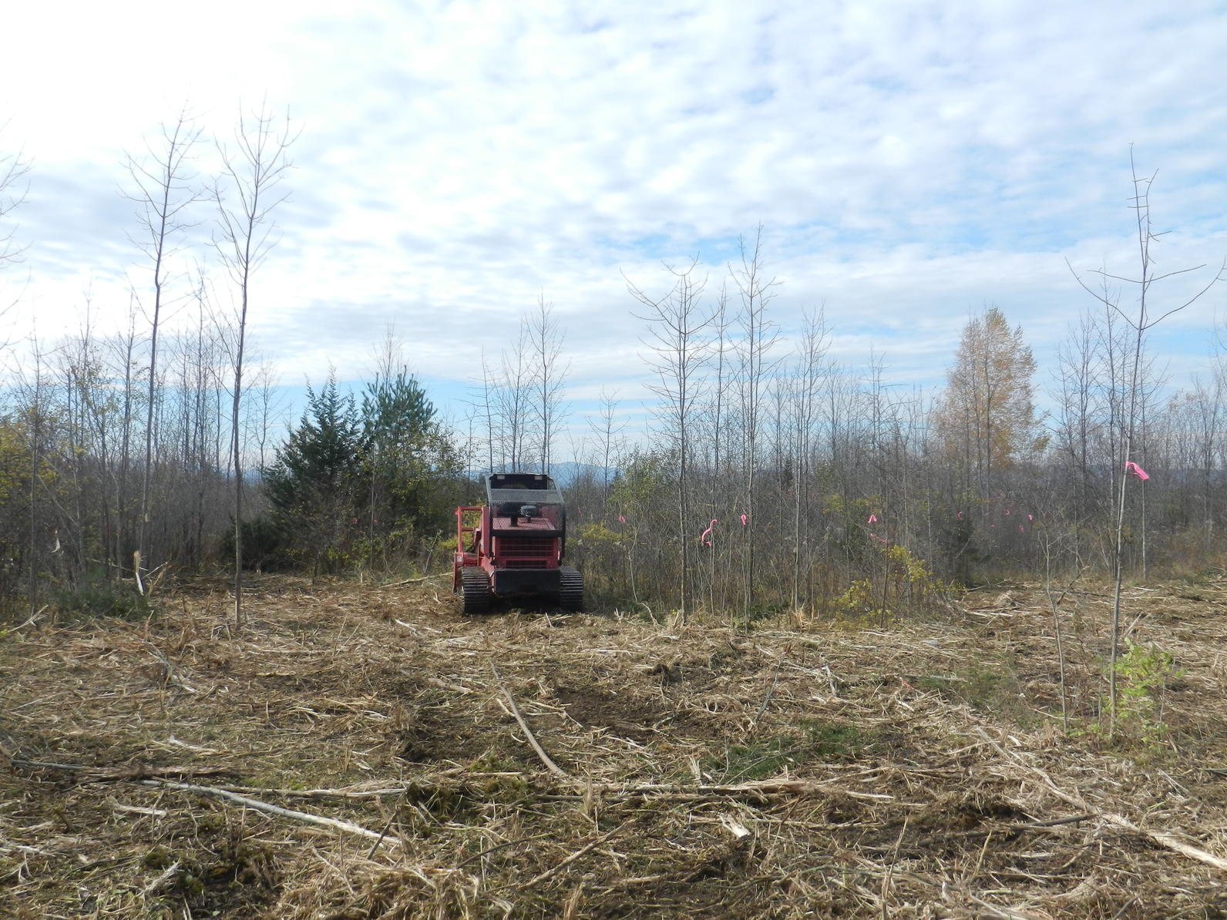
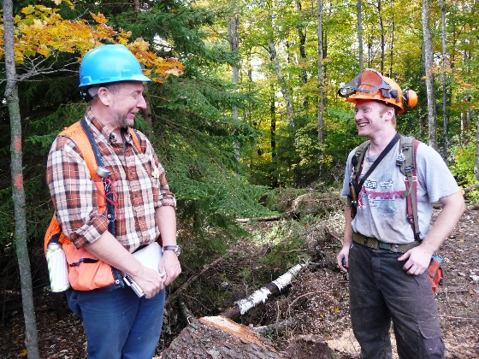
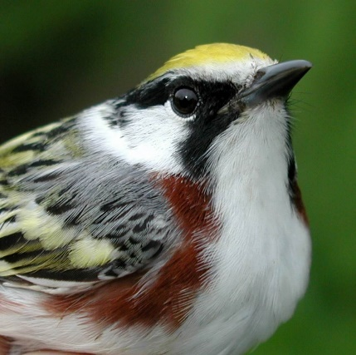

A NEW PARADIGM FOR FOREST BIRD CONSERVATION
A holistic approach to managing for multiple species guilds
2018 FEMC Conference

Slide 2
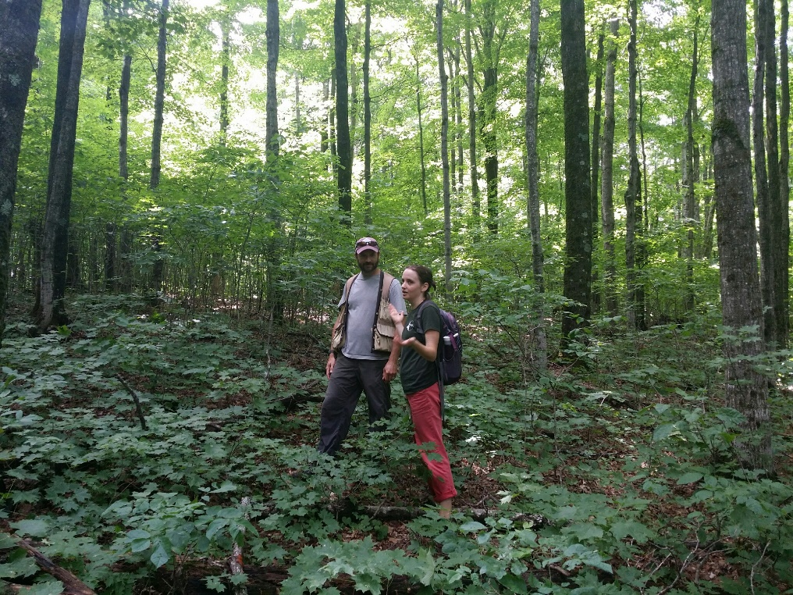
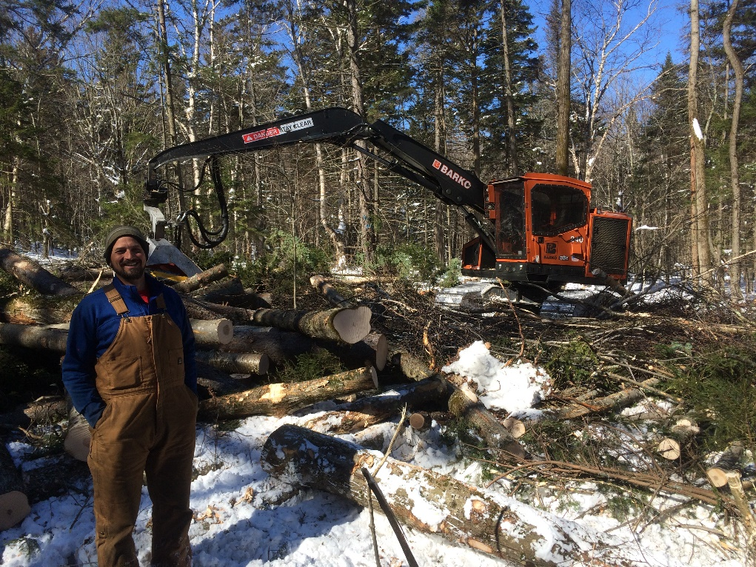

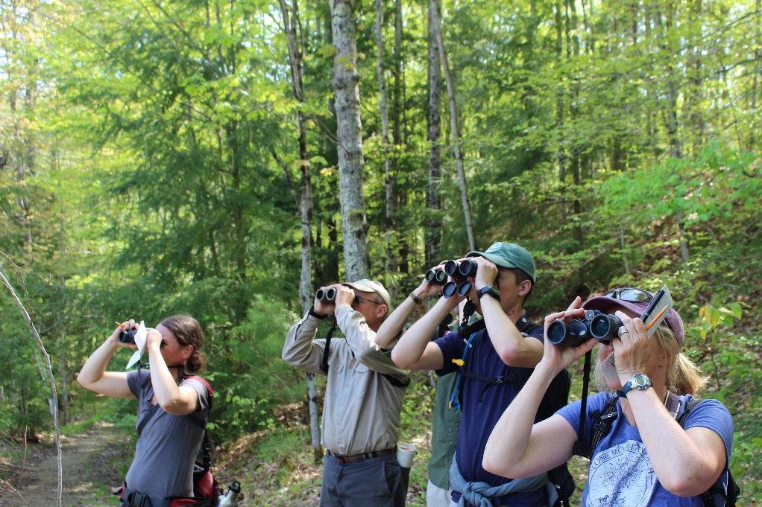

Slide 3
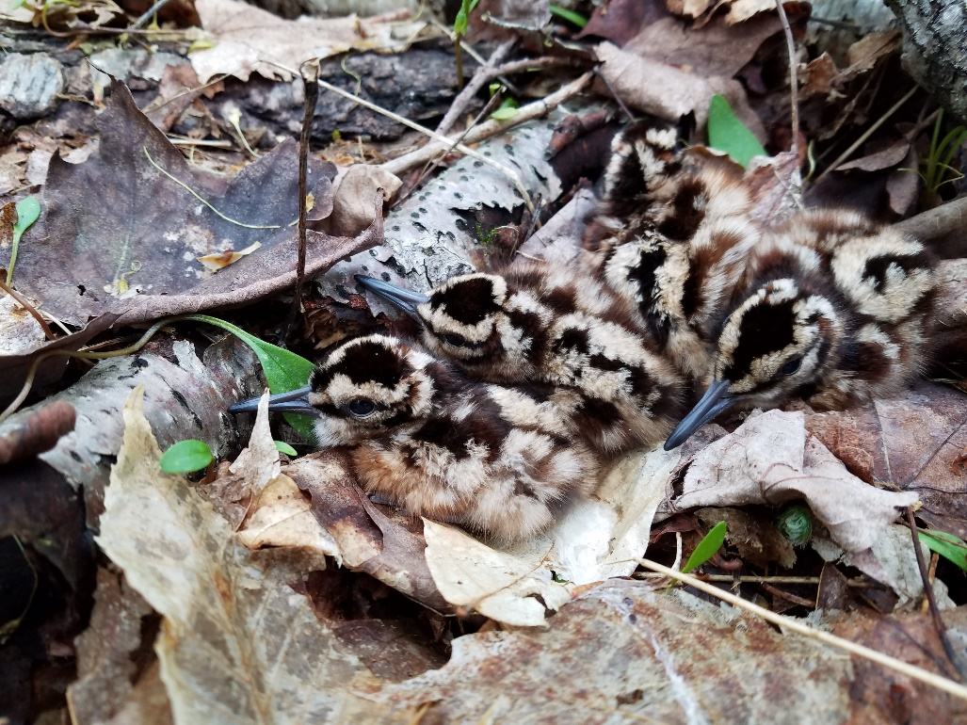
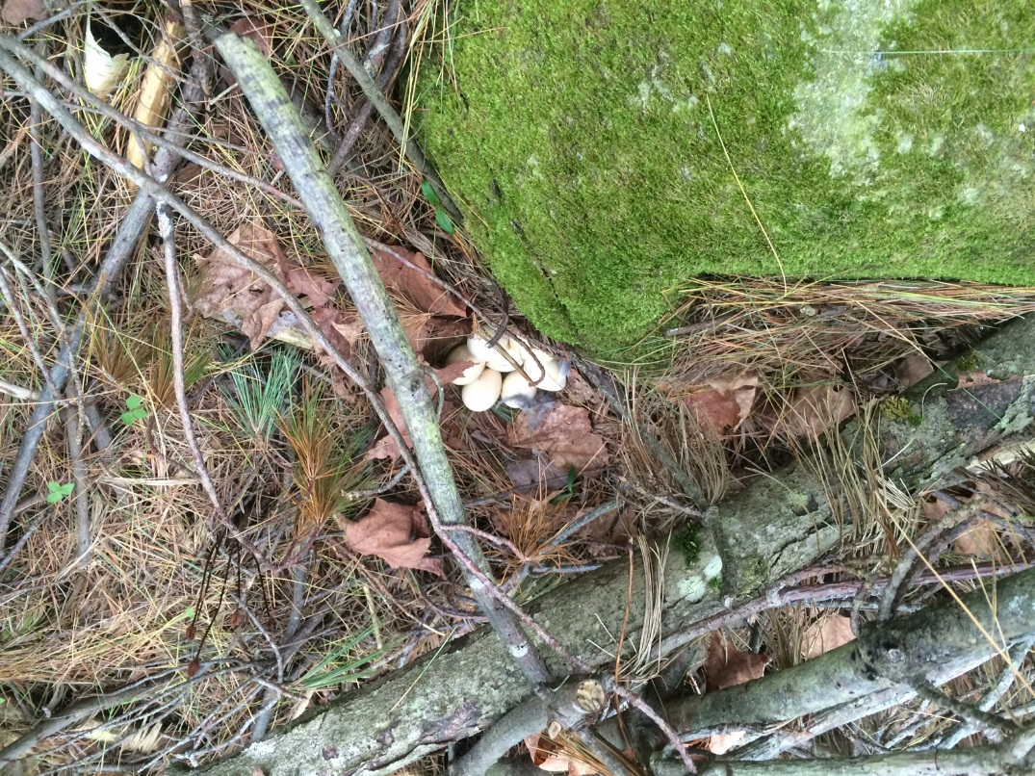
A Successful Approach
Photo: Brendan Moore
Photo: Audubon VT

Slide 4
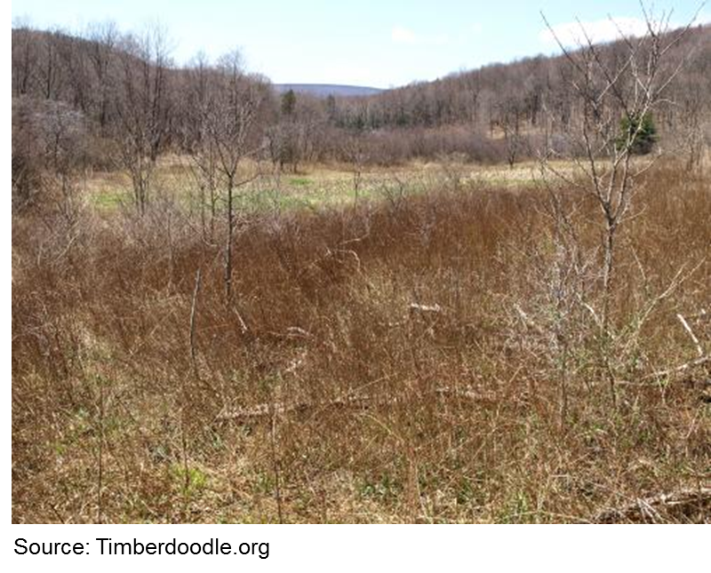
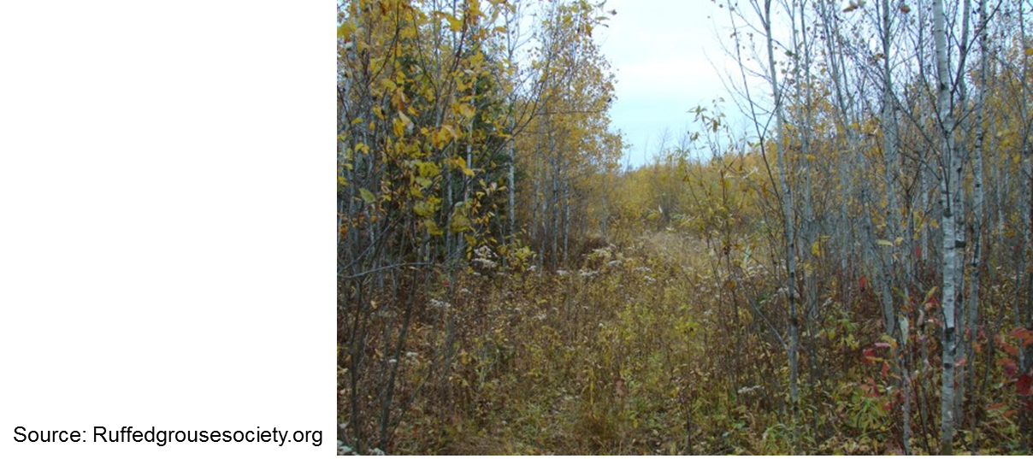
A Successful Approach

Slide 5
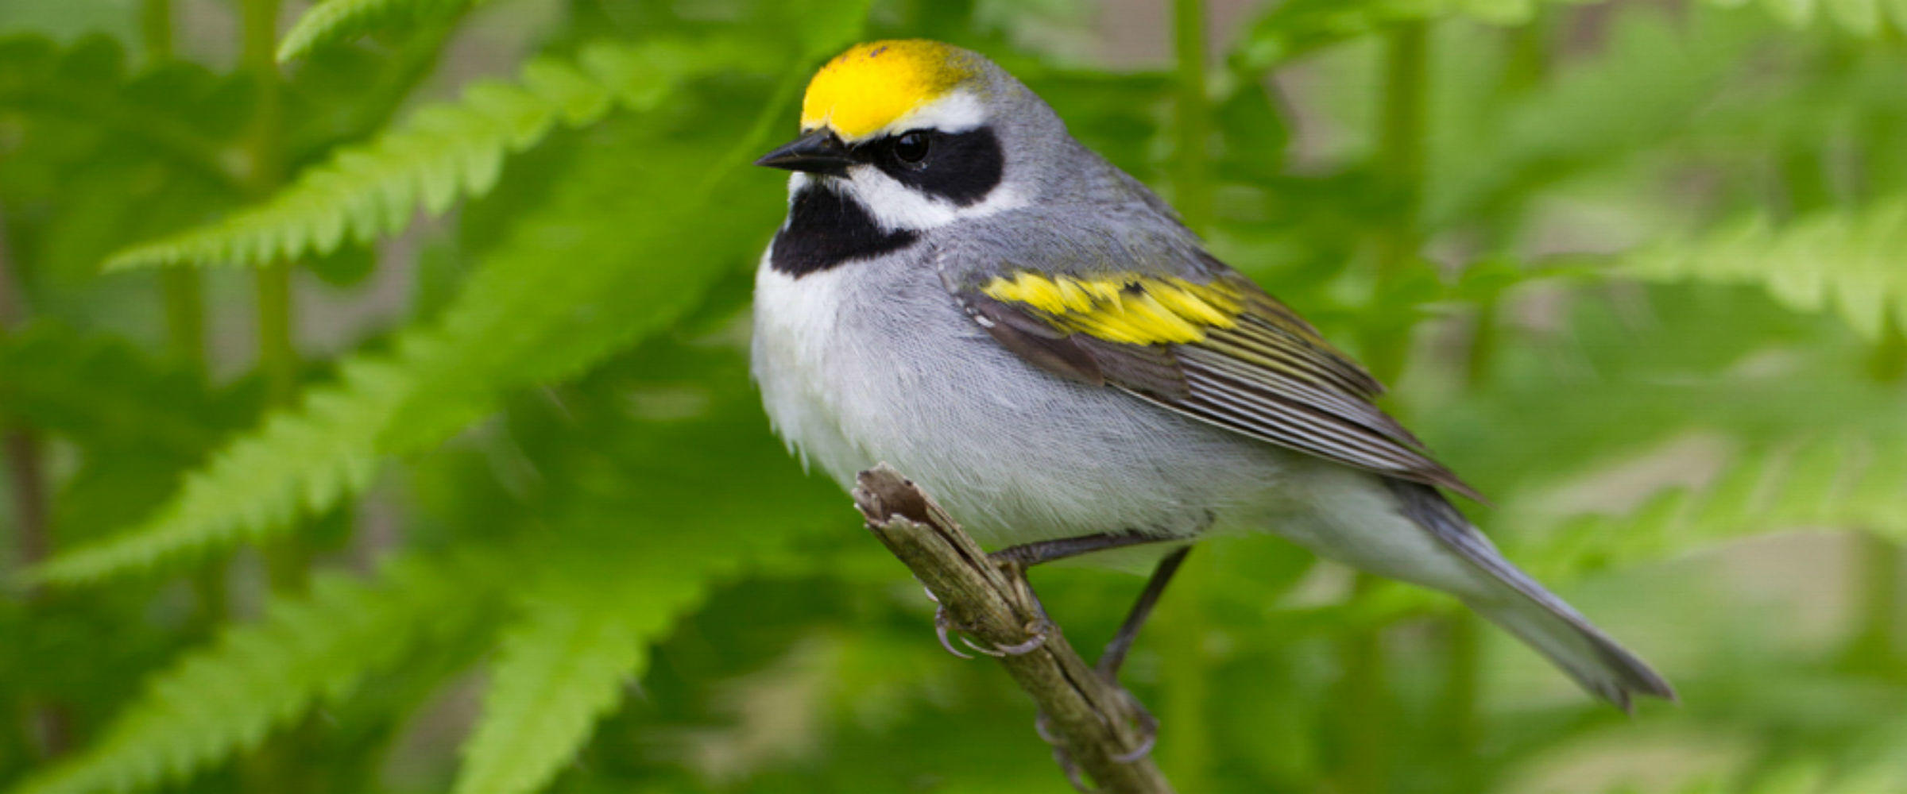
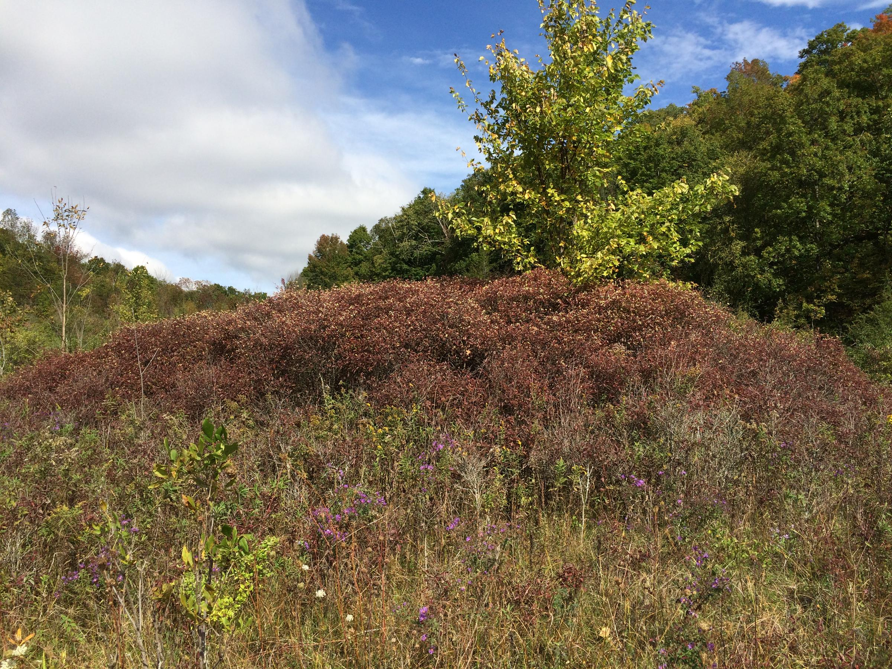
A Successful Approach
Photo: Michael Stubblefield
Photo: Audubon VT

Slide 6
Works Well When…
Landowner is interested in birds, particularly the focal species, or required habitat
Parcel and landscape context supports habitat
Funding supports habitat management

Slide 7
But What About the Rest of Us?

Slide 8
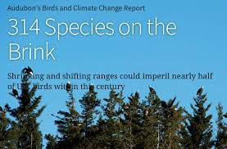
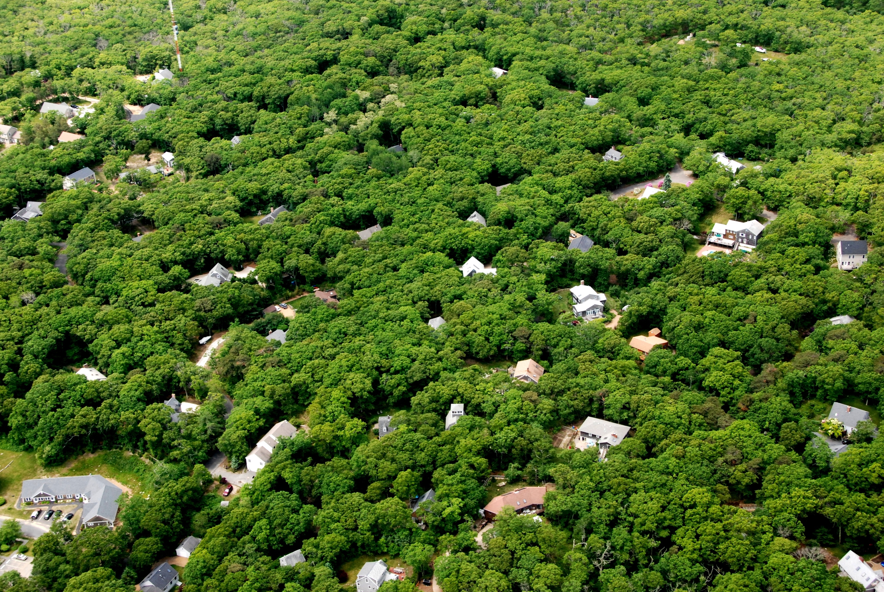
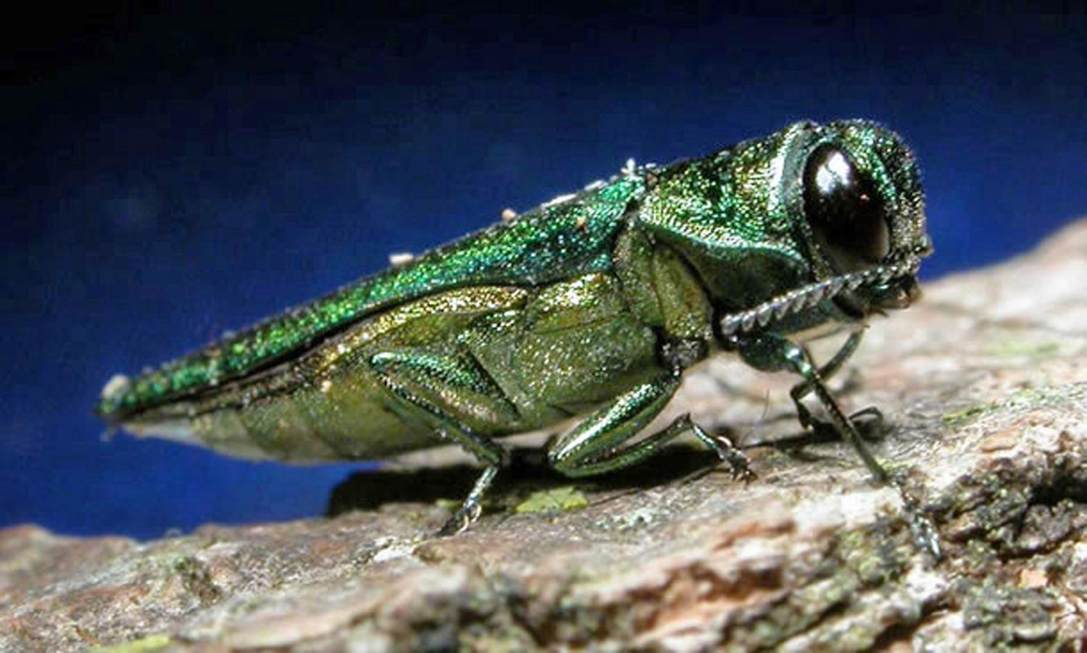
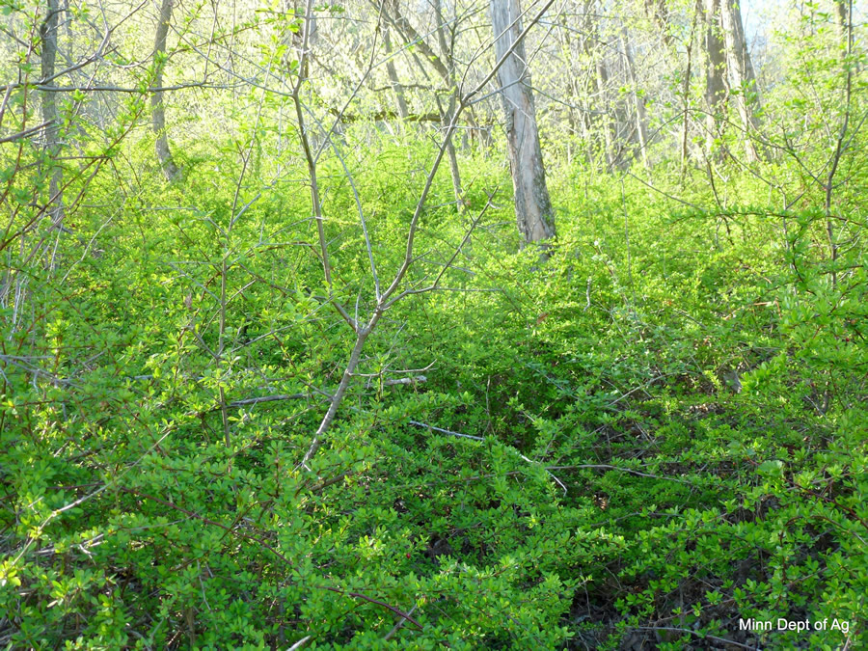
A Paradigm Shift
Source: audubon.org
Source: Harvard Forest
Photo: MN DNR

Slide 9
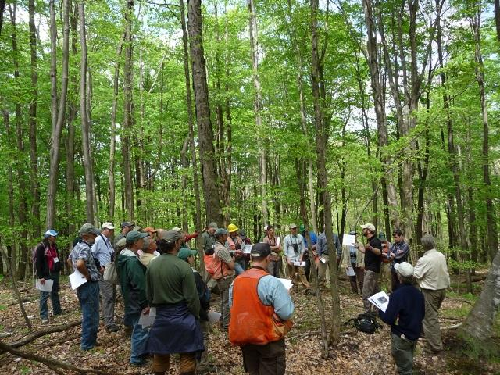
Creating a Culture of Bird Conservation
Photo: Audubon VT

Slide 10
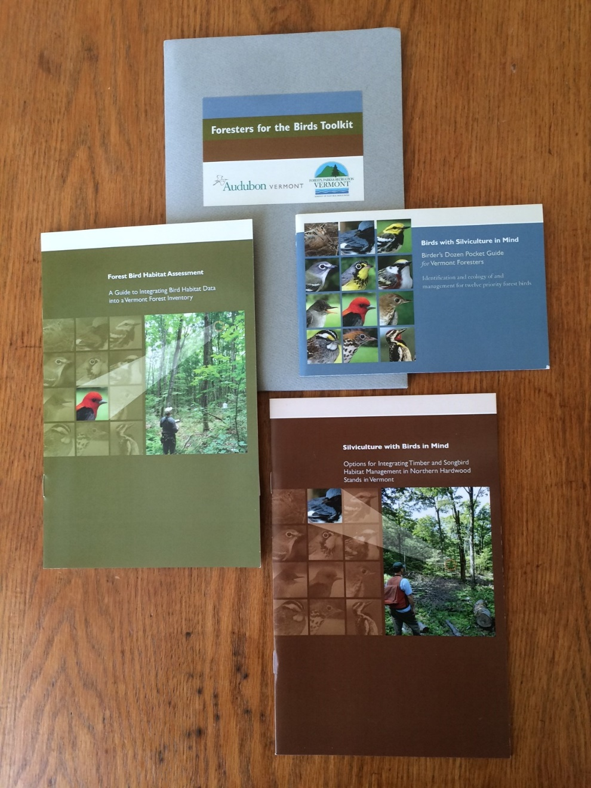

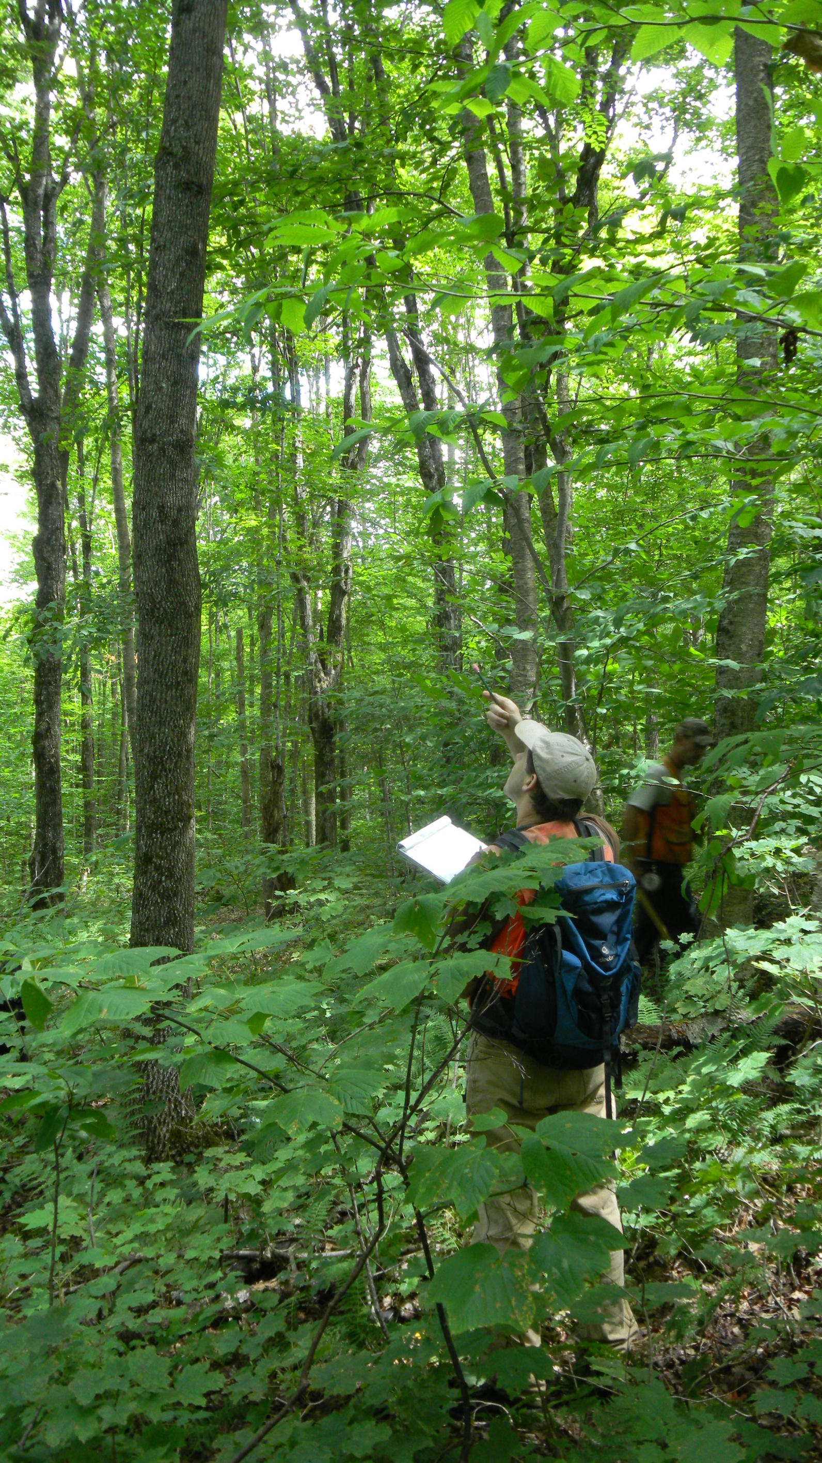
Creating a Culture of Bird Conservation
Photo: Audubon VT

Slide 11
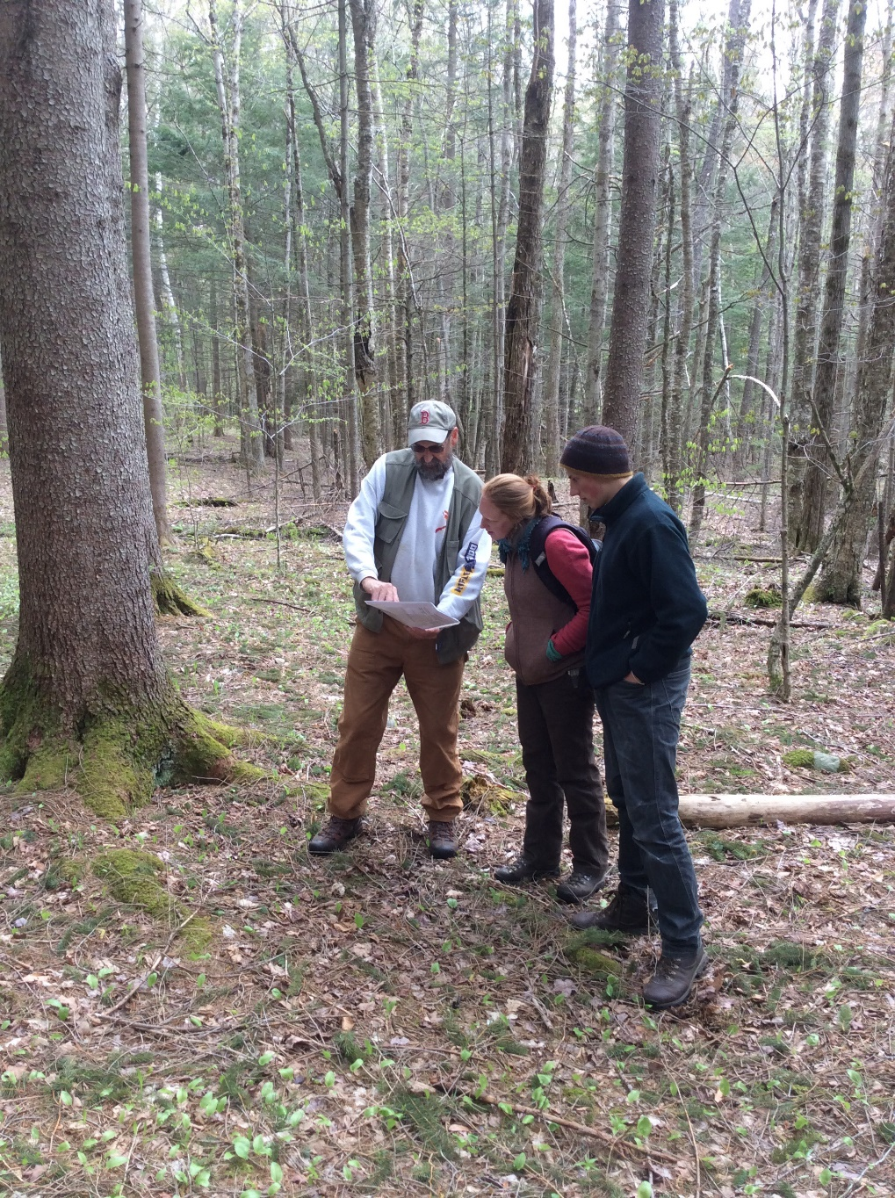


Creating a Culture of Bird Conservation
Photo: Audubon VT

Slide 12
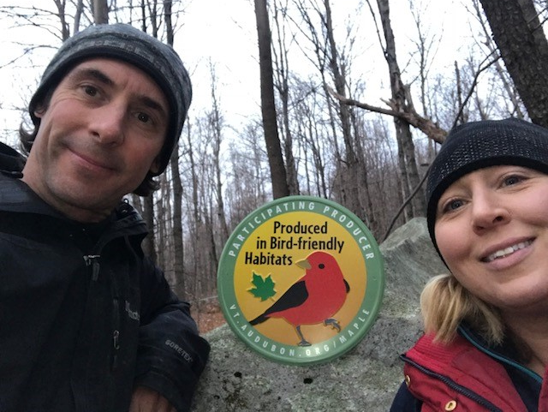
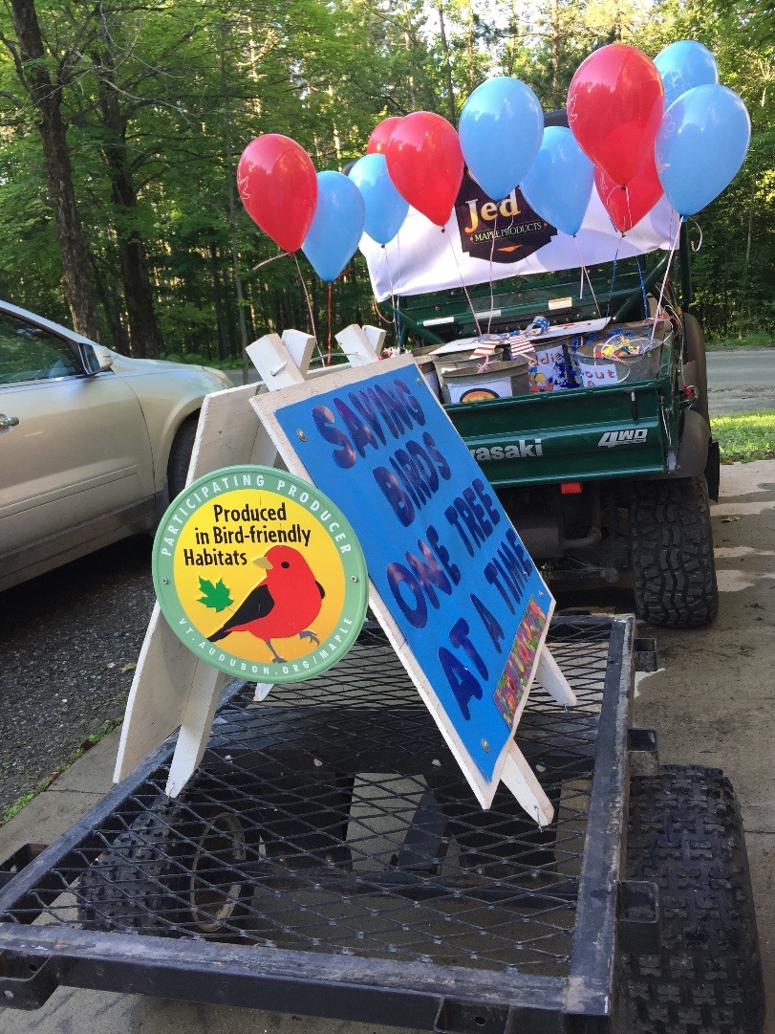
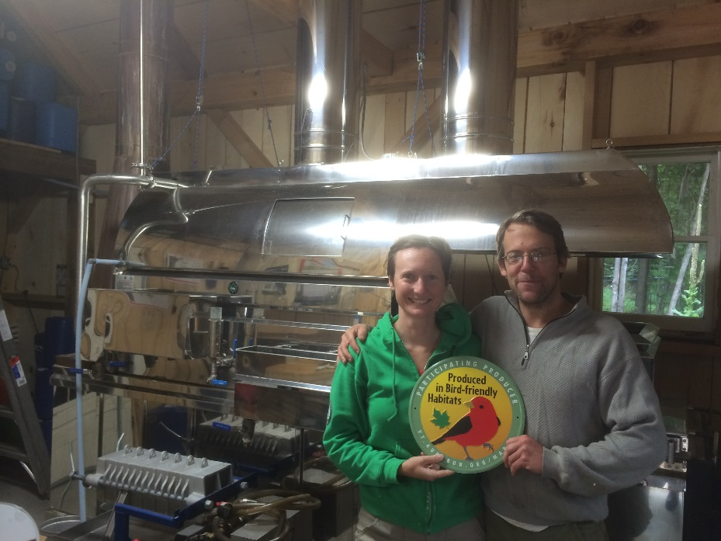

Creating a Culture of Bird Conservation
Photo: Couching Lion Maple Sugar Farm
Photo: Jed’s Maple Products
Photo: Audubon VT
Photo: Audubon VT

Slide 13
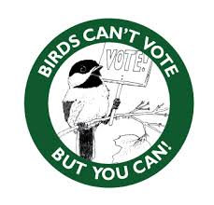
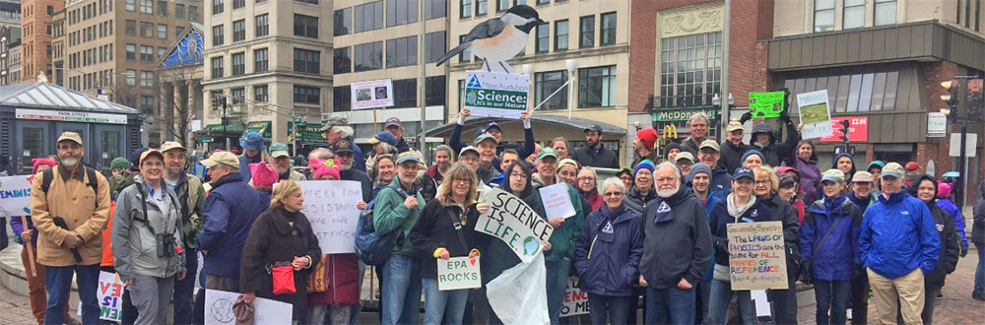
Creating a Culture of Bird Conservation
Source: Birds of VT Museum
Photo: Mass Audubon

Slide 14
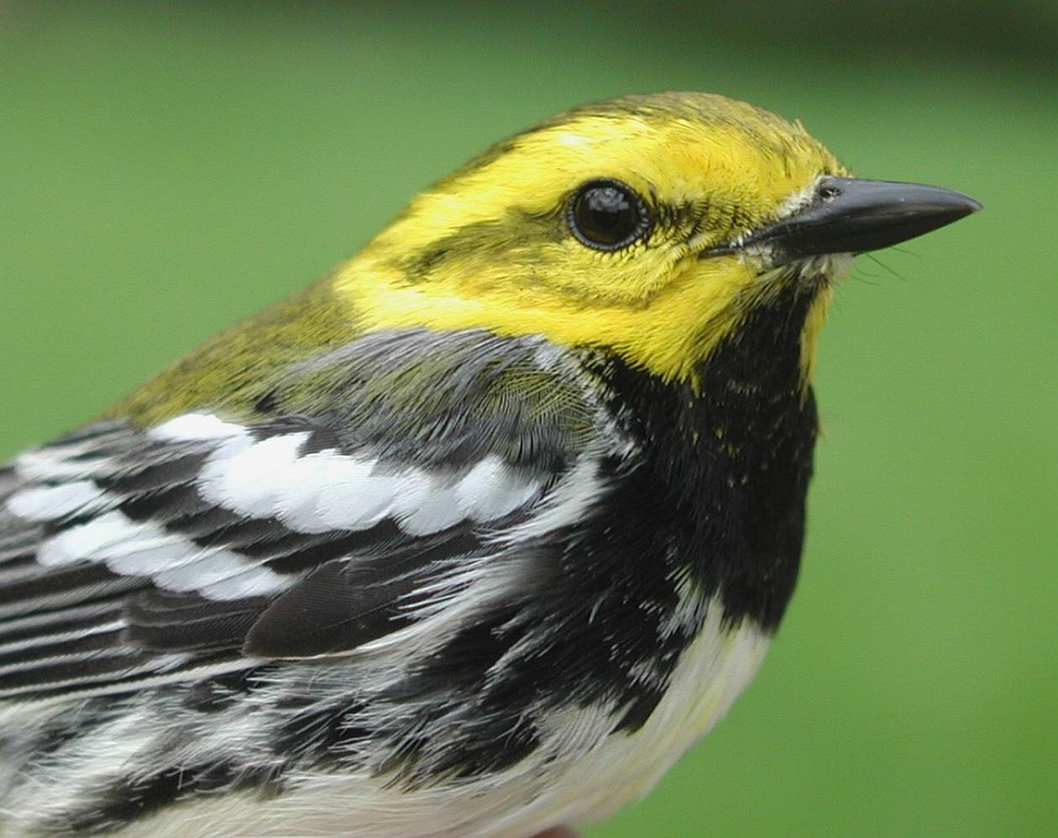
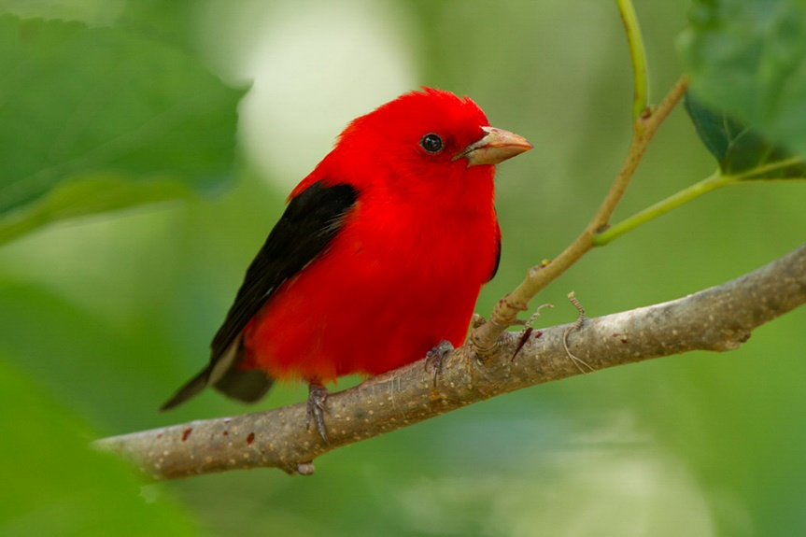
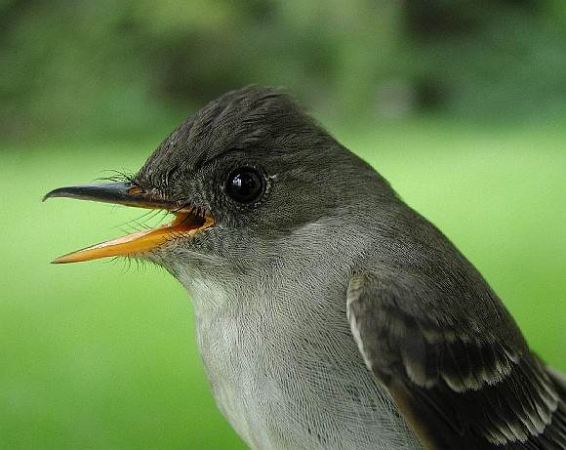
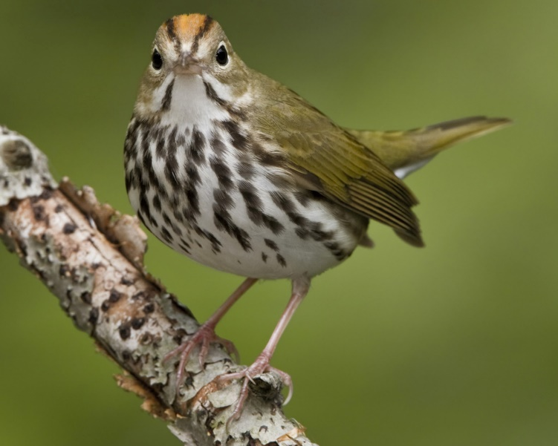
Proactive Conservation
Photo: Linda Steele
Photo: Powdermill Avian Research Center
Photo: Powdermill Avian Research Center
Photo: Glenn Bartley

