Slide 1
Importance of woody debris dynamics in understanding the forest carbon cycle Shawn Fraver, Chris Woodall, Tony D’Amato, Jodi Forrester
Forest Ecosystem Monitoring Cooperative conference
14 December, 2018
Notes:
Affiliation….

Slide 2
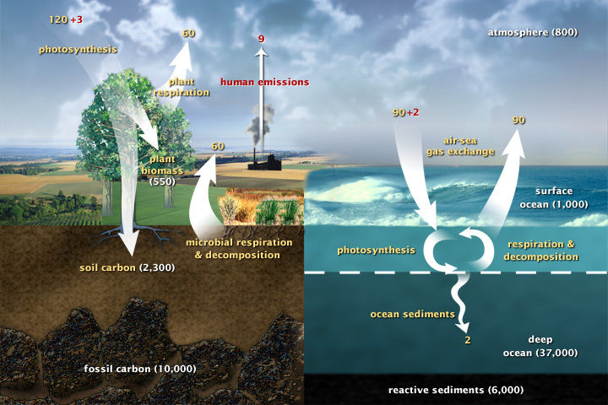
Global carbon cycle
Notes:
Gigatones/yr
CO2 from decomposition is ca 7X higher than fossil fuels emissions

Slide 3
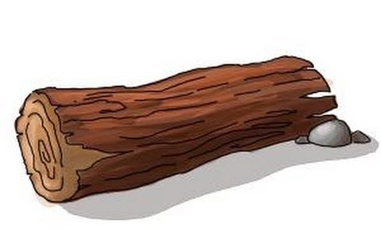
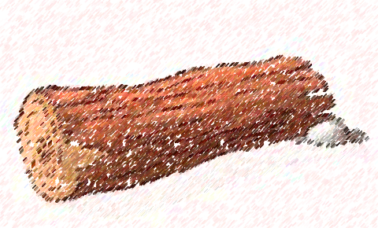
Knowledge gaps in the forest carbon cycle
Sequestration,
storage
Relatively well understood
Decomposition
Less well understood
Notes:
G & Y models, Dynamic Veg Models

Slide 4
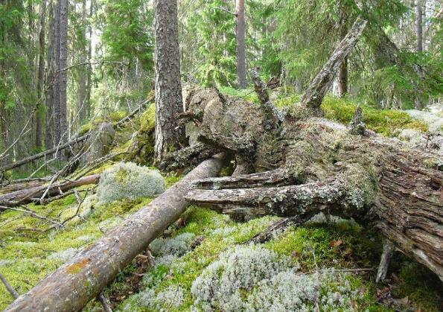
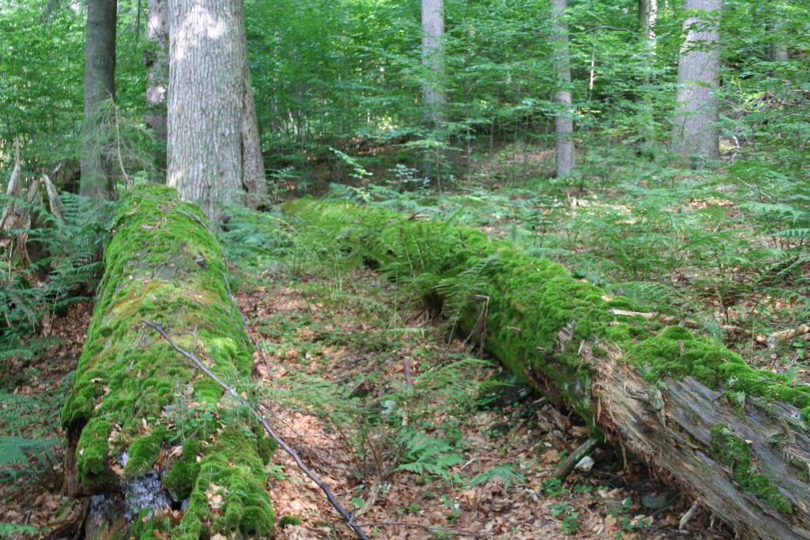
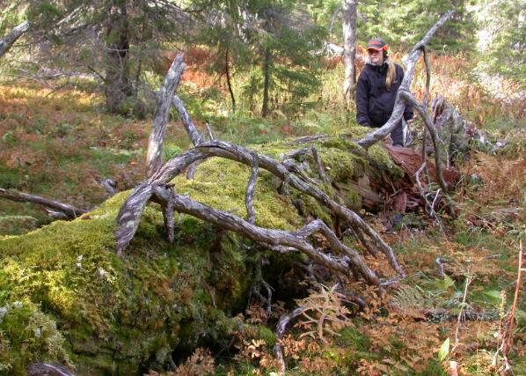
Carbon storage and downed woody debris
Downed woody debris often represents 15-20% of aboveground wood mass
50% of wood mass is carbon
Notes:
Slow release following tree death

Slide 5
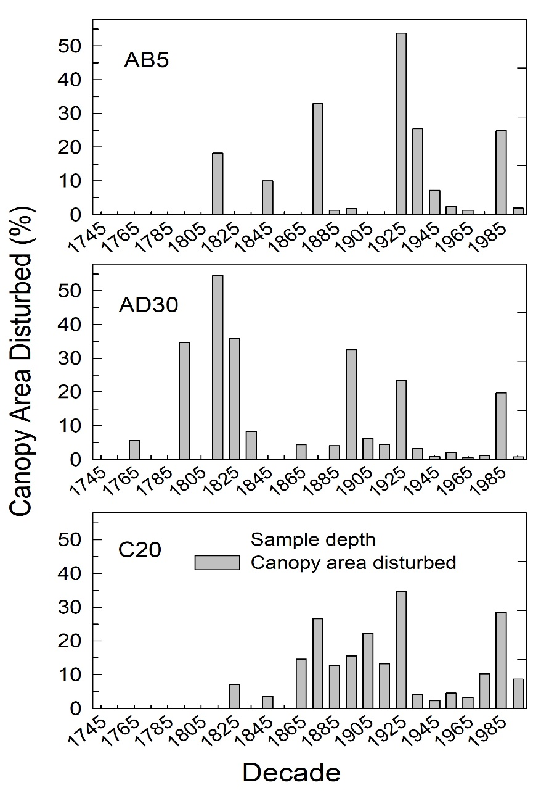
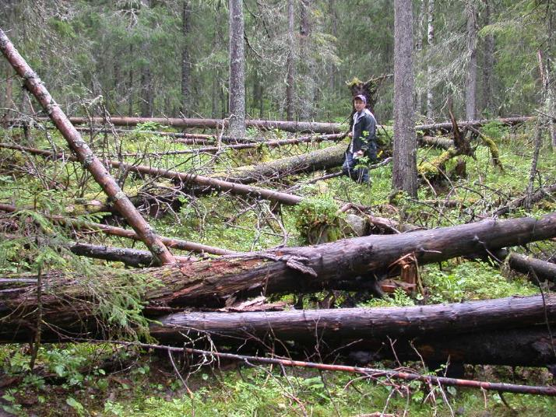
Natural disturbances create woody debris in pulses
Three old-growth spruce stands, Maine
Fraver & White 2005
Notes:
Explain dendro work – growth releases

Slide 6
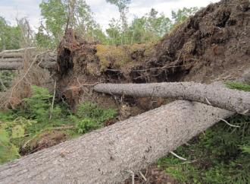
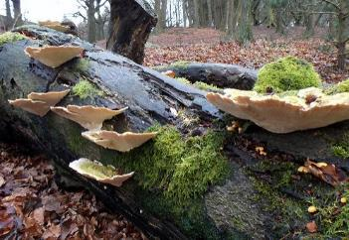
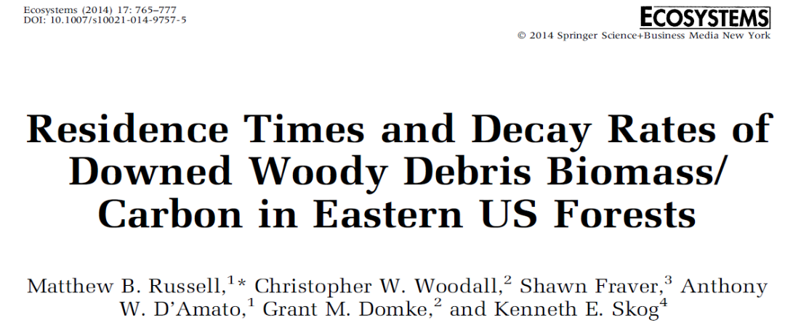
Balance between Additions and Depletions
Three old-growth spruce stands, Maine
Additions
Depletions
Fraver & White 2005

Slide 7
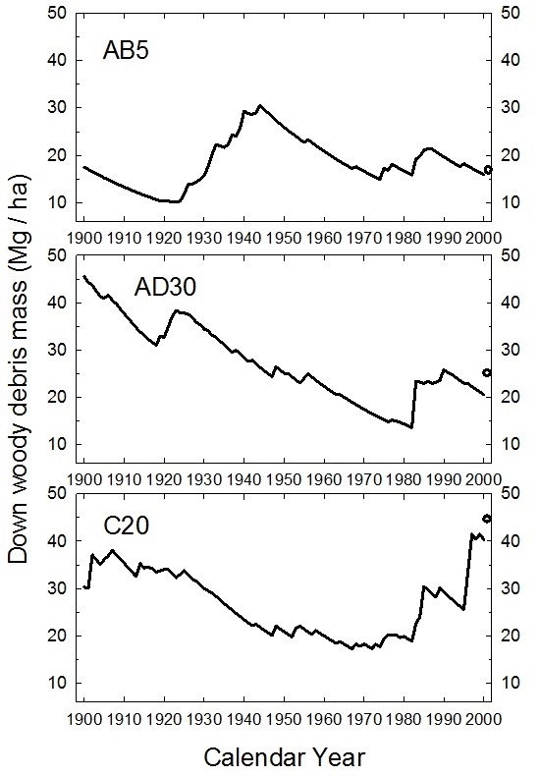
Combining Additions and Depletions
Three old-growth spruce stands, Maine
Additions
Depletions
Woody debris mass fluctuates dramatically through time
Fraver, Aakala & D’Amato 2017
Notes:
Total aboveground biomass could be 8 X higher than these DWD values (at mean 25 Mg/ ha)
The mean is about 100 cubic m / ha
NATURAL RANGE OF VARIABILITY

Slide 8
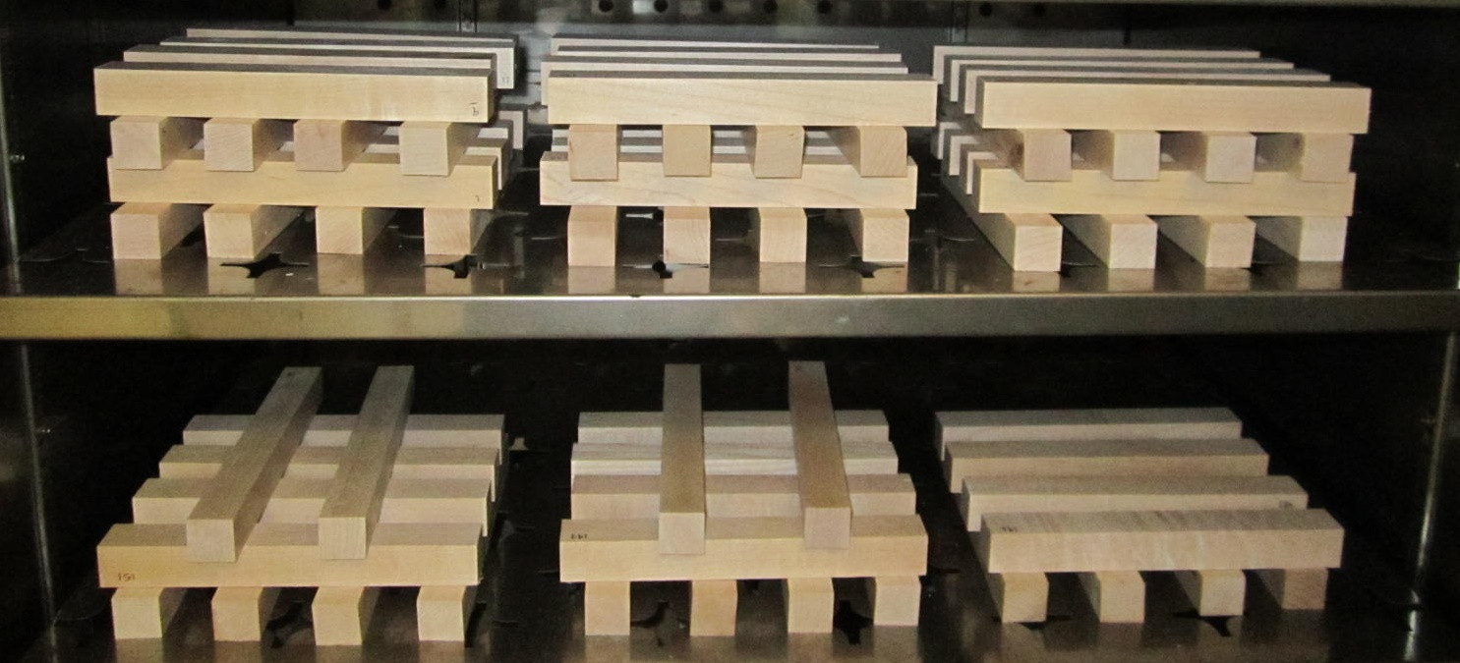
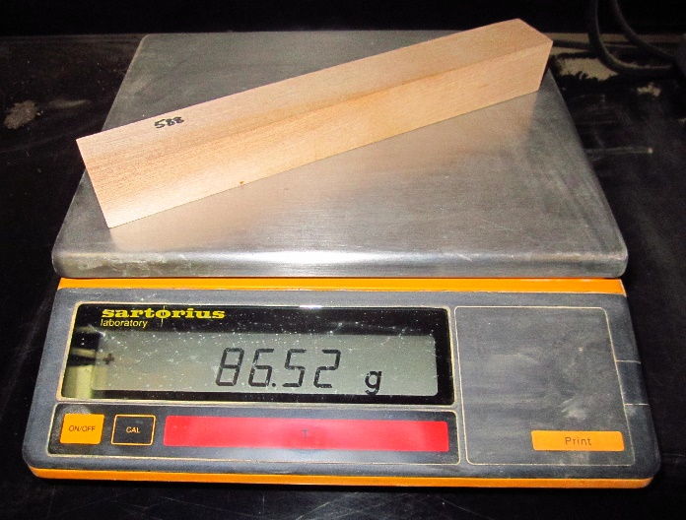
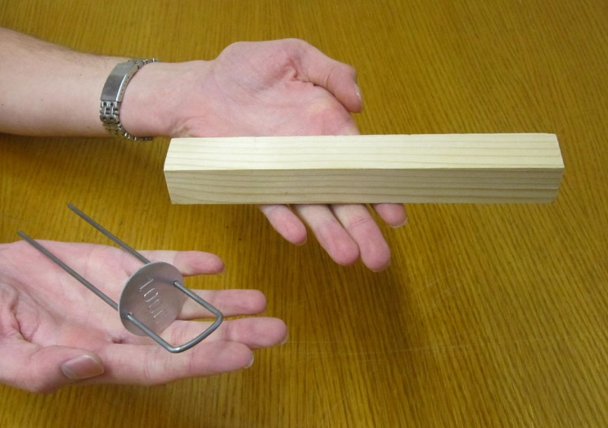
Decay stakes as a research tool
Notes:
Fabricated to precise size, weighed dry, individually tagged, deployed

Slide 9
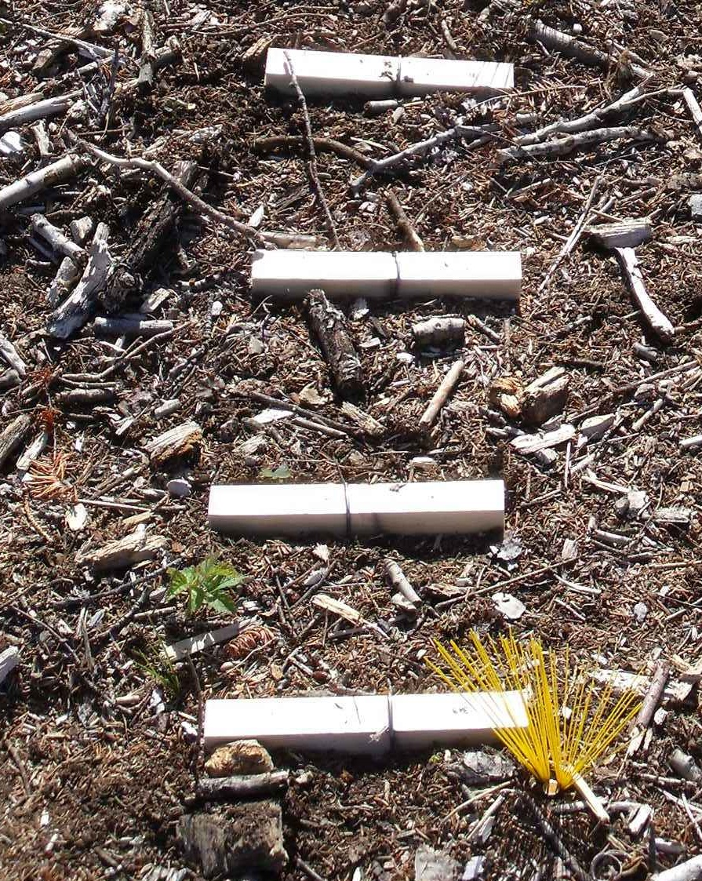
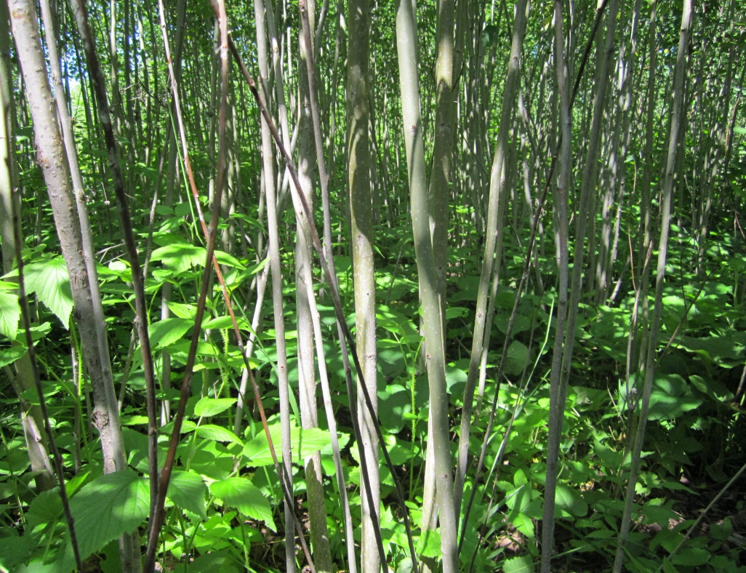
Decay stakes as a research tool
Deployed in 2010
2012
2014
2016
2018
Notes:
Missing from one of 96 locations – 700+ stakes in MN
ALSO at ASCC NH

Slide 10
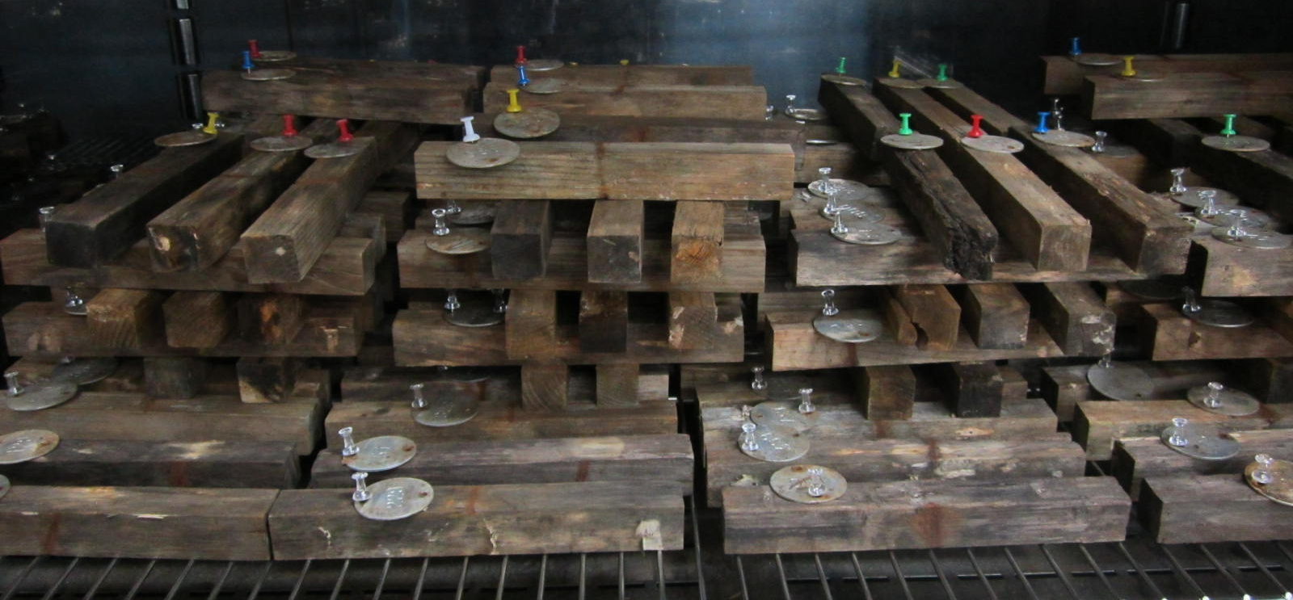
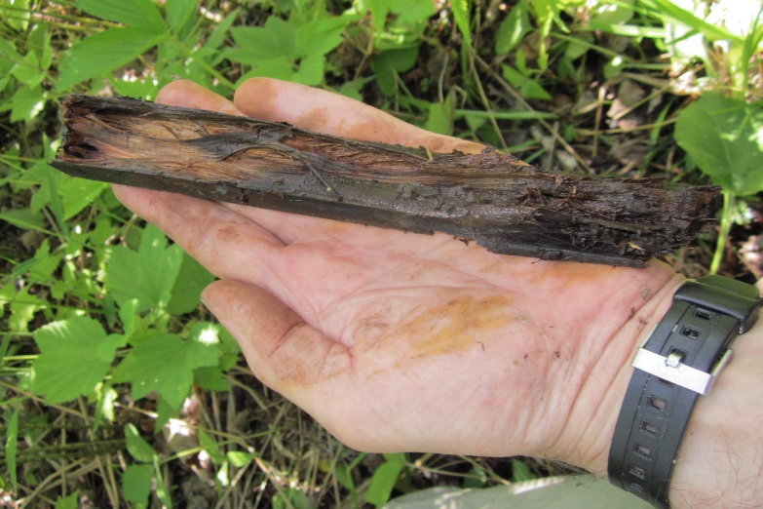
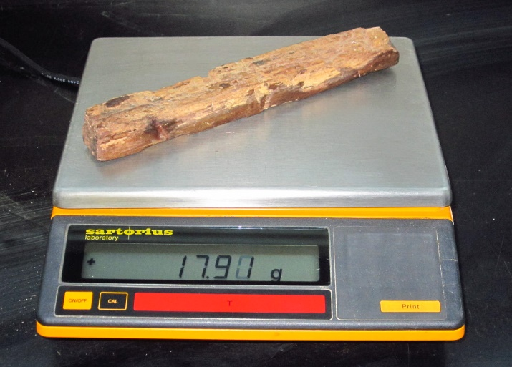
Collect to determine mass loss
After 2 years

Slide 11
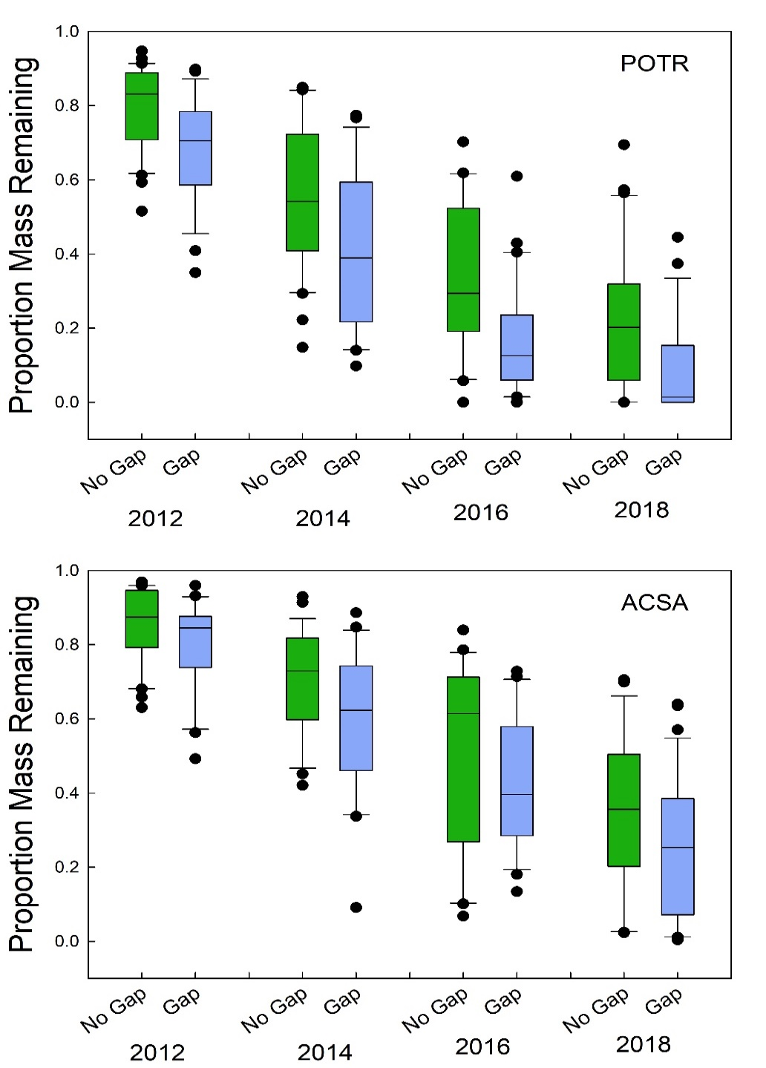
Results: Faster decay in gaps
Stakes were deployed in 2010
Aspen
Maple
Notes:
Gaps are a bit warmer (same moisture)

Slide 12
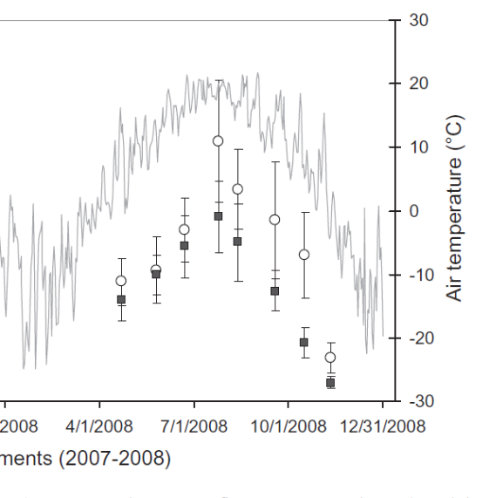
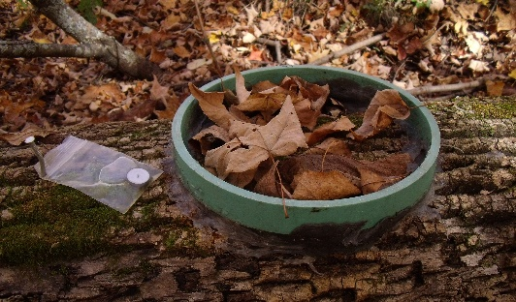
Stakes were deployed in 2010
Aspen
Results: Faster decay in gaps
Maple
Day of measurement
Forrester et al. 2012
Notes:
Gaps are a bit warmer (same moisture)

Slide 13
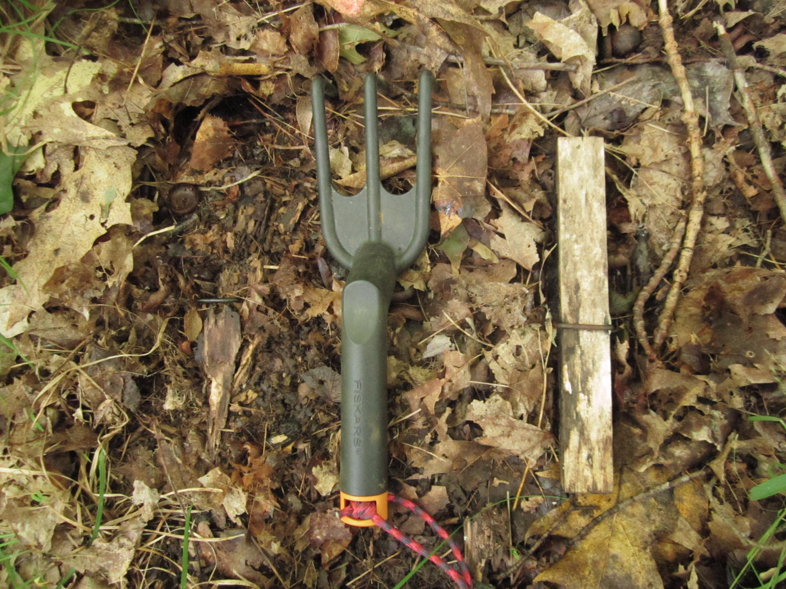
Importance of the fungal community

Slide 14
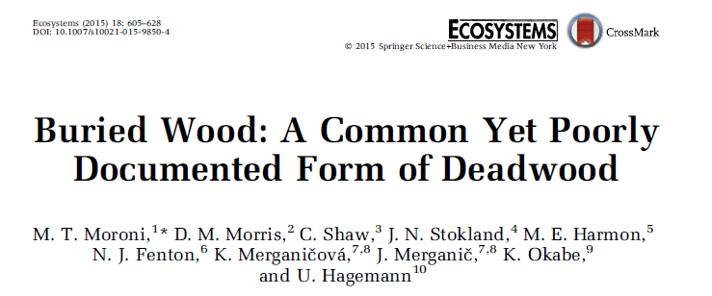
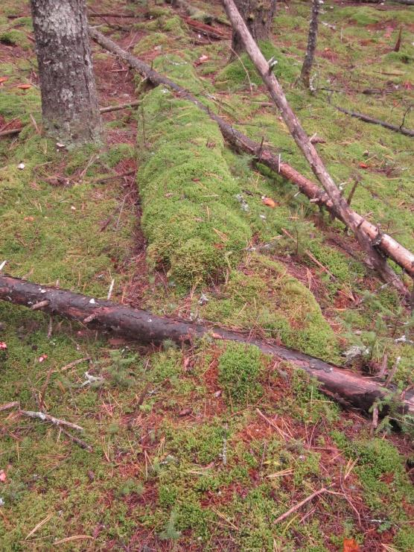
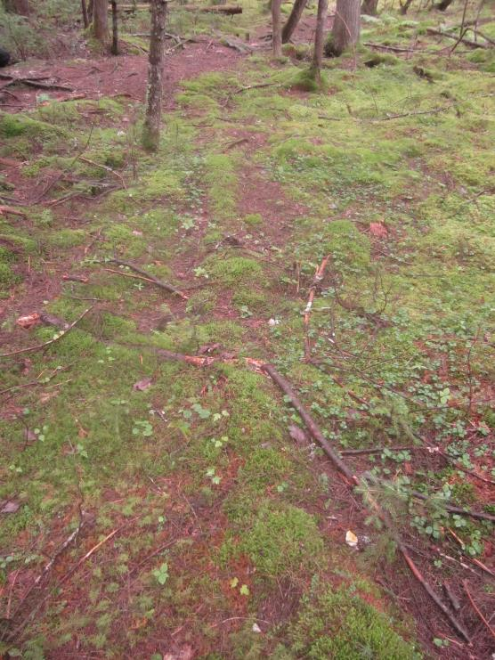
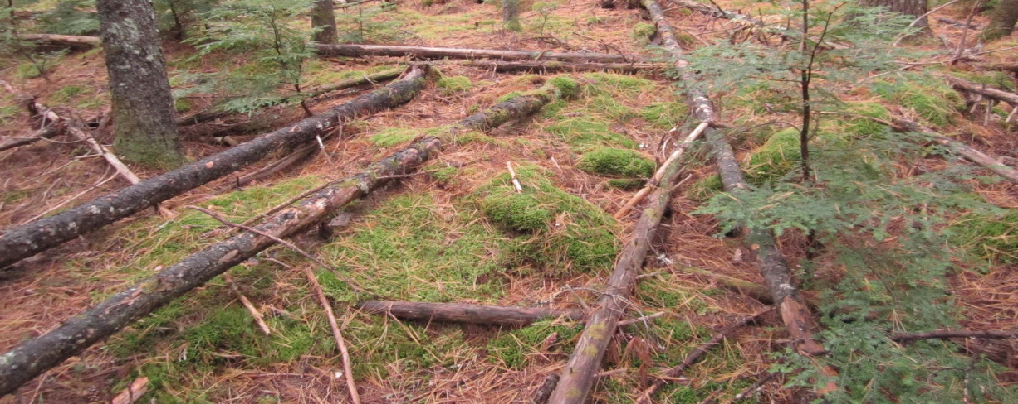
“In some forests, buried wood was effectively preserved, and volumes of buried wood exceeded the volume of all other live and deadwood combined.”
Notes:
Another control on wood decay – BURIAL by moss
Important -- decays slowly

Slide 15
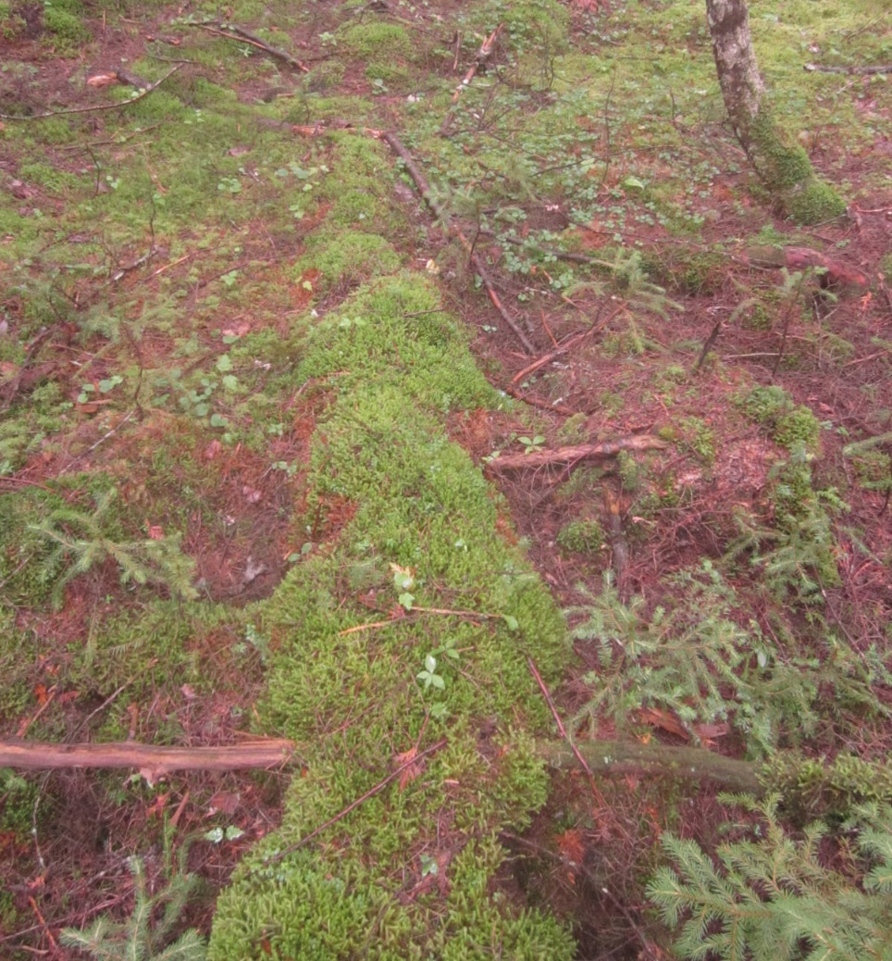
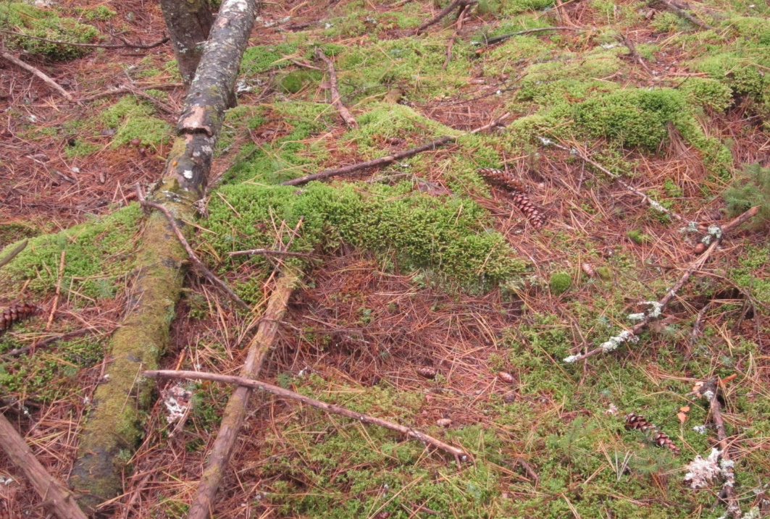
Prevalence of ‘buried’ wood
Howland Forest, Maine
43% of coarse woody
debris volume ‘buried’
A missing carbon pool?
Notes:
MISSING C pool

Slide 16
Buried wood proposals
NSRC 2016: Buried wood as the missing carbon pool in Northern Forest. (Fraver, Woodall, Fernandez, others)
DOE 2016: Modeling death and decay: addressing deadwood as a key control in forest carbon cycling. (Fraver, Hayes, Woodall, Hollinger)
DOE 2018: Modeling death and decay: addressing deadwood as a key control in forest carbon cycling. (Fraver, Hayes, Woodall, Hollinger)
Rejected
Rejected
Rejected

Slide 17
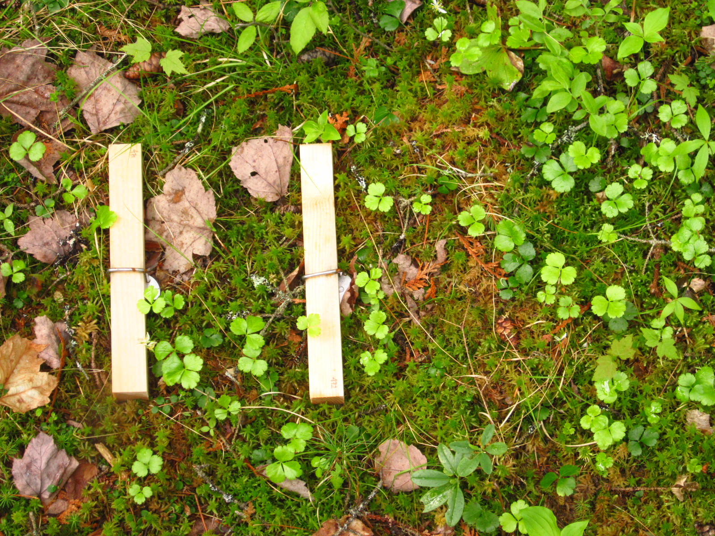
Decay stakes installed across a wetland gradient, Howland Research Forest
Notes:
Explain three….. Some moss covered after 2 yrs…. Leave ALL 3 (not staggered) in place for 6 yrs
48 locations of triplets

Slide 18
Understanding woody debris dynamics is important… QUESTIONS?
Forest Ecosystem Monitoring Cooperative conference
14 December, 2018
Notes:
Affiliation….

Slide 20
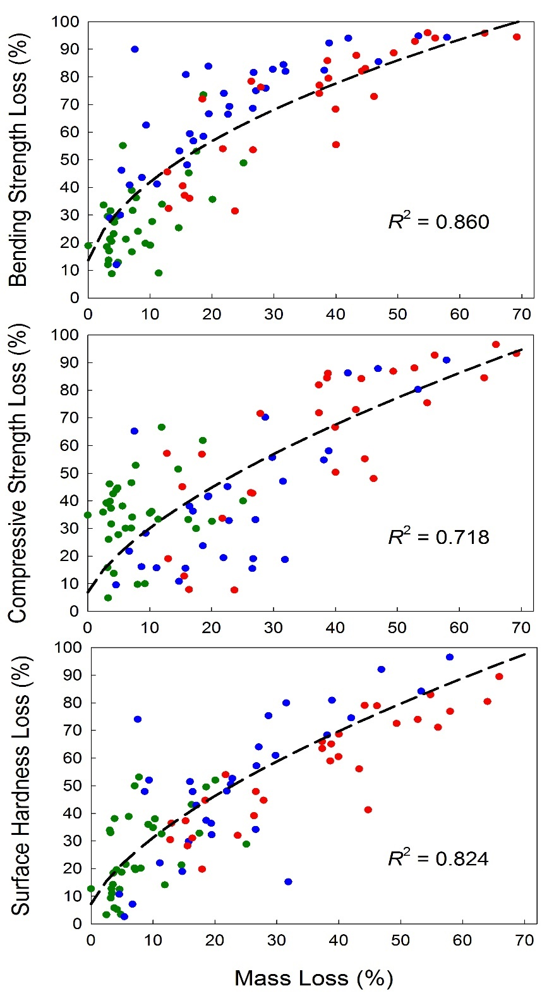
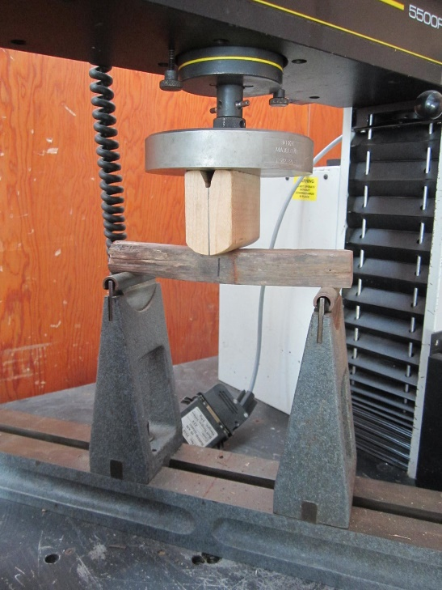
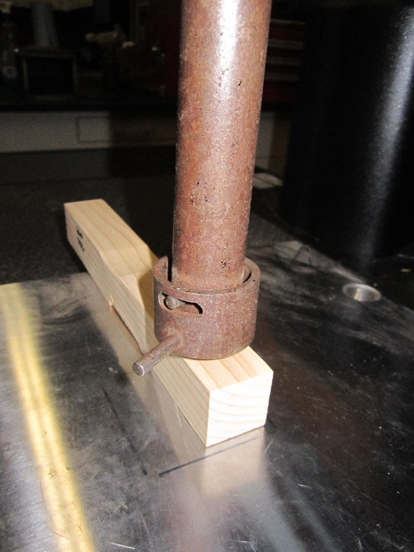
Strength loss occurs before any mass loss
Fraver et al. 2017
Notes:
(1) Depth a sharp object penetrates (2) surface hardness (3) ability to hold own weight (4) resistance to breakage

Slide 21
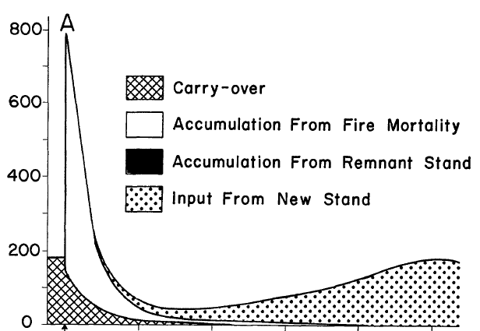
Woody debris mass following stand-replacing disturbance (stand-level)
Spies et al. 1988
CWD from pre-disturbance stand
CWD from disturbance mortality
CWD Mass (Mg/ha)
CWD from developing stand
200 300 400 500
Stand age (years)
Disturbance
Notes:
Stand-replacing an over-simplification

Slide 22
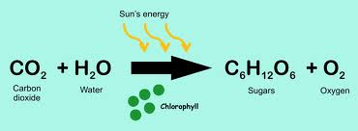
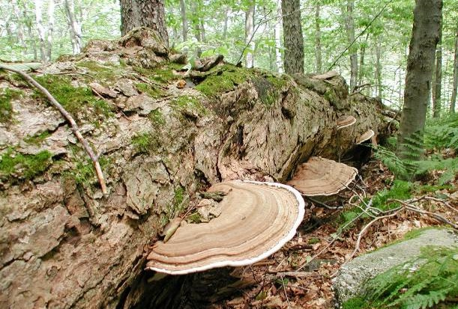
Photosynthesis
Decomposition (i.e., respiration)
energy released
Carbs + O₂ CO₂ + H₂O
Fungi
Notes:
We know a whole lot about how forests sequester carbon – in part because of the economic benefits of such knowledge – G & Y models, Dyn Veg Models
We know far less about how forest lose carbon trough decomposition – my focus in rest of lecture
Photosynthesis in reverse

Slide 23
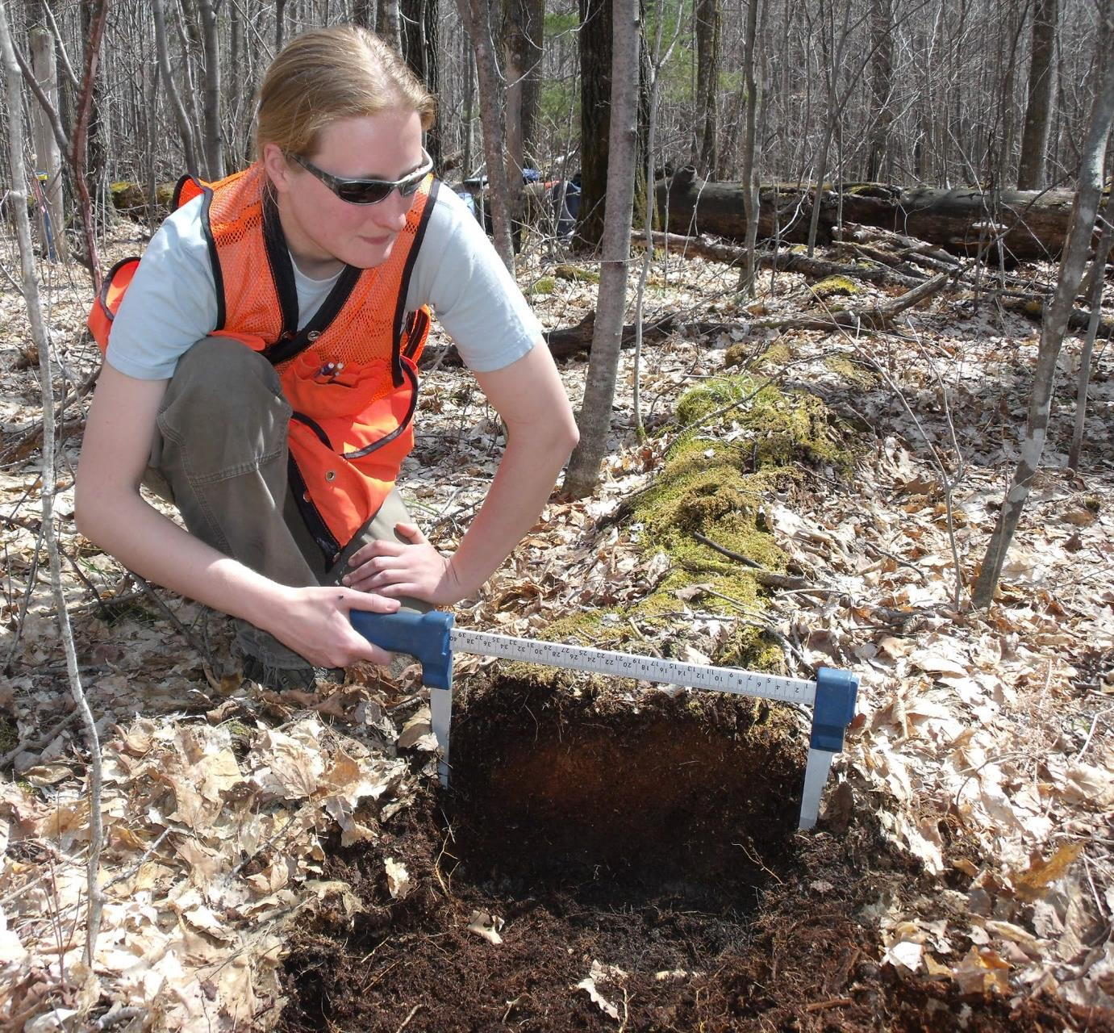
Determine log volumes using a collapse ratio
Notes:
One of our finding s is that log width remains relatively constant throughout the decay process. As a log decays, it collapse upon itself under the force of gravity, such that its cross-section becomes elliptical… but it’s width remains stable. Now some of you may be thinking that this can’t possibly be true – so let’s look at the data:
EXCAVATION

Slide 24
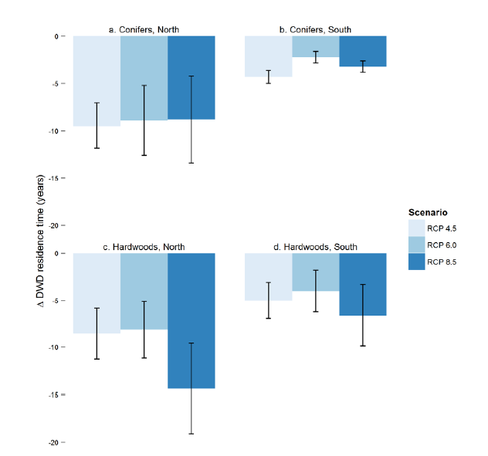
Climate change projected to increase woody debris decay rates (ie, reduce residence times)
∆ in CWD residence time (yrs)
Three climate
change scenarios
Russell et al. 2014
Notes:
200 years … RCP = Representative Concentration Pathway
BUT JUST EFFECT OF CLIMATE

