Slide 1

Examining the future forest
through tree seedling experiments
Forest Ecosystem Monitoring Cooperative
Nicholas Fisichelli, Ph.D.
Forest Ecology Director
December 14, 2018

Slide 2
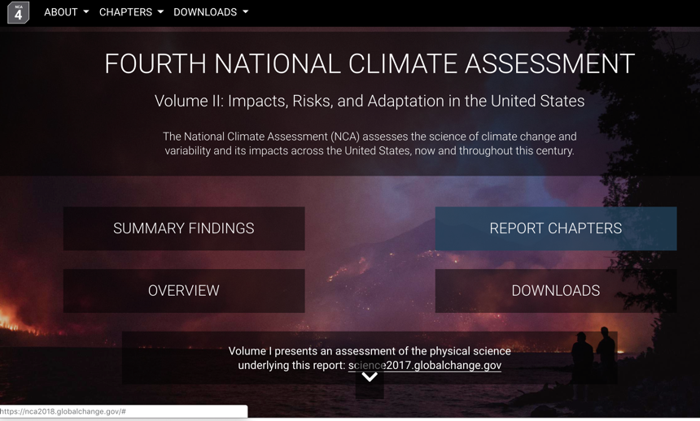
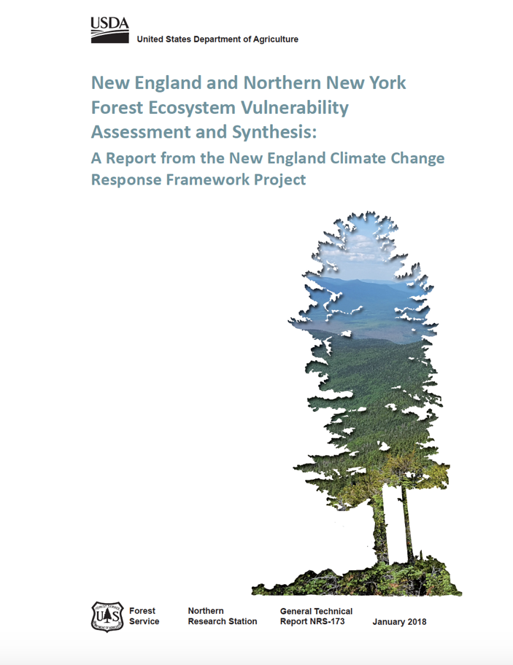

Slide 3

Change and Uncertainties
Janowiak et al. 2018
NCA 2018

Slide 4
Change and Uncertainties
Janowiak et al. 2018
NCA 2018
We need more on-the-ground experiments

Slide 5
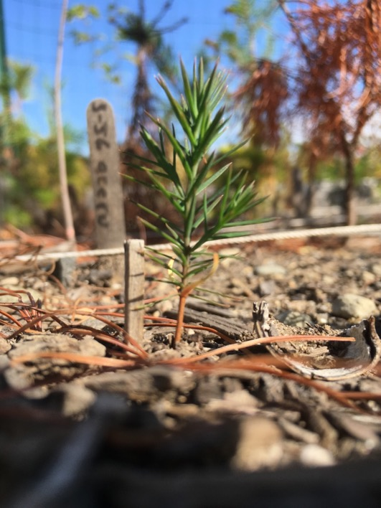
Seedlings are the forest future
Species able to establish, persist, grow, and recruit into larger size classes are likely to form the future overstory
Notes:
Lots of selective pressures
Warming temperatures,
Too much water,
Hot droughts,
Frost,
Too much shade,
Too many deer,
Non-native species,
N deposition,
Too many competitors,
Space is limited
Species able to establish, persist, grow, and recruit into larger size classes are likely to form the future overstory

Slide 6
Seedlings are the forest future
Species able to establish, persist, grow, and recruit into larger size classes are likely to form the future overstory
Overarching research questions:
What drives seedling performance?
How are seedlings responding to multiple global change pressures?
-warming temperatures
-climate variability: drought
-non-native species
-deer browse
Notes:
Lots of selective pressures
Warming temperatures,
Too much water,
Hot droughts,
Frost,
Too much shade,
Too many deer,
Non-native species,
N deposition,
Too many competitors,
Space is limited
Species able to establish, persist, grow, and recruit into larger size classes are likely to form the future overstory

Slide 7
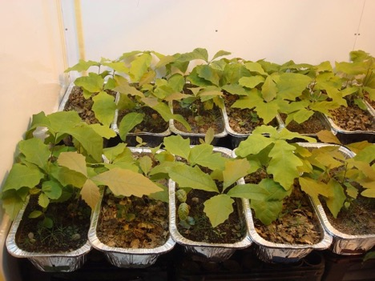
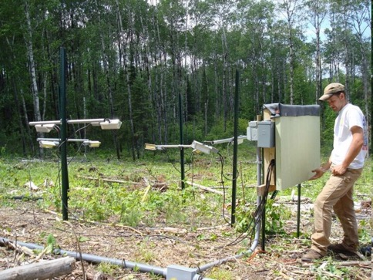
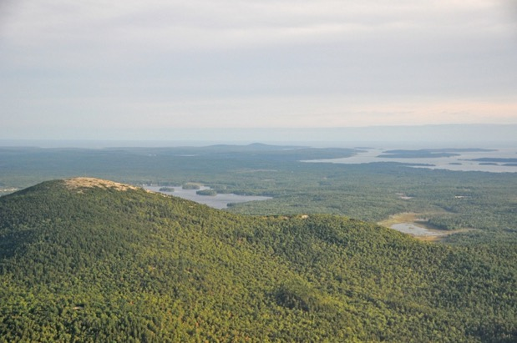
-use observational field studies and controlled experiments
Growth chamber studies
Field experiments
Observational field studies

Slide 8
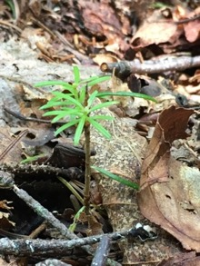
Field experiment
Seedling diversity decreases with warming and time
B4WarmED
Wright et al. 2018.

Slide 9
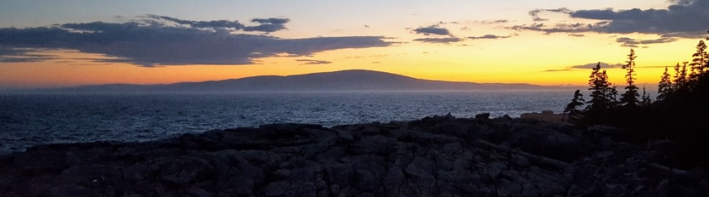
Field experiment
Acadia National Park – Cadillac Mountain
Cadillac Summit
High
454 m elev
Mid
300 m elev
Low
100 m elev
Ocean
Maritime
23 m elev

Slide 10
Field experiment
Acadia National Park – Cadillac Mountain
2.3 ° C summer temperature gradient
Cadillac Summit
High
17.4 °C
8.7 % Soil H₂O
Mid
17.8 °C
8.1 % Soil H₂O
Low
18.3 °C
6.0 % Soil H₂O
Ocean
Maritime
16.0 °C
16.5 % Soil H₂O

Slide 11
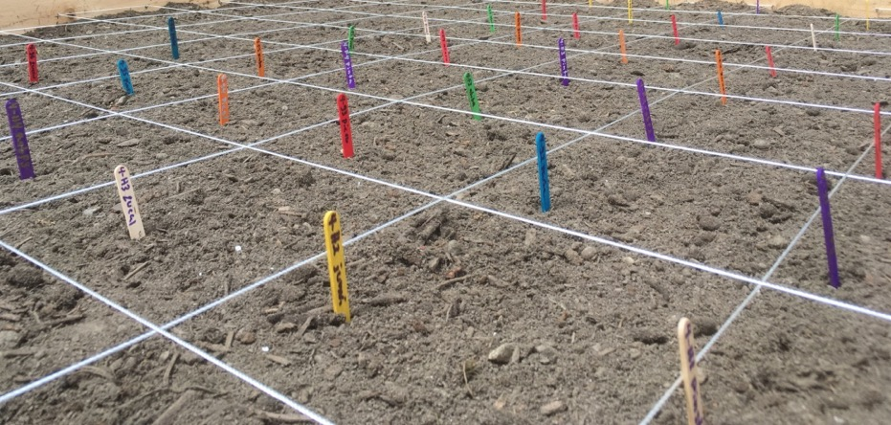
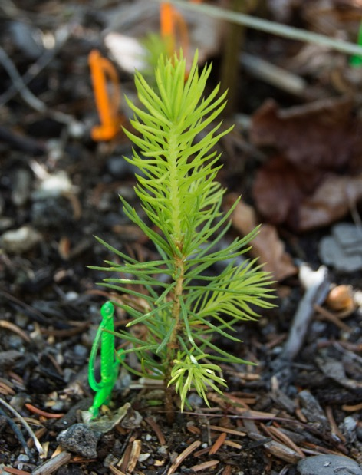
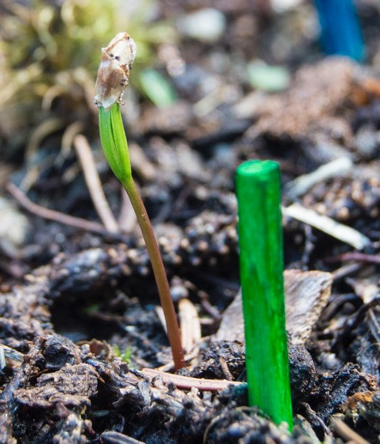
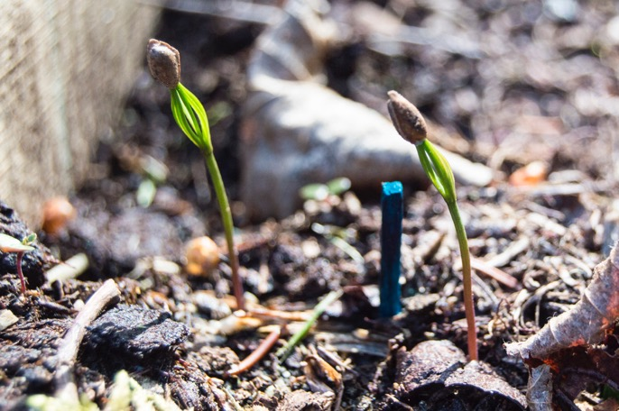
Field experiment
Acadia National Park – Cadillac Mountain
Cadillac Summit
High
17.4 °C
8.7 % Soil H₂O
Mid
17.8 °C
8.1 % Soil H₂O
Low
18.3 °C
6.0 % Soil H₂O
Ocean
Maritime
16.0 °C
16.5 % Soil H₂O

Slide 12
Field experiment
Acadia National Park – Cadillac Mountain
Cadillac Summit
High
Mid
Low
Ocean
Maritime
Preliminary analyses (yr 2 of 3-yr study)

Slide 13
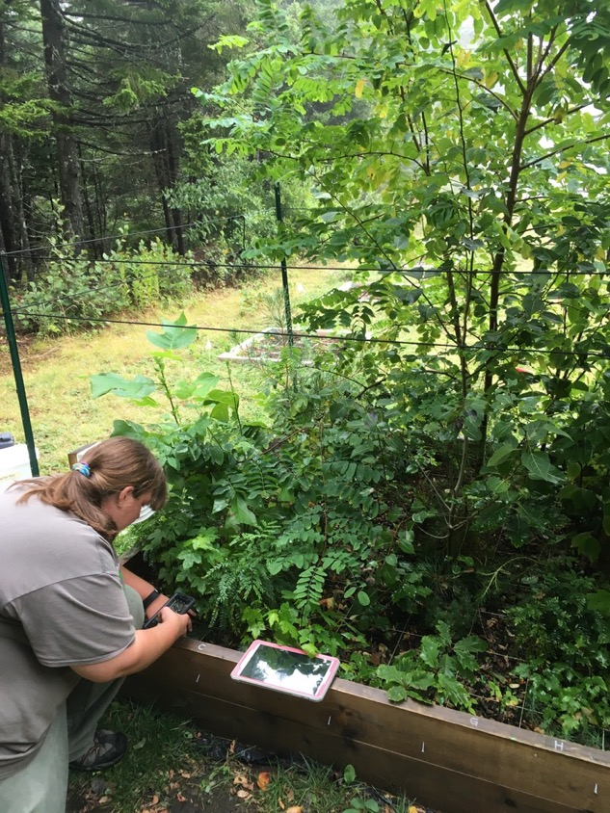
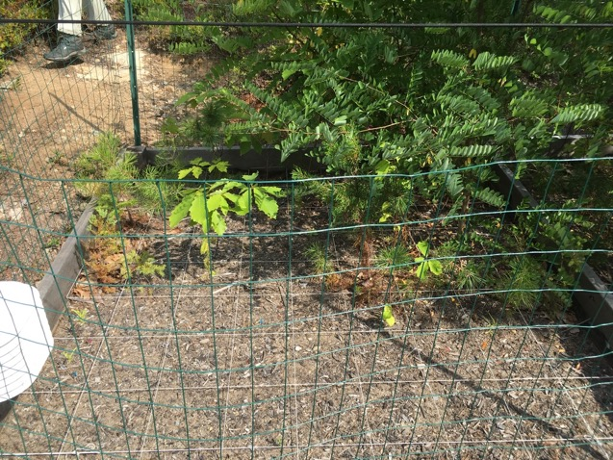
Field experiment
Acadia National Park – Cadillac Mountain
Low
(fewest seedlings: 19)
Marine
(most seedlings: 475)

Slide 14
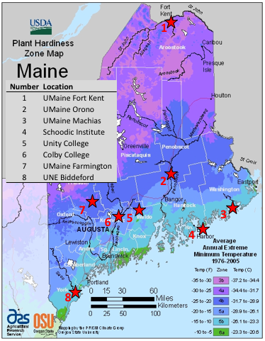
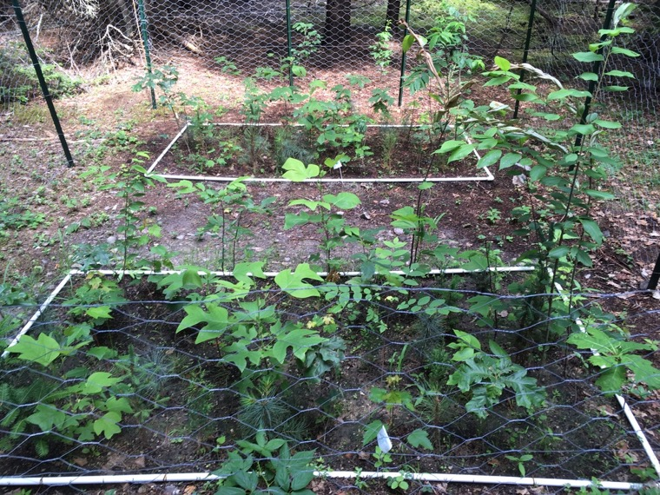
Field experiment
Common Campus Tree Experiment
-common garden experiment at
8 education campuses
-12 tree species
Co-PIs: Andrew Barton, Justin Becknell, Dylan Dillaway, Eric Jones, Thomas Klak, Neil Thompson, YongJiang (John) Zhang
Notes:
Andrew Barton, University of Maine, Farmington
Justin Becknell, Colby College
Dylan Dillaway, Unity College
Eric Jones, University of Maine, Machias
Thomas Klak, University of New England
Neil Thompson, University of Maine, Fort Kent
YongJiang (John) Zhang, University of Maine, Orono

Slide 15
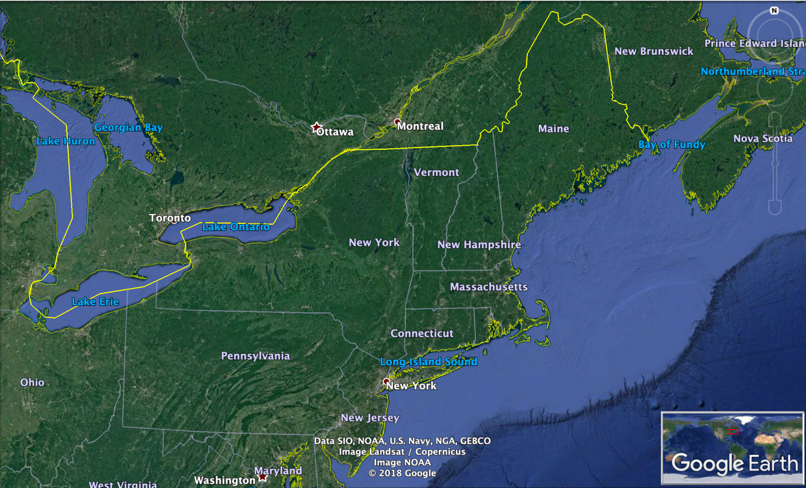
Field experiment
The Future
A coordinated network of sites across a large climate gradient
conducting seedling experiments
Interested? Contact me: NFisichelli@SchoodicInstitute.org

Slide 16
Take Homes
Seedlings are responsive to small shifts in climate
and interacting global change pressures
-warming temperatures
-climate variability: drought and late spring frost
-non-native species (plants, pests, and earthworms)
-deer browse
These responses can have lasting effects to future overstory composition (trees spend decades in the canopy) – potential for a depauperate overstory (low diversity)
We need more field experiments!
Coordinated network of experiments
Engage learners of all ages in these experiments (citizen science)

Slide 17
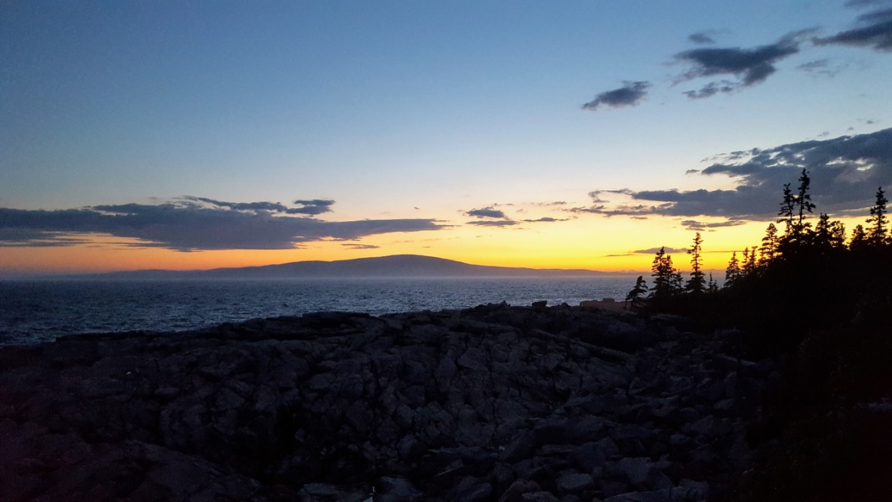

Thank You
Nicholas Fisichelli
NFisichelli@SchoodicInstitute.org
www.schoodicinstitute.org/about/forest-ecology-program/

