Slide 1
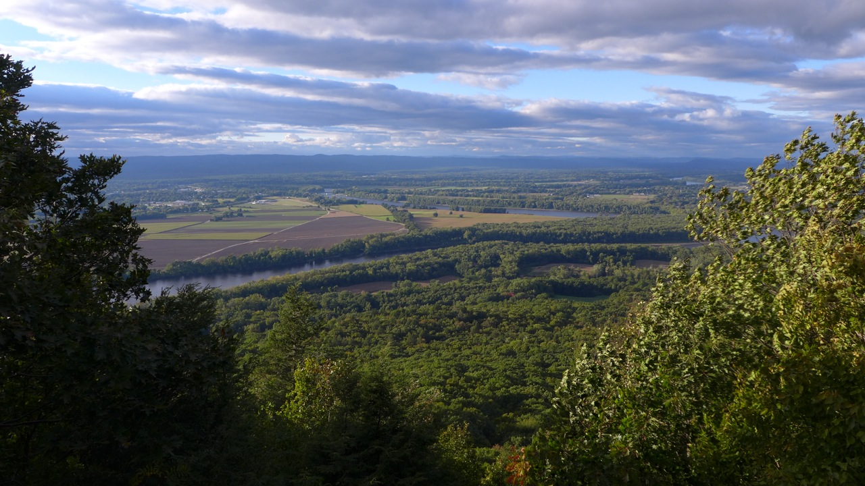



Relative impacts of climate change and urban growth on northeastern wildlife
William V. DeLuca^{1,2}, Ethan Plunkett¹, Bradley W. Compton¹, Joanna Grand³,
W. Scott Schwenk⁴, Kevin McGarigal¹
¹Department of Environmental Conservation, UMass, Amherst
²Northeast Climate Adaptation Science Center, UMass, Amherst
³National Audubon Society
⁴US Fish & Wildlife Service

Slide 2

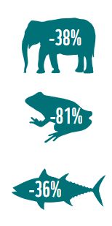
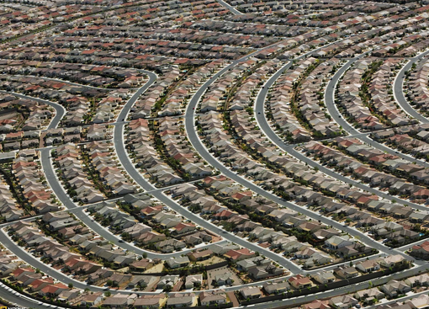
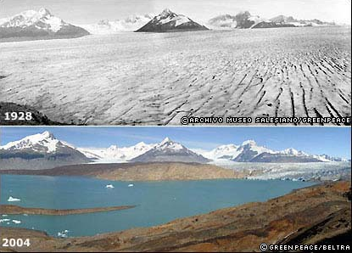
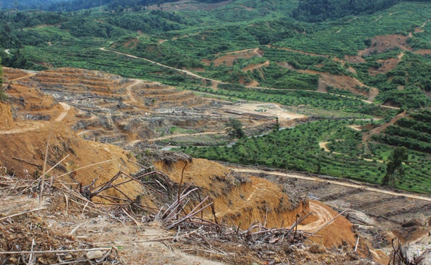
Wildlife populations at risk
Global populations of vertebrates have decreased by 58% since 1970
WWF, Living Planet Report 2016
¹
Notes:
Loosing wildlife and wildly thought to be caused by climate change and urban growth but rarely are have they relative importance to biodiversity conservation been quantified. Here in the NE, we’ve recently had an opportunity to 1. develop strategies conserve biodiversity and 2. to quatify the relative effects of projected climate change and urban growth

Slide 3

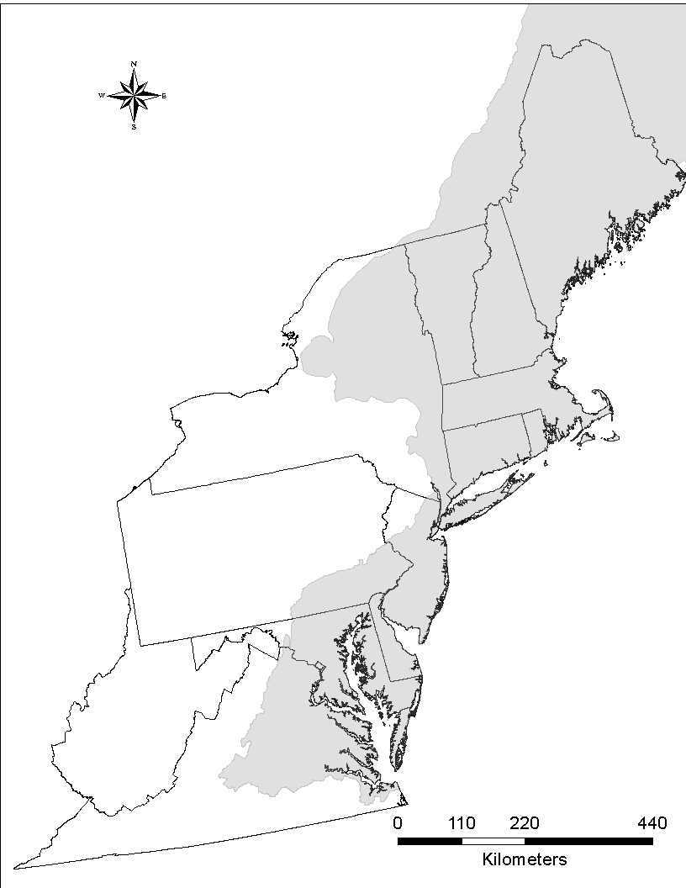
Designing Sustainable
Landscapes Project
NALCC
Assess the capability of current and potential future landscapes in the Northeast to provide integral ecosystems and suitable habitat for a suite of representative species, and provide guidance for strategic habitat conservation
Notes:
Project objectives

Slide 4
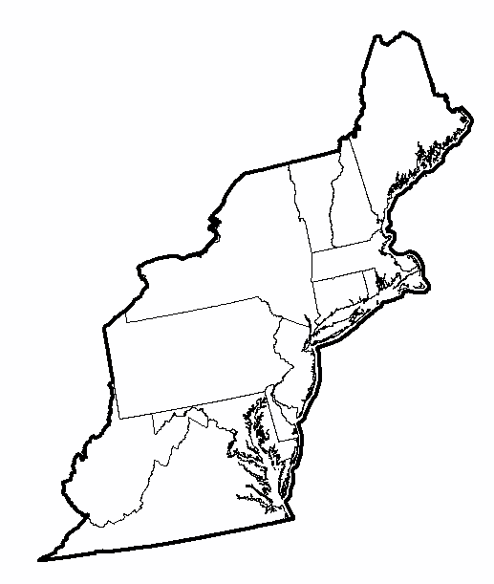



















Diverse group of stakeholder to develop a regional LCD
27 organizations, 13 states, 7 NGOs

Slide 5
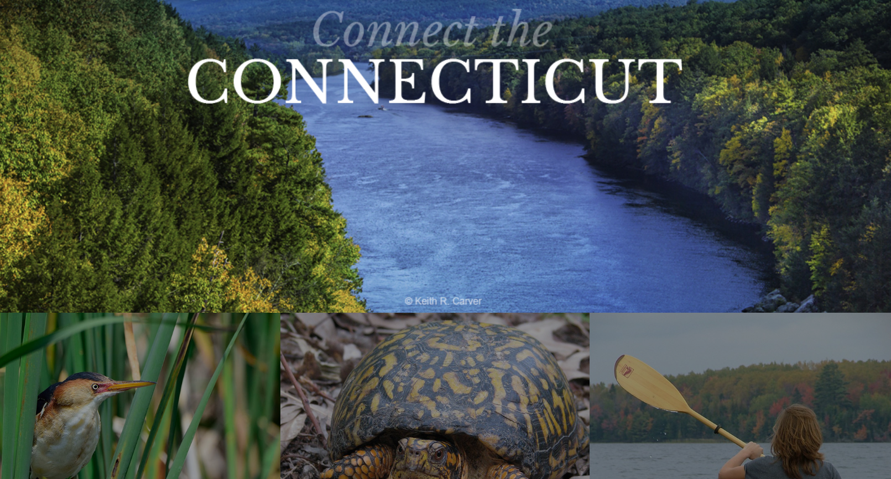
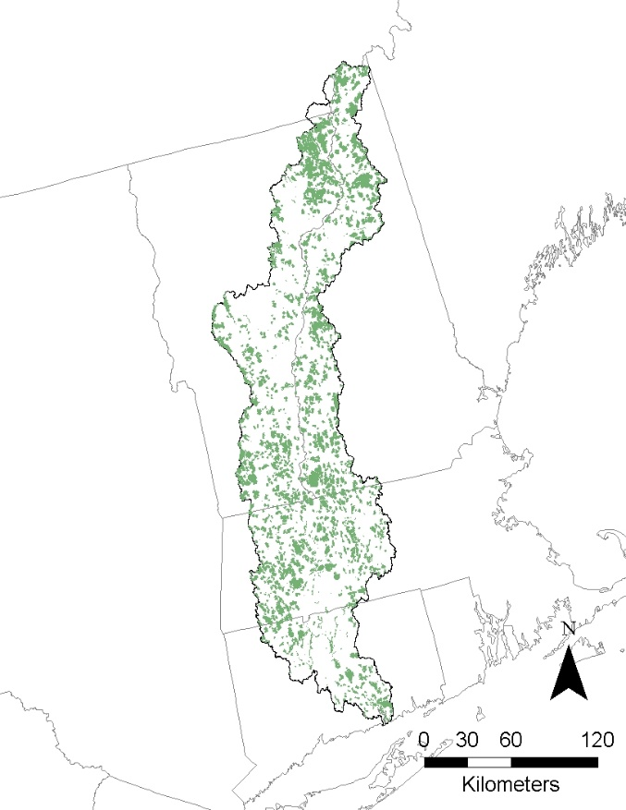
CT River Watershed Pilot Landscape Conservation Design
connecttheconnecticut.org

Slide 6
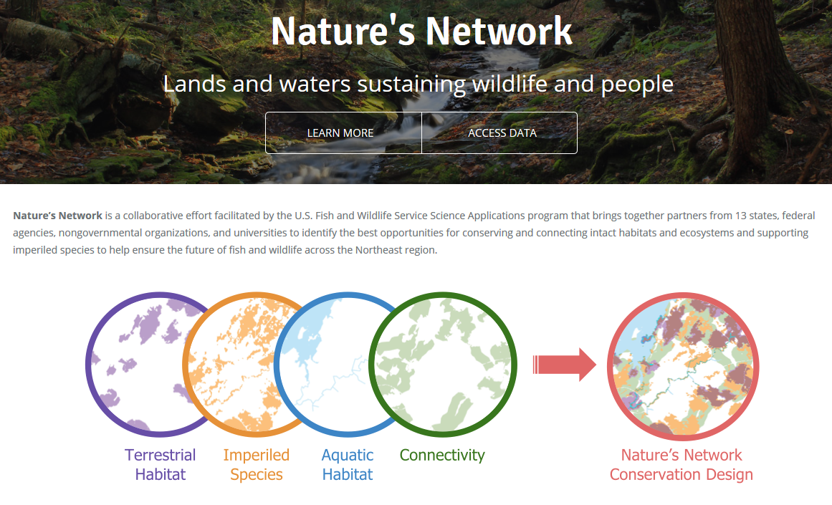
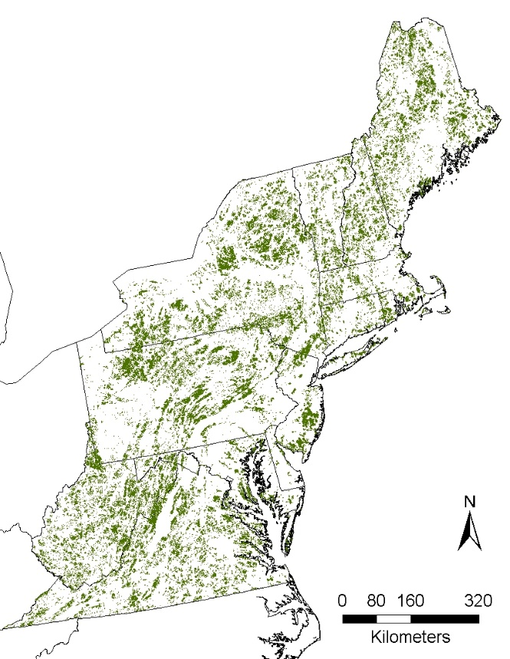
Northeast Regional Landscape Conservation Design
naturesnetwork.org

Slide 7
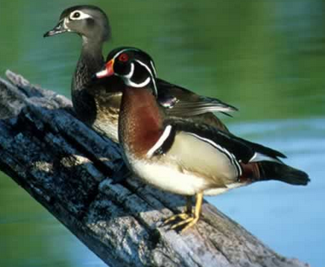
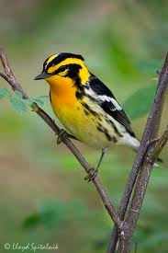
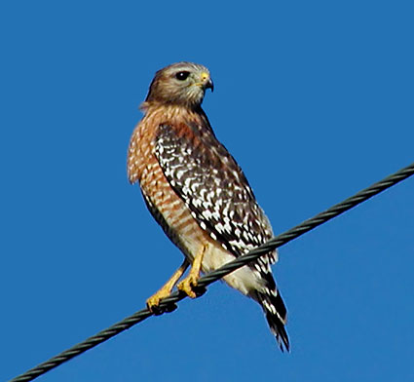
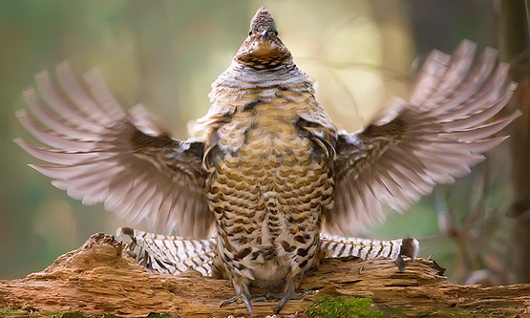
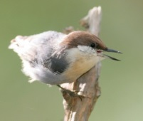
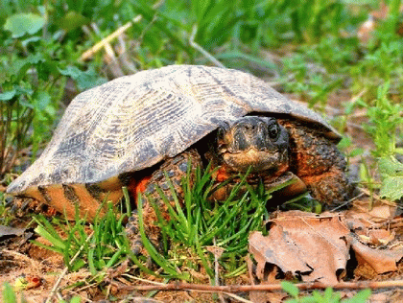
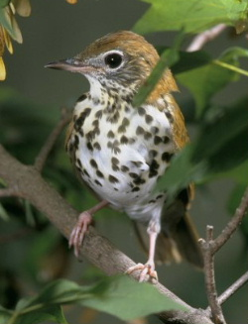
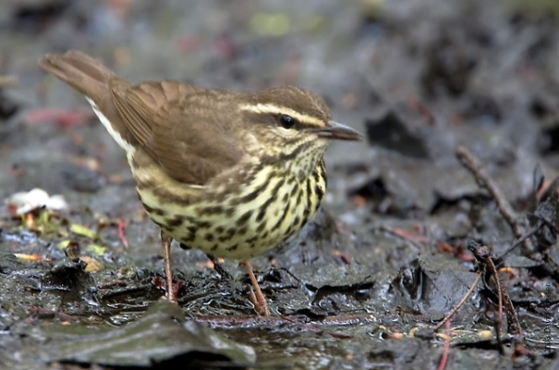
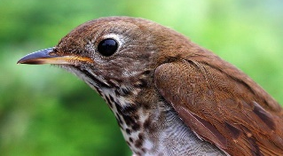
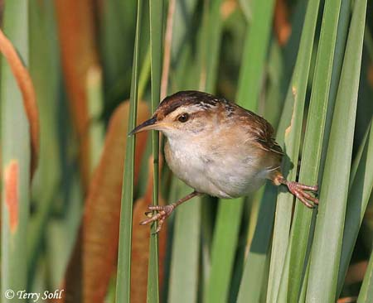
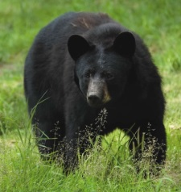
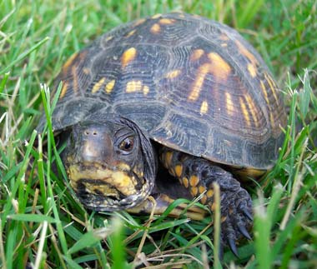
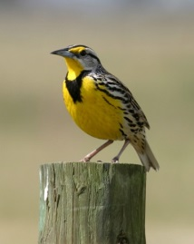
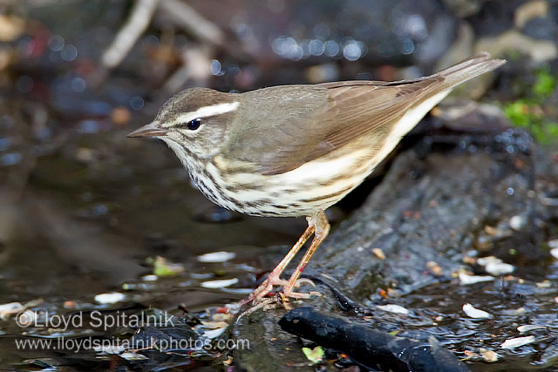
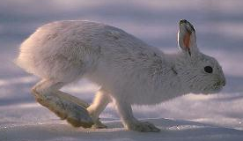
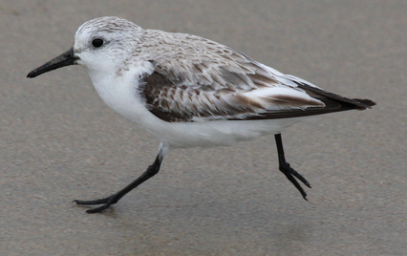
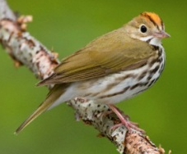
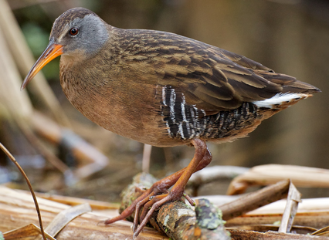
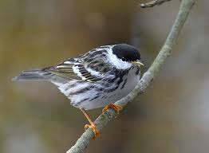
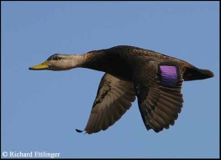
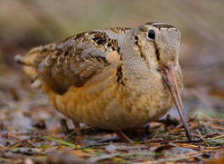
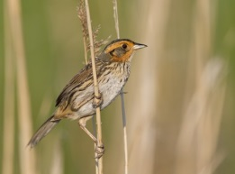
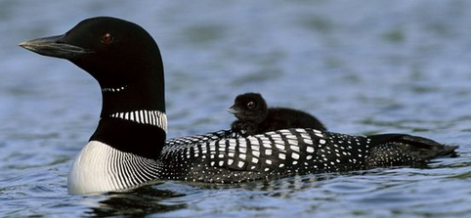
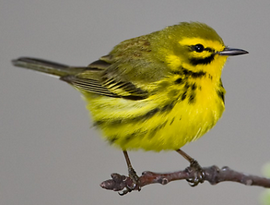
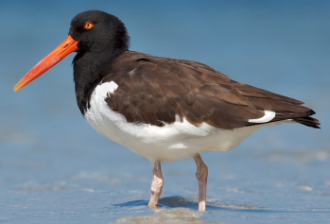
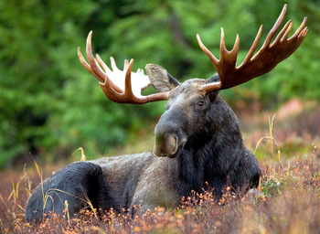
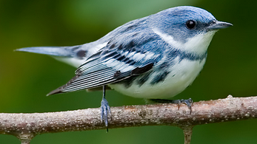
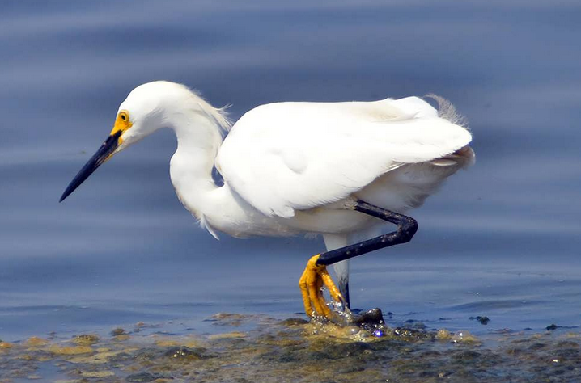
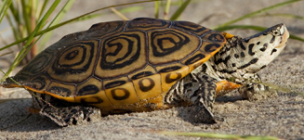
Surrogate species
Notes:
One significant part to help identify core areas in the LCD

Slide 8
Landscape Capability Models
Landscape Capability (LC) – capability of the landscape to provide suitable and accessible habitat
Ultimately informs landscape conservation design

Slide 9
Landscape Capability
Habitat
Capability
Climate
Suitability
Landscape
Capability

Slide 10
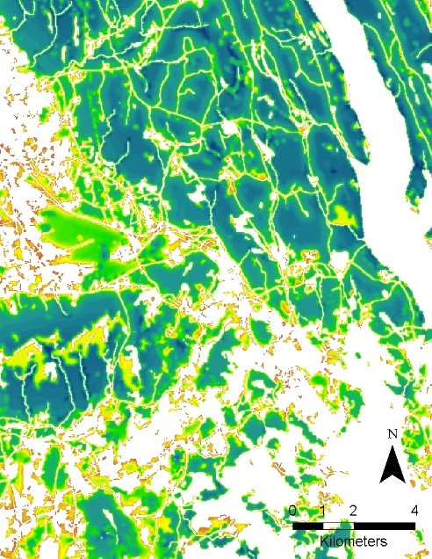
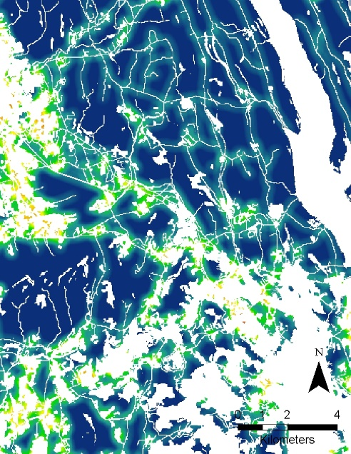
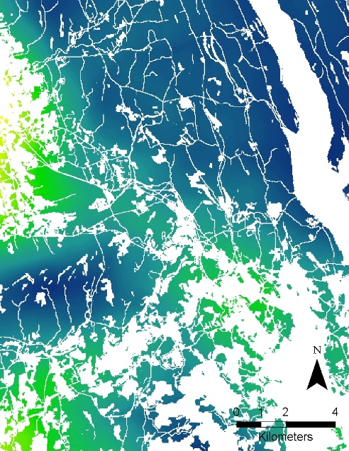
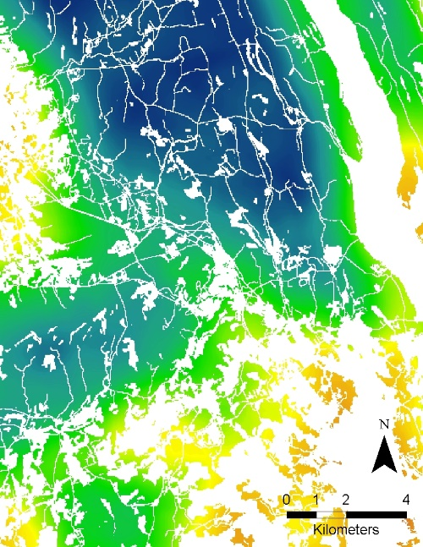
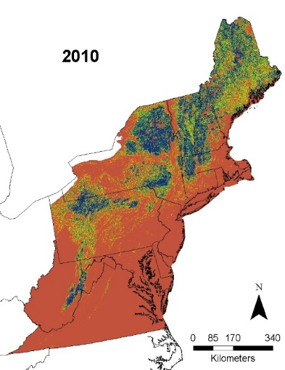
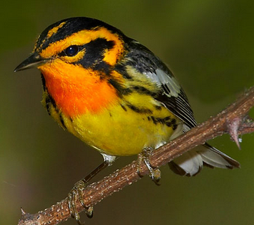
Habitat Capability
Homerange Capability
Fine Scale Development
coarse Scale Development
Habitat Quantity
Habitat Capability
Unsuitable
Suitable
Low
High

Slide 11
Landscape Capability
Habitat
Capability
Climate
Suitability
Landscape
Capability

Slide 12
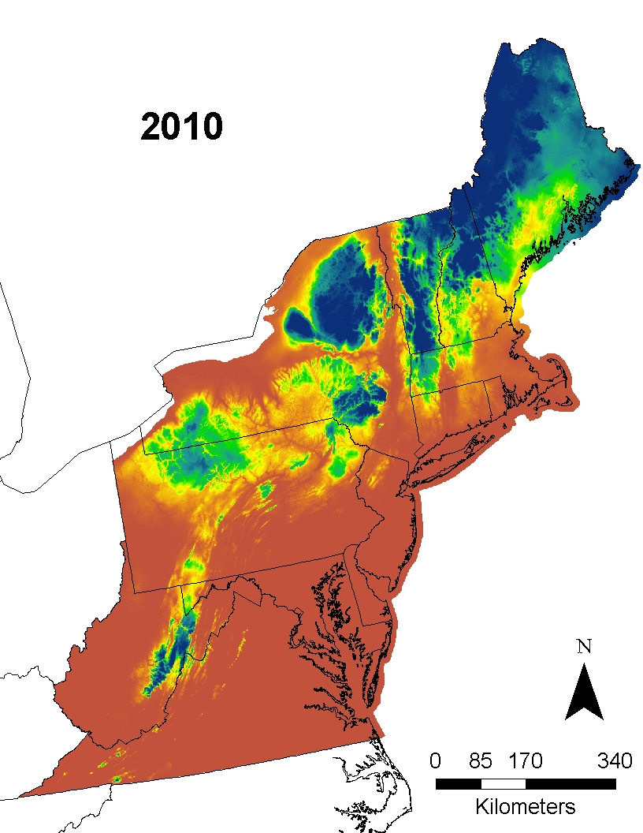
Climate Suitability
Unsuitable
Suitable
Notes:
BBS, logistic regression

Slide 13

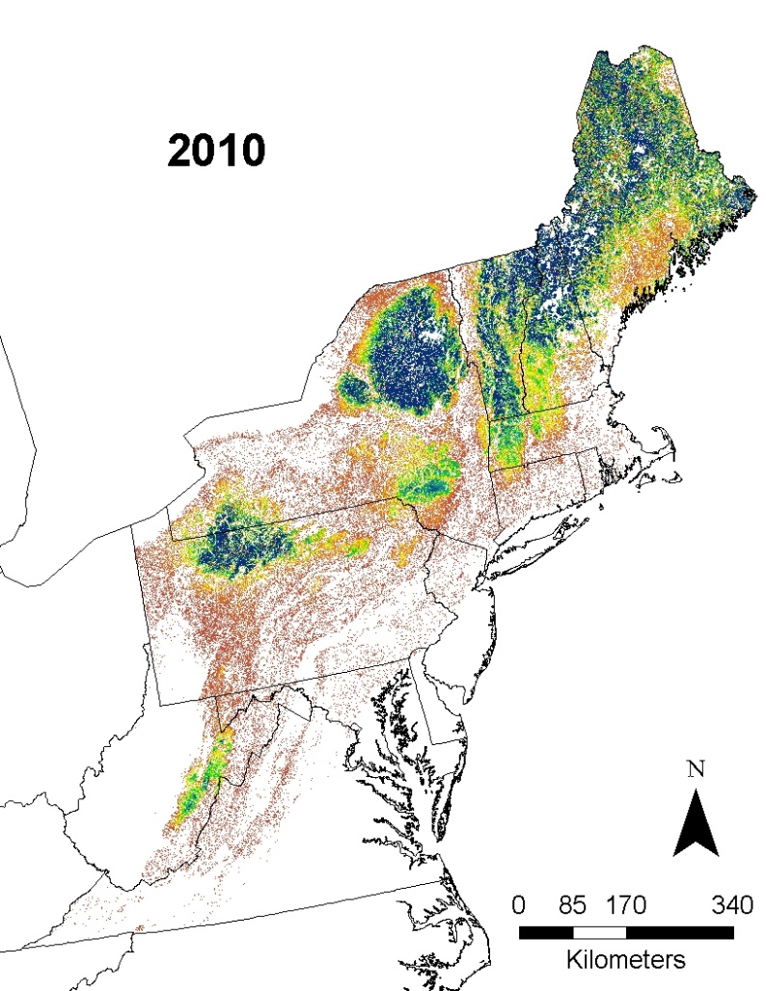

2010 Landscape Capability (LC)
Landscape Capability
Habitat Capability
Product
Climate Suitability
Low
High

Slide 14
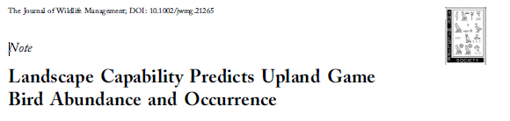
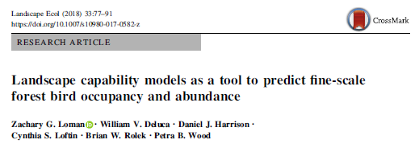
Landscape Capability model evaluation

Slide 15



Urban growth (SPRAWL) model
Probability of
Development
2080
2080 Landcover

Slide 16


Climate Suitability
Unsuitable
Suitable
Notes:
BBS, logistic regression

Slide 17



2080 Landscape Capability (LC)
2080
Habitat capability
Product
2080
Climate
suitability
Low
High

Slide 18

Future Uncertainty
Environmental Scenarios
Uncertainty of future (2080) conditions
 | Climate |  | SLR | SPRAWL
 | RCP 4.5 | RCP 8.5 | USGS | Baseline | Plus

Slide 19
Future Uncertainty
Environmental Scenarios
Uncertainty of future (2080) conditions
 | Climate |  | SLR | SPRAWL
 | RCP 4.5 | RCP 8.5 | USGS | Baseline | Plus
Habitat change only
Climate change only Tracking
Climate change only Refugia
Species Response Scenarios
Uncertainty of how species
will respond to 2080 conditions

Slide 20

Future Uncertainty
Environmental Scenarios
Uncertainty of future (2080) conditions
 | Climate |  | SLR | SPRAWL
 | RCP 4.5 | RCP 8.5 | USGS | Baseline | Plus
Habitat change only |  |  |  | X | X
Climate change only Tracking | X | X
Climate change only Refugia | X | X
Species Response Scenarios
Uncertainty of how species
will respond to 2080 conditions

Slide 21




Considering species range: Southern example
2010
2080
Unsuitable
Suitable
Notes:
Given these examples we really wanted to make sure we put our comparison of climate vs sprawl in appropriate context.

Slide 22




Considering species range: Northern example
2010
2080
Unsuitable
Suitable
Notes:
Given these examples we really wanted to make sure we put our comparison of climate vs sprawl in appropriate context.

Slide 23


North
Northern species
Low responsibility
Shifting out?
Less concern?
Northern species
High responsibility
Shifting out?
More concern?
Specie range center
Southern species
Low responsibility
Shifting in?
Concern?
Southern species
High responsibility
Shifting in?
Concern?
South
Low
High
Regional responsibility

Slide 24

























North
Specie range center
South
Low
High
Regional responsibility

Slide 25


Strong positive
climate effects
Strong negative
urban growth
effects
Strong negative
climate effects
Notes:
- axis; - box shape and uncertainty; - legend; - effect regions; - Results 1. northern species, regardless of responsibility typically have a strong negative climate effect; 2. Southern species mixed results +- climate and – climate; 3. species by species management information

Slide 26
Conclusions
Co-produced LCD can be effective
Scaling up from a pilot landscape is also effective
Not only is the final LCD useful, but its components are also informative

Slide 27

Conclusions
In the Northeast Region:
Northern species typically lose LC due to climate change
Southern species have a variable response to future conditions:
    Lose LC due to urban growth
    Lose LC due to climate change
    Gain LC due to climate change
When considering a species, this can inform management actions

Slide 28

Thank you

Slide 29


