Slide 1
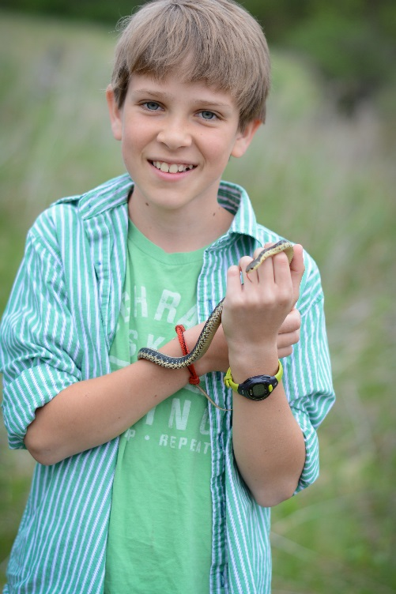
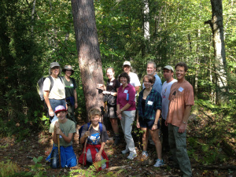
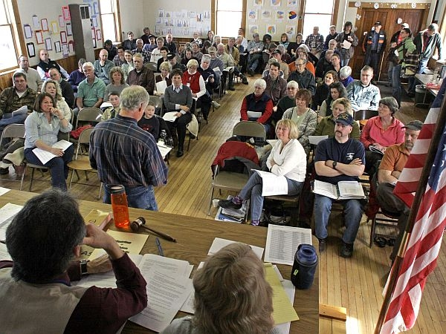

Effective Communication with a Municipal Audience
Jens C. Hilke & Monica Przyperhart
Vermont Fish & Wildlife Department

Slide 2
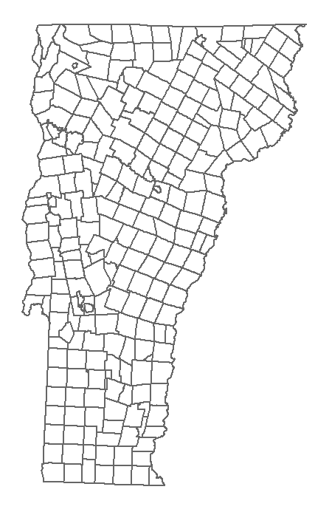
VT Municipalities
251 Towns in Vermont
Each with its own Land Use Planning & Regulatory Authority
Volunteers!
Constant turn-over
Little Institutional Memory
Lack of Capacity/Time
Notes:
Success requires many partners at multiple scales
Summarize scope of partnership/collaboration
Expanded the partners to who we thought was needed to implement this kind of strategy at this kind of scale
Many nested circles of partners at different scales
Energy, enthusiasm, and cohesion of the partners
from the outset when we identified the opportunity, and continuing now as we move into implementation.
Structure of partnership:
4-state steering committee meets monthly
individual project teams for 11 components – meet as needed
VT steering committee – shifting from monthly to quarterly meetings
G9 – intermediate level subcommittee in VT, meets monthly
Challenges and complexities of managing a partnership this big

Slide 3
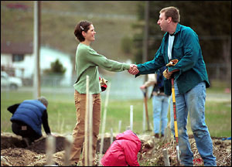
Technical Assistance is KEY
83% of the land is in private ownership
Notes:
We are responsible for entire spectrum of scientific concepts from wetlands and vernal pools to forests, habitats and rare species

Slide 4
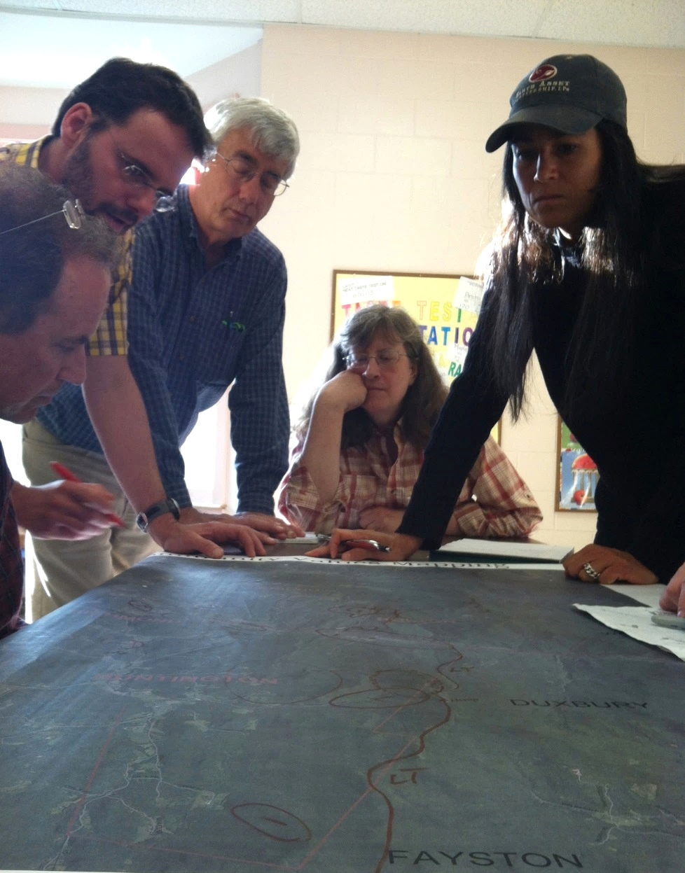
Community values mapping: an activity to capture local knowledge
VALUES
Economic
Hunting & Fishing
Scenic
Wildlife
Working lands (forestry, agriculture)
Recreation
Historic and community resources
Notes:
With that in mind, I’d like to go into detail on one approach : community values mapping. How many people here have participated in community values mapping?
A reason to do this is that there are a lot of people in communities who know about natural resources from different vantage points: foresters, hunters, anglers, birders, hikers, bikers, foragers, boaters, kids, property owners. This brings them together.
This exercise allows people to identify the locations of the they value, and where there are overlapping values. Later, you can look at how those values overlap with mapped natural resources. Doing this can help prioritize actual locations to focus projects and outreach.
Where values overlap, these represent opportunities. They indicate potential allies – “the hunters and the mountain bikers both care about this location.” It may also reveal potential friction or differing goals – but even that is a way to initiate a discussion about whether compromise might make sense.
This is different from a survey. A survey is great for getting a lot of people to participate, but a limitation of a survey is that it can be hard to prioritize. People could say, for example, that they favor both more commercial tax base in town and more conservation, which is possible to accomplish, but a survey doesn’t give you much information where each should go, and how to measure tradeoffs. Actually drawing on a map helps identify the locations of different values on the ground.
__________
Image note: Community values mapping exercise in Mad River Valley, VT, as part of the Forests, Wildlife and Communities Program.

Slide 5
Translation
Belt Width
B = 3.7W^{1.12} Williams, 1986
Using Williams Regression
Meander width ratio B/W = 5 to 6 channel widths
Vermont Meander Width Ratios
Low gradient, unconfined alluvial streams
B
Belt Width
N = 66
R² = 0.67
Vegetated Buffer
Toe of left valley wall
Toe of right valley wall
B = 10^1.93(log W)^{10^0.49}
B/W = 6 to 8.5
For a 50 foot wide stream B/W = 6.7
Meander Centerline MCL
Flow
Belt Widths are a function of
drainage area = D
stream width = W
valley slope & width
stream sensitivity

Slide 6
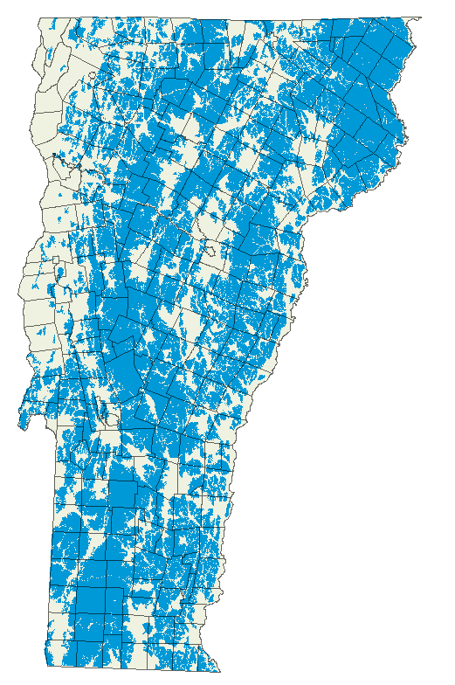
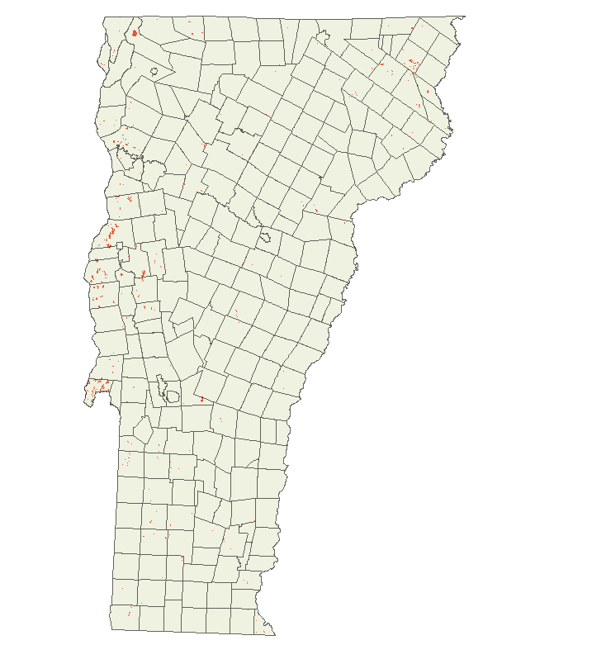
Scale
includes coarse and fine filter elements
Habitat Blocks – 60% of VT
Rare Natural Communities– 0.31% of VT

Slide 7
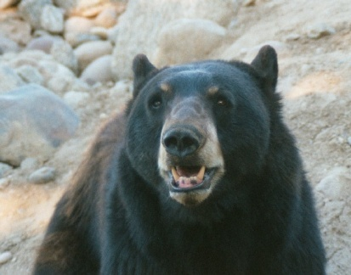
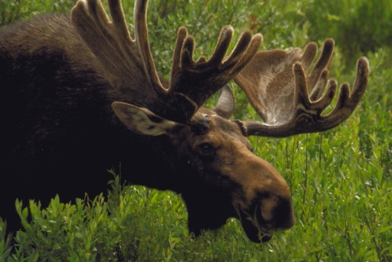
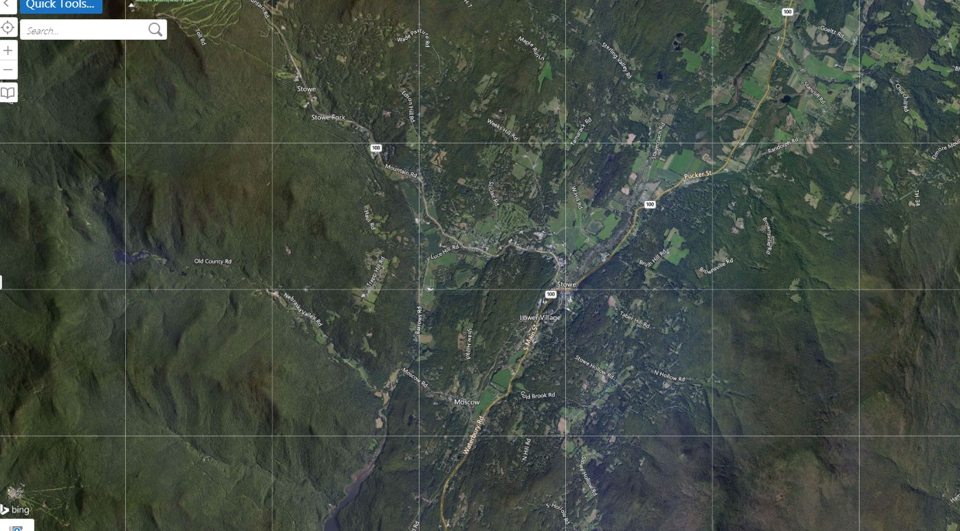
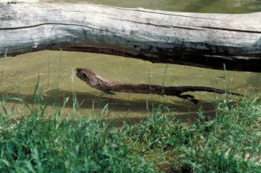
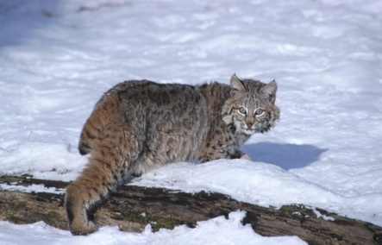
Scale
Black Bear
30+ square miles
Moose
2-20 square miles
Bobcat
27 square miles
River Otter
15-30 linear miles
Notes:
Looking at a location on a landscape, think about how this bear may move across it, staying largely under cover. Will it be able to link together the patches of forest to travel between them? Is there an appropriate place to cross the large road? Can it use riparian areas or other vegetated strips to get between other blocks?
This landscape is fragmented. But if connections between fragments can be made, the effects can be somewhat lessened.

Slide 8
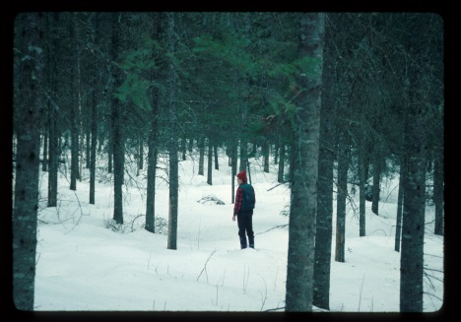
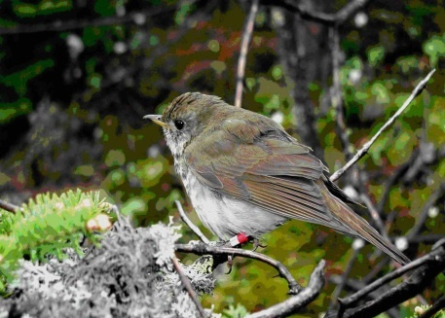
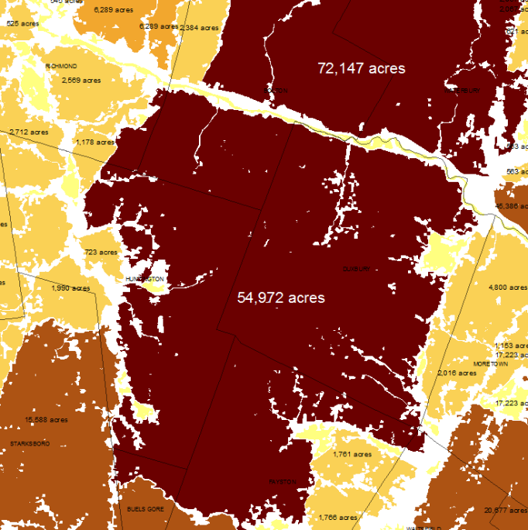
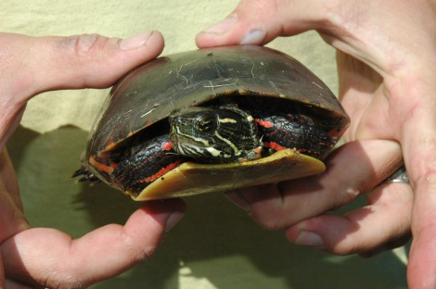
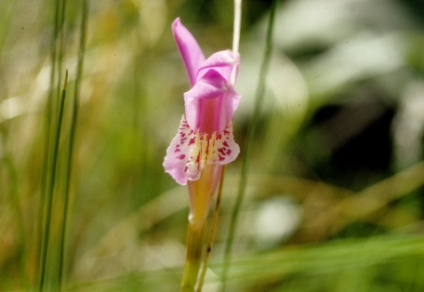
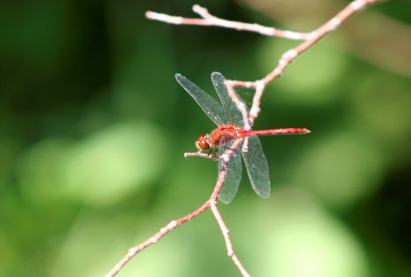
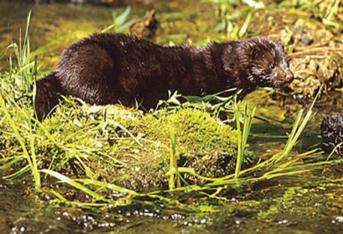
Coarse filter
  If examples of all coarse-filter elements are conserved at the scale at which they naturally occur, most of the species they contain—from the largest trees and mammals to the smallest insects—will also be conserved.

Slide 9
Effective Communication with a Municipal Audience
Monica Przyperhart
Vermont Fish & Wildlife Department

Slide 10
We need to:
Inspire communities to care about a scientific concept
Keep our messages consistent
The Messaging Triangle

Slide 11
Point #1
Each corner =
a Pivot Point
Key Message
Point #2
Point #3
Notes:
Marketing Tool
HOW?
Corners are pivot points
Points are broad messages that can be backed up with more specific detail.

Slide 12
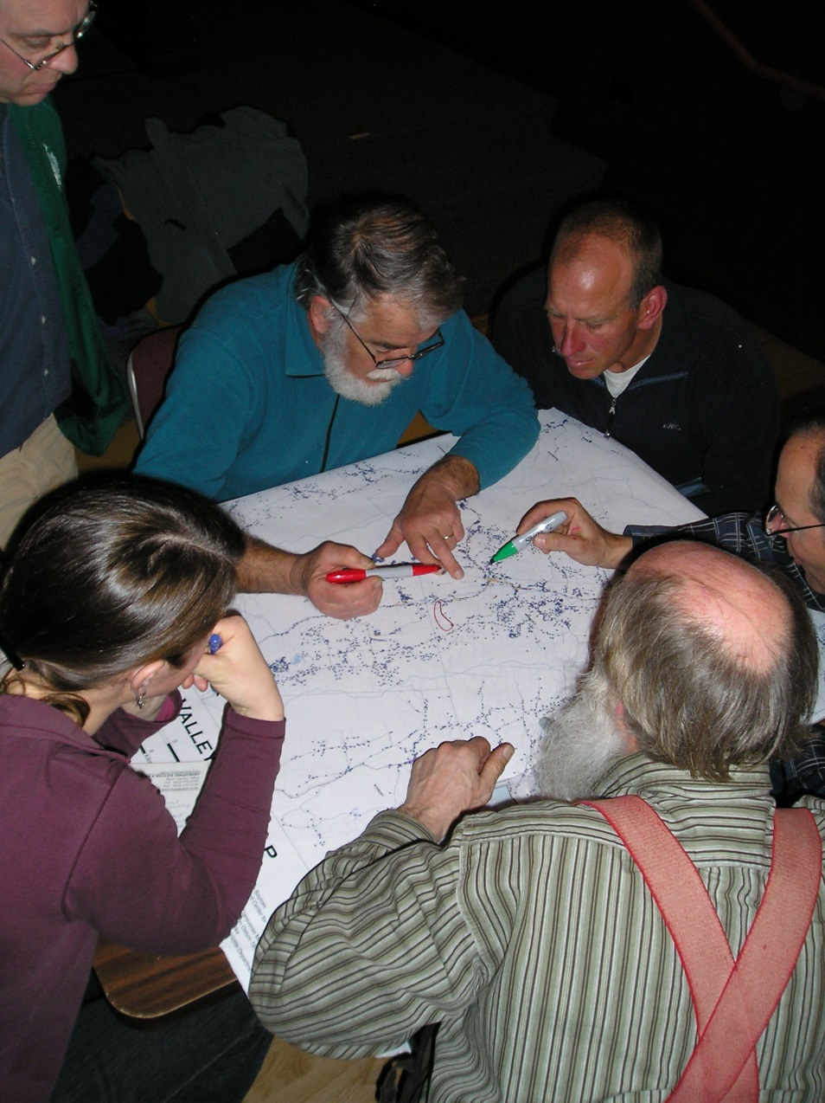
What do we want ALL municipal audiences to hear?

Slide 13
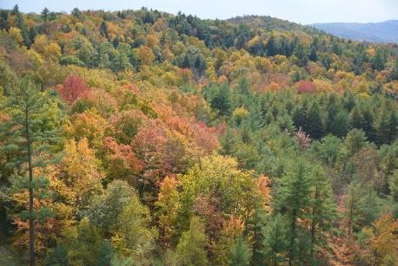
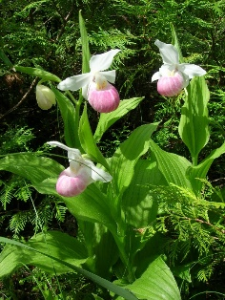
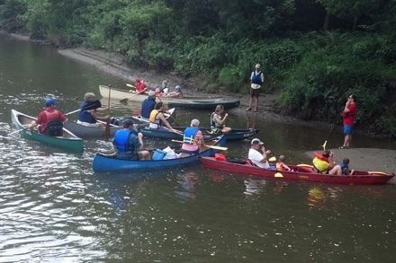


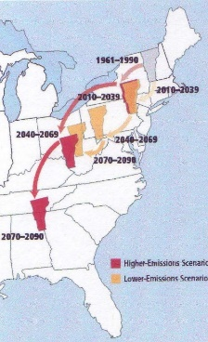
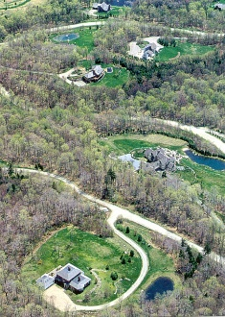
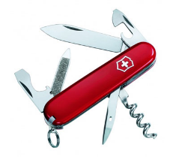
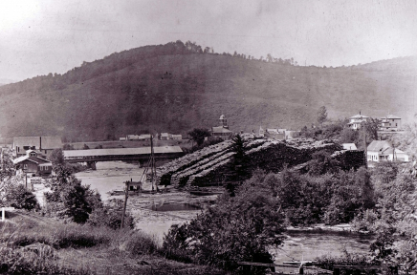
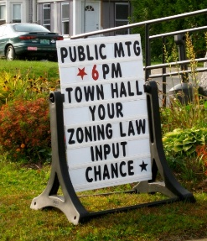
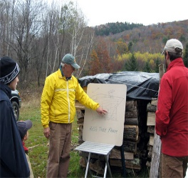
Connect to your PLACE
Healthy Ecology,
Healthy Economy,
Healthy Community
Understand CHANGE
Know your OPTIONS
Notes:
Data fits into this framework

Slide 14
Connect to your PLACE
Science?
Human Connections
Healthy Ecology,
Healthy Economy,
Healthy Community
Understand CHANGE
Know your OPTIONS
Notes:
The beauty of this is that it helps us to TRANSLATE science into focus areas that people care about.

Slide 15
Connect to your PLACE
Rare Species
Wetlands
Healthy Ecology,
Healthy Economy,
Healthy Community
Understand CHANGE
Know your OPTIONS
Notes:
How it all works together
Give an example for starting at each corner:
Climate Change/ Fragmentation: (Start at change)
Rare species: Start at place
Zoning requests/CC general “what can we do to help wildlife” requests: Start at tools/options
ALWAYs come back to Ecology, Economy, Community

Slide 16
Connect to your PLACE
Fragmentation
Development Trends
Healthy Ecology,
Healthy Economy,
Healthy Community
Understand CHANGE
Know your OPTIONS
Notes:
How it all works together
Give an example for starting at each corner:
Climate Change/ Fragmentation: (Start at change)
Rare species: Start at place
Zoning requests/CC general “what can we do to help wildlife” requests: Start at tools/options
ALWAYs come back to Ecology, Economy, Community

Slide 17
Connect to your PLACE
Zoning
Healthy Ecology,
Healthy Economy,
Healthy Community
Understand CHANGE
Know your OPTIONS
Notes:
How it all works together
Give an example for starting at each corner:
Climate Change/ Fragmentation: (Start at change)
Rare species: Start at place
Zoning requests/CC general “what can we do to help wildlife” requests: Start at tools/options
ALWAYs come back to Ecology, Economy, Community

Slide 18
Connect to your PLACE
Scale
Course Filter Conservation
Healthy Ecology,
Healthy Economy,
Healthy Community
Understand CHANGE
Know your OPTIONS
Notes:
Complex concepts can be carried through
Options: Regulatory standard much more specific at finer scale, more general at larger scale
Change: Forest frag is a change that mostly impacts landscape scale, not individual parcels

Slide 19
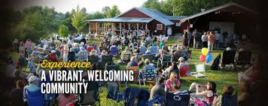
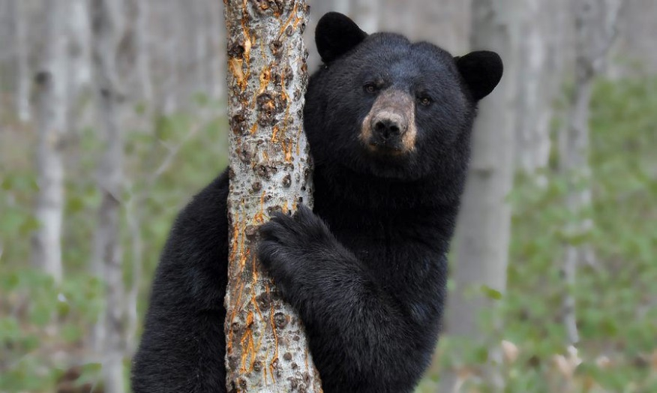
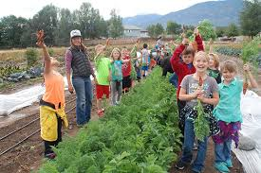
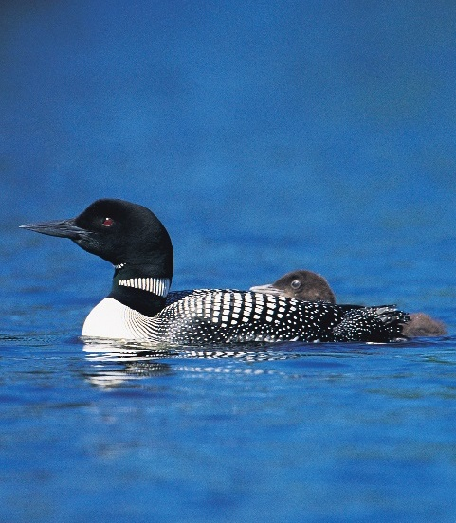
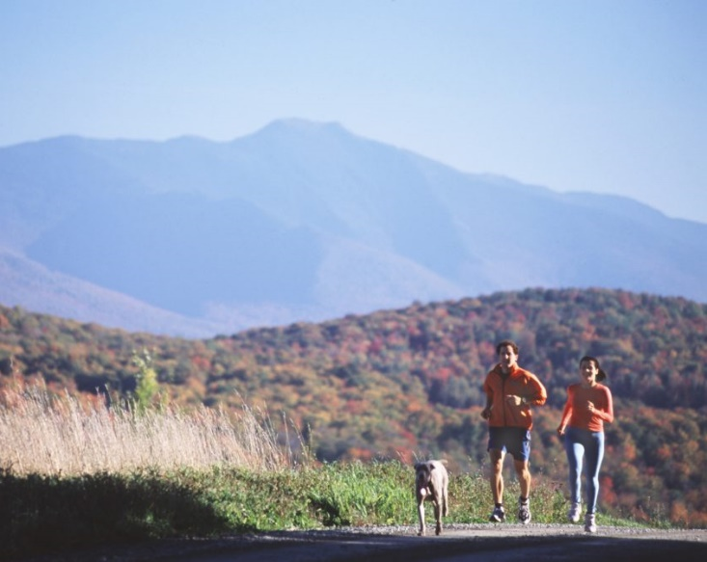
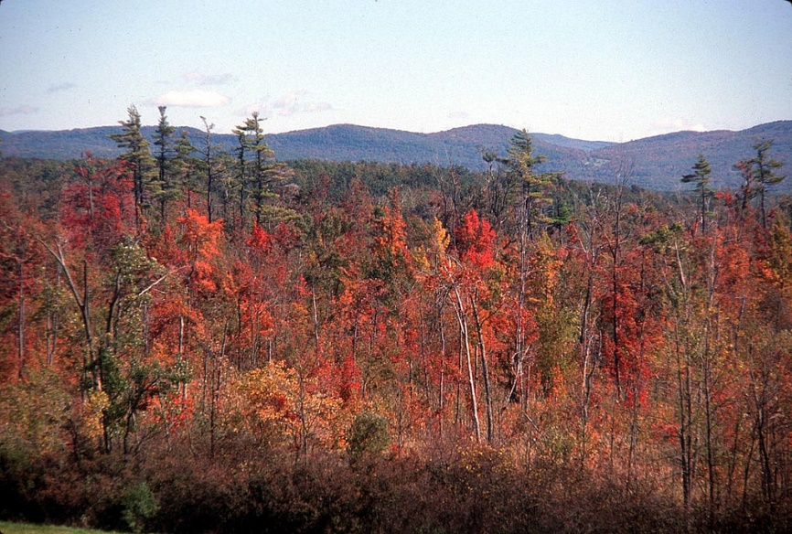
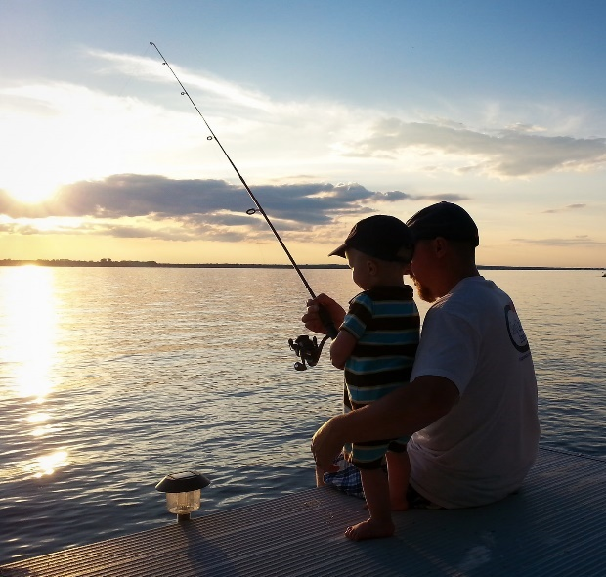
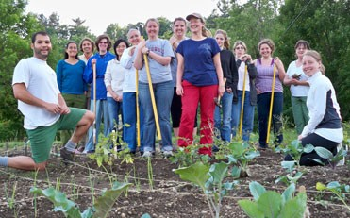
Healthy
Ecology Economy Community

Slide 20
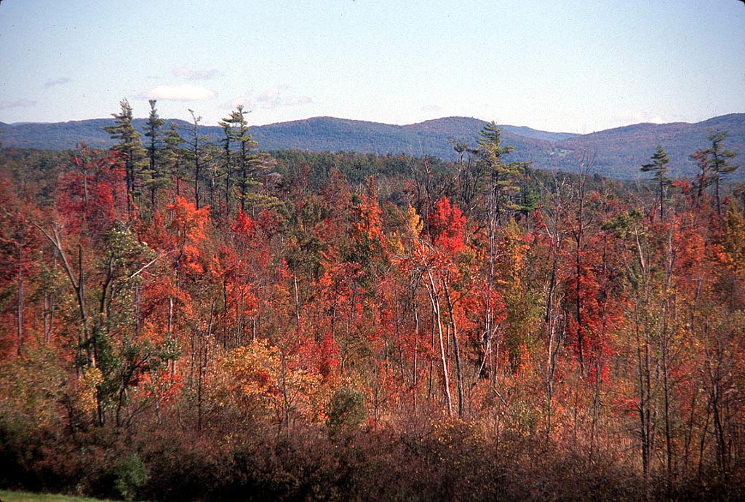
Jens Hilke
Monica Przyperhart
Community Wildlife Program
Vermont Fish & Wildlife Department

