Slide 1
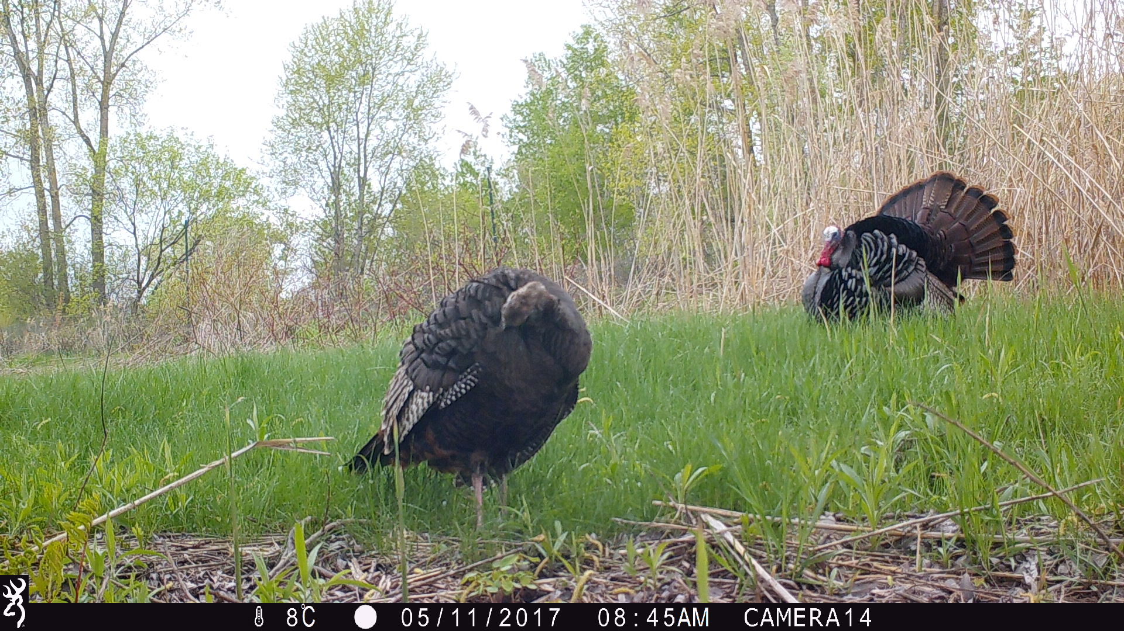
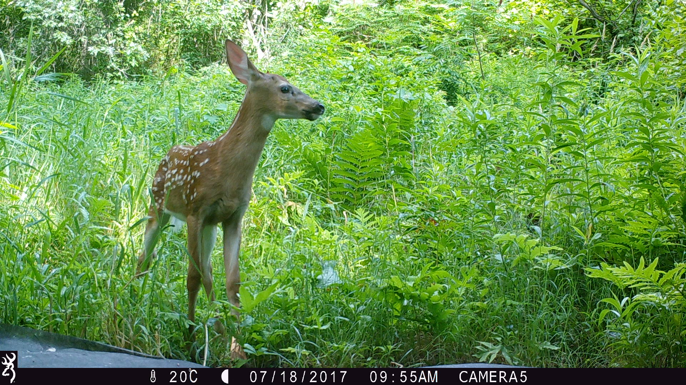
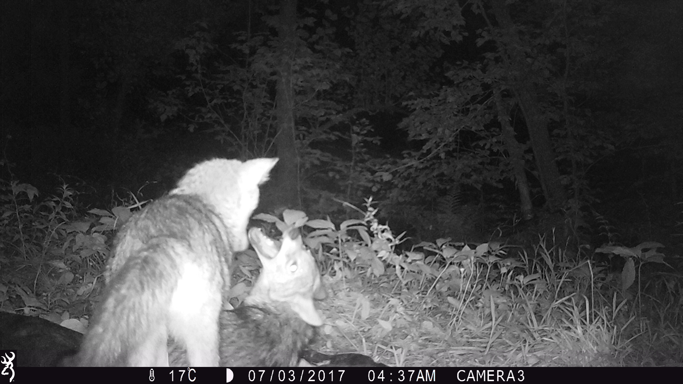
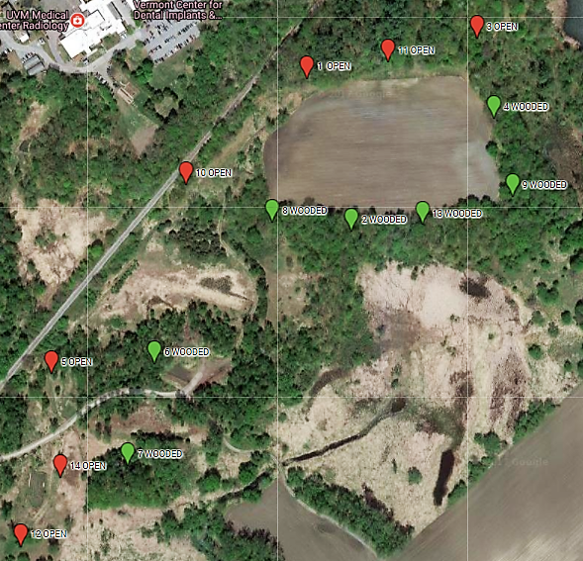
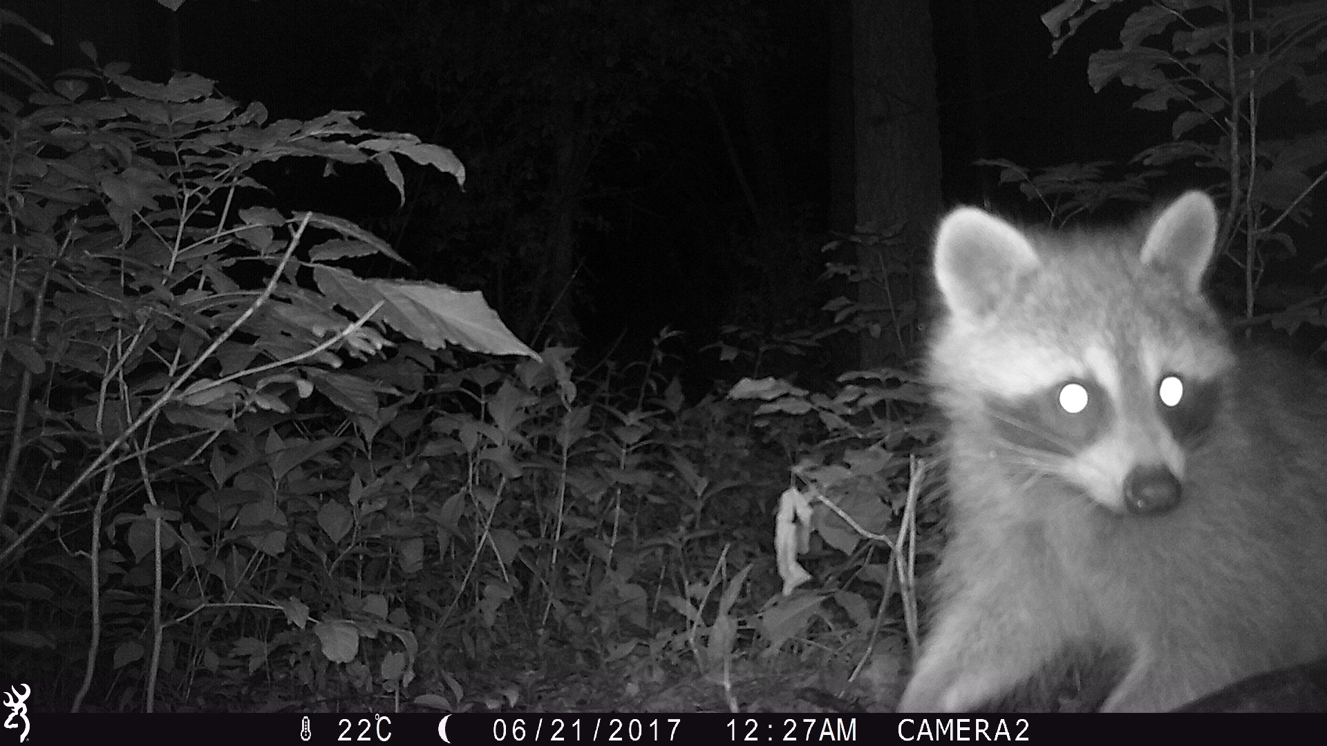
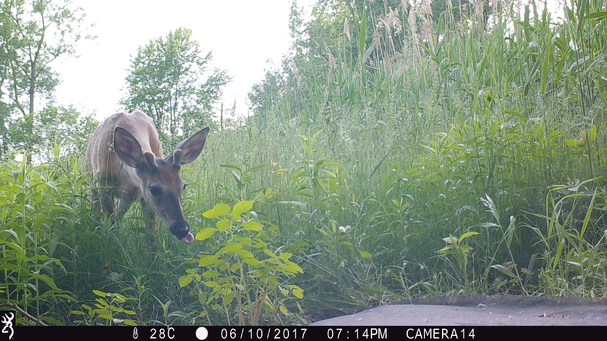
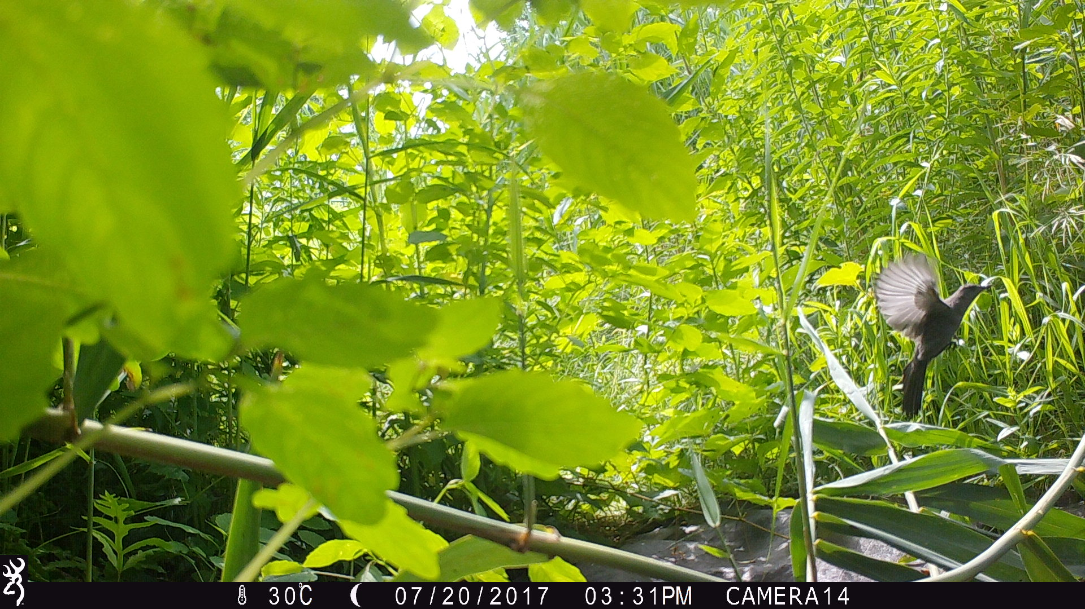
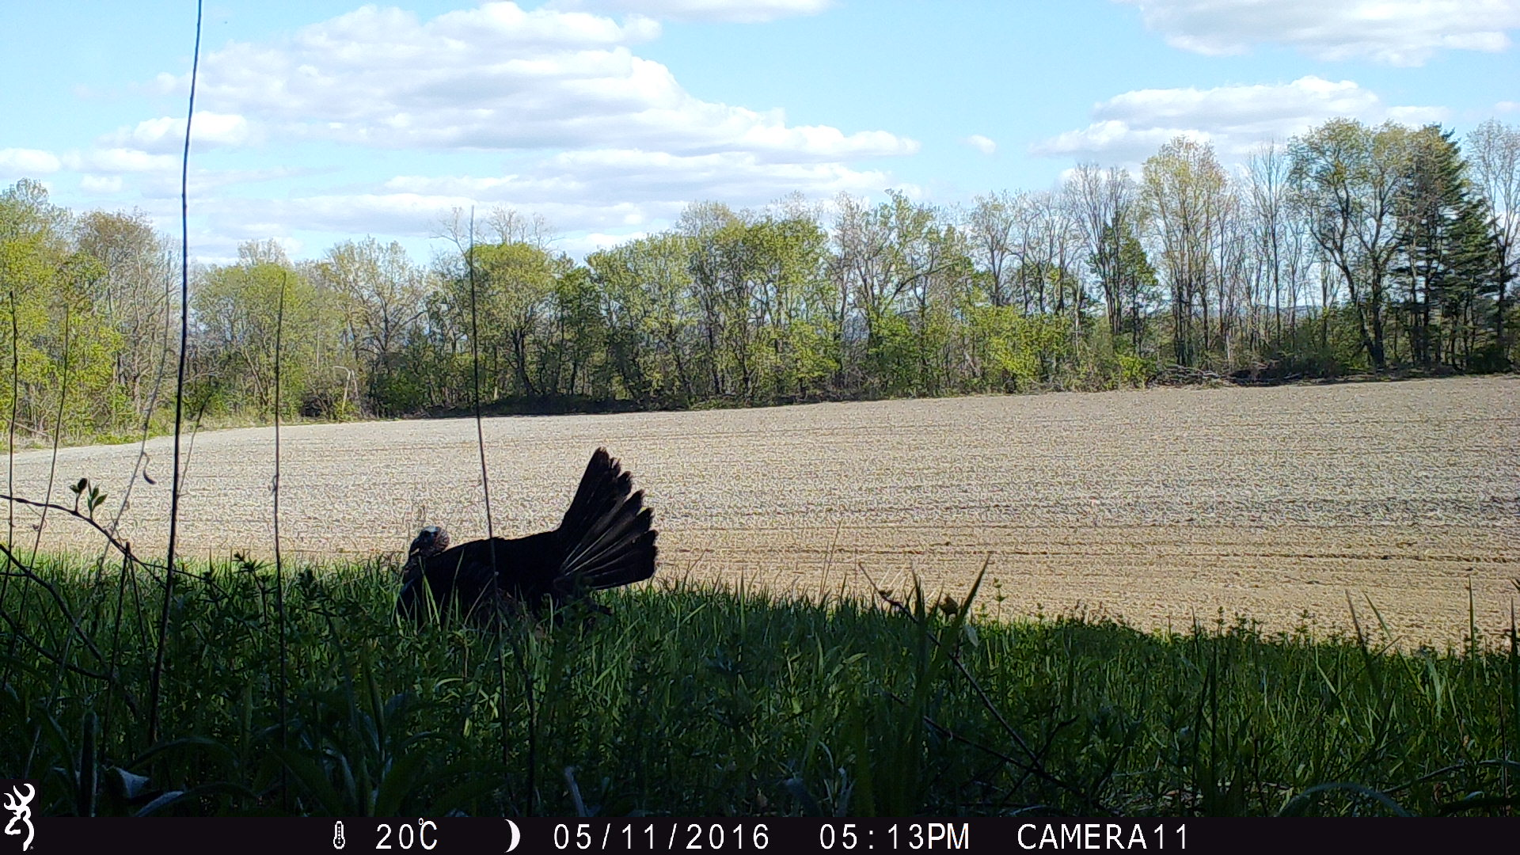
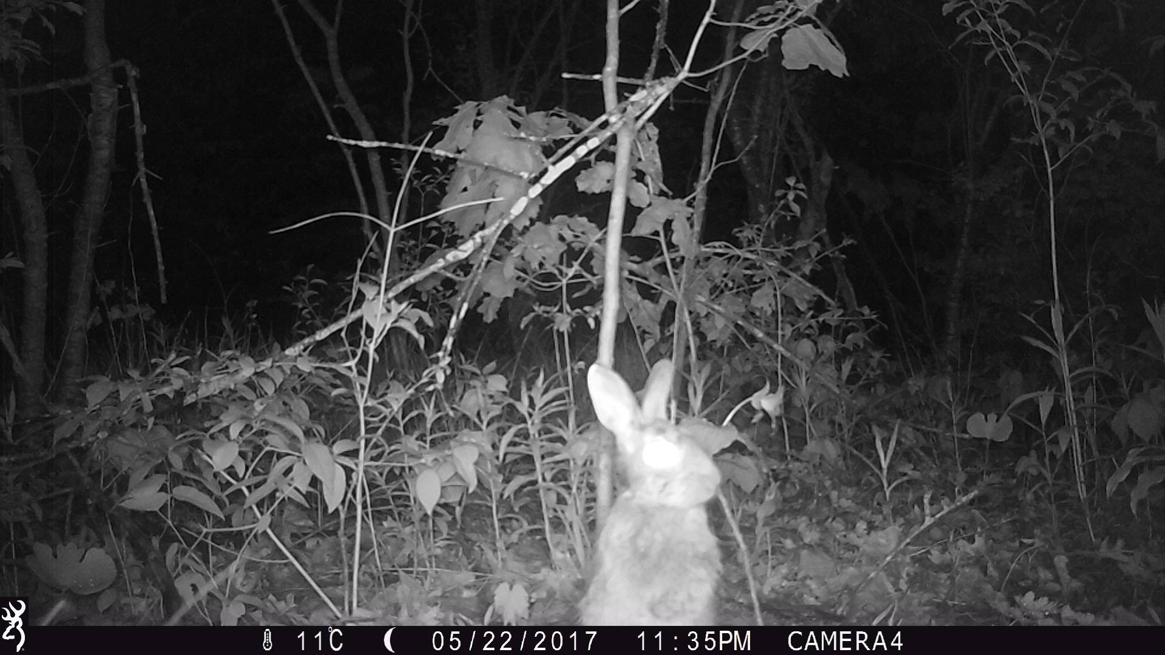
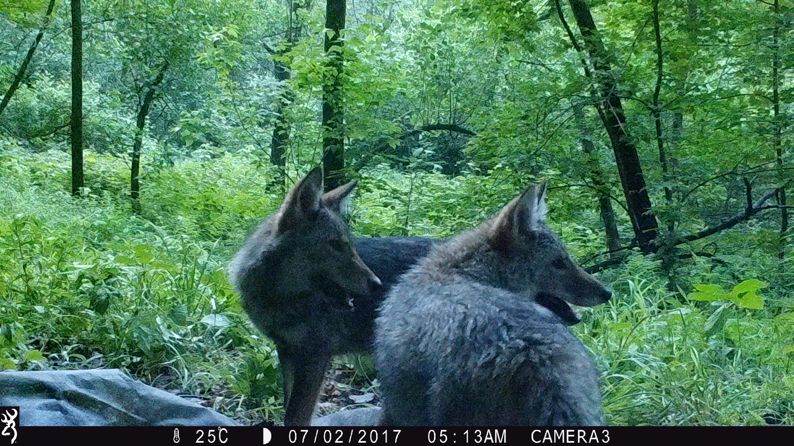
Effects of woody shrub and tree density on species richness and habitat preference
Alyssa Valentyn ’19, Declan McCabe
Biology Department, Saint Michael’s College, Colchester, VT
Abstract
Human modification of landscapes alters the structure of plant communities, thus modifying mammal habitats and mobility pathways. The Saint Michael’s Natural Area in Colchester, VT, contains wetlands which have previously been used for agriculture but which may soon undergo restoration. This research establishes a base understanding of the distribution of mammal species across habitat types based on size and time of day. We surveyed the area surrounding a cornfield using Browning Strikeforce trail cameras (n=14), deployed for a total of 1,253 trap nights during May, June, and July 2017. We collected camera SD cards monthly and cataloged each photo by species, date, time, and size of animal sighting. Camera sites were determined by forest density and considered “wooded” (n=7 sites) or “open” (n=7 sites) based on tree density. Site categories were verified and site density was determined using shrub and tree diameters at breast height (DBH) and an estimation of canopy cover. We found a greater number of species in wooded sites than in open sites. Notably, wooded sites were generally frequented by small and medium- sized animals while open sites were generally preferred by larger animals. Species richness was mildly influenced by tree density. These findings suggest that habitat restoration to a more wooded state may favor small mammal populations.
Results
Discussion
SPECIES RICHNESS
Tree density and canopy cover were positively correlated with species richness, though neither relationship was significant (p>0.05; Figure 2).
Tree density had a stronger impact on species richness than cover (Figure 2).
ANIMAL SIZE DISTRIBUTION
Larger animals were more common in open habitats while smaller animals dominated wooded habitats. (Figure 3).
Small mammals will move to areas with cover in order to avoid predation, and predators will move to areas to catch predators (Fahrig 2007).
Medium-sized animals were more common in wooded areas than in open areas (Figure 3). Mobility through both habitat types may have been influenced by the prey presence of small mammals seeking cover in wooded sites.
Coyotes were more commonly seen in wooded sites than open sites, though Person & Hirth (1986) documented coyote preference for open habitat type. Presence of prey species likely influenced distribution.
Deer were the only “large” animal documented.
HABITAT TYPE ON DIEL ACTIVITY PATTERNS
Daytime activity occurred mainly in open habitat types, excepting squirrels (Figure 4).
Beier & McCullough (1990) found that deer preferred wooded habitats during daytime in summer months, but would move into open areas during other times. We found a preference for open sites regardless of time of day (Figure 4).
Nighttime activity was fairly evenly distributed across open and wooded habitat types (Figure 4).
a. b.
FIGURE 2. (a) As site density, represented by DBH, increased, more species were sighted. (b) As cover increased, the amount of species sited increased.
N
203
Introduction
BACKGROUND
Patchy environments are linked by woody movement corridors.
Animals will alter paths based on species-specific needs for cover. As cover decreases, the movement paths tend to follow straight lines (Fahrig 2007), increasing the likelihood of animal sightings.
Species’ presence is directly influenced by proximity to forest edges and orientation within ecosystem (Moruzzi et al. 2002).
If we can understand how habitat type affects species composition and distribution, then we can begin to understand how altering landscapes through restoration will affect local fauna.
MAIN QUESTIONS
Does tree density and canopy cover affect species richness?
Do animals of different sizes frequent one habitat type over another?
How does habitat type impact the diel distribution of animal sightings?
162
111
59
58
50
39
27
Acknowledgements
I would like to thank the Saint Michael’s College Vice President of Academic Affairs, Karen Talentino, for providing the opportunity to do research, and the Board of Trustees for providing funding. Thanks also to the Hartnett Fellowship for providing funding. I would additionally like to thank Professor Peter Hope for his guidance and expertise on plant identification.
FIGURE 3. Animals seen per habitat type, categorized by size. Animal size increased among open habitat types and decreased among wooded habitat types.
FIGURE 4. Sightings of most abundant species, categorized by time of day and habitat type. This visualization compiles activity patterns of animals in the Colchester area as documented.
Methods
STUDY AREA
Saint Michael’s Natural Area in Colchester, VT
3-month time period beginning in May and ending in July
Study sites around one of two corn fields, adjacent to floodplain and sandplain forest
14 Browning Strikeforce trail cameras set at 7 wooded and 7 open sites
SITE DENSITY AND COVER
Measured woody shrubs and trees at breast height in centimeters, and considered any woody stem greater than 6 cm to be a tree
Used 2.5m x 2.5m quadrat method to estimate tree cover in meters
DOCUMENTING MAMMAL DATA
Documented by animal, date, time of sighting, time of day¹, and size of animal²
Sightings of same animal type logged separately if they occurred outside of a 30-minute interval (Karlin & de la Paz 2015; Gompper et al. 2006; Yasuda 2004; and others)
¹Time of day based on Christensen (2016). ²Size of animal based on Bellis et al. (2013)
Gallery
Literature Cited
Beier, P., & McCullough, D. R. 1990. Factors influencing white-tailed deer activity
patterns and habitat use. Wildlife Monographs, 109: 3-51.
Bellis, M. A., Griffin, C. R., Warren, P., & Jackson, S. D. 2013. Utilizing a multi- technique, multi-taxa approach to monitoring wildlife passageways in southern Vermont. Oecologia Archives, 17(1): 111-128.
Christensen, D. R. 2016. A simple approach to collecting useful wildlife data using remote camera-traps in undergraduate biology courses. Bioscene: Journal of College Biology Teaching, 42(1): 25-31.
Fahrig, L. 2007. Non-optimal animal movement in human-altered landscapes. Functional Ecology, 21(6): 1003-1015.
Gompper, M. E., Kays, R. W., Ray, J. C., Lapoint, S. D., Bogan, D. A., & Cryan, J. R. 2006. A comparison of noninvasive techniques to survey carnivore communities in northeastern North America. Wildlife Society Bulletin, 34(4): 1142-1152.
Karlin, M., & de la Paz, G. 2015. Using camera-trap technology to improve undergraduate education and citizen-science contributions in wildlife research. The Southwestern Naturalist, 60(2-3): 171-179.
Moruzzi, T. L., Fuller, T. K., DeGraaf, R. M., Brooks, R. T., & Li, W. 2002. Assessing remotely triggered cameras for surveying carnivore distribution. Wildlife Society Bulletin, 30(2): 380-386.
Person, D. K., & Hirth, D. H. 1986. Home range and habitat use of coyotes in a farm region of Vermont. The Journal of Wildlife Management, 55(3): 433- 441.
Yasuda, M. 2004. Monitoring diversity and abundance of mammals with camera traps: A case study on Mount Tsukuba, central Japan. Mammal Study, 29: 37-46.
FIGURE 1. Site map of camera sites in Colchester, VT. Note land-use patches include agricultural sites, a compost site, and a water treatment facility.

