Slide 1




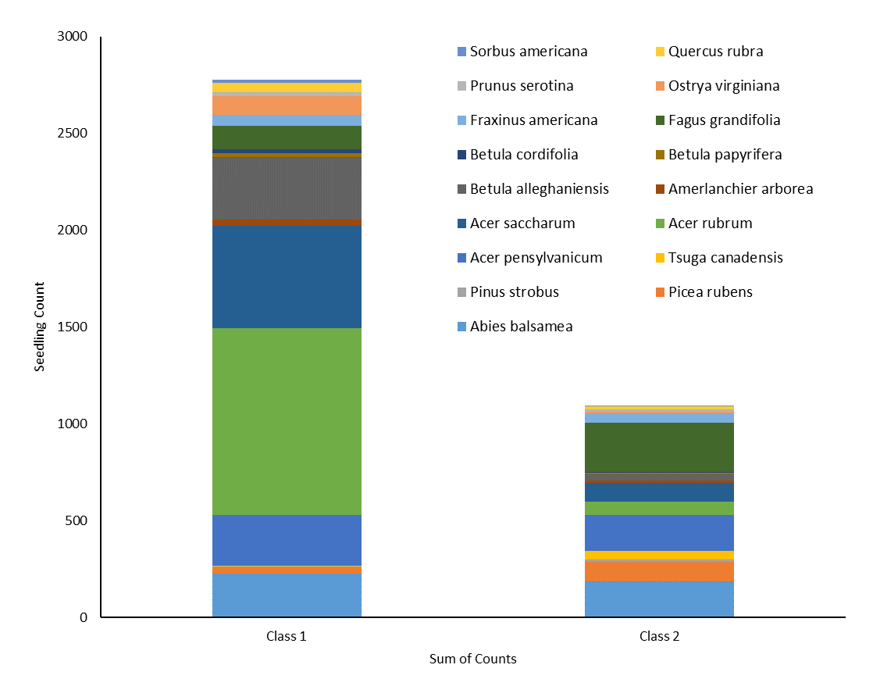
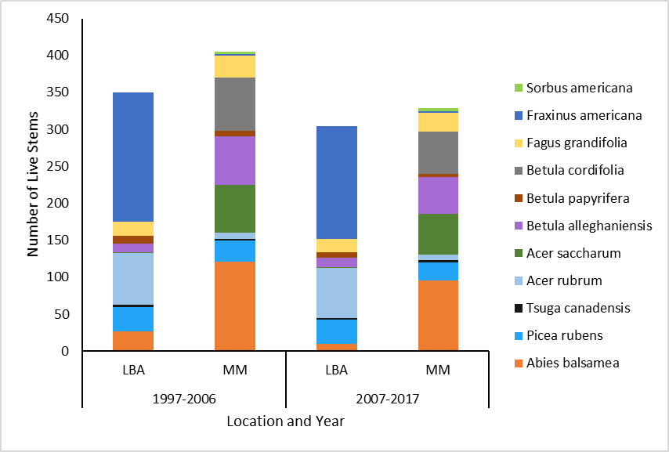
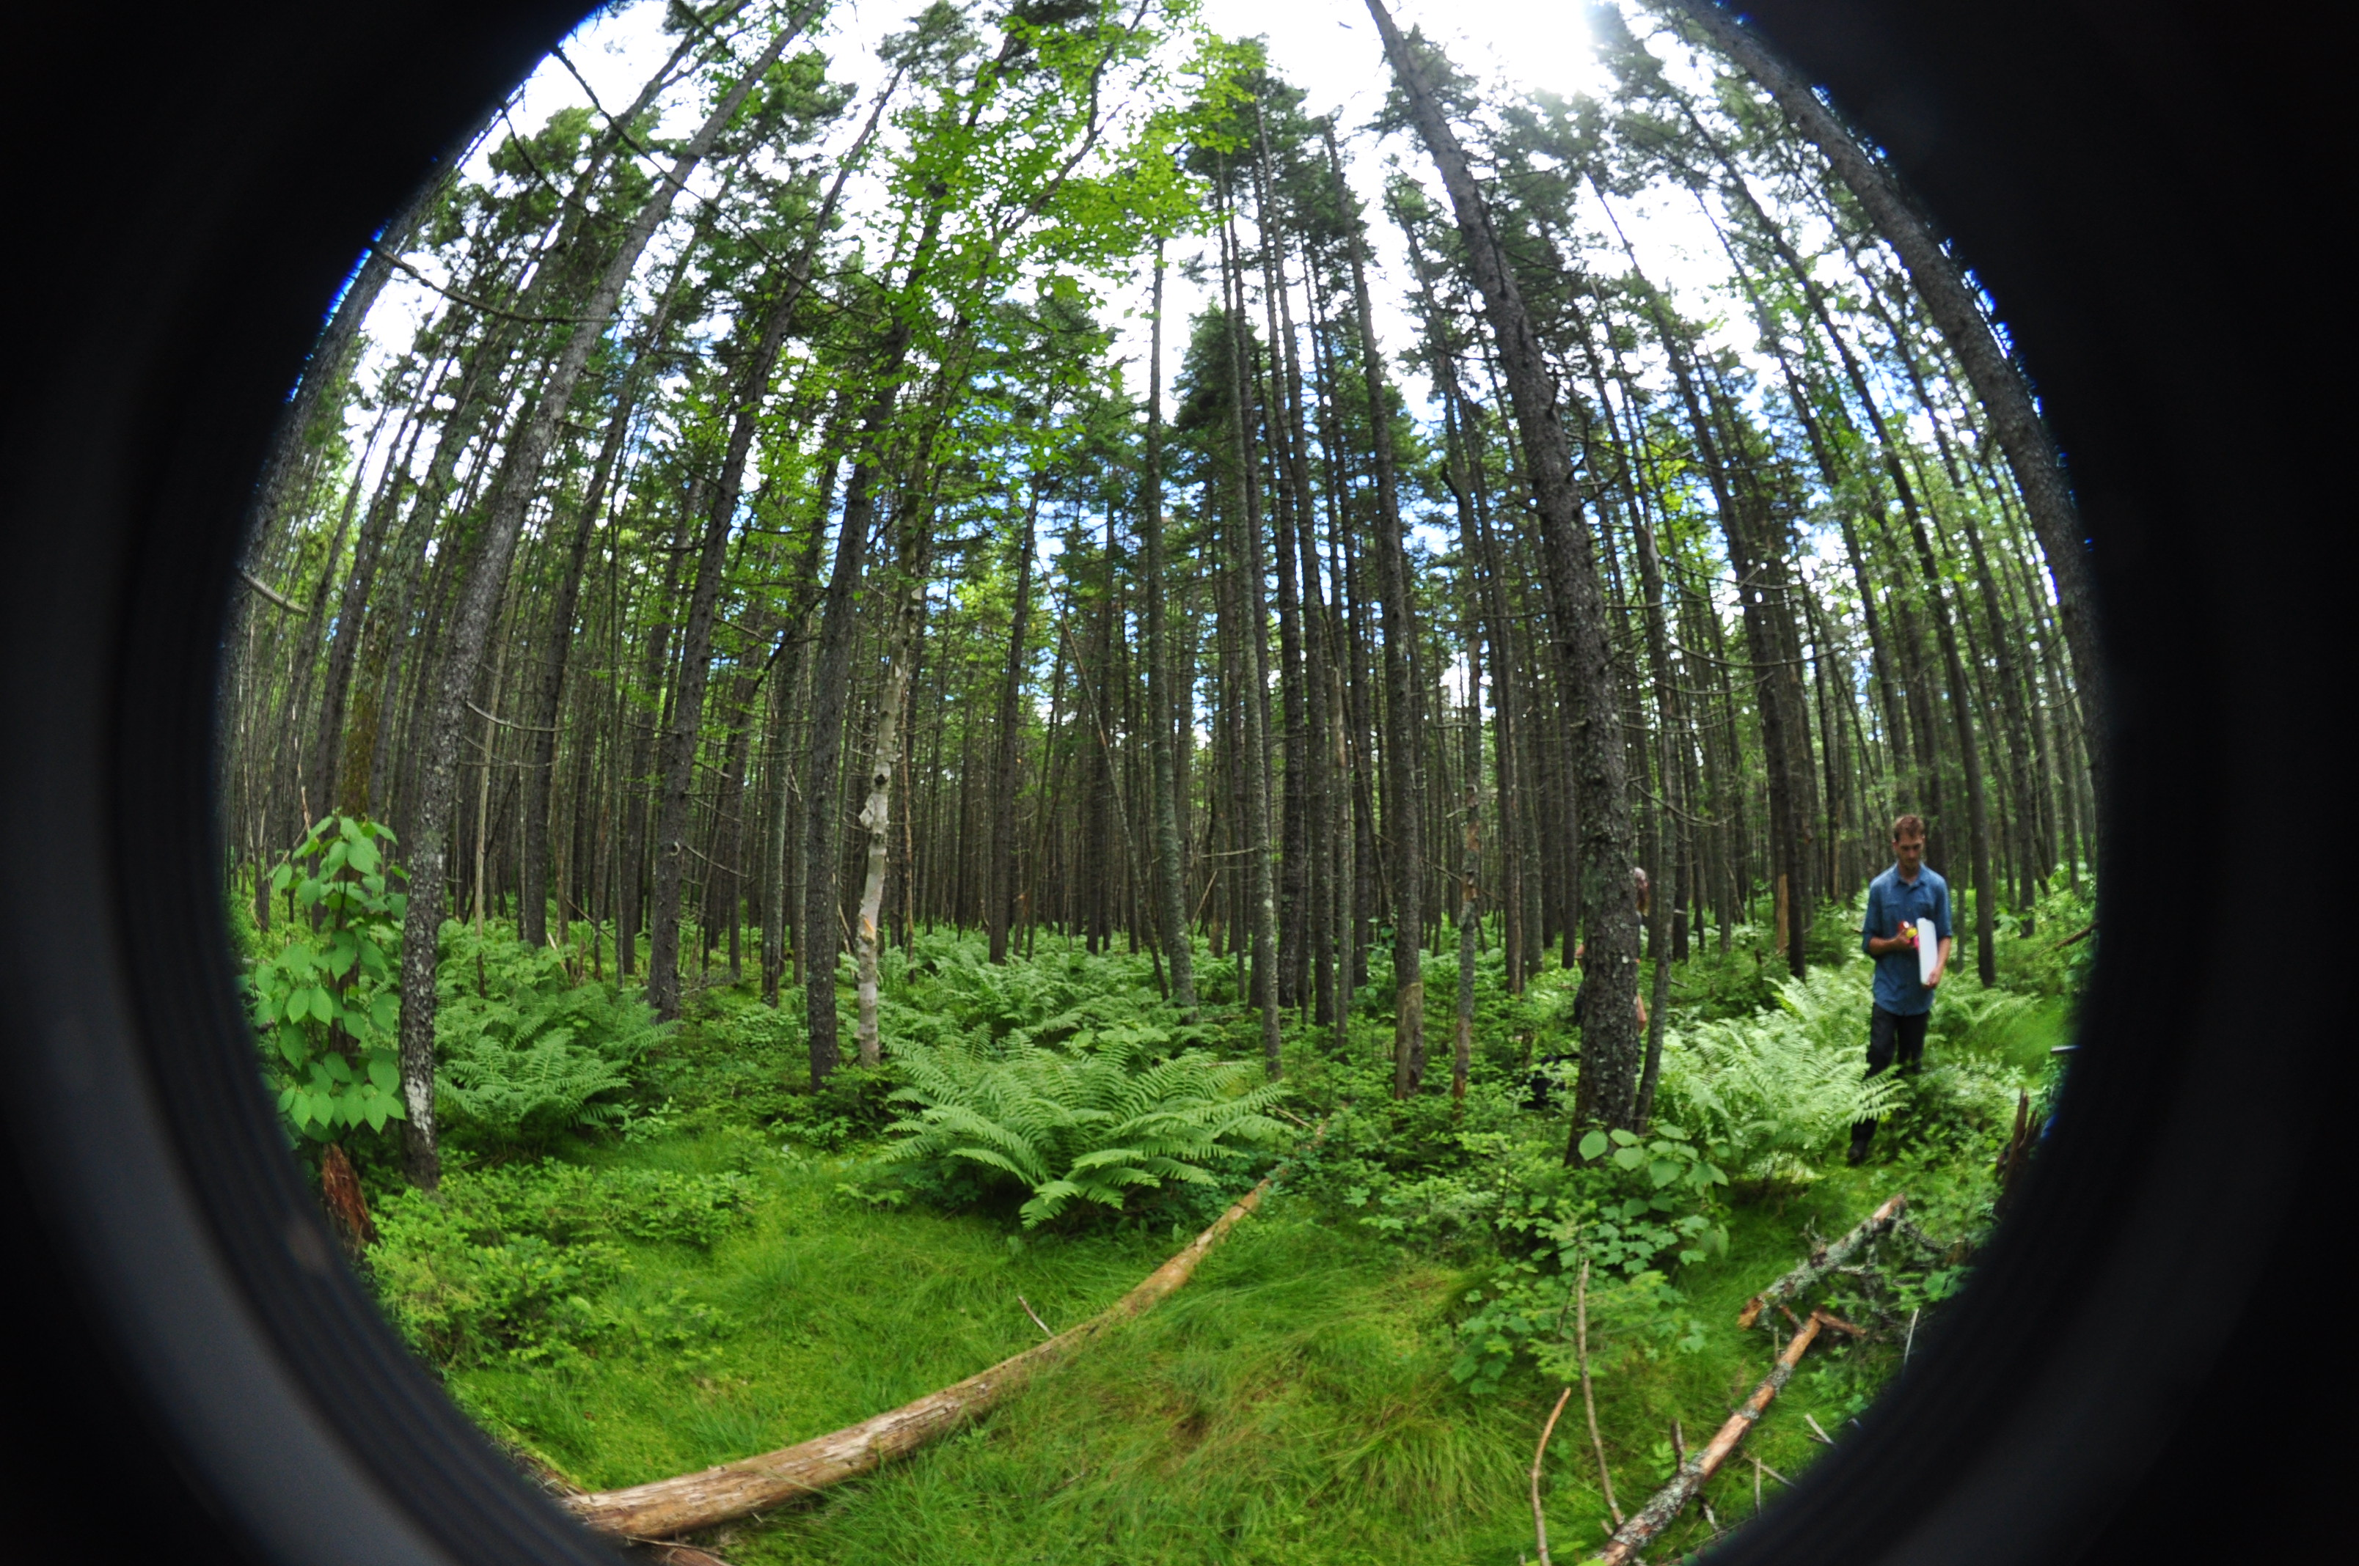
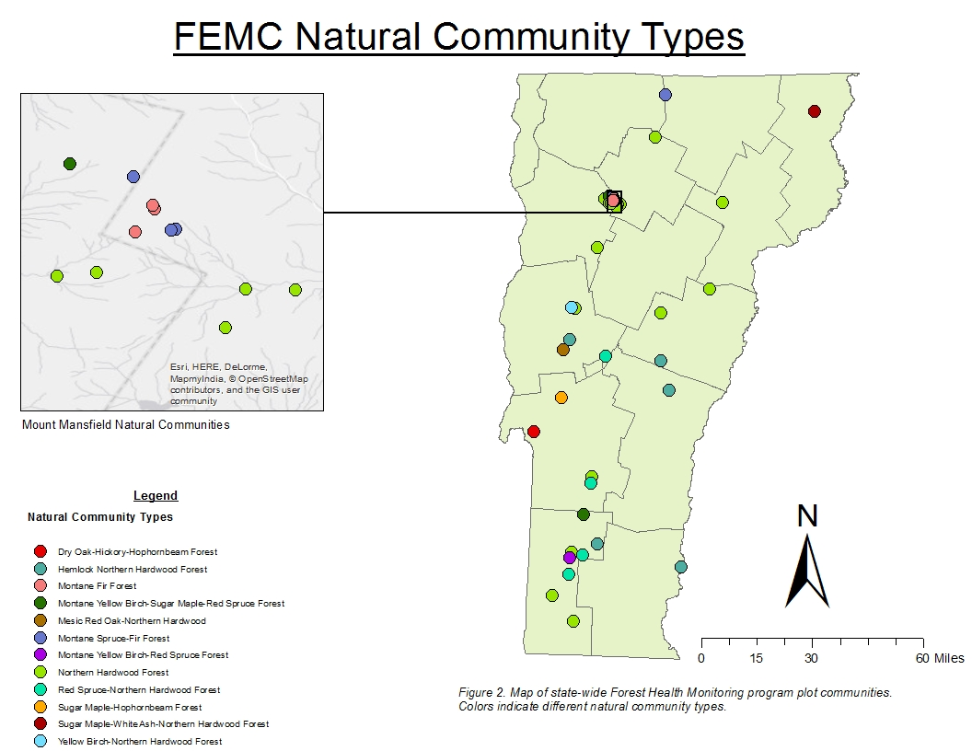
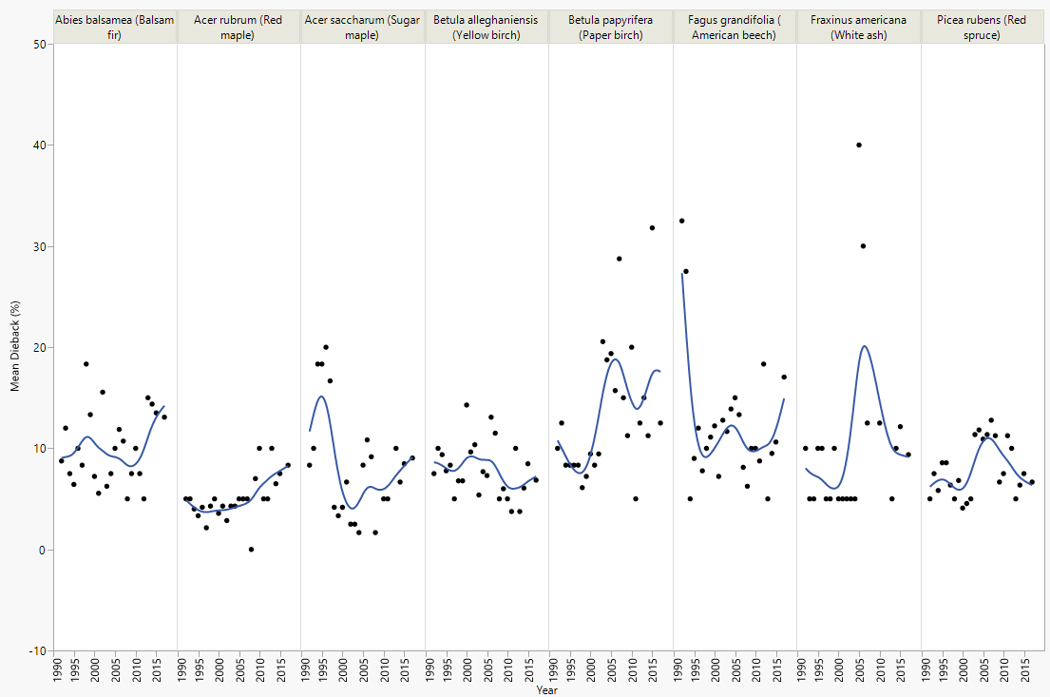
Monitoring the Health of Vermont’s Forests: Long-Term Trends and Natural Communities
Kelsey Hamm^{1,2}, Caroline Drayton^{1,2}, Beth Romaker^{1,2}, Mike Perrin^{1,2}, John Truong^{1,2}
James Duncan^{1,2} and Sawyer Updike^{1,2}
¹University of Vermont Rubenstein School of Environment and Natural Resources, ²Forest Ecosystem Monitoring Cooperative
a
By establishing a diverse and robust network of long-term forest health monitoring plots with detailed, yearly measurements, the FEMC aims to provide a baseline of forest health conditions across the state of Vermont. Such field measurements are critical for detecting subtle changes in forest health and exploring potential drivers of decline.
Introduction
Figure 1. Up until 2014 only class 2 seedlings were counted. In 2014, the definition of a seedling was expanded to include any seedling with true leaves. 2017 was the first year that seedlings have been separated by class. Class 1 hardwood seedlings are defined as less than 30.48cm tall, whereas class 2 seedlings are above 30.48cm and are less than 2.54cm in DBH. Class 1 conifers are less than 15.24cm while class 2 seedlings are above 15.24cm and have less than a 2.54cm DBH.
In 1991, the Forest Ecosystem Monitoring Cooperative, formerly the Vermont Monitoring Cooperative, and the Vermont Department of Forests, Parks and Recreation created a statewide forest health monitoring network, designed to uncover important relationships, changes, and stressors impacting Vermont’s forested landscape. The plots were initially located in intensive study sites on Mt. Mansfield and in the Lye Brook Wilderness area and were surveyed annually. In the last three years, the network was expanded from 14 to 48 plots by co-locating with other forest health monitoring efforts such as the USFS Forest Inventory and Analysis, the North American Maple Project, and others. The expansion better represents a cross-section of Vermont’s forests and long-term trends in forest health.
Additional Data Collection in 2017
Figure 3. The average tree abundance by species from 1997 to 2017 between the Lye Brook Wilderness Area (LBA) and the Mount Mansfield (MM) plots.
Methods
Figure 4. Mean percent dieback in the canopy of overstory species by year. Despite high annual variations, the average of the mean dieback ranges from 5-20%.
Plots are established using the National Forest Health Monitoring protocol. Four 7.32 m radius subplots are established, with Subplot 1 in the center and the remaining subplots 36.57 m away from Subplot 1 at azimuths of 0°, 120°, and 240°. Each subplot contains a 2.01 m radius microplot located 3.66 m east of the subplot center.
At each plot we assessed the following forest health metrics:
Tree health metrics (vigor, dieback, transparency, discoloration, other damages)
Tree heights and diameters at breast height
Hemispherical photos to determine the percentage of light reaching the forest floor
Canopy photography to quantify transparency
Abundance of seedling and physiology of saplings recorded
Prism data
Presence/Absence of animal browse
Abundance/Type of invasive plants
Results and Conclusions
Continued efforts to monitor plots annually, with standardized protocol used by various organizations throughout the region, will result in new insight into broader forest health trends.
The separation of seedlings more accurately displays regeneration characteristics because it is now comparable to historical data.
The declining abundance of high elevation species, such as balsam fir, is an indicator of compositional change in Mt. Mansfield plots. Continued monitoring will display further and more conclusive trends.
Public accessibility of FEMC data provides for diverse utility across the environmental spectrum. This allows monitoring initiatives to identify more subtle changes in annual data, while independent researchers can use this as supplemental data.
During the 2017 field season, additional data was collected at each plot in order to classify the varying types of natural communities across Vermont. Species of trees, shrubs, and vegetation were identified and assigned an abundance of either dominant, common, occasional, or rare to display the unique species composition and abundance of each site. In addition, soil samples were collected at each plot. Natural community types were based on the criteria provided by VT Natural Community Ecologist Eric Sorenson’s Wetland, Woodland, Wildland: A Guide to the Natural Communities of Vermont. The purpose of the project is to organize and compare forest types in different locations around the state and gain insight into the variation of species composition and abundance through time. In the future, data such as percent canopy cover and ages of representative tree species could be collected to further classify these natural communities.

