Slide 1
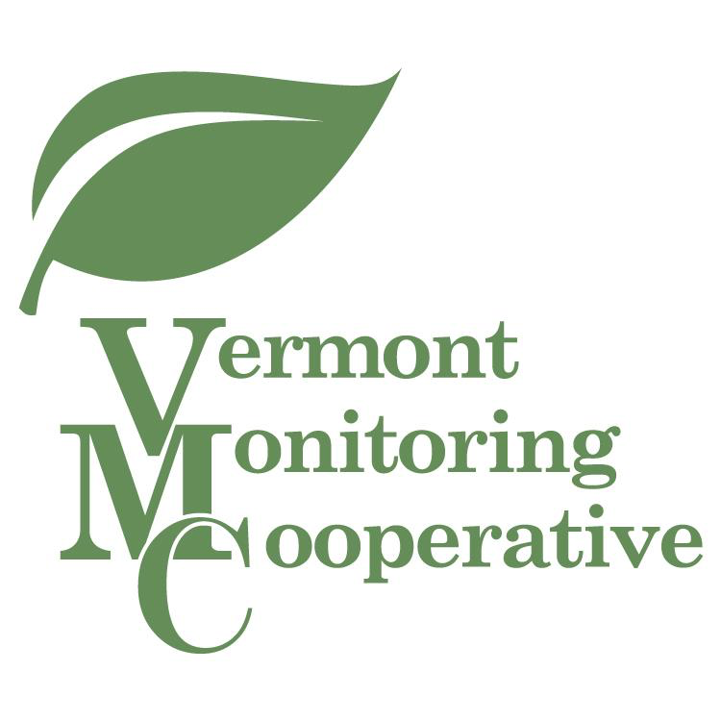
Karl Honkonen
US Forest Service
Northeast Area
State and Private Forestry Program
Toni Lyn Morelli
US Geological Survey
Northeast Climate Science Center
Colin Beier
SUNY College of Environmental Science and Forestry
Dept. of Forest and Natural Resources Mgt
Notes:
Karl Honkonen, Toni Lyn Morelli, and Colin Beier have joined us to help explore different ways to use indicators of ecosystem condition to plan and adapt management of forests and watersheds.
In the first talk, Karl will share insights about managing riparian forest buffers
Toni Lyn will then describe an effort to improve management strategies for invasive species
And finally, Colin will describe how he and his colleagues go about assessing the combined effects of different agents of change on ecosystem services
Although they approach their work from different perspectives, they’re all upholding a tradition of adaptive natural resource management that has been at the heart of the VMC since its beginning

Slide 2
Plan
Implement
Evaluate
Adapt
Monitor
Adaptive Management
Notes:
Most of you are probably familiar with some version of this diagram, which presents an approach formalized by Carl Walters and C.S. Holling 30 and 40 years ago
In fact you probably engage in the adaptive management cycle on a daily basis
By a show of hands, who here spends some of their time [working in each phase of the cycle]
The VMC Annual meeting is an opportunity to keep the cycle moving
For scientists to report on their findings and for planners and managers to make adjustments based on what we learn from the data
The VMC Annual Meeting is a way to fulfill the promise of a complementary model . . .

Slide 3
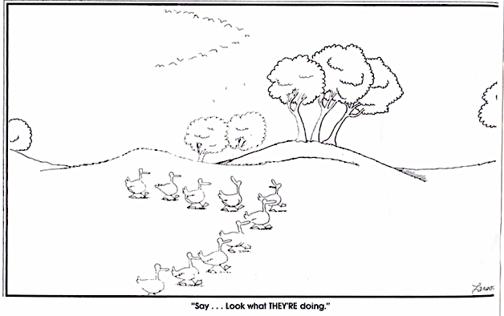
Say . . . Look what THEY’RE doing.
Notes:
One emphasizes the value of learning how others pursue similar goals.
It’s in this spirit of learning not just from results, but from process, that Jim and Jen have organized this panel
Format and introductions

