Slide 1
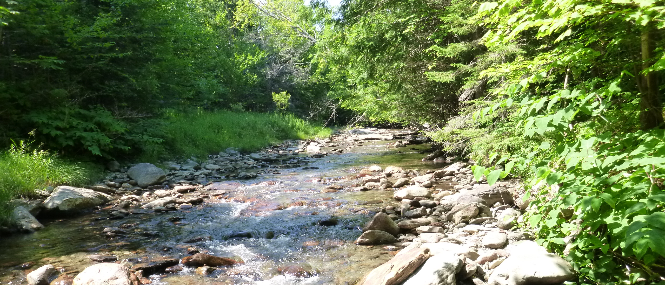
Welcome to the
2016 Vermont Monitoring
Cooperative Conference
December 2, 2016
Davis Center, University of Vermont

Slide 2
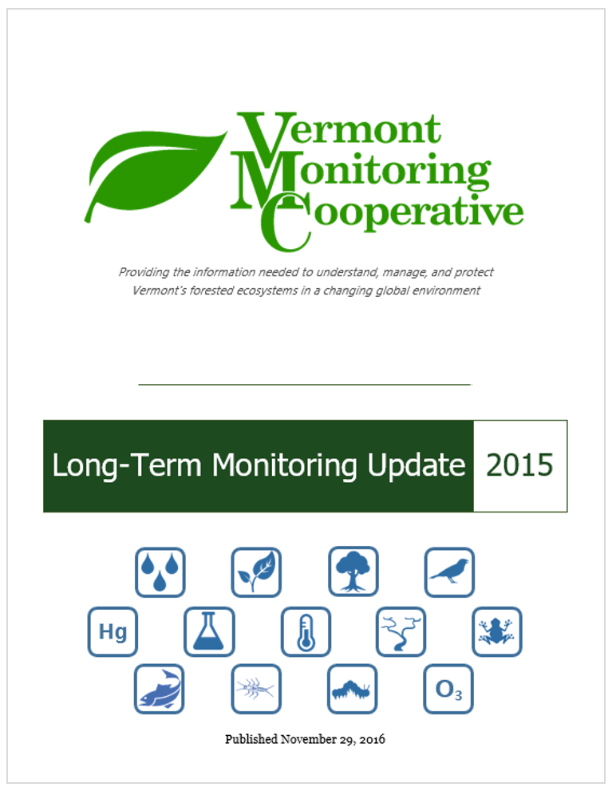
2015 Long-Term Monitoring Update
Long-term trends covering decades of monitoring data
Trout (new!)
Forest health
Bird populations
Lake chemistry
Mercury deposition
Plus nine more sections.
www.uvm.edu/vmc/about/annual_report/2015

Slide 3




Acknowledgments – Core Funding
Notes:
USFS Forest Health Monitoring and Northeastern Area State and Private Forestry – Core funding
VT Forests Parks and Rec – Conference and partnership support
UVM RSENR – Administrative and partnership support

Slide 4

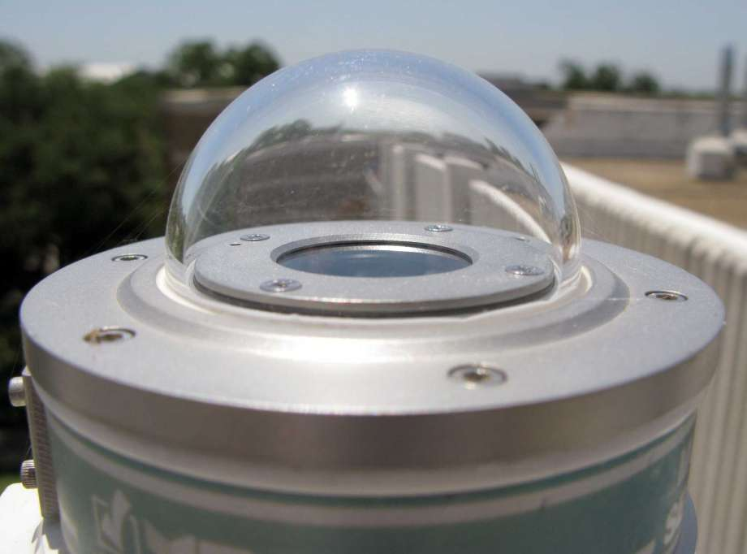


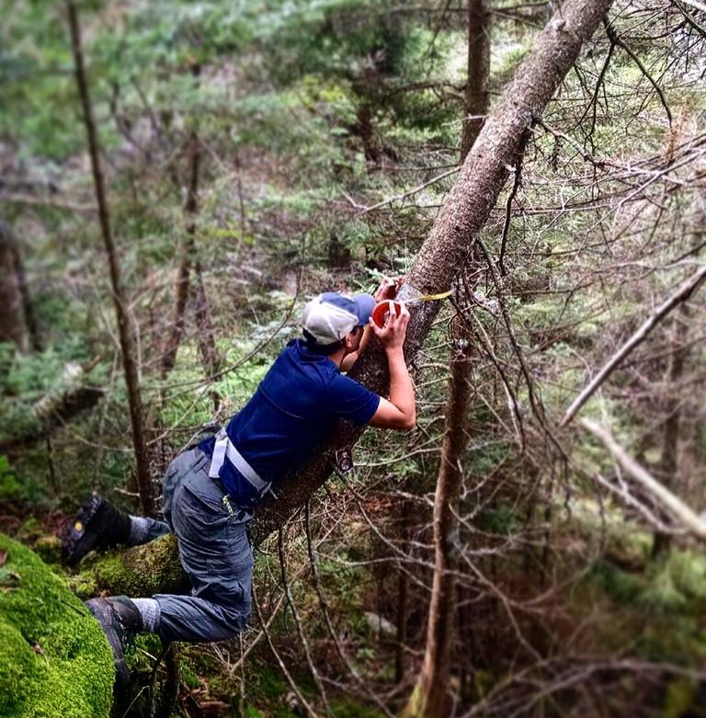
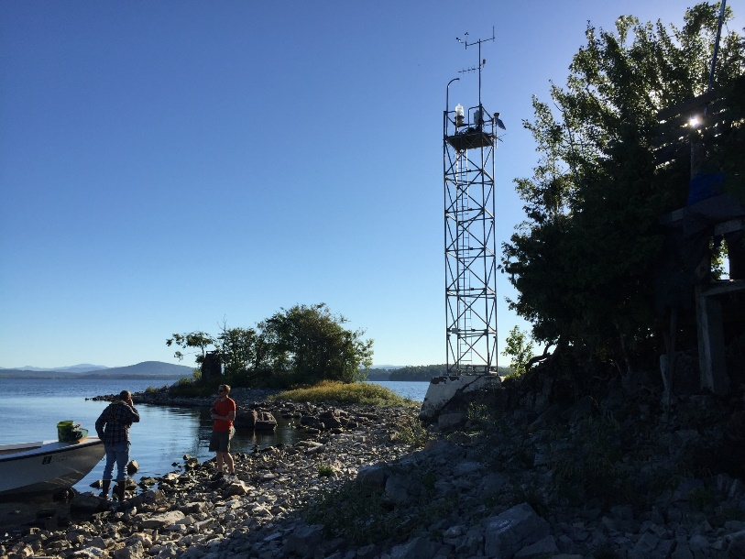

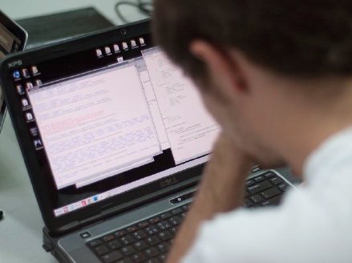


Acknowledgments - Additional Funding
Precipitation Chemistry Monitoring
UV-B Monitoring
Soils and Forest Monitoring/Data
Lake Meteorological Monitoring
Data Infrastructure
Green Mountain and Finger Lakes National Forests

Slide 5
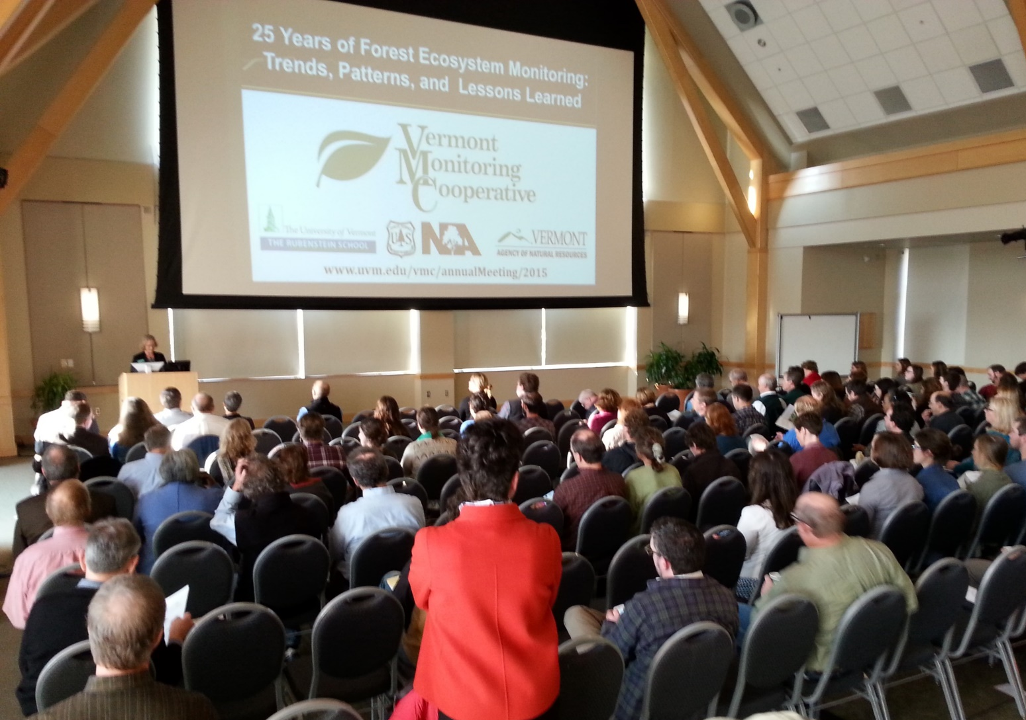
Acknowledgments – Our Supporters
And the Cooperative!
The VMC Steering Committee
The VMC Advisory Committee

Slide 6
Where we’re headed…
Notes:
this may be the last meeting of the VMC, because we’re transitioning to a new structure
The VMC will become the Forest Ecosystem Monitoring Cooperative (f-E-M-C)

Slide 7
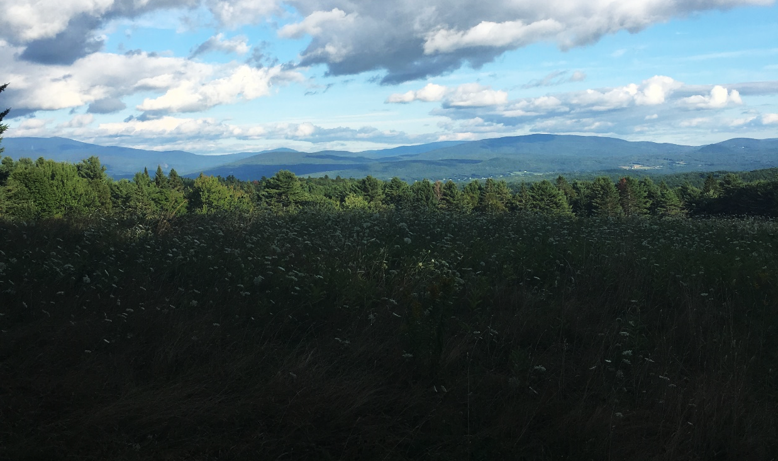
The State of the
Cooperative
Announcing the Forest Ecosystem Monitoring Cooperative
Photo: John Truong
Notes:
GOAL:
Inform you that we’re changing
how we’ve been catalyzing that change
how it will affect you
how you can get involved.
Sky Pic: John Truong

Slide 8

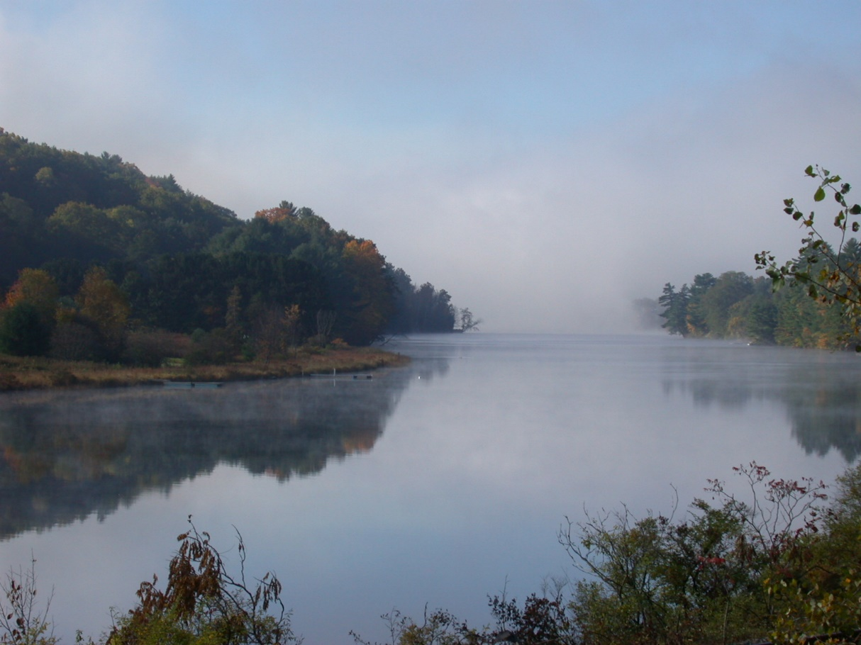


Regional Approaches are Needed
Forested Ecosystem
Photo: Arjan Almekinders
Synthesis
VT
NH
Photo: Connecticut River Joint Council
Image: Council for Community and Economic Research
Notes:
People and organizations continue to work in parallel
Forest health challenges and solutions don’t follow political boundaries
Increasingly need synthesis ALONGSIDE monitoring
Pic with leaves changing colors:
Link: https://www.flickr.com/photos/almekinders/5055545286/in/photolist-8GJZtU-pbpzBM-nRaGGe-9TNVs-eBAk9D-5qWDAh-4qFJQK-e9k7Eh-8KbF6w-dkhTDE-5qWDzy-Dwi9hJ-q85FnN-ob416-5xrMif-j8afRd-9Nk9KR-fuGKRV-mUkwX4-2T395F-biAJMv-2T7wPC-a4T2VV-6ostzj-76nvCt-qYea9o-azbkYr-eeZz3M-iyFL8i-CDipti-etHX9c-8tX9Gj-4Ce1pt-rBu3ZB-vccz3-fm1emh-2T7AEd-ntV8Nc-RZaLJ-DTtz3b-qEH5JF-brCPnD-mTrKzJ-dgys4Q-bFNFQB-9wkuTh-2SuYZ3-bFNGmz-p2o2kb-qWbCN
By: Arjan Almekinders
http://blog.c2er.org/2014/09/simplifying-data-overload-using-indicators/

Slide 9
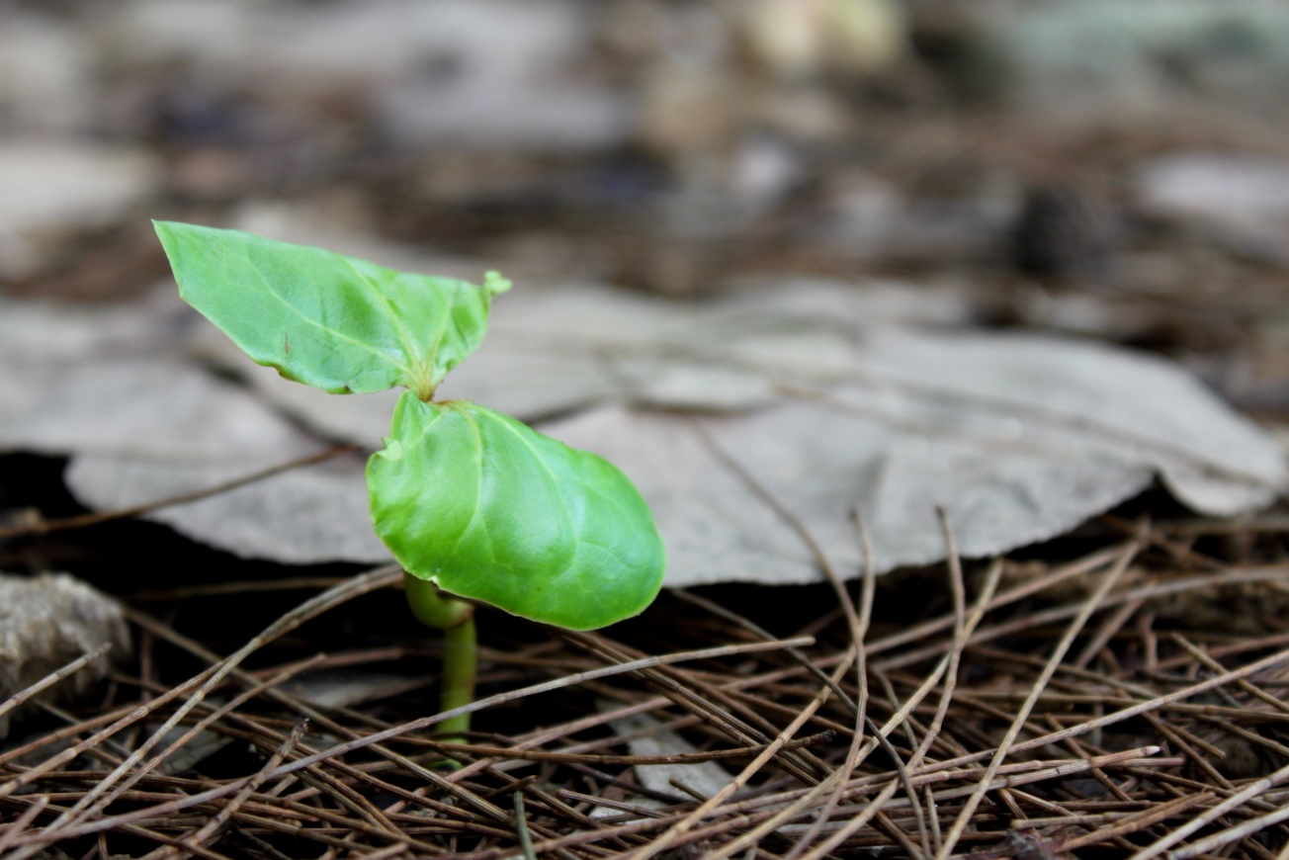
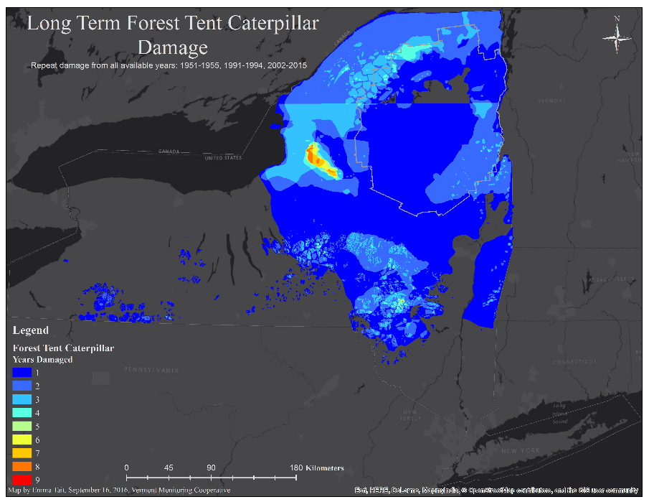

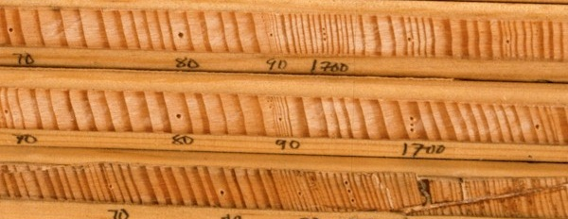
Towards a More Regional Cooperative
Ecological Dendrochronology Database
Photo: Charles Salutan
Notes:
Building off work at last meeting, we have been attempting to seed this effort
This has included work in multiple states on projects related to forest monitoring
These are examples of how the VMC is attempting to serve a larger group of stakeholders.
These seeds are catalyzing the transition to a broader cooperative
One seedling growing by charles salutan by https://www.flickr.com/photos/rubberkid/4611953154/in/photolist-82xsZG-6Sp4eo-dPWjD-5aHZ6e-giVYB-ecuPnU-6dWtr-fNBmQQ-dDKJX-5zsC4J-6m15Vq-5X813b-fvFu7a-ejMRe5-oyLnQN-stY29d-6127RP-f9EKYN-iH2yu1-72VGm2-qZNLpa-bEtvhP-ooTCZX-65KEob-edvoCC-9WCoSi-wdSDKc-hNKNPg-55pua1-EaxY8q-dia7cY-rchbHH-8LBnnC-Ga39hy-fcPay5-bgwSUn-7h38jk-oJcyD3-3JXmig-6dyK72-ynkCa-4tPoY2-9eBiUL-6ahuYi-4BTQpH-oaW9u3-96KtMd-bxU1Rg-9EY1nt-af5xzZ

Slide 10
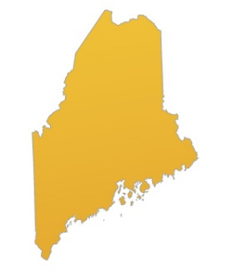
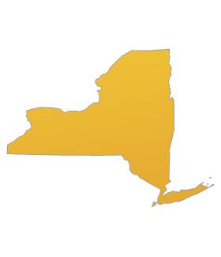
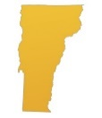
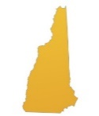
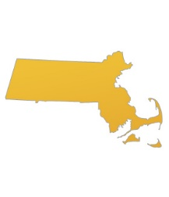
The Forest Ecosystem Monitoring Cooperative (FEMC)
An opportunity to expand integrative approach to other states…
… and a new name and structure for the VMC
Notes:
Over last year, engaged in process to become more regional
This will be phased in in early 2017
Jigsaw piece and people by Yoel Ben-Avraham link: https://www.flickr.com/photos/epublicist/8718123610/in/photolist-ehoEq3-dEy8gj-6MtBEu-aNxPcP-8QJjZH-67tit6-ak8hgN-gkUTrJ-dXGPx3-rxKjHf-5ugeqj-ds6MG3-qnq957-7UQXbQ-7vEVv7-7j3c1-bxHVka-8QMq4b-edrtNS-8Nqnvv-7T8nft-q2KALd-9tpZJb-aKpWiz-jBjfM1-qaHwqK-9M5H7L-8tixm-a5E3tn-8KadYU-BtE67-6JB6sD-78aisf-4XxQF3-hHqbh-8cj2Kj-oGrQrW-6M9nNP-8QMqgj-5EpEkU-5RSP6E-5xJT9V-c5nHu3-8rg1nz-yfSvt-8Yf1jc-5s7AQJ-8QMq9u-5kNdDL-HVCw2
Colorful circle of people by Yoel Ben-Avraham link: https://www.flickr.com/photos/epublicist/3545251137/in/photolist-6phkDB-HMWseE-aoRRUW-dQRkLj-821FeM-jtxX8x-fMSW16-jq33gL-dhZYAt-msKo8-7SHeo-cKHQyf-fefx8R-GWHfNS-ioMHVR-9c1rDB-kEhh-3b1dhJ-4pUyRS-9GZGPY-fK9M5m-wTVvDs-9kd6eQ-wU3XPi-DwNDms-jCBk4r-uiF6v-6qFiGW-nKY8Z2-dzJs7X-DhjaT9-xaLZRJ-dEcFQi-acHUFE-59yhc9-8kTwtT-4oYv6f-cZHYzy-bV67KW-brK2Lq-d1cjmm-9x6zJw-6zBKS7-ayvEkj-fmMXfn-zyJd1-n3Ydwz-77kq7B-7q3v8k-GJEcNB
Colorful people with jigsaw puzzle by AJ Cann link: https://www.flickr.com/photos/ajc1/13059415974/in/photolist-kU1Voo-bLkkX8-brdqET-9TbhtS-cSZuhq-JDzcM-eRGr17-6Er1Pr-cVV7em-dRnzdP-4jFUbM-a1a3gf-auBzVF-87UBWg-6SGVKv-dSPND3-9ZTe2k-m3XDc7-fH8fnF-dQk8n8-qo6bR9-nPxEuD-abUPDG-oFkt1L-9Y3k5W-6jJkuU-6LuBRB-6HTMEv-gtgAYR-5yjcUb-8wNeNw-NyhFw-dgqnND-bV6t7D-buKSFF-ohVn47-nHUSJq-7NrsEa-25Cwr7-cDoxgE-9ZmC2N-9ewer-cQQ7oS-ouC7DK-dvv5Mf-9hxm4t-4cURfv-63cAYM-cRQqU9-kCqNNP

Slide 11
New Structure Means New Opportunities to Engage…
Set strategic regional direction
Approve budget and review progress
Expanded
Steering Committee
State Partnership Committees
MA
ME
NH
NY
VT
Identify regional priorities
Technical guidance for state- and region-level work
NEW!
Advisory Resource Group
Provide scientific and technical support to FEMC Cooperators and staff
Expanded
Notes:
VMC has been governed by a steering committee and received technical and budgetary guidance from an advisory committee.
We are actively looking for people to populate the state partnership committees
These committees will help determine how FEMC budget will be allocated
We need your help in guiding these agendas for a regional cooperative

Slide 12
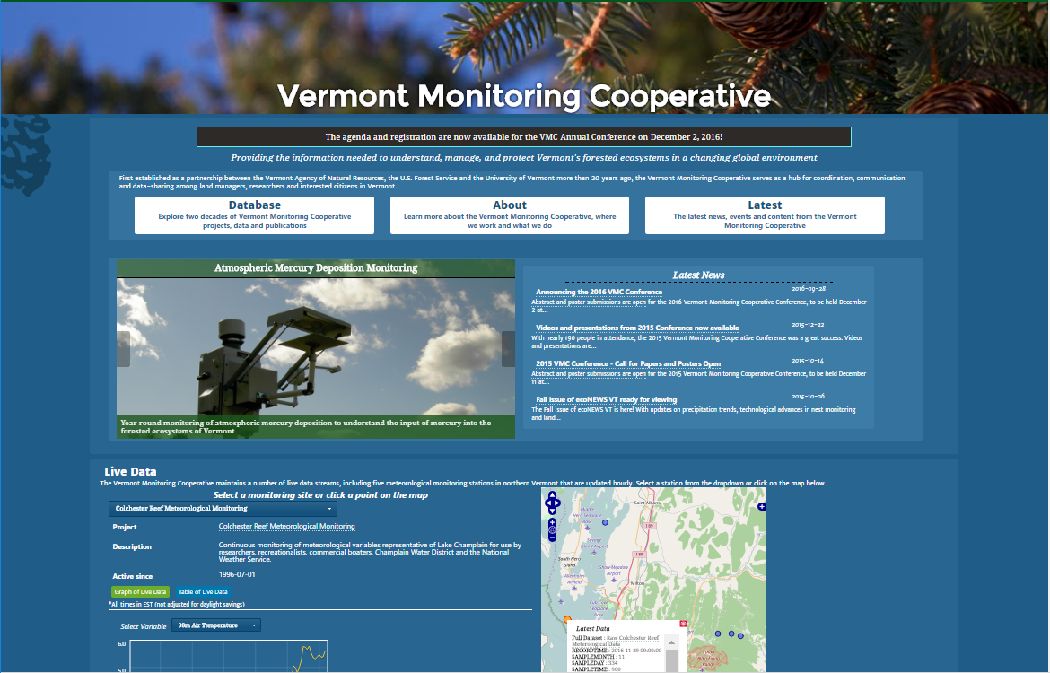

Bringing New Capacities to the Cooperative
Management Portal
Fee-for-Service
Field crews
Basic data services
Advanced database and data analytics
Photo: Niklas Morberg
Notes:
Management portal is now open for business – why is that important? Investigators can keep ownership and control over their work, while supporting the larger effort of collaborative forest monitoring and management within the region
Involvement with RDA supports VMC’s niche role of providing cutting edge data services to ecosystem monitoring professionals in the region
Fee-for-Service makes us more agile in responding to the needs of cooperators for specific monitoring and data-based services
Open sign by Niklas Morberg link: https://www.flickr.com/photos/morberg/3032353648/in/photolist-5BXB6s-fpQVqJ-96pLS-6fqih2-pqRbeu-9HCsVo-77TJvj-qTTH6j-f1A5mw-98ynaW-dqVqMa-bu2GET-bawGH6-4Qw2kp-qTTHFs-qBnZ67-pWXm9U-fMeLb-8aMmsq-oqBPKJ-aap9-qBnYQC-qTPd9Z-qBnXXf-qBvdAa-qBo1eE-qTNpjr-qTSWSj-qTSX1f-qBvepp-qBveSP-dCZP5m-qTPcGX-pXbUWk-4pGM7R-qTTHNm-aDyGCH-qBxv1P-qTYai4-qBoLNu-qTXohn-aU6xJF-cyA4Hb-obo5gm-7fyyF-h1udpi-2EPNqS-aDCxJj-qTYabF-qBpTUy

Slide 13
Panel
Forest Management and Watershed Condition
Notes:
As an example of this broader regional focus, we’ve invited people from across the region to participate in this panel

