Slide 1
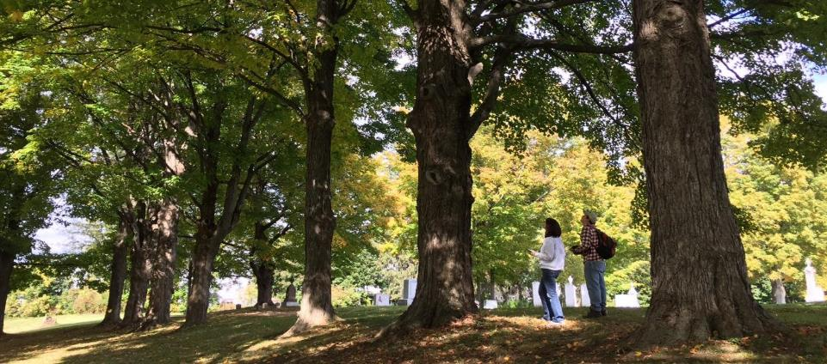
16,673
15,001 Trees and Counting
Elise Schadler
Technical Assistance Coordinator Vermont Urban & Community Forestry Program
Vermont Monitoring Cooperative Annual Meeting
December 2nd, 2016

Slide 2
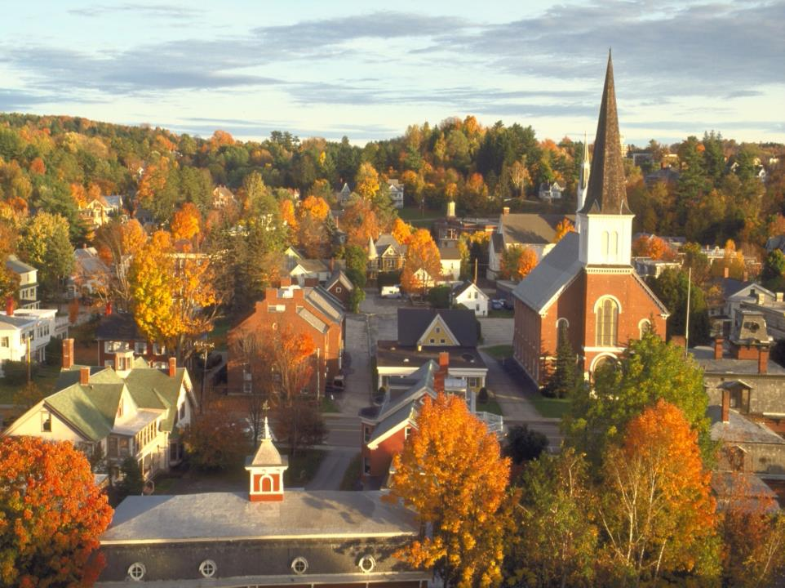
Vermont Urban & Community Forestry Program
(VT Forests, Parks, & Recreation + UVM Extension)

Slide 3
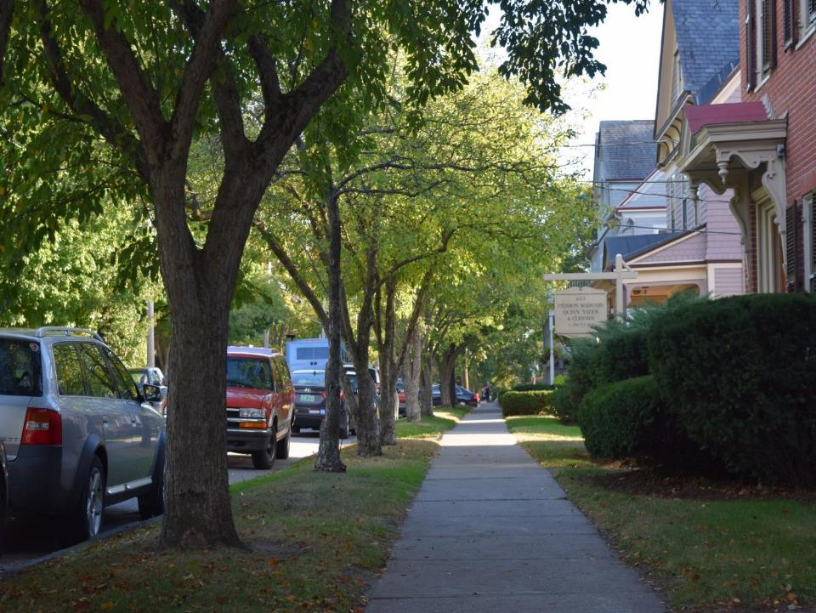
Vermont Municipalities & Public Tree Programs
Few staff,
Small (or no) budgets for trees,
Local tree programs often led by citizen tree champions

Slide 4
Our Approach
Historically, we’ve achieved our mission by focusing on citizen tree stewards and volunteerism
500+ Participants
Thousands of Volunteer Hours
$1million +for Community Trees
Citizen Training
Stewardship of the Urban Landscape Course and Forest Pest First Detectors Training
Fostering Citizen Action and Volunteerism
Connecting SOUL and FPFD participants to local opportunities.
Grants for Communities
Annual grants program; Over 800 grants allocated since 1991

Slide 5
Care of the Urban Forest Project
2013 Redesign Grant USDA Forest Service funds
A multi-year, three – pronged approach to support 20 priority communities
Inventory
Planning
In-house Technical Training
www.websitename.com
49

Slide 6
Community | Initial Contact | Community Lead Contact | Pre-Inventory Meetings | MOU signed | Roads and ROW | Inv. Format | Inventory dates | Inventory complete | Inventory Report Complete | Number of Trees Inventoried | Number of Vacant Spots ID’d | Action Plan Lead | Action Plan Complete | Training Lead | Training Date and Time | Training Complete
Essex Junction | X | Nick Meyer | X | n/a | X | LANDS and UCF Intern | July 2013, July 2014 | X | X | 632 | 349 | Mandy, Darby, Nick | X | Warren | Summer 2014 | X
Colchester | X | Tim Moran | X | n/a | X | Volunteer | August 2012 – March 2013 | X | X | 663 | n/a | Lee |  | Mark D. | October 2015 | X
Shelburne | X | Ann Milovsoroff, Gail H.-King | X | X | X | LANDS | June 2014 | X | X | 722 | 64 | Lee | X | Mark D. | October 2015 | X
Swanton | X | Reg Beliveau Jr. | X | X | X | LANDS | July 2014 | X | X | 449 | 59 | Amanda H. | X | Mark D. | October 2015 | X
Northfield | X | Ruth Ruttenberg, Russ Barrett | X | X | X | LANDS | July 2014 | X | X | 303 + 1145 rural road ash | 44 | Gail | X | Mark D. | June 2016 | X
Winooski | X | Joe Shaw, Peter Wernsdorfer | n/a | n/a | n/a | Intern; UVM students | Summer 2013, Winter 2014 | X | X | 800 | n/a | WinooskiNRCD – Sarah? |  | Mark D | July 2016 | X
Johnson | X | Sue Lovering | X | X | X | UCF and Volunteers | September 2014 | X | X | 363 | 20 | Sue Lovering | X | Mark D. | October 2015 | X
Bristol | X | Randy Durand | X | X | X | LANDS | October 2014 | X | X | 562 | 106 | Claire Tebbs | X | Mark D. | October 2015 | X
Vergennes | X | Mel Hawley, Mike Winslow | X | X | X | LANDS | October 2014 | X | X | 518 | 29 | Elise |  | Mark D. | October 2015 | X
Middlebury | X | Eric Blair, Leslie Kameny | X | X | X | LANDS | October 2014 | X | X | 726 | 44 | Middlebury Tree Committee | X | Mark D. | October 2015 | X
Montpelier | X | Geoff Beyer, Mont. Tree Board | X | n/a | n/a | Montp. Parks, FPR, UCF | May – June 2016 | IN PROCESS | n/a | n/a | n/a
Lyndon | X | Kaela Grey, Planning Dept. | X | X | X | FPR staff | Summer 2015 | X | X | 244 | 41 | Andrea Urbano | X | Mark D. | October 2016 | X
Rockingham | X | Polly Thompson | X | X | X | FPR staff | Summer 2015 | X | X | 489 | 83 | Andrea Urbano | X | Mark D. | October 2016 | X
Milton | X | Eric Wells | X | X | X | UCF and FPR staff | Summer 2015 | X | X | 1050 | 535 | Andrea Urbano | X | Mark D. | June 2016 | X
Hinesburg | X | Marie and Paul | X | X | X | UCF and FPR staff | Summer 2015 | X | X | 838 | 61 | Andrea Urbano | X | Mark D. | September 2016 | X
St. Albans City | X | Curtis Comfort | X | X | X | UCF and FPR staff | Summer 2015 | X | X | 1715 | 1205 | Andrea Urbano | X | Mark D. | May 2016 | X
Newport | X | Andy Cappello & Jeff Fellinger | X | X | X | UCF and FPR staff | August 2016 | X | X | 268 | n/a
Springfield | X | Kelly Stettner, Tom Yennerell | X | X | X | FPR staff | Summer 2015 | X | X | 861 | 155 | Andrea Urbano | X | N/A | N/A | N/A
Brattleboro | X | Dan Adams, Roz Blake | X | X | X | FPR Staff | Summer 2015 | X | X | 362 + 41 neighborhood ash | 20 | Brattleboro Tree Advisory Board | X | Mark D. | October 2016 | X
Barre City | X | Jeff Bergeron | X | X | X | UCF and FPR staff | Fall 2015 | X | X | 555 | n/a | Andrea Urbano | X | Mark D. | October 2016 | X

Slide 7
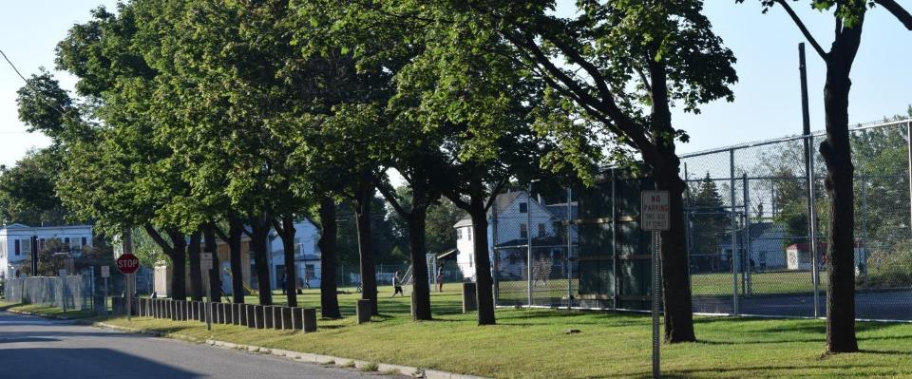
Our Process
Identify Towns
Develop MOU
Conduct Public Tree Inventory
Analyze data, provide report
Develop action plan based on inventory
Facilitate training

Slide 8
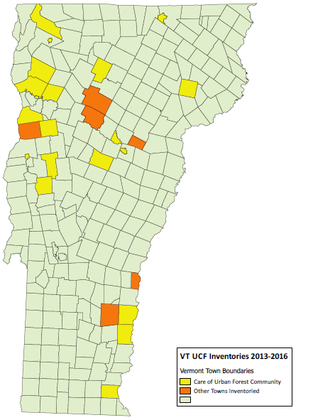
20 Towns
& 7 additional public tree inventories
Newport City
Swanton Village
St. Albans City
Johnson
Lyndonville
Milton
Colchester
Winooski
Essex Junction
Essex Town*
Stowe*
Waterbury*
Montpelier
Barre City
Plainfield*
Shelburne
Charlotte*
Hinesburg
Northfield
Vergennes
Middlebury
Bristol
Windsor*
Springfield
Chester*
Rockingham
Brattleboro

Slide 9
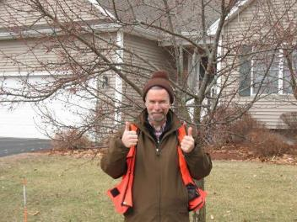
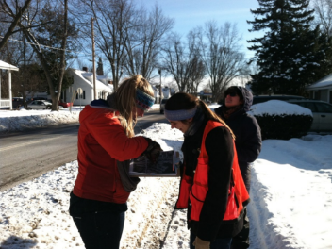
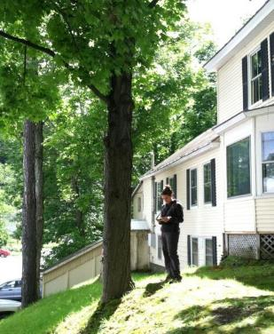
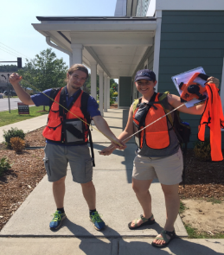
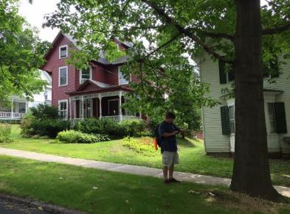
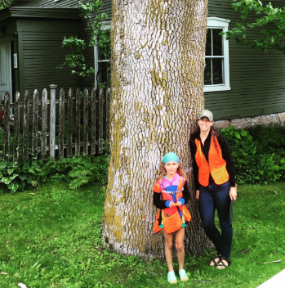
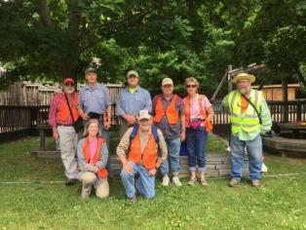
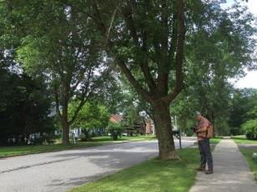

Slide 10
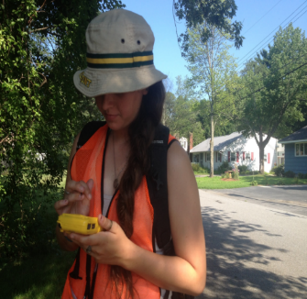
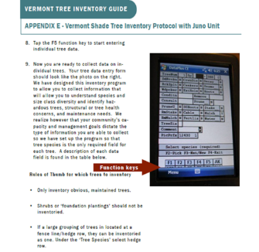
Inventory V.1
Juno Units
Database (from hell)
Dataplus on one computer
Students and volunteers

Slide 11
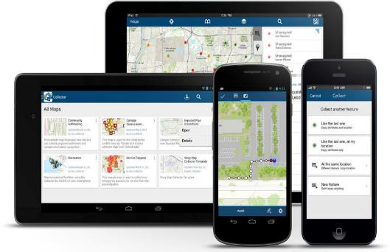
ArcGis Collector: http://doc.arcgis.com/en/collector/
VT Agency of Natural Resources Atlas tool
http://anr.vermont.gov/maps/nr-atlas

Slide 12
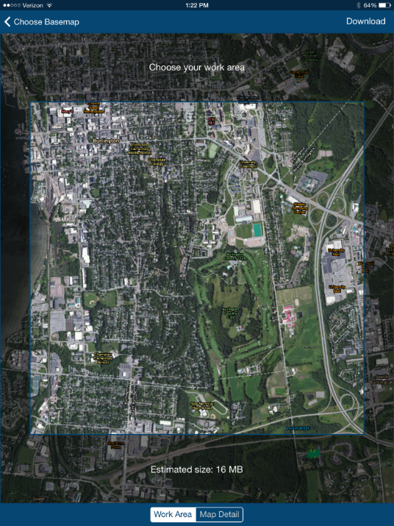

Slide 13
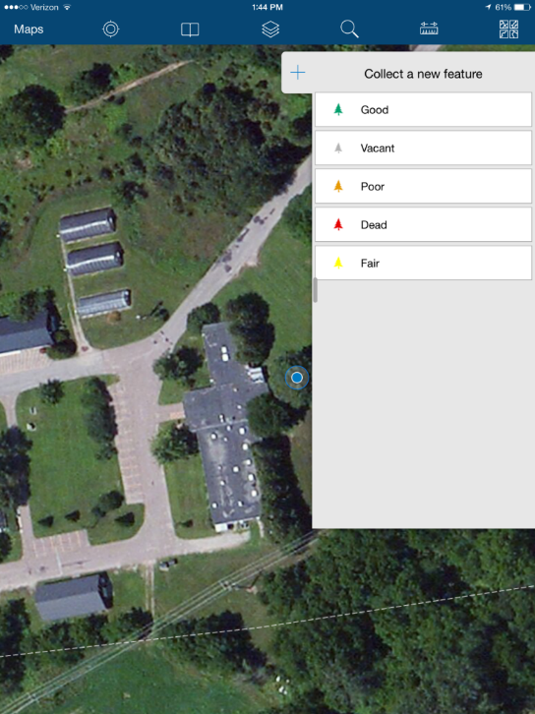

Slide 14
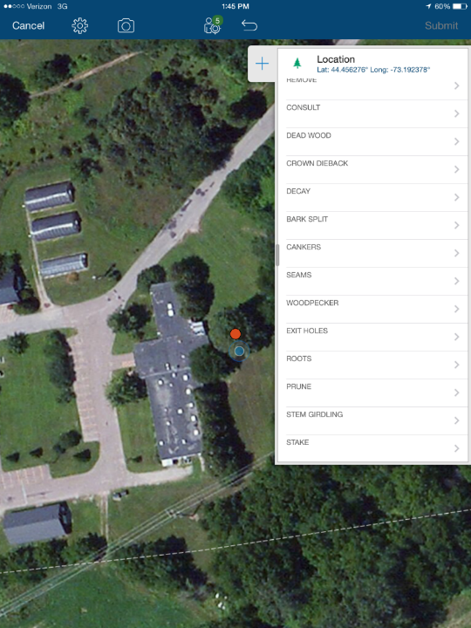

Slide 15
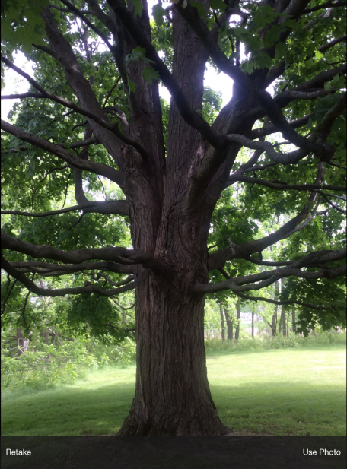
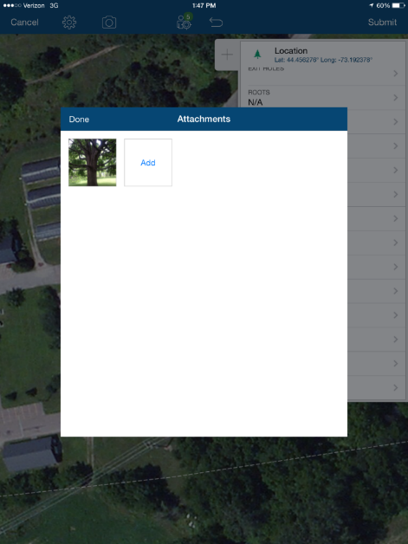

Slide 16
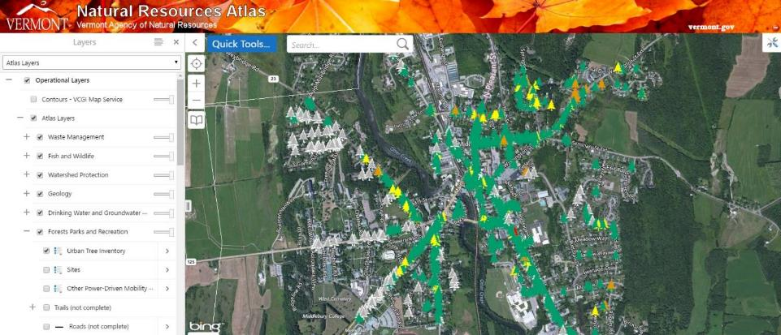

Slide 17
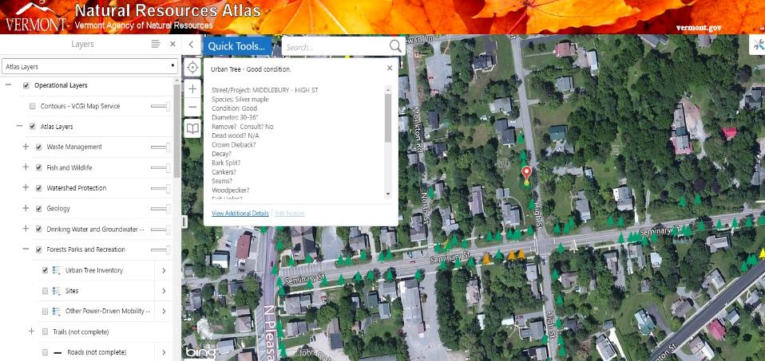

Slide 18
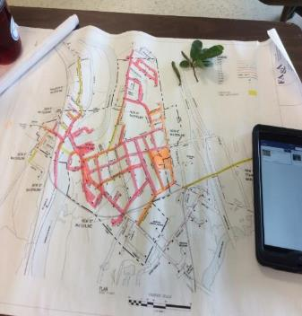
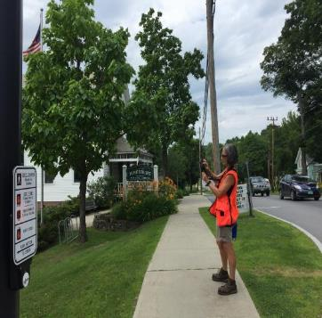
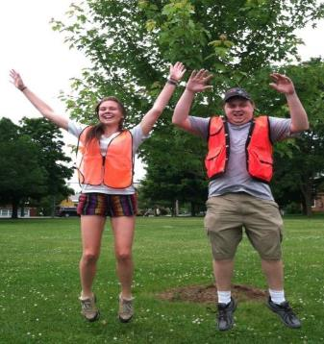
Inventory V.2
ANR GIS team partnership
Collector; iPads
Excel spreadsheets
Students, AmeriCorps, volunteers, State Lands Foresters

Slide 19
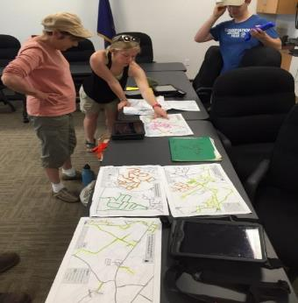
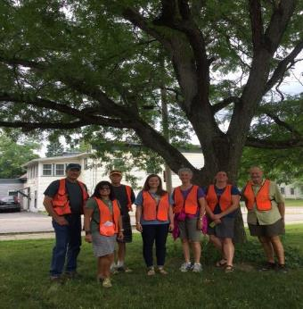
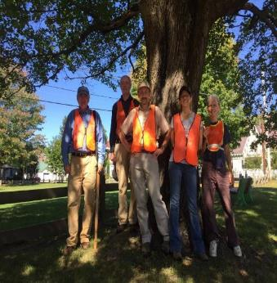
Inventory V. 3 and Beyond
Request basis
iPads on loan
Communities responsible for recruiting data collectors
VT UCF training and data analysis
⬧

Slide 20
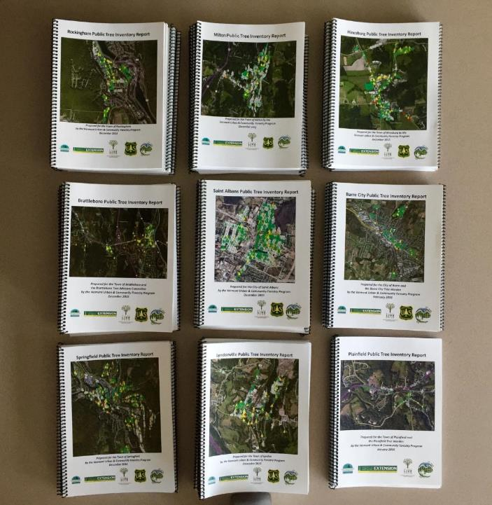

Slide 21
Street/Site name | ROW Extent (feet) | Number of Trees
Barre City Auditorium | All planted landscape trees | 15
Barre City Fire & Police Department | All planted landscape trees | 42
Barre City Library | All planted landscape trees | 10
Church Street | Full road ROW | 4
Cottage Street | Full road ROW | 8
Currier Park | All planted landscape trees | 19
Elmwood Cemetery | All planted landscape trees | 100
Hope Cemetery | All planted landscape trees | 168
Jefferson Street | Full road ROW | 7
Maple Avenue/Rt. 14 | Full road ROW | 1
Merchant Street | From 302/Main (S) to intersection with Summer Street (N); ROW | 8
North Main Street | From 6th Street (NW) to end/City Park (SE) | 56
Prospect Street | From Merchants Row (W) to end/intersection with Main (E); ROW | 6
Rotary Park | All planted landscape trees | 52
Seminary Street | From 302/Main Street to Summer Street (N); ROW | 2
South Main Street | From start/Vermont City Park (N) to railroad crossing/45 S. Main Street (S); ROW | 3
St. Monica Cemetery | All planted landscape trees | 14
Summer Street | Full road ROW | 5
Vermont City Park (on Church Street) | All planted landscape trees | 23
Washington Street | From start/Vermont City Park (W) Mount Street (E); ROW | 12
The following streets were either inventoried and had zero trees located within its public ROW, or were not inventoried due to time restraints and should be revisited in future inventories: Short Street, Bugbee Avenue, Gable Place, Granite Street, Enterprice Alley, Williams Lane, Metro Way, Merchants Row, Academy Street, Elm Street, Keith Avenue, Pearl Street, Buzzell Place, West Street, Campbell Place, Tomasi Street.

Slide 22
Common Name | Scientific Name | Number of Trees | Percent of Total Population
Norway maple | Acer platanoides | 75 | 15.31%
Crabapple | Malus sp. | 75 | 15.31%
Sugar maple | Acer saccharum | 45 | 9.18%
Honeylocust | Gleditsia triacanthos | 34 | 6.94%
Northern White Cedar | Thuja occidentalis | 27 | 5.51%
Northern red oak | Quercus rubra | 27 | 5.51%
Eastern White Pine | Pinus strobus | 23 | 4.69%
Green ash | Fraxinus pennsylvanica | 16 | 3.27%
Norway spruce | Picea abies | 14 | 2.86%
Red maple | Acer rubrum | 12 | 2.45%
Japanese Zelkova | Zelkova serrata | 12 | 2.45%
Pear | Pyrus sp. | 10 | 2.04%
Serviceberry | Amelanchier arborea | 10 | 2.04%
Broadleaf deciduous small | Broadleaf | 9 | 1.84%
American elm | Ulmus americana | 8 | 1.63%
Red cedar | Thuja plicata | 8 | 1.63%
Black locust | Robinia pseudoacacia | 8 | 1.63%
Littleleaf linden | Tilia cordata | 8 | 1.63%
Maple | Acer sp. | 7 | 1.43%
Cherry Plum | Prunus cerasifera | 7 | 1.43%
Conifer Evergreen Large | Conifer sp. | 5 | 1.02%
Pine | Pinus sp. | 4 | 0.82%
Blue spruce | Picea pungens | 4 | 0.82%
Black Cherry | Prunus serotina | 4 | 0.82%
Lilac | Syringa vulgaris | 3 | 0.61%
Douglas fir | Pseudotsuga menziesii | 3 | 0.61%
Broadleaf deciduous large | Broadleaf | 3 | 0.61%
Pin oak | Quercus palustris | 2 | 0.41%
Boxelder | Acer negundo | 2 | 0.41%
Japanese tree lilac | Syringa reticulata | 2 | 0.41%
Hawthorn | Crataegus sp. | 2 | 0.41%
American basswood | Tilia americana | 2 | 0.41%
Broadleaf deciduous medium | Broadleaf | 2 | 0.41%
White ash | Fraxinus americana | 2 | 0.41%
Freeman maple | Acer sp. | 2 | 0.41%
White spruce | Picea glauca | 2 | 0.41%
Silver maple | Acer saccharinum | 1 | 0.20%
Pussy willow | Salix sp. | 1 | 0.20%
European beech | Fagus sylvatica | 1 | 0.20%
Juniper | Juniperus sp. | 1 | 0.20%
Butternut | Juglans cinerea | 1 | 0.20%
White fir | Abies concolor | 1 | 0.20%
Red mulberry | Morus rubra | 1 | 0.20%
European hornbeam | Carpinus betulus | 1 | 0.20%
Beech | Fagus sp. | 1 | 0.20%
Cottonwood | Aigeiros sp. | 1 | 0.20%

Slide 24
 | Number of trees requiring consult
 | Yes | No | Null
crown dieback | 61 | 494 | 0
decay | 48 | 488 | 19
bark split | 99 | 456 | 0
woodpecker activity | 11 | 544 | 27
root maintenance | 17 | 538 | 0
prune | 201 | 349 | 5
stem girdling roots | 5 | 550 | 0
mulch maintenace | 6 | 549 | 0

Slide 25
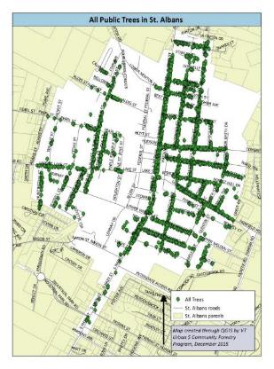
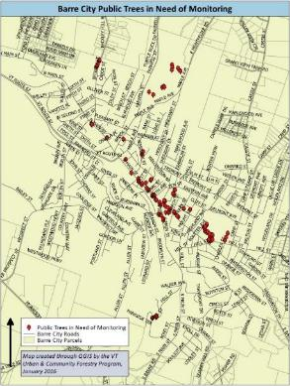
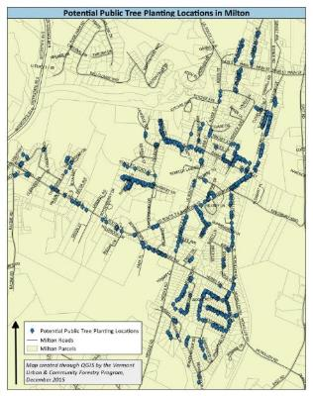
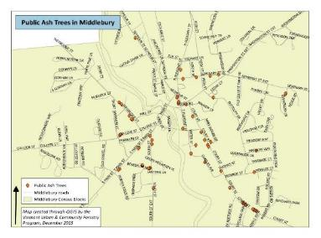

Slide 26
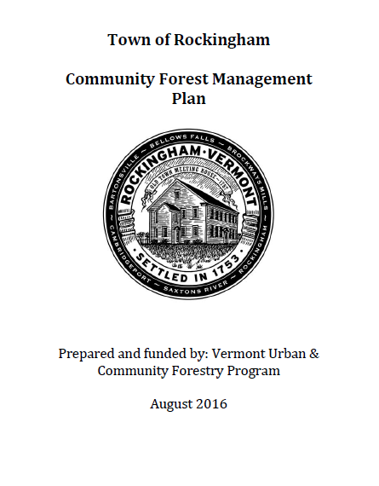
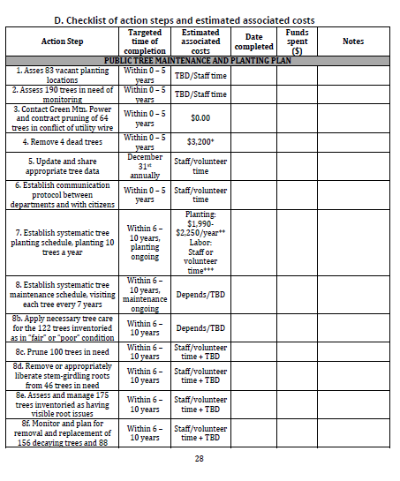
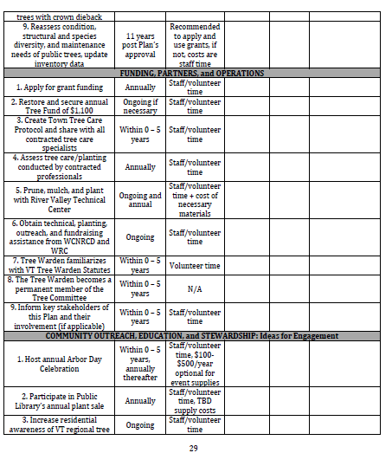

Slide 27
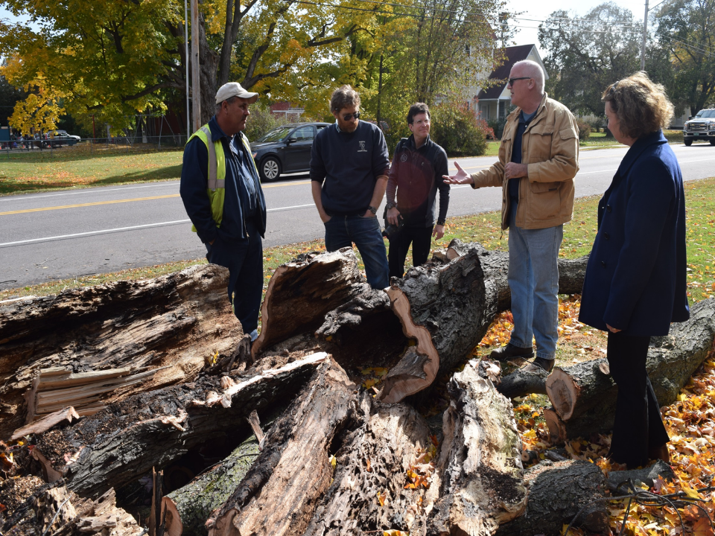

Slide 28
90+ municipal and 40 + citizen volunteers trained
Topics Include:
Proper planting, pruning
Establishing systemic tree inspection program
Understanding tree risk
Trees and utilities
Reallocating budgets for tree maintenance
Economic value of trees
Local policy and trees

Slide 29
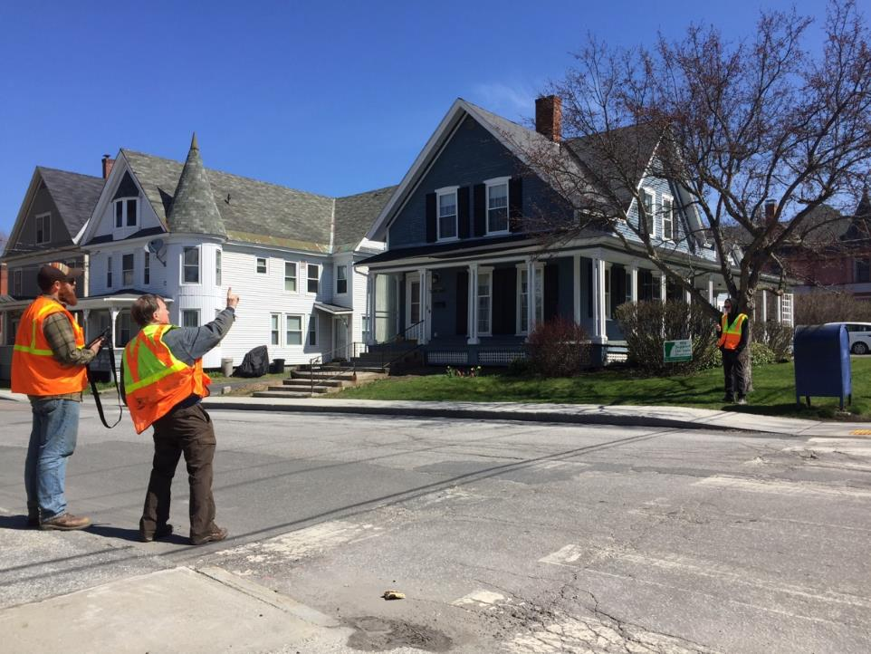
“…really gave our Tree Committee a purpose and direction…..”
“…. we were trying to confront the challenges of the future and not really knowing how. We now have a plan….”
“….You have launched a new level of activism for our Conservation Commission….”
“…the committee would not have been able to make progress within the community and town government structure without this help…”
“….Mark is worth his weight in gold ! An expert on exactly what it is we, the Tree Advisory Board need to know to make educated decisions and choices in setting up an annual tree care program…”

Slide 30
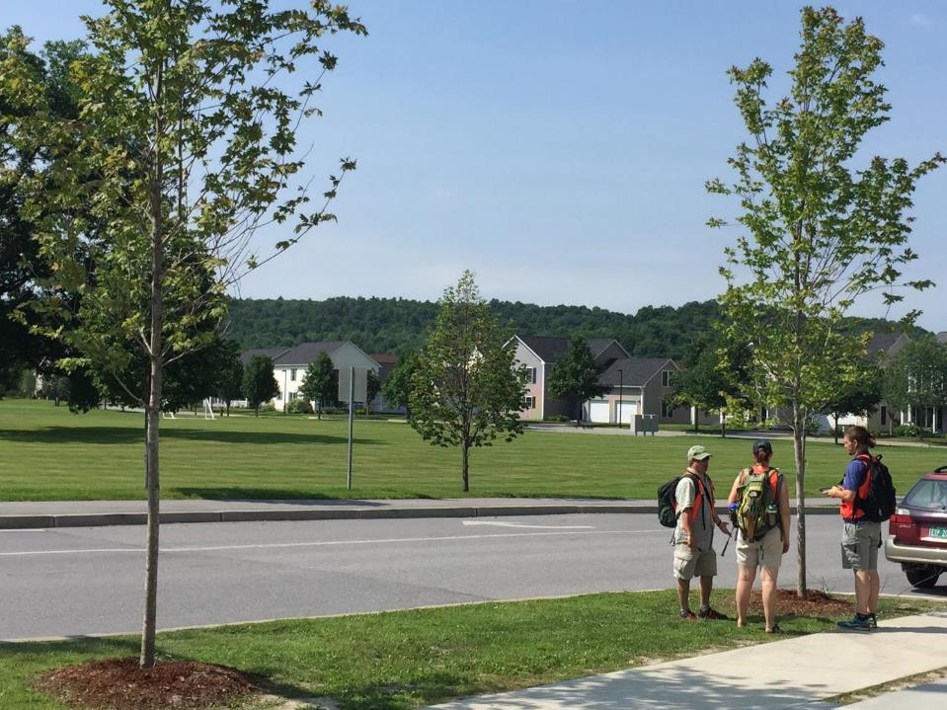
Comprehensive Inventory Analysis:
16,673 Trees in 27 Vermont Communities

Slide 31
56 genera

Slide 32
112 species

Slide 34
Diameter Distribution

Slide 36
i-Tree Streets Ecosystem Services Value
Town | Number of Trees Input | Air Quality | Aethetics | Energy | CO2 | Stormwater | Total | Total per tree annually
Colchester | 663 | $ 3,668 | $ 27,507 | $ 20,439 | $ 505 | $ 4,835 | $ 62,170 | $ 94
Essex Junction | 489 (only done on initial inventory round, didn't do for expanded inventory) | $ 2,893 | $ 7,947 | $ 12,051 | $ 331 | $ 3,826 | $ 27,048 | $ 55
Winooski | n/a - haven't done iTree streets
Shelburne | 722 | $ 4,001 | $ 12,056 | $ 21,489 | $ 467 | $ 5,458 | $ 43,471 | $ 60
Northfield | 303 | $ 2,734 | $ 13,203 | $ 14,328 | $ 353 | $ 3,902 | $ 34,520 | $ 114
Swanton | 449 | $ 5,384 | $ 21,358 | $ 26,008 | $ 691 | $ 7,773 | $ 61,214 | $ 136
Johnson | 363 | $ 2,616 | $ 7,591 | $ 14,816 | $ 311 | $ 3,669 | $ 29,003 | $ 80
Vergennes | 518 | $ 4,253 | $ 15,518 | $ 24,897 | $ 548 | $ 5,647 | $ 50,863 | $ 100
Middlebury | 797 | $ 6,513 | $ 37,687 | $ 36,667 | $ 807 | $ 8,421 | $ 90,892 | $ 114
Bristol | 562 | $ 5,062 | $ 20,631 | $ 29,507 | $ 631 | $ 6,782 | $ 62,613 | $ 111
Hinesburg | 838 | $ 6,602 | $ 33,367 | $ 35,535 | $ 836 | $ 8,470 | $ 84,811 | $ 101
Milton | 1050 | $ 8,822 | $ 38,127 | $ 50,784 | $ 1,107 | $ 12,710 | $ 111,552 | $ 106
Rockingham | 489 | $ 4,452 | $ 11,031 | $ 24,927 | $ 570 | $ 5,588 | $ 46,568 | $ 95
Springfield | 861 | $ 8,893 | $ 18,502 | $ 49,160 | $ 1,193 | $ 12,442 | $ 90,191 | $ 105
Lyndonville | 244 | $ 1,605 | $ 3,513 | $ 9,513 | $ 200 | $ 2,154 | $ 16,895 | $ 70
St. Albans City | 1715 | $ 17,408 | $ 50,184 | $ 98,359 | $ 2,262 | $ 25,057 | $ 193,271 | $ 113
Brattleboro | 362 | $ 3,641 | $ 11,413 | $ 20,460 | $ 476 | $ 5,264 | $ 41,254 | $ 114
Barre City | 555 | $ 4,272 | $ 10,921 | $ 24,308 | $ 537 | $ 6,052 | $ 46,090 | $ 83
Newport City | 268 | $ 1,860 | $ 6,211 | $ 10,466 | $ 219 | $ 2,437 | $ 21,205 | $ 79
Montpelier | n/a - haven't done iTree streets
Plainfield | 126 | $ 797 | $ 2,906 | $ 4,523 | $ 106 | $ 1,004 | $ 9,336 | $ 74
Waterbury | 292 | $ 1,944 | $ 10,899 | $ 10,941 | $ 263 | $ 2,522 | $ 26,599 | $ 91
Chester | 117 | $ 1,036 | $ 4,463 | $ 5,800 | $ 133 | $ 1,364 | $ 12,796 | $ 109
Stowe | 160 | $ 1,258 | $ 6,265 | $ 7,323 | $ 147 | $ 1,541 | $ 16,533 | $ 103
Windsor | 169 | $ 1,973 | $ 8,643 | $ 10,611 | $ 260 | $ 2,927 | $ 24,414 | $ 146
Charlotte | 342 | $ 2,670 | $ 18,070 | $ 15,578 | $ 323 | $ 3,196 | $ 39,838 | $ 116
Essex | n/a - haven't done iTree streets
TOTAL |  | $ 104,357 | $ 398,013 | $ 578,490 | $ 13,276 | $ 143,041 | $ 1,243,147 | $ 100.00

Slide 37
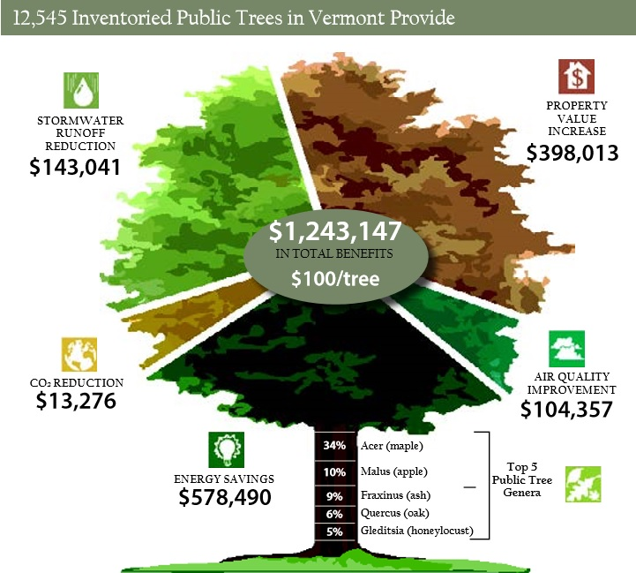

Slide 38
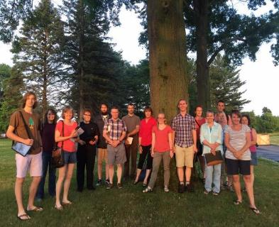
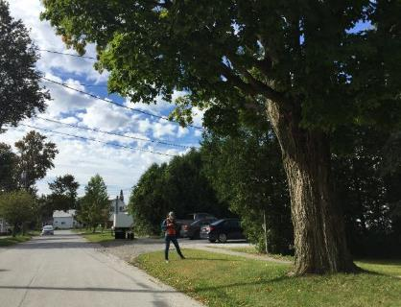
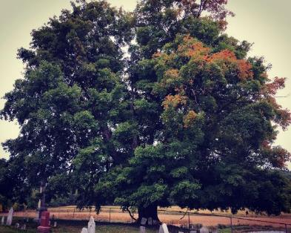
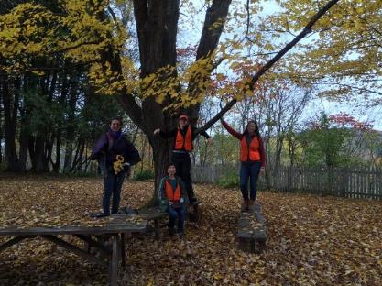
Lessons & Insights

Slide 39
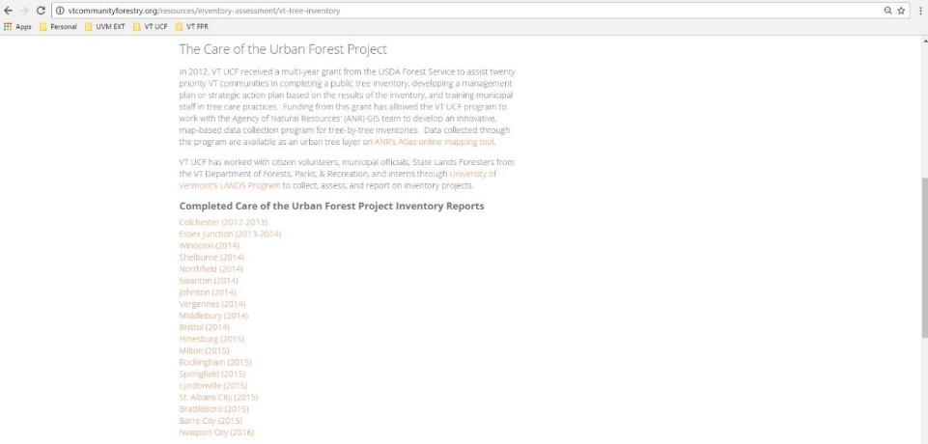
vtcommunityforestry.org/resources/inventory-assessment/vt-tree-inventory

Slide 40
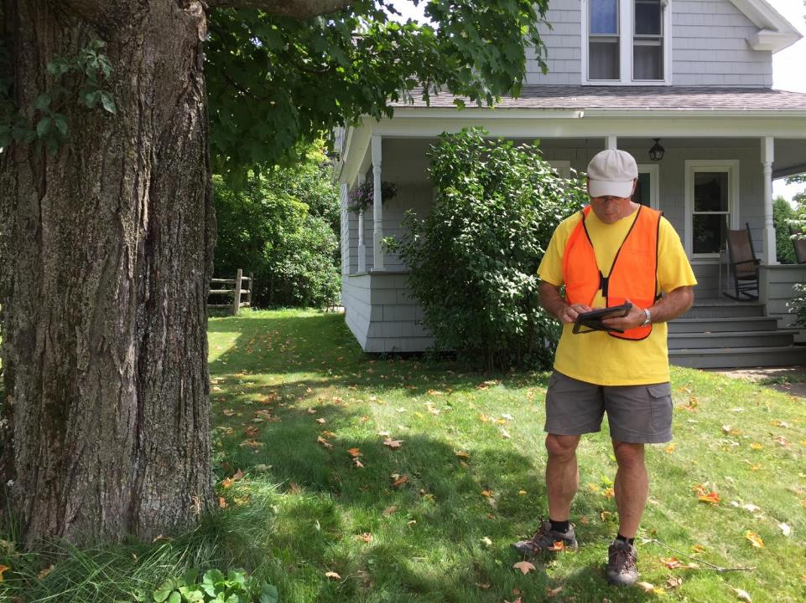
What’s Next? Care of the Urban Forest Project 2.0?

Slide 41
www.vtcommunityforestry.org
Elise.Schadler@uvm.edu
802.881.1256
Questions?

