Slide 1
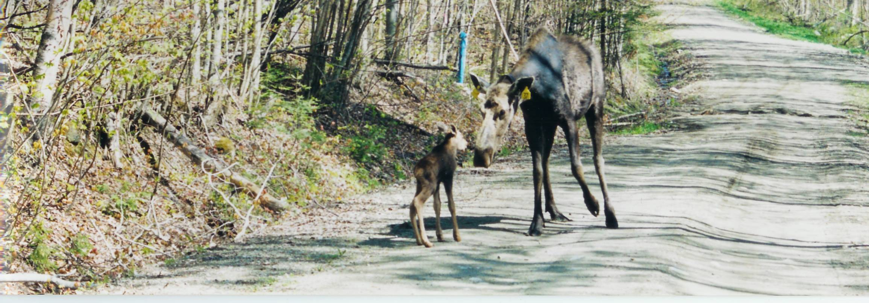
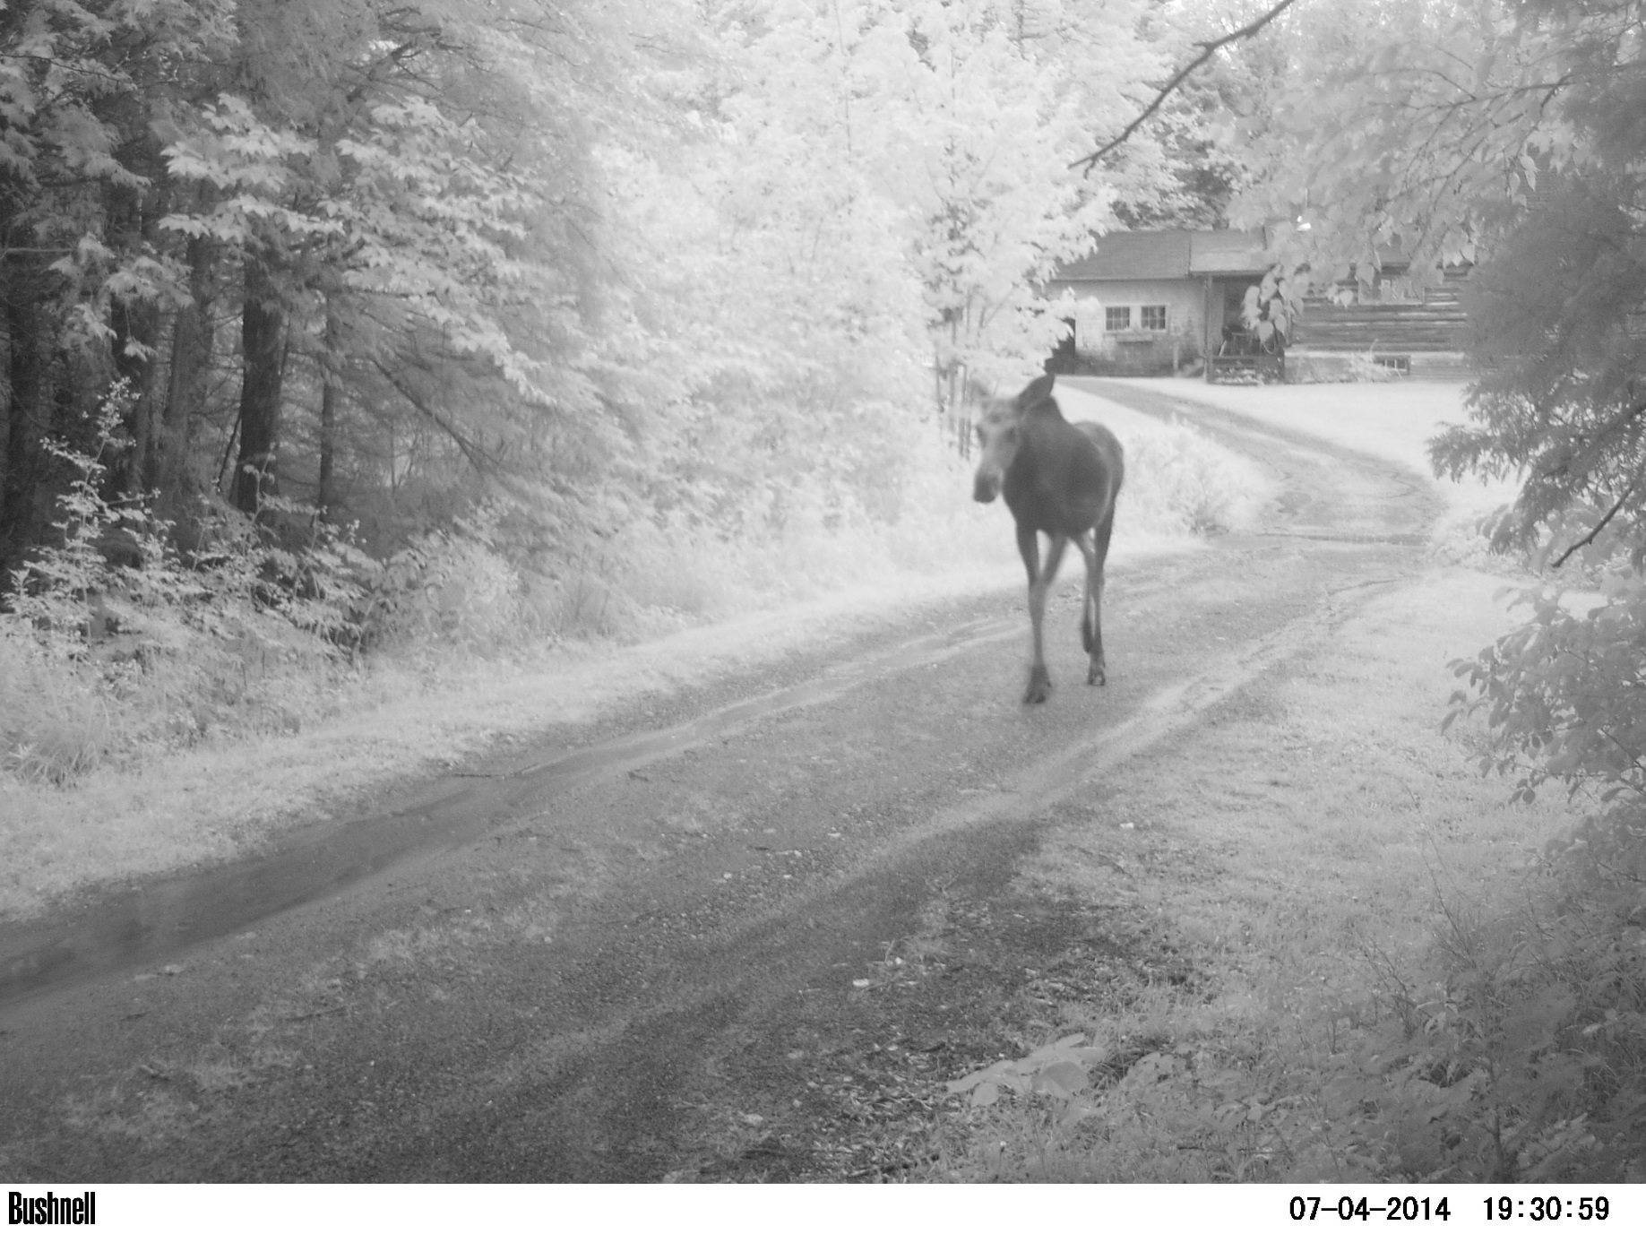
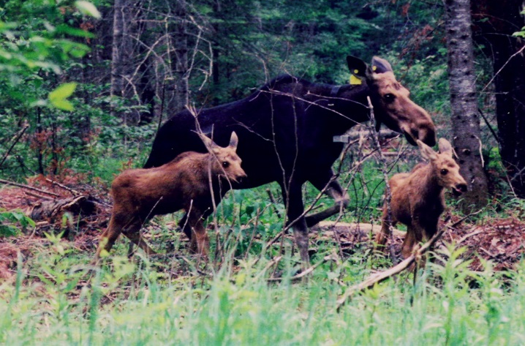
Metabolic Impacts of Winter Tick Infestations:
Understanding Mortality and Productivity Consequences to Moose

Slide 2

Population Modeling: New Hampshire 2002-2005
Model I (radio-marked fecundity) and Model II (harvest fecundity) using (a) lower 95% CI of winter survival rate of calves and yearling/adults and (b) lower 95% CI of fall survival rate of yearling/adults
a) Model II (λ=0.98)
b) Model II (λ=1.01)
Model I (λ=0.97)
Model I (λ=0.95)
g
NH moose population has dropped about 40-50% since…. who would of thought??? Why?
The high frequency of winter tick epizootics since 2005 (5 since 2008, 3 successive in 2014-2016).
The impacts on calf survival & productivity mimics the worst situation (Model I radio-marked).

Slide 3
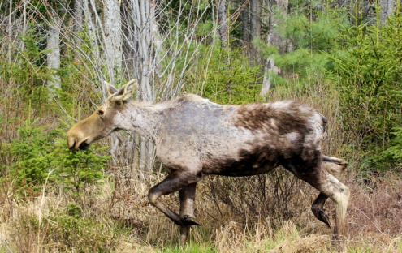

Physical Characteristics and Reproduction
A continued decline in corpora lutea count and body weight of yearling cows occurred from 1988-1998 to 2005-2009 in New Hampshire. Ovulation requires field-dressed weight >200 kg.
We can’t even generate these data anymore…..

Slide 4
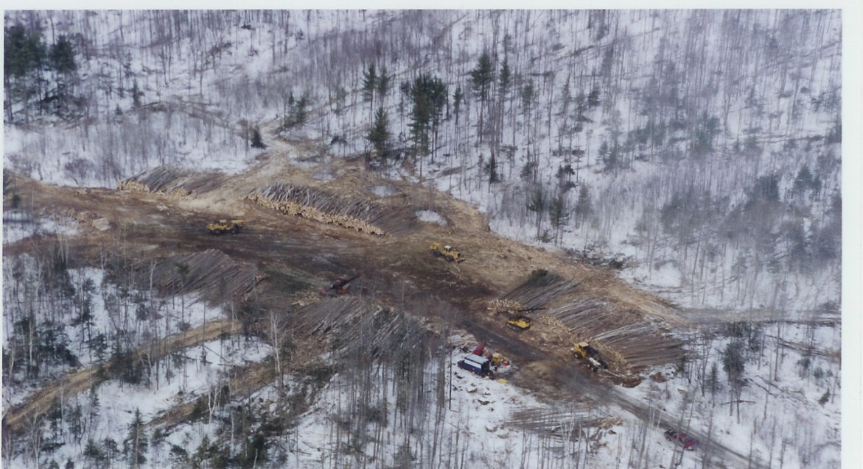
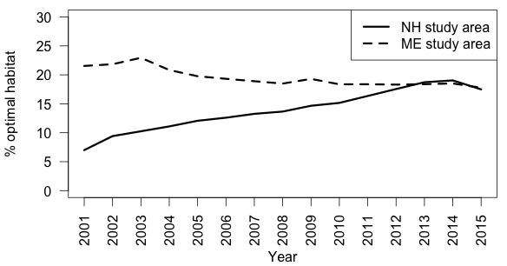
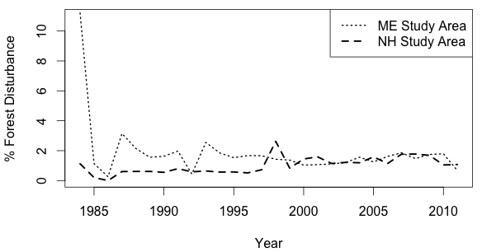
HIGH MORTALITY IN YOUNG, DELAYED MATURITY, DECLINING BODY WEIGHTS –
CHARACTERISTICS OF A POPULATION WELL ABOVE K/NUTRITIONALLY DEPRIVED
SO WHAT OF HABITAT – 4-16 year regen?
HABITAT QUALITY AND QUANTITY ARE NEAR OPTIMAL

Slide 5
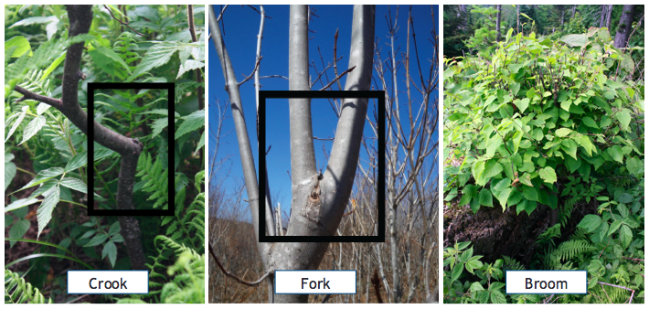
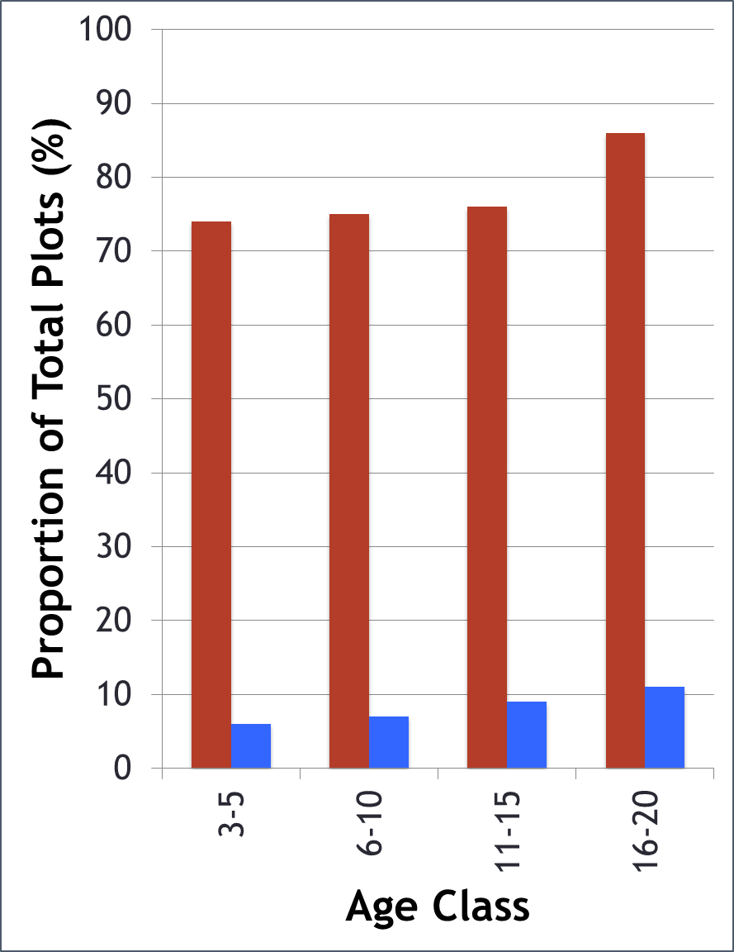

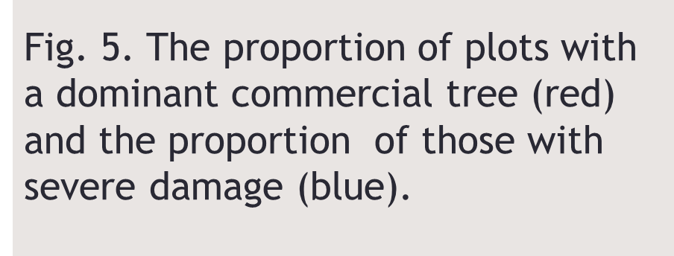
FOREST DAMAGE STUDIES – NH, VT, ME
 | Vigor
Form | R1 | R2 | R3 | R4 | Form Totals
F1 | 0.39 | 0.11 | 0.01 | 0.00 | 0.51
F2 | 0.13 | 0.13 | 0.00 | 0.00 | 0.27
F3 | 0.01 | 0.01 | 0.00 | 0.00 | 0.03
F4 | 0.00 | 0.00 | 0.00 | 0.00 | 0.01
F5 | 0.00 | 0.01 | 0.00 | 0.00 | 0.02
F6 | 0.03 | 0.04 | 0.00 | 0.00 | 0.07
F7 | 0.01 | 0.01 | 0.00 | 0.00 | 0.02
F8 | 0.03 | 0.04 | 0.00 | 0.00 | 0.07
Vigor Totals | 0.60 | 0.36 | 0.01 | 0.01 | 1.00
Table 2. Proportional distribution of form and vigor ratings as assigned by the New Brunswick classification protocol in older stands (>30 years old). The majority of trees were F1/F2 (78%) or R1/R2 (96%) indicating commercial value; 39% had the highest combined rating (F1-R1).
(NOT MUCH HERE…..)

Slide 6
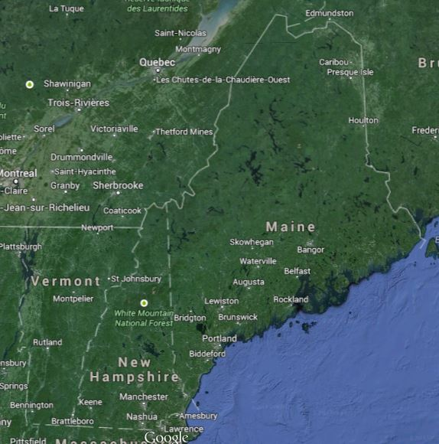
New Brun.
Quebec
Maine
Vermont
New Hamp.
MOOSE STUDY SITES IN NEW ENGLAND

Slide 7
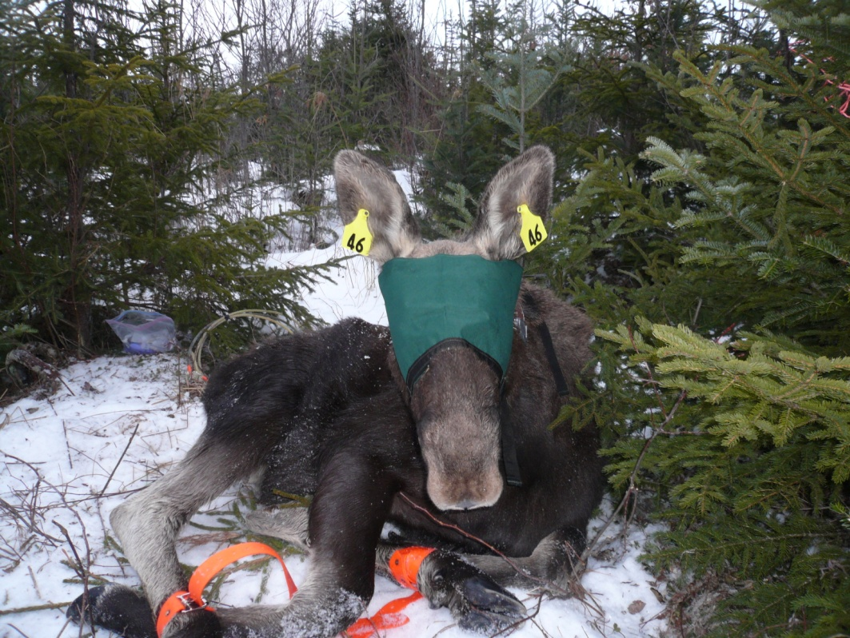
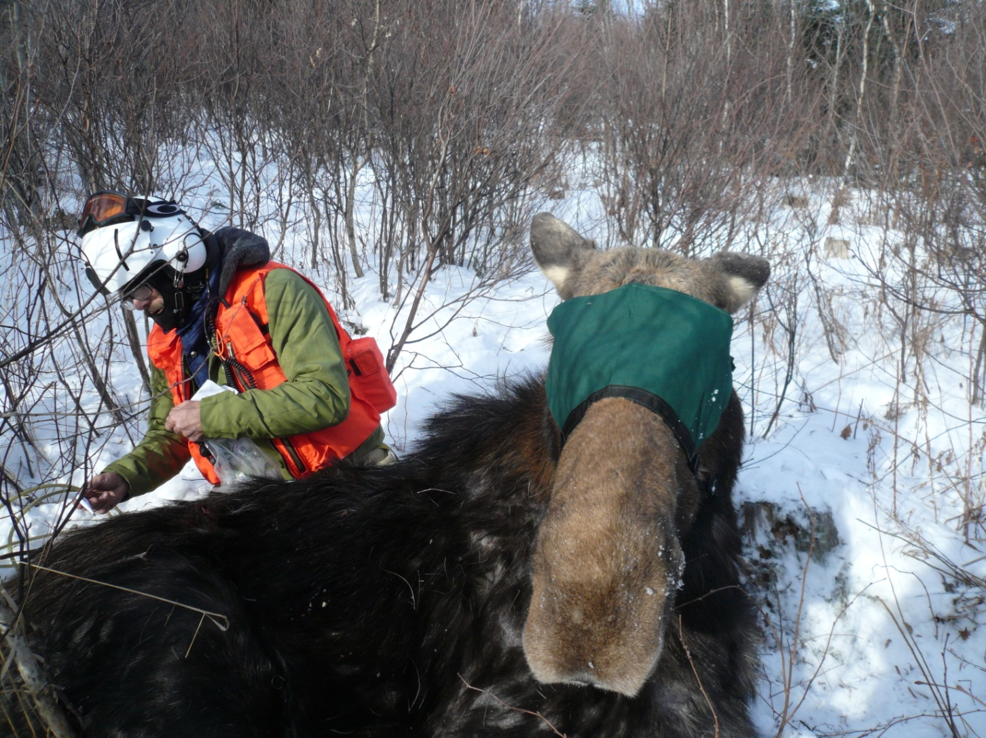
Productivity & Mortality (2014-2017)
- Productivity of cows
- Neonatal survival
Annual survival/mortality
Cause of mortality

Slide 8
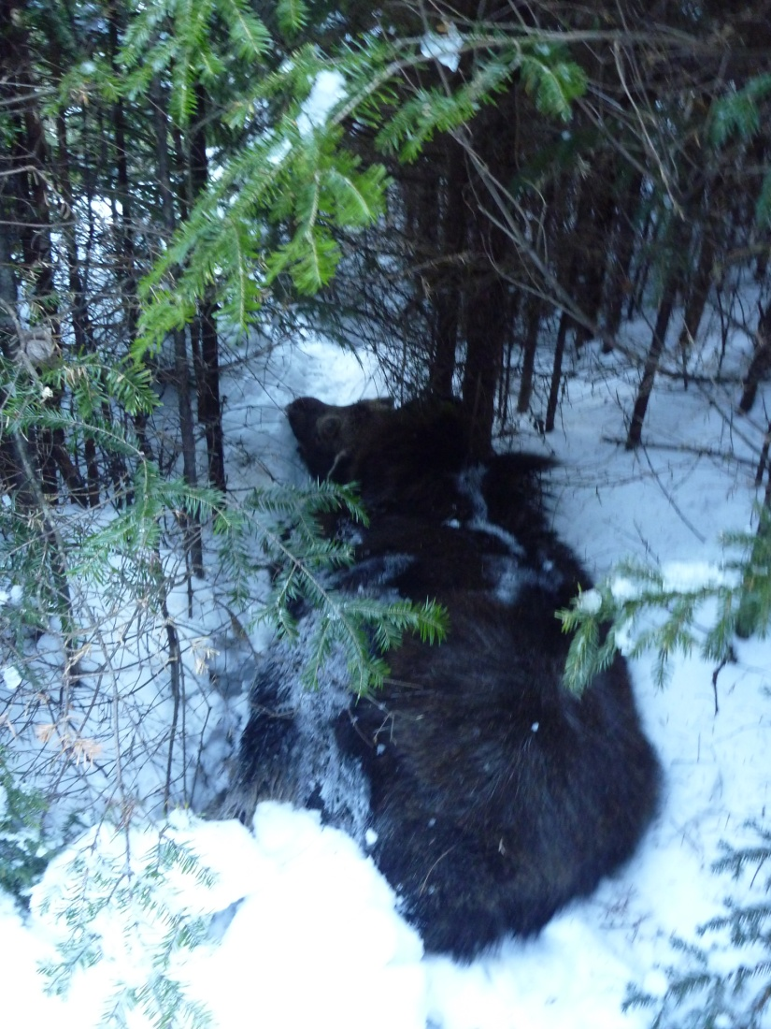
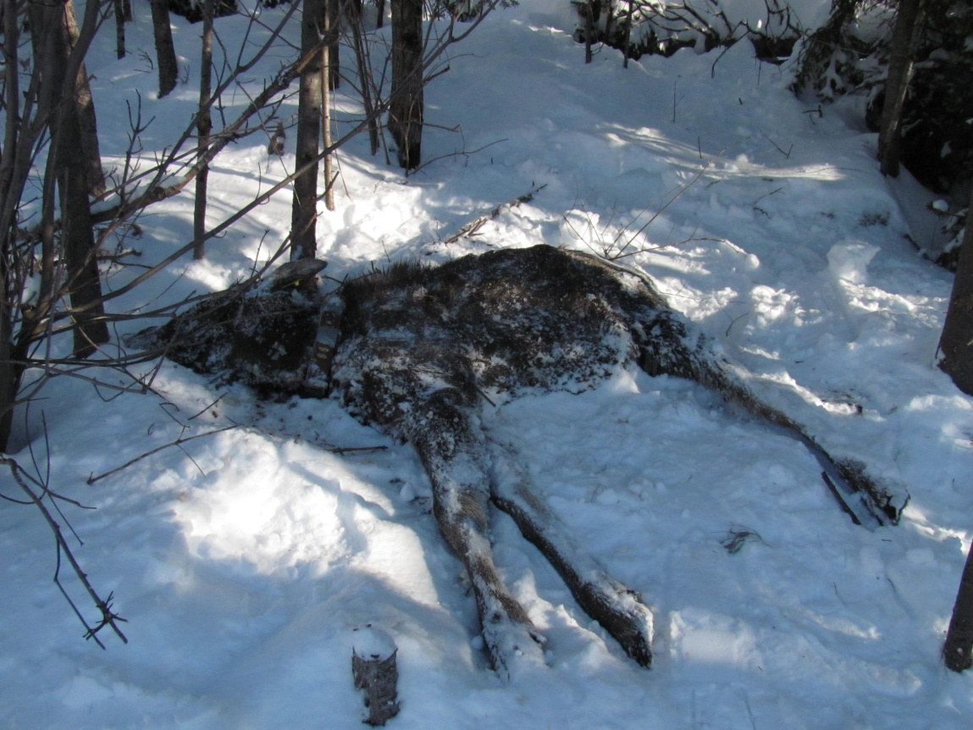
3-YEAR RESULTS (2014-2016)
                - ALL WERE EPIZOOTICS (& 2003, 08, 11)
                - 70% CALF MORTALITY; 15% ADULT
                - ACUTE ANEMIA & SEVERE WEIGHT LOSS
                - LOWER CALF MORTALITY IN NORTHERN MAINE (45%)

Slide 9
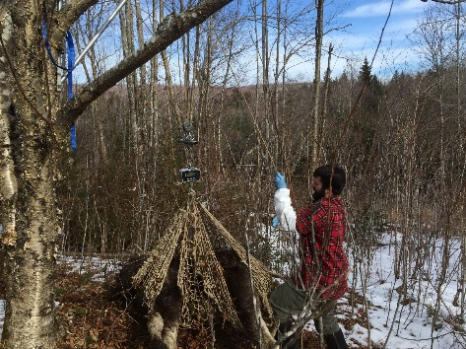
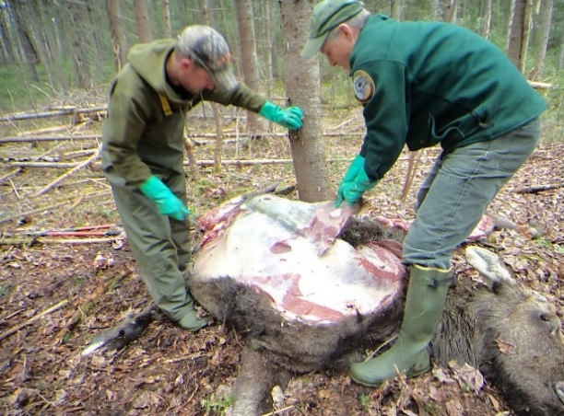
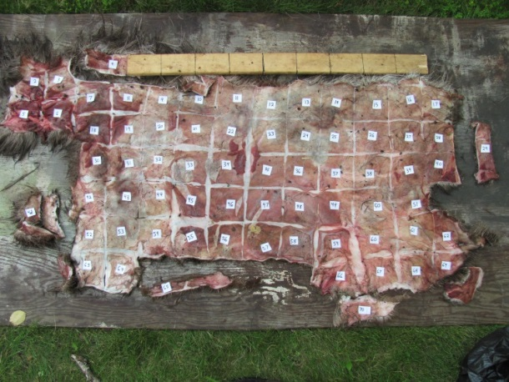
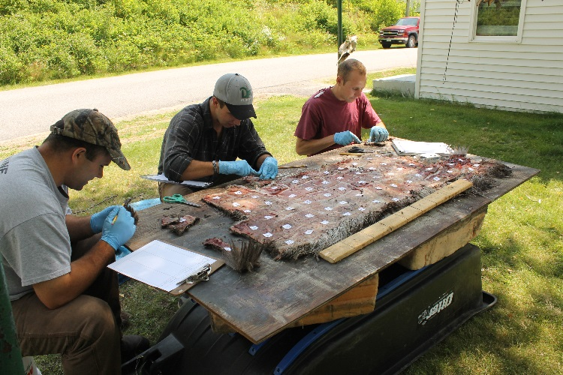
HIGH CALF MORTALITY FROM TICKS CAN OCCUR IN ANY WINTER!
COUNTING TICKS - YOU CAN’T SEE THE LONG TRAIL…

Slide 10
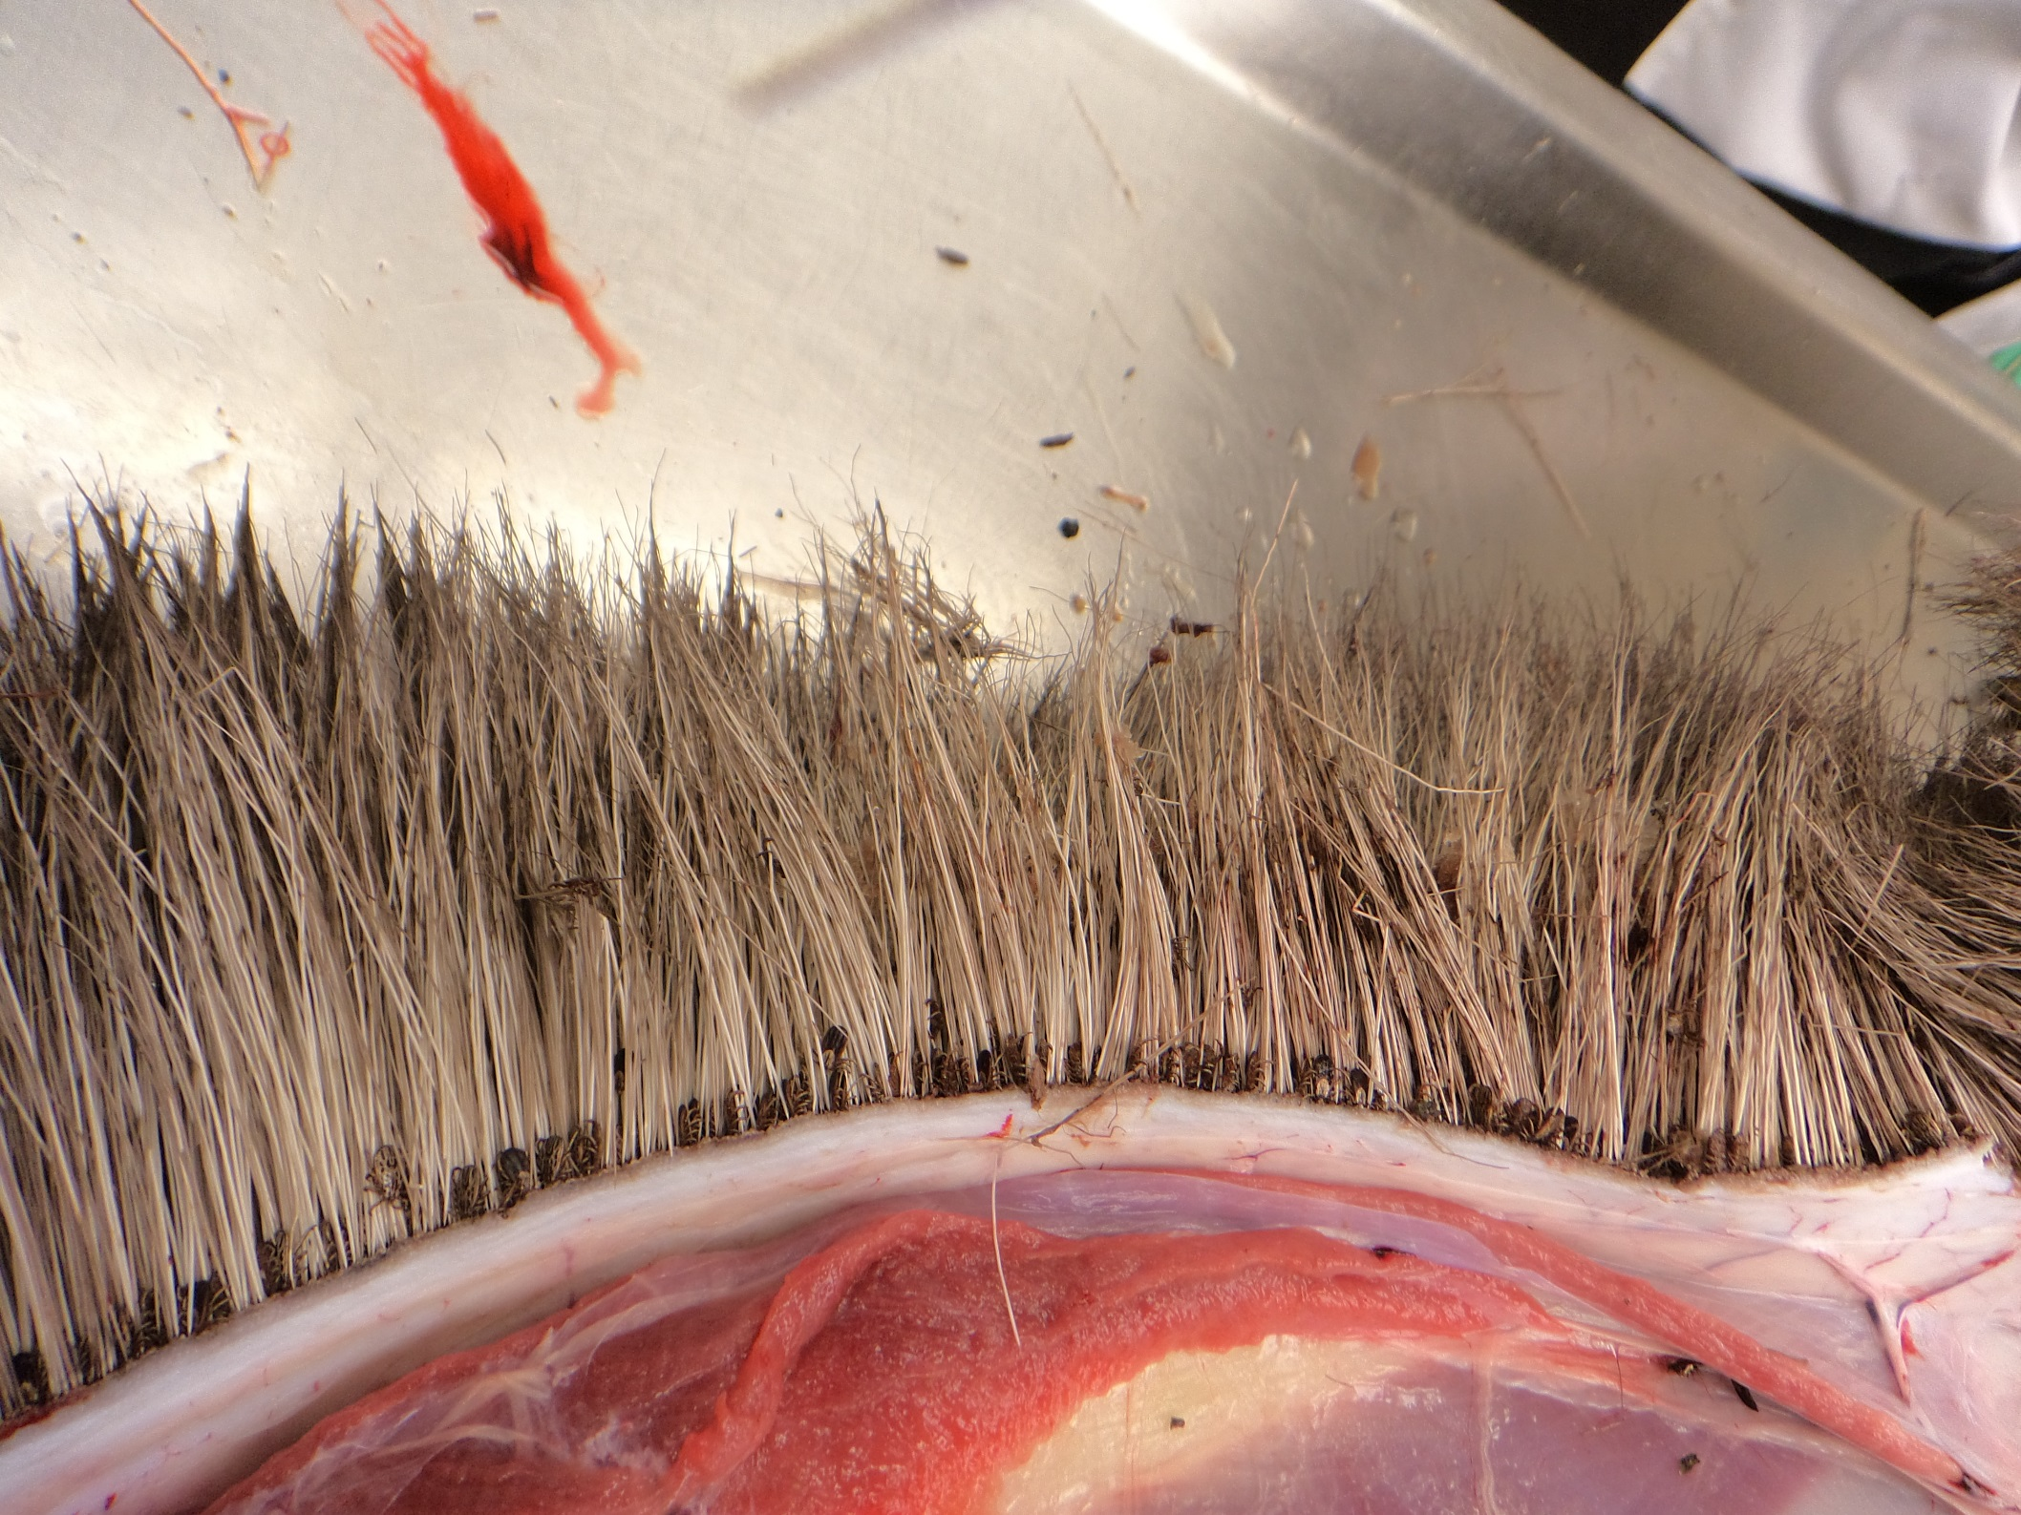
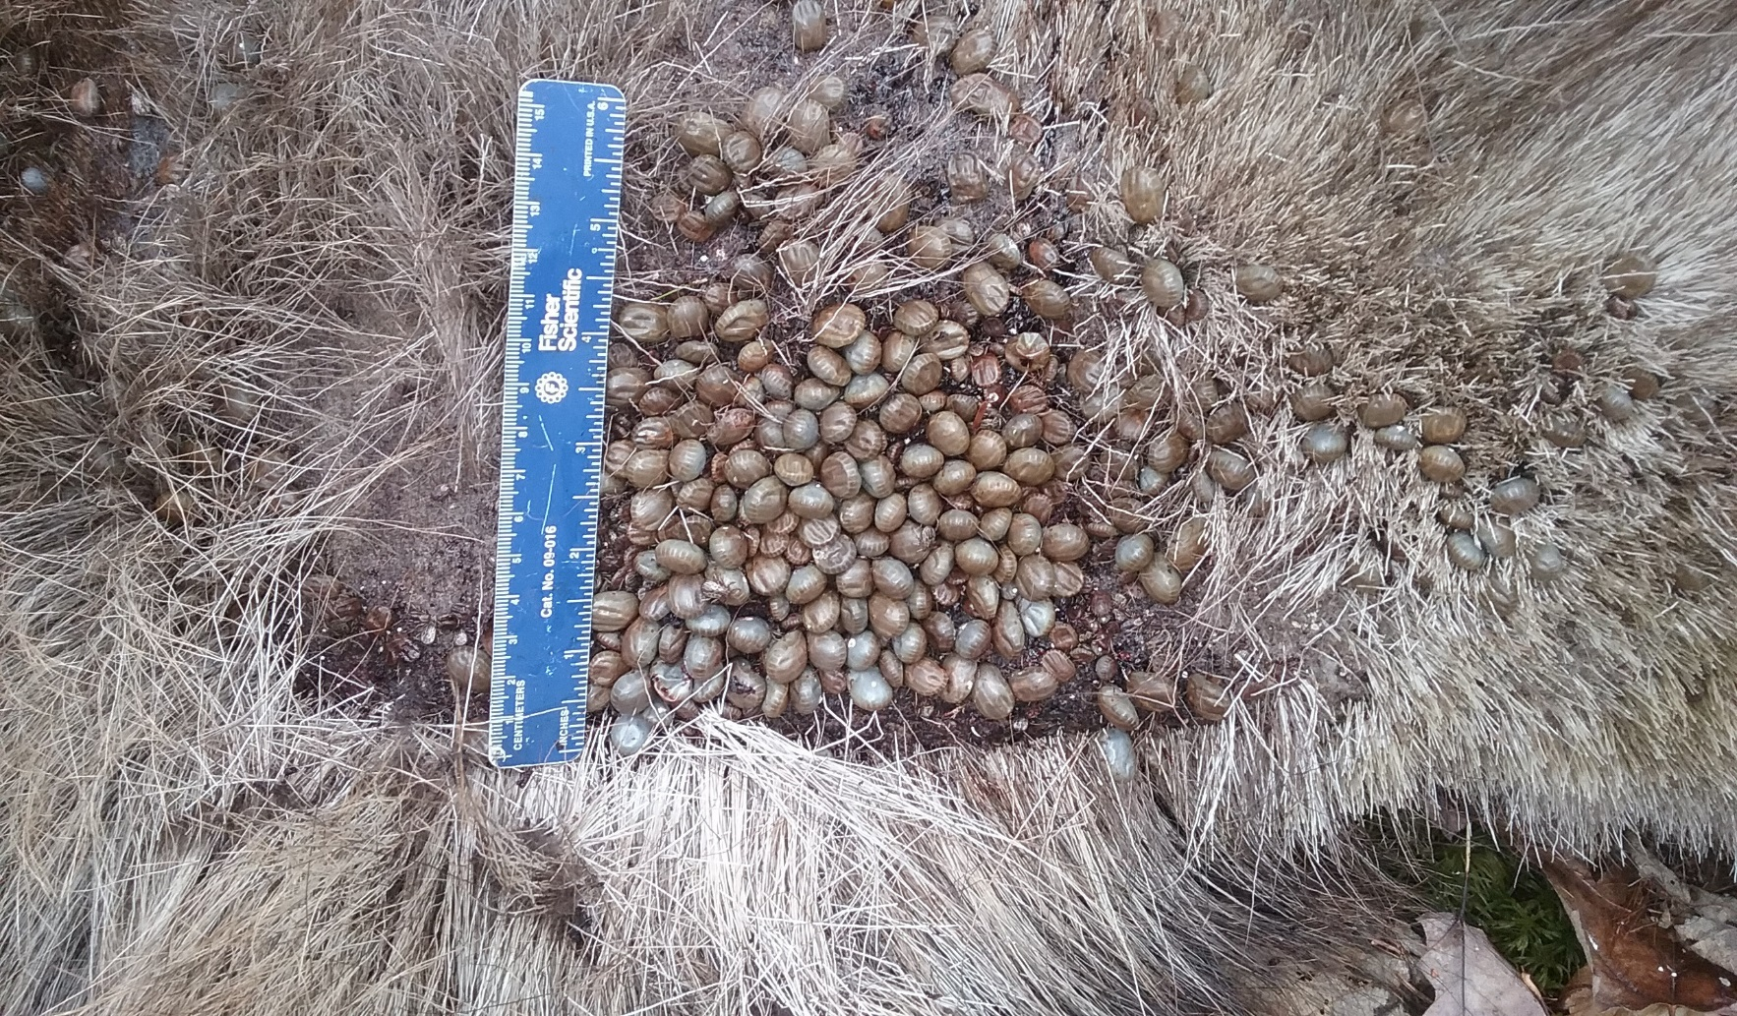
“For all moose, but most certainly for calves, ticks suck!” (B. Samuel)
“We” are counting tick loads of 35,000 - >90,000 thousand on calves (conservative estimates)!

Slide 11
Volume & Energy Cost of Blood Loss
  Severe Tick Load (70,000)
  - Calves lose entire blood volume in 3 week period!
  ~15-20% of daily ME in 2 week “surge” to replace blood
  They are toast!
  ”

Slide 12
Protein Deficit – Calves
  Peak Protein Loss = 50>100% of daily requirement!!!
  Adults: 30-40% of daily requirement (70,000 ticks)

Slide 13
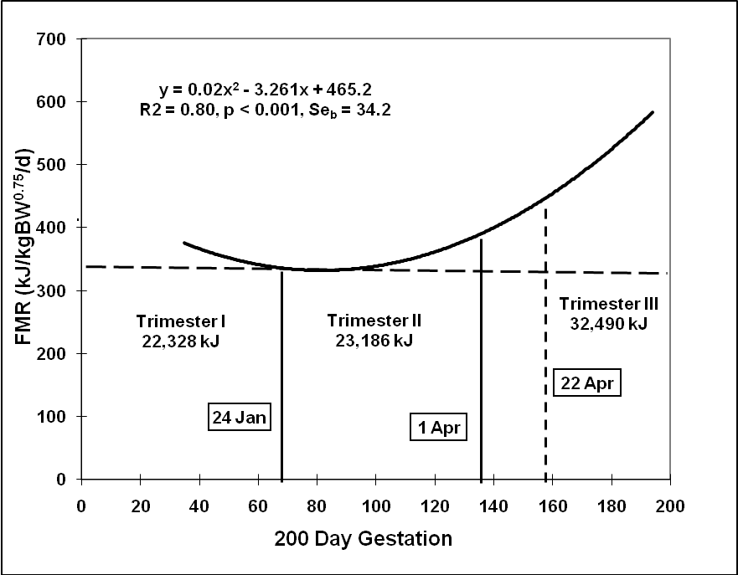
ENERGY COST OF GESTATION (DEER)
Key Points:
Delayed development addresses protein-deficient winter diet
90⁺ % of cost in 3rd trimester
~75% of cost & lactation occur after spring green-up
MOOSE DO NOT USE THIS STRATEGY!
spring green-up occurs after birth
“Winter” forage and body tissues provide the cost of gestation and early lactation.
(Or, as Jonas taught us –
size matters - sorry Murray….)

Slide 14
BALANCING GESTATION & “TICK COST”:
SIGNIFICANCE OF BODY WEIGHT & CONDITION
  Some assumptions:
  1) Maintain body weight from forage consumption until January
  2) Body weight is equal in January and May
  2) Period 1 = January & February (60 days) – no gestational cost
  3) Period 2 (3rd trimester) = March-May 17 (77 days) – 100% gestational and tick costs
  Balance = (FMR*+ gestation cost + tick cost) – (forage energy) – (tissue/fat energy)
3 Adult Cows: Body Weights = 325 kg (15% body fat), 350 (20%), 375 (25%)
  * FMR = field metabolic rate

Slide 15
BALANCING GESTATION & TICKS:
SIGNIFICANCE OF BODY WEIGHT & CONDITION
Field metabolic rate: FMR = ME (maintenance energy requirement) x 1.1
where ME = 131 kcal/kg^{0.75}/d
Gestational cost:
  1) assumed zero until last trimester (77 days)
  2) trimester broken into 3 periods: 21 (1.2 x ME), 28 (1.3 x ME), and 28 (1.6 x ME) days
  Tick cost (70,000 ticks):
  The 3 periods also represent 3 distinct periods of blood loss:
  pre (10%), engorge (75%), post (15%) = total cost = 41,000 kcal
  Forage consumption: 1% (dry) of body weight
  325 kg = 7150 kcal/d; 350 = 7775; 375 = 8250
  Fat Energy: 9.4 kcal/g – (325 = 460,600 kcal; 350 = 658,000; 375 = 878,900)

Slide 16
Largest cows are in deficit in the last
4-week period only (post-engorgement):
350 kg = 9259/day
375 kg = 5880/day
Ticks represent 4-8 days of this deficit.
KCAL (fat)
Mar 21
Jan 1
Mar 1
325 kg cow - deficit occurs in early April????
Apr 19
May 18

Slide 17
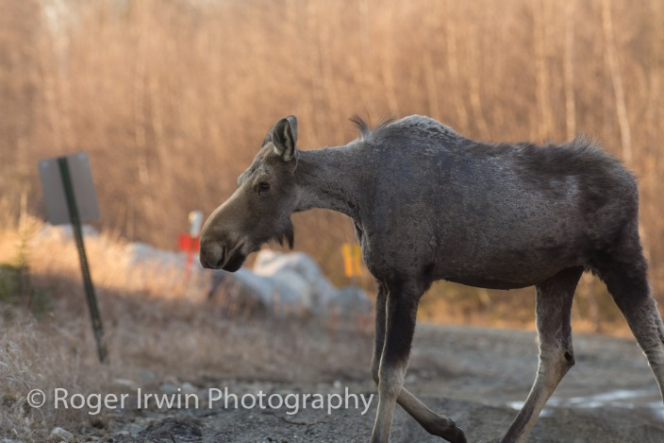
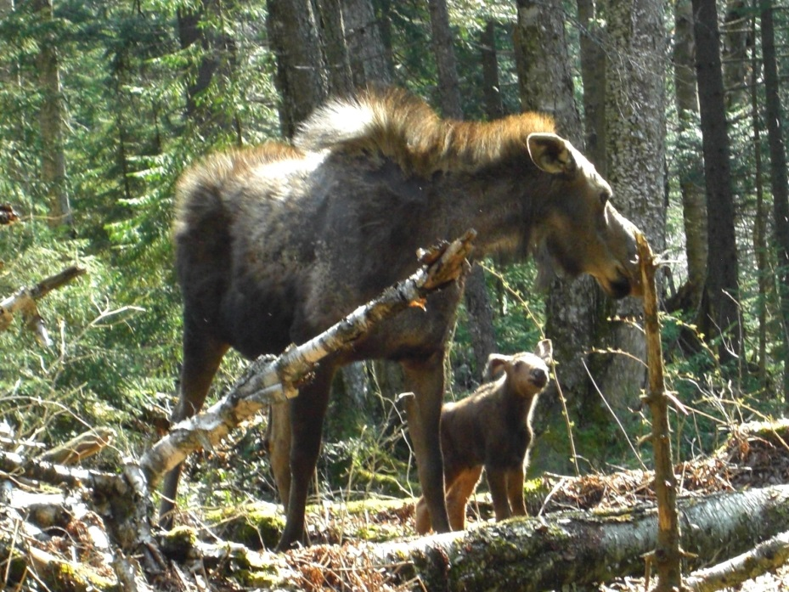
Healthy Ghost Moose!

Slide 18
So what the hell is going on??? It’s complex…
Protein deficit is problematic during fetal growth phase
(30-40% daily deficit– the length of this period is key – size matters)
Limits of compensatory growth (non-breeding years increase; <50%)
Cumulative physiological impacts (frequent vs. pulsed epizootic events)
Later maturation (surviving calves are severely compromised)
Age/size of cows becomes more influential on productivity
Individual productivity declines (low twinning rate)

Slide 19
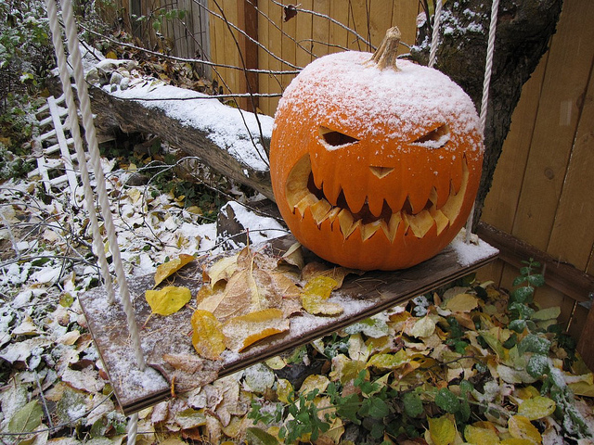
What of Climate Change?
1) Tick survival, productivity, and abundance – all increase (except drought years)
  - longer falls (questing), shorter winters (adult female survival)
  - ticks cost ~4 days of energy and substantial protein imbalance during fetal growth
2) New moose-tick relationship: continuous/multi-year impacts vs. annual pulses
- higher annual frequency of epizootics
3) Moose population: what is the lower “stable/normal” population in face of #2?
Management Options?
Adjust population goals relative to “new” host-parasite relationship.
Reduce moose density to disrupt the “new” host-parasite relationship.
Wait, watch, hope….
”frost on the pumpkin” will solve our woes!

Slide 20
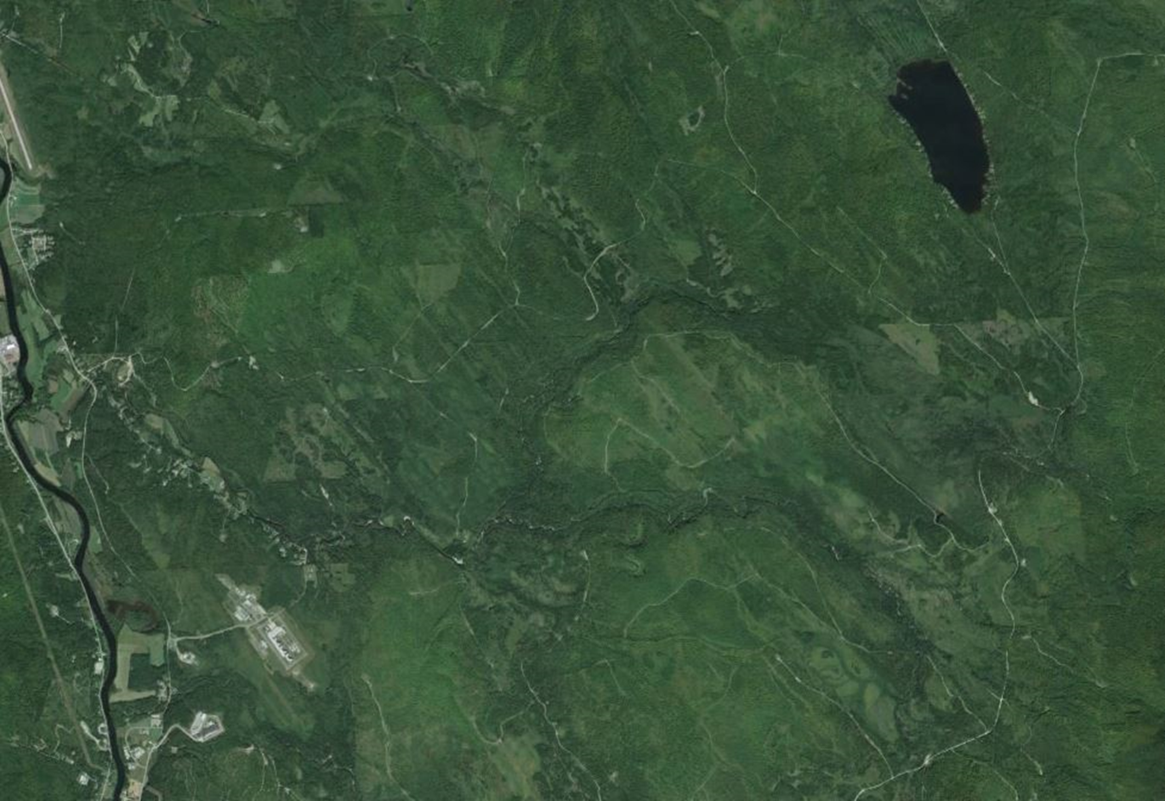
Good Habitat Awaits a “Released Population”

