Slide 1
Regional Environmental Monitoring Through Collaborative Research at Cary Institute of Ecosystem Studies
Vicky Kelly
Cary Institute of Ecosystem Studies
VMC Annual Meeting
December 2, 2016

Slide 2
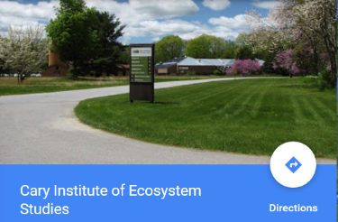
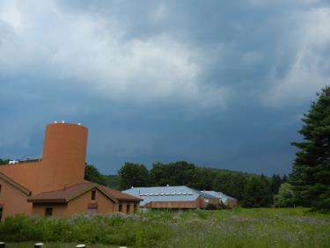
Overview of the Cary Institute
Notes:
Located in rural mid-Hudson River valley. 2000 acres - mixture forest & fields with perennial stream, ponds, wetlands, research lab facilities, 16 core scientific staff including forest, urban, disease & aquatic ecologists

Slide 3
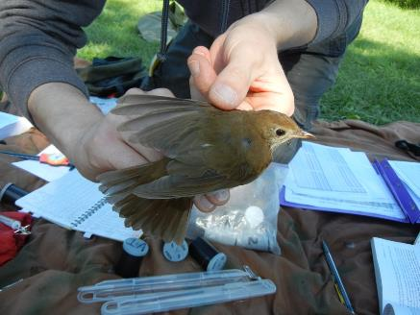
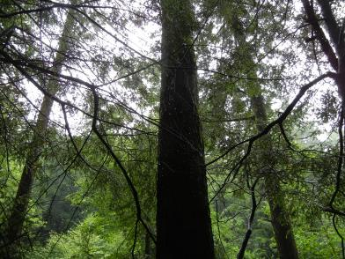
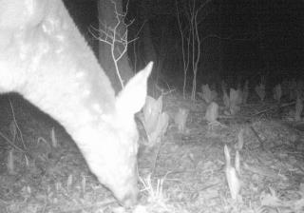
Environmental Monitoring at Cary
Notes:
Environmental monitoring at Cary includes long-term studies of mice, ticks, Lyme disease, birds, deer, forest health & more. Most of these programs were designed to answer specific questions and have secured ongoing funding, thus serendipitously provide long-term data.

Slide 4
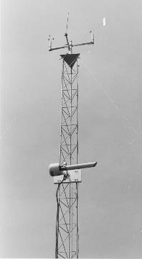
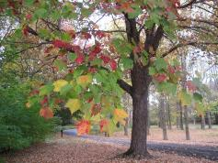
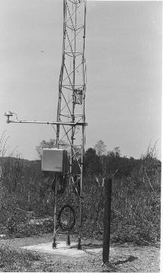
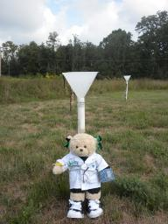
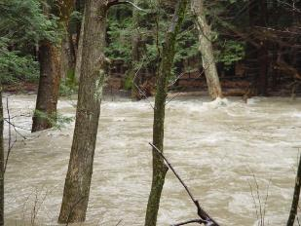
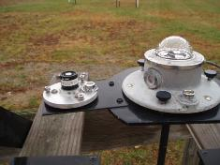
Environmental Monitoring Program
Weather & Climate
Chemistry – Precipitation, Air, Stream
Solar Radiation
Phenology (biological monitoring)
Water
Notes:
Program that was designed to provide ongoing, long-term data make up the core Environmental Monitoring Program. It provides data in 5 main focal areas.

Slide 5
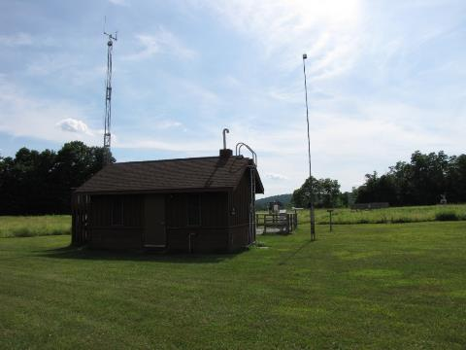
Weather & Climate (1988 – present)
Temperature
Relative Humidity
Precipitation Volume
Snow
Wind speed & direction
Barometric Pressure
Daily, Hourly (1988-present)
3-minute (2011-present)

Slide 6
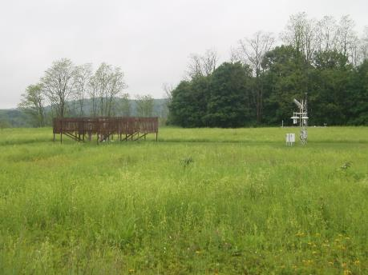
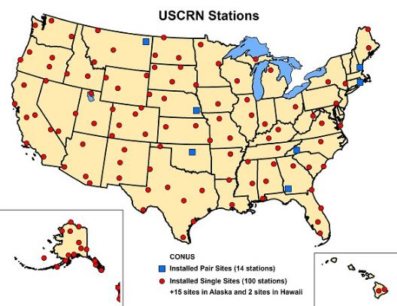
NOAA US Climate Reference Network (2004-present) Hourly, Daily, 5-minute data Air Temperature, RH, Precipitation, Soil Moisture & Temp., Wetness, Surface Temp., Solar Radiation

Slide 7
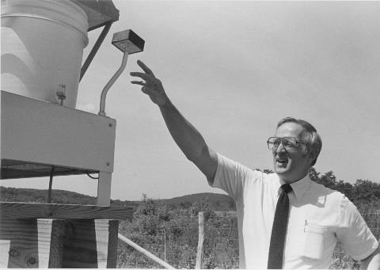
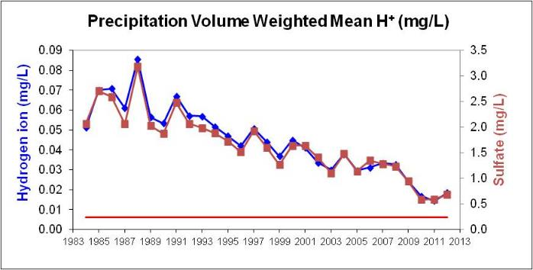
Precipitation Chemistry (1983-present) event-based sampling

Slide 8
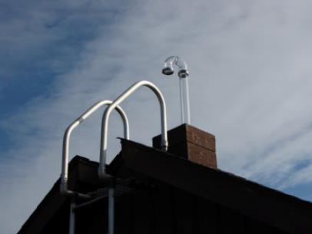
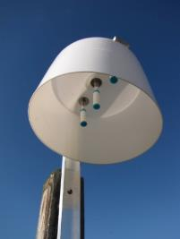
Air Chemistry
Low-volume filter pack – fine particles, HNO3,
SO2 (CASTNet, 1988-present)
Ground level ozone (NY DEC 1988-present)
Ammonia (NADP 2009-present)
CO2 (2009-present)

Slide 9
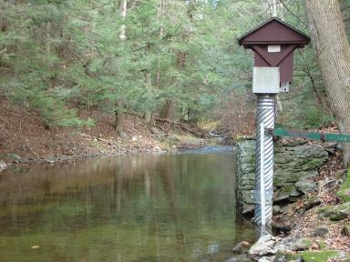
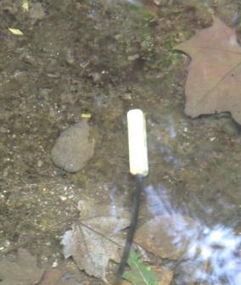
Stream Chemistry (1986-present) (15-min conductivity 2005-present)

Slide 10
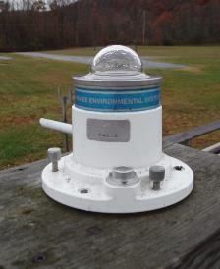
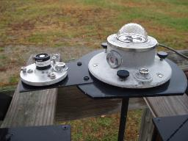
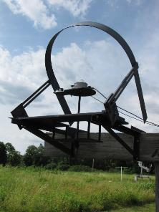
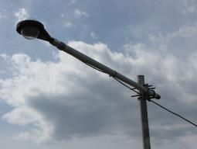
Solar Radiation (1988-present)
UVB (2000-present)
Shortwave
PAR
Net Radiation
Diffuse SW & PAR (shadowband)

Slide 11
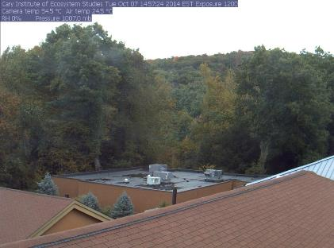
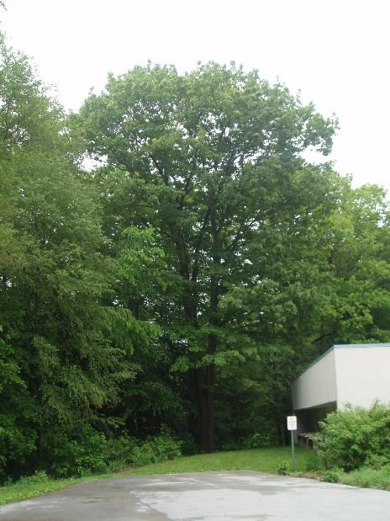
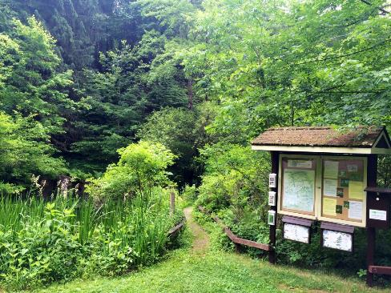
Phenology

Slide 12
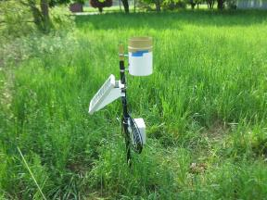
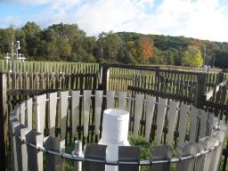
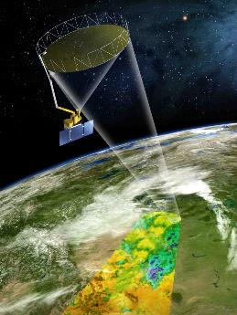
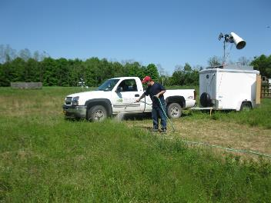
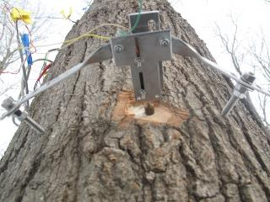
Water
Soil Moisture & Freeze/Thaw State
Stream Flow
Precipitation
Remote Sensing
Water Movement in Trees

Slide 13
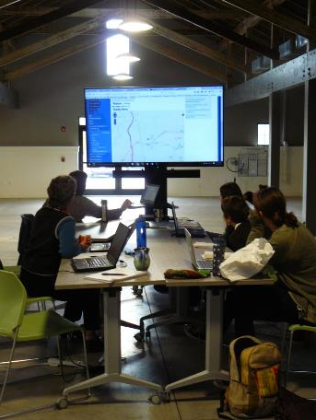
Partners & Collaborations
NOAA
NASA
USDA
CCNY
NY DEC
NADP
CASTNet
USA NPN
NYPP
UNH
EMMA

Slide 14
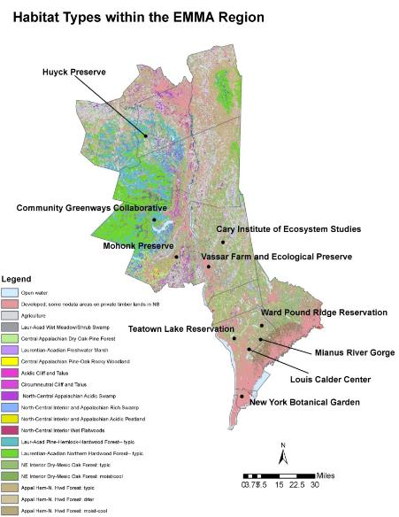
Environmental Monitoring & Management Alliance

Slide 15
EMMA Background
Created in 2013 with small grant from NY State Conservation Partnership Program - administered by the Land Trust Alliance.
Additional LTA grant in 2016 to purchase more equipment & develop website.
Large grant from Helmsley Foundation to Vassar College – funded EMMA Coordinator for 2 years – expires Aug 2017

Slide 16
Pressing Environmental Issues for the Region
Climate change
Habitat loss & fragmentation
Invasive species
Deer overabundance
Notes:
When EMMA initially formed, we identified these key issues

Slide 17
3 Initial Projects
Weather Stations – Climate change
Phenology Trails – Native species monitoring – how species respond to climate change, invasive species & habitat fragmentation. Allows for public participation through citizen science.
Deer Exclosures – Effects of deer on forest regeneration under different deer management, urbanization & habitat fragmentation
(Camera Traps added)
(Veg maps added for some sites)
Notes:
We then developed 3 environmental monitoring projects that would provide us with scientifically sound information to develop, justify or adjust management strategies in the face of those key environmental issues. Note the gradient of sites represent a range of habitat fragmentation & urbanization.

Slide 18
Infrastructure & Planning Thus Far
Strategic Plan
Data Management System -
Vermont Monitoring Cooperative
To do
Membership & Governance
Standardize project methods
Fund

Slide 19
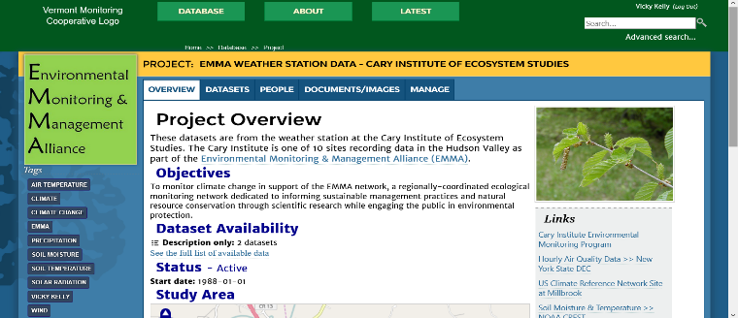
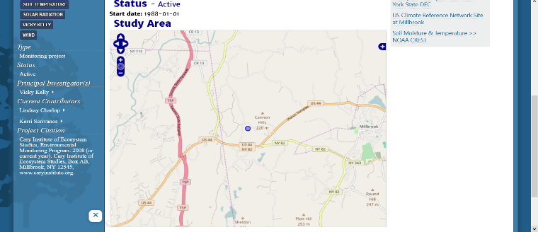
Thank You! Questions
Contact: Vicky Kelly 845 677-7600 ext 174
KellyV@caryinstitute.org

