Slide 1
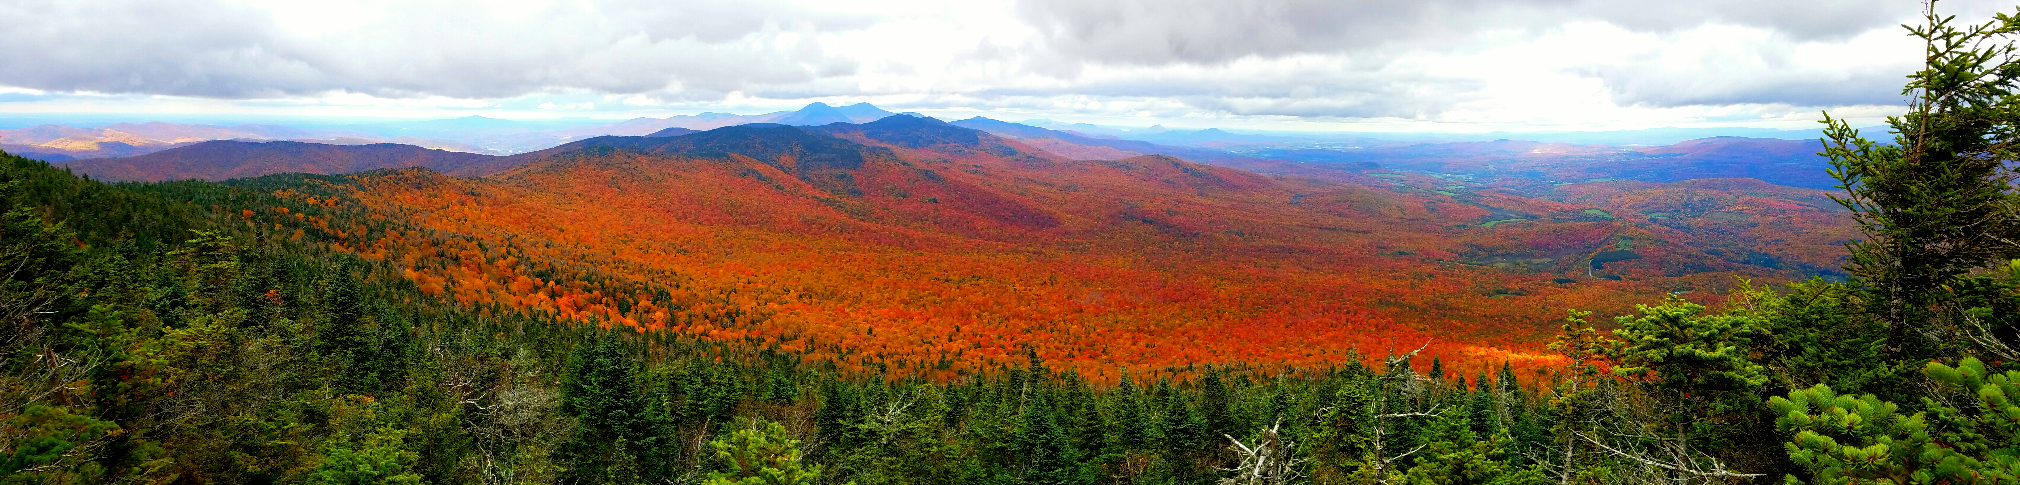
Exploring Spatiotemporal Trends in Northeastern Tree Species Distributions over the Past 30 Years
David Gudex-Cross¹, Jennifer Pontius¹, and Alison Adams¹
¹Rubenstein School of Environment and Natural Resources, University of Vermont
Aiken Center, 81 Carrigan Drive, Burlington, VT 05401
Main Objectives:
Map the % basal area (%BA) distribution of 10 key tree species across northern NY/VT…
In five year intervals from 1985-2015 using forest inventory data and Landsat imagery…
And investigate spatiotemporal trends in species %BA distributions.

Slide 2
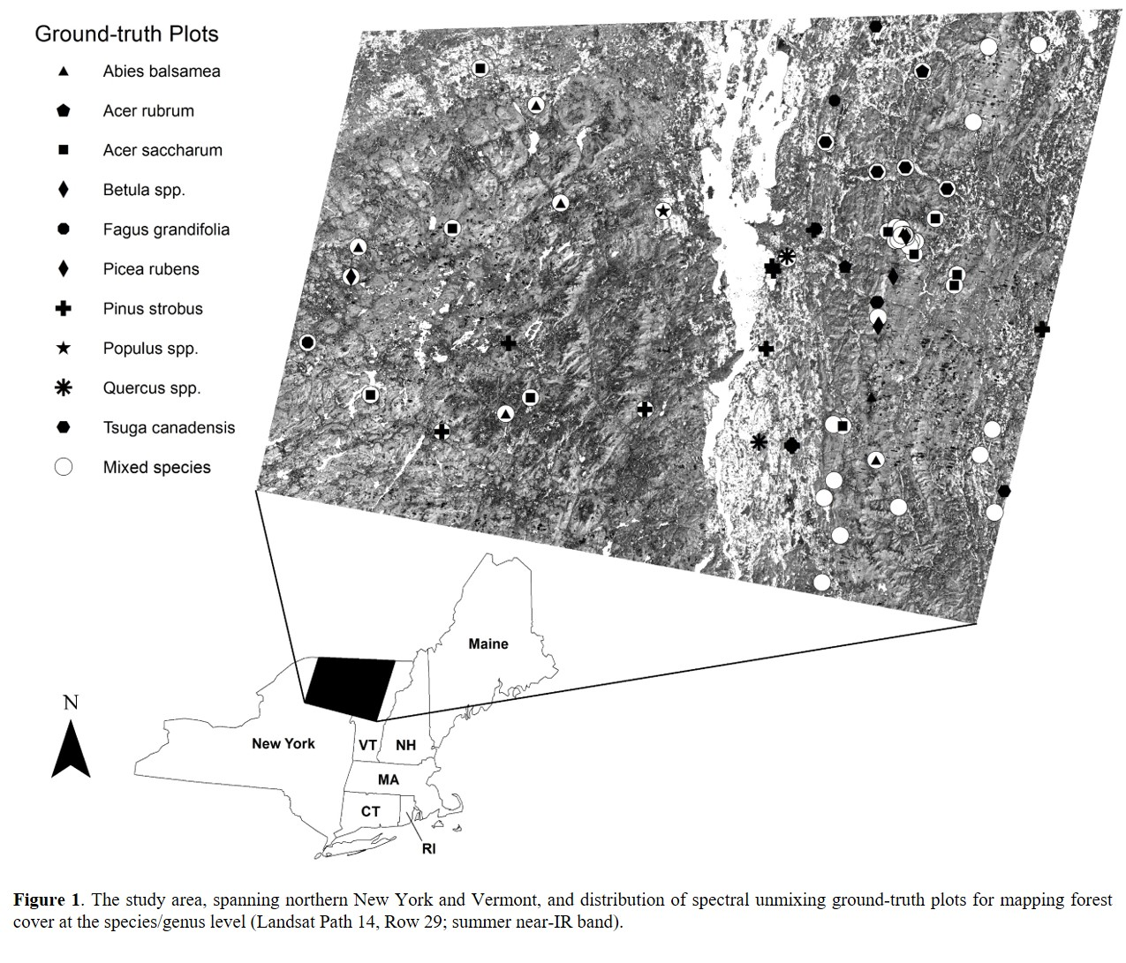
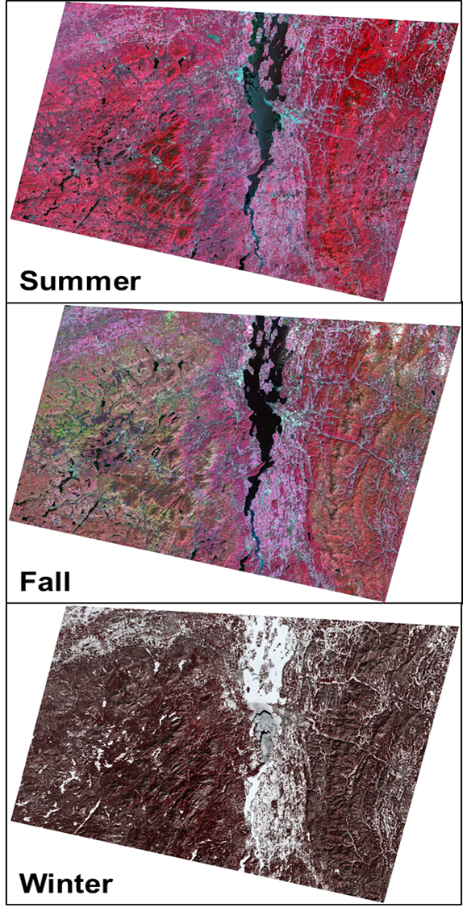
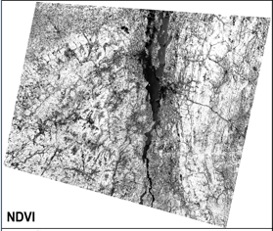
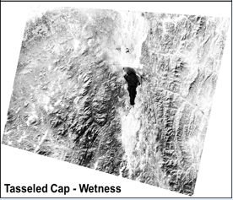
Methods: % Basal Area Mapping
Forest Inventory Data (FIA/VMC)
Good spatial distribution and species representation
Species >80% BA = “Pure Stand” = Spectral Signature
Mixed Species Plots = Validation Data
Landsat Satellite Imagery
Publicly available and long-term (1984-Present)
Seasonal Images and Vegetation Indices = Important Phenological Differences, Unique Spectral Combos

Slide 3
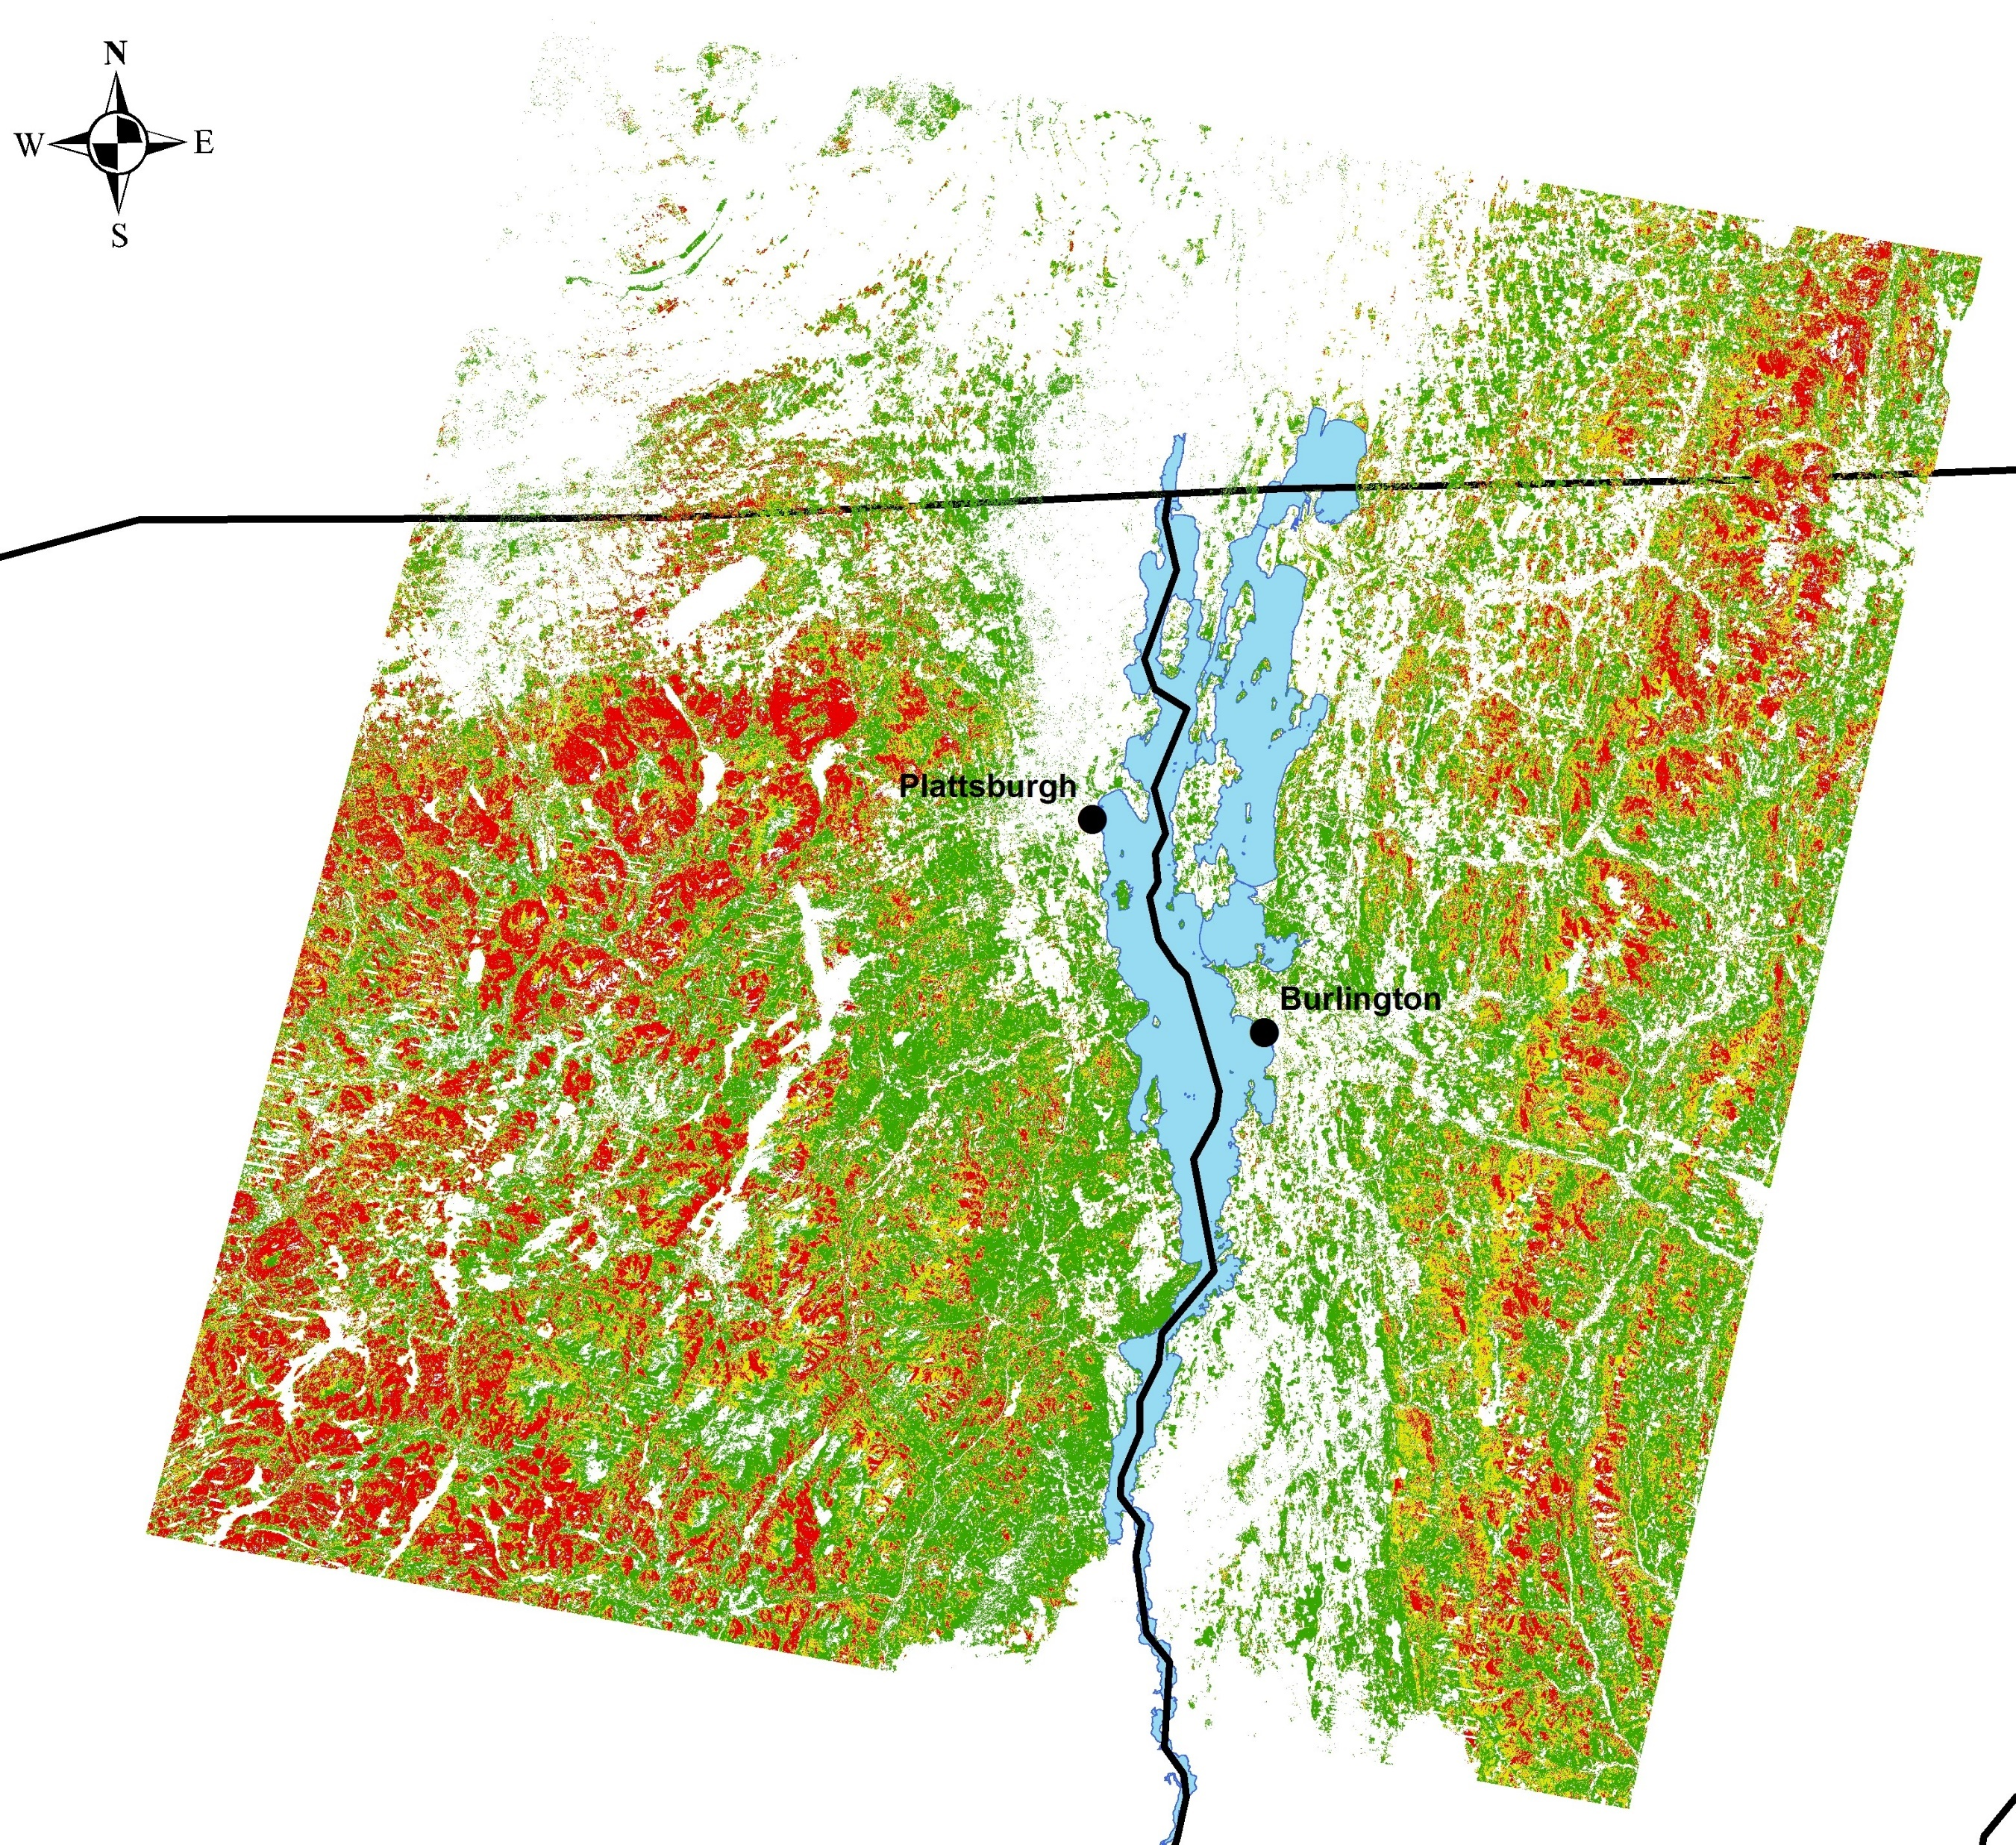
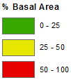
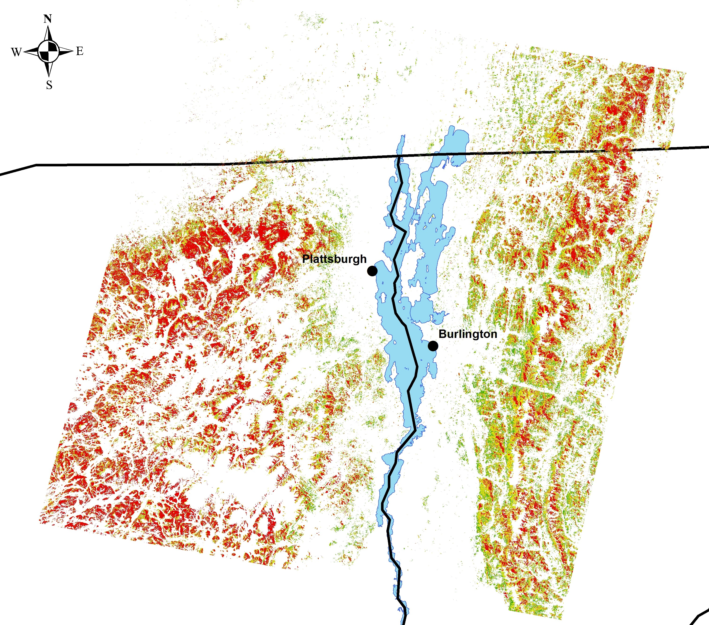

Methods: % Basal Area Mapping
Spectral Unmixing
Sub-pixel proportions of target tree species
Regression modeling using unmixing values to predict field-measured %BA:
%BA Maps for Trend Analyses
Removed Pixels if any year:
  Had no data due to cloud cover
  Was predicted as having <5%BA of target species
Initial 1985 Sugar Maple Map
Revised 1985 Sugar Maple Map
r² Values ranged from 0.12-0.79 across species
Results rival those derived from hyperspectral imagery

Slide 4
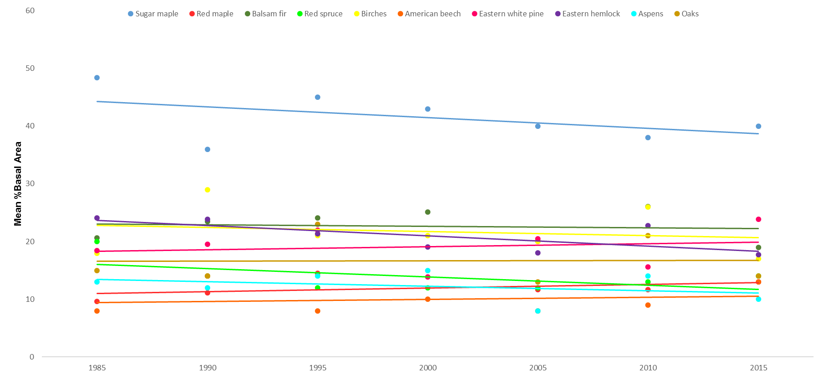
Results: Species % Basal Area Trends
Relative Consistency Across Years
Sugar, sugar, sugar!

Slide 5
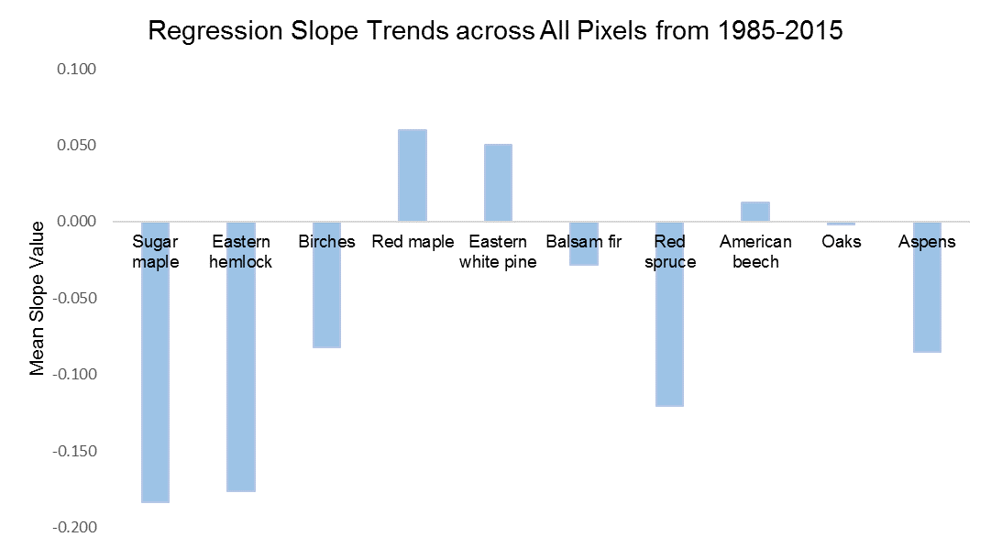
Results: Species % Basal Area Trends
+2%
+2%
+<1%
-<1%
-1%
-2%
-3%
-4%
-5%
-5%

Slide 6
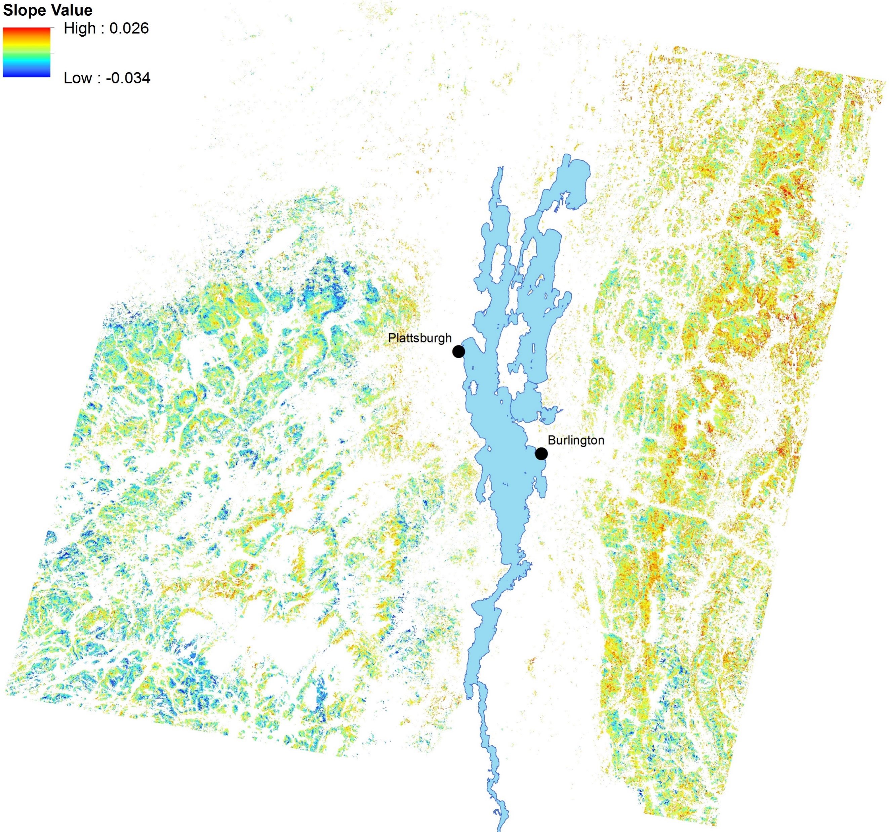
Results: Sugar Maple Trends
Decreasing across elevations, especially mid + high
New York is hatin’ on sugar maple
The Northern Greens are (mostly) alright
Slope: -0.29
Slope: -0.09
Slope: -0.38

Slide 7
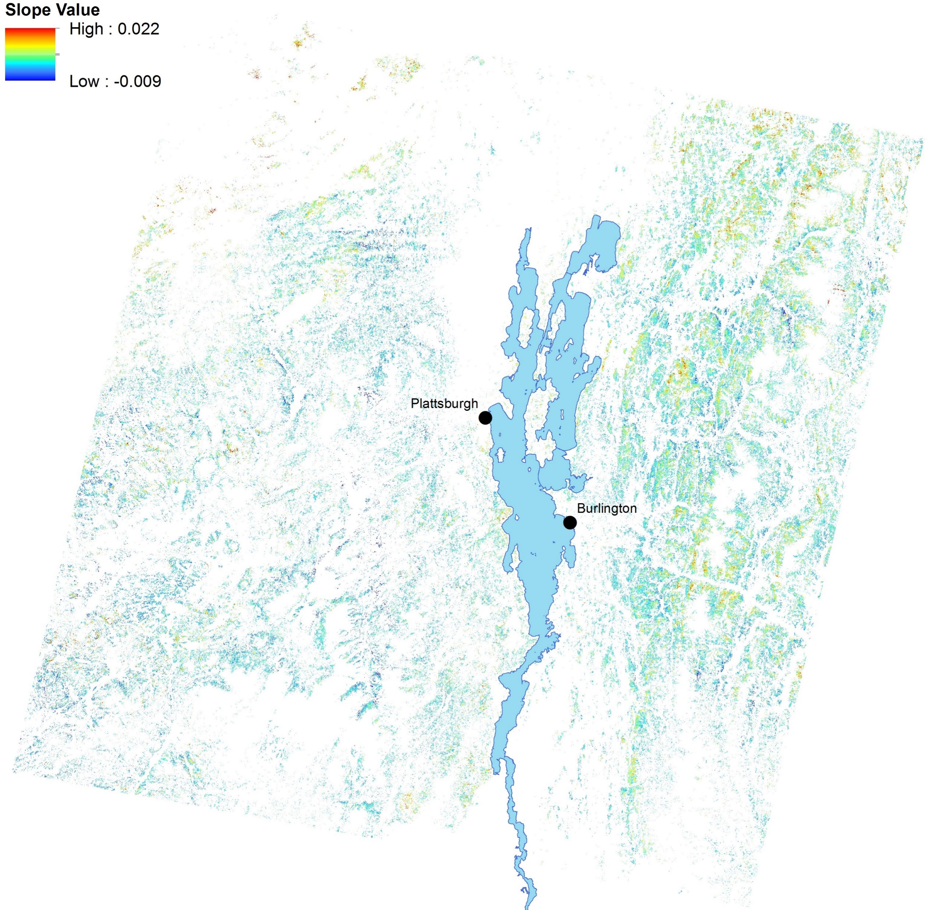
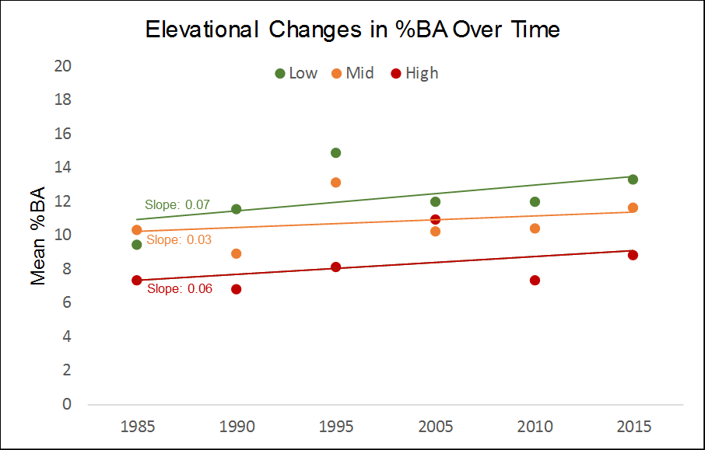
Results: Red Maple Trends
Slightly increasing across elevations
Hotspot increases making up for sea of blue?
RM loves Canada, St. Albans, and Waterbury

Slide 8
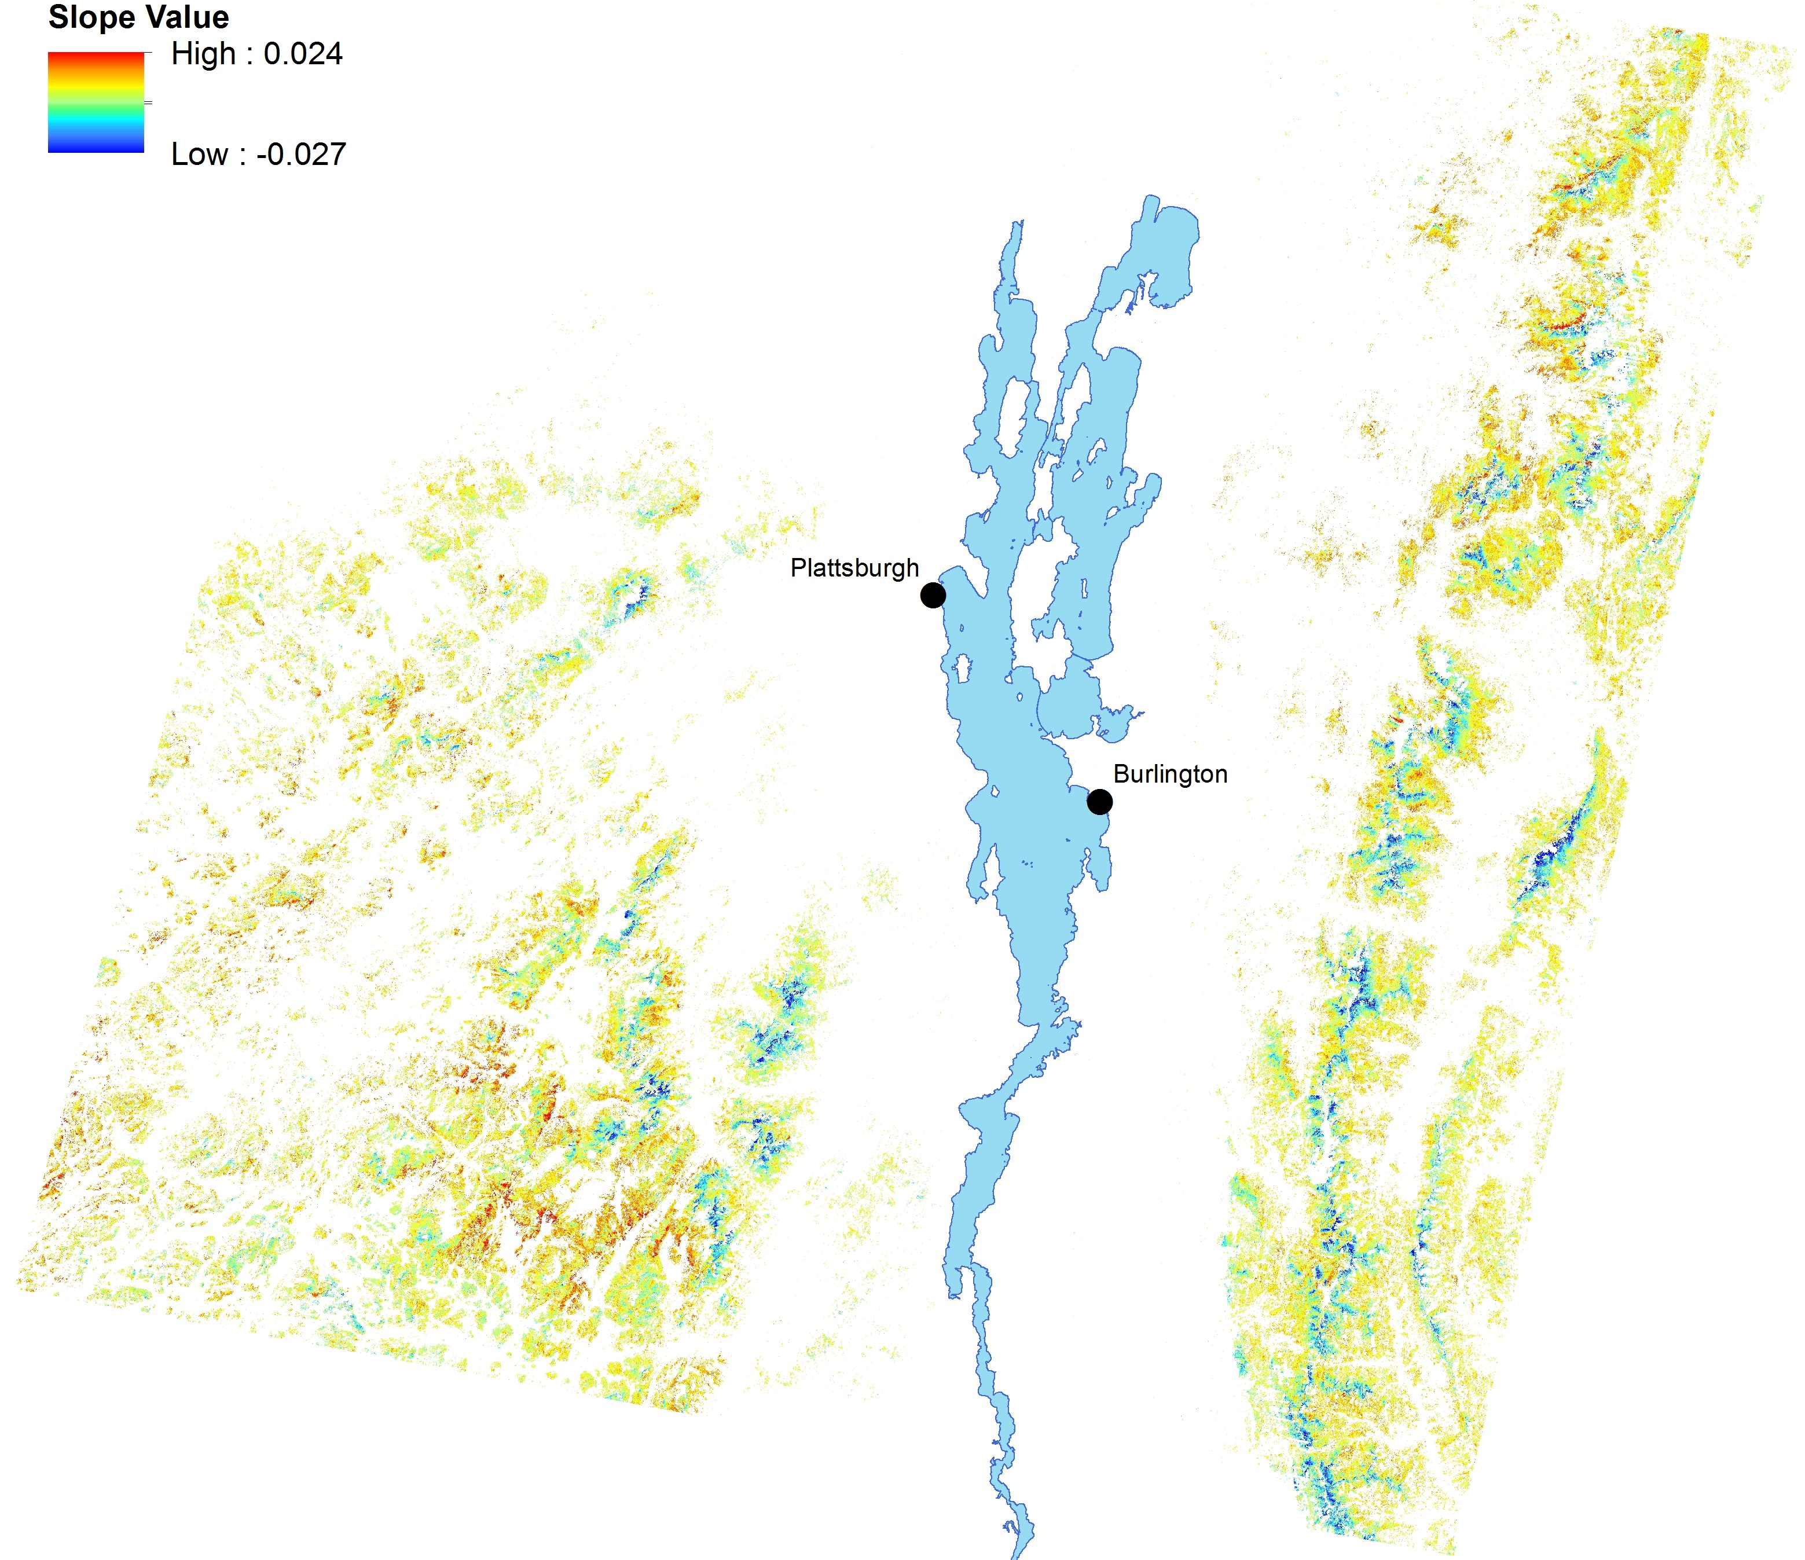
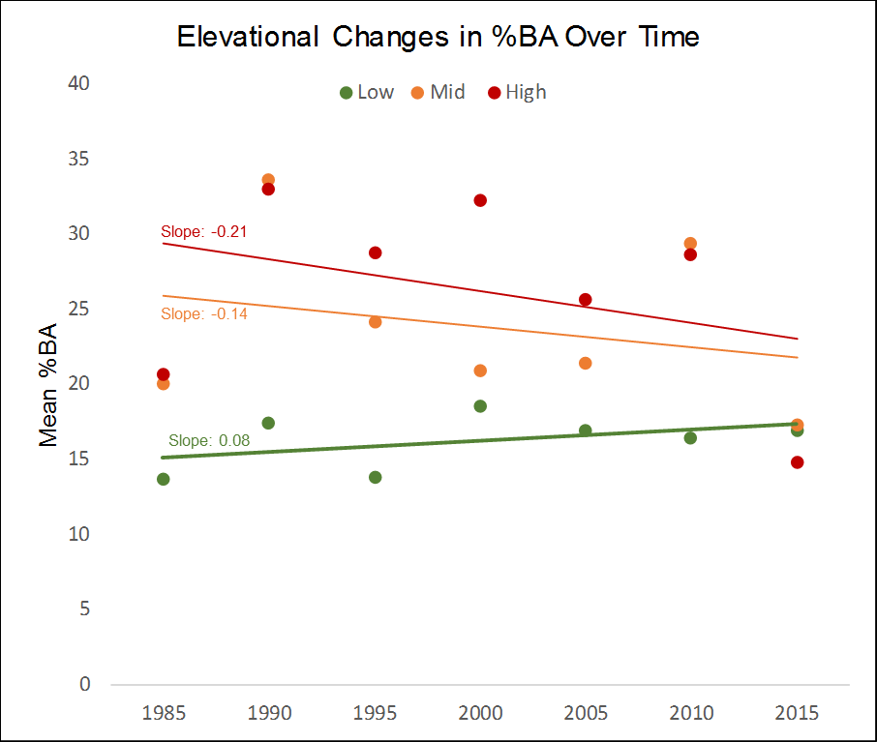
Results: Birch sp. Trends
Slightly increasing at low, decreasing at mid + high
Birches are sliding down the mountains
Hanging tough in parts of the Adirondacks

Slide 9
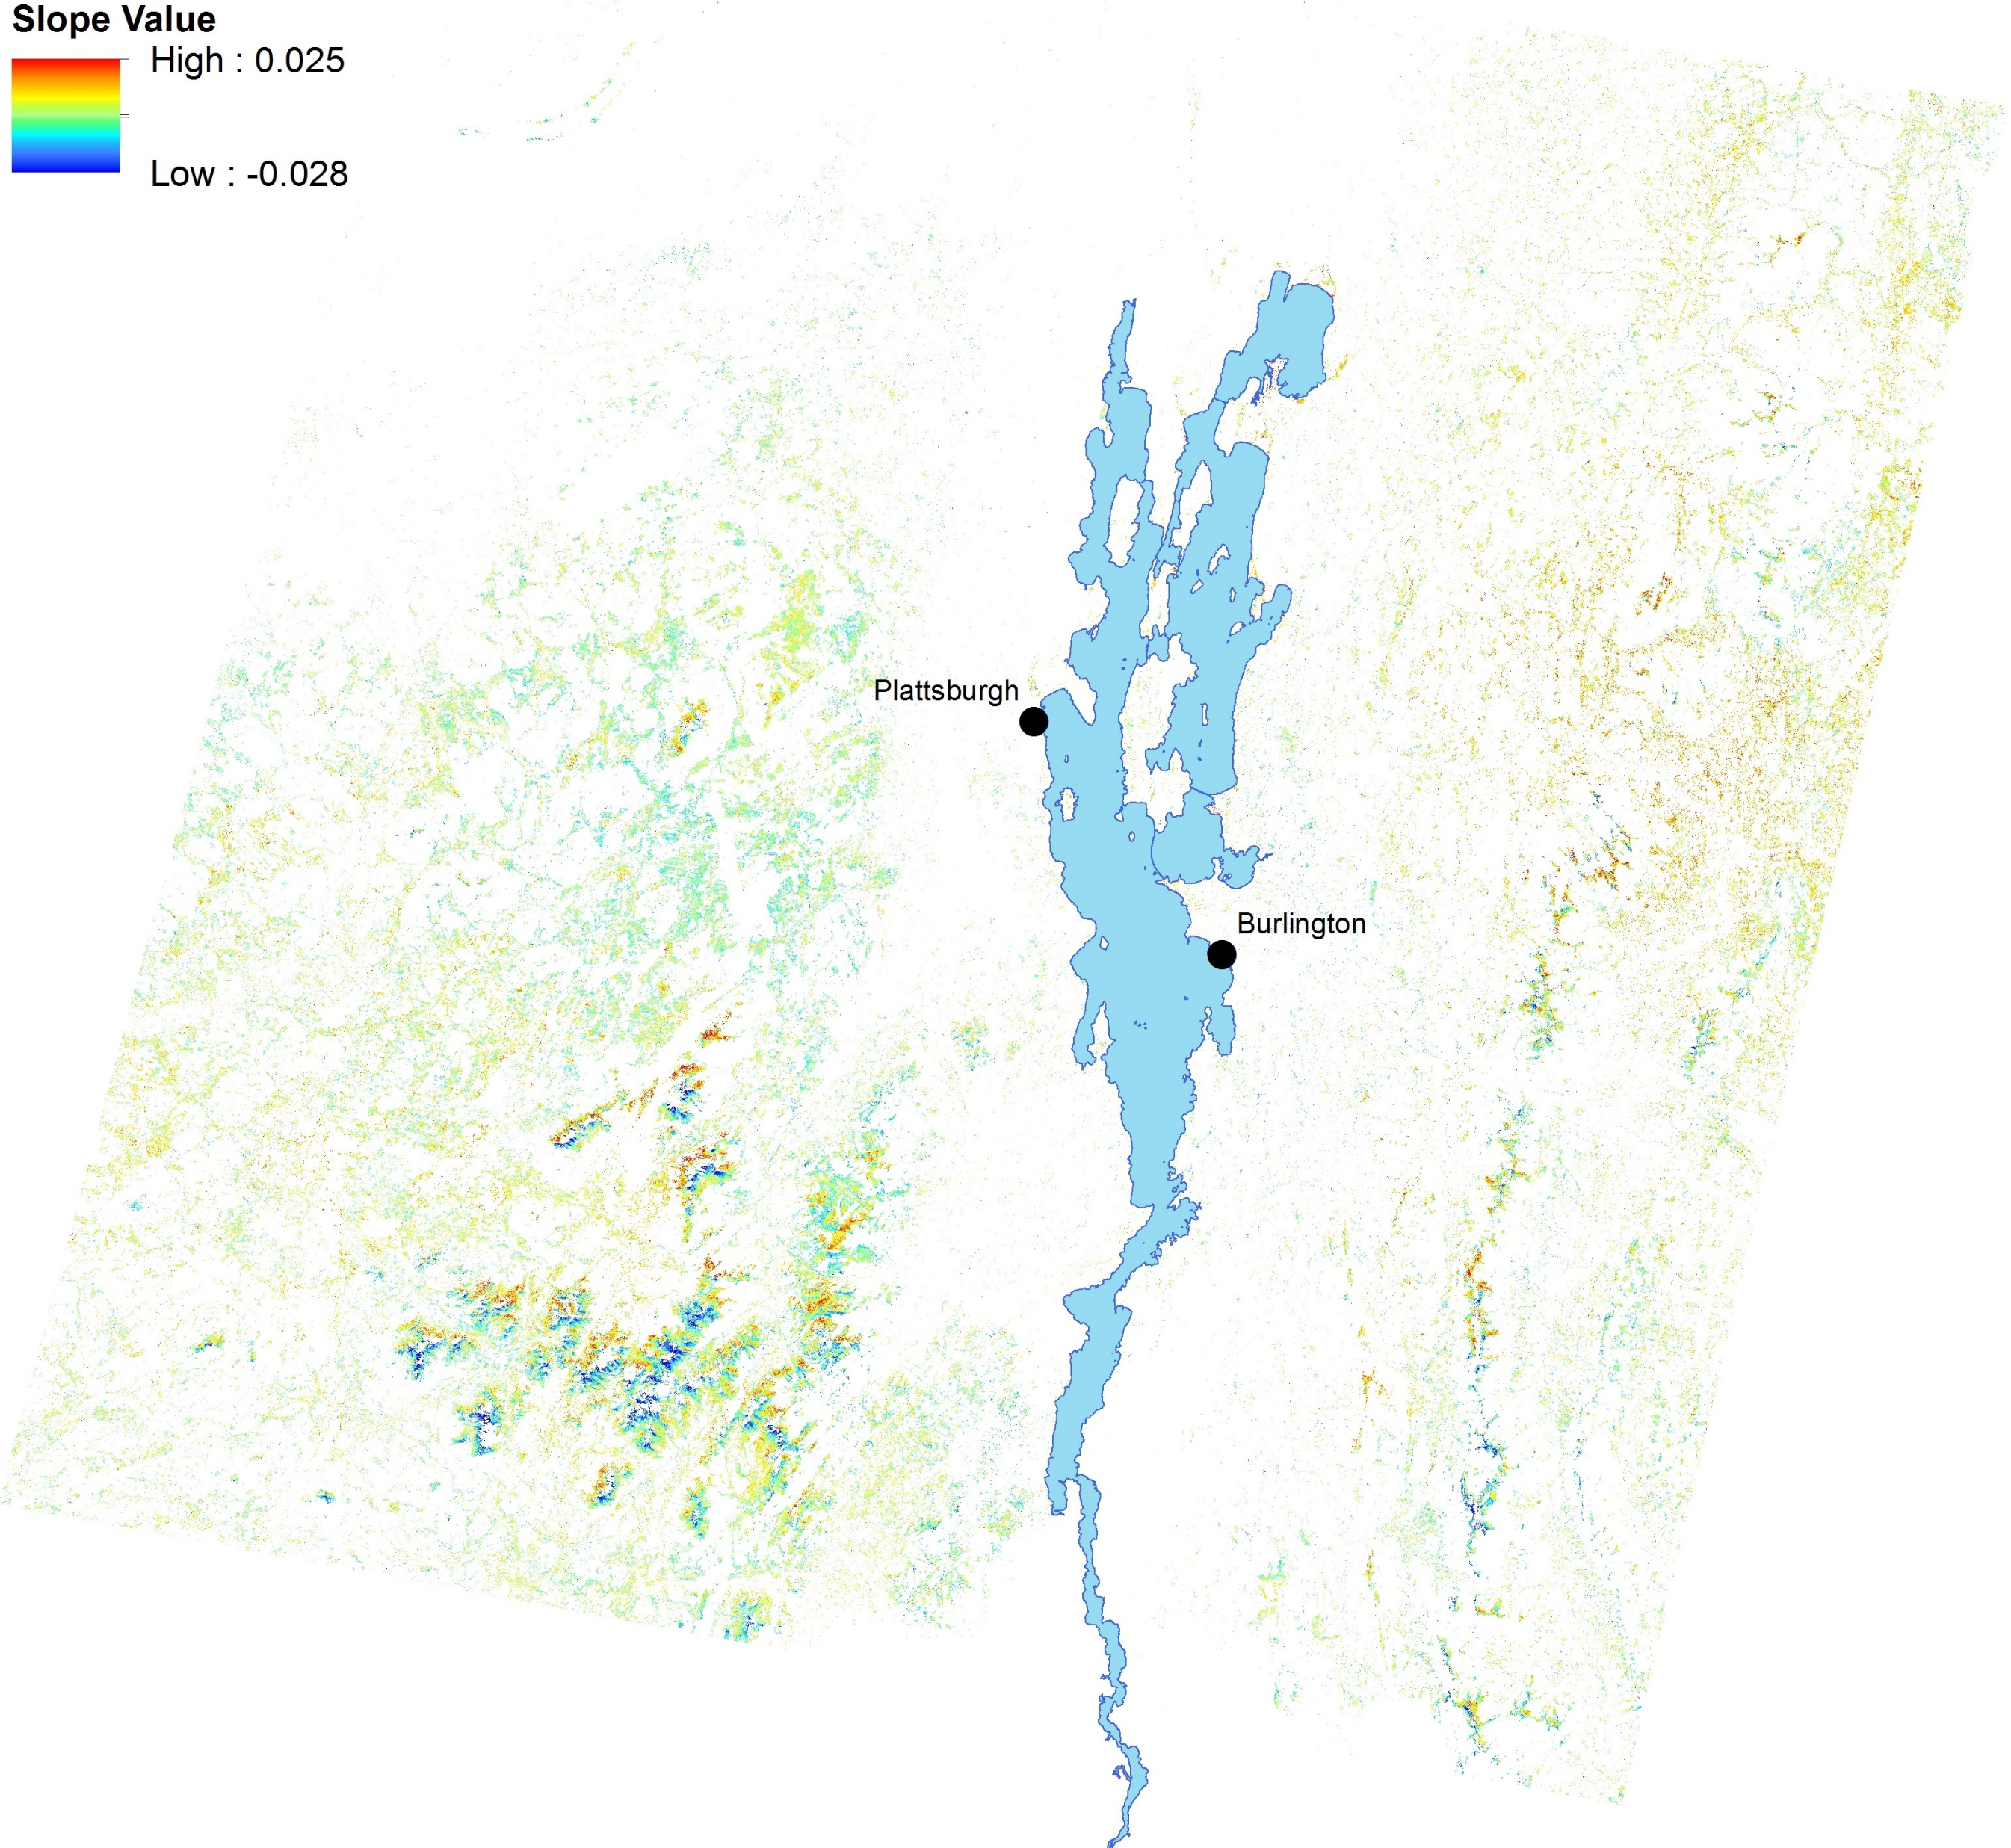
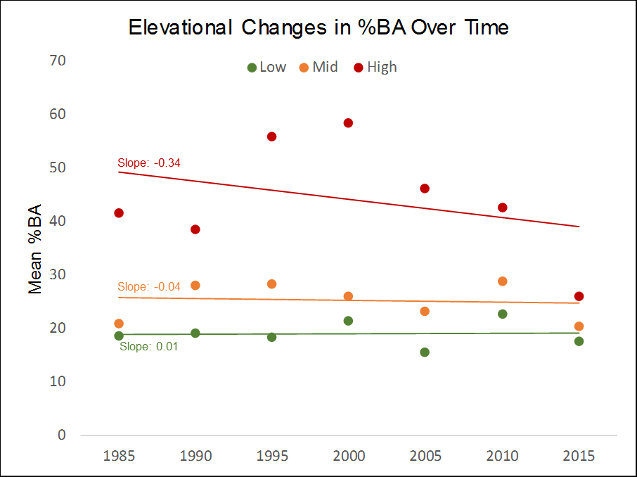
Results: Balsam Fir Trends
Decreasing at high elevation, otherwise largely stable
Sharpest losses on peaks of the ‘Dacks, Greens
Gains along the border of the Northeast Kingdom

Slide 10
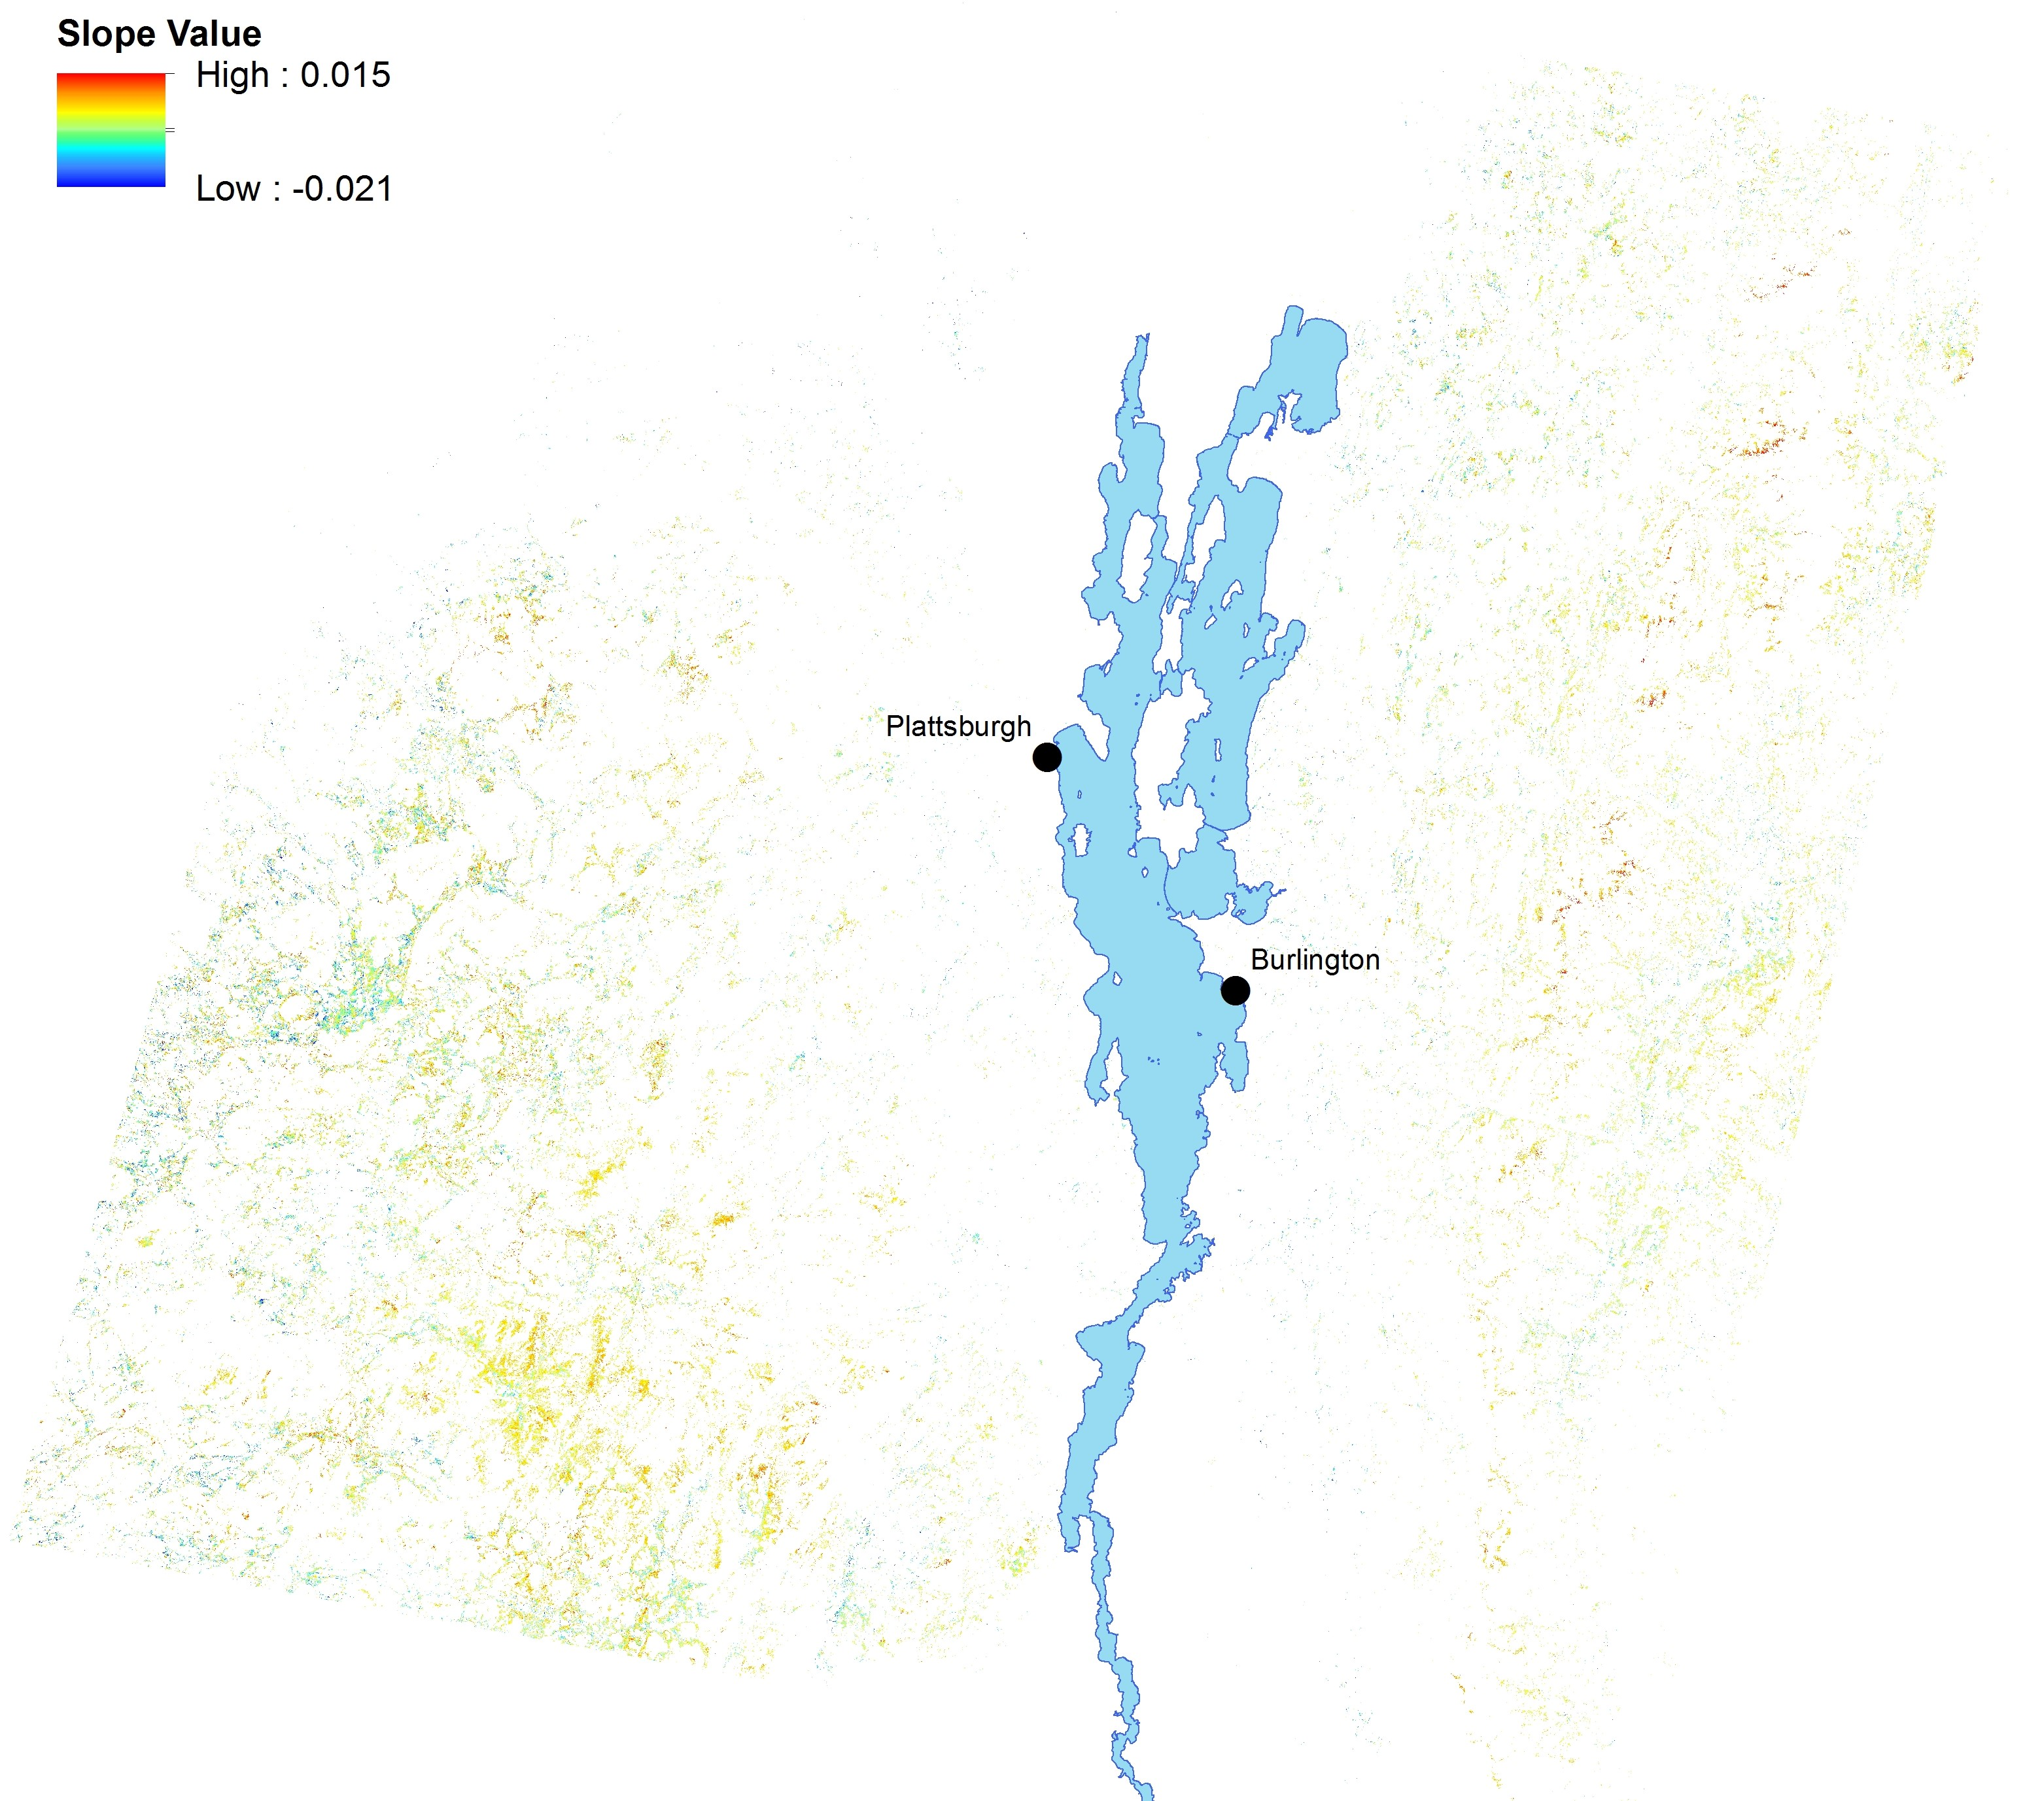
Results: Red Spruce Trends
Decreasing at low + mid elevations, increasing at high
Alpine rebound from 80’s-90’s losses?
Gains in both Adirondacks and Greens
Slope: -0.18
Slope: -0.04
Slope: 0.09

Slide 11
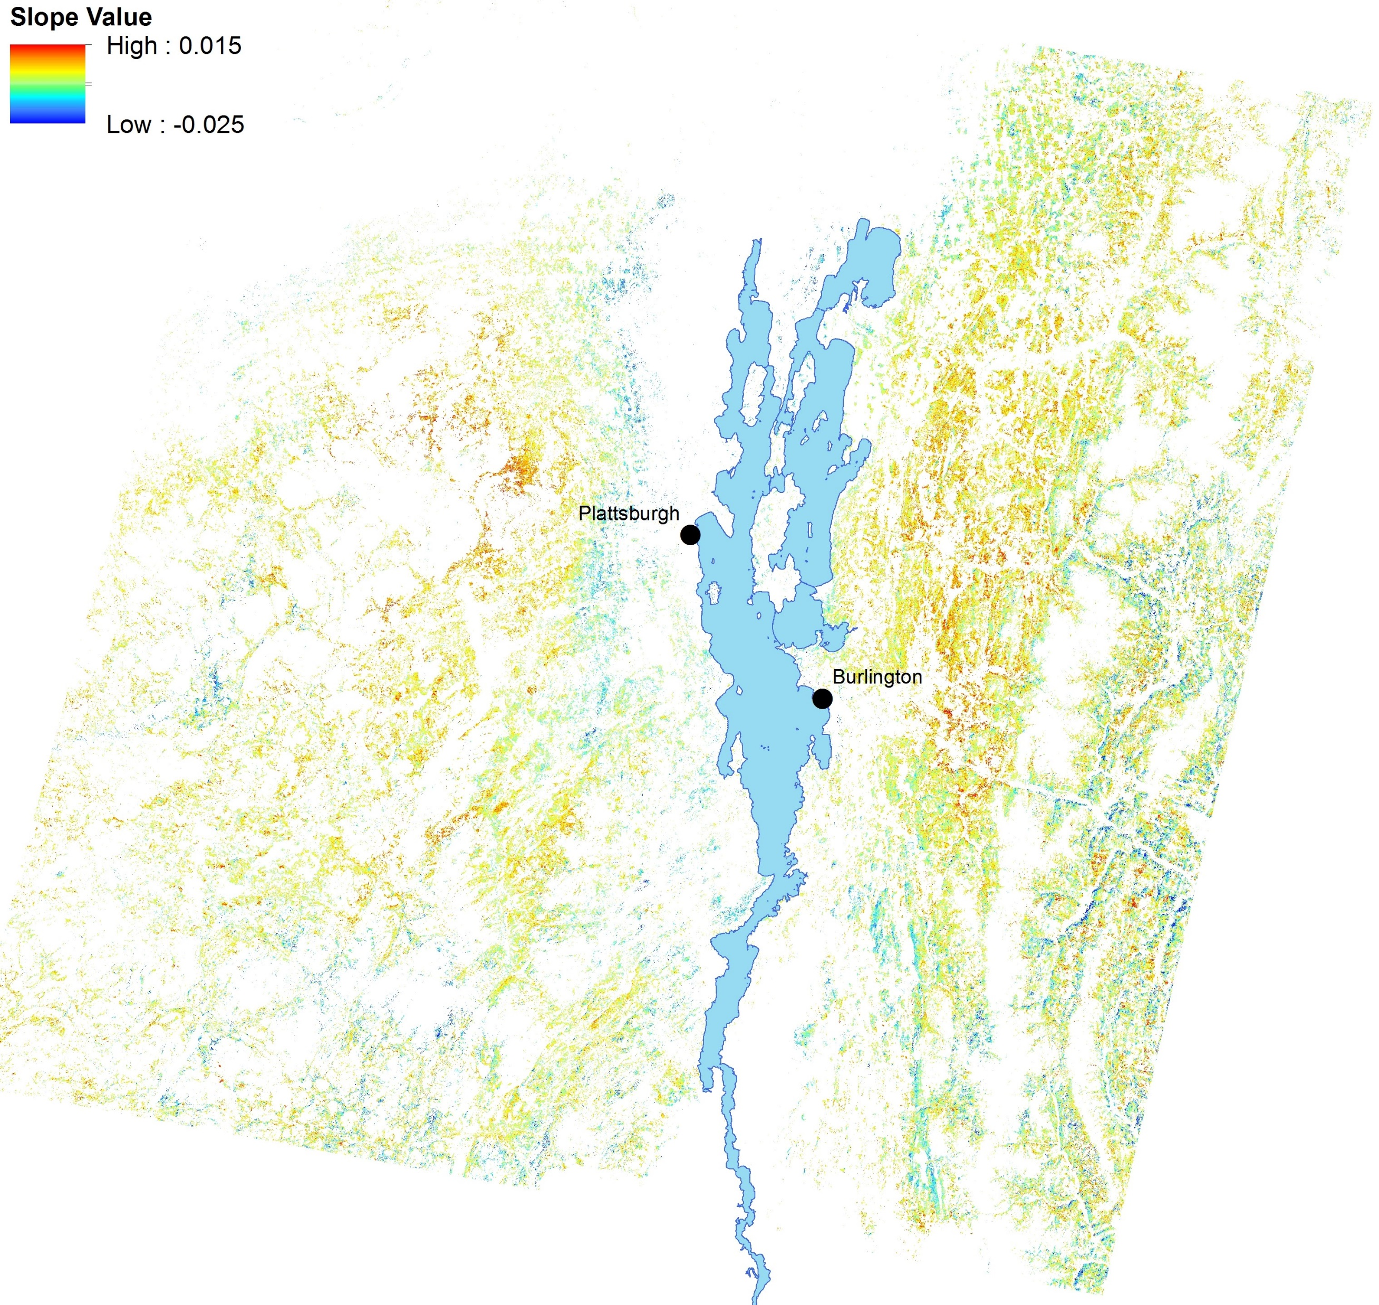
Results: Eastern Hemlock Trends
Decreasing at all elevations
Faring well in VT’s Champlain Valley, not in NY’s
Hemlock has the Highway 100 Blues
Slope: -0.18
Slope: -0.17
Slope: -0.40

Slide 12
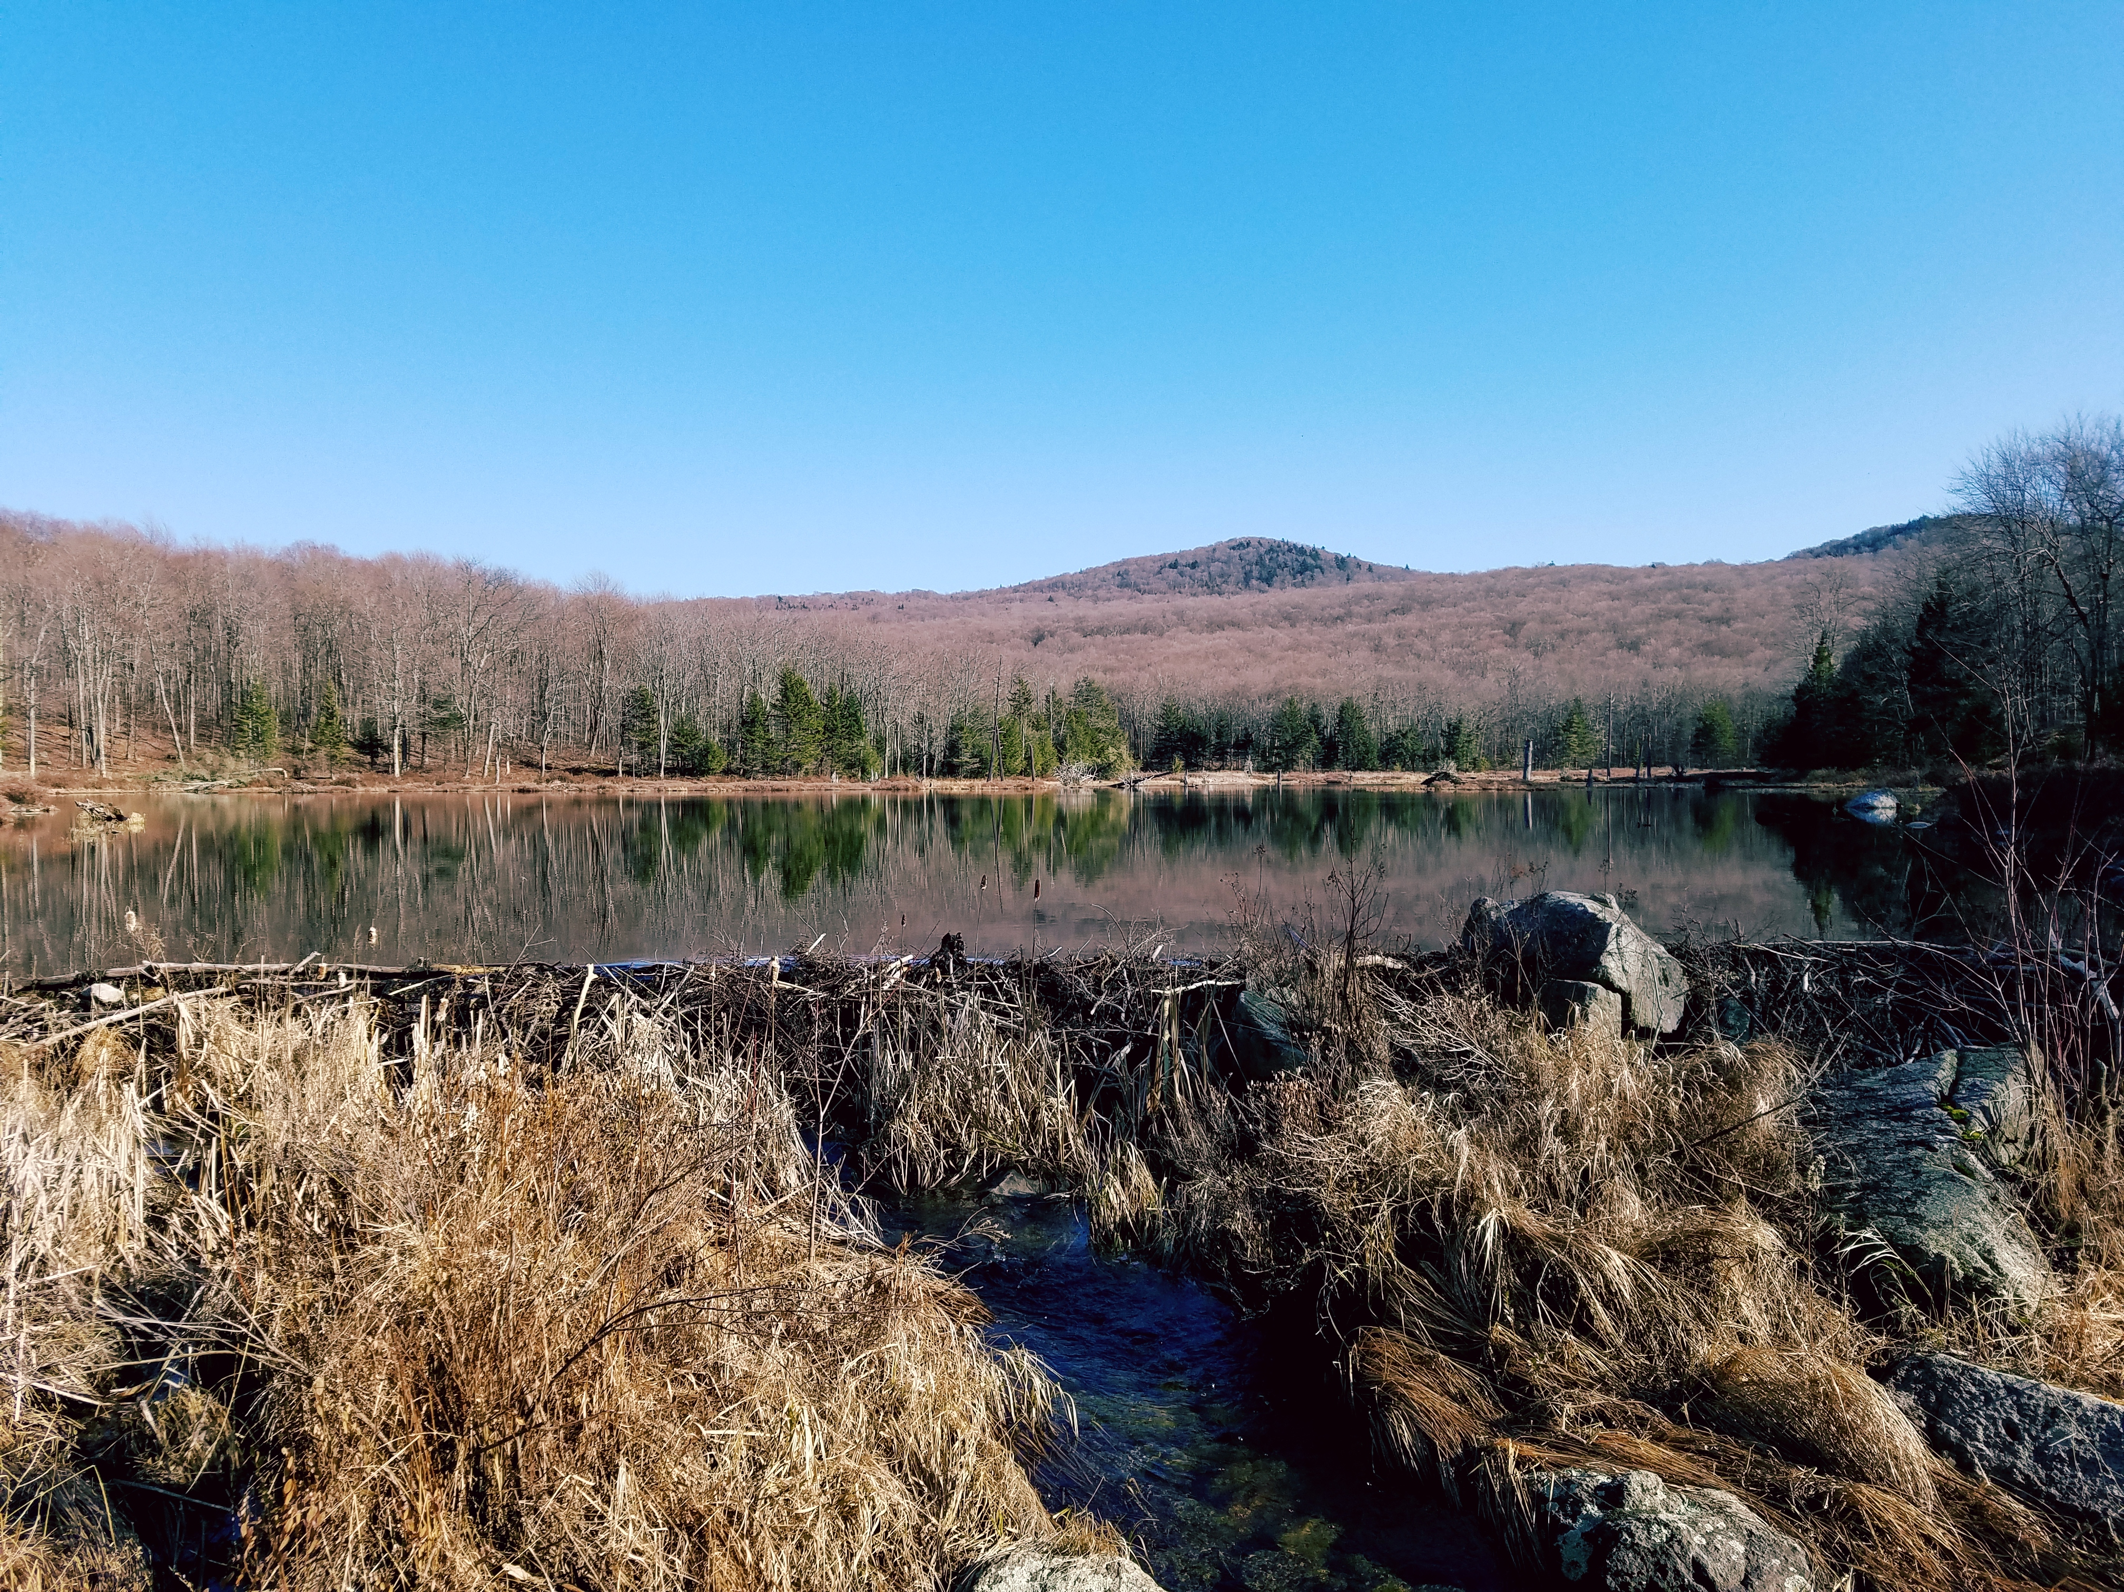
Recap and Next Steps
Overall %BA Trends
Relatively stable from 1985-2015 for all species.
  Slope values near zero, low net %BA gains/losses.
Sugar Maple dominates %BA distribution, but has also seen biggest decrease.
Only red maple, white pine, and beech saw increases over the 30 years.
Elevational %BA Trends
High elevations are seeing increases in red spruce, losses of balsam fir and birch.
Sugar maple and birch losses mainly from mid-high elevation, red maple and white pine (not shown) gaining here.
  Acid deposition/weather/pest effects?
Low elevations generally saw the lowest amount of %BA loss across species, except for hemlock.
Next Steps
Repeat %BA Mapping for Landsat Path 12 (NH, southern ME) and 13 (eastern VT, western NH)
Investigate REGIONAL trends!
Test for drivers of %BA spatiotemporal trends?
Projections for the future?

Slide 13
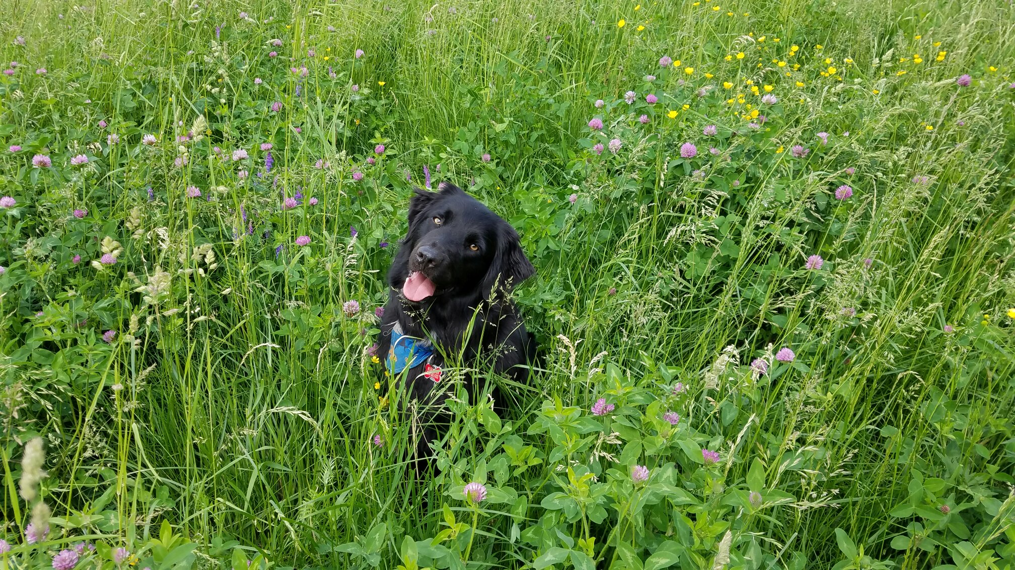
Questions?

