Slide 1
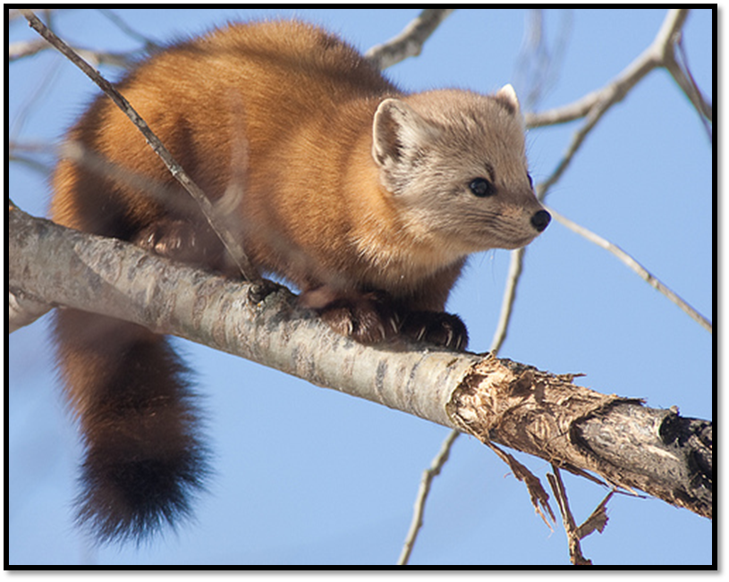
Estimating the source of American marten in Vermont and their distribution in the Northeast
Cody Aylward
Dr. James D. Murdoch
Dr. C. William Kilpatrick
Dr. Therese M. Donovan

Slide 2
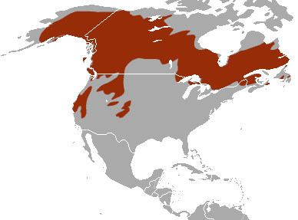
American Marten
Class Mammalia; Order Carnivora; Family Mustelidea; Martes americana
Late Successional Forest
Indicator Species
Snow
Vulnerable to Climate Change
Endangered species in Vermont
High priority Species of Greatest Conservation Need

Slide 3
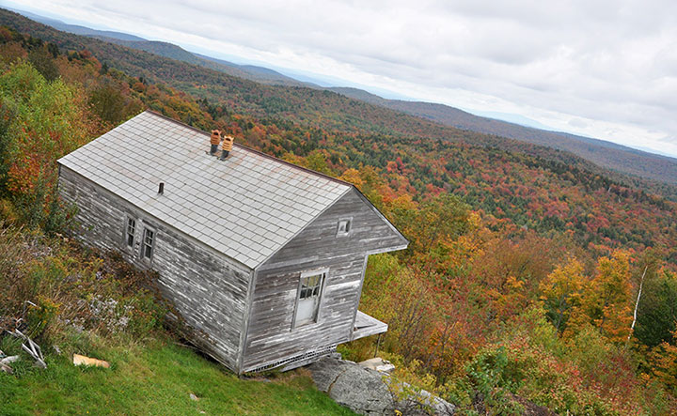
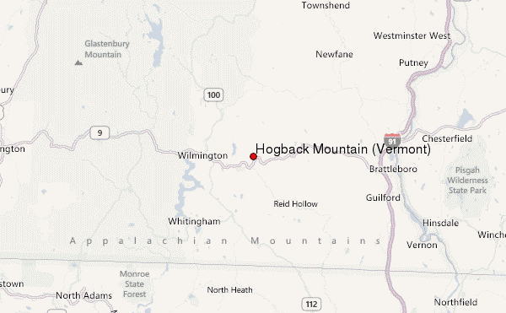
American Martens in Vermont
Early 1800s – Population was plentiful and ranged throughout the state (Thompson 1853)
Late 1800s – Population decline due to habitat conversion and overharvest
Last known record from Hogback Mountain in 1954 (Fuller 1987).

Slide 4
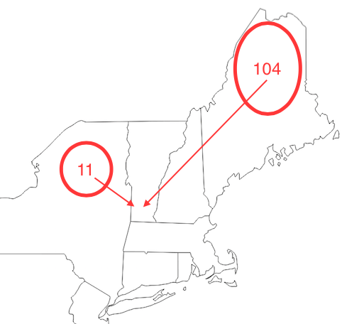
Reintroduction
United States Forest Service and Vermont Fish and Wildlife Department released 115 individuals from Maine (n=104) and New York (n=11) in the southern Green Mountain National Forest from 1989-1991
By 1998, monitoring efforts did not detect any individuals in Vermont

Slide 5
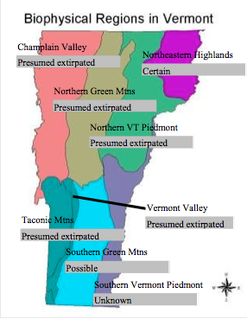
Current Status
We are currently aware of two populations in Vermont:
Northeast Kingdom - 1998
Southern GMNF - 2010
Questions
Source?
Connectivity?
Other areas of suitable habitat?

Slide 6
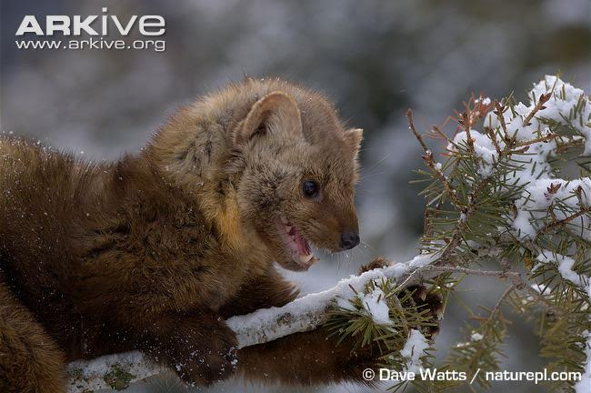
Goals
Determine the source to current populations of martens in Vermont using genetic markers
Determine the potential distribution of martens in Vermont
Identify dispersal corridors between two current populations
Identify high quality habitat parcels where populations may be re-established and persist long-term
Refine an expert elicitation method for modeling wildlife habitat

Slide 7
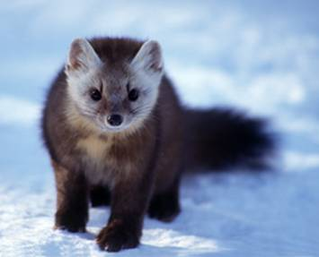
Methods – Population Genetics
Tissue samples collected from state biologists Chris Bernier (VT), Jill Kilborn (NH), Paul Jensen (NY) and Cory Mosby (ME)
DNA Extraction
PCR
mtDNA (d-loop)
11 microsatellites
Sequencing and Sizing
Statistical tests to determine source of VT populations
Fst – population differentiation
Population Assignment/Exclusion

Slide 8
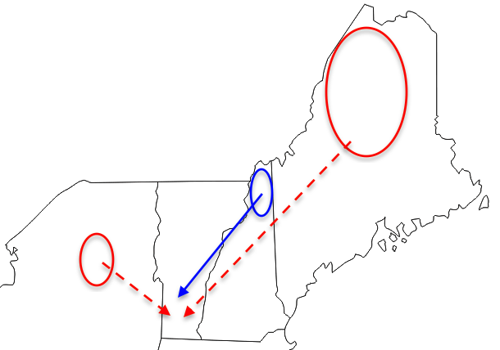
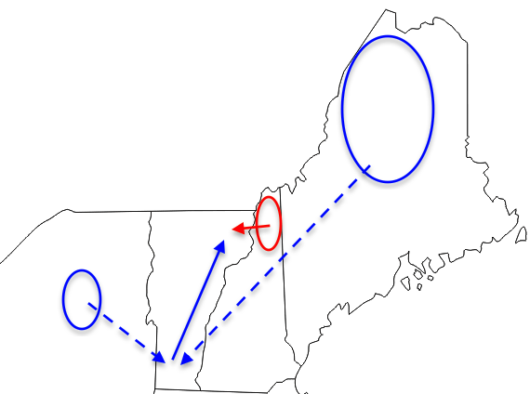
Source of Vermont Marten Populations - Hypotheses
The population in Southern VT consists of descendants of the reintroduced individuals - primarily from Maine
The population in the Northern VT derives from migrants out of northern New Hampshire (Kelly 2005)
Primary hypothesis
Alternative hypothesis

Slide 9
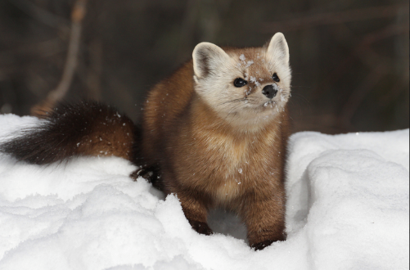
Results - mtDNA
87 individuals sequenced
12 Haplotypes identified
26 polymorphic sites
 | Population
Haplotype | VT-N | VT-S | NH | ME | NY | All Populations
A | 6 | 6 | 3 | 1 | 10 | 26
B | 4 | 0 | 12 | 2 | 0 | 18
C | 3 | 1 | 3 | 5 | 0 | 12
D | 2 | 0 | 0 | 1 | 1 | 4
E | 0 | 0 | 3 | 0 | 0 | 3
F | 0 | 0 | 0 | 5 | 0 | 5
G | 0 | 0 | 0 | 1 | 0 | 1
H | 0 | 0 | 0 | 2 | 0 | 2
I | 0 | 0 | 0 | 0 | 9 | 9
J | 0 | 0 | 0 | 0 | 3 | 3
K | 0 | 0 | 0 | 0 | 3 | 3
L | 0 | 0 | 0 | 0 | 1 | 1
 | n=15 | n=7 | n=21 | n=17 | n=27 | n=87

Slide 10
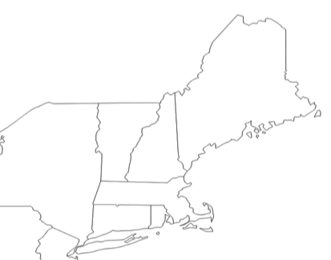
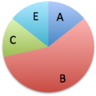
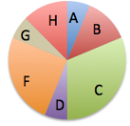
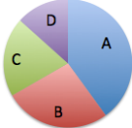
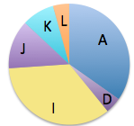
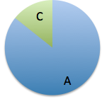
Results - mtDNA
NH
ME
VT-N
NY
VT-S

Slide 11
Results - mtDNA
Translocation
Dispersal
No significant gene flow
NH
ME
VT-N
Fst = 0.44037**
NY
VT-S

Slide 12
Results - mtDNA
Translocation
Dispersal
No significant gene flow
NH
ME
VT-N
Fst = 0.20398**
NY
VT-S

Slide 13
Results - mtDNA
Translocation
Dispersal
No significant gene flow
NH
ME
VT-N
Fst = 0.20398**
NY
VT-S

Slide 14
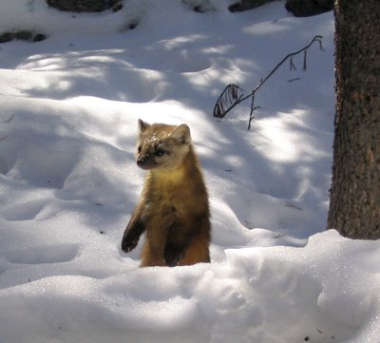
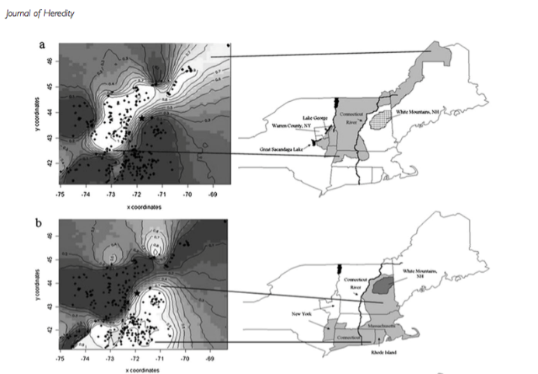
What is next?
Increase microsatellite data
Population Assignment/Exclusion
Identify and map genetic clusters – barriers to gene flow
Hapeman et al. 2011
(http://jhered.oxfordjournals.org/content/102/3/251.full)

Slide 15
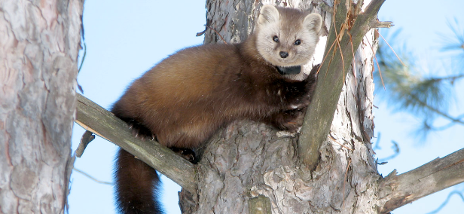
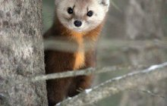
Marten Distribution
Develop an Occupancy Model
Estimates the probability that a parcel of land is occupied based on the habitat characteristics of the land parcel
Historically, occupancy models have been built using field survey data
Expert opinion can tap into local knowledge of species distribution and habitat selection where field data are scarce

Slide 16
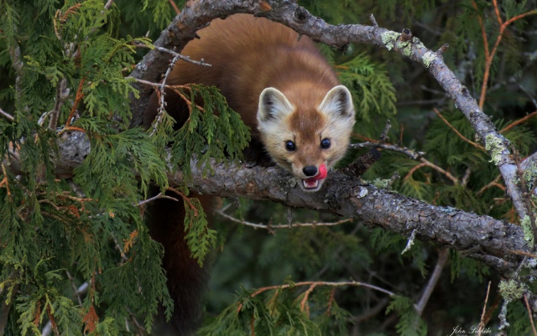
Methods – Expert Elicitation
Identify local experts and habitat variables associated with marten occupancy
Compile habitat layers in ArcGIS and develop sampling scheme
Develop survey platform for expert elicitation and distribute survey to experts
Experts predict occupancy at a suite of sites
Develop multiple models using logistic regression
Create suite of occupancy maps
Identify high-occupancy habitat patches and corridors

Slide 17
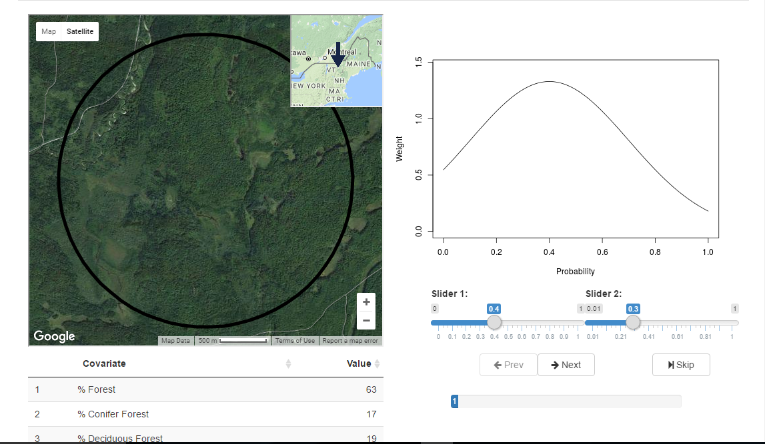
Expert Elicitation

Slide 18
% Forest | Road Density | Winter Precipitation | Temperature | Prob.
10 | 1.8 | 31 | 22 | 0.4
65 | 0.02 | 23 | 39 | 0.2
24 | 0.9 | 55 | 25 | 0.7
98 | 0 | 109 | 29 | 0.6
44 | 2.56 | 66 | 24 | 0.8
7 | 8.4 | 12 | 41 | 0.1
56 | 1.2 | 43 | 33 | 0.4
Regression
P(Occupancy) = 0.43 + 0.023*(%Forest) – 0.35*(RoadDensity)

Slide 19
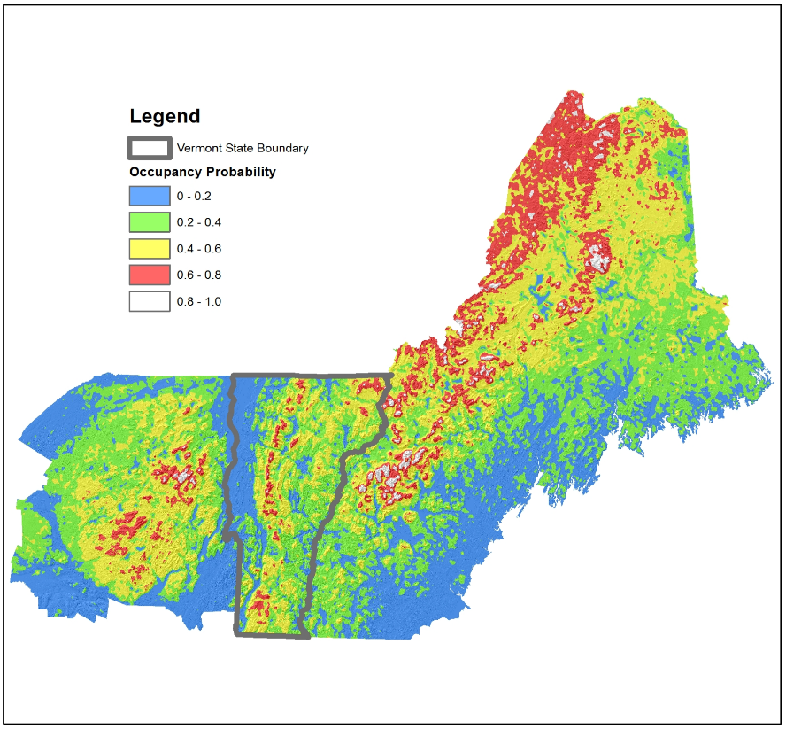
Expert Elicitation
The “Cody” Model

Slide 20
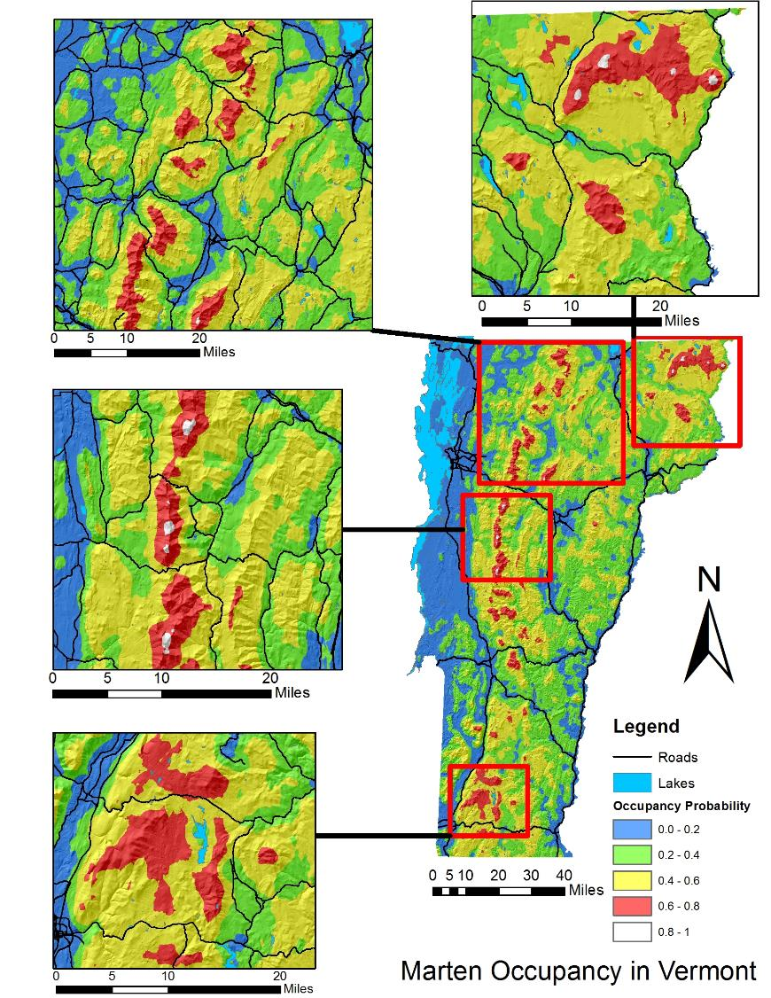

Slide 21
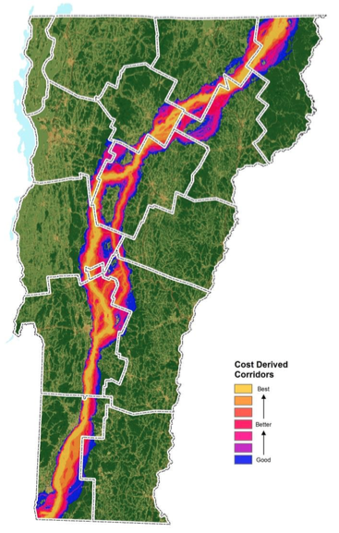
CircuitScape
Dispersal corridors
Pinchpoints and Barriers
Sorenson and Osborne 2014
(http://www.vtfishandwildlife.com/common/pages/DisplayFile.aspx?itemId=111635)

Slide 22
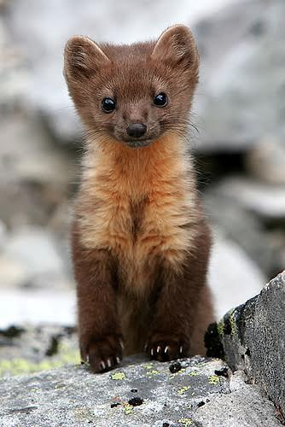
Conclusions
Reintroduction in Southern Vermont appears to have been successful
mtDNA
Dispersers from New Hampshire likely contributed to colonization of Northern Vermont
Role of Southern Vermont and Maine in colonization of Northern Vermont unclear
Level of contemporary gene flow between VT-S and VT-N unclear

Slide 23
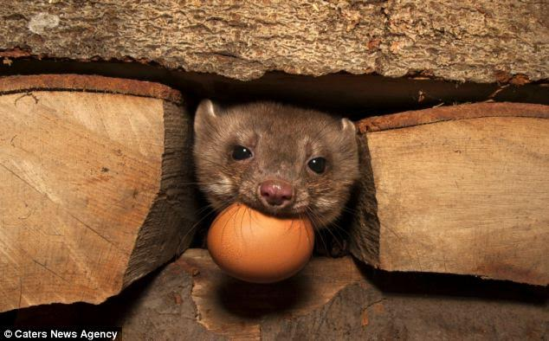
Planning/Products
Better understanding of the functional/genetic connectivity of the landscape
Maps of potential occupancy and corridors will be published on NSRC website (http://nsrcforest.org/)
High-occupancy parcels and corridors should be key targets for future recovery planning
Map and model can be used for future research applications:
Climate change scenarios
Forest management scenarios

Slide 24
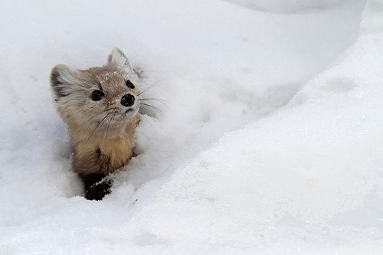
Acknowledgements
Jed Murdoch
Bill Kilpatrick
Terri Donovan
Jonathan Katz
APLE Fund
Pittman-Robertson Federal Aid
Northeastern States Research Cooperative
McIntyre-Stennis
Rubenstein School of Environment and Natural Resources
Vermont Cooperative Fish and Wildlife Research Unit
University of Vermont Department of Biology
Vermont Fish and Wildlife Department
Chris Bernier
Jill Kilborn
Alexij Siren
Cory Mosby
John DePue
Adam Vashon
Paul Jensen
Kim Royar
Craig Nolan
Expert Trappers
Katy Crumley
Paul Hapeman
Rachel Cliche
Katie O’Shea

