Slide 1
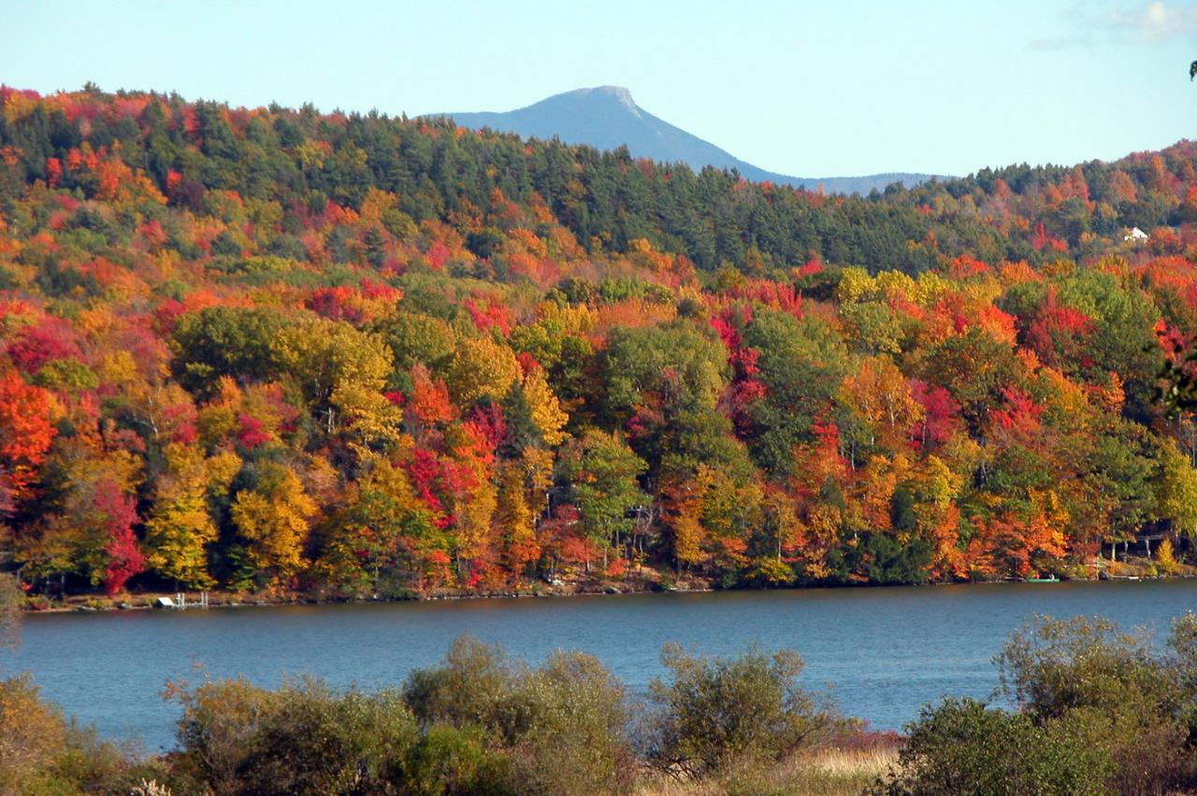
30 years of forest conversion in the Northeast: historical patterns and future projections
Alison Adams^{1,2}, Jennifer Pontius^{1,3}, Gillian Galford^{1,2},Scott Merrill⁴, David Gudex-Cross¹
¹UVM Rubenstein School; ² Gund Institute for Ecological Economics; ³ US Forest Service; ⁴ UVM Dept of Plant and Soil Science

Slide 2
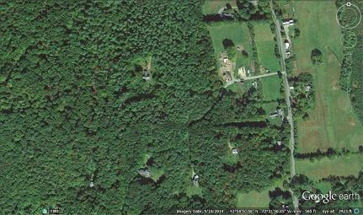
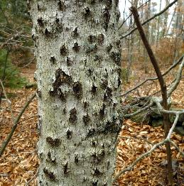
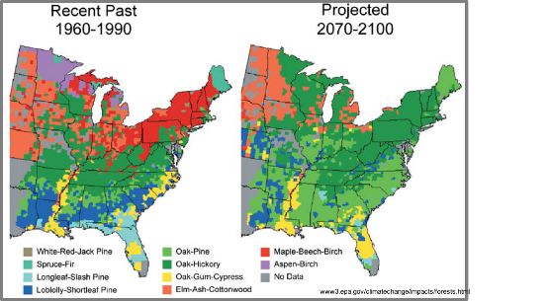
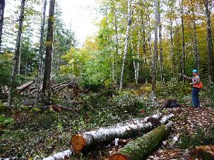
Why does modeling forests matter?
The BIG
Picture
Methods
Results &
Products
Additional
analyses
Conclusions
Product use &
applications
Understanding trends and patterns
Identify primary drivers of trends
Estimate or simulate data that doesn’t exist (temporally, spatially…)
Manage forests in changing conditions
Notes:
Modeling provides a lens through which we can analyze and understand trends over time, space, different environmental conditions
It allows us to identify critical drivers of trends, and also to get a sense of how much variability in the system we’re modeling is due to randomness or at least factors we haven’t incorporated yet
It allows us to estimate or simulate data we don’t have, whether it’s a location we don’t have data for, or a time period, like the future…
And perhaps most importantly, it provides a tool to aid us in managing forests in changing conditions
And conditions are changing!
Clockwise from top
Forest parcelization and fragmentation
Pests & pathogens
climate change altering species distribution in forests
Forest management practices themselves can alter forest conditions
Modeling helps us manage our forests for certain outcomes given these changing conditions

Slide 3
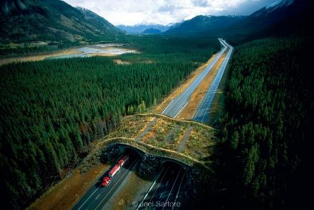
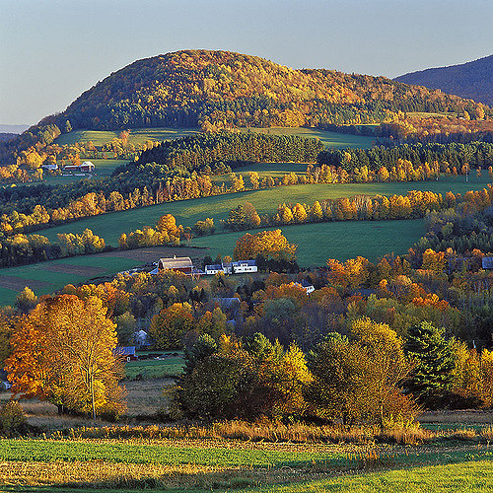
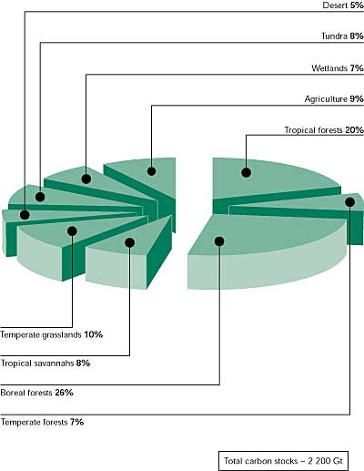
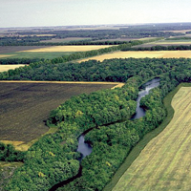
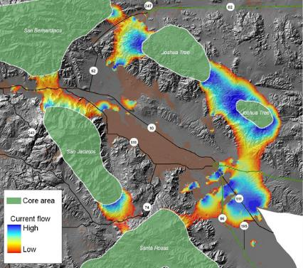
Forest pattern and extent
The BIG
Picture
Methods
Results &
Products
Additional
analyses
Conclusions
Product use &
applications
Forests = 53% of
terrestrial carbon
Food and Agriculture Organization 2001
Photo by Ed Post
B. McRae, UCSB NCEAS
Notes:
Why does forest extent and pattern matter?
Forests provide a number of services, including:
-riparian buffers for water purification/filtration
famous Catskills example – protected to preserve NYC’s water quality
-climate regulation via carbon storage/sequestration
-extent and configuration can affect connectivity which affects biodiversity
-well being, sense of place, identity
-in addition, number of pressures that are driving change in northern forests, including parcelization, climate change, pests and pathogens…
So…

Slide 4
Objective
The BIG
Picture
Methods
Results &
Products
Additional
analyses
Conclusions
Product use &
applications
Analyze patterns of past changes in forest cover
and
use these patterns to project future changes in forest cover

Slide 5
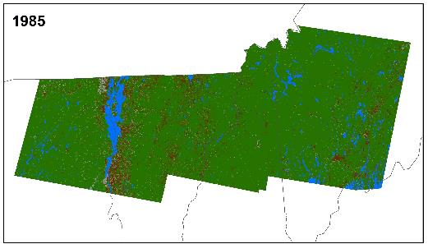
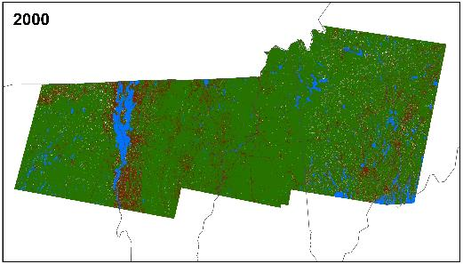
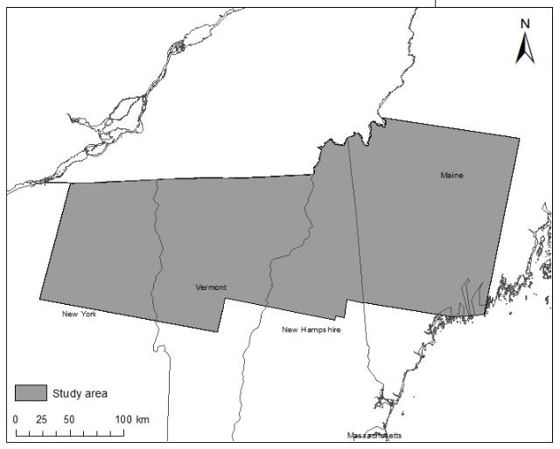
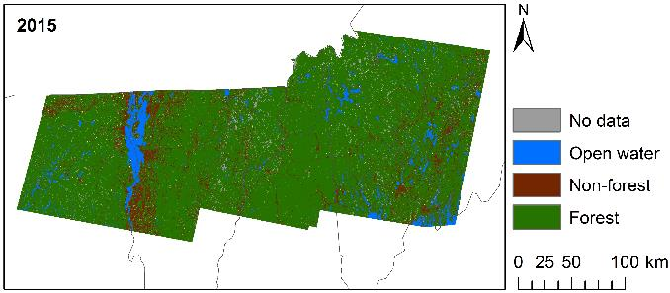
Study area & land cover data
The BIG
Picture
Methods
Results &
Products
Additional
analyses
Conclusions
Product use &
applications
Model calibration
Model
validation
Derived from Gudex-Cross et al. in progress
Notes:
This was the study area for this project—roughly the northern forest region
And here’s the input land cover data we used
This is derived from David and Jen’s forthcoming classified maps, but boiled down to just forest, non-forest, and water.
For these models we’re only dealing with changes in the forest non-forest class, and we assume all else is constant
1985 to 2000 was used for model calibration, and 2000 to 2015 was used for model validation

Slide 6
Model flow
The BIG
Picture
Methods
Results &
Products
Additional
analyses
Conclusions
Product use &
applications
1985
2000
2015
Calculate transition rates
Calculate correlations
with other spatial
variables
(“weights of evidence”)
3. Refine and remove
insignificant and correlated
variables
(About 61,000 ha)
(About 320,000 ha)
Notes:
Modeled in Dinamica

Slide 7
Model flow
The BIG
Picture
Methods
Results &
Products
Additional
analyses
Conclusions
Product use &
applications
1985
2000
2015
Calculate transition rates
Calculate correlations
with other spatial
variables
(“weights of evidence”)
Refine and remove
insignificant and correlated
variables
5. Compare
2015
4. Simulate

Slide 8
Model flow
The BIG
Picture
Methods
Results &
Products
Additional
analyses
Conclusions
Product use &
applications
1985
2000
2015
Calculate transition rates
Calculate correlations
with other spatial
variables
(“weights of evidence”)
3. Refine and remove
correlated variables
5. Compare
Constant
climate
2030
2045
2060
2015
4. Simulate
Scenario A
(slow)
2030
2045
2060
Scenario B
(med.)
2030
2045
2060
Scenario C
(fast)
2030
2045
2060
Notes:
So then we ran our four models for three time steps each
One assuming constant climate, and then three with different climate scenarios
The climate scenarios weren’t substantially different

Slide 9
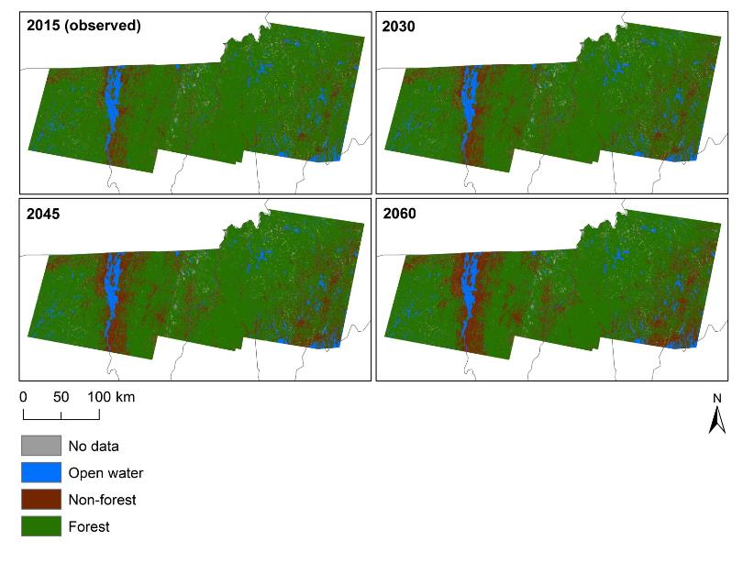
Simulated maps
The BIG
Picture
Methods
Results &
Products
Additional
analyses
Conclusions
Product use &
applications
Notes:
Here are the results we got for constant climate, but I’m not going to spend a lot of time looking at these maps because they aren’t very useful at this scale—you can see increasing development on the maine coast and around lake champlain over time, but it’s hard to pull out a lot more than that…

Slide 10
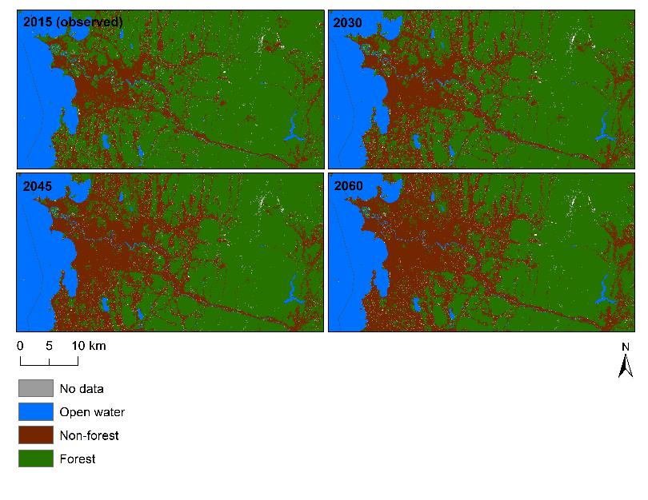
Simulated maps – Burlington area
The BIG
Picture
Methods
Results &
Products
Additional
analyses
Conclusions
Product use &
applications
2015 (observed)
2030
2045
2060
Notes:
Burlington area – increasing non-forest area overall

Slide 11
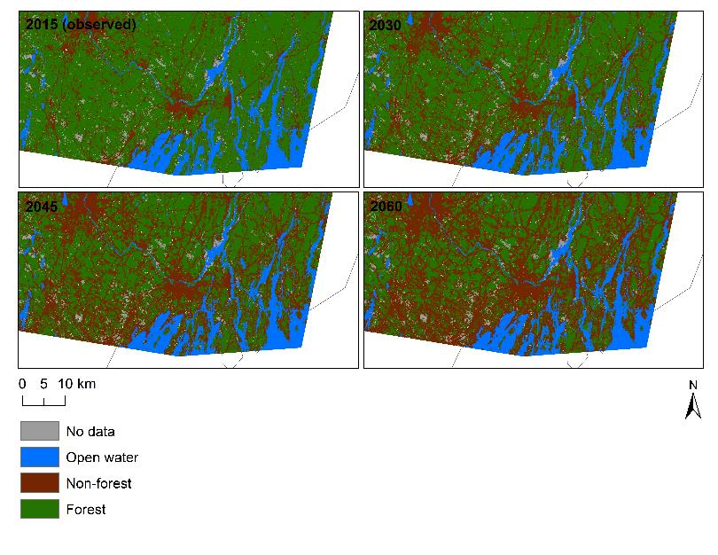
Simulated maps – Maine coast
The BIG
Picture
Methods
Results &
Products
Additional
analyses
Conclusions
Product use &
applications
2015 (observed)
2030
2045
2060
Notes:
Maine coast _ dramatic increase of non-forest
Note some gaps in data (obvious clouds here)
Brunswick on coast, Auburn in corner

Slide 12
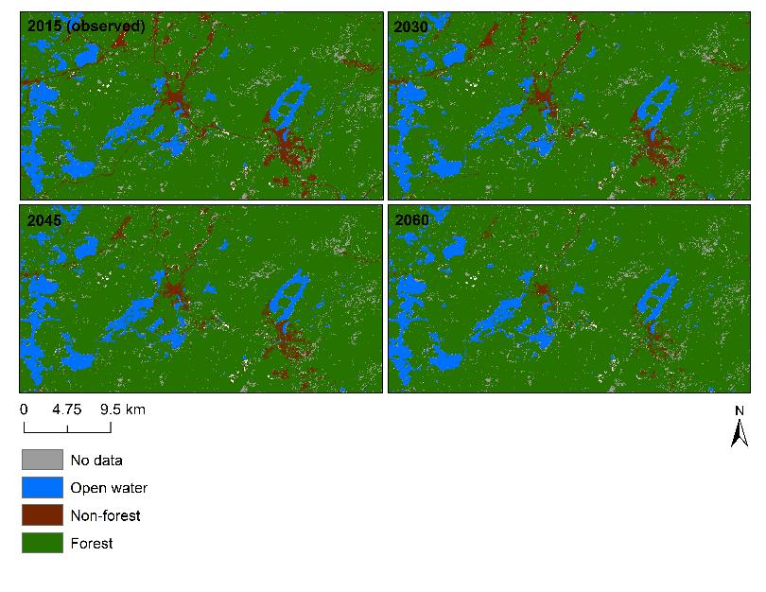
Simulated maps – Adirondacks
The BIG
Picture
Methods
Results &
Products
Additional
analyses
Conclusions
Product use &
applications
2015 (observed)
2030
2045
2060
Notes:
Do see regrowth of forest in some areas, e.g. this area of the Adirondacks

Slide 13
Observed & projected transitions
The BIG
Picture
Methods
Results &
Products
Additional
analyses
Conclusions
Product use &
applications
Decreasing forest area over time
Notes:
Data is also useful for looking at landscape-wide trends over time, especially net transitions into and out of forest
What we see is an overall trend of decreasing forest area if you look at that last column which is just net change in forest
except this one time step, and I’ll discuss that more in a minute

Slide 14
Forest configuration
The BIG
Picture
Methods
Results &
Products
Additional
analyses
Conclusions
Product use &
applications
All measures show increasing fragmentation over time
…even for 2000 - 2015, when forest area increased
Notes:
Next we looked at how forest pattern or configuration changed over time in the different scenarios
To do this we used four metrics of fragmentation
And for every time step and every scenario, we see a trend of increasing fragmentation measures
There are just a few places in here where fragmentation measures level out or decrease very slightly, but those can be due to transition assignment randomness
Again, we aren’t talking about the climate scenarios here—as you can see they aren’t substantially different

Slide 15
Important explanatory variables
The BIG
Picture
Methods
Results &
Products
Additional
analyses
Conclusions
Product use &
applications
Forest regrowth likely…
Low population densities
Far from roads
High elevations
Steeper slopes
Deforestation likely…
High population densities
Near other non-forest
Low elevations
Flatter areas
Less protected
Notes:
The last thing we looked at is which variables are most influential in determining where these two transitions will take place
ALL of these variables WERE significant, or they would have been excluded; just some are more influential than others
Here are the ones that are most important; and the model behaves how you would expect w/r/t to these variables
In other words…
< read lists >
So, development-type drivers are clearly important here

Slide 16
But what about that 2000 – 2015 forest gain?
The BIG
Picture
Methods
Results &
Products
Additional
analyses
Conclusions
Product use &
applications
Notes:
Finally, I want to go back to that weird time step– 2000 to 2015—when we observed an increase in forest cover
We think that this okay, because of the importance of development drivers

Slide 17
But what about that 2000 – 2015 forest gain?
The BIG
Picture
Methods
Results &
Products
Additional
analyses
Conclusions
Product use &
applications
Housing Price
Index (HPI)
Federal Housing Finance Agency
Notes:
If development is a major force in transitions between forest and non-forest
Then let’s look at real estate prices, which are a major factor driving development
<describe what we see>
So
Economics matters! And
We’re probably good to model on the 1985 – 2000 patterns
(The HPI is a broad measure of the movement of single-family house prices. The HPI is a weighted, repeat-sales index, meaning that it measures average price changes in repeat sales or refinancings on the same properties.)

Slide 18
Conclusions
The BIG
Picture
Methods
Results &
Products
Additional
analyses
Conclusions
Product use &
applications
If 1985 – 2000 trends are consistent with what’s happening today, and if those trends continue, forest area will decrease over the next few decades
Development appears to be a major factor in which locations experience deforestation or reforestation
Climate doesn’t play a significant role at this temporal scale
Notes:
(3 points)

Slide 19
How can these maps inform management?
The BIG
Picture
Methods
Results &
Products
Additional
analyses
Conclusions
Product use &
applications
Where forest is likely to disappear in the future, impact of that for fragmentation, etc.
Basis for conservation for connectivity
Future estimates of forest-based ecosystem services
Many other applications…
In other words…
where to prioritize for conservation

Slide 20





The BIG
Picture
Methods
Results &
Products
Additional
analyses
Conclusions
Product use &
applications
Questions?
Many thanks to…

Slide 21
Product use considerations
The BIG
Picture
Methods
Results &
Products
Additional
analyses
Conclusions
Product use &
applications
Simulations of likely change
Relies heavily on the state of the economy, development pressures
Don’t differentiate between types of non-forest
Climate may play a role in longer-range simulations

Slide 22
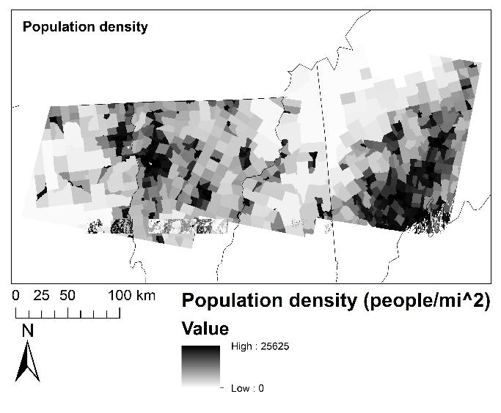
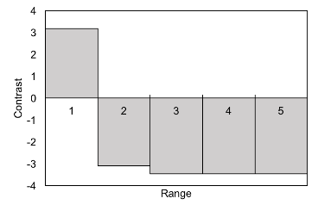
Important explanatory variables
The BIG
Picture
Methods
Results &
Products
Additional
analyses
Conclusions
Product use &
applications
Non-forest to forest: population density
Likely reforestation if population density is very low
Notes:
One range is 5,020 people per square mile
This shows that non-forest has strong a positive likelihood of transitioning to forest ONLY at very low population densities, and otherwise it’s very unlikely to transition to forest

Slide 23
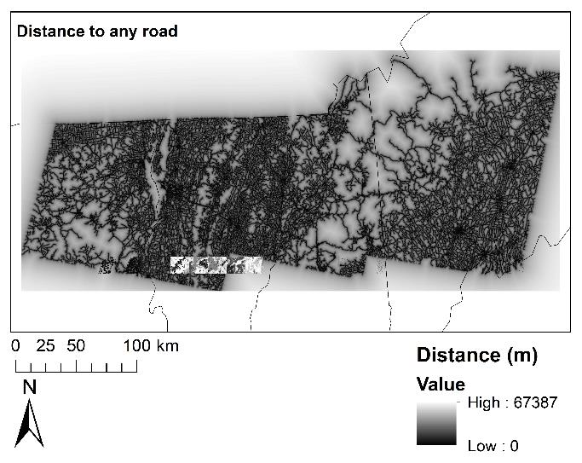
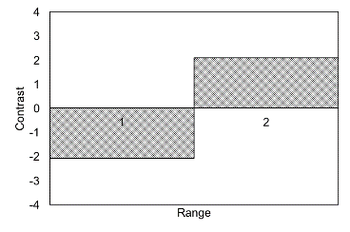
Important explanatory variables
The BIG
Picture
Methods
Results &
Products
Additional
analyses
Conclusions
Product use &
applications
Non-forest to forest: distance to any road
Likely reforestation far from any road
Notes:
One range is 13480 m
This shows that non-forest has strong a positive likelihood of transitioning to forest ONLY at distances from roads higher than 13km

Slide 24
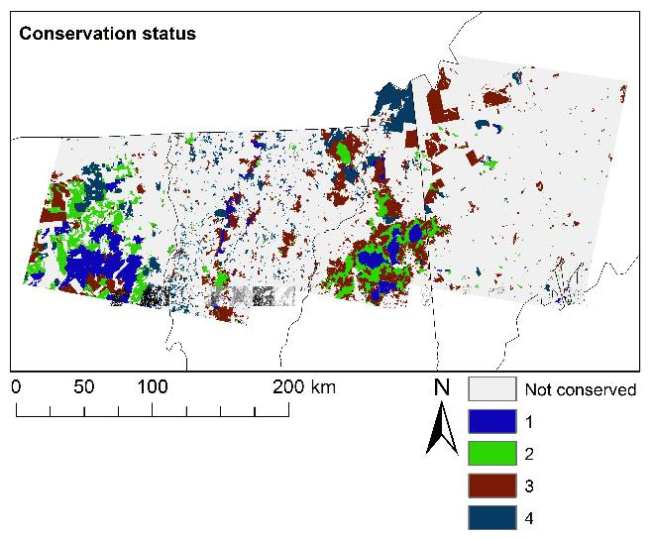
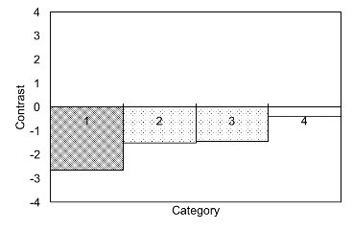
Important explanatory variables
The BIG
Picture
Methods
Results &
Products
Additional
analyses
Conclusions
Product use &
applications
Forest to non-forest: conservation status
Decreasing likelihood of deforestation as conservation strength increases

Slide 25
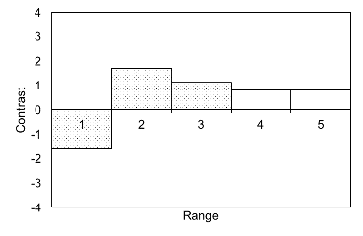
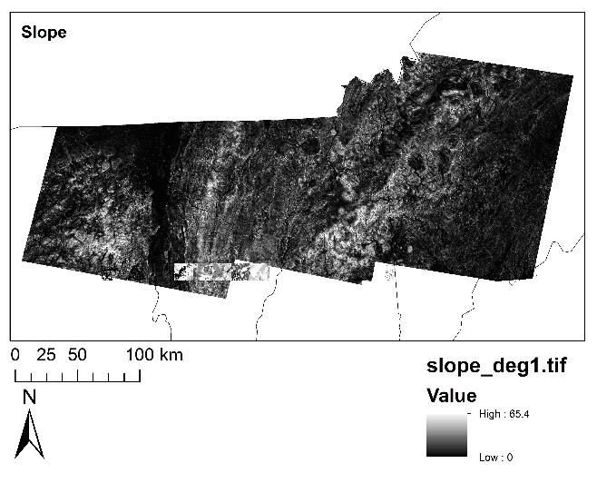
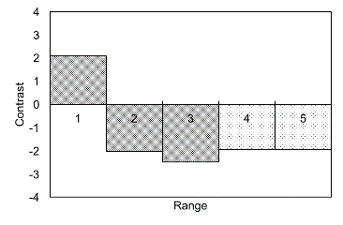
Important explanatory variables
The BIG
Picture
Methods
Results &
Products
Additional
analyses
Conclusions
Product use &
applications
Slope
Non-forest to forest
Positive likelihood on steeper slopes
Forest to non-forest
Positive likelihood in
flatter areas
Slope (degrees)
Notes:
One range is 13.2 degrees
This shows that non-forest has strong a positive likelihood of transitioning to forest on steeper slopes, while the opposite is likely to happen on shallower slopes
So overall, it seems like development is a very important factor here—forests are more likely to regrow away from roads and population centers, construction-friendly areas are more likely to be deforested, and strong conservation status is likely to protect forests from being cut down

Slide 26
Areas for future research
The BIG
Picture
Methods
Results &
Products
Additional
analyses
Conclusions
Product use &
applications
Improvement of stand age estimates
Carbon storage estimates that don’t rely on stand age to better isolate effect of tree species
Regional or local analyses of forest/non-forest transitions to improve applicability to local management
More forest and non-forest classes in land cover change models
Include or focus mostly on economic drivers for forest cover change models

