Slide 1
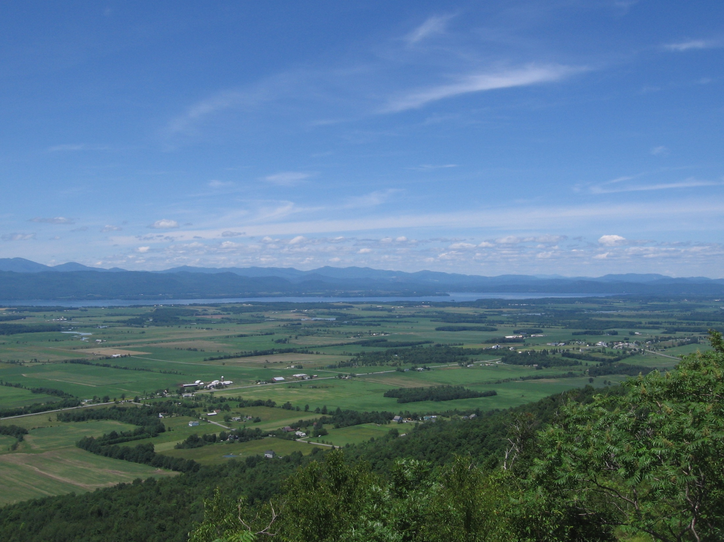

Edge of Field Monitoring
in the Lake Champlain Basin of Vermont
Kip Potter, NRCS
on behalf of: Julie Moore, Dave Braun, Don Meals, Mike Middleman and Eric Howe
December 11, 2015
Notes:
Conservation planning is the foundation of the conservation work of the agency and our conservation partnership.

Slide 2
Lake Champlain Efforts to Reduce Phosphorus
Multiple NRCS Watershed Projects dating back to 1980
Lake Champlain Basin Act passed – 1990
  Increased coordination of conservation in basin – basin plan
  Provided several million $ of epa and glfc funding each year
NRCS has contracted $51,000,000 of conservation since 2002
2002 Phosphorus TMDL Required an overall reduction in NPS P load of 27%
New Phosphorus tmdl will require overall reduction of 35%, some ag watersheds will need a 83% reduction

Slide 3
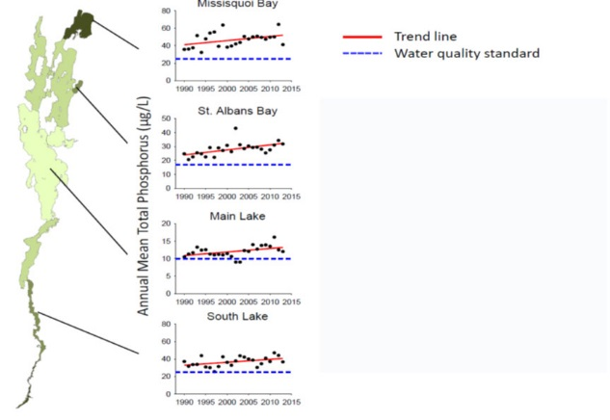
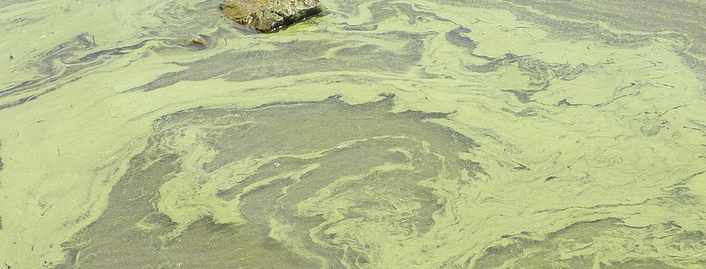
Phosphorus Trends in Lake Champlain
Notes:
Former TMDL challenged by the Conservation Law Foundation
EPA decided to revise the TMDL rather than face a legal battle
New P TMDL conducted by EPA and private consultations includes both in lake modeling and watershed modeling
New TMDL goals for P are much higher, more demanding: loading reductions are much higher

Slide 4
Need for Additional Monitoring in the Lake Champlain Basin
Researchers have not been able to demonstrate significant in-lake and major tributary improvements in water quality
new EPA TMDL and will require much higher loading reductions
Uncertainty about effectiveness of conservation practices and approach
Public perception of Ag role is very negative in some areas
Adaptive management strategy requires sound information on conservation practice effectiveness

Slide 5
Monitoring on at least 4 levels
In lake
Major tributary
Subwatershed
Edge of field

Slide 6
NRCS Monitoring and Evaluation for Water Quality
Pilot program started in 2012 – 7 projects in vermont
New NRCS national Edge of Field Monitoring and Evaluation Program in 2014 using eqip funds – 2 new projects in LCB
NRCS “activity standards” provide technical criteria for monitoring
NRCS payment schedule provides flat rate payments for activity (approximately 75% of cost)
Practices to be evaluated prioritized by a partner committee

Slide 7
Objectives for edge of field monitoring
To quantify baseline nutrient concentrations and loadings from different cropping systems and soils
To quantify the treatment effect of applying single conservation practices and systems of practices
To provide more accurate practice efficiency data for models and accounting systems
inform incentive program structure to ensure the most effective practices are emphasized
To support an adaptive management strategy in the basin
To increase farmer involvement and interest in providing and understanding water quality data
To help the public appreciate efforts of ag producers

Slide 8
Partner Contributions
Project implemented through EQIP contracts with farmers at no cost to them
VAAFM is served as coordinating entity to provide some matching funds and solicit private contractor to conduct work
Most of match is GLFC funds through the lcbp
VTDEC providing free lab services for sample analysis
Stone Environmental was contracted for site installation, site maintenance, and data collection and analysis

Slide 9
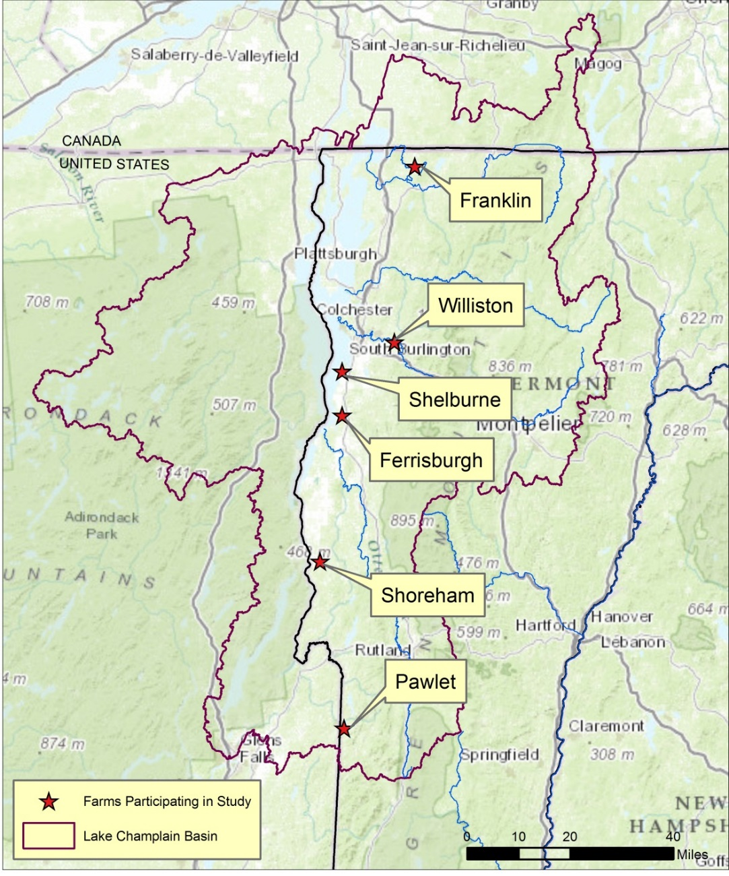
Seven projects on 6 farms started in 2013
Two new sites added in 2015, one in Charlotte, one with the Miner Institute in NY
Practices evaluated include cover crops, manure incorporation on hay, drainage water management and a system of no-till, manure injection and cover crops

Slide 10
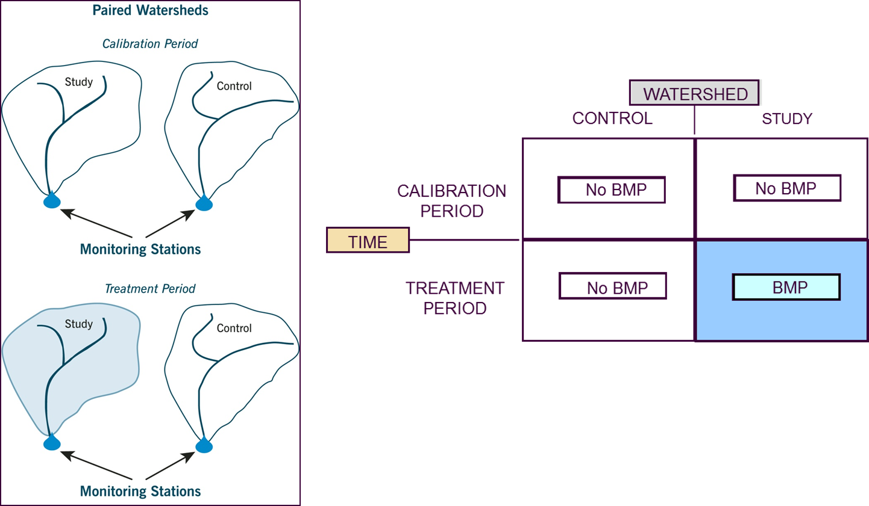

Slide 11
Paired Watershed Analysis

Slide 12
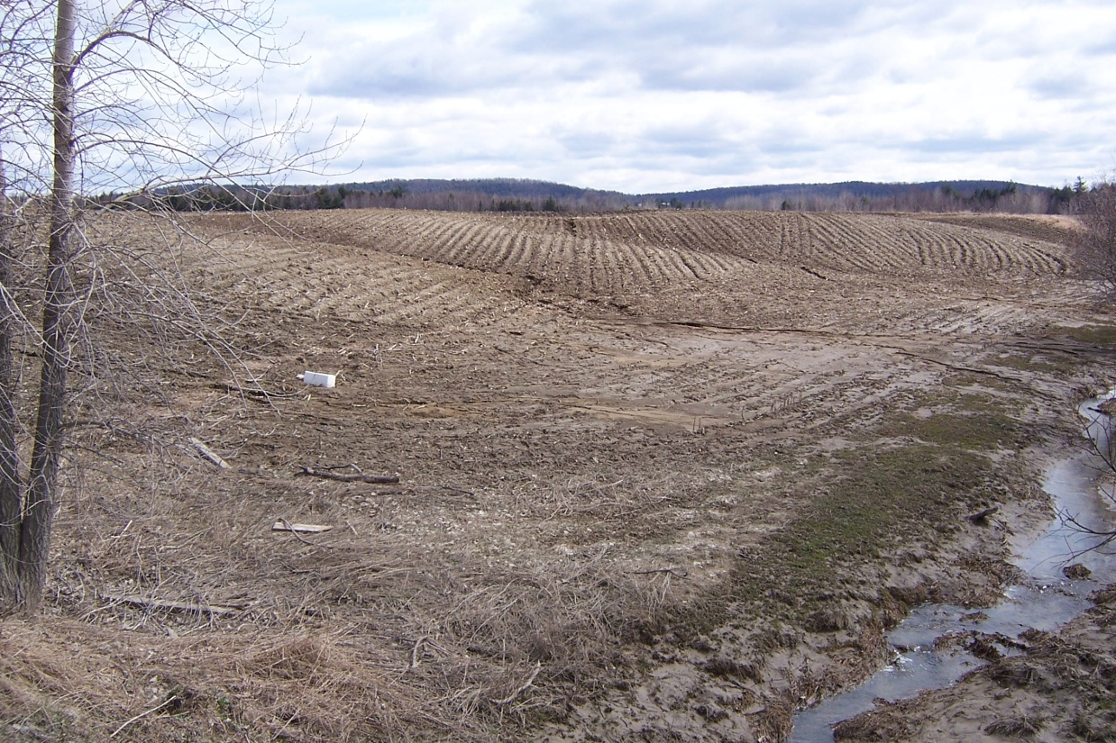
Parameters Monitored
Total Phosphorus
Dissolved Phosphorus (DRP and SRP)
Total Suspended Sediment
Nitrate Nitrogen
Total Nitrogen (TKN and
NH₄)
Water Discharge (Stage)
Others include: Soil Phosphorus (Modified Morgan’s), Soil Texture, Water Temperature, Precipitation, Air Temperature

Slide 13
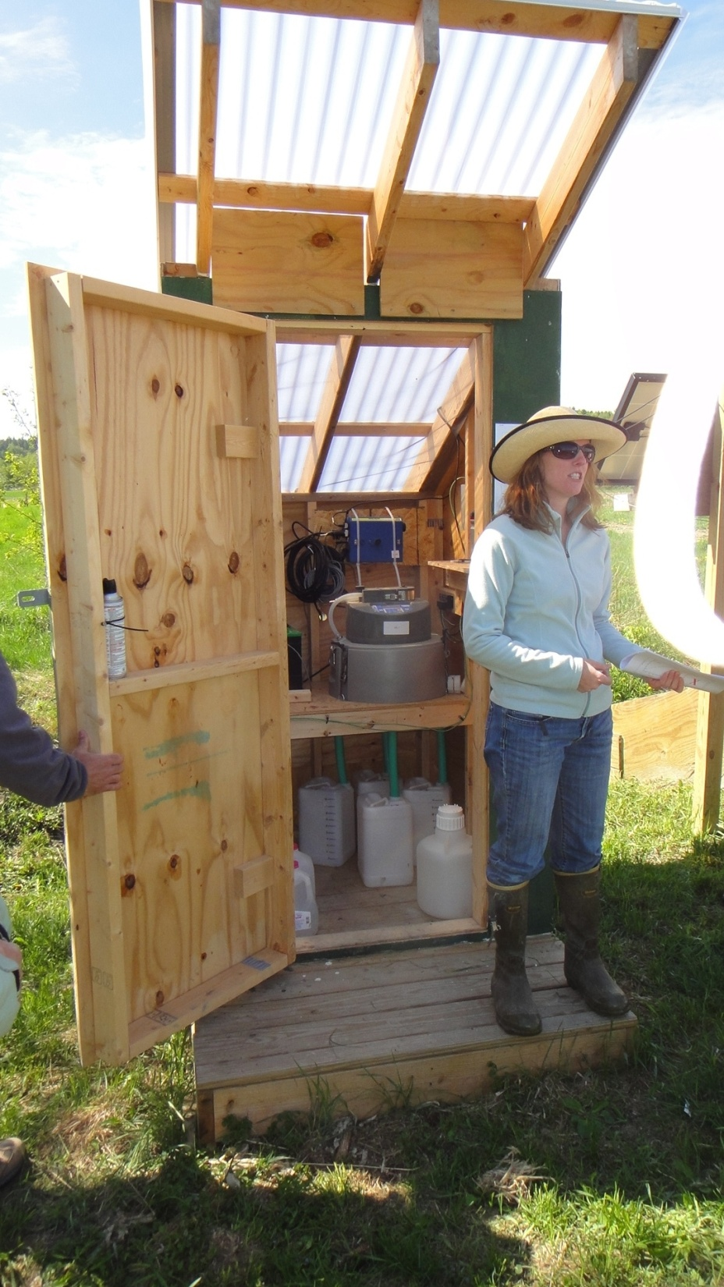
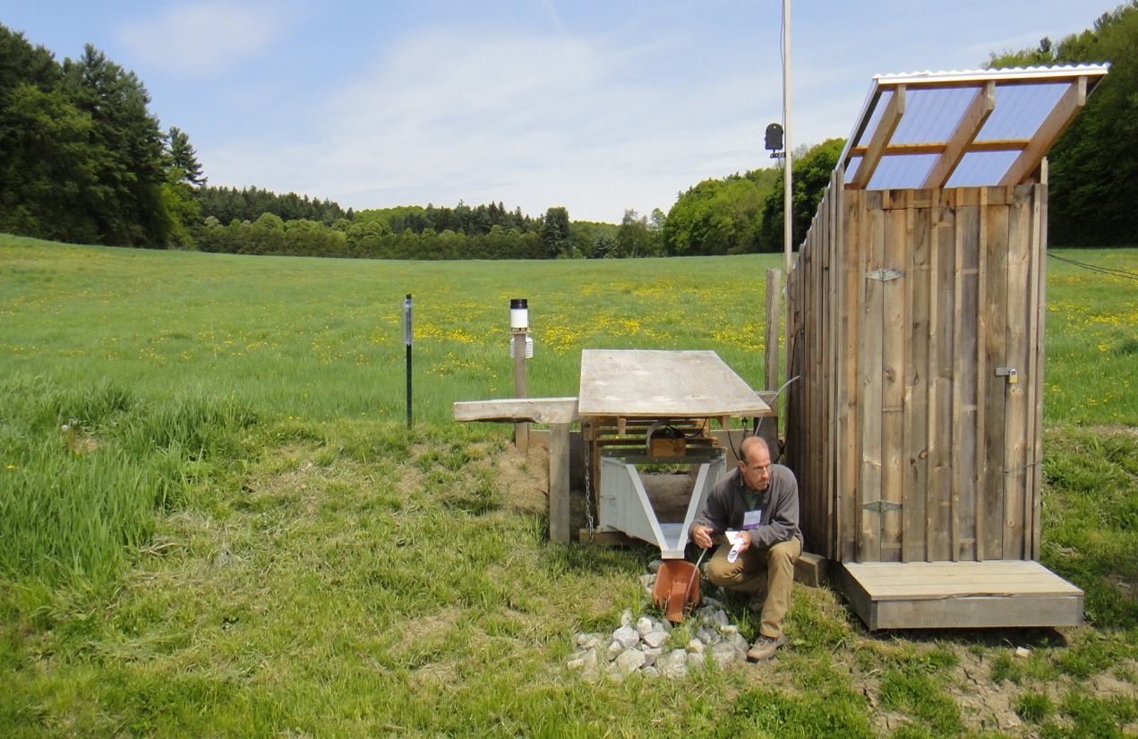
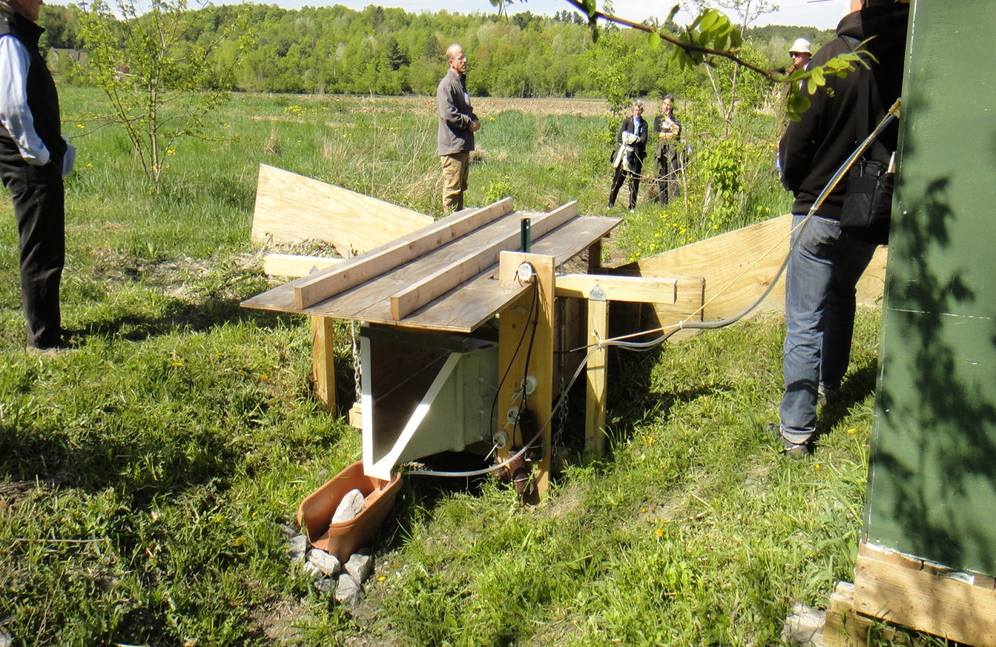

Slide 14
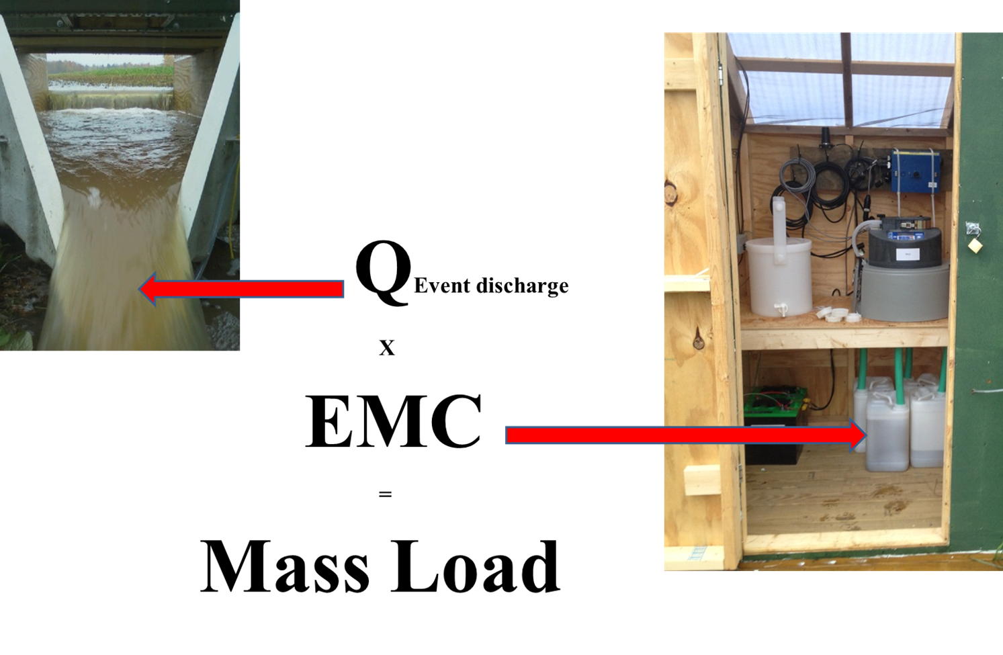
Event Based Sampling

Slide 15
Status of Monitoring and Data
Have collected 2+ years of baseline data on 6 projects (12 fields), still collecting treatment data
One project (sediment basin) was discontinued
Original 6 projects are currently in the treatment phase (no treatment data to date)
Two new projects started this fall under the Eof program
One new project, a phosphorus removal system on a tile outlet also started this fall

Slide 16
TP, TN, and TSS Concentrations
Corn Sites
Hay Sites
FRA1 | TP (µg/L) | TN (mg/L) | TSS (mg/L)
Range | 195 – 2,080 | 2.1 - 20.4 | 12.2 – 2,398
Mean¹ | 594 | 5.7 | 58.1
FRA2 | TP (µg/L) | TN (mg/L) | TSS (mg/L)
Range | 230 – 1,910 | 2.2 - 26.6 | 8.8 – 1,414
Mean¹ | 606 | 6.1 | 48.3
FER1 | TP (µg/L) | TN (mg/L) | TSS (mg/L)
Range | 188 – 15,560 | 1.1 - 100.6 | 15.3 - 700
Mean¹ | 548 | 2.7 | 96.7
FER2 | TP (µg/L) | TN (mg/L) | TSS (mg/L)
Range | 343 – 4,040 | 1.6 - 19.7 | 4.4 - 288.1
Mean¹ | 619 | 2.5 | 28.8
PAW1 | TP (µg/L) | TN (mg/L) | TSS (mg/L)
Range | 68 – 2,280 | 0.9 - 34.1 | 3.7 – 4,428
Mean¹ | 382 | 3.3 | 125.6
PAW2 | TP (µg/L) | TN (mg/L) | TSS (mg/L)
Range | 72 – 1,555 | 0.6 - 31 | 7.9 – 1,850
Mean¹ | 323 | 2.3 | 89.8
SHE1 | TP (µg/L) | TN (mg/L) | TSS (mg/L)
Range | 123 - 748 | 0.8 - 12.7 | 3.8 - 152.2
Mean¹ | 249 | 1.5 | 13.7
SHE2 | TP (µg/L) | TN (mg/L) | TSS (mg/L)
Range | 131 – 698 | 0.9 - 2.1 | 1.8 - 20.4
Mean¹ | 312 | 1.3 | 6.3
WIL1 | TP (µg/L) | TN (mg/L) | TSS (mg/L)
Range | 295 – 1,558 | 1.4 - 6 | 7.7 - 596
Mean¹ | 624 | 2.4 | 69.4
WIL2 | TP (µg/L) | TN (mg/L) | TSS (mg/L)
Range | 429 – 3,300 | 1.1 - 6.4 | 16.2 – 1,384
Mean¹ | 1,126 | 2.5 | 145.9
SHO1 | TP (µg/L) | TN (mg/L) | TSS (mg/L)
Range | 168 – 1,698 | 1.7 - 5.1 | 6.9 - 77.5
Mean¹ | 419 | 2.6 | 18.7
SHO2 | TP (µg/L) | TN (mg/L) | TSS (mg/L)
Range | 214 - 829 | 1.4 - 2.5 | 21.3 - 62.5
Mean¹ | 324 | 2.0 | 27.5

Slide 17
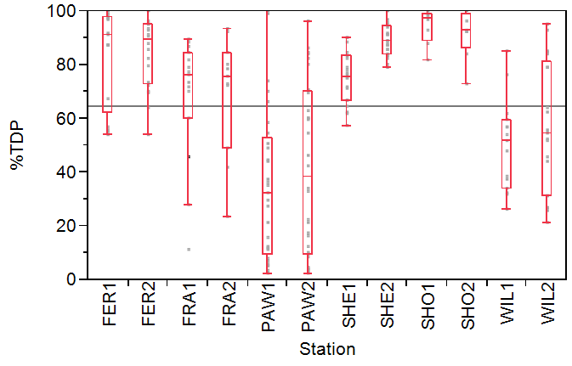
Percent of TP as Dissolved
On the average across all monitored stations, about 65 percent of TP has occurred as TDP – significant implications

Slide 18
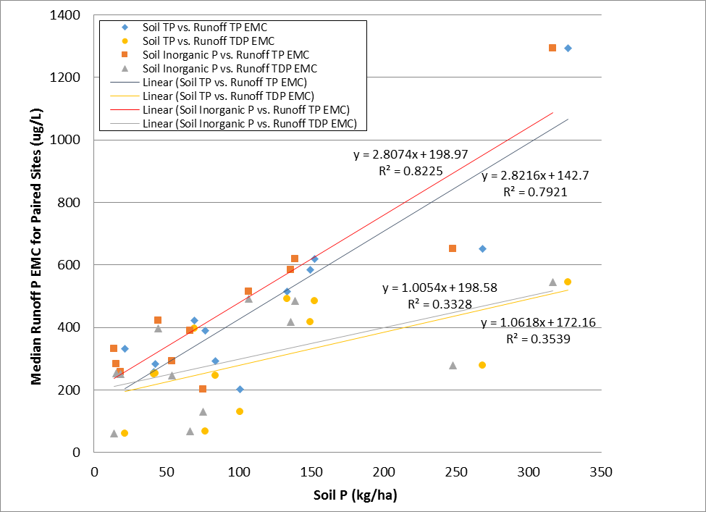
Relationships between Soil P and Median P EMCs in Runoff from Study Watersheds

Slide 19
Summary of EOF P Results
Number of surface flow events were limited (about 12 per year) and of short duration (a few hours to a few days)
Loading of TP was 60 percent higher from cornfields
  TP EMC on cornfields ranged from 323 to 1,126 ug/l
  TP EMC on hayfields ranged from 249 to 548 ug/l
Loading of TDP was 33 percent higher from hay fields
Hayfields had a higher percentage of soluble P in runoff (84 percent vs. 43 percent)
Overall, approximately 65 percent of the P in surface runoff was in the dissolved form (TDP)
Highest single EMC of TP and TDP was from a hayfield (15,560 ug/l), but even then 98% of the manure p stayed on the field
Strong correlation between soil p levels and emc p

Slide 20
Implications of EOF Results from the Project Calibration Phase
The highest P concentrations were from hay fields where manure was applied before/during rainfall, better guidelines need to be provided to farmers on this issue
Hay fields can contribute significant amounts of soluble P to surface waters and manure needs to be better managed on these fields (timing, aeration, injection)
Even on corn fields soluble P is a major portion of the total P load- need more than erosion control practices (manure injection, nutrient management, soil amendments?)
Importance of managing soil p levels to maintain them at optimal levels
New projects will operate year round – annual loading rates will be calculated

Slide 21
Future eof monitoring Plans
Extend some of the existing projects for another year
Initiate several new projects using the NRCS standards and existing partnership
Highest priority is the evaluation of practices treating tile discharge or reducing soluble phosphorus in tile discharge
these include: nutrient management, manure injection, phosphorus removal systems and soil amendments

Slide 22

Partner Support:
Vermont Agency of Agriculture and Markets – funding and administration
Lake Champlain basin Program – funding
Stone Environmental – monitoring and data analysis
Photo Courtesy of the LCBP
Notes:
Conservation planning is the foundation of the conservation work of the agency and our conservation partnership.

