Slide 1
An Overview of the Vermont Boreal Flora
Bob Popp
Vermont Dept of Fish & Wildlife
Natural Heritage Inventory

Slide 2
Northeast Alpine Zone
Total Ca. 13 Square Miles (8,320 Acres)
  New Hampshire: 7 Square Miles
  Maine: 6 Square Miles
  New York: 90 Acres
  Vermont: 110 Acres
    Mt Mansfield: 103
    Camel’s Hump: 6
    Other: 1

Slide 3
Missing & Presumed Extirpated in Vermont
Gentianella amarella (Felwort): Last observed 1961 SN & MM
Arnica lanceolata (New England Arnica): Last Obs.1911 SN & MM?
Empetrum atropurpureum (Purple Crowberry): Last obs.1908 MM
Geocaulon lividum (Northern Toadflax): Last obs.1901 MM(1976?)
Bistorta vivipara (Alpine Smartweed) Last obs 1876 CH &1895 MM
Vahlodea atropurpurea (MT. Hairgrass): Last obs. 1852 MM & SN

Slide 4
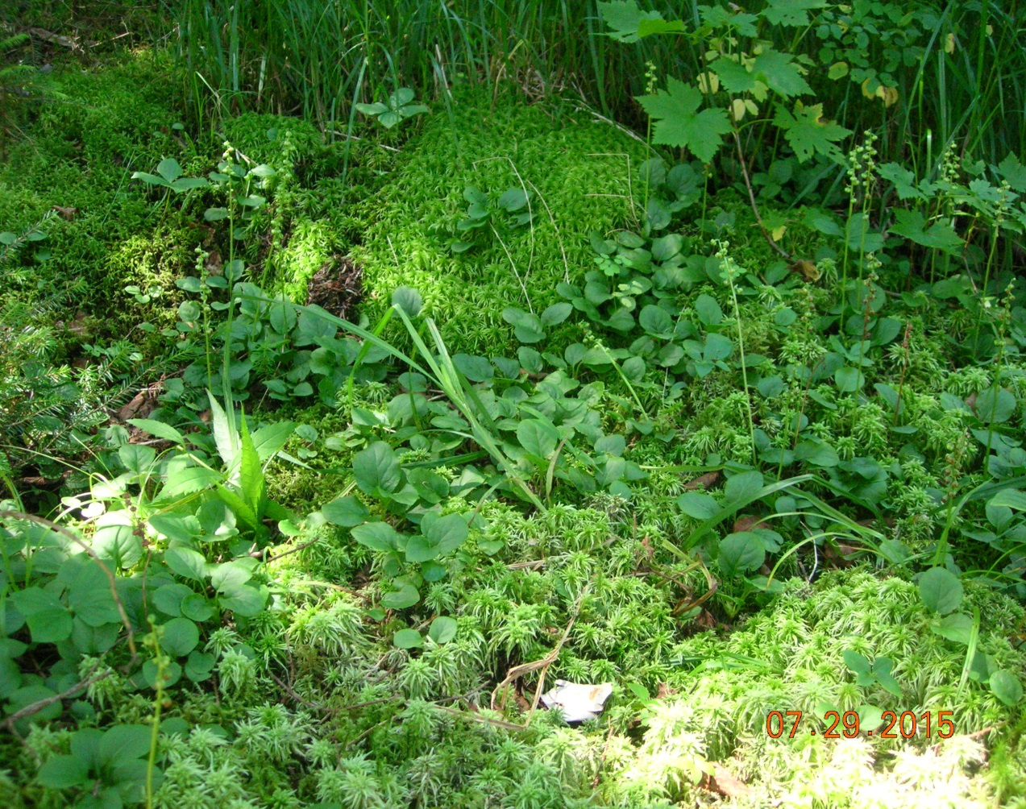
Locally Extirpated
Pyrola minor (Lesser Pyrola)
Last observed 1896
In Smugglers Notch
Last observed 1997
at Pico Peak
Extant at Camel’s Hump

Slide 5
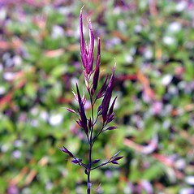
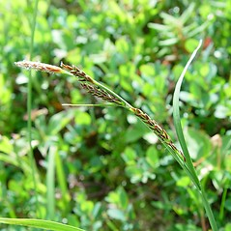
Possible Local Extirpations
Agrostis mertensii (Boreal bentgrass)
  Mt Abe Last observed in 1989: 3 stems
  not observed in 3 subsequent visits
  Extant on Mt. Hunger 2007
Carex bigelowii ( Bigelow’s sedge)
  Reported extant on Mt. Abe in 2008
  Extant on Mt. Hunger 2002, but heavily trampled

Slide 6
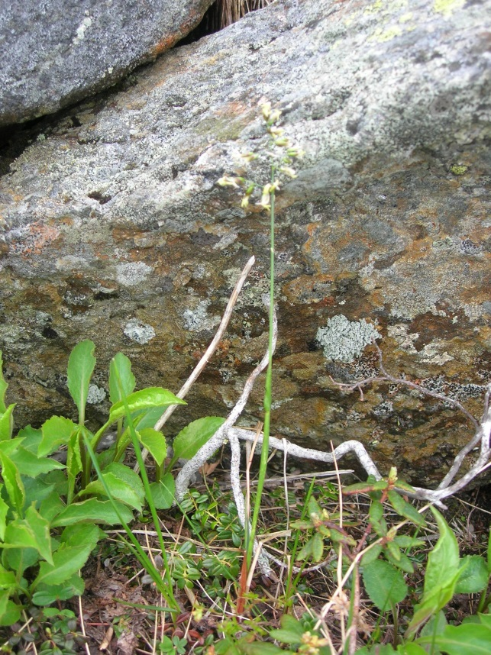
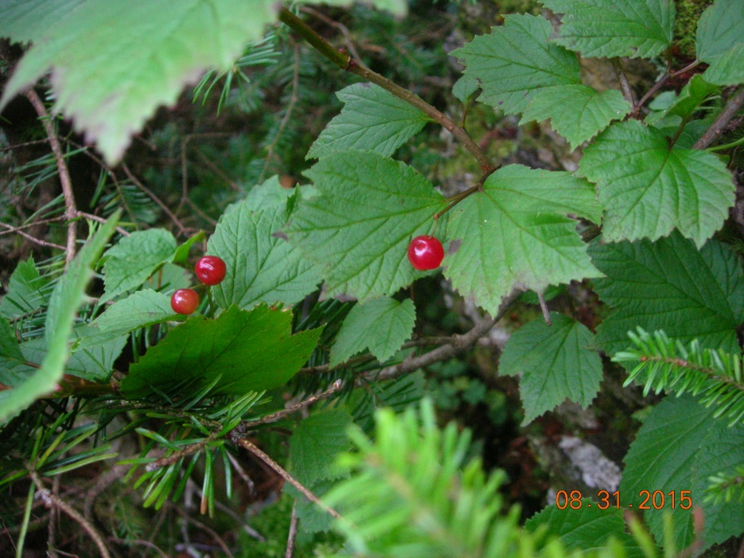
Possible Local Extirpations
Anthoxanthum monticola (Alpine sweet-grass)
  Last observed in 1876 at Camel’s Hump; rpt obs. by Umass Grad Student late 1990s
  Extant on Mt. Mansfield
Viburnum edule (Squashberry)
Camels Hump: last obs 1982: 9 plants
Mt. Monadnock:
  last obs in 1999: 10 plants; dense in “85
Killington: last obs. 1899
Stratton Mt:
Mt. Mansfield: Extant

Slide 7
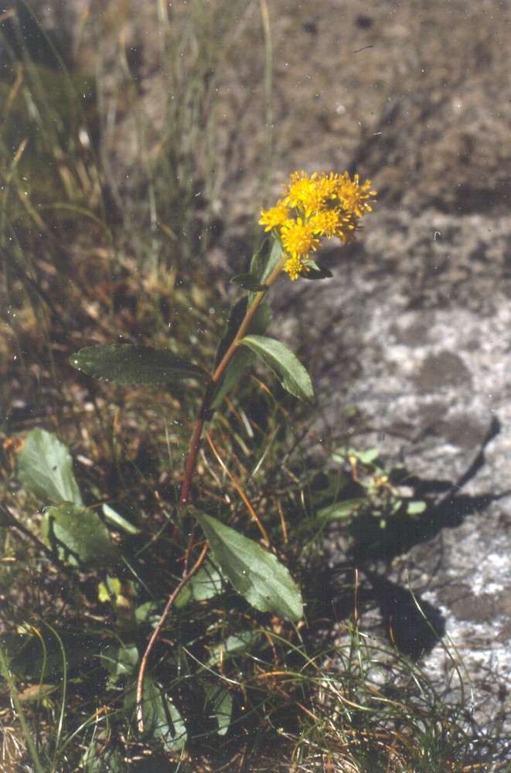
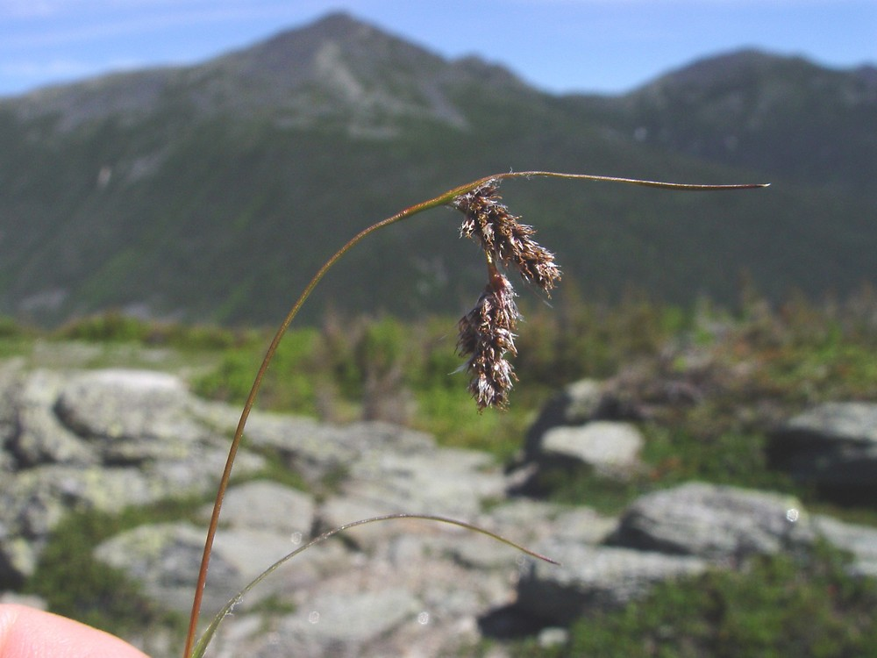
Rediscovery
Solidago leiocarpa (Cutler’s goldenrod) @ SN 1990
  Missing from CH 1887 Locally Com
  Missing from MM. Last obs 1908
Luzula spicata (Spiked woodrush) @ Smuggler’s Notch 1990
Notes:
Cutler’s Goldenrod and Dwarf Birch

Slide 8
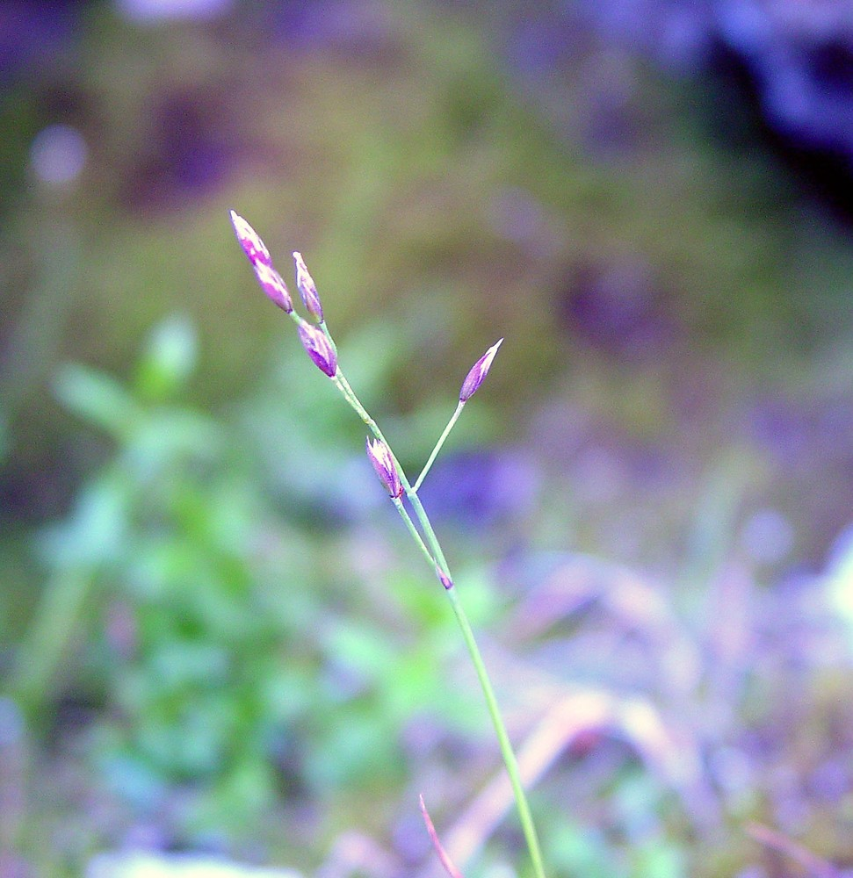
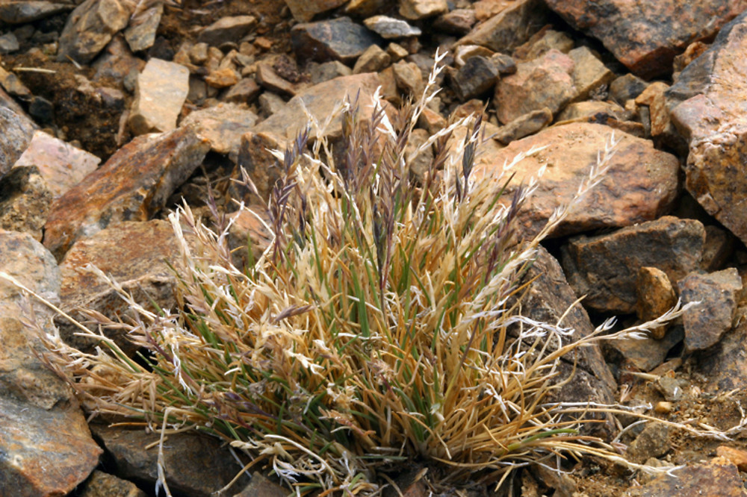
Rediscovered 1990
Festuca brachyphylla (Alpine fescue) @ Smugglers Notch
Poa laxa ssp fernaldiana (Fernald’s bluegrass) @ MM

Slide 9
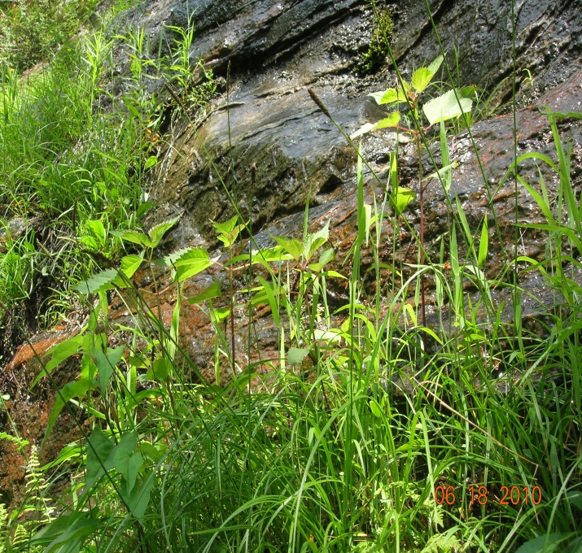
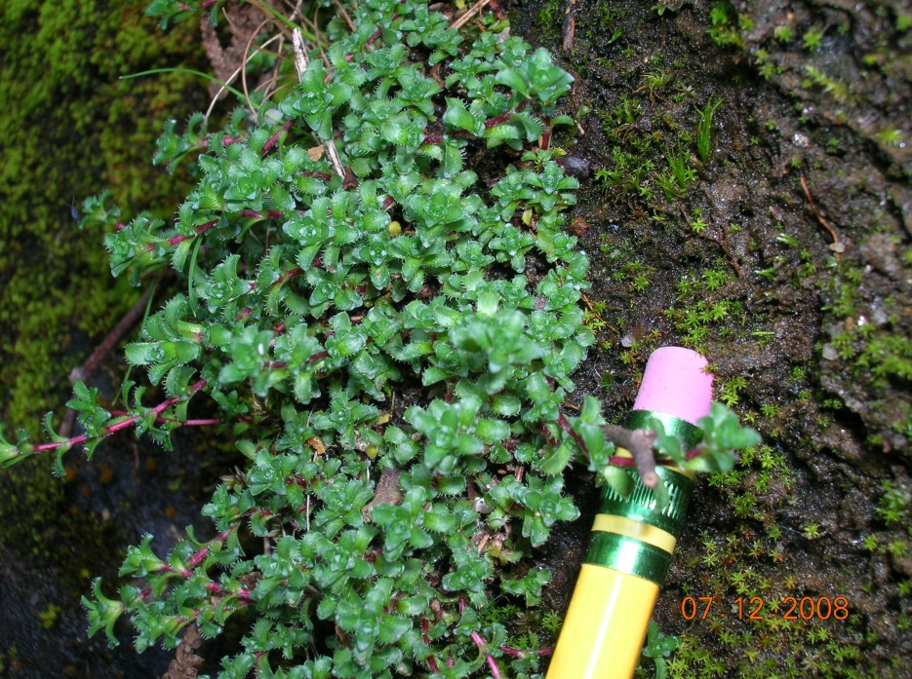
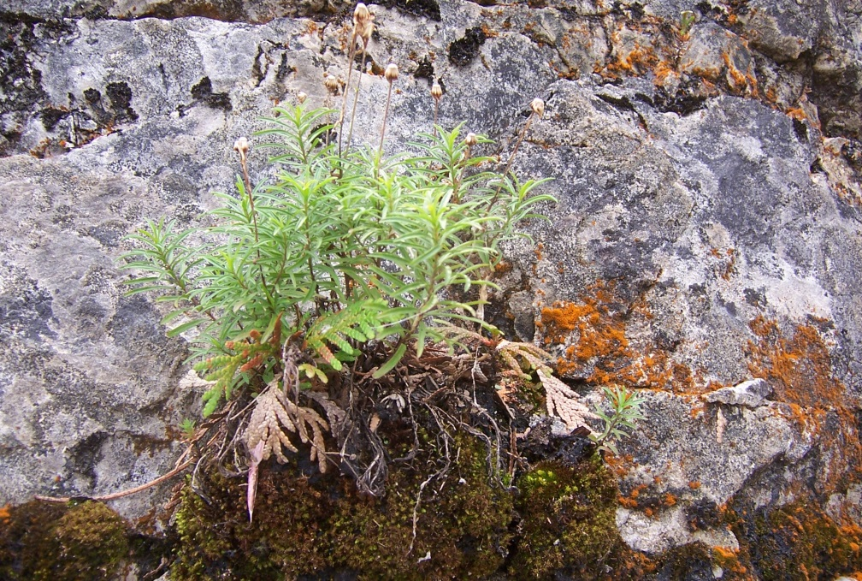
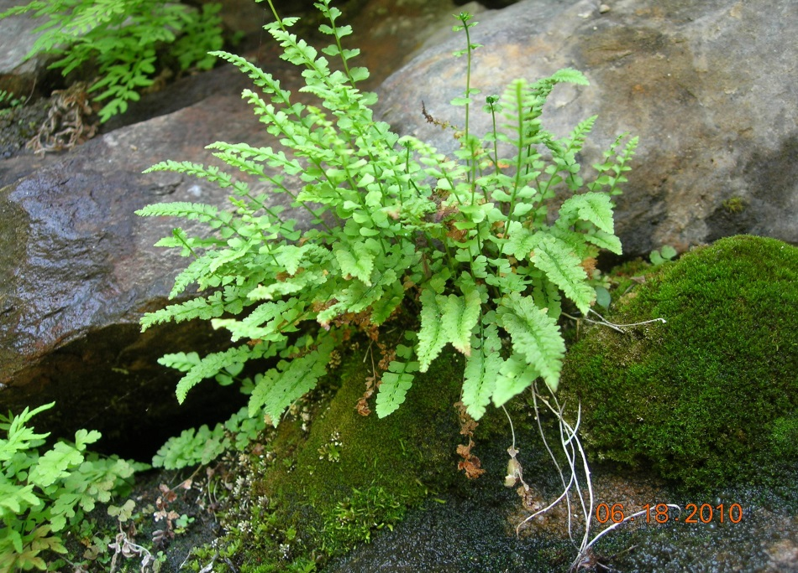
Rediscovery in 2004 of Arthur Stanley Pease Site from 1929
Not Found: Astragalus robinsii var. minor, Braya humilis, Artemisia campestris ssp. canadensis, Draba arabisans
Notes:
Carex scirpoidea, Saxifraga oppositifolia, Erigeron hyssopifolius, Woodsia glabella, & Calamagrostic stricta ssp inexpansa, Carex buxbaumii (not shown)

Slide 10
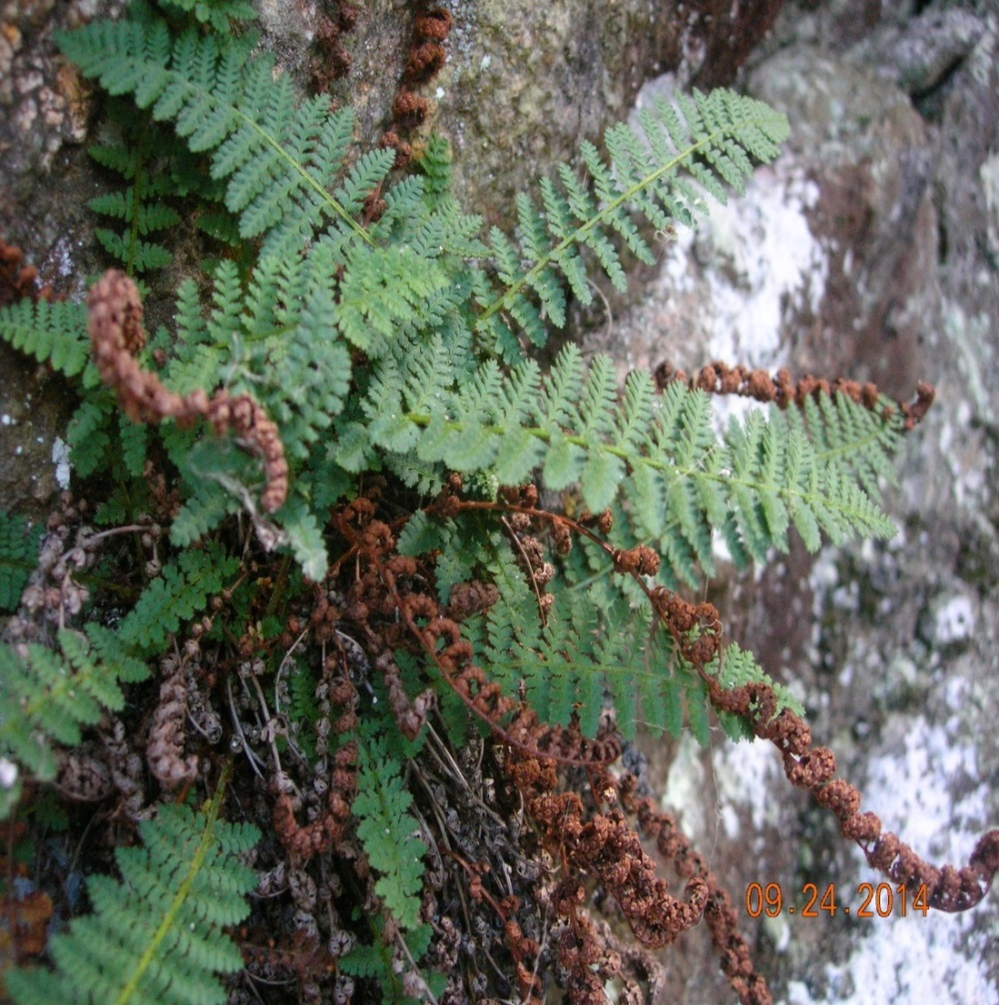
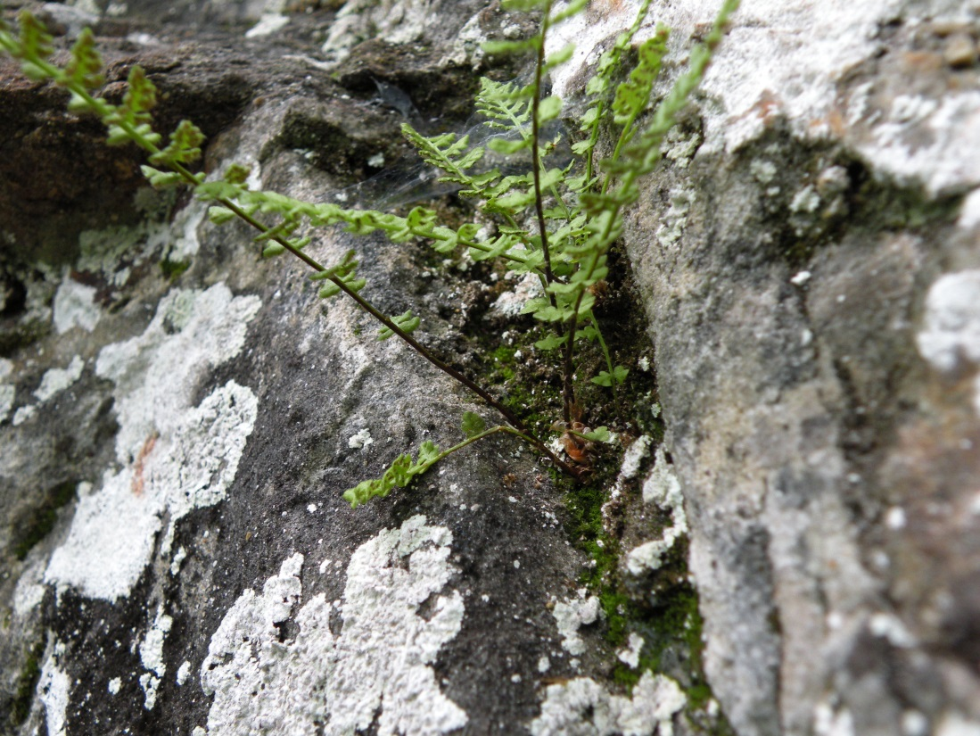
Rediscovery/Local Extirpation
Woodsia alpina ( Alpine woodsia) Dryopteris fragilis (Fragrant Fern) Relocated @ Mt. Pisgah 2011. Last observed Relocated Neb Notch 2014. Last obs 1906
  in 1952
  Possibly extirpated from Nebaska Notch.
  Last observed in 1897

Slide 11
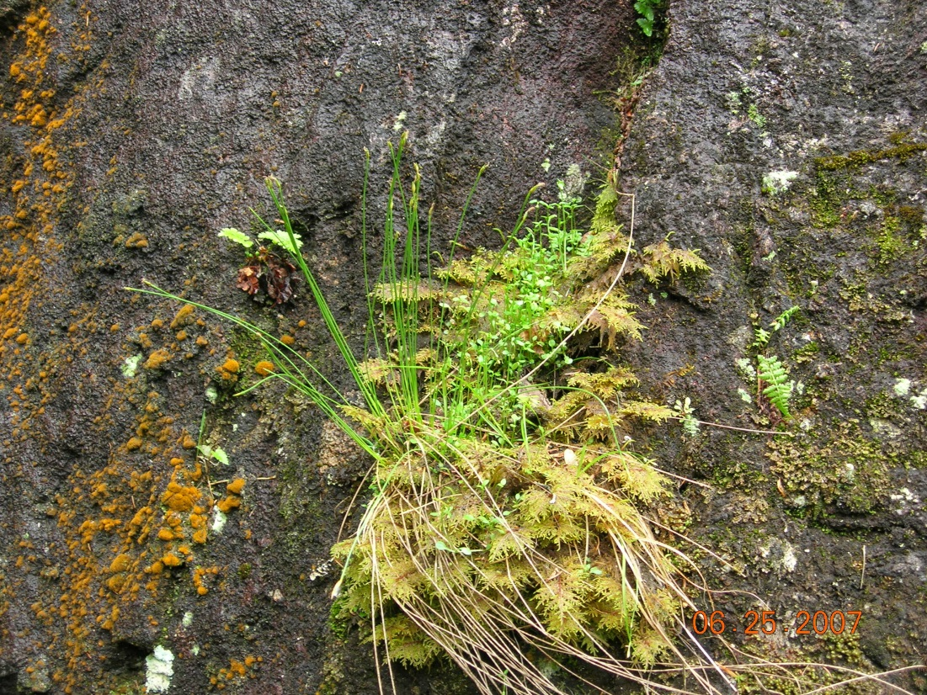
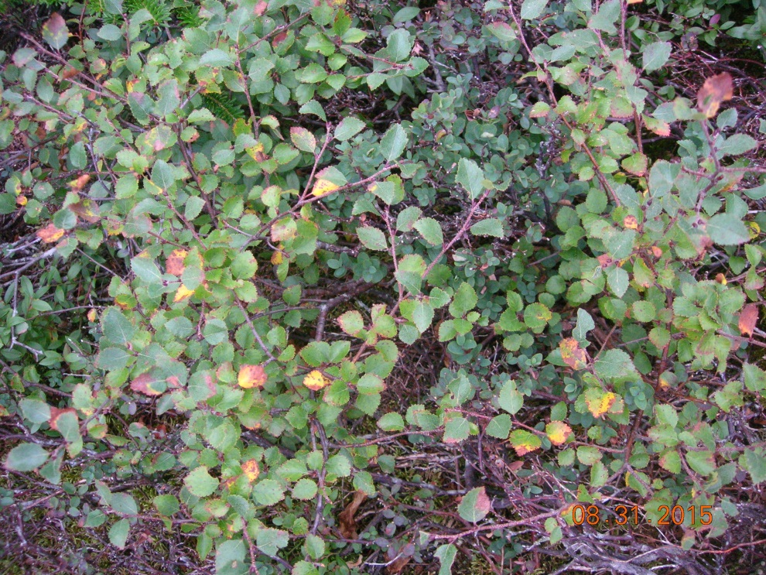
New Finds
Betula minor (Dwarf birch) New sub-
population on Mt. Mansfield
Trichophorum cespitosum (Deer-hair Sedge) @ Top of Smuggler’s Notch 2015.
Last obs on MM ridgeline 1979
Notes:
Alpine Sweet grass

Slide 12
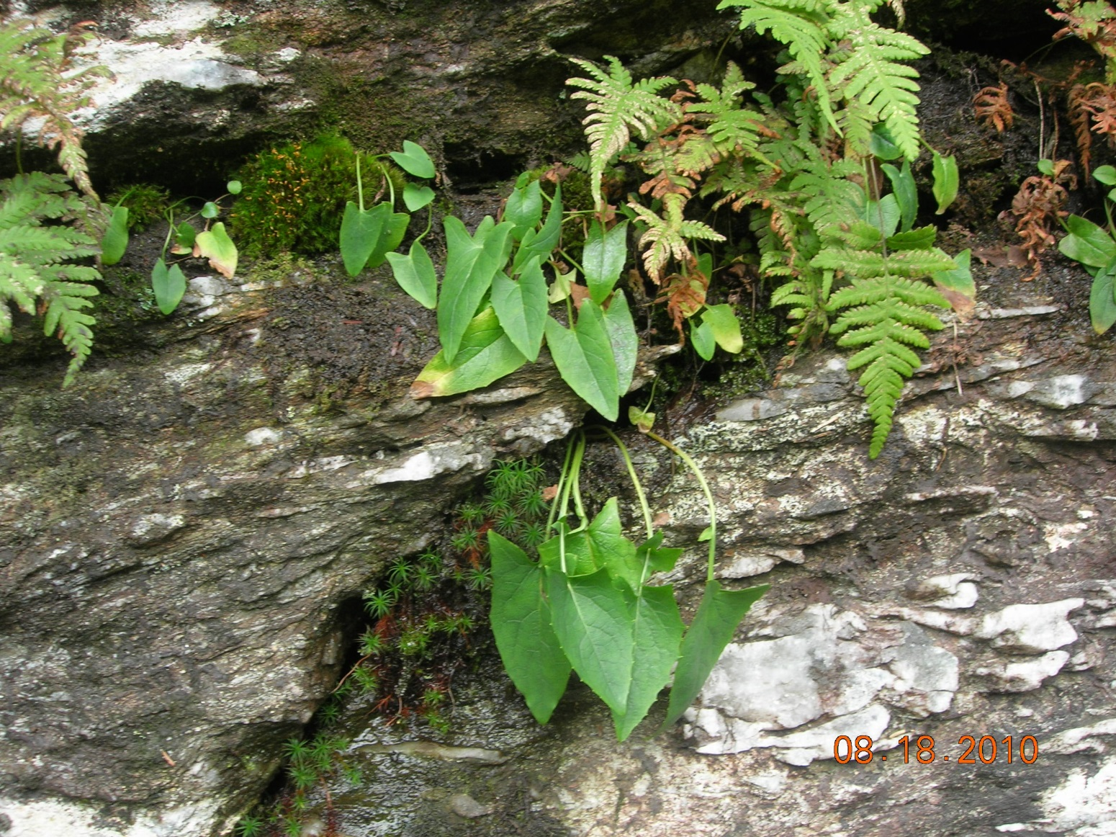
New Finds
Nabalus boottii (Boott’s rattlesnake-root) @ Stark Mt. 2006

Slide 13
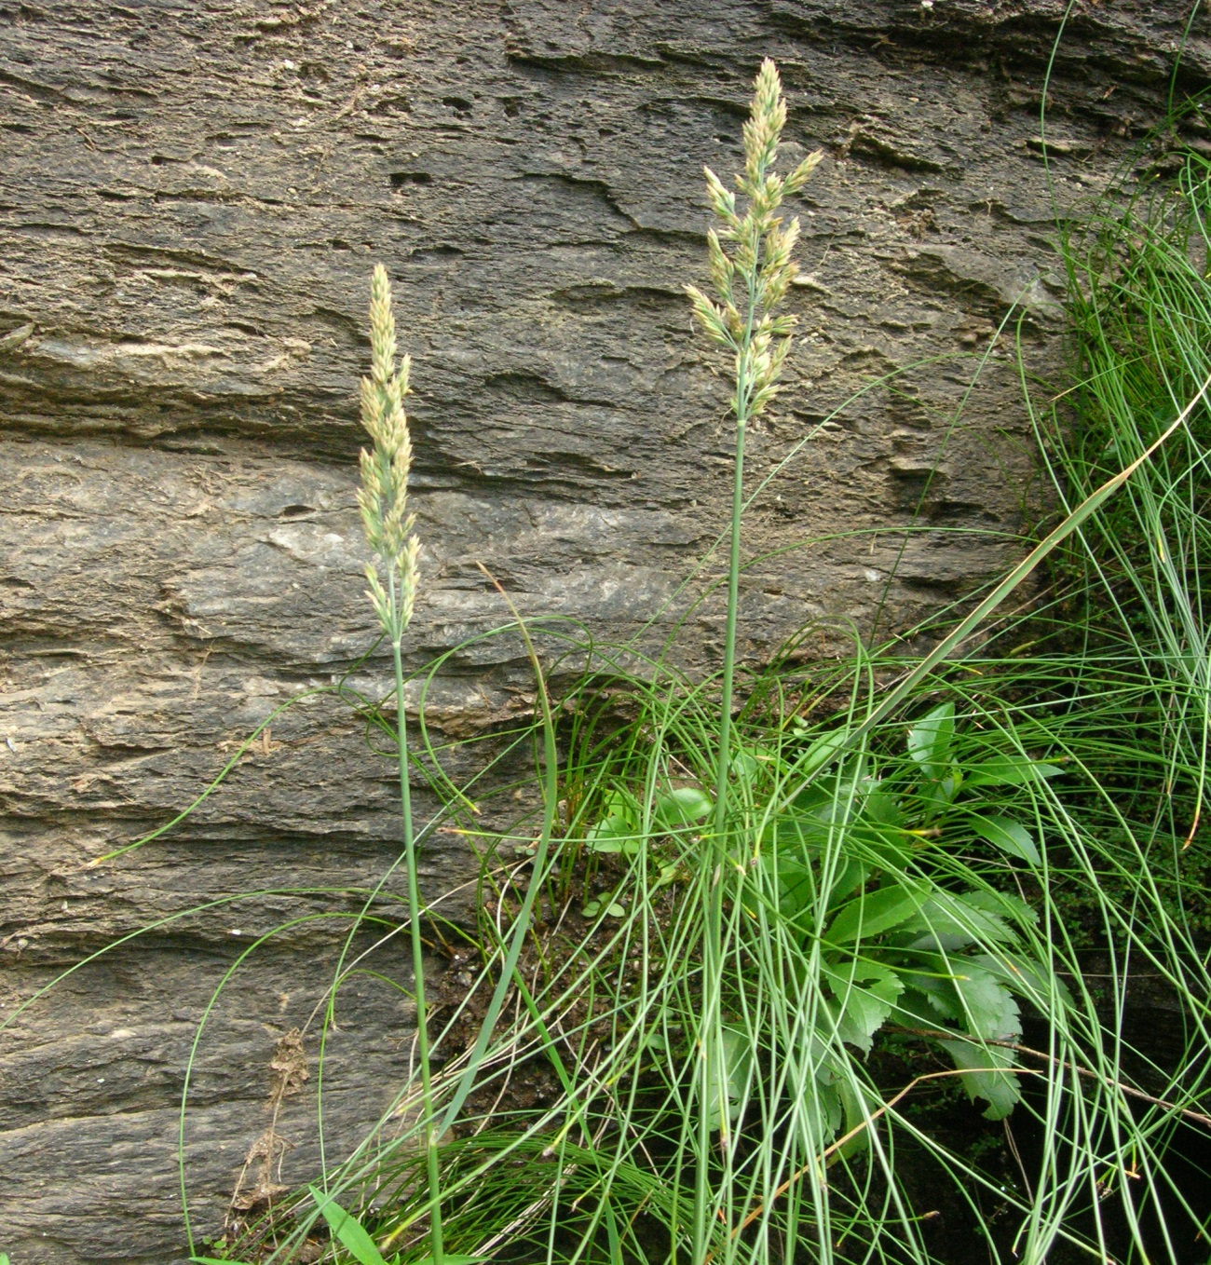
New Finds
Calamagrostis stricta
  ssp. inexpansa (Northern reedgrass)
@ Nebraska Notch 2014

Slide 14
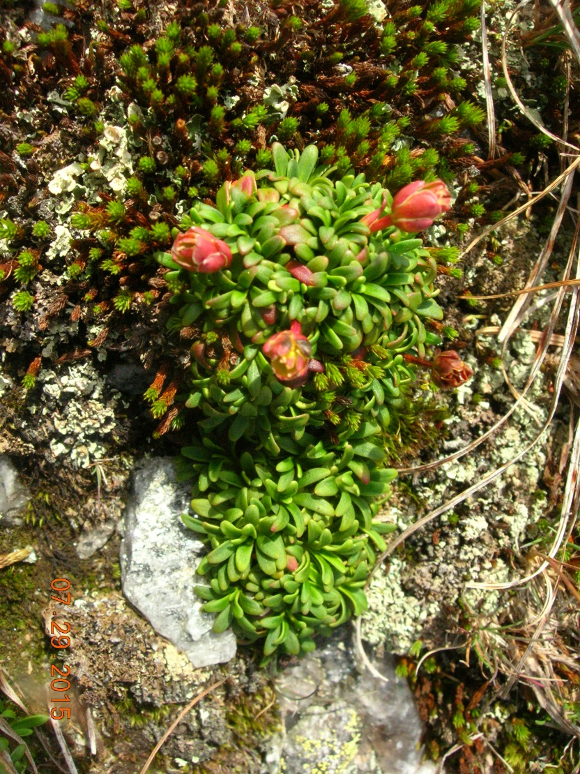
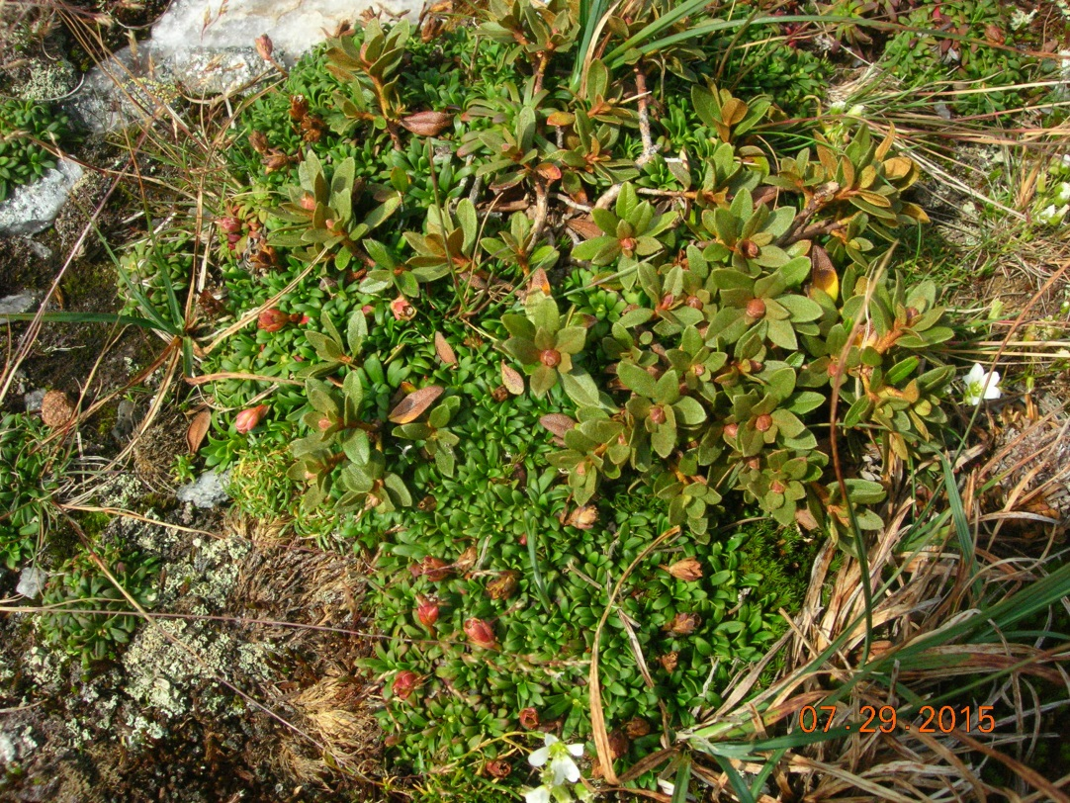
New Finds
Diapensia laponica at Camel’s Hump 2014

Slide 15
Results/Conclusions
Presumed Extirpated in the State: 6 Species consisting of 9 populations
  Arnica lanceolata * Gentianella amarella (2)**
  Bistorta vivipara (2 populations) ** Geocaulon lividum
  Empetrum atropurpureum Vahlodea atropurpurea (2)**
Locally Extirpated: 16 Populations
  Agrostis mertensii Castilleja occidentalis**
  Anthoxanthum monticola ** Draba arabisans**
  Artemissia campestris ssp. canadensis** Pyrola minor (2)
  Astragalus robinsii var. minor** Solidago leiocarpa (2) **
  Braya humilis** Viburnum edule (3)
  Carex bigelowii Woodsia alpina**
Locations:
    Mt. Mansfield: 7 populations
    Smugglers Notch: 4 populations * Denotes on Flora Conservanda Div I
    Camel’s Hump: 3 populations
    Other (8 sites) 11 populations ** Denotes on Flora Conservanda Div II

Slide 16
Results/Conclusions
Rediscovered Historic: 11 Populations at 8 Sites
  Calamagrosti stricta ssp. inexpansa ** Luzula spicata**
  Carex scirpoidea ** Poa laxa ssp fernaldiana *
  Dryopteris fragrans Saxifraga oppositifolia **
  Erigeron hyssopifolius ** Solidago leiocarpa **
  Festuca brachyphylla ** Woodsia alpina **
  Woodsia glabella **
New Previously Undiscovered: 2 Populations at 2 Sites New Subpopulations:
  Calamagrosti stricta ssp. inexpansa ** Betula minor**
  Nabalus boottii * Erigeron hyssopifolius **
  Diapensia laponica ??? Trichophorum cespitosum
Locations:
    Mt. Mansfield: 1 populations
    Smugglers Notch: 3 populations * Denotes on Flora Conservanda Div I
    Camel’s Hump: 1 population ?
    Other (4 sites) 9 populations ** Denotes on Flora Conservanda Div II

