Slide 1

Vermont’s Acid Lakes and Sentinel Streams WQ Monitoring Programs
Vermont Monitoring Cooperative’s
Annual Meeting
December 11, 2015

Slide 2
A LITTLE PERSPECTIVE
VT DEC has monitored the effects of acid deposition on remote lakes since the summer of 1980. This program is referred to as the Vermont Long-Term Monitoring Program or LTM. It is funded in part by the US EPA.
The global research community was entering a very long period of studies documenting “acid rain”. NAPAP was congressionally passed as a 10 year research and assessment program.
We initiated the Sentinel Stream Monitoring Program to assess CC and is a subset of DEC’s Ambient Biomonitoring Network which evaluates the state of Vermont’s streams.

Slide 3
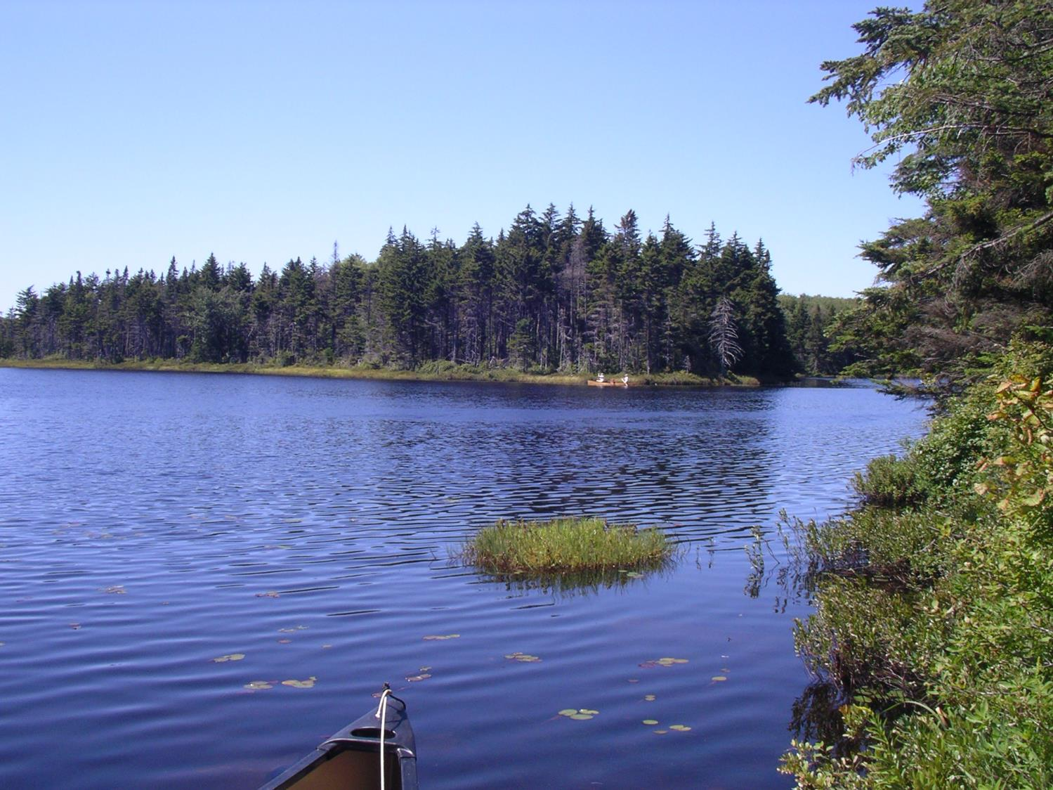
Bourn Pond
Tannic with Fish
Notes:
In 1980, at the time Southern VT was receiving approximately 25 kg/ha/yr of sulfate deposition and had an average pH of 4.3. Today, SO4 deposition has been reduced to 6 kg/ha/year and the average pH has rebounded to between 5 and 5.10.

Slide 4
Branch Pond - Acidity
Notes:
20 ueq/l = 1 mg/ so 40 ueq/l = 2 thus 50 (the threshold for TMDL) is 2.5.
For all regressions – p<0.05

Slide 5
Branch Pond - Anions
Notes:
Sulfate deposition not only has an acidifying effect, but results in Ca and other base cation leaching. Nitrogen saturation occurs when excess N is noted during the growing season. While we don’t see this, we do see spikes in N, during winter thaws and snow melt that persist in the spring. This is referred to as episodic acidification and is a critical period to monitor lakes and streams. These short-term episodes of highly acid pulses may be more devastating to the biological community than long-term chronic chemistry issues.

Slide 6
Branch Pond - Cations
Notes:
Ca and other base cations have been depleted as a result of sulfur and nitrogen deposition. It appears that this pattern may be beginning to level off and that the base cations will stabilize allowing soils and lakes to further neutralize. Ongoing emission reductions are necessary to decrease soil and water acidification. While this is not that expected to replenish lost cations, it will partially recover reserves.

Slide 7
Branch Pond - Color
Notes:
Our lakes have begun to “darken”. Most observable in the clearest lakes where I had initially reported on an unnatural shade of blue. Now, we are observing a slight brownish tinge to some of those same waters.

Slide 8
Branch Pond - Water Clarity
Notes:
No trend in Secchi, both DOC and color do show an increasing trend. There is a general decrease in transparency most notably beginning in 2004.

Slide 9
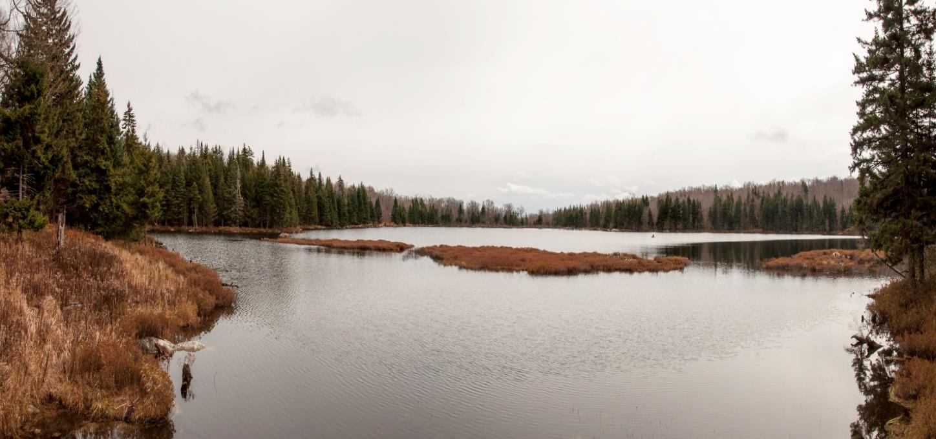
Little Pond
Clear and Fishless

Slide 10
Little Pond - Anions

Slide 11
Little Pond - Acidity

Slide 12
Little Pond - Base Cations

Slide 13
Little Pond - Color
Notes:
While no regression line has been drawn, there is an increasing trend in both color and DOC in this clear water pond

Slide 14
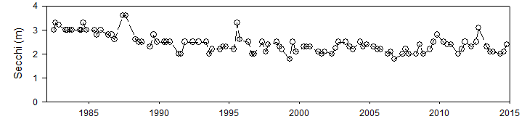
Little Pond - Water Clarity

Slide 15
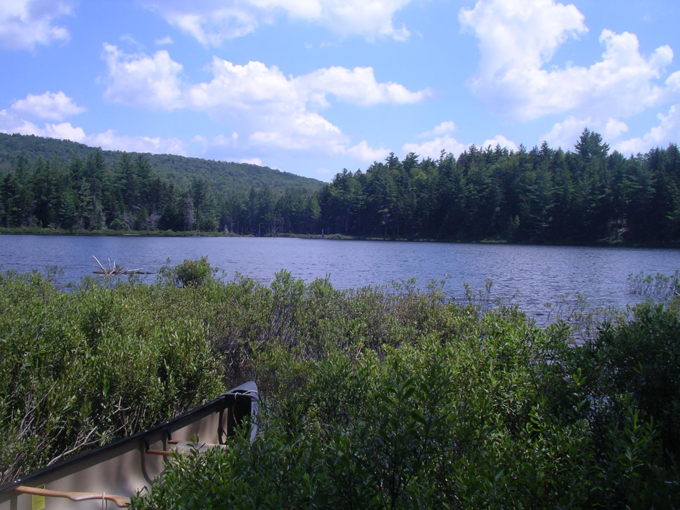
Forester Pond
Clear, Fish(?) and Stressed

Slide 16
Forester Pond-Road Salt

Slide 17
Forester Pond - Acidity
Notes:
10 LAKES ARE SHOWING AN INCREASING TREND IN ANC. ONE IS DECREASING AND ONE SHOWS NO TREND.

Slide 18
Summary of Seasonal Kendall Tau Trends for Vermont LTM Lakes
Through 2013
Increasing Trends | Decreasing Trends | Mixed | Undetermined or Weak*
DOC | SO4 | Si | NO3
Color | CL |  | Al (Total filterable)
ANC | Ca
pH (6/12) | Mg
MAl (Speciated) (5/12) | Na
 | K

Slide 19
Ranch Brook
Benthic Response to Peak Flow
(Density)
Notes:
Highest density during the period after 2008 were recorded in 2009 and 2012 with low peak discharges.

Slide 20
Ranch Brook
Long-Term Biological Response
(Richness)
Notes:
Overall, richness is a measure of the stream’s biodiversity as it’s the count of the individual taxa. Here we are counting both all taxa and just the sensitive EPT. When plotted against annual peak discharge, it appears that both metrics are less affected by hydrology than density. We have seen this lack of diversity variability elsewhere. In fact, this reference streams diversity is very similar to that of 15 years ago.

Slide 21
Winhall River
Long-Term Biological Response
(Density and Richness)
Notes:
Similar to Ranch Brook, Winhall responds to high flow events by decreasing density often followed by a rapid build up of early colonizers that can cause a spike in density levels.

Slide 22
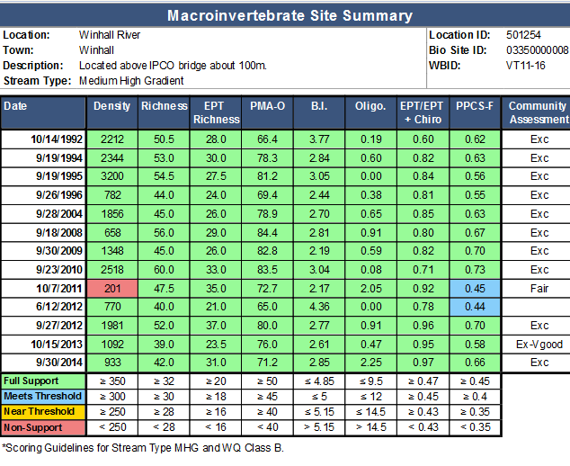
Notes:
Community scoring of Winhall River over the past 12 years. It was scoured by Hurricane Irene, but recovered by 2013.

Slide 23
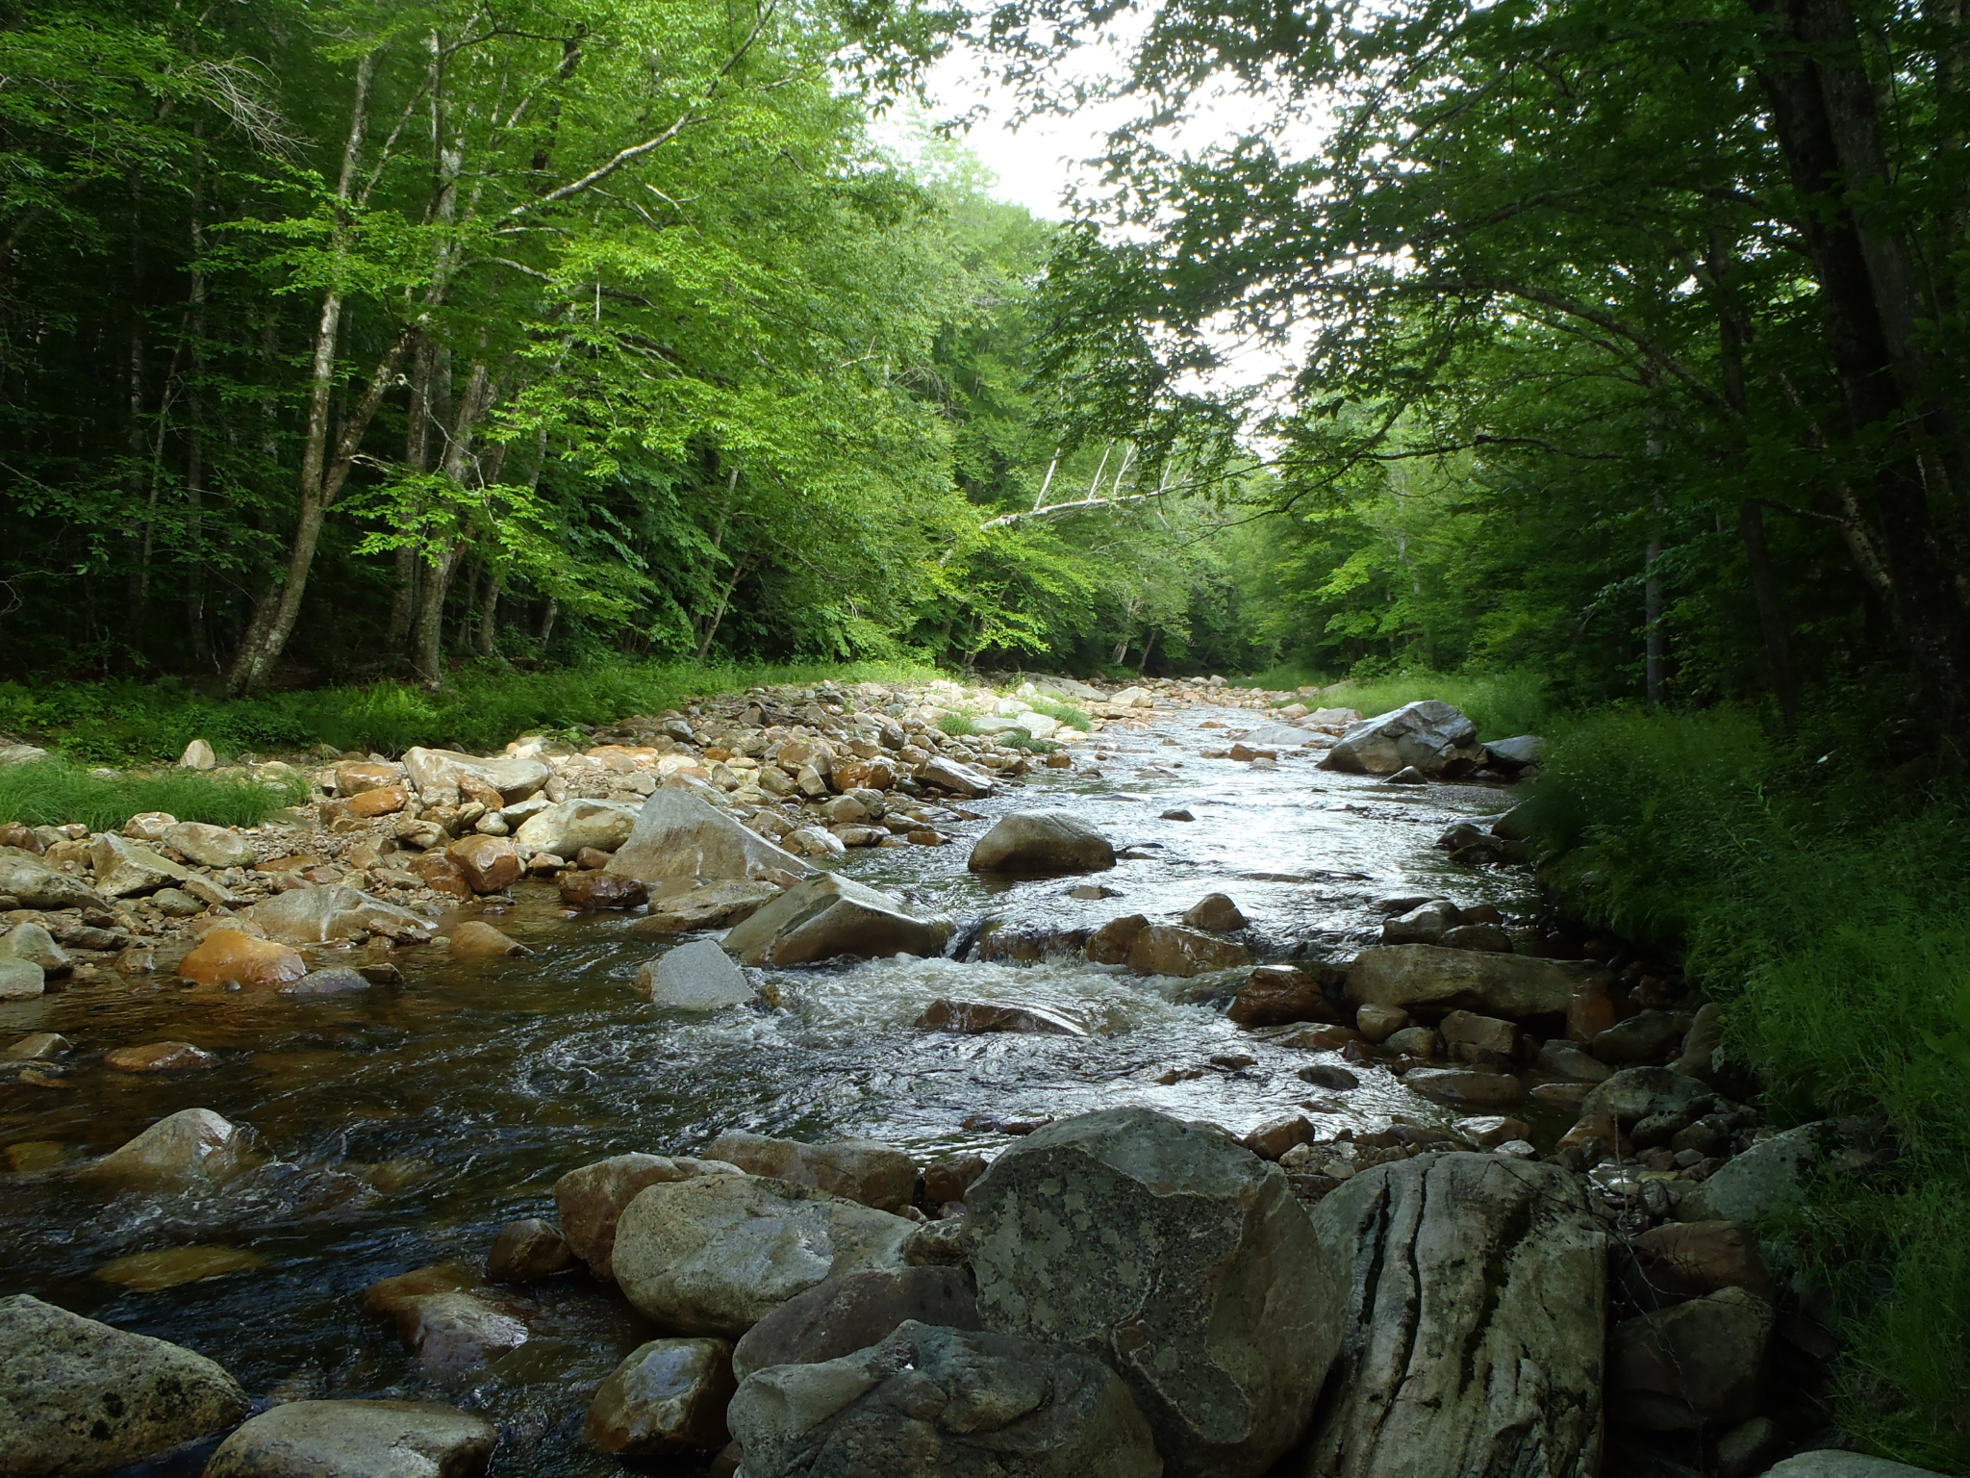

Slide 24
The Acid Lakes
Vermont has seen a reductions in atmospheric S and N deposition, and an improvement in water chemistry. Despite this, many remote and undeveloped waters have acidity levels that are still to harmful to support the expected community of plants, fish and other aquatic biota.
Vermont lakes have responded to emission reductions with ANC increases, some pH increases, increases in DOC and decreases in base cations and mixed trends in aluminum. The DOC increases could potentially limit pH increases, reduce Al toxicity and increase methylation and biomagnification of Hg.

Slide 25
The Sentinel Streams
10 streams are monitored annually for trends in water quality, macroinvertebrates and fish communities, physical habitat, and water temperature.
These are mostly reference streams and was designed to observe long-term changes or impacts related to climate change.
A primary goal of this project is to investigate how the macroinvertebrate community is responding to increasing temperatures and hydrology.
Our past studies indicate that the macroinvertebrate community is highly resilient and can recover after a high flow disturbance.
High flows can scour the substrate, which can also have a negative affect on the fish community.
Some sentinel streams like Ranch are having a difficult time recovering density while diversity seems relatively unaffected.

