Slide 1


FPR and VMC – 25 years of phenology monitoring
Josh Halman
Vermont Department of Forests, Parks and Recreation
December 11, 2015

Slide 2
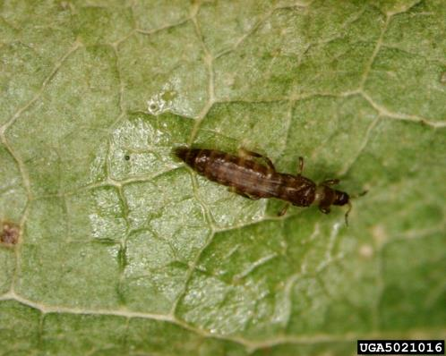
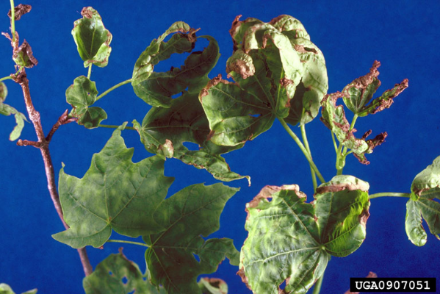
History of spring monitoring - PMRC
Initial efforts – Pear thrips and sugar maple foliage damage

Slide 3

Pear thrips monitoring

Slide 4
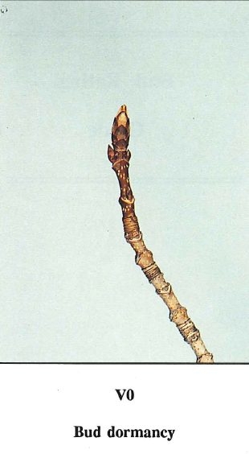
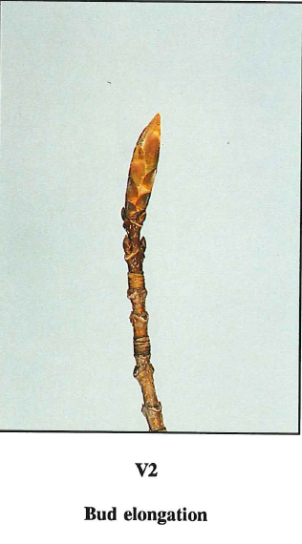
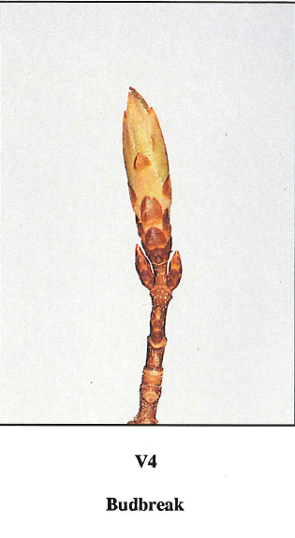
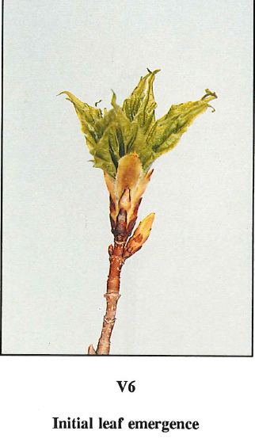
Bud development stages

Slide 5
History of spring monitoring
Initial efforts – Pear thrips and sugar maple foliage damage
Continued efforts
  Bud and leaf development of sugar maple
  Additional hardwood species
    American beech, yellow birch, red maple, white ash
  Bud development and current-year stressors
    E.g., spring frosts, insect feeding

Slide 6
Early season monitoring – phenology
Average sugar maple budbreak
Average sugar maple leaf-out

Slide 7
Climate change context
Broader use of data as climate change became a concern
Identify trends in:
  Timing of spring
  Fall senescence and color change
  Growing season changes

Slide 8
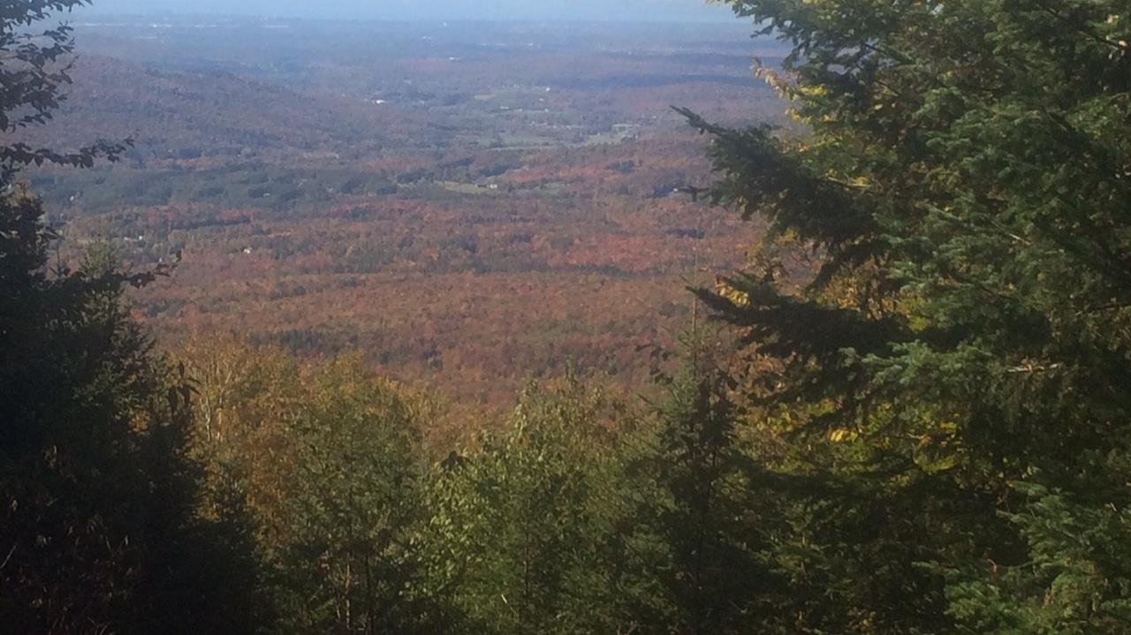
Fall phenology monitoring
Leaf color and leaf drop
Continued with sugar maple, along with other species
  White ash, yellow birch, paper birch
Added an additional elevation (2200’)
Ability to track progression of autumn
Ability to track changes in length of growing season

Slide 9
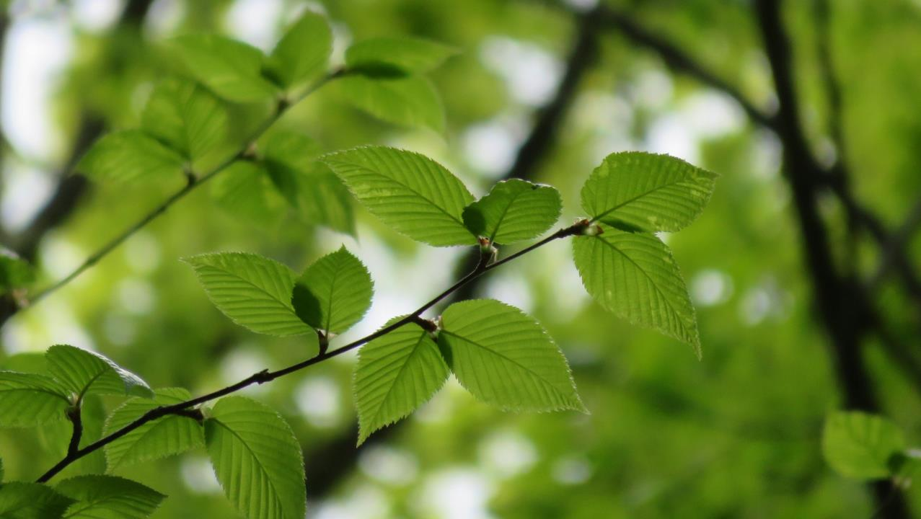
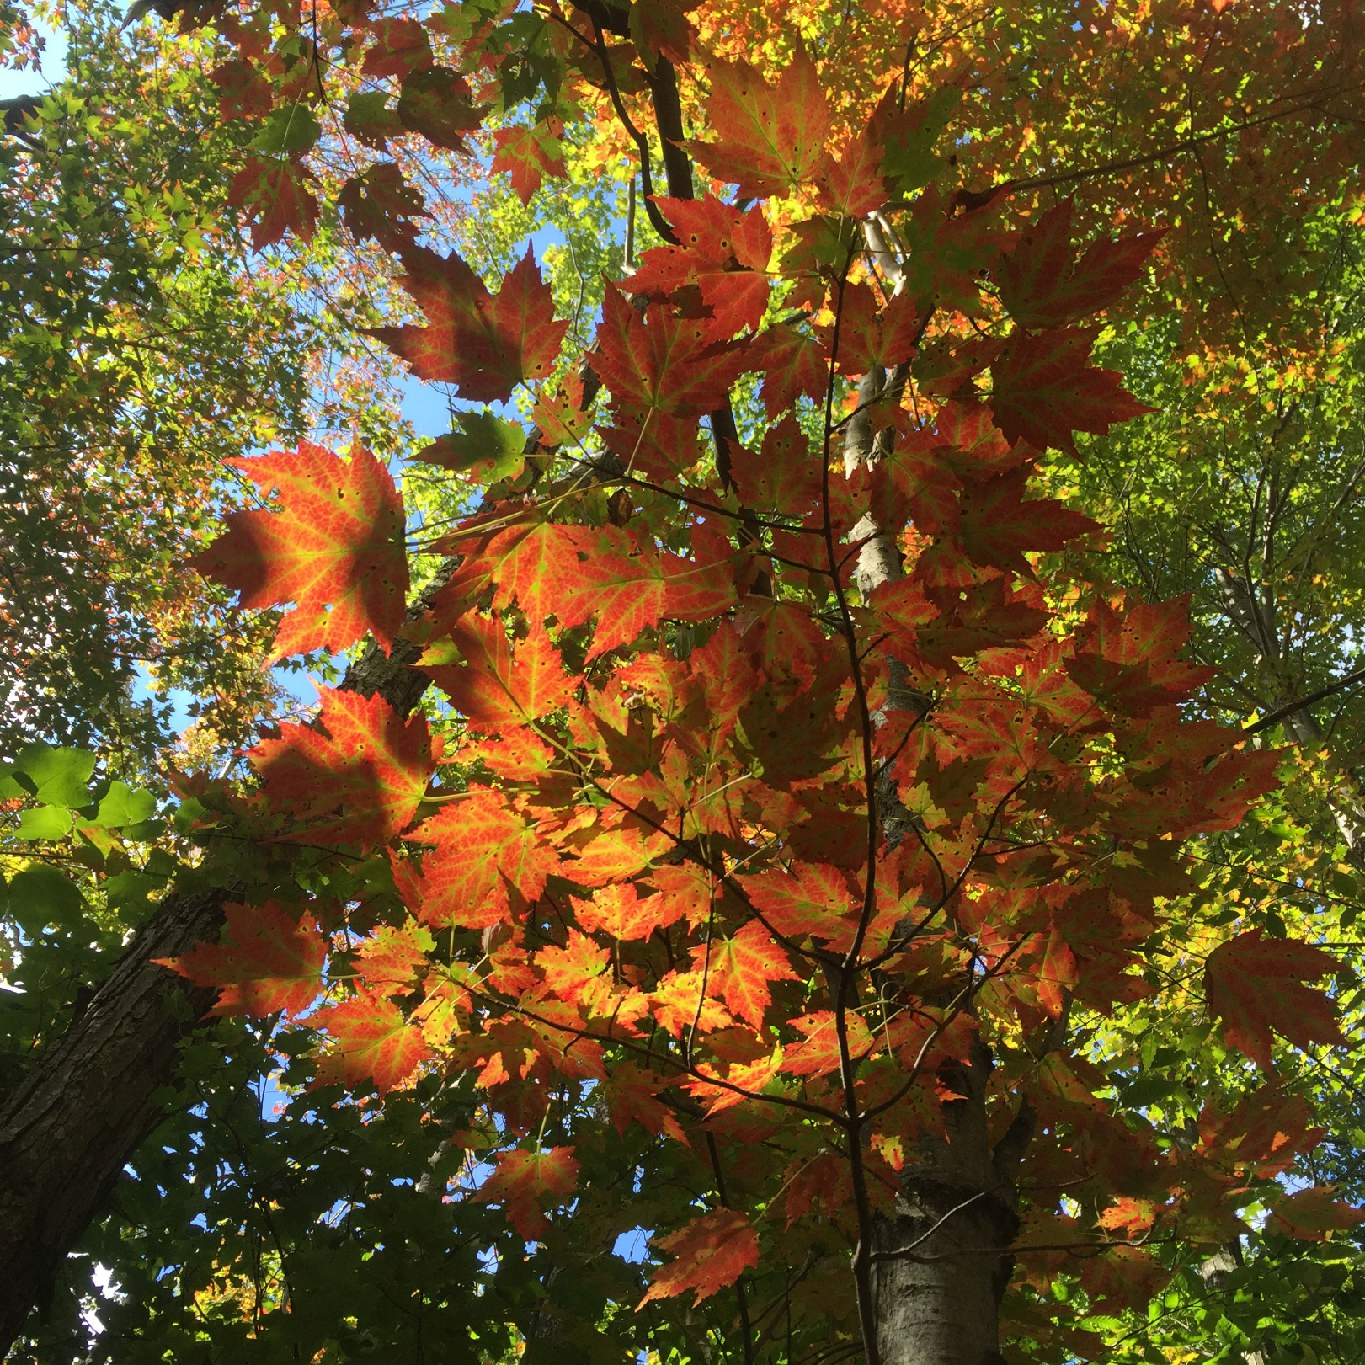

Slide 10
Fall phenology data – color and leaf drop
Peak color
Leaf Drop
P_{415m} = 0.014
P_{415m} = 0.014

Slide 11
Length of growing season – gradually extending

Slide 12
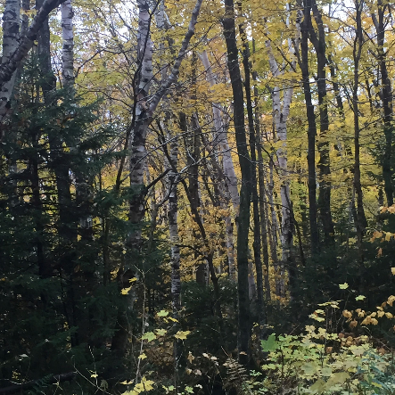
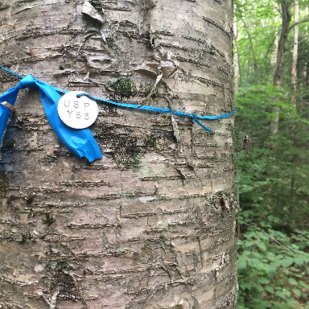
Next steps
Evaluate same trees in spring and fall to look at changes in growing season length of individuals

Slide 13
Next steps
Analyze data based on more appropriate models of development
Average sugar maple budbreak
Average sugar maple leaf-out

Slide 14
Contact info
Josh Halman
joshua.halman@vermont.gov
(802) 279-9999

