Slide 1
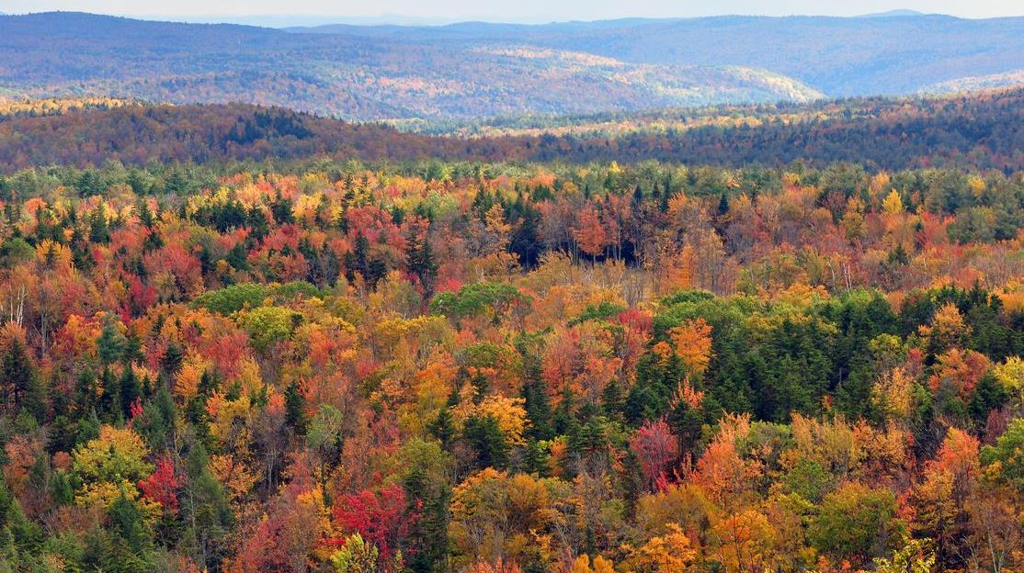
Improving Large-scale Forest Mapping in the Northeast:
Coupling Pixel-based and Object-based Analysis
of Multitemporal Landsat Imagery
David Gudex-Cross¹, Jennifer Pontius¹, and Alison Adams¹
¹Rubenstein School of Environment and Natural Resources, University of Vermont
Aiken Center, 81 Carrigan Drive, Burlington, VT 05401
Goals:
Percent basal area maps for key tree species/genera.
Traditional thematic maps of species/genera distributions.
Compare our results to existing large-scale datasets.
Target Species or Genus
Scientific Name | Common Name
Abies balsamea | Balsam Fir
Acer rubrum | Red Maple
Acer saccharum | Sugar Maple
Betula spp. | Birches
Fagus grandifolia | American Beech
Picea rubens | Red Spruce
Pinus spp. | True Pines
Populus spp. | Aspens
Prunus spp. | Cherries
Quercus rubra | Northern Red Oak
Tsuga canadensis | Eastern Hemlock
Applications:
Tree species distributions and forest structure.
Quantifying forest ecosystem services.
Wildlife and invasive insect/pathogen habitat modeling.
MANY, MANY MORE!
Image by: chensiyuan (Wikipedia)
Notes:
Under tutelage of Dr. Jen Pontius, with invaluable help from Alison Adams (who you’ll be hearing from later)
Challenge in the NE: forests are highly mixed and heterogeneous
Advanced techniques to improve forest mapping – Spectral Unmixing and OBIA

Slide 2
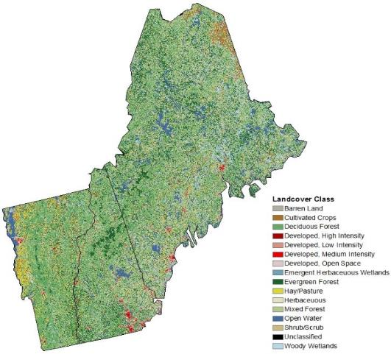
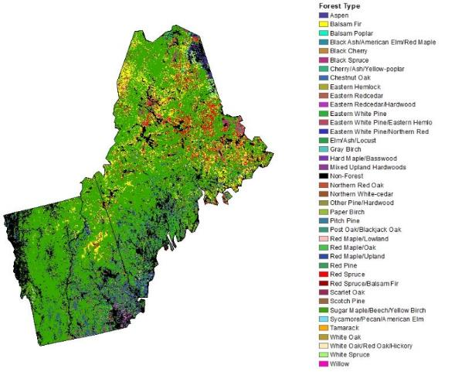
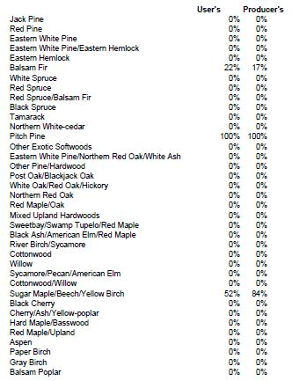
Why do we need to improve large-scale forest mapping in the Northeast?
NLCD
National Forest Type Dataset
COARSE, but…
Best temporal resolution available.
Marginal regional accuracy rates:
  47±4% for the NE (Wickham et al. 2013).
SPECIFIC, but…
Low accuracy rates per species or species assemblage (Ruefenacht et al. 2008).
“The data should not be displayed at scales smaller than 1:2,000,000.”
Notes:
Current large-scale forest maps have very coarse “type” classifications minimal validation
Challenge in the NE: forests are highly mixed and heterogeneous
Getting to species-level is the “Holy Grail” of remotely-sensed forest classifications
Advanced techniques to improve forest mapping: spectral unmixing and OBIA

Slide 3
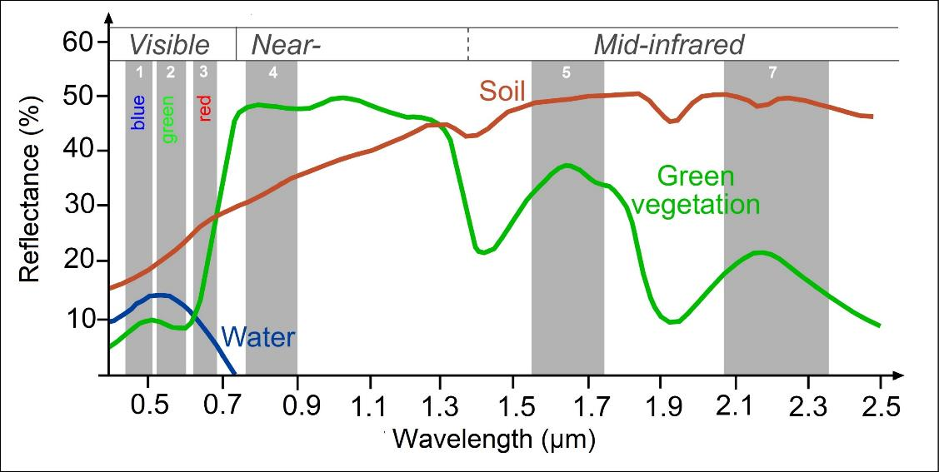
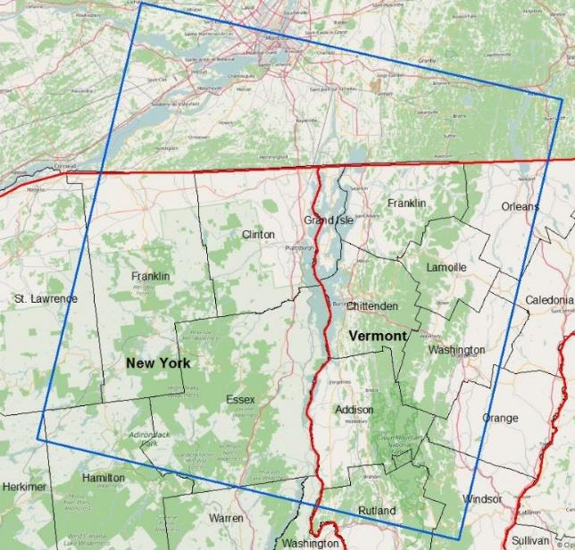
Landsat TM/ETM Spectra + Current Path of Interest
LANDSAT Band Spectral Signatures
Row 29, Path 14
Image By: SEOS
Notes:
Current large-scale forest maps have very coarse “type” classifications minimal validation
Challenge in the NE: forests are highly mixed and heterogeneous
Getting to species-level is the “Holy Grail” of remotely-sensed forest classifications
Advanced techniques to improve forest mapping: spectral unmixing and OBIA

Slide 4
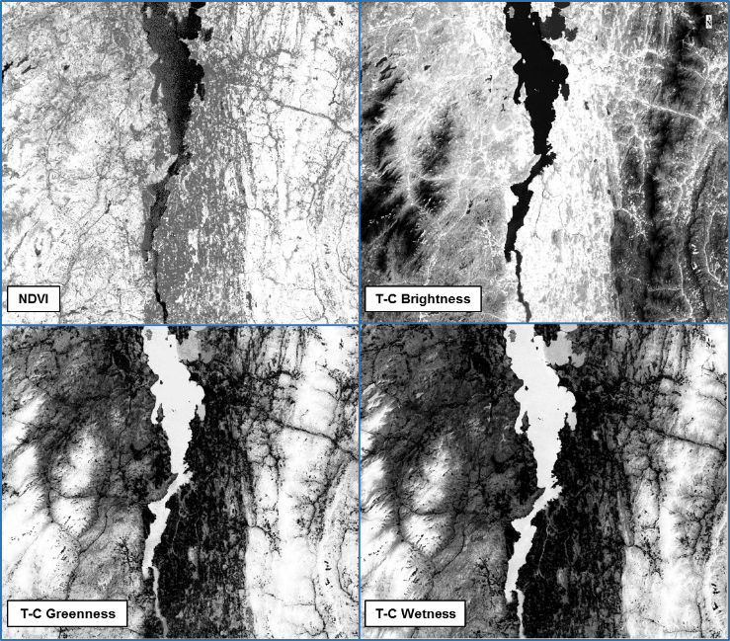
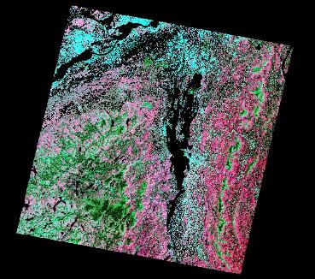
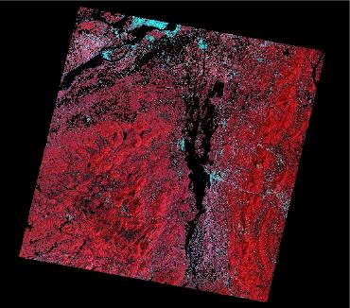
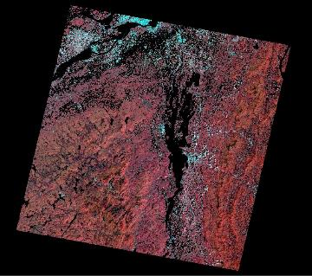
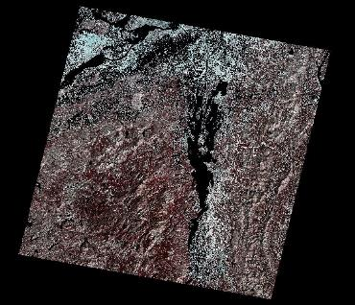
Pixel-based Workflow
50 Band “Hyperspectral” Image
Imagery Acquisition
Preprocessing
Derive Indices
Layer Stacking
Principal Components Analysis
Leaf Out
(Spring)
Radiometric Calibration
  Surface Reflectance
  Brightness Temperature
Normalized Difference Vegetation Index
Layer Restacking
Growing Season
(Summer)
Atmospheric Correction
  Dark-object subtraction
Tasseled Cap Transform
  Brightness
  Wetness
  Greenness
Leaf Out
Minimum Noise Fraction
Spectral Unmixing
Multiple Linear Regression
Growing Season
Senescence
(Fall)
Cloud Masking
Leaf Off/Snow
(Winter)
NEW! EXCITING!
Species Basal Area Raster
Senescence
Leaf Off/Snow

Slide 5
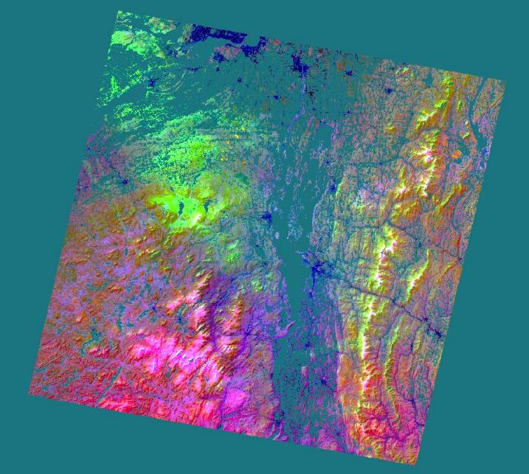
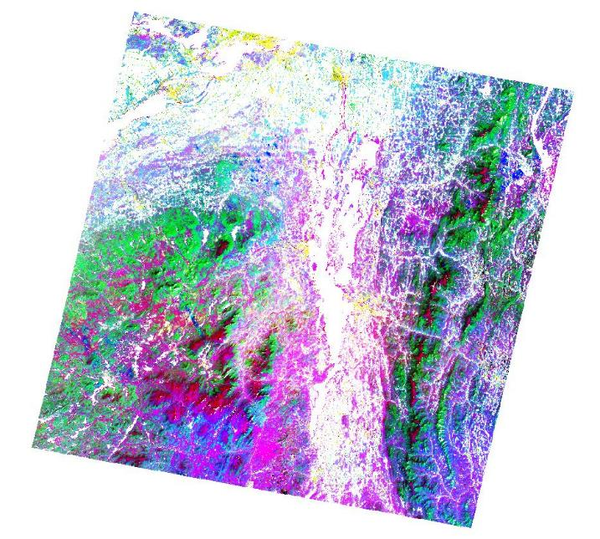
Pixel-based Workflow
50 Band “Hyperspectral” Image
Layer Stacking
Principal Components Analysis
Spring
Bands 1-7
NDVI
Tasseled Cap
Layer Restacking
Summer
Bands 1-7
NDVI
Tasseled Cap
PCA Bands
Accounting for ≥99% spectral variability
Fall
Bands 1-7
NDVI
Tasseled Cap
Summer
Bands 1-7
NDVI
Tasseled Cap
Winter
Bands 1-7
NDVI
Seasonal Tasseled Cap Differences
SU – SP
SU – FA
Seasonal Tasseled Cap Differences
SU – SP
SU – FA
Minimum Noise Fraction

Slide 6
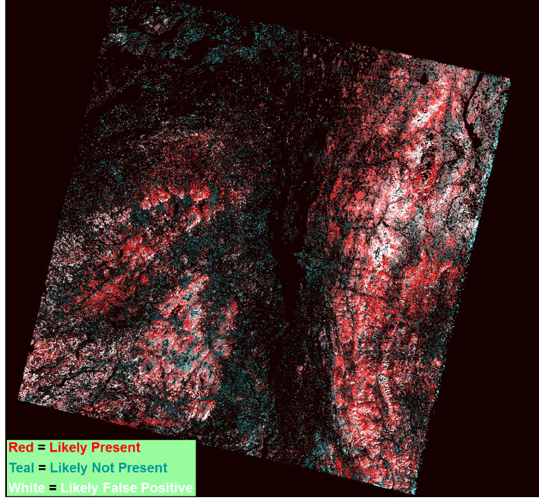
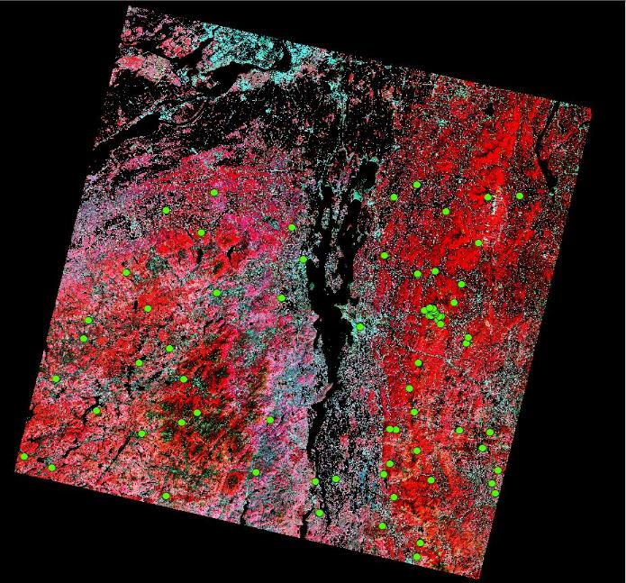
Pixel-based Workflow
Spectral Unmixing
Multiple Linear Regression
Pixel Purity Index
Species Basal Area Equations
MTMF output to predict Field % BA
80+% basal area = “Pure Pixel” = Target Endmember
Mixture Tuned Matched Filtering
Band Math
  Regression equations applied to MTMF image
Species Basal Area Raster

Slide 7
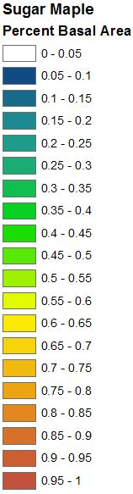
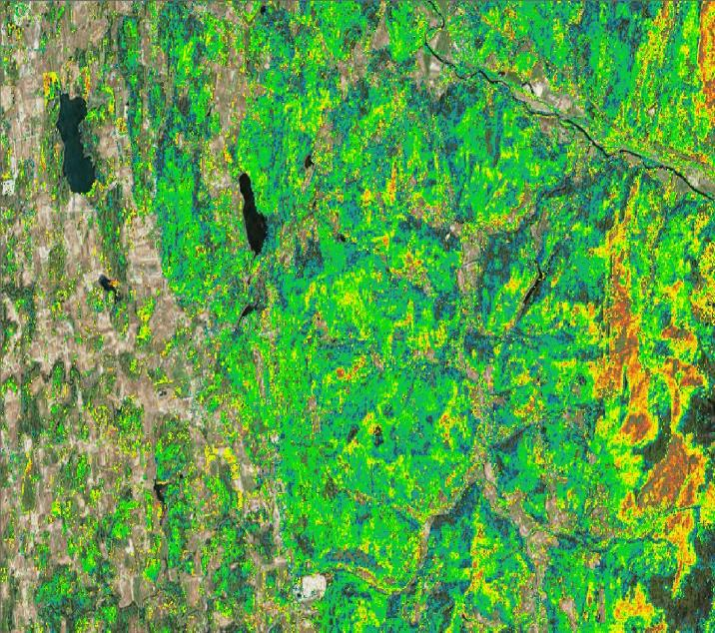
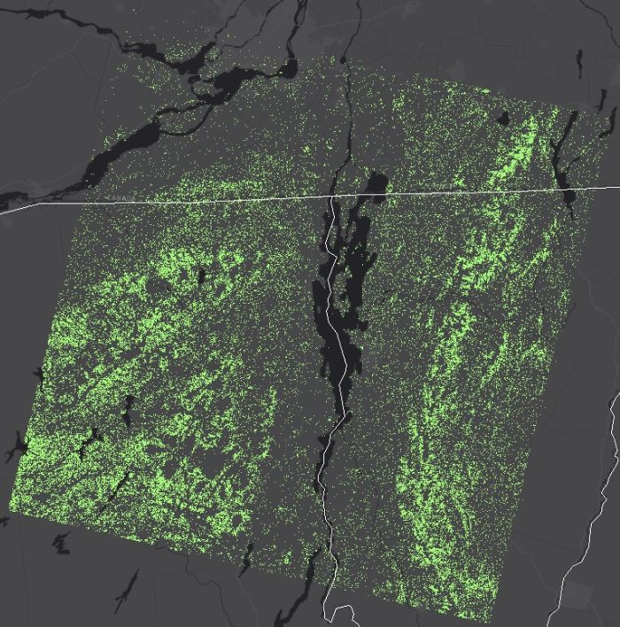
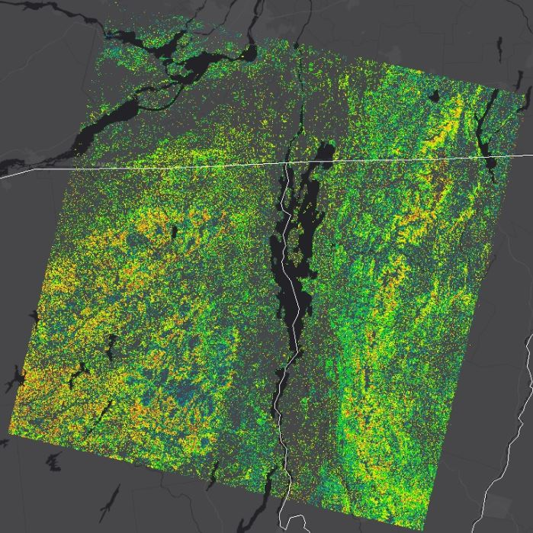
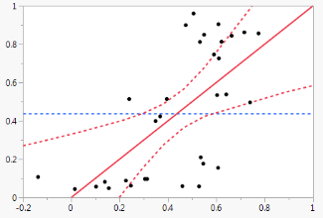

Sugar Maple: 2014 Landsat Path 14 Results
Percent Basal Area
r² = 0.44
p = 0.0028
RMSE = 0.27
Press = 0.29
Winooski River
Actual %BA
Shelburne Pond
Predicted %BA
Overall Accuracy: 81%
Predicted
Actual
True Positive Rate: 95%
Precision (predict yes=actual yes) : 77%
False Positive Rate: 36%
Specificity (actual no=predicted no): 64%
Camels Hump SP

Slide 8
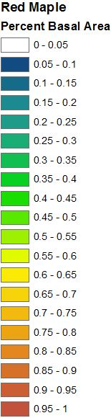
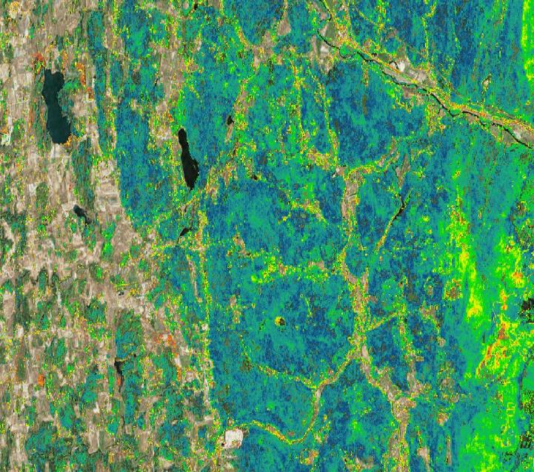
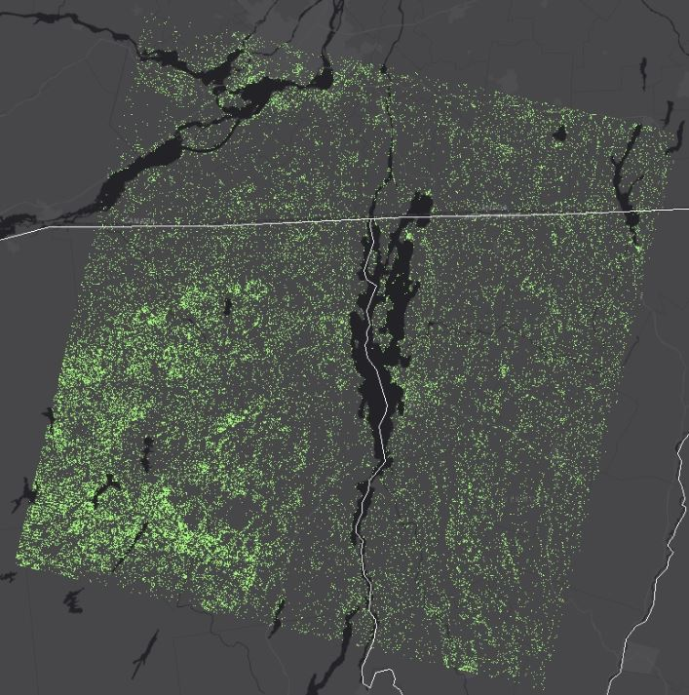
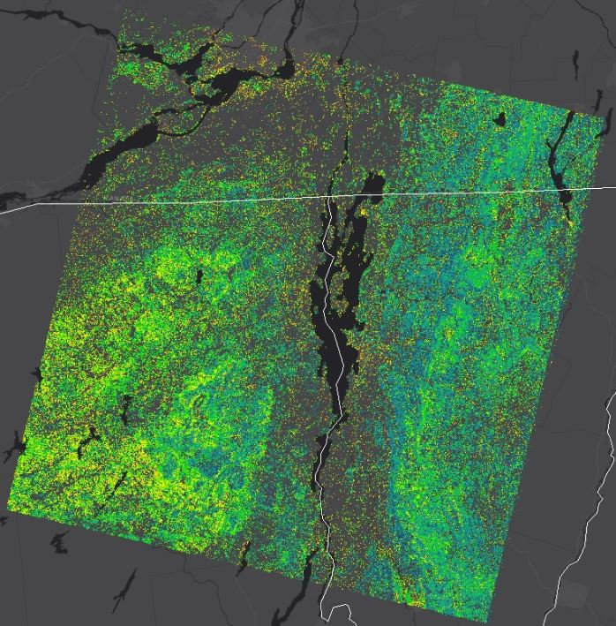
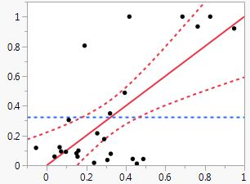

Red Maple: 2014 Landsat Path 14 Results
Percent Basal Area
r² = 0.48
p = 0.0007
RMSE = 0.28
Press = 0.29
Winooski River
Actual %BA
Shelburne Pond
Predicted %BA
Overall Accuracy: 80%
Predicted
Actual
True Positive Rate: 75%
Precision (predict yes=actual yes) : 67%
False Positive Rate: 18%
Specificity (actual no=predicted no): 82%
Camels Hump SP

Slide 9
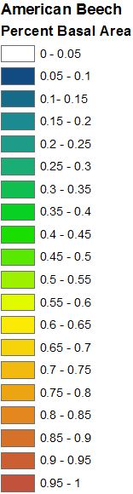
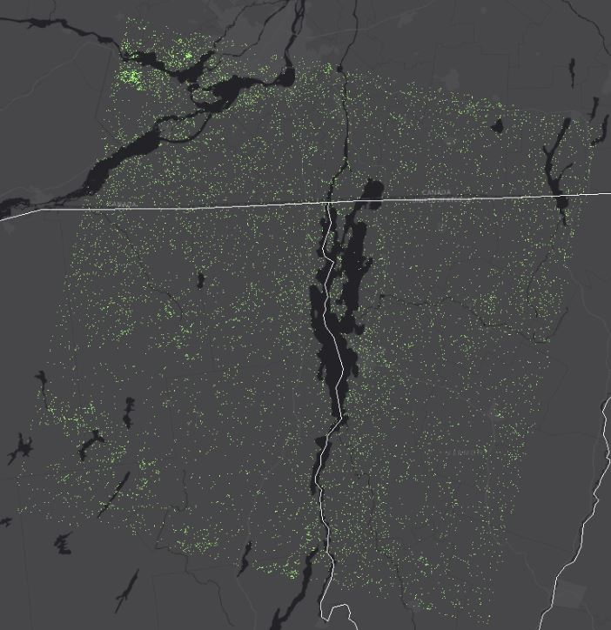
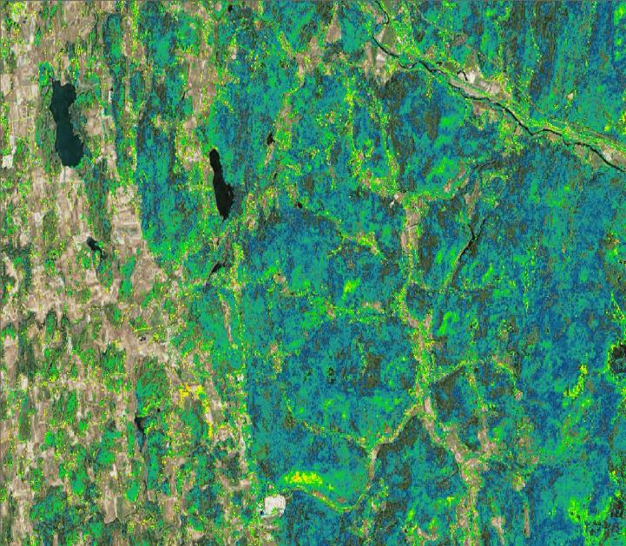
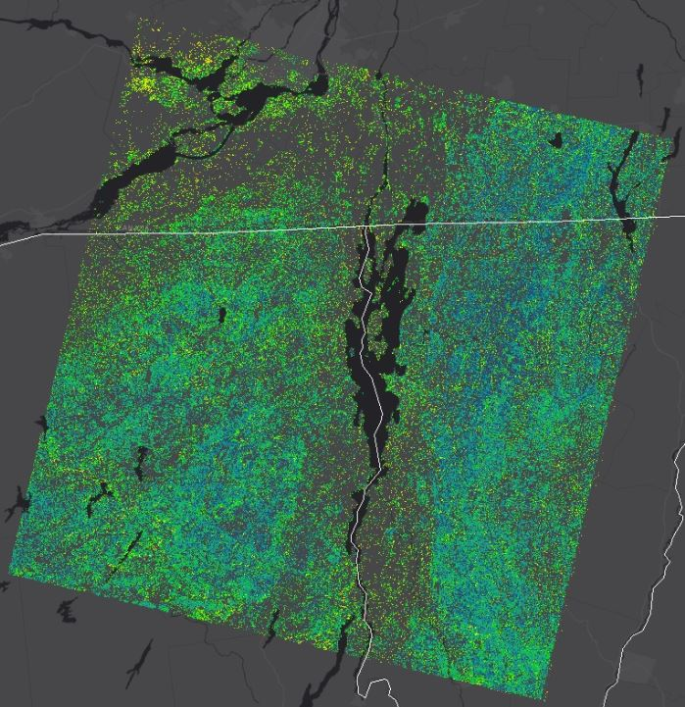
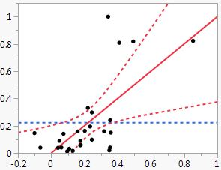

American Beech: 2014 Landsat Path 14 Results
Percent Basal Area
r² = 0.45
p = 0.0086
RMSE = 0.23
Press = 0.25
Winooski River
Actual %BA
Shelburne Pond
Predicted %BA
Overall Accuracy: 82%
Predicted
Actual
True Positive Rate: 80%
Precision (predict yes=actual yes) : 50%
False Positive Rate: 18%
Specificity (actual no=predicted no): 82%
Camels Hump SP

Slide 10
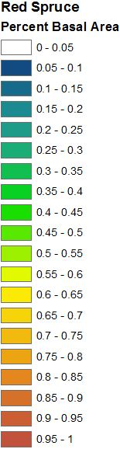
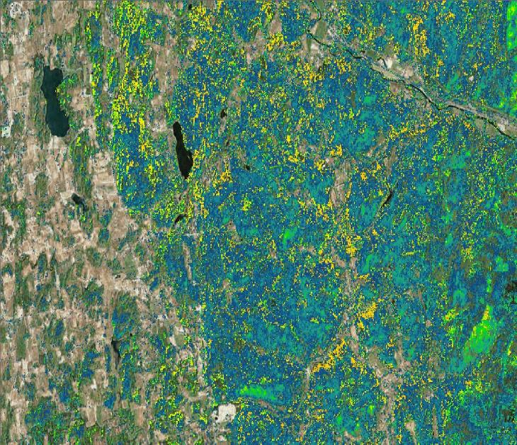
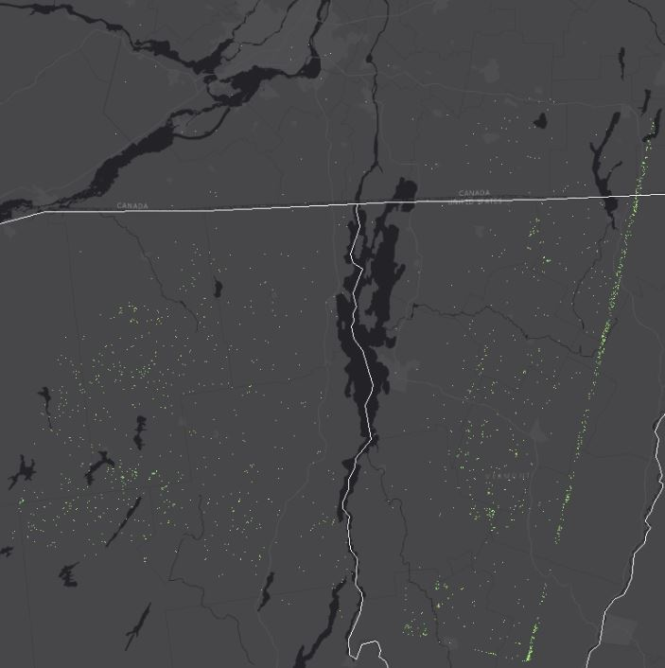
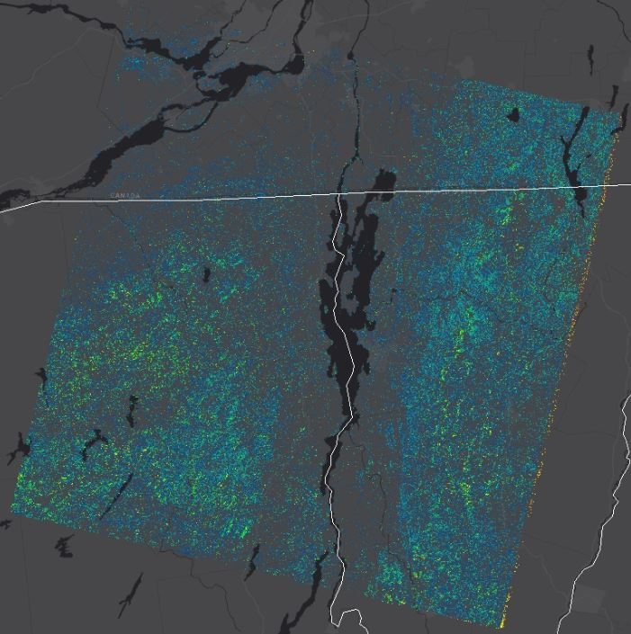
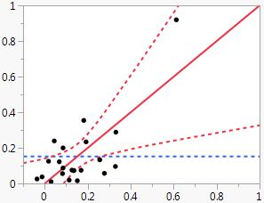

Red Spruce: 2014 Landsat Path 14 Results
Percent Basal Area
r² = 0.55
p = 0.0097
RMSE = 0.15
Press = 0.23
Winooski River
Actual %BA
Shelburne Pond
Predicted %BA
Overall Accuracy: 91%
Predicted
Actual
True Positive Rate: 50%
Precision (predict yes=actual yes) : 50%
False Positive Rate: 5%
Specificity (actual no=predicted no): 95%
Camels Hump SP

Slide 11
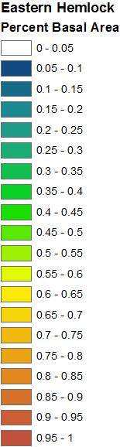
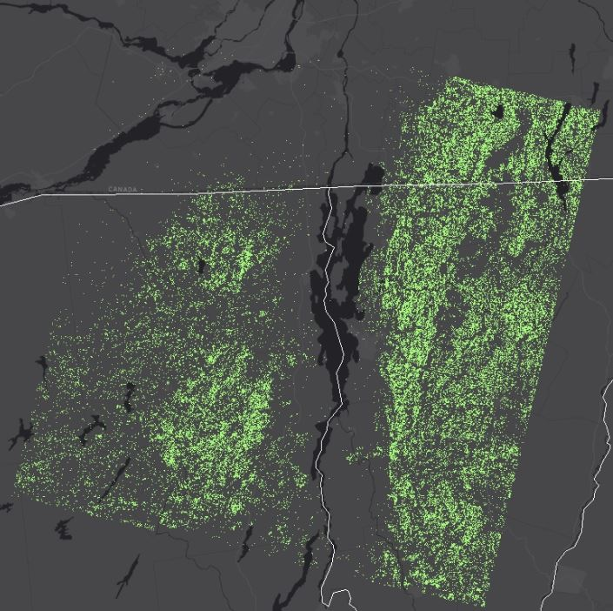
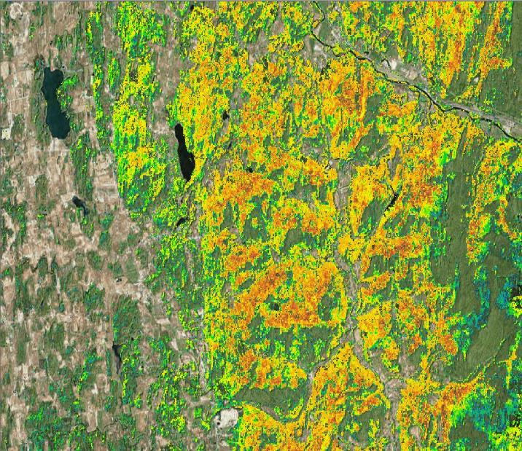
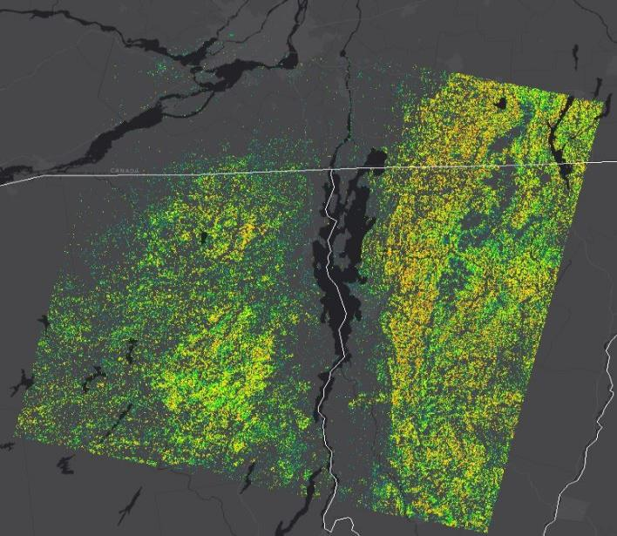
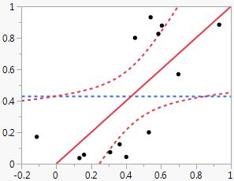

Eastern Hemlock: 2014 Landsat Path 14 Results
Percent Basal Area
r² = 0.50
p = 0.03
RMSE = 0.29
Press = 0.36
Winooski River
Actual %BA
Shelburne Pond
Predicted %BA
Overall Accuracy: 77%
Predicted
Actual
True Positive Rate: 100%
Precision (predict yes=actual yes) : 67%
False Positive Rate: 43%
Specificity (actual no=predicted no): 57%
Camels Hump SP

Slide 12

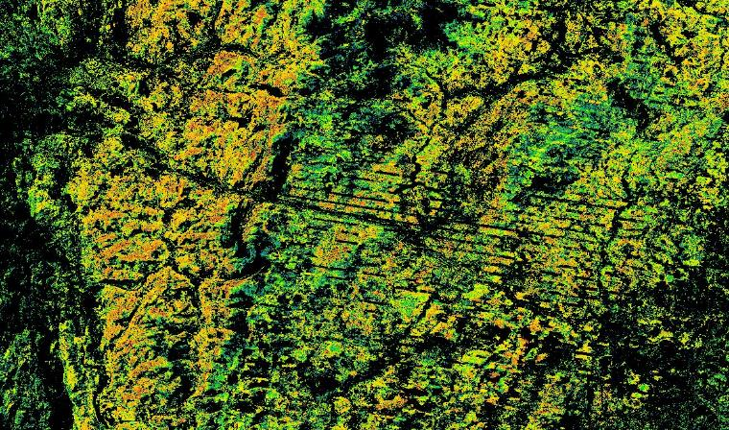

Not So Good ☹ 2014 Landsat Path 14 Results
Balsam Fir Overall Accuracy: 46%
Landsat 7 Sensor Line Correction failure: affects 2010 & 2014 timesteps – use Landsat 5 or 8 or backfill with similar date from close year when possible.
Product of thin canopy/bare rock reflectance from mountain-top BF training plots?
Red Oak Overall Accuracy: 100%!!
Yeah…about that…OVERFIT MODEL – too few “pure pixel” training plots likely culprit.

Slide 13
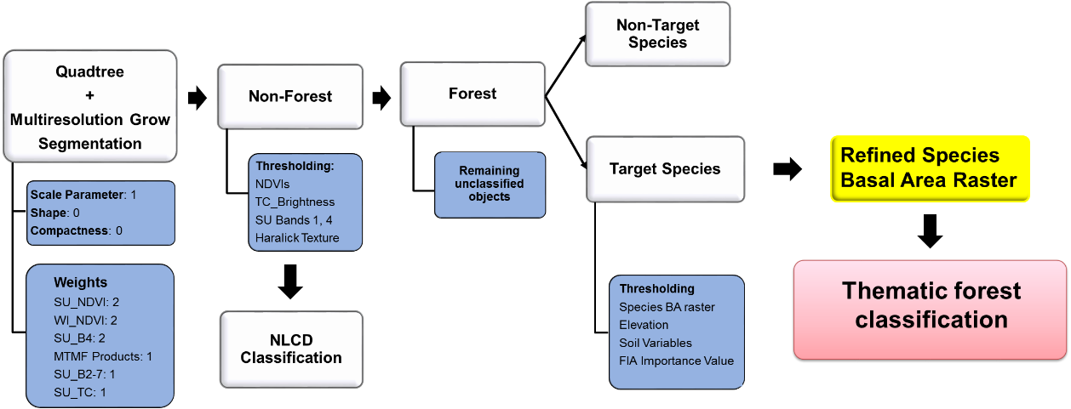
Overview of Object-based Workflow for
Refining Pixel-based Classification
Notes:
Scale up from pixel to forest stand level
Get away from noise introduced in pixelated images
Ability to bring in ancillary environmental data to refine basal area rasters

Slide 14
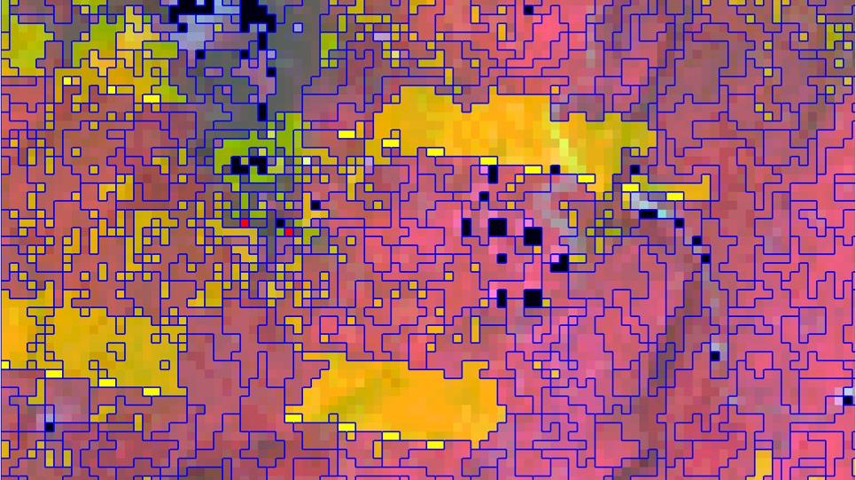




Acknowledgements:
Advisor:
Jen Pontius
Committee Members:
Shelly Rayback (Chair), Tony D’Amato, and Terri Donovan
Helpful Friends, Collaborators, and Colleagues:
Alison Adams, Jarlath O’Neil-Dunne, Noah Ahles,
Jim Duncan, Ben Comai, Anna Smith, Matthias Sirch,
Monica Johnson, Will Sherman, Quinn Wilcox, and Harry Voelkel
References:
Ruefenacht, B., M. Finco, M. Nelson, R. Czaplewski, E. Helmer, J. Blackard, G. Holden, A. Lister, D. Salajanu, and D. Weyermann. 2008. Conterminous US and Alaska forest type mapping using forest inventory and analysis data. Photogrammetric Engineering & Remote Sensing 74:1379-1388.
Wickham, J. D., S. V. Stehman, L. Gass, J. Dewitz, J. A. Fry, and T. G. Wade. 2013. Accuracy assessment of NLCD 2006 land cover and impervious surface. Remote sensing of environment 130:294-304.

