Slide 1
Assessing the Effectiveness of the
LaRosa Program
A partnership with Vermont DEC
Watershed Management Division
Sam Clerkin, Rachael DeWitt, Lauren Jenness
and Caitlin Trimmer
Notes:
R

Slide 2
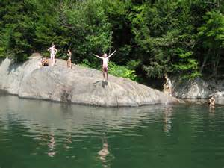
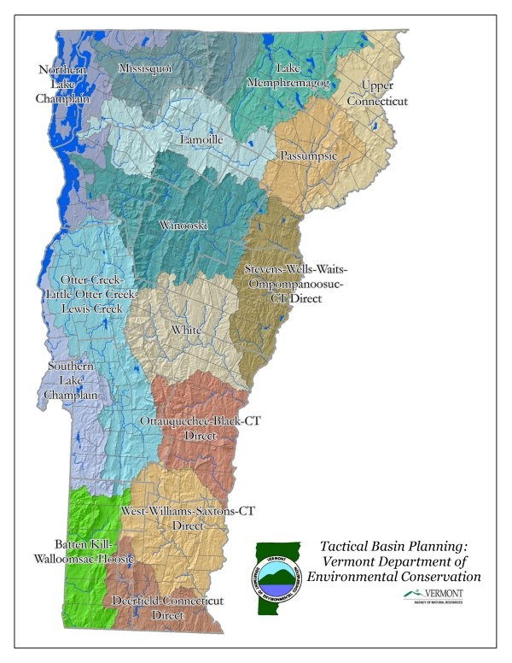
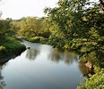
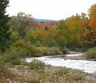
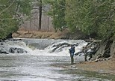
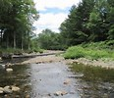
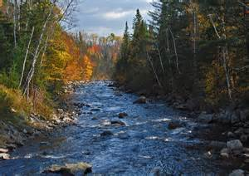
Notes:
Rachael- participants from across the state

Slide 3
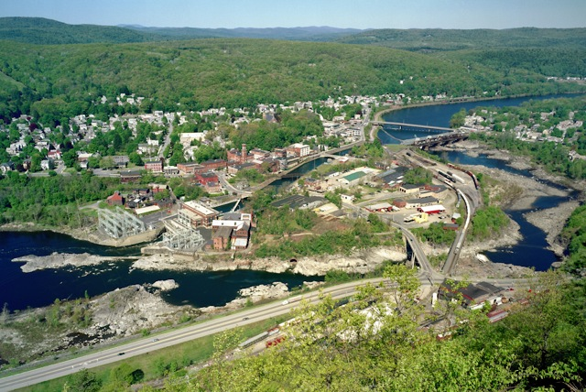
Background
UVM Service Learning Course
Vermont DEC Watershed Management Division
La Rosa Program
Watershed Association Involvement
Connecticut River in Bellows Falls, VT which is monitored by the Connecticut River Watershed Council. (http://www.pictureconnecticutriver.com/NH-VT%20Gallery/files/page6-1025-full.html)
Notes:
Rachael
-Vermont Department of Environmental Conservation Watershed Management Division
-Monitor the health of watersheds throughout Vermont
-Established La Rosa Program to assist WA with the analysis of water samples
-mutualistc relationship WA’s get free analysis on their water samples and DEC is able to attain water quality data on a larger scale

Slide 4
Goals
Goal 1: Foster communication between the LaRosa program and the individual watershed organizations that comprise it
Goal 2: Assess the effectiveness of the LaRosa program in order for it to evolve in the future
Goal 3: Determine roadblocks watershed associations may encounter while attempting to implement and plan projects.
Notes:
Goals for our project
SC

Slide 5
Methods
Interviewed individuals from citizen-based water monitoring organizations in other states
Sent emails to watershed associations
Sent surveys
Conducted interviews with watershed associations
Notes:
SC

Slide 6
Questions Asked:
About the watershed
  How do you use the data you collect?
  If you had $10,000 to coordinate your work related to the LaRosa program, how would you use it?
About collecting water samples
  Would more lab training/field training be effective? What kind? What would this look like?
About the effectiveness of the program
  What is your perspective regarding the creation and submission of the Quality Assurance Report?
About the lab experience
  Are there scheduling challenges with sampling and submission? What are they?
Notes:
SC
Asked 11 questions in an online survey and more in the interviews. Summarized the responses to analyze and create the recommendations. Some examples of our questions.

Slide 7
What does success mean for your organization?
Good quality data retrieval
Long-term water quality monitoring
Submission of useful data
Ability to present the data to the public
Production of a report
Inspire community involvement
Notes:
CT

Slide 8
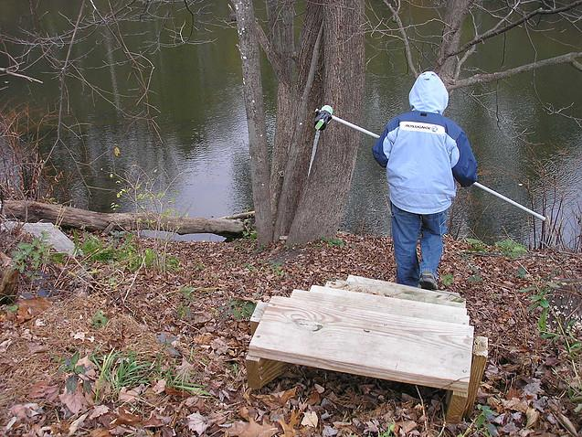
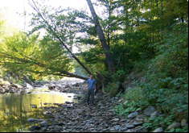
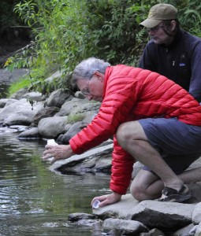
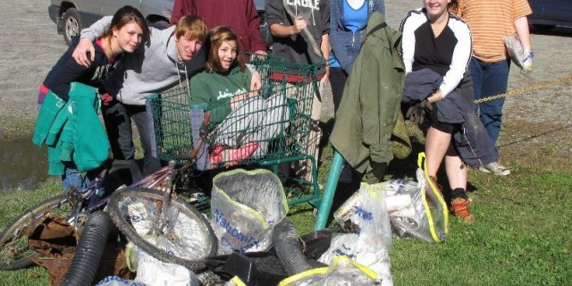
Is there any communication/collaboration between your group and other watershed associations? If so, how?
Friends of the Mad River
Black River Action Team
Addison County River Watch Collaborative
White River Partnership
Notes:
CT
Majority of Watershed Associations said that they have too little money, time, and resources for more meetings.Some said that they would meet, but only for strategic meetings. More dialogue would be nice, but many groups felt that Watersheds United was already filling that niche.
Many watershed associations work together, but at varying levels. Sometimes sharing data/resources, sometimes with awareness events. Collaboration is sometimes difficult because of different sampling methods and/or goals.

Slide 9
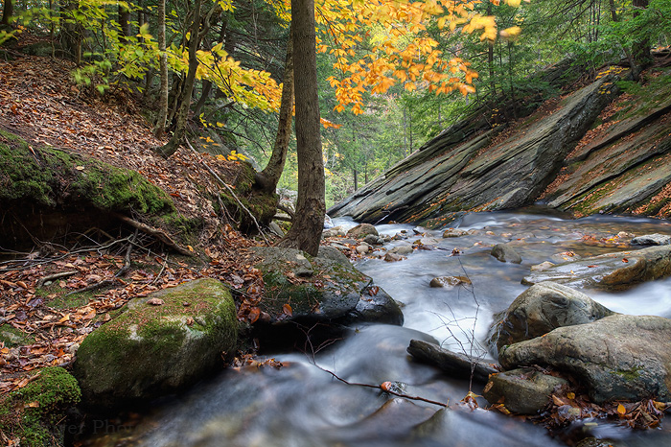
If you had $10,000 to coordinate your work related to the LaRosa program, how would you use it?
Paying Stipends
  Hiring Consultants, Interns, Engineers, Data Analyzer
  Paying Volunteers & Project Coordinator
Sampling
  Increase sampling sites
  Increase number of tests
Compiling Data and Implementation
  Making recommendations based on the data
  Remediation efforts
  Compiling data from previous years
  Education and outreach
Sample Transport
  Reimburse for gas/milage
  Hire courier service
Notes:
CT

Slide 10
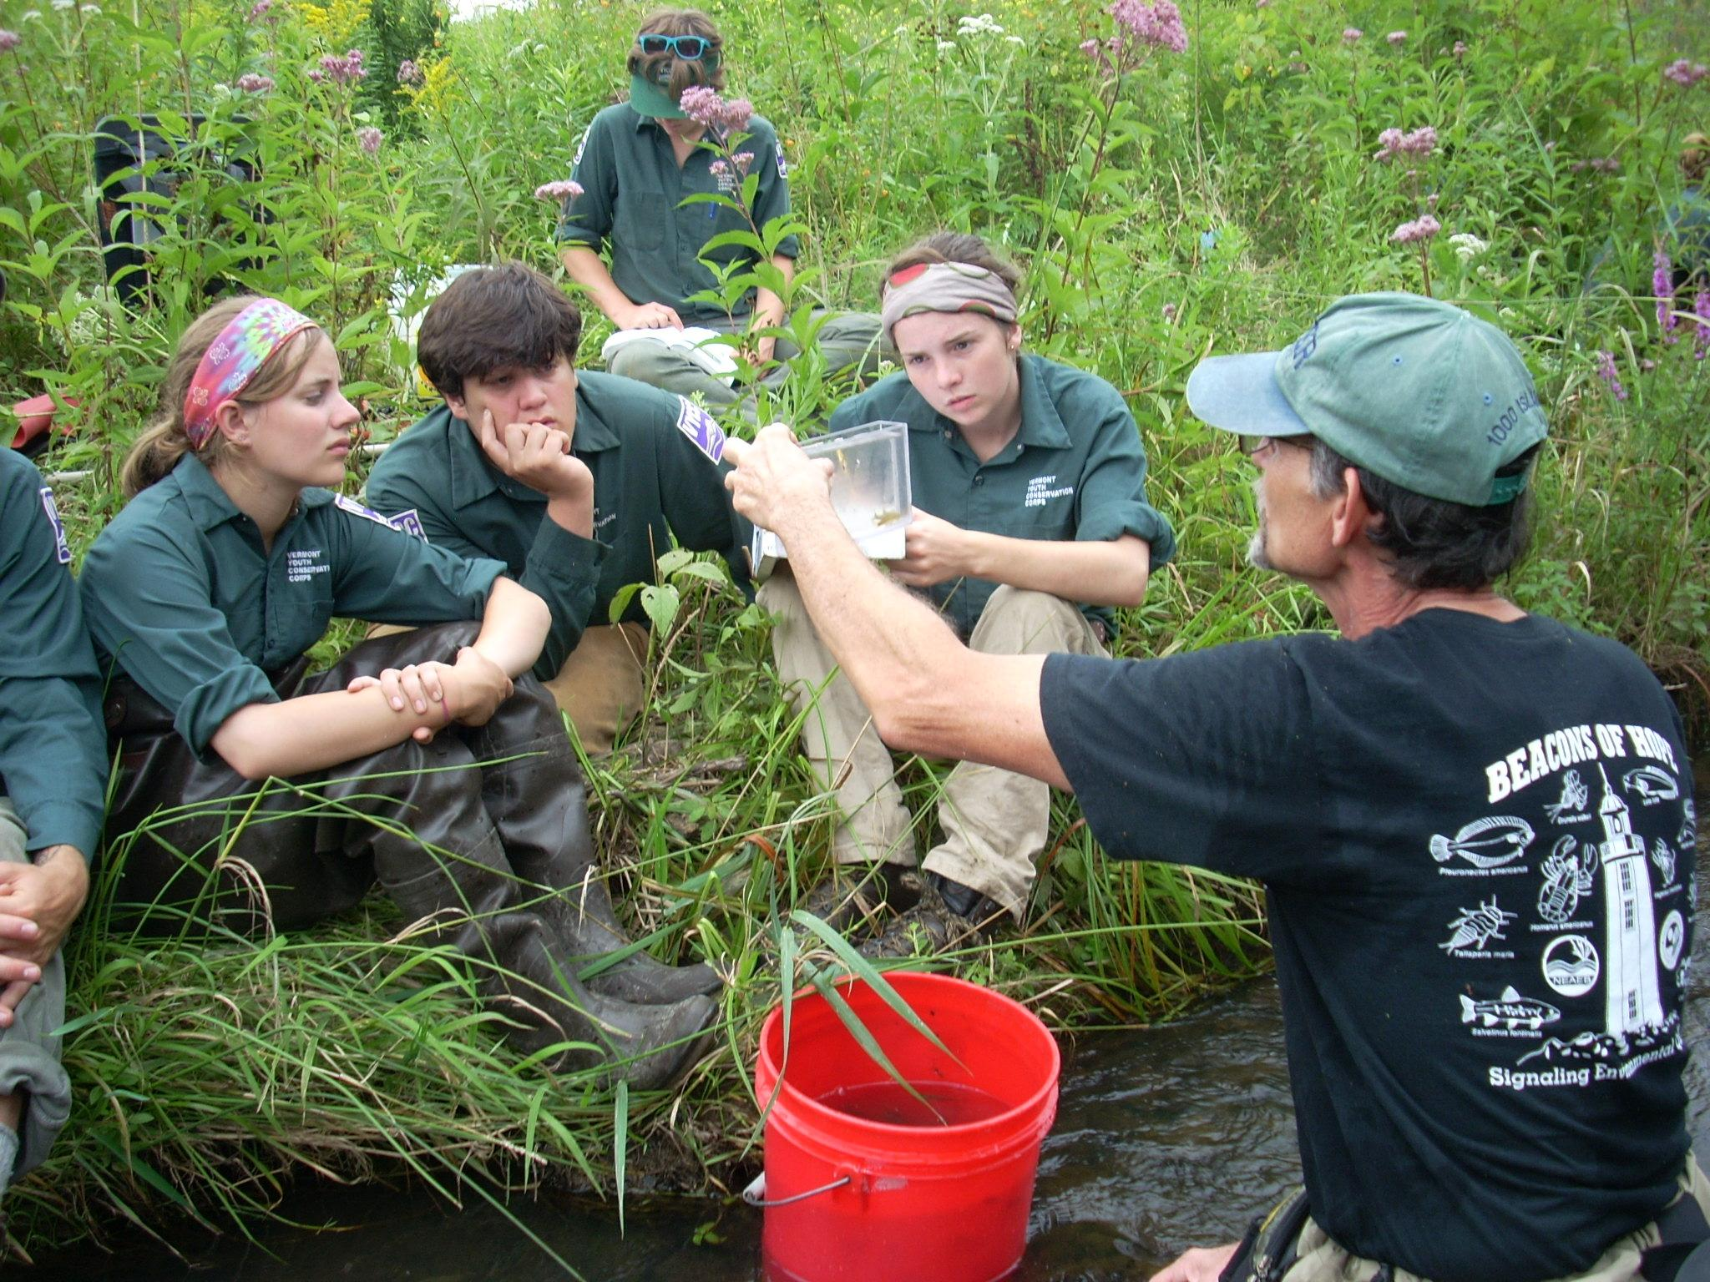
Would more lab training/field training be effective? What kind? What would this look like?
Sampling done in teams is more effective
Field training from the DEC would be helpful
Overall satisfied with training for staff and volunteers
Interest in a training video to be widely distributed
Incorporate feedback
Williston Conservation Commission
Notes:
CT
Asked a variety of questions about the lab and sampling process.
Wide range of volunteer participation, experience and scientific background.
Most respondents wanted hands-on visits from the DEC.

Slide 11
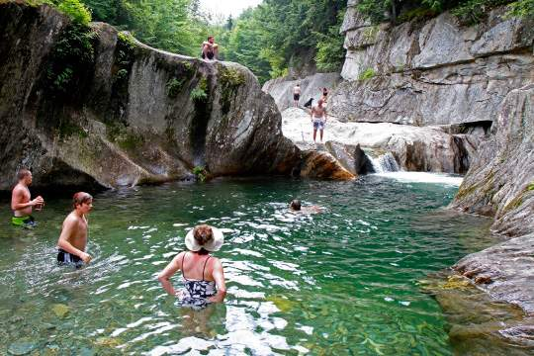
How do the watershed associations use the data?
Reports that can be distributed to the community
Evaluation of safety for recreational use in some areas
Identification of long-term trends for remediation planning
Assess developmental and agricultural impacts
Warren Falls
Notes:
CT

Slide 12
What is the effectiveness of the LaRosa Program?
Benefits:
The LaRosa program is great!
Well supported and well run
Staff are helpful
Readily available for assistance
Free lab support and analysis is critical, some groups cannot function without this
Opportunities for Improvement:
More analysis from lab is needed
Clarification with how data is being used
DEC assistance in determining solutions and implementation of solutions
Assistance getting samples to the lab
Notes:
LJ

Slide 13
Are there other approaches the DEC should consider in the evolution of the LaRosa program?
17 groups specifically answered this question.
Five mentioned the difficulty in getting the samples to and from the lab.
Three groups mentioned wanting better analysis of their data.
Two mentioned wanting consistent/fast data results.
Two groups mentioned wanting to know how the state is using their data.
Notes:
LJ

Slide 14
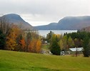
Key Recommendations the Watershed Associations are Interested In:
More material online about the LaRosa program
Transportation system for water sample bottles
Help with the analysis of their water sample data
Information about how the state uses their data
Faster results from the lab
Notes:
LJ

Slide 15
Next Steps
La Rosa Partnership Website
Creation of watershed association summaries
Notes:
This would allow for the continuation of dialogue, which all of the associations interviewed felt was important.

Slide 16
Acknowledgements
Thank you for providing help and support
Neil Kamman
Zac Ispa-Landa
Marcella Dent
Jim Kellogg
Guy Roberts
Bethany Sargent
Dan Needham
Linda Green
Kris Stepenuck
Fritz Gerhardt
Marty Illick

Slide 17
Acknowledgements
Thank you for participation!
Peter Benevento: Franklin Watershed Association
Mary Childs: White River Natural Resource Conservation District
Andrea Donlon: Connecticut River Watershed Council (CRWC)
Fritz Gerhardt: Memphremagog Watershed Association
Bill Hoadley: South Chittenden River Watch (SCRW)
Eric Howe: Williston Conservation Commission
Marty Illick: Lewis Creek Association
John Little: Missisquoi River Basin Association (MRBA)
Bill Manner: Black River Action Team (BRAT)
Nanci McGuire: Rutland Natural Resource Conservation District
Upper and Otter Creek Watershed
Kelly Stettner: Black River Action Team (BRAT)
Corrie Miller: Friends of Mad River
Ryan O’Donnell: Southeastern Vermont Watershed Commission
Mary Russ: White River Partnership
Dan Sharpe: Lake Iroquois Association
Ann Smith: Friends of Winooski River
Denise Smith: Friends of Northern Lake Champlain
Hillary Solomon: Poultney Mettowee Nat. Res. Cons. District
Kristen Underwood: Addison County River Watch Collaborative
Matt Witten: Addison County River Watch Collaborative
Aaron Worthley: Huntington Conservation Commission
Shawn White: Chittenden County Stream Team, Winooski
Headwaters, and 4 Rivers Partnership

Slide 18
If you would like to learn more...attend the Water Monitoring Council Meeting...
Notes:
Please go to…..

