Slide 1
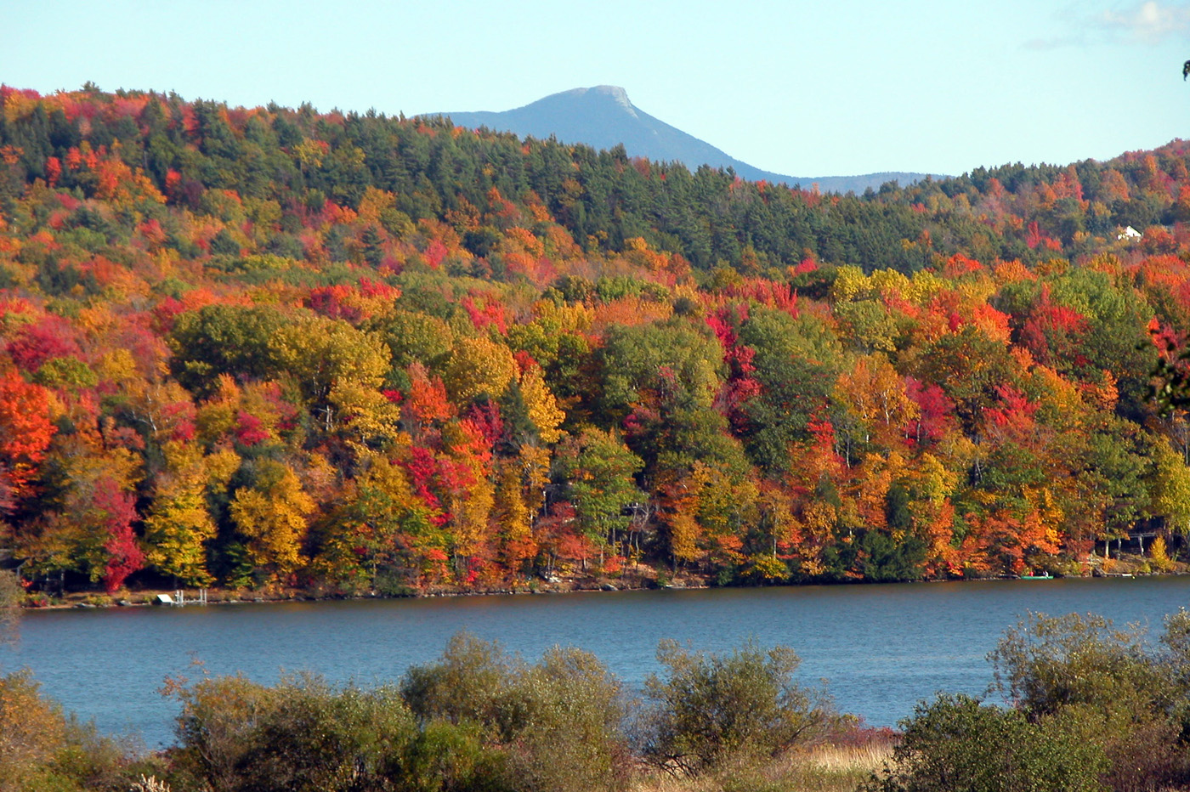
Calculating carbon storage in the Northern Forest: a methods comparison
Committee:
Jennifer Pontius
Gillian Galford
Scott Merrill
Alison Adams
VMC Annual Meeting
December 11, 2015
Notes:
Thanks Cathleen and thanks everyone for being here. Today I’m going to be talking about my work to map and predict forest change and carbon storage in the northern forest region.
This work is part of a larger project to map historical and projected changes in land use and land cover, particularly changes in forest composition, and quantify the associated changes in carbon stored at a regional and local scale

Slide 2
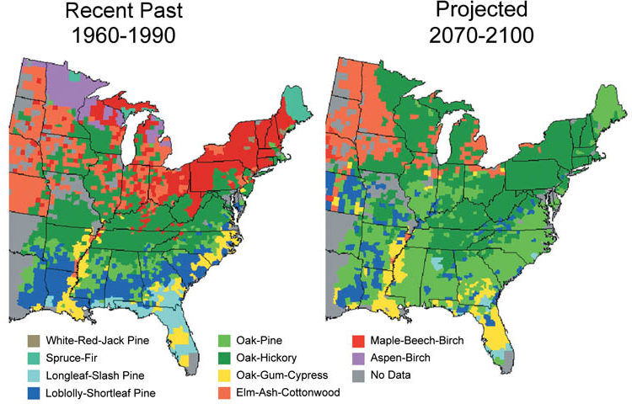
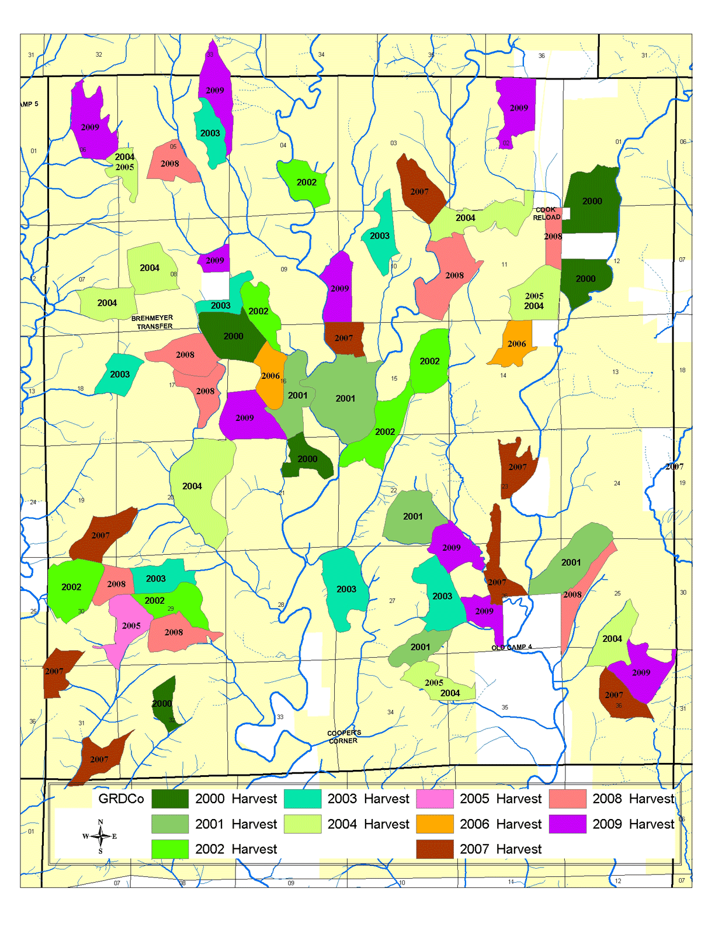
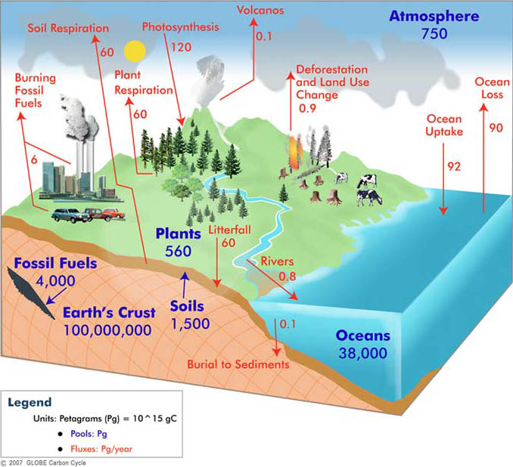
Why compare methods? Importance
?
http://www.forestsandfish.com/images/sust-ten-year-harvest-plan-lg.png
www3.epa.gov/climatechange/impacts/forests.html
http://globecarboncycle.unh.edu/graphics/CCdiagramWEB.jpg
Notes:
SLOW DOWN
-quantifying changes in carbon storage associated with changes in land cover is crucial for making informed local and regional management decisions in the face of climate change resulting changes in species composition
-carbon storage influence on ecosystem processes such as nutrient cycling

Slide 3
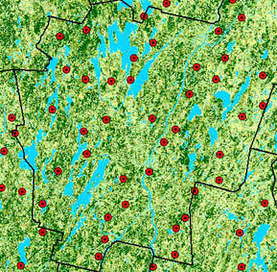
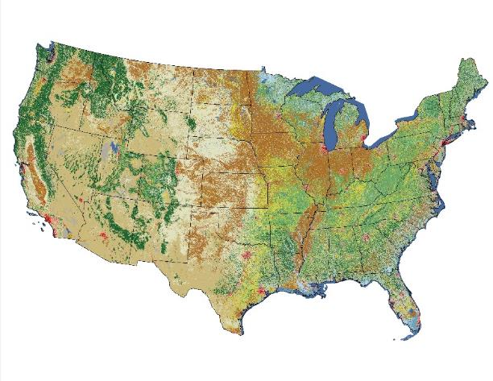

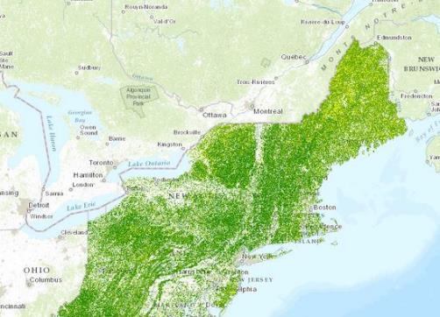
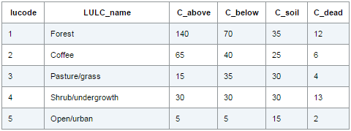
Why compare methods? What’s done now
Remotely-sensed biomass map (Kellndorfer et al., 2012; NBCD 2000)
FIA data interpolation
Land cover maps plus carbon storage data (e.g. NLCD 2011)
Notes:
Also, existing methods to calculate carbon are either too coarse to be very useful at a regional scale, or expensive to generate
SLOW DOWN
-Krig forest inventory points, which means interpolating data between points (not super accurate in heterogeneous landscapes)
-Land cover maps with broad forest classes – doesn’t reflect difference in carbon stored between different species types and therefore is also inaccurate in heterogeneous landscapes and not useful for local decisions
-Remotely-sensed biomass maps – expensive, not replicable for multiple time steps (difficult to track change)
This second method, using land cover and carbon storage information for land cover types, is where we’d like to improve—can we get something that is relatively inexpensive, replicable over time, and useful at a local or regional scale?

Slide 4
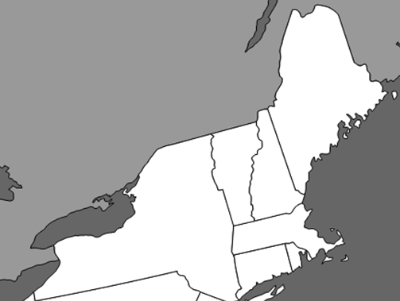
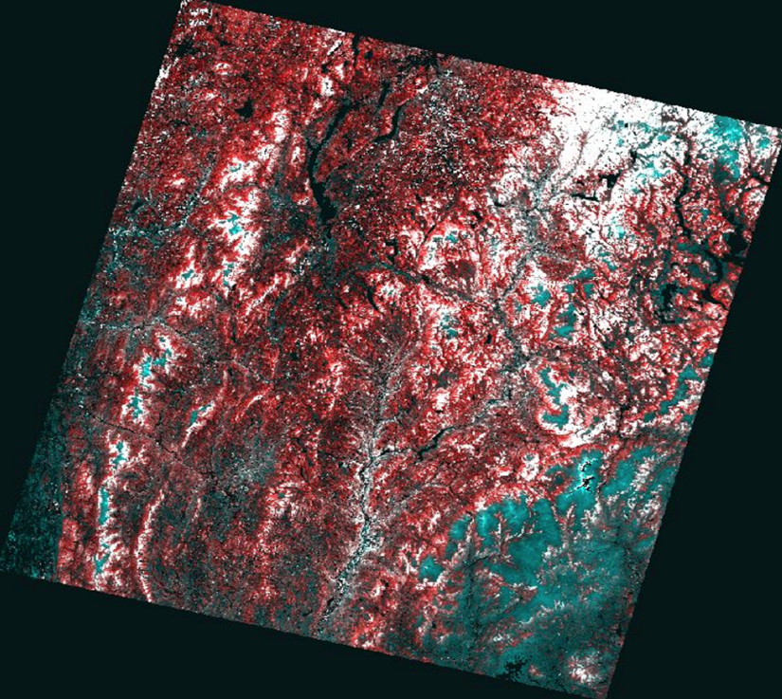
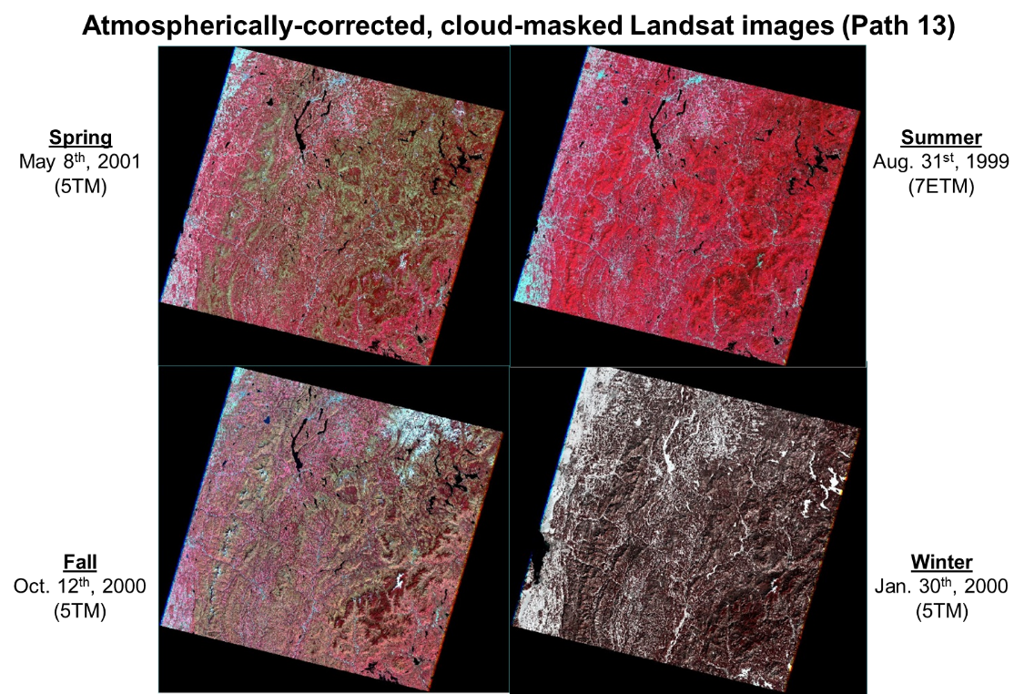
Mapping land cover & basal area
Approximate area of study
Present but likely false positive
Sugar likely maple present
Sugar maple likely absent
Advanced remote sensing techniques used to create maps of relative basal area for common species in the Northeast (Gudex-Cross et al., in progress)
Notes:
SLOW DOWN
So how do we do this?
-Working with David Gudex-Cross and Jen Pontius to create maps of basal area by species for the northern forest for seven timesteps from 1985-2014
-Using Landsat imagery, which is 30x30m resolution
-The process uses a “spectral unmixing” technique to create maps like this one showing where species are present, not present, and maybe present but probably false positive
-Then David will be using object-based image analysis to turn these into maps of basal area → DO THIS FOR EA. SPECIES
-This is exciting! Maps of relative basal area are a new product compared to current land cover maps that show broad forest classifications such as decid., evergreen, mixed; or in rare cases more specific forest type categories → Affects the kind of land cover and carbon calculations I’m able to do
(note in case of Qs: this is a pixel-based product shown here, not the final product which will be object-based but then returned to a 30x30m pixel size raster)

Slide 5
Research Questions
Improve on carbon storage estimates?
Do differing levels of land cover specificity make a difference?
Notes:
SLOW DOWN
-Given this data, can we improve carbon storage estimates to reflect forest heterogeneity while maintaining spatial extent?
Do differing levels of land cover specificity make a difference?
Is the time/money/effort to generate more specific maps actually necessary to calculate accurate carbon storage estimates?
Which is best?

Slide 6
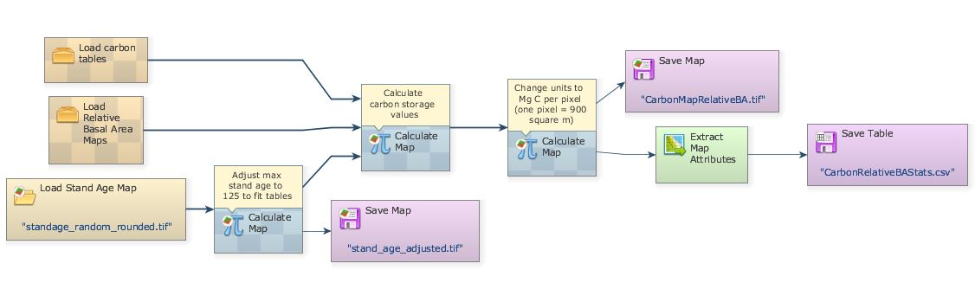
How to calculate carbon stored?
Modeling in Dinamica EGO
Notes:
Update images to actual results, stand age, basal area maps, forest classes
SLOW DOWN
To answer this question, I’m building three models in Dinamica to calculate stored carbon
Although Dinamica is particularly well-suited for studying land use and land cover change, but it’s also great for doing simple calculations (faster than Arc, a bit more user-friendly), so it’s what I’ll be using here
These models are based on the InVEST carbon calculation model, which takes a land cover map and applies a carbon storage value to each pixel based on the land cover type in that pixel
**Please note that the data here are for illustration purposes; not all real data**
Models will calculate carbon based on:
ALL models will start with the same basal area base map
-pure basal area numbers from David’s land cover maps (use allometric equations to calculate biomass → carbon stored)
-species associations, assigned based on basal area values in each pixel
-general forest type classifications (the ones typically seen in land cover maps like NLCD)

Slide 7
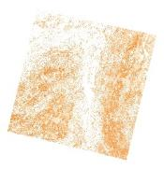
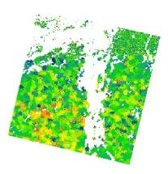
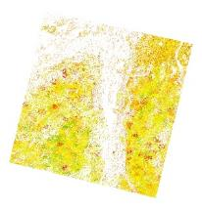
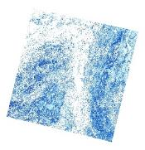
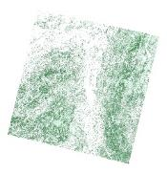
How to calculate carbon stored?
Outputs
(carbon storage maps)
Three models:
Inputs
+
+
1.
Stand age map
Relative basal area maps for each species
Notes:
Update images to actual results, stand age, basal area maps, forest classes
SLOW DOWN
To answer this question, I’m building three models in Dinamica to calculate stored carbon
Although Dinamica is particularly well-suited for studying land use and land cover change, but it’s also great for doing simple calculations (faster than Arc, a bit more user-friendly), so it’s what I’ll be using here
These models are based on the InVEST carbon calculation model, which takes a land cover map and applies a carbon storage value to each pixel based on the land cover type in that pixel
**Please note that the data here are for illustration purposes; not all real data**
Models will calculate carbon based on:
ALL models will start with the same basal area base map
-pure basal area numbers from David’s land cover maps (use allometric equations to calculate biomass → carbon stored)
-species associations, assigned based on basal area values in each pixel
-general forest type classifications (the ones typically seen in land cover maps like NLCD)

Slide 8
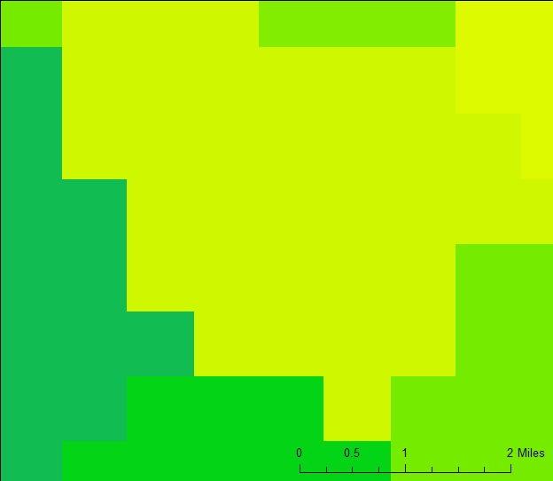
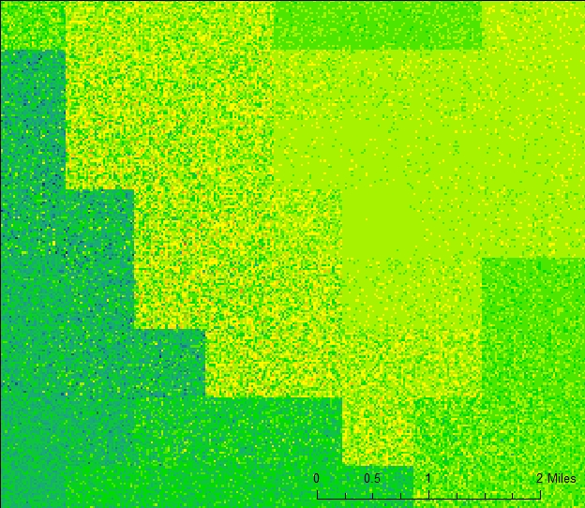
How to calculate carbon stored?
Outputs
(carbon storage maps)
Three models:
Inputs
+
+
1.
Stand age map
Relative basal area maps for each species
Notes:
Update images to actual results, stand age, basal area maps, forest classes
SLOW DOWN
To answer this question, I’m building three models in Dinamica to calculate stored carbon
Although Dinamica is particularly well-suited for studying land use and land cover change, but it’s also great for doing simple calculations (faster than Arc, a bit more user-friendly), so it’s what I’ll be using here
These models are based on the InVEST carbon calculation model, which takes a land cover map and applies a carbon storage value to each pixel based on the land cover type in that pixel
**Please note that the data here are for illustration purposes; not all real data**
Models will calculate carbon based on:
ALL models will start with the same basal area base map
-pure basal area numbers from David’s land cover maps (use allometric equations to calculate biomass → carbon stored)
-species associations, assigned based on basal area values in each pixel
-general forest type classifications (the ones typically seen in land cover maps like NLCD)

Slide 9
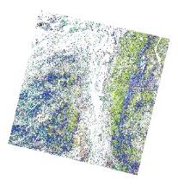
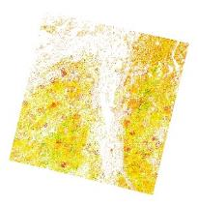
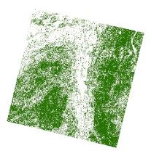
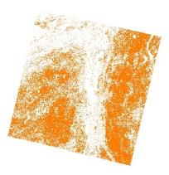
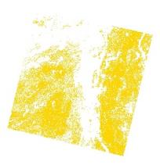
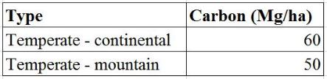
How to calculate carbon stored?
Outputs
(carbon storage maps)
Three models:
Inputs
+
+
1.
Stand age map
Relative basal area maps for each species
+
+
2.
Map with dominant species classifications
Stand age map
Forest/non-forest map (one forest type)
+
3.
(one calculation for each)
low
high
Notes:
Update images to actual results, stand age, basal area maps, forest classes
SLOW DOWN
To answer this question, I’m building three models in Dinamica to calculate stored carbon
Although Dinamica is particularly well-suited for studying land use and land cover change, but it’s also great for doing simple calculations (faster than Arc, a bit more user-friendly), so it’s what I’ll be using here
These models are based on the InVEST carbon calculation model, which takes a land cover map and applies a carbon storage value to each pixel based on the land cover type in that pixel
**Please note that the data here are for illustration purposes; not all real data**
Models will calculate carbon based on:
ALL models will start with the same basal area base map
-pure basal area numbers from David’s land cover maps (use allometric equations to calculate biomass → carbon stored)
-species associations, assigned based on basal area values in each pixel
-general forest type classifications (the ones typically seen in land cover maps like NLCD)

Slide 10
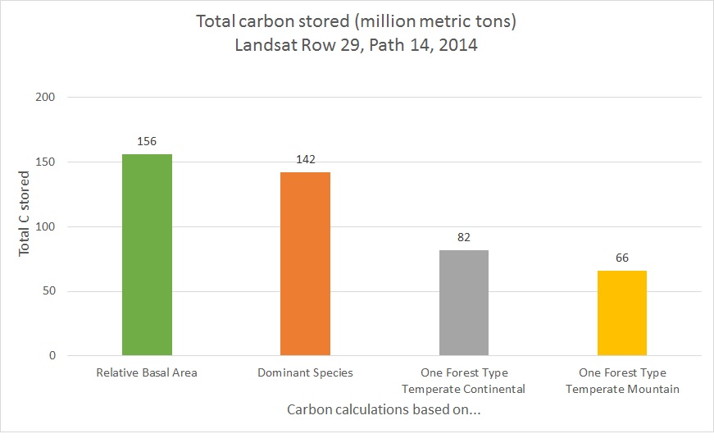
Results
~106 metric tons/ha)
~96 metric tons/ha)
~56 metric tons/ha)
~44 metric
tons/ha)
Notes:
SLOW DOWN
The standard error per pixel multiplied out to the whole map extent is so small it isn’t visible on this chart—relative BA hovers around 156 million, dominant spp hovers around 142 million, and one forest type doesn’t change at all, since all of the pixels were the same value and therefore there was no standard error
The difference between relative basal area and dominant species is around 10%

Slide 11

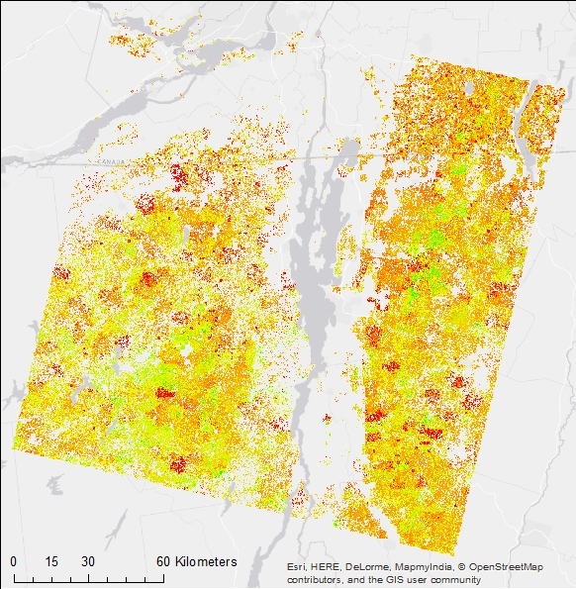
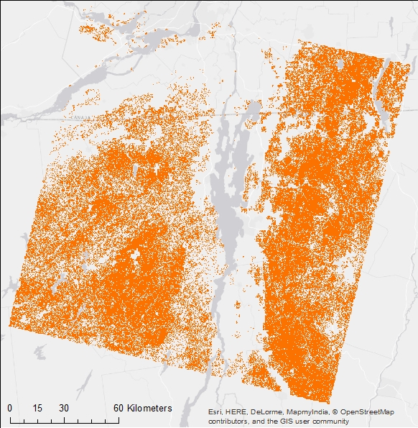

Results
Metric tonnes C
Carbon calculated based on…
Relative basal area
IPCC-style/one forest type
Notes:
Here’s the map based on relative basal area
…and here’s the one based on one forest type from IPCC

Slide 12
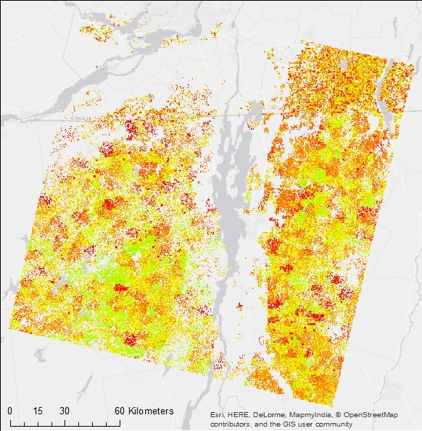
Results
Metric tonnes C
Carbon calculated based on…
Dominant species
IPCC-style/one forest type
Notes:
And here’s the one based on dominant species—pretty similar spatially, but lower values overall
-clearly stand age is a major driver of spatial heterogeneity, so using maps where you can incorporate stand age in the values is important
-dominant species is very similar to relative BA except for a few differences in the values, but the predominant pattern is still driven by the stand age map

Slide 13
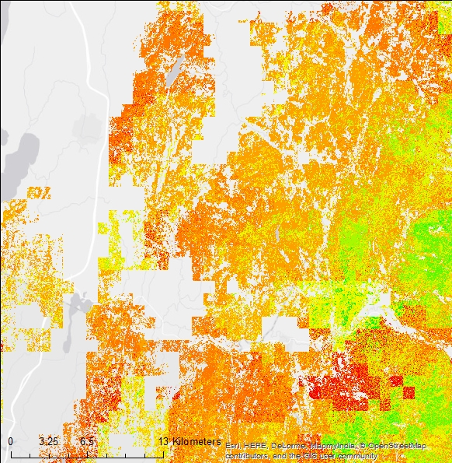
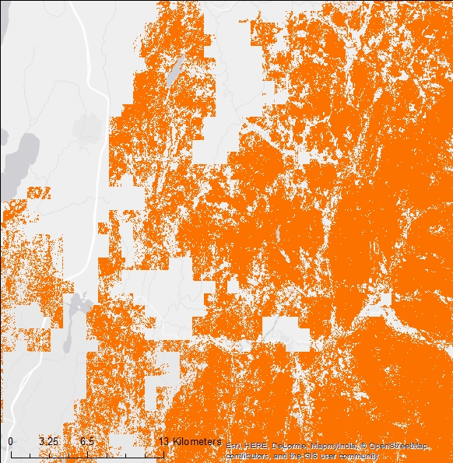
Results
Metric tonnes C
Carbon calculated based on…
Dominant species
IPCC-style/one forest type
Notes:
Zoomed in…
Here again you see that standard broad-scale carbon calculations miss the spatial heterogeneity that is more representative of the northern forest

Slide 14
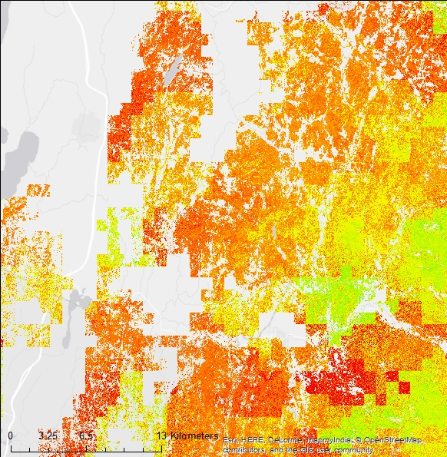
Results
Metric tonnes C
Carbon calculated based on…
Dominant species
IPCC-style/one forest type
Notes:
Dominant vs Relative BA zoomed in…
This is just to show that they are similar spatially but you do get slightly different values locally

Slide 15
Results
They’re different!
…so the specificity of the land cover maps might matter!
Notes:
SLOW DOWN

Slide 16
Results
By adding species distribution data & stand age…
→ Spatial pattern reflects heterogeneity
By including relative basal areas…
Generate higher carbon storage estimates
Using just general forest class & carbon values…
→ May underestimate carbon stored
Notes:
SLOW DOWN
Adding spp distribution improves spatial pattern to reflect heterogeneity
By including relative basal areas we generated higher carbon storage estimates
To calculate carbon based on land cover we may be underestimated carbon stored

Slide 17
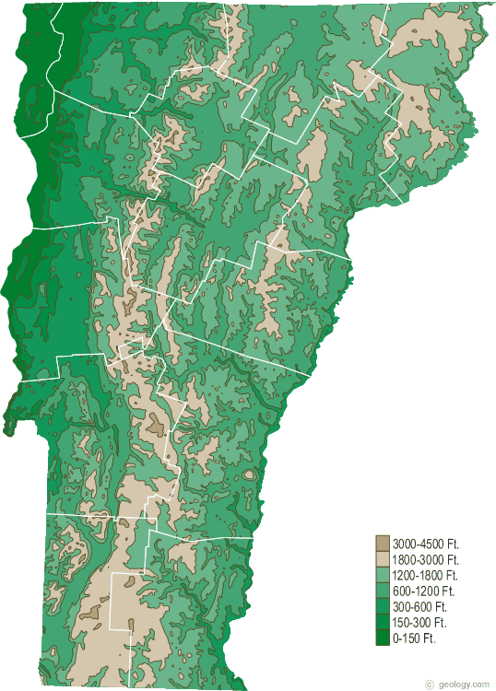
Next steps
Accuracy assessment
Carbon calculated based on relative basal area
Carbon calculated based on dominant forest type + Smith et al. tables
Carbon calculated based IPCC approach (two values)
vs
(not actual site locations)
Notes:
SLOW DOWN
-Use stand inventories from ~40 plots monitored by Vermont Monitoring Cooperative
-Compare carbon calculations from each model to the carbon calculated for each of those plots
-ultimately I’ll be applying the best model to all of the historical imagery that David and Jen and I are creating
(note for Qs: one point = 4 30-meter pixels; take average C storage value for the four pixels around the plot center)

Slide 18
Next steps
Accuracy assessment
Refine relative basal area maps with more ancillary data
Include non-forest land cover types (based on NLCD)
Include additional carbon pools (soil, down dead wood, etc.)
Notes:
SLOW DOWN

Slide 19





Questions?
Thanks to…
Committee members: Jennifer Pontius (advisor), Gillian Galford, and Scott Merrill
Jennifer Pontius and David Gudex-Cross for leading the work on the basal area maps
Notes:
Q: Is that a final map of sugar maple? No, this is a pixel-based product shown here, not the final product which will be object-based but then returned to a 30x30m pixel size raster
Q: How will you validate points given the mismatch between pixel size and plot size? one point = 4 30-meter pixels; take average C storage value for the four pixels around the plot center
Q: Isn’t this ambitious for a Master’s? Yes, this is a big project. That’s why a PhD student is working on the maps, and I applied for and received a grant to free up more of my time to work on this project this spring, too
Q: How are the Smith tables derived? Using carbon accounting models based on allometric equations and inventory data
Q: How is the stand age map derived? Based primarily on FIA data (stand age estimated by examining tree rings in cores), also used disturbance data from NASA Landsat Ecosystem Disturbance Adaptive Processing System (NASA LEDAPS); stdev in eastern US is ~10 years in most cases (reflecting spatial age heterogeneity of stands)
Q: Isn’t it kind of circular to compare the allometric results with the other results? It’s really more of a control
Q: What species are you mapping? For the basal areas, it depends on which species have sufficient training pixels; for species associations: aspen-birch, maple-beech-birch, oak-hickory, oak-pine, spruce-balsam fir, red pine-white pine-jack pine, or elm-ash-cottonwood

