Slide 1
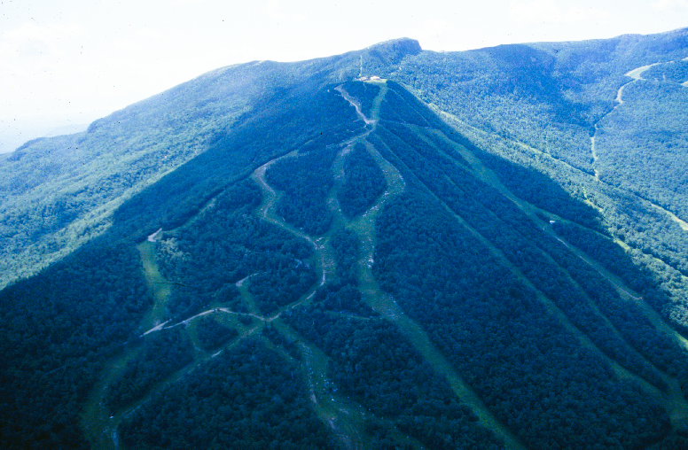

Extremes at elevation – high flow events on Mount Mansfield
2014 VMC Meeting
Jamie Shanley
U.S. Geological Survey
Beverley Wemple
University of Vermont

Slide 2
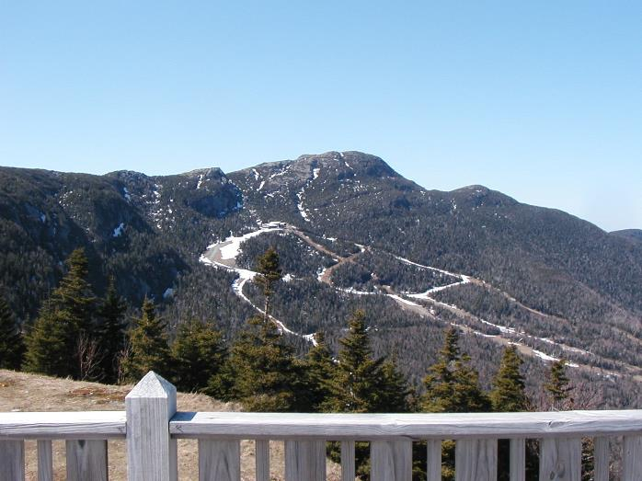
Outline
1. High elevation hydrology
2. Paired watershed study background
3. General findings
4. Extreme events
5. Climate change implications
Notes:
Proposed development is shown here in blue – new trails and expanded snowmaking coverage. Additional pond to store water for snowmaking.
Slopeside village will be constructed at the site of the current Spruce Peak parking lot.
Golf course is also planned, but most will fall outside of the basin.
When expansion is complete, approximately 24% of the basin will be developed.

Slide 3
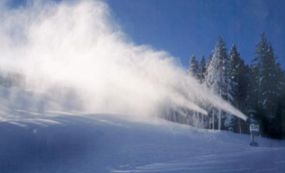
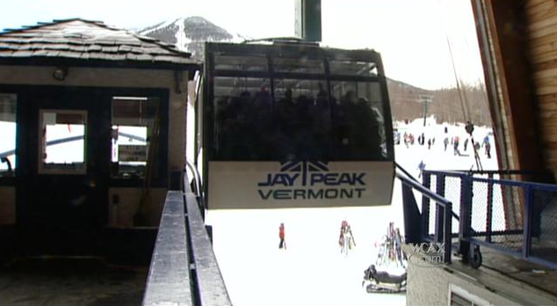
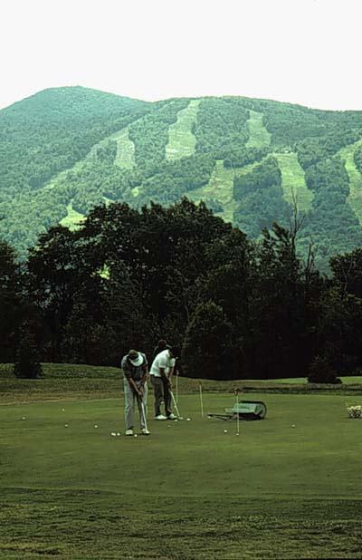
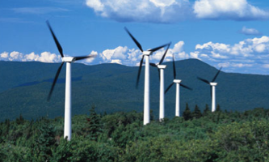
High elevation pressures

Slide 4
Climate pressures
Number of days per year with greater than 1” of precipitation (BTV station).
Vermont Climate Assessment, 2014
Notes:
Insert after your Slide 3 on high elevation pressures (to make the point that we are seeing patterns of more extreme events)

Slide 5
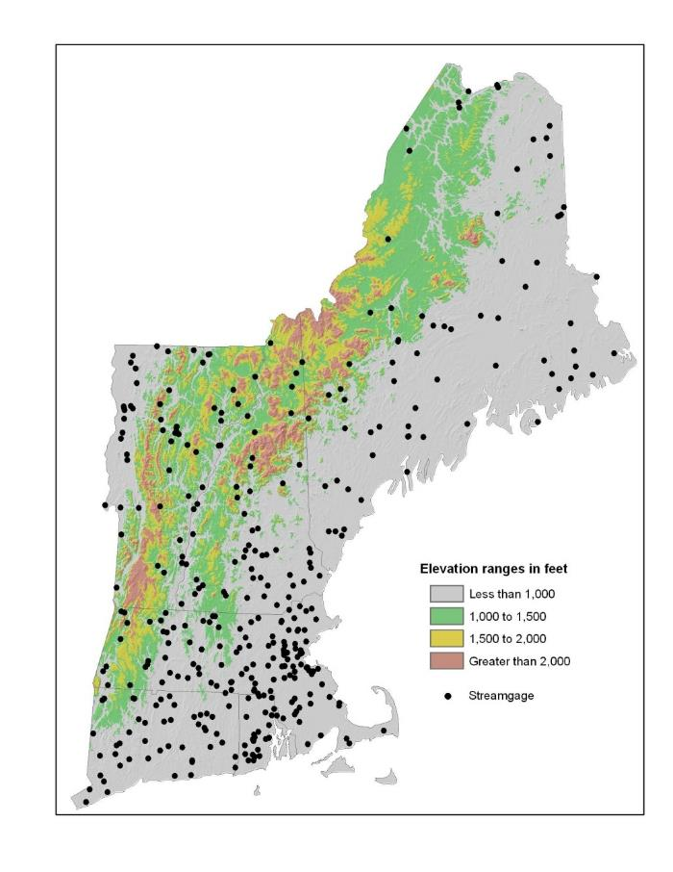
The need for science
In New England….
One-third of the land area is over 1000’, but only 4% of the USGS stream gages.

Slide 6
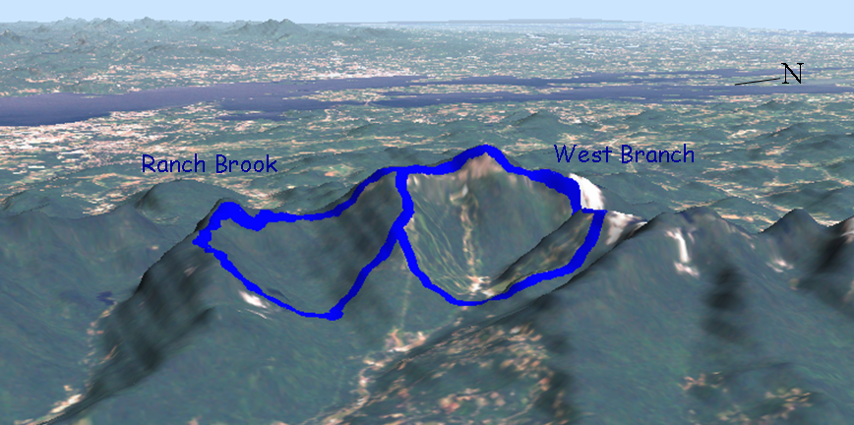
Mt. Mansfield paired-watershed study
Motivations
Notes:
To address the need for improved understanding of the effects of alpine development on stream flow and water quality, we initiated in the fall of 2000 a paired-watershed study on the eastern slopes of Mt. Mansfield.
The design is similar to that of other paired-watershed studies used in forest hydrology where two adjacent watersheds are selected for continuous monitoring of stream flow and water quality, one of which becomes the experimentally treated watershed. Our watersheds include the 9.8km2 Ranch Brook watershed which lies on state forest land and has been set aside for research and monitoring and the 10.7 km2 West Branch watershed that encompasses the entire Stowe Mountain Resort.
Some of you may know that in 1999 Stowe Mountain Resort received approval for a permit to expand operations and infrastructure, including development of the Spruce Peak base area, trail clearing and expanded makmaking, and summer recreational amenities including a golf course.

Slide 7
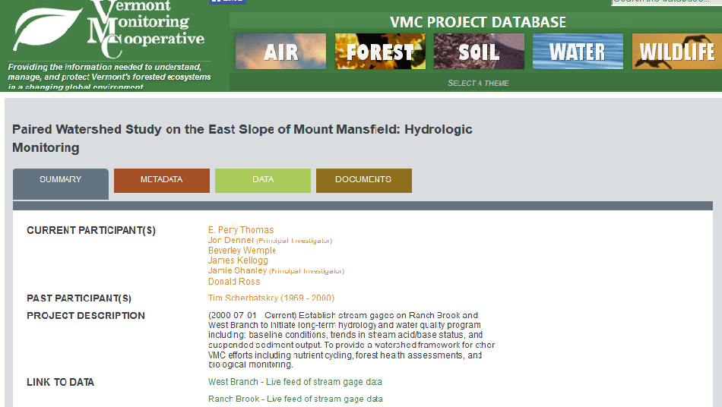
VMC website

Slide 8
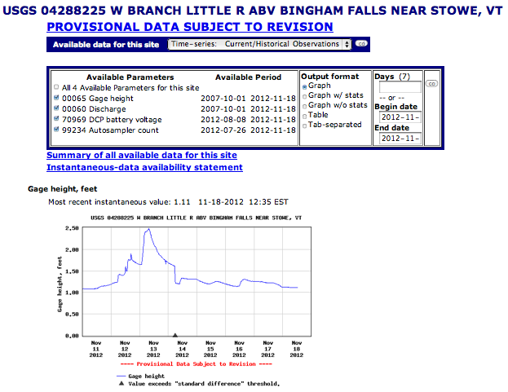
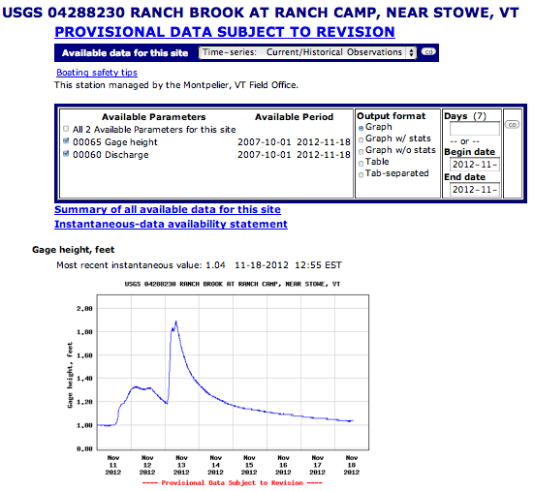
USGS real-time streamflow website
West Branch
Ranch Brook

Slide 9
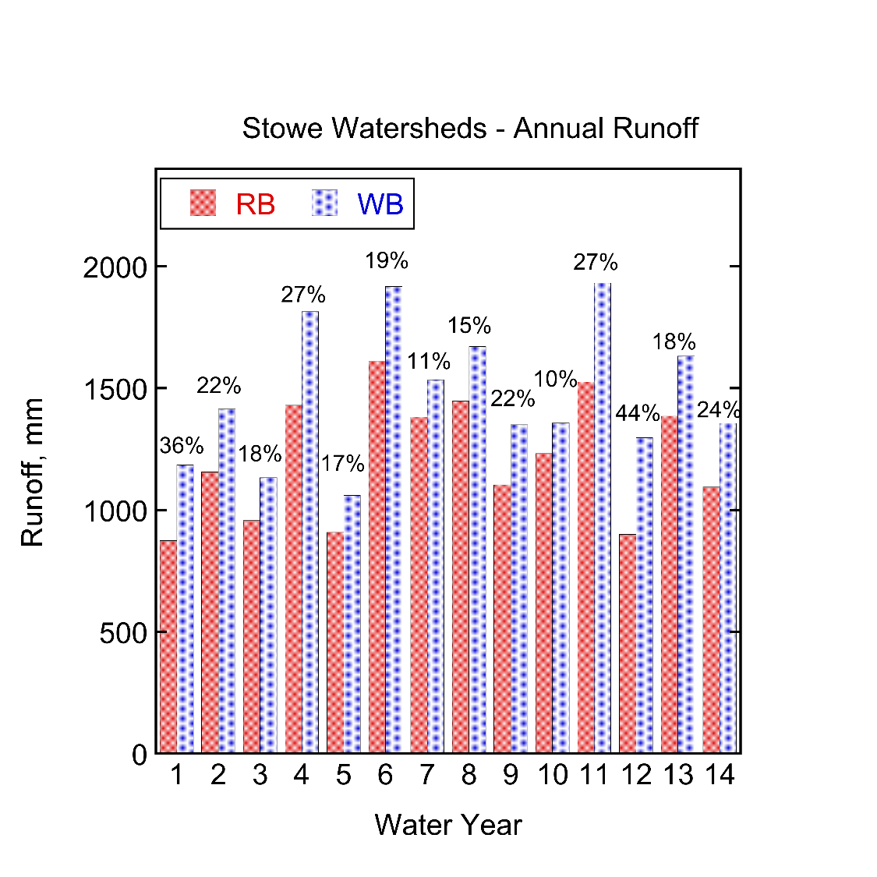

Slide 10
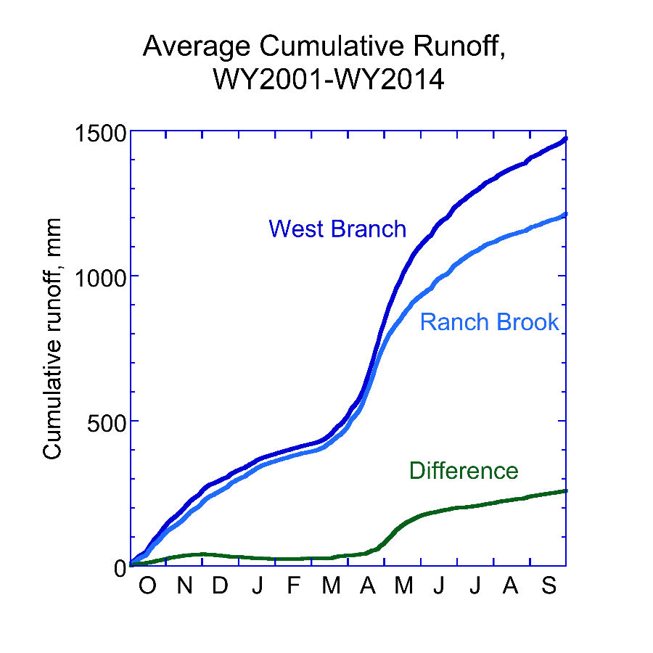
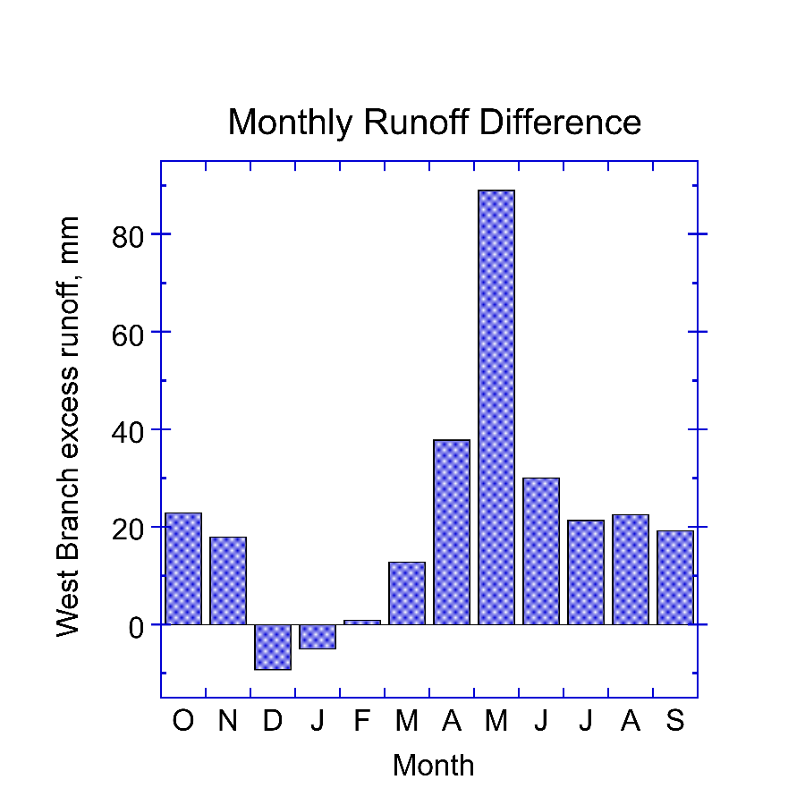
Pattern through the Year

Slide 11
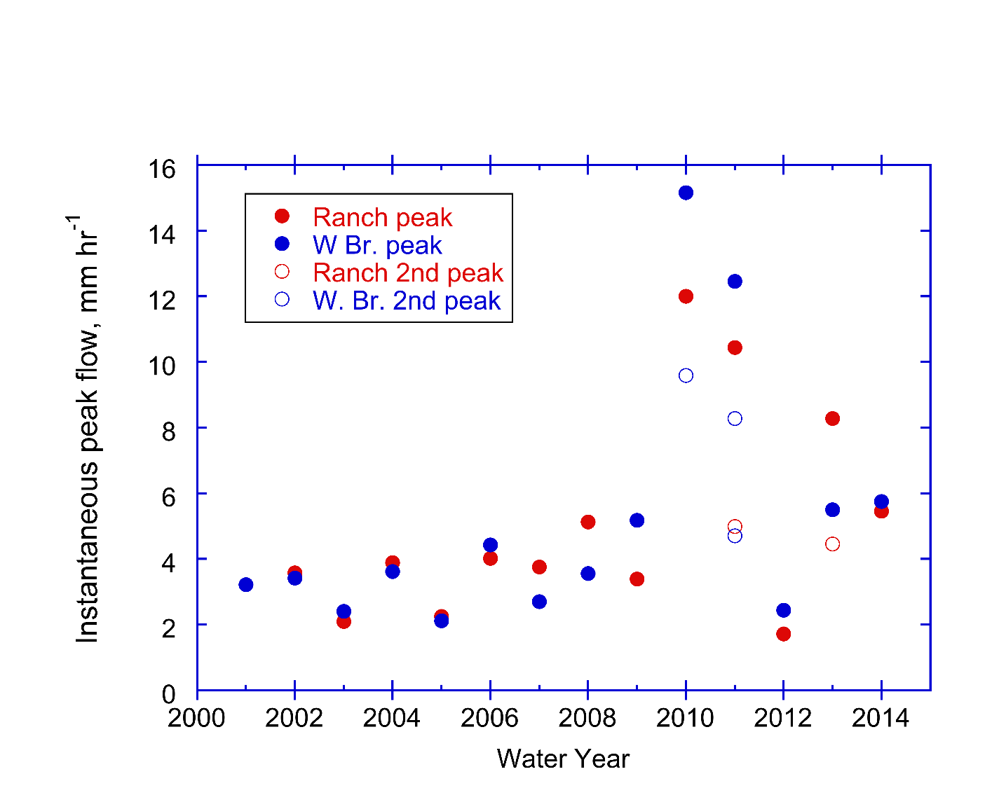
Annual flow peaks
1740 cfs, 381 cfsm
1130 cfs,
299 cfsm
Highest flow at Sleepers
River W-3 since 1991

Slide 12
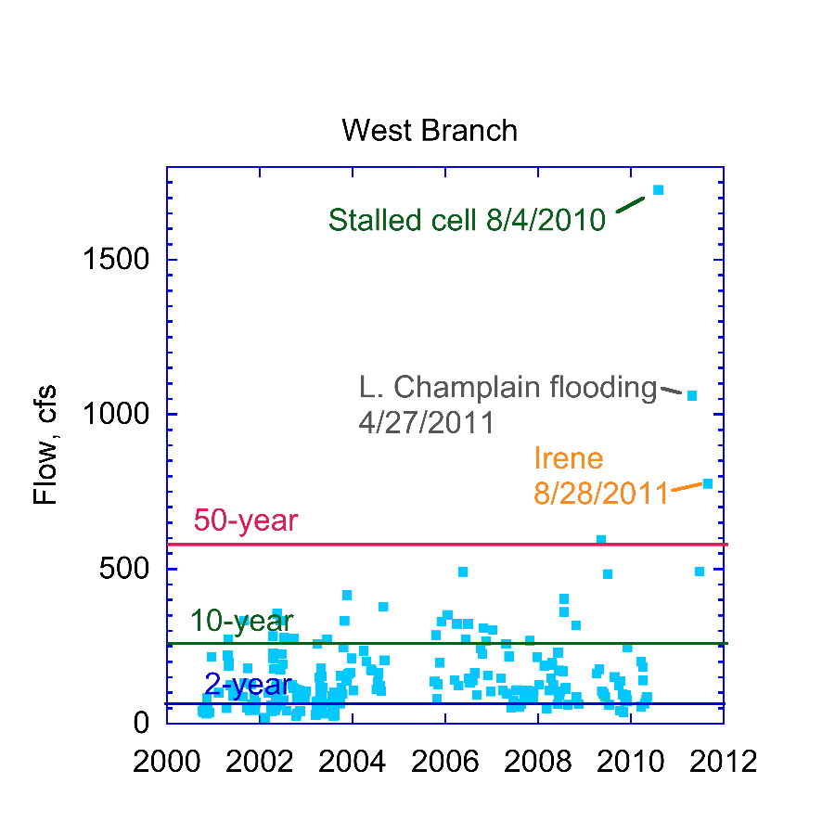
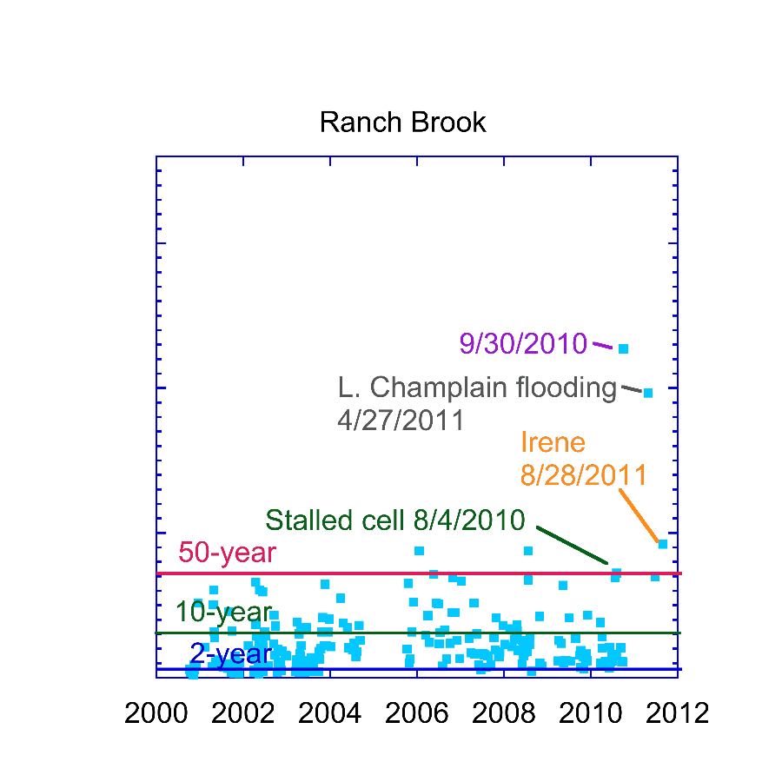
Peak Timeline vs. Design floods
1975
1325
50-yr flood from
Olson and Bent, 2013

Slide 13
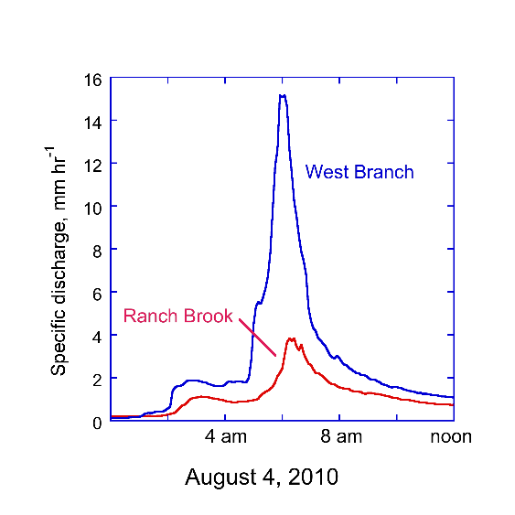
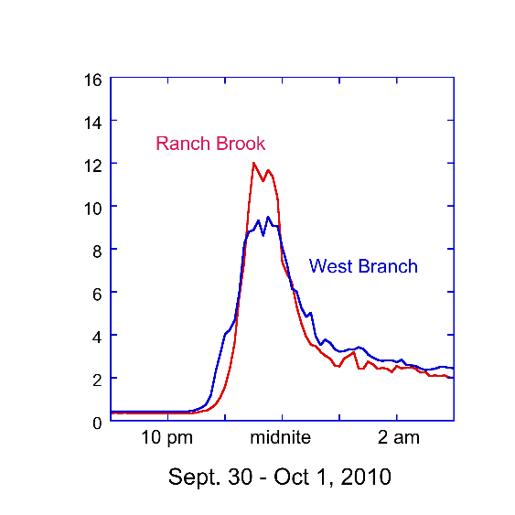
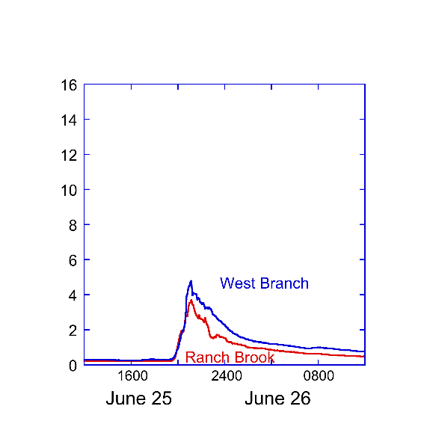
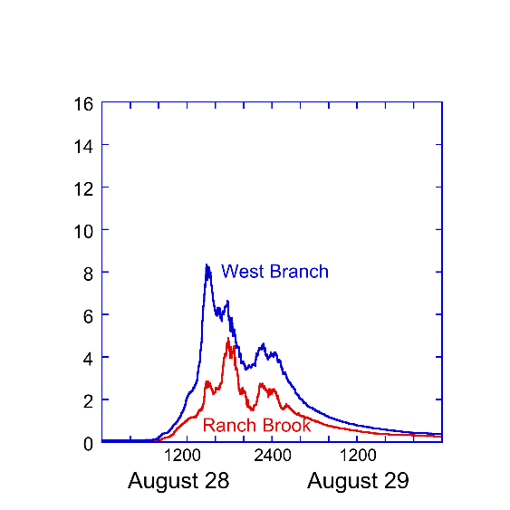
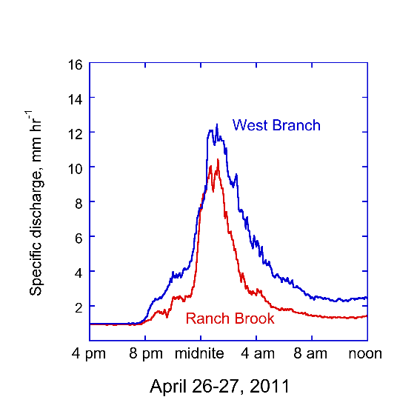
Five large
peaks in
2010-2011
Stalled
cell
L. Champlain flooding
Irene

Slide 14
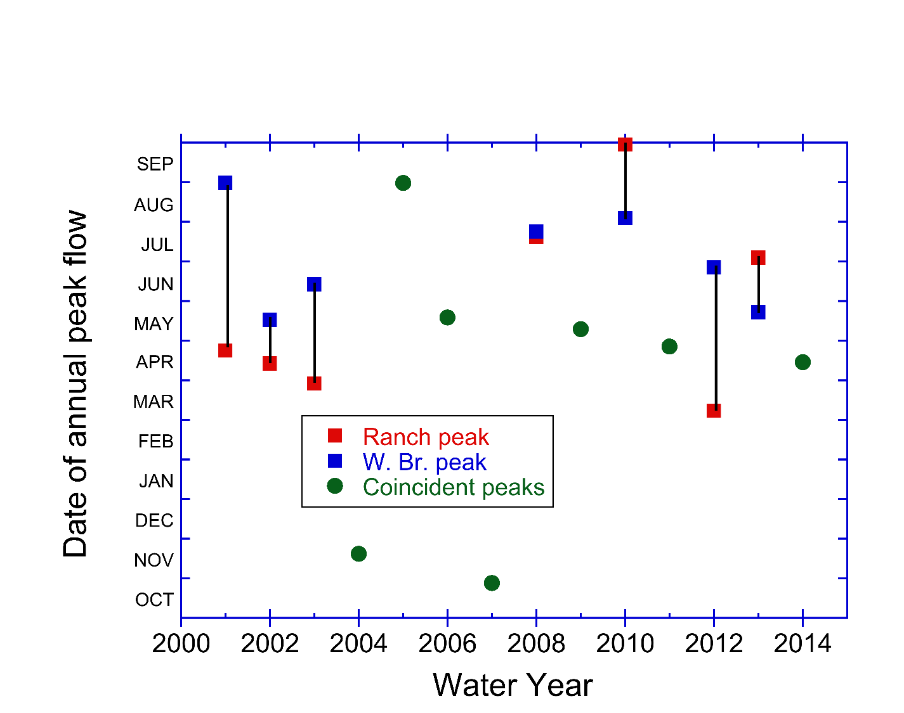
Annual peak dates

Slide 15
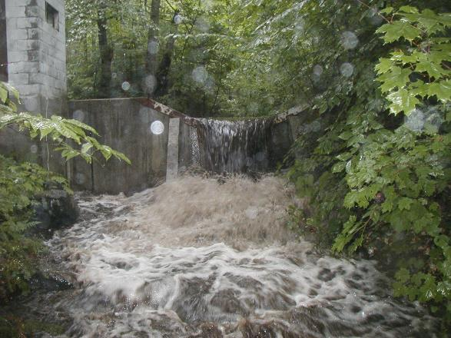
Take home
Consistent pattern of higher annual runoff in developed basin
Very high flow peaks (per unit area) compared to lowlands
Recent extremes -- In 14 years of record, 4 to 6 of the largest storms at each gage have occurred in the last 5 years.
Magnitude and timing annual peak varies greatly between gages and among years
VMC’s continued support of gages provides high elevation flow record not available elsewhere in the state

