Slide 1

Monitoring Recreation Impacts in Vermont and the Northern Forest
Park Studies Laboratory University of Vermont
Kelly Goonan
Robert Manning
Carena van Riper
Rubenstien School of Environment and Natural Resources
University of Vermont
Chris Monz
College of Natural Resources
Utah State University

Slide 2
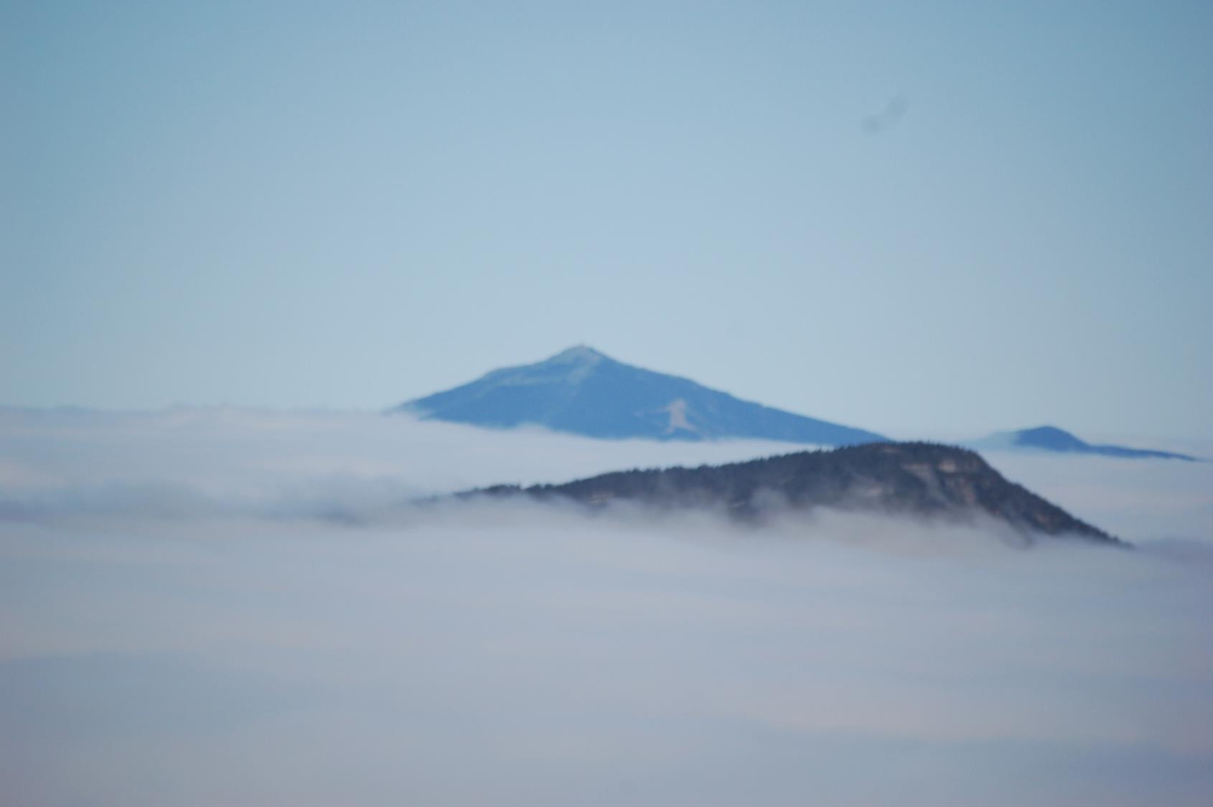
Isolated & Confined

Slide 3
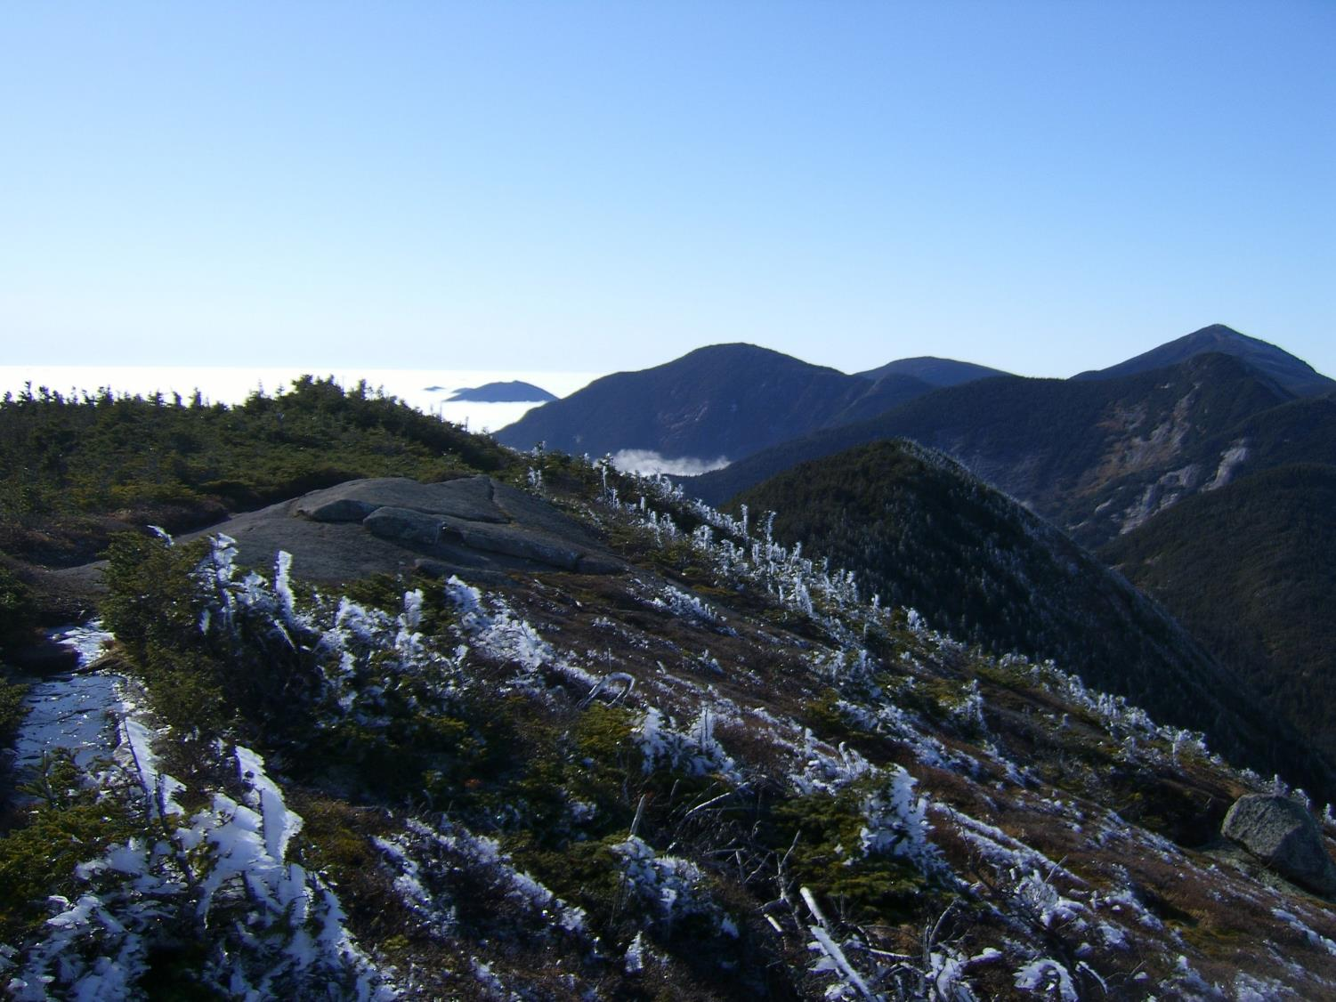
Rare & Fragile

Slide 4
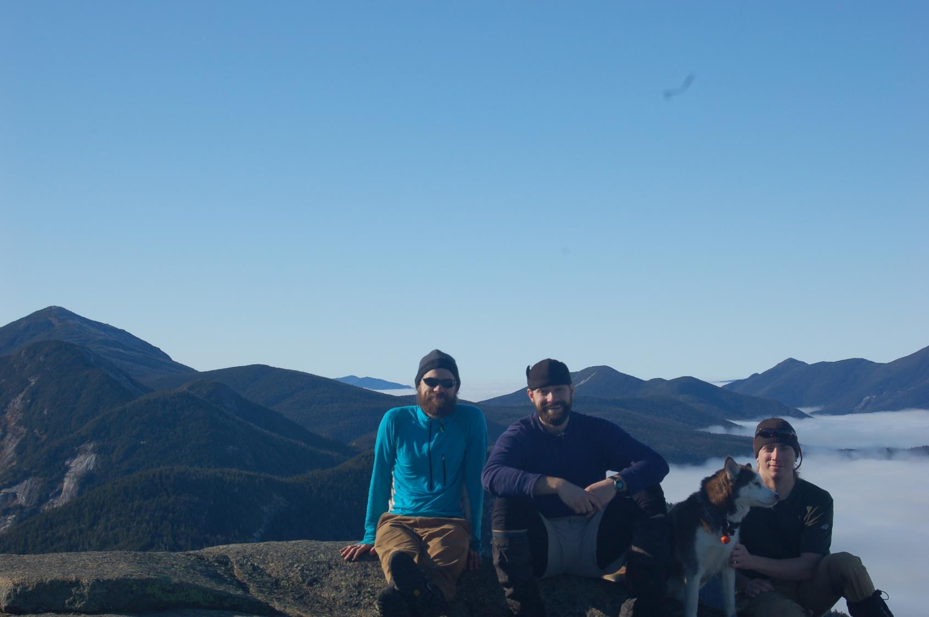
Valuable & Popular

Slide 5
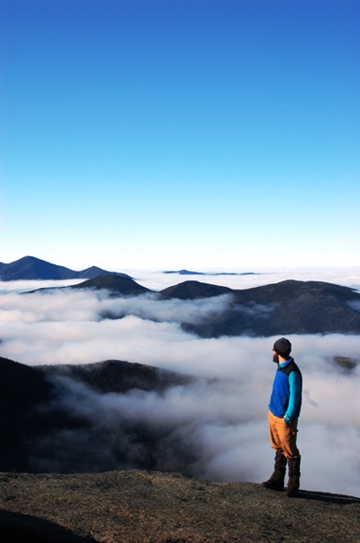
Management Objectives
Facilitate public access
Protect natural resources
Preserve experiential quality

Slide 6
Management by Objectives
Objective
Indicators
Monitoring
Standards

Slide 7
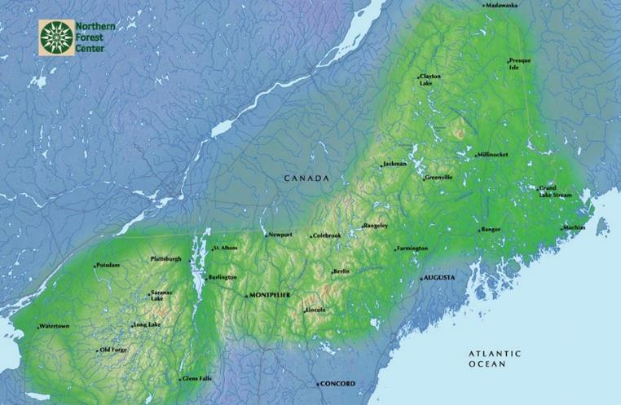
The Northern Forest
Park Studies Laboratory University of Vermont
Nearly 30 million acres
Mosaic of public/private ownership
Variety of recreational uses
1.5 million permanent residents
10 million visitors each year
www.northernforest.org

Slide 8
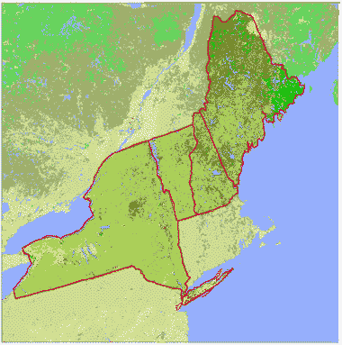
Research Sites
Park Studies Laboratory University of Vermont
Cascade Mountain, NY
Camel’s Hump, VT
Cadillac Mountain, ME
http://www.ncfcnfr.net/demo.html

Slide 9
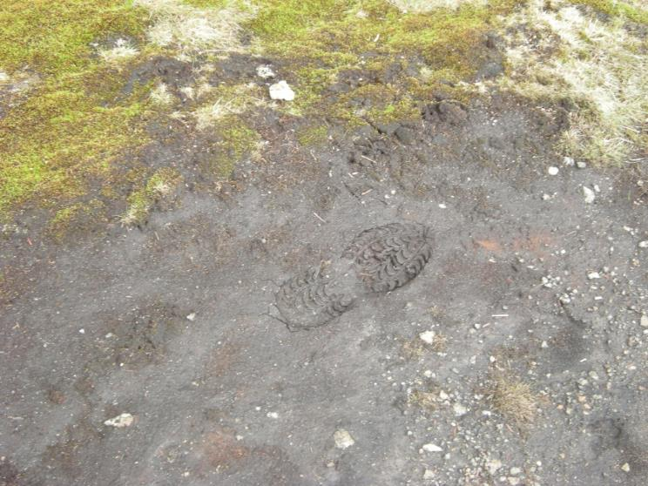
Recreation Ecology Methods
Mapped summit area using GPS
  Cadillac : 71,020 m²
  Cascade: 7,606 m²
  Camel’s Hump: 5,336 m²
All trails mapped and assessed
Transect sampling and digital image analysis of 1m² quadrats to assess resource conditions and quantify land cover types
Cascade, Adirondack State Park, NY

Slide 10
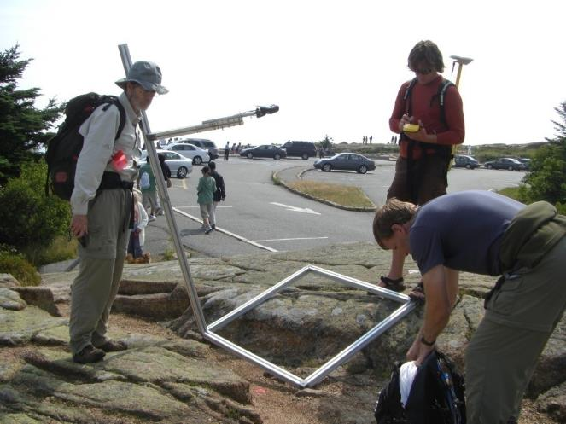
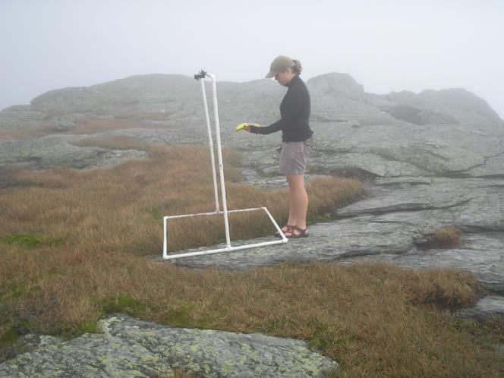
Recreation Ecology Methods:
Land Cover Analysis

Slide 11
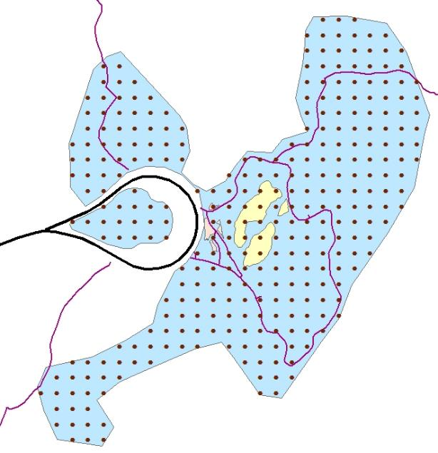
Recreation Ecology Methods:
Land Cover Analysis
Adapted methods used in campsite impact analysis (Marion 1991) and range management (Booth and Cox 2008)
Grid transect method
Grid created using Hawth’s Analysis Tools in ArcGIS
Digital images of 1m² quadrats
Images analyzed using SamplePoint
13 land cover classes measured

Slide 12
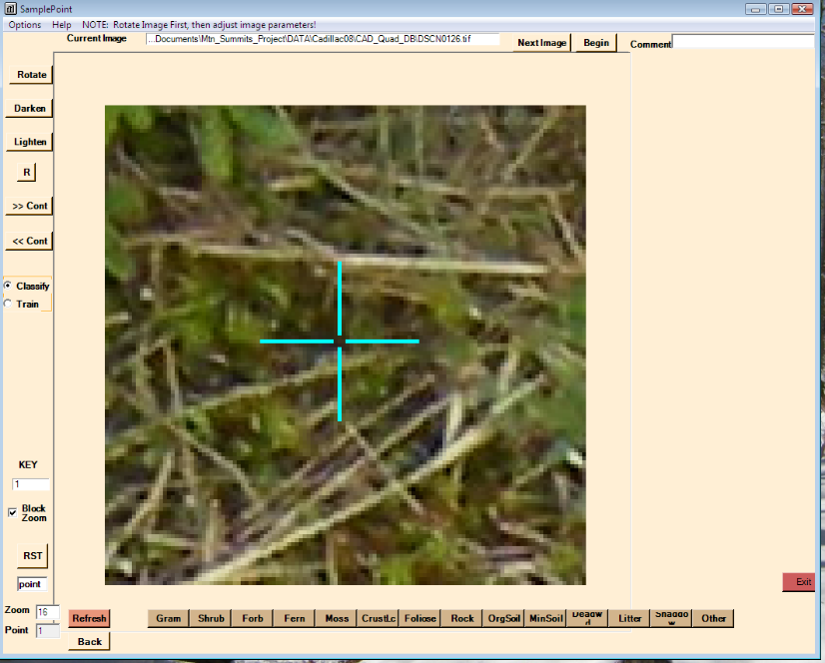
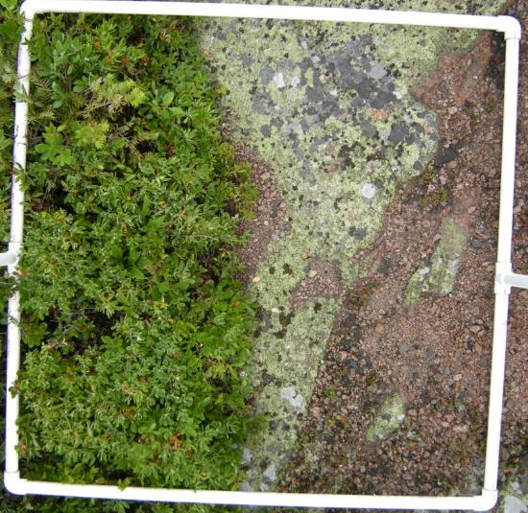
Recreation Ecology Methods:
Land Cover Analysis

Slide 13
Ecological Assessment:
Land Cover Analysis
Land Cover Class | Cascade | Camel’s Hump | Cadillac | F-value | p-value
Vegetation | 20.40^{a,c} | 44.25ª | 44.29^{c} | 32.879 | < .001
Lichens | 3.14^{a,c} | 32.70ª | 36.25^{c} | 116.557 | < .001
Organic Soil | 1.78^{a,c} | 0.52ª | 0.39^{c} | 11.047 | < .001
Mineral Soil | 4.72ª | 0.59^{a,b} | 6.73^{b} | 20.703 | < .001
Bare Rock | 68.45^{a,c} | 20.11^{a,b} | 11.27^{b,c} | 369.198 | < .001
Any two summits that share a superscript are significantly different (p < 0.05) according to Bonferroni’s least significant difference test

Slide 14
 | Cascade | Camel’s Hump | Cadillac Mountain
 | Percent | Percent | Percent
Vegetation Cover Present | 20.4 | 44.3 | 44.3
Visitors said they typically saw… | 61.7 | 67.0 | 72.0
Acceptability | 44.3 | 42.9 | 46.7

Slide 15
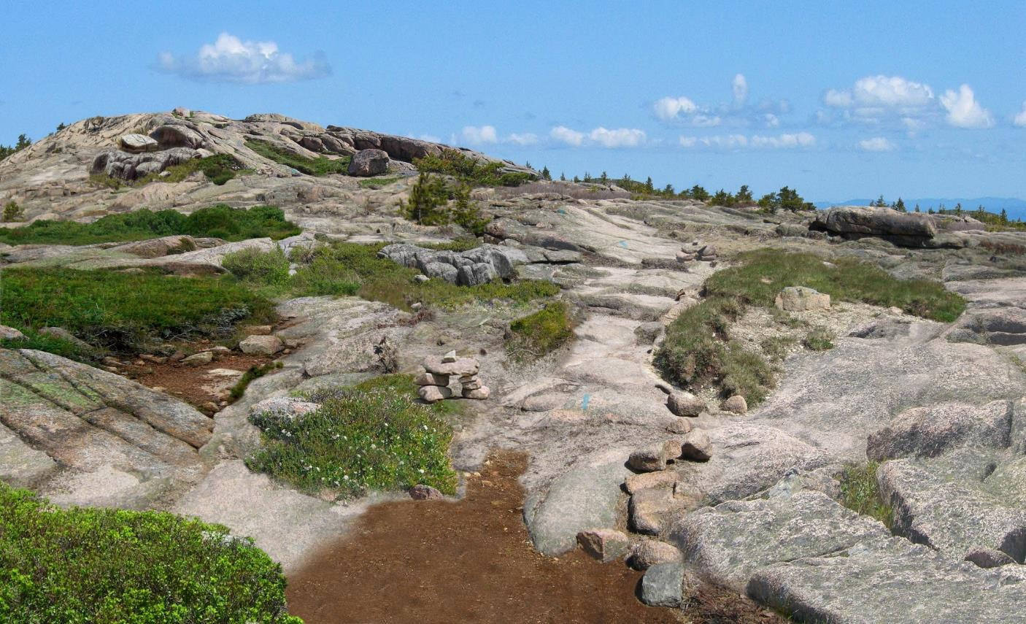
Park Studies Laboratory University of Vermont

Slide 16
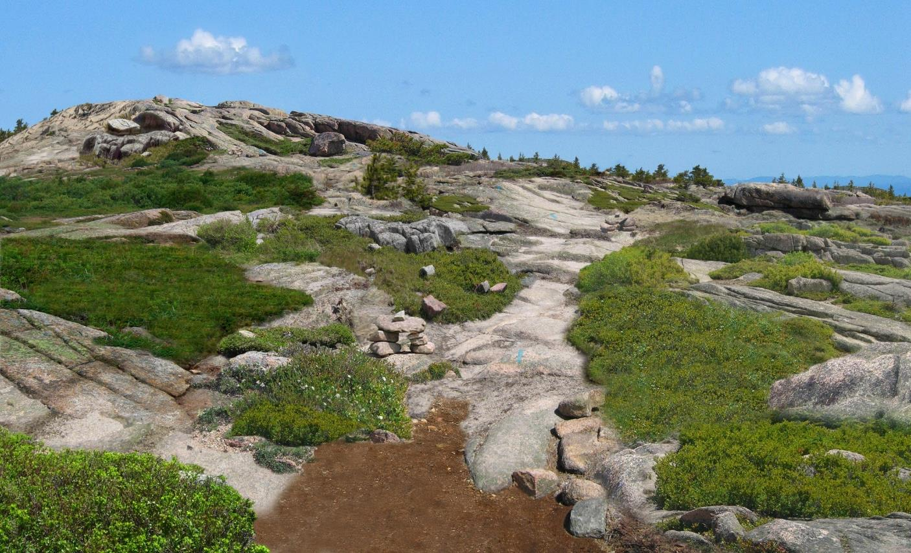
Park Studies Laboratory University of Vermont

Slide 17
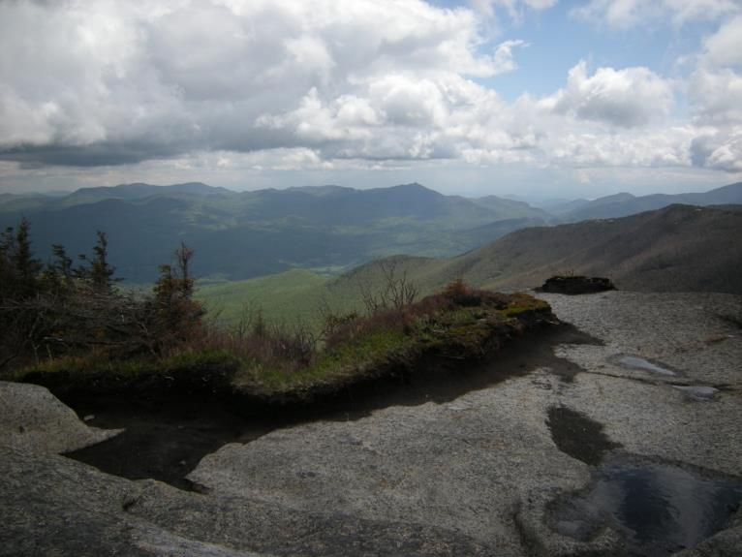
Visitor Awareness of Ecological Impacts
About 45% of visitors noticed impacts
  Cascade: 56%
  Camel’s Hump: 37%
  Cadillac Mountain: 45%
Visitors tended to rate impacts as “slight” or “moderate”
Ecological assessments would describe impacts as severe on Cascade and moderate to severe on Camel’s Hump and Cadillac Mountain
Cascade, Adirondack State Park, NY

Slide 18
Visitor Awareness of Ecological Impacts
About 45% of visitors noticed impacts
  Cascade: 56%
  Camel’s Hump: 37%
  Cadillac Mountain: 45%
Visitors tended to rate impacts as “slight” or “moderate”
Ecological assessments would describe impacts as severe on Cascade and moderate to severe on Camel’s Hump and Cadillac Mountain
Cascade, Adirondack State Park, NY

Slide 19
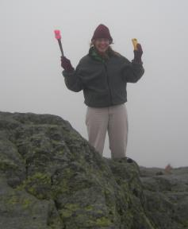
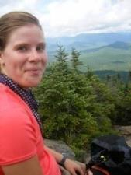
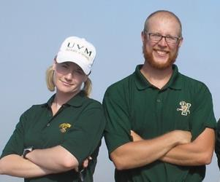
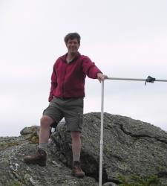
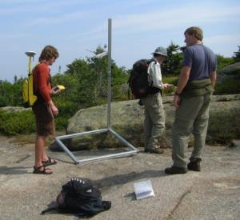






Special Thanks
Park Studies Laboratory University of Vermont
Lauren Chicote
Carena van Riper
& Pete Pettengill
Bill Valliere
Laura Anderson
The VT Crew
New York State DEC
Vermont Nongame
Natural Heritage
Program
Acadia NP
Green Mountain Club
Northeastern States Research Cooperative
Vermont Dept. of Forests, Parks & Recreation

Slide 20
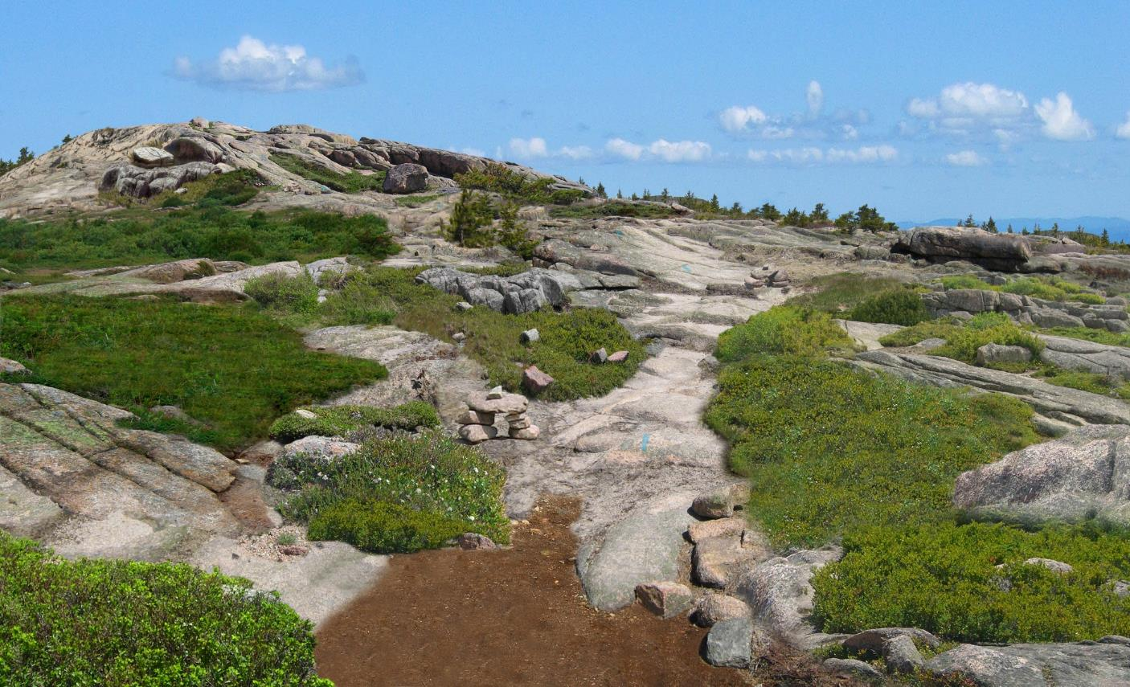
Park Studies Laboratory University of Vermont

Slide 21
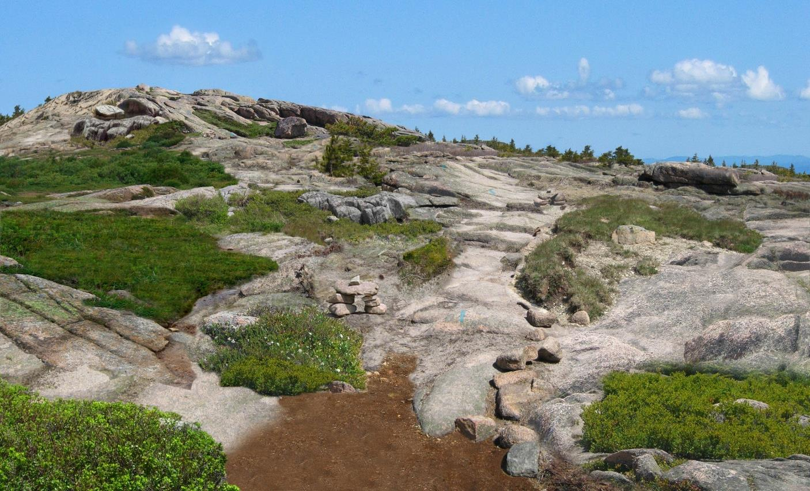
Park Studies Laboratory University of Vermont

Slide 22
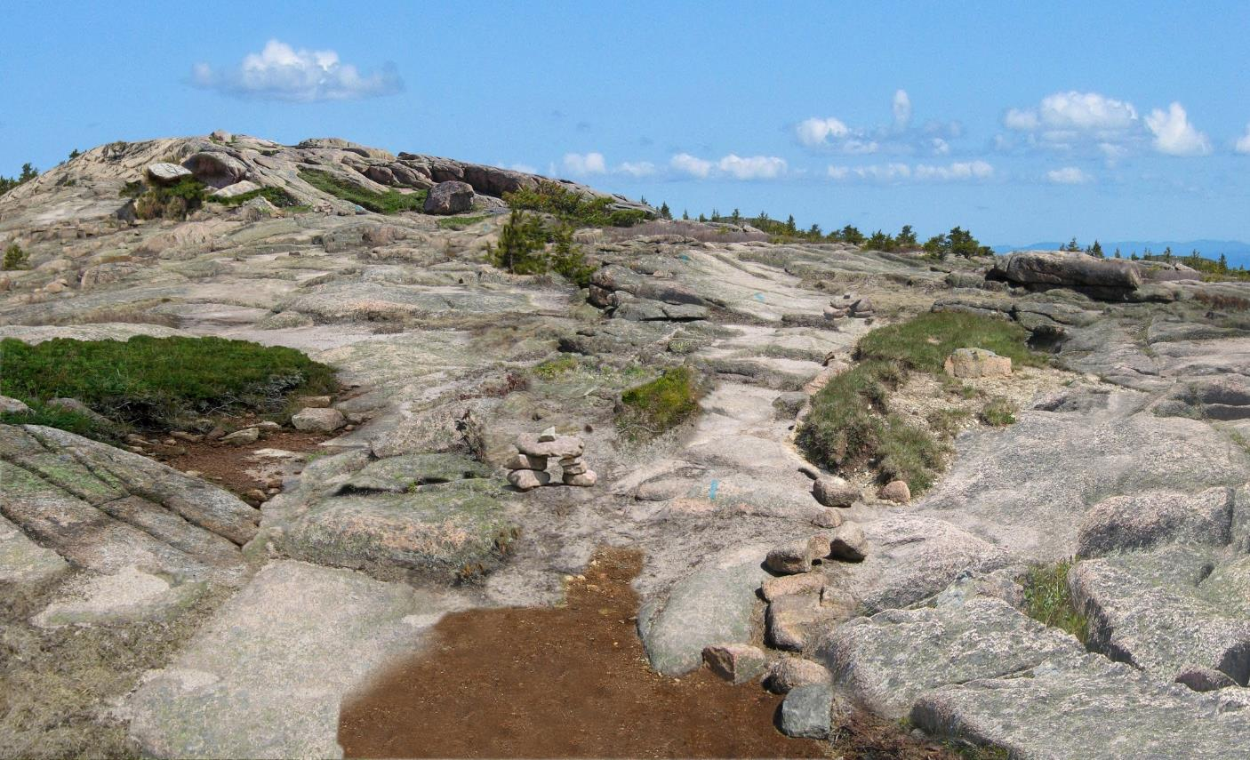
Park Studies Laboratory University of Vermont

Slide 23
Park Studies Laboratory University of Vermont

Slide 24
Park Studies Laboratory University of Vermont

Slide 25

Park Studies Laboratory University of Vermont

Slide 26
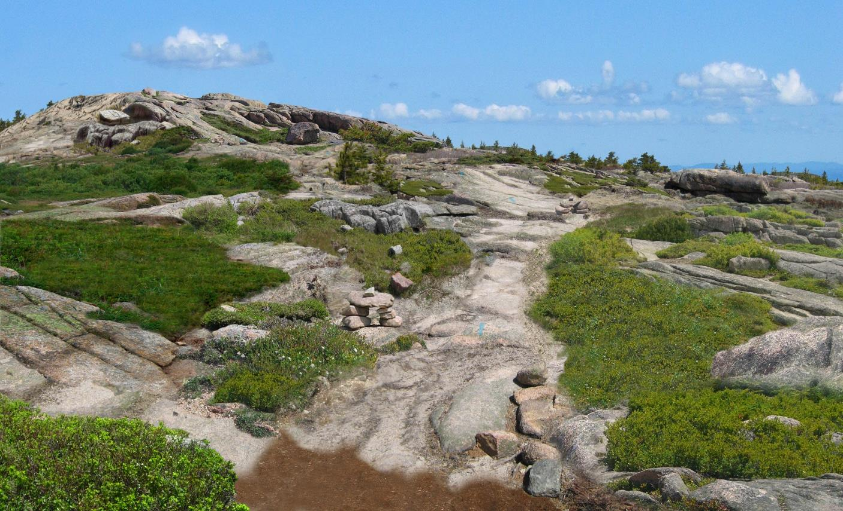
Park Studies Laboratory University of Vermont

Slide 27
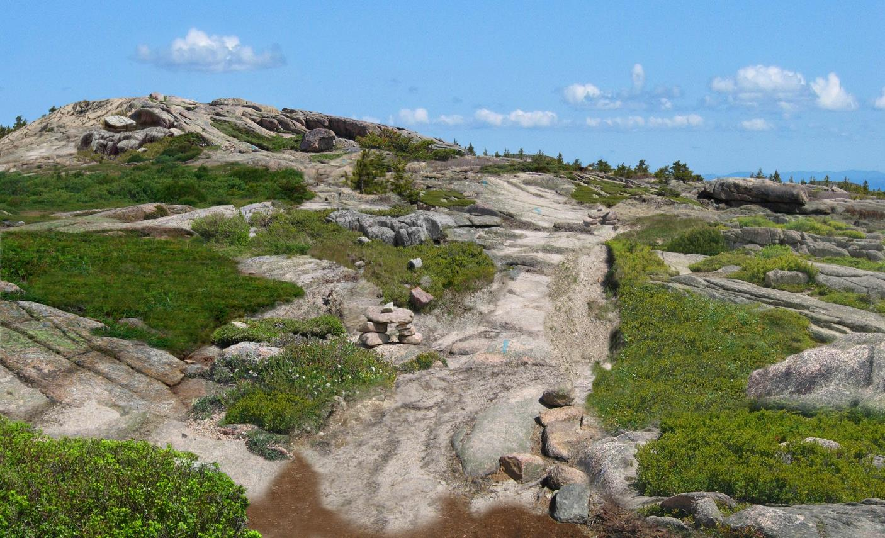
Park Studies Laboratory University of Vermont

Slide 28
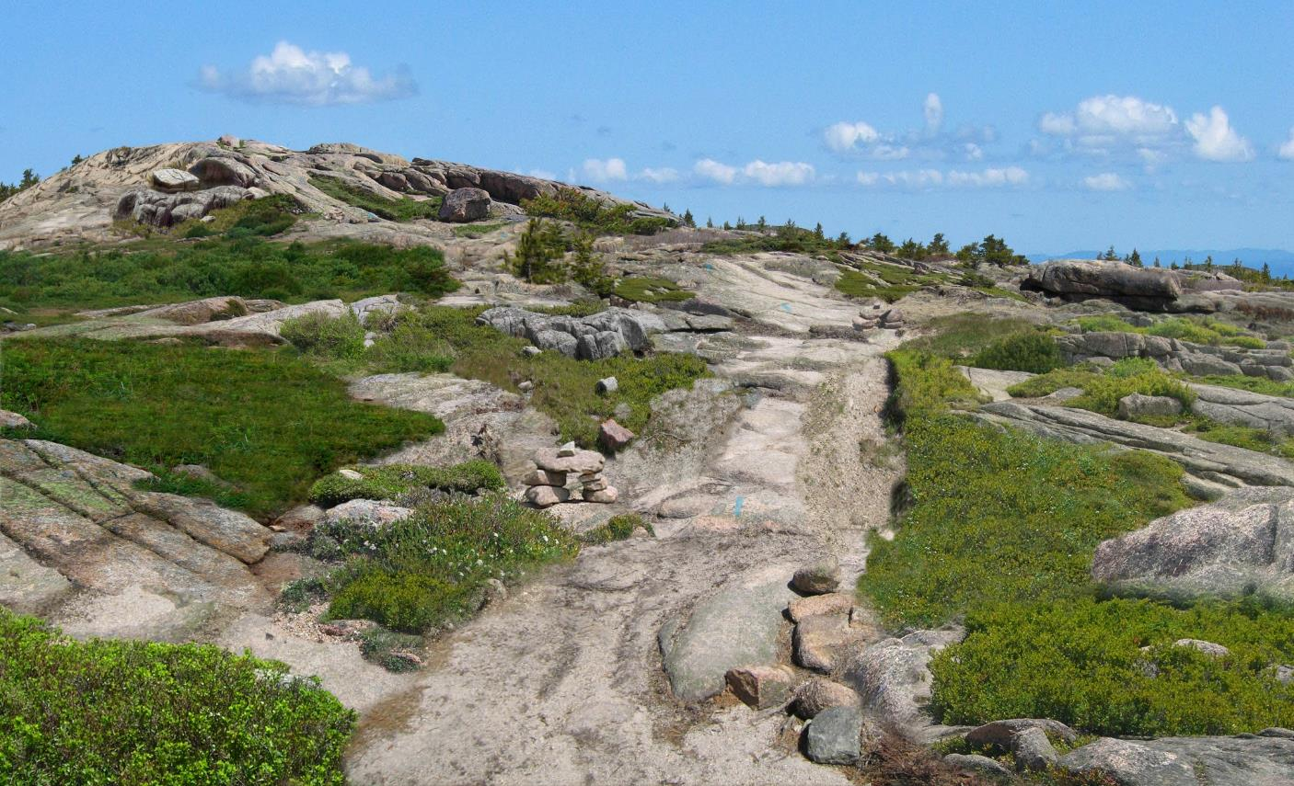
Park Studies Laboratory University of Vermont

Slide 29
Park Studies Laboratory University of Vermont

Slide 30
Park Studies Laboratory University of Vermont

Slide 31
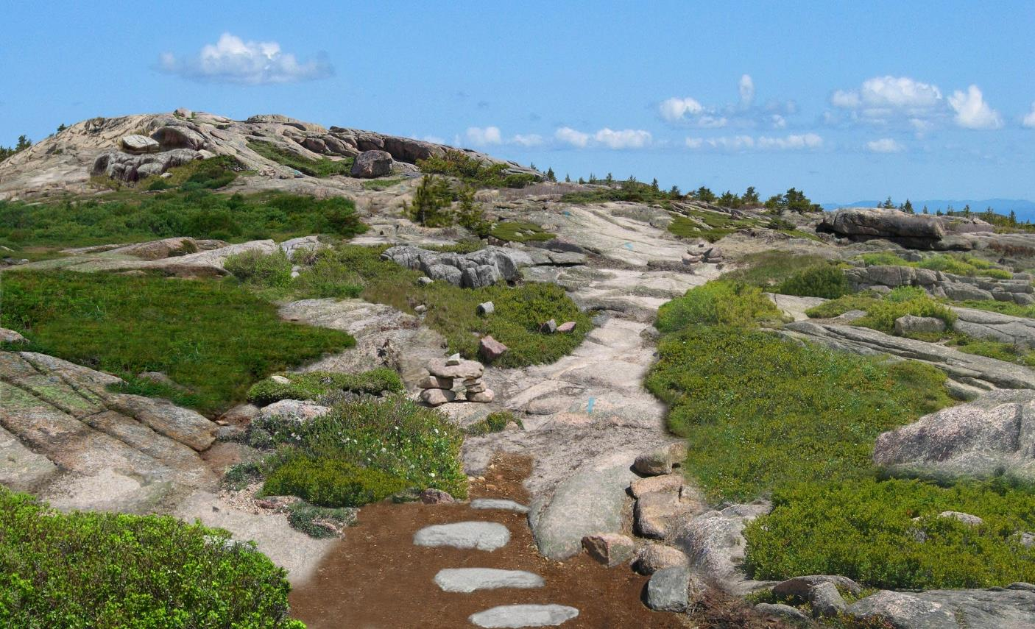
Park Studies Laboratory University of Vermont

Slide 32
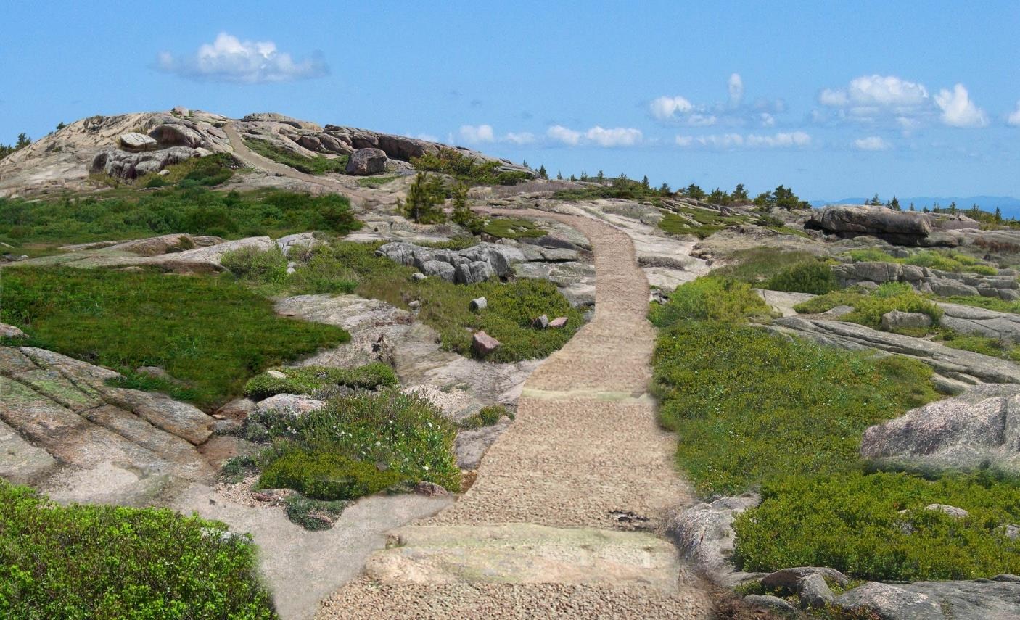
Park Studies Laboratory University of Vermont

Slide 33
Survey Research Methods
Park Studies Laboratory University of Vermont
On-site visitor survey conducted during summer and fall 2008 (n = 476; 82.9% response)
  Cascade: n=126, 92% response
  Camel’s Hump: n=157, 92.4% response
  Cadillac: n=193, 72.3% response
Objectives:
  Identify indicators of quality
  Identify standards of quality for selected indicator variables

Slide 34
Park Studies Laboratory University of Vermont

Slide 35

Park Studies Laboratory University of Vermont

Slide 36
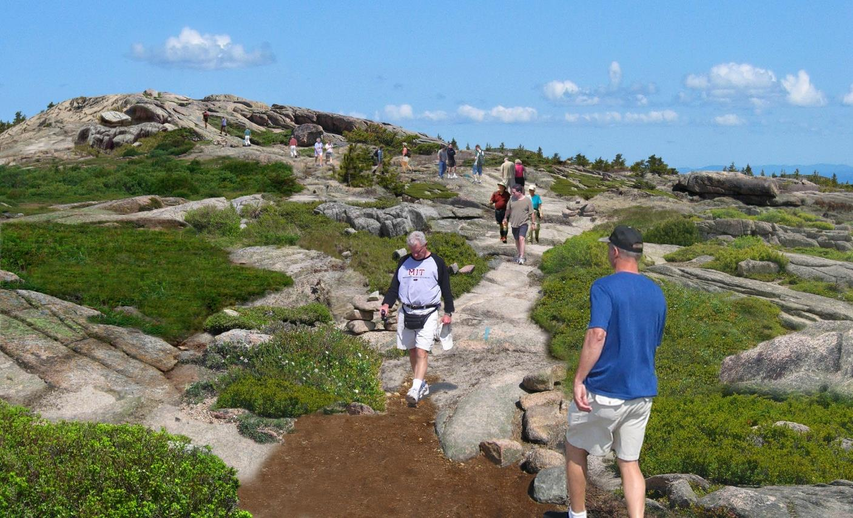
Park Studies Laboratory University of Vermont

Slide 37
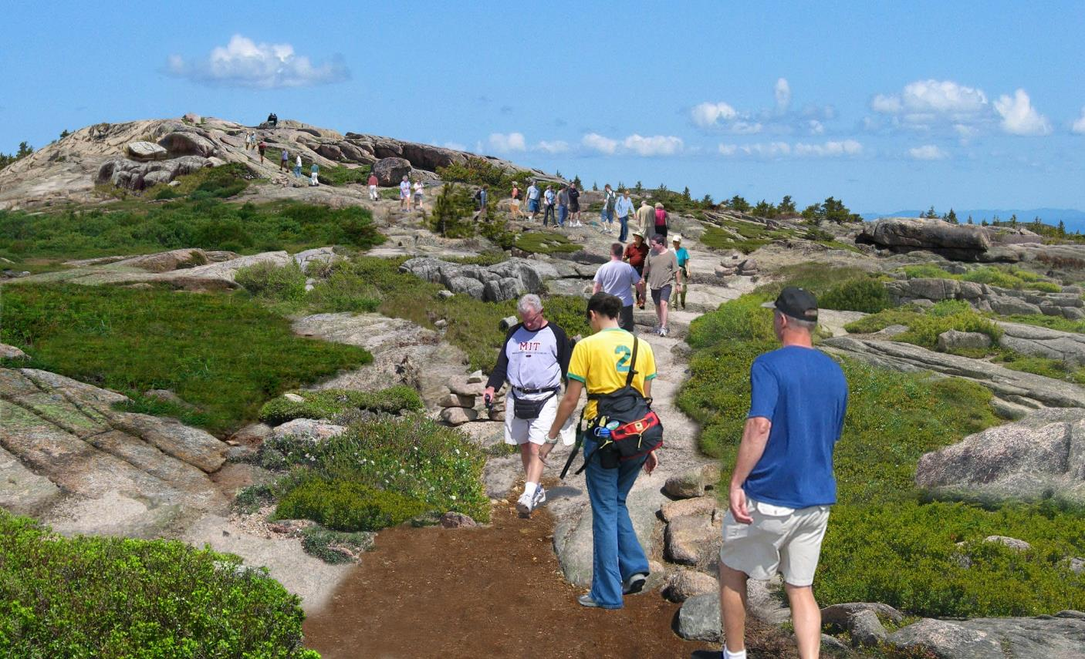
Park Studies Laboratory University of Vermont

Slide 38
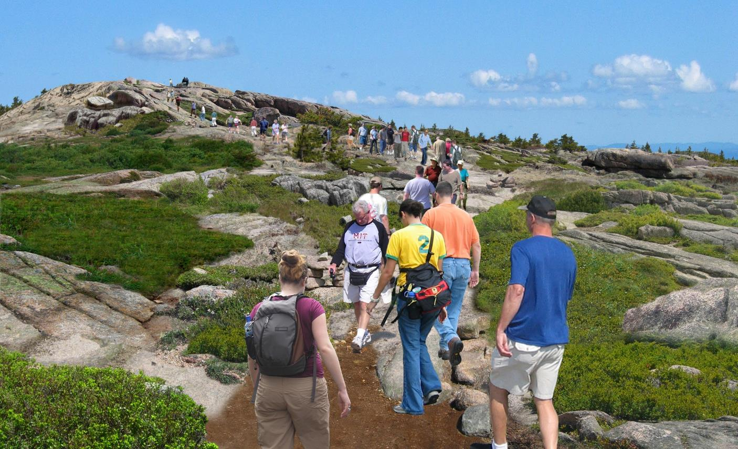
Park Studies Laboratory University of Vermont

Slide 39
Park Studies Laboratory University of Vermont

Slide 40
Park Studies Laboratory University of Vermont

Slide 41
Summary of Respondent Ratings of On-trail Use Level Photographs
Park Studies Laboratory University of Vermont
 | Cascade (n = 117-124) | Camel’s Hump (n = 143-156) | Cadillac (n = 177-192) | ANOVA
Use Level | Mean | Mean | Mean | F-value | p-value
0 people | 3.56 | 3.67 | 3.38 | 1.722 | .180
9 people | 2.68ª | 2.14^{a,b} | 3.10^{b} | 13.474 | < .001
18 people | 1.08^{c} | 0.63^{b} | 1.85^{b,c} | 13.051 | < .001
27 people | -0.73^{c} | -0.93^{b} | 0.13^{b,c} | 9.479 | < .001
36 people | -2.38^{c} | -2.47^{b} | -1.51^{b,c} | 8.918 | < .001
Acceptability | 23.37 | 21.63 | 27.71 | − | −
Typically Seen | 13.59^{a,c} | 10.71^{a,b} | 19.08^{b,c} | 43.367 | < .001
Any two summits that share a superscript are significantly different (p < 0.05) according to Bonferroni’s least significant difference test

Slide 42
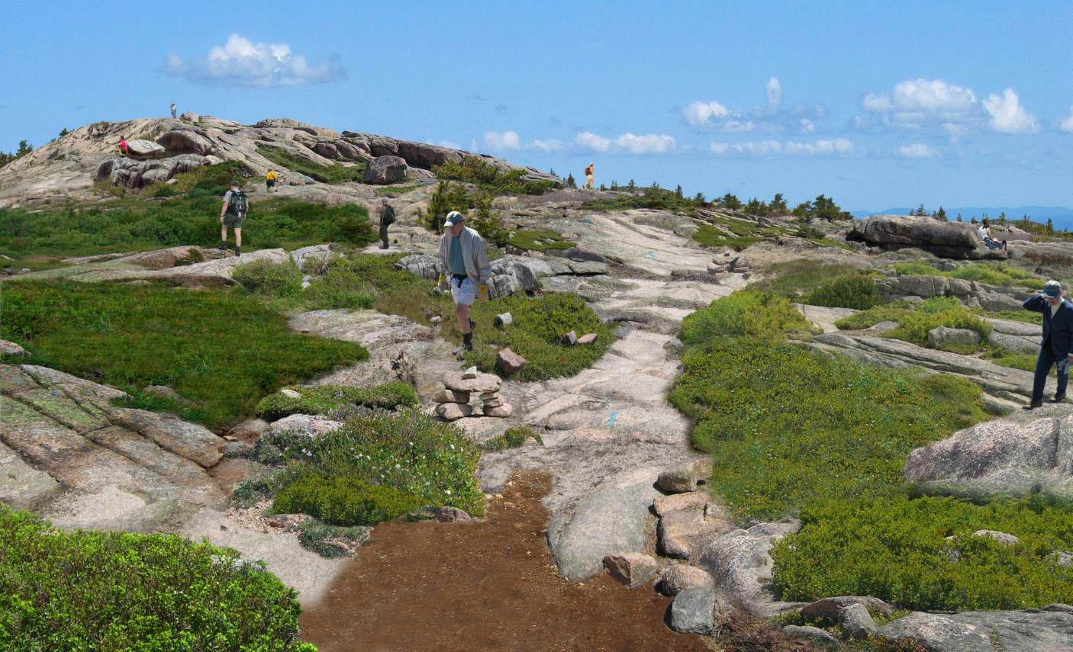
Park Studies Laboratory University of Vermont

Slide 43
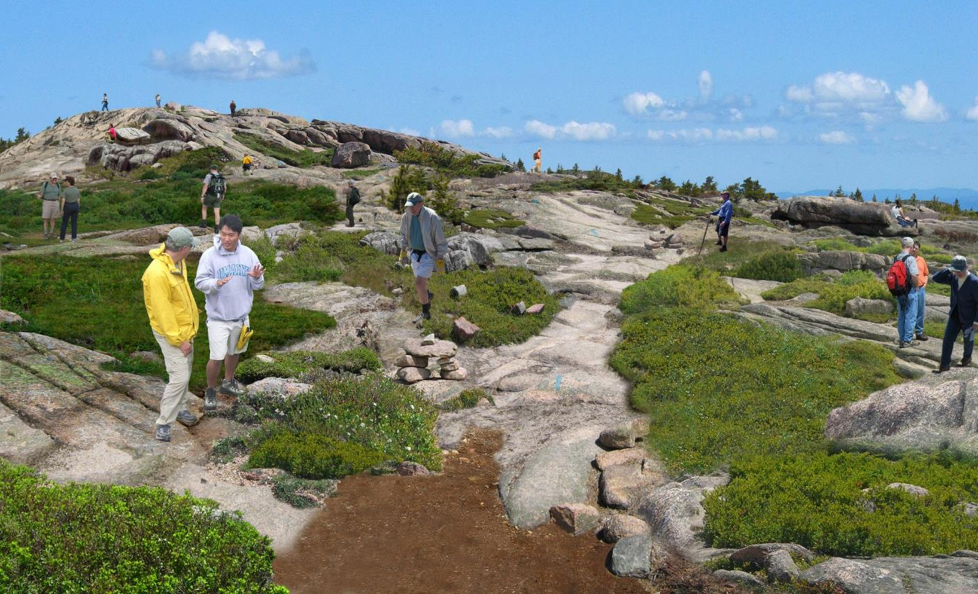
Park Studies Laboratory University of Vermont

Slide 44

Park Studies Laboratory University of Vermont

Slide 45
Park Studies Laboratory University of Vermont

Slide 46
Park Studies Laboratory University of Vermont

Slide 47
Park Studies Laboratory University of Vermont

Slide 48
Park Studies Laboratory University of Vermont

Slide 49

Park Studies Laboratory University of Vermont

Slide 50

Park Studies Laboratory University of Vermont

Slide 51
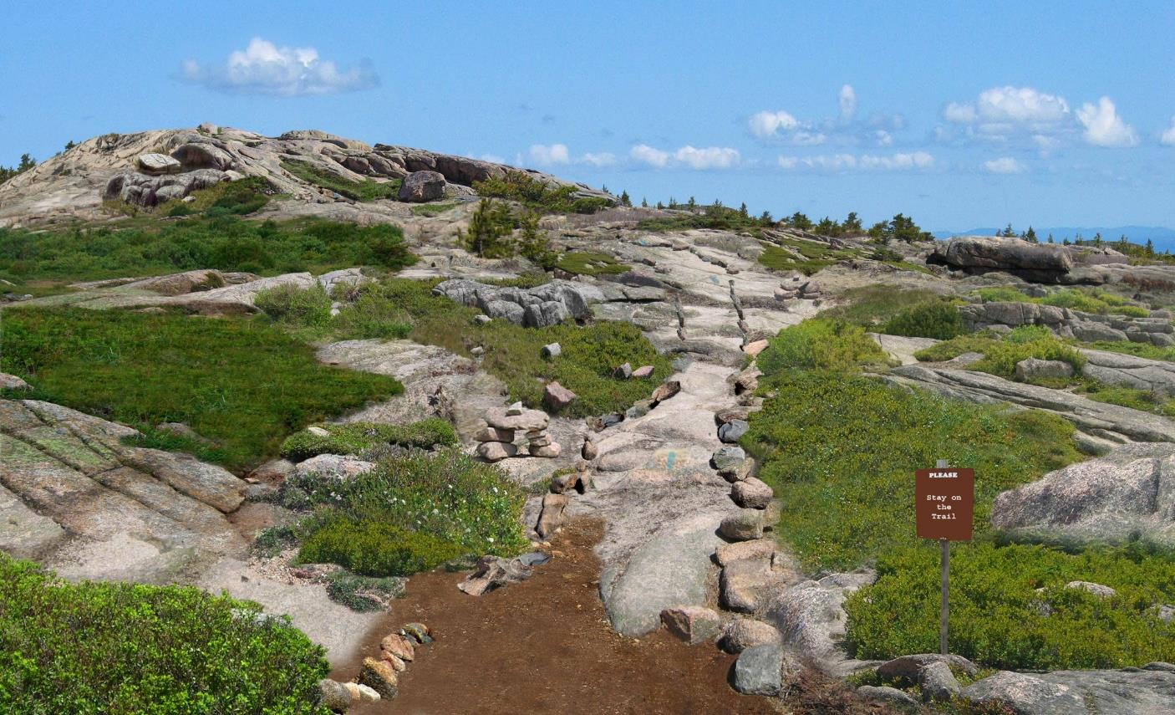
Park Studies Laboratory University of Vermont

Slide 52
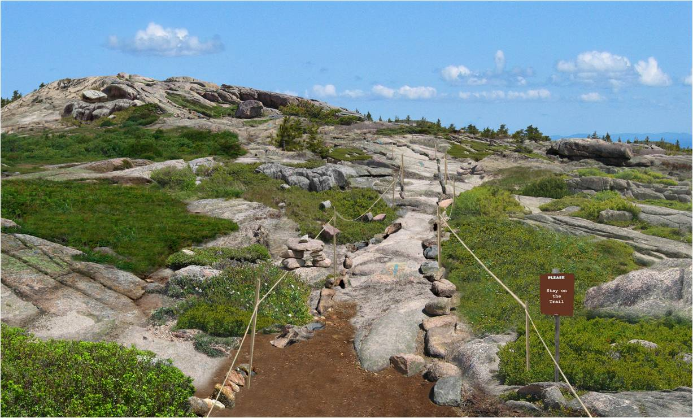
Park Studies Laboratory University of Vermont

Slide 53
Park Studies Laboratory University of Vermont

Slide 54
Conclusions
Park Studies Laboratory University of Vermont
Cascade visitors sensitive to
  Off trail summit use
  Impacts from off trail summit use
  “Obtrusive” management instillations
Cascade visitors NOT sensitive to
  Trail impacts
  “Natural” management instillations

Slide 55
Recreation Ecology Methods
Mapped summit area using GPS
  Cadillac : 71,020 m²
  Cascade: 7,606 m²
  Camel’s Hump: 5,336 m²
All trails mapped and assessed
Transect sampling and digital image analysis of 1m² quadrats to assess resource conditions and quantify land cover types
Cascade, Adirondack State Park, NY

Slide 56
Recreation Ecology Methods:
Land Cover Analysis

Slide 57
Recreation Ecology Methods:
Land Cover Analysis
Adapted methods used in campsite impact analysis (Marion 1991) and range management (Booth and Cox 2008)
Grid transect method
Grid created using Hawth’s Analysis Tools in ArcGIS
Digital images of 1m² quadrats
Images analyzed using SamplePoint
13 land cover classes measured

Slide 58
Recreation Ecology Methods:
Land Cover Analysis

Slide 59
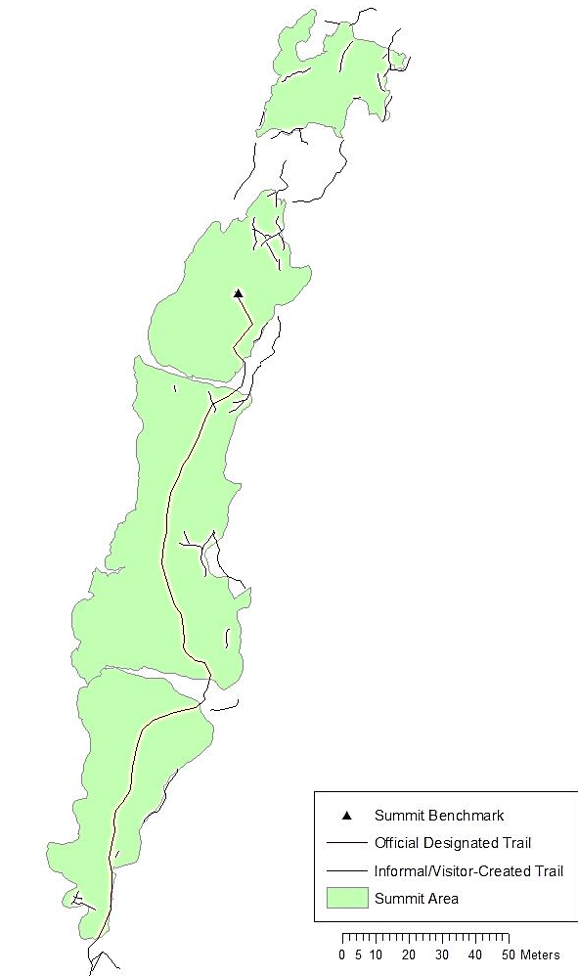
Ecological Assessment: Trail Analysis - Cascade
Number of Segments | 45
Linear Extent (miles) | 0.26
Average Trail Width (inches):
Minimum | 8
Maximum | 30
Mean | 15.3
Condition Class:
CC1 | 6.7%
CC2 | 26.7%
CC3 | 33.3%
CC4 | 24.4%

Slide 60
Ecological Assessment:
Land Cover Analysis
Land Cover Class | Cascade | Camel’s Hump | Cadillac | F-value | p-value
Vegetation | 20.40^{a,c} | 44.25ª | 44.29^{c} | 32.879 | < .001
Lichens | 3.14^{a,c} | 32.70ª | 36.25^{c} | 116.557 | < .001
Organic Soil | 1.78^{a,c} | 0.52ª | 0.39^{c} | 11.047 | < .001
Mineral Soil | 4.72ª | 0.59^{a,b} | 6.73^{b} | 20.703 | < .001
Bare Rock | 68.45^{a,c} | 20.11^{a,b} | 11.27^{b,c} | 369.198 | < .001
Any two summits that share a superscript are significantly different (p < 0.05) according to Bonferroni’s least significant difference test

Slide 61
 | Cascade | Camel’s Hump | Cadillac Mountain
 | Percent | Percent | Percent
Vegetation Cover Present | 20.4 | 44.3 | 44.3
Visitors said they typically saw… | 61.7 | 67.0 | 72.0
Acceptability | 44.3 | 42.9 | 46.7

Slide 62
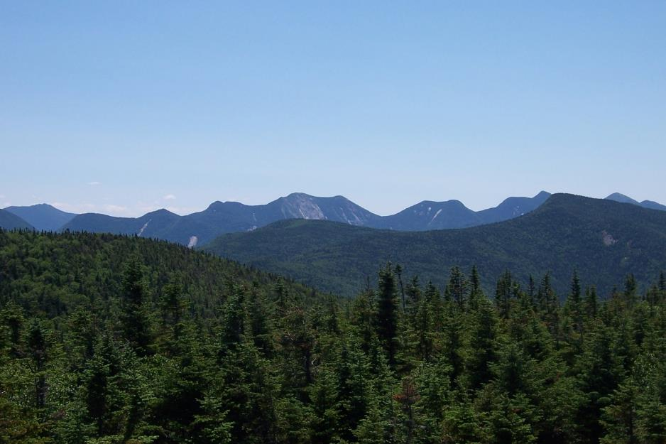
University of Vermont
Park Studies Laboratory
Park Studies Laboratory University of Vermont
http://www.uvm.edu/parkstudies/
View of the Great Range from summit of Cascade, Adirondack State Park, NY

