Slide 1
Field Trip to Lye Brook Wilderness Area
Assessment of Campsite Impact on Water Quality

Slide 2
Branch Pond near trailhead: our first stop

Slide 3
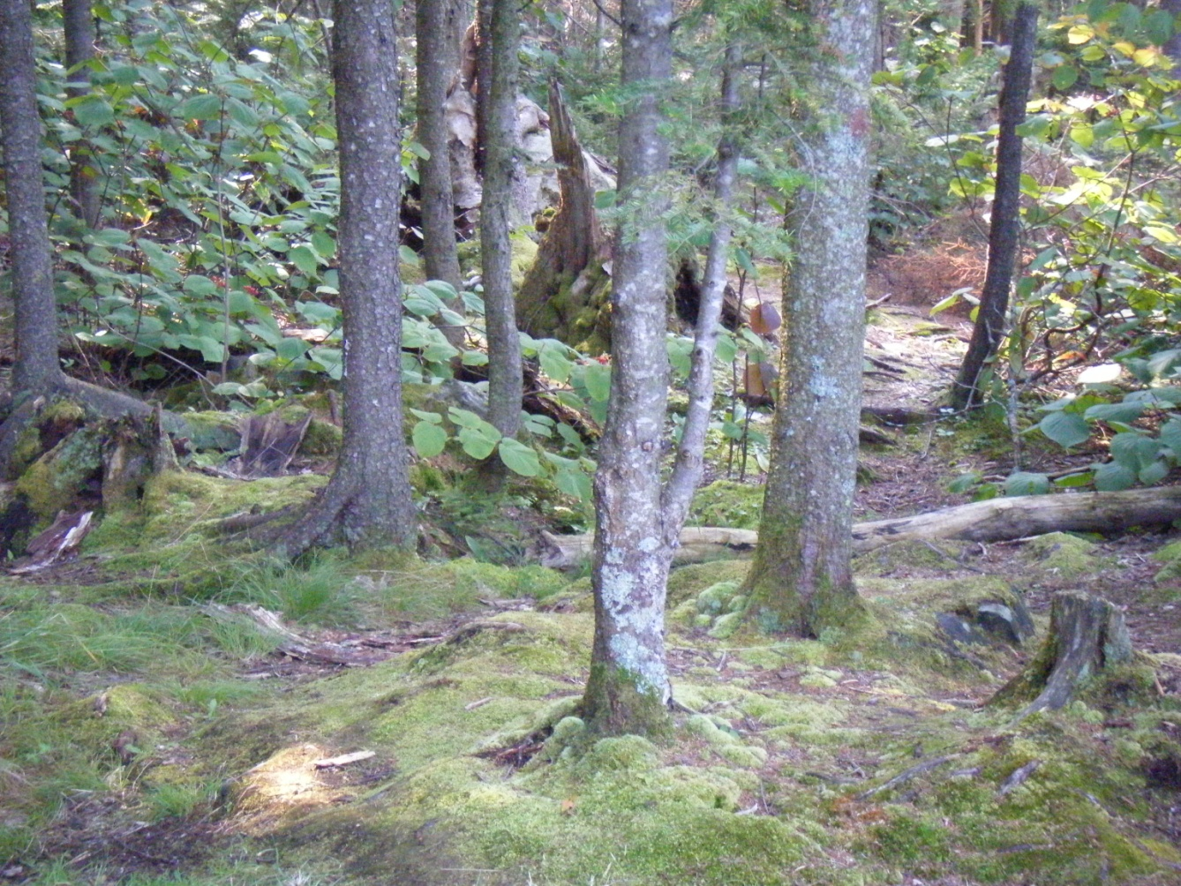
Branch Pond
Branch Pond near the trailhead at the end of Kelly Stand Road. Networks of trails to many tent sites exist. What is the impact of these sites on water quality, if any?

Slide 4
Tent site complex at Branch Pond
Note fire ring, and proximity of site to water’s edge. Counterclockwise from upper left: Diane Burbank (FS); Ben Cowan from GMC who will be staying at Bourn and Branch Ponds; Jim Kellogg (VT ANR) and Danna Strout (FS).

Slide 5
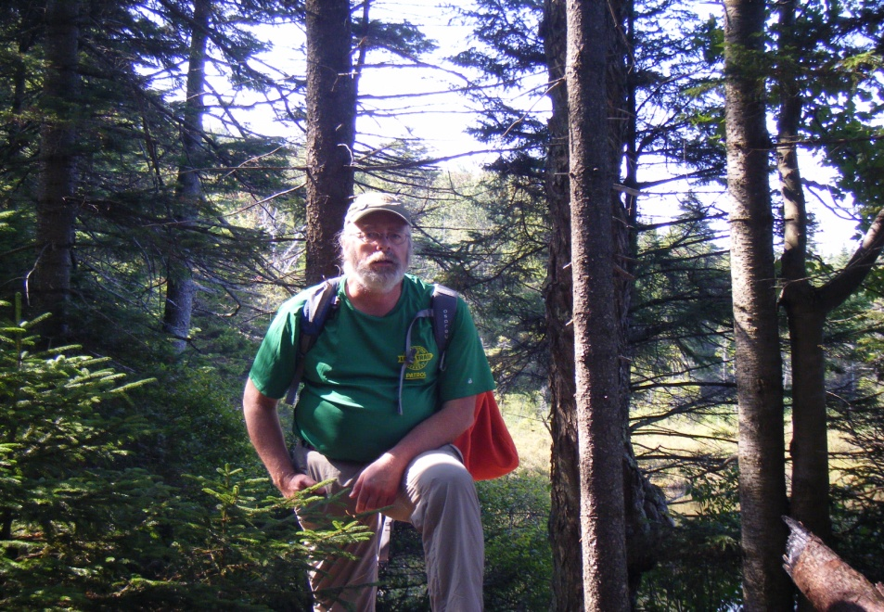
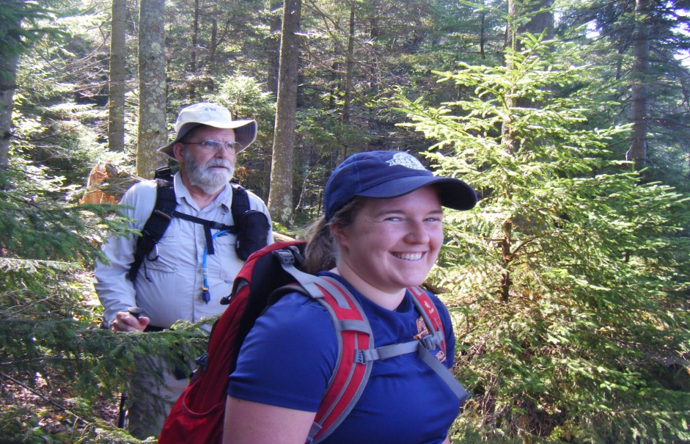
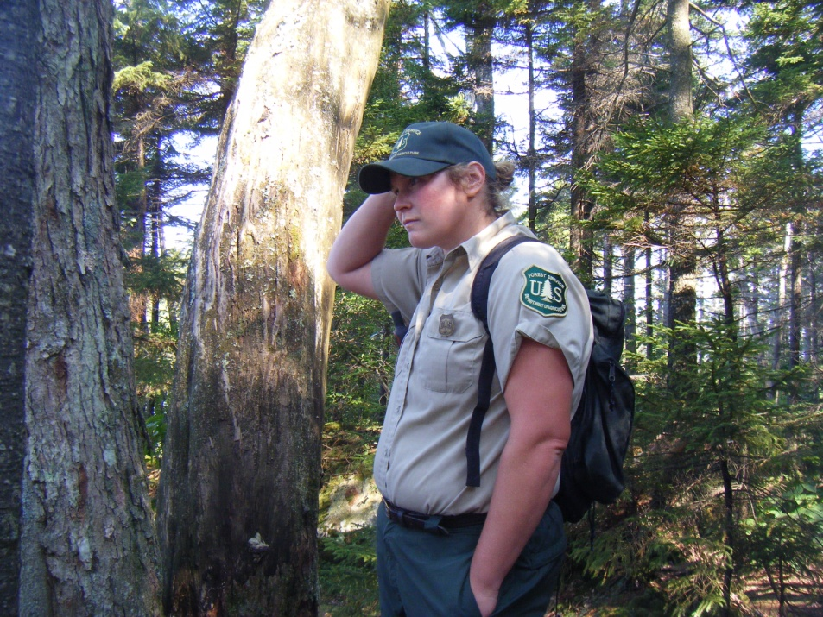
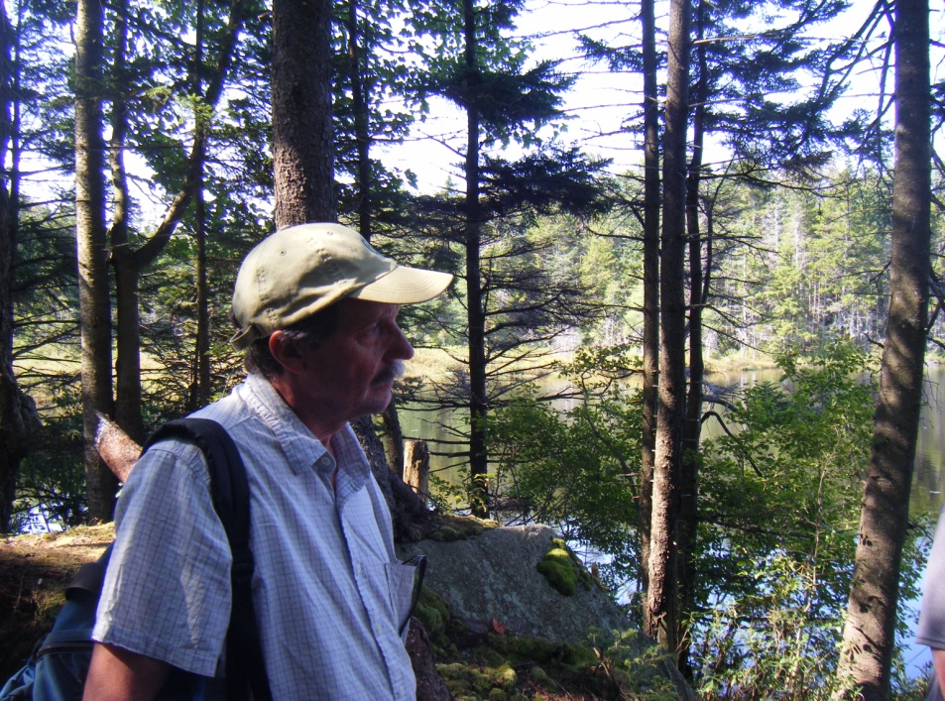
Different management outlooks
Dave Hardy
GMC
Jeff Sullivan and Emily Benning
Dave Hardy
Danna Strout
FS
VT ANR
Jim Kellogg
Danna Strout

Slide 6
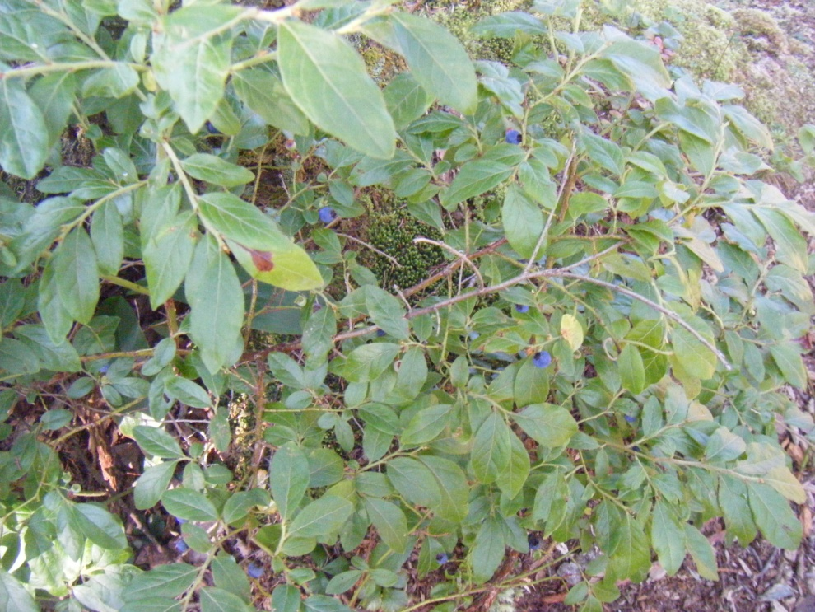
WQ and poopage
One item that was discussed at our first stop at Branch Pond was whether it would help to have a port-a-potty installed, to decrease the side trails into the woods and to reduce E. coli and other poop related bacteria from running off into the pond.
Wilderness considerations come into play in this discussion, too, though Branch Pond is not in the wilderness area.

Slide 7
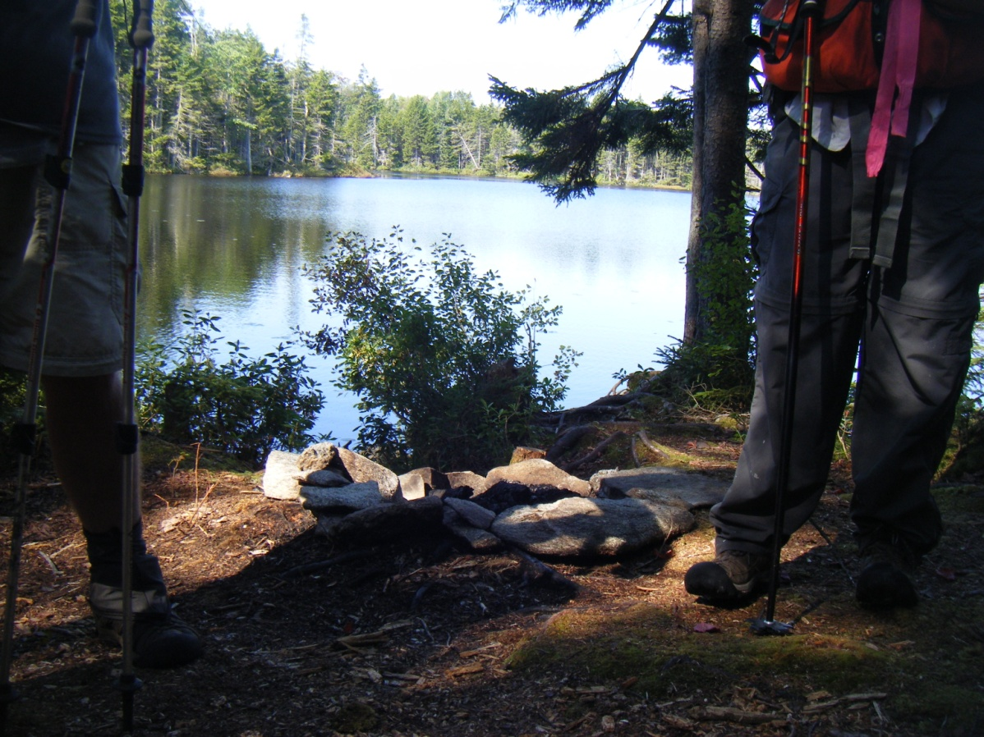
Site Closure?
Jim would be happy to see all the high impact sites closed to allow for hardening up and recovery. But he is supportive of any efforts to reduce erosion and other WQ impairment.
Note the lack of vegetative recovery at this site, despite the closure of Kelly Stand Rd for several years post – Irene.

Slide 8
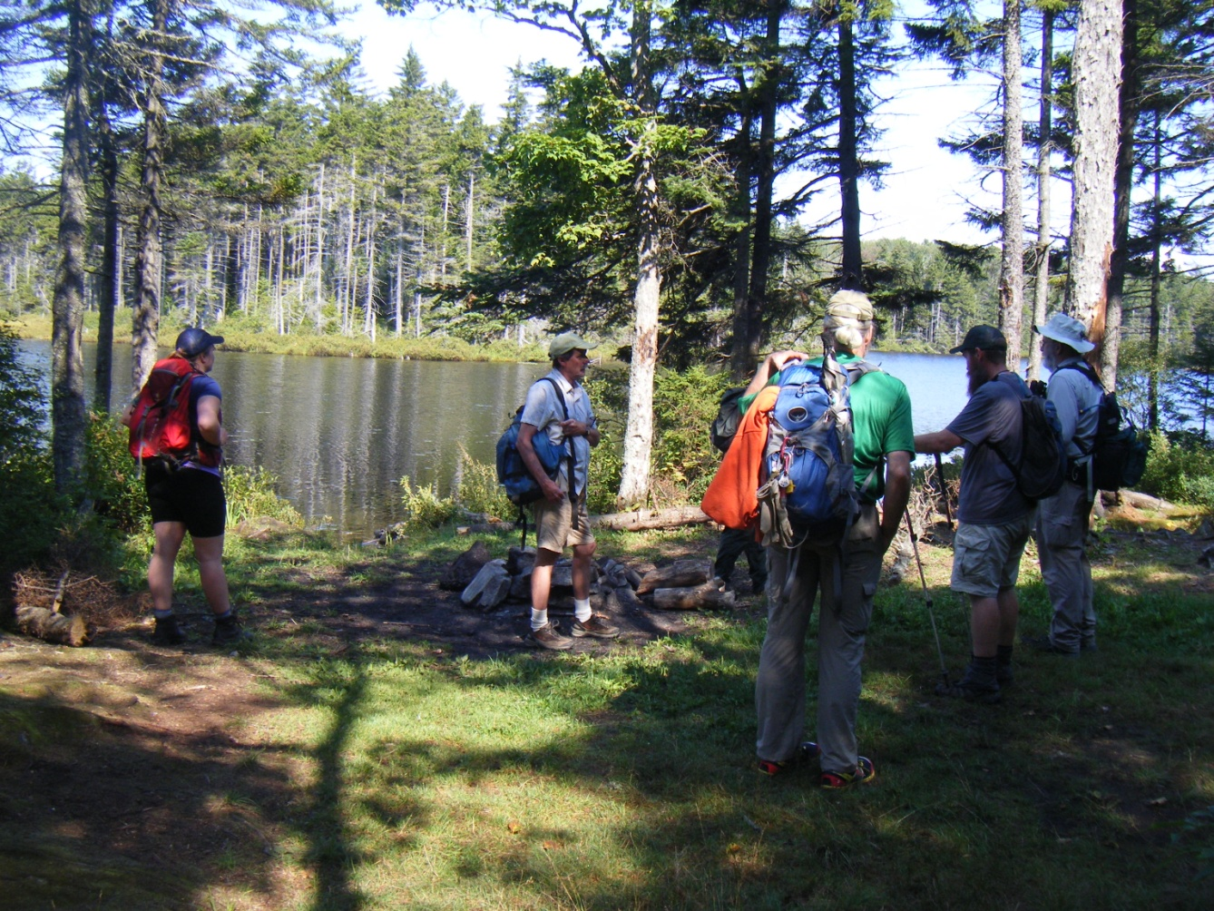
Survey use
The GMC folks are eager to allow for recreation but understand the impact concerns, and have hired a person who will live at the ponds and survey usage. This person may eventually be more of a caretaker/educator.

Slide 9
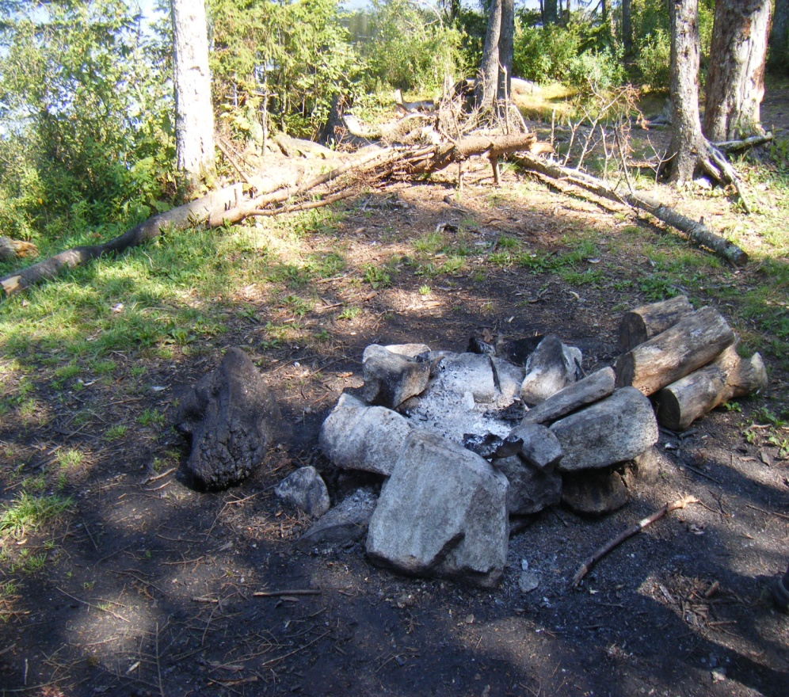
FS perspectives
The Forest Service folks are a tad more laissez-faire, being constrained by budgets and limited personnel.
Enforcement of closure would not be easy.
Note the grass that has recovered at this site, likely due to the limited access while Kelly Stand Rd was closed.

Slide 10
Limited availability of personnel would make enforcing site closure difficult.

Slide 11
Many sites are in use

Slide 13
Bourne Pond
Campers have cut trees down in addition to using downed wood to construct fire pit furniture

Slide 14
Data on WQ Impact?
Is there any evidence of water quality impairment from tent sites? Yes, in terms of erosion – silt (settled) can be observed in the ponds where trails come down to the water, and can be observed during rain events. E. coli is not measured, and WQ sampling is not done frequently enough or close enough to the sites to detect direct impact.

Slide 15
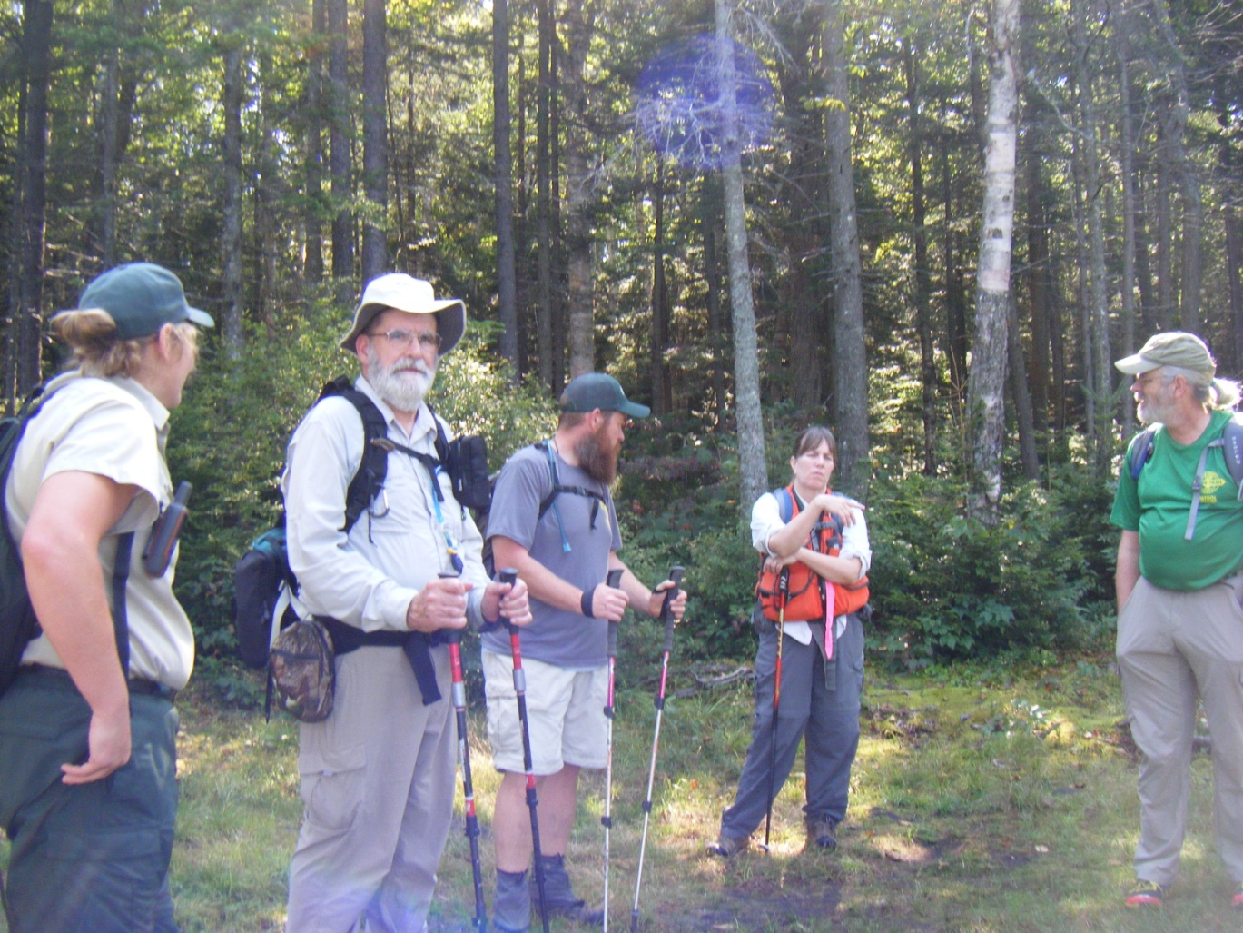
Other options were discussed
From left to right, above: Dave Hardy, (GMC), Angie Quintana, (USFS), Emily Benning, (GMC), and Jim Kellogg (VT ANR)
From left to right: Danna Strout (USFS), Jim Sullivan and Ben Cowan, (GMC), Diane Burbank (USFS), and Dave Hardy (GMC)

Slide 16
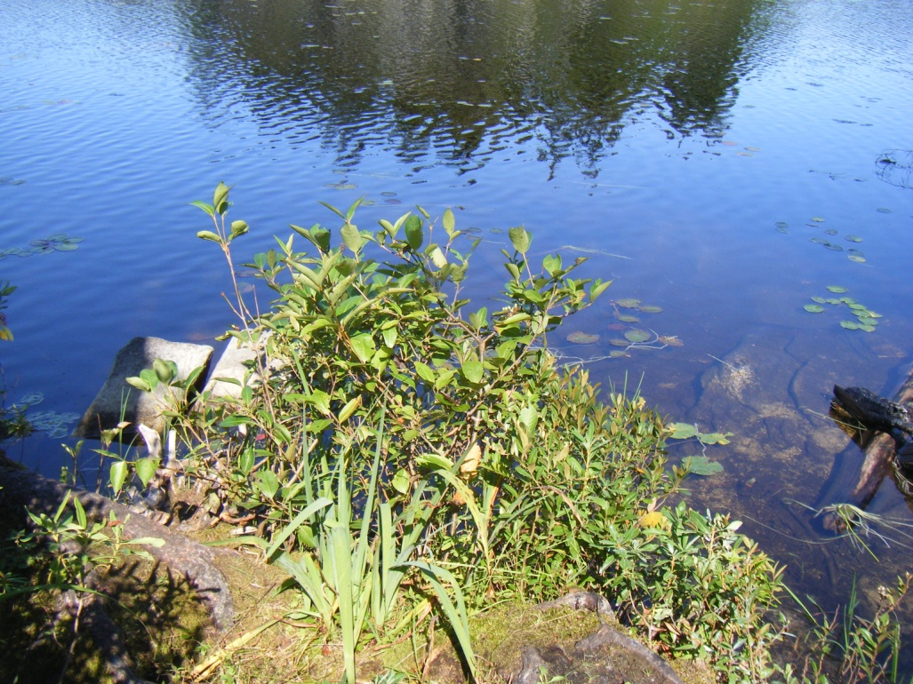
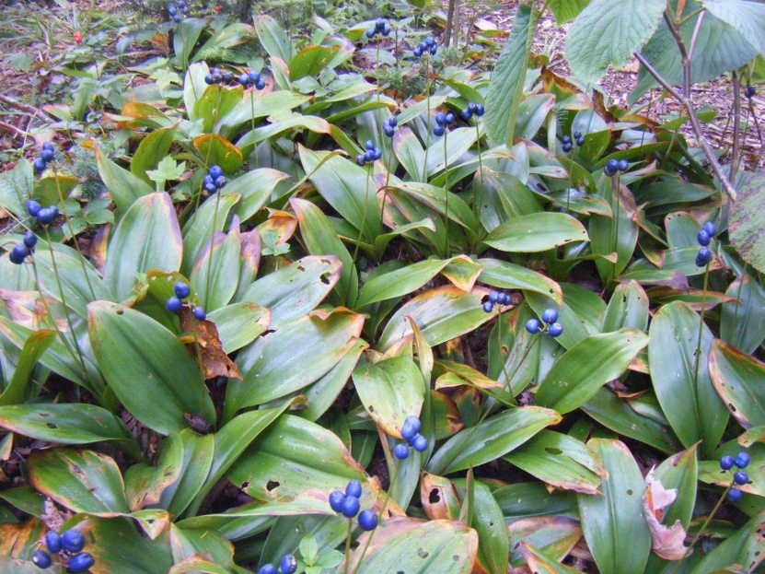
Mitigating run-off by strategic placement of boulders and berms might be the easiest first step.

Slide 17
Other discussion points
Desire to have people recreate and experience wilderness
Need to have someone at the tent sites like MM summit caretaker
Recent lakeshore protection legislation – does it cover Branch Pond (which is not wilderness)?

Slide 18
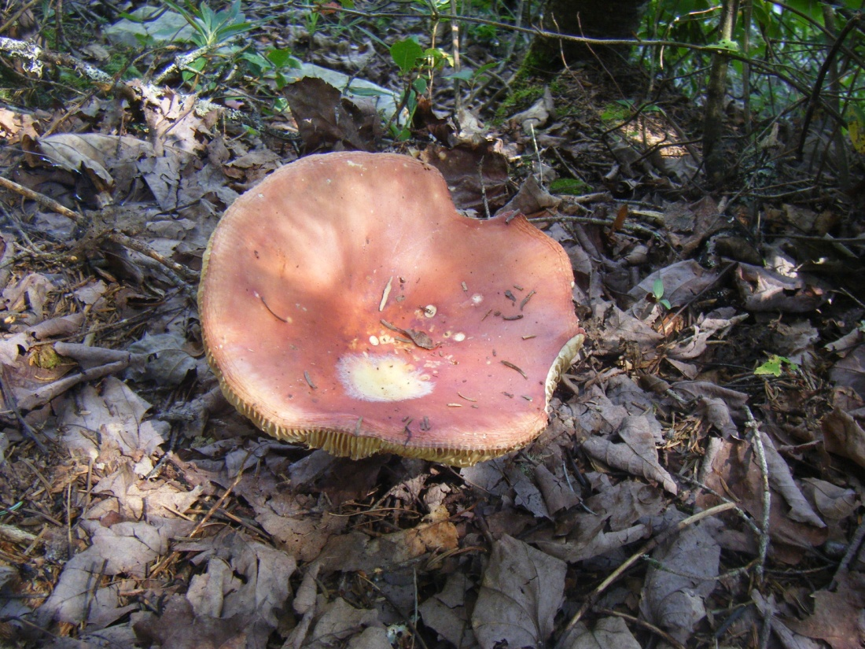
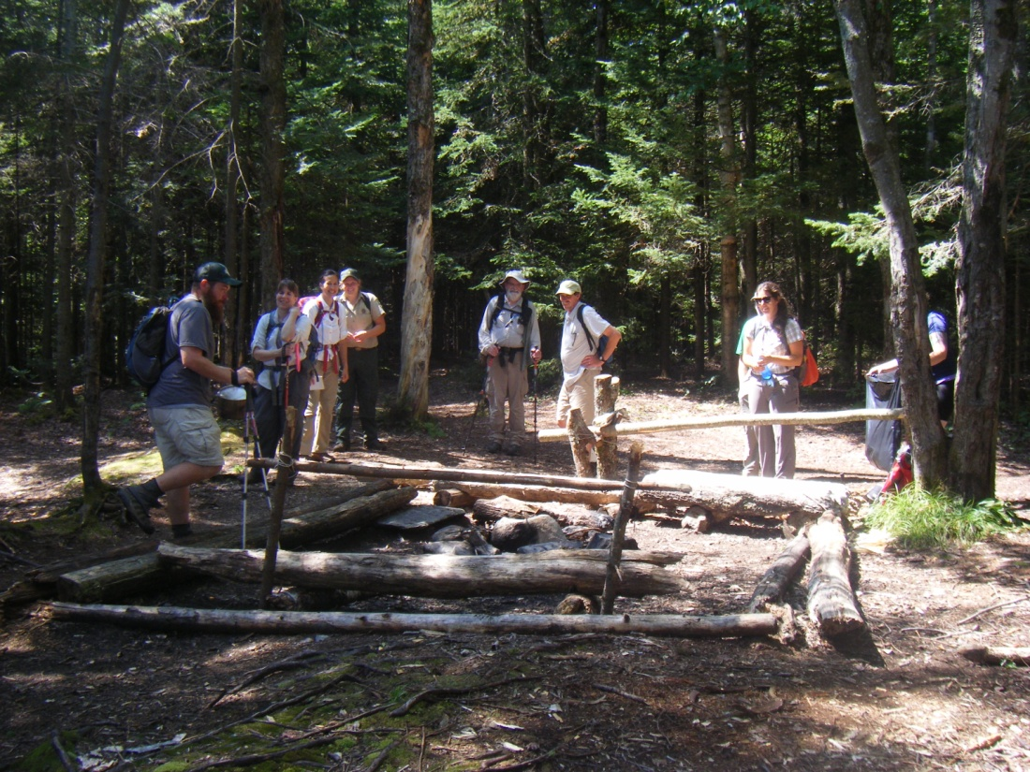
Contemplating wilderness experience and unofficial, structured campsites. Note damage to vegetation.

Slide 19
Debating the issues…

Slide 20
And despite differences
Everybody loves this place…

Slide 22
The end

