Slide 1
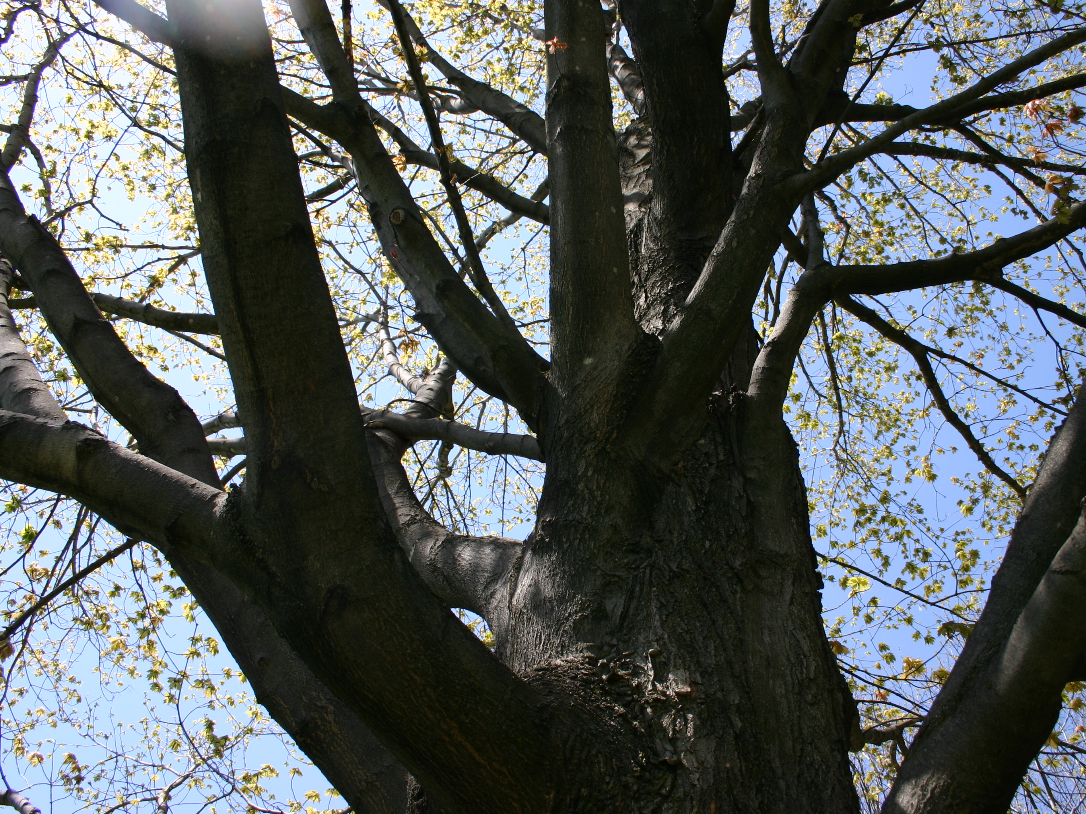

Key Findings and Recommendations from an i-Tree Eco inventory in the City of Winooski
Phase 1
Prepared for the
Winooski Natural Resources Conservation District
by Alexandra Kosiba
March 2015
www.winooskinrcd.org

Slide 2
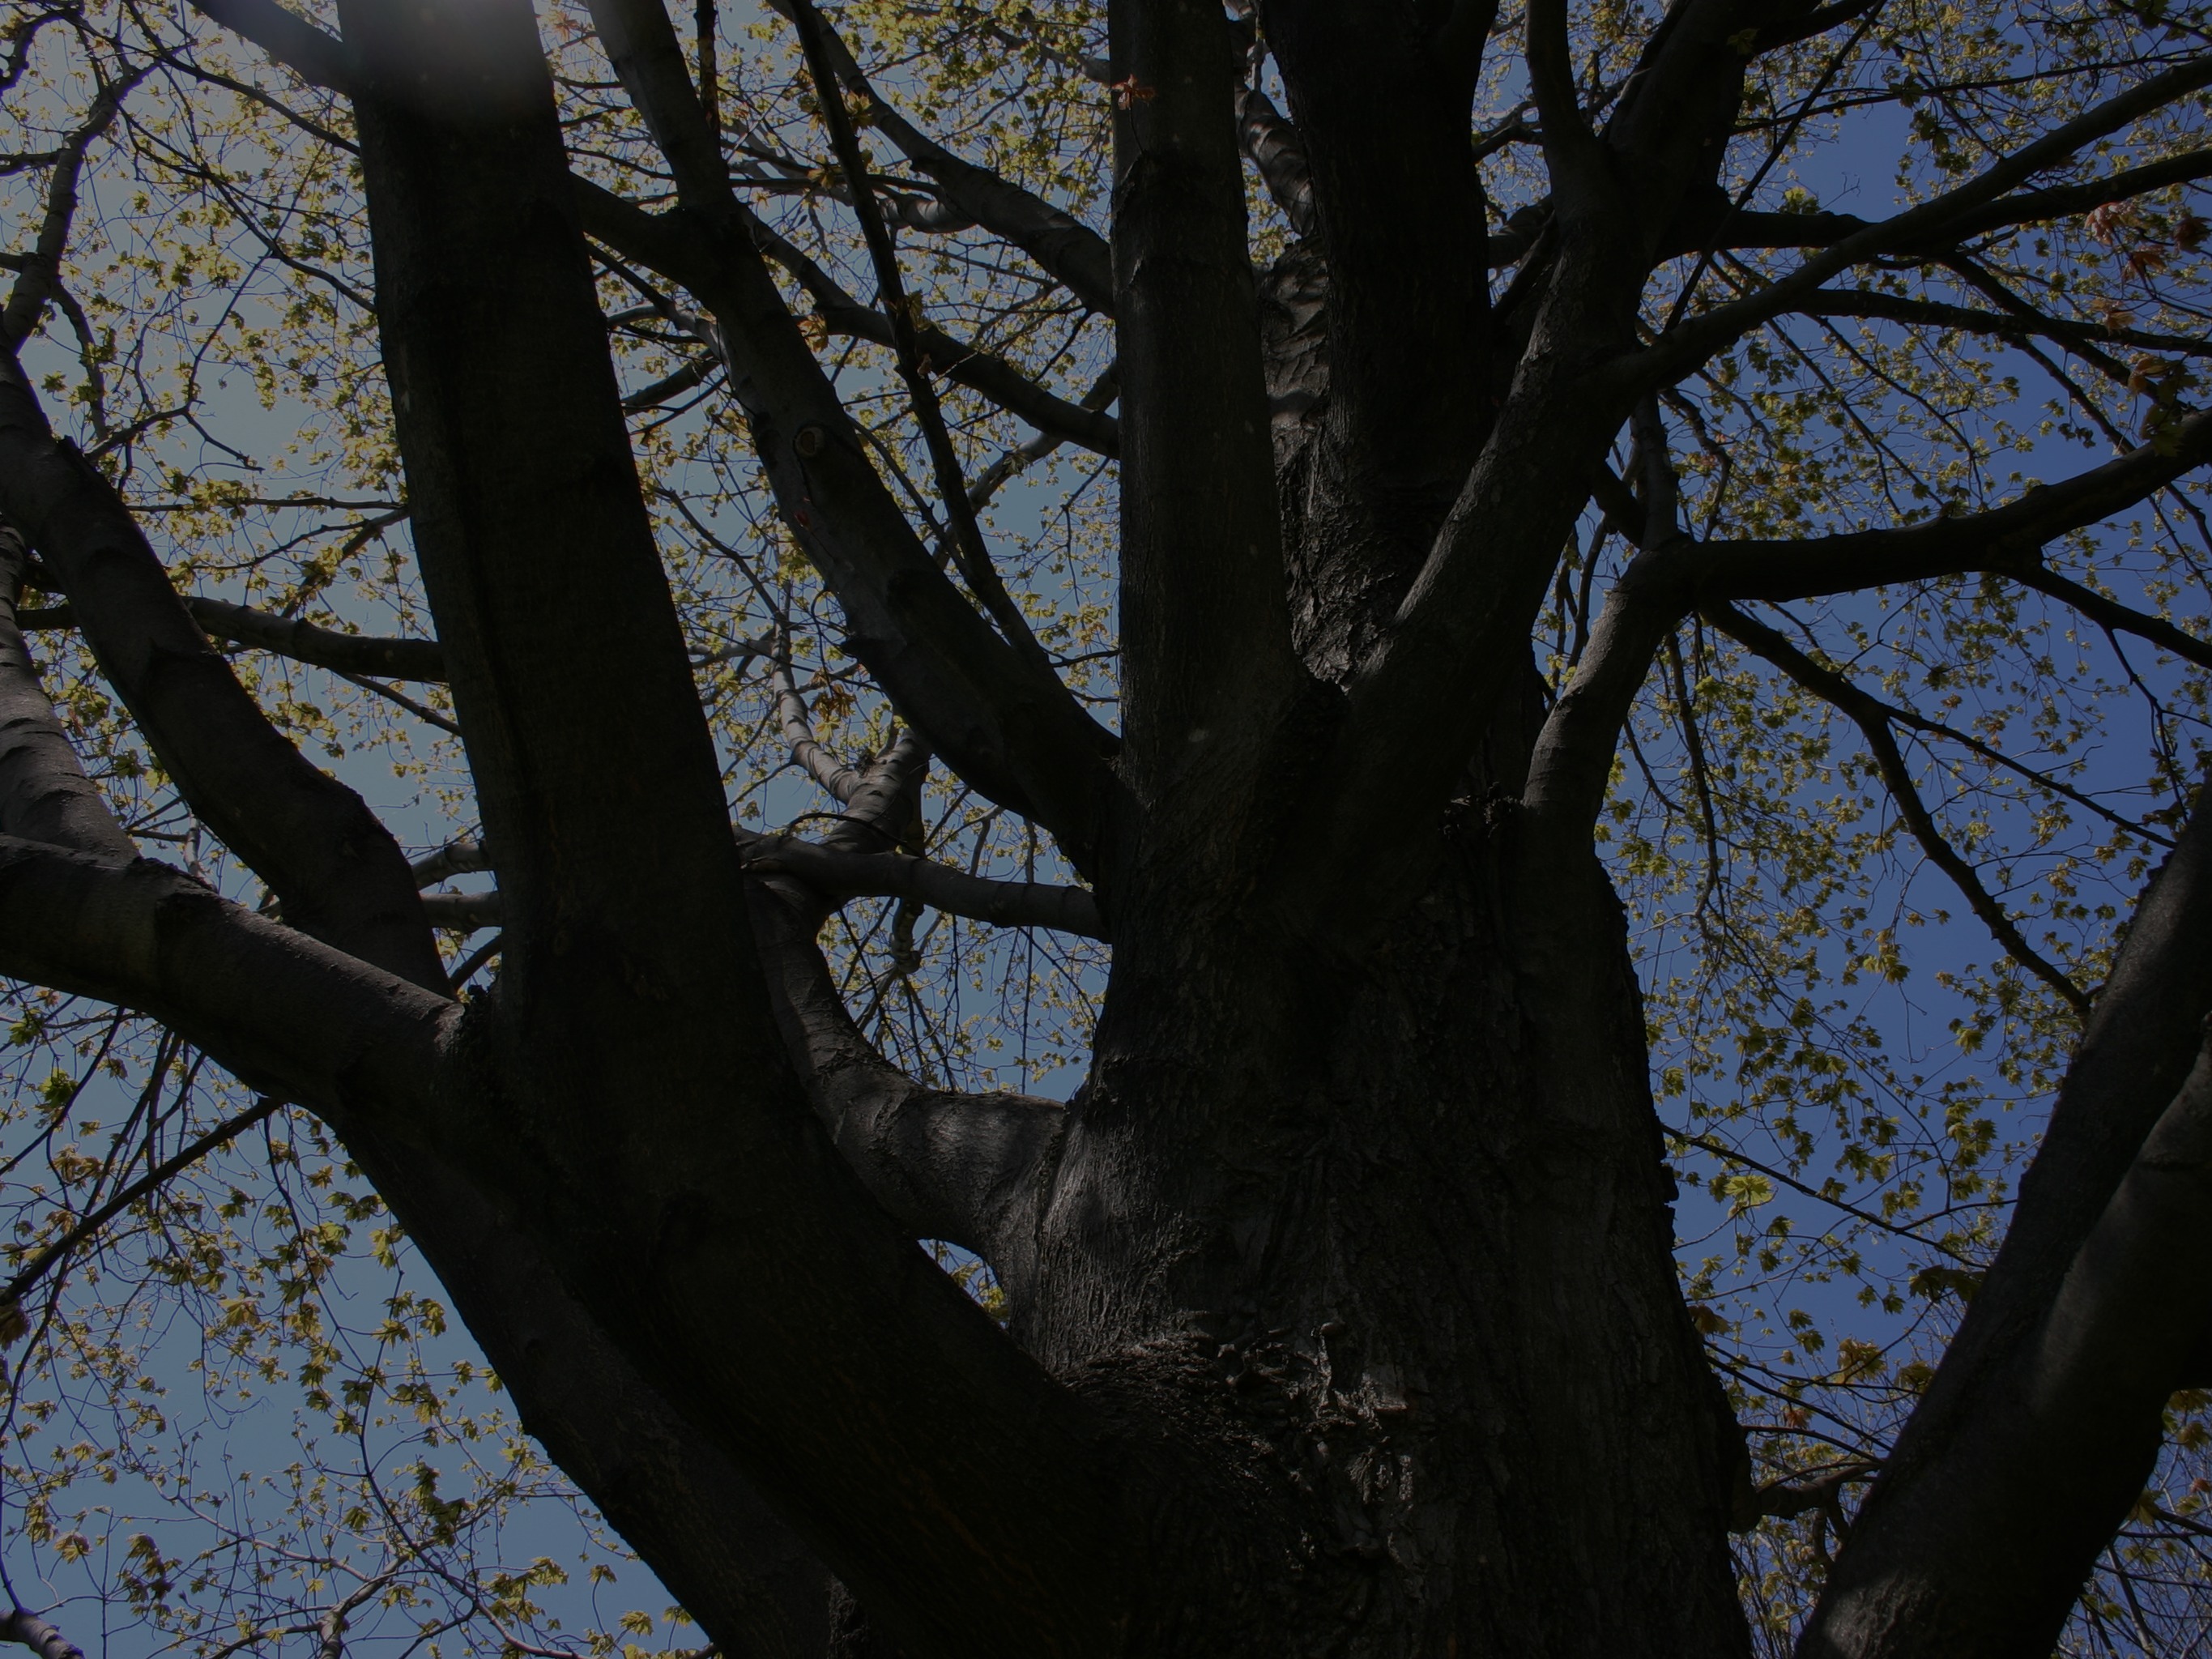




Urban Canopy Inventory in Winooski
  In 2014, The Winooski Natural Resources Conservation District (WNRCD) received a Caring for Canopy grant from the Vermont Department of Forests, Parks and Recreation to complete an ecosystem service inventory of the urban tree canopy of the City of Winooski.
  WNRCD worked with multiple partners to complete this inventory, including: The Vermont Monitoring Cooperative, Winooski Department of Public Works and student volunteers from the Rubenstein School of Environment and Natural Resources at the University of Vermont.

Slide 3
Why Complete a Canopy Inventory in Winooski?
As the most densely populated city in Vermont, Winooski’s urban canopy has an extremely important role to play both socially and environmentally.
An inventory of the urban canopy will help the City of Winooski and its residents understand the makeup and function of the existing urban forest.
The collected and analyzed data will strengthen current City efforts to develop a community-driven tree program that maximizes ecosystem services provided by trees, including carbon storage and stormwater runoff absorption.

Slide 4
Summary of i-Tree inventory process conducted by UVM volunteers
Data collected from 39 field plots in Winooski in 2014
  stratified by land use type: residential, commercial-industrial, or public
Collected data on
  ground and tree cover
  available planting space
  individual tree and shrub attributes – such as, species, stem diameter, height, crown width, dieback, and proximity to residential buildings
Analyzed using i-Tree Eco model (U.S. Forest Service)
  estimates trees per species and land use type, plot characteristics, and ecosystem services provided by the woody vegetation

Slide 5
Project Goals
Quantify the carbon sequestration and rainfall infiltration (avoided runoff) by the urban forest in Winooski
    Values of ecosystem services are quantified using national ecosystem service values
      Social cost of carbon – default value and current value (2014)
        $22.8 → $25.89/metric ton CO₂
      Cost of stormwater treatment: national value
        $0.0089 per gallon
Use these results to communicate the value of the urban canopy in Winooski and to recommend future plantings to maximize these two ecosystem services

Slide 6
Key Findings & Estimates
Estimated number of urban trees: 58,600
Tree cover: 30.9%
Most common species: White ash, Eastern red cedar, American elm
Percentage of trees less than 6"diameter: 62.6%
Estimated pollution removal: 11 metric tons/yr ($419,000/yr)
Estimated carbon storage: 10,600 metric tons ($836, 000 to $1,040,000)
Estimated carbon sequestration: 325 metric tons/yr ($25,500 /yr to $31, 700/yr)
Estimated oxygen production: 705 metric tons/yr
Estimated avoided runoff: 29,200 m³/yr ($68,700/yr)
Estimated structural value: $56,000,000
Total estimated valuation of urban forest: $57,349,200 - $57,559,400

Slide 7
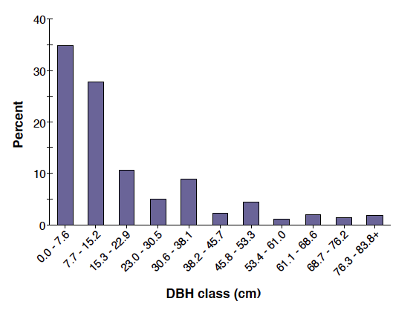
Percent of tree population by diameter class
62.6% are less than 6” in diameter
DBH= Diameter at Breast Height (1.4m)
From: i-Tree Eco Report

Slide 8
Percent of trees by assessed crown condition city wide

Slide 9
Percent of trees by assessed crown condition by land use type

Slide 10
Estimated tree density

Slide 11
Estimated rainfall intercepted by woody vegetation

Slide 12
Estimated percent of groundcover per land use type

Slide 13
Estimated percent of space available for planting

Slide 14
Relative Tree Effects
Total carbon storage is equivalent to… | Amount of carbon emitted in Winooski in 98 days Annual emissions from 7,040 automobiles Annual emissions from 3,540 single-family houses
Annual carbon sequestration is equivalent to… | Amount of carbon emitted in Winooski in 3 days Annual emissions from 200 automobiles Annual emissions from 100 single-family houses
Carbon monoxide removal is equivalent to… | Annual emissions from 1 automobile Annual emissions from 2 single-family houses
Nitrogen dioxide removal is equivalent to… | Annual emissions from 81 automobiles Annual emissions from 54 single-family houses
Sulfur dioxide removal is equivalent to… | Annual emissions from 252 automobiles Annual emissions from 4 single-family houses
Particulate matter less than 10 micron (PM₁₀) removal is equivalent to… | Annual emissions from 13,400 automobiles Annual emissions from 1,300 single-family houses

Slide 15
Recommendations
Task | Outcome
Increase the number of sampled plots for i-Tree Eco | Decreases standard error (uncertainty) around estimates
Increase the total number of trees in Winooski | Increase both total carbon storage and annual sequestration Increase the total leaf cover and rainfall infiltration Increase pollution abatement
Increase the number of large trees | Increase total carbon storage Increase the total leaf cover and rainfall infiltration Increase pollution abatement
Maintain good health of the city’s current trees | Maintain total carbon storage and annual sequestration Maintain tree’s full leaf canopy and rainfall infiltration Maintain pollution abatement Long-term investment

Slide 16
Recommendations
Task | Outcome
Promote long-lived tree species | Increase long-term carbon storage Avoid replanting costs Reduces pollutant emissions from planting and removal
Increase the structural diversity of planted areas e.g., maintaining woody shrubs and small trees below large trees | Increase both total carbon storage and annual sequestration Increase the total leaf cover and rainfall infiltration Increase pollution abatement
Promote trees with high leaf area indexes e.g., larger trees, certain species | Increase rainfall infiltration Increase pollution abatement
Utilize evergreen trees | Increase removal of particulate matter for more months of year Increase rainfall infiltration for more months of year

Slide 17
Recommendations
Task | Outcome
Utilize low maintenance trees | Reduce pollutants emissions from maintenance activities Reduces maintenance costs
Increase tree cover in commercial-industrial lands Commercial-industrial lands contain a high percentage of impervious surface and have the lowest number of trees/shrubs | Increase both total carbon storage and annual carbon sequestration Decrease runoff Increase pollution removal – esp. if proximal to parking lots/buildings
Promote a diversity of species | Help mitigate detrimental effects of introduced pest/pathogens Provides structural and genetic diversity Provides resiliency to effects of climate change

Slide 18
Summary
Inventory analysis shows that an increase in Winooski’s urban forest will increase the benefits of the ecosystem services the trees provide
Carbon sequestration and storage, avoided runoff, and pollution abatement, and structure values of the urban forest are not inconsequential. These services carry a high monetary valuation, with a total valuation of $57,349,200 to $57,559,400 depending on the cost of carbon
The analysis suggests increasing the number, size, and variety of trees in Winooski, especially focusing on commercial-industrial areas where tree and shrub density is low to increase ecosystem service values.
About 80% of Winooski’s trees are classified at excellent or good health
Only 39 plots were surveyed for this study; therefore results should be interpreted with caution due to the small sample size. It is recommended to continue the inventory with additional plots

Slide 19
Additional Project Components and Next Steps
Volunteers worked with the Winooski Natural Resources Conservation District and the Winooski Department of Public Works to plant 130 trees at the Wastewater Treatment Facility on West Allen Street. These trees were planted to help reduce stormwater runoff.
The inventory will be continued in the summer of 2015. An additional 20 plots will be inventoried in Winooski. The newly collected data will be combined and analyzed with the 2014 data.
The expanded inventory will contribute important baseline data for the development of a Winooski Tree Management Plan.
The Winooski Natural Resources Conservation District will work with the City of Winooski to develop a citizen-run Tree-Board to oversee tree health and management in the City.

Slide 20
Special Thanks to…..
Thank you to the UVM volunteers who participated in the inventory!
Kristen Switzer
James Biddle
Angela Karas
Chris Griffin
Jackson Massey
Tyler Kinne
The UVM Climate Change Adaptation and Relief Efforts (CARE) student club
Aswini Cherukuri
Olivia Lukacic

