Slide 1

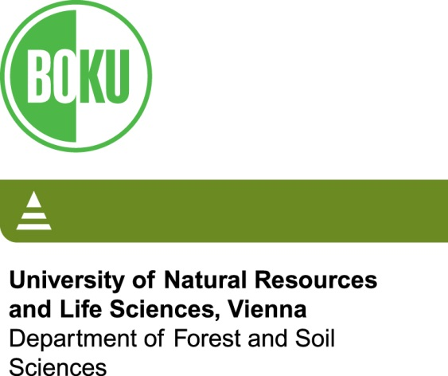



Forest structure could mitigate negative impacts of climate change on functional diversity in northeastern North America
Dominik Thom, Anthony Taylor, Rupert Seidl, Wilfried Thuiller, Jiejie Wang, Marie Robideau, William Keeton
Notes:
1

Slide 2
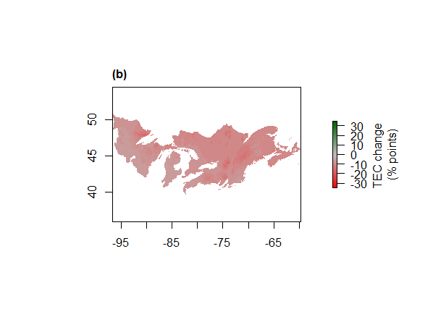
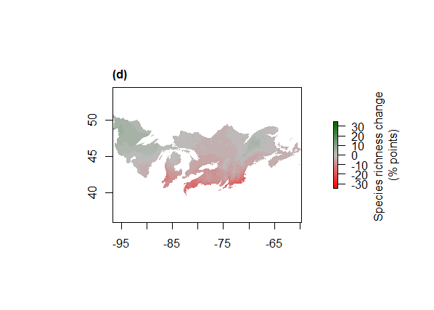
Climate change affects biodiversity and ecosystem services
Climate change challenges the objectives of forest management in northeastern North America
Thom et al. (2019)
12/13/2019
Dominik Thom

Slide 3
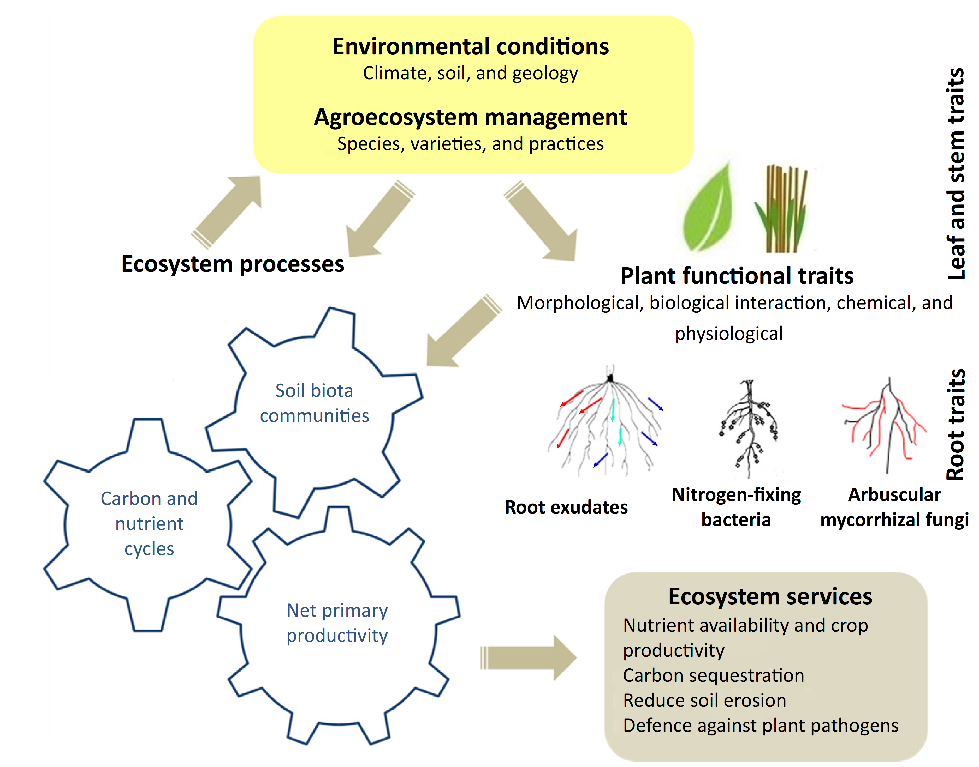
Ecosystem response depends on functional trait diversity
Faucon et al. (2017)
12/13/2019
Dominik Thom

Slide 4

Challenges for forest management
Increasing functional diversity is a promising, yet not well-understood strategy to increase adaptive capacity
  Which regions are poor in functional diversity?
  What drives functional diversity?
  Is functional diversity sensitive to climate change?
12/13/2019
Dominik Thom

Slide 5
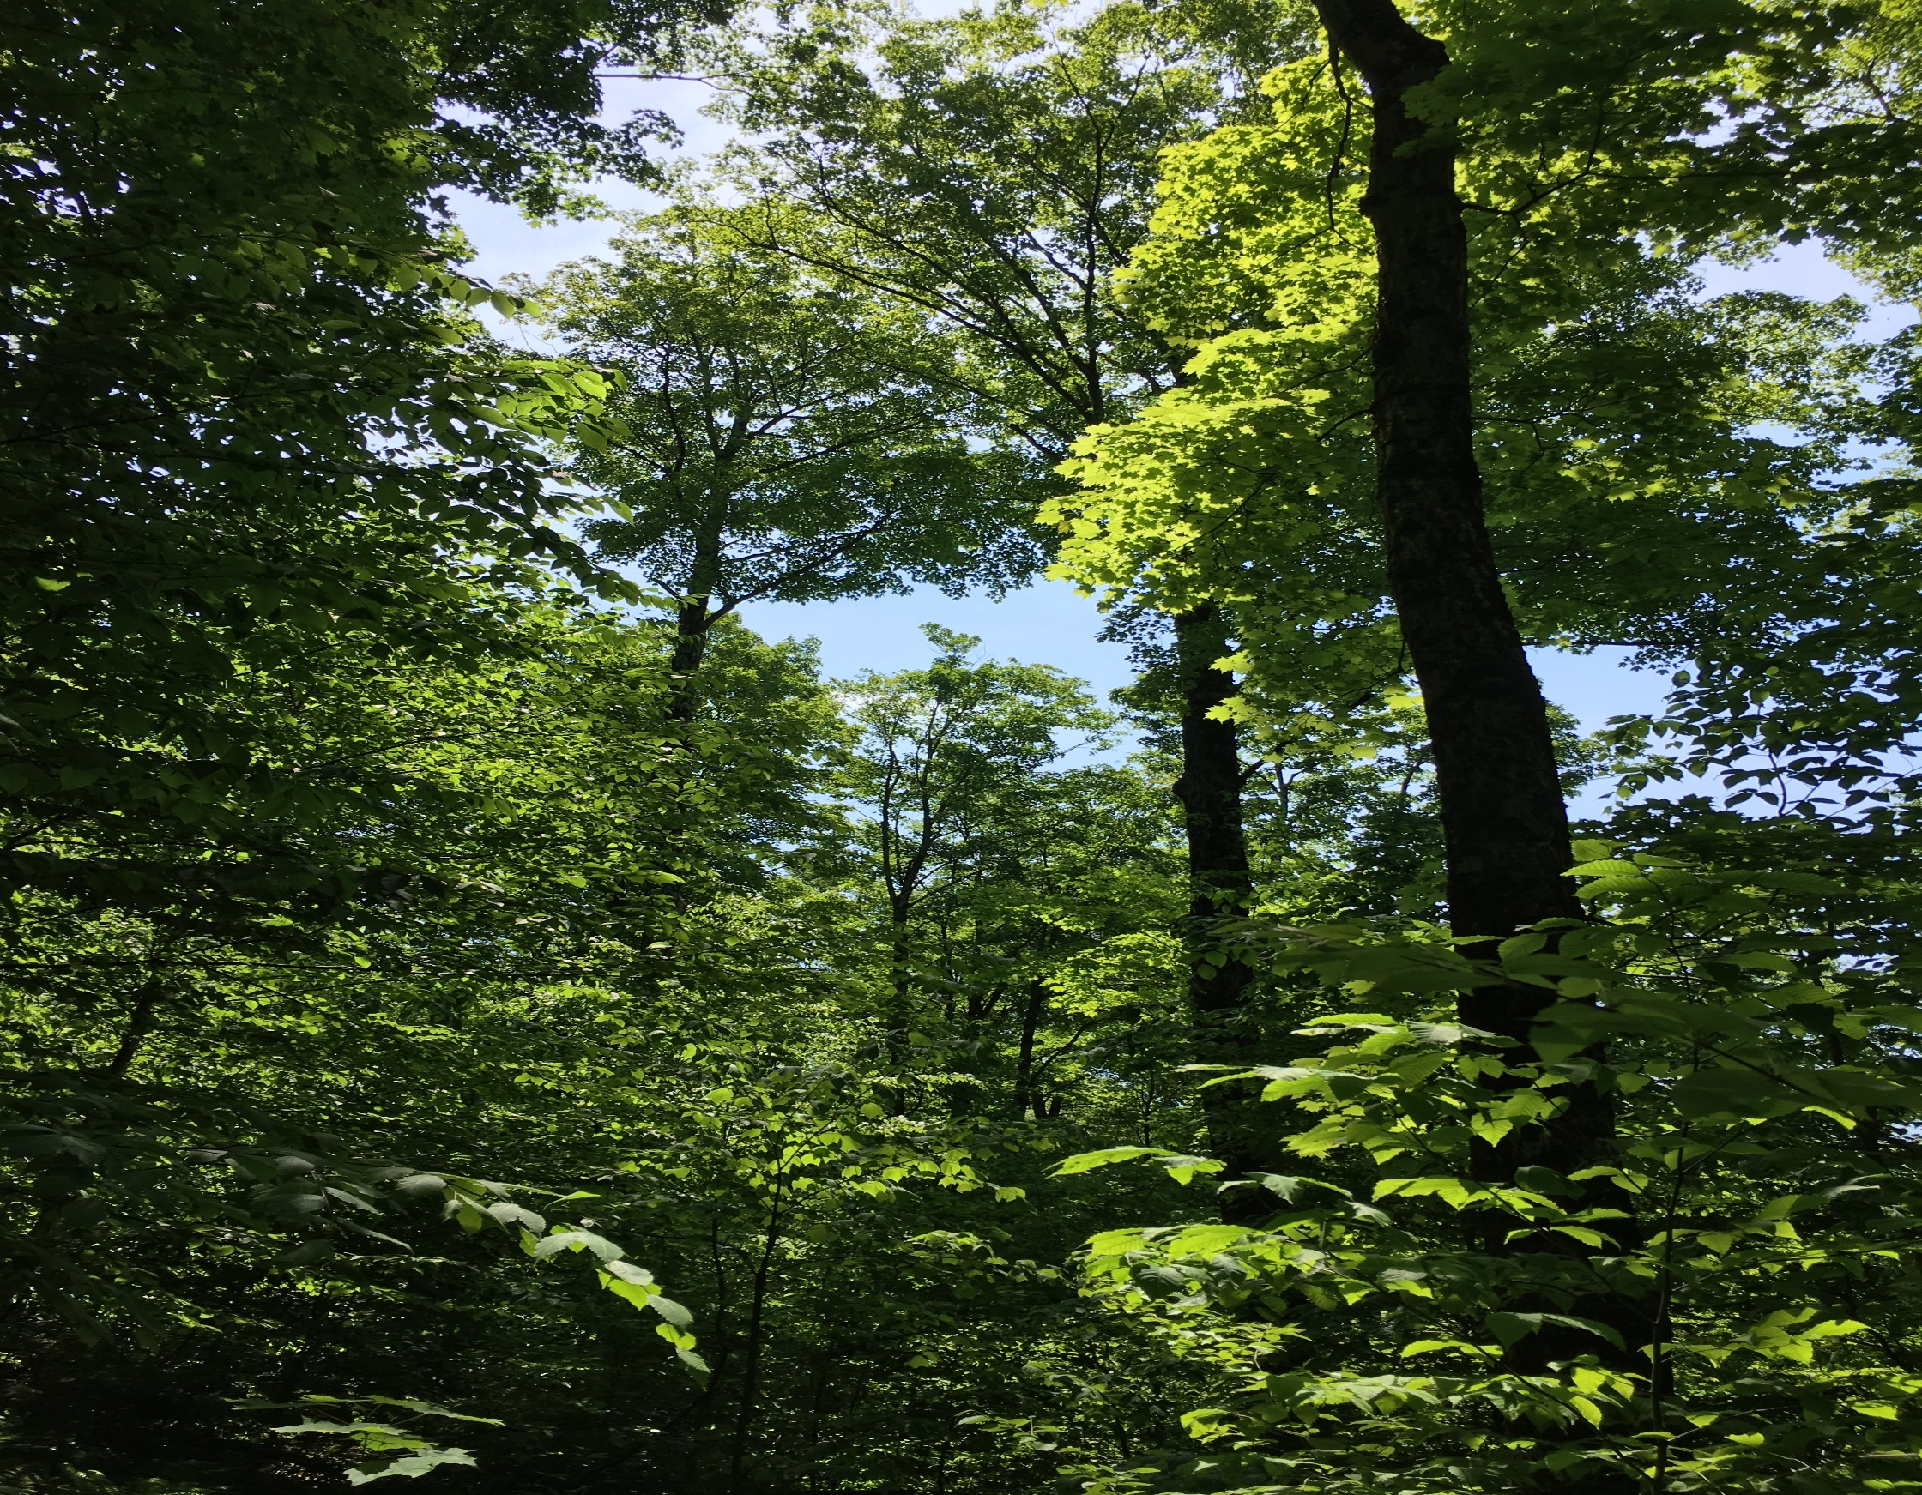
Objectives
1. Map the current functional trait diversity distribution throughout northeastern North America
2. Analyze the functional diversity drivers
3. Test the sensitivity of functional diversity to projected increases in temperature and precipitation

Slide 6
Functional trait data
Literature and database review for growth, recruitment, and survival traits
In total 1570 traits of 43 northeastern tree species found
http://www.kalkalpen.at
12/13/2019
Dominik Thom

Slide 7
Community data and drivers
Five boreal and temperate ecoregions with ca. 2.8 Mio km² forest cover
> 48,000 permanent sample plots
25 explanatory variables related to forest structure, climate, topography, soils, and stewardship
http://www.kalkalpen.at
12/13/2019
Dominik Thom

Slide 8
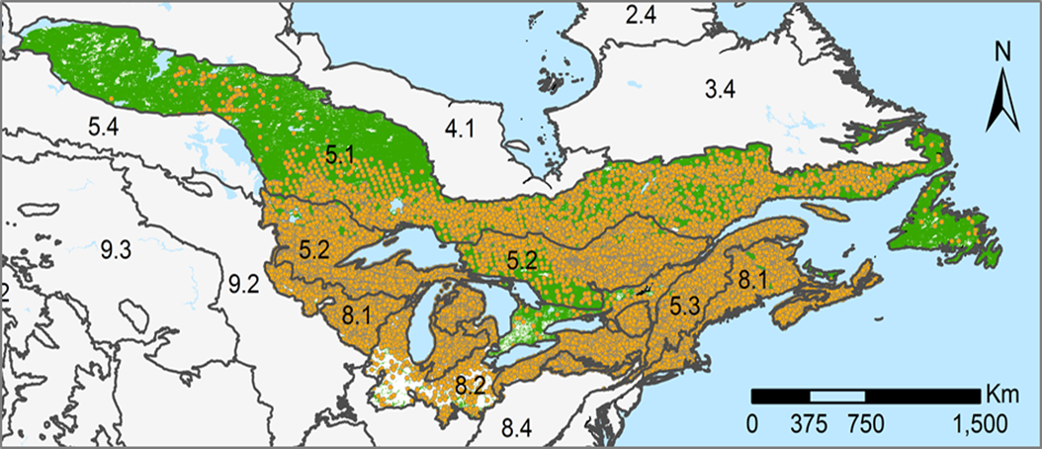
Functional diversity analysis
Functional similarity of tree species
90 non-parametric models to test functional diversity drivers
Climate sensitivity analysis (+4°C, +200mm)
Functional diversity at each inventory plot
http://www.kalkalpen.at
12/13/2019
Dominik Thom

Slide 9
Functional distance among tree species of northeastern North America
Four distinct functional groups:
  (i) early-seral northern hardwoods
  (ii) mid- and late-seral northern hardwoods
  (iii) central hardwoods
  (iv) conifers
Biggest difference between northern hardwoods and conifers
12/13/2019
Dominik Thom

Slide 10
Functional diversity distributions
Highest functional diversity in temperature forests and the ecotone east and northeast of the Great Lakes
Low functional diversity northeastern boreal forest and the ecotone west of the Great Lakes
http://www.kalkalpen.at
12/13/2019
Dominik Thom

Slide 11
Functional diversity drivers
Strong positive association between functional diversity and forest structure
Climate of secondary importance with varying positive and negative responses
http://www.kalkalpen.at
12/13/2019
Dominik Thom

Slide 12
Climate sensitivity
Increasing functional diversity in boreal forests
Decreasing functional diversity in temperate forests
http://www.kalkalpen.at
12/13/2019
Dominik Thom

Slide 13
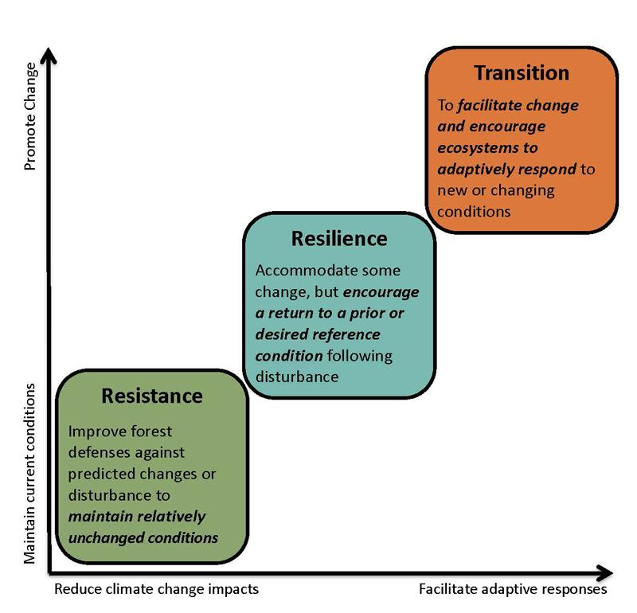
Adaptive silviculture for climate change
Millar et al. (2007); https://www.adaptivesilviculture.org/
http://www.kalkalpen.at
12/13/2019
Dominik Thom

Slide 14
Adaptive silviculture based on functional traits
Resistance: mixing species with high disturbance tolerance
  Drought: Jack pine, Oaks, Hickories
  Fire: Shagbark hickory, Balsam poplar, Quaking aspen
  Wind: White Ash, Hickories, Scarlet oak
  Biotic disturbances: American larch, Eastern white pine, White oak
Resilience: mixing species with high recovery speed
  Resprouting ability: Poplars, Cherries
  Fast juvenile growth: Big toothed aspen, Sugar maple
  Serotiny: Jack pine
  Species with high photosynthesis rate under current and future conditions
Transition
  Assisted migration of species with better adapted traits
http://www.kalkalpen.at
12/13/2019
Dominik Thom

Slide 15
Mix species of different functional groups
Different seral stages
Northern and Central hardwoods
Broadleaved and coniferous species
12/13/2019
Dominik Thom

Slide 16

Managing structural diversity as surrogate for functional diversity
Complex forest structure provides niches for a diversity of species
http://www.kalkalpen.at
12/13/2019
Dominik Thom

Slide 17
Conclusions
Forest structure is more important than climate for functional diversity
Functional diversity is lowest in boreal forests and may decrease in temperate forests under climate change
Managing for functional diversity to increase the adaptive capacity could be a new and promising approach to safeguard ecosystems processes and services in the future

Slide 18
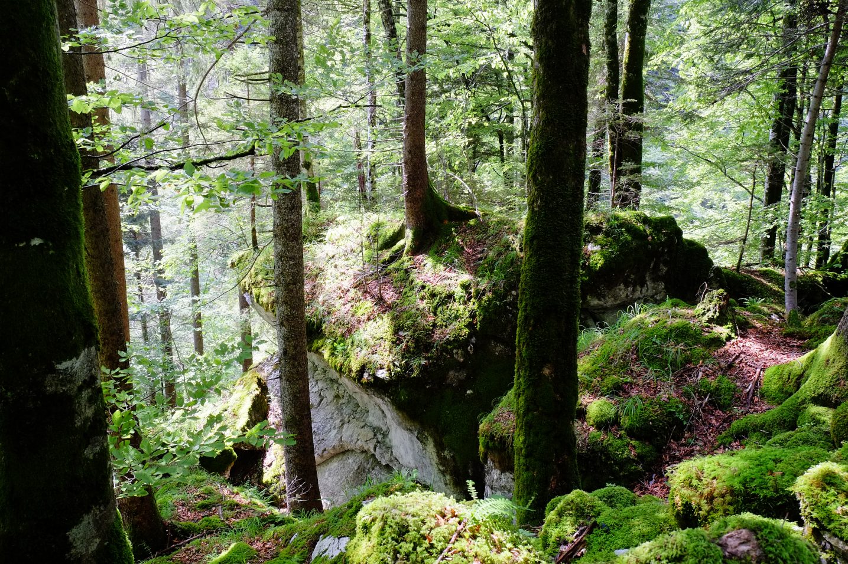
dominik.thom@boku.ac.at
www.wabo.boku.ac.at/thom.htm
Thank you!

Slide 19
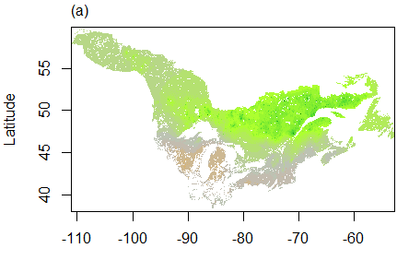
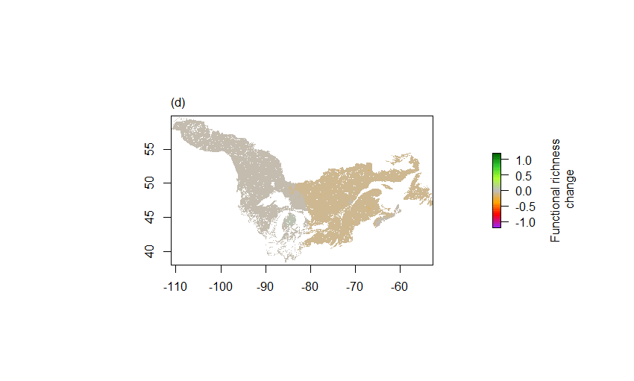
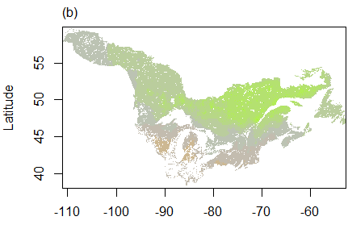
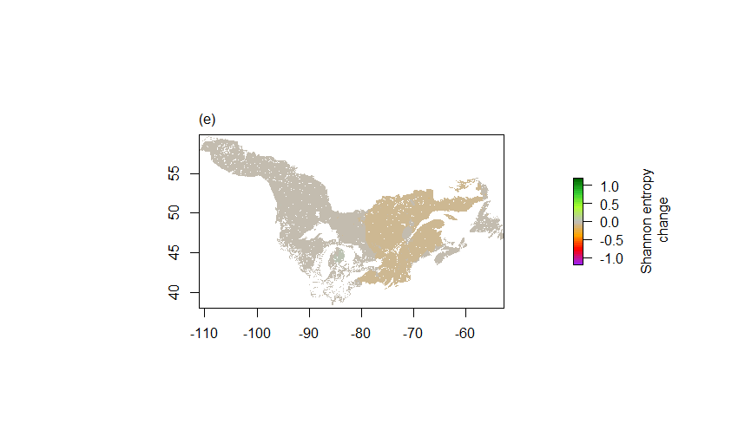
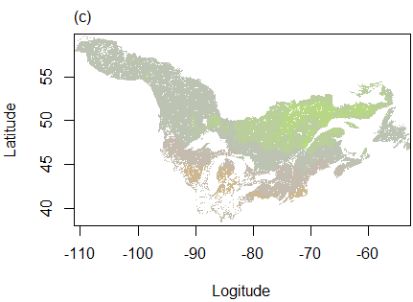
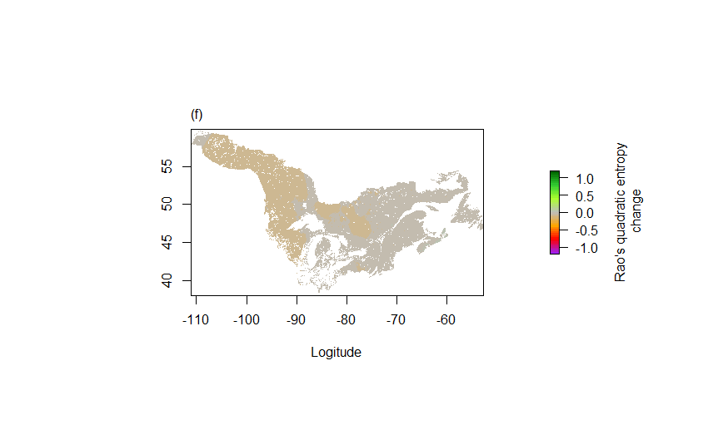
Climate sensitivity
http://www.kalkalpen.at
12/13/2019
Dominik Thom

Slide 20
Managing structural diversity as surrogate for functional diversity
High basal area, concentrated on large trees
Rich understory
Variation in heights and diameter
→ e.g., irregular shelterwood systems, variable retention harvesting, modified group selection approaches
http://www.kalkalpen.at
12/13/2019
Dominik Thom

