Slide 1
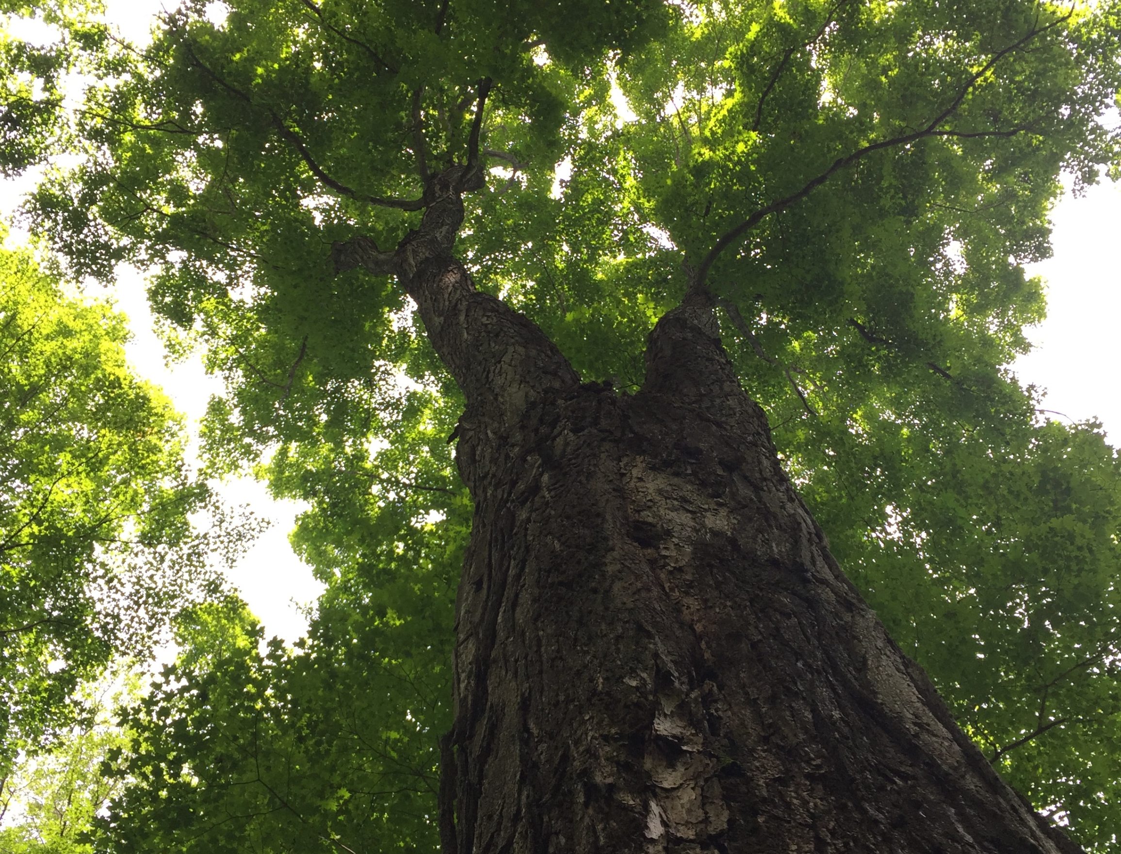
Trends and environmental drivers of tree growth for seven major species in Vermont:
future implications in the context of climate change
Rebecca L. Stern ¹, Paul G. Schaberg ², Shelly A. Rayback ³,
Christopher F. Hansen ¹, Paula F. Murakami ², Gary J. Hawley ¹
¹Rubenstein School of Environment and Natural Resources, University of Vermont, Burlington, VT, USA
²USDA Forest Service, Burlington, VT, USA
³Department of Geography, University of Vermont, Burlington, VT, USA
Forest Ecosystem Monitoring Conference
University of Vermont, December 2018
Rebecca L. Stern
August 28, 2019

Slide 2
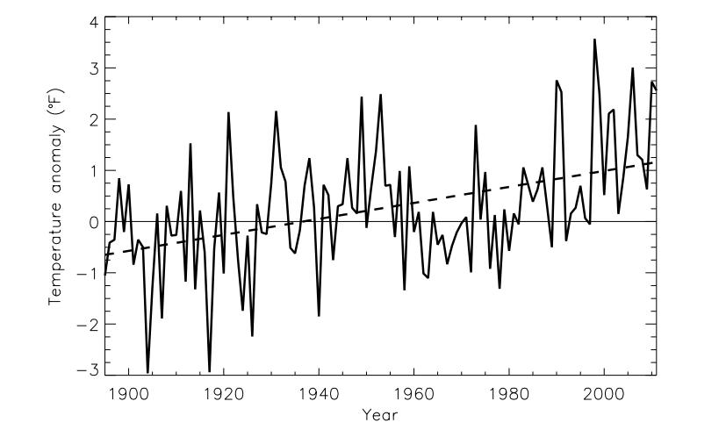
Annual temperature anomaly (deviations from the 1901-1960 average, °F)
for the northeast.
Kunkel et al. (2013)
Notes:
-the focus of my projects is on environmental drivers of tree growth. As we all know, over the past century, the northeastern US has seen an increase in temperature, but this increase has not occurred uniformly across all seasons.

Slide 3
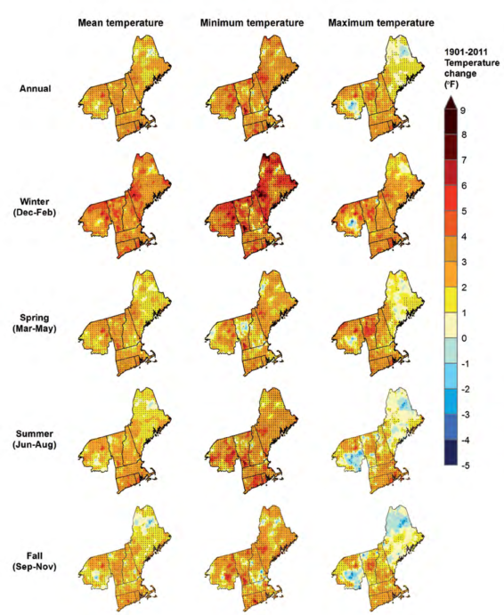
Temp change: 1901 thru 2011
Janowiak
et al. 2018
Notes:
For example, winter has exhibited the greatest temperature increases (Janowiak et al. 2018).

Slide 4
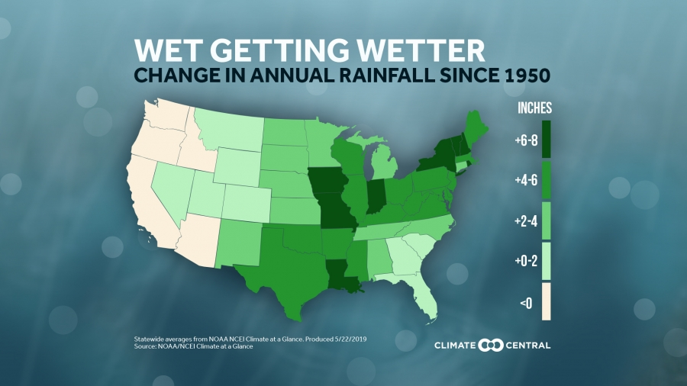
Last forty years: some of the wettest in the last 500 years (Pederson et al. 2013)
Notes:
Total annual rainfall has increased as well-in fact, the last forty years, have been some of the wettest in the last 500 years (Pederson 2013).

Slide 5
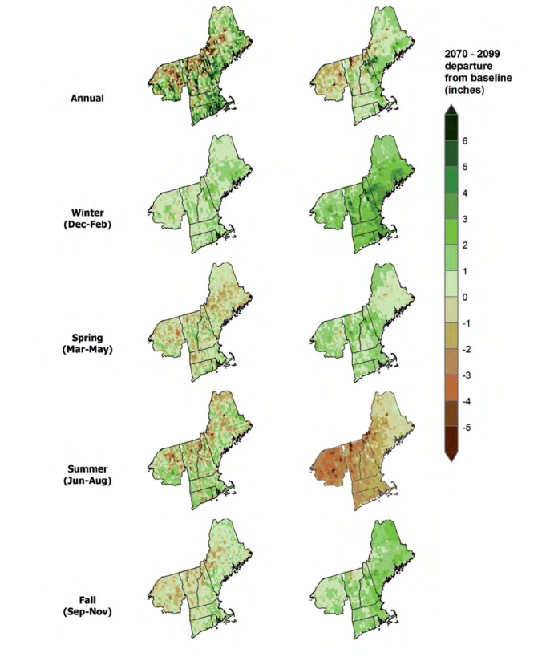
Low
High
Projected changes in mean precip:
2070 thru 2099
Janowiak
et al. 2018
Or show little change in summer (Lynch et al. 2016)
Notes:
-In thinking about what this means for the future, increases in precip are projected for winter and spring, but summer precipitation is expected to either show little change (Lynch et al. 2016) or to decrease, depending on the emissions scenario (Janowiak et al. 2018). This is compared to baseline annual precip from 1971-2000.

Slide 6
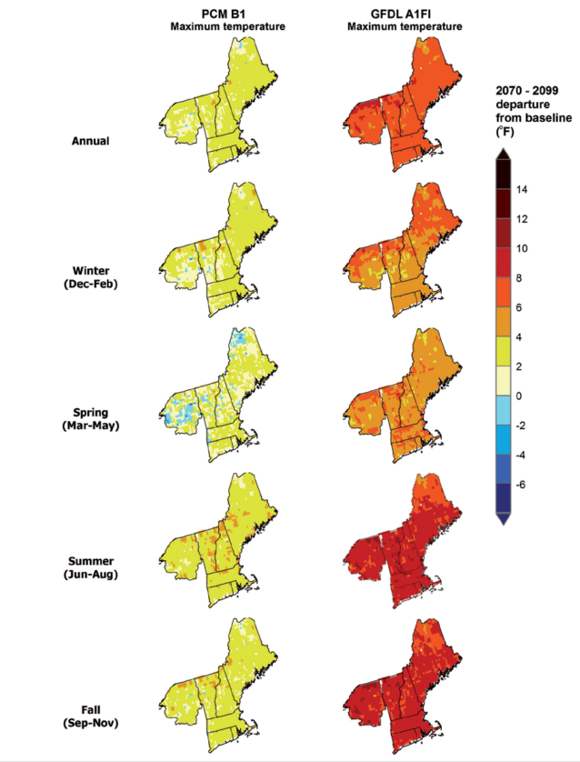
Projected increases in maximum
temp:
2070 thru 2099
Janowiak
et al. 2018
Notes:
In terms of temperature, under a high emissions scenario, summer temperatures are projected to show the greatest increases moving forward

Slide 7
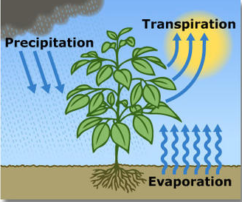
Higher summer temps
+ longer growing season
→higher potential evapotranspiration rates
(Thibeault and Seth 2014)
Notes:
Simulations show that projected increases in summer temperatures over a longer growing season will result in higher potential evapotranspiration rates (Thibeault and Seth 2014), especially since precipitation increases will largely be driven by late winter and early spring rainfall (Lynch et al. 2016).

Slide 8
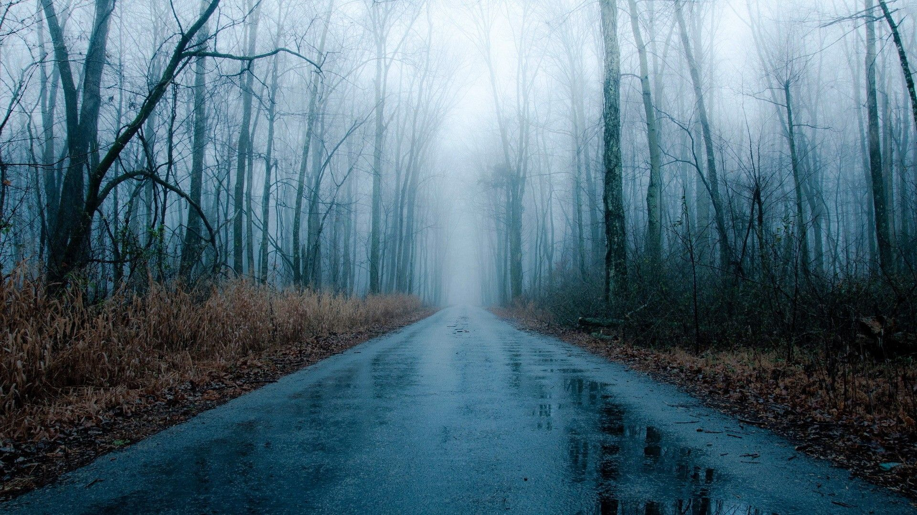
Winter precipitation: more rain than snow
Ning and Bradley 2015
Notes:
Also, under a high emissions scenario, minimum winter temperatures are expected to warm 5.5°C by the end of the century (Janowiak et al. 2018). As winters warm, winter precipitation is more likely to fall as rain than snow (Ning and Bradley 2015).

Slide 9
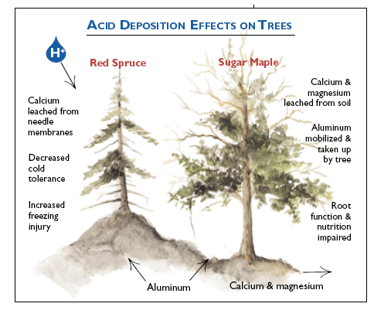
Driscoll et al. 2001
Leaching of calcium and magnesium from forest soils
(e.g., Likens et al. 1996; Likens et al. 1998)
Notes:
-In addition to changes in climate, another anthropogenic stressor- pollutant deposition – has negatively impacted the health and growth of tree species in the northern forest, most notably red spruce and sugar maple

Slide 10
Notes:
These changes in temperature and precipitation regimes, along with the legacies of pollutant deposition, will have impacts on suitable habitat for tree species in the northeast.

Slide 11
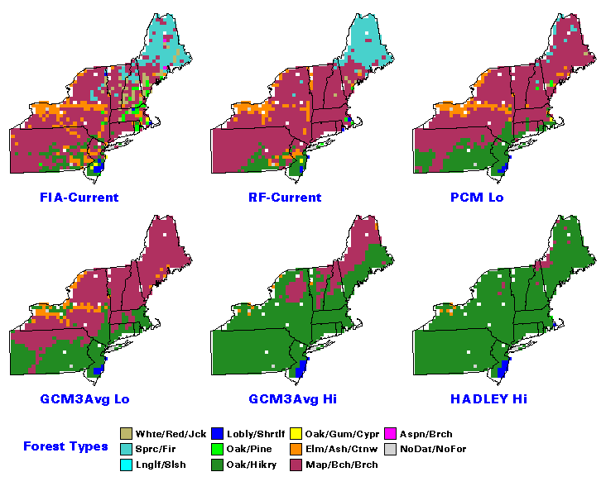
Projections of Potential Forest Type Changes: 2100
Habitat suitability
Prasad et al. (2007-ongoing)
Notes:
-Projections exist for future habitat suitability. One of these, the Climate Change Tree Atlas, projects that this area will become less suitable for the maple-beech-birch forest type and more suitable for the oak-hickory forest type.

Slide 12
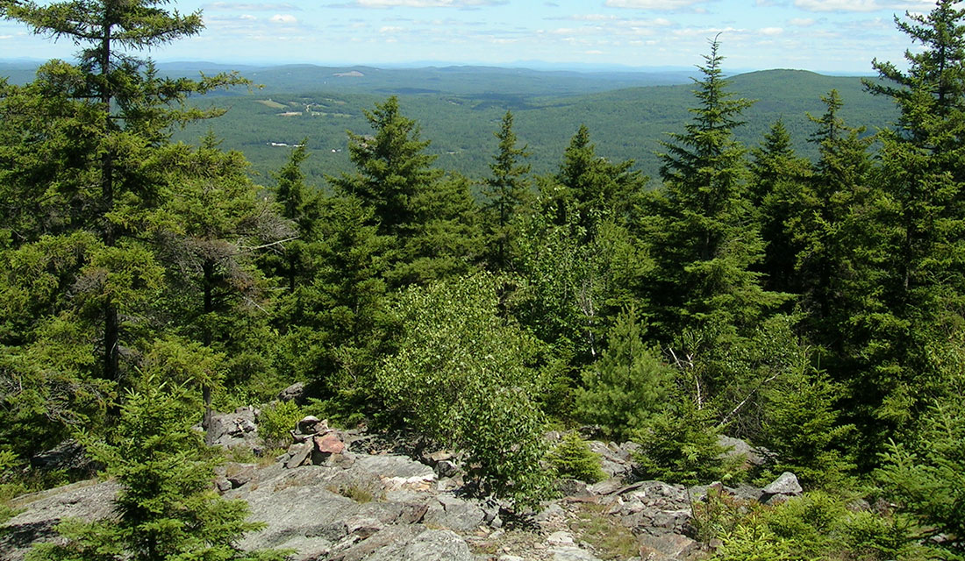
Future
Past
acjv.org
Future loss of boreal conifer forests and species
(Tang and Beckage 2010, Wang et al. 2017)
Notes:
Other projections show a loss of boreal conifer forests and species and an increase in other species, like red maple. Understanding the past response of trees to climate may provide keys to how species will respond in the future, but perhaps even more importantly, can show us if, how, and when tree responses to climate have changed.
-To gain a better understanding of possible trajectories of our northern forest communities and individual species, we need more empirical evidence to ground-truth these models

Slide 13
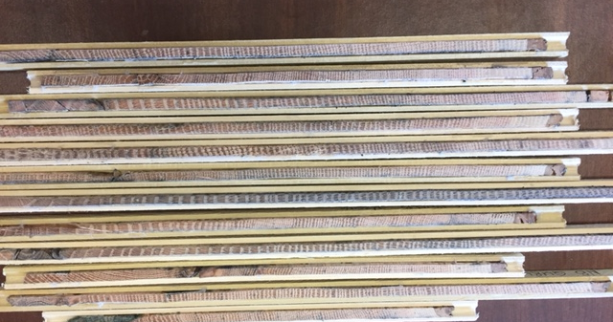
Need more empirical evidence to ground-truth models
Tree rings: how have relationships shifted in accordance with changes in environmental cues?
Notes:
-Tree-ring data can provide this valuable evidence with its unique ability to document growth data to develop historical relationships between tree growth and climate.
-With chronologies spanning decades to centuries, tree rings can highlight how these relationships have shifted in accordance with changes in climate and other environmental variables, like pollution

Slide 14
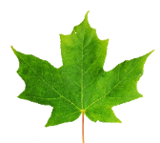
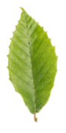
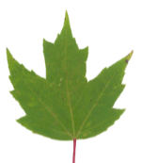
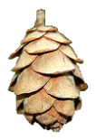
Climate and pollutant drivers of tree growth
Northern red oak: near its northern range limit
Northern hardwood species: sugar maple, American beech, yellow birch + red maple
3) Temperate conifers:
eastern white pine and eastern hemlock
Notes:
Here, I present the overall concluding results from three studies on climate and pollutant drivers of growth for seven major tree species in the state of VT, and also their icons which you’ll see on some of the following slides.

Slide 15
Map of all sites
Notes:
Methods- similar for all three studies

Slide 16
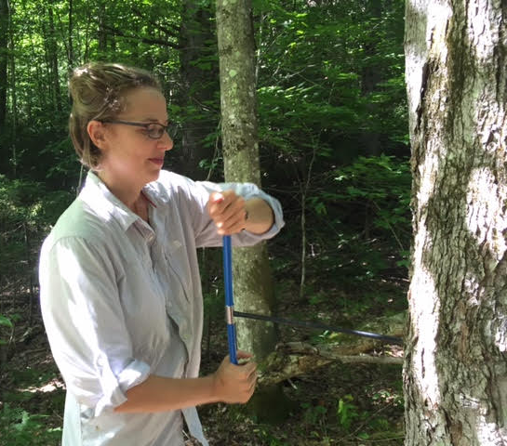
Methods
-Standard dendrochronological techniques (Stokes and Smiley 1968): dominant and codominant trees only
-Program COFECHA for crossdating (Holmes 1983, Grissino-Mayer 2001)
-Standardized to created mean growth chronologies across all sites, per species
Notes:
Methods- similar for all three studies

Slide 17
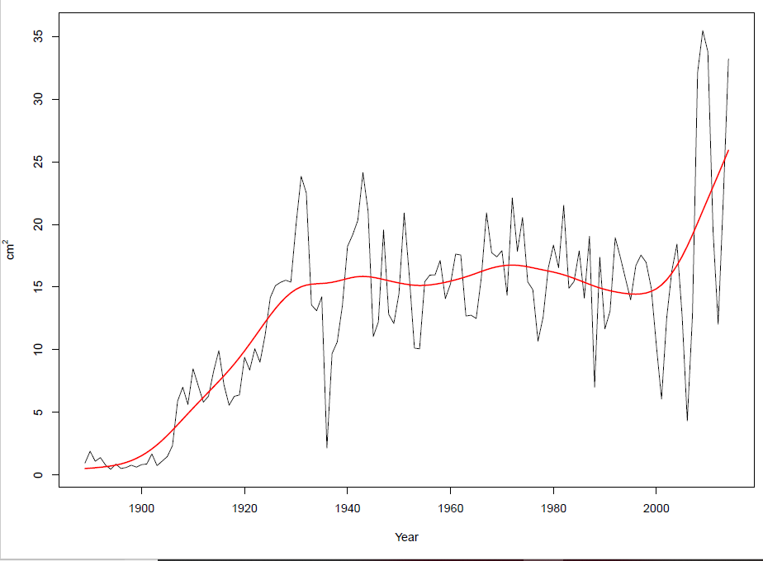
Methods
After standardizing growth, evaluated:
Growth trends (basal area increment) for each
species’ mean chronology
2) Correlated tree growth
(ring width index) with climate and pollution variables

Slide 18
Climate/environmental variables
Data Source | Variables
NOAA¹ | Monthly + seasonal Tmin Monthly + seasonal Tmax Heating degree days (HDD) <18.3° C (65° F) Cooling degree days (CDD) >18.3° C (65° F)
¹NOAA National Climatic Data Center (2018)
Notes:
-HDD: gauge of low temperature exposure, calculated as the number of degrees that a day’s average temperature is below 18.3° C
-CDD is a measure of high temperature exposure, calculated as the number of degrees that a day’s average temperature is above 18.3° C

Slide 19
Climate/environmental variables
Data Source | Variables
NOAA¹ | Monthly + seasonal Tmin Monthly + seasonal Tmax Heating degree days (HDD) <18.3° C (65° F) Cooling degree days (CDD) >18.3° C (65° F)
Global Standardized Precipitation-Evapotranspiration Index (SPEI) database² | SPEI-01: 1-month moisture index: specific times of influence SPEI-03: 3-month moisture index: seasonal
¹NOAA National Climatic Data Center (2018)
² Vicente-Serrano et al. (2017)
Notes:
-SPEI: a moisture index, at two different time scales. SPEI may be a better measure of available water to trees than straight precipitation

Slide 20
Climate/environmental variables
Data Source | Variables
NOAA¹ | Monthly + seasonal Tmin Monthly + seasonal Tmax Heating degree days (HDD) <18.3° C (65° F) Cooling degree days (CDD) >18.3° C (65° F)
Global Standardized Precipitation-Evapotranspiration Index (SPEI) database² | SPEI-01: 1-month moisture index: specific times of influence SPEI-03: 3-month moisture index: seasonal
¹NOAA National Climatic Data Center (2018)
² Vicente-Serrano et al. (2017)
Notes:
-SPEI: a moisture index, at two different time scales. SPEI may be a better measure of available water to trees than straight precipitation

Slide 21
Climate/environmental variables
Data Source | Variables
NOAA¹ | Monthly + seasonal Tmin Monthly + seasonal Tmax Heating degree days (HDD) <18.3° C (65° F) Cooling degree days (CDD) >18.3° C (65° F)
Global Standardized Precipitation-Evapotranspiration Index (SPEI) database² | SPEI-01: 1-month moisture index: specific times of influence SPEI-03: 3-month moisture index: seasonal
National Atmospheric Deposition Program³ | SO₄²⁻ NO₃⁻ Ratio of cations to anions rainfall pH
¹NOAA National Climatic Data Center (2018)
² Vicente-Serrano et al. (2017)
³ National Atmospheric Deposition Program (2017) NADP/NTN Monitoring
values for current and previous year
Notes:
-we also looked at pollutant deposition data. These are markers for pollutants.
-values for current and previous year, since climate conditions during one year can influence tree growth in subsequent years.

Slide 22
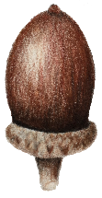
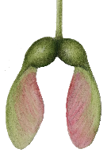
Overall conclusions and
implications for future growth

Slide 23
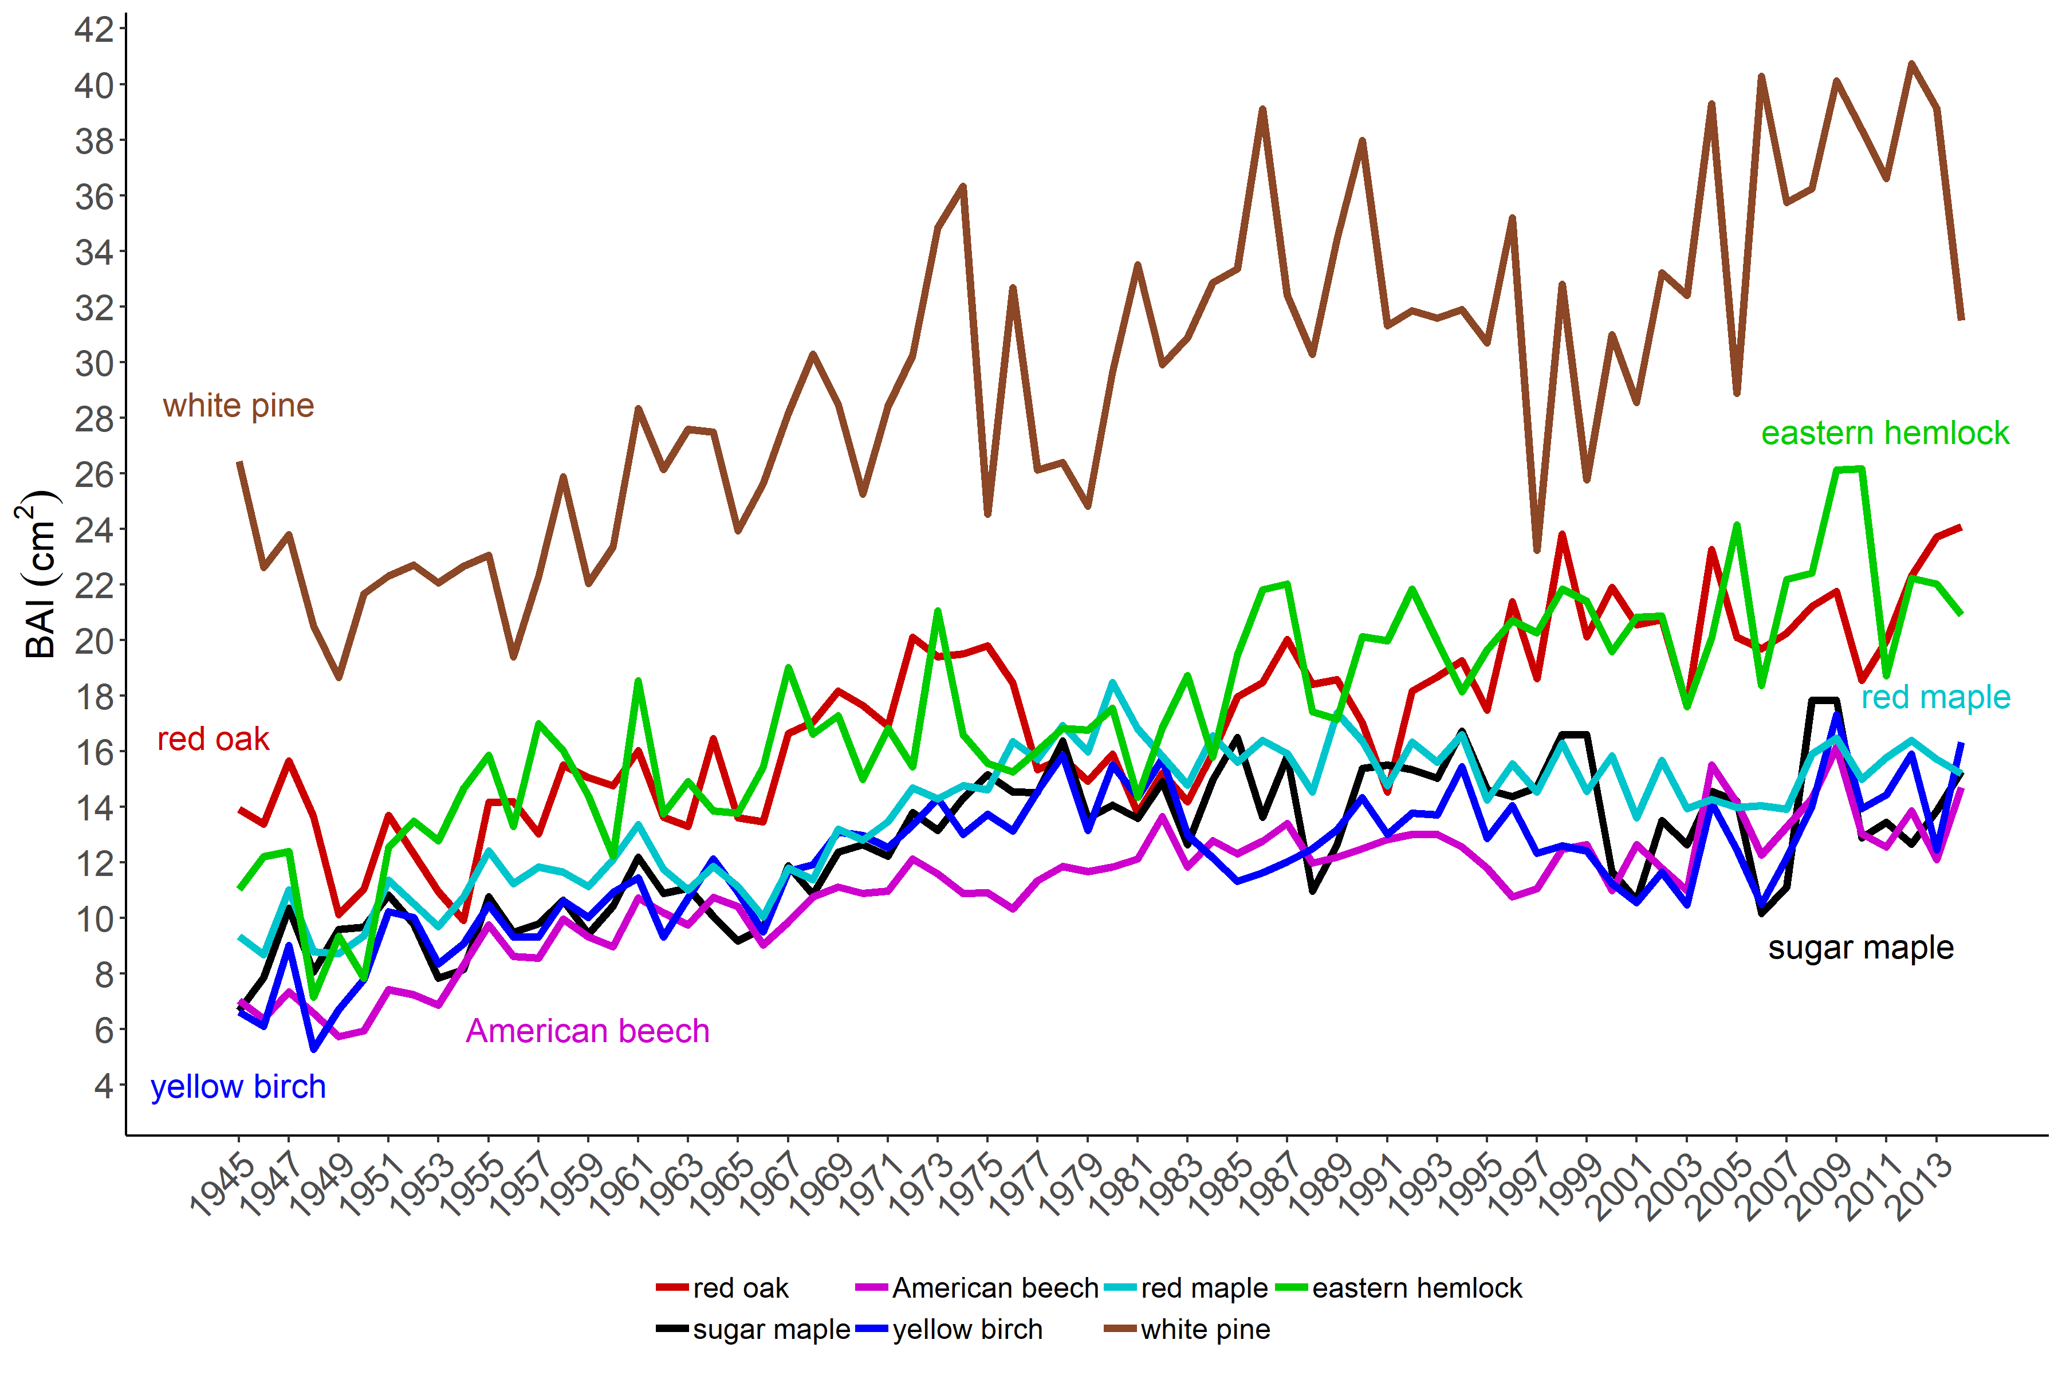
Growth (BAI) of all species
Notes:
White pine growing the most, with eastern hemlock and red oak next.

Slide 24
Focus on summer
Association | Species
positive with summer moisture
negative with summer temperature
(low elevation)
(low elevation)
Drought a significant driver of tree growth and migration in eastern North America
(Martin-Benito and Pederson 2015;
Fei et al. 2017; D'Orangeville et al. 2018)
Notes:
-American beech: only at low elevations (maybe because moisture is more limiting at lower elev sites than higher)
-red maple: only at low elevations. At high elevations, actually saw a positive correlation with summer Tmin
-this negative correlation could be pointing to a drought signal.
Large-scale studies: drought a significant driver

Slide 25
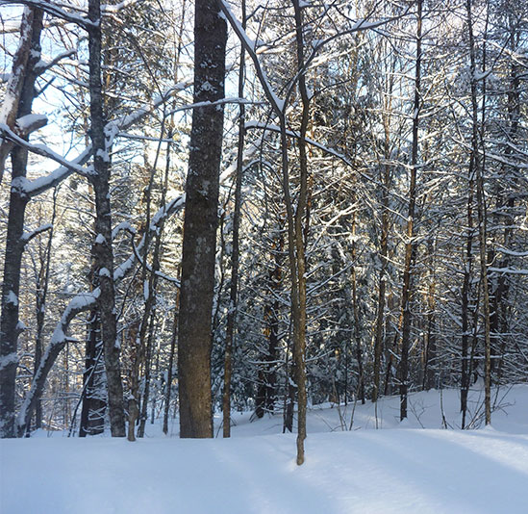
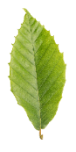
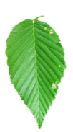
Northern hardwood species
Sugar maple, American beech, yellow birch: importance of winter snowpack and cold winter temperatures
bu.edu
Notes:
-This was exhibited as positive correlations with winter moisture for all three species, particularly at the beginning of winter, in December
-since we didn’t see this for red maple, it could point to a competitive advantage for that species
-as future winter precipitation is projected to fall as rain rather than snow

Slide 26
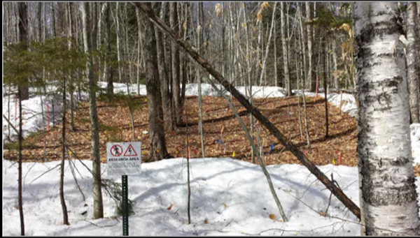
Red maple
Snow removal
experiment
soil
freezing
red maple
radial growth
Reinmann and Templer 2016
Photo by Pamela Templer
Notes:
-In fact in a snow removal experiment where soil freezing occurred, red maple actually showed an increase in radial growth – at least in the short term, it stimulated radial growth.
-so this species exhibits some different responses than the three classic species of the northern hardwood forest.

Slide 27
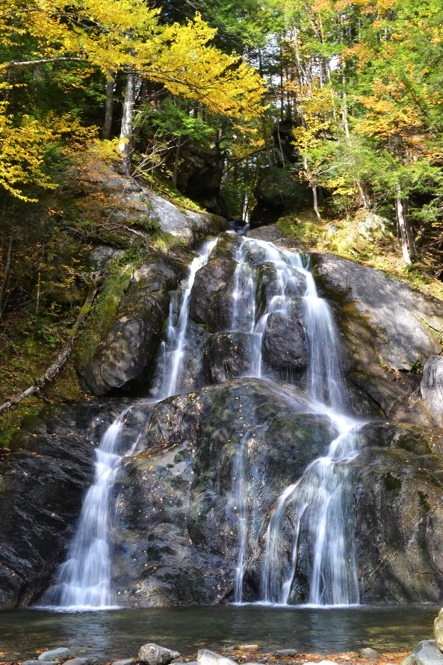
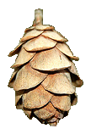
Temperate conifer species
Positive associations
with spring and fall
temperatures
-Rapid increase in C uptake by hemlock trees in mid-April
-continued photosynthesis in October and November.
Hadley and Schedlbauer (2002)
Notes:
Photosynthesis, of course, is temperature dependent.

Slide 28
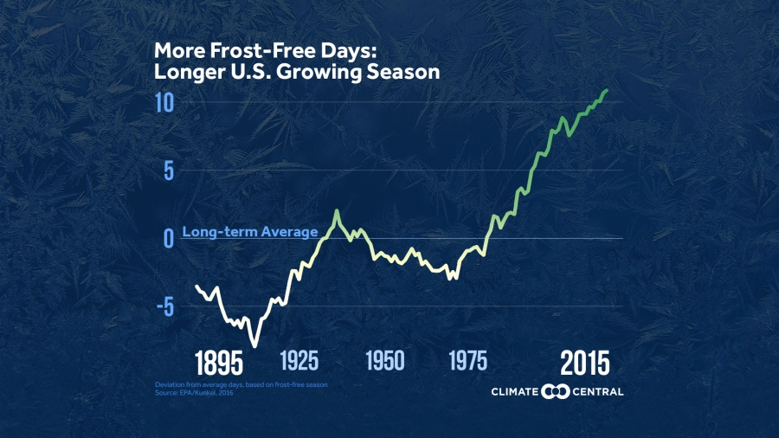
Longer growing season and freeze-free season
EPA, Kunkel et al. 2016
Notes:
-Growing season length has been increasing, a trend which is expected to continue.
-So a longer growing season could be offering a competitive advantage to these conifer species, as compared to deciduous species which cannot photosynthesize all year.

Slide 29
Pollutant deposition
All species except American beech:
negative association with pollutant
deposition
Notes:
-These findings indicate a much broader sensitivity of tree species to pollution deposition and its legacy
-of course, pollution has decreased with the Clean Air Act and subsequent amendments

Slide 30
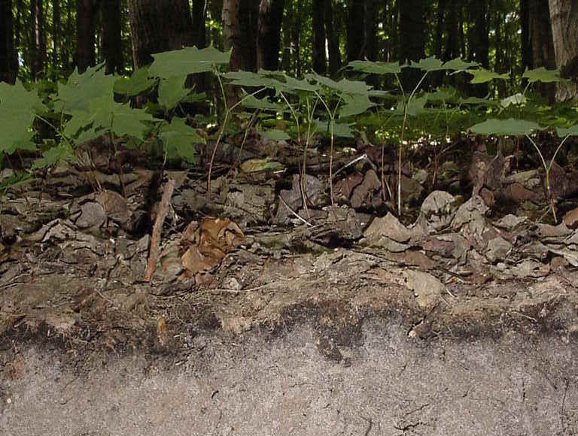
Pollutant deposition legacy
Soils in the Northeast are showing some evidence of improvement
Lawrence et al. 2015
Recovery will be spatially and temporally heterogeneous
Lawrence et al. 2015; Siemion et al. 2018
Decades for the most impacted sites to rebound from chronic acidification and nutrient loss
Driscoll et al. 2001; Likens et al. 1996;
Lawrence et al. 2015; Siemion et al. 2018.
msu.edu
Notes:
-and soils in the Northeast are showing some evidence of improvement, broader recovery will likely be spatially and temporally heterogeneous, and some sites will take many decades to rebound

Slide 31
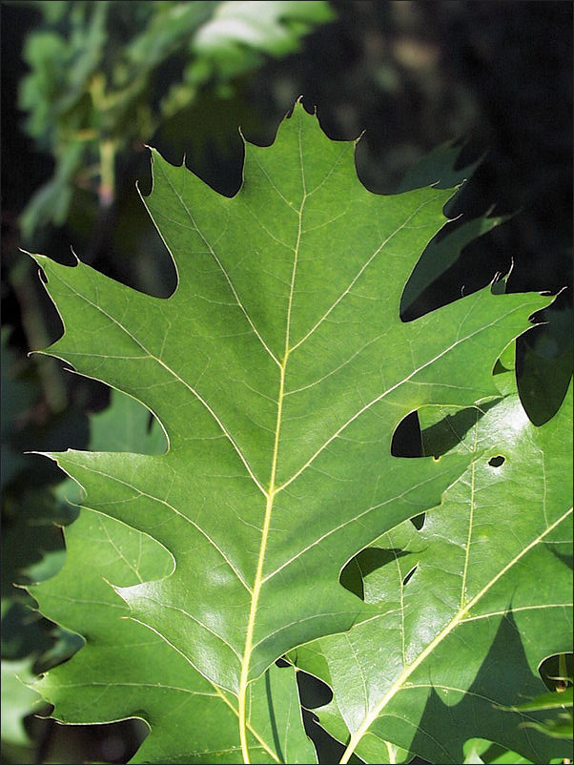
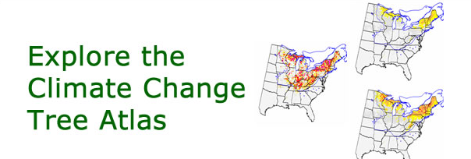
Future projections: red oak
CCTA:
Increase in suitable habitat
CCTA
Notes:
-Now I’ll talk briefly about future projections of each species in the context of our findings, and I’m focusing on habitat suitability from the Climate Change Tree Atlas, which projects changes in suitable habitat for entire forest types as well as individual species.
-However, while red oak sites in our study exhibited substantial growth, there may be mounting constraints on this growth into the next century,

Slide 32
Projected increases in maximum
temp:
2070 thru 2099
Janowiak
et al. 2018
Notes:
-If the climate variables most associated with reduced growth – increased summer temperatures- become more extreme.

Slide 33
Projected changes in mean precip:
2070 thru 2099
Janowiak
et al. 2018
Notes:
-Also, multiple summer moisture metrics were pivotal to red oak growth
-However, summer is the singular season in which projections show a decrease in precipitation in the northeastern U.S.

Slide 34
Future projections: northern hardwoods
CCTA: decrease in importance value for sugar maple, American beech, yellow birch
CCTA predictors: included January temp, but not winter moisture
Notes:
IV: dominance of a species in a given forest area
-CCTA: January temperature was one predictor of habitat suitability for all three species, but winter moisture was not.
-Our study indicates that winter precipitation may be another factor to consider in determining future habitat suitability for tree species adapted to cold climates.

Slide 35
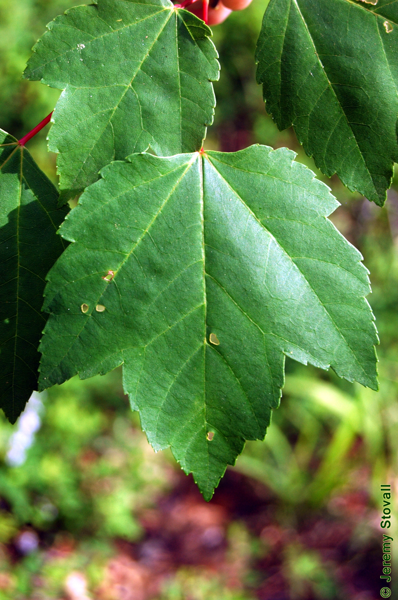
Future projections: red maple
CCTA:
Increase in suitable habitat
Red maple will show a positive growth response to a warming climate (Dombroskie et al. 2010).
Notes:
-CCTA indicates a future increase in red maple in VT
-in our study, red maple showed a positive correlation with winter temperatures at higher elevation sites, suggesting that a warming climate may actually benefit this species by extending its growing season.

Slide 36
Future projections: eastern white pine, eastern hemlock
CCTA: slight decrease in suitable habitat at lower elevations
CCTA: Increase in suitable habitat at higher elevations
Notes:
-our results indicate that an increased growing season may be beneficial to these temperate conifer species in VT.
-One of the top predictors of suitable habitat for eastern white pine and eastern hemlock in the Tree Atlas is mean July temperature, which highlights the role that hotter summer temperatures could play in the future habitat suitability for these species

Slide 37
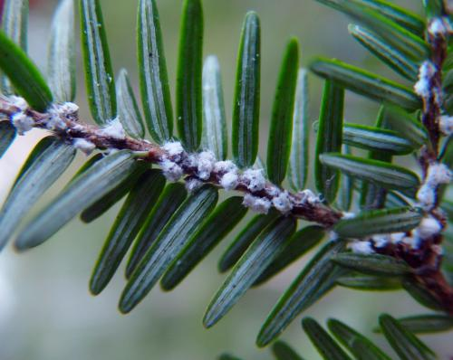
Hemlock woolly adelgid
Hemlock tree mortality may be slower to occur in northern forests (Paradis et al. 2008)
Even after hemlock woolly adelgid infestation, northern hemlock forests continued to accumulate carbon (Krebs et al. 2017)
University of Illinois
Notes:
Of course, the close proximity of the HWA invasion to northern hemlock stands makes any projections of hemlock growth uncertain
-However, tree mortality may be slower to occur in northern forests due to low temperature constraints on HWA buildups (Paradis et al. 2008),
-and simulations have shown that even after hemlock woolly adelgid infestation, northern hemlock forests continued to accumulate C Krebs et al. (2017)

Slide 38
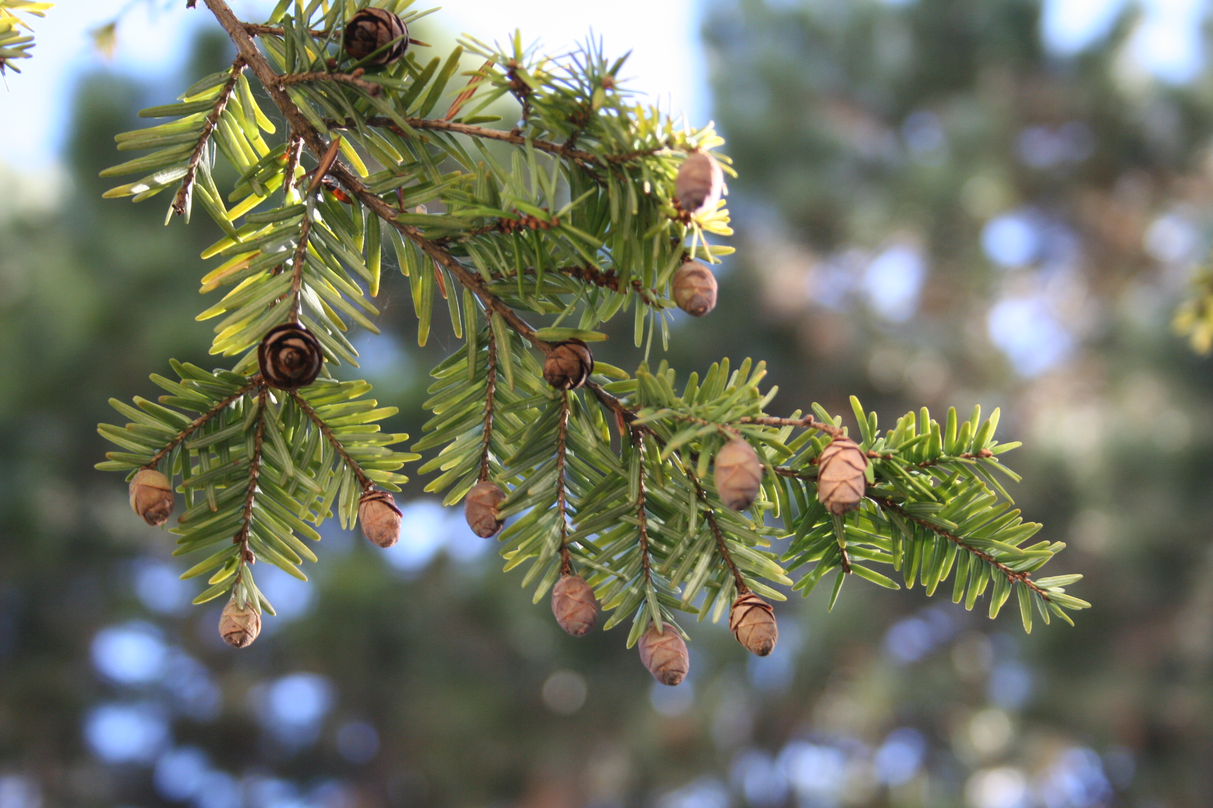
nfs.unl.edu
Notes:
So even with HWA infestation, eastern hemlock may still have great potential for C capture and growth within the Northern Forest.

Slide 39
Acknowledgements
Forest Ecology Research Group
Paul Schaberg
Paula Murakami
Chris Hansen
Gary Hawley
Forest Ecosystem Monitoring
Cooperative
Ali Kosiba
Jim Duncan
Staff and interns:
Jeremy Gerber
Elizabeth Bannar
Jordan Davis
Becca Rossell
Jack Kilbride
Michelle Deslauriers
Isabel Molina
Sarah Erskine
Marissa Ng
McIntire-Stennis
RSENR

Slide 40
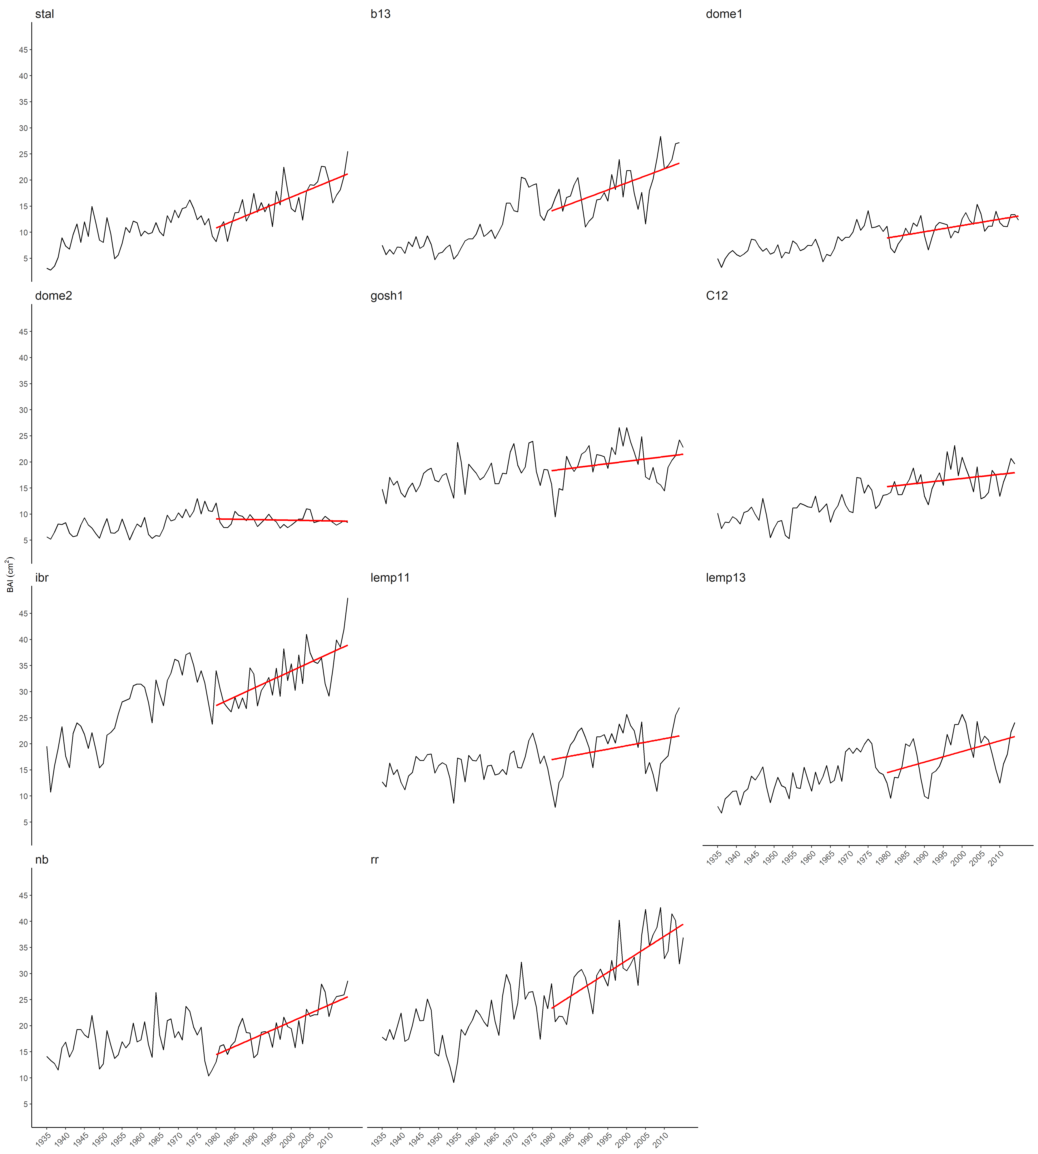
Red oak growth (BAI)

Slide 41
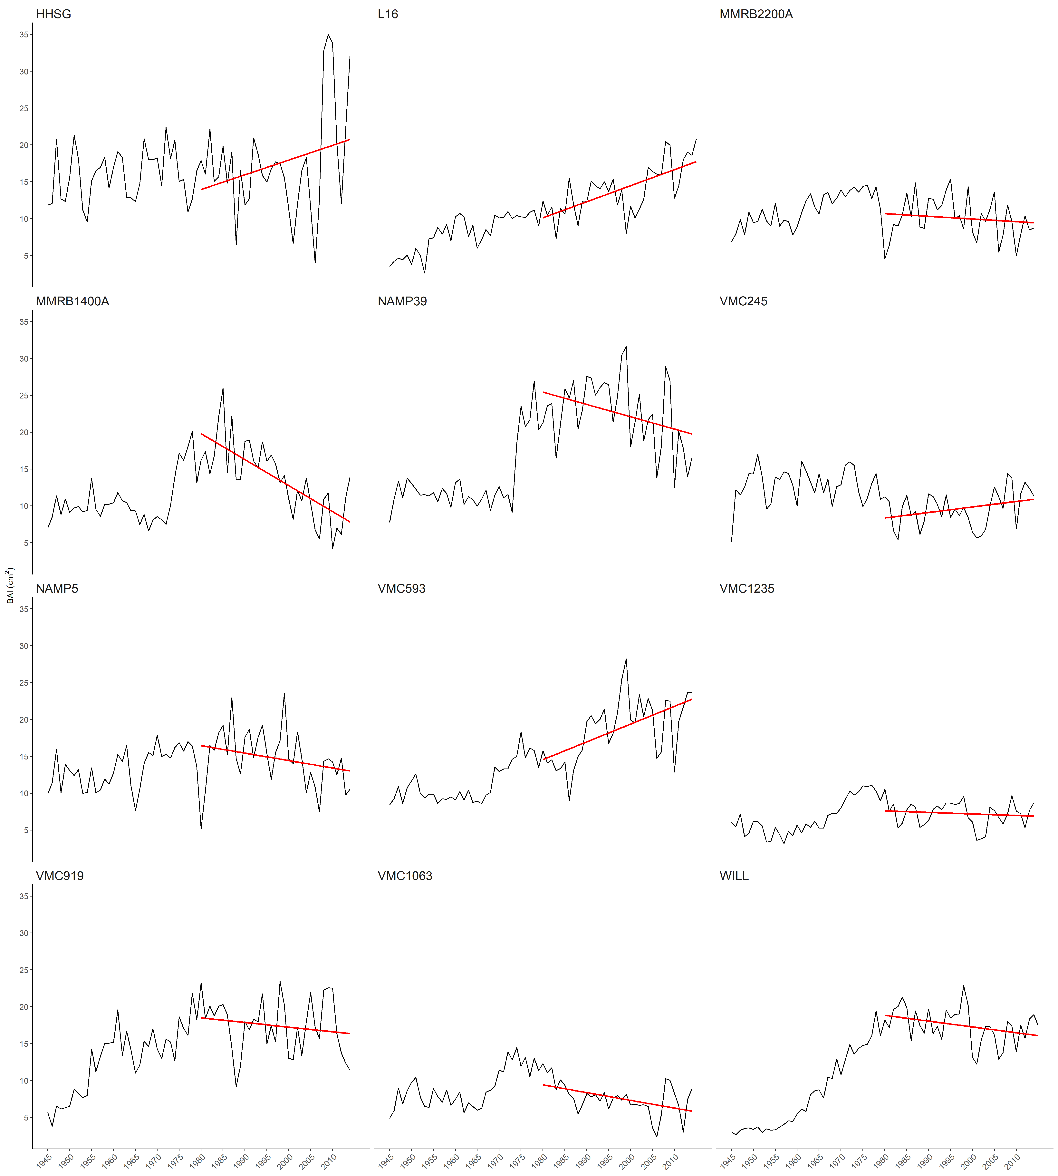
Sugar maple growth (BAI)

Slide 42
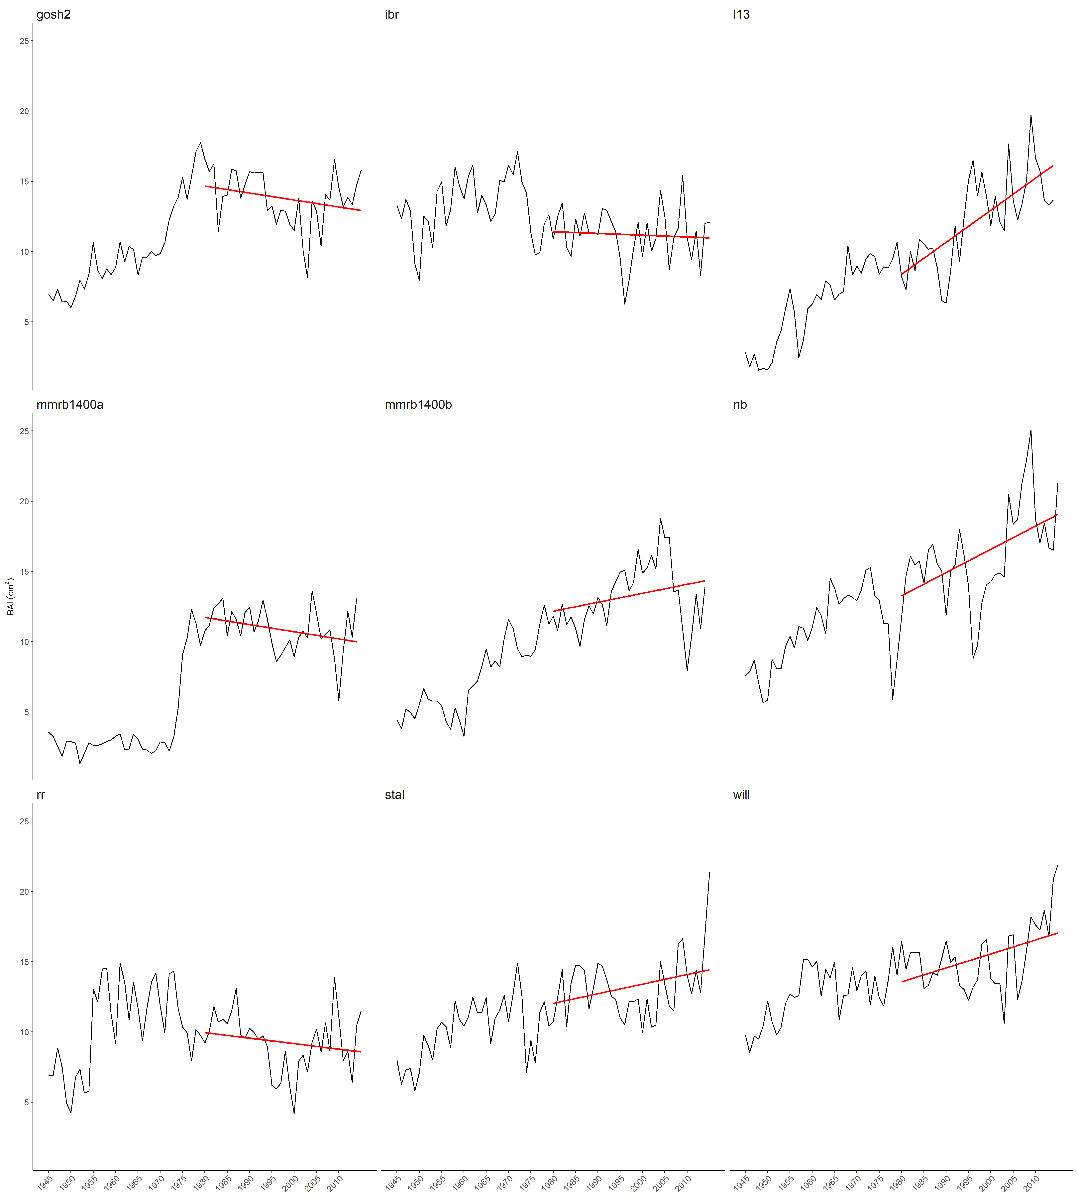
American beech growth (BAI): elevation class median: 928 ft.
Notes:
Growth (BAI)

Slide 43
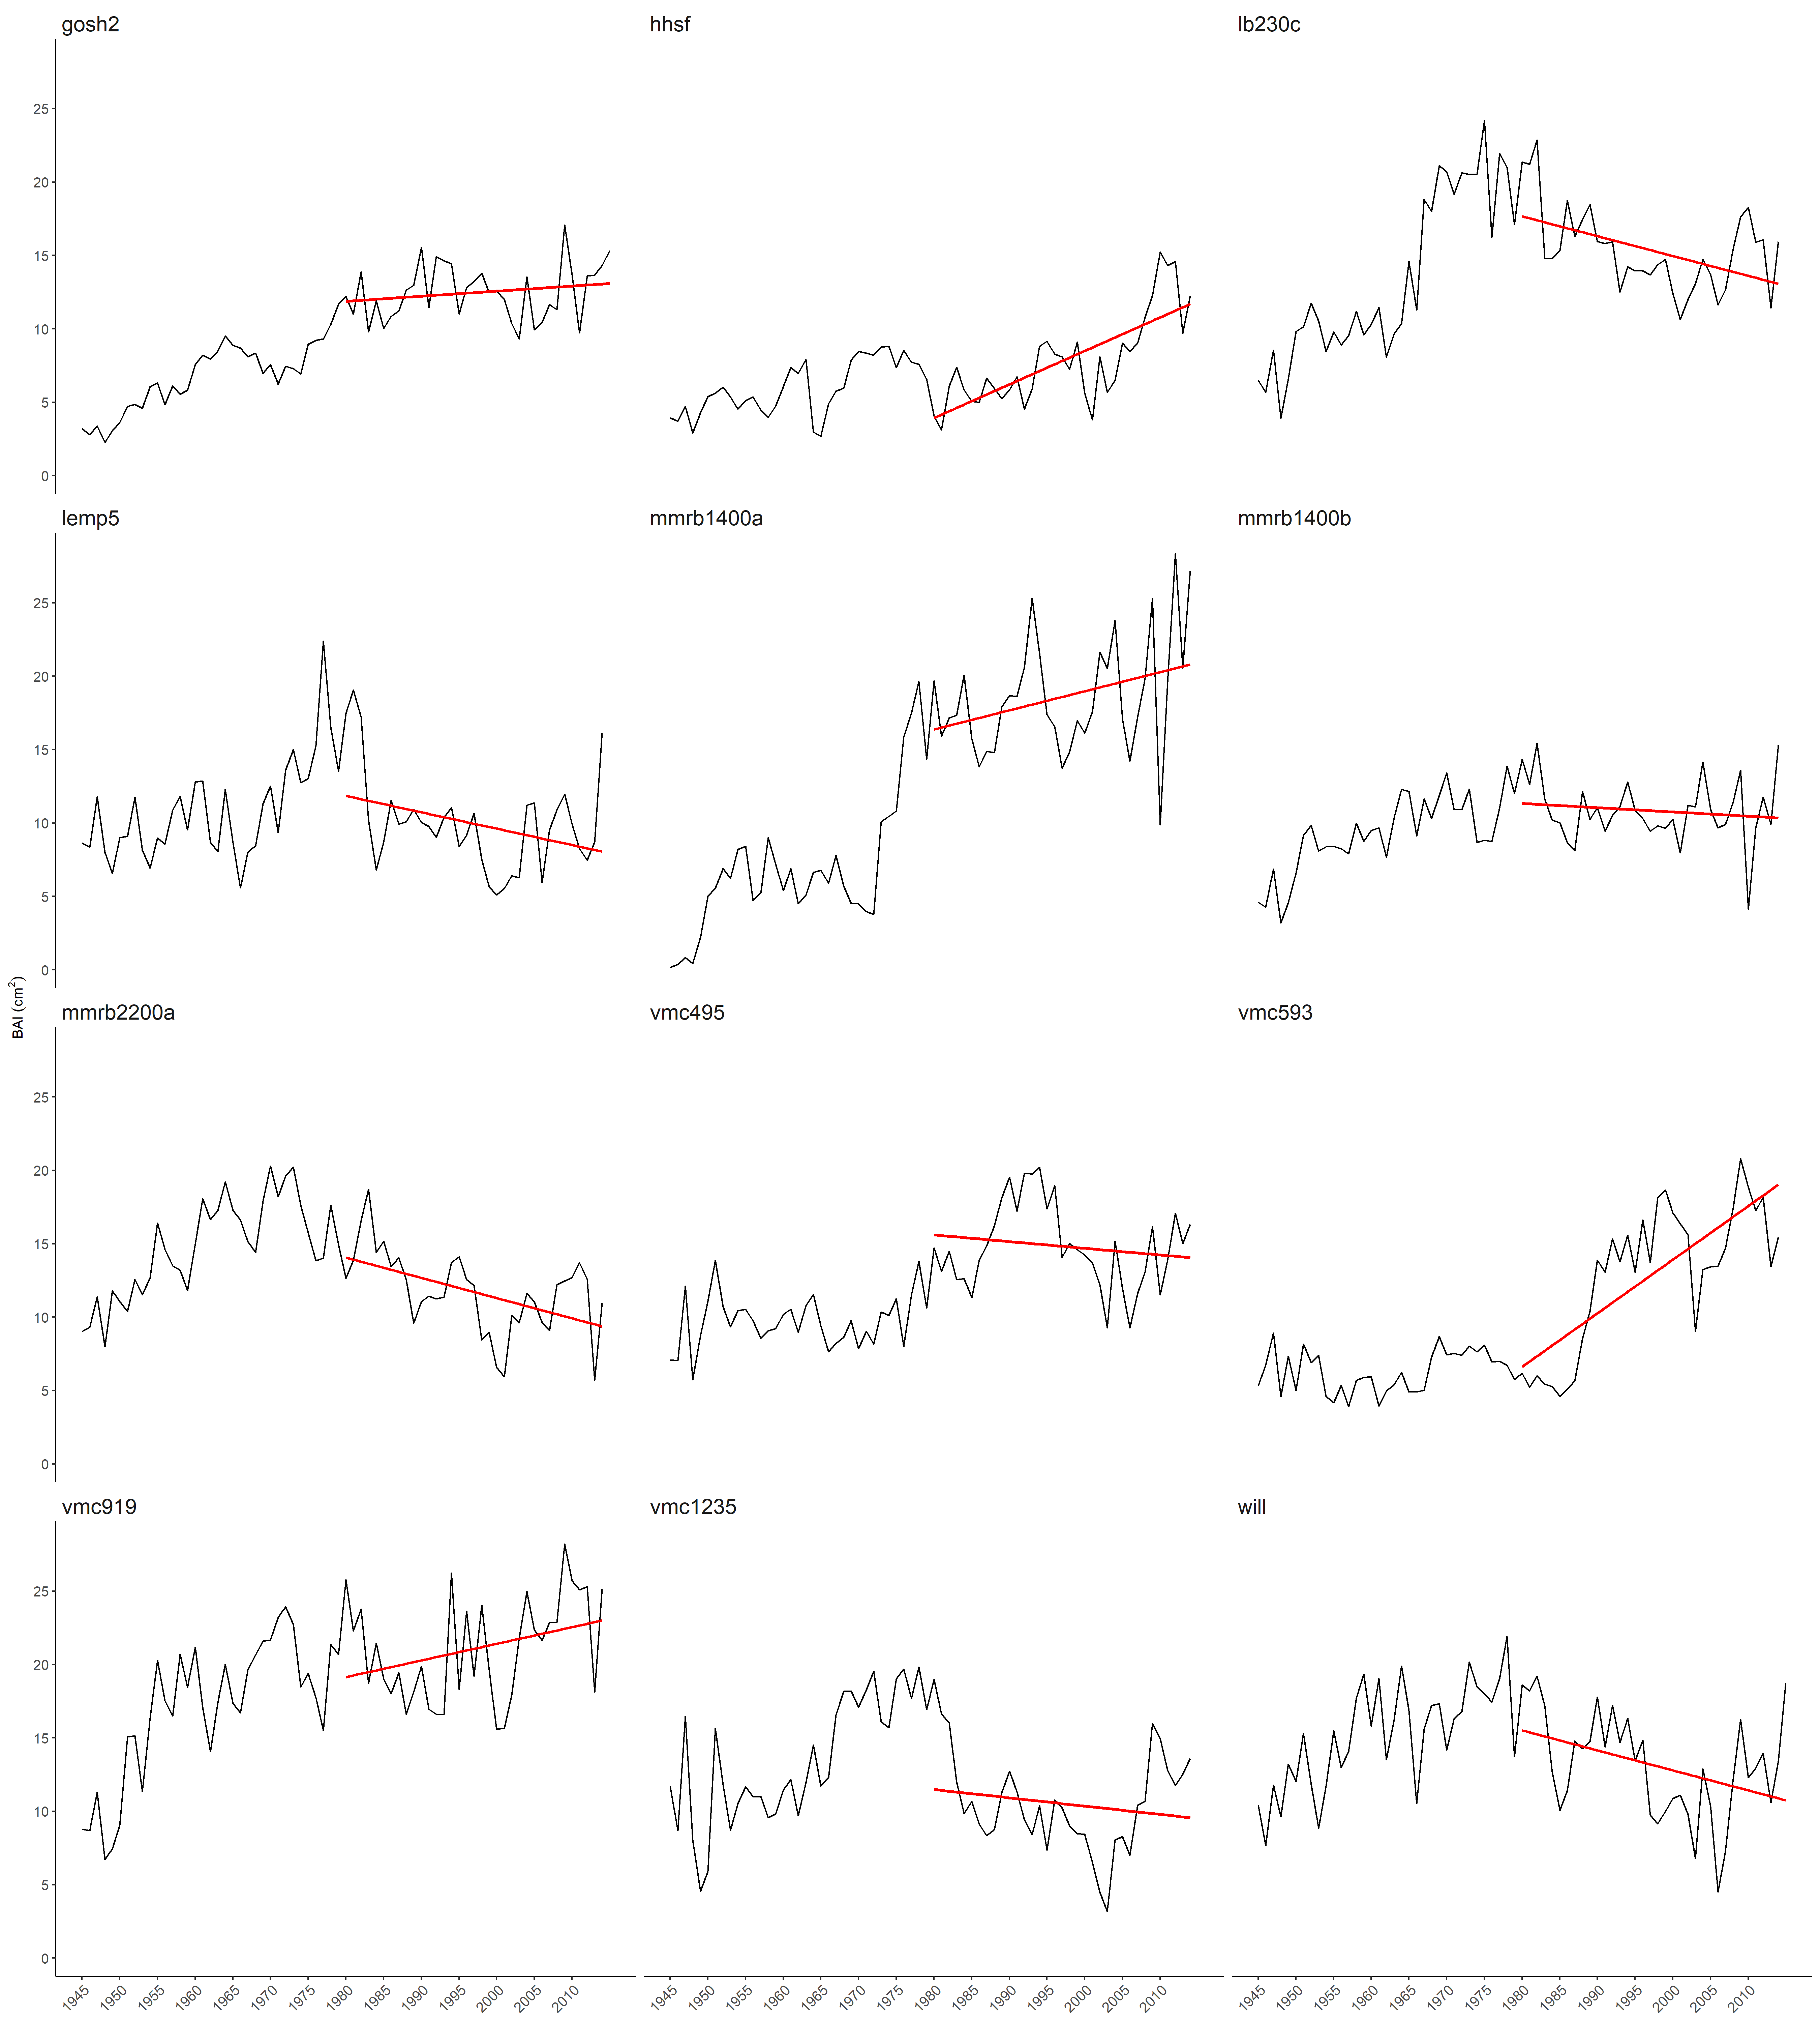
Yellow birch growth (BAI)

Slide 44
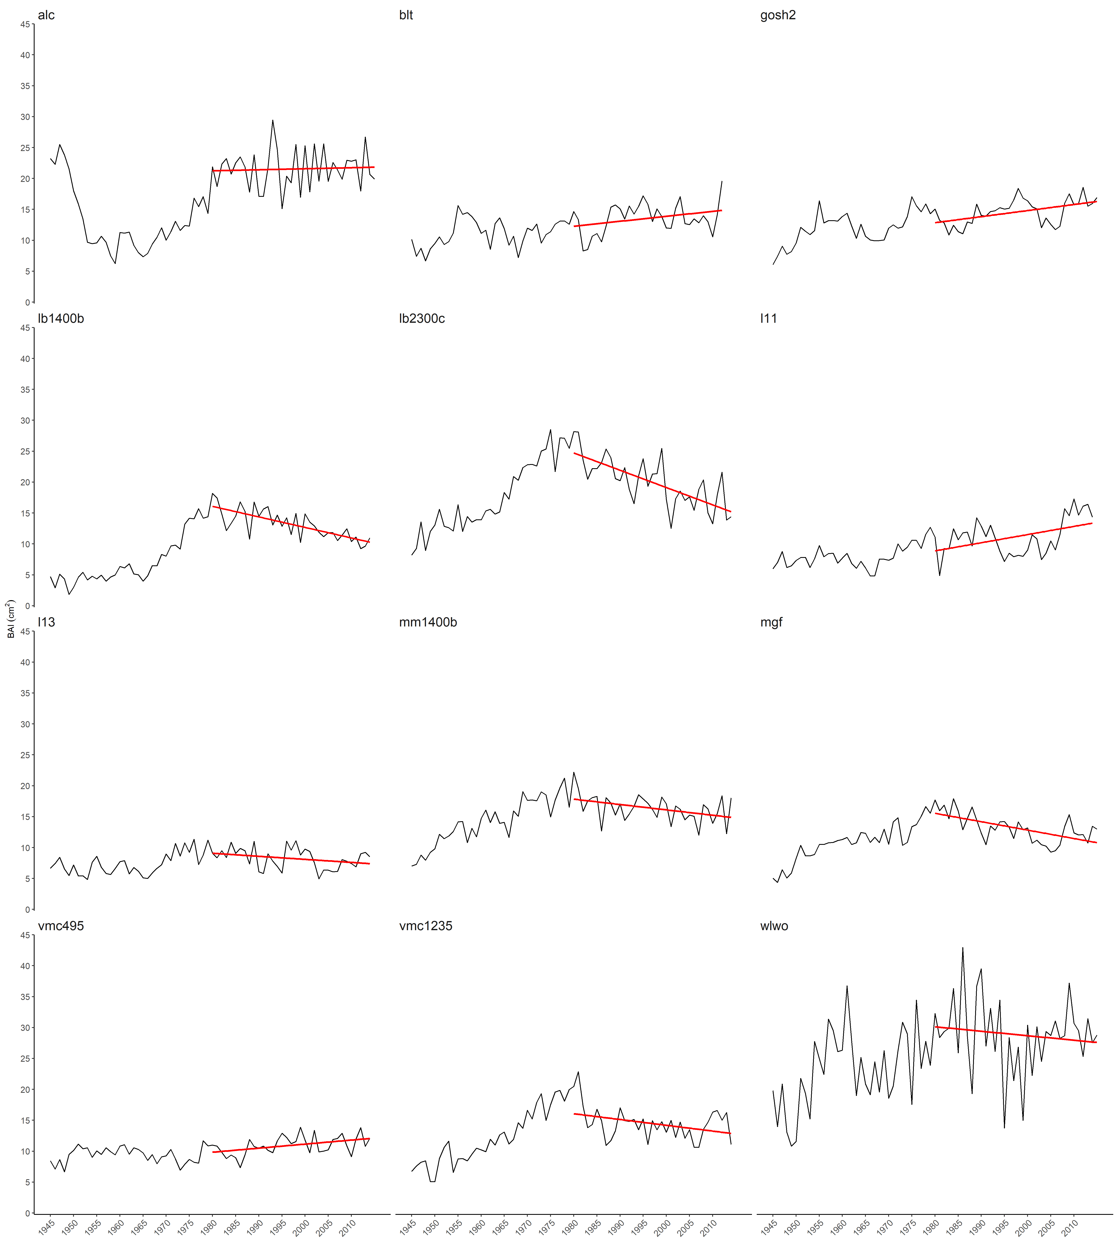
Red maple growth (BAI): elev class median: 1206 ft.

Slide 45
White pine growth (BAI)

Slide 46
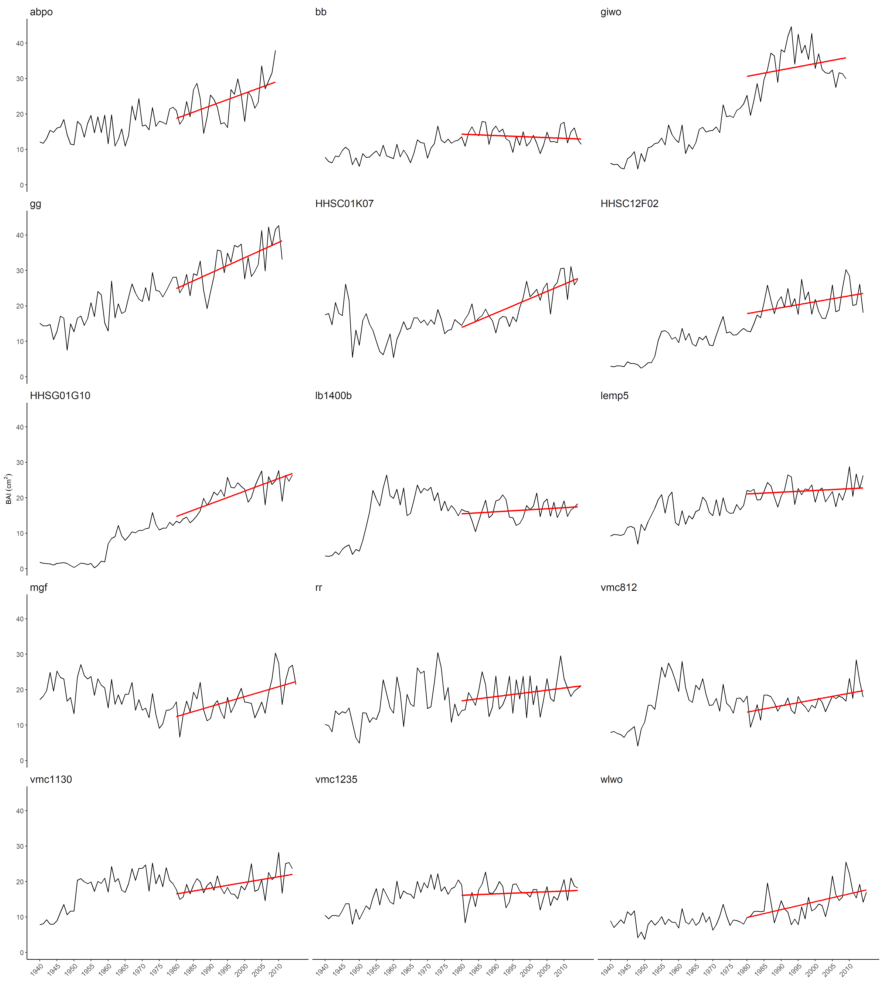
Eastern hemlock growth (BAI)

Slide 47
Red oak study sites:
11 sites
213 trees
Notes:
Map of our study sites

Slide 48
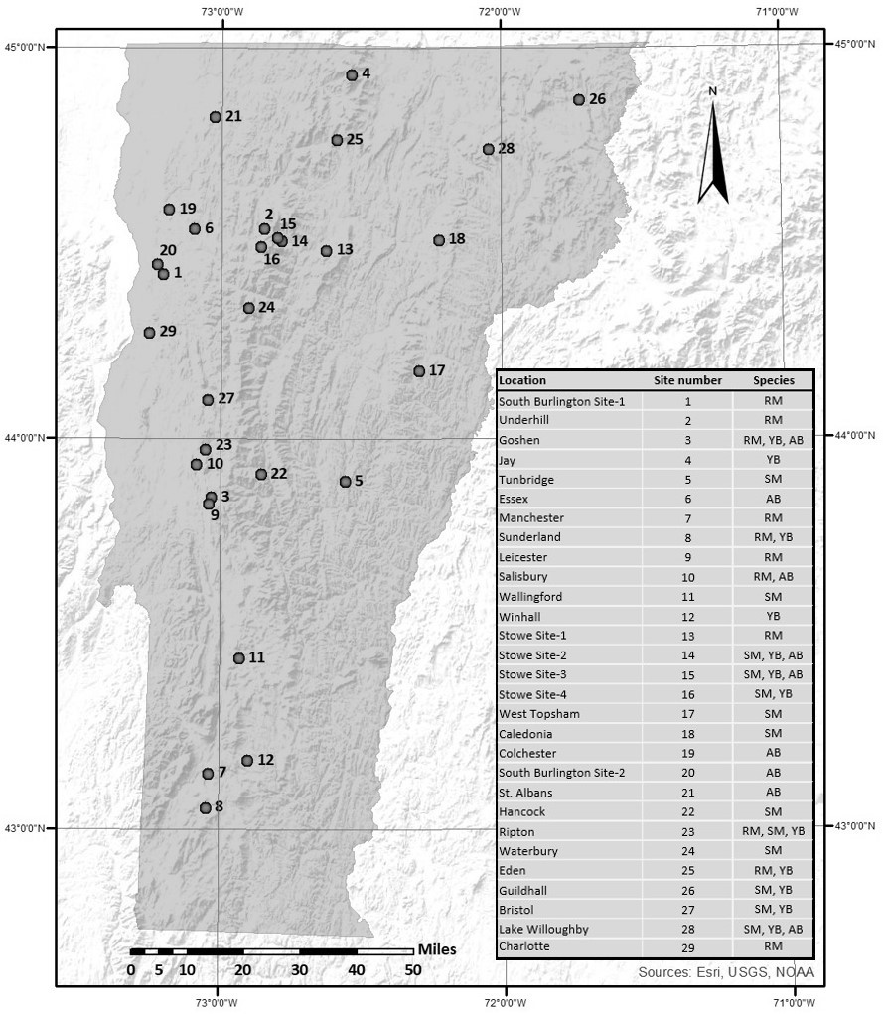
Northern hardwood sampling sites
Sites:
12 sugar maple
9 American beech
12 yellow birch
12 red maple
Notes:
690 trees sampled:
203 sugar maple
137 American beech
172 yellow birch
178 red maple

Slide 49
Temperate conifer sampling sites
23 sites:
8 white pine
10 eastern hemlock
5 both species
476 trees:
219 white pine
257 eastern hemlock
EH

