Slide 1
Assessing Ecosystem Controls on Soil Carbon Storage Across the Northeastern United States Adam Noel PhD. Candidate - RSENR 13 December 2019

Slide 2
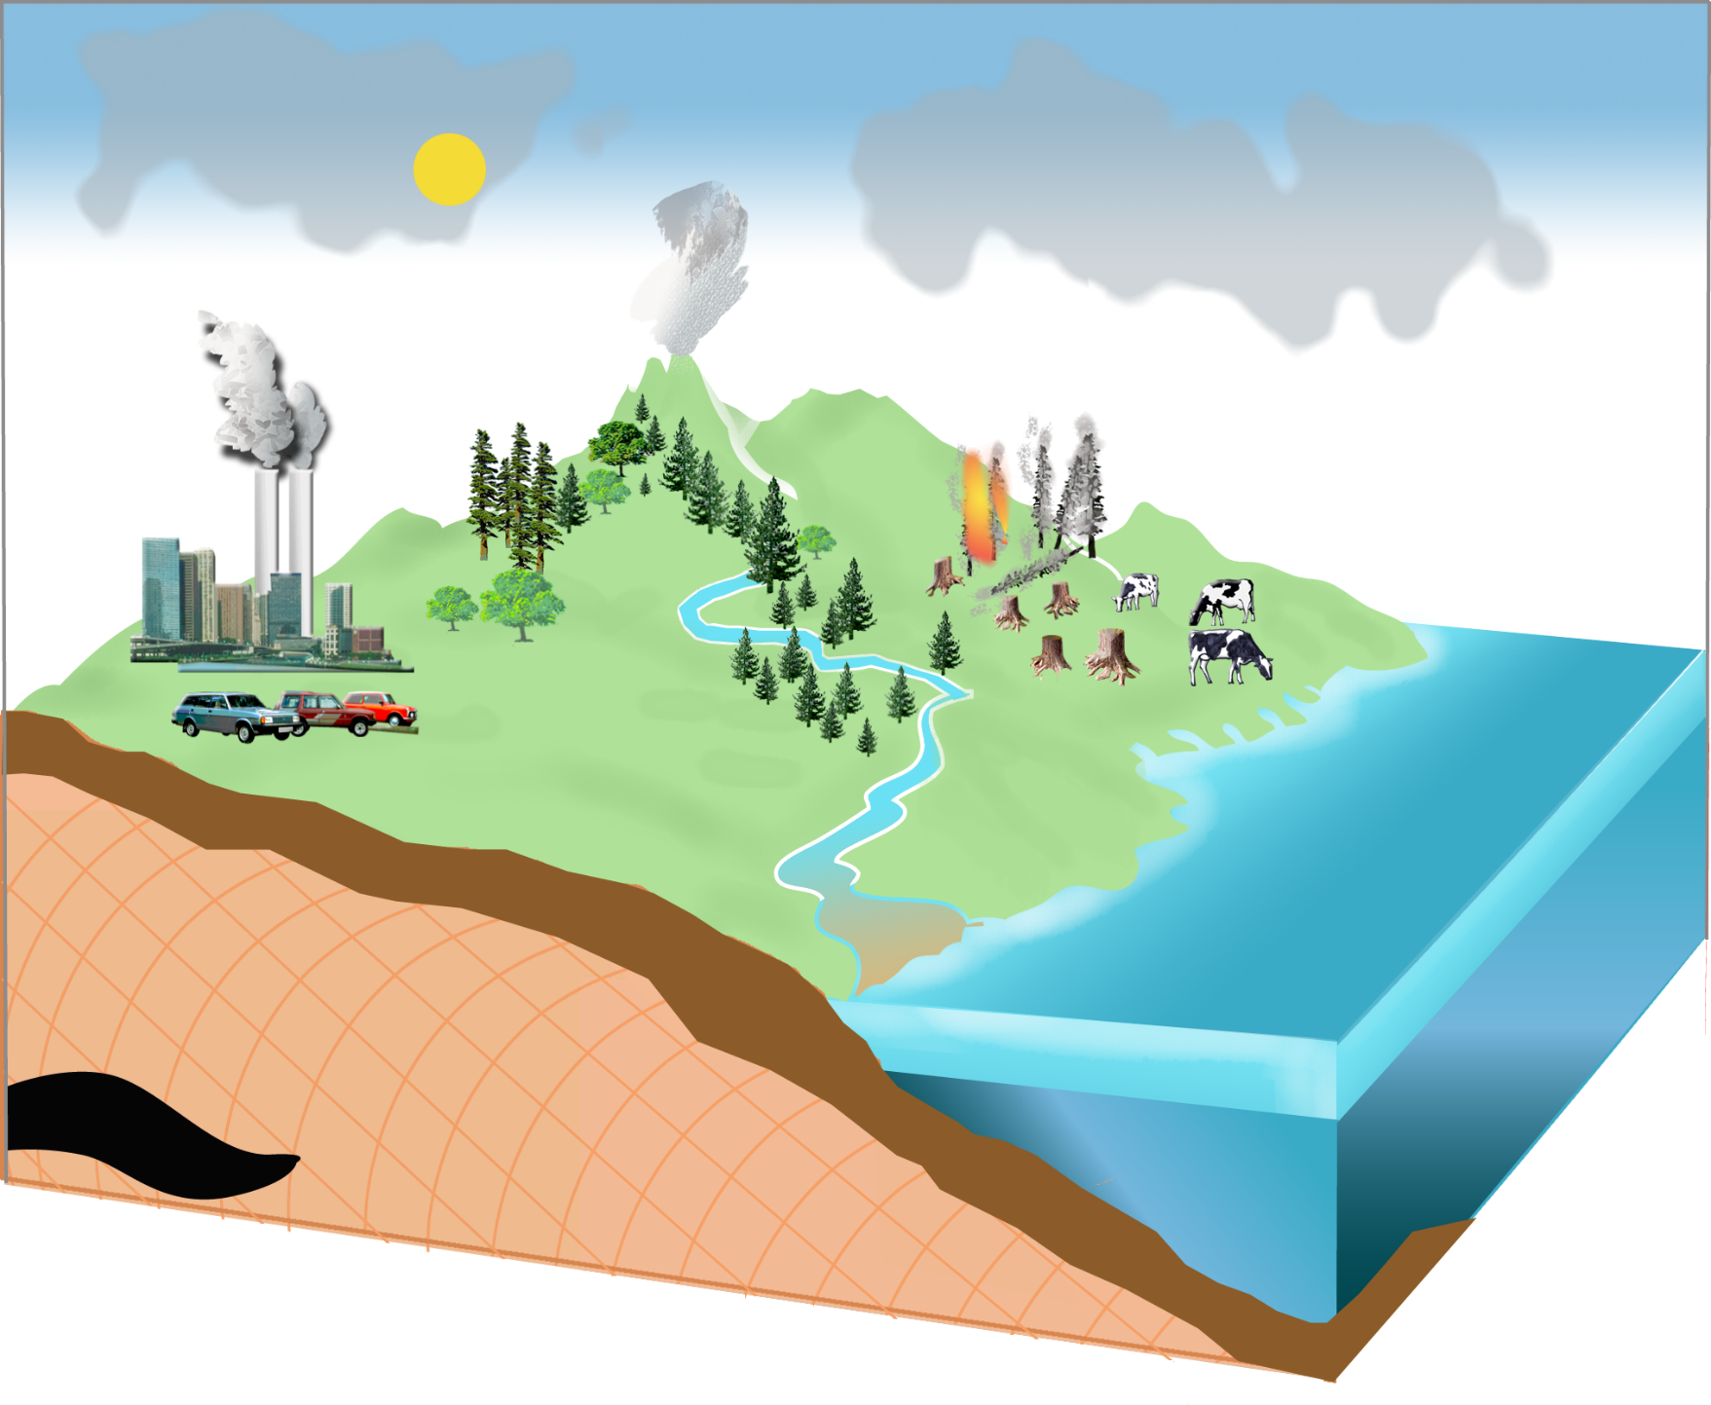
Soil Carbon is Important!
Soil Respiration
(Decomposition)
Photosynthesis
Atmosphere
58
750
Largest terrestrial carbon sink
120
Plant Respiration
Burning
Fossil
Fuels
59
7.7
Plants
560
Litterfall
59
Soils
1,500
Legend .
Petagrams (Pg) = 10¹⁵ g
Pools: Pg
Fluxes: Pg/year

Slide 3
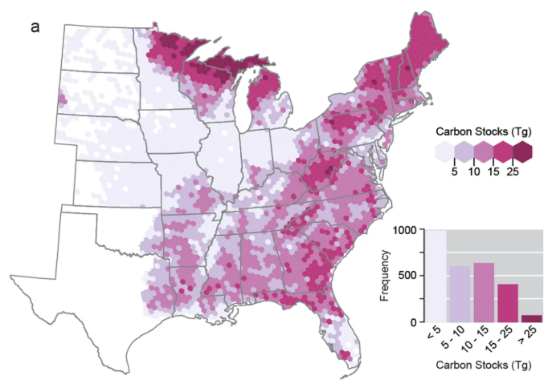
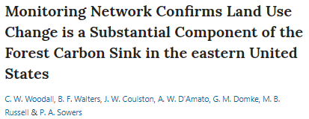
Northeastern U.S. is a Carbon Sink
Forest Carbon Stocks (aboveground)

Slide 4
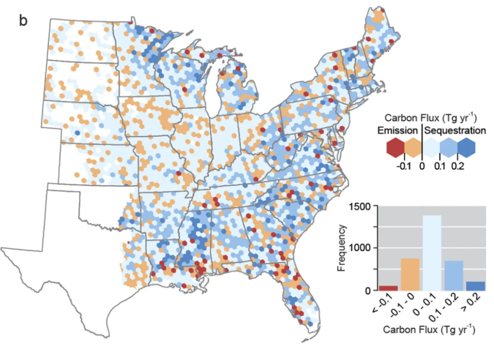
Northeastern U.S. is a Carbon Sink
Change in Forest Carbon Stocks (aboveground)

Slide 5
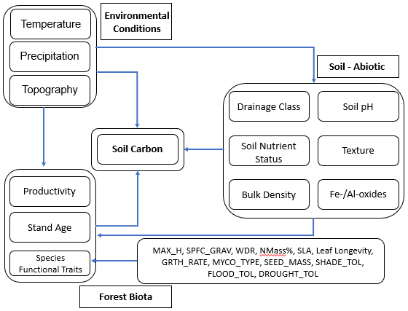
Temperate Forests – Difficult to Study
Interactions between many factors:
temperature, precipitation, .
topography .
.

Slide 6
Temperate Forests – Difficult to Study
Interactions between many factors:
temperature, precipitation, .
topography .
forest density, composition, age
.

Slide 7
Temperate Forests – Difficult to Study
Interactions between many factors:
temperature, precipitation, .
topography .
forest density, composition, age
soil nutrients .
↓ .
soil carbon .

Slide 8
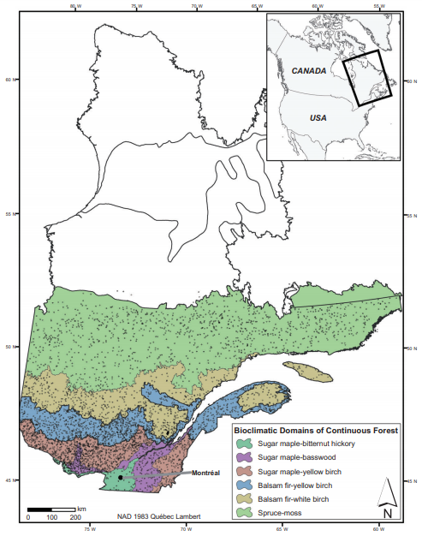
Similar Studies
Quebec Forest Survey dataset
Aboveground productivity

Slide 9
Similar Studies
Quebec Forest Survey dataset
Aboveground productivity
Found effects of:
-Temperature
-Drainage
-Stand Density
-Biodiversity as measured by
functional trait diversity

Slide 10
Functional Traits – different facets of biodiversity
How does the mean or the spread of ___ trait values affect ___ process?
Notes:
-

Slide 11
Functional Traits – different facets of biodiversity
species maximum height
soil carbon storage?
How does the mean or the spread of ___ trait values affect _ process?

Slide 12
Functional Traits – different facets of biodiversity
species maximum height
soil carbon storage?
How does the mean or the spread of ___ trait values affect _ process?
CWM
FDis
= functional . dispersion
CWM
FDis

Slide 13
Functional Traits – different facets of biodiversity
species maximum height
soil carbon storage?
How does the mean or the spread of ___ trait values affect _ process?
wood decay resistance,
flood, drought, shade tolerances,
LMA, leaf longevity, leaf N% ,
growth rate, seed mass,
specific gravity (density)

Slide 14
Study Goals
Include all ecosystem factors in one model to
compare relative strength of effects on soil C storage.
---------------------------------------------------------------------------------------

Slide 15
Study Goals
Include all ecosystem factors in one model to
compare relative strength of effects on soil C storage.
---------------------------------------------------------------------------------------
Do the environmental conditions, forest biota, or soil conditions have the largest effect on soil C?
How do each of these groups express their effects?

Slide 16
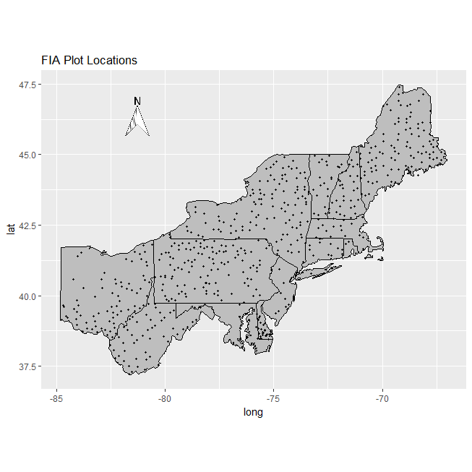
Forest Inventory Analysis
Phase 2 & Phase 3 Measurements
n = 542

Slide 17
Phase 2 & Phase 3 Measurements
Soil Carbon (SOC)
Soil Nutrients: N, P, K, Ca, Fe, Al
Forest Age
Forest Composition

Slide 18
Phase 2 & Phase 3 Measurements
Soil Carbon (SOC)
Soil Nutrients: N, P, K, Ca, Fe, Al
Forest Age
Forest Composition
More Data!
Mean Temp.
Mean Precip.
Topographic Wetness Index (TWI)
Stand Density Index (SDI)
Functional Trait Metrics
(CWM & FDis)

Slide 19
Variable Selection & Model Testing
Boosted Regression Trees
SOC
Avg.Temp
TWI
Avg.Precip
Std.Age

Slide 20
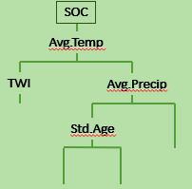
Variable Selection & Model Testing
Boosted Regression Trees
* 1800
Output = list of variables

Slide 21
Variable Selection & Model Testing
Boosted Regression Trees
Structural Equation Modelling
122 models
Best 3 sets included:
Specific Gravity - CWM
%N per Leaf Mass - FDis
Phylogenetic Species Variability
* 1800
Output = list of variables

Slide 22
Variable Selection & Model Testing
Boosted Regression Trees
Structural Equation Modelling
122 models
Best 3 sets included:
Specific Gravity - CWM
%N per Leaf Mass - FDis
Phylogenetic Species Variability
* 1800
Δ AIC = 848
Output = list of variables

Slide 23
Best Model
TWI
-0.151
SPFC_GRAV_CWM
0.195
Stand Age
R² = .249
-0.277
0.246
0.086
0.339
0.079
Mean Temp.
SOC
Stand Density Index .
R² = .378
R² = .146
0.097
0.185
-0.135
0.157
0.525
-0.207
Mean Precip
Fe
Al
N
P
K
Ca

Slide 24
Best Model
TWI
-0.151
SPFC_GRAV_CWM
0.195
Stand Age
R² = .249
-0.277
0.246
0.086
0.339
0.079
Mean Temp.
SOC
Stand Density Index .
R² = .378
R² = .146
New R² = .375
0.097
0.185
-0.135
0.157
0.525
-0.207
Mean Precip
Fe
Al
N
P
K
Ca

Slide 25
Best Model
TWI
-0.151
SPFC_GRAV_CWM
0.195
Stand Age
R² = .249
-0.277
0.246
0.086
0.339
0.079
Mean Temp.
SOC
Stand Density Index .
R² = .378
R² = .146
New R² = .375
0.097
0.185
-0.135
0.157
0.525
-0.207
Mean Precip
Fe
Al
N
P
K
Ca

Slide 26
Best Model
TWI
-0.151
SPFC_GRAV_CWM
0.195
Stand Age
R² = .249
-0.277
0.246
0.086
0.339
0.079
Mean Temp.
SOC
Stand Density Index .
R² = .378
R² = .146
New R² = .079
0.097
0.185
-0.135
0.157
0.525
-0.207
Mean Precip
Fe
Al
N
P
K
Ca

Slide 27
Goals Revisited
Do environmental conditions, forest biota, or soil conditions
have the largest effect on soil C?
- Soil conditions – largest effect!
- Forest biota & Environmental conditions – underwhelming.

Slide 28
Goals Revisited
Do environmental conditions, forest biota, or soil conditions
have the largest effect on soil C?
- Soil conditions – largest effect!
- Forest biota & Environmental conditions – underwhelming.
How do each of these groups express their effects?
- Direct soil impacts
- Weak, indirect effects of environmental conditions
- Weak, mixed effects of forest biota

Slide 29
Questions?

