Slide 1
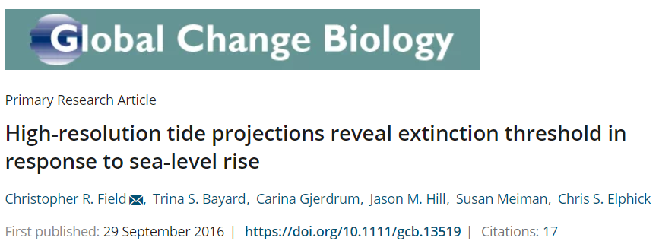
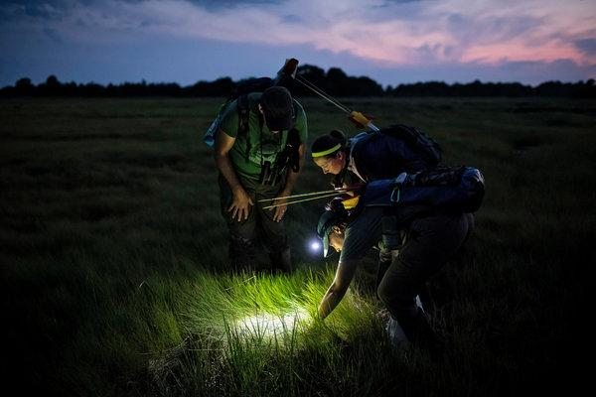
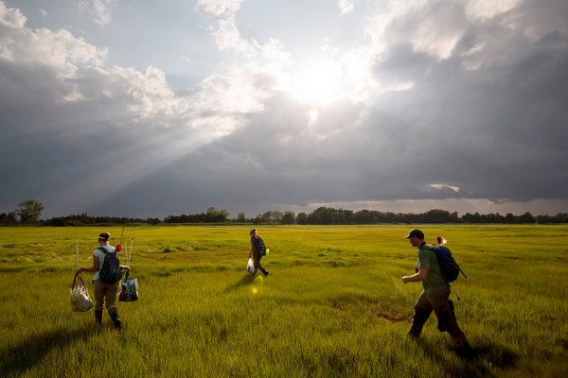
Photos: Karsten Moran for The New York Times
Notes:
NYDEC: Sea levels along New York's coast have already risen more than a foot since 1900.
Sea level is projected to rise along the New York State coastline and in the tidal Hudson zone by 9-21 inches by the 2050s, and 14-39 inches by the 2080s
New York State Energy Research and Development Authority, Updating the 2011 ClimAID Climate Risk Information Supplement to NYSERDA Report 11-18 (Responding to Climate Change in New York State): source.

Slide 2




Elevational Shifts of Montane Spruce-fir Forest Birds (2011-2019)
Jason Hill
Funding generously provided: U.S. Fish and Wildlife Service Region 5, U.S. Forest Service, the National Fish and Wildlife Foundation, the National Park Service, the Canadian Wildlife Service, the Vermont Agency of Natural Resources, Plum Creek, the Cullman Foundation, the New York State Department of Environmental Conservation, and numerous private donors.
Thank you MBW’ers!

Slide 3
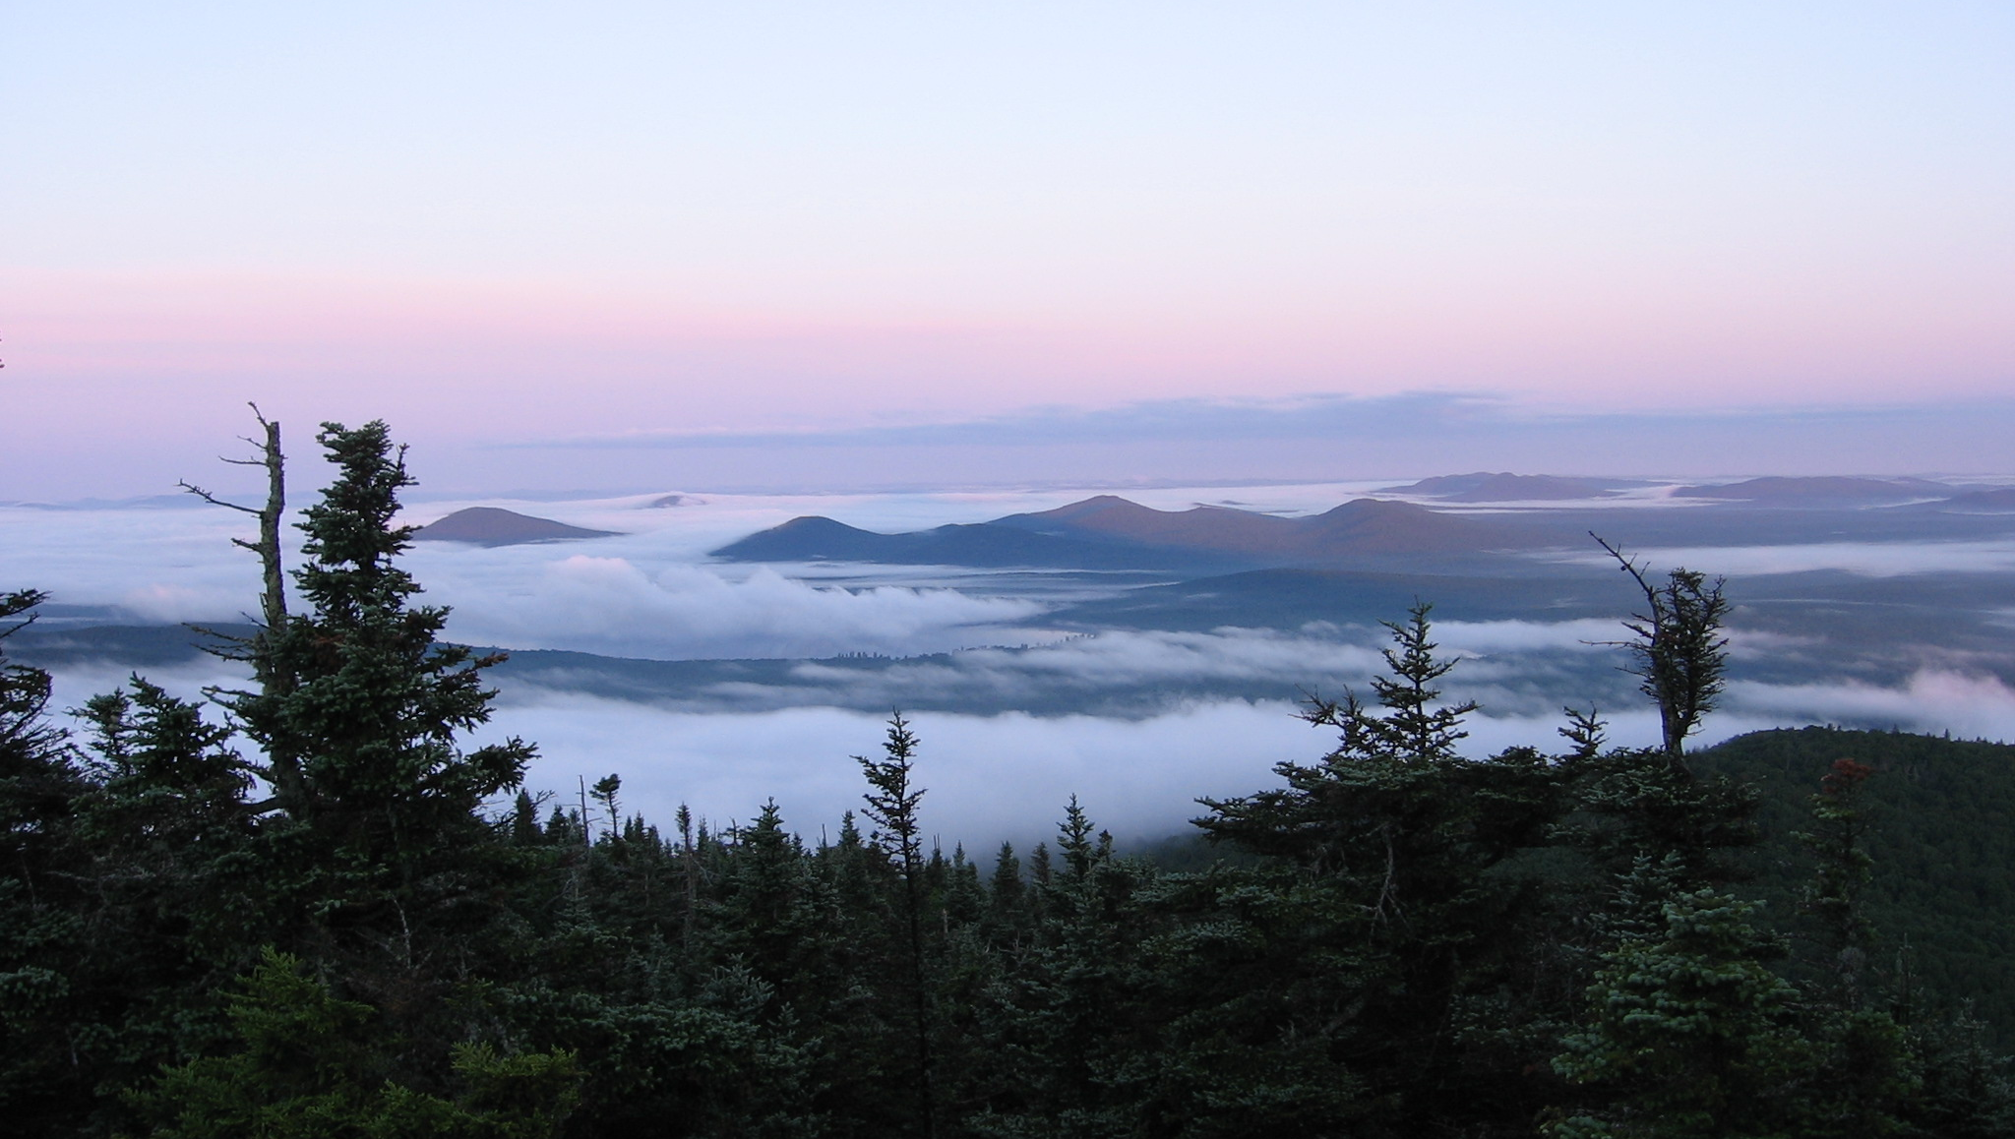
C. Debar
Notes:
Mountains are warming twice as fast as the rest of the world, and mountaintops perhaps 5X the global rate.
Nature paper: 87% of European mountain peaks are being colonized by lower elevational plant species due to milder weather at the top
In the Andes, we see high-elevation species (over 1200 m) with shrinking ranges and abundance.
Globally, we see distributions of species have recently shifted to higher elevations at a median rate of 11.0 meters per decade, and to higher latitudes at a median rate of 16.9 kilometers per decade.

Slide 4
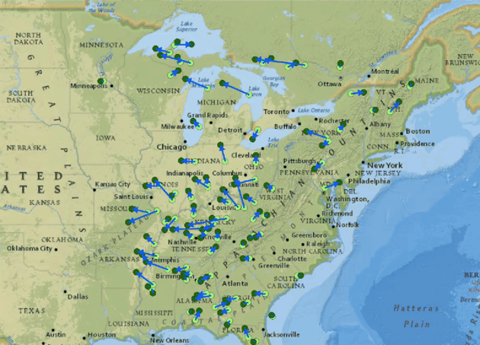
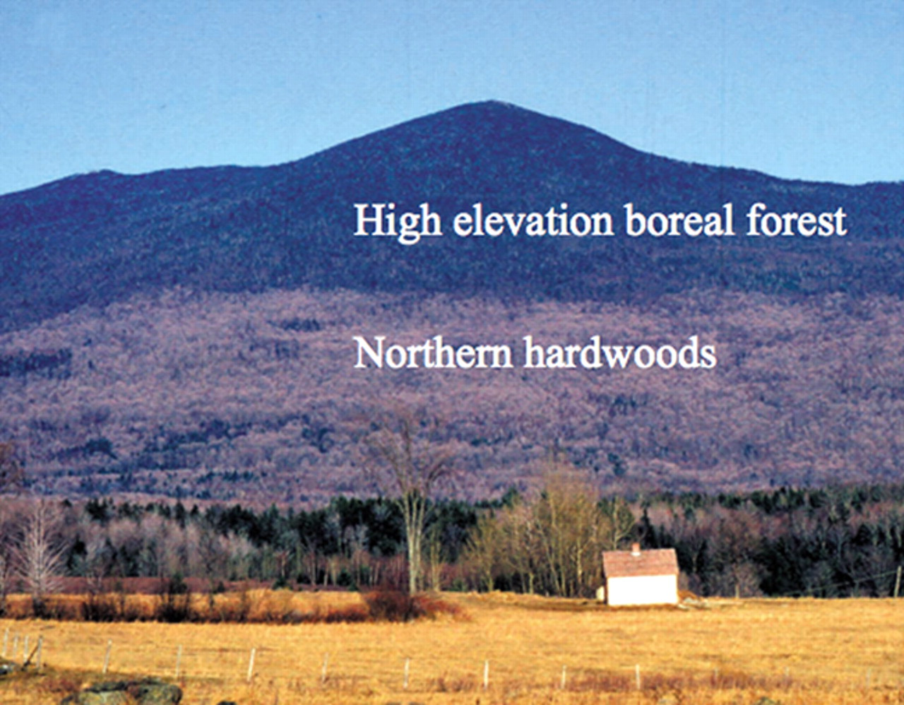
Northeastern U.S. vegetation already responding to changing climate
Fei et al. 2017
Beckage et al. 2018
Notes:
Climate has already changed in the NE US, & will continue to change no matter what we do at this point.
Fei et al. 2017: 86 tree species across the eastern United States spanning the last 30 years. More tree species have experienced a westward shift (73%) than a poleward shift (62%) in their abundance, a trend that is stronger for saplings than adult trees
Beckage et al. 2018: from 1964 to 2004. They used aerial photographs and satellite imagery to estimate a 91- to 119-m upslope shift in the upper limits of the NBE from 1962 to 2005

Slide 5
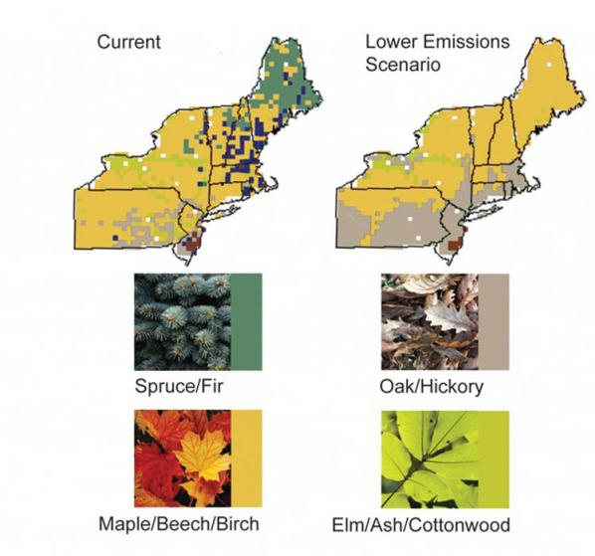
Future of northeastern U.S. boreal forests
Sensu Iverson et al. 2008
& Wang et al. 2016
Notes:
Via climate change over the next 300 years, we expect >50% of the Northeast spruce-fir community (shown in green) to be replaced by the upslope movement of maple-beech forests (shown in brown).
Unlike other ecosystem types, where organisms may be able to track their preferred habitat as it moves up in elevation in response to climate change, that simply won’t be possible for organisms that already live at the top of the mountain. So we can expect a shrinking suitable climate envelope for high-elevation birds.

Slide 6
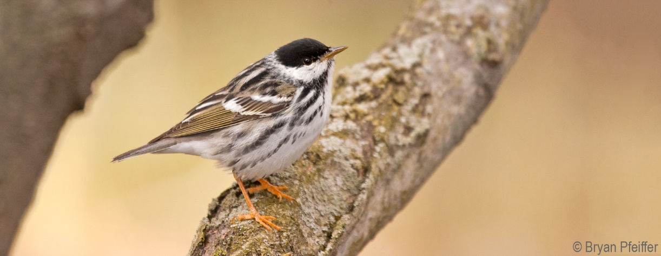
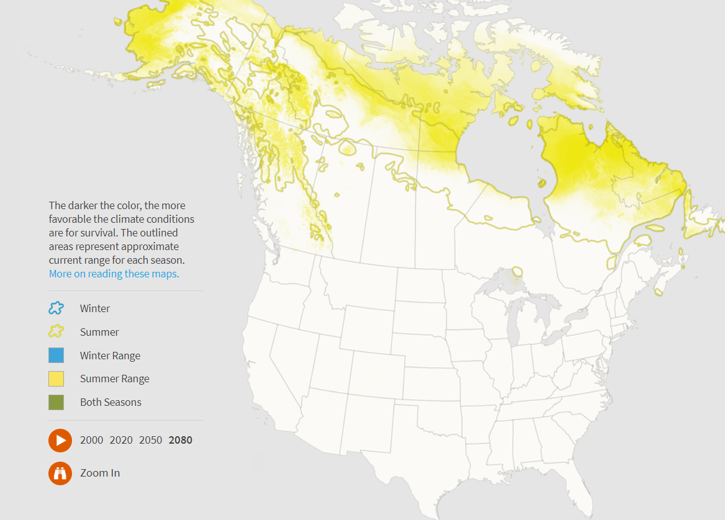
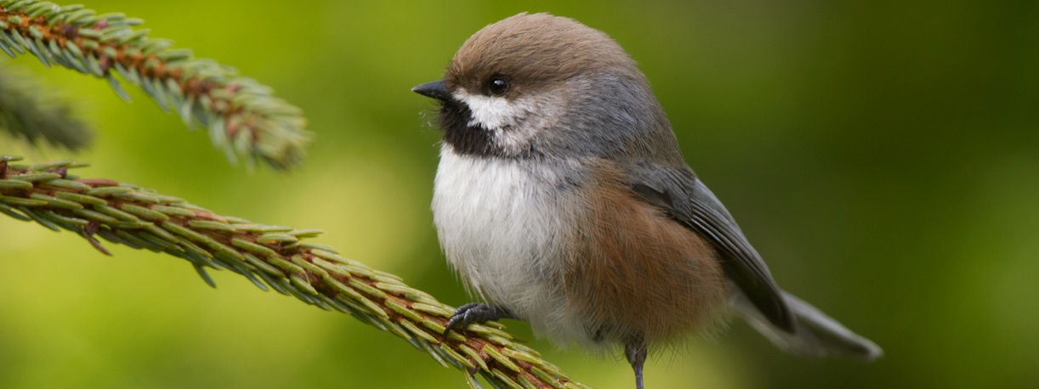
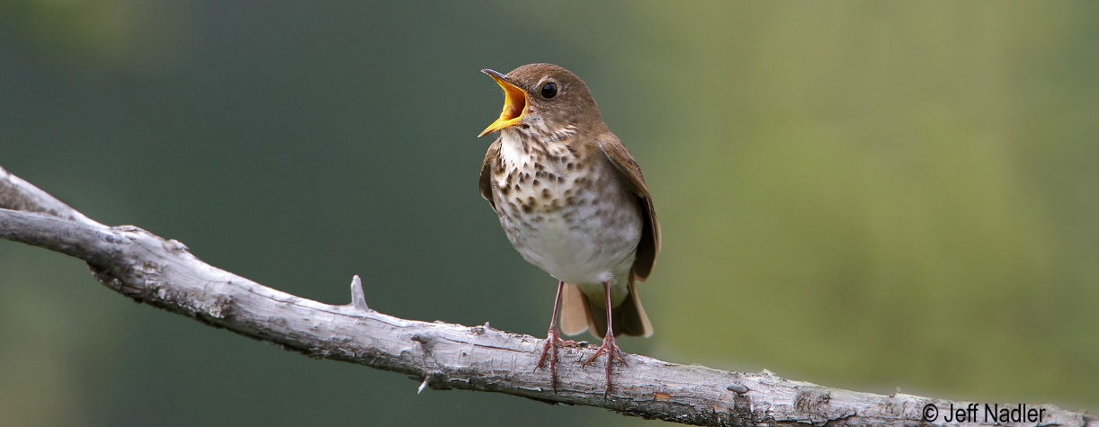
Latitudinal & upslope retreat for our mountain birds
Kent McFarland
Langham et al. 2015; Audubon’s birds & climate change report 2015.
Notes:
Montane birds around the world are responding similarly.
Freeman and Freeman 2014. 50 years, Papua New Guinea, ~75% of the bird species have moved up 100-150 m in elevation.
Ralston and Kirchman 2013: PREDICTED THAT Breeding distributions of nearly all boreal bird species are predicted to expand as they shift northward, but will dramatically decrease or be completely lost from mountain populations in New York, Vermont, and New Hampshire by 2080.
Deluca and King: 20+ year study from Northern New Hampshire saw slight downward shifts in high-elevation bird species.
BUT HOW ABOUT THE REST OF NEW ENGLAND

Slide 7
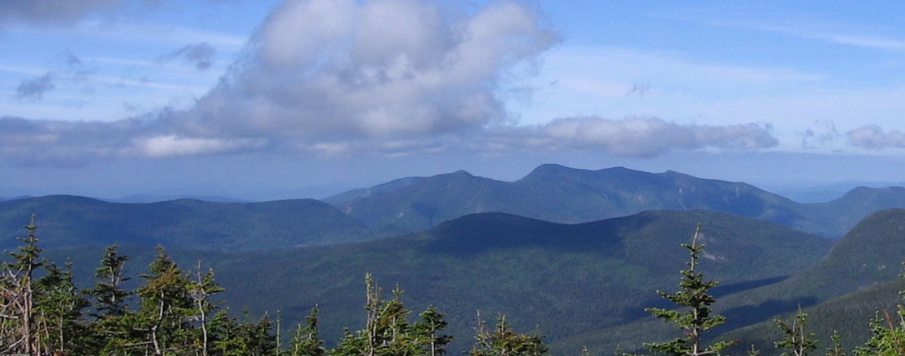
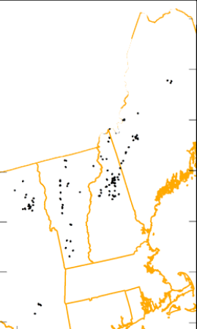
Mountain Birdwatch
Yellow-bellied Flycatcher
Bicknell’s Thrush
Hermit Thrush
Swainson’s Thrush
Boreal Chickadee
Black-capped Chickadee
Winter Wren
Blackpoll Warbler
White-throated Sparrow
Fox Sparrow
(Red Squirrel)
C. Debar
Notes:
Started in 2000, Mountain Birdwatch is an initiative by the Vermont Center for Ecostudies to engage hikers and wildlife enthusiasts, and to harness the power of the public to conduct wildlife monitoring across northern New England and eastern New York.

Slide 8
N-mixture models, hierarchical Bayesian framework: 2011-2019
Detection components:
Year
Survey start time²
Survey date²
Abundance components:
Latitude
Elevation² by Year
Random site effect
C. Debar

Slide 9
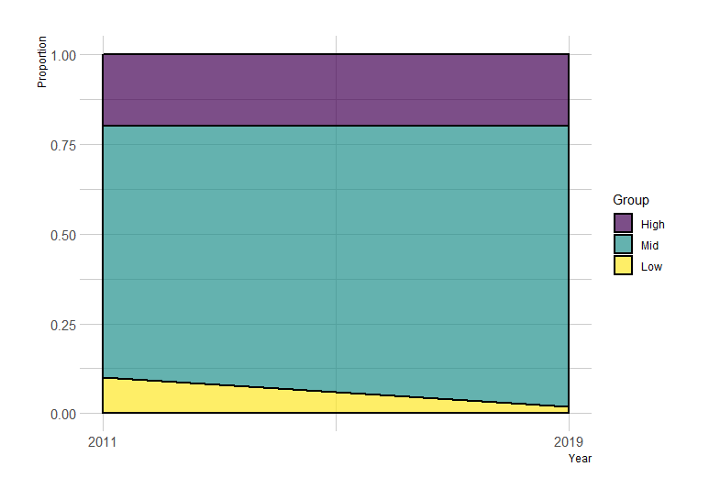
Elevational Proportion Change
1200-1500 m
900-1200 m
600-900 m

Slide 10
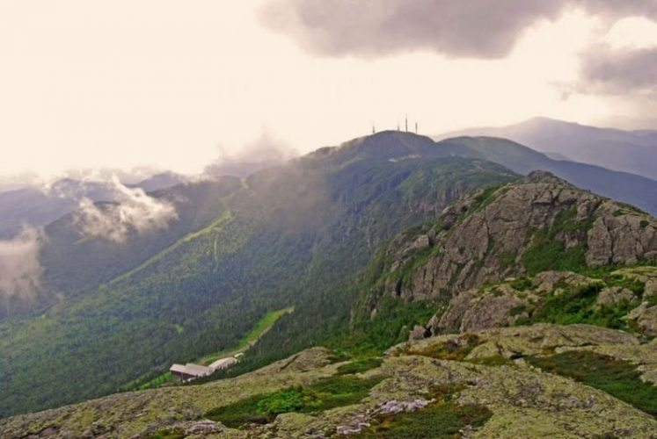
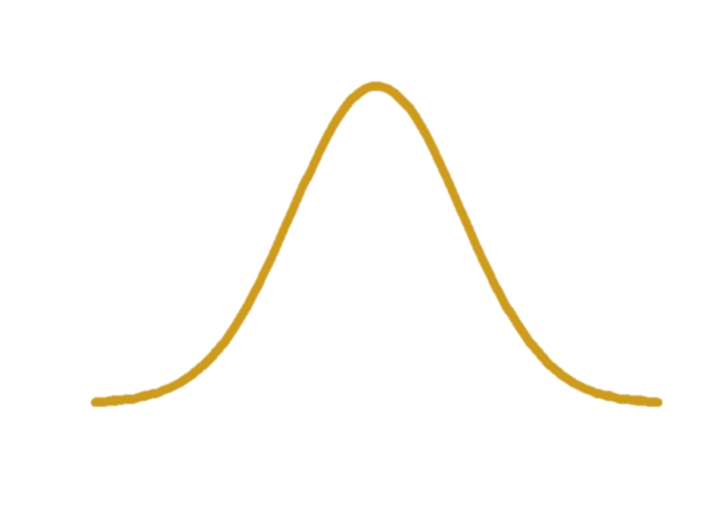
9-Year Elevational Shifts

Slide 11
9-Year Elevational Shifts
50%

Slide 12
9-Year Elevational Shifts
75%
25%

Slide 13
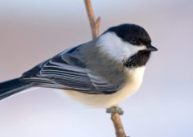
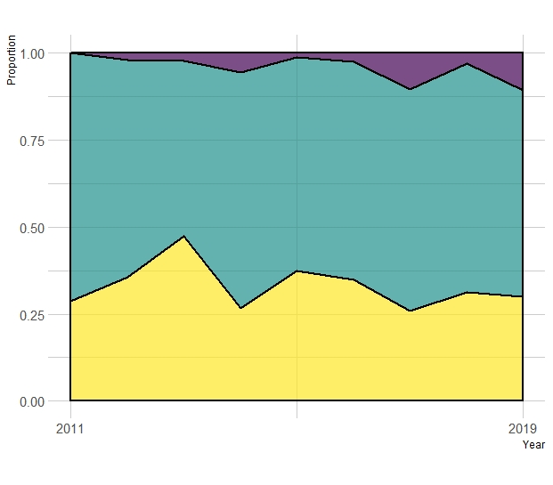
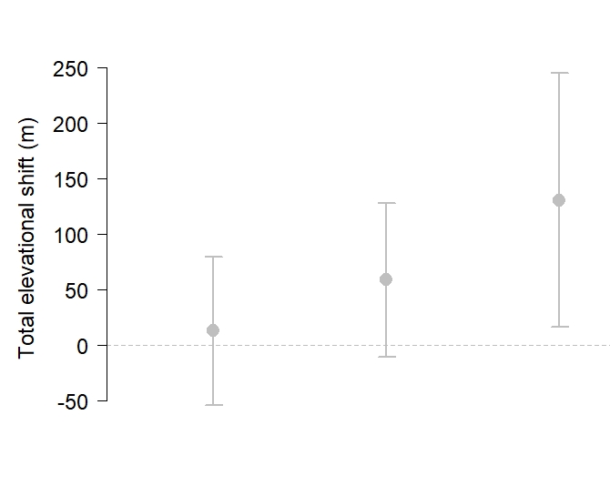
Black-capped Chickadee
1200 – 1500 m
900 – 1200 m
Middle
boundary
Upper
boundary
600 – 900 m
Lower
boundary
Notes:
Let’s start with a familiar species, that is steadily increasing across the US and breeds in our backyards and up the mountains.

Slide 14
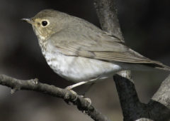
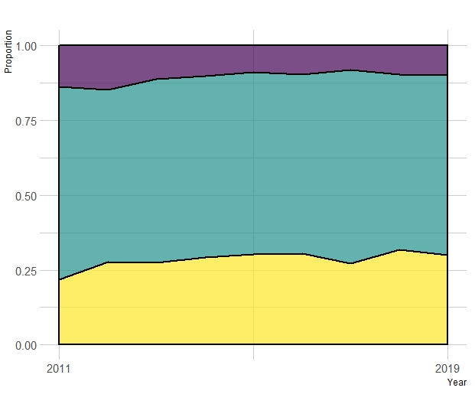
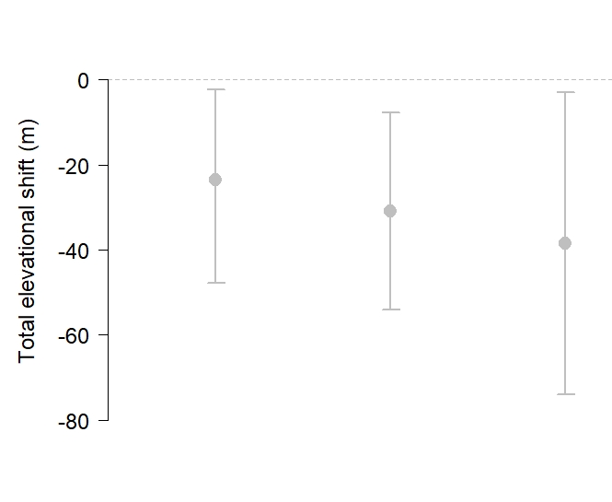
Swainson’s Thrush
1200 – 1500 m
900 – 1200 m
Lower
boundary
Middle
boundary
600 – 900 m
Upper
boundary
Notes:
Swainson’s Thrush breed in northern hardwood forests of New England, too, but are far more common in the high-elevation forests of spruce and fir.
Banding data from Mansfield tracks this pattern, and these results agree with Deluca and King for northern New Hampshire.

Slide 15
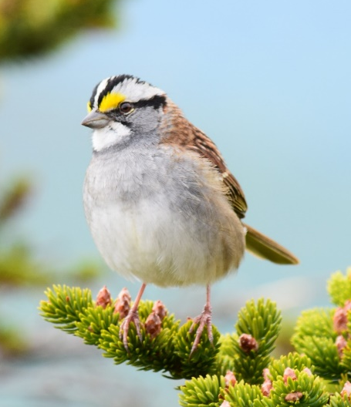
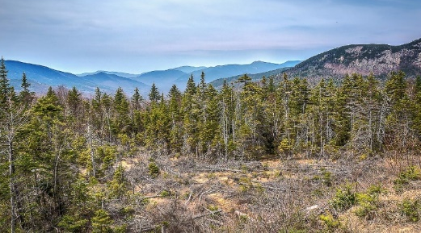
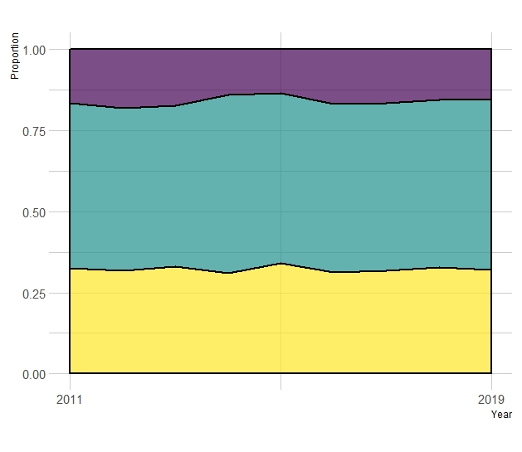
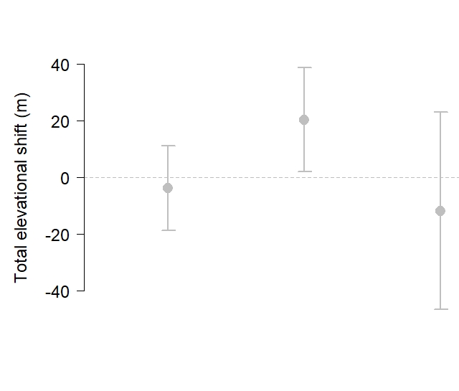
White-throated Sparrow
1200 – 1500 m
T. Perkins
900 – 1200 m
Middle
boundary
Lower
boundary
600 – 900 m
Upper
boundary
Notes:
During the breeding season, White-throated Sparrows inhabit boreal and mixed-forest of the northern United States and Canada. Within this region, they are most often found nesting on forest edges or in patches of young forest created by timber harvest or natural disturbances. Steadily declining in BBS data.

Slide 16
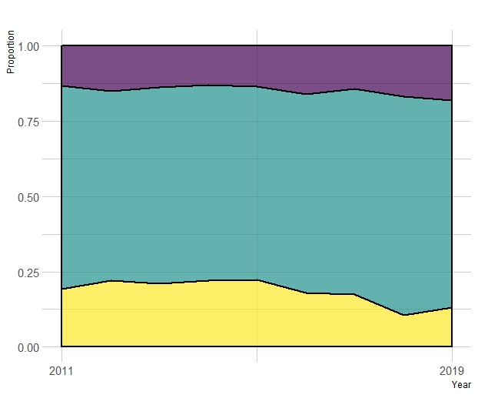
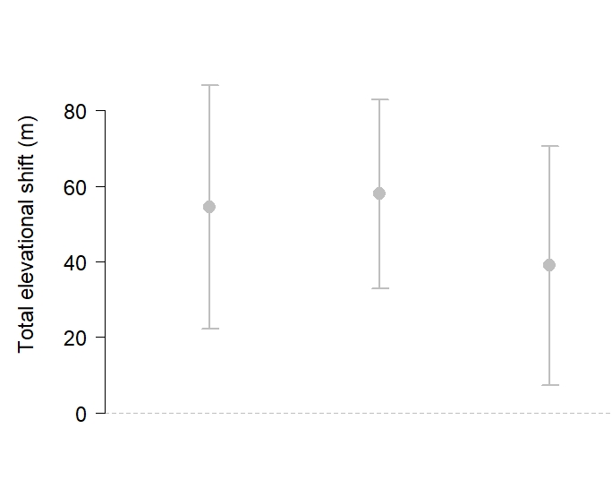

Blackpoll Warbler
1200 – 1500 m
900 – 1200 m
Middle
boundary
Lower
boundary
600 – 900 m
Upper
boundary
Notes:
Blackpoll Warblers breed throughout the boreal forest of Canada and Alaska, in addition to the high peaks of the northeastern United States. Blackpoll Warblers make one of the longest migrations of any North American bird.

Slide 17
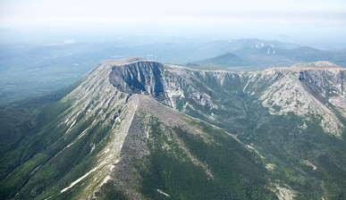
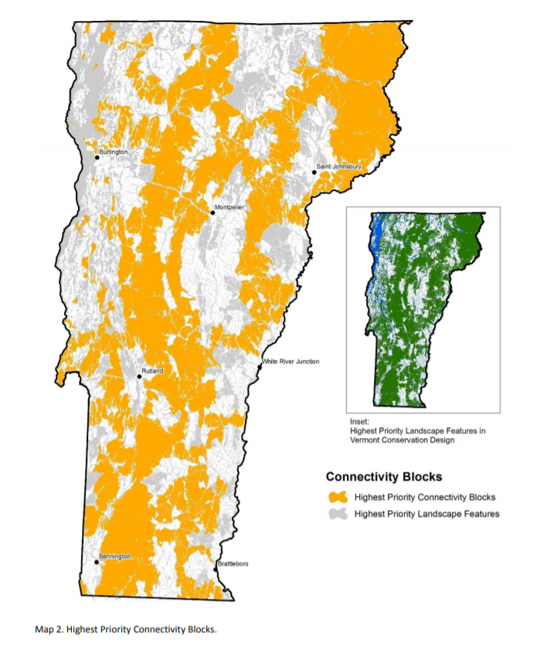
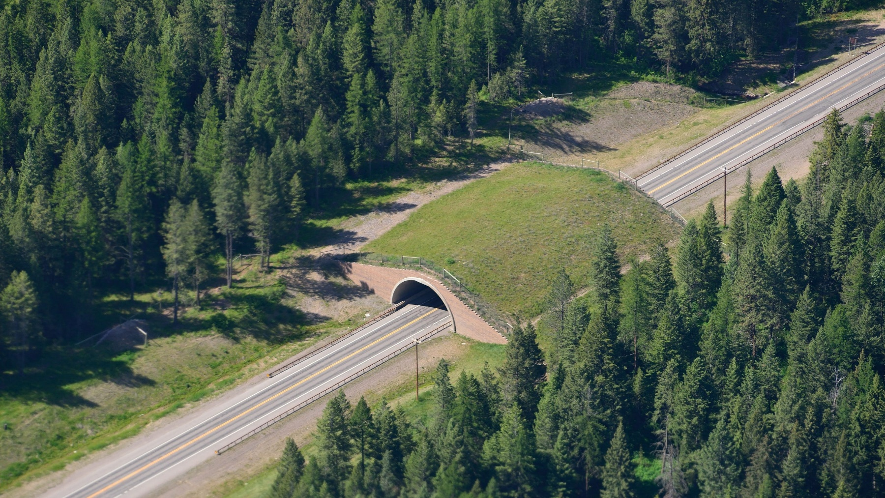

Slide 18



MountainBirdwatch.org: Hike mountains, count birds, be merry.
Need a last minute holiday gift idea?

