Slide 1



Evaluating Success of
Monitoring for Impacts of Climate Change on State Wildlife Lands in Massachusetts
John Scanlon, MassWildlife Habitat Program Supervisor
2019 Forest Ecosystem Monitoring Cooperative Conference

Slide 2
Outline
What are we managing for?
What environmental stressors are impacting the forested ecosystems we are managing?
How do we monitor to assess impacts of management relative to environmental stressors such as Climate Change?

Slide 3
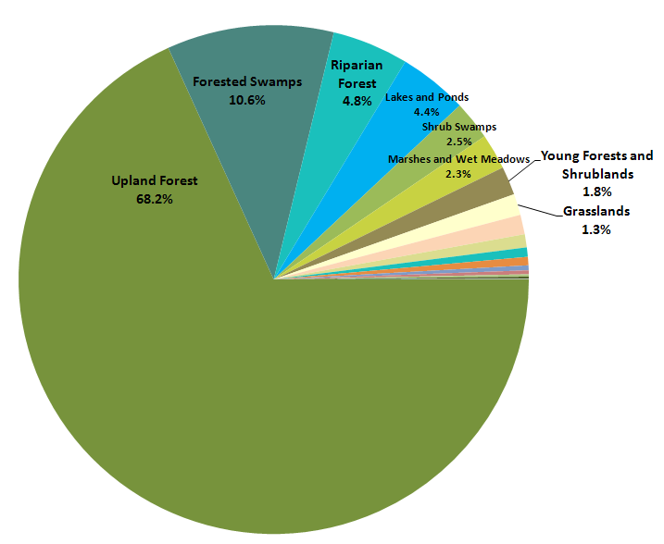
Summary of major SWAP habitats
https://www.mass.gov/service-details/state-wildlife-action-plan-swap
Notes:
This graph represents all undeveloped lands in Massachusetts (>3 million acres). Note the low level of young forest, shrubland, and grassland.

Slide 4
MassWildlife Upland Habitat Goals

Slide 5
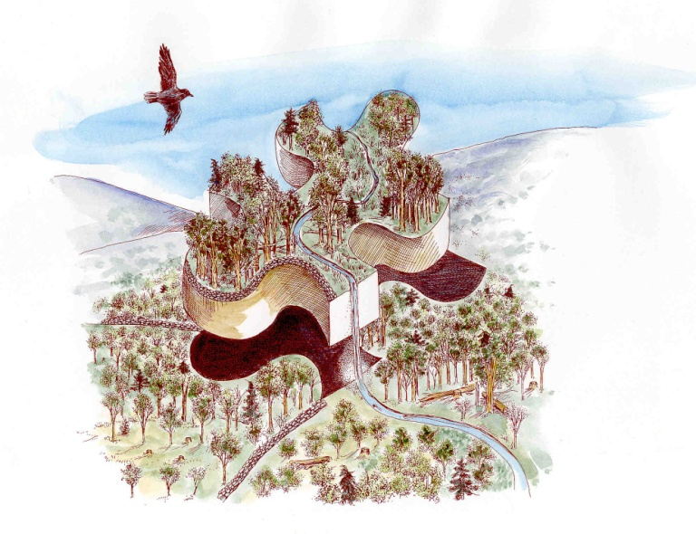
MassWildlife Landscape Habitat Goals for Upland Areas
Habitat Type | Current | Desired
Grassland | 1% | 1-2%
Shrubland | 4% | 7-9%
Young Forest | 4% | 10-15%
Full Canopy Forest | 81% | 60-70%
Forest Reserve | 10% | 10-15%
Notes:
Grassland, Shrubland, and Forest Reserve habitat types “stay put” on the landscape. Young forest and full canopy forest are provided in a shifting mosaic across the landscape in that after management to establish a patch of young forest, the unique values of this ephemeral habitat type are lost by age 20-30, but these 20-30 year old forest patches are allowed to continue succession until 90-120 years of age before they are set back again.

Slide 6
Generalized Habitat Types for Upland Areas
Habitat Type | Xeric | Mesic
Grassland | Warm-Season | Cool-Season
Shrubland | Scrub Oak Barrens Sandplain Heathland | Abandoned Field (Viburnum/Dogwood)
Young Forest | Mixed Oak/Pine | Aspen Coppice
Full Canopy Forest | Mixed Oak/Pine | Northern Hardwoods
Forest Reserve | Mixed Oak/Pine | Northern Hardwoods

Slide 7
MassWildlife Open Habitat Goals
Notes:
Within that 20-25% open habitat goal, the board set more specific goals of:
1-2% Grassland
7-10% Shrubland
10-15% Young Forest
In 2001, we had almost no grassland habitat, and just about 1% of our upland was in shrubland.
By 2016, with the help of the Key Sites initiative, we had increased our grassland to about 1% and shrubland to 3%. While we still have a ways to go with those habitat types, we now want to turn our focus to young forest habitat, which represents just about 4% of the MassWildlife upland habitat in 2016.

Slide 8
MassWildlife FY2019 Habitat Management Summary

Slide 9
Habitat Restoration & Management Process
Assess Natural Community Type (>100 recognized community types: https://www.mass.gov/natural-communities)

Slide 10
Natural Communities
Assemblages of plants & animals that recur together across the landscape under particular environmental conditions
  Terrestrial Communities (48) typically occur on relatively well-drained soils
    Ten Oak Community Types (e.g., Black Oak-Scarlet Oak Woodland; Chestnut Oak Woodland; Oak-Hickory Forest)
    Unique Types (e.g., Pitch Pine-Scrub Oak; Hickory-Hop Hornbeam Woodland; Rich Mesic Forest)
  Palustrine Communities (49) are freshwater wetlands
    Forested (e.g., Atlantic White Cedar Bog; Red Maple-Black Gum)
    Non-Forested (e.g., Calcareous Fen; Coastal Plain Pond Shore)
  Estuarine Communities (9) are tidal wetlands
    All non-forested ( e.g., Saltmarsh; Brackish Tidal Marsh;
https://www.mass.gov/service-details/terrestrial-palustrine-and-estuarine-community-types

Slide 11
Habitat Restoration & Management Process
Assess Natural Community Type
Determine Desired Future Condition (DFC)
Determine Priority for Restoration & Management
Conduct Initial Biological Monitoring
Prepare Habitat Site Plan
  Identify Grassland, Shrubland, and Forest Units
  Fine Tune DFC for Each Unit
  Prepare Rx Fire Management Plan as Needed
Submit Environmental Permitting
Prepare Mgt Contracts for Public Competitive Bid

Slide 12
Environmental Stressors Impacting Forested Ecosystems in the Northeastern U.S.
Back in the day (before climate change)
  Human land use history: deforestation, agricultural conversion, and subsequent abandonment
  Acid rain
  Invasive organisms & Deer herbivory
Climate Change
  Shifts in growing season timing & duration
  Shifts in precipitation form & pattern
Notes:
Before we address monitoring for impacts of climate change, step back in time 20-30 years to consider where our focus was before climate change came to dominate our perspective.

Slide 13
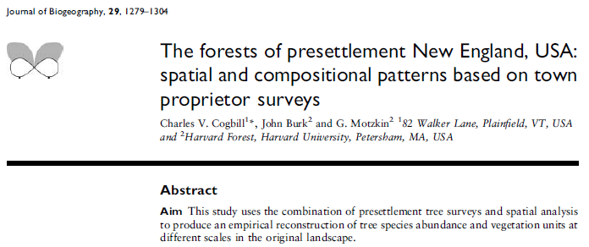


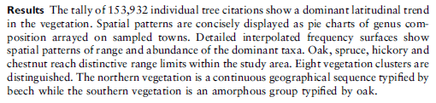

(2002)
………
Notes:
How many in the audience have not read this paper? Consider it an assignment! This is a fine piece of ecological scholarship. The take home point is that prior to European colonization, a “discrete tension zone” occurred for multiple centuries between northern hardwood forest dominated by beech and oak forest that had a variable fire component

Slide 14
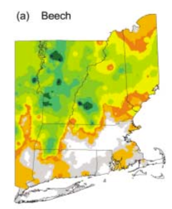
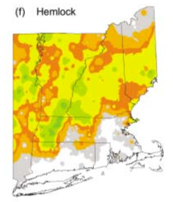
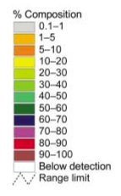
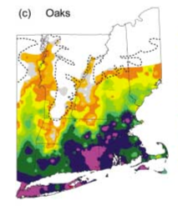
Notes:
Here is the discrete tension zone.

Slide 15
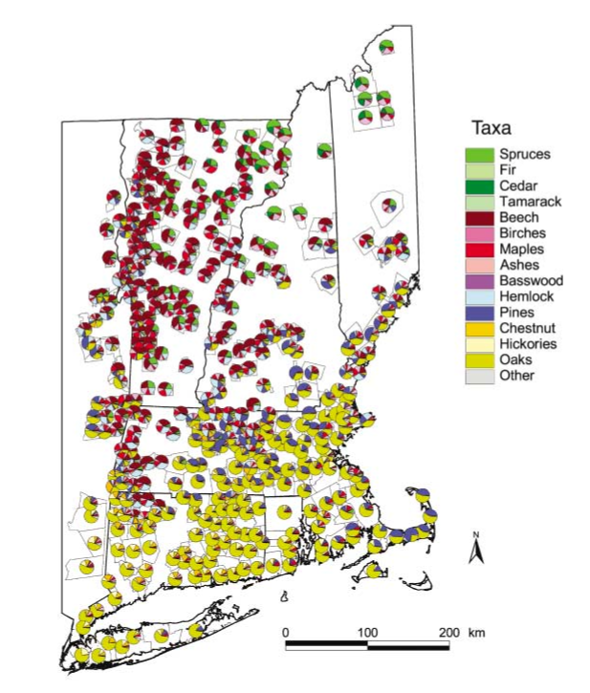
Notes:
Here is the discrete tension zone.

Slide 16
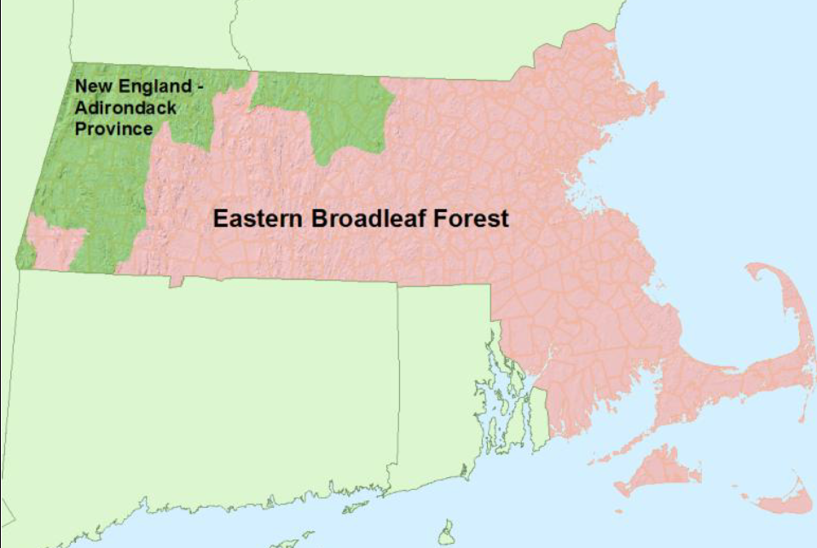

Notes:
Here is the discrete tension zone. Think of this as a two-color quilt that covered the landscape. The deforestation, agricultural conversion, agricultural abandonment and subsequent reforestation shook that quilt profoundly, and the quilt is in fact still in the process of settling back onto the landscape. This kind of disturbance leaves an enduring mark that is, in fact, still in the making.

Slide 17
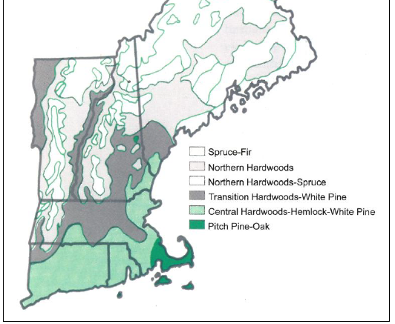
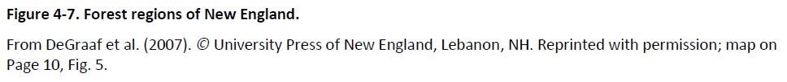
Notes:
This is how the forest cover quilt has re-settled so far. Note the occurrence of pitch pine on cape cod and the islands. There is actually more at some inland locations….

Slide 18
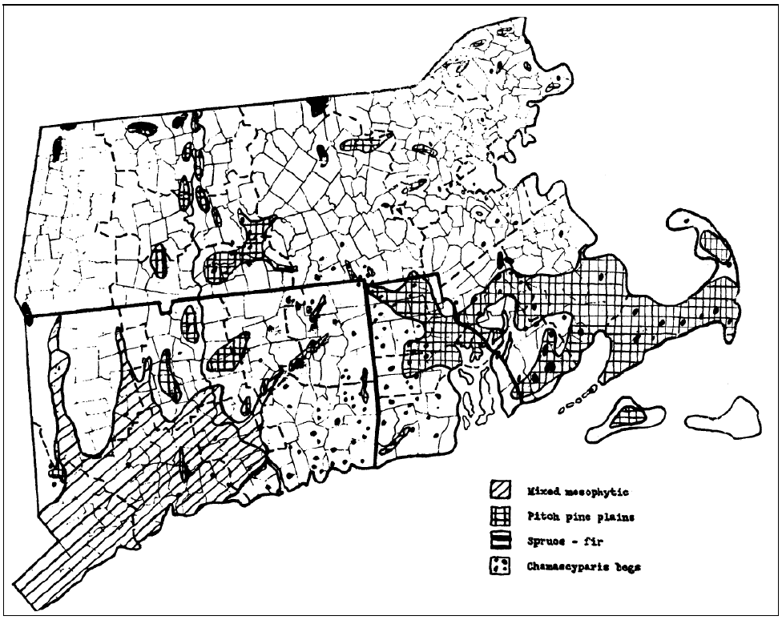




Notes:
Here is another good read – hot off the press!!. What became of the extensive pitch pine plains in south-central MA? This is where the cities of Springfield and Chicopee and Westover Air Force Base occur.

Slide 19
Notes:
OK – Back to how the forest cover quilt is settling – let’s add the original “discrete tension zone”.

Slide 20
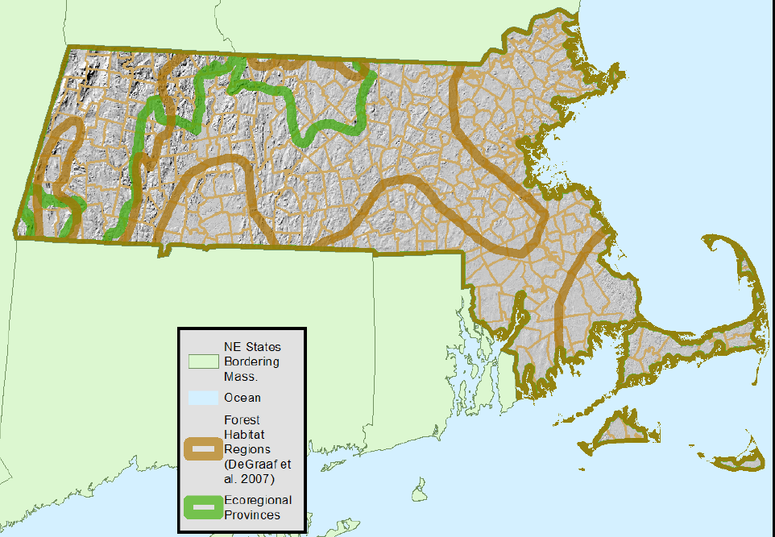
Notes:
The original discrete tension zone is shown in green. Note that this tension zone, that endured for centuries, was obliterated by human land use change and is now transitional white pine-hardwood forest on both sides of the former tension zone.

Slide 21
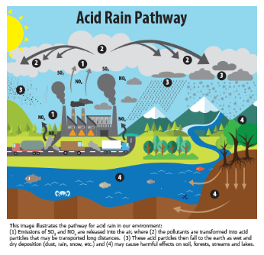
This image illustrates the pathway for acid rain in our environment: (1) Emissions of Sulphur Dioxide and Nitrous Oxide are released into the are, where (2) the pollutants are transformed into acid particles that may be transported long distances. (3) These acid particles then fall to earth as wet and dry deposition (dust, rain, snow, etc.) and (4) may cause harmful effects on soil, forests, streams, and lakes.
https://www.adirondackcouncil.org/page/acid-rain-86.html?gclid=CjwKCAiAob3vBRAUEiwAIbs5Trfoq_FvQRF3hOs9zMlP7KKUAMyNVBmAH4cbycZoQGTHypgRkSzd5RoCY6AQAvD_BwE
Notes:
Kids used to be afraid to go outside in the rain because they thought they might get melted or burned by the acid rain. This interfered with prime frog-catching time!!

Slide 22
Acid Rain
Leads to mercury contamination of food chain
Dissolves soil nutrients needed for plant growth (calcium)
Releases aluminum (kills tree roots)
Weakens insects, snails, and other calcium-shelled invertebrates (reduces bird food)
Aluminum destroys adult fish gills and toughens fish egg membranes (reduces hatching)
https://www.adirondackcouncil.org/page/acid-rain-86.html?gclid=CjwKCAiAob3vBRAUEiwAIbs5Trfoq_FvQRF3hOs9zMlP7KKUAMyNVBmAH4cbycZoQGTHypgRkSzd5RoCY6AQAvD_BwE

Slide 23
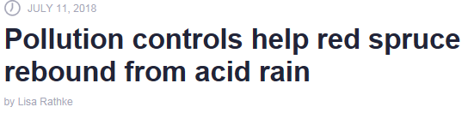

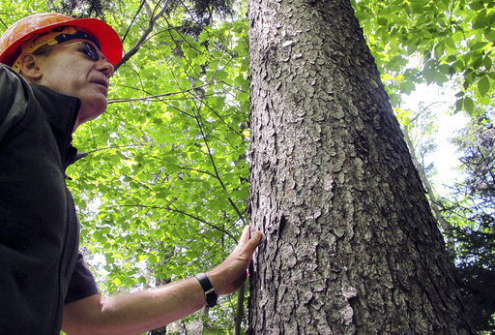
The researchers examined 658 red spruce trees in 52 plots in Vermont, New Hampshire, New York, Massachusetts and Maine. They found that 75 percent of the trees and 90 percent of the plots showed increasing growth since 2001. They credit cleaner air and a warming climate that extended the growing season.
"Higher temperatures help some species and hurt others—right now, red spruce are benefiting, but they could be vulnerable to change in the future," Schaberg said.
In this June 12, 2018, photo, U.S. Forest Service scientist Paul Schaberg stands beside a healthy red spruce tree growing on Mount Mansfield in Stowe, Vt. Schaberg is co-author of a new study that found that the tree species, once heavily damaged by acid rain, is rebounding in five Northeast states due to stricter air pollution regulations and a changing climate. (AP Photo/Lisa Rathke).
https://phys.org/news/2018-07-pollution-red-spruce-rebound-acid.html
Notes:
Concerns of acid rain led to the 1990 Clean Air Act, and red spruce has actually rebounded nicely, but is still projected to have trouble under climate change.

Slide 24
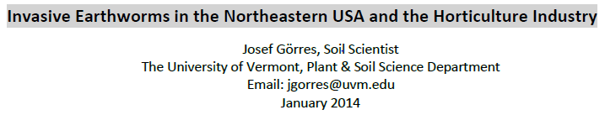
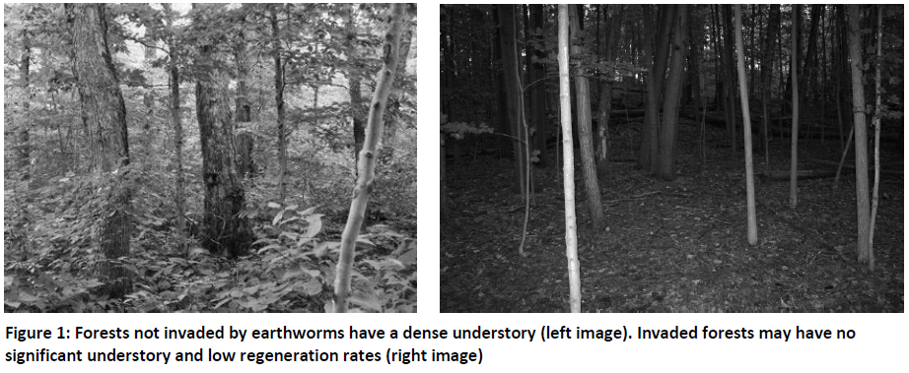
Two species originating from North America (Bimastos parvus & Microscolex phosphoreus)
Twenty Nine other species are exotic and some are invasive
Three Earthworm Ecotypes:
  Epigeic (tend to live near the surface in resource rich portions of soil)
  Endogeic (live below the soil surface, feed on microorganisms in mineral soil, leaching)
  Anecic (feed on soil & litter, make deep burrows – Nightcrawler (Lumbricus terrestris)
https://www.uvm.edu/~entlab/Greenhouse%20IPM/Workshops/2014/InvasiveEarthworms.pdf

Slide 25
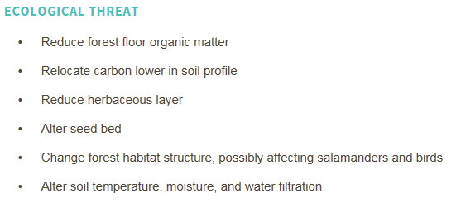
Invasive Earthworms
https://www.vtinvasives.org/invasive/earthworms
Sharp declines in soil invertebrate communities (food for ovenbird, hermit thrush, and woodland salamanders)
Decline in plant community richness (e.g., Lily’s such as Trillium, True and False Solomon’s Seal
Invasive shrubs appear to benefit from invaded soils (Lonicera spp., Berbis spp.)
http://www.nyisri.org/2016/09/underground-invaders-impacts-implications-non-native-earthworms-north-america/
Notes:
The invasive nobody wants to talk about, and which we honestly can’t do much about. Are we having trouble regenerating sugar maple due to climate change, or due to earthworms? The answer may be “Yes”.

Slide 26
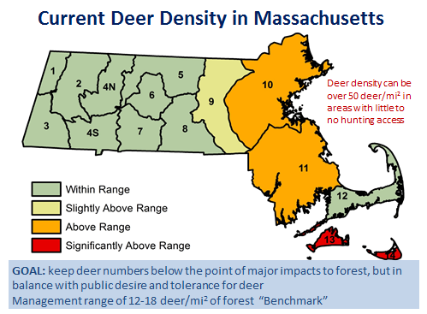
Notes:
The Zone 6 Quabbin story. Death threats over the proposed start of deer hunting at Quabbin in the mid-1980’s, but we did it, and a few years later it was big news with Lady’s slippers and hemlock seedlings were seen at Quabbin for the first time in decades. Prior to getting the deer hunt started, well-educated people would look at the lush vegetation in the deer exclosure areas at Quabbin and stammer “It must be something else besides deer browsing!!”. I wanted to shake them by the collar and scream “No, you idiot, it is simply an herbivorous prey animal with a high reproductive capacity after all predators have been removed!!”

Slide 27
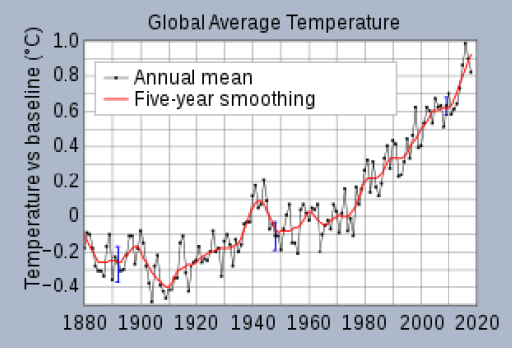
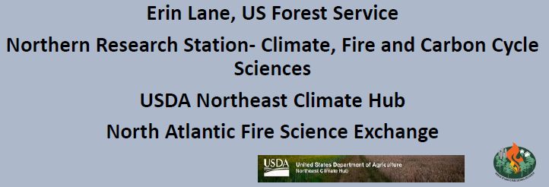
Climate Change
Notes:
As if we didn’t already have enough to deal with…..

Slide 28
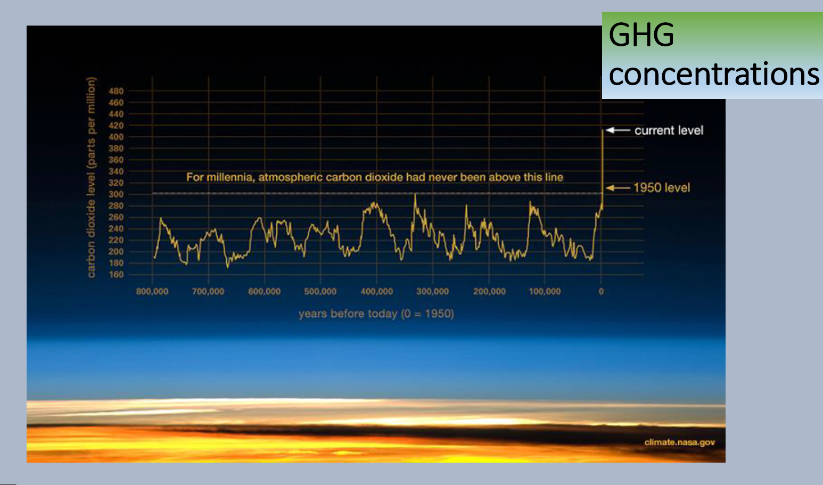
Climate Change
Notes:
We are out of time…..

Slide 29
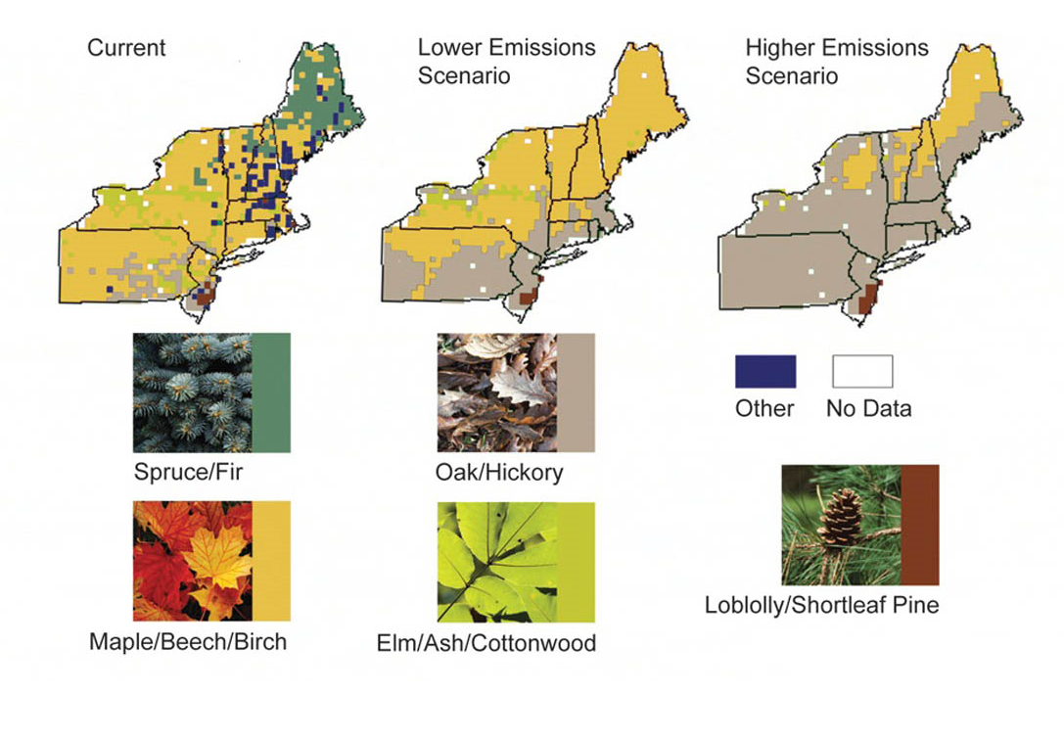
- Generally shifting northward
- Range Area by Species:
> Expands for Oak/Hickory
& Loblolly/shortleaf
> Contracts for Spruce/Fir,
Maple/Birch, & Elm/Ash
Range Areas for Tree Species in the Northeast
https://19january2017snapshot.epa.gov/climate-impacts/climate-impacts-northeast_.html

Slide 30
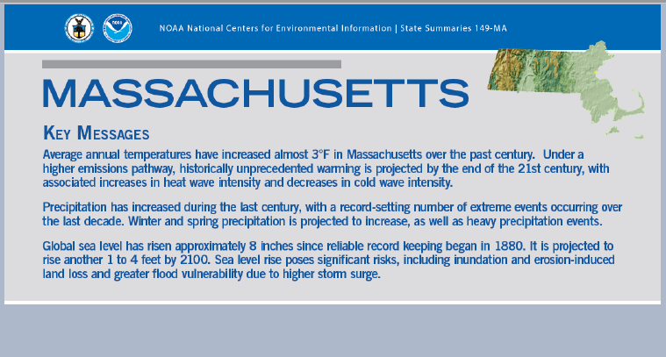
Climate Change

Slide 31
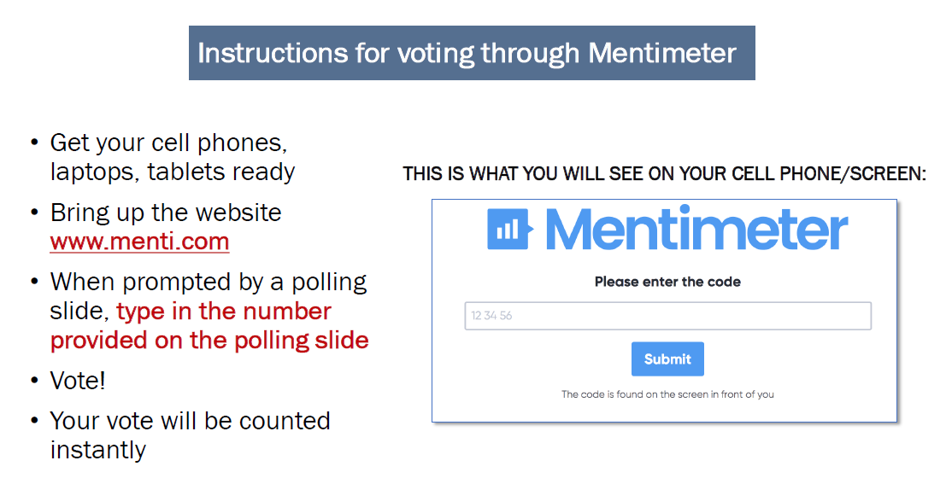
Monitoring
Your Input Needed Here!!

Slide 32
Polling Slide
Tap on the Code box
Type 94 37 78 (no spaces needed)
We will all answer three questions (one at a time)

Slide 33

Your goal is to monitor impacts of climate change on your forestlands. If you can only monitor one thing, what would it be?

Slide 34

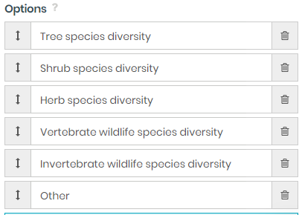
What aspect of forested ecosystems of the Northeastern U.S will be most effected by climate change?

Slide 35

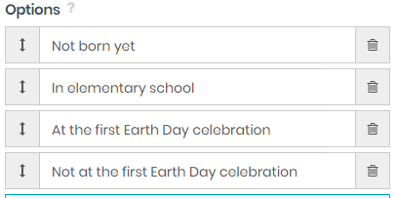

Slide 36
Monitoring on MassWildlife Lands
Vegetation
  Stratified Random & Subjective
Breeding Birds
  Point Counts & Transects
Pollinating Insects
  Netting & Cup Traps
Vernal Pools
Carbon
Notes:
We do NOT conduct all of this monitoring at all sites.

Slide 37
Monitoring:
Baseline Vegetation Survey Protocol
Conducted 1-2 years before treatment, 2 years after treatment, then as warranted, but only at major sites
Combined Point Intercept & Cover Estimate
  Stratified 200 m grid lines
  Each intersection is the center point of four 15 m transects laid in cardinal directions
  At each 3 m point along a transect, record all species that intersect (stem, leaf, flower, fruit, etc.) a vertical sample line from that point in each of six vertical strata

Slide 38
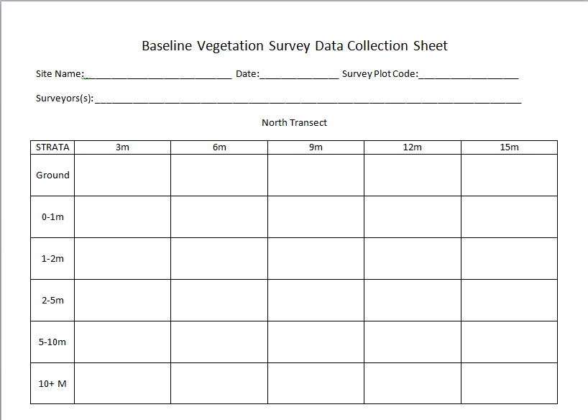
Ground Strata features include features include: bare ground, litter, dead wood, rock, water

Slide 39
Monitoring:
Baseline Vegetation Survey Protocol
Following point intercept survey on each of the four 15 m long cardinal direction transects, return to center point.
Record cover estimates for a 15 m radius circle
  % ground cover and dominant/codominant species
  % shrub cover and dominant/codominant species
  % canopy cover and dominant/codominant species
Provides data on species occurrence and relative abundance by vertical strata

Slide 40
Monitoring:
Optional Wandering Vegetation Survey Protocol
With summary data from point intercept and cover estimates in hand:
  Visit all landforms within treatment area looking for any additional species not already represented in the summary data
  Map observed concentrations of species in the ground and 0-1 m strata that are specified in the Desired Future Condition (DFC)
Use map data to locate retention groups

Slide 41
Map Data
North
Northern Hardwoods and/or Spruce
Oak/Hickory
and/or Pitch Pine
Invasive Plants
Retention Group
Notes:
Formerly located retention groups primarily or solely where biological legacy trees were found. Now we may want to locate retention groups to promote mapped advance regeneration.

Slide 42
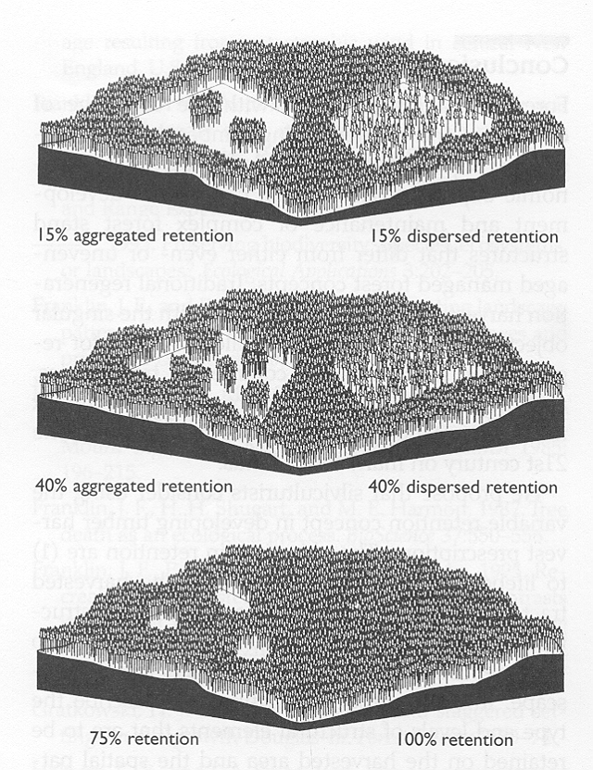
Harvesting Patterns
Retention
What you keep is more important than what you take
What kinds of habitat will each of these create?
How long will it last?
Notes:
If timber value is your top priority, which of these patterns will maximize the growth of the remaining trees?
What kinds of habitat will each produce and how long will it last?
Which of these might produce young forest habitat (a forest dominated by young, small trees)?
Dispersed retention works great for timber value, by maximizing the sunlight and other resources for each retained tree and results in the quickest regeneration of the forest. However, this approach limits the amount of young forest habitat created, and what is created usually is very ephemeral, with the canopy quickly closing in just a few short years.
Aggregated retention does reduce the growth of timber volume by a small amount, since trees in the center of the retention groups do not receive as much additional light. This maximizes the amount and duration of young forest habitat created, and the habitat created can last as long as 30 years.

Slide 43
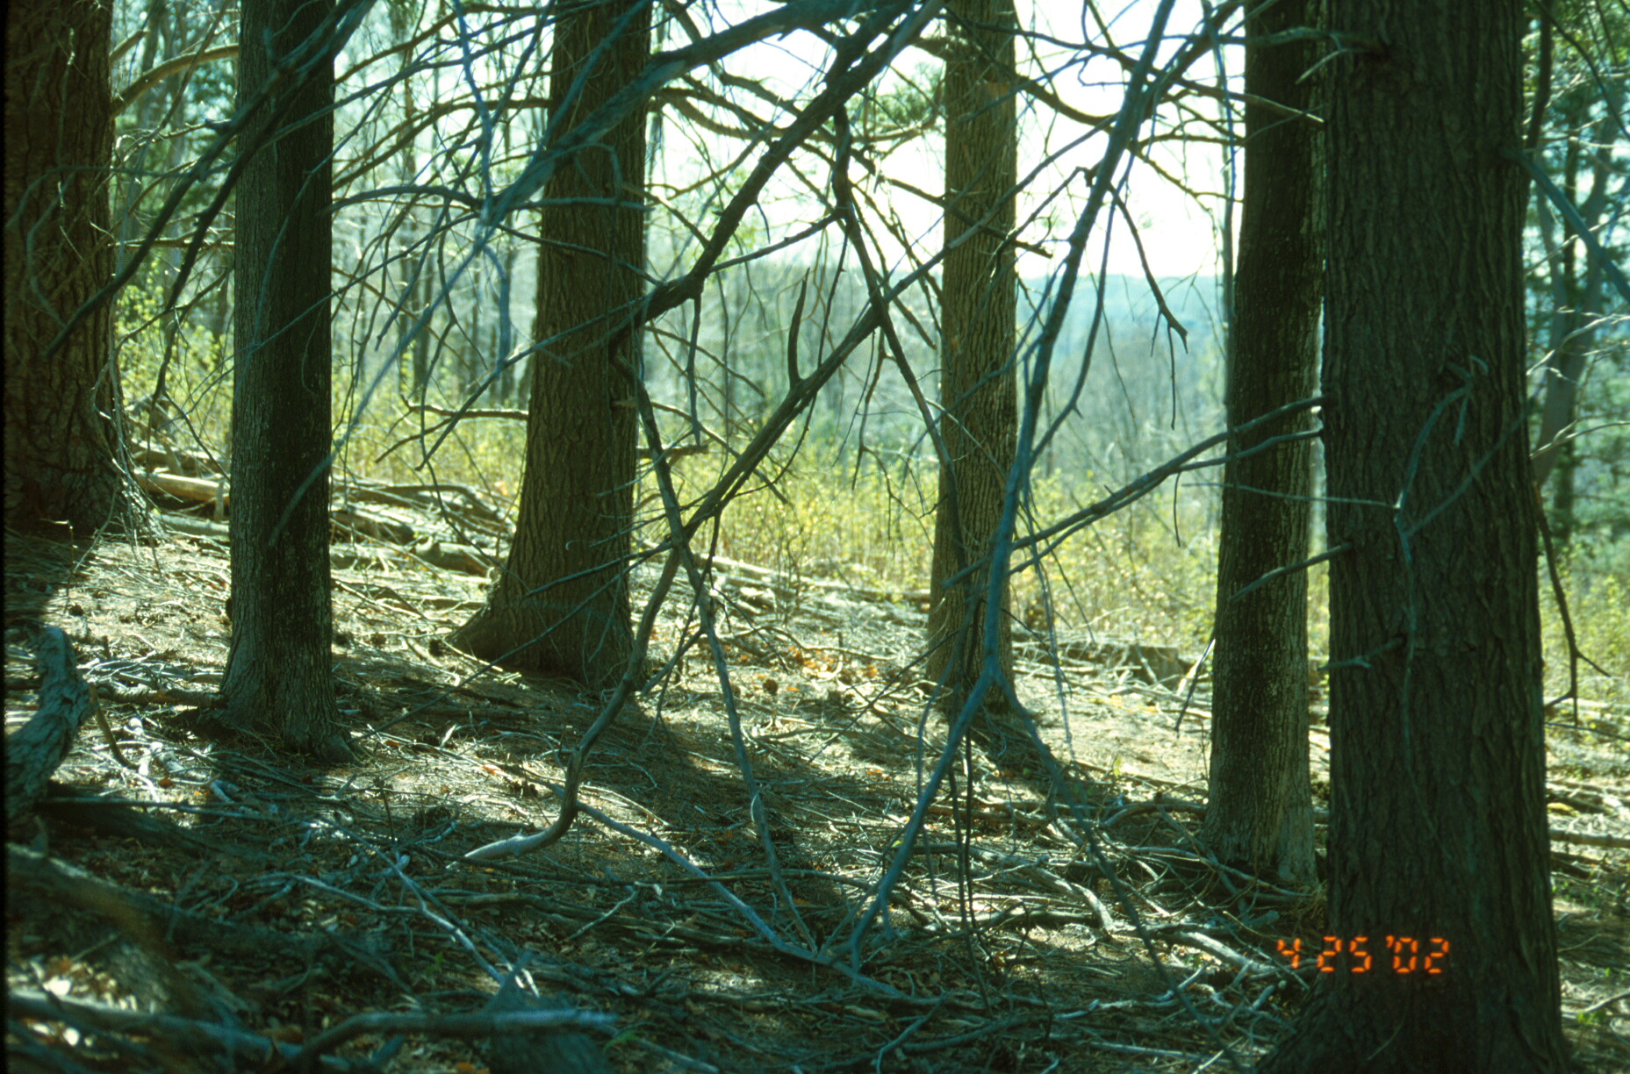
The View from Within
Notes:
The following year, the habitat within the retention groups remains similar to pre-harvest conditions (although more light penetrates from the sides), while the habitat outside the retention groups regenerates to vigorous young forest, that will last up to 30 years.

Slide 44
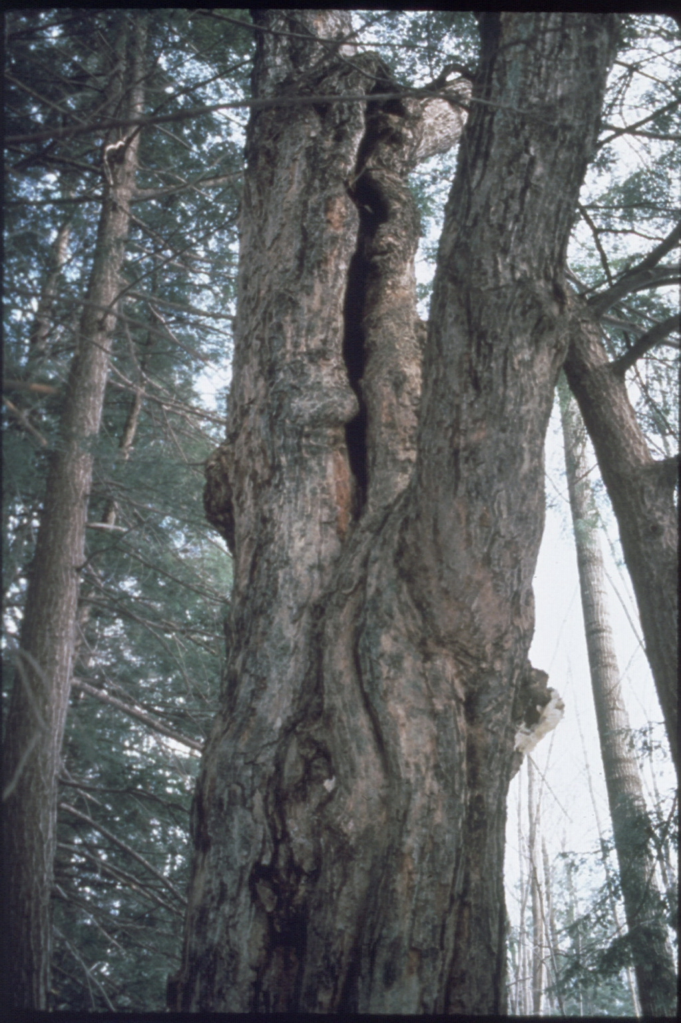
Biological Legacies
Notes:
Retain biological legacies

Slide 45
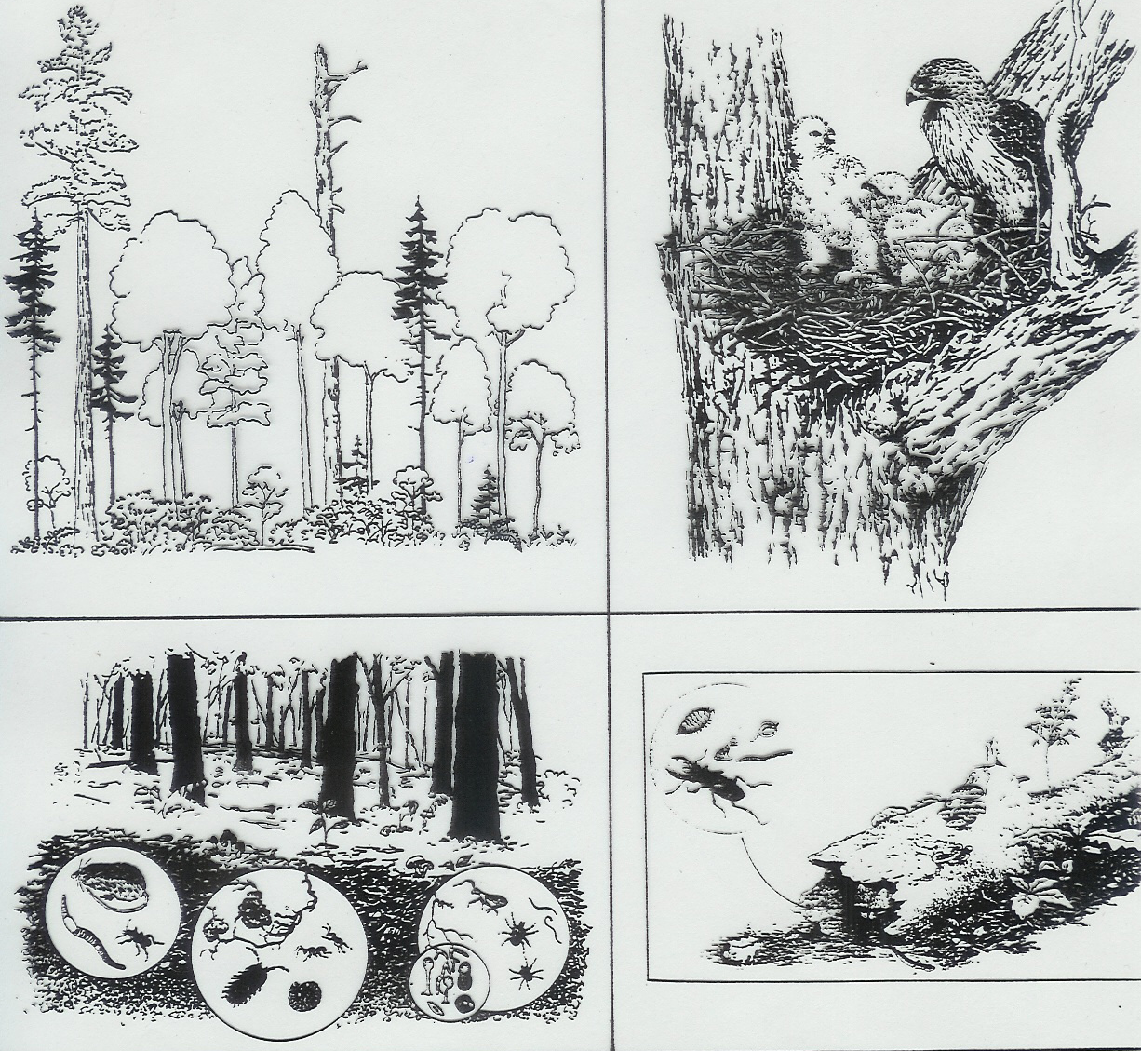
Biological Legacies
Biological Legacies
Notes:
When you identify a forested site for a cutting operation, the most important decision is not what to cut, but what to retain.

Slide 46
Map Data
North
Northern Hardwoods and/or Spruce
Oak/Hickory
and/or Pitch Pine
Invasive Plants
Retention Group
Notes:
Formerly located retention groups primarily or solely where biological legacy trees were found. Now we may want to locate retention groups to promote mapped advance regeneration.

Slide 47
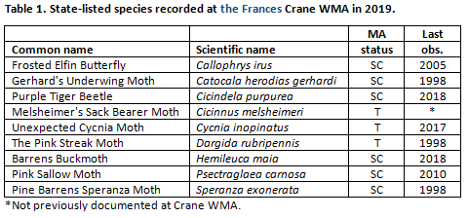
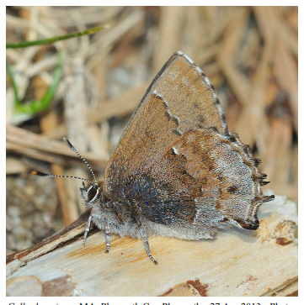
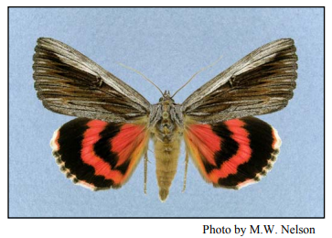
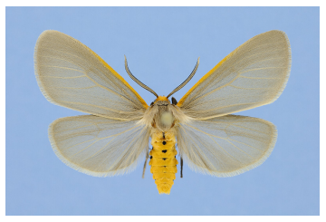
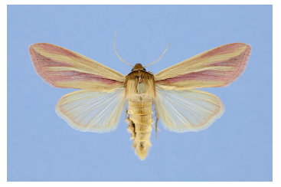
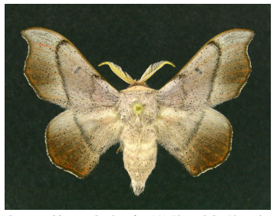
Pollinating Insects

Slide 48
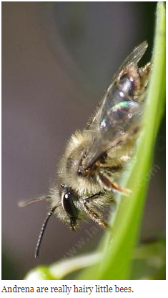
Pollinating Insects
Montague Plains WMA
  >200 Insect Species to date
  >50% of statewide bee fauna at this one site
    More bee species than all of Martha’s Vineyard
    More bee species than any other surveyed MA site
    Several very rare, highly specialized species, including one bee species that is apparently native and may be new to science (DNA analysis pending)

Slide 49
Provisional Carbon Budgeting for
MassWildlife Forestlands
Brian Hawthorne, MassWildlife Habitat Planning Coordinator
John Scanlon, MassWildlife Habitat Program Supervisor

Slide 50
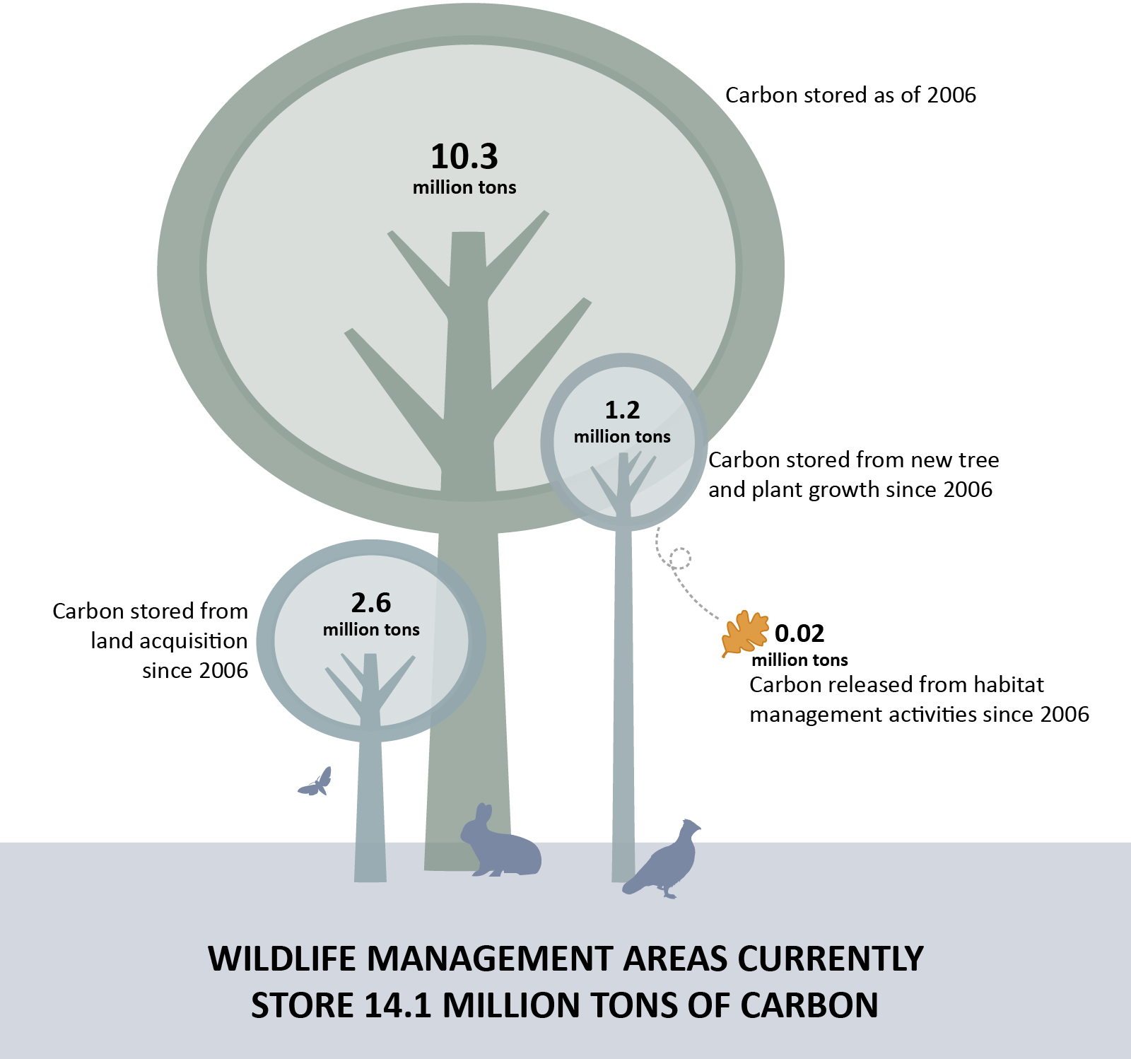
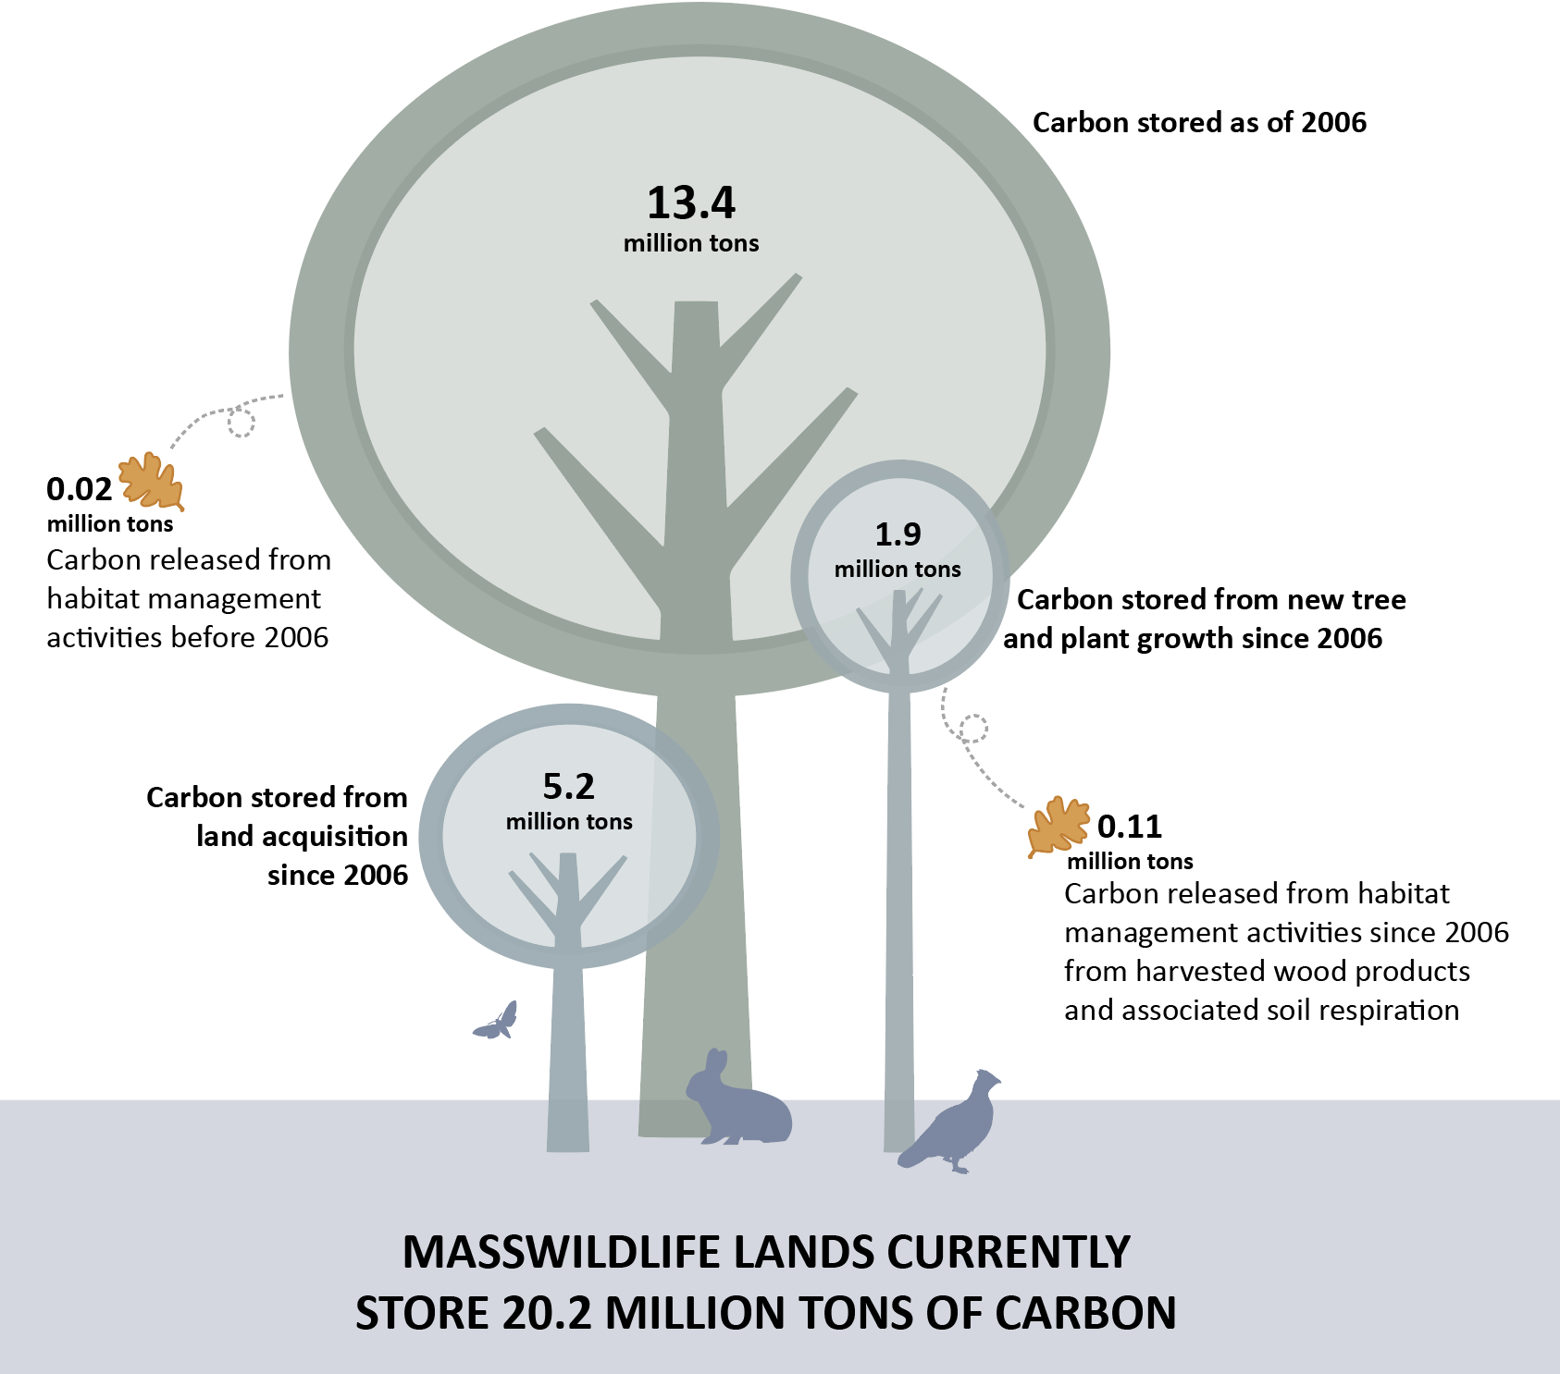
13.4
1.9
5.2
0.11
https://www.mass.gov/service-details/carbon-storage-on-masswildlife-lands

Slide 51
Average Carbon Storage on MassWildlife Forestlands (net of growth and removals)

Slide 52
Carbon Storage and Release on MassWildlife Forestlands (tons)
13,000,000

Slide 53
13.4
Current ratio of carbon storage to release is 17:1
Net average annual change in carbon storage is +0.8 tons/acre
1.9
5.2
0.11

Slide 54
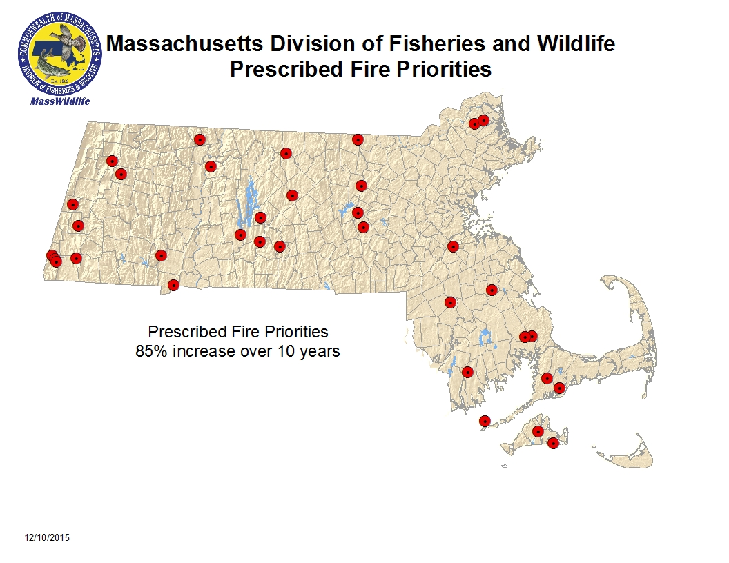
Prescribed Fire
Notes:
Have not yet accounted for prescribed fire in our carbon budgeting…..

Slide 55
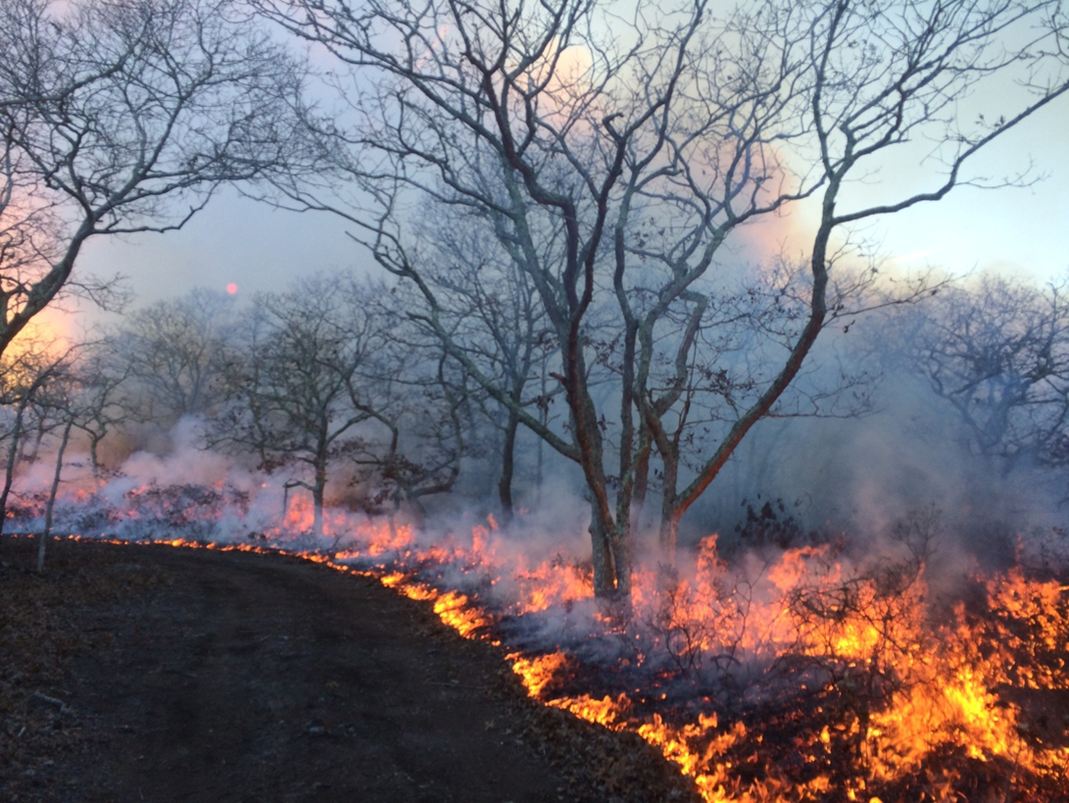
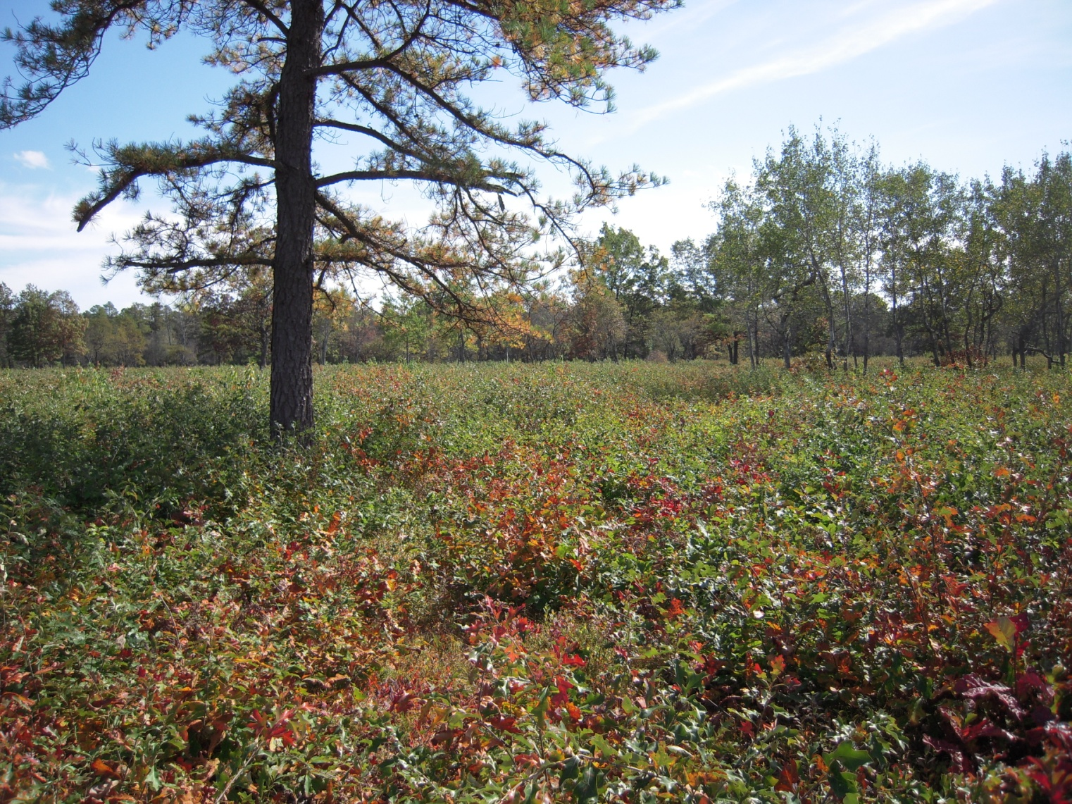
During (large photo) and first growing season after initial prescribed fire (inset)

Slide 56
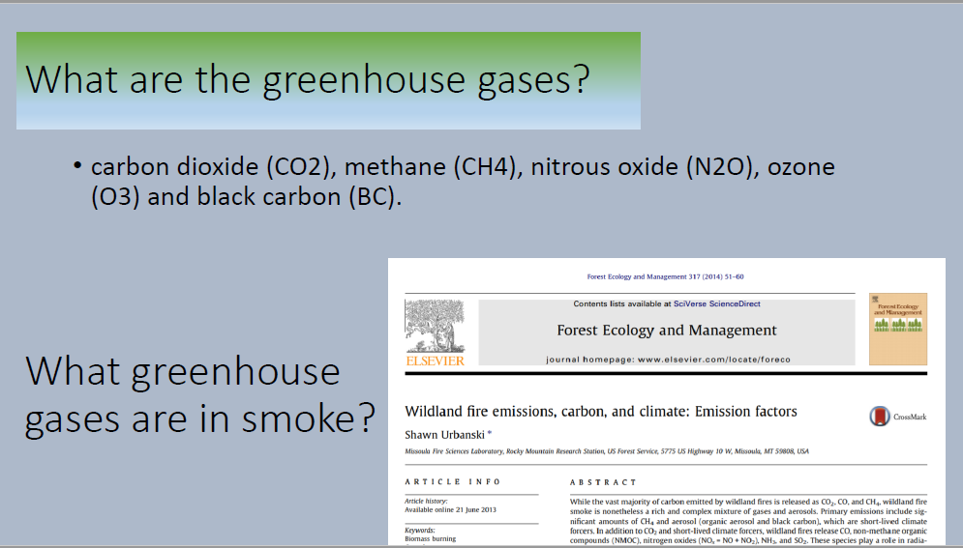
Climate Change & Fire

Slide 57
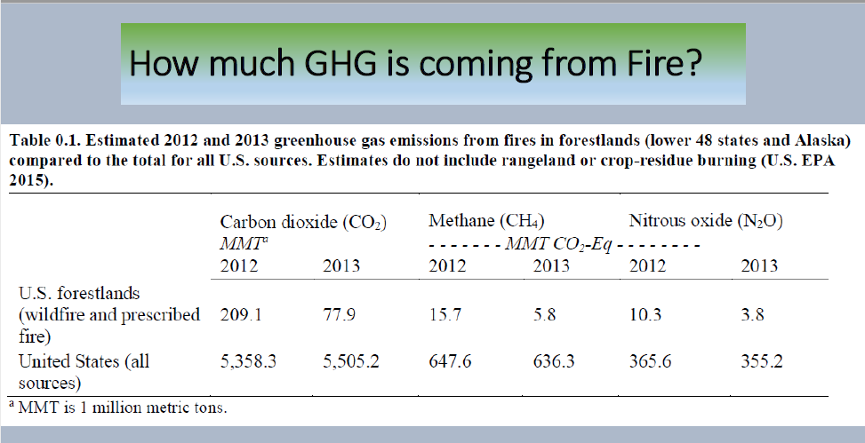

Slide 58
Monitoring for Impacts of Climate Change on State Wildlife Lands in Massachusetts
Identify specifics (metrics) for your DFC that incorporate successful mitigation & adaptation for climate change
  Species composition & Relative abundance
  Structural composition & Diversity
Establish monitoring practices the provide necessary metrics
Practice adaptive management, and adjust practices as needed to obtain needed metrics

Slide 59
Where did we lose control??
Notes:
We saw this graph earlier…..

Slide 60
First Earth Day (April 22, 1970)
Notes:
Consider attending the 50th anniversary of Earth Day next April, and making it count…….

Slide 61
Evaluating Success of
Monitoring for Impacts of Climate Change on State Wildlife Lands in Massachusetts
John Scanlon, MassWildlife Habitat Program Supervisor
2019 Forest Ecosystem Monitoring Cooperative Conference

Slide 62
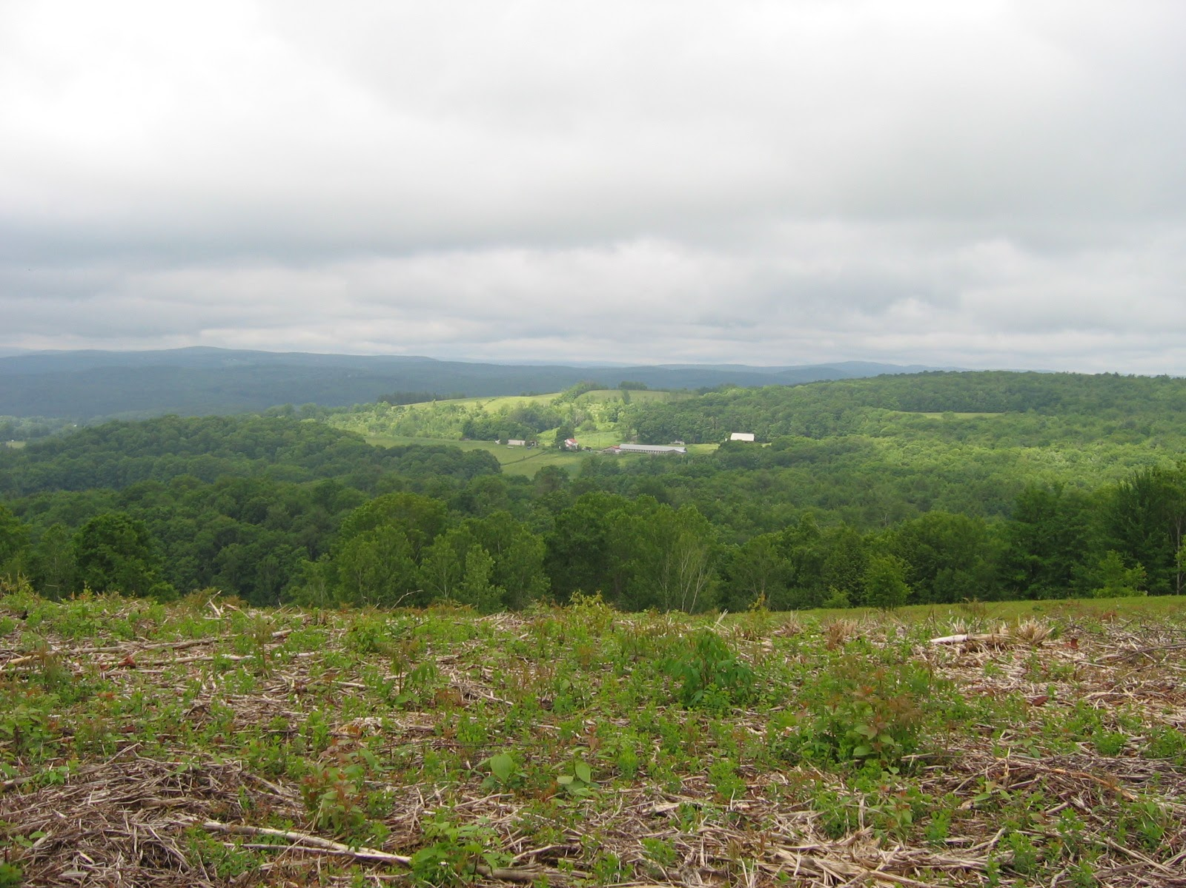
Conclusions
While doubling the amount of grassland, shrubland, and young forest on state wildlife lands since 2006, MassWildlife has released about 0.11 million tons C from short-lived forest products and forest soils.
This is only 5.8% of the 1.9 million tons sequestered by growth alone since 2006.
The ratio of carbon storage to release on MassWildlife forestlands is currently 17:1 (one pound of carbon is released through management for every seventeen pounds of carbon stored through growth).
MassWildlife can meet its landscape habitat goals while continuing dramatic net-positive carbon sequestration.
  Habitat restoration and management can help
  “… enhance climate adaptation, build resilience, and mitigate climate change.” EO 569 3a(vi)
  https://www.mass.gov/service-details/carbon-storage-on-masswildlife-lands
Leyden WMA, Shrubland and Grassland habitat management

Slide 63
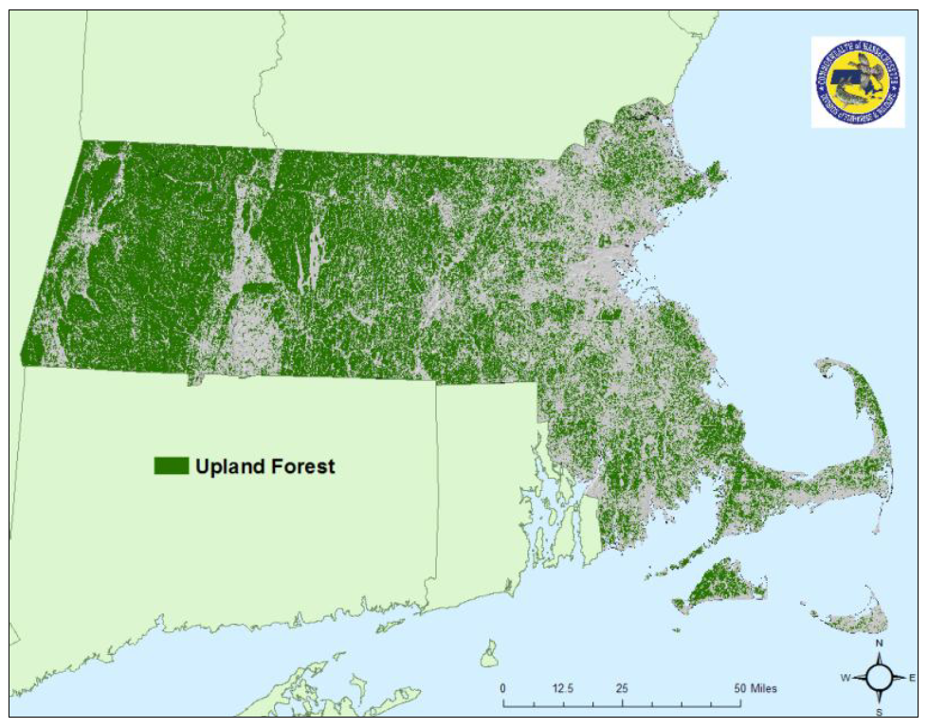

Slide 64


Slide 65


Barrens Habitat
Ben C. Jones Photo
While barrens are widely recognized for their importance to rare plants and invertebrates, their value to early successional wildlife [e.g. ruffed grouse, snowshoe hare] is often overlooked.
Due to changes in disturbance regimen, barrens habitats are disappearing in Pennsylvania; however, with a keen eye and the right tools, managers can restore and maintain these key habitats.

Slide 66
Barrens Habitat
Ben C. Jones Photo
Barrens occur on well-drained, sandy and acidic (nutrient poor) soils. Frequent disturbance (especially fire) and thin soils historically limited tree growth on these sites. Healthy barrens have early successional structure with abundant ground cover, shrubs, herbaceous pockets, and scattered trees. An array of wildlife food and cover are provided by pitch pine, tree oak, scrub oak, blueberry, huckleberry, blackberry, and herbaceous plants.

Slide 67

Fire plays an integral role.
Barrens Habitat
George Gress Photo
Barrens were maintained for thousands of years by lightning-induced and native-set fires that promoted berries and improved hunting grounds. Fire suppression was initiated in the early 1900s to control wildfires. Though necessary, suppression ended fire’s long standing influence on barrens and other important habitats. In the absence of fire, trees that were minor components in healthy barrens expanded and changed habitat structure from dry, open, early successional conditions to mesic, closed canopy forest. Without fire, understory diversity is lost to the shading. effect of trees…

Slide 68
Results of Edaphic Features Analysis
About 67% of the 3.1 million acres of forest in MA (2.1 million acres), and 61% of MassWildlife forestlands (132,000 ac) are potentially amenable for management of young forest habitats based on:
  Soil type
  Landform (Slope & Aspect)
  Landscape Position
  Landuse History
Only 30-45% of MassWildlife forestlands needed to provide a shifting mosaic with 10-15% YF
Where to conduct YF management to maximize benefits to YD wildlife?
Notes:
Here are the take-home messages on how many acres we need:
We have 80,000 unrestricted upland forest acres available.
To meet the board goal of 10-15%, we only need 25-50 thousand of those acres to create a shifting mosaic of young forest habitat.
To get there, we need to create at least 375 acres of young forest each year.

Slide 69
Potential Young Forest Focus Areas

Slide 70

Potential Young Forest Focus Areas for State-Listed Species
Whip-poor-will
Mourning warbler
Golden-winged warbler
Southern bog Lemming
New England Cottontail
Northern Bobwhite

Slide 71

Potential Xeric Shrubland Focus Areas for State-Listed Species
Various moths, butterflies & beetles

Slide 72




Slide 73


Advanced Regeneration

Slide 74






Oak Regeneration, Phillipston WMA
Year 1
Year 2
Year 3

Slide 75



Slide 76


Slide 77


Slide 78


