Slide 1
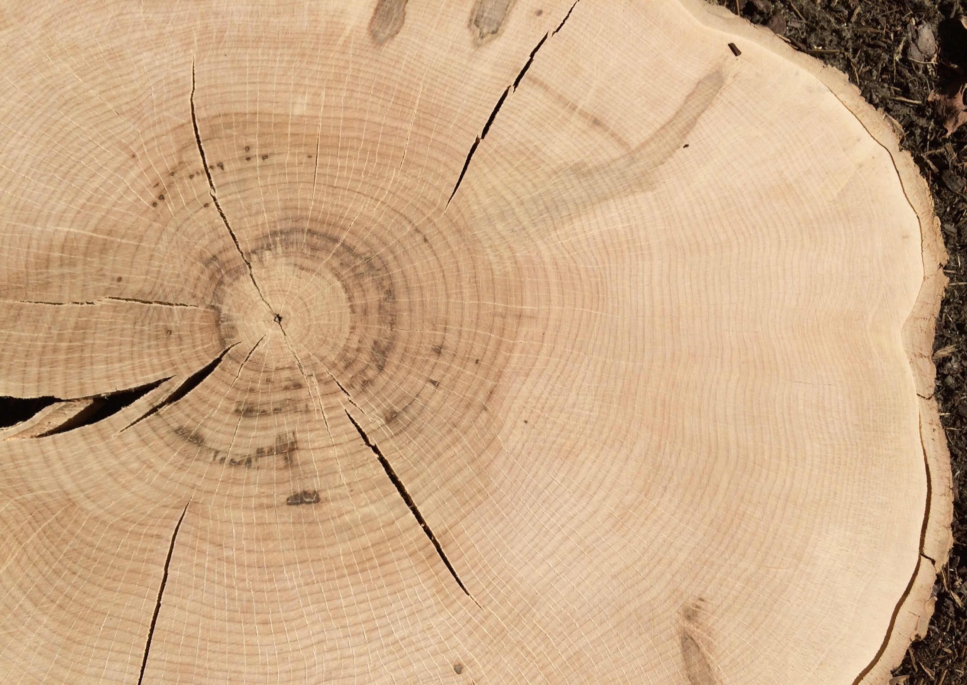
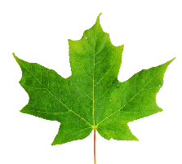
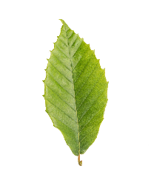
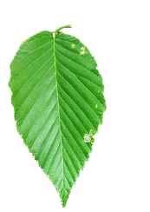
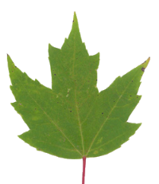
Major species of the Northern Hardwood forest: evaluating trends and drivers of growth in the state of Vermont
Rebecca L. Stern ¹, Paul G. Schaberg ², Shelly A. Rayback ³,
Christopher F. Hansen ¹, Paula F. Murakami ², Gary J. Hawley ¹
¹Rubenstein School of Environment and Natural Resources, University of Vermont, Burlington, VT, USA
²USDA Forest Service, Burlington, VT, USA
³Department of Geography, University of Vermont, Burlington, VT, USA
Forest Ecosystem Monitoring Conference
University of Vermont, December 2018
Notes:
-Today I will be presenting part of one chapter of my dissertation.
-Thanks so much for coming!

Slide 2


Acknowledgements
Forest Ecology Research Group
    Paul Schaberg
    Shelly Rayback
    Chris Hansen
    Paula Murakami
    Gary Hawley
FEMC
Ali Kosiba
Jim Duncan
Staff and interns:
Jeremy Gerber Elizabeth Bannar
Becca Rossell Jack Kilbride
Isabel Molina Sarah Erskine
Marissa Ng Michelle Deslauriers
Jordan Davis
McIntire-Stennis

Slide 3
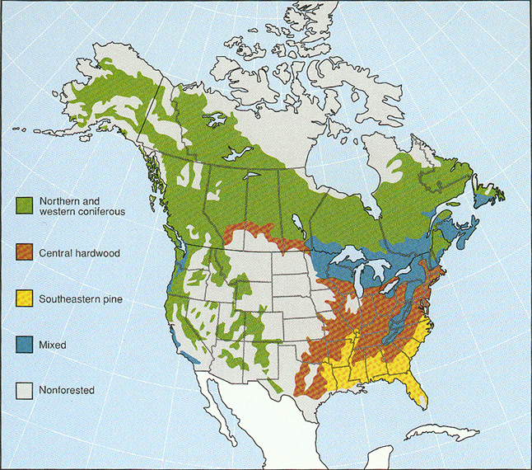
geo.msu.edu
Notes:
VT is in an interesting climatic zone- where the Central Hardwood and Northern hardwood forests come together.
Climate change will affect these forest types, and there are many endeavors underway to understand how these changes will occur.

Slide 4
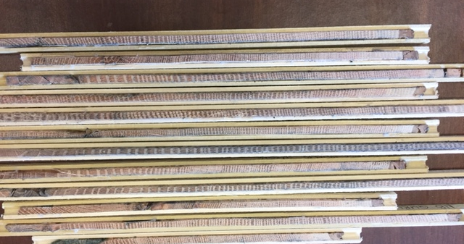
Our Future Forests
Multiple types of data required
One important metric: tree growth
Notes:
How forest types will change is dependent on multiple types of data.

Slide 5
Research Questions
Sugar maple, American beech, yellow birch, and red maple:
What growth patterns are evident in these species during the last 70 years?
Which climate variables are best associated with these species?

Slide 6
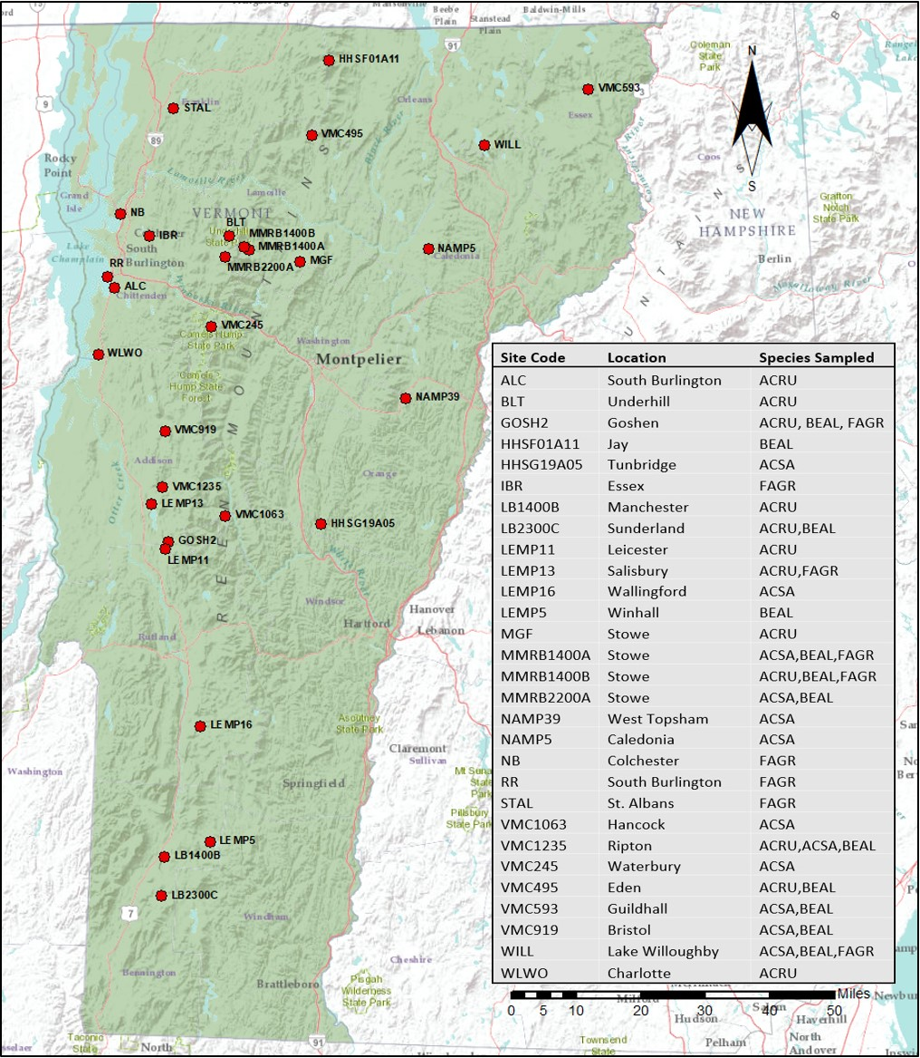
Notes:
As you can see, we’ve been all over the state, from the Champlain Valley to the mountains, and from the south to the Northeast Kingdom.

Slide 7
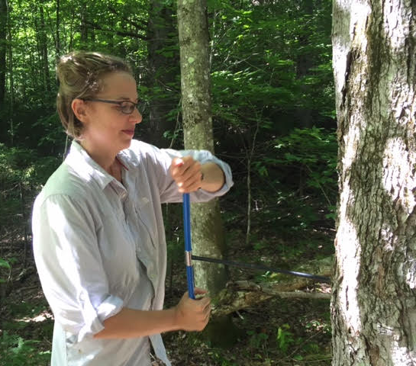
Methods
-Standard dendrochronological techniques (Stokes and Smiley 1968)
-Program COFECHA for crossdating (Holmes 1983, Grissino-Mayer 2001)
-Standardized to created mean growth chronology across all sites, per species
Notes:
-not going to say a lot about methods, but happy to talk about this after if anyone is interested. Or come to my defense this spring to hear all the details!
-Site-based chronologies were constructed for each plot in order to get at stand-wide signals, rather than a signal dominated by individual trees.

Slide 8
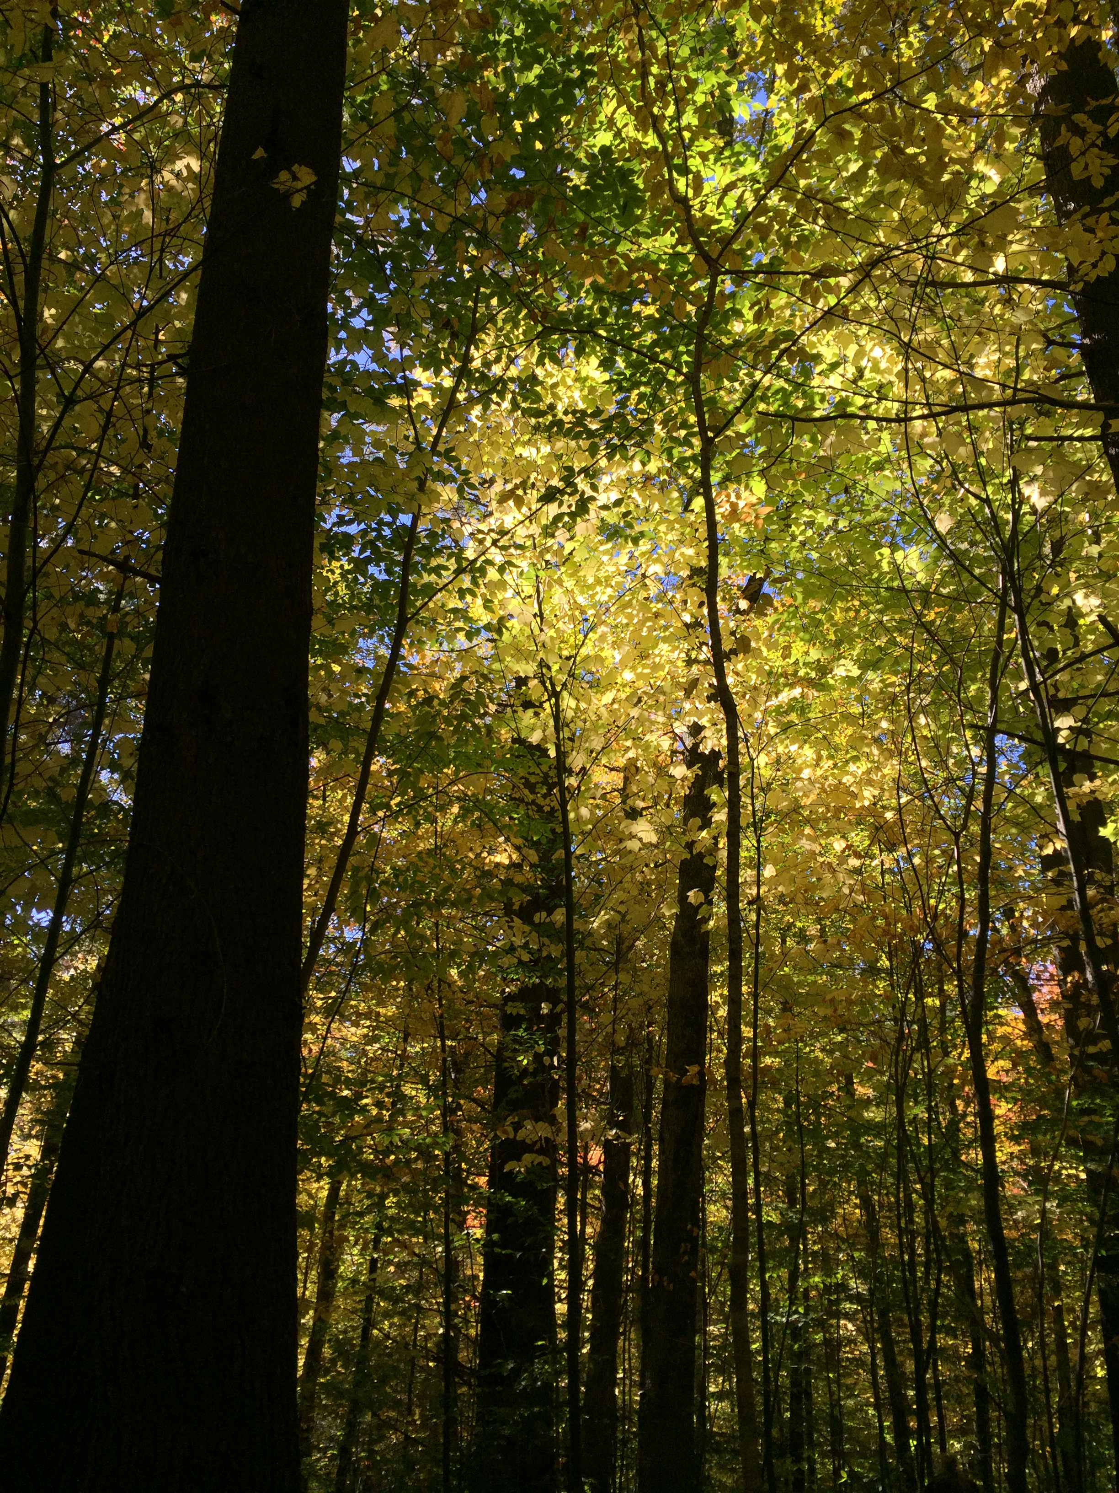
Growth
Trends
iastate.edu

Slide 9
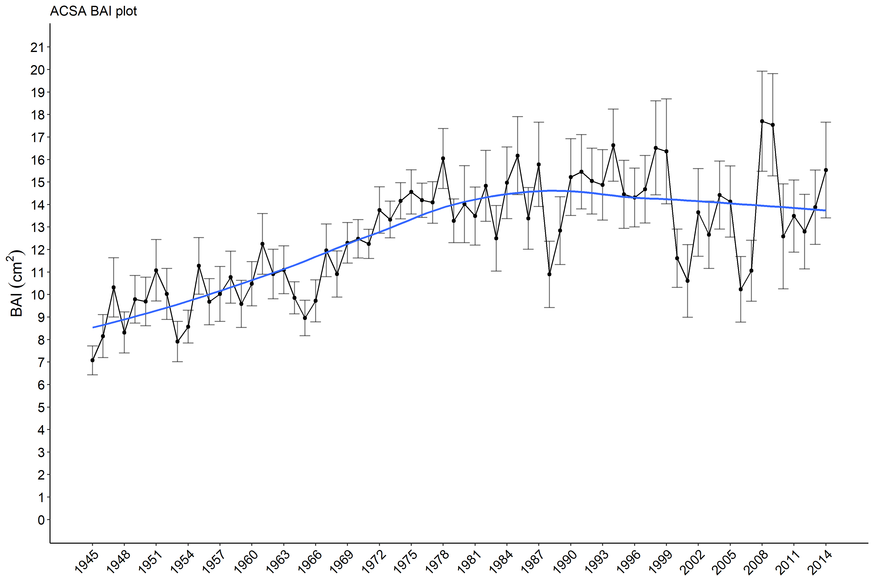
Sugar maple growth: basal area increment (BAI)
Slower rate of growth post-1980, P<0.01
12 sites, 398 cores
Notes:
-For all four species, we see evidence of two clear phases of growth: first half of the chronology showing stand maturation, and the second half showing a mature forest response. We chose 1980 based on the documented decline of sugar maple during this period.
-There is a significantly slower rate of growth in the second phase
-During this second phase, we would expect growth to be closely tied to environmental factors, since trees have reached the canopy and are no longer really responding to competition.
-one visibly notable feature with sugar maple: it appears there is more variability in growth (and among sites) during the second half of the chronology, as evidenced by the error bars.
-One of our next steps is to look at this variability statistically, and to try to understand what may be causing it.

Slide 10
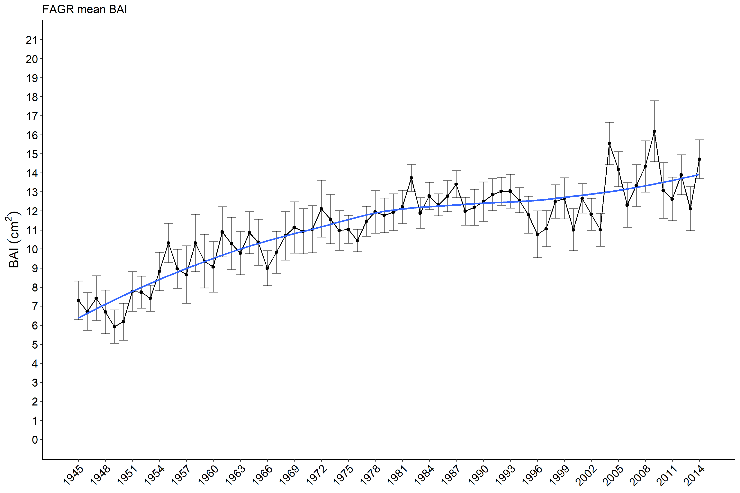
American beech growth: BAI
Slower rate of growth post-1980, P<0.01
9 sites, 275 cores
Notes:
-not as much variability in second half

Slide 11
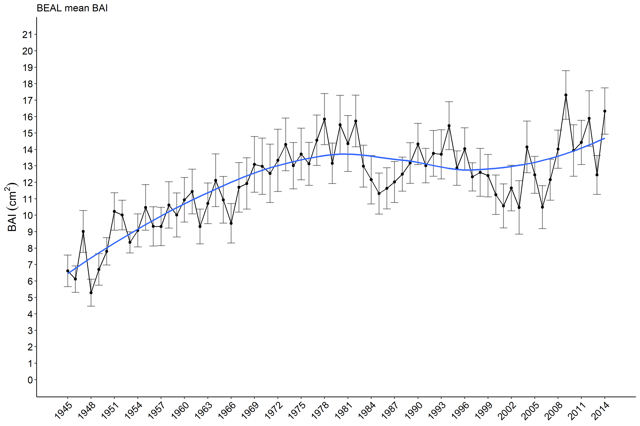
Yellow birch growth: BAI
Slower rate of growth post-1980, P<0.01
12 sites, 315 cores
Notes:
-Like sugar maple, yellow birch may also show greater variability during the second half of the chronology.
-these two species have shown a regional decline, at least partially attributed to abiotic variables.
-This may be related to why we see greater variability with these two species, but not American beech…

Slide 12
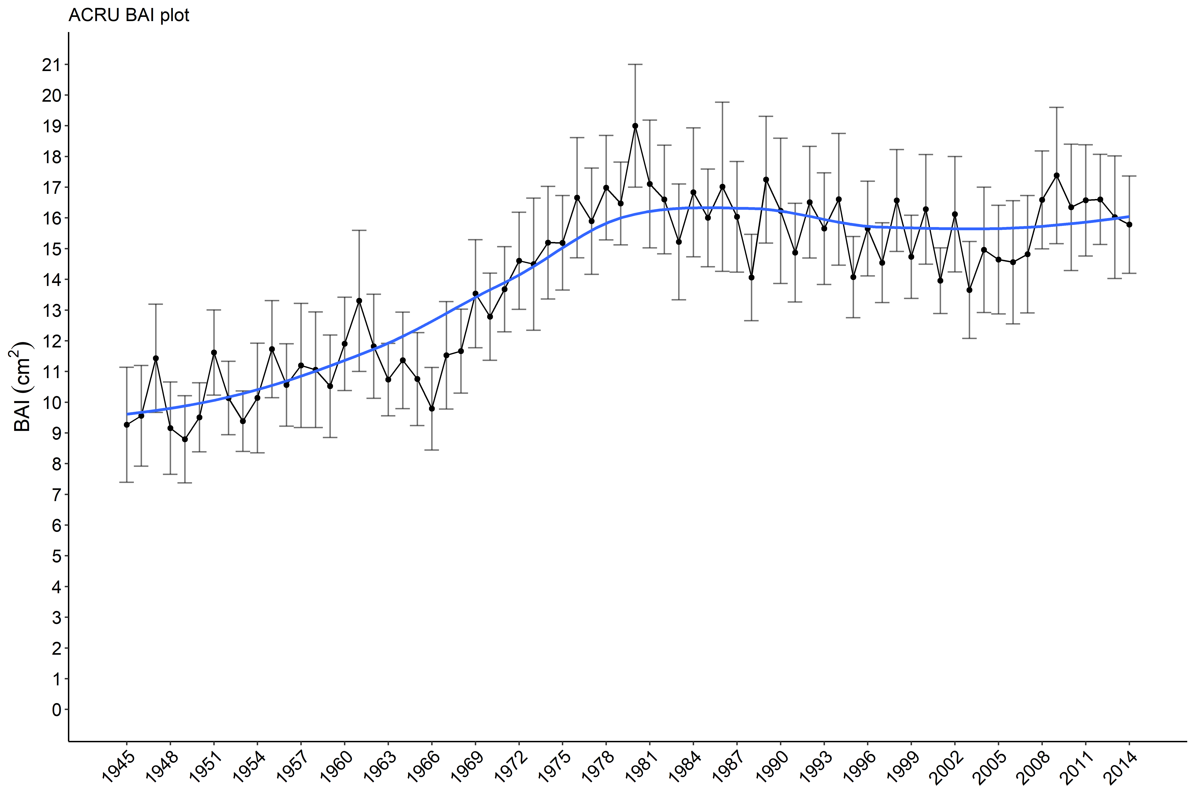
Red maple growth: BAI
Slower rate of growth post-1980, P<0.01
12 sites, 358 cores
Notes:
…or red maple

Slide 13
Summary of Growth
All four species:
1945-1980: stand maturation
1980-2014: mature stand response
Sugar maple, yellow birch:
Possibly greater variability in growth post-1980
Notes:
-These patterns are what you would expect to see in a second-growth forest.

Slide 14
Climate-
Growth
Correlations

Slide 15
Climate/environmental variables
Data Source | Variables
NOAA¹ | Monthly Tmin Monthly Tmax Monthly total precipitation Heating degree days (HDD) Cooling degree days (CDD)
Global Standardized Precipitation-Evapotranspiration Index (SPEI) database² | SPEI-01: 1 month moisture index SPEI-03: 3 month moisture index SPEI-06: 6 month moisture index SPEI-09: 9 month moisture index
National Atmospheric Deposition Program³ | SO₄²⁻ NO₃⁻ Ratio of cations to anions rainfall pH
¹NOAA National Climatic Data Center (2018)
² Vicente-Serrano et al. (2017)
³ National Atmospheric Deposition Program (2017) NADP/NTN Monitoring
Climate data correlated with ring-width index chronology for each species
Notes:
-SPEI: a moisture index, looked at four different time scales. SPEI may be a better measure of available water to trees than straight precipitation
-HDD: gauge of low temperature exposure, calculated as the number of degrees that a day’s average temperature is below 18.3° C (65° F).
-CDD is a measure of high temperature exposure, calculated as the number of degrees that a day’s average temperature is above 18.3° C (65° F).
-we also looked at pollutant deposition data
-values for current and previous year

Slide 16
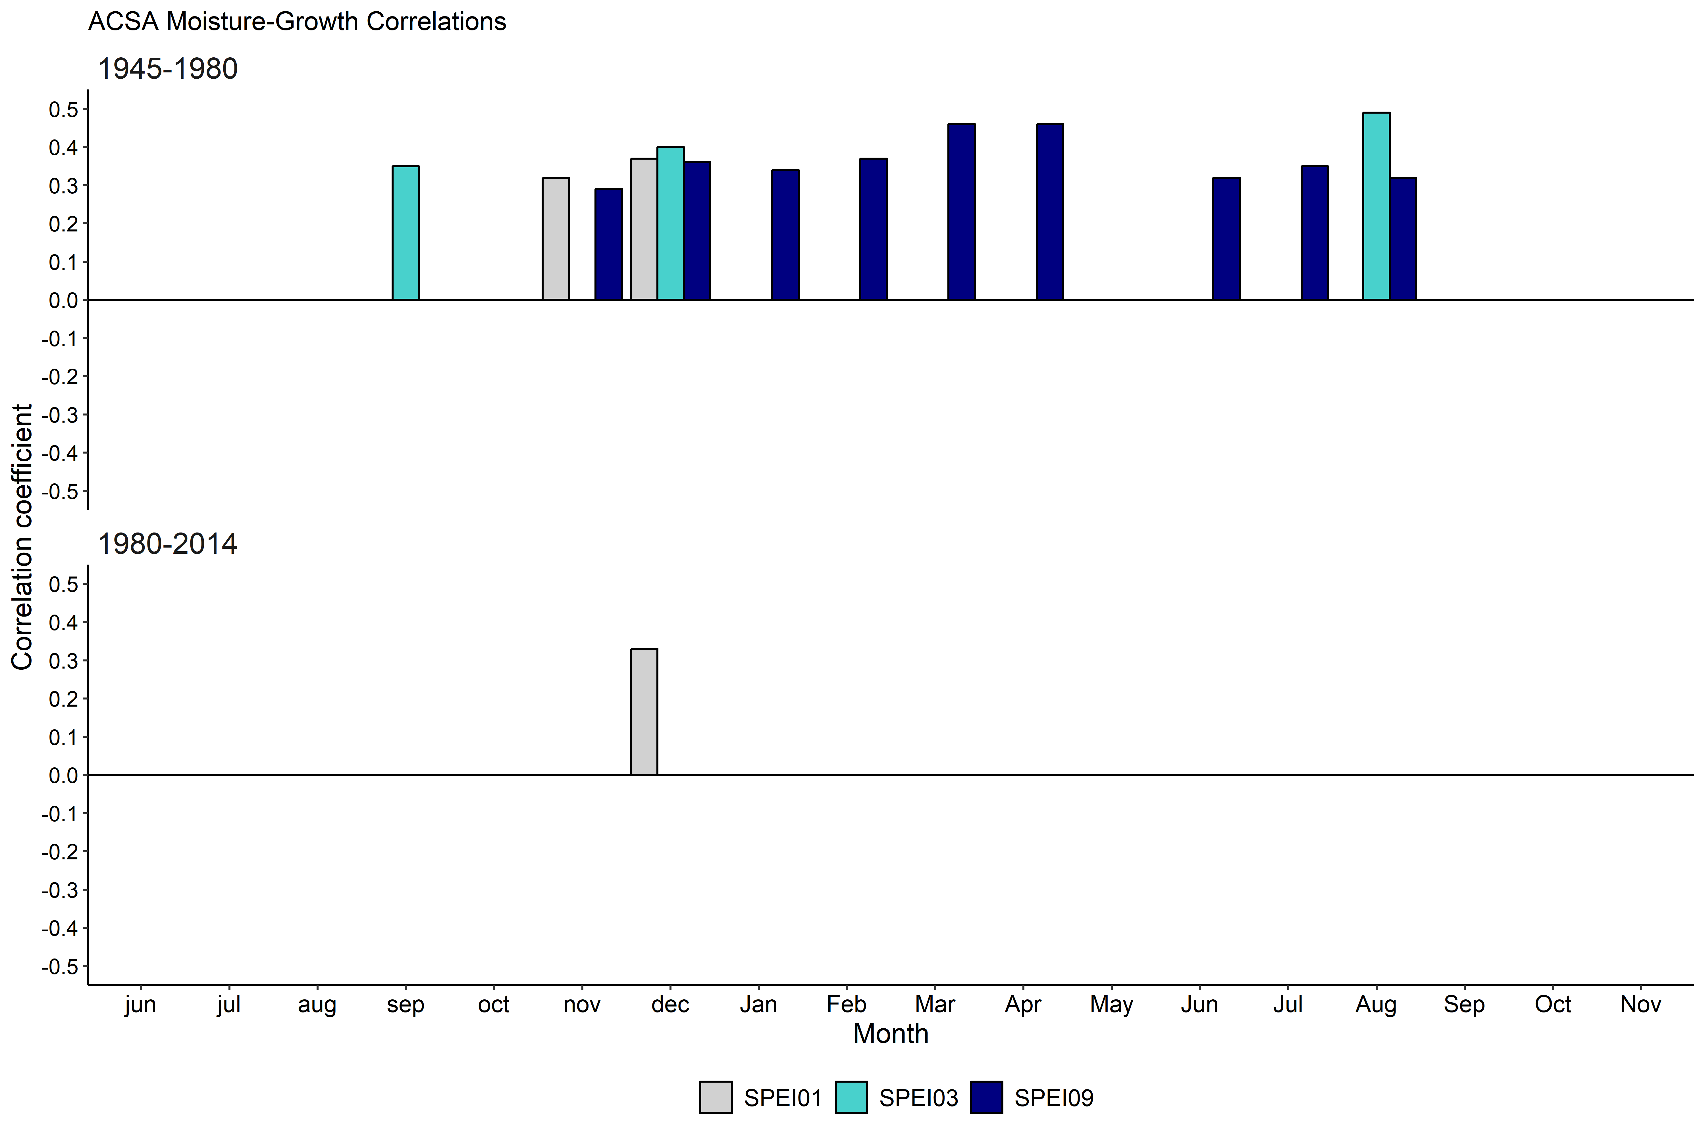
Sugar maple: moisture-growth correlations
Notes:
-Explain graph. Also, to reduce redundancy, we only are showing SPEI01, 03, 09
-We see multiple correlations in the first half of the chronology. This makes sense since there was a big drought in the mid-1960’s.
-so during this time period, there were likely years where less moisture was associated with less growth, which is a positive correlation.

Slide 17
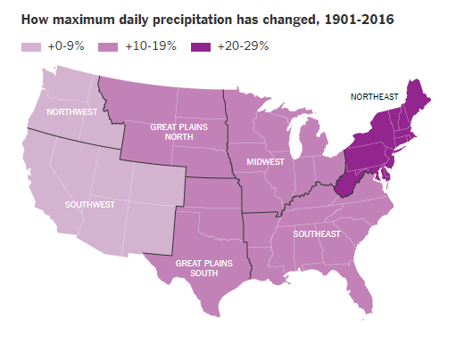
Image: NYTimes, Aug. 2017
Wuebbles et al. (2017)
U.S. Global Change Research Program Climate Science Special Report
Notes:
However, precipitation is increasing in the northeast over the past century, so this could be a reason why we no longer see moisture showing up, as it may no longer be limiting.

Slide 18
Sugar maple: moisture-growth correlations
Notes:
-During this later period, the only significant correlation with moisture is during the previous December.
-Assuming this precipitation is snow, this could point to the importance of snow at the beginning of winter.

Slide 19
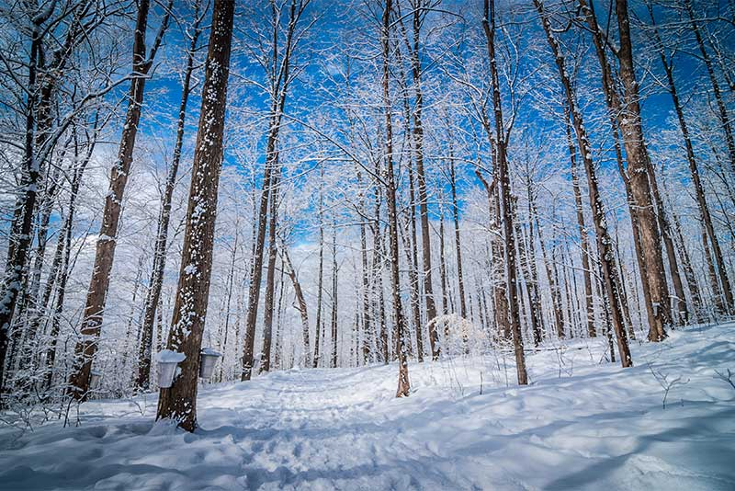
Sugar maple physiology
-Susceptible to root damage due to soil freezing (Tierney et al. 2001, Comerford et al. 2013)
-adverse impacts of reduced snowpack and increased soil freezing on the physiology of sugar maple (Reinmann et al. 2018)
bu.edu
Notes:
-snow acts as an insulator for fine roots.
-experimental evidence shows that reduced snowpack is detrimental to sugar maple roots.
-Our observational findings are in line with this experimental evidence.

Slide 20
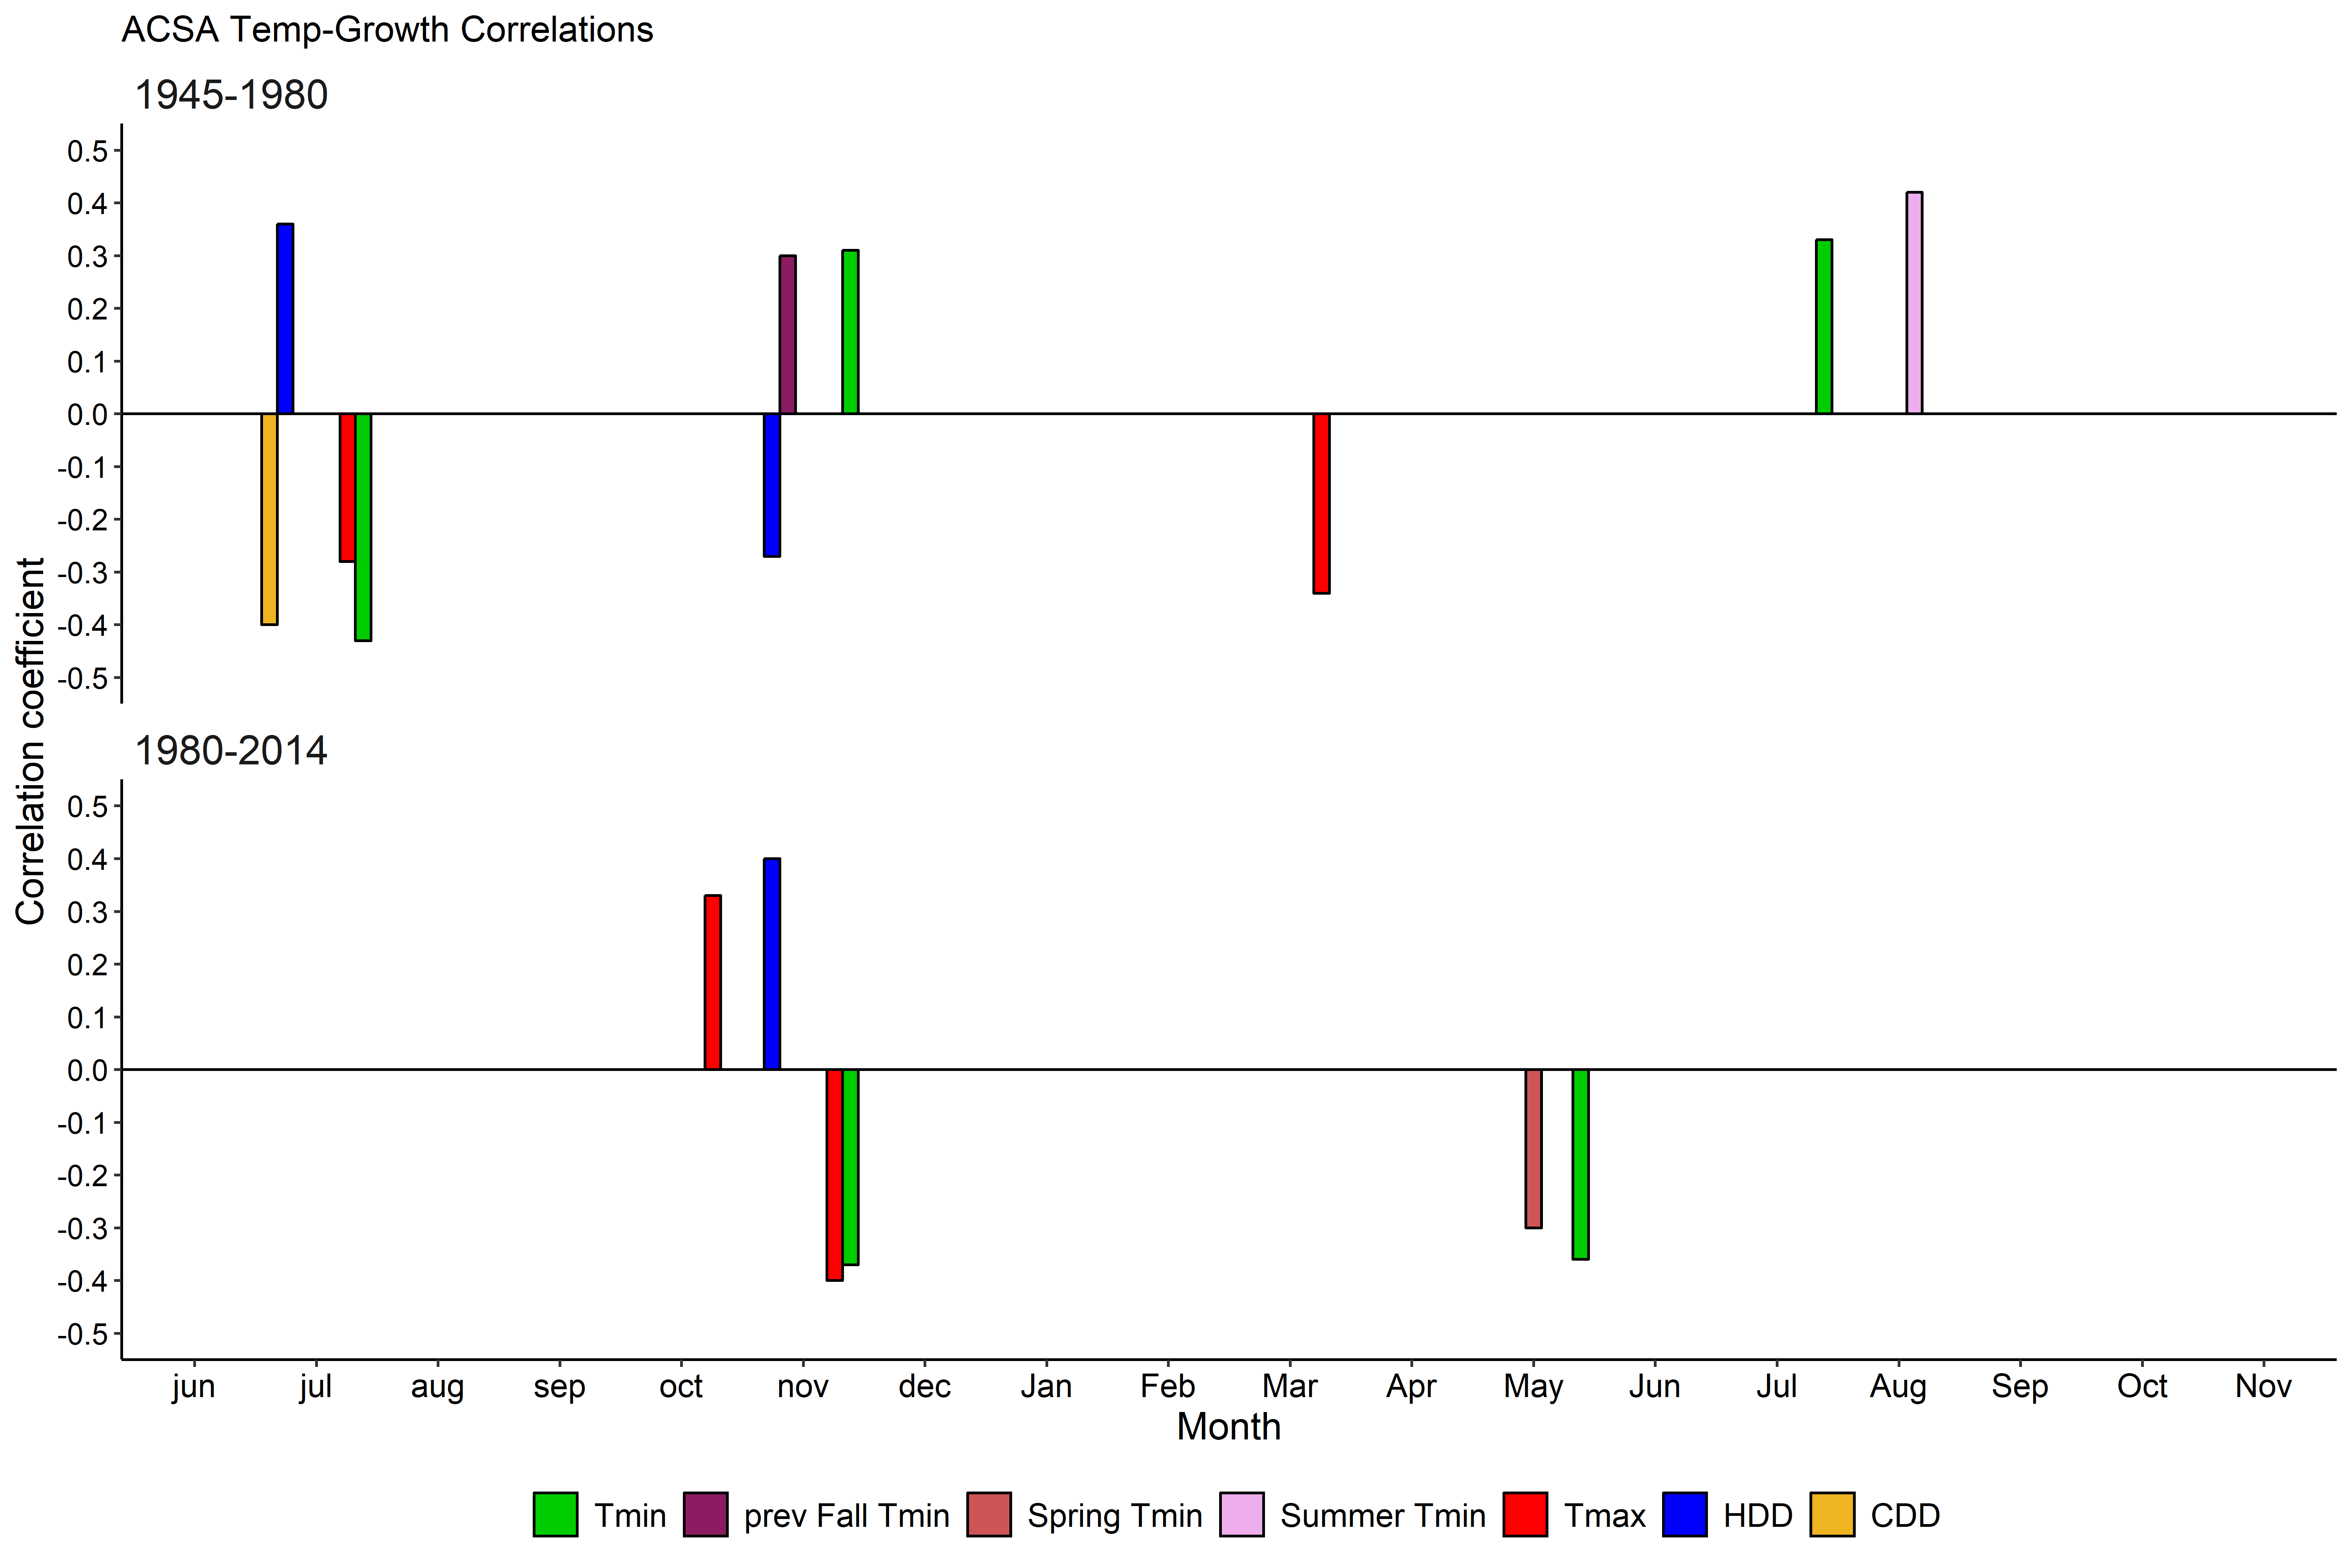
Sugar maple: temperature-growth correlations
Nov
Notes:
-just focus on one correlation here.
-If we look at previous fall/beginning of winter temperatures. During the first half of the chronology, we see a positive correlation with warmer minimum temperatures.
-don’t be confused by tmin and tmax. There is less growth with warmer minimum temperatures.
-This is consistent with what we saw for moisture: that precipitation at the beginning of winter (Dec) showed a positive correlation with growth.
-warmer temperatures could mean more rain, rather than snow, which would lead to a lack of insulation throughout the winter.

Slide 21
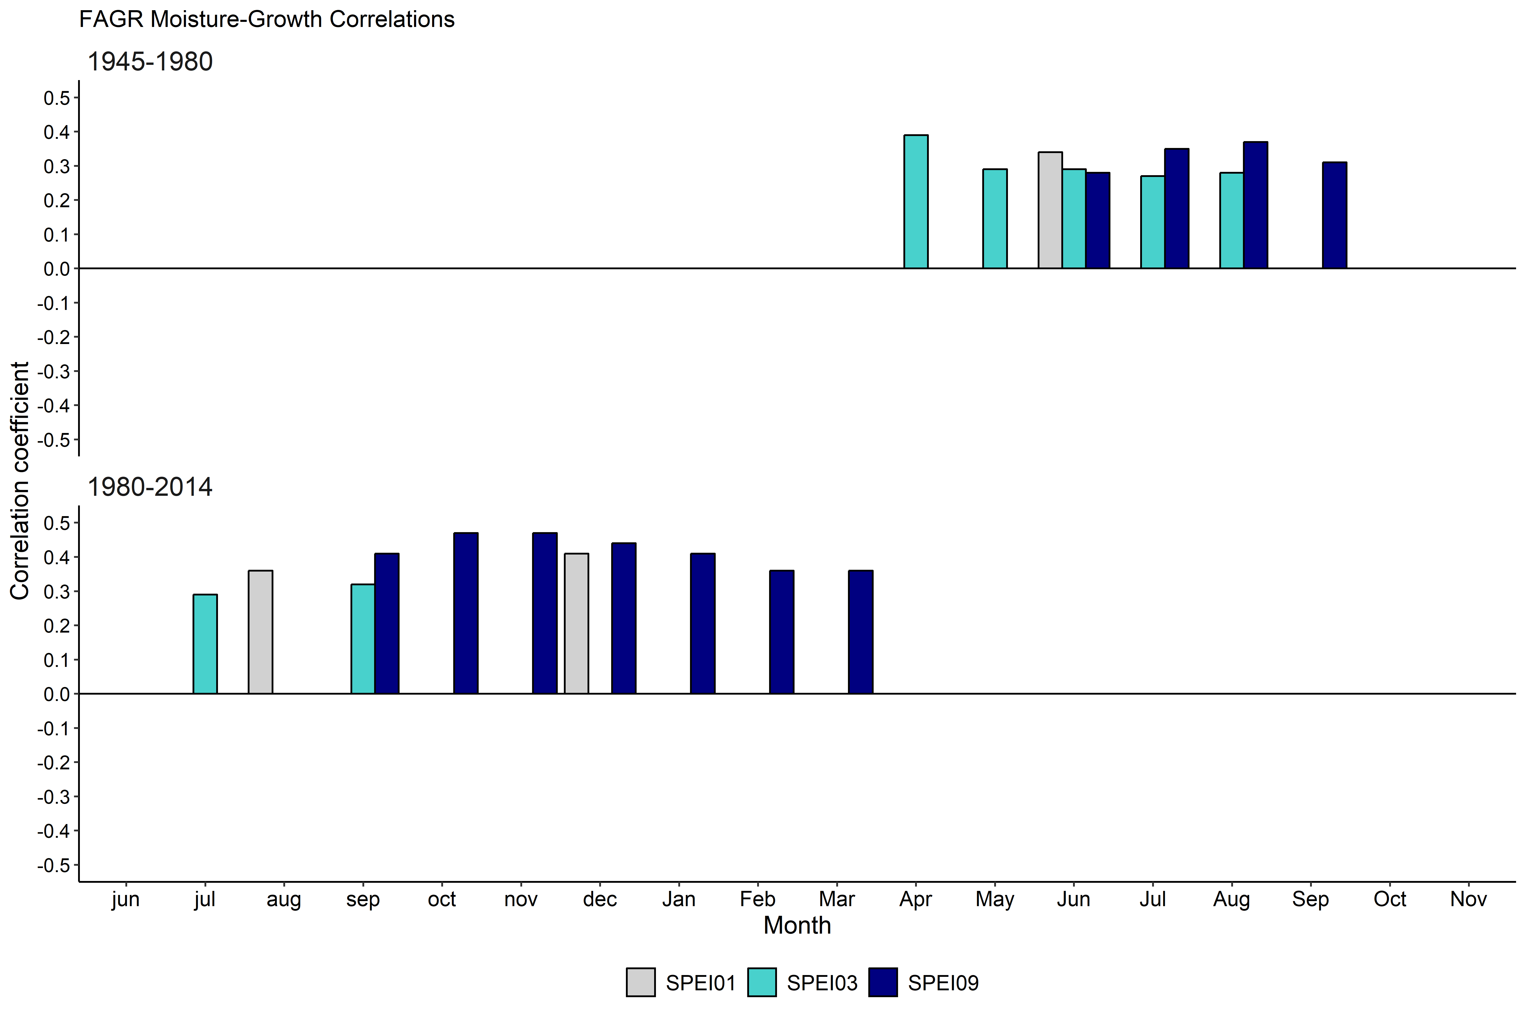
American beech: moisture-growth correlations
Notes:
-what’s most notable is the shift in importance from current year to previous year’s moisture.
-why this is, is unclear. But it points to a change of importance of moisture to the species.
-also notice that SPEI01, which indicates importance of a particular month, is significant in previous December, which we saw for sugar maple, too.
-This also may point towards the importance of snow at the beginning of winter, to act as an insulator.

Slide 22
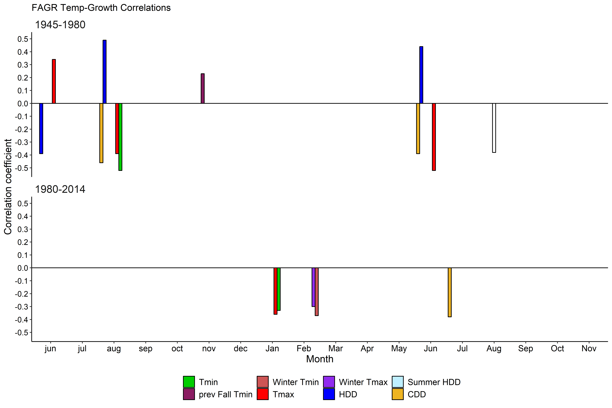
American beech: temperature-growth correlations
June
Notes:
-shift in negative correlations with maximum temperature, to negative correlations with winter minimum and maximum temperatures.
-another indication of how important winter is.
-What is notable is not just maximum temperatures, but minimum temperatures.
-These shifts to winter and minimum temps makes sense in terms of the climate patterns we have seen in the northeast. (next slide)

Slide 23
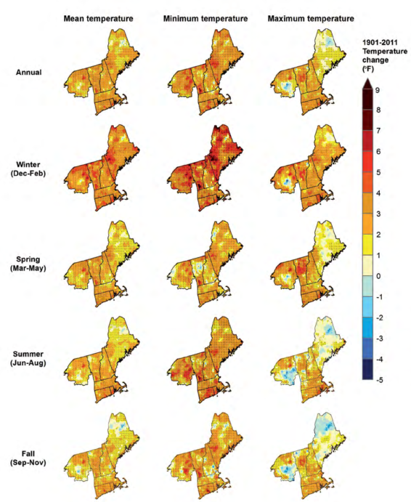
Temp change: 1901 thru 2011
Janowiak
et al. 2018
Notes:
-for the northeastern US, the greatest temperature change during the 20th century was observed in winter

Slide 24
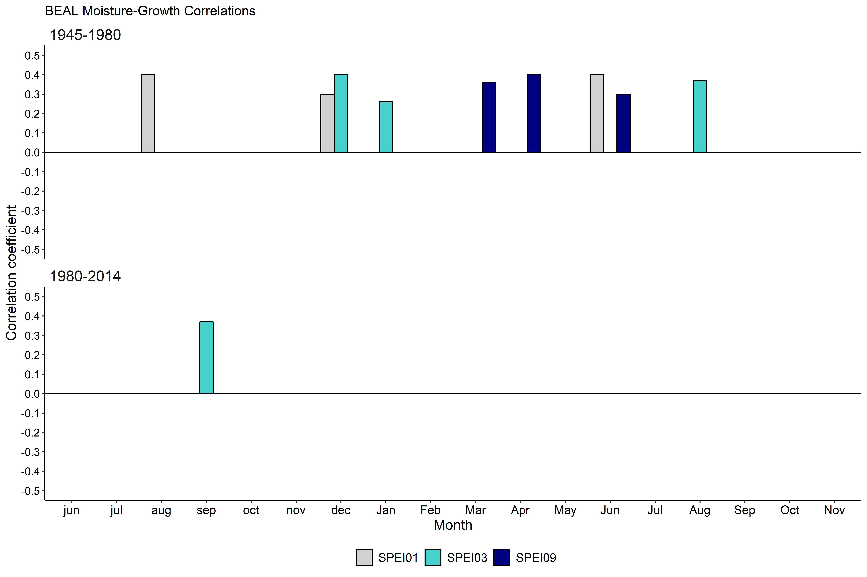
Yellow birch: moisture-growth correlations
Notes:
-We see a similar shift in decreasing importance of moisture with yellow birch as we did for sugar maple.
-Again, pointing to abundance of moisture in the northeast.

Slide 25
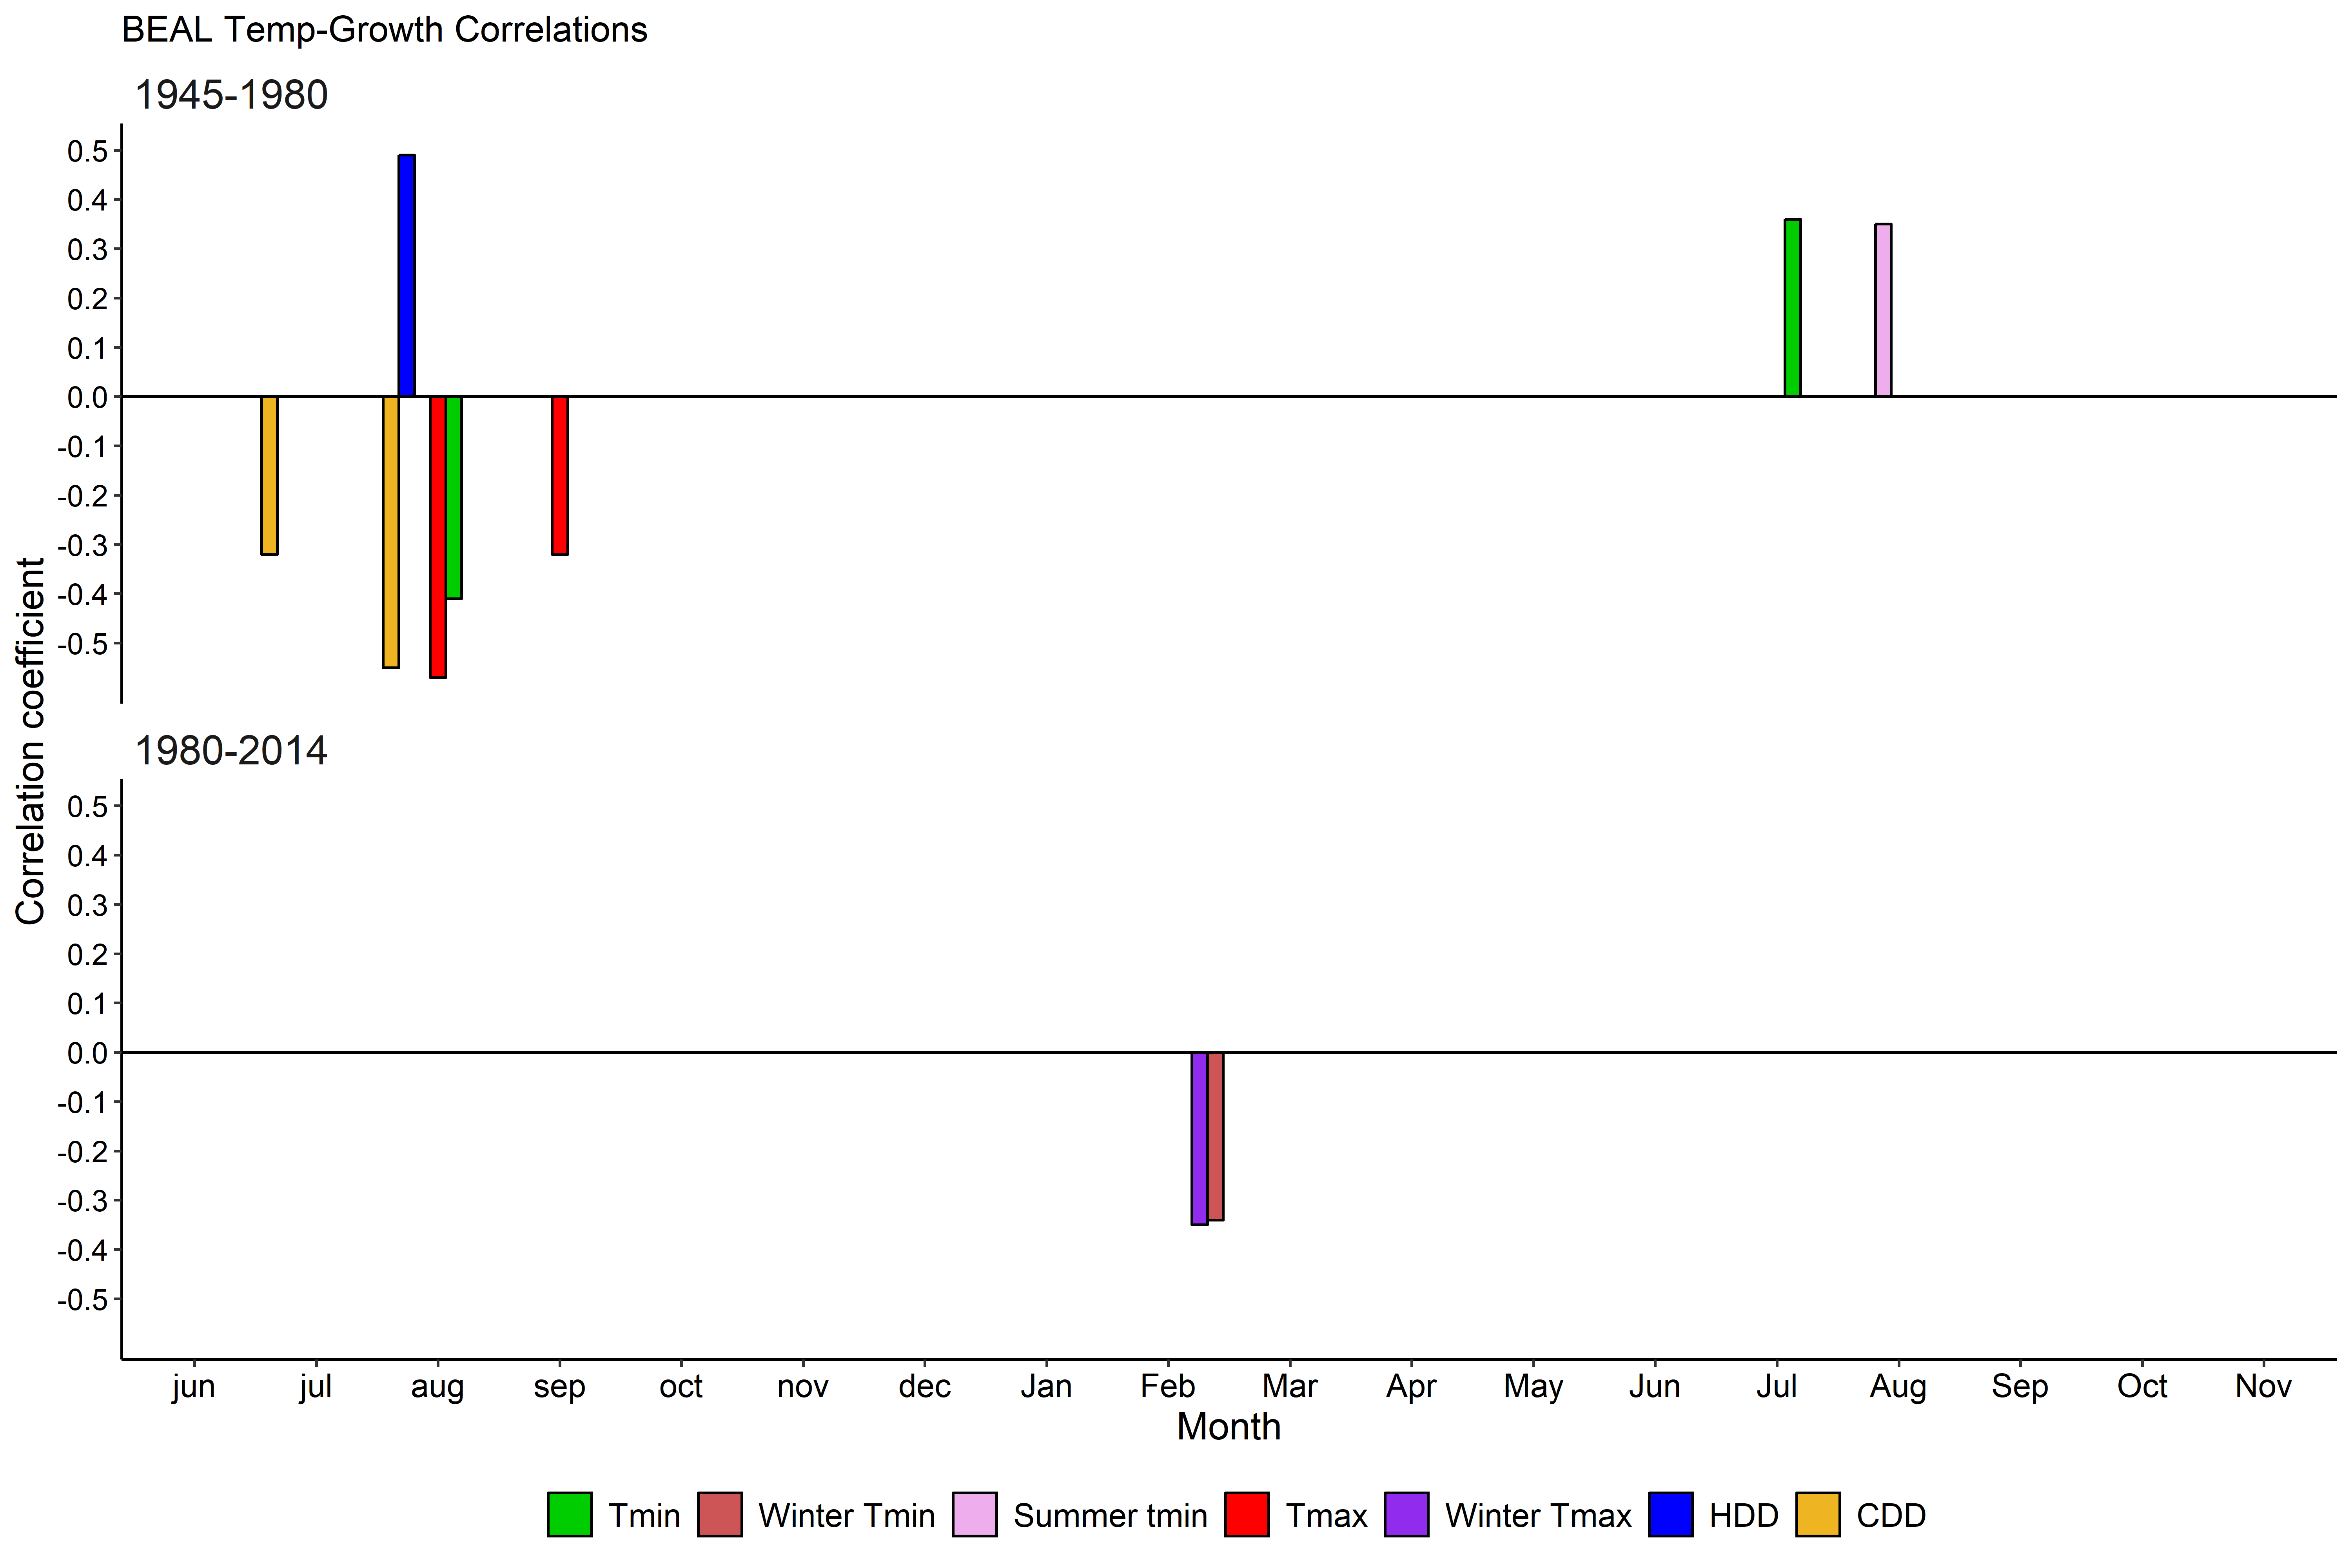
Yellow birch: temperature-growth correlations
Jul Aug
Notes:
-And a similar shift from positive correlation with summer temperatures to negative correlation with winter temperatures.
-With yellow birch, we see correlations with both winter tmin and tmax.
-Temperature could be related to snow, again- but with yellow birch, we didn’t see correlations with winter moisture, the way we did with sugar maple. (next slide)

Slide 26
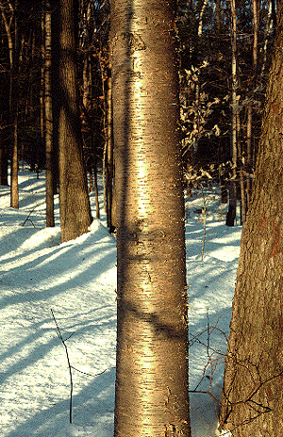
Freeze-thaw cycles
winter
temperatures
freeze-thaw
cycles
freezing-induced embolism and subsequent poor recovery
Zhu et al. 2000, 2002
uvm.edu
Notes:
-One explanation for this negative correlation with winter temperatures could be freeze/thaw cycles.
-Warmer winter temperatures can cause thaws, leading to freeze-thaw cycles throughout winter.
-These freeze-thaw cycles have been documented as detrimental to yellow birch roots, due to freezing-induced embolism and subsequently poor recovery

Slide 27
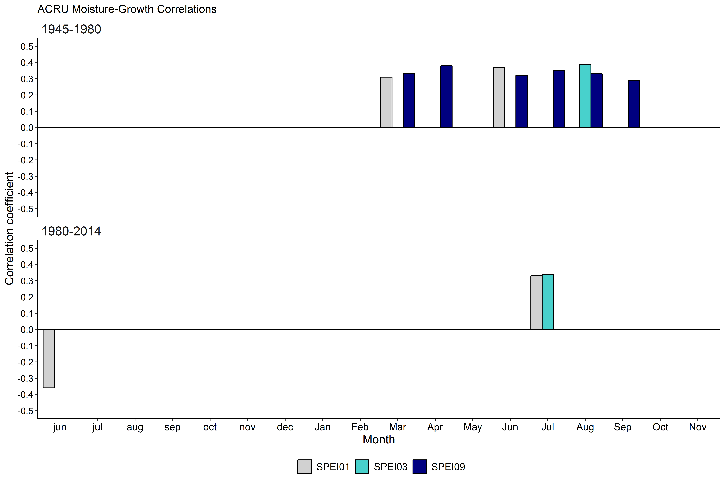
Red maple: moisture-growth correlations
Notes:
-The last species we analyzed is red maple.
-Like sugar maple and yellow birch, we see a decrease in the number of moisture variables overall.

Slide 28
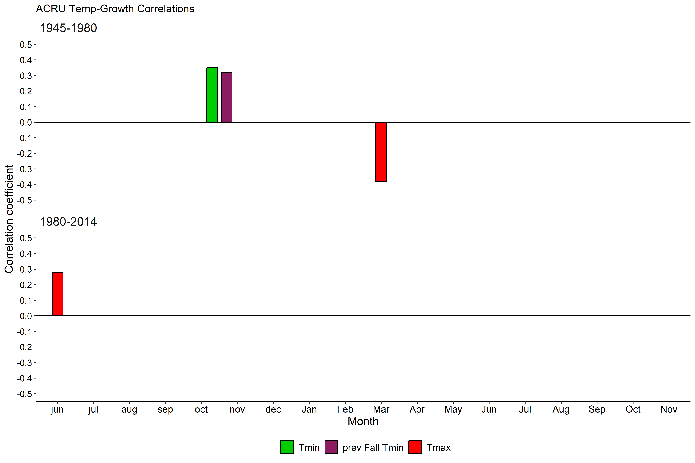
Red maple: temperature-growth correlations
Notes:
And for temperature, very few correlations in either time period, but even fewer in the second half of the chronology.
-One reason why this may be is because red maple is a generalist species. (next slide)

Slide 29
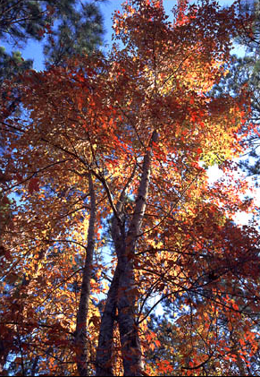
Red maple
Generalist species:
-can exist in greatly varying conditions
-exhibits genotypic variation in different ecosystems
Abrams1998
ufl.edu
Notes:
-can exist in greatly varying conditions, from dry ridges, (next slide)

Slide 30
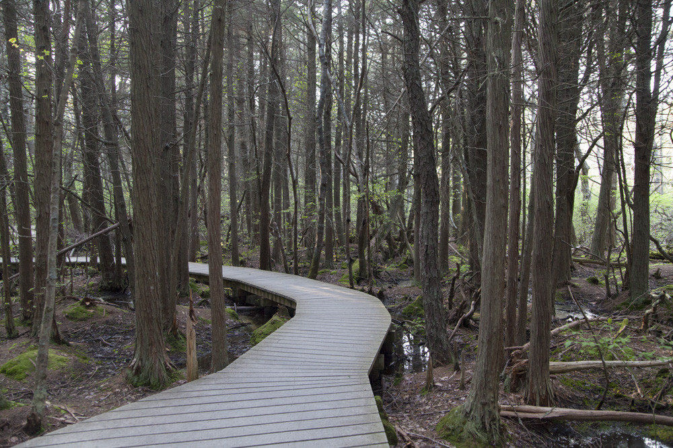
Red maple swamp
capecod.com
Notes:
- to swamps, and can exist on varying soil textures and pH.
-so it’s likely that climate is not very limiting to red maple.

Slide 31
Summary of climate-growth correlations
Over time… | Species
Moisture has become less important overall | sugar maple, yellow birch, red maple

Slide 32
Summary of climate-growth correlations
Over time… | Species
Moisture has become less important overall | sugar maple, yellow birch, red maple
Moisture (likely snow) has become more important at the beginning of winter | sugar maple, American beech

Slide 33
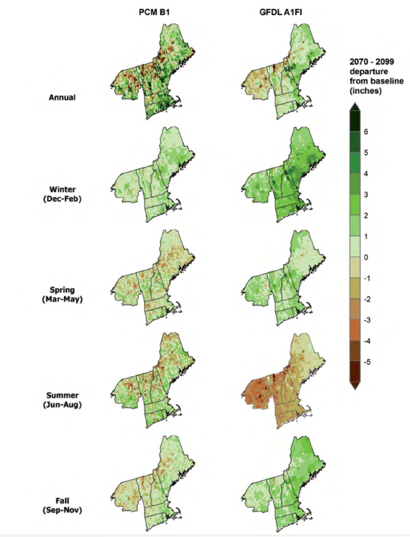


Snow or rain?
By 2099, projected
49%–95% reduction in forest area experiencing snowpack
(Reinmann et al. 2018)
Annual projected precip
2070 thru 2099
Janowiak
et al. 2018

Slide 34
Summary of climate-growth correlations
Over time… | Species
Moisture has become less important overall | sugar maple, yellow birch, red maple
Moisture (likely snow) has become more important at the beginning of winter | sugar maple, American beech
Temperature has become more important in winter | sugar maple, American beech, yellow birch
Notes:
Changes in winter temperatures and precip may be affecting these three species more than red maple.

Slide 35
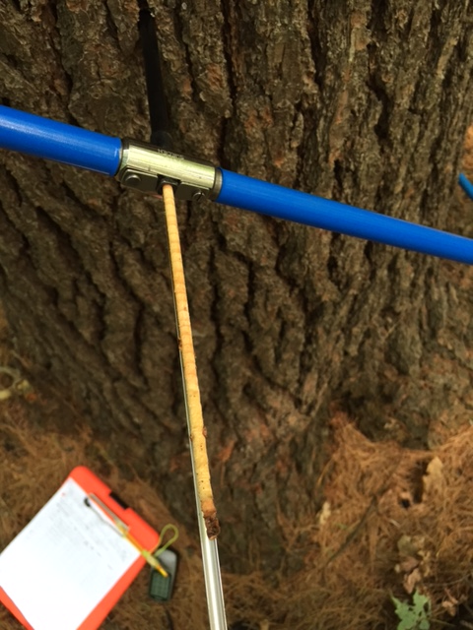
Questions?
Rebecca Stern
rstern1@uvm.edu

Slide 36
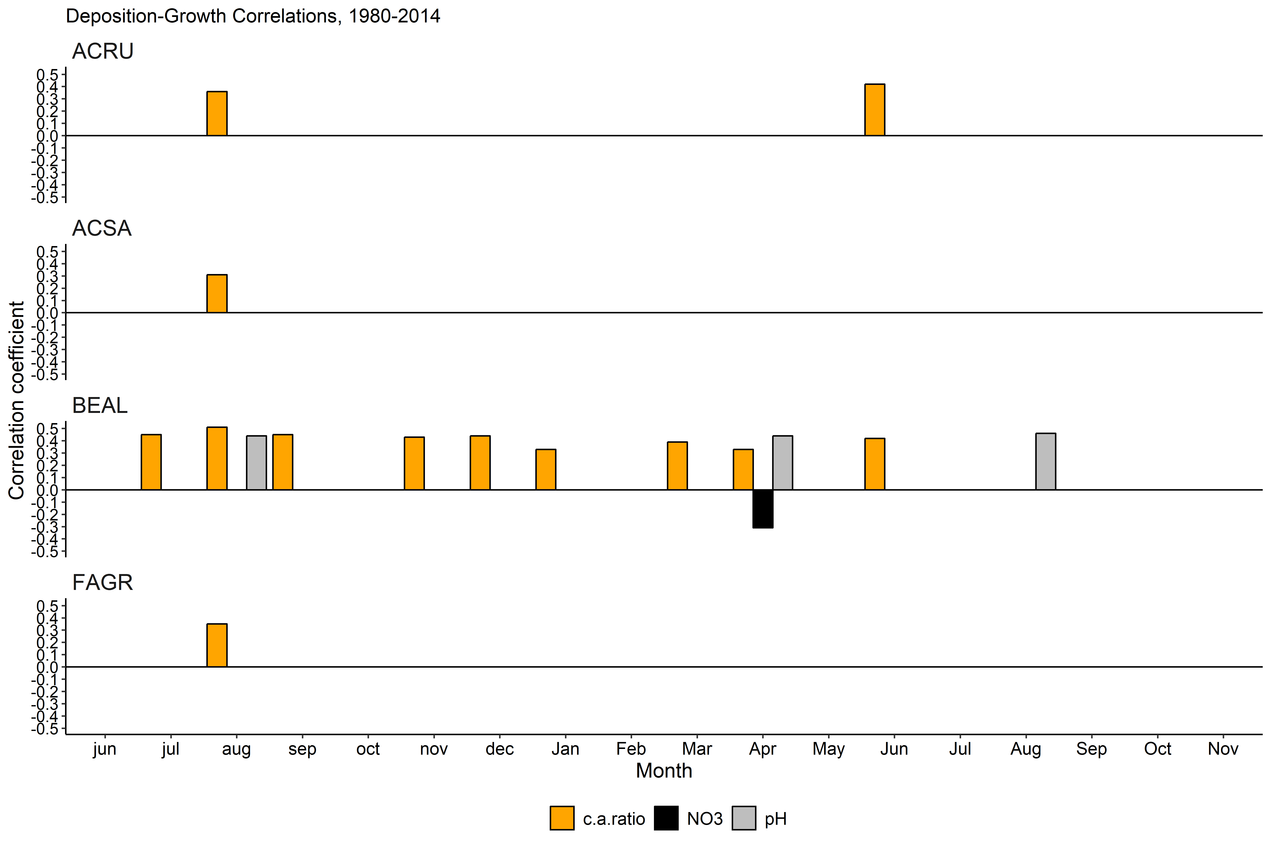
Deposition-growth correlations (1980-2014)

Slide 37
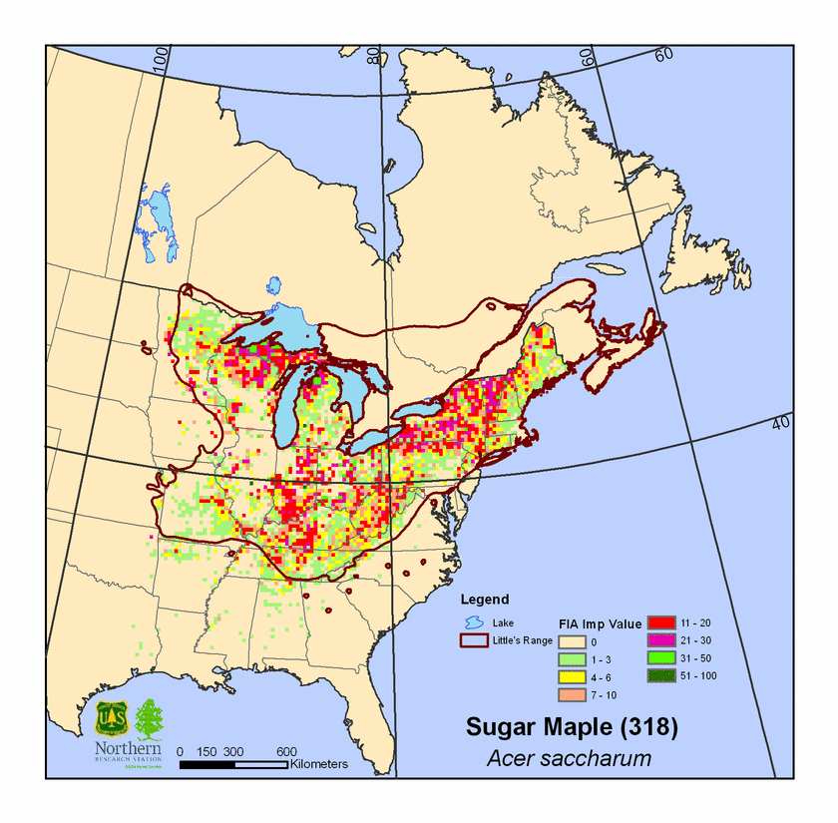
Range of sugar maple

Slide 38
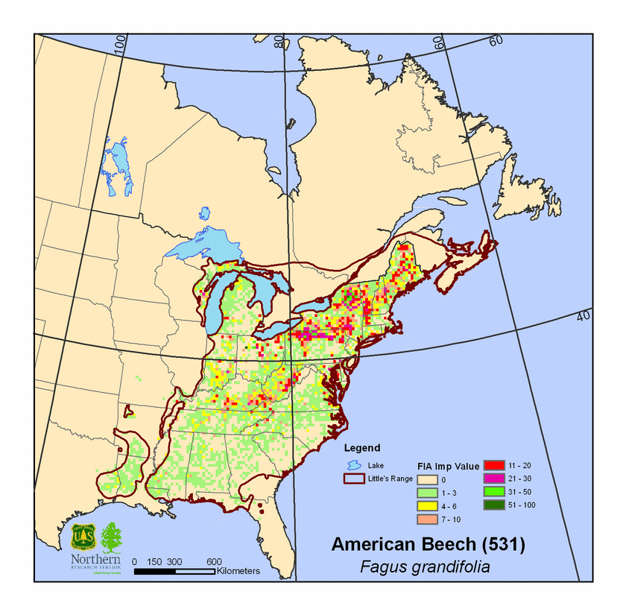
Range of American beech

Slide 39
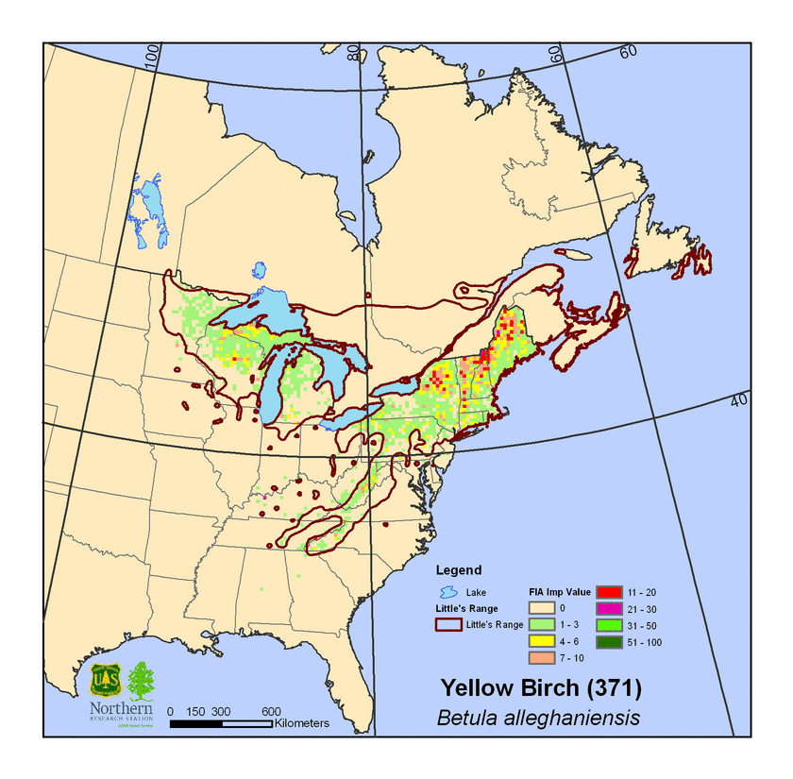
Range of yellow birch

Slide 40
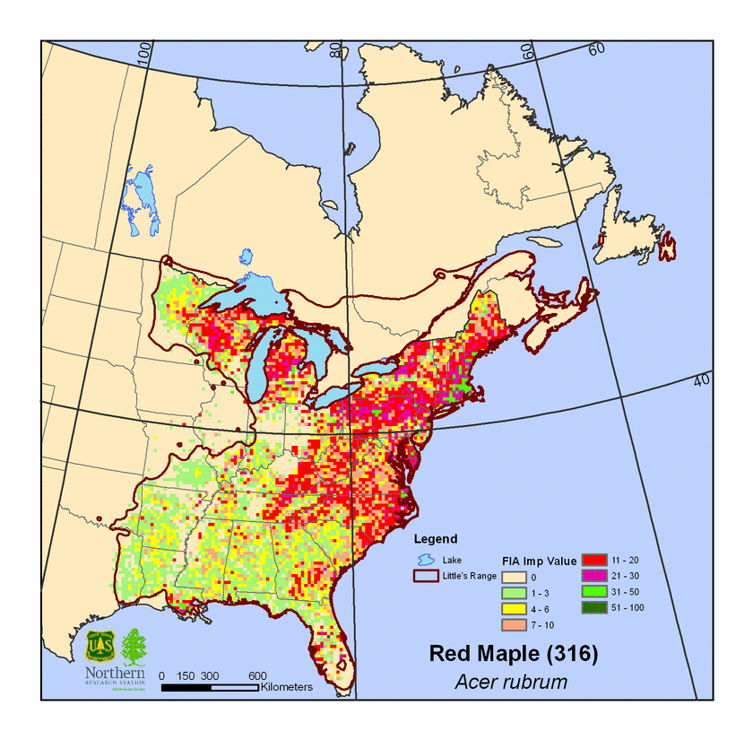
Range of red maple

Slide 41
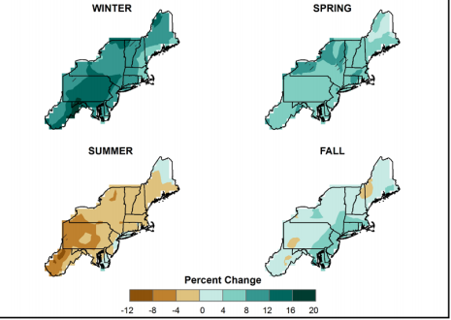
Projections: simulated difference in seasonal mean precipitation for 2041-2070 with respect to the reference period of 1971-2000
Snow or rain?
high (A2) emissions scenario
Kunkel et al. (2013)
Notes:
-Simulated difference in seasonal mean precipitation (%) for the Northeast region, for 2041-2070 with respect to the reference period of 1971-2000. Note that these projections are uncertain.
-These are multi-model means from 11 NARCCAP regional climate simulations for the high (A2) emissions scenario.
-If red oak has exhibited a positive relationship with summer precipitation, rather than months in which precipitation is projected to increase, then this species may not actually benefit from both observed and projected changes in seasonal precipitation.

