Slide 1
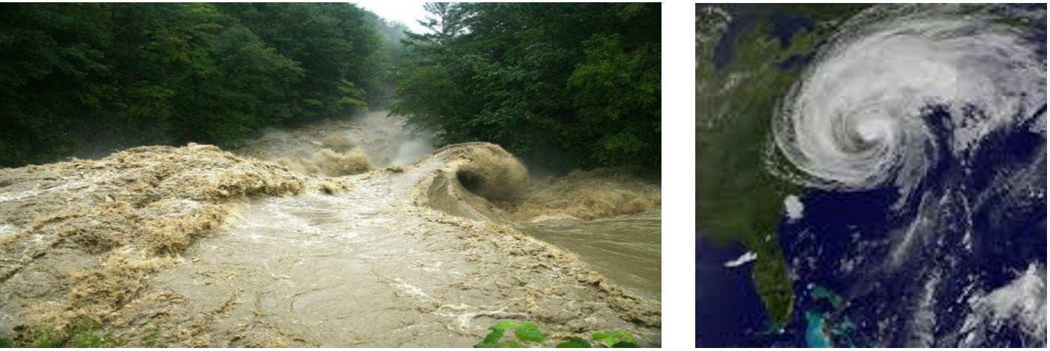
Effects of Extreme High Flow Events on Macroinvertebrate Communities in Vermont Streams
Jen Stamp, Jeroen Gerritsen & Anna Hamilton - Tetra Tech, Inc.
Aaron Moore - Vermont Agency of Agriculture Food and Markets (AAFM)
Steve Fiske - Vermont Department of Environmental Conservation (VTDEC)
Forest Ecosystem Monitoring Cooperative Conference
Burlington, VT
December 14, 2018

Slide 2
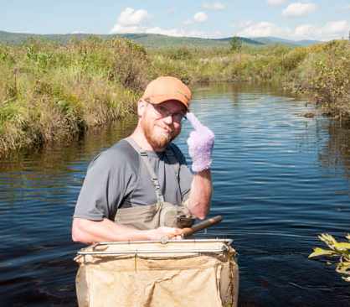
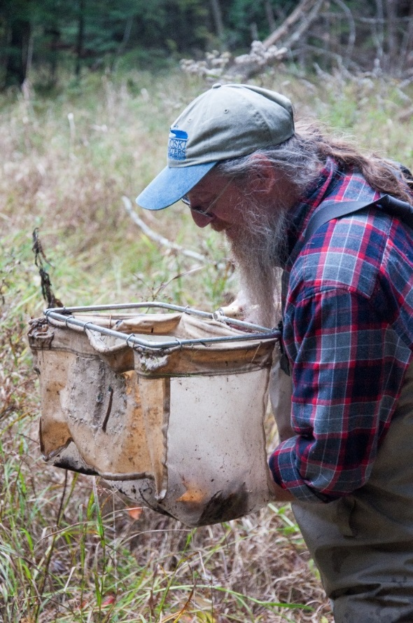

Up-Front Acknowledgments
Data were provided by VT DEC, along with some of the photos and slides (as well as in-depth knowledge about the sites and taxa).
Aaron Moore
Steve Fiske

Slide 3
Acknowledgments
Britta Bierwagen – Tetra Tech’s work on this project has been funded by EPA/ORD. It contributes to the furthering of our knowledge about the effects of climate change on biological communities and potential impacts on biomonitoring programs.
& Disclaimer…
The views expressed in this presentation are those of the author and they do not necessarily reflect the views or policies of the U.S. Environmental Protection Agency, VT DEC or other collaborating agencies.

Slide 4
Extreme climatic events (ECEs)
Ecosystems are experiencing not only gradual shifts in mean climate conditions but also changes in the frequency, magnitude, timing, and duration of ECEs such as droughts, floods, severe storms, and heat waves.
ECEs are projected to become more frequent and more intense with ongoing climate change.
These types of events can dramatically affect ecological and evolutionary processes.
Percent changes in the amount of precipitation falling in very heavy events (the heaviest 1%) from 1958 to 2012 for each region. There is a clear national trend toward a greater amount of precipitation being concentrated in very heavy events, particularly in the Northeast and Midwest. (Figure source: updated from Karl et al. 2009 ).
There is a lack of long-term time-series data from natural systems that capture the response and recovery of organisms to extreme events.

Slide 5
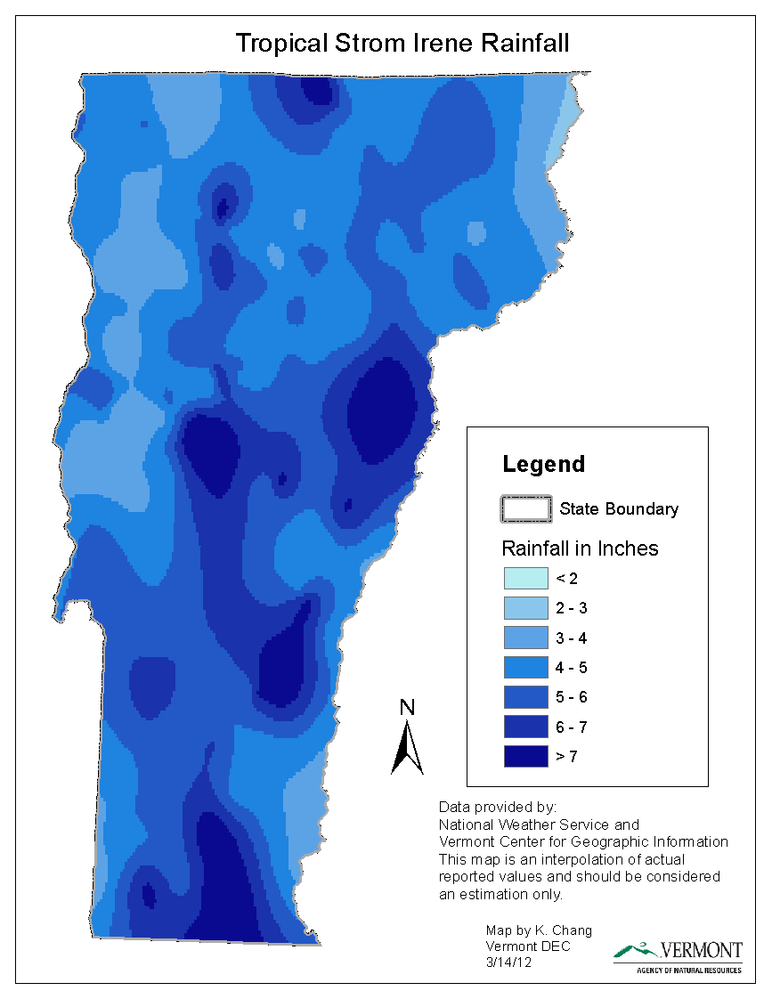
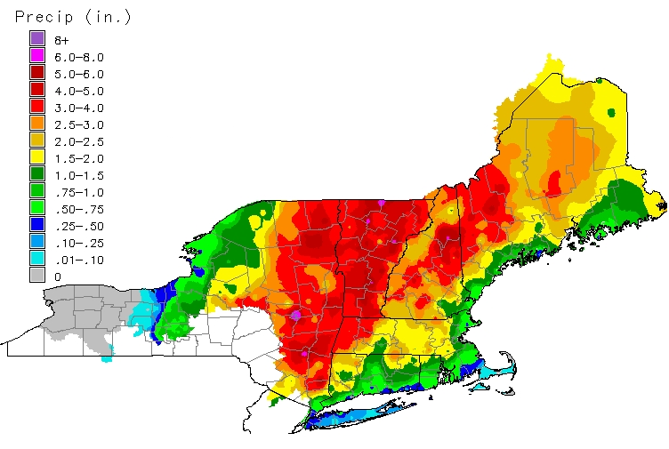
Irene - the perfect storm
2011 = wettest year on record
Irene rainfall 4-8 inches 24HR
Of 16 long-term USGS flow gages 10 set record flows, all in top 3 flows recorded
Groundwater at record high levels
August 28-29
24 Hour Rainfall Total
(NOAA)

Slide 6
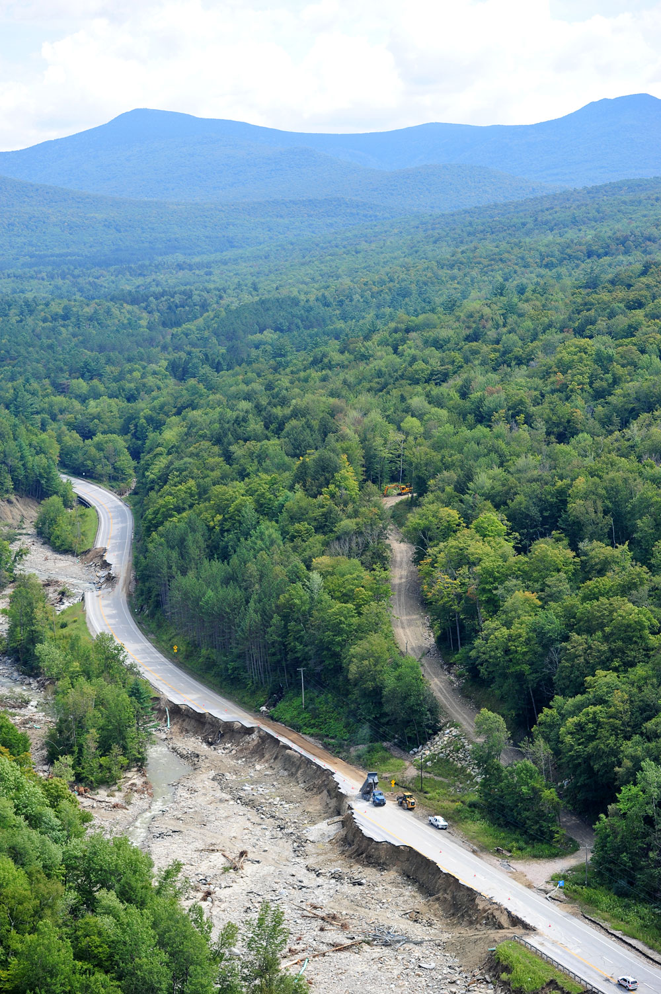
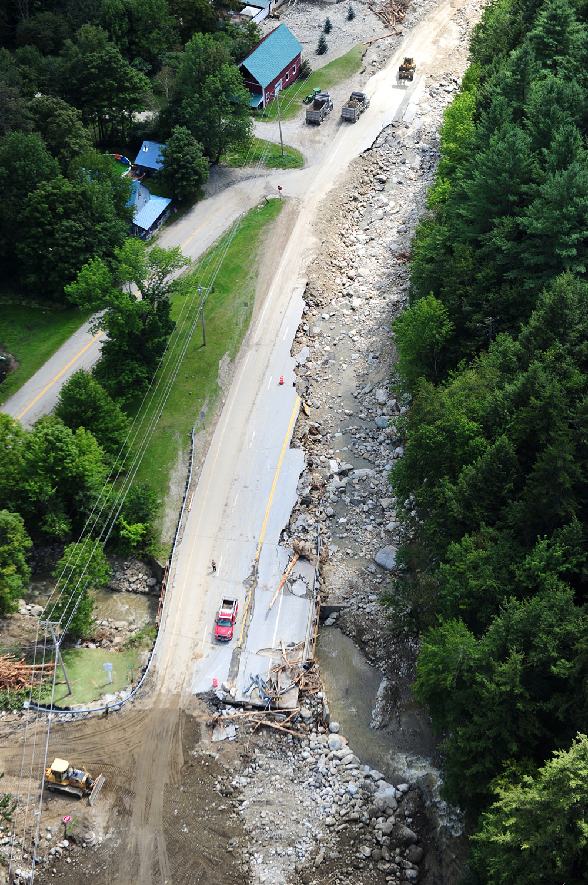
Aftermath of Irene
Notes:
-Route 4 between Rutland and Killington, one of major cross-state routes

Slide 7
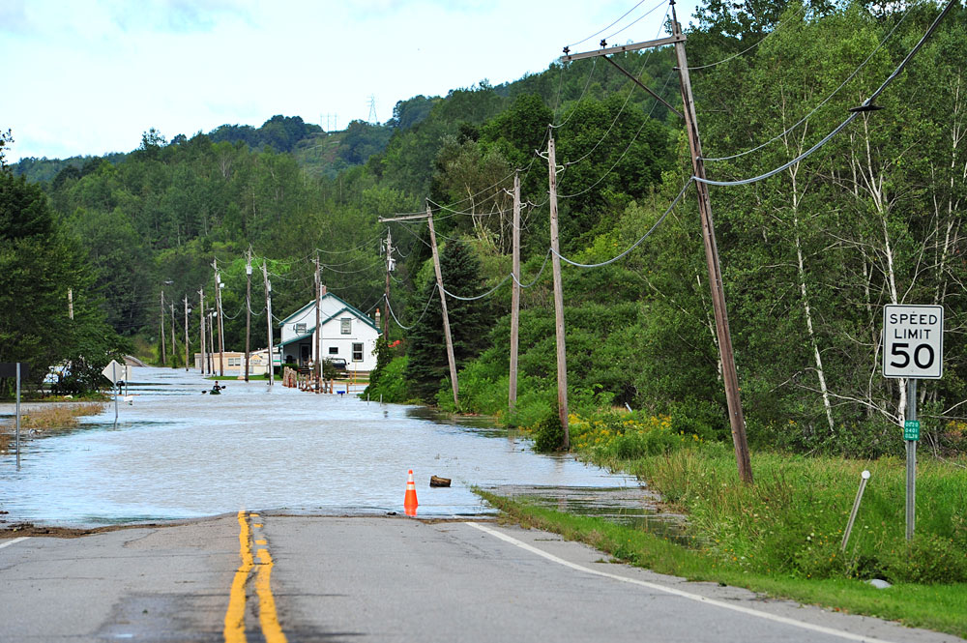
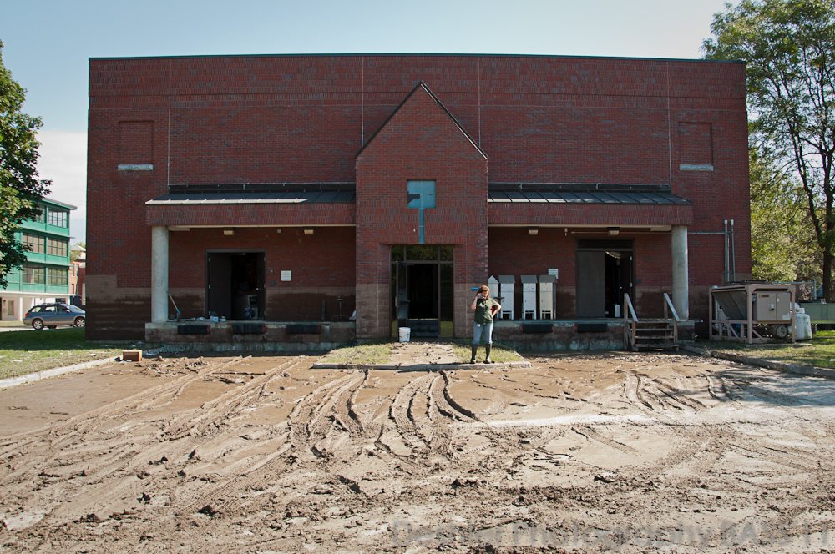
Aftermath of Irene
Notes:
-Waterbury one of hardest hit by inundation
-Home to the biomonitoring lab (and over 100 other state employees)
-Note the flood water line on our building

Slide 8
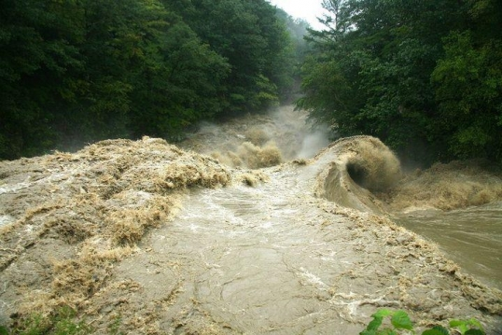
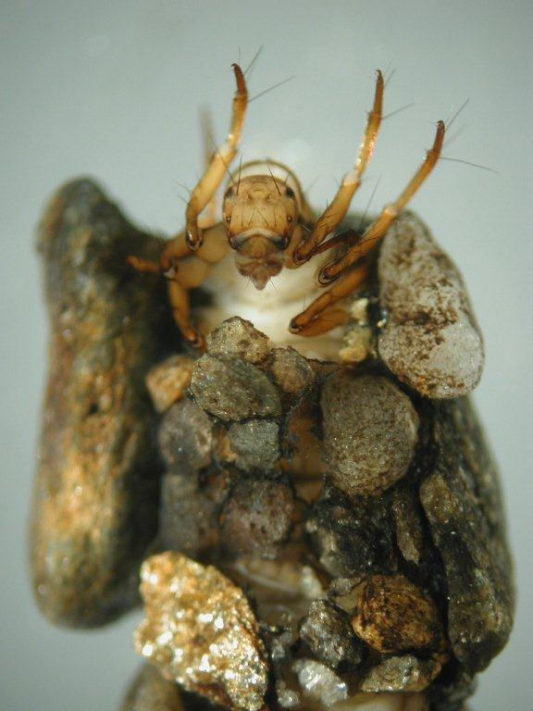
Goals
Evaluate the effects of high flows associated with Irene on macroinvertebrates, substrate composition and periphyton cover
2) Better understand potential effects of more frequent and intense high flow events on the VT DEC’s bioassessment program.
Notes:
Storms like TS Irene have implications for biomonitoring programs like the one run by the Vermont Department of Environmental Conservation (VT DEC), which determines compliance with the Clean Water Act (CWA) based on bioassessment results in comparison to biocriteria (VTWQS). The VT DEC’s biomonitoring program uses sampling and evaluation of macroinvertebrate and fish communities to assess the biological integrity of the state’s wadeable streams and rivers
Effects of high flow events on stream biota can vary depending on the magnitude, duration, and timing of the event, the physical characteristics of the stream, and the ecological characteristics of the biota. Important stream and ecological features include slope, drainage area, the availability of refugia, and the traits and adaptive capacity of organisms (e.g., life history, behavioral) (Lake 2000, Lytle and Poff 2004, Woodward et al. 2015). High streamflow events and floods can affect stream biota by physically crushing, burying, or displacing organisms (including eggs), and by changing physical habitat, water quality, food and energy inputs, and aquatic community interactions (Poff et al. 1997, Lake 2000, Lytle and Poff 2004). Habitats can be altered by scouring and abrasion of the streambed, movement and redistribution of substrates, loss of snags and woody debris, channel widening, and channel incision. In some cases, effects on habitat can have more of a negative effect on biota than the direct effects of flooding (Death et al. 2015).

Slide 9
Study Sites
Nine ‘reference’ streams monitored on an annual basis from 2009-2013
Waterbody name | Watershed | Type | Drainage Area (km²) | Slope (%) | Elevation (m) | % Natural land cover
Kidder | West | SHG | 4.3 | 9.2 | 533.1 | 95.2
Smith | White | SHG | 4.6 | 6.4 | 585.2 | 99.9
Ranch | Winooski | SHG | 9.9 | 5.3 | 378 | 95.6
Bingo | White | SHG | 23.5 | 1.9 | 341.4 | 97.6
Winhall | West | MHG | 46.6 | 1.7 | 448.1 | 98.8
East Branch North | Deerfield | MHG | 103.3 | 1.6 | 268.2 | 86.3
White | White | MHG | 510.0 | 0.2 | 217.9 | 92.1
Lewis | Lewis | WWMG | 208 | 0.3 | 33.5 | 69.8
Nulhegan | Nulhegan | WWMG | 352 | 0.3 | 271.6 | 94.2

Slide 10
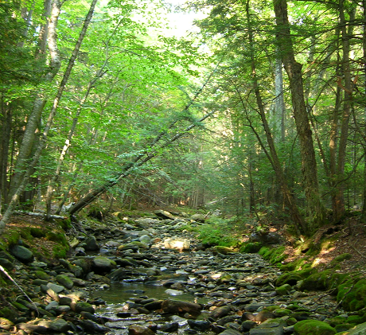
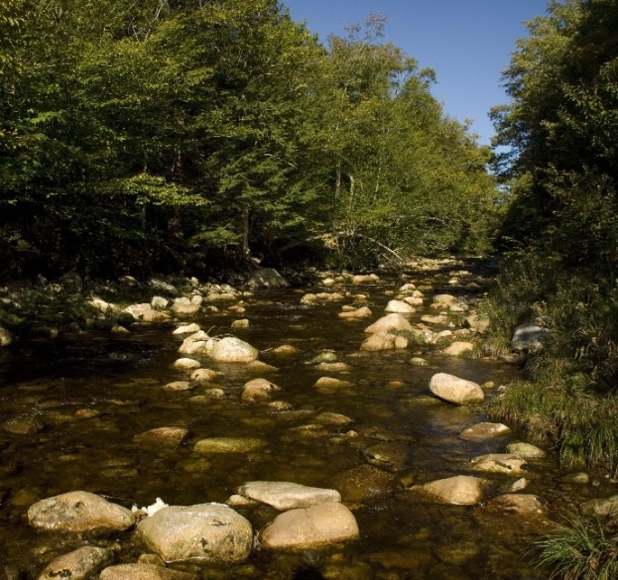
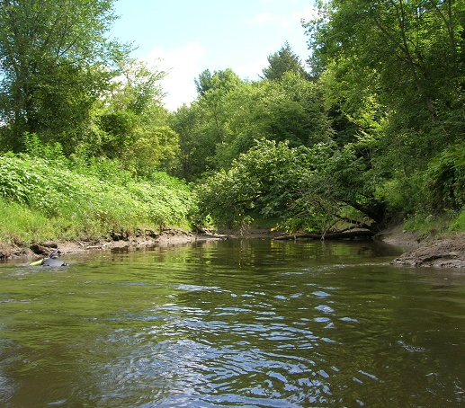
Represent 3 different stream types for macroinvertebrate communities
Small High Gradient
(SHG)
Medium High Gradient
(MHG)
Warm Water Moderate Gradient (WWMG)
Increased Drainage Area and Order
Increased Slope
Decreased Elevation
Decreased Canopy Cover
Increased % Fine Sediments
Increased pH, Alkalinity, Conductivity, Temperature
Notes:
In setting metric cutoffs for our streams, aware that
-All streams not created equal, need separate bench marks based on STREAM TYPE because communities are so fundamentally different
-Biocriteria development led to three distinct community types (SHG, MHG, WWMG); go over phys-chem characteristics

Slide 11
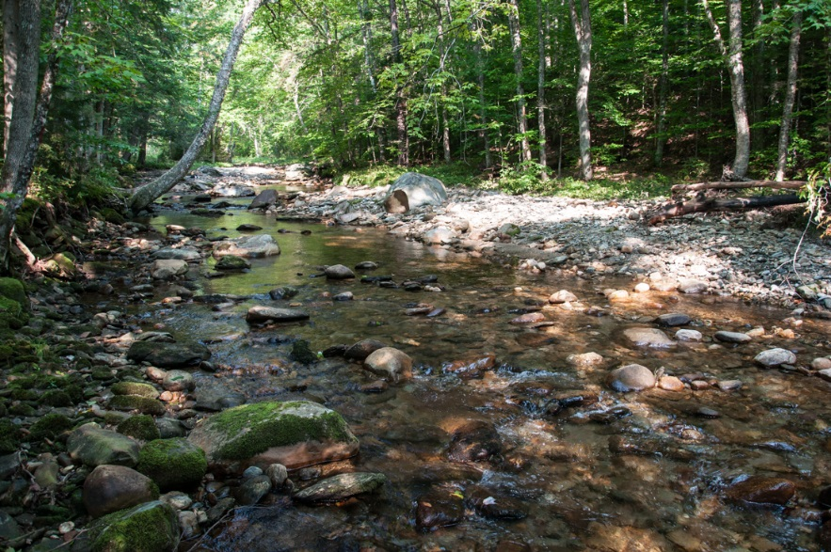
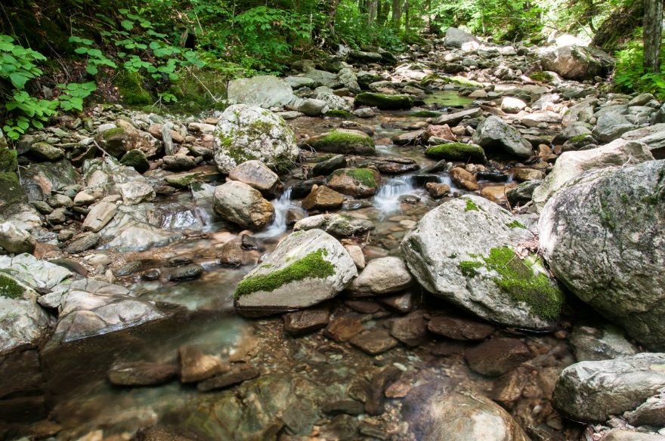
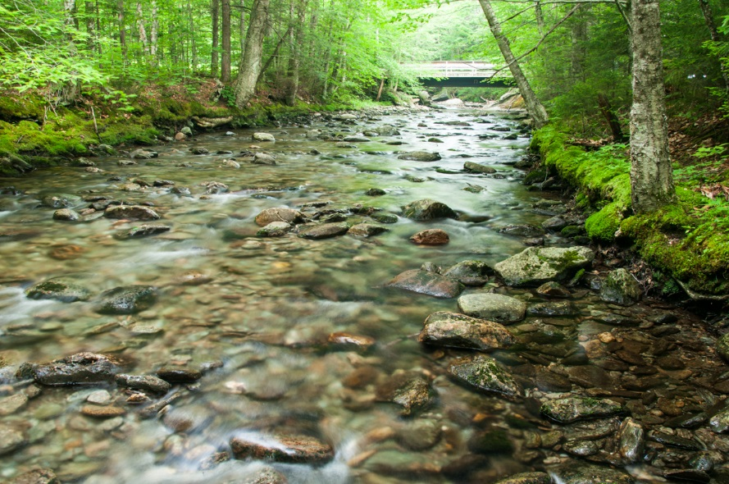
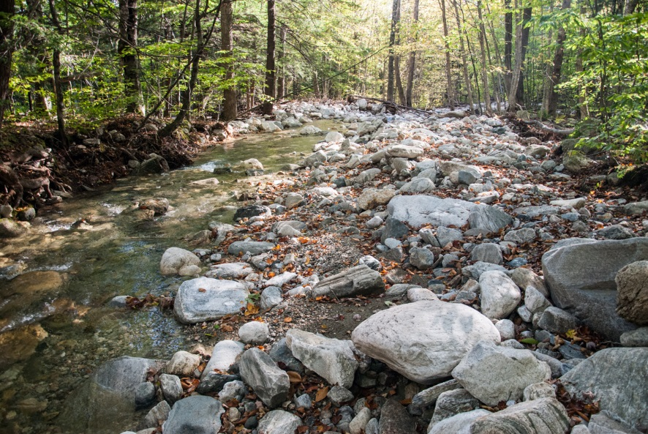
Small High Gradient (SHG) Streams
Photos provided by Jim Deshler, VT DEC
Bingo
Smith
Ranch
Kidder

Slide 12
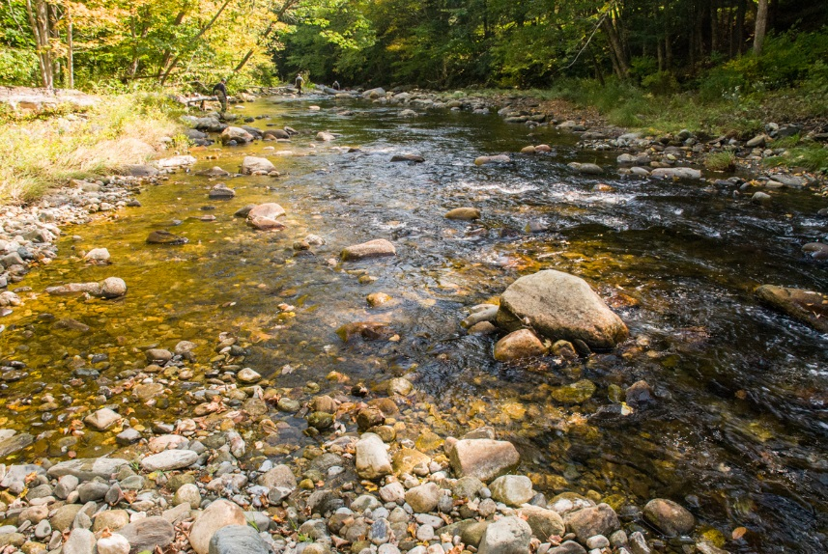
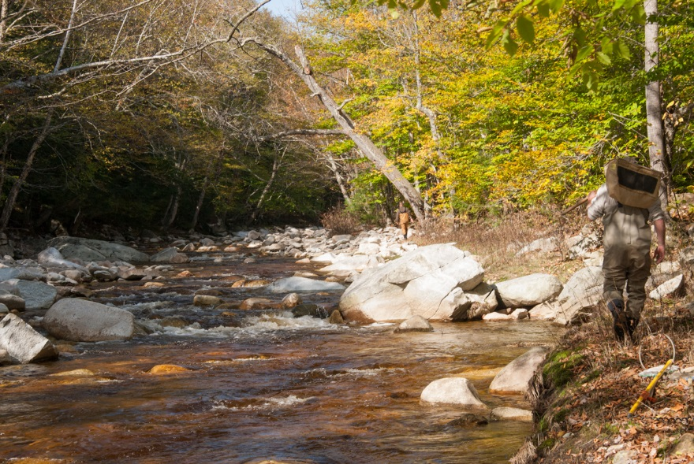
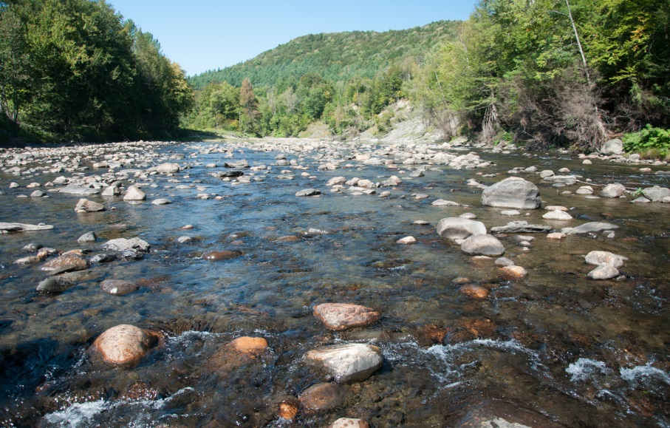
Medium High Gradient (MHG) Streams
Photos provided by Jim Deshler, VT DEC
East Branch North
Winhall
White

Slide 13
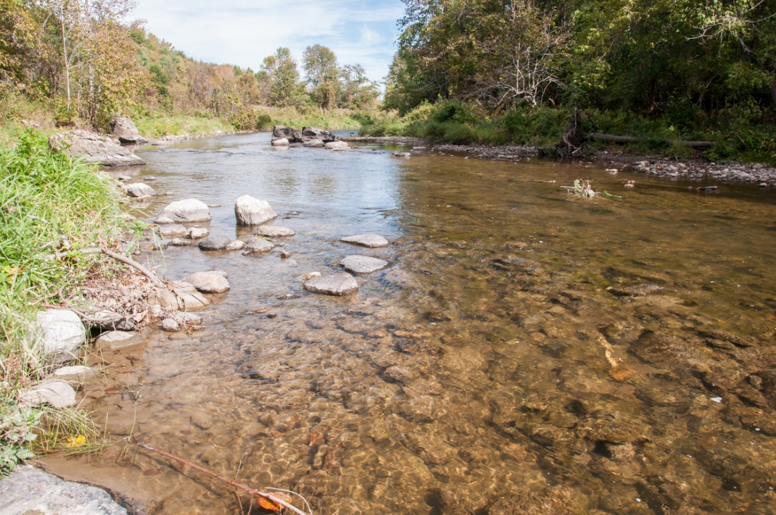
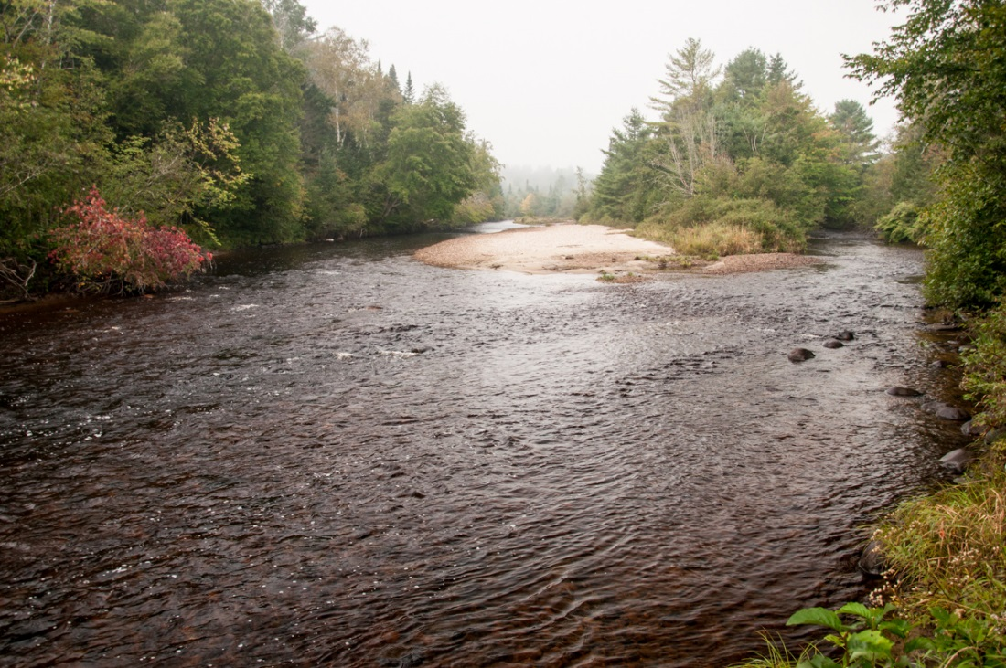
Warm Water Moderate Gradient (WWMG) Streams
Photos provided by Jim Deshler, VT DEC
Lewis
Nulhegan

Slide 14
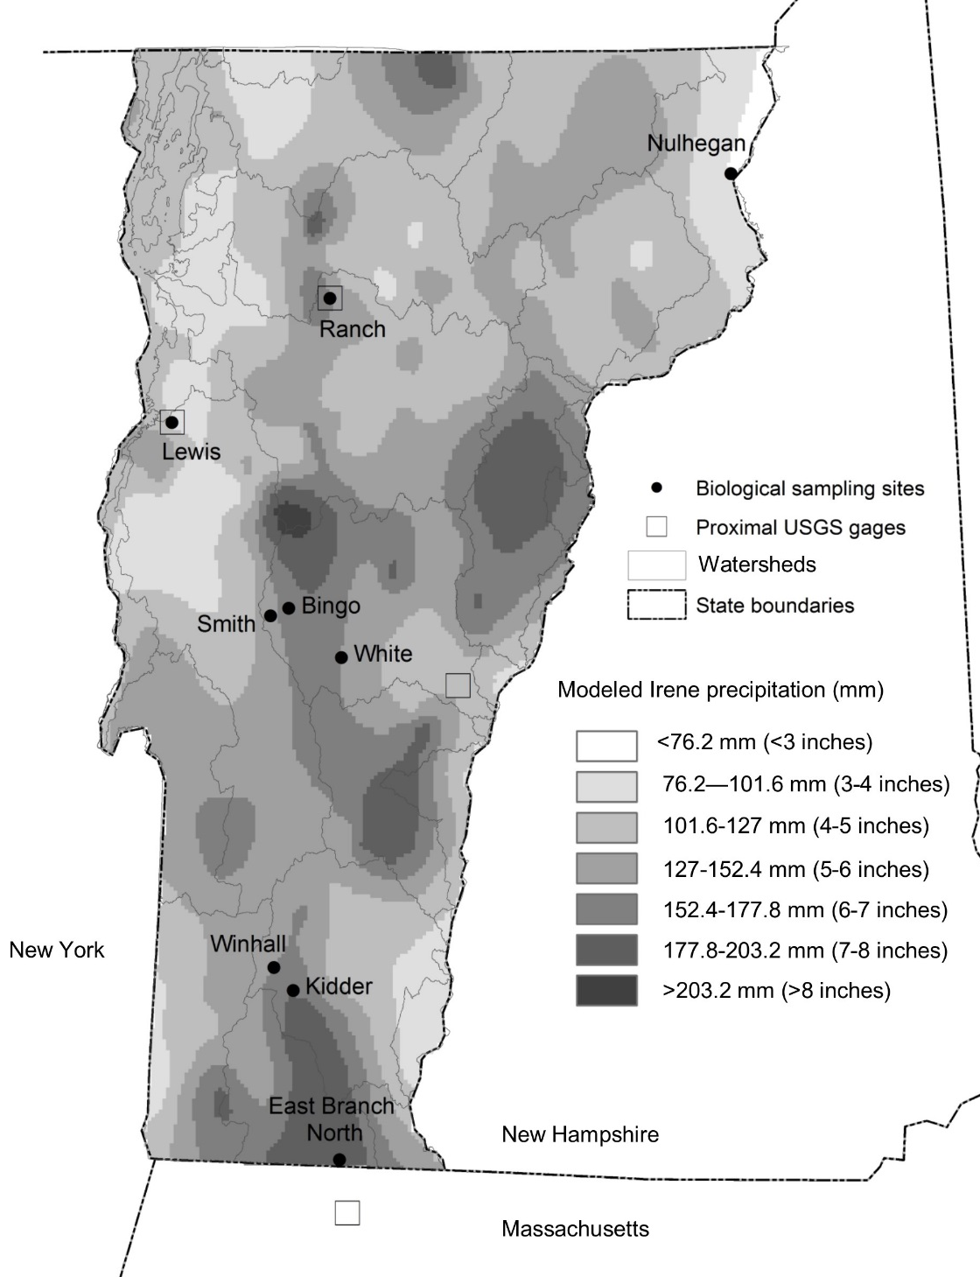
The sites capture a range of exposures (some were hit harder than others)
On average, the SHG and MHG sites received the greatest amount of rainfall (about 6.5”), with one site (East Branch North) receiving over 7”of rain.
The two WWMG sites (Lewis and Nulhegan) received the least amount of rain (3-4”).

Slide 15
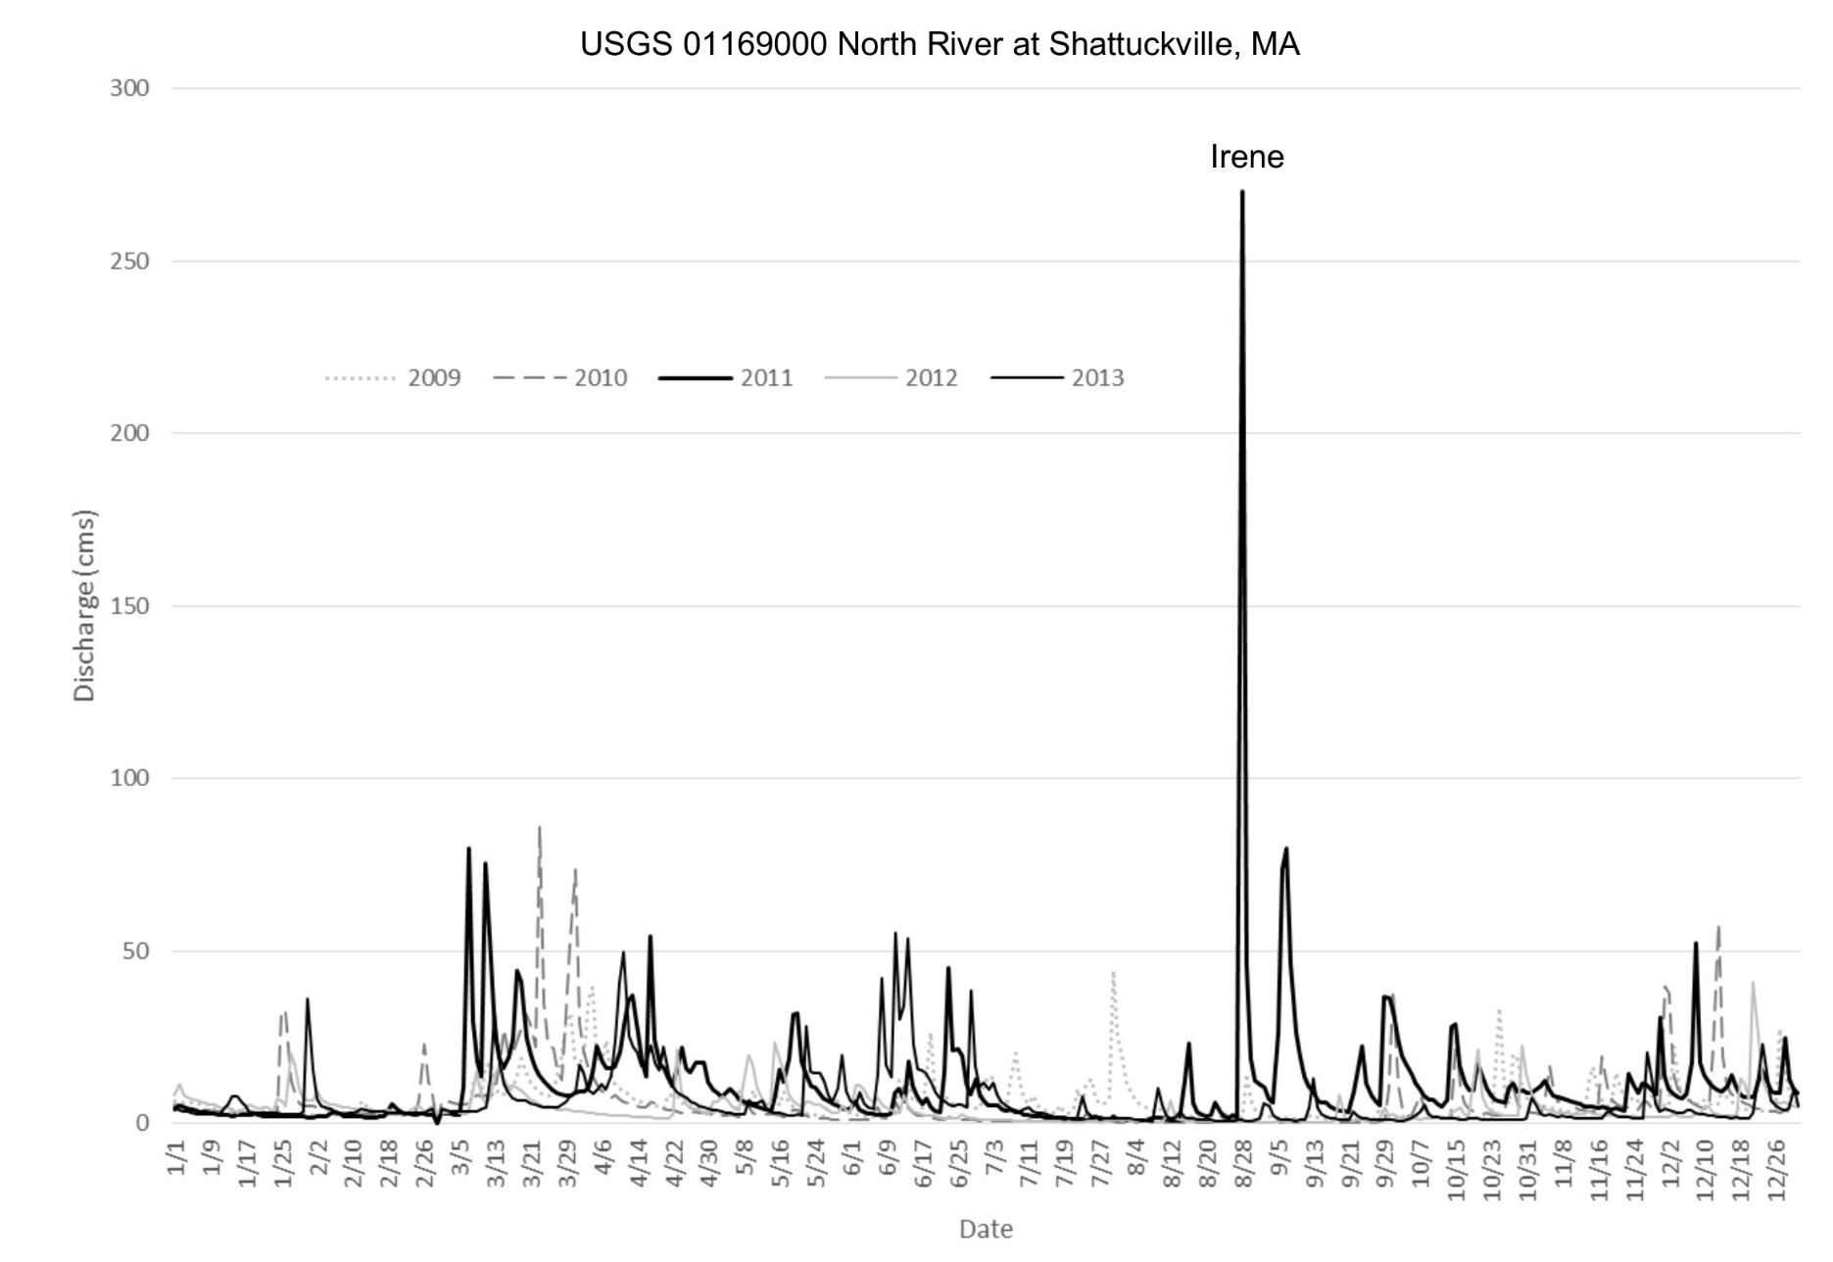
Hydrologic Data
Six sites were matched with USGS gages.
North River gage (matched with East Branch North site) - highest annual peak flow during Irene. Its period of record (POR) begins in 1940.
White River gage (matched with Bingo, Smith and White) - second highest annual peak flow during Irene. POR begins in 1916.
Atypical timing (high flows in Vermont typically occur during spring runoff and are driven largely by snowmelt)
East Branch North had its highest annual peak flow on record during TS Irene
Notes:
Comparatively, flows at the USGS gages on Lewis and Ranch, which have shorter periods of record (beginning in 1990 and 2001, respectively), were not as extreme during TS Irene. Mean daily flows were actually higher at these sites during spring 2011 (Figure 4). Both Ranch and Lewis also had high flow events (of slightly higher magnitude than TS Irene) during late September 2010, and Ranch had experienced multiple other high flow events during the fall season (Figure 4). No representative USGS gage data were available for the Nulhegan, and hydrologic data from the USGS gage near Winhall and Kidder were excluded because its stream flows are influenced by a hydroelectric dam

Slide 16
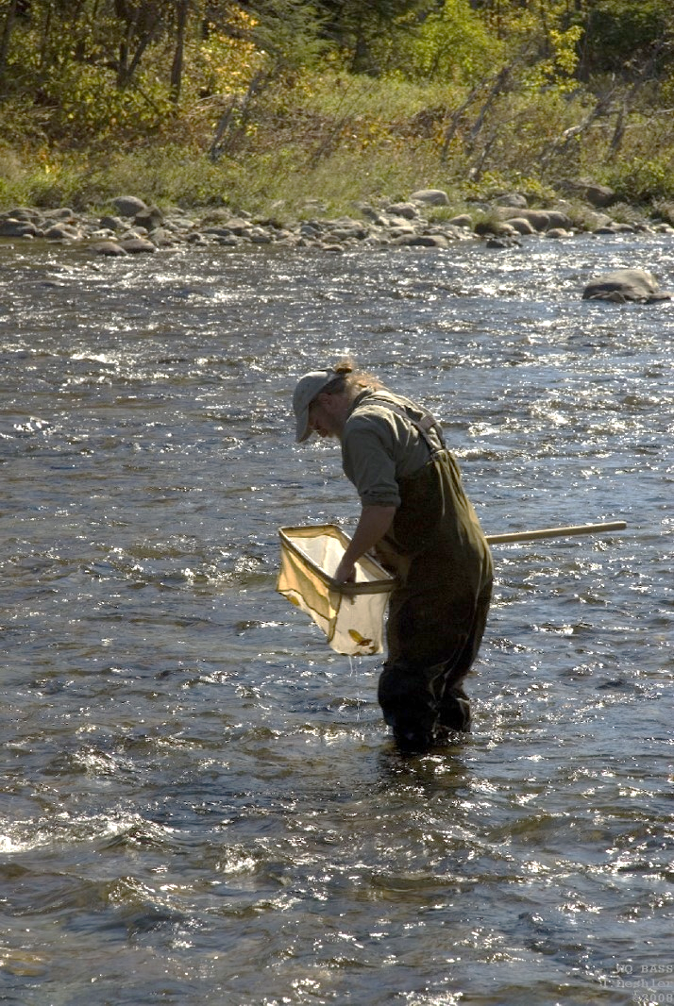
Macroinvertebrate Collection
Kick samples are taken from riffle habitats in 4 different locations in the sampling reach. At each location the substrate is disturbed for approximately 30 seconds, for a total active sampling effort of 2 minutes.
D-frame net with 500-μm mesh.
Biomonitoring index period: Sept 1st – Oct 15th
METHODS
In 2011, sampling dates ranged from one week to one month after Irene.
2011 data were compared to samples collected two years before and two years after Irene.
Pre: 2009-2010
Irene: 2011
Post: 2012-2013
Note: two sets of samples were collected from Ranch in 2011 (one 11 days after Irene and the other 57 days after).
Notes:
A brief background on our particular monitoring program before getting to results
Unit tasked with collecting fish and macro community data used in biological assessments
Biota as the most direct measure of water quality and stream health
Also associated habitat evaluation and water samples (nutrients, metals, etc)

Slide 17
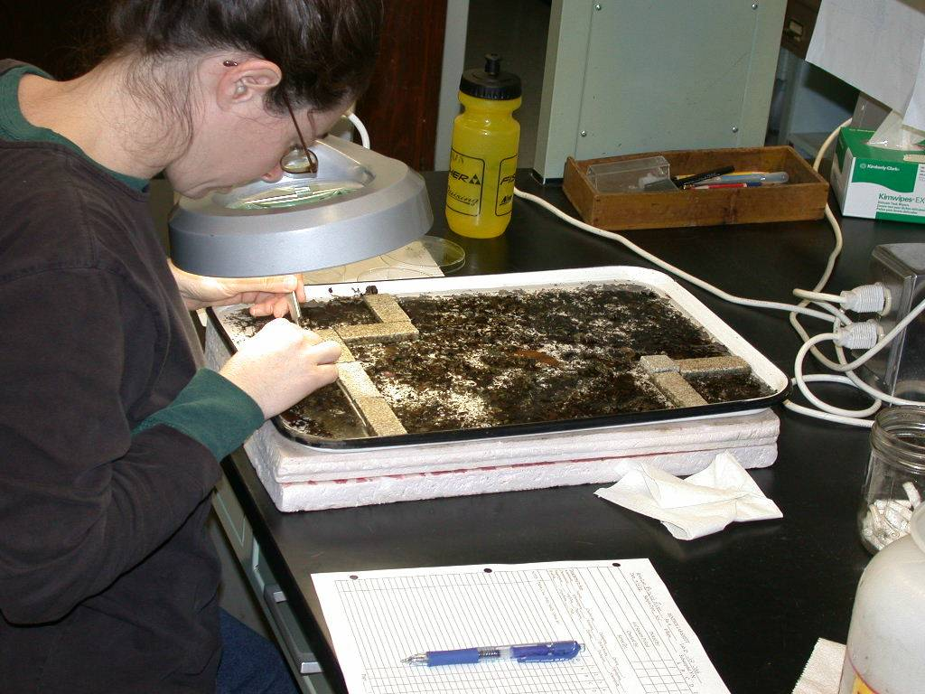
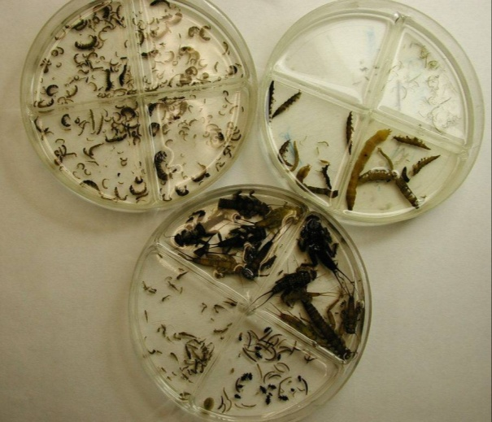
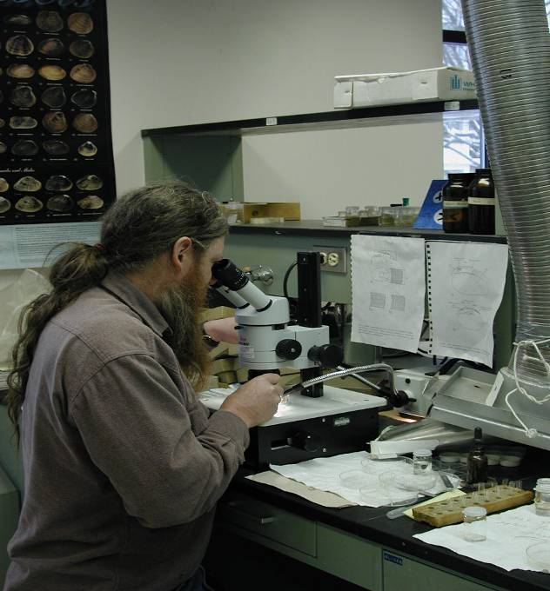
Macroinvertebrate Processing
Subsampled in lab, minimum of 25% or 300 individuals
  Identified to species or lowest possible level
METHODS
Notes:
Sampling communities
Backpack shocking and identify fish to species in field
Kicknet sampling @ 1m2, and identify minimum of 25% of sample
Taxonomy done in house by “specialists”
To lowest possible level in laboratory (species target)

Slide 18
VT DEC Macroinvertebrate Biocriteria
INPUT METRICS
METRIC
Density | Number of invertebrates per square meter
Richness | Total number of distinct taxa in sample
EPT Richness | Total number of distinct Ephemeroptera, Plecoptera and Trichoptera taxa in sample
PMA-O | Percent Model Affinity–Order Level: Measure of similarity to a model based on reference streams
PPCS-FG | Pinkham Pearson Coefficient of Similarity based on Functional Groups: Measure of FFG similarity to a model based on reference streams
Biotic Index | Measure of community sensitivity/tolerance toward enrichment
EPT/EPT+Chiro | Ratio of EPT abundance to the combined abundance of EPT and Chironomidae
% Oligochaeta | Percent of Oligochaeta out of total sample abundance
METHODS
Notes:
-These are the metrics used for Macroinvertebrate communities
-How the metrics were chosen:
-Responsive metrics: Showed strong signals between reference streams, and streams with known impairments
-Inclusive of variables that measure structure, function, sensitivity
-Discuss metrics responses and definitions briefly (especially the models)
- Note that high densities can indicate issues too, but behold this threshold we know problem
- Note that for our analysis, focusing on first six metrics.
- Chiro and Oligo naturally low abun and proportion throughout ref streams, didn’t change from Irene

Slide 19
Macroinvertebrate Metric Thresholds
 | SHG |  | MHG |  | WWMG
 | A1 | B2 | A1 | B2 | A1 | B2
Density | >500 | >300 | >500 | >300 | >500 | >300
Richness* | >35 | >27 | >43 | >30 | >40 | >30
EPT Richness* | >21 | >16 | >24 | >18 | >21 | >16
PMAO | >65 | >45 | >65 | >45 | >65 | >45
PPCS-FG | >.50 | >.40 | >.50 | >.40 | >.50 | >.40
Biotic Index* | <3.0 | <4.5 | <3.5 | <5.0 | <4.25 | <5.4
EPT/ EPT+C | >.65 | >.45 | >.65 | >.45 | >.65 | >.45
% Oligo | <2% | <12% | <2% | <12% | <2% | <12%
Assessments based on passing thresholds for all metrics for a given assessment level, with opportunities for some BPJ
Ratings range from excellent to poor.
METHODS
Notes:
-These are the cutoffs that were determined for high quality waters in Vermont
-Point out which ones differ between stream types (rich, ept, BI), denoted by asterisks
-Focusing here on B1 and A1 criteria because those denote highest quality.
-Note that these A1/B1 thresholds for these metrics will be used extensively later in the talk
-failure of any metric = non-attainment of ALU support, again most VT streams held to B1 standard, but A1 indicates best streams

Slide 20
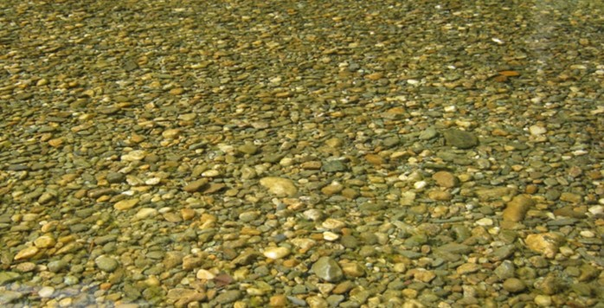
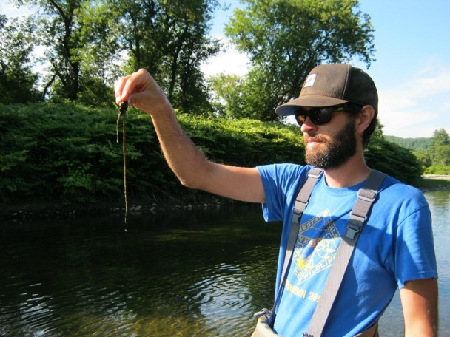
Pebble Count
Estimated riffle substrate composition using a modified pebble count. Approximately 100 randomly-selected substrate particles were examined in each reach.
METHODS
Rapid Periphyton Assessment
Estimated algal cover (moss & macro-algae cover, micro-algae thickness) in conjunction with pebble counts.

Slide 21
Analyses
ANOVA
One-way: differences between mean values of the three “Event” groups (pre/Irene/post)
Two-way: interactions between “Event” and “Type” (SHG, MHG, WWMG)
p-values <0.1 were interpreted as indicating significant association
Interpret with caution: small sample size and non-random site selection
Scatterplots
Visualize temporal patterns and year-to-year variability
Separate sets of plots for each stream type (SHG, MHG, WWMG)
Included all samples collected from 2000 to 2015
Non-metric multidimensional scaling (NMS) ordinations
Look for changes in taxonomic composition associated with Irene
2009-2013 macroinvertebrate presence-absence & relative abundance data
METHODS

Slide 22
Macroinvertebrate Density
Showed the most consistent, noticeable change in 2011 (Irene), with mean values decreasing strongly. Densities rebounded the following year.
RESULTS
Density reduction was most evident at the SHG and MHG sites, which, on average, received the greatest amount of rainfall during Irene.
Notes:
high variability of the density metric, as evidenced by the large SD
The density reductions are consistent with results from other studies, in which floods resulted in initial reduction in densities followed by a rebound in numbers within weeks to months (Scrimgeour and Winterbourn 1989, Lake 2000, Robinson et al. 2003, Suren and Jowett 2006).

Slide 23
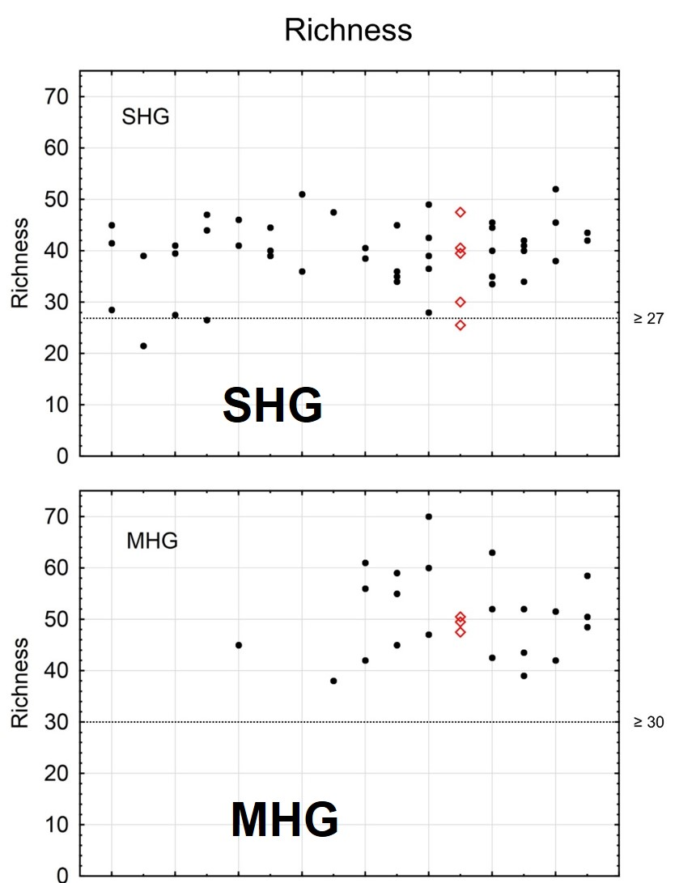
Total Taxa Richness
Did not show a significant association with “Event” but mean values did decrease in all three stream types in 2011.
Largest reduction in mean richness occurred at the MHG sites, and were slower to rebound to pre-Irene levels.
Reduced richness was likely driven in part by the reduced densities (with fewer organisms in the samples, there are likely to be fewer taxa).
The dramatic decrease in densities but not richness metrics suggests that the scouring flows were not selective in eliminating certain types of taxa or functional feeding groups.
Many taxa were likely able to find refugia in sheltered microhabitats, and some likely drifted in from upstream tributaries.
RESULTS
Notes:
Total stream power (or total energy available to scour substrate) and substrate mobility may have influenced the degree of impact as well, given the high-gradient channel type. MHG sites may be more prone to scour. However, stream power is difficult to accurately predict (and generalize across stream types) due to site-specific factors such as slope and discharge

Slide 24
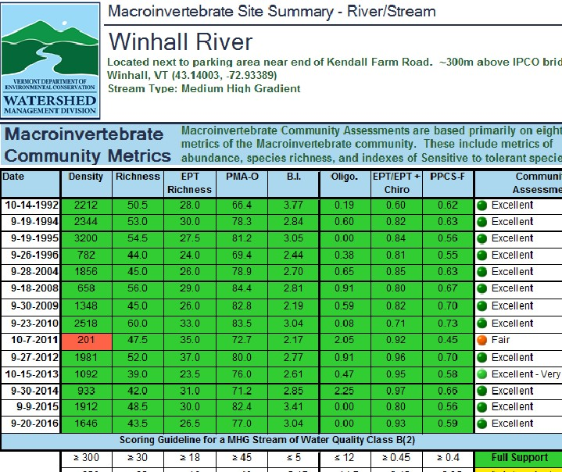
Bioassessment Scores
At five of the SHG and MHG sites, densities in 2011 were below the VT DEC’s biocriteria density threshold of 300 organisms per square meter, which lowered macroinvertebrate biocriteria scores at those sites.
Dquick to rebound the following yearsensities were.
RESULTS

Slide 25
NMDS Ordination
Taxonomic composition most strongly driven by variables related to stream type
Some of the 2011 samples were distinctively further from the non-Irene samples in ordination space (suggesting that shifts in taxonomic composition may have occurred in association with Irene)
Fair amount of inter-year compositional change at the sites unrelated to TS Irene
RESULTS
Orthogonal, two-axis solution
Notes:
The 2011 (TS Irene) samples at East Branch North, Lewis, Smith, Winhall, Nulhegan and Kidder were distinctively further from the non-TS Irene samples in ordination space (suggesting that shifts in taxonomic composition may have occurred in association with TS Irene)
For example, sites like Smith and Ranch are quite different taxonomically, with Smith having high numbers of Peltoperlidae (stoneflies) and shredders, whereas Ranch is comprised of greater numbers of mayfly taxa. We also performed an ordination on relative abundance data (using the same methods) and found similar results

Slide 26
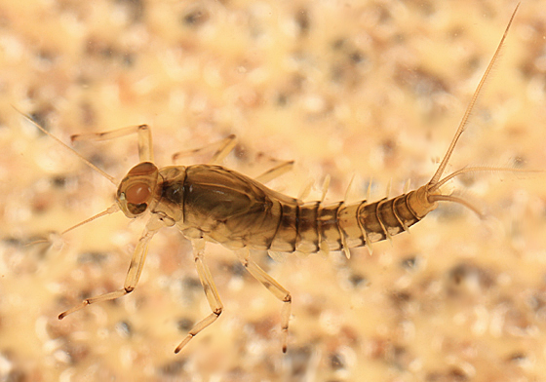
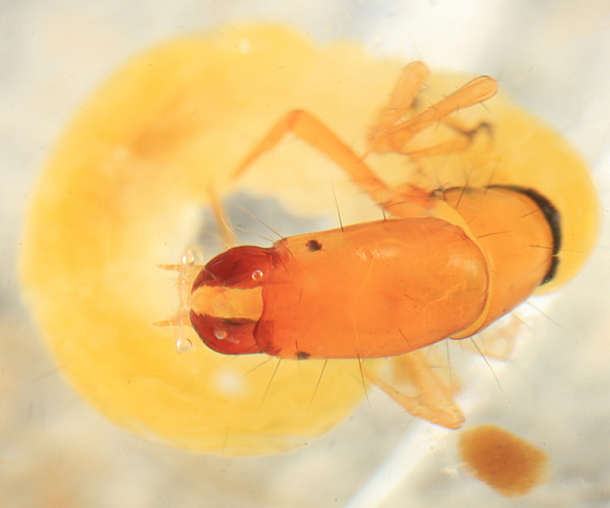
Individual Response Patterns
At some sites, such as Kidder and Bingo, Baetis tricaudatus complex made a rapid recovery following the flood, increasing in relative abundance compared to the two years prior to TS Irene.
RESULTS
Dolophilodes (a common but intolerant filter-feeding caddisfly that attaches to the underside of cobble/boulder substrate) was absent or decreased in relative abundance at 6 of the 7 SHG and MHG sites in 2011 when compared to pre-Irene levels, and in several streams the population did not fully rebound within the two years following the flood.
Notes:
-Individual taxa: Richness and Proportions maintained, but community members same?
-YES; communities mostly the same at lower abundance
-Couple exceptions;
-SHG; B. tricaudatus
-MHG; Dolophilodes sp
-WWMG; no generalizable pattern, not affected as much
-Further stat analysis (ordination?) to see other patterns

Slide 27
Substrate & Periphyton
Data were variable from year to year and statistically non-significant.
Substrate:
Some patterns did emerge with sand and gravel that were likely related to mobilization of substrates during the high flows associated with TS Irene (and likely contributed to reductions in macroinvertebrate densities and periphyton cover).
Results suggest that some substrates moved during the high flows associated with TS Irene, and may have been replaced by similar-sized particles from upstream (thus not significantly changing overall substrate composition). However, we have no way of formally testing this theory.
Periphyton:
Overall decrease in moss or periphyton cover in 2011, potentially due to scour. This pattern was most evident with micro-algae at MHG sites.
Our sites were ‘reference’ streams with low nutrient concentrations and low periphyton cover. If comparable data had been available for nutrient enriched sites with higher periphyton cover, we believe a scouring effect would have been more evident.
RESULTS
Notes:
Other types of assessments, such as comprehensive geomorphic surveys, may be better suited to document habitat changes resulting from high flow events. These would not have to be completed annually; rather they could be performed periodically (e.g., once every five years.

Slide 28

QUESTIONS? COMMENTS?
Jen Stamp (Jen.Stamp@tetratech.com)
Aaron Moore (Aaron.Moore@vermont.gov)
Steve Fiske (Steve.Fiske@vermont.gov)

