Slide 1
Cold sensitivity of American elm
bred for enhanced tolerance
to Dutch elm disease
Paul Schaberg
Gary Hawley
Paula Murakami
Christopher Hansen
Christian Marks
Jim Slavicek

Slide 2
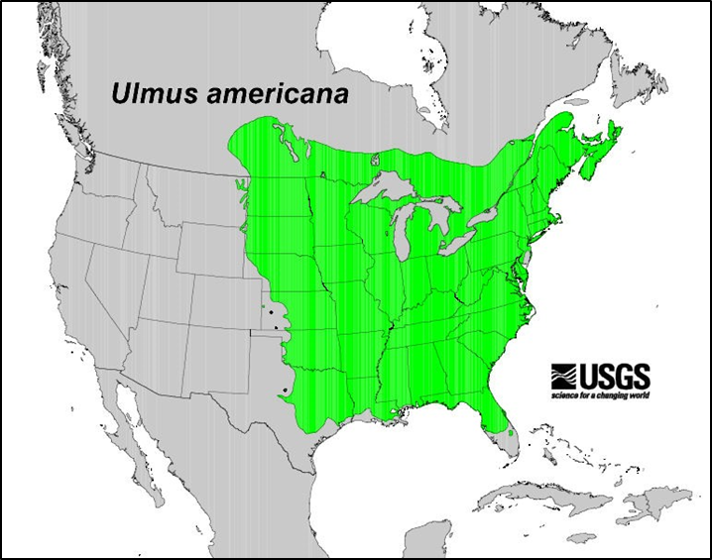
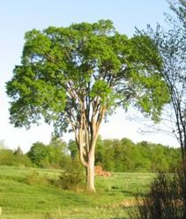
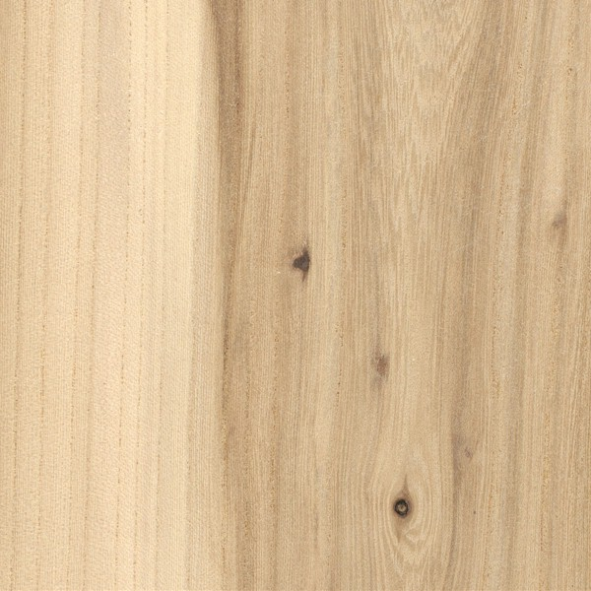
American Elm (Ulmus americana)
Important component of floodplain and riparian forests
Vast range with varied species assemblages
Support range of ecosystem services – carbon sequestration, water and nutrient cycling, wildlife habitat, etc.
Wood – strong interlocking grain, furniture, flooring, boxes, baskets, hockey sticks, wood pulp, paper, etc.
Photo courtesy of Jim Slavicek, USDA
https://www.wood-database.com/american-elm

Slide 3
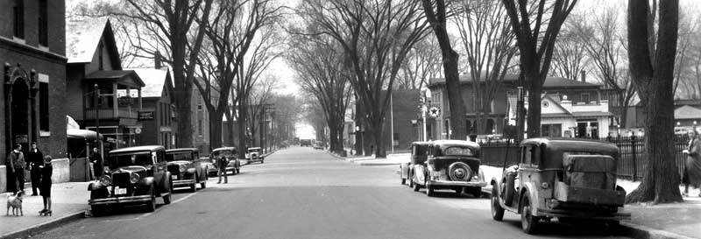
Urban Forests
Distinct vase-shaped crown
High tolerance to salt and other stresses
The most common urban tree in North America
Until drastic population declines associated with…
Looking west toward Lake Champlain at intersection of Pearl St. and Church St. in 1934
Photo by Louis L. McAllister, http://www.uvm.edu/~hp206/2006/Mardorf/WEB/Pearl5.html

Slide 4
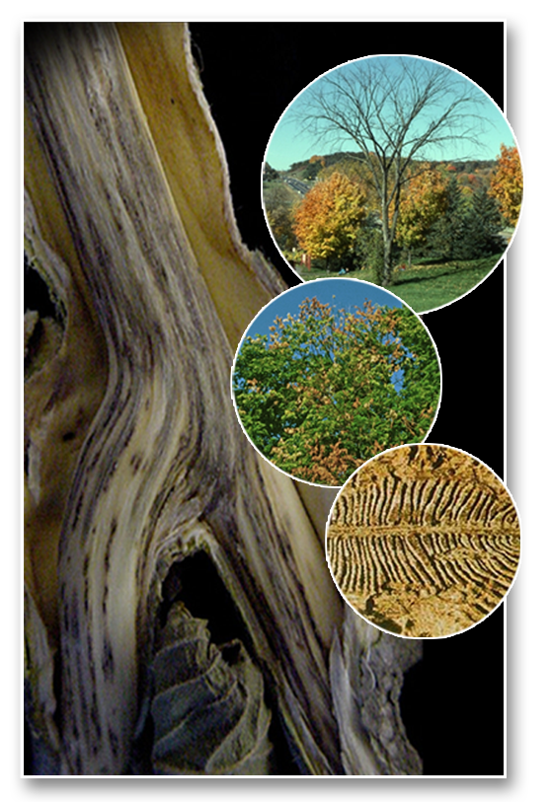
Dutch Elm Disease (DED)
Vascular wilt disease caused by fungal pathogens
Ophiostoma ulmi and Ophiostoma novo-ulmi
Spread by native and European bark beetles
Beetles burrow into stem carrying spores
Fungi grow and spread in vasculature
Clogs xylem - restricts water transport
Leaf desiccation
Branch dieback
Crown deterioration and tree death

Slide 5
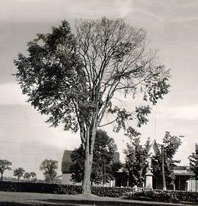
Dutch Elm Disease (DED)
Non-native of Asian origin
First reported in US in 1928
Fungi in veneer logs
Initial quarantine
Slow spread up until WWII
Rapid spread in 1950s-1970s
By 1989 >75% of estimated 77 million elms in North America killed

Slide 6
DED Control
Mechanical – pruning and burning
Chemical
- insecticides for beetle control
- pheromones to lure/trap beetles
- fungicides (e.g., Arbotect and Alamo)
Biological – vaccination with weakened Verticillium
albo-atrum to bolster immune response
Breeding for DED tolerance
- Hybrids with Asian elms resistant to DED
- Selection for DED-tolerant American elm
- ± 25 cultivars, but not much genetic diversity
for restoration across broad range

Slide 7
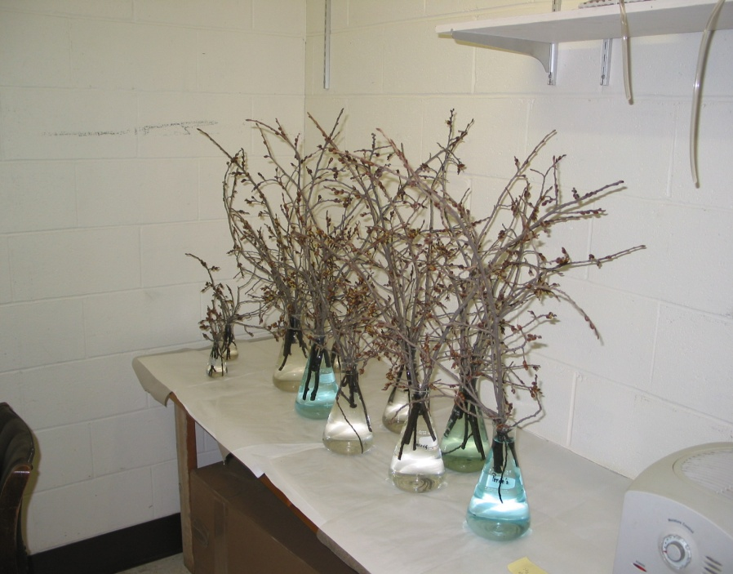
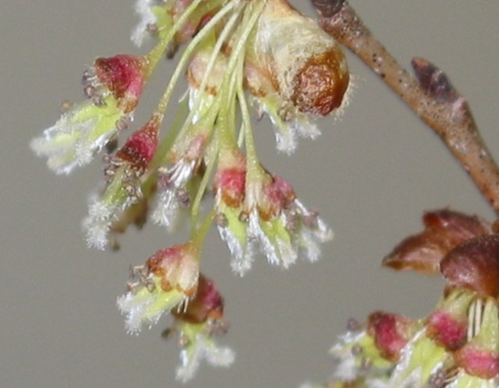
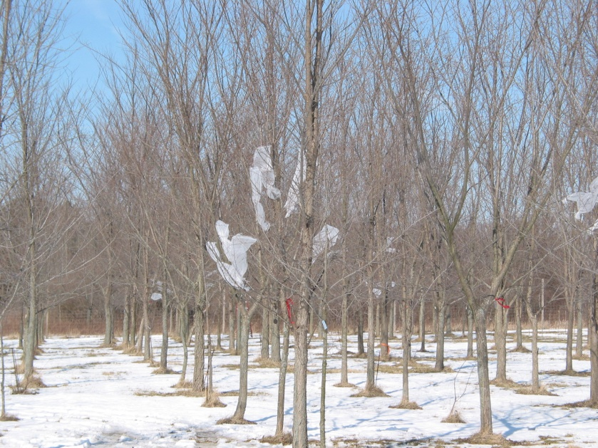
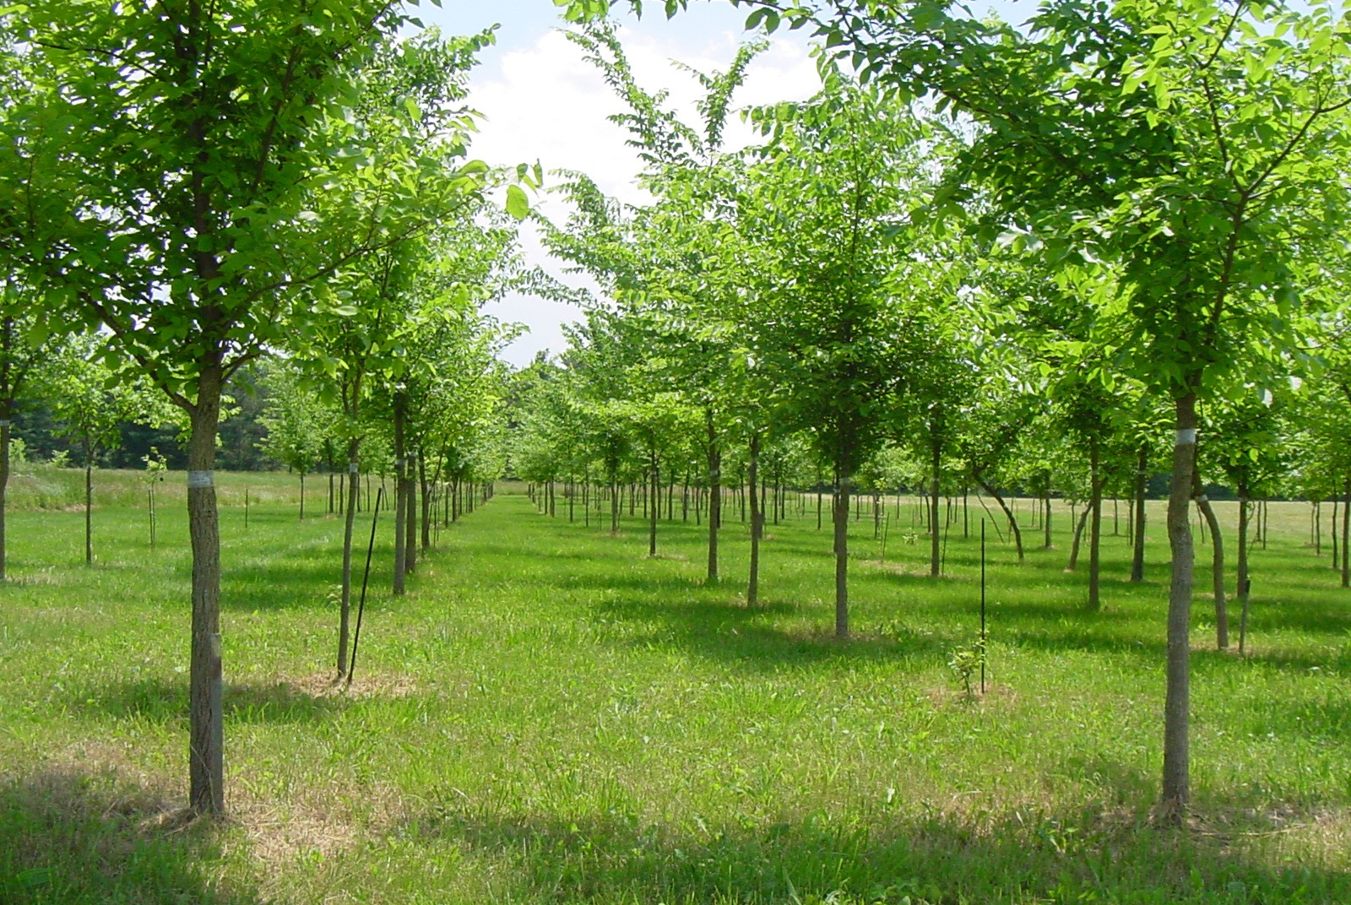
US Forest Service NRS / TNC Partnership
Cross DED tolerant American elm cultivars
Large survivor elms from many locations
Test for DED-tolerance and local adaptation
Sam Burr Elm, Vermont, USA

Slide 8
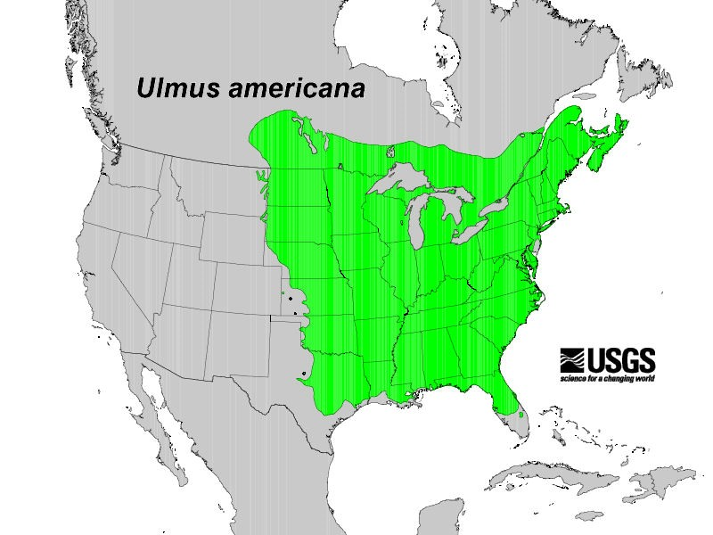
Local adaptation?
Wide range of conditions:
- temperatures
- water regimes
- soils
- vegetative communities
- etc.

Slide 9
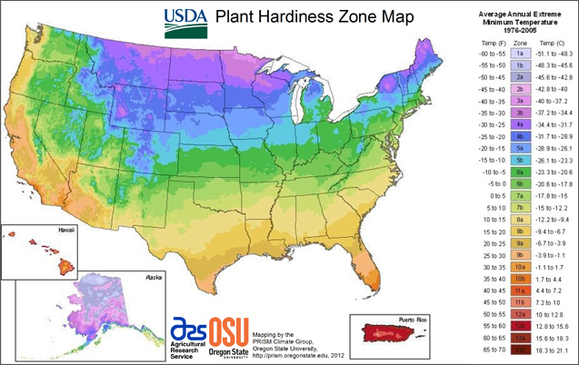
Winter cold
Range from Zone 9b (-1 °C)
to Zone 2b (-43 °C)

Slide 10
Cold hardiness of northern restoration stock?
Shoot cold tolerance
- Controlled laboratory freezing tests
Genetic crosses
-Maternal - DED-tolerance
- Paternal - different USDA Plant Hardiness Zones
Variation across seasons
- fall, winter and spring
Field freezing injury
- laboratory measures help resolve differences among
sources and seasons but may overestimate tolerance

Slide 11
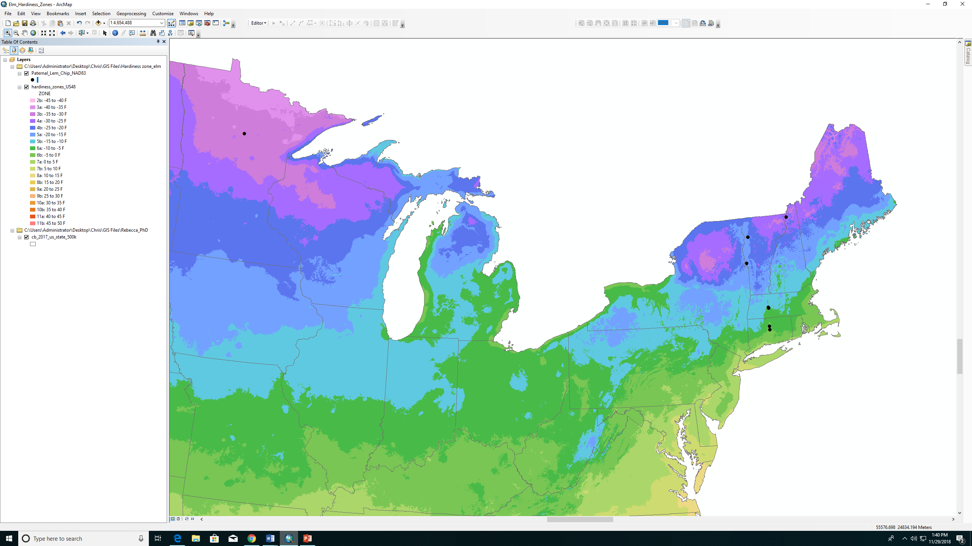
Plant Material
Maternal sources – Valley Forge and R18-2
Paternal sources – large surviving elms in zones 6b, 6a, 5a
Field site - Lemington, VT zone 3b
Chippewa National Forest, MN zone 3a

Slide 12
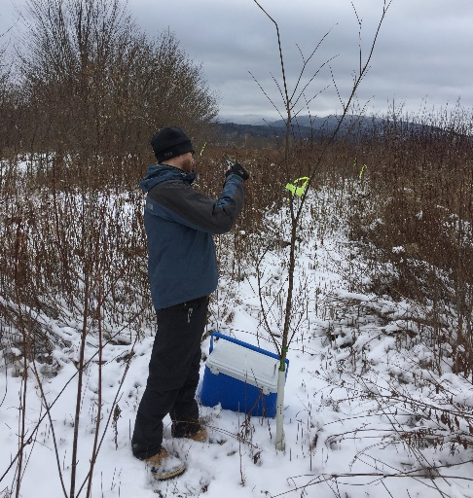
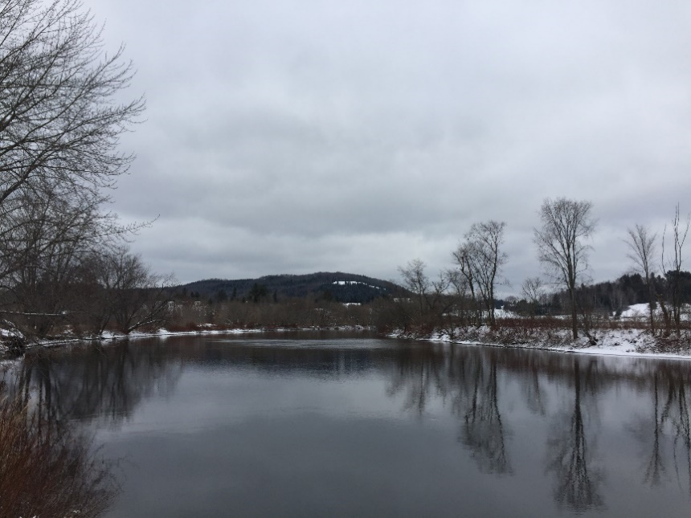
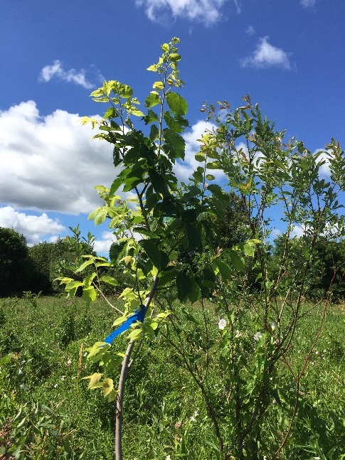
Field collection
Field site Lemington, VT (zone 3b)
Planted in 2014
Current-year shoots harvested December 2016, February and April 2017
Field winter injury assessed in July 2017

Slide 13
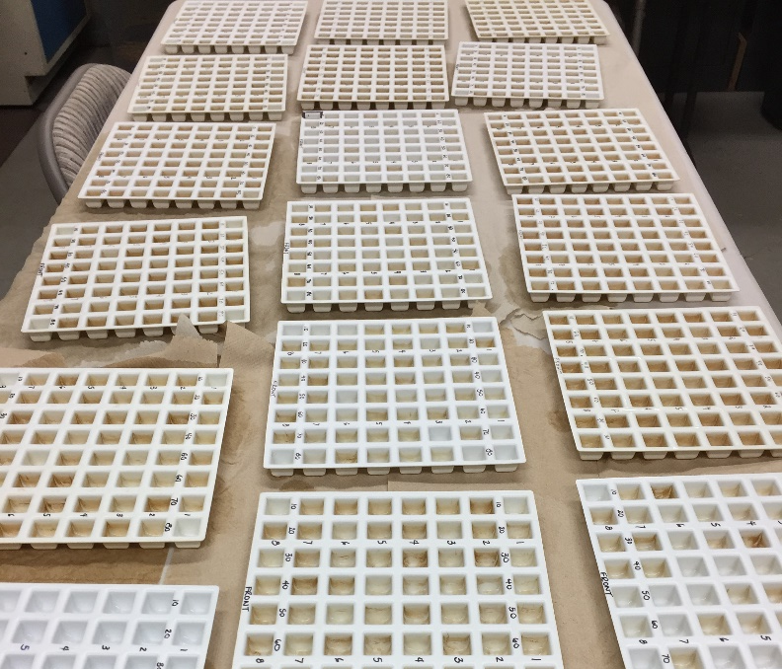
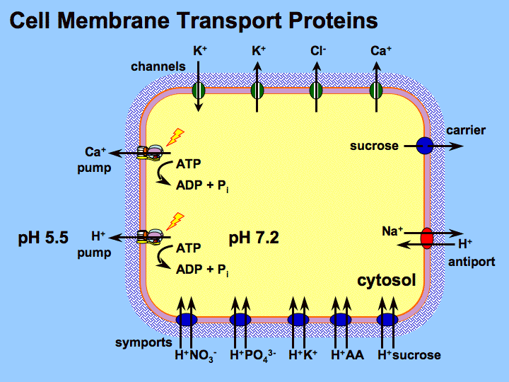
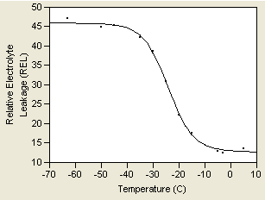
Laboratory Cold Tolerance
Shoots chopped into 5-mm segments
15-17 test temperatures - from +5°C to –90°C
Damage = ↑Relative Electrolyte Leakage (REL)
K+
Tm

Slide 14
Parental sources – all dates combined
ab
a
b

Slide 15
Cold tolerance results
D
Δ mean cold tolerance between 5a and 6a sources was ± 5.5 °C –
the average Δ in low temperatures for these zones
a
b
ab

Slide 16
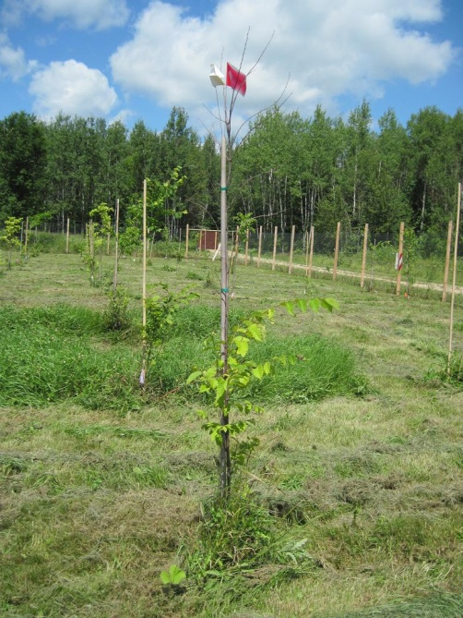
Field winter injury
Winter temperatures dropped to -28.3 °C
Over 83% of trees sampled experienced shoot freezing injury
Chippewa National Forest, MN

Slide 17
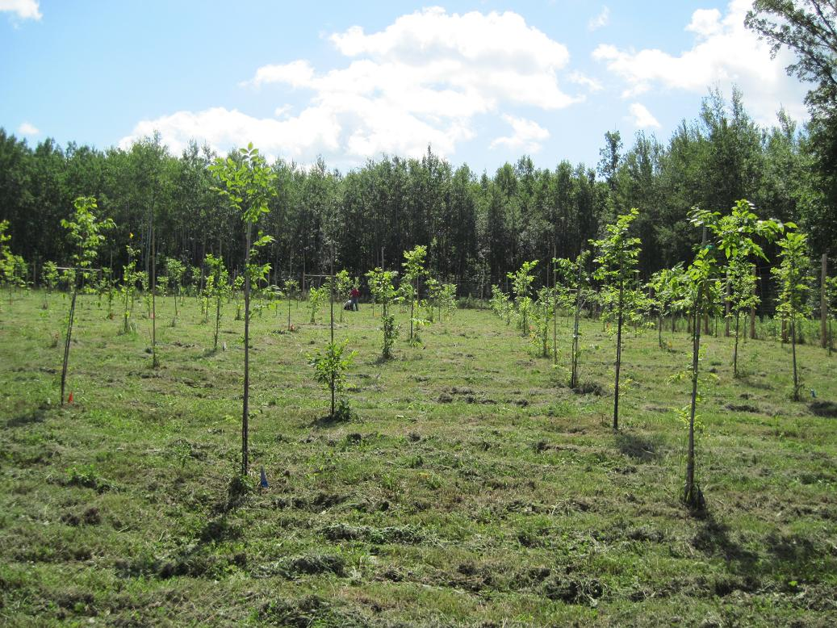
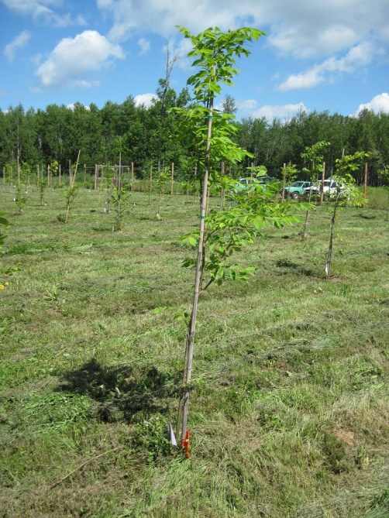
Implications
Shoot freezing injury is an issue for American elm in the north
Source Hardiness Zone a good predictor of elm shoot cold tolerance
Breed and plant sources from the local Hardiness Zone or lower
Restoration of American elm on Chippewa National Forest in Minnesota

Slide 18
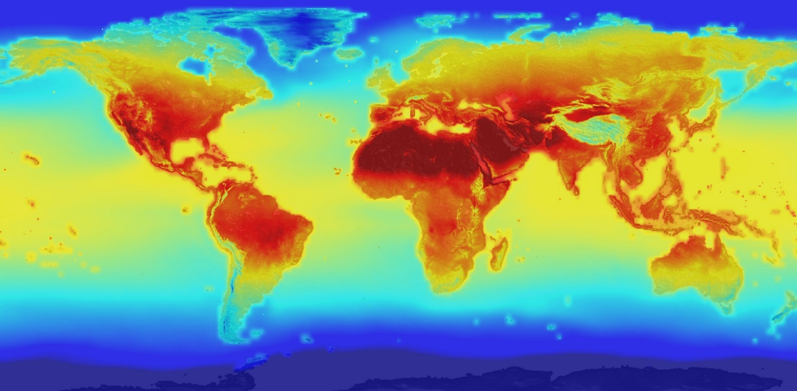
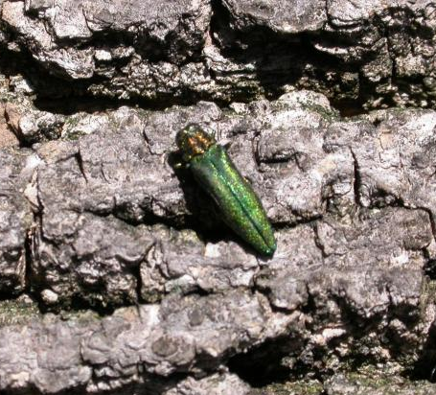
Elm Restoration and Emerging Threats
Climate change – northern populations possible migration front as climate warms
Emerald ash borer (EAB) is killing ash in region
- Decreasing diversity in riparian and floodplain forests
- Ash heavily planted in urban settings when DED killed elm
- DED-tolerant elm needed for ash replacement
https://www.nasa.gov/nasa-global-climate-change-projections
https://vtinvasives.org/invasive/emerald-ash-borer

Slide 19
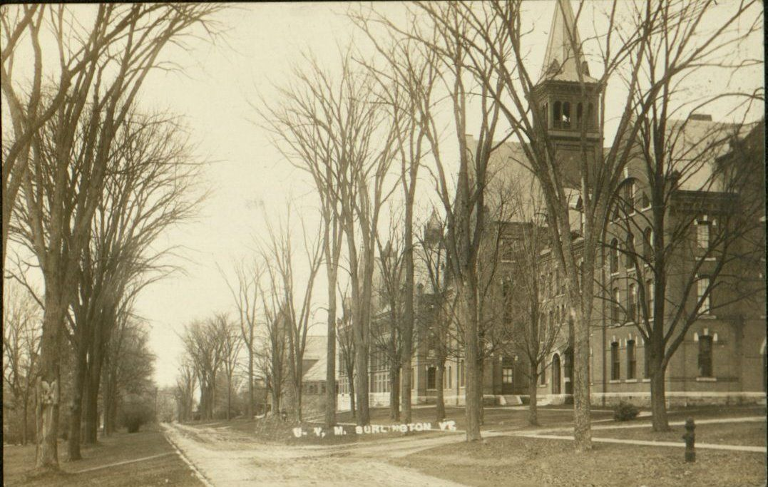
Questions-
“American elm - Dutch elm disease,” Omeka@CTL, accessed November 16, 2018, http://ctl.w3.uvm.edu/omeka/items/show/1236.
Looking north on University Place in 1825
http://www.uvm.edu/~hp206/2006/Zanavich/Web%20Pages/U4.html

