Slide 1
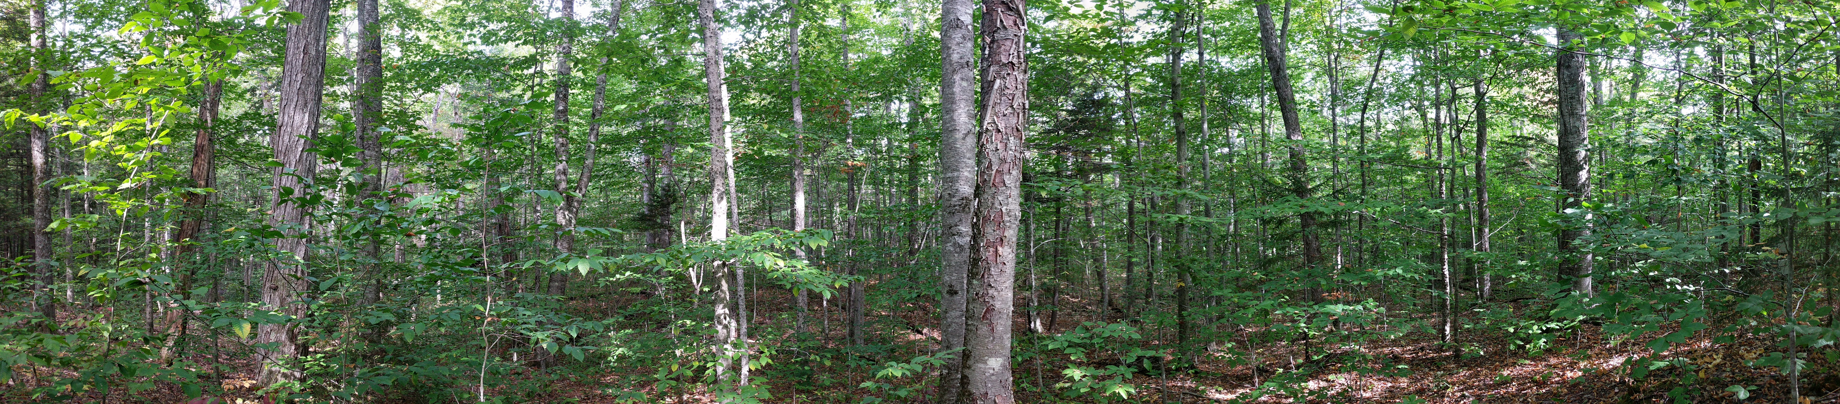
Tracking Trajectories and Sensitivities in Forest Water Use
Mark Green
Plymouth State University, Center for the Environment
US Forest Service, Northern Research Station

Slide 2
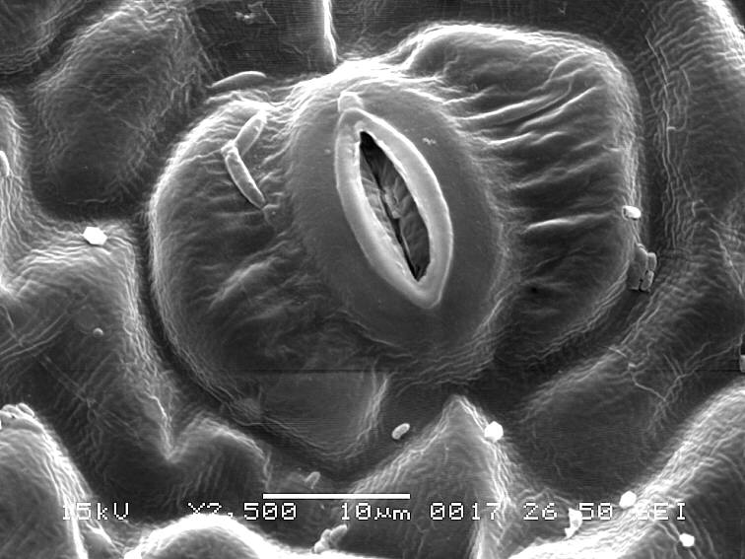
This is a stomate.
Paul-Robert Takacs, http://botablog2.unblog.fr/2012/07/11/toutes-les-plantes-respirent/

Slide 3
When open:
CO₂ diffuses in
H₂O diffuses out
Paul-Robert Takacs, http://botablog2.unblog.fr/2012/07/11/toutes-les-plantes-respirent/

Slide 4
When open:
CO₂ diffuses in
f(CO₂ conc.)
H₂O diffuses out
f(H₂O conc.)
Paul-Robert Takacs, http://botablog2.unblog.fr/2012/07/11/toutes-les-plantes-respirent/

Slide 5
Closes:
At night
Water stress
Photosynthesis stress
Paul-Robert Takacs, http://botablog2.unblog.fr/2012/07/11/toutes-les-plantes-respirent/

Slide 6
400 stomata per mm²
6 layers of leaves on average (LAI)
2.4 billion stomata per m²
Notes:
This is the view that most of our hydrologic forecasts

Slide 7
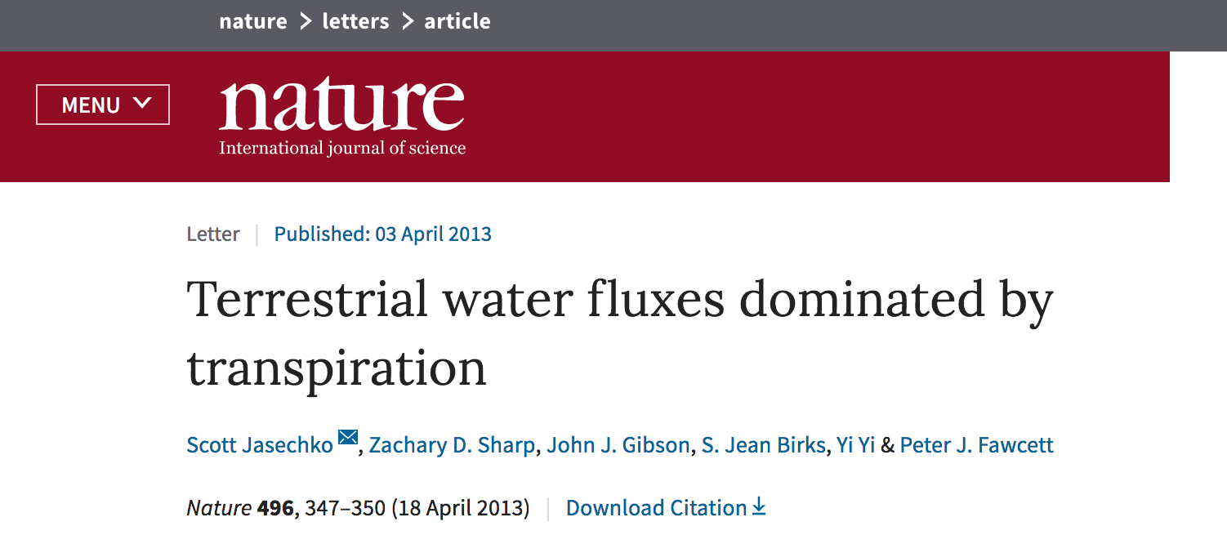
A vast majority of water vapor leaving land moves through stomata.

Slide 8
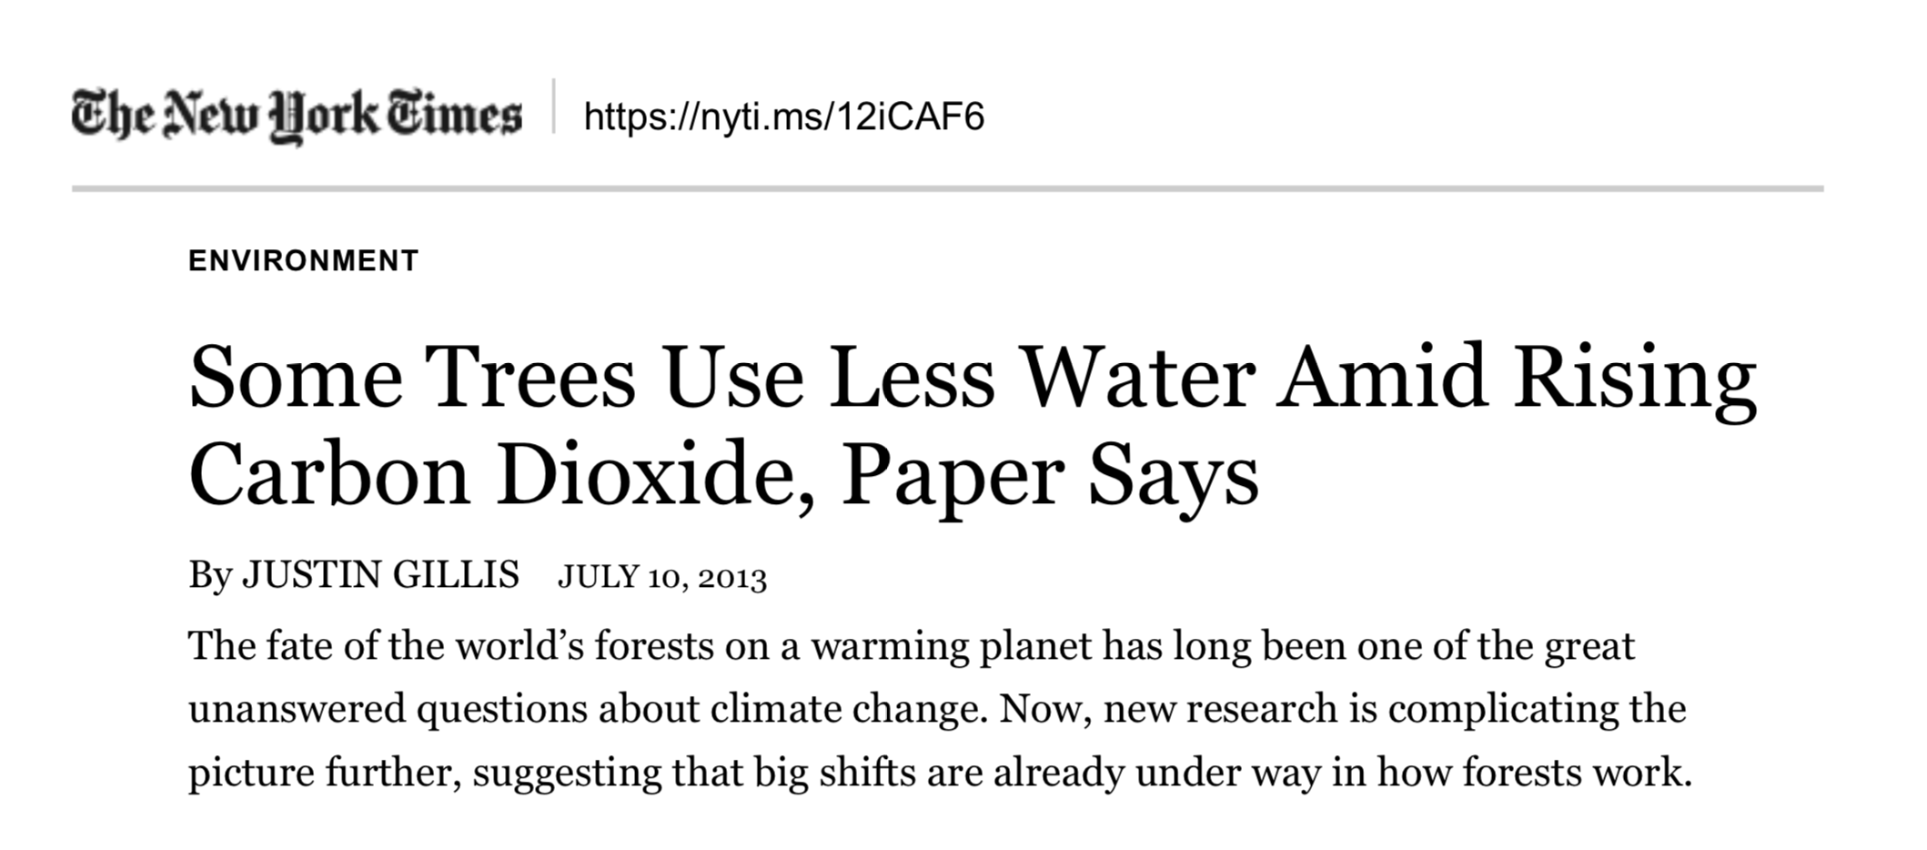
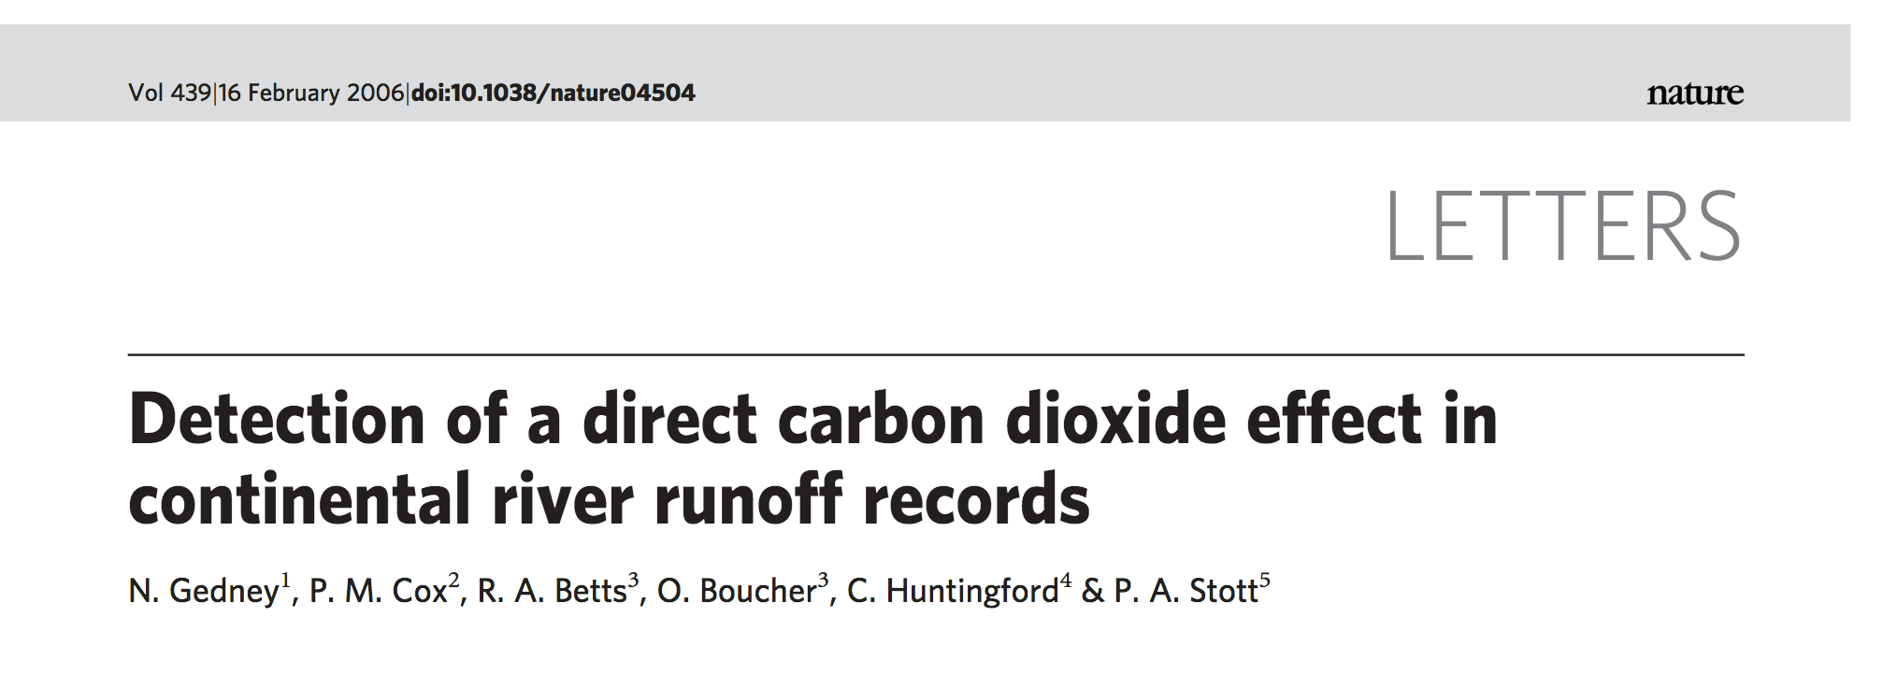
This micro-system has global importance.

Slide 9
Water vapor carries significant amounts of heat
Gosz et al. (1978)
The Flow of Energy in a
Forest Ecosystem
Notes:
Point: here is the past energy budget, and it doesn’t include the soil heat flux. G is super important because it determines the soil T.

Slide 10
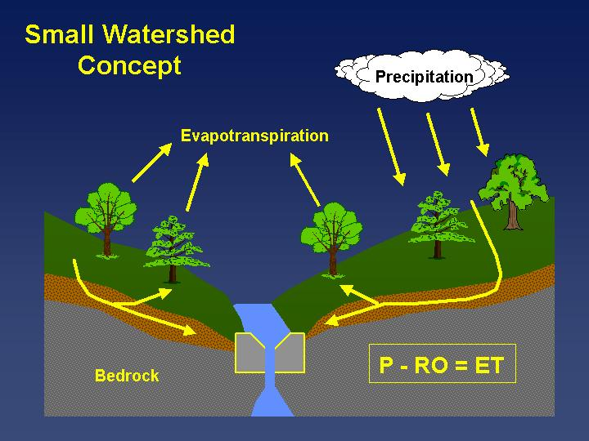

Slide 11
Evapotranspiration (ET) trends in the northeastern U.S.
Vadeboncoeur et al. (2018)

Slide 12
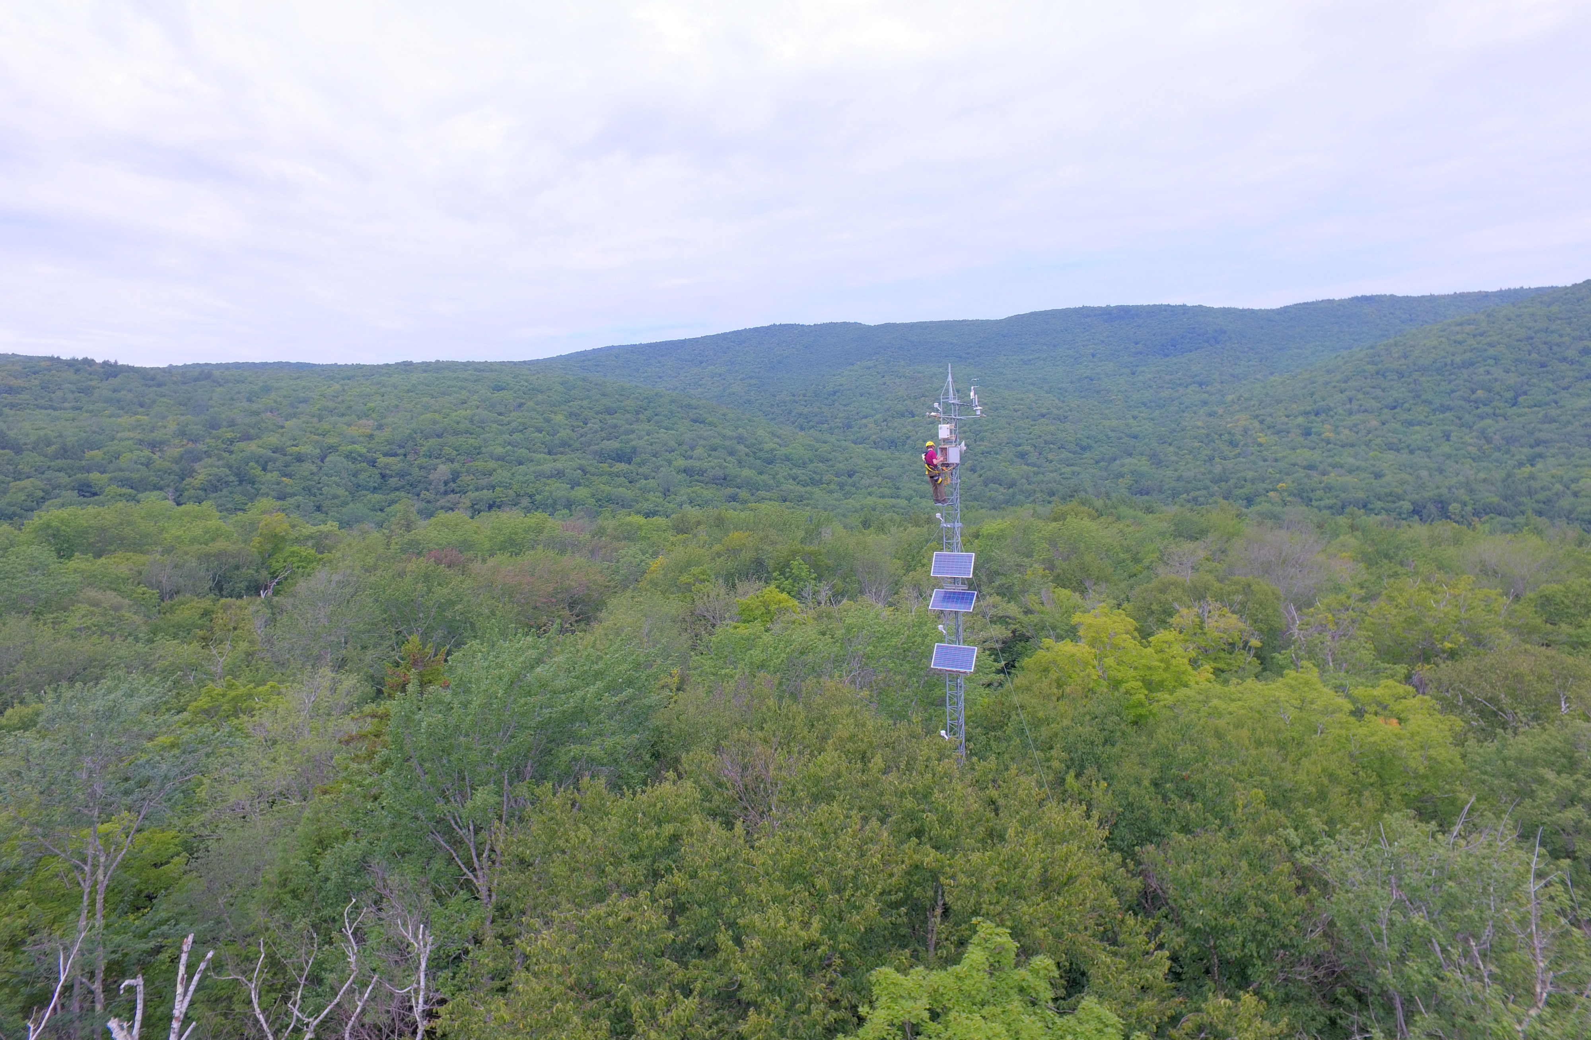
Regional flux towers can provide insights into what is driving these trends.

Slide 13
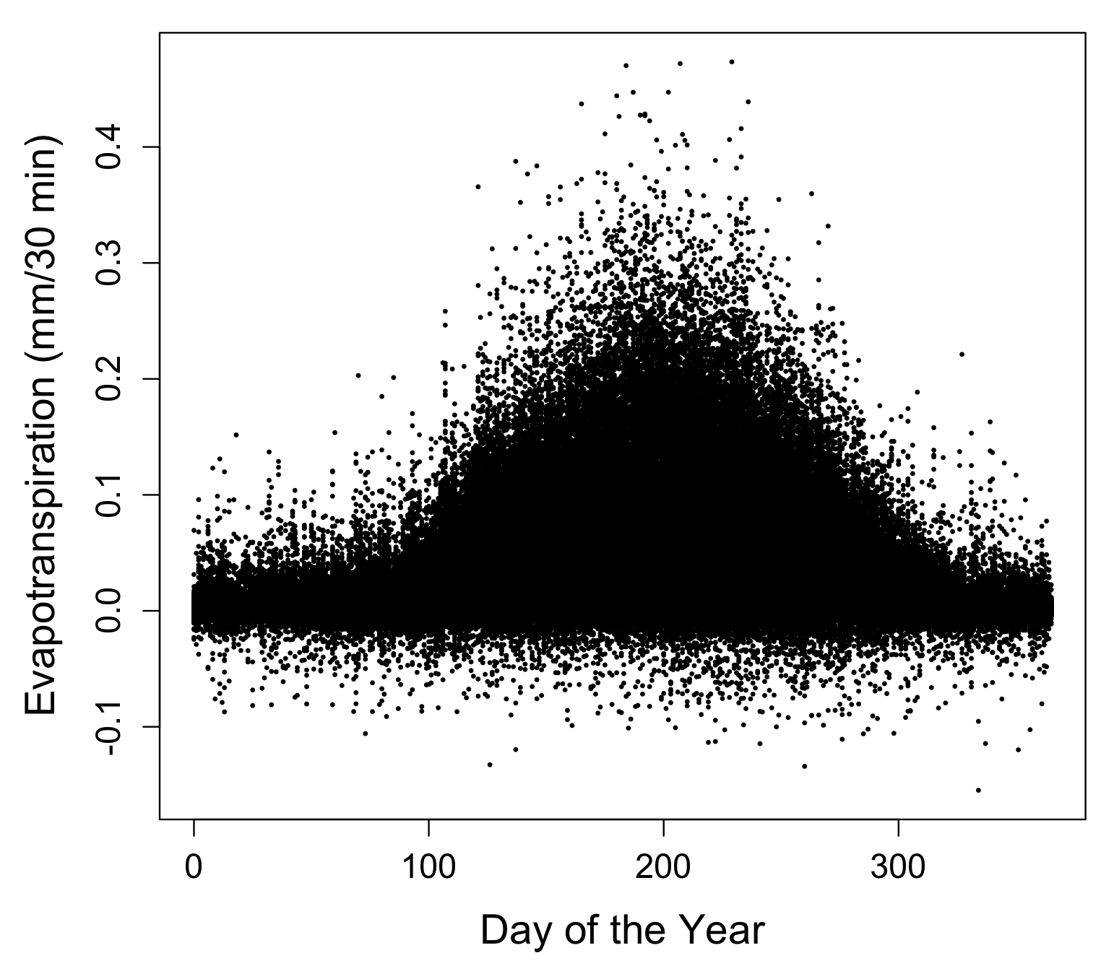
Seasonality of water use at Howland
Data courtesy of:
Dave Hollinger
Bob Evans
Holly Hughes
Shawn Fraver

Slide 14
Evapotranspiration
= f(photosynthesis, vapor pressure gradient)

Slide 15
Physical drivers show the tightest correlation with evapotranspiration.
Spearman Rank Corr. | Howland | Bartlett | Hubbard Brook
Net Radiation | 0.76 | 0.79 | 0.81
Vapor Pressure Deficit | 0.68 | 0.71 | 0.61
CO₂ Flux | -0.60 | -0.63 | -0.76
Air Temperature | 0.60 | 0.59 | 0.52
Wind | 0.35 | 0.36 | -0.02
Soil Water | 0.02 | 0.01 | 0.02

Slide 16
What if we experience a 1% change in these drivers?
% change in ET | Howland | Bartlett | Hubbard Brook
Net Radiation | 6.8% | 8.4% | 4.8%
Vapor Pressure Deficit | 4.3% | 4.0% | 3.6%
CO₂ Flux | 1.3% | 1.6% | 2.2%
Air Temperature | 2.0% | 2.5% | 1.4%

Slide 17
Take home points…
Colder, more energy-limited areas appear more prone to ET increases.
Flux tower data allow us to hone in on the most important drivers to explain regional trends.
Feedbacks in the forest-atmosphere system complicate identifying causes for ET changes.

Slide 18
Net Radiation
Temperature
Relative
Humidity
Photosynthesis
Evapotranspiration

Slide 19
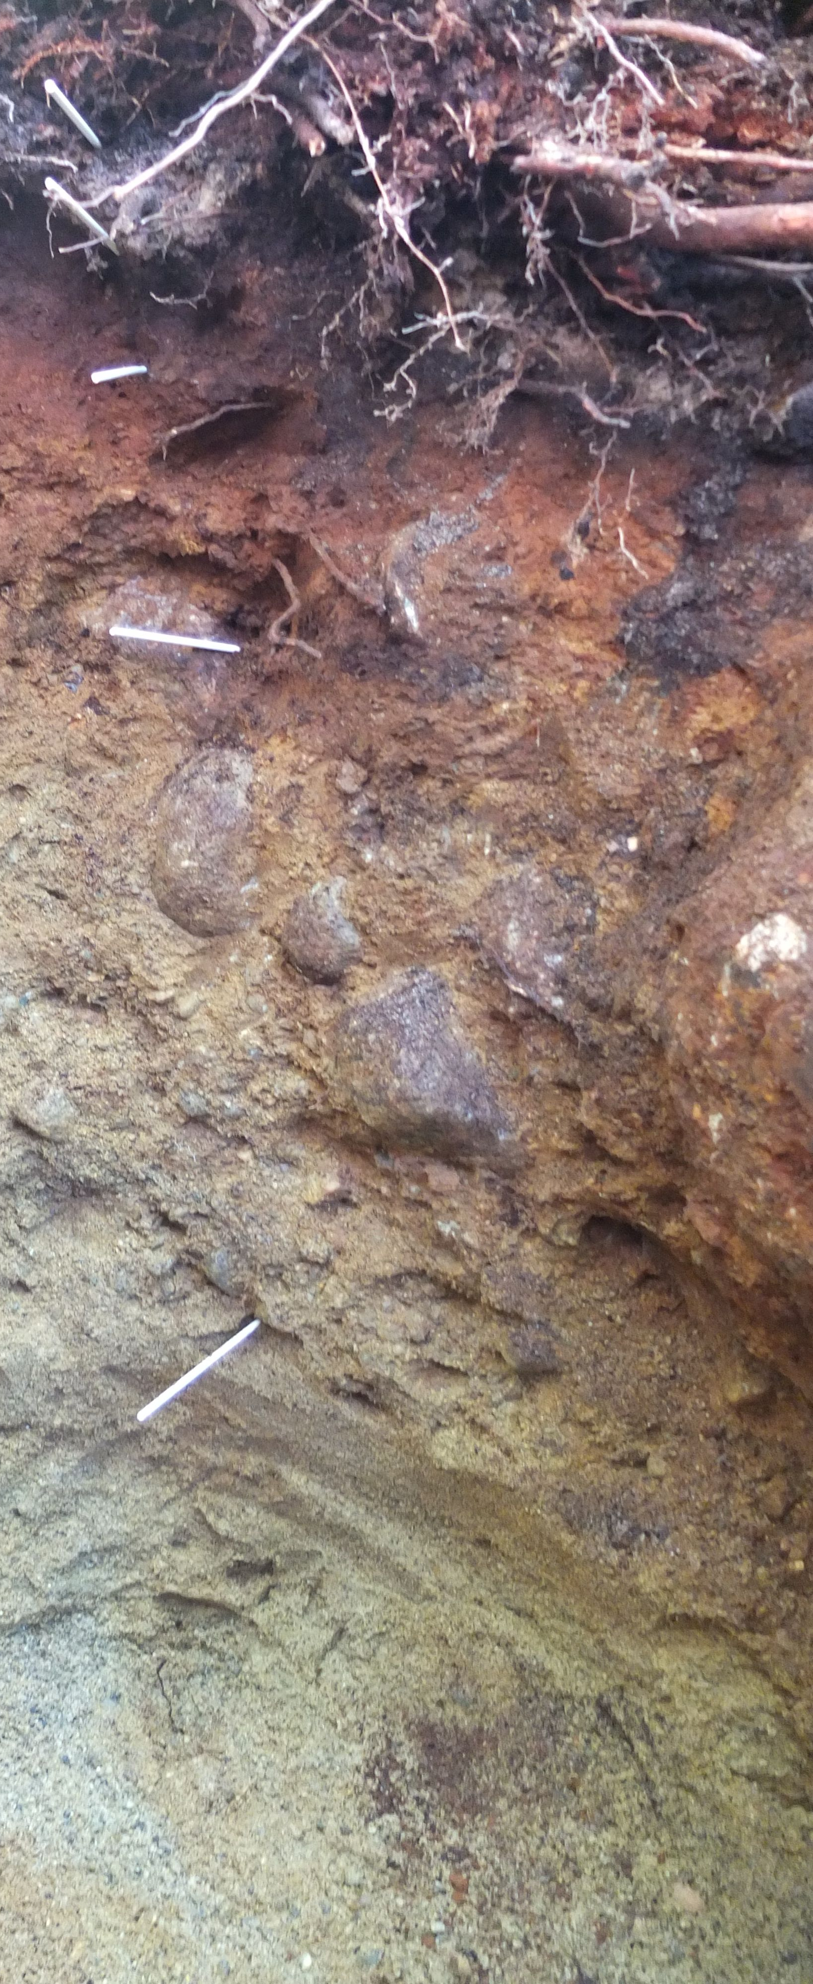
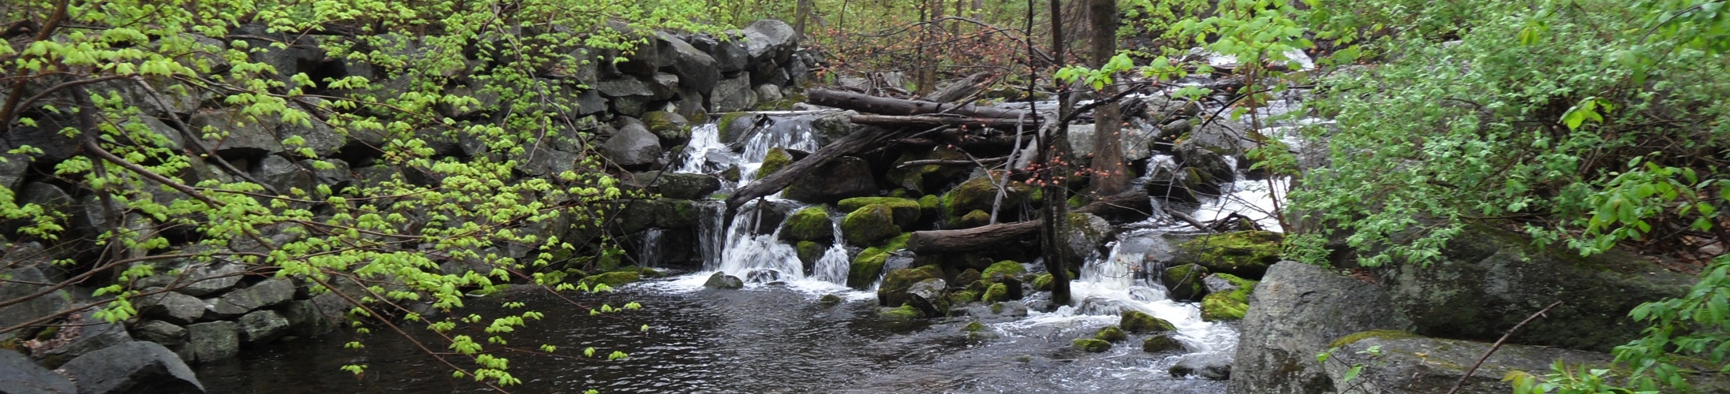
Photo from NH Division of Forests and Lands
Photo by Matt Betts

Slide 20
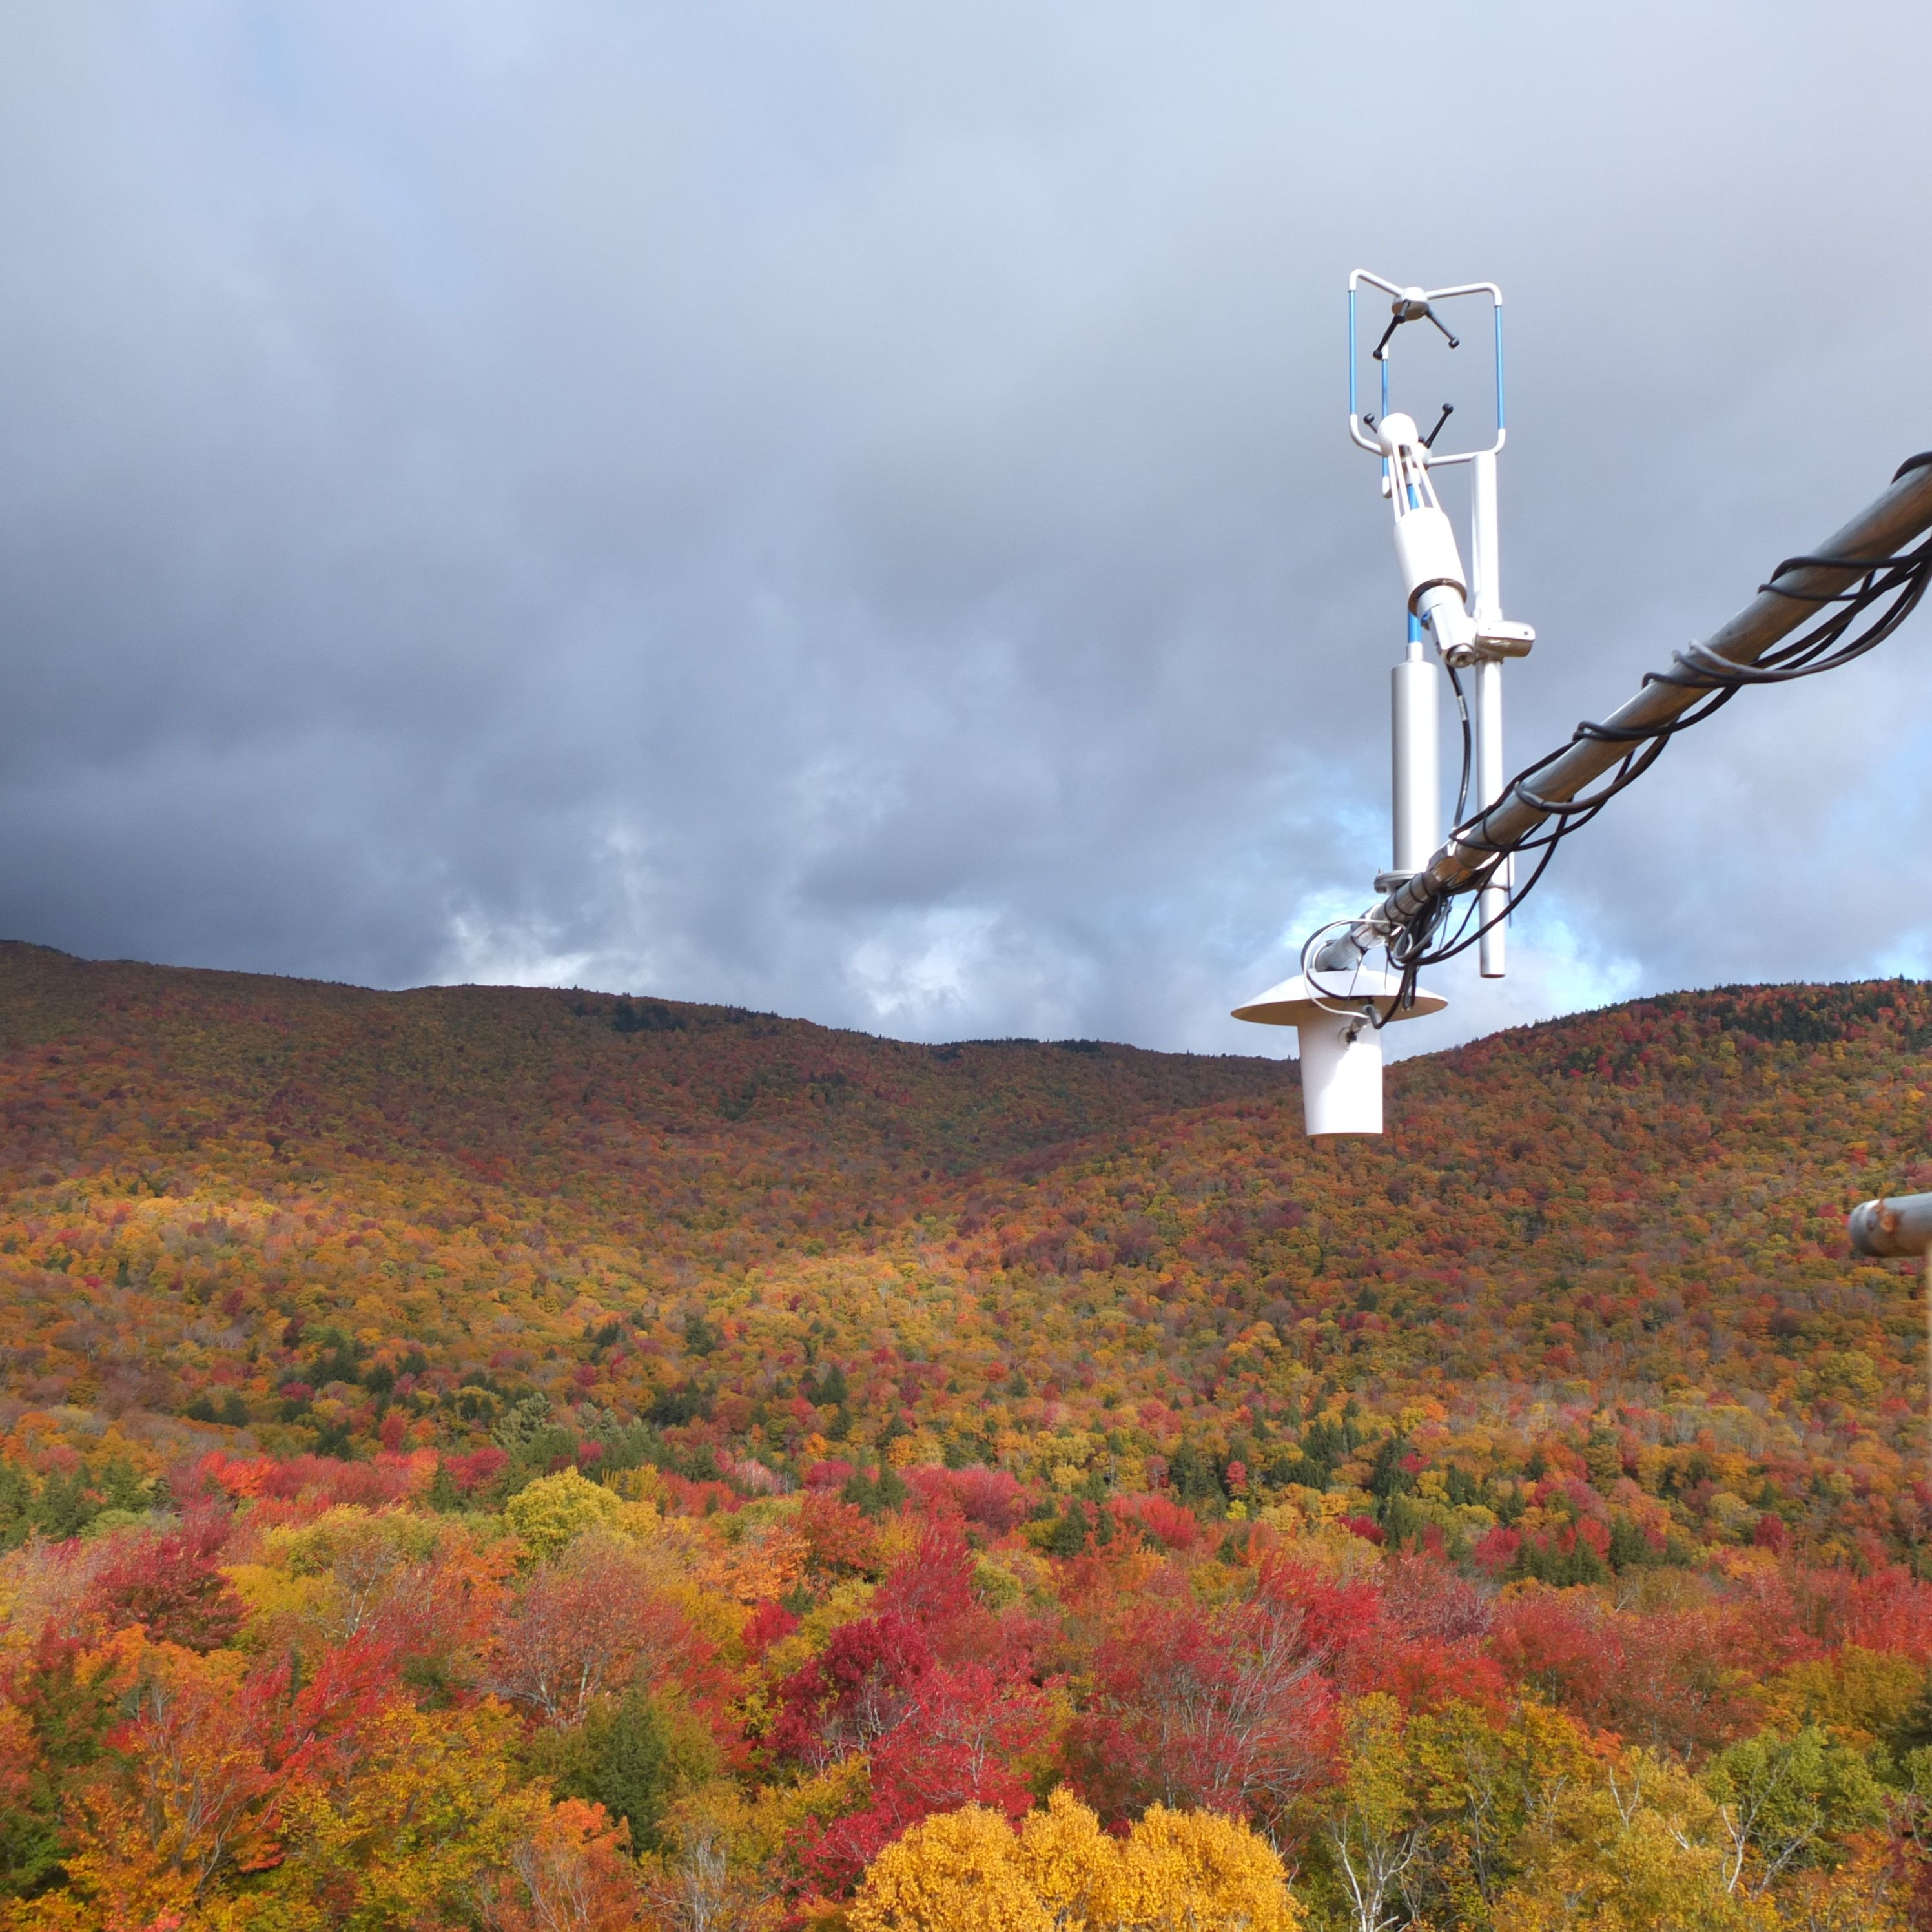






Acknowledgements
Matt Vadeboncoeur
John Campbell
Heidi Asbjornsen
Mary Beth Adams
Beth Boyer
Doug Burns
Ivan Fernandez
Myron Mitchell
Jamie Shanley
Dan Evans
Eric Kelsey
Frank Bowles
Dave Hollinger
Bob Evans
Shawn Fraver
Andrew Richardson

