Slide 1
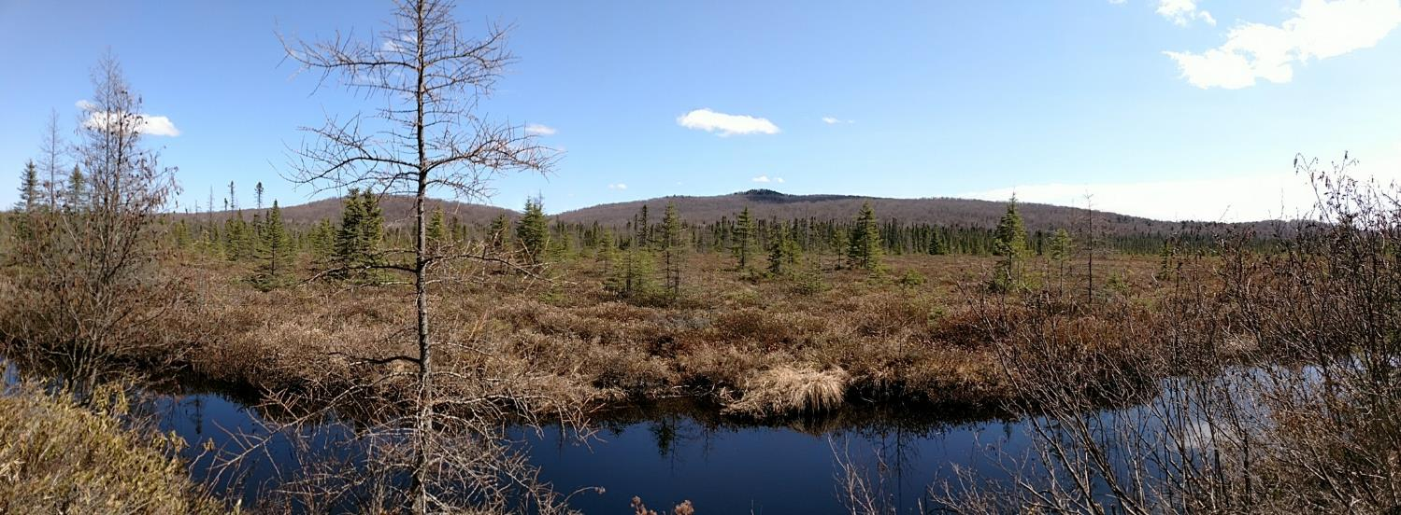



A Slow Loss of Northern Forest Icons:
Dynamics of Boreal Birds at the Edge of Their Range in the Adirondack Park
Michale Glennon
Paul Smith’s College
Adirondack Watershed Institute
Steve Langdon
Shingle Shanty Preserve and Research Station
Notes:
Intro – not much needed here, basically I just say I’ll describe the results of one of our long-running monitoring efforts in the Adks.

Slide 2
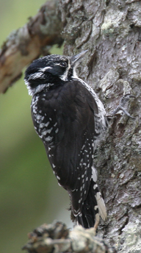
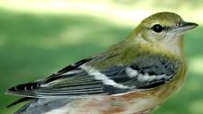
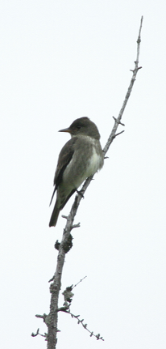
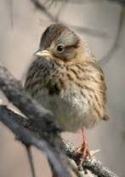
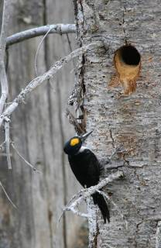
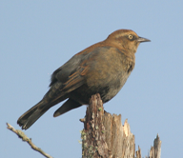
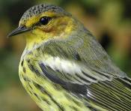
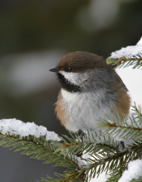
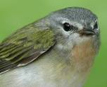
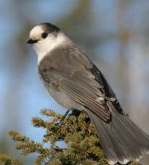
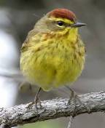
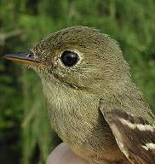
Target Species
Bay-breasted
warbler
Rusty blackbird
Three-toed
woodpecker
Lincoln’s sparrow
Cape May warbler
Olive-sided
flycatcher
Black-backed
woodpecker
Boreal
chickadee
Canada
jay
Tennessee warbler
Yellow-bellied
flycatcher
Palm warbler
Photos: J. Nadler, A. Dettling
Notes:
Only thing to point out here is that spruce grouse was on the list for political reasons (DEC wanted it there). We are not using the right methods to find spruce grouse. We leave that up to Angie.

Slide 3
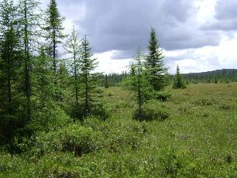
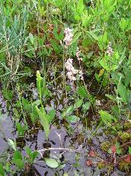
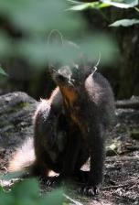
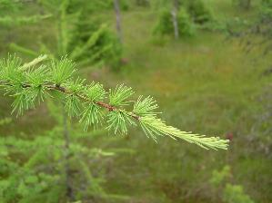
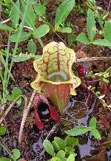
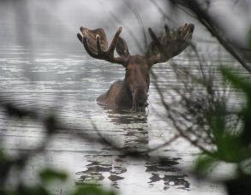
Boreal Habitats in the Adirondacks
Northern Peatland – Boreal-Laurentian Bog, Boreal-Laurentian Acadian Acidic Basin Fen
Northern Swamp – Laurentian-Acadian Alkaline Conifer-Hardwood Swamp, Laurentian-Acadian Large River Floodplain, Northern Appalachian-Acadian Conifer-Hardwood Acidic Swamp
Boreal Upland Forest – Acadian Low Elevation Spruce-Fir Hardwood Forest, Acadian Sub-boreal Spruce Flat

Slide 4
Findings: General Trends
Notes:
Update graph

Slide 5
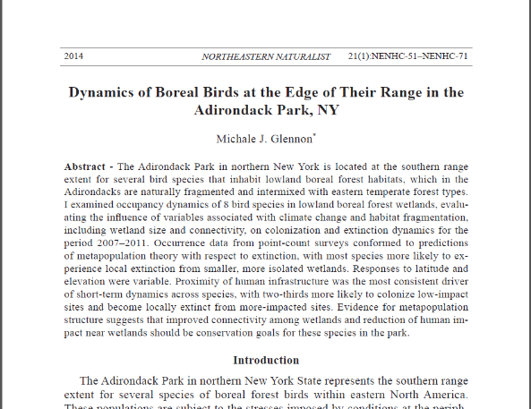
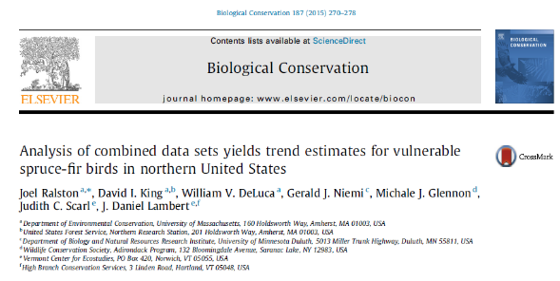
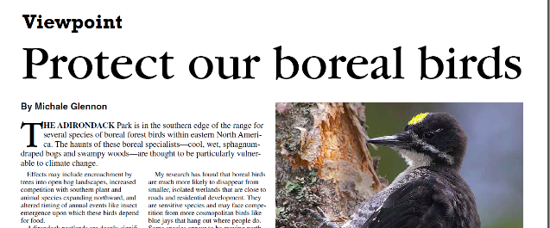
Findings: Drivers
Persistence higher in
  Larger, more connected wetlands
  Sites with low levels of human impact
Response to climate change?
  Not sure, but we were looking at proxy variables

Slide 6
What is the role of climate in influencing recent trends in boreal bird occupancy?
Can we identify refugia?
Notes:
Is there a difference in the rate and type of change in these communities that relates to their resilience?

Slide 7
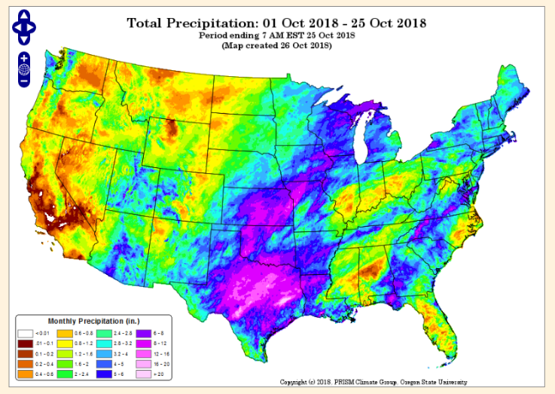

Climate
Mean, variability, extremes in
  Breeding and winter season temperature
  Breeding and winter season precipitation

Slide 8




Climate: Broad Patterns
Breeding Season Precip
Winter
Precip
Means vs Extremes
Breeding vs Winter
Breeding Season Temp
Temp vs Precip*
Colonization vs Persistence
Winter
Temp
Negative

Slide 9




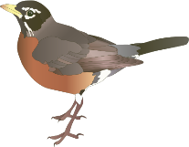
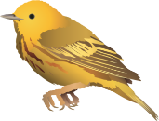
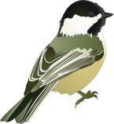
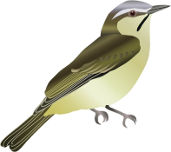

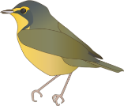

Trajectories of Change
Can we characterize the pace and type of change in these communities? Can we identify refugia?
Courtesy of ian.umces.edu
Notes:
Is there a difference in the rate and type of change in these communities that relates to their resilience?

Slide 10
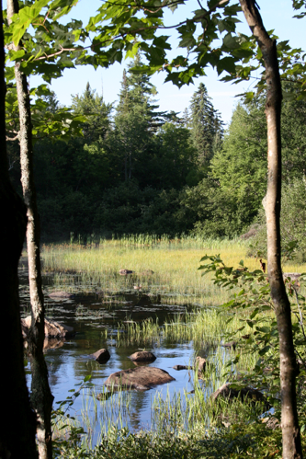
Community Level Change
  Boreal, forest interior, scrubland, Neotropical migrants, blackbirds, flycatchers, shrub nesters
  Forest generalists, insectivores, cavity nesters, southern species, commensals, species with widespread winter distribution

Slide 11
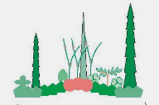
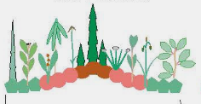
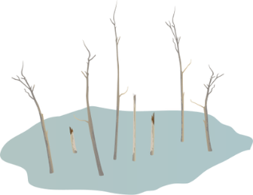
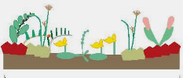
Can We Identify Refugia?
Competition
Habitat Type
Climate Stability
What distinguishes sites with high, medium, and low levels of extinction of boreal species?

Slide 12
Persistence of Boreal Species
Highest at
Sites with low colonization rates for commensal and southern species
Sites with lowest deviation from normal winter precipitation patterns
Sites dominated by Northern Peatland – large open bogs

Slide 13
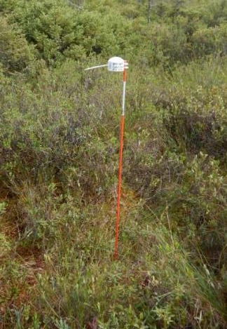
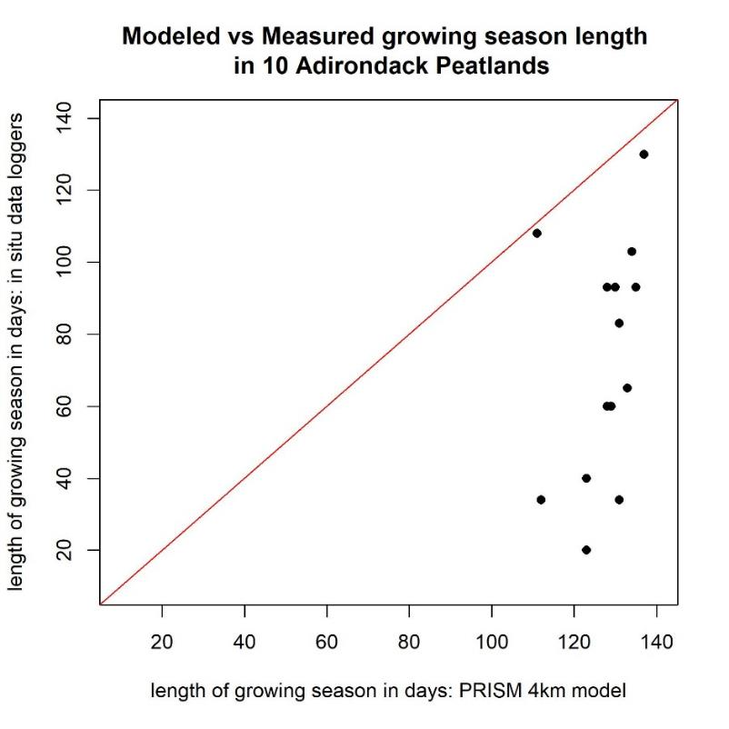
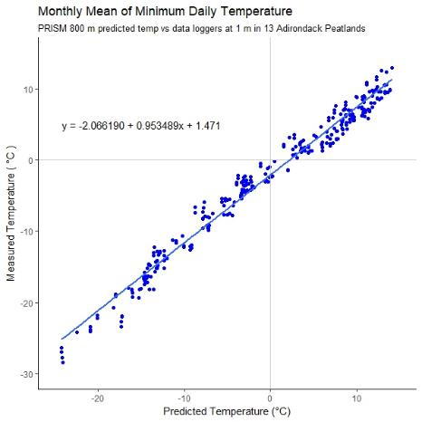
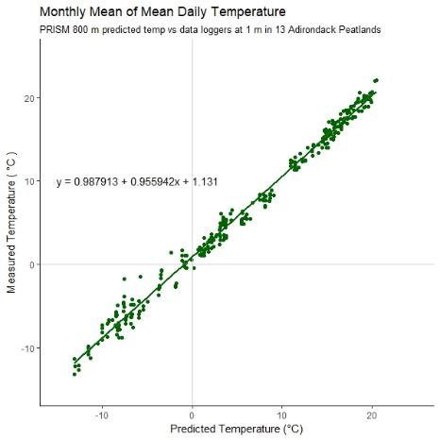
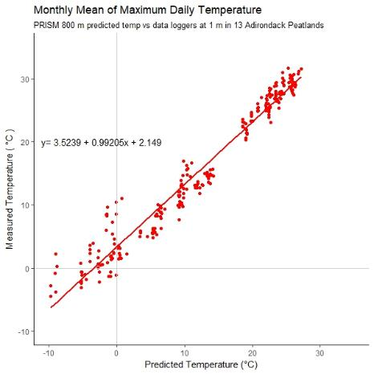
Climate: Caveat
Tmin is 2° C colder
Tmean is 1° C warmer
Tmax is 3.5° C warmer

Slide 14
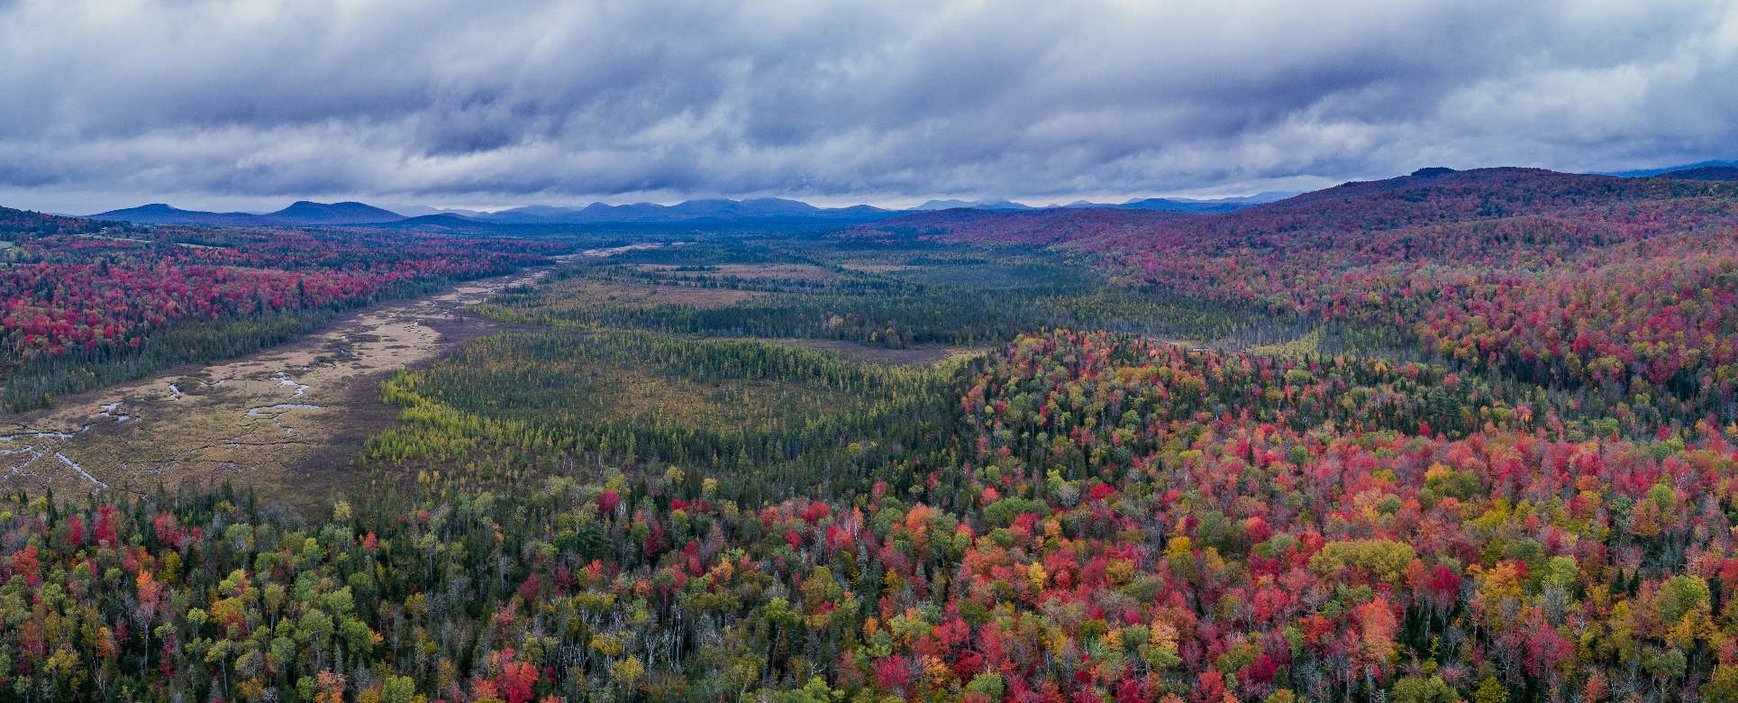
What does a perfect site look like?
Abundant Open Peatland
Large, connected
High Latitude
Low Elevation
Low Human Footprint
Few Human-Adapted Species
Stable Winter Precipitation
Warm, dry?
Brendan Wiltse
Notes:
Come back to metapopulation biology, 40% of these habitats are on private land, most wetlands are small and isolated, we can influence human footprint and connectedness.

Slide 15
Acknowledgements
NYSDEC
USGS – Northeast Climate Science Center
Northern New York Audubon Society – Cullman Foundation
WCS
Kresge Foundation
Larry Master
Adirondack Nature Conservancy
Kildare Club, Lyme Timber, Dan Christmas
Brian McAllister, Brian Keelan, Valerie Stein, Melanie McCormack, Gary Lee, Fuat Latif, Evan Obercian, Nick Laviola, Chad Seewagen, Quentin Hays, Mark Dettling, Alan Belford, Angie Ross, Andy Dettling, Jeff Nadler, Julie Mahar, Kristel Guimara, Steve Langdon, Gordon Dimmig, Kevin Jablonbski, Stacy McNulty
Jerry Jenkins

Slide 16
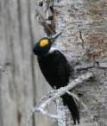

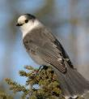

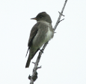
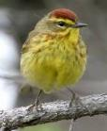

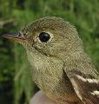

Climate: Species Responses
Breeding temp
Winter temp
Breeding ppt
Winter ppt

