Slide 1
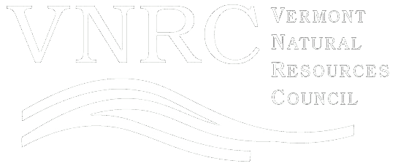
Tracking Parcelization Over Time to Inform Planning and Policy: Parcelization Trends in Vermont
Jamey Fidel
Forest & Wildlife Program Director/
General Counsel

Slide 2
Parcelization
The breaking up of land into smaller and smaller parcels, usually through subdivision.
Increased, potentially disjointed ownership of parent parcel;
Step toward new development, housing and infrastructure that may fragment natural resources and intact forests depending on how it occurs;
Less viable tracts for forestry; and
Potential negative ecological impacts.
A. Blake Gardner

Slide 3
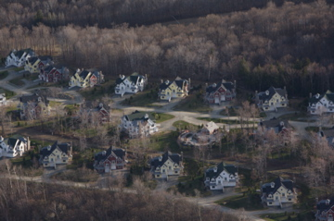
Forest Loss
While close to 80% of Vermont is forested, forest cover is actually declining. According to the Forest Service, Vermont may have lost 102,000 acres of forestland from 2012 to 2017 (Morin et al (2017)).
In order to minimize forest fragmentation and forest loss, it is necessary to understand where parcelization and subdivision are occurring, and the rate at which they are occurring.
A. Blake Gardner
Morin et al (2017). Forests of Vermont, 2016. Resource Update FS-119. Department of Agriculture, Forest Service, Northern Research Station. Available at https://www.fs.fed.us/nrs/pubs/ru/ru_fs119.pdf

Slide 4
Background on VNRC Research
Phase 1 (2010) Statewide parcelization trends,
2003-2009.
Phase 2 (2014) Subdivisions in 22 case study towns.
Phase 3 (2018) Parcelization trends, 2004-2016
(state, regional planning commission, county, & town levels)
Funded by Northeastern States Research Cooperative (NSRC), a partnership of Northern Forest states (New Hampshire, Vermont, Maine, and New York) in coordination with the
USDA Forest Service
Notes:
We will be presenting the results of Phase 3 today.
We won’t cover all the material that is available, but we hope to give you a snapshot of what we’ve done with the report and the accompanying website.

Slide 5
Steering Committee & Partners
DATABASE DEVELOPER
Brian Voigt, Fellow, Gund Institute for Ecological Economics (UVM Rubenstein School of Environment and Natural Resources)
WEBSITE DEVELOPER:
Steve Sharp, GIS Operations Manager (Vermont Center for Geographic Information)
COLLABORATORS
John Adams, Director (Vermont Center for Geographic Information)
John Austin, Lands and Habitat Program Director (Vermont Department of Fish and Wildlife)
Pam Brangan, GIS Data & IT Manager (Chittenden County Regional Planning Commission)
Deb Brighton, Research Associate (Vermont Family Forests)
Jim Duncan, Director (Forest Ecosystem Monitoring Cooperative)
Erik Engstrom, GIS Project Supervisor (Vermont Agency of Natural Resources)
Doug Farnham, Policy Director and Economist (Vermont Department of Taxes)
Danielle Fitzko, Urban & Community Forestry Program Manager (Vermont Department of Forests, Parks, and Recreation)
Jens Hilke, Community Wildlife Program (Vermont Department of Fish and Wildlife)
Elizabeth Hunt, Current Use Program Chief (Vermont Department of Taxes)
Jon Osborne, GIS Director (Vermont Land Trust)
Jennifer Pontius, Research Assistant Professor (UVM Rubenstein School of Environment and Natural Resources)
Jill Remick, Director (Property Valuation and Review Division, Vermont Department of Taxes)
Kim Royar, Wildlife Biologist (Vermont Department of Fish and Wildlife)
Steve Sinclair, Director of Forests (Vermont Department of Forests, Parks, and Recreation)
Keith Thompson, Private Lands Program Manager (Vermont Department of Forests, Parks, and Recreation)

Slide 6
Goals for Phase 3 Research
Quantify the degree to which subdivision is affecting the viability of large parcels for resource management and conservation;
Quantify the extent to which residential development is occurring;
Quantify the extent to which large undeveloped woodland parcels are declining; and
Document trends that may be relevant for policies and programs that support resource management and/or minimize the fragmentation of land.

Slide 7
Methods
Vermont Department of Taxes Grand List
Tax Years 2004 to 2016
Use Value Appraisal (Current Use) Data
Designed Metrics to look at various trends within the data:
  Number of parcels
  Acreage
  Parcel Sizes
  Parcel types
  Dwellings
  Land Values
  Use Value Program
Notes:
Before we provide any results, we want to make clear where the data comes from.

Slide 8
Project Components
Phase 3 Report:
Background
Methodology
Data, trends, and analysis
Data limitations
Findings and recommendations
Website:
Explore data with various interactive tools
Notes:
Before we provide any results, we want to make clear where the data comes from.

Slide 9
Uses & Limitations
Data can be used for… | Data should not be used for…
Identifying trends over time | Parcel-level decision making
Identify areas that may be vulnerable to forest loss | Reliance in real estate transaction
Inform municipal and regional planning | Estimating land value of individual parcels
Inform conservation planning | Conclusively estimating the exact percentage of a land type in a town/region (e.g., woodland, residential, etc.) due to possible inconsistencies between towns. CAN be used for trends in these metrics.
Target technical assistance
Notes:
Before we provide any results, we want to make clear where the data comes from.

Slide 10

Private Land Trends
In 2016, roughly 3,350,000 acres (70.4% of the land) were in parcels 50 acres or larger.*
*residential 43.3%
*woodland 22.8%
Notes:
In 2004, acreage in parcels 50 acres or larger was made up of 40% residential, 25.7% woodland, 18% other, and 16.3% farm.
In 2016, acreage in parcels 50 acres or larger was made up of 43.3% residential, 22.8% woodland, 18.6% other, and 15.2% farm.

Slide 11
Number of Parcels by Parcel Size
Small parcels are increasing, especially in the 2-5 and 5-10 acre categories, a size commonly used for “rural residential” house lots.
Notes:
The number of small parcels is increasing in Vermont.
While the number of larger (50+ acres) parcels decreased by 703 parcels, the number of smaller parcels increased by 8,746, showing that larger parcels are being divided into smaller parcels.
The parcel size category of 100 to 200 acres lost the greatest number of parcels, while the parcel size category of 2 to 5 acres gained the greatest number of parcels.
Parcels 200+ acres in size lost the highest percentage of parcels, about 4.9%.
Parcels from 5 to 10 acres in size increased the fastest, by about 15.2%, gaining a total of 2,789 parcels. Parcels in the 2 to 5 acre category were close behind, growing by 10.25% during the study period.

Slide 12
Acreage in Parcels ≥ 50 Acres in Size
Between 2004 and 2016, the amount of land in parcels 50 acres or larger declined by about 110,300 acres, or roughly 8,485 acres per year.
Notes:
Between 2004 and 2016, the amount of land in parcels 50 acres or larger declined by about 110,300 acres, or roughly 8,485 acres per year.
Acreage in parcels 50 acres or larger decreased by 3.18% during the study period, but the trend was more noticeable from 2004 to 2009, when acreage decreased by 2.6%, versus 2009 to 2016, when parcels deceased at a slower rate, by 0.6 %.
Transfer of land to public ownership contributed to a portion of the decrease in large parcels; however, available data demonstrates that public land transfer likely consisted of up to a quarter of the 110,300 acre decrease in large parcels

Slide 13
Acreage by Parcel Type
The number of acres in the “residential” category is increasing, while “farm” and “woodland” acreage is decreasing, with “woodland” acreage decreasing the fastest.
Residential increased by 162,670 acres, a 7% increase over the study period
Notes:
Residential acreage increased by about 162,670 acres from 2,326,959 acres in 2004 to 2,489,629 acres in 2016.
Woodland acreage decreased by about 147,680 acres from 994,090 acres in 2004 to 846,410 acres in 2016. Caveat for public land transfer.
Farm acreage decreased by about 53,400 acres from 575,030 acres in 2004 to 521,630 acres in 2016.

Slide 14
Acreage in Parcels ≥ 50 Acres by Parcel Type
The loss of large (50+ acre) woodland parcels outpaced the loss of large parcels in general.
Notes:
Residential acreage increased by about 63,970 acres, from 1,387,053 acres in 2004 to 1,451,022 acres in 2016 in larger parcels.
Woodland acreage decreased by about 124,840 acres, from 889,637 acres in 2004 to 764,792 acres in 2016 in larger parcels.
Farm acreage decreased by about 53,100 acres, from 564,312 acres in 2004 to 511,215 acres in 2016 in larger parcels.

Slide 15
Number of Parcels with Dwellings by Parcel Size
Most dwellings are built on smaller parcels compared to larger parcels.
Parcels less than 50 acres in size with dwellings increased by 20,737 parcels, which is an 8.8% increase over the study period

Slide 16
Land Values
The per-acre value of land in Vermont nearly doubled during the study period.
Notes:
Land value almost doubled from $990 per acre to $1,827 per acre over the study period.
It is interesting to note that much of the increase occurred between 2004 and 2008 before the market crash, and then stabilized for the following years.

Slide 17
Land Values – Woodland Parcels
The per-acre value of woodland also nearly doubled, though on average woodland remains less expensive per acre than land in general.
Notes:
Land value almost doubled from $581 per acre to $1064 per acre over the study period.
It is interesting to note that much of the increase occurred between 2004 and 2008 before the market crash, and then stabilized for the following years.

Slide 18
Percent of UVA Parcels by Parcel Size
Enrollment in UVA is increasing most in the 25-50 acre category, while enrollment of 100+ acre parcels is decreasing.
Notes:
The number of parcels between 25-50 acres in size enrolled in the UVA program increased by 3.1 percentage points, from 23.3% to 26.4%.
Parcels that are 27-30 acres in size make up 14.8% of all parcels enrolled in UVA, highlighting that landowners with a house may be enrolling in the minimum acreage required for enrollment in the forestland category (25 acres plus 2 acres for the homestead).
The share of UVA parcels in the 100-200 acre category decreased by 2.1 percentage points, from 24.8% to 22.7%.
The share in the 200+ acre category decreased by 2.7 percentage points, from 17.57% to 14.87%.

Slide 19
UVA Helps Retain Woodland
UVA is playing a role in protecting large woodland parcels: Of the woodland in parcels over 50 acres, 84% of the woodland enrolled in UVA remained woodland by 2016; by contrast, only 73% of non-UVA woodland remained.
Woodland in parcels ≥ 50 acres | In UVA in 2004 | Not in UVA in 2004
Remained as Woodland in (2016) | 84.16% | 73.15%
No Longer Woodland in (2016) | 15.84% | 26.85%
Notes:
84.16% of land enrolled in UVA in 2004 remained as woodland in 2016.
73.15% of land not enrolled in UVA in 2004 remained as woodland in 2016.

Slide 20
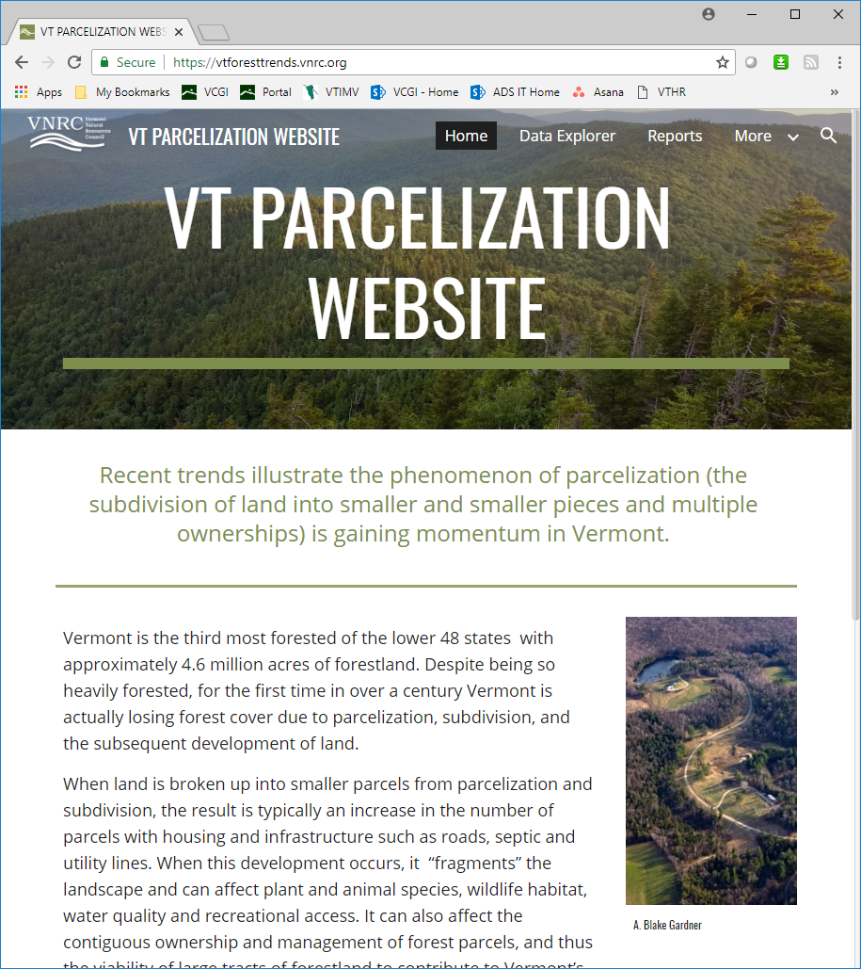
Parcelization Website
Available at: vtforesttrends.vnrc.org
Explore parcelization data at the town, county, regional, or statewide level using different tools:
Generate geographically-specific reports.
Download the raw data.
Download parcelization reports.
Notes:
Preview
About to go public; we have a little work to do
We’ll provide the URL when it’s ready.
Who
What
Why
Where

Slide 21
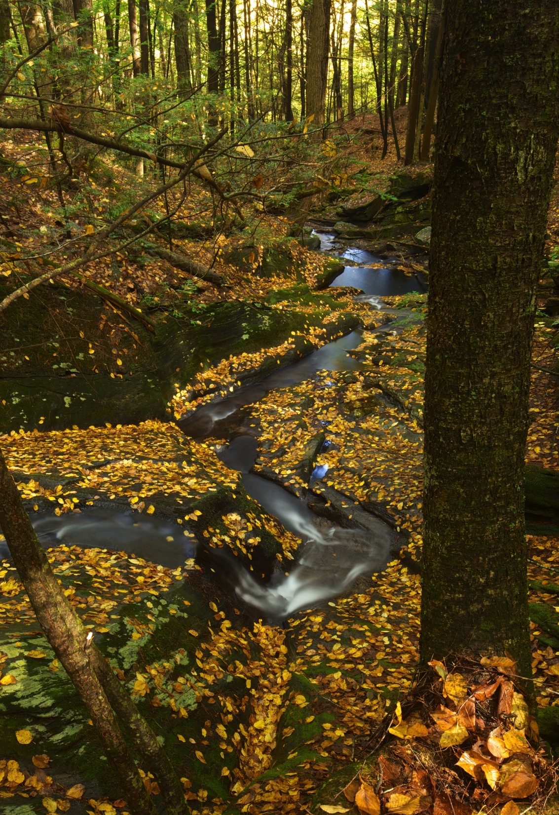
Recommendations for use:
Land Use Planning
Town and regional planning including Act 171 planning
  Snapshot of the town or region
  View of town/region in the state context
  Inform updated forest planning requirements (Act 171)
Specific trends can inform land use policies and strategies to reduce parcelization and fragmentation
A way to evaluate zoning and subdivision regulations
A. Blake Gardner

Slide 22
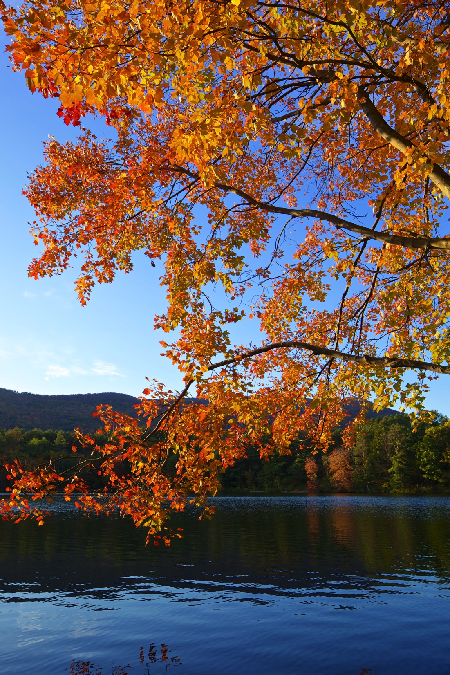
Recommendations for use:
Land Conservation Planning
To understand:
Locations that are experiencing a high degree of parcelization and woodland loss
Locations that present conservation opportunity because of the presence of large parcels, or large undeveloped woodland parcels
How to quantify parcelization threat in a particular area to justify conservation funding
A. Blake Gardner

Slide 23
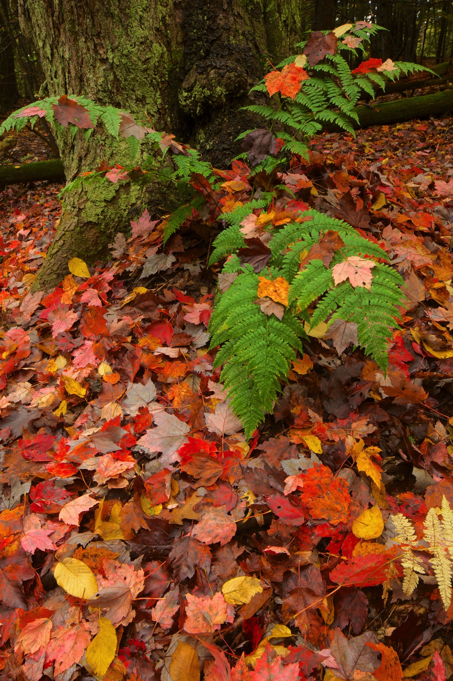
Recommendations for use:
Foresters
To understand:
Locations that are experiencing a high degree of woodland loss
Locations that would benefit from increased Use Value Appraisal enrollment
Use Value Appraisal enrollment, and parcel size and ownership trends in a particular town or county
A. Blake Gardner
Notes:
We’re especially interested in knowing your thoughts on land value.
From a conservation-oriented perspective...happy to talk more... For example if you see decline in woodland and a landowner might be interested in UVA...

Slide 24
Recommendations for State Policy
Recommendations for state policy and investments
Support diversified strategies to reduce the pressures on landowners to subdivide land.
Boost investment in land conservation and landowner incentives for conservation easements.
Increase support to woodland landowners for succession planning to minimize the subdivision of land.
Continue to support working forests by funding the Current Use Program and the administration of new forestland enrollment.
Provide full statutory funding for the Vermont Housing and Conservation Board (VHCB), and adequate funding for the Working Lands Enterprise Initiative.
Support outreach efforts and public policy to encourage the aggregation of land for conservation purposes.
Address the gaps in Act 250 and strengthen it to play a more meaningful role in reviewing the impacts of development on forestland.

Slide 25
Recommendations for Local Action and Research
Recommendations for local actions
Municipalities that have zoning and subdivision regulations should review and strengthen natural resource policies to reduce forest fragmentation, with a particular focus on their rural residential type districts.
Municipalities that do not have subdivision regulations should adopt them in order to minimize the fragmenting impacts of subdivision on forestland.
Recommendations for future research
Conduct additional research to understand how dwellings and associated infrastructure impact the functions and integrity of forests.
Utilize digital parcel maps, future LIDAR and other remote sensing data, and available modeling to understand any relationships between subdivision of land and subsequent development and forest loss/fragmentation.
Maintain and enhance the parcelization website on an annual basis to aid land conservation, land use planning, technical assistance, and policy making.

Slide 26

Q & A
Thank you!
Jamey Fidel, jfidel@vnrc.org / 223-2328, x. 117
Kate McCarthy, kmccarthy@vnrc.org / 223-2328, x. 114
www.vnrc.org

