Slide 1
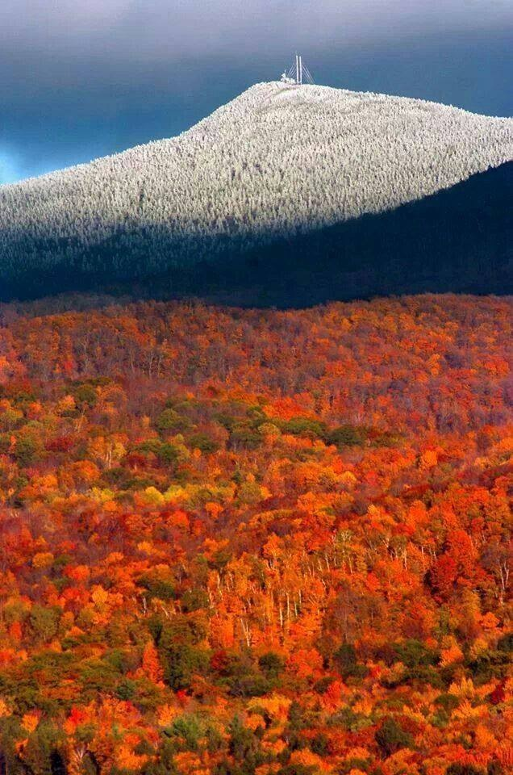
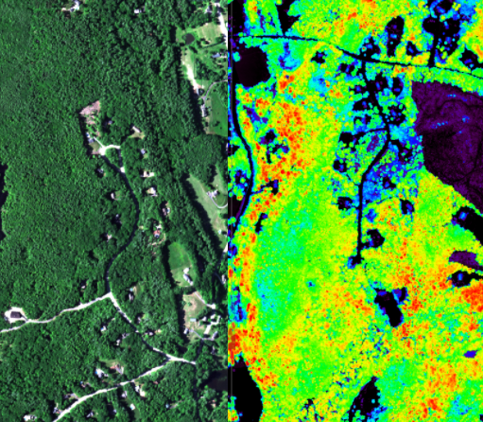
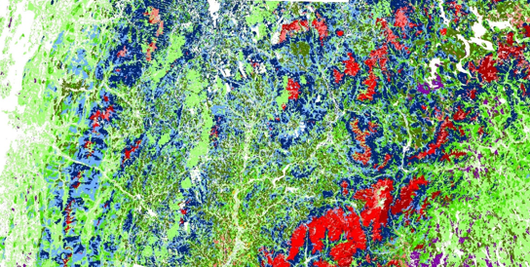
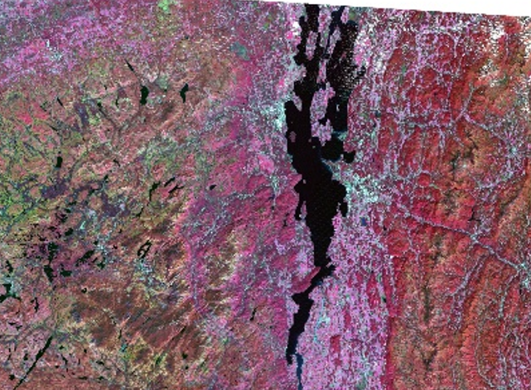
What remote sensing tells us about the region’s changing forests
Alison Adams UVM Gund Institute
Jennifer Pontius UVM and USFS NRS
David Gudex-Cross UVM RSENR
Notes:
For the birders in the audience, this may seems like an odd fit for a Year of the Bird special session.
But ornithologists have long understood the importance of landscape characteristics in the health and stability of avian populations.
This is why John Lloyd thought that it might be useful for us to share some of our recent remote sensing work with this group …..
To summarize briefly what the latest remote sensing efforts tell us about how forests across the northeast have changed and may continue to change in ways that could have broad impacts on many avian communities.
Here we will focus on two efforts:
1) One to look at the composition of tree species and how that has been changing over time
And
2) One to look at historical changes in forest cover and fragmentation patterns and what this implies about the future connectivity of the forested landscape.

Slide 2



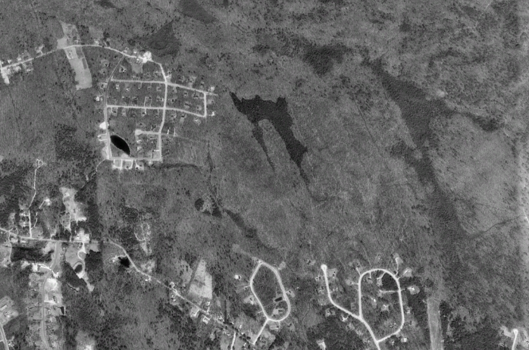
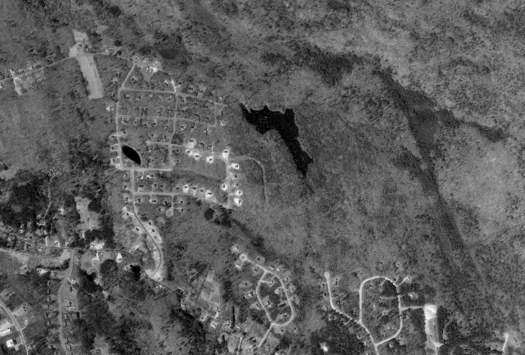
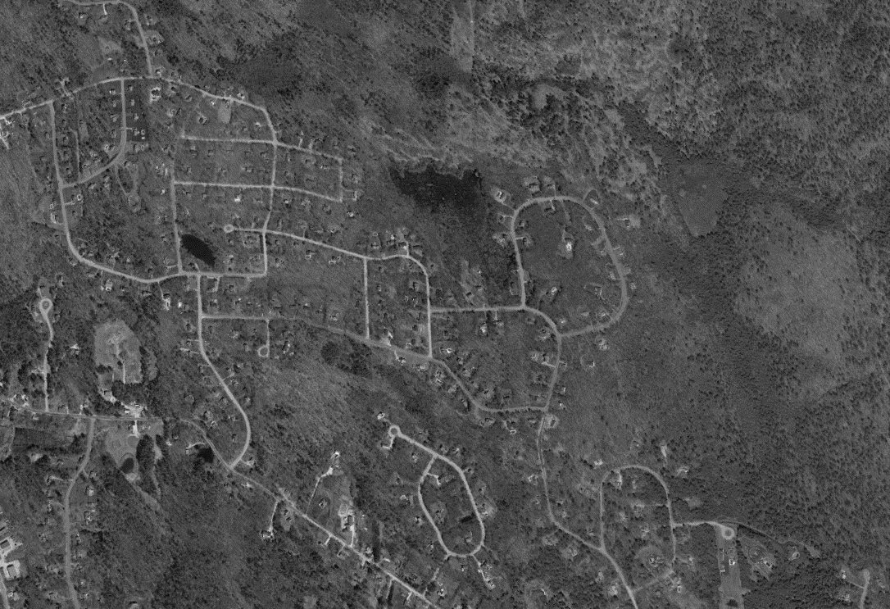
Project Summary
Using novel remote sensing techniques we generated a region-wide forest cover database from 1984 to 2015. This resource was then used to:
  examine historical patterns of species composition, forest conversion and fragmentation
  Link these changes to potential drivers
  Project changes into the future and identify resources at risk.
South Hooksett, NH
1992
1998
2003
Notes:
This work stems from a research project funded by the northern states research cooperative.
The goal was to develop improved methods to map forest species composition and forest cover, and apply those techniques to 30+ years of historical imagery to see what it tells us about our changing forest and how those changes differ across the landscape.
This example of South Hookset NH exemplifies how fast some of these changes over the 30 record have been.

Slide 3
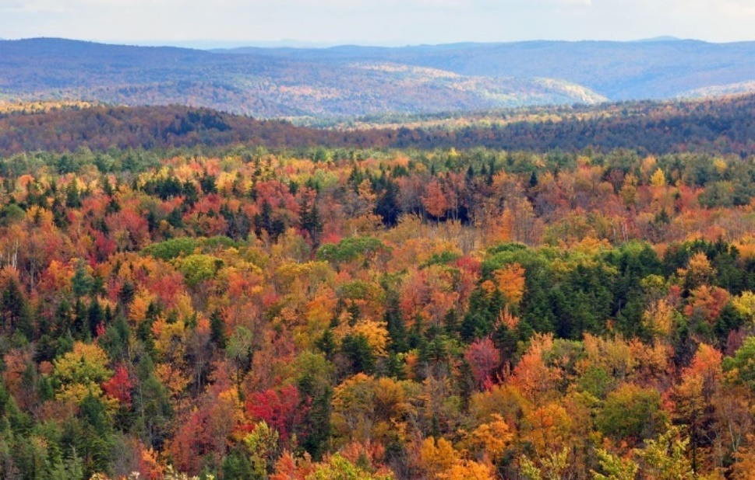
Project 1: Forest Cover Mapping
Goal: improve forest mapping using novel remote sensing workflows, to produce current and historical forest cover maps across the Northeast and assess spatial and temporal patterns in forest cover
Notes:
We will start with the tree species and forest cover mapping……
Note that I will gloss over the methods considering that this audience is probably more interested in the products and implications than the remote sensing methodologies.
But I encourage anyone who would like more information to meet with me (or Jen Pontius) later
Novel remote sensing approach integrates pixel- and object-based techniques
Pixel-based spectral unmixing results in species-specific percent basal area maps
Object-based classification refines and scales %BA maps to stand level to produce forest cover maps.

Slide 4
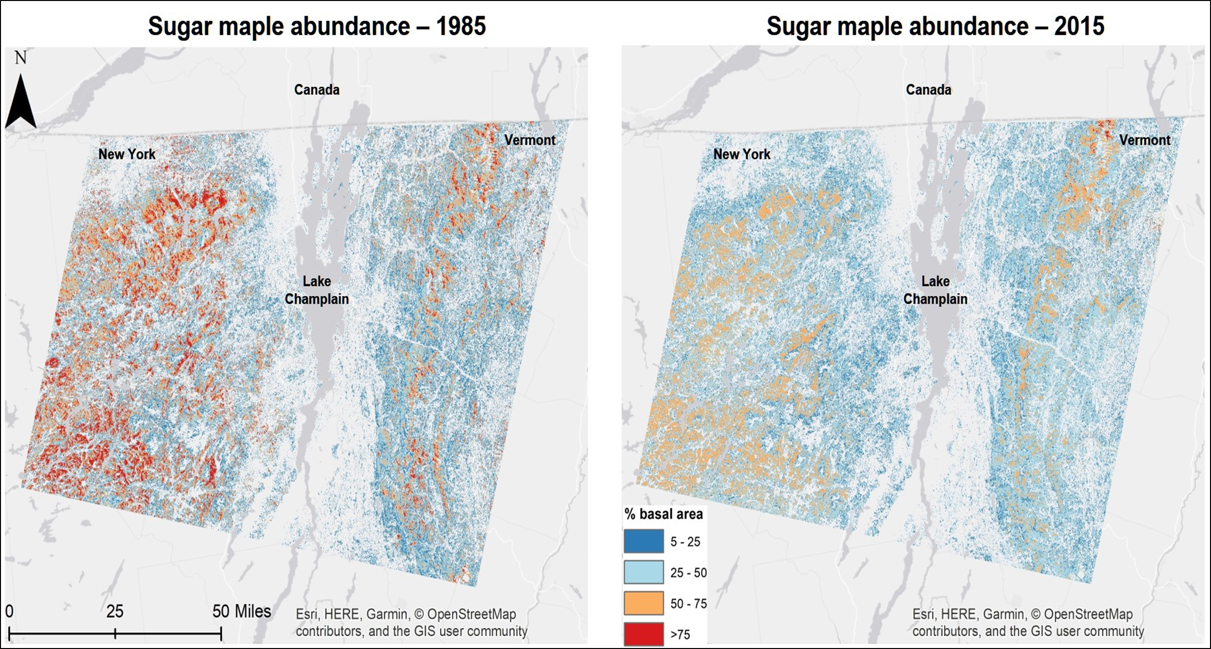
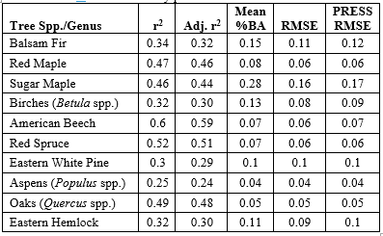
Forest Cover Mapping Results
Species %BA Accuracy
Using this method it is possible to map fractional abundance in a complex landscape dominated by mixed forests.
Accuracy is highest for common species with many pure training plots
Notes:
We found that using this novel approach, we could map not only species distribution, but also species abundance ….
Resulting in % basal area maps that we then used to examine how species composition has changed over the past 30 years and begin to explore why those changes may be happening.
Note that we are able to predict percent basal area at each 30m pixel to within 10% for most species, even in highly mixed, heterogeneous forests.

Slide 5
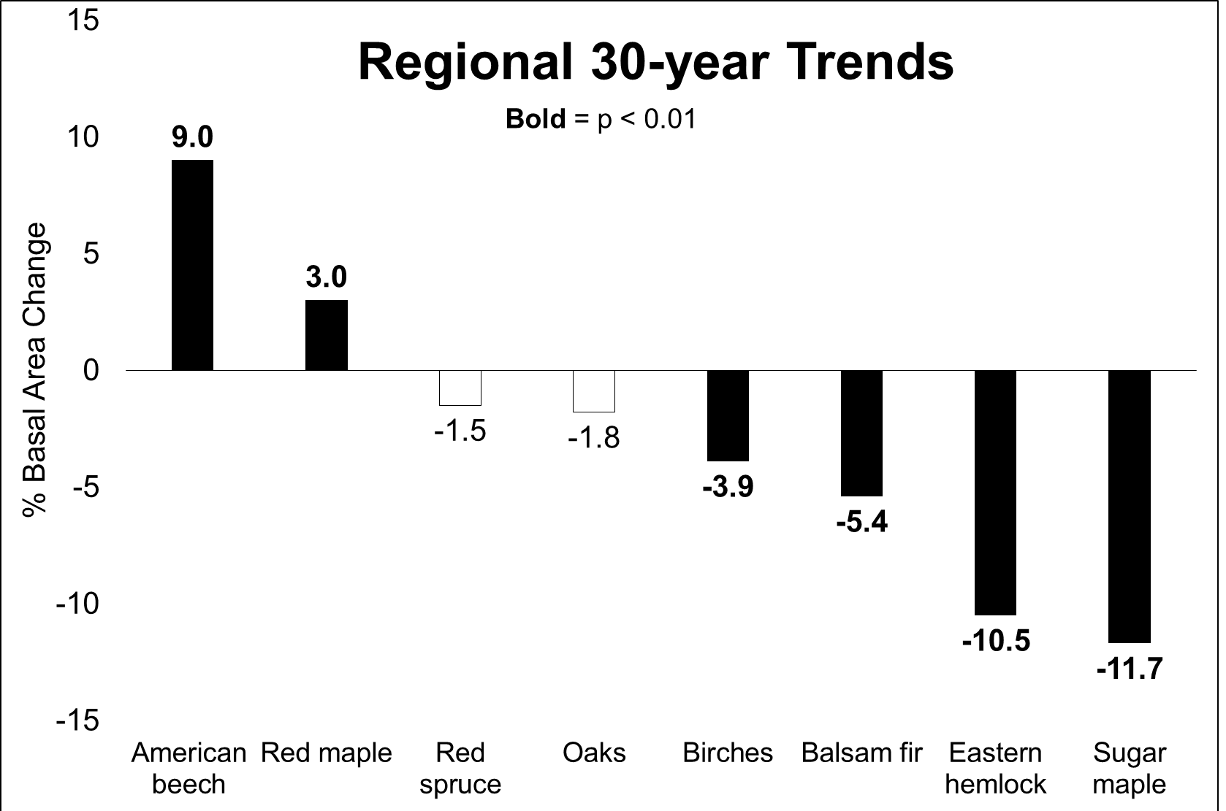
Forest Cover Mapping
Changes Revealed
We detected significant region-wide reductions in sugar maple, eastern hemlock, balsam fir, and birches, and increases in American beech and red maple.
Notes:
Considering that many species favor forest type specific habitats, we wanted to tell you a little about how the composition of the regions forests are changing.
Looking at average abundance across the region, we did see significant changes in the abundance of some species
For some species this makes sense based on what we know about our maturing forests and natural successional patterns (e.g. decline in birches and increase in shade tolerant species such as American beech.
But other species are defying what would be expected: (e.g. decline in shade tolerant sugar maple and eastern hemlock.

Slide 6
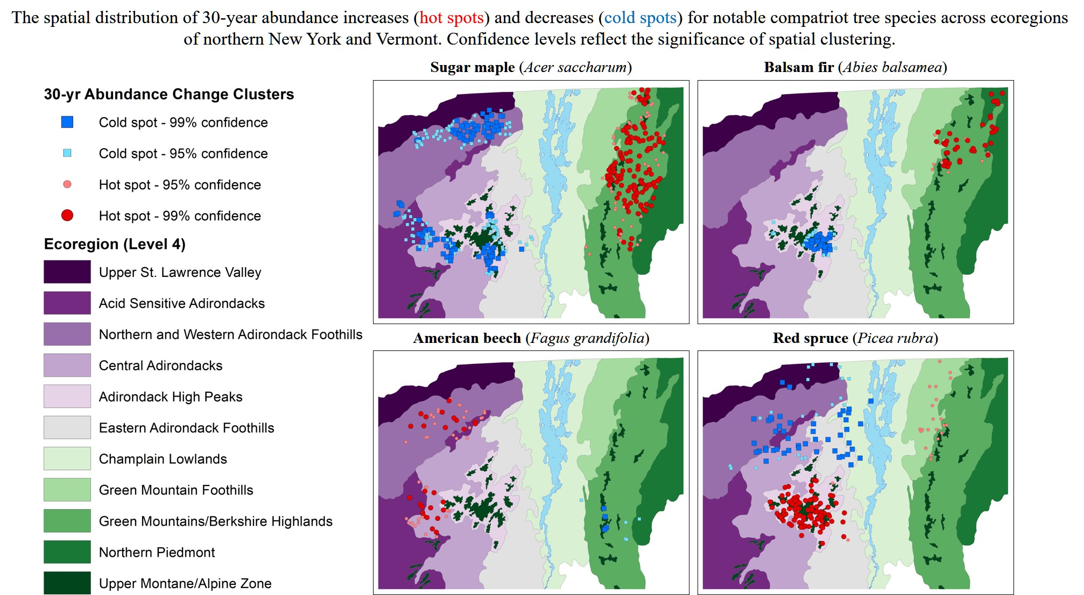
Forest Cover Mapping
Changes Revealed
Co-occurring, compatriot species often exhibited opposing trends (e.g. increased balsam fir with decreased red spruce, and increased American beech with decreased sugar maple)
Notes:
It is important to note that these changes were not uniform across the landscape……
But it is interesting to note that many of the largest changes we saw were in locations where two common compatriot species occupied the same forest. (e.g. sugar maple / beech or spruce / fir).
In these locations we saw connected, opposing patterns, indicating that competitive dynamics may be shifting between this compatriot species.

Slide 7
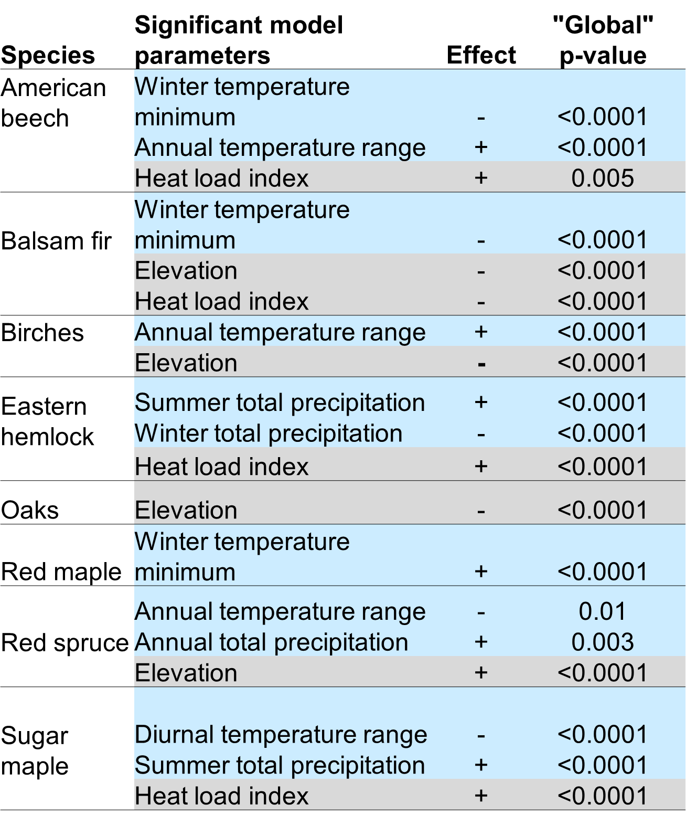
Forest Cover Mapping
Changes Revealed
Changes in species composition varied across the landscape indicating that changes are mitigated by local conditions.
Climate factors were the dominant predictors of changes in species abundance.
These localized responses to site, stand and climate factors are the rule rather than the exception.
Notes:
Looking at potential drivers of these changes, reveals several interesting points:
Different species appear to be sensitive to different conditions. For some like eastern hemlock, it is tied to water availability, while for others like balsam fir it is tied to temperature extremes
In spite of the range in which climate variables are most significantly related to species changes, climate variables dominate the list (note we includes, soils, topography, stand, and pollution metrics. This indicates that climate is a driving force in what our current and future forests look like.

Slide 8
Avian Implications: Species Shifts
Forest types with significant compositional changes include spruce-fir forests. How might this connect to avian populations?
Eastern populations of several bird species associated with the spruce-fir forests have declining population trends. (Ralston et al. 2015)
USGS Breeding Bird Survey data corroborate these significant declines in abundance for 11 of 17 spruce-fir bird species. (Sauer et al., 2017)
Bicknell’s Thrush is one of the species at greatest risk, with declines across the region, including localized extinctions (Townsend et al. 2015)
Similarly , spruce grouse (endangered in NY) declined 25% (71% in extent) over the last 30 years. (Ross et al. 2016)
Notes:
But what does this all mean for our feathered friends.
While this work did not look specifically at avian populations directly in connection to changes in species abundance, we can see that bird populations in these forest types are also in flux:
J. Ralston, D.I. King, W.V. DeLuca, G.J. Niemi, M.J. Glennon, J.C. Scarl, J.D. LambertAnalysis of combined data sets yields trend estimates for vulnerable spruce-fir birds in northern United States
Sauer, J., Niven, D., Hines, J., Ziolkowski, D., Pardieck, K., Fallon, J., Link, W., 2017. The North American breeding bird survey, results and analysis 1966-2015.
Hill, J.M. and Lloyd, J.D., 2017. A fine‐scale US population estimate of a montane spruce–fir bird species of conservation concern. Ecosphere, 8(8).
Ross, A.M., Johnson, G. and Gibbs, J.P., 2016. Spruce grouse decline in maturing lowland boreal forests of New York. Forest Ecology and Management, 359, pp.118-125.

Slide 9
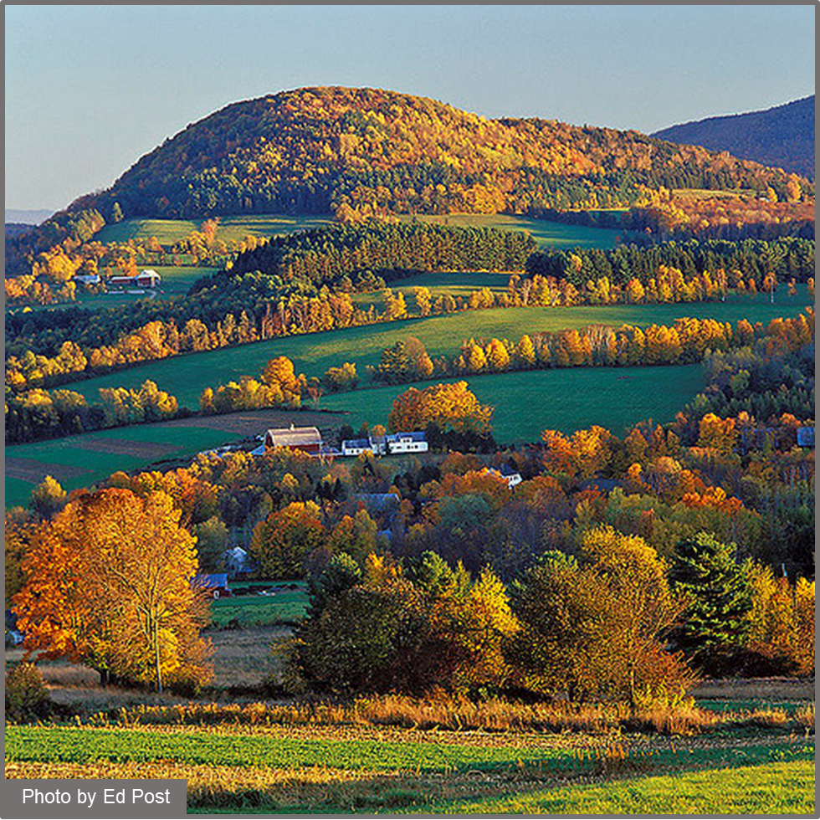
Project 2: Forest Conversion and Fragmentation
Goal: Examine historical patterns and drivers of forest loss and fragmentation, to model future forest extent and identify areas at risk of conversion.
Notes:
Switching gears to fragmentation
A natural extension of the species and forest cover mapping was to examine how forest cover has changed over the same 30 year period.
Again, this is of particular interest to this YOB session because of the documented connections between avian populations and forest connectivity.

Slide 10
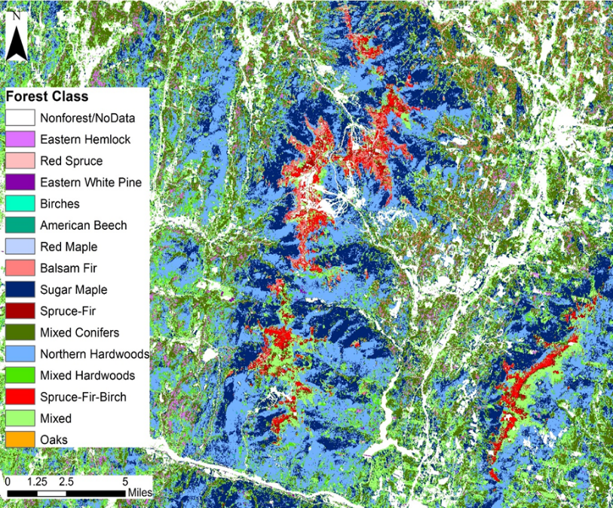
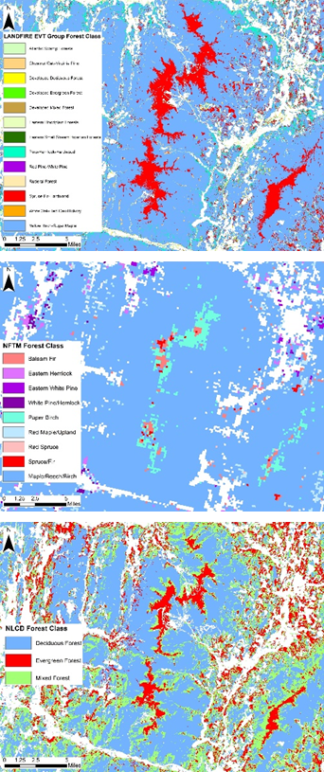
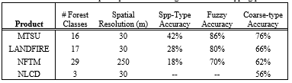
Forest Fragmentation Methods
Forest Cover Maps
NSRC
Landfire
NFTM
NLCD
Classification accuracy and detail surpasses all current forest species mapping products
Notes:
First we had to develop forest cover maps.
These extended from the percent basal area maps we just discussed.
These maps cover the northeast, but here we zoom in to Mt. Mansfield to exemplify the differences between this product and other common forest mapping products.
This mapping product is more detailed (classes for forest types) and accurate than any existing Here everything white is non forest

Slide 11
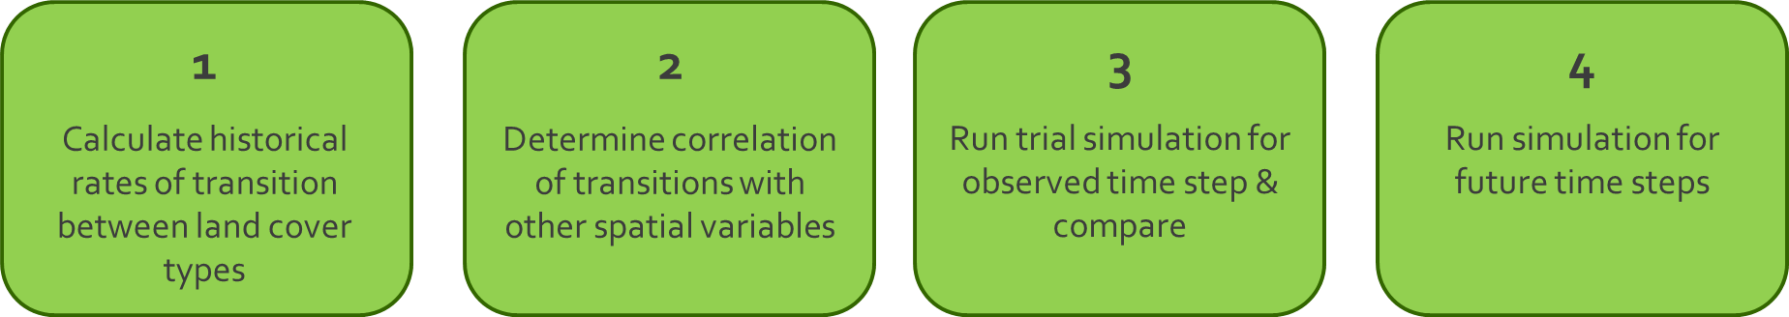
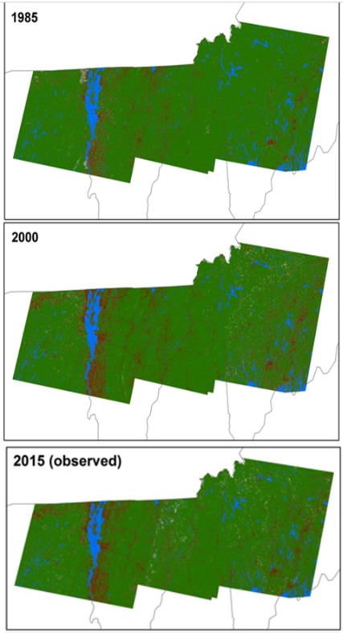
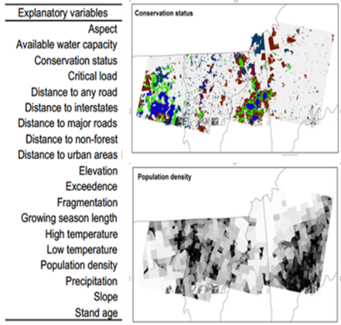
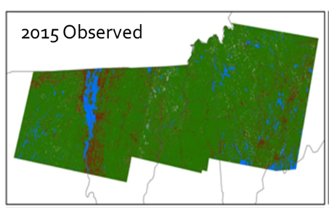
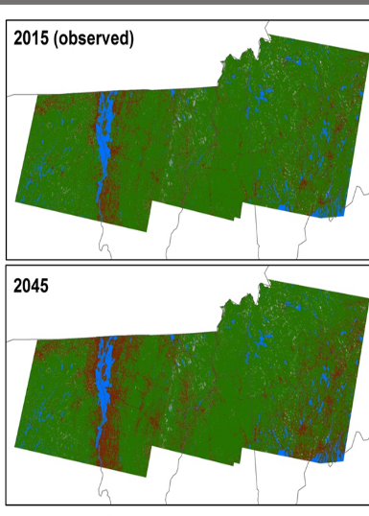
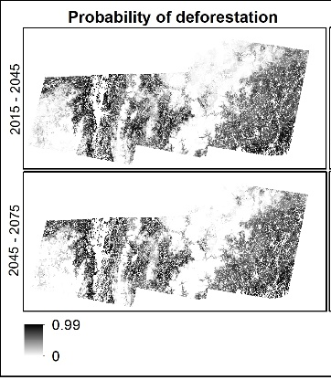


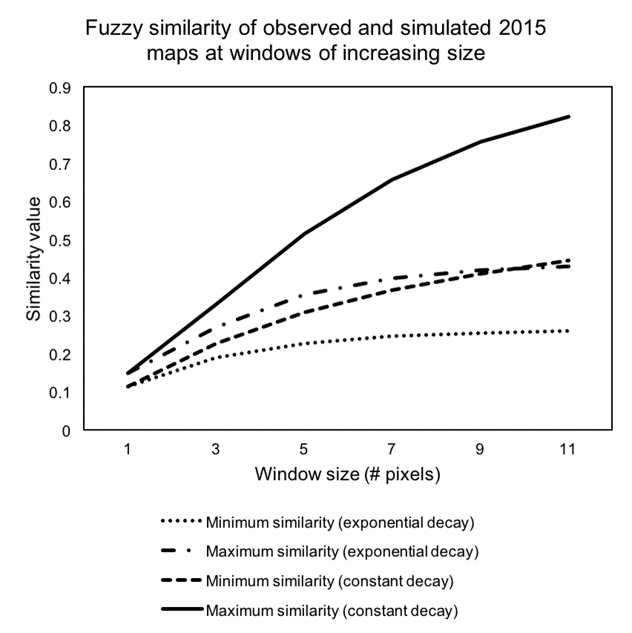
Forest Fragmentation Methods
Forest Conversion Modeling
5
Re-run to create a probability of conversion map
Notes:
This is a lot for the eyes….so to summarize in a nutshell:
We linked changes in forest cover between 1985 and 2000 with a suite of possible landscape correlates.
We used those correlates to predict what forest cover should look like in 2015 and compared it to the actual forest cover in 2015 (this is for validation)
With confidence in the correlate (drivers) we then model what forest cover will look like into the future.

Slide 12
Forest Fragmentation Results
Changes Revealed
While the rates of forest loss vary over time based on economic pressures, forest area has and will continue to decrease over the next few decades, creating an increasingly fragmented landscape.
Notes:
Key take home messages from this work include:
Historically the RATE of forest conversion varied over time….
But even when the total forest area was constant, the patterns of conversion continued to advance fragmentation of the landscape.

Slide 13
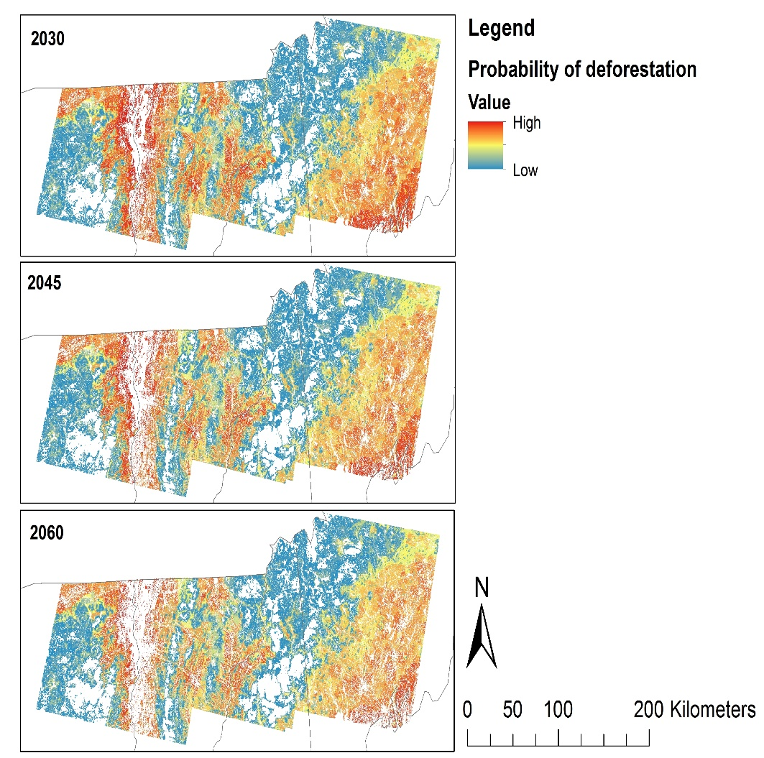
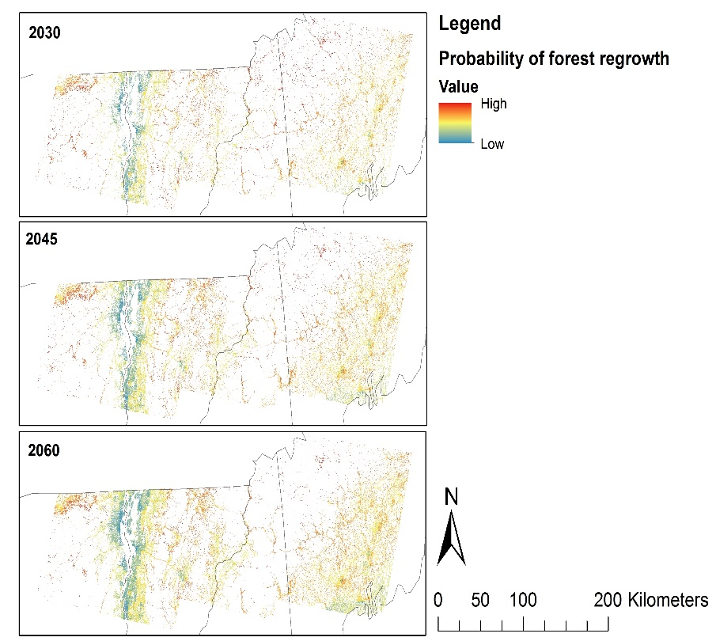
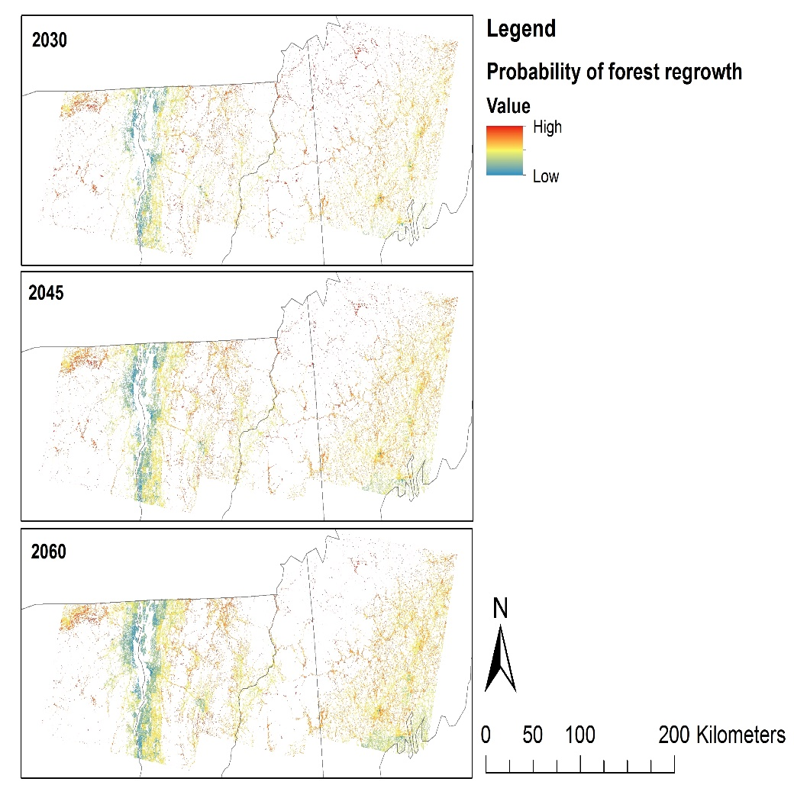
Forest Fragmentation Results
Changes Revealed
Probability of deforestation
Development pressures are a significant factor in which locations experience deforestation.
Increased probability of forest loss were related to:
Population density (higher)
Distance to roads (closer)
Slopes (steeper)
Elevations (lower)
Distance to urban area (closer)
Conservation status (unenrolled)
Notes:
While we included a suite of possible correlates, the primary drivers reflect characteristics of locations with higher development pressure.
Perhaps take this moment to point out some of the highest risk areas across the region (generally speaking)

Slide 14
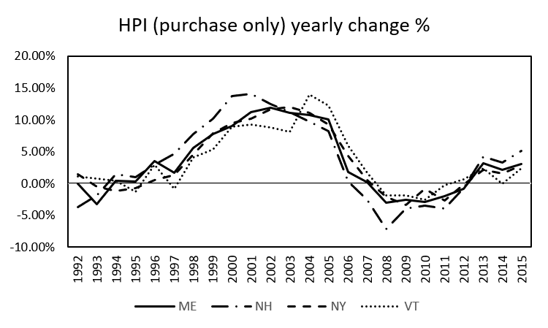
Forest Fragmentation Results
Changes Revealed
Development pressures are a significant factor in which locations experience deforestation.
In fact, the variable rate of forest loss witnessed across the 30 year period reflects patterns in the strength of the regional housing market.
The high rate of deforestation coincides with a period of increasing home prices, while the following period of forest conversion stabilization tracks the housing market crash between 2000 and 2015.
Notes:
The high rate of deforestation coincides with a period of increasing home prices, while the following period of forest conversion stabilization tracks the housing market crash between 2000 and 2015.

Slide 15
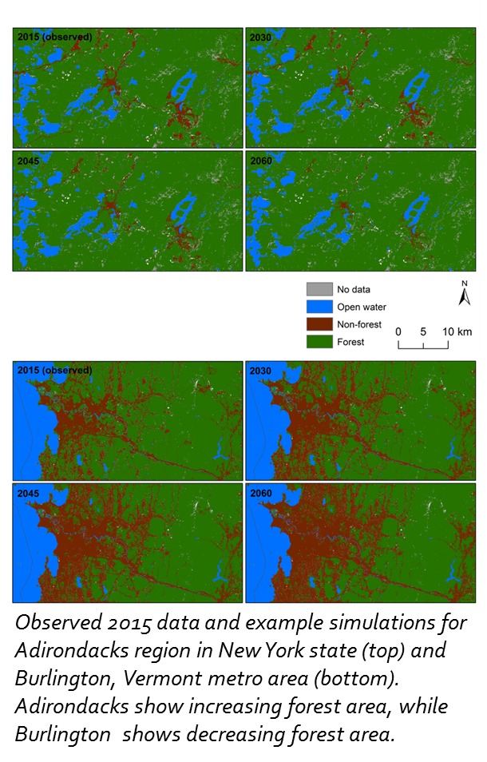
Forest Fragmentation Results
Future Projections
Applying this model across the region shows the highly variable nature of forest conversion probability.
Conservation efforts should target high quality, high risk habitats for conservation and management activities.
Notes:
Self explainatory….
But a good Segway to introduce our MS tool that is trying to do just that.

Slide 16
Avian Implications: fragmentation
There is almost half a century of research on the impact of forest fragmentation on avian populations:
“The local abundance of almost every bird species breeding in the interior of upland forests was found to be significantly influenced by forest area, isolation, structure, of floristics, or combinations of these factors.” (Lynch and Whigham 1984) Maryland
“The prescription of maintaining viable breeding populations of migratory songbirds in the North is relatively simple: avoid fragmenting forests.” ( Askins 1992) Eastern North America
Donovan and Flather (2002) found “significant, negative relationship between the proportion of the breeding population occupying fragmented landscapes and the (negative) population trend.” Eastern US
“… loss of interior forest is an important incremental factor in forest bird population declines” (Gardner et al. 2017) Massachusetts
Notes:
But what does this all mean for our feathered friends.
While this work did not look specifically at avian populations directly in connection to these products, we can hypothesize potential changes on avian populations from the literature:
The vast majority of work has been conducted in tropical and subtropical landscape
But here I present just a selection (one from each decade) highlighting the connection between forest connectivity and avian populations.
Askins, R. A. (1992). Forest fragmentation and the decline of migratory songbirds. Bird Observer, 20(1). Retrieved from https://digitalcommons.conncoll.edu/cgi/viewcontent.cgi?article=1017&context=biofacpub
Donovan, T.M. & Flather, C.H. (2002) Relationships Amoung North American Songbird Trends, Habitat Fragmentation, and Landscape Occupancy. Ecolocial Applications. 12(2): 346-374
Lent, R.A. & Capen, D.E. (1995). Effects of small-scale habitat disturbance on the ecology of breeding birds in a Vermont (USA) hardwood forest. Ecography 18: 97-108.
Robbins, C.S., 1979. Effect of forest fragmentation on bird populations.
Gardner, T.J., Eagan, C.R. and Bertin, R.I., 2017. Forest Bird Populations in Massachusetts: Breeding Habitat Loss and Other Influences. Northeastern Naturalist, 24(3), pp.267-288.
Carvajal, M.A., Alaniz, A.J., Smith‐Ramírez, C. and Sieving, K.E., 2018. Assessing habitat loss and fragmentation and their effects on population viability of forest specialist birds: Linking biogeographical and population approaches. Diversity and Distributions, 24(6), pp.820-830.
Lynch, J.F. and Whigham, D.F., 1984. Effects of forest fragmentation on breeding bird communities in Maryland, USA. Biological Conservation, 28(4), pp.287-324.

Slide 17
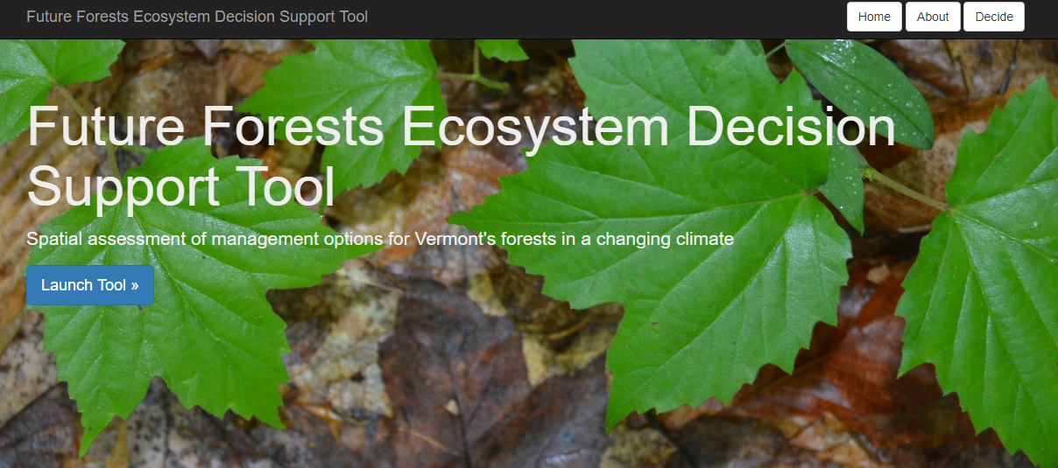
Future Directions
Using science to inform management and conservation
The species composition and fragmentation risk maps developed here are being incorporated into an online forest management decision support tool funded through the McIntire-Stennis Forestry research program with development by FEMC staff.
This brings the science directly to the land managers and planning specialists who need the information.
Notes:
So clearly fragmentation is important for managing avian populations.
But how can this information go from this screen to the conservation decision making arena
The key is to take all of this great science (and other exciting science discoveries) and bring them to the people who can use them on the ground.
One such tool is currently in development here at UVM.

Slide 18
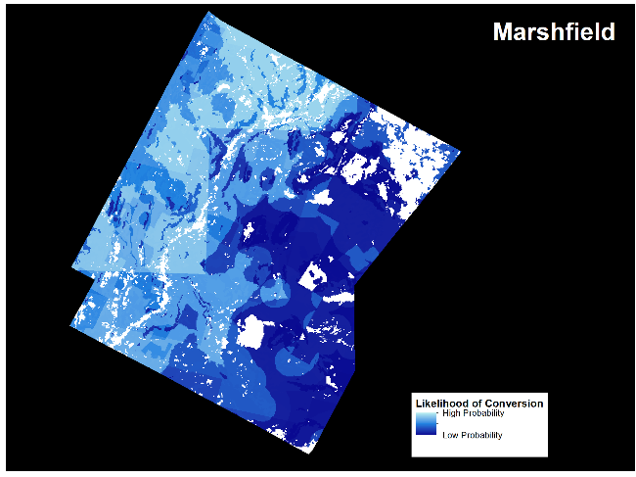
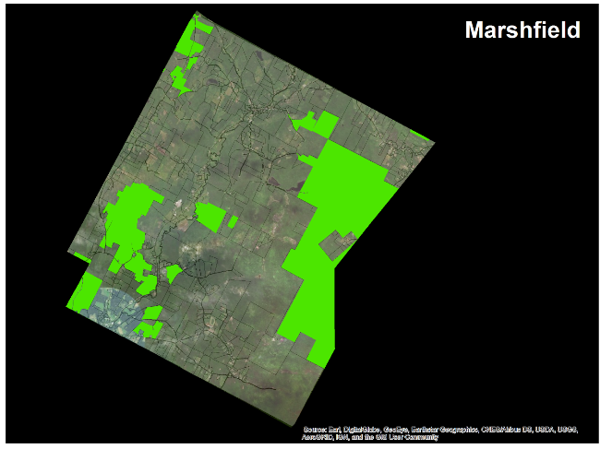
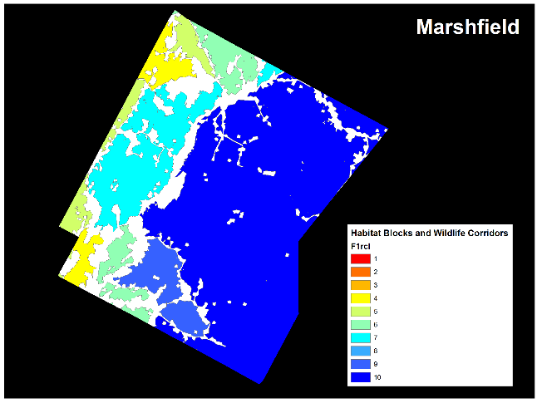
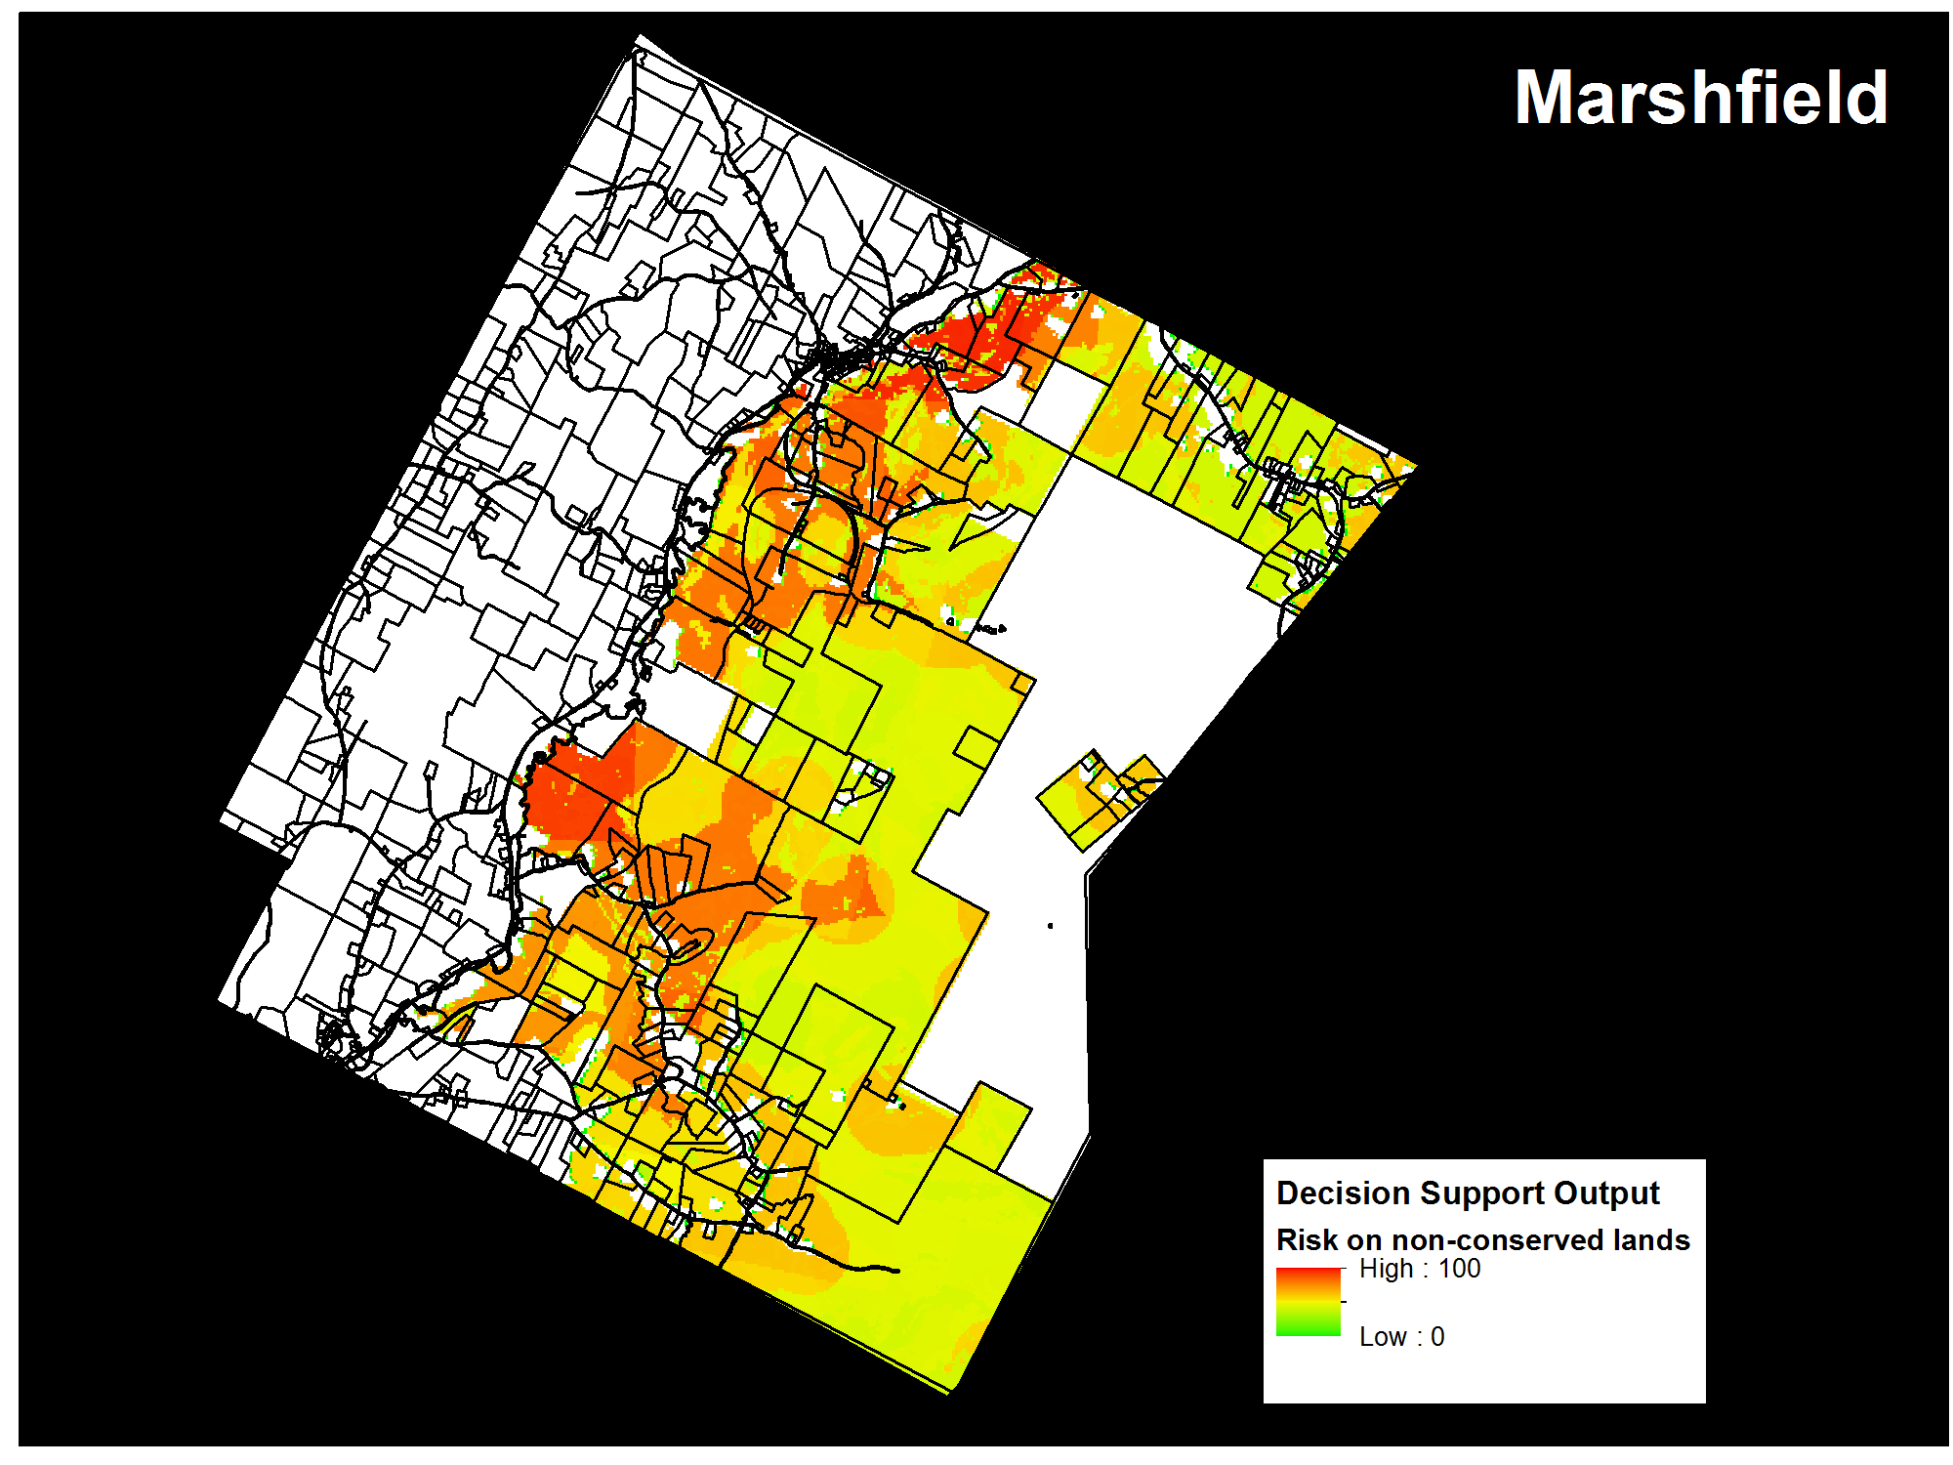
An example: Town Level-conservation planning
Future Directions
Using science to inform management and conservation
What we care about: High quality habitat blocks
What might drive change: Probability of conversion
What can we exclude: Properties already enrolled in conservation programs
High priority locations
Notes:
This tool allows us to aggregate various geospatial data layers of interest to identify locations or (in this case) parcels of highest value for our management and conservation activities.
Here red indicates higher priority to converse high quality, high conversion risk habitats.

Slide 19
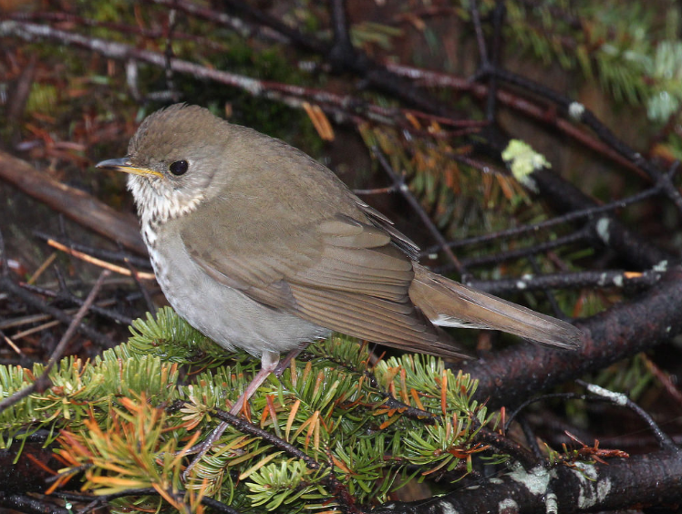
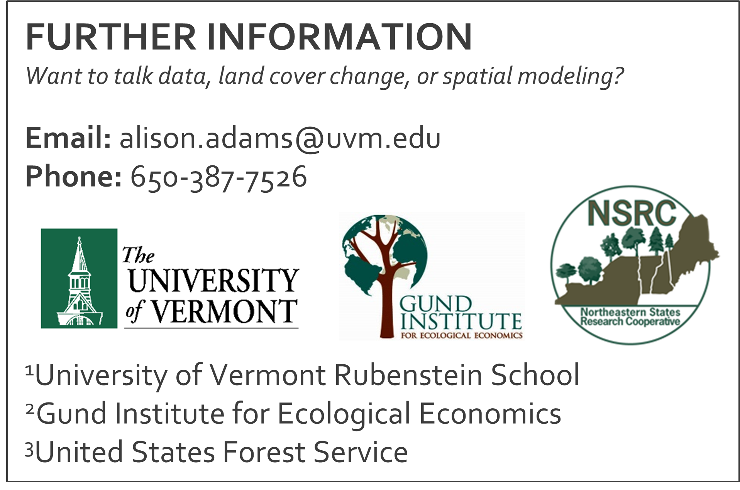
Future Directions
Using science to inform management and conservation
This information is particularly important in light of the continued stress of changing climate conditions and development pressures in this highly populated region.

