Slide 1
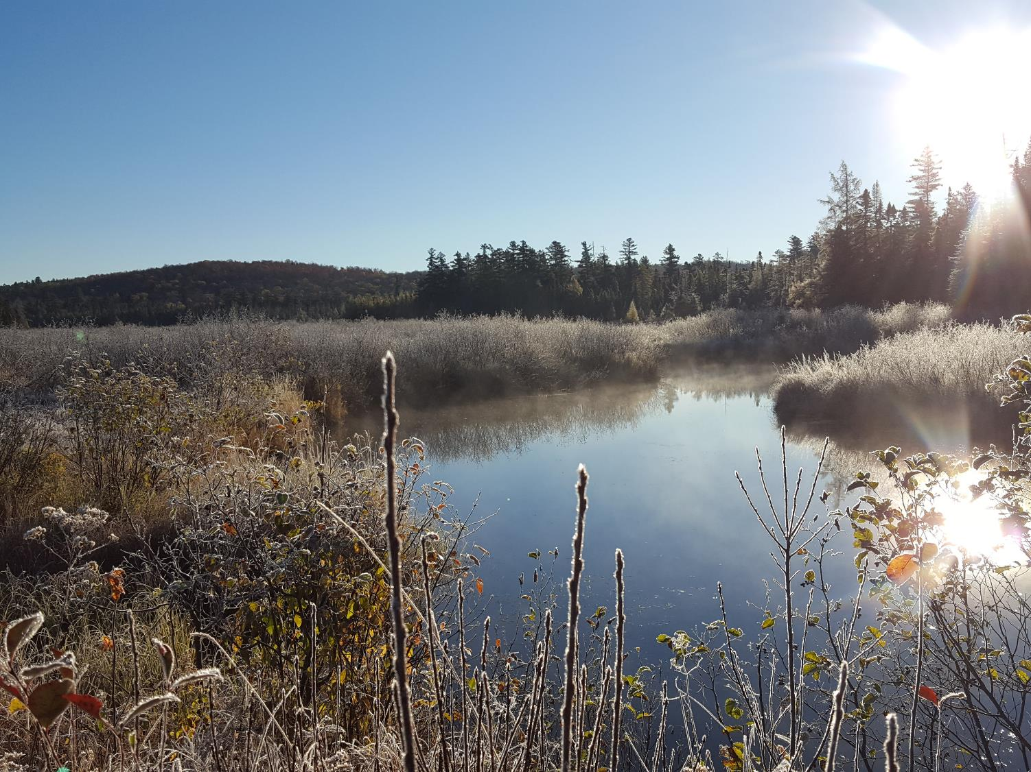


Climate change vulnerability and adaptation of forest wildlife
Toni Lyn Morelli
Notes:
Notes for NH talk: audience = land trusts, con comms, dfg ; speak about WAP; include coastal impacts (eg lobsters)
20 min talk, + 10 min discussion

Slide 2
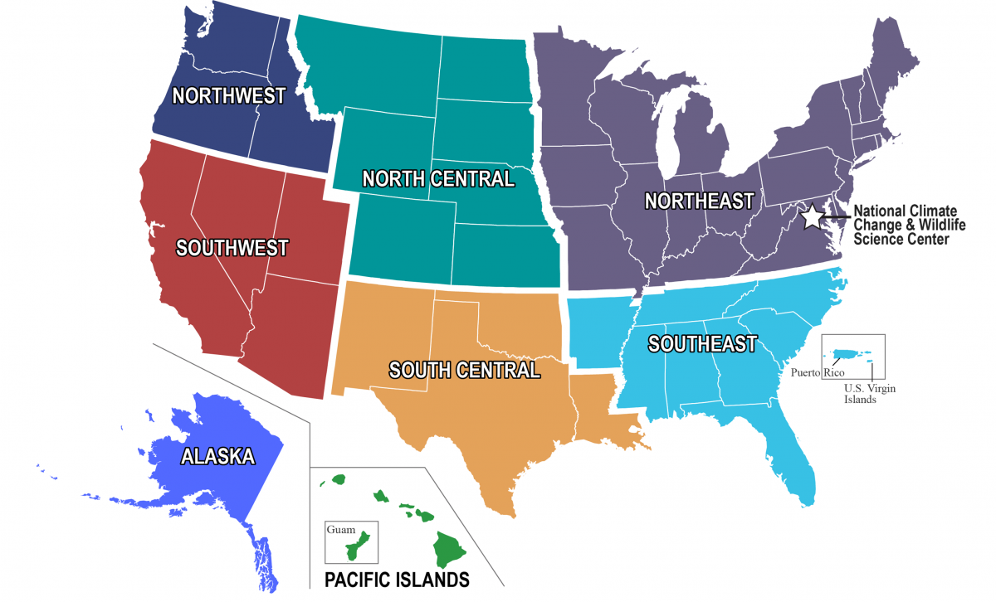








DOI Climate Adaptation Science Centers
Goal: To assist natural resource managers in
planning and development of climate
adaptation strategies on local and regional scales
necsc.umass.edu

Slide 3
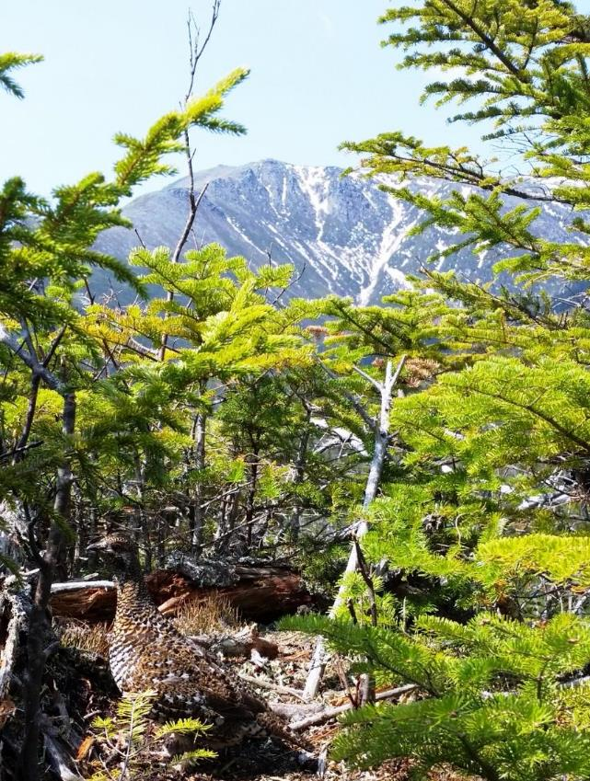
Climate change vulnerability and adaptation of forest wildlife
Review
  Climate Change
  Forest Habitat Vulnerability
Focus on Forest Wildlife
What can we do?
  Climate adaptation
  Climate Change Refugia
  Invasive Species Managemt
  Climate Project Screening Tool
Notes:
Global causes

Slide 4
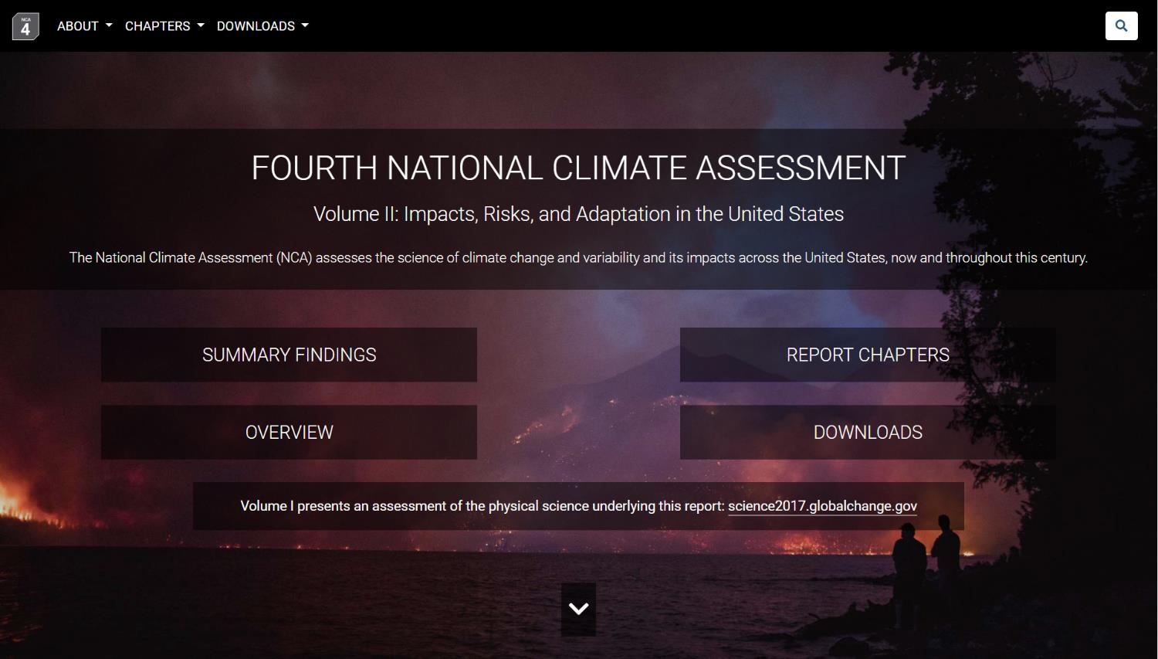

"It's super easy to read (x4),
and it's important that you do!"

Slide 5
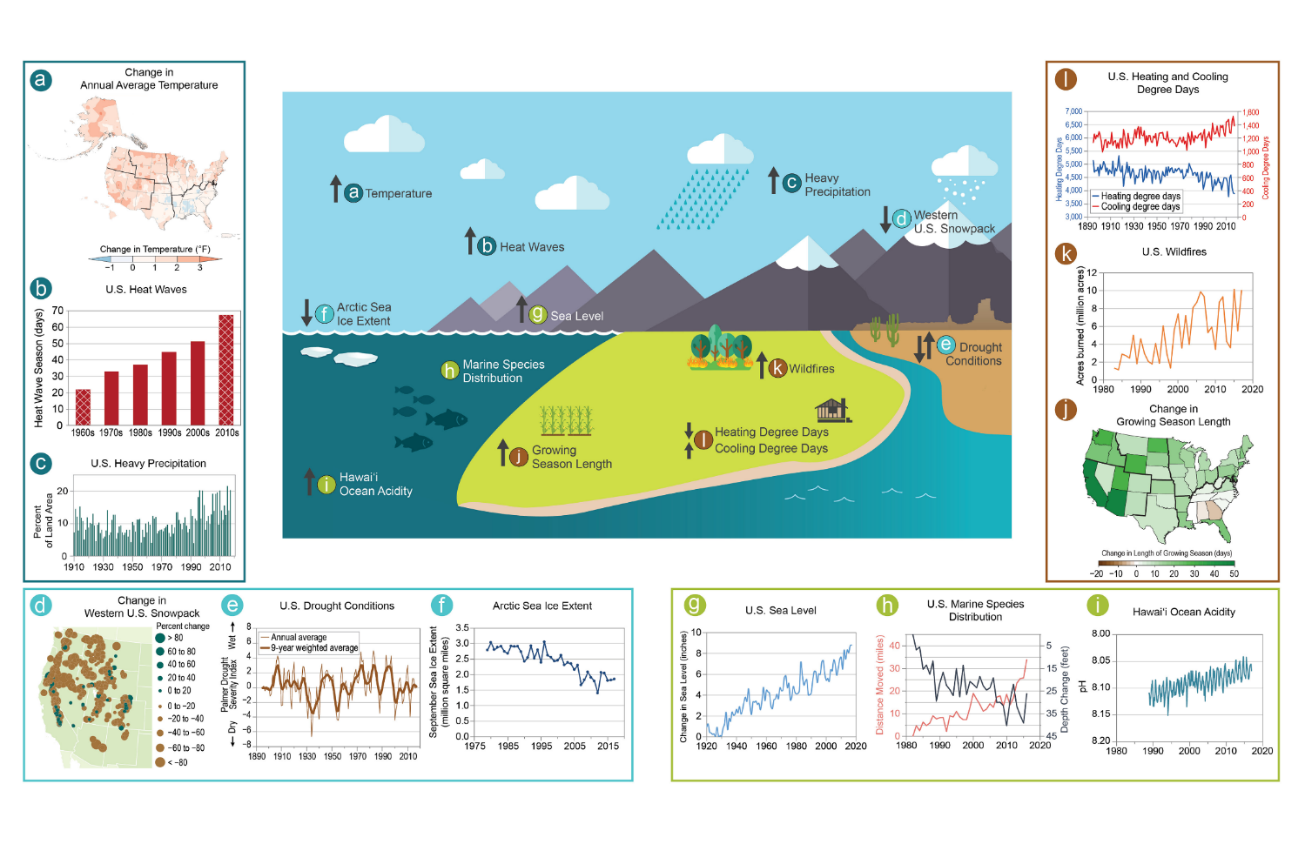
Indicators of Climate Change
National Climate Assessment, 2018

Slide 6
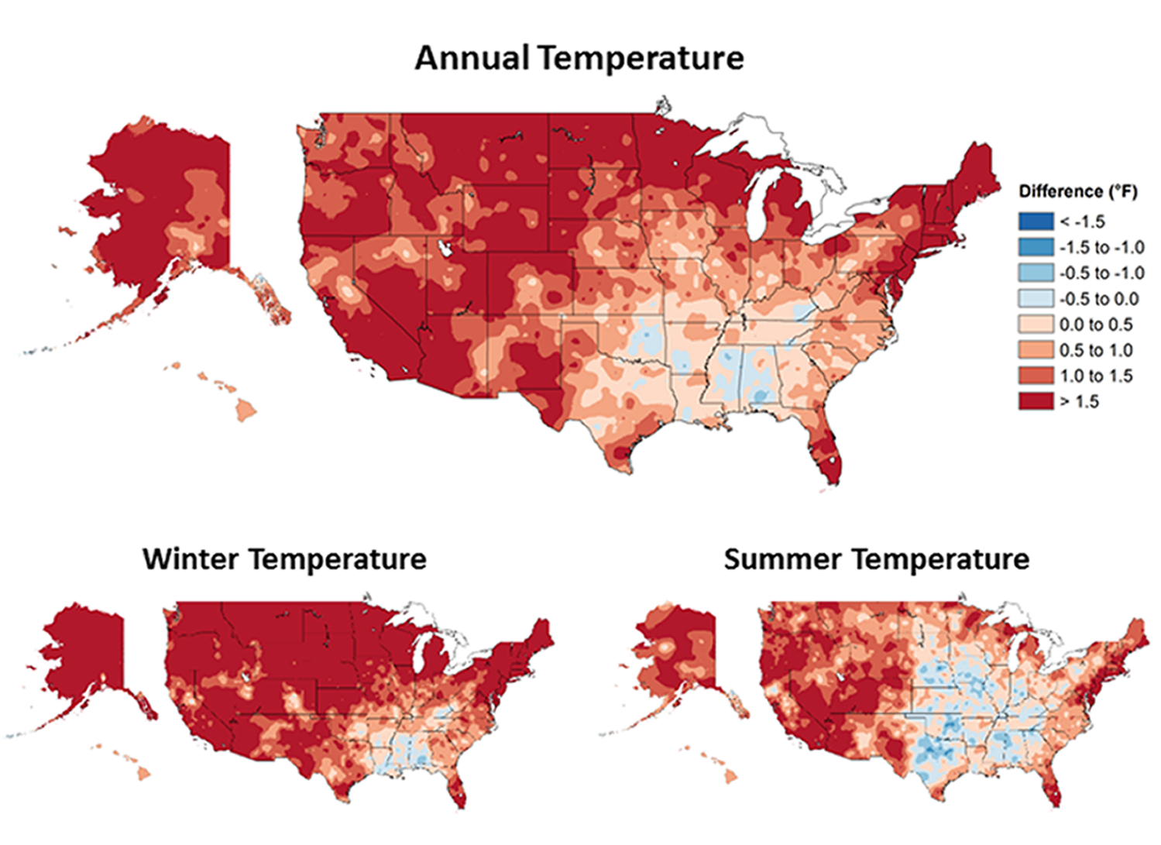
Observed changes (1986-2016 vs. 1901-1960)
NCA4 Vol 1
Notes:
Observed changes in annual, winter, and summer temperature (°F). Changes are the difference between the average for present-day (1986–2016) and the average for the first half of the last century (1901–1960 for the contiguous United States, 1925–1960 for Alaska and Hawai‘i). Estimates are derived from the nClimDiv dataset. , (Figure source: NOAA/NCEI).

Slide 7
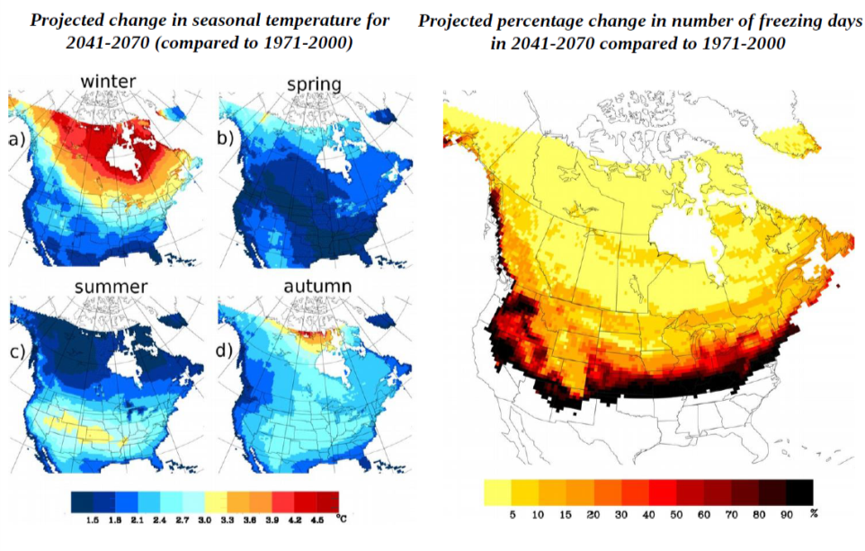
Climate Projections
Rawlins, Bradley et al 2016

Slide 8
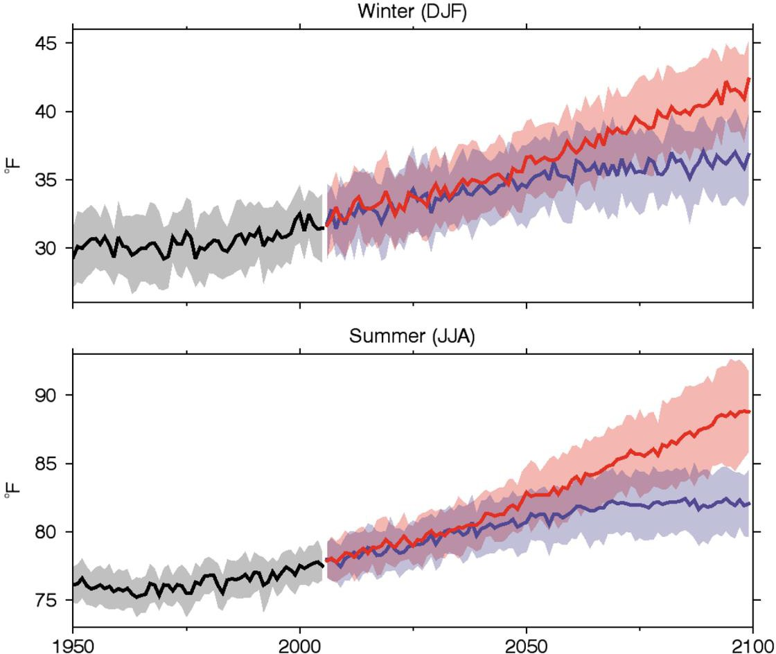


NH/VT
Winter
Projections
Historical
Higher Emissions
Lower Emissions
The coldest winters in future will be like the warmest of recent years
Summer
hottest summers …
…will become the coolest
Source: USGS
Karmalkar 2016
Notes:
NH

Slide 9
Northeast may face rapid warming
Northeast is projected to reach the 2ºC mark about 20 years before global mean T
When global mean T reaches 2ºC, Northeast is warmer by 3ºC
Karmalkar and Bradley, 2017
NE
GLOBE
80% of projections reach 2C in the NE by 2040
80% of projections reach 2C globally by 2060

Slide 10
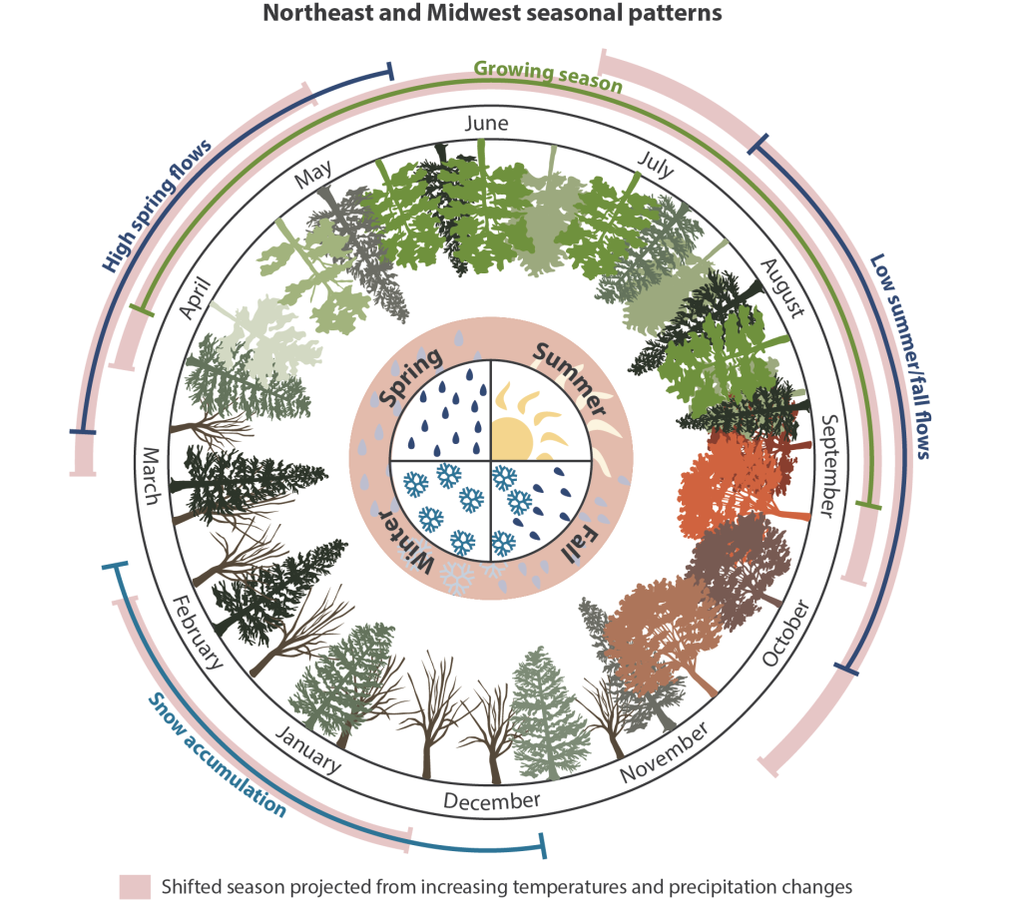

necsc.umass.edu
Notes:
The landscapes of the Northeast and Midwest depend on abundant and relatively predictable seasonal water regimes. Human uses of water compete with environmental
flows for aquatic species, especially during drought periods. With increasing temperatures and increasing precipitation variability, low water levels could
occur earlier in spring and summer months, causing earlier droughts that persist longer into the growing season. Higher temperatures result in shorter, milder winters. A shift from snowfall to rainfall in winter months will lead to changes in snow depth, snow hardness, and rain on snow events. As the frequency and period of low stream flows increase, the stress for flora and fauna dependent on water levels and seasonal wetlands will also increase. Combined with more successive days of higher than normal temperatures, this will result in increased cumulative heat stress, particularly in spring, summer, and fall. An increase in rainfall from heavy precipitation events leads to increased flooding and sediment scouring, and delivery of nutrients and pollutants to aquatic systems and downstream coastal habitats.

Slide 11
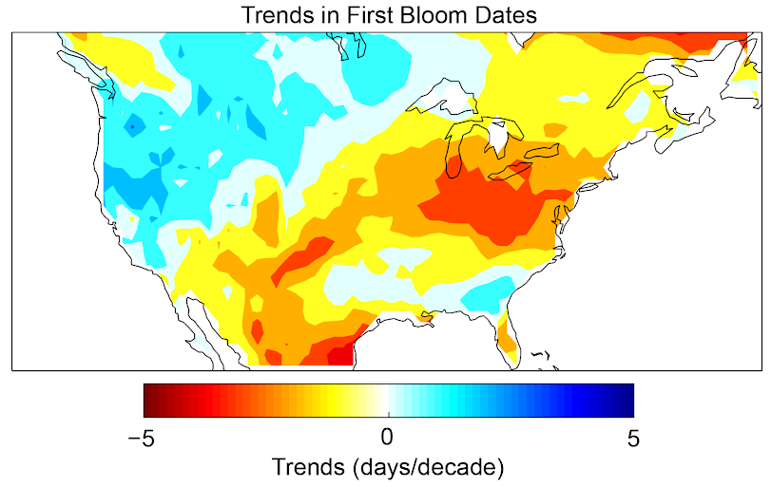
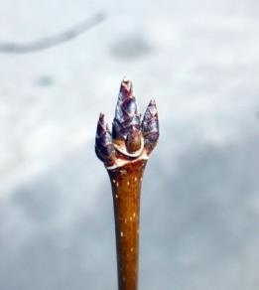
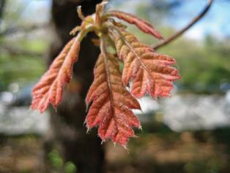
The growing season is getting longer
~half a week per decade!
Notes:
Spring is arriving earlier, fall is arriving later. This shows that the first bloom
Figure 7.3: Changes in the timing of the start of spring over the period 1981-2010, as represented by the timing of first bloom date. Reds and yellows indicate negative values (a trend toward earlier date of first leaf or bloom); blues denote positive values (a trend towards later date). Units are days per decade. Source: adapted from Ault et al. 2015

Slide 12
Habitat Vulnerability
Reinmann et al. 2018
Notes:
Spatial patterns in the vulnerability of forest growth to changes in winter climate as a function of projected declines in insulating winter snowpack and the current relative basal area of sugar maple trees. Mean historical (1951–2005) (a) and projected (2051–2099 under RCP 8.5) (b) likelihood of an insulating snowpack (>20 cm deep) being present during midwinter (January and February). (c) Projected decline in likelihood of an insulating snowpack during midwinter between the historical (1951–2005) and projected time periods (2051–2099). (d)
Current sugar maple contribution to total forest basal area (from FIA data). (e) Historic and RCP 8.5 projected changes in the area of forest influenced by an insulating midwinter snowpack. Data from the 2011 National Land Cover Database (NLCD) were used to determine forest area. Changes in forest area influenced by an insulating snowpack were calculated using a combination of the spatially explicit NLCD forest cover data and the snowpack data used for panels “a” and “c” derived from the VIC model described in the methods. “Unlikely” indicates that the probability of an insulating snowpack in any year is <50%, while “Likely” indicates the probability in any year is >50%. (f) Forest aboveground growth vulnerability to projected declines in midwinter snowpack and increases in soil freezing during 2051–2099 relative to the period 1951–2005. The Forest Vulnerability to Soil Frost Index is a unitless value that increases with forest vulnerability (i.e., potential for reduced forest productivity) and is calculated by multiplying the values in panels C and E (see Section 2 for details). We highlight RCP 8.5 projections here because it is currently the most likely scenario (Sanford, Frumhoff, Luers, & Gulledge, 2014

Slide 13
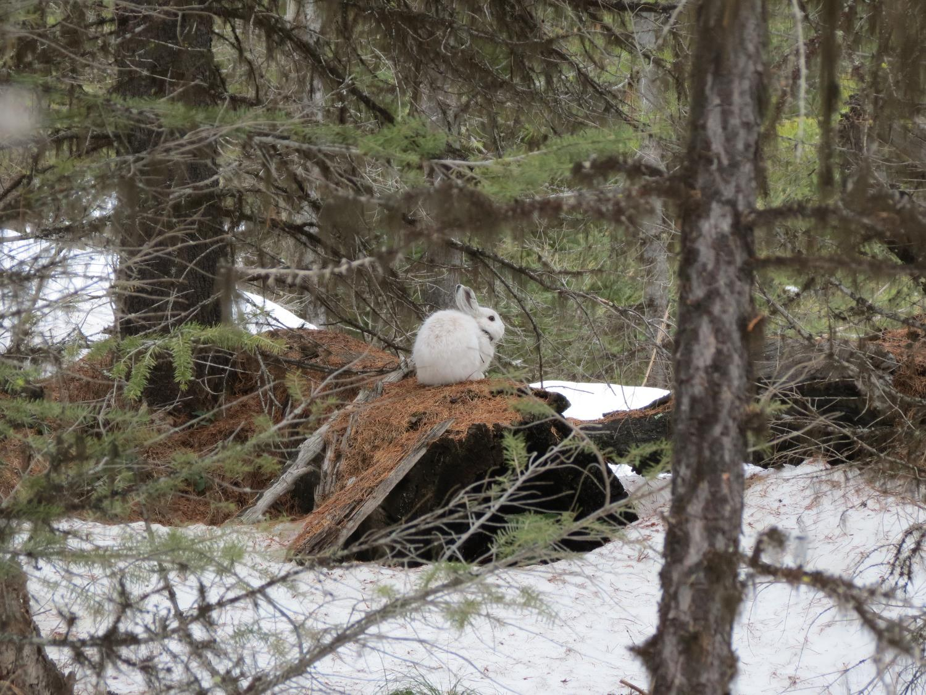
S. Faccio
Credit:
S. Mills Lab

Slide 14
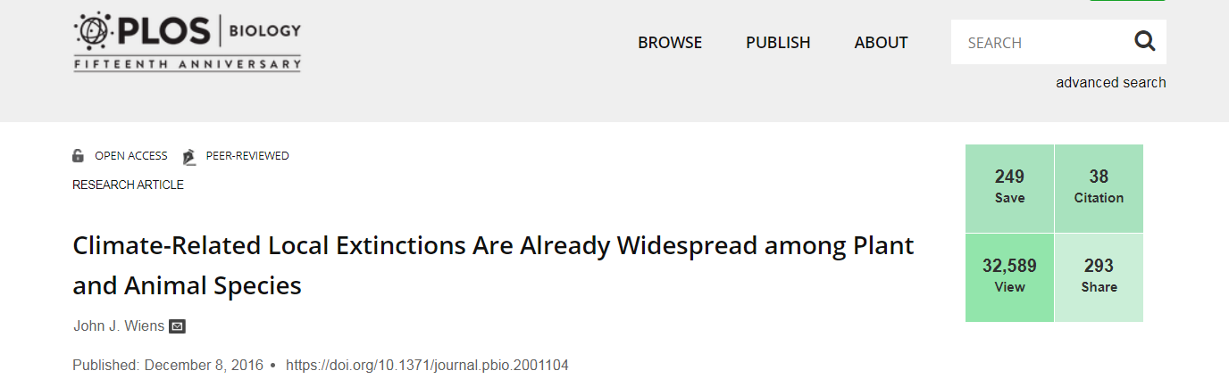
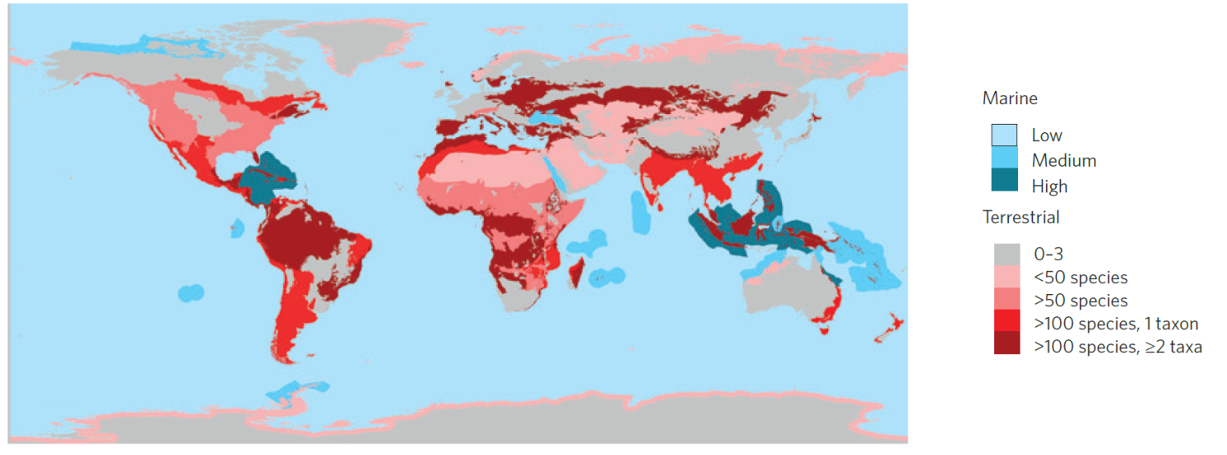
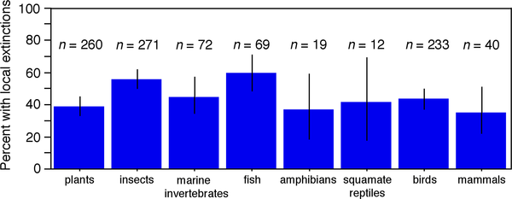
Wildlife Vulnerability
Pacifici et al. 2014, 2017 Nature Climate Change

Slide 15
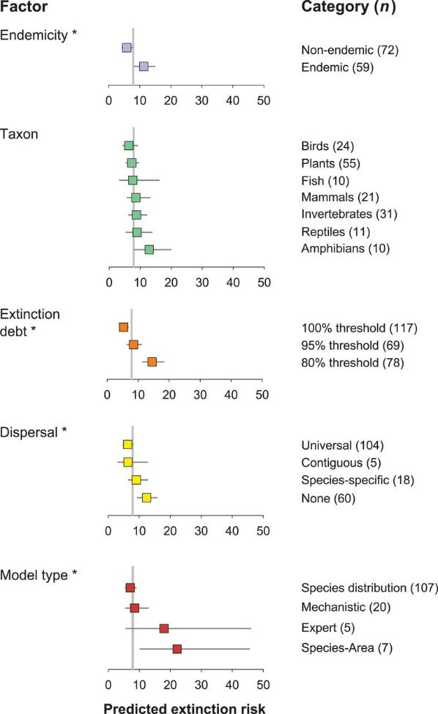
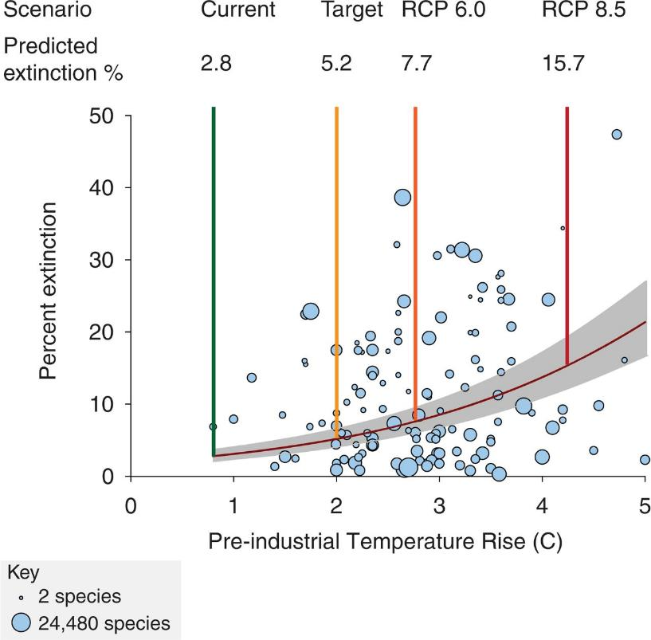
Predicted extinction risks from climate change
accelerate with global temperature rise
Urban 2015
Notes:
Predicted extinction risks from climate change accelerate with global temperature rise. The gray band indicates 95% CIs. Preindustrial rise was calculated by using standard methods (27). Circles indicate posterior means with area proportional to log₁₀ sample size (bottom left, key). Extinction risks for four scenarios are provided: the current postindustrial temperature rise of 0.8°C (5), the policy target of 2°C, and RCPs 6.0 and 8.5.

Slide 16
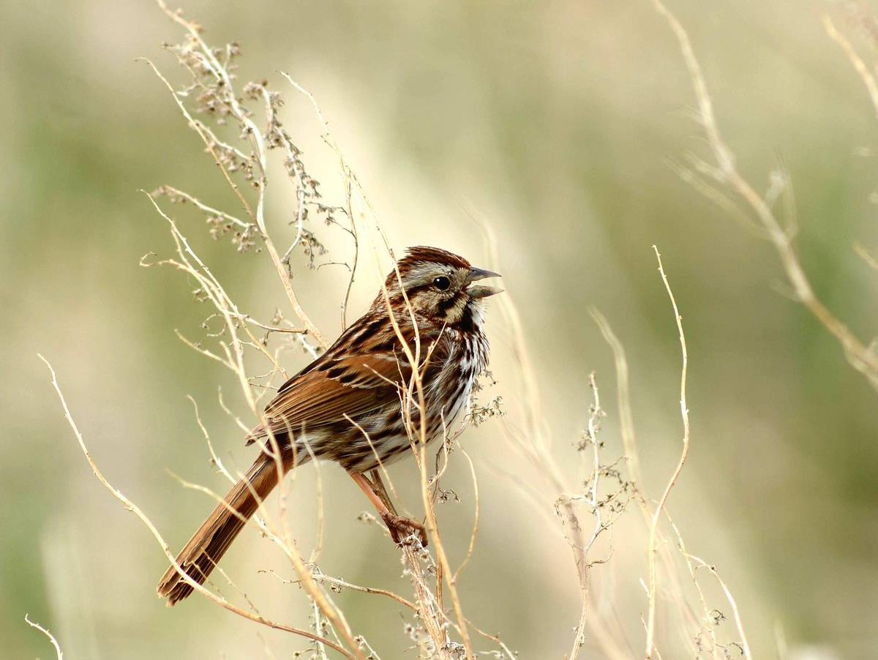
USFWS
Notes:
Fig. 3 Seasonal timing of juvenile captures (the Julian day at which 10% of young were captured) as a function of year for one early breeder: Song Sparrow, one mid-season breeder: Wood Thrush, and two late-season breeders: American Gold- finch and Cedar Waxwing. Birds were captured over five dec- ades at a constant effort mist-netting station in Pennsylvania.

Slide 17
McDermott & DeGroote 2016
Notes:
Fig. 3 Seasonal timing of juvenile captures (the Julian day at which 10% of young were captured) as a function of year for one early breeder: Song Sparrow, one mid-season breeder: Wood Thrush, and two late-season breeders: American Gold- finch and Cedar Waxwing. Birds were captured over five dec- ades at a constant effort mist-netting station in Pennsylvania.

Slide 18
McDermott & DeGroote 2016
Notes:
Fig. 3 Seasonal timing of juvenile captures (the Julian day at which 10% of young were captured) as a function of year for one early breeder: Song Sparrow, one mid-season breeder: Wood Thrush, and two late-season breeders: American Gold- finch and Cedar Waxwing. Birds were captured over five dec- ades at a constant effort mist-netting station in Pennsylvania.

Slide 19
Climate Change Vulnerability Assessments
Tools used as an initial step in adaptation planning
Identify species and habitats at greatest risk from climate change
Descriptions of why species/habitats are vulnerable
Provide index of relative vulnerabilities
Inform conservation strategies designed to reduce those vulnerabilities
Exposure
Sensitivity
Potential impact
Adaptive capacity
Vulnerability
Figure adapted from Glick et al. 2011
Notes:
Vulnerability: the susceptibility of a species, system or resource to the negative effects of climate change and other stressors (direct and indirect)
Exposure - the character, magnitude, and rate of change a species experiences
Sensitivity - the degree to which a species or habitat is likely to be affected or responsive to impacts
Adaptive capacity - the ability of a species to cope and persist under changing conditions through local or regional acclimation, dispersal or migration, adaptation, and/or evolution
Climate change vulnerability is comprised of three separate but related components: exposure, sensitivity, and adaptive capacity
Examples of Exposure - temperature, precipitation, and extreme events, but could also include habitat shifts due to changing vegetation or ocean acidification
Examples of Sensitivity – thermal tolerance, dependence on a specific hydrological regime
Examples of A/C - behavioral changes, dispersal ability, and genetic variation

Slide 20
U.S. Forest Service

Slide 21
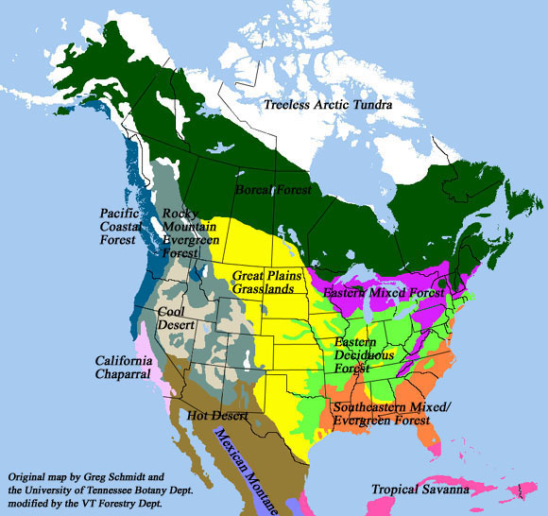
Map of boreal forest

Slide 22
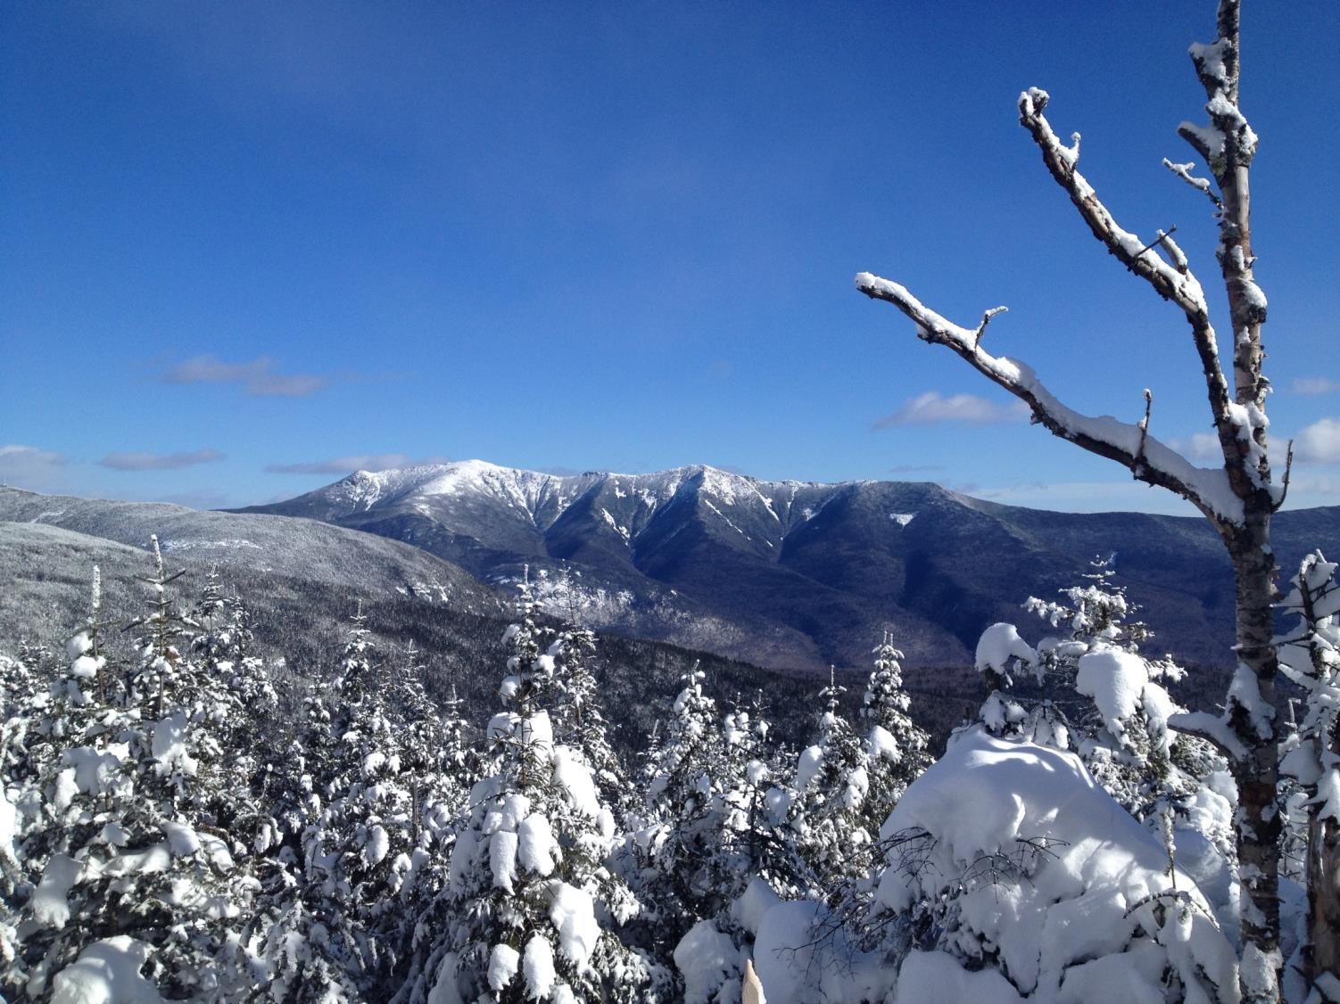
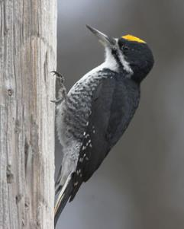
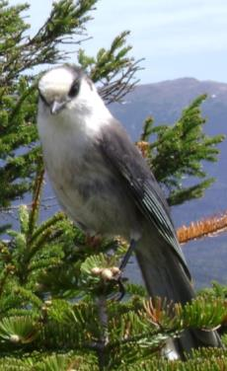
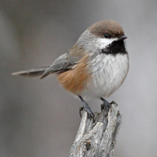
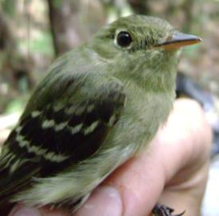
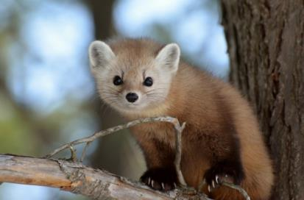
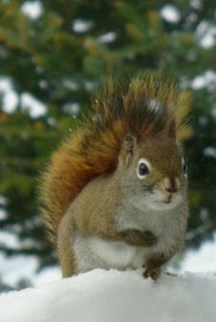
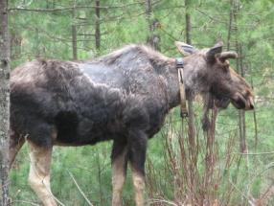
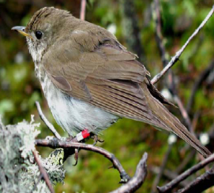
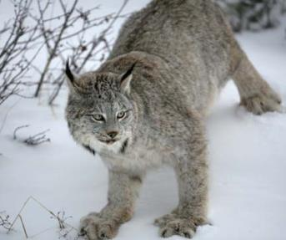
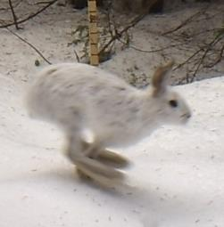
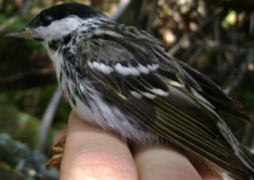
Boreal forests contribute significantly to region’s biodiversity
Notes:
The way that climate change will impact species ranges through habitat change and modify species interactions is not well enough understood. We took a community view of the climate-vulnerable, biologically-important spruce-fir forest ecosystem of the northeastern U.S., examining if and how species are responding to warming and changing precipitation patterns. We examined how fluctuations in temperature and snowpack influence distributional shifts along elevational and latitudinal gradients; for example, milder winter conditions may allow generalist carnivores such as bobcats to access boreal forest habitat, increasing direct and indirect competition with Canada lynx and American marten for prey. In another example of climate-driven predation shifts, upslope shifts of American red squirrels may increase predation rates on vulnerable montane songbirds.
We combined data from weather stations with model-based high resolution data to obtain information on historical and present climate variables. We forecasted spruce-fir forest extent using landscape and ecosystem models under a combination of global circulation model projections and representative concentration pathways for the northern Appalachians. Presence and abundance data from animal surveys were used to build occupancy models to assess the habitat, climate, and species relationships.
Species responded individually with geographic variation in response within and across species. Some species closely tracked climate changes, whereas others showed no response, or even responses such as shifts southward that were counter to what would be expected. For example, although low elevation boreal bird species showed evidence of expanding upslope, most high elevation species expanded downslope.
This work highlights the need to take a mechanistic perspective of species responses to climate change and avoid generalizations of simple shifts northward and upward. Understanding how climate change affects community dynamics will improve predictions of how individual species will respond to climate change. These predictions then provide information about how distributional shifts will occur in a biologically critical ecosystem and if there will be climate change refugia they can target for management.
Toni Lyn Morelli^{1,2,3*}, William V. DeLuca^{1,3}, Timothy R. Duclos^{1,3}, Joel Ralston⁶,
¹DOI Northeast Climate Science Center (NE CSC), ²U.S. Geological Survey,
³Department of Environmental Conservation, University of Massachusetts, Amherst, ⁴Vermont Center for Ecostudies,
⁵Association of Fish and Wildlife Agencies, ⁶Saint Mary’s College, ⁷U.S. Forest Service, Northern Research Station

Slide 23
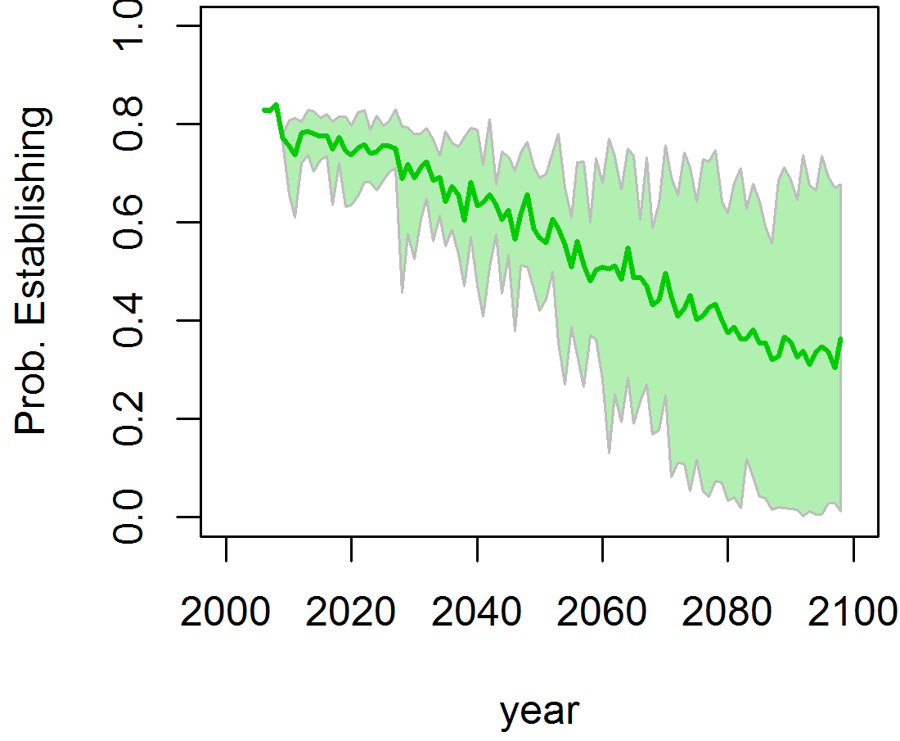
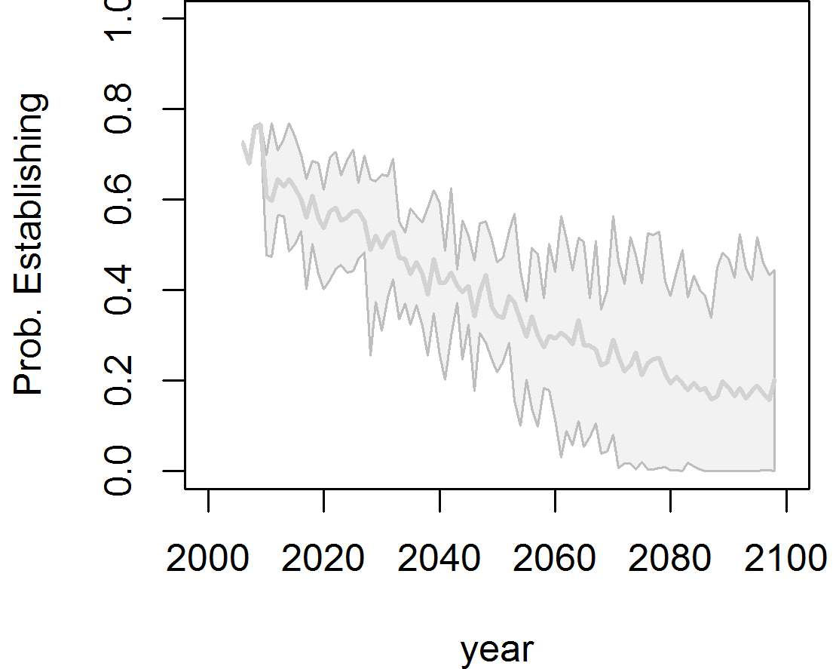
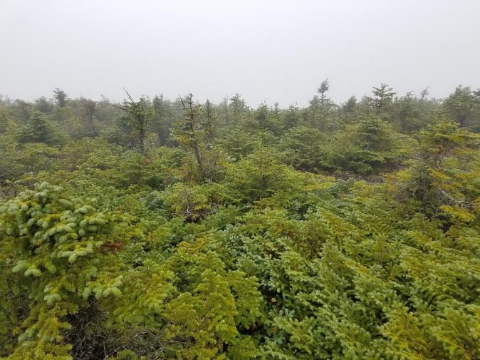
Potential vital rates under 12 climate scenarios – Fir/birch
Balsam fir
Paper birch
Foster/D’Amato

Slide 24
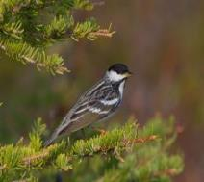
Spruce-fir obligate species are declining
BBS data
1980-2007
6.3% annual decline
Ralston et al. 2015
Notes:
Spruce-fir obligate species were more likely to decline significantly than species that use spruce-fir in addition to other habitat types

Slide 25
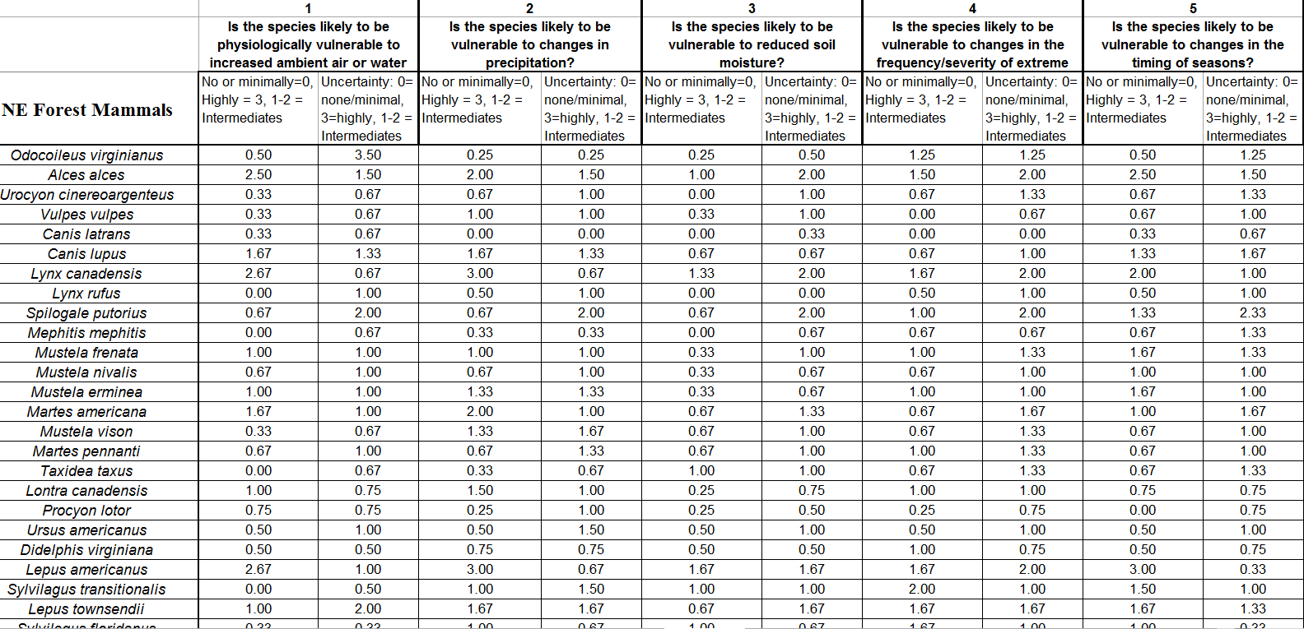
Rapid Vulnerability Assessment -
NE Forest Mammals
14 assessors, 75 species, 3-4 assessments each

Slide 26
Morelli et al. In Revision

Slide 27
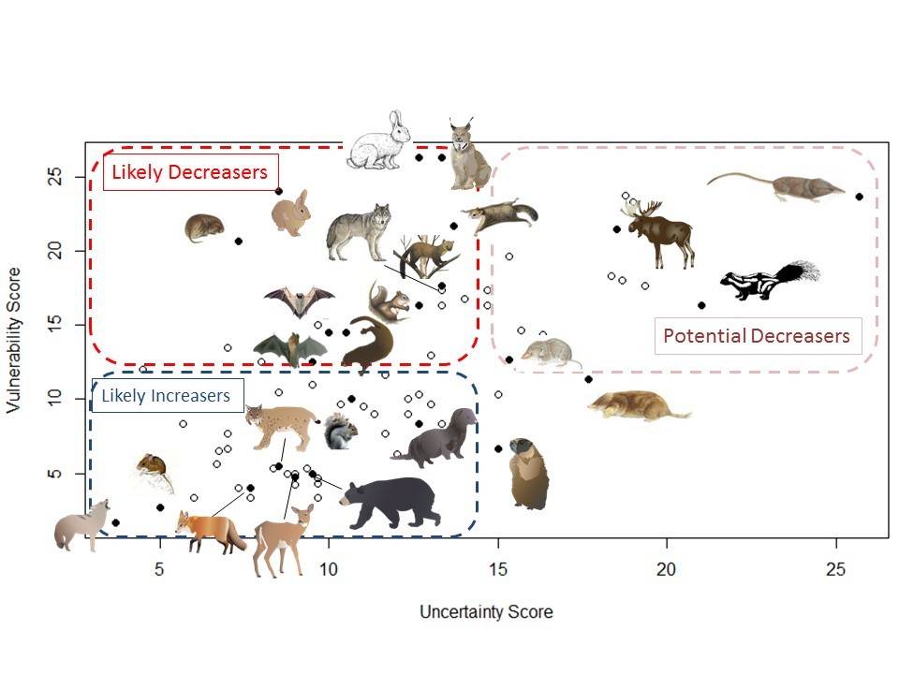
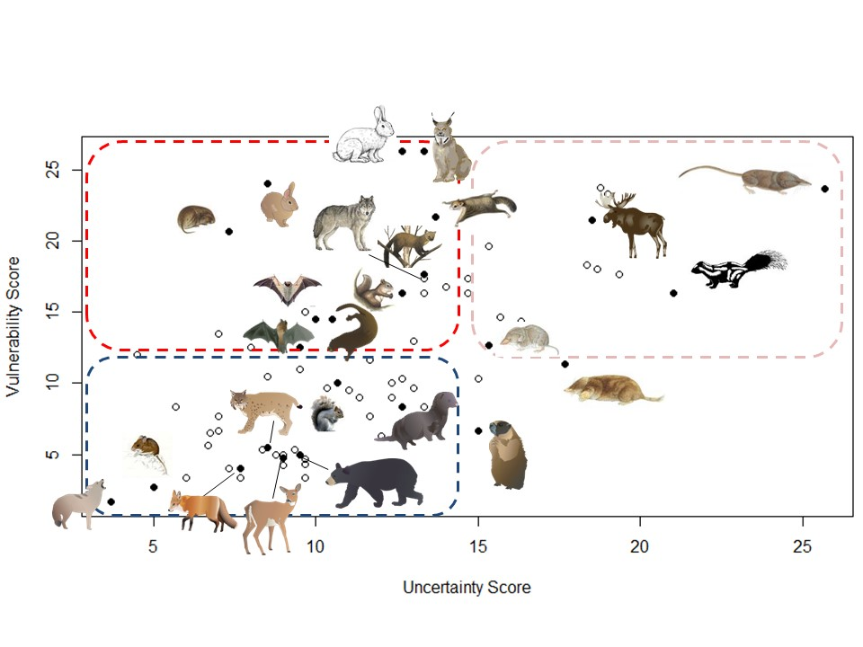
NE Forest Mammals Vulnerability
Morelli et al. In Revision
Icons courtesy of ian.umces.edu/symbols/
Notes:
Moose --- our best index (counts by deer hunters during Quabbin controlled deer hunt) is still holding pretty steady, indicating that the population around the Quabbin is still relatively stable. There may be a hint of a slight decline over the past 10 years but if true, certainly it is minor and not of the dramatic types of drops in numbers seen elsewhere such as in MN. Also, moose seem to be in pretty good shape and we are still seeing twins (indicating good nutrition and health of the females). Definitely seeing winter tick and likely brainworm, so who knows what the future may bring.
Bears --- doing really well by all indications. Population growing and spreading, good reproduction, good body condition. Seem like warmer temps are making them more active during winter months.

Slide 28
NE Forest Mammals Vulnerability
Morelli et al. In Revision
Icons courtesy of ian.umces.edu/symbols/
Notes:
Moose --- our best index (counts by deer hunters during Quabbin controlled deer hunt) is still holding pretty steady, indicating that the population around the Quabbin is still relatively stable. There may be a hint of a slight decline over the past 10 years but if true, certainly it is minor and not of the dramatic types of drops in numbers seen elsewhere such as in MN. Also, moose seem to be in pretty good shape and we are still seeing twins (indicating good nutrition and health of the females). Definitely seeing winter tick and likely brainworm, so who knows what the future may bring.
Bears --- doing really well by all indications. Population growing and spreading, good reproduction, good body condition. Seem like warmer temps are making them more active during winter months.

Slide 29
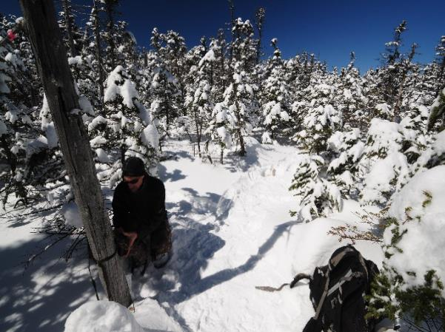
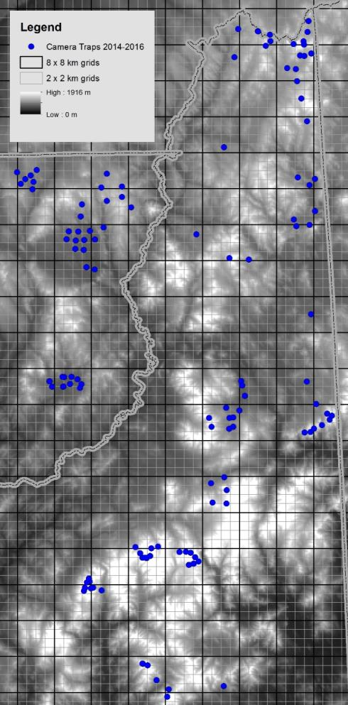
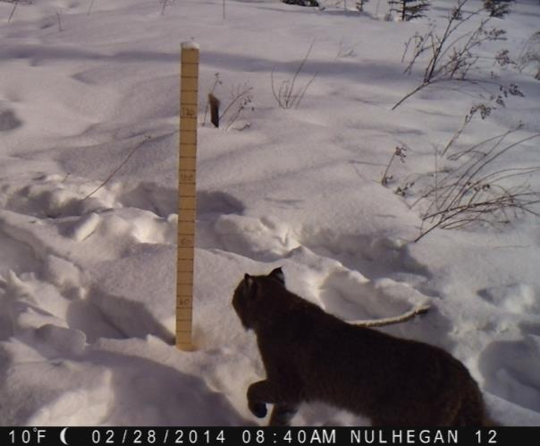
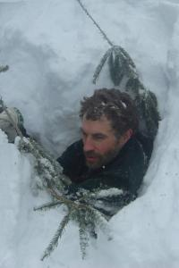
How might snow influence carnivore range shifts?
Design
  Elevation & latitudinal gradients
  Nested grids
Cameras
  Snow depth
  Temperature
  Species
Data
  Detection/non-detection
  Daily climate variables
  Structural variables
VT
NH
Alexej Siren
Notes:
Describe camera trap method.

Slide 30

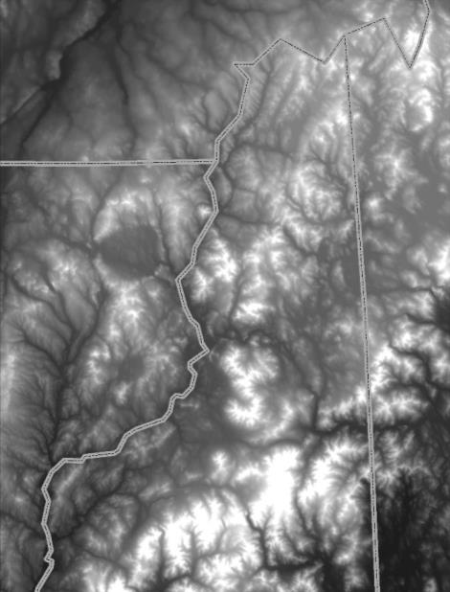
Evidence of snow influencing latitudinal range
Winters 2010-2011
Winters 2012-2013
Winters 2014-2015
Lynx Colonization
Lynx retreat
Lynx colonization
Siren In Prep
Notes:
Teasing out the influence of snowpack-distribution dynamics with respect to latitude.

Slide 31
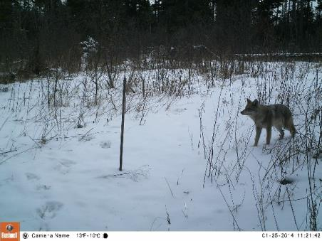
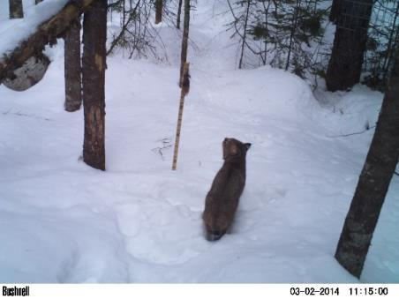
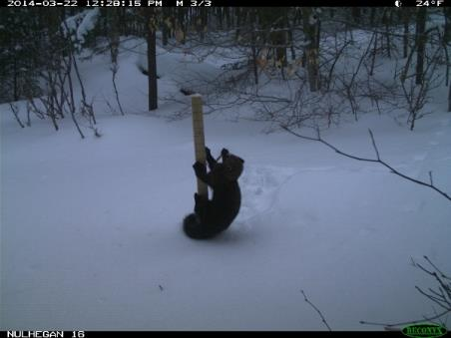
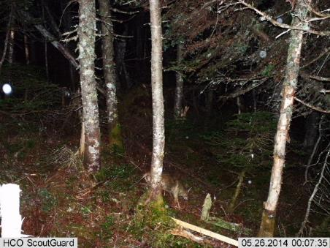
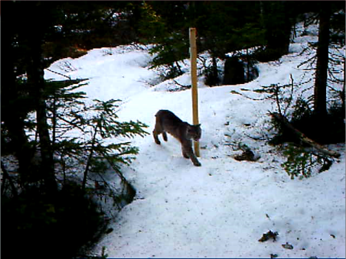
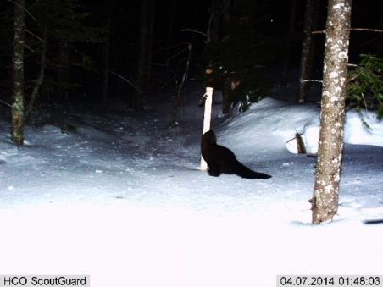
Evidence of snow influencing elevational range
coyote
bobcat
fisher
Mid-winter
Generalists at Low Elevations
Late winter
Generalists at High Elevations
Notes:
Increase in high elevation detections of generalist carnivores as snowpack melts and dis

Slide 32





Donovan Drummey
ECO, UMass
>36,000 photos, 30 individs
561 km trails of scat surveys (n=658)
Notes:
33 cameras
5 lines
10-11 blocks/line
3 cameras sites/block
Set for 10 days
Rebaited after 5 days
Cameras set February 2nd thru April 7th
Total of 1560 survey nights

Slide 33


Preliminary results
Marten Density Plot
Our density:
$\hat{D}$ = 0.11 individuals/km²
Other reported densities:
0.5 – 1.7 individuals/km²
Northing
Donovan Drummey
ECO, UMass
Easting

Slide 34
NE Forest Mammals Vulnerability
Morelli et al. In Revision
Icons courtesy of ian.umces.edu/symbols/
Notes:
Moose --- our best index (counts by deer hunters during Quabbin controlled deer hunt) is still holding pretty steady, indicating that the population around the Quabbin is still relatively stable. There may be a hint of a slight decline over the past 10 years but if true, certainly it is minor and not of the dramatic types of drops in numbers seen elsewhere such as in MN. Also, moose seem to be in pretty good shape and we are still seeing twins (indicating good nutrition and health of the females). Definitely seeing winter tick and likely brainworm, so who knows what the future may bring.
Bears --- doing really well by all indications. Population growing and spreading, good reproduction, good body condition. Seem like warmer temps are making them more active during winter months.

Slide 35

Alexej Siren

Slide 36



Moose: Climate Vulnerable
More forage
  Pests
  Extreme events
Shorter winters
Heat Stress
Higher deer abundance
More winter ticks
Dave Wattles
Notes:
Snail = brainworm

Slide 37

Winter tick life cycle and climate
Timing of spring snowmelt
can affect tick abundance later
in fall - survival and potential
for egg laying is lower if
females fall on snow versus
bare forest ground
Mar-April
The swollen females disengage from
the animal and fall to the ground
Feb-Mar
The adults feed
and mate on the host
Oct-Feb
The nymphs feed
on the host and
transform into adults
Hotter and dryer falls
may decrease survival
of winter tick larvae
Sept-Nov
The larvae feed
on the host and
transform into nymphs
Timing of first snowfall
can impact tick loads
during winter
June
The swollen females lay their
eggs on the ground
Sept-Oct
The larvae climb onto
plants and wait for a host to come by

Slide 38









































Scenario Planning

Slide 39
NE Forest Mammals Vulnerability
Morelli et al. In Revision
Icons courtesy of ian.umces.edu/symbols/
Notes:
Moose --- our best index (counts by deer hunters during Quabbin controlled deer hunt) is still holding pretty steady, indicating that the population around the Quabbin is still relatively stable. There may be a hint of a slight decline over the past 10 years but if true, certainly it is minor and not of the dramatic types of drops in numbers seen elsewhere such as in MN. Also, moose seem to be in pretty good shape and we are still seeing twins (indicating good nutrition and health of the females). Definitely seeing winter tick and likely brainworm, so who knows what the future may bring.
Bears --- doing really well by all indications. Population growing and spreading, good reproduction, good body condition. Seem like warmer temps are making them more active during winter months.

Slide 40






UNH HCGS
USFS
Smith 2012
Roger Barbour
Don Chernoff
Krichbaum et al. 2010
Notes:
Northern flying squirrels (Glaucomys sabrinus) are an example of a species threatened by the indirect effects of climate. The northern forest that the northern flying squirrel inhabits is shifting northward (Iverson et al. 2008). Climate change may decrease the fungi and lichen that are important food sources for the northern flying squirrel. Most notably, habitat and temperature changes are already allowing southern flying squirrels (Glaucomys volans) to expand northward, with a subsequent decline of northern flying squirrels associated with disease transmission and competition (Smith 2012).

Slide 41
NE Forest Mammals Vulnerability
Morelli et al. In Revision
Icons courtesy of ian.umces.edu/symbols/
Notes:
Moose --- our best index (counts by deer hunters during Quabbin controlled deer hunt) is still holding pretty steady, indicating that the population around the Quabbin is still relatively stable. There may be a hint of a slight decline over the past 10 years but if true, certainly it is minor and not of the dramatic types of drops in numbers seen elsewhere such as in MN. Also, moose seem to be in pretty good shape and we are still seeing twins (indicating good nutrition and health of the females). Definitely seeing winter tick and likely brainworm, so who knows what the future may bring.
Bears --- doing really well by all indications. Population growing and spreading, good reproduction, good body condition. Seem like warmer temps are making them more active during winter months.

Slide 42



Wildlife Responses to Climate Change
Notes:
Fix the animations
Add Snowshoe hare

Slide 43
Wildlife Responses to Climate Change
Notes:
Fix the animations
Add Snowshoe hare

Slide 44


Are Red Squirrels Shifting their Ranges?
1075 sites surveyed from 1999-2014 = 5,464 detections/ nondetections
Data from DeLuca, Duclos, VCE bird surveys
Notes:
Fig 4. Field Sites where red squirrels were sampled, color-coded by study
Occupancy modeling framework in the R package “unmarked”

Slide 45






Boreal bird communities are shifting their ranges
125 m (±24.3m) upslope shift, 1993-2009
DeLuca & King 2017, J. of Ornithology
Notes:
Low elevations bird species appear to be tracking this habitat shift upslope

Slide 46


No apparent range shift
Faccio
Morelli et al. In prep
Notes:
A model with year as a detection covariate and year and elevation as occupancy covariates was selected as the best model according to AIC. Mean detection probability was 0.46 across sites. However, we did not find an increasing trend in occupancy by elevation over the 15 years of surveys; there was no difference between the early surveys and the later surveys.

Slide 47

Predicted to
move upslope

Slide 48


So far, not moving up!
Green Mountains
White Mountains
upper boundary elevations
lower boundary elevations
for the boreal-hardwood forest ecotone
Foster and D’Amato
2015 PNAS
Notes:
between weighted means of boundary locations detected in spring leafoff conditions (understory visible to sensor, 1991 to 2010). Dotted grey lines and circles show boundary locations detected in fall conditions (understory less visible to sensor, 1984, 2000, and 2011).
Fig. 3. Violin plots show the distribution of upper (blue) and lower (yellow) boundary elevations for the boreal-hardwood forest ecotone in the Green Mountains (a) and the White Mountains (b). Black dashed lines and circles show the trend between weighted means of boundary locations detected in spring leafoff conditions (understory visible to sensor, 1991 to 2010). Dotted grey lines and circles show boundary locations detected in fall conditions (understory less visible to sensor, 1984, 2000, and 2011). Data represented by violin plots varies by year as shown by the number of subset models (n) that could be fit in each Landsat date. Lower ecotone boundary distribution is offset +0.5 years for clarity. Error bars show ±1 SD (variance among subset models).

Slide 49





Boreal bird communities are changing
9 of 11 species 19 m downslope shift, 1993-2009
DeLuca & King 2017, J. of Ornithology
Notes:
Low elevations bird species appear to be tracking this habitat shift upslope

Slide 50










New England Adaptive Silviculture for CC
New England Adaptive Silviculture for Climate Change (ASCC)
Co-developed, operational (~400 acre) examination of adaptive silviculture
Dartmouth College Second College Grant, NH

Slide 51



New England Adaptive Silviculture for CC
Experimental Treatments for New England ASCC (4, 25-ac reps)
Resistance | Resilience | Transition
Single-tree selection 70-80 ft²/ac Multi-cohort structure ↑ downed dead wood Favor BBD resistant residual stems | Group selection and single-tree selection 20% gaps 0.01-0.25 ac / 20% reserves / matrix of 70-80 ft²/ac Multiple pathways ↑ downed dead wood ↑ wind and ice resistant species | Variable density thin / Irregular shelterwood 20% gaps 0.25-1 ac / 10-20% reserves / matrix 70-80 ft²/ac ↑ future-adapted component through planting

Slide 52


SiMPL ASCC
Dead Diamond, Block 3
Camera spacing
  200-300 m apart
4 treatments/block
  Transition
    3 cameras
  Resistance/Control
    2 cameras
  Resilience
    1 camera

Slide 53

SiMPL
1-2 m from trap
peanuts & peanut butter
check 4-5x/year
species presence-absence
Snow depth

Slide 54


Slide 55


Slide 56


Slide 57


Slide 58

What Can We Do About It?

Slide 59

What can we do about it?
Areas relatively buffered from contemporary climate change that enable persistence
of valued physical, ecological, and socio-cultural resources
Notes:
One focus of a resistance strategy can be climate change refugia, a concept borrowed in recent years from the field of paleoecology to the XX of climate adaptation. Last year, a group of scientist and management colleagues of mine, after lengthy discussions across disciplines and partnerships, published a definition of climate change refugia as “Areas…

Slide 60



Slide 61



Slide 62
Morelli et al. 2016
PLOS ONE
Notes:
Minimize overgrazing impacts; Remove encroaching conifers; Remove invasive species; Mitigate road and trail impacts; Assist migration of lower elevation meadow species; Species translocation; Snow fencing to trap snow in desired locations; Manage recreation and development to minimize negative impacts; Increase connectivity

Slide 63


Forest modeling landscapes - UVM - LANDIS-II
Jane Foster & Tony D’Amato UVM/NECSC/WSC
Green Mountains - Completed
Adirondacks - Expected fall 2018
Marsh Billings ~ 2018
White Mountains ~ 2019
Northeast Kingdom ~ 2019
Adaptive Silviculture for Climate–
- Dartmouth 2nd College Grant
Northeast Kingdom
Adirondacks
Whites
Marsh
Billings
Greens

Slide 64



LANDIS-II Scenarios
Climate RCP 4.5, 8.5 | Wind | Insect | Harvest
Current | X | X | X
CCSM4 | X | X | X
CESM1 | X | X | X
HadGEM2 | X | X | X
MPI-ESM | X | X | X
200 year simulations, annual timesteps.
Climate data from CMIP-5 GCMs, NEX 800 m resolution
Photos:
FTC: Ronald S. Kelley, Vermont Department of Forests, Parks and Recreation, Bugwood.org
Logging: Brian Lockhart, USDA Forest Service

Slide 65











2200
2150
2050
2100
2010
2010
Results: Current Climate
Results: CMIP5 GCM RCP 8.5

Slide 66



Notes:
ADD NW SCREENSHOT

Slide 67
Morelli et al. 2016
PLOS ONE
Notes:
Minimize overgrazing impacts; Remove encroaching conifers; Remove invasive species; Mitigate road and trail impacts; Assist migration of lower elevation meadow species; Species translocation; Snow fencing to trap snow in desired locations; Manage recreation and development to minimize negative impacts; Increase connectivity

Slide 68

http://necsc.umass.edu/projects

Slide 69




Slide 70


www.treesearch.fs.fed.us/pubs/40319

Slide 71
CPST Framework
Documented review of ongoing or near-term projects to ensure that CC is considered
Begins the discussion of how the project might impact climate change, or how climate change will impact the project
Identifies relevant modifications to projects
Priority-Setting
Identifies projects that need comprehensive redesign or cancellation
Process-oriented
Notes:
This tool is intended to help integrate climate change considerations at the pre-NEPA project planning level.
It allows you to document whether or not climate change was considered in a project and whether or not the project will aid in climate adaptation efforts
The CPST addresses ongoing or near-term projects that would benefit from review for consistency with adaptation goals. It acts as an audit or review tool to remind managers to consider climate change in current and impending projects; if issues arise during the review that suggest climate implications conflicting with project design, modifications to projects can be recommended to the approving decisionmaker. The CPST also serves as a review of priorities among current projects; whereas project goals and treatments may not need modification, climate concerns might trigger changes in resource allocation. Finally, some projects as originally designed might be deemed inappropriate altogether, and these would be recommended to the deciding officer for comprehensive redesign or removal from activity lists.
We found that the CPST is process-oriented, whereby the activity of going through the questionnaire is as important as the answers themselves. In considering the general implications of climate change for their resource area, staff brainstormed how these climate-change effects would manifest at the project site and reassessed the assumptions and objectives they used to determine current practices. The CPST is also a priority-setting tool, allowing managers to consider effects of different actions and direct management accordingly. Finally, the CPST, by exploring local climate change effects, helps lower uncertainty by identifying the range of impacts that management actions may have on resources.

Slide 72

Climate Project Screening Tool

Slide 73



Notes:
All files and further information are available at our website

Slide 74





climateactiontool.org
Notes:
Homepage
Learn about climate change
Start off by explaining how you can learn more about climate change impacts in MA
Can also access through quick start

Slide 75


necsc.umass.edu
Notes:
This and a lot of other information can be found on our NE CSC website

Slide 76

Toni Lyn Morelli tmorelli@usgs.gov
Questions?
Notes:
Global causes

