Slide 1
Fifteen-Year Update on Vermont Long-term Soil Monitoring Study
Thom Villars, USDA NRCS
Don Ross, University of Vermont
Scott Bailey, USFS Northern Research Station
Angie Quintana, USFS GMNF
Jim Duncan, VT Forest Ecosystem Monitoring Cooperative
Sandy Wilmot, Vermont Dept. of Forest, Parks and Recreation
Deane Wang, University of Vermont

Slide 2
Long-term forest soil monitoring
Overall goal - detect changes in soils due to (indirect) human-caused impacts (i.e. air pollution, climate change) at two forested sites in Vermont.
Monitoring strategy - measure changes in soil properties in forest locations where ecological processes (nutrient cycling, ecosystem development, disturbance) are in a “steady state.”

Slide 3
Why establish a long-term forest soil monitoring study?
What are the impacts of air pollution and climate change on forest soil quality?
fate of heavy metals (e.g. mercury and lead) deposited from the atmosphere
loss of available nutrients (especially calcium and magnesium) from acid anion-induced leaching
Changes in nitrogen status due to nitrogen saturation
changes in carbon due to decomposition and/or sequestration
loss of biodiversity and forest productivity (growth and mortality rates)
degradation of water quality (increases in heavy metal, aluminum and nitrate concentrations, and decreases in pH, base cations and alkalinity).
Documentation of temporal patterns in forest soil quality is rare and difficult to obtain due to -
confounding effects of spatial variability, and
the slow rate of change in soils compared to the time span of typical scientific studies.

Slide 4
Initial Project Goals:
Establish five 50 x 50 m relatively uniform plots in sites associated with the VMC.
Sample plots at designated intervals: 0, 5, 10, 25, 50, 100, 150, and 200 years (with 2 other times in reserve)
Year 0 = 2002
Analyze initial samples to determine baseline values.
Archive samples for later comparisons.
Protect the plots for future monitoring.

Slide 5
5 Monitoring Sites:
Mt. Mansfield Ranch Brook
northern hardwood
Mt. Mansfield Forehead
high elevation spruce/fir
Mt. Mansfield Underhill State Park
transitional forest
SCAN site
Lye Brook “Road”
northern hardwood
SCAN site
Lye Brook “Trail”
transitional forest

Slide 6
Sampling years have been:
Year 0 – 2002
Year 5 – 2007
Year 10 – 2012
Year 15 - 2017
Sampling Protocols for 2007, 2012, 2017:
4 large sample bags collected from each soil pit
Oi and Oe combined: Litter layer
Oa and/or A: near-surface humified horizons
B horizon: Top 10 cm
Between 60-70 cm (usually is the C horizon)
And small sample bags of each genetic horizon
Fourth sampling round of all sites was completed in summer of 2017.
No lab data available for these samples yet.

Slide 7
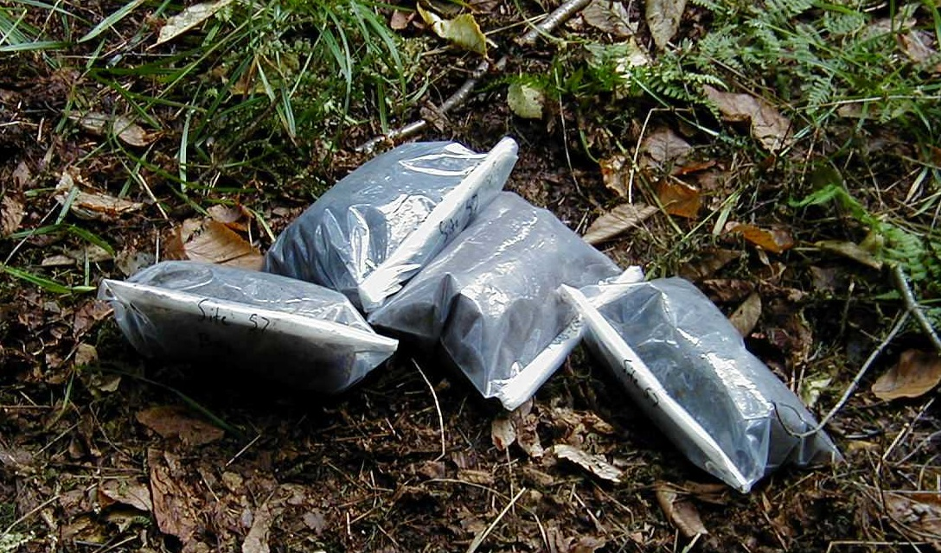
Four bulk samples taken from each soil pit

Slide 8
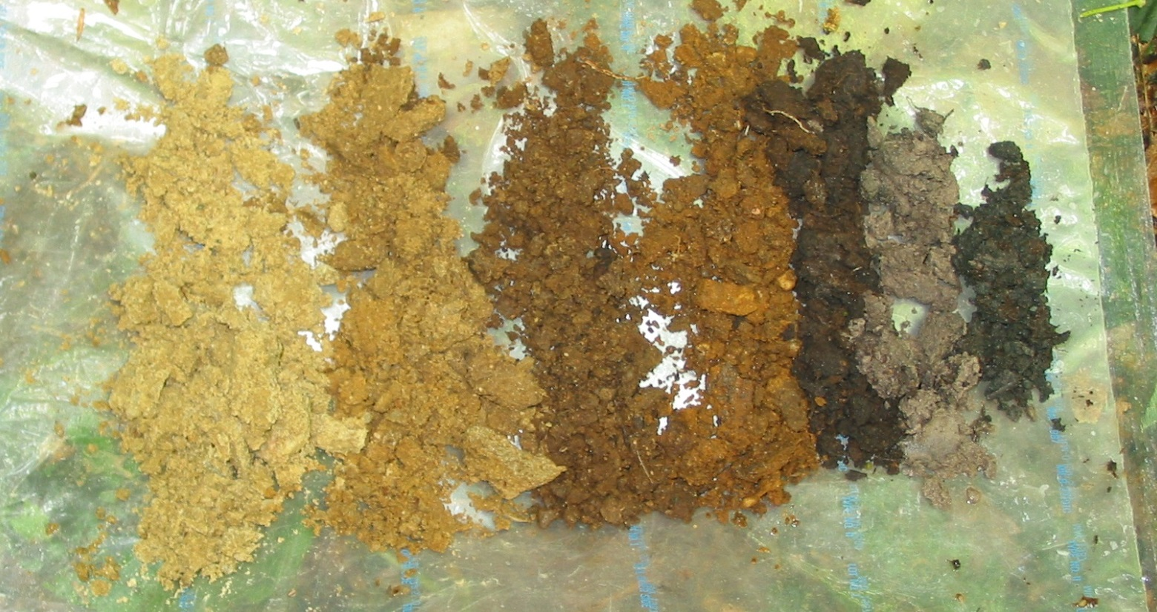
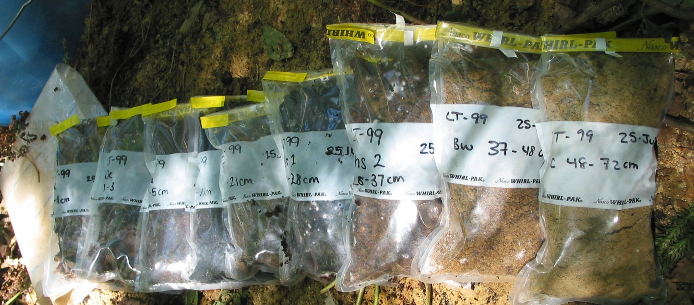
Genetic horizons at each soil pit
sampled in smaller bags

Slide 9
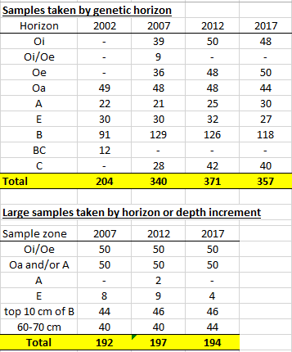
Over 1800 soil samples have been collected since 2002 at the 5 study sites.
The last three sampling rounds have each generated over 500 unique soil samples. These are used for lab analysis and are archived at UVM.
=1855

Slide 10
(Almost) everyone involved in 2017:
Sandy Wilmot, Vermont Forests, Parks and Rec
Joshua Halman, Vermont Forests, Parks and Rec
Isaac Estey, Vermont Forests, Parks and Rec
Deane Wang, UVM
Don Ross, UVM
Emily Piersiak, UVM
Liza Lemieux, UVM
Jim Duncan, FEMC
John Truong, FEMC
Matt Gorton, FEMC
Scott Bailey, US Forest Service, Northern Research Station
Emily Piche, US Forest Service, Northern Research Station (now UVM)
Angie Quintana, US Forest Service, GMNF
Josh Lobe, US Forest Service, GMNF
Thom Villars, NRCS-VT
Alexis Clune, NRCS-VT
Vermont Youth Conservation Corps (8 crew members)
Funding generousy provided by FEMC and Green Mountain and Finger Lakes National Forests

Slide 11
VYCC crew getting digging instructions on 2017 Day One at Ranch Brook site

Slide 12
Kat, VYCC, using sign (ASL) with her co-workers

Slide 13
Scott Bailey, USFS, and Emily Piersiak, UVM, sampling at Forehead site

Slide 14
Angie Quintana-- end of a long day, or thinking about her truck breaking down on Mt Mansfield Toll Road?

Slide 15
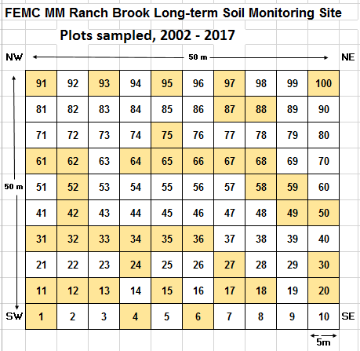
Typical site plan with 100 5x5m plots.
Plots in yellow have been sampled in 2002-2017 (40 plots to date).

Slide 16
What have we learned in the last 15 years?
There is a lot more soil variability than anticipated. Separating trends from natural variation is a challenge.
With data from 4th sampling round in 2017, we are just to the point of having enough data to establish baseline levels.
Sampling years require a lot of work, a lot of time, a lot of travel, a lot of coordination, and a lot of people. And good luck with the weather.
Archiving samples is an ongoing challenge.
Sampling intervals needed to be changed to consistent time interval – 5 year interval. Length of study shortened from 200 years to 50 years. With precise GPS, we hope to split and re-use each plot up to 4 times, which would add to number of sampling rounds available.
Passing the project on to the next generation of scientists is underway.
There are unexpected (and perhaps as yet unknown) benefits to the study, as new environmental concerns come to the fore, such as climate change and effects of invasive forest pests like ALB & EAB.

Slide 17
Time period between sampling years revised from increasing yearly interval to constant 5 year interval
2027

Slide 18
Forehead soil profiles – all years FH is only site that has bedrock within depth of study

Slide 20
Carbon in the soil = almost half of all C stored in forest Estimates of carbon stored in Vermont forests, and the annual removal of CO₂ from the atmosphere through forest sequestration.

Slide 21
Lye Brook Trail soil profiles – all years

Slide 22
Lye Brook Trail plot 1 with thick O horizon

Slide 23
Ranch Brook soil profiles – all years

Slide 24
Ranch Brook plot 15 with shallow O horizon

Slide 25
Range in thickness of organic soil layers - Lye Brook Trail vs Ranch Brook

Slide 26
Carbon in the Oa/A horizon

Slide 27
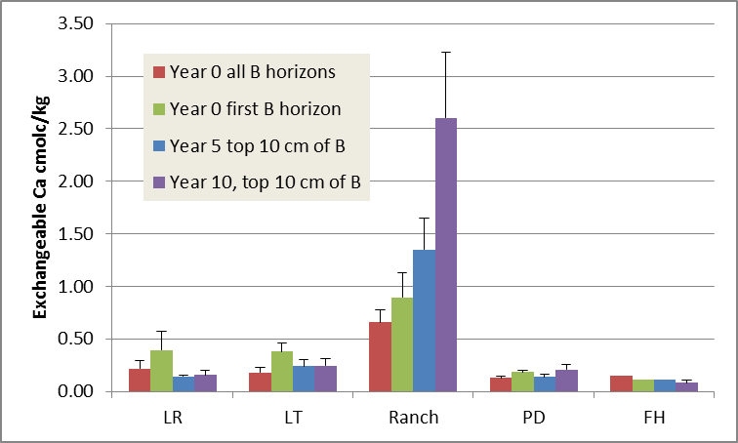
Exchangeable Calcium in B horizons
(Ranch Brook in class by itself)

Slide 28
Can soil show evidence of climate change?

Slide 29
New analysis by research institute Climate Central of average wintertime temperatures since 1970 reveals that the U.S. city that’s experienced the most warming is Burlington, Vermont, where average winter temperatures have risen 7°F in the last 47 years.

Slide 30
Steering Committee Membership
The planning for a long-term soil monitoring study began with a workshop held at the Proctor Maple Research Center in April,1998. From this initial discussion, a working group was formed to move the project forward:
Tim Scherbatskoy (UVM) (moved out of state)
Nancy Burt (USFS-GMNF) (retired 2013)
Deane Wang (UVM)
Sandy Wilmot (VT-ANR)
Thom Villars (NRCS)
Don Ross (UVM)
Scott Bailey (USFS-NERS)

Slide 31
In 2017, the FEMC (previously VMC, …and VForEM) Vermont Long-term Soil Monitoring Project Steering Team is:
Angie Quintana, USFS Green Mountain National Forest
Jim Duncan, VT Forest Ecosystem Monitoring Cooperative
Deane Wang, University of Vermont (retired June 2017)
Sandy Wilmot, Vermont Dept. of Forests, Parks and Recreation (retiring January 2018)
Thom Villars, USDA Natural Resources Conservation Service (2022)
Don Ross, University of Vermont (2022)
Scott Bailey, USFS Northern Research Station (2022)

Slide 32
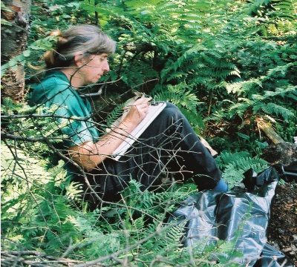
Thank you, Sandy!

