Slide 1


Ridges, Valleys, Bedrock & Soil: Using the Physical Landscape to Conserve Species in a Changing Climate
Liz Thompson, Bob Zaino

Slide 2
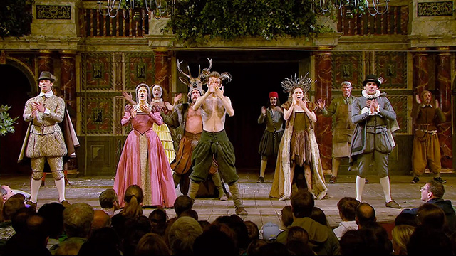

Slide 3
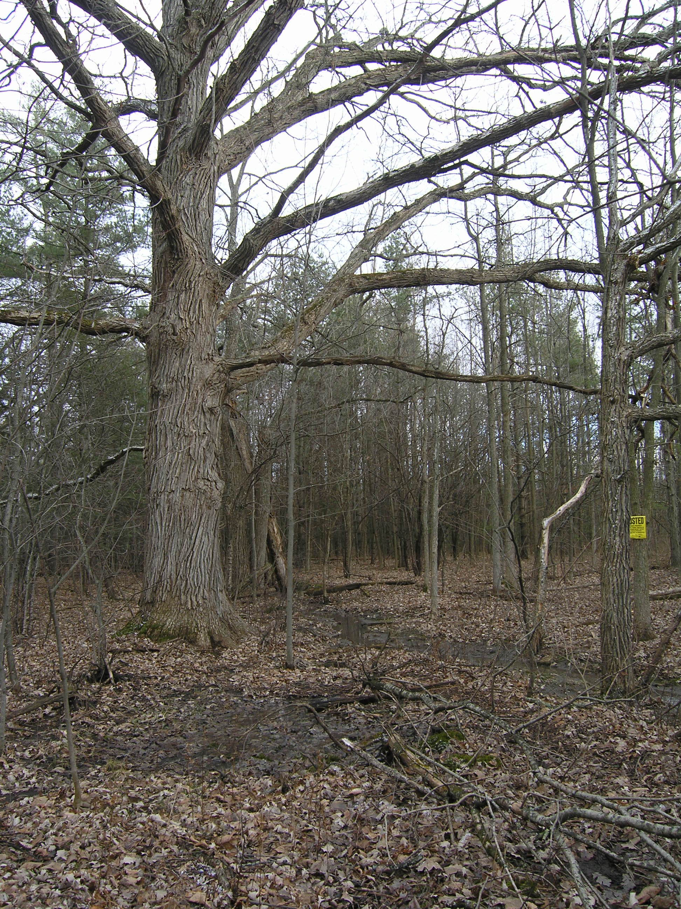

Slide 4
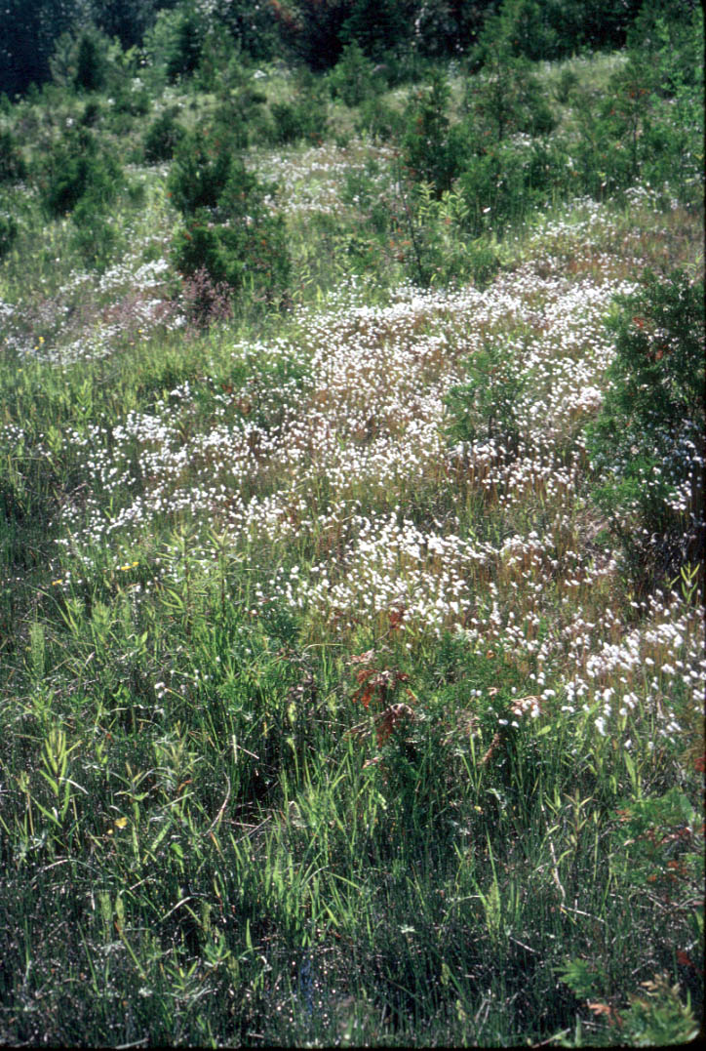

Slide 5
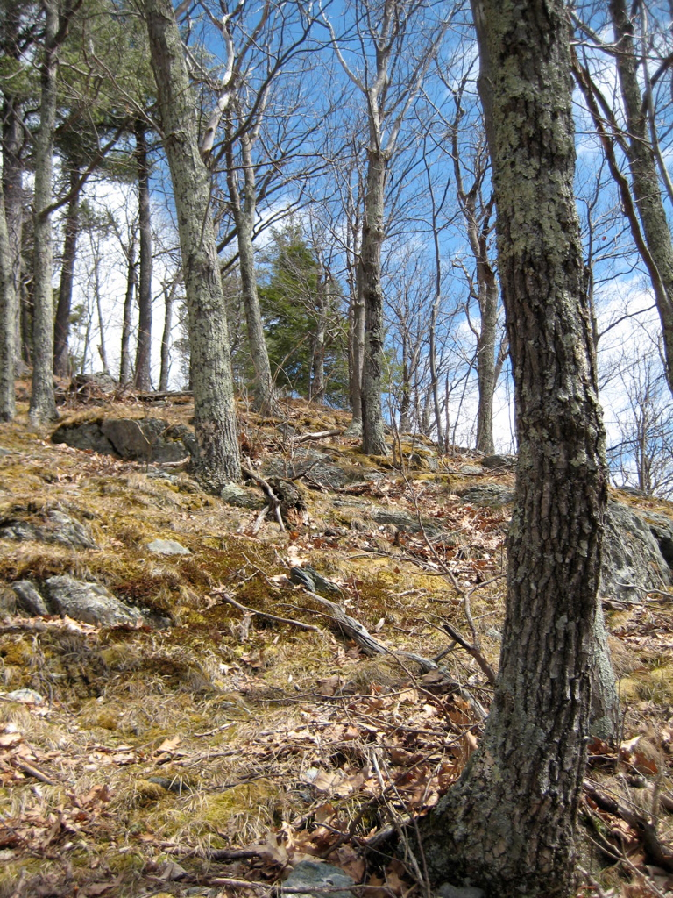

Slide 6
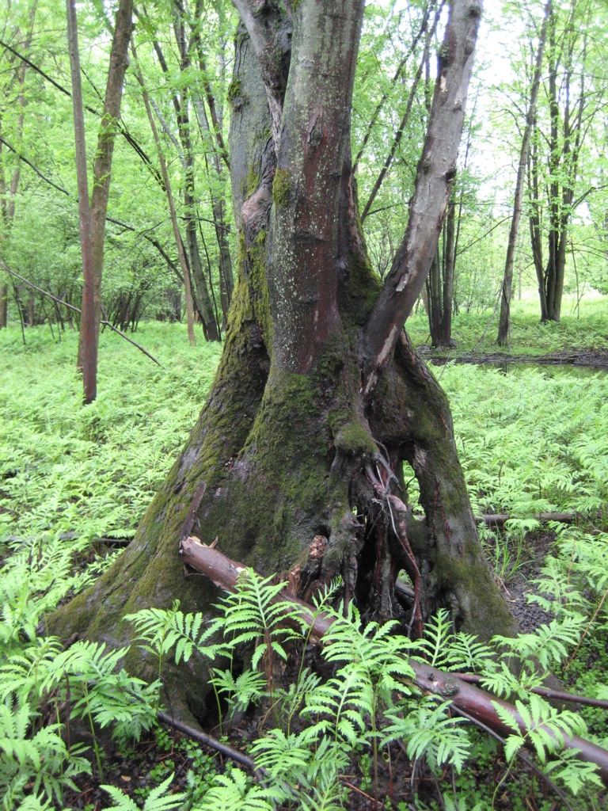

Slide 7
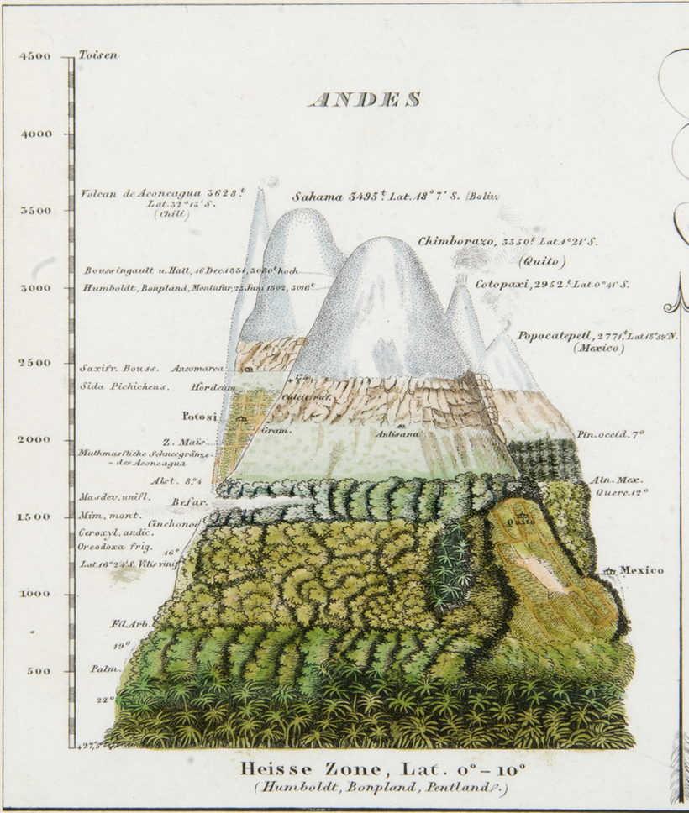

Slide 8
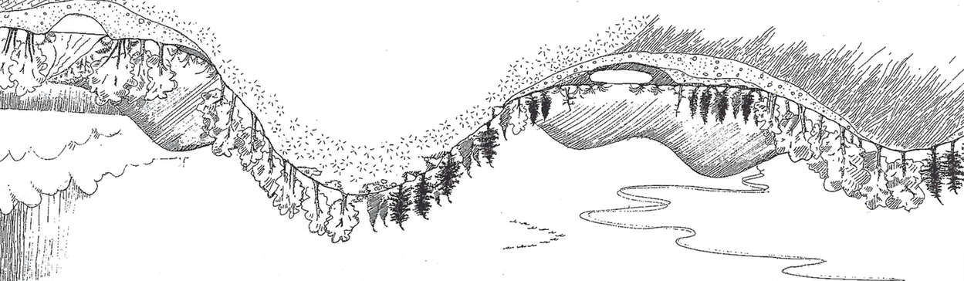

Slide 9
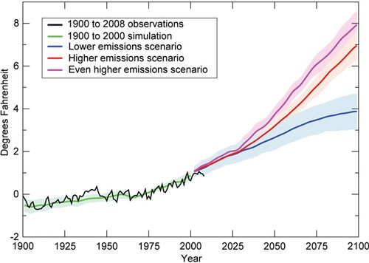

Slide 10
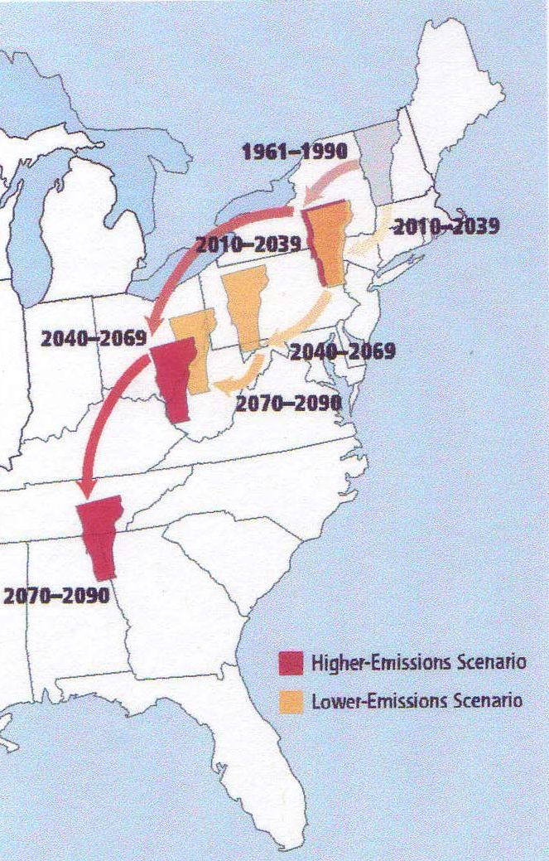

Slide 11
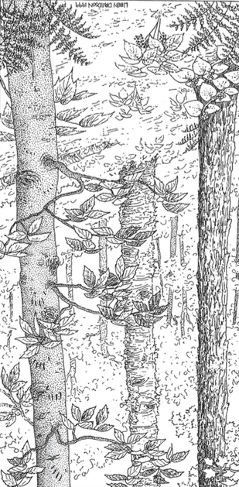

Slide 12
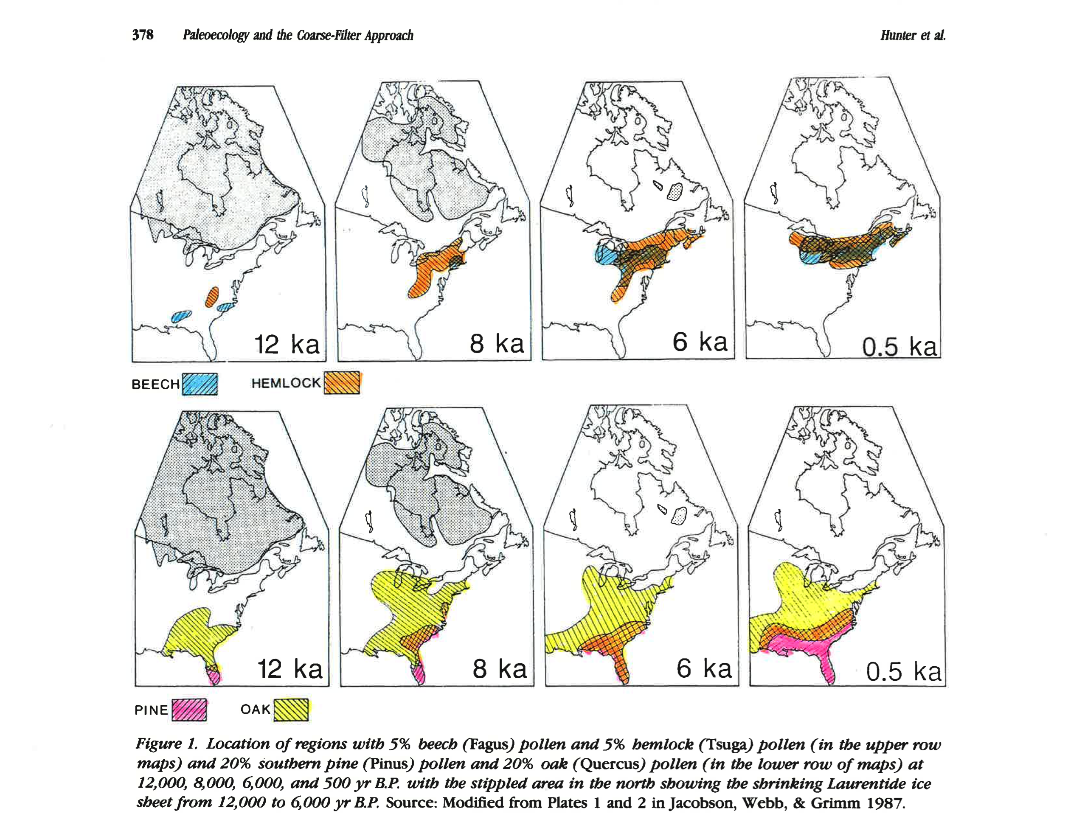

Slide 13
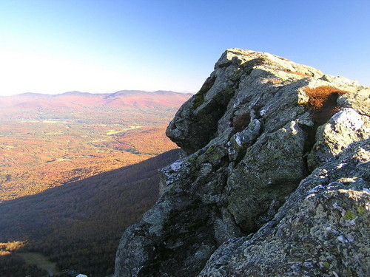

Slide 14
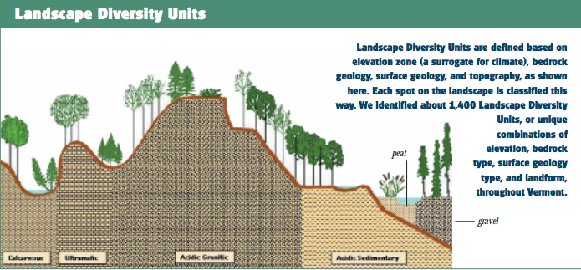

Slide 15
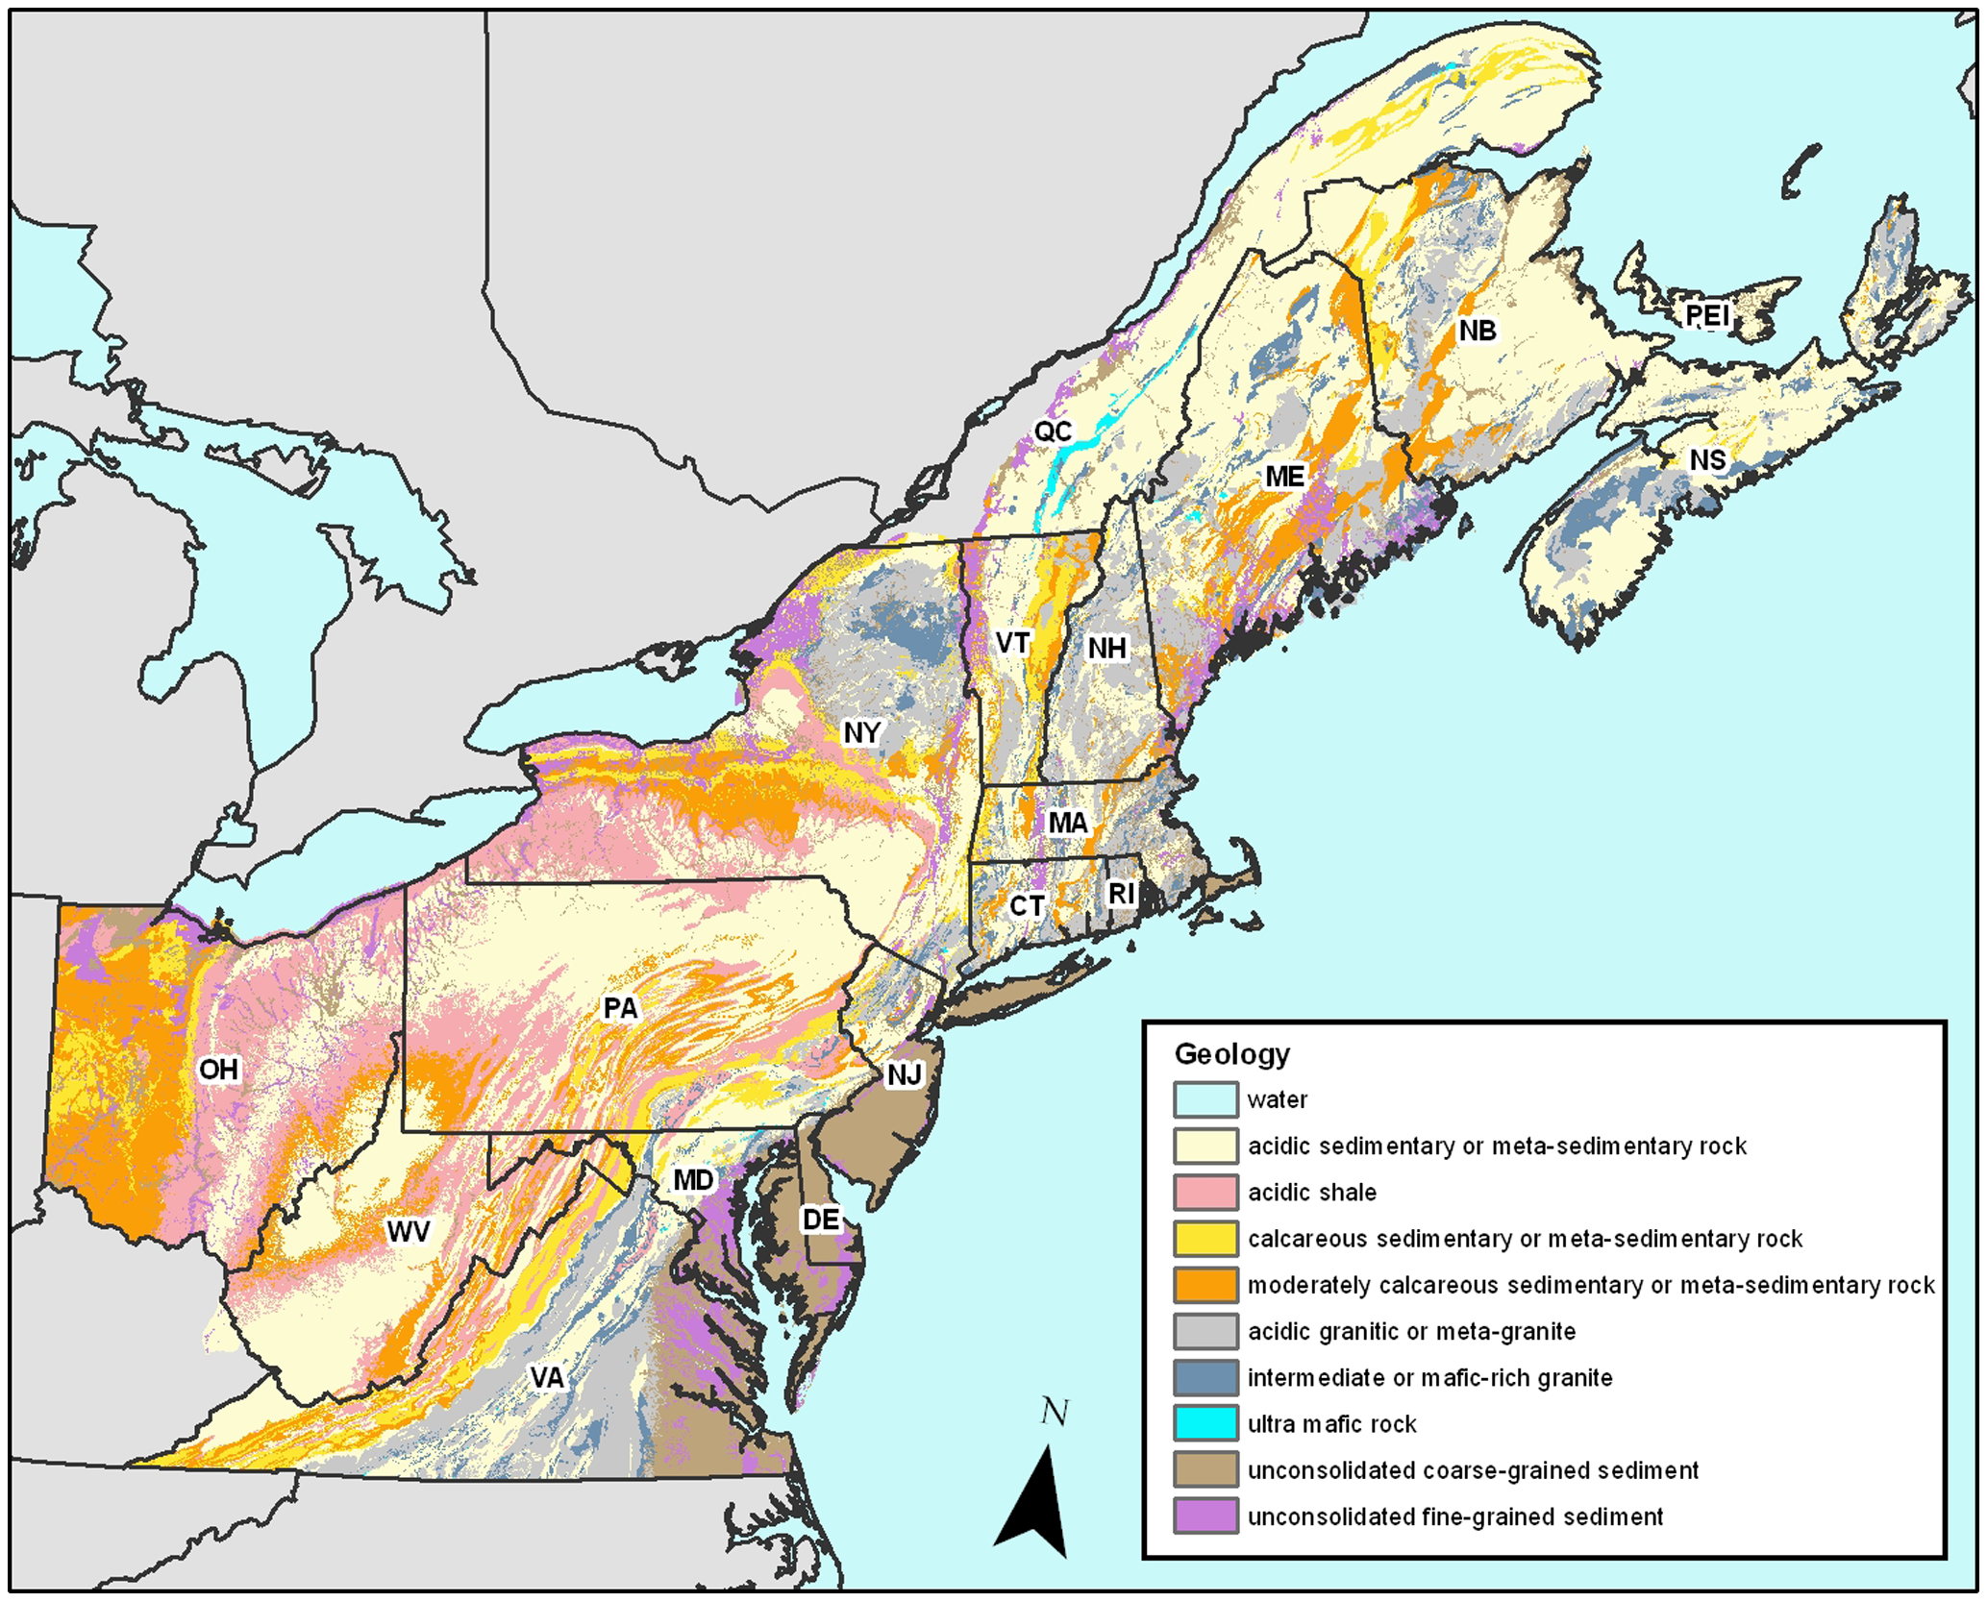

Slide 17
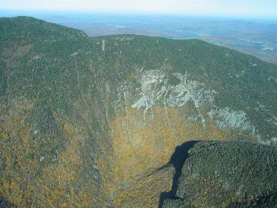
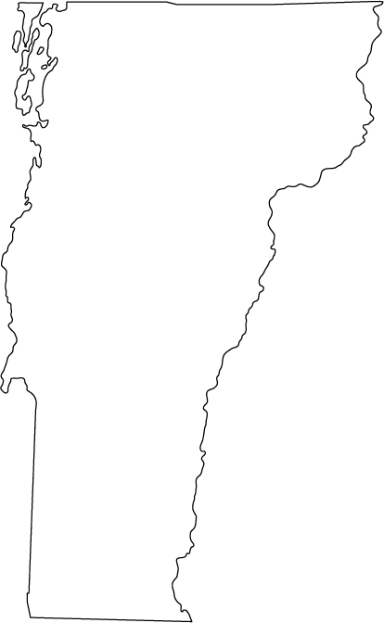
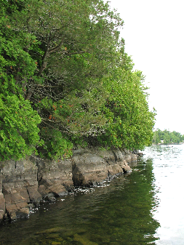
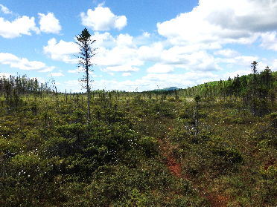
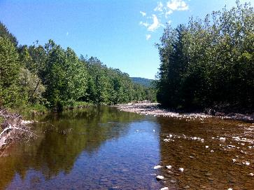
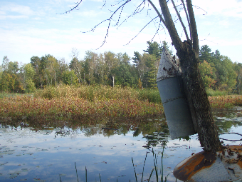

Slide 18
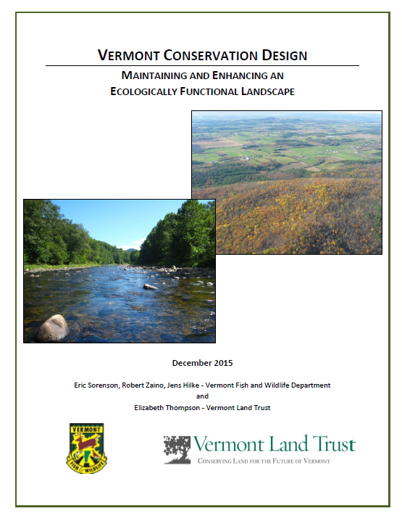

Slide 19
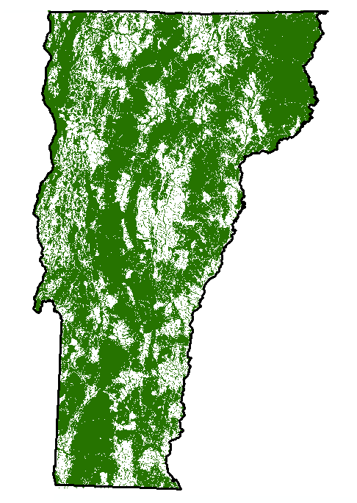
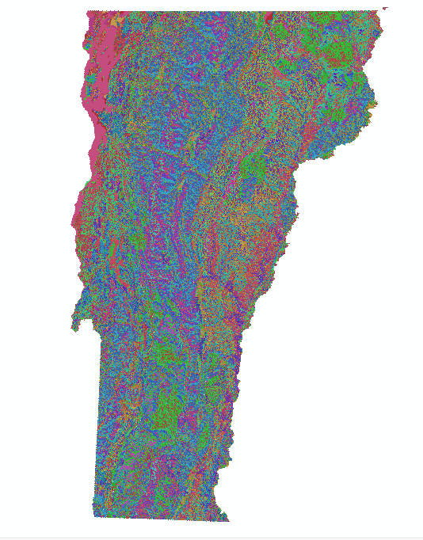
Forest Blocks
Surface Waters and Riparian Areas

Slide 21
Rare
Responsibility
Representative
(We are scientists, not marketing experts)

Slide 22
Rare Physical Landscapes

Slide 24
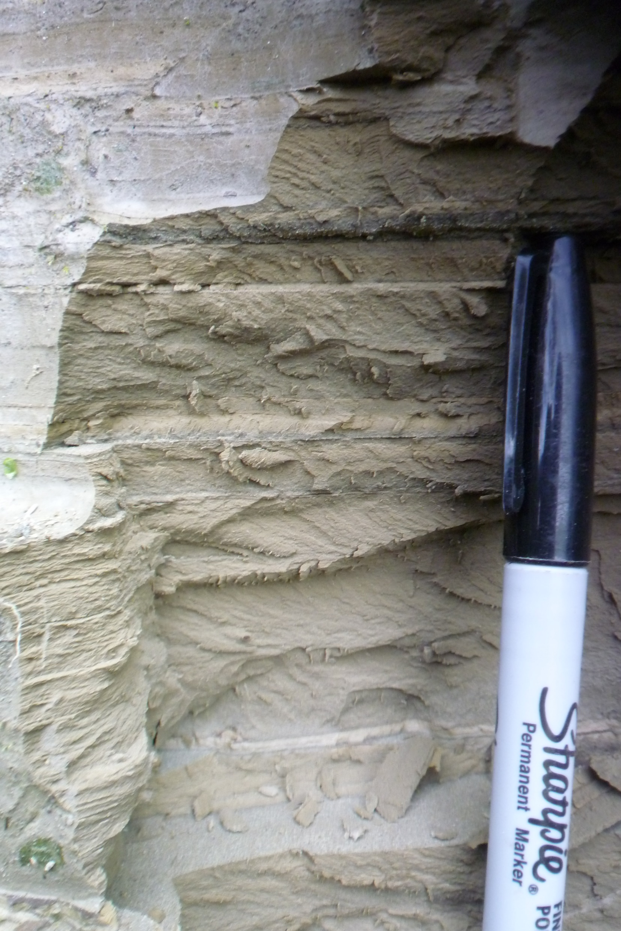

Slide 25
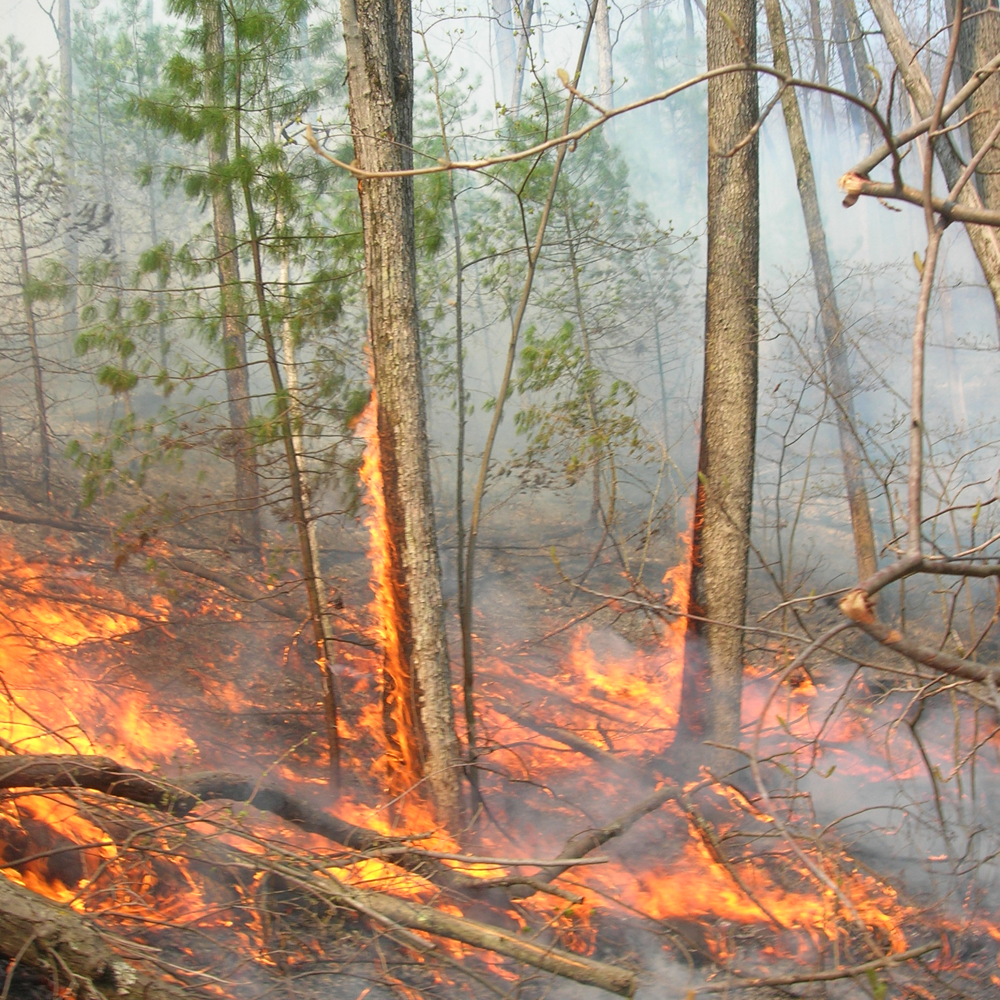

Slide 26
Responsibility Physical Landscapes

Slide 27
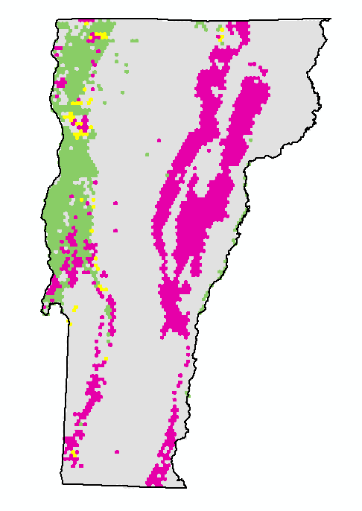
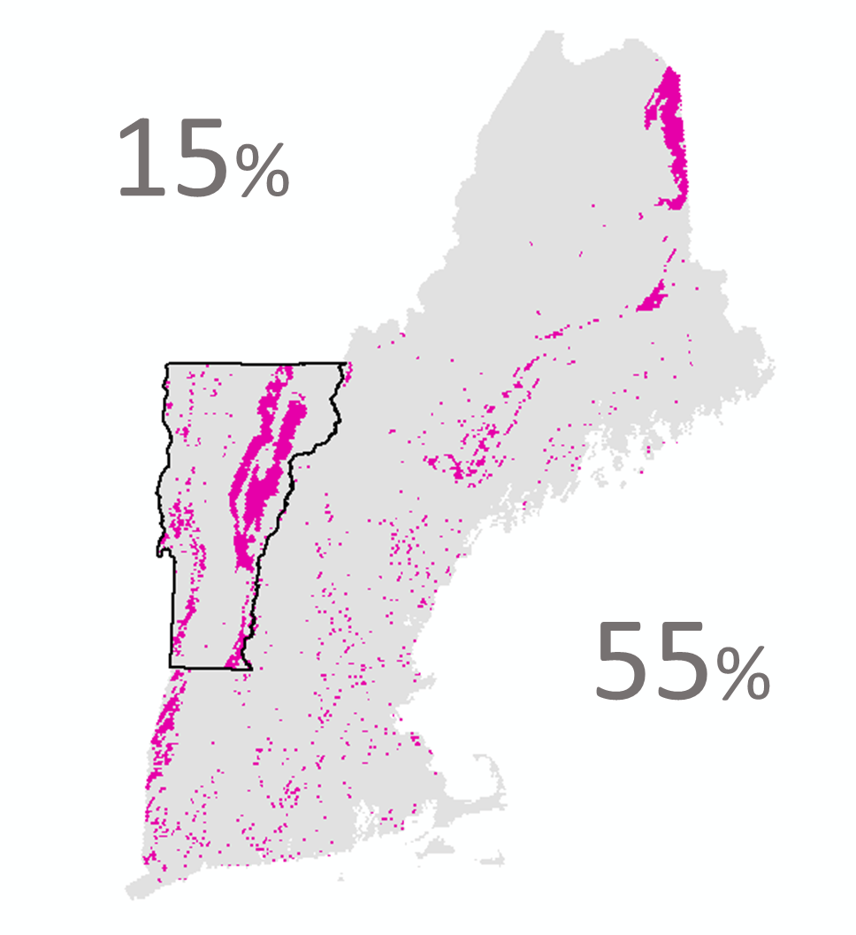
calcareous bedrock
coarse sediment
fine surficial sediment
55%
15%

Slide 28
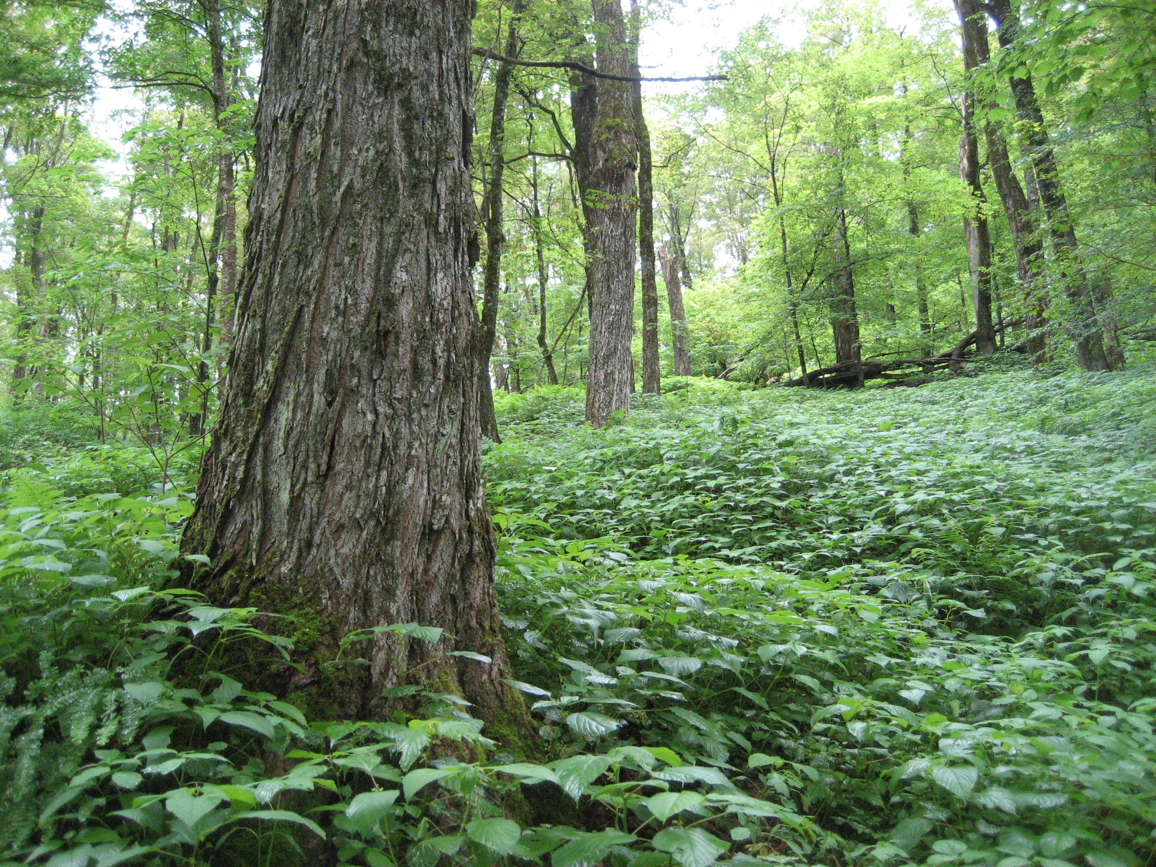

Slide 29
Representative Physical Landscapes

Slide 30
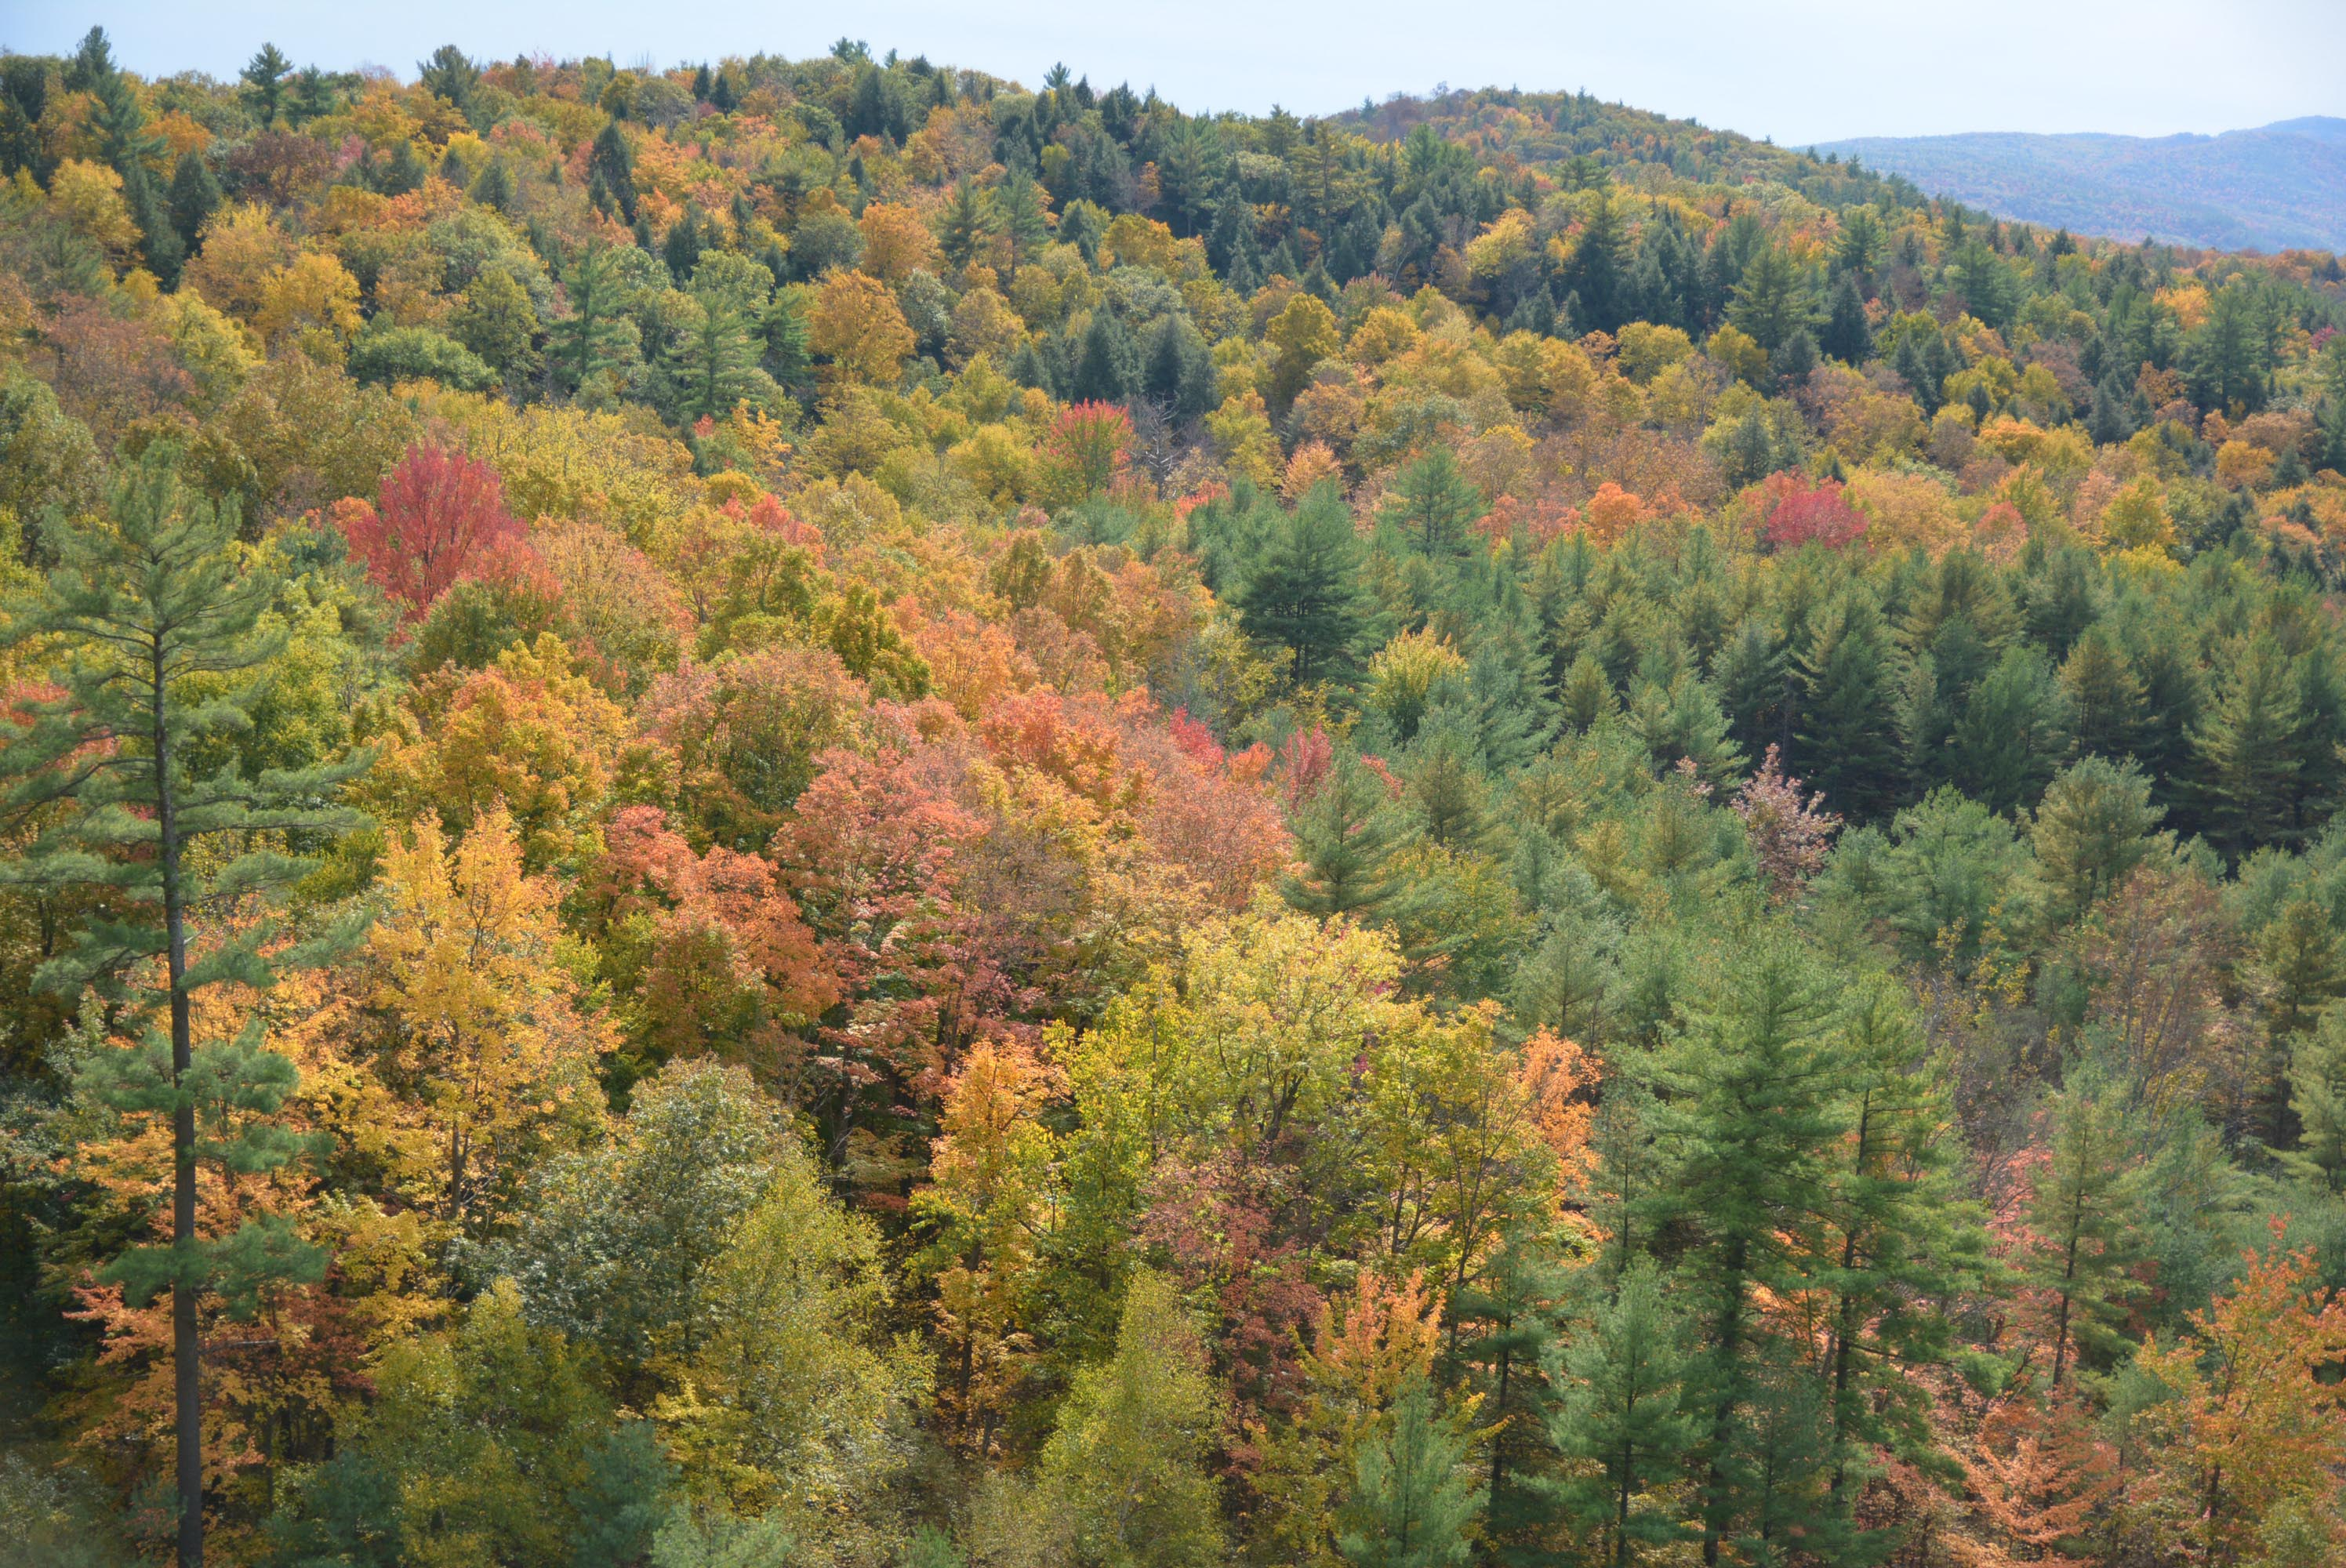

Slide 31
LTAs: Land Type Associations
Examples
Clayplain
Granite Mid-Elevation Hills
Sandplain
Serpentine Bedrock
Upper Mtn Slopes/Mountaintops
Vermont Escarpment

Slide 32
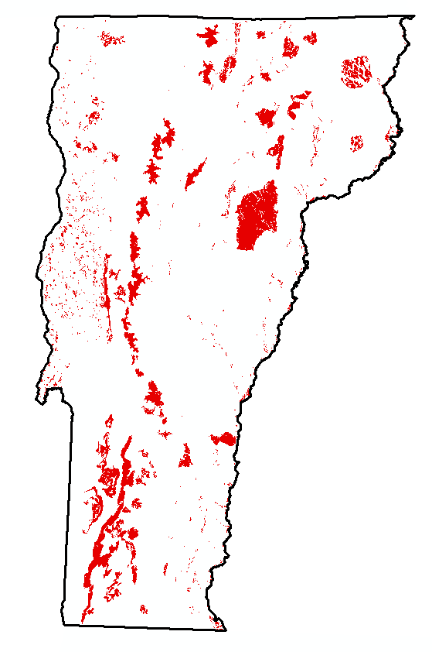

Slide 33


Slide 34
EELUs:
Elevational-Ecological Land Units
Examples
Mid-to-upper elevation transitional : Ultramafic : Steep slope, cool aspect
High elevation : Acidic granitic : Valley/toeslope
Low elevation : Calcareous sed/metased : Hilltop (flat)
(There are 459 of these!)

Slide 35
Mid-to-upper elevation transitional : Ultramafic : Steep slope, cool aspect

Slide 36
4%
0.8%
2.2%
5%
1.7%

Slide 37
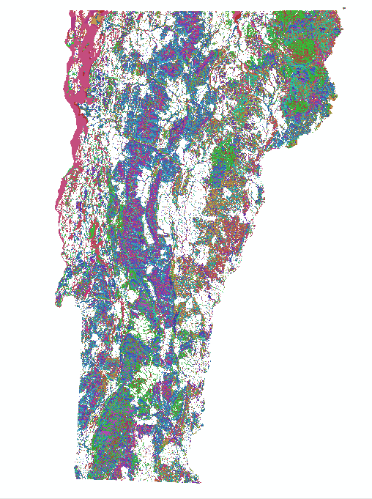
4%
0.8%
2.2%
5%
1.7%

Slide 39
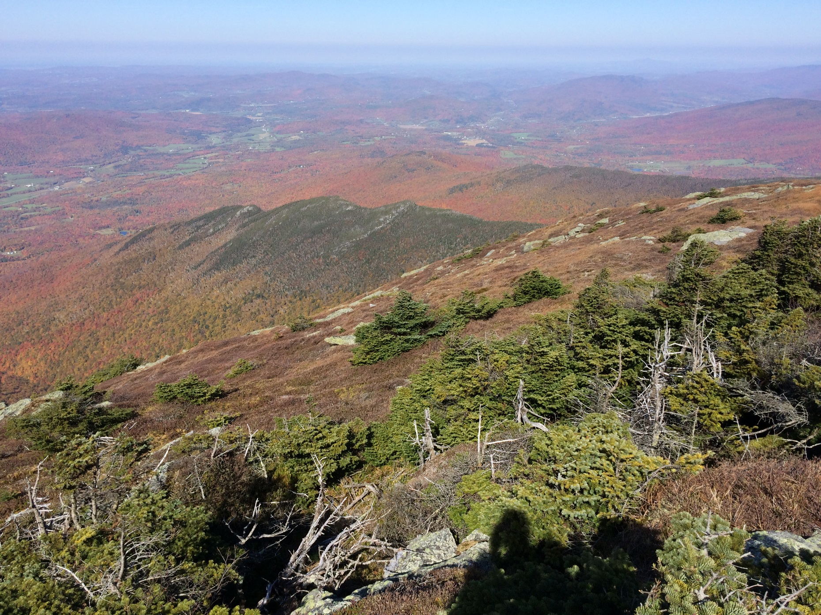
Thank you… Questions?
Liz Thompson
liz@vlt.org
Bob Zaino
robert.zaino@vermont.gov
http://www.vtfishandwildlife.com/conserve/
conservation_planning/vermont_conservation_design

